Slide 1
W⁺W⁻ Production at ATLAS
arXiv:1210.2979v1[hep-ex] 18 pages (not including the pages with the ~3000 names)
submitted to PRD.
Yanwen Liu
6th FCPPL workshop, Nanjing Univ. 2013.3.27

Slide 2
FCPPL 2010
the 3rd workshop

Slide 3
FCPPL 2010

Slide 4
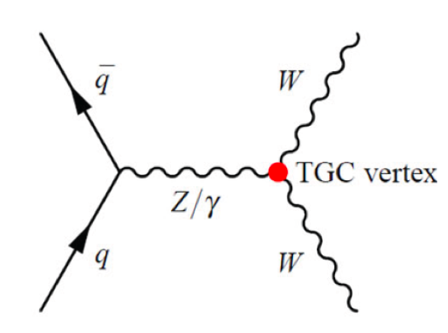
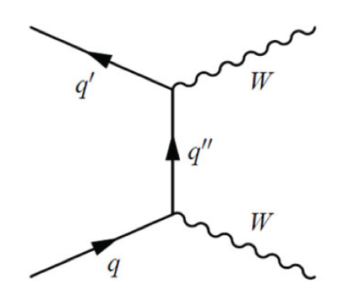
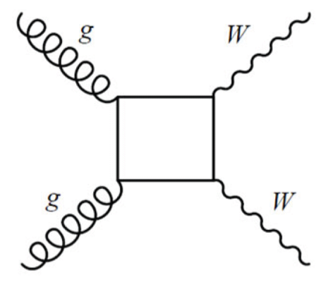
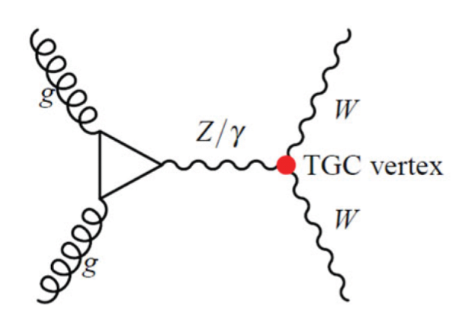
Introduction
Precise measurement of gauge couplings
Irreducible background for Higgs->WW
Background for “Wilder” new physics: SUSY, Graviton, Z’, Technicolor Mesons…
LO process: qqbar “annihilation”
NNLO – gg via quark loops contributing 3%
Higgs contributing 3%

Slide 5
signature : di-lepton + MET
Event selection : two leptons + MET
Major background
Drell-Yan (mis-measured MET)
ttbar (suppressed with veto on hadronic jets)
W+jet (jet faking leptons)
Other di-boson process : WZ, ZZ (missing leptons)

Slide 6
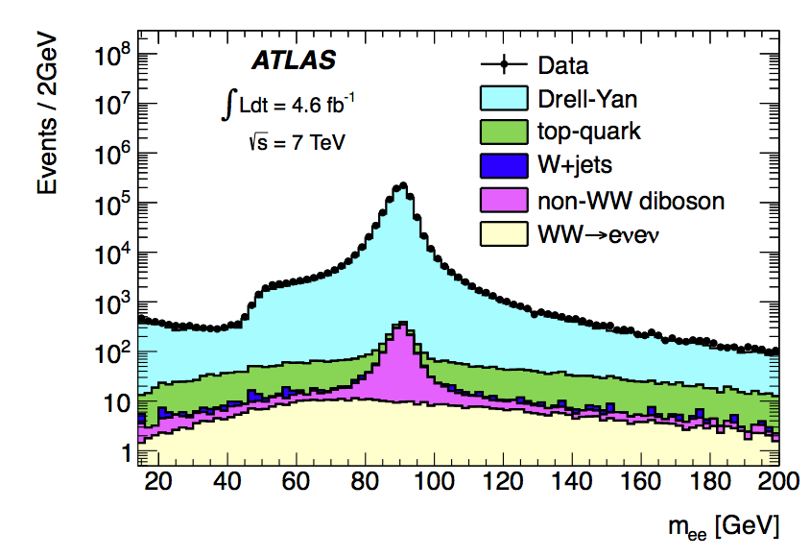
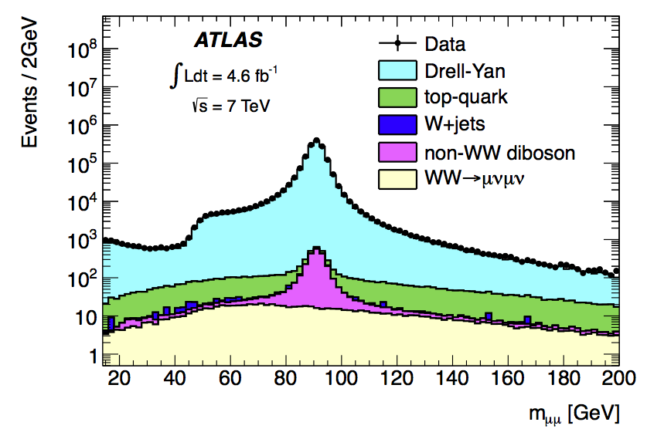
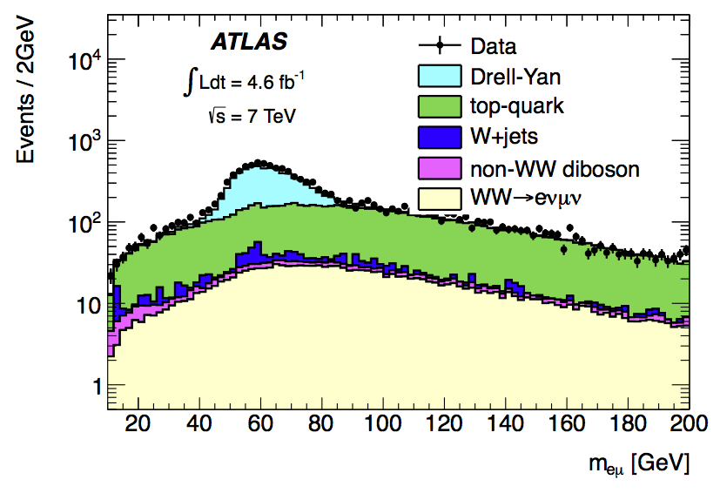
di-lepton events
Dominating Drell-Yan
for eμ, top dominating at high mass

Slide 7
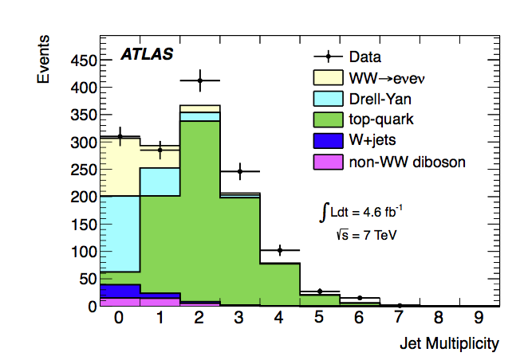
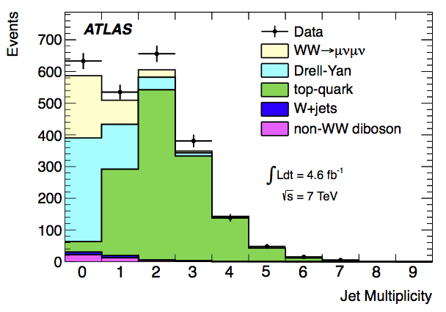
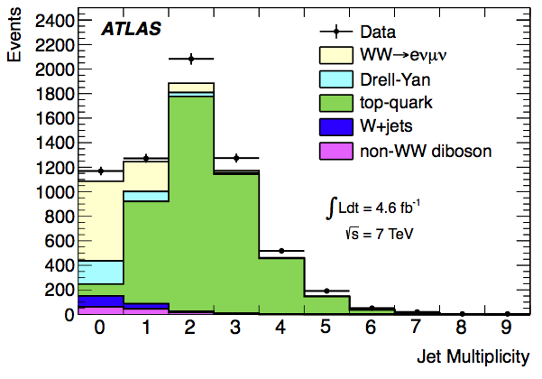
added MET cut to suppress DY
Events selected at this stage dominated by top events. Defined as Extended Signal Region for top background estimation.
ee μμ eμ
Mll > 15 15 10 GeV
METr > 45 45 25 GeV
same flavor |Mll – MZ| > 15 GeV
“MET relative to the closest lepton or jet
in x-y plane”

Slide 8
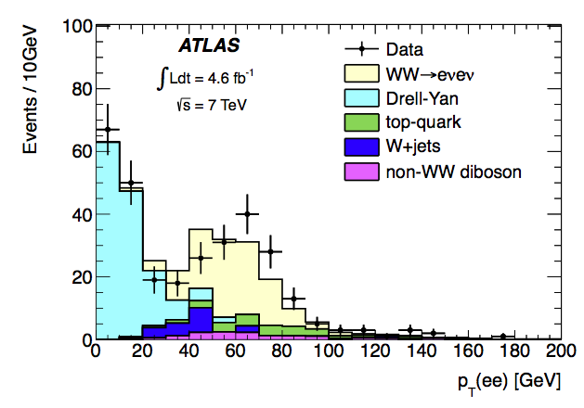
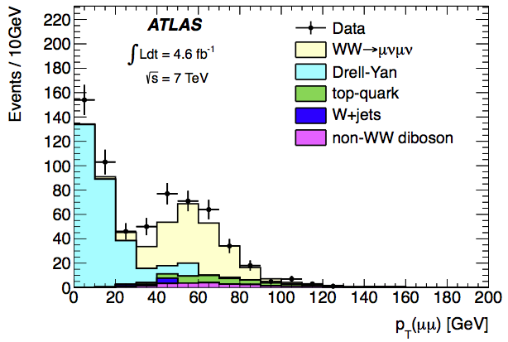
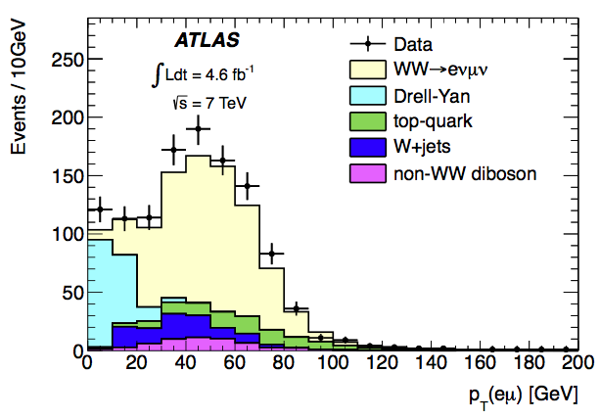
added Jet veto to suppress ttbar
pT(ll) > 30 GeV to suppress DY further

Slide 9
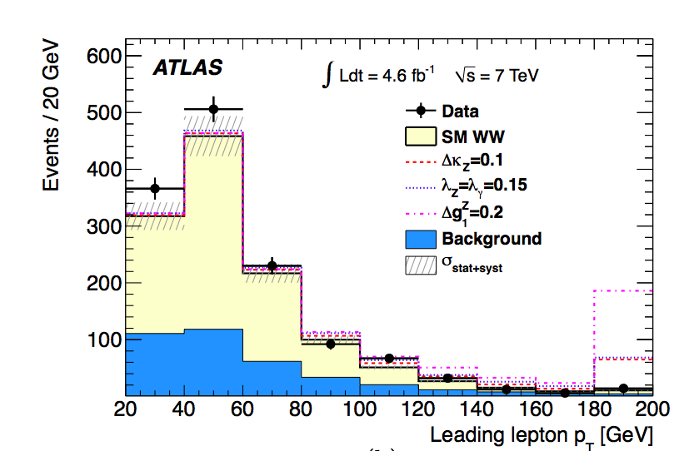
Leading lepton PT (all selections)
Additional Lagrangian terms for anomalous couplings : C and P conserved operators only.
V=gamma, Z.

Slide 10
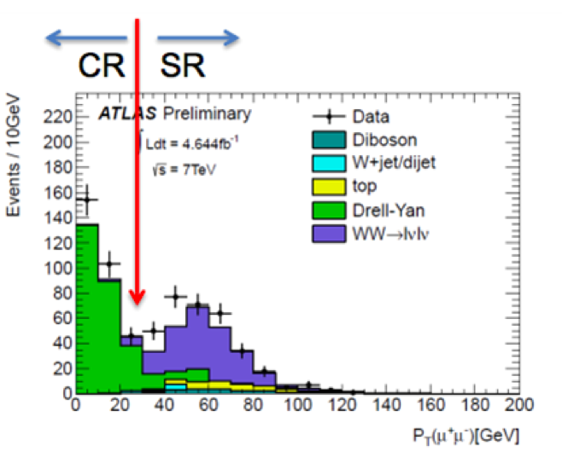
Background Estimation (DY)
Drell-Yan: normalized with control region: pT(ll) < 30 GeV

Slide 11
Background estimation (ttbar)
“Extended Signal Region ” – all event selection but (jet veto and pTll) ESR
require a b-tag to define top control region(CR)
derive the ratio of ESR/CR from top MC.
An estimation of top contribution in ESR.
Use MC to get the fraction of top events with 0 jets in ESR.
Cross checked
with alternative
method.

Slide 12
Background estimation (W+jet)
Control region: “tight lepton + anti-lepton”
Scaled with a fake-factor : ratio of jets
identified as “tight lepton” over “anti-lepton”
Fake factor measured with di-jet data sample.
W+j : the most important area for improvement.

Slide 13
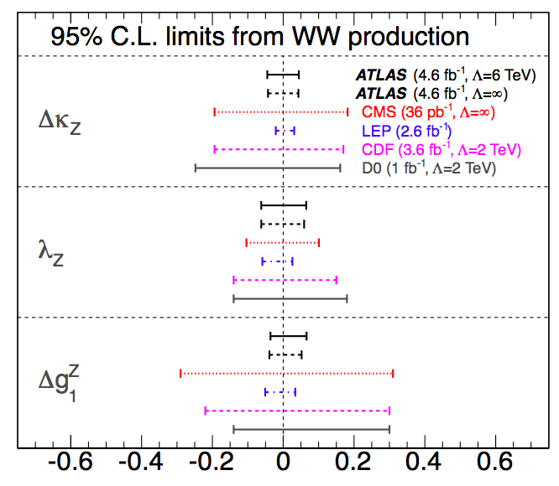
Limits on anomalous couplings

Slide 14
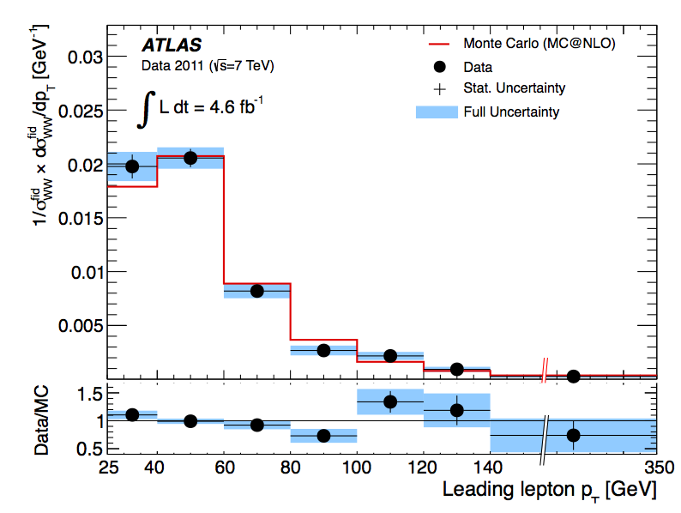
Bonus: differential cross section
Unfolded with regularized
inversion of response matrix.
(3 iterations)
Ready to be compared to any theory.

Slide 15
Summary and Outlook
Measured W⁺W⁻ with full 7 TeV dataset.
First differential measurement
Precision of the coupling close to LEP combined
Analysis of the full 8 TeV sample in progress.
Mr. Jun GAO : improving the W+j estimation
Anomalous couplings and Constraint some specific New Physics Models.
First coPhD of USTC/CPPM.
Well done! Dr Li!
In acknowledgements of CSC and Eiffel grants + NSFC+MOST+CAS+FCPPL.

