Slide 1
High rate glass RPC for CMS
Imad Laktineh
for the GRPC-CMS groups

Slide 2
Outline
French-Chinese collaboration
CMS-GRPC project
- Motivation
- Proposal
- R&D activities
Conclusion

Slide 3
Collaboration
IPNL-Tsinghua
First contact in 2008 during IEEE-NSS, Dresden.
Collaboration started on GRPC in general and on high rate GRPC in particular in 2009.
Tsinghua joined CALICE collaboration in 2008 to work together with IPNL on SDHCAL
A prototype of 1.3 m³ (6 λ_{i}) with 48 units using power-pulsing and triggerless modes was completed in 2011.
First results obtained with the prototype exposed to CERN beams validated completely the SDHCAL concept which was chosen as one of the two options of the ILD project proposed for ILC.
In parallel the two groups collaborated on high rate GRPC.
Recently joined by other French (OMEGA) and Chinese (NCEPU) groups and a project to equip the CMS high eta region with muon detectors. The R&D is now an official R&D of CMS.

Slide 4
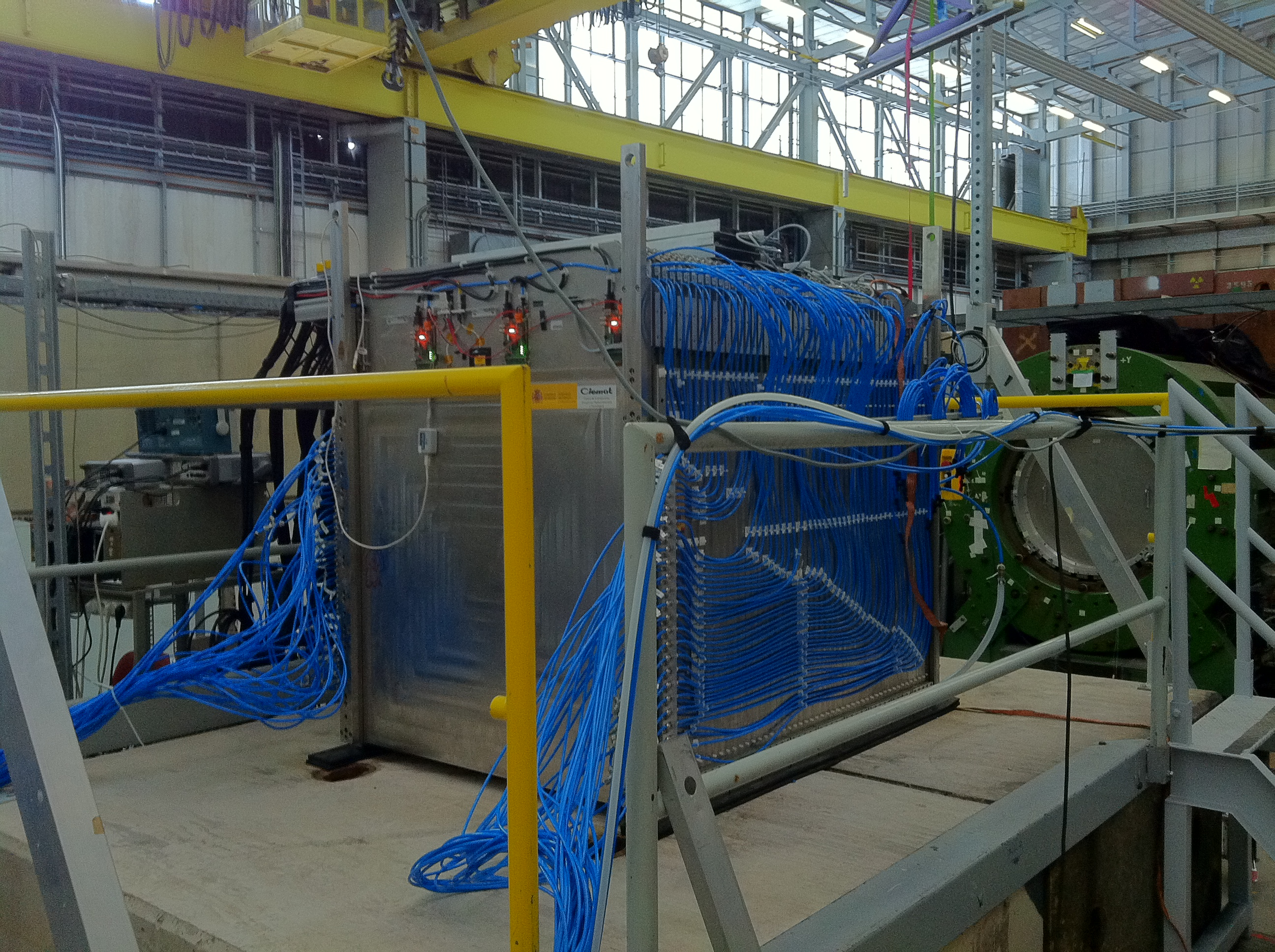
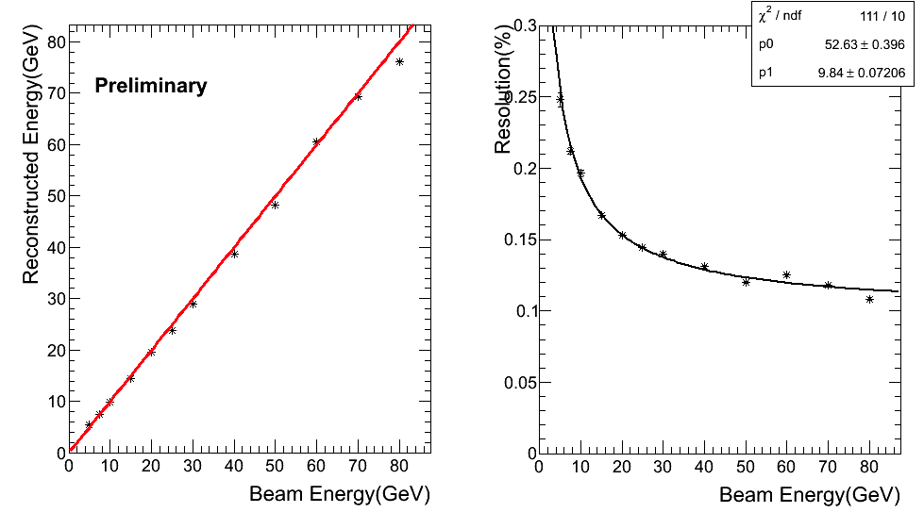
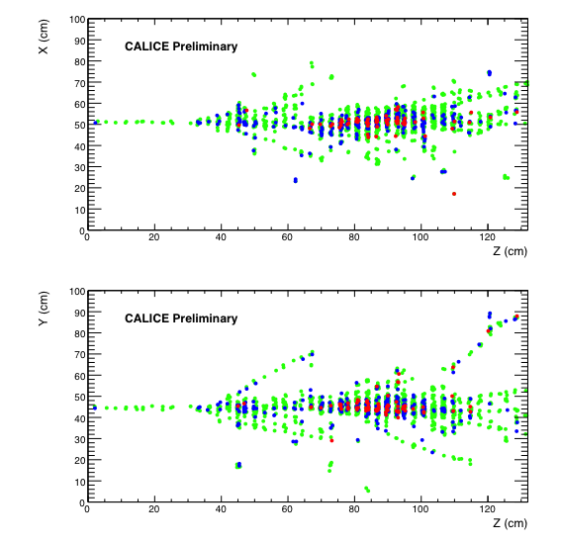
80 GeVpion

Slide 5
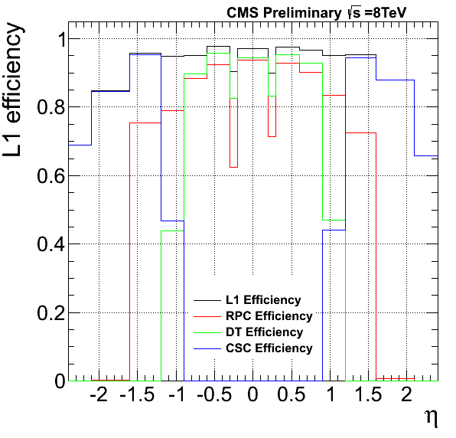
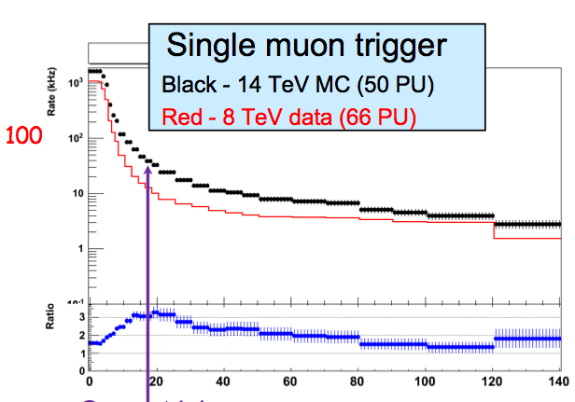
CMS-GRPC project
The standard Bakelite RPC used as muon detectors in CMS are absent from the high eta region (>1.6) because of their rate limitation
(< 1000 Hz/cm²).
The presence of (Cathode Strip Chambers) CSC at high eta is not enough (low trigger efficiency)
With the increase of luminosity
x6 in Phase I (E = 14 TeV) and additional x10 the HL-LHC scenario needs to be addressed by improving on the trigger efficiency if wants to avoid increasing P_{t} selection cut which may affect physics.
So there is a need to equip the high eta region.
P_{t}

Slide 6
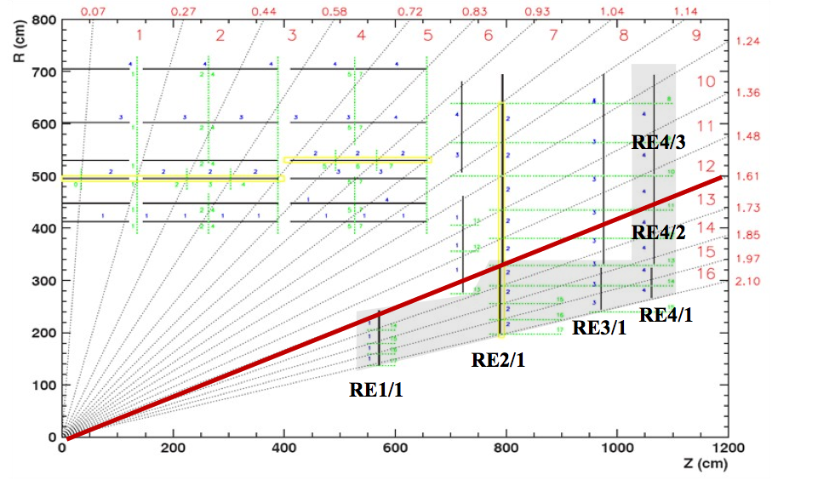
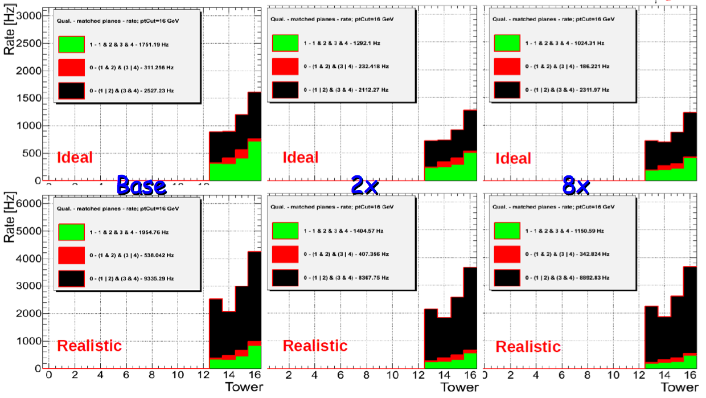
Motivation
The low-resistivity glass developed by the Tsinghua group allows to build GRPC detector with high rate capability that can stand the high rate in the high eta region (up to 60 k Hz/cm²)
A rate reduction of factor 3∼4 for 2X, 8∼9 for 8X can be obtained
Notes:
Realistic: efficiency 95%

Slide 7
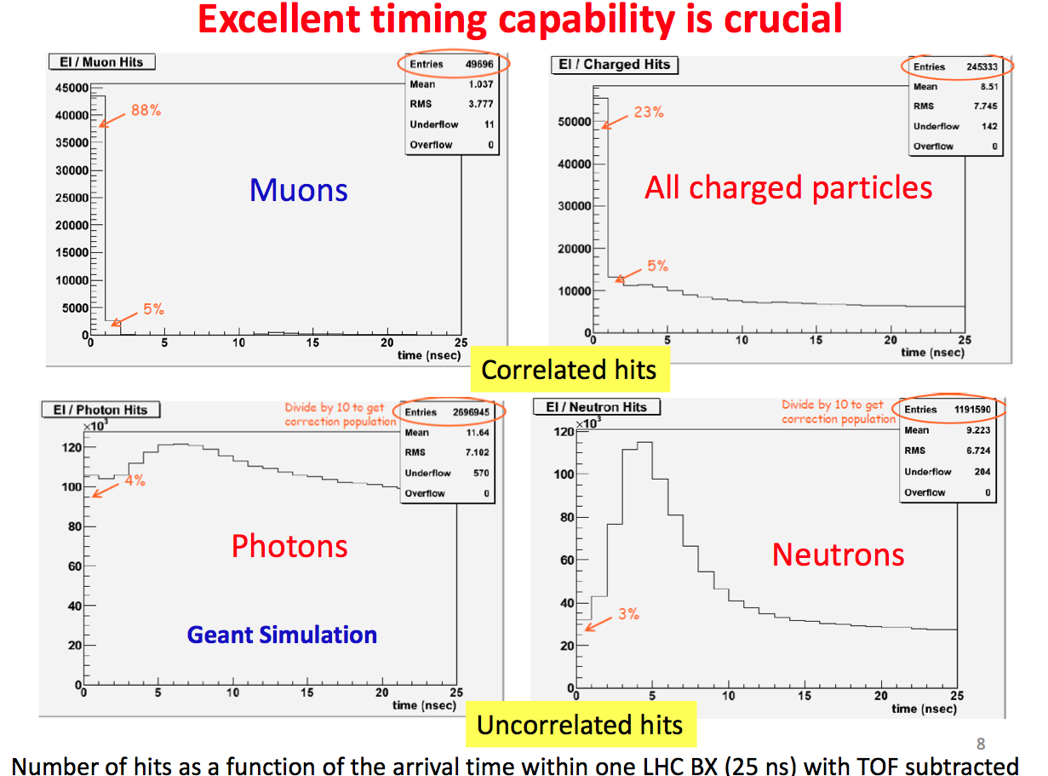
Using the time resolution the RPC we expect to do much better. This study was performed in the case of ATLAS.
J.Zhu, ATLAS collaboration, RPC2012

Slide 8
Proposal
GRPC using low-resistivity glass is an excellent solution :
1- It stands high rate (> 60 KHz/cm²)
2- It is similar to theBakelite RPC. It has the same advantages
- Excellent time resolution,
Easy construction
Cost-effective
but without the oil problem.
3- It uses the same gas mixture but no humidity needed.
R&D on high rate GRPC has started 4 years ago. Single-gap and multi-gap detectors were built and successfully tested. Readout strips and pads were both tested. Many groups have participated to this activity.

Slide 9
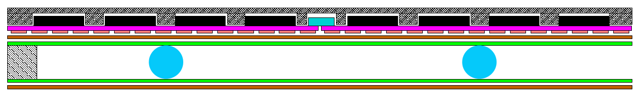
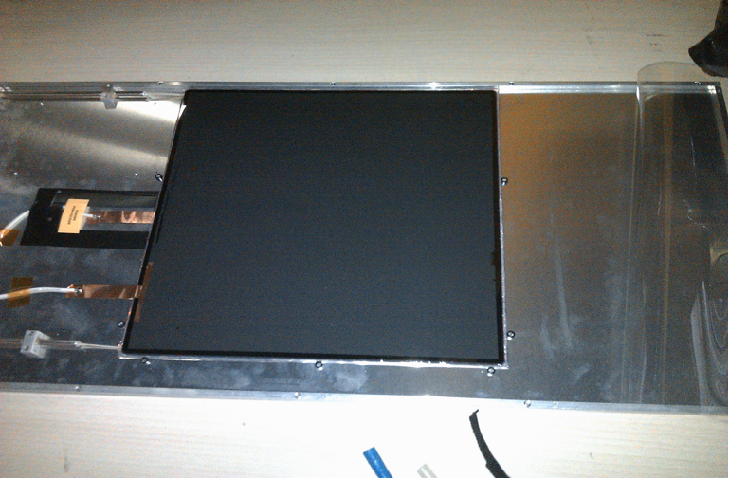
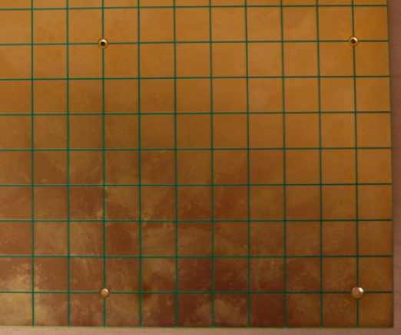
R&D
Single gap
Mylar layer (50μ)
Readout pads
(1cm x 1cm)
PCB interconnect
PCB (1.2mm)+ASICs(1.7 mm)
Readout ASIC
(Hardroc2, 1.6mm)
PCB support (polycarbonate)
Gas gap(1.2mm)
Mylar (175μ)
Cathode glass (1.1mm)
+ resistive coating
Ceramic ball spacer
Anode glass (0.7mm)
+ resistive coating
Glass fiber frame (≈1.2mm)
Total thickness (detector 3 mm+ readoutelectronics 3 mm): 6.0mm
30X30 cm²

Slide 10
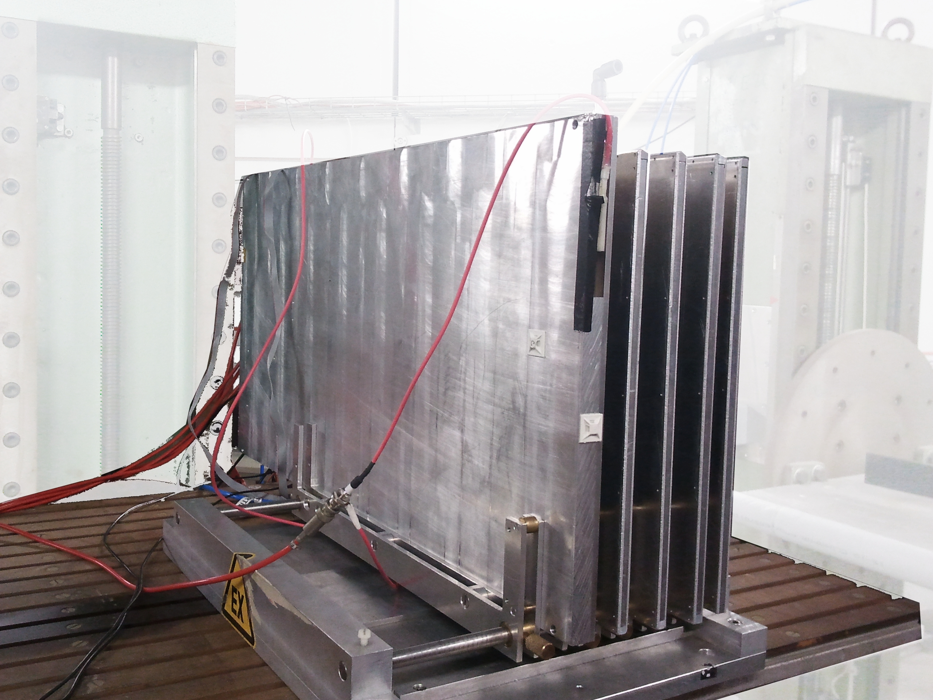
R&D
Beam test setup
GRPC running conditions :
Gas flow : 2 l/h
Gas mixture:
93% R134A, 5% CO_{2,} 2% SF₆
2 Scint-PM
Beam counter Scint-PM
DESY electronbeam
1 standard GRPC+ 4 semi-conductive GRPC
Measurements :
Efficiencyof one chamber is estimated
using tracks built from clusters of at least 3 other RPCs. Only one cluster per RPC is allowed for this study
Multiplicityof a track in one chamber is number of pads associated to the track in that chamber
x
x
?
x
x

Slide 11
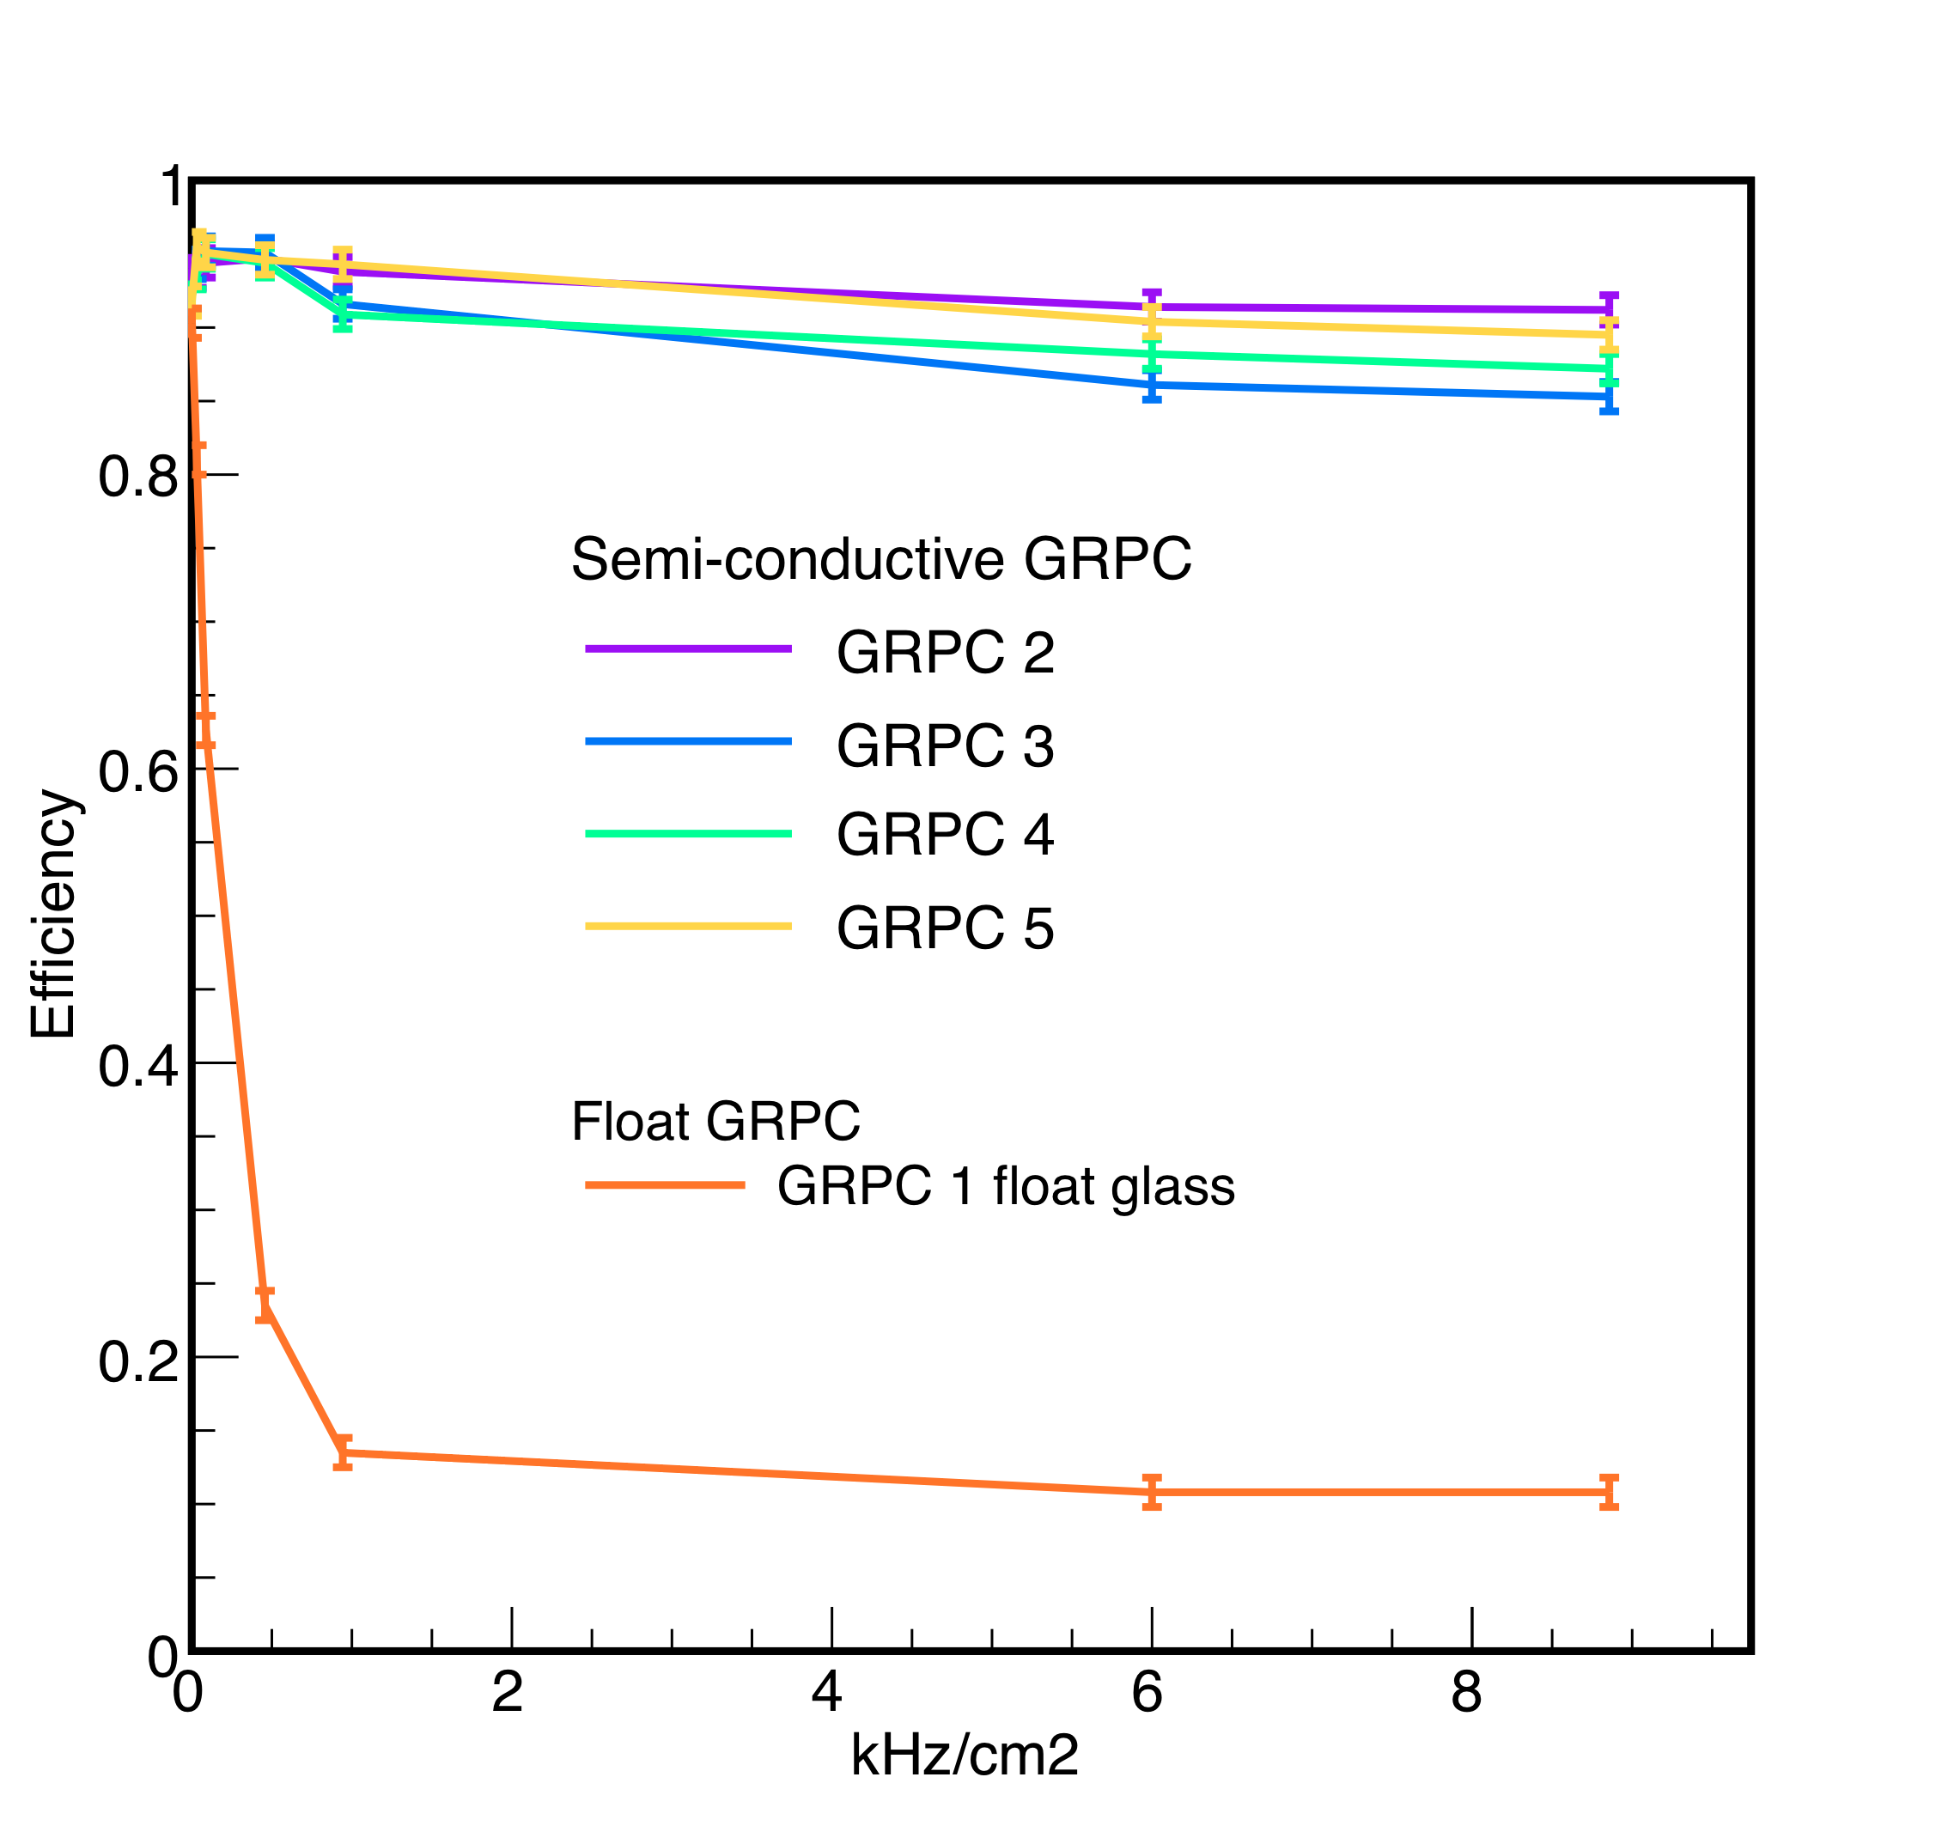
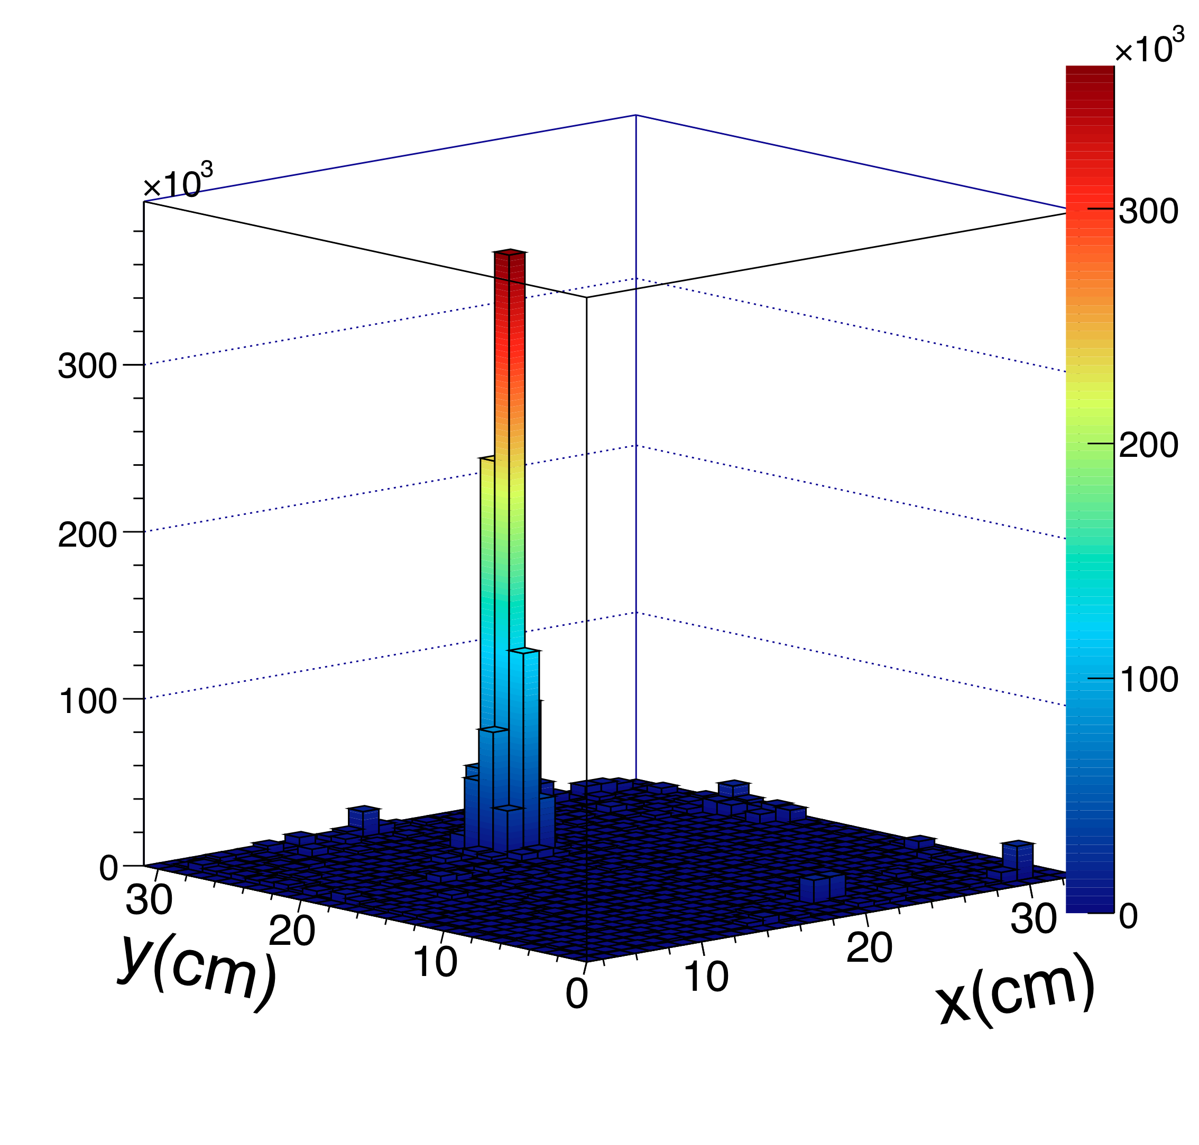
R&D
Low-resistivity GRPC performance at high rate
9 kHz/cm² is highest rate one can get at DESY

Slide 12
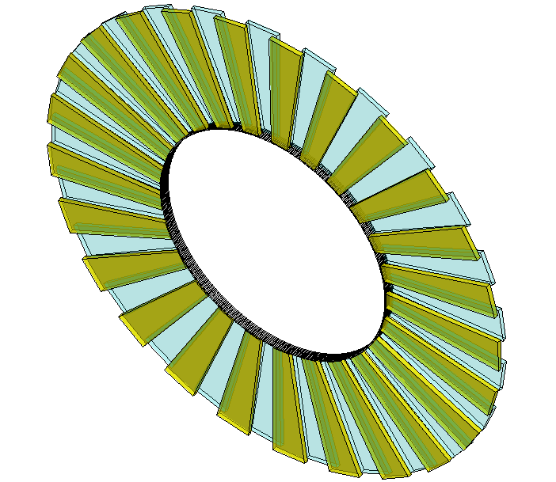
R&D
Multi-gap
Tsinghua is working on a new large detector for the SoLID TOF of JLab
MRPC3
28cm
MRPC2
16cm
100cm
MRPC1
Main Requirements for TOF:
  -Time resolution < 80ps
  -Rate capability > 10kHz/cm²
MRPC TOF wall is designed to contain 150 MRPC modules in total, with 50 gas boxes and 3 counters in each box, covering the area of 10m².

Slide 13
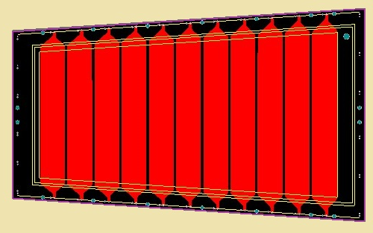
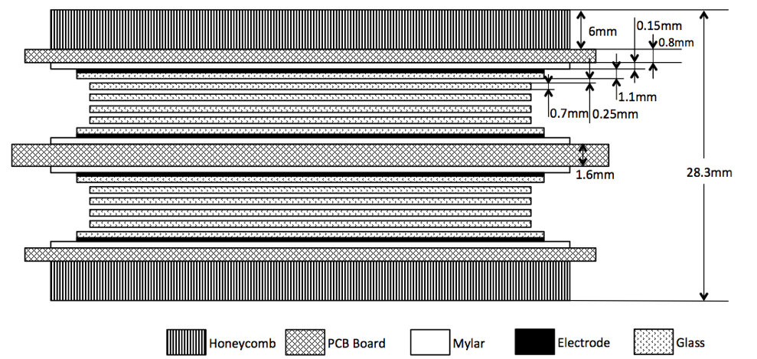
R&D
Gas Mixture(Pre-mixed) | Freon 90% iso-butane 5% SF6 5%
Working Voltage | ±6800V
Electrical field | ~108.8kV/cm
219mm
The design of MRPC readout
171mm
Interval | 3mm
Strip width | 25mm
Readout mode | Differential
Dimensions
363mm
 | Length/mm | Width/mm | Thickness/mm
Gas gap | - | - | 0.25×10
Inner glass | 320 | 130-171 | 0.7
Outer glass | 330 | 138-182 | 1.1
Mylar | 335 | 153-198 | 0.18
Inner PCB | 350 | 182-228 | 1.6
Outer PCB | 350 | 172-218 | 0.8
Honeycomb | 330 | 153-198 | 6

Slide 14
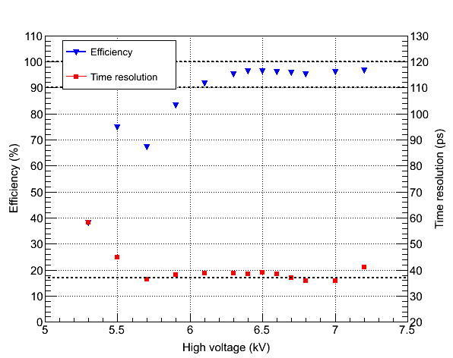
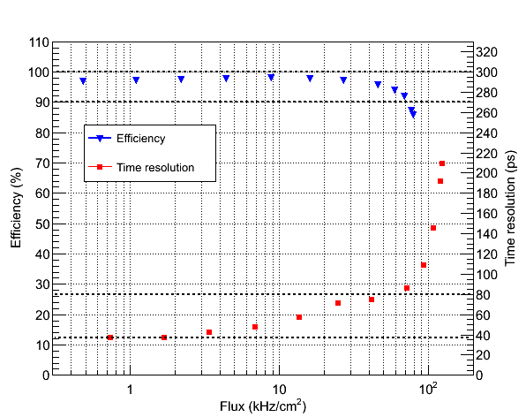
R&D
Beam Test@HZDR June, 2012
Time Resolution < 40ps
HV scan
Rate scan

Slide 15
R&D
CMS-GRPC
Goals in 2013:
-To study detector stability at GIF (with higher rate than the previous study) and to perform tracking with the chambers.
To build single gap GRPC that can be accommodated in the RE1/1
already conceived cassette, but also for the other stations (RE4/1 for
instance)
Idem with a multi-gap GRPC
To develop/adapt readout electronics which stands high rate and
allows to exploit the time precision the RPC could allow
If successful we intend to propose to equip some or all of the RE1/X stations.

Slide 16
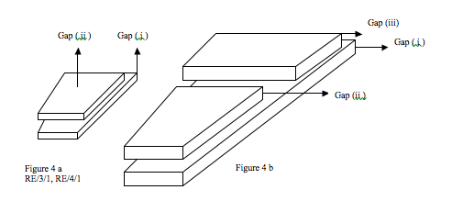
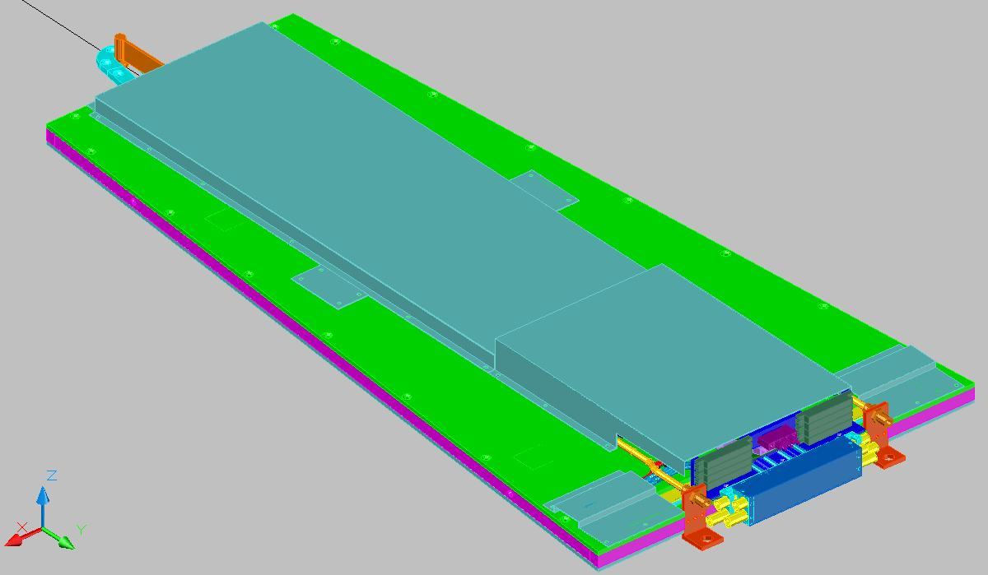
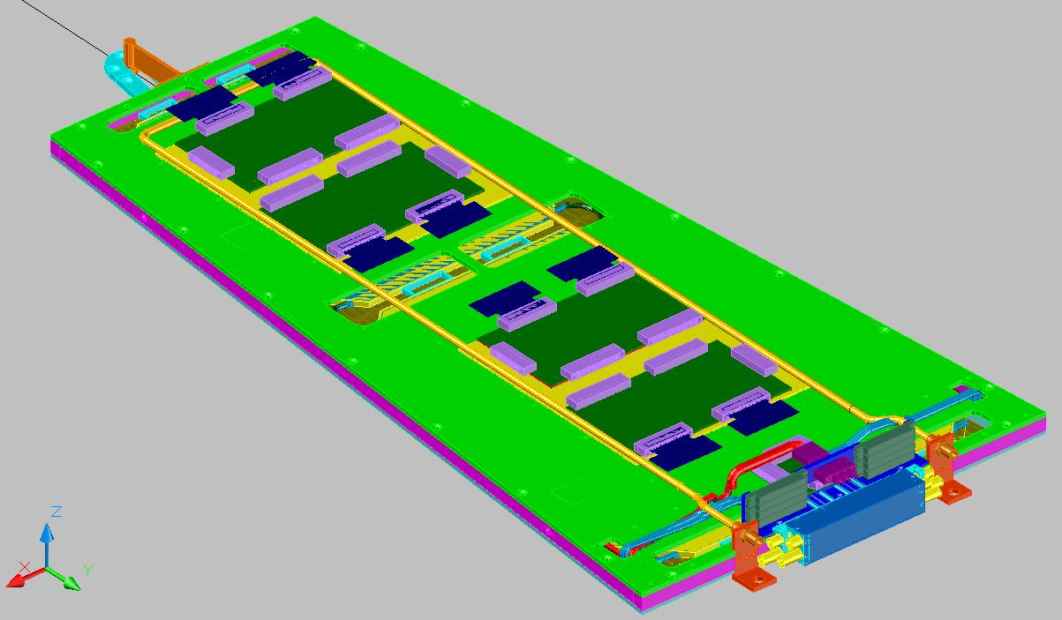
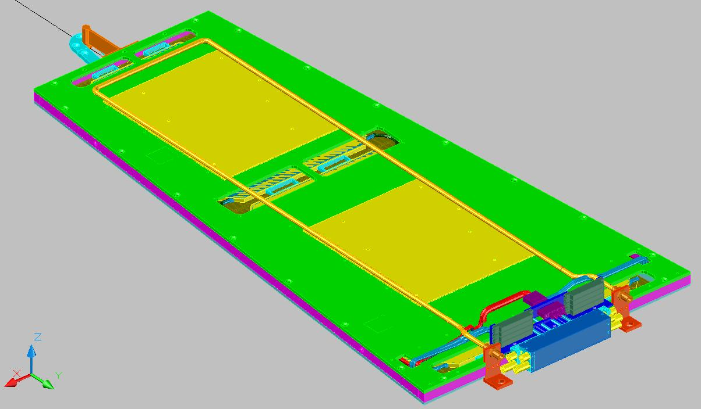
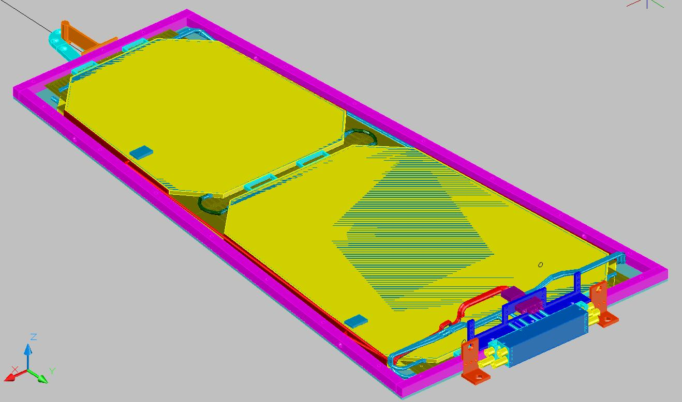
R&D
Detector:
RPC in the stations RE1/X were foreseen in the CMS TDR.
The cassettes were designed.
Few Bakelite RPC units were built by a Korean group
4 FEBs of RE1/1
Cooling base and pipe
Top Gas Gaps

Slide 17
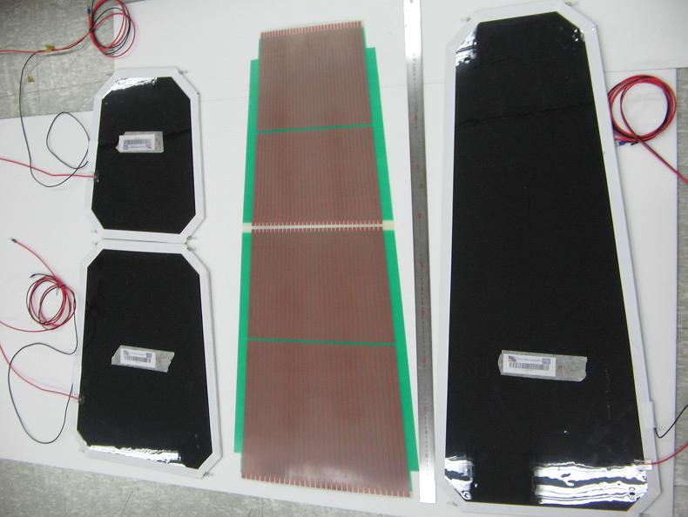
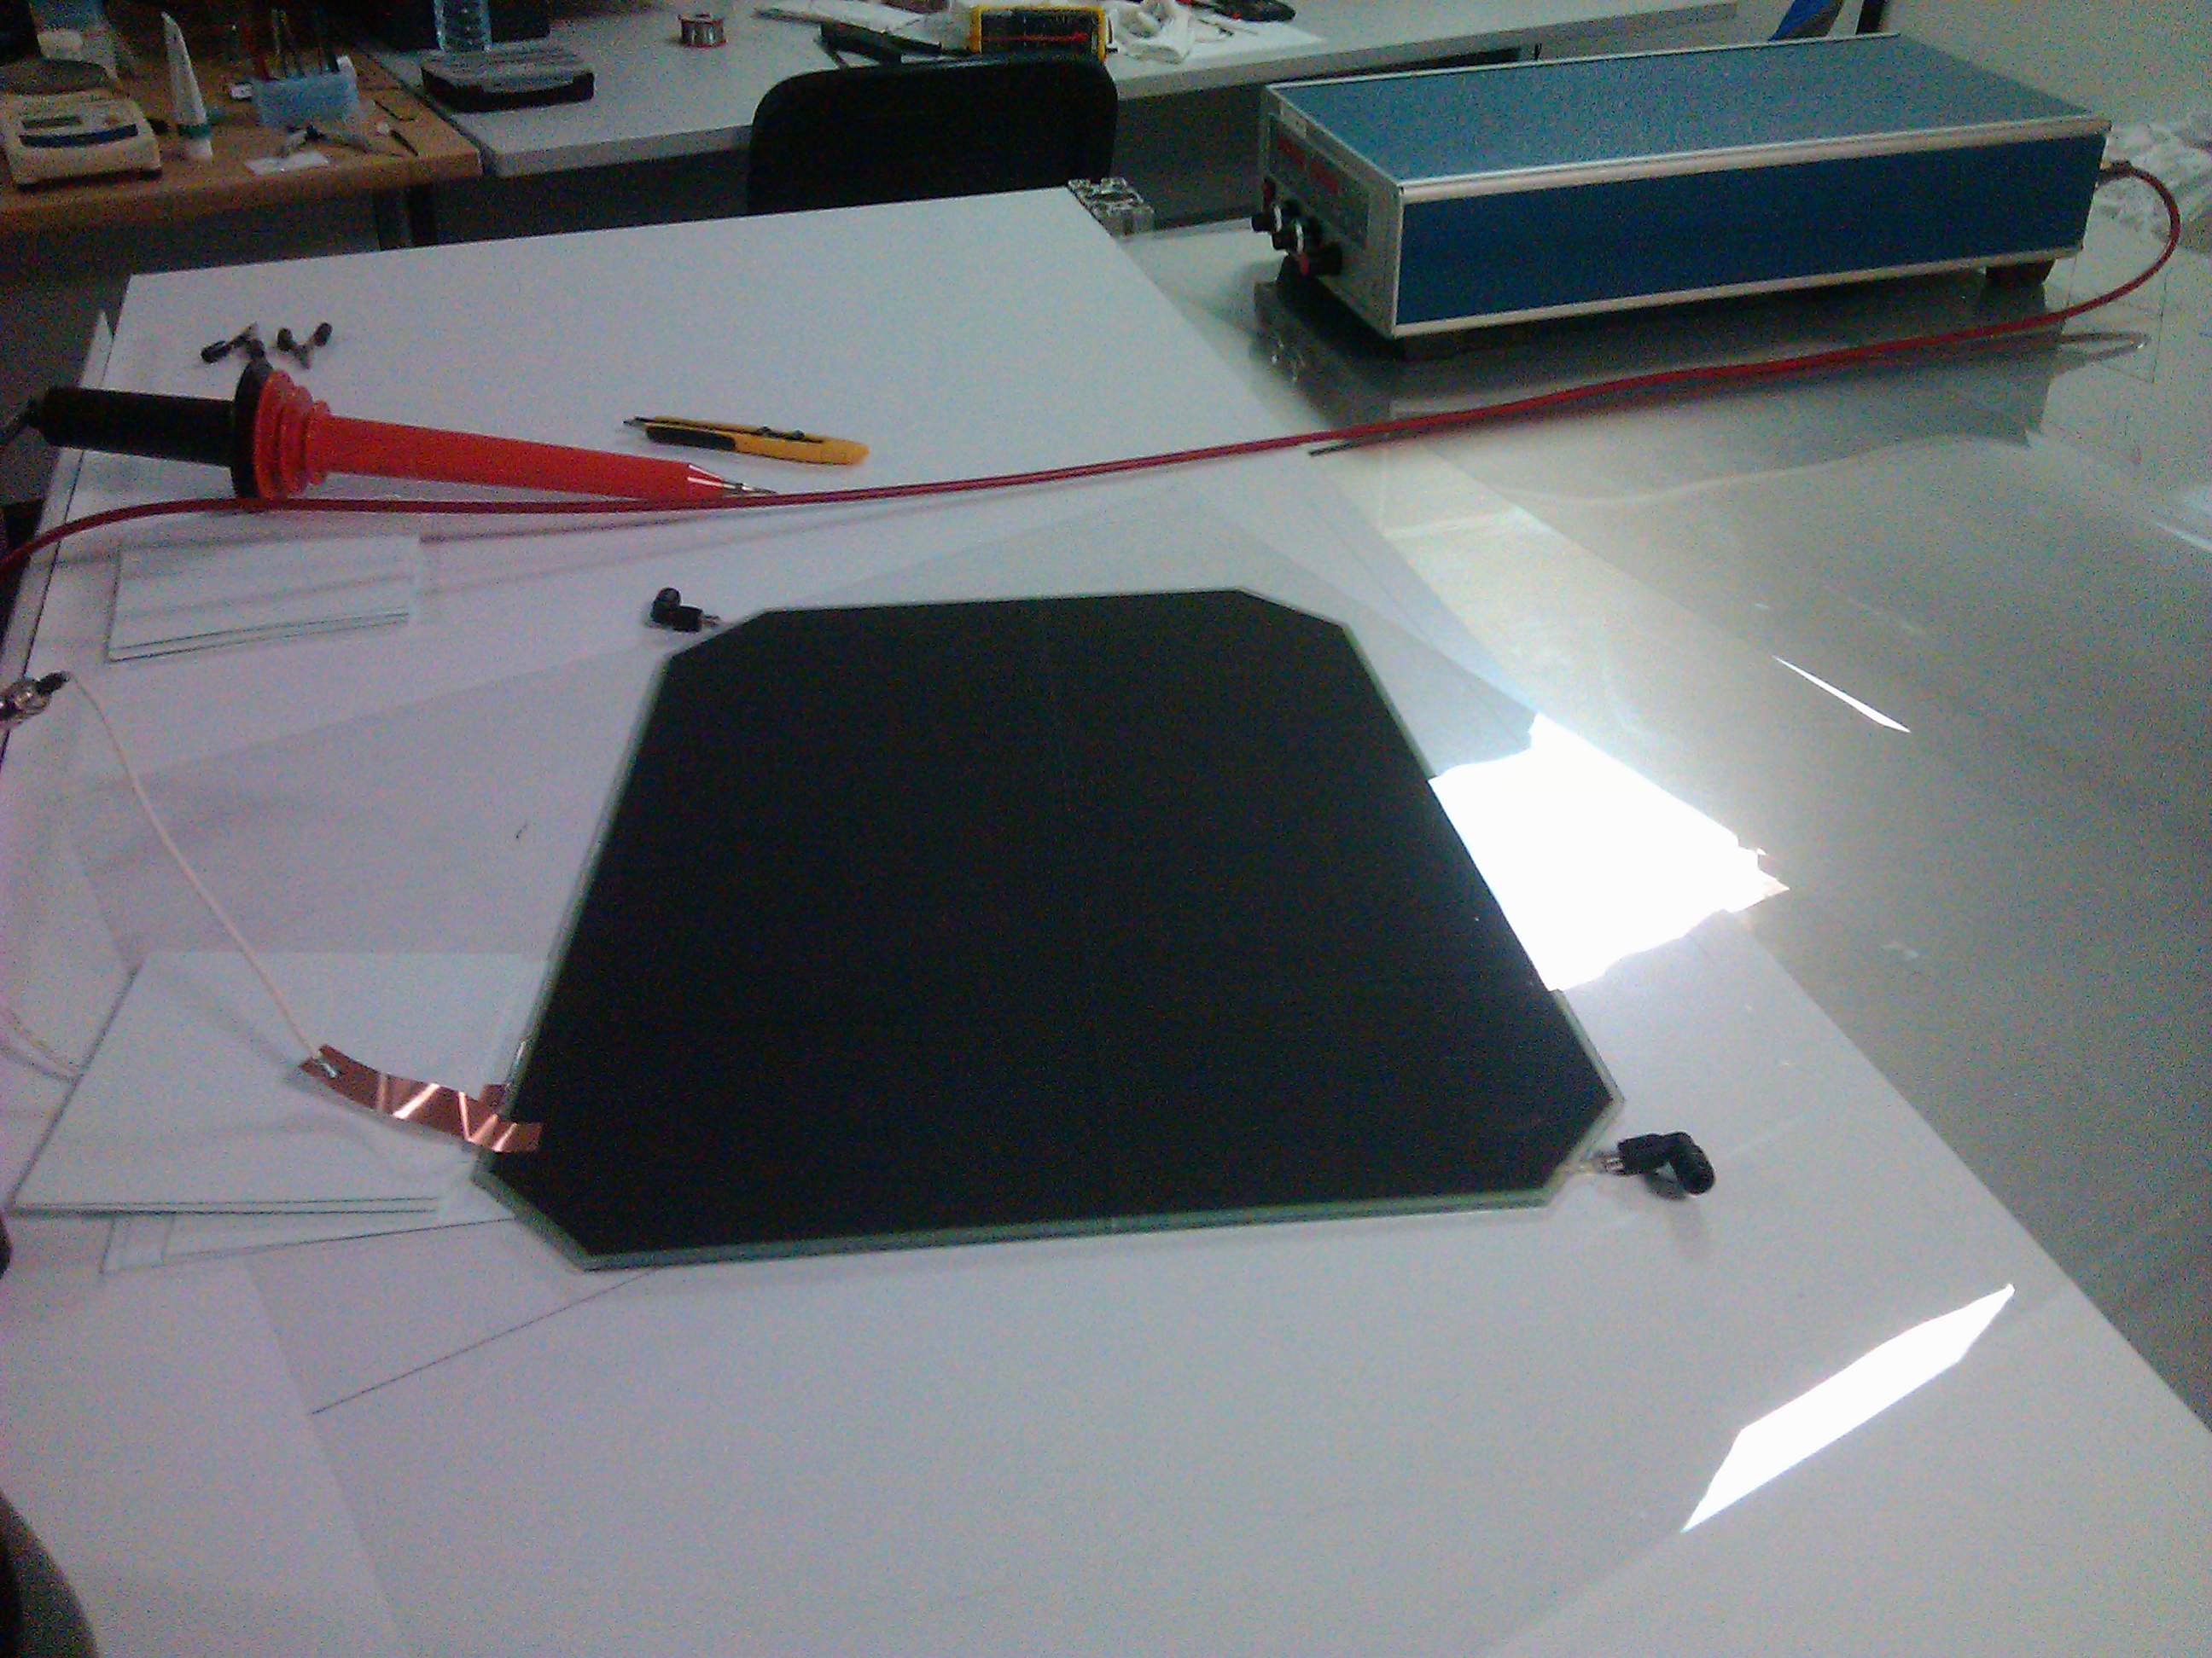
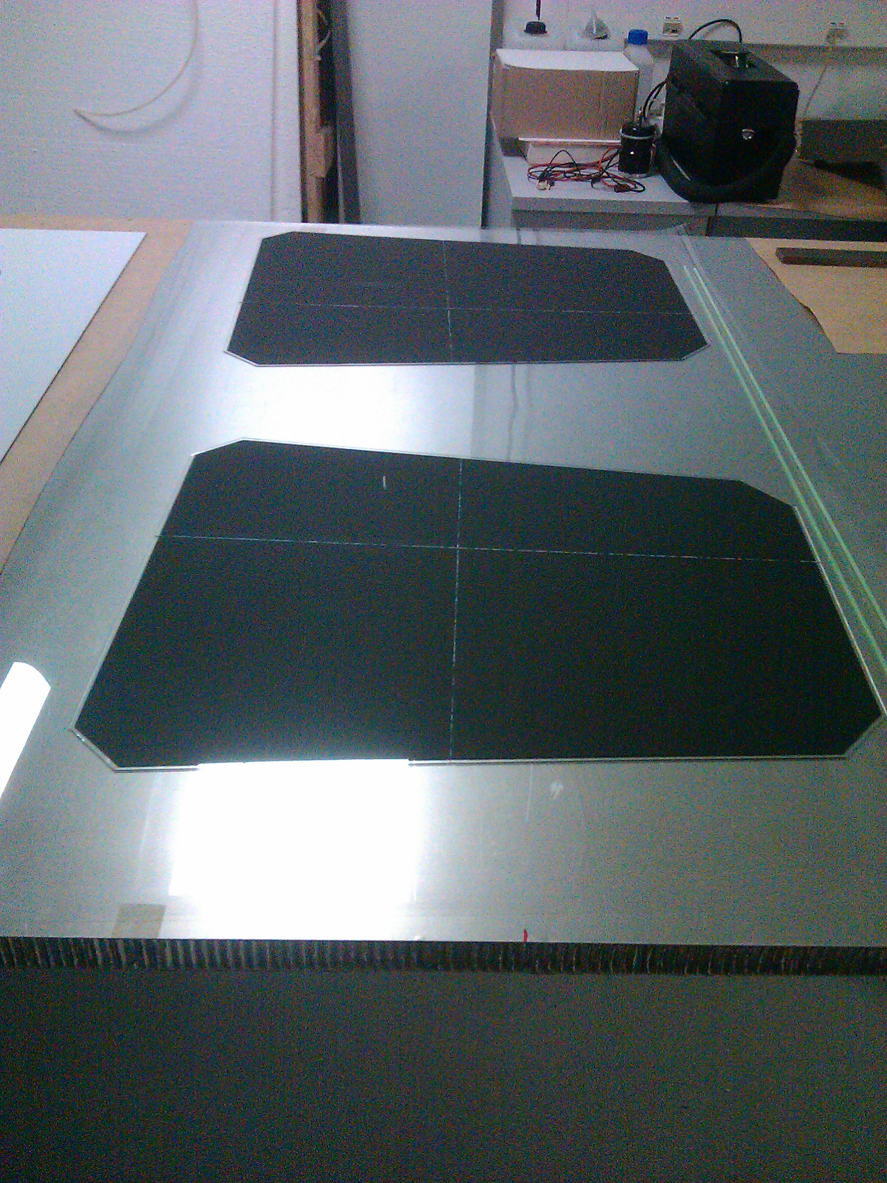
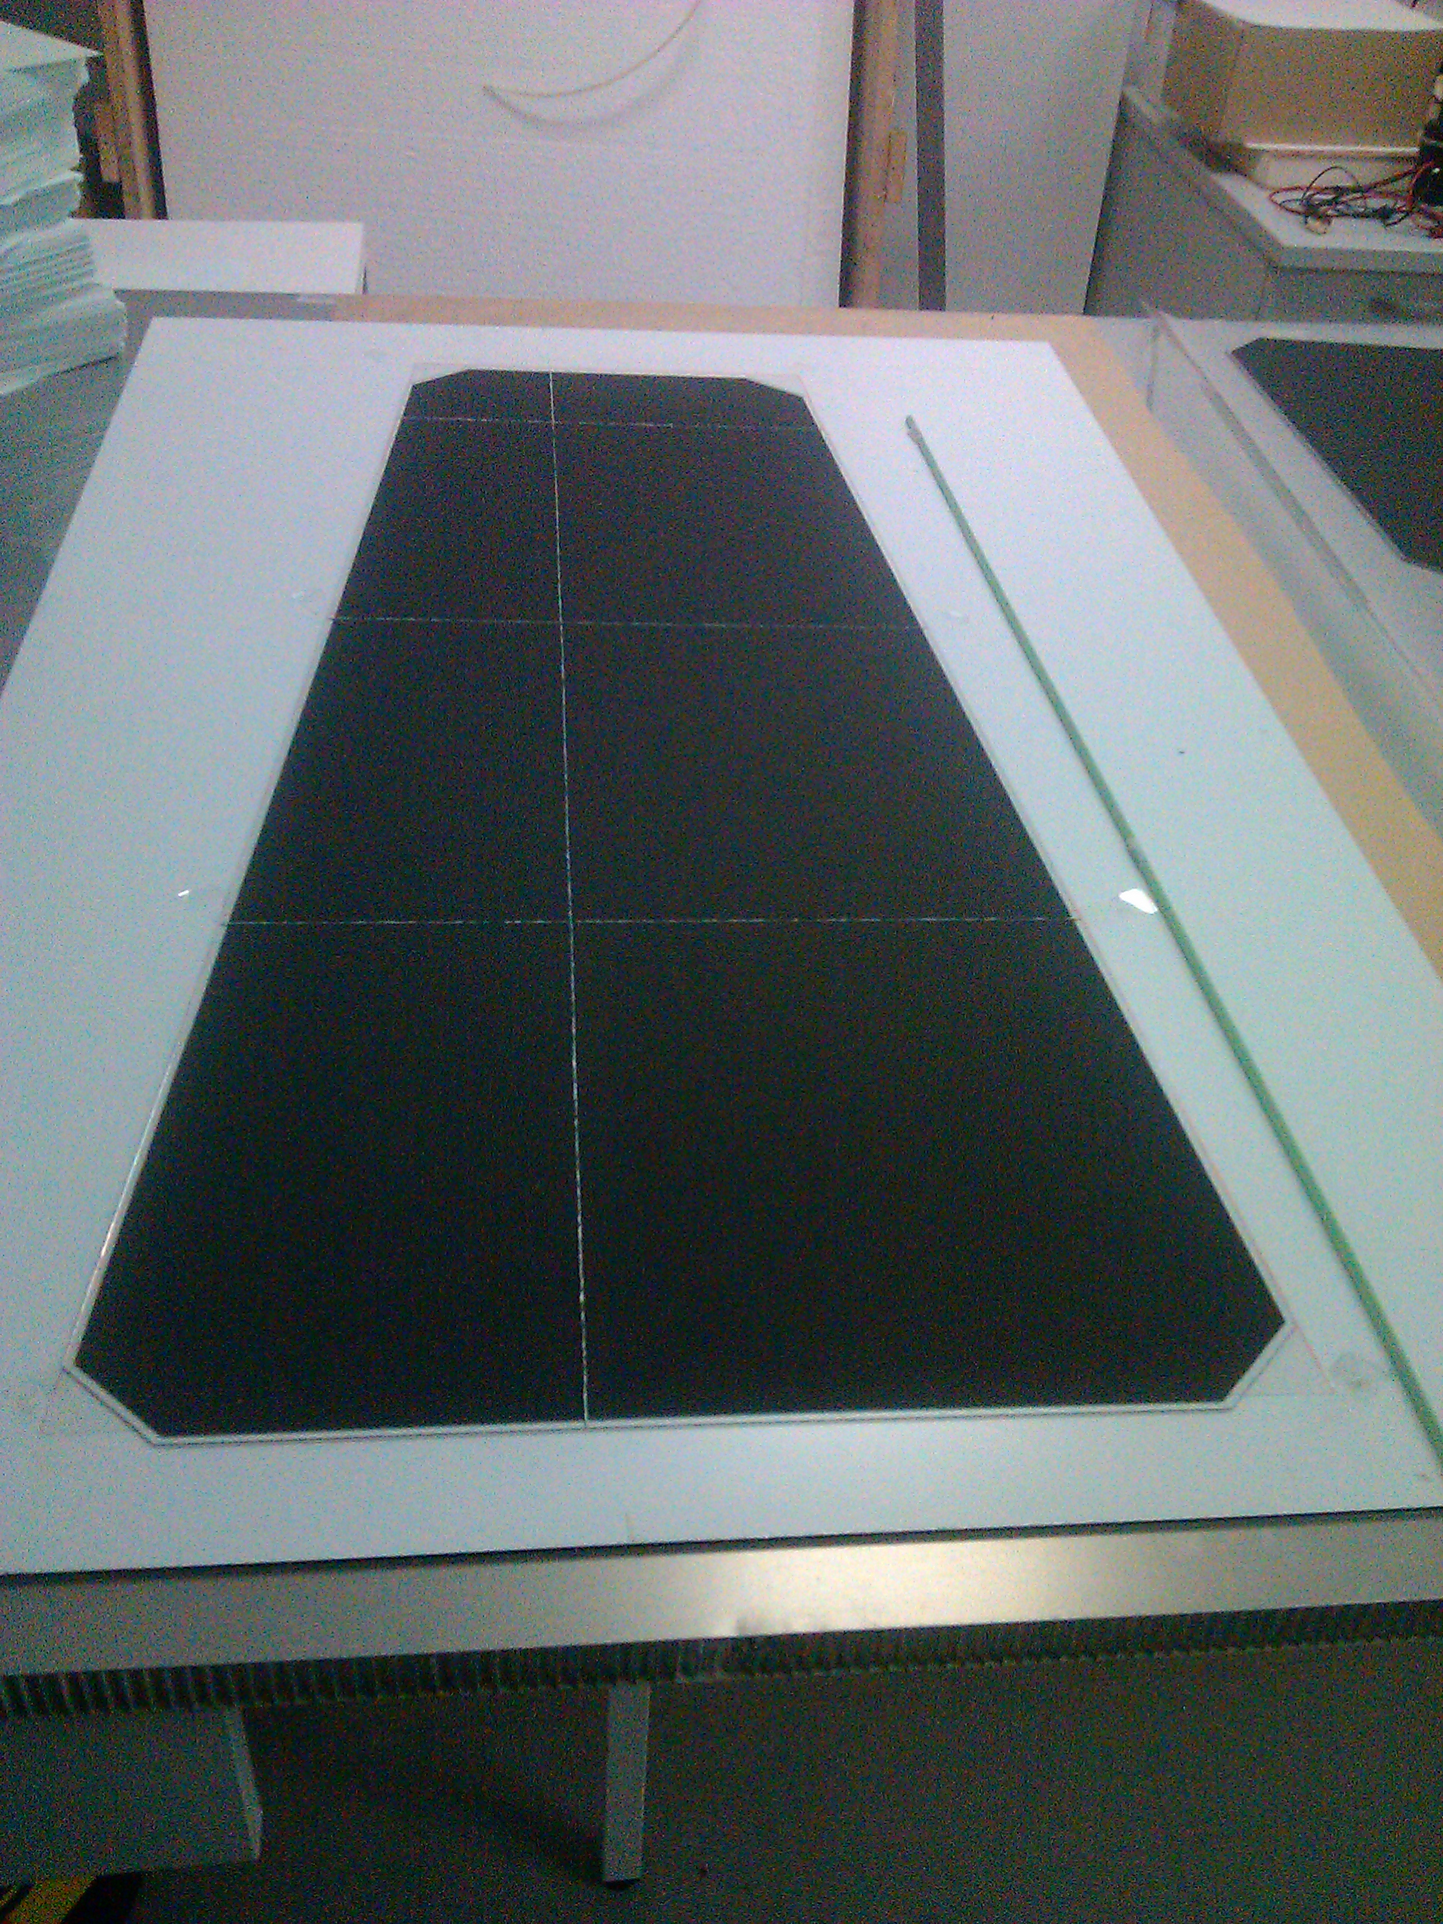
Bakelite RPC
GRPC
A similar GRPC using standard glass plates smaller than 30X30 cm² were built at IPNL. After validation, identical GRPC will be built using low-resistivity glass

Slide 18
R&D
Readout electronics:
First step is to use the CMS existing readout electronics (FEB) to read out the GRPC. However this electronics was not conceived to deal with high rate and its timing precision is > 1 nanosecond.
Two activities started in parallel with the aim to have FE electronics
able to deal with the high rate and to provide a sub-nanosecond time measurement capability.

Slide 19
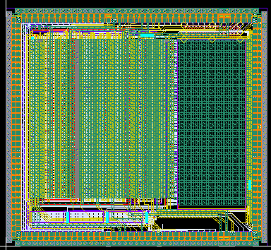
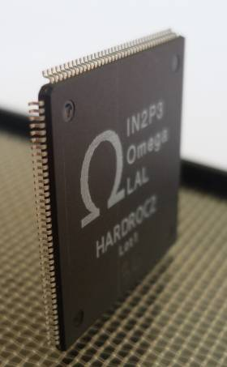
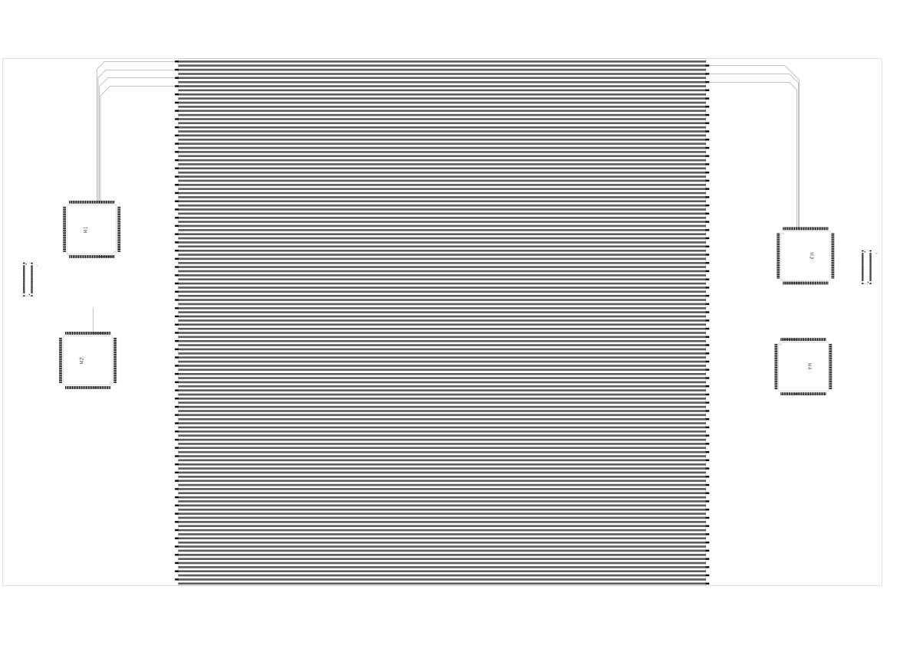
R&D for single gap and sub-nanosecond time resolution
- Use the 64-channel HARDROC ASICs (well tested in SDHCAL and
available)
Use appropriate “Link Box” (available)
Use a TDC with 100 ps time resolution (available) per ASIC
(use the ∪64 available signal)
Design new PCB with pick-up strips (pitch of 2 mm)
rectangular shape (30X30 cm²).
This can be used to equip the small GRPC already tested
with the same electronics (but without the TDC ) and then use cosmic rays to check the sub-nanosecond time resolution.
Electronics board is designed (4HR). First results before July 2013.
4.7 mm
4.3mm
IPNL

Slide 20
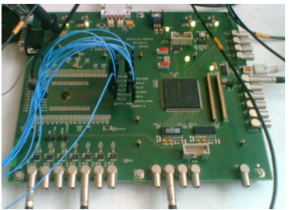
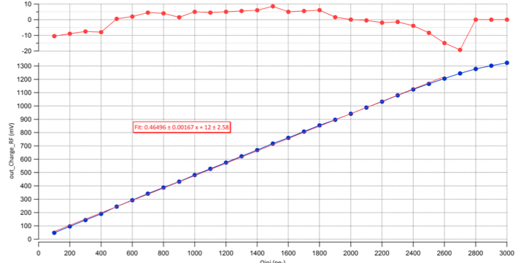
R&D for multi gap and <100 ps time resolution
Use the 16-channel PETIROC ASICs (available) :
High bandwidth preamp (GBWP> 10 GHz), <3 mW/ch, dual time and charge measurement up to 2500 pe, jitter< 10 psrms
Develop a new Link Box
Use a TDC with 25 ps time resolution (available) per ASIC
(use the ∪16 available signal)
Design new PCB with pick-up strips (different values of pitch)
ASICs and the LB are on the same PCB (on the edge)
the two strip’s ends are read out with two different ASICs
-The final size of the PCB will be that of RE1/X detector.
First results before end of 2013.
OMEGA, NCEPU, TSINGUHA
The aim is to include a TDC in each channel (2014)

Slide 21
High irradiation test:
We would like to install 4 high-rate GRPC close to the GIF source to study the detector stability in high irradiation environment but rather to have only one detector the presence of 3-4 detectors will allow to study the efficiency evolution in time using the cosmic rays.
We intend to use in the future the PAVIA university accelerator facility to study the electronics readout resistance to higher irradiation environment ( that of GIF is limited to 7 kHz/cm²).

Slide 22
Conclusion
The R&D of GRPC for CMS is going to be an exciting one. The benefits of this will have a large scope of applications.
Many groups are eager to share the responsibility to show that the GRPC in the high eta region is the right detector to improve on the trigger efficiency and to enhance the physics potential of CMS.
French and Chinese groups are the leader in this project and this is thanks to the FCPPL support since longtime.

Slide 23
BACKUP

Slide 24
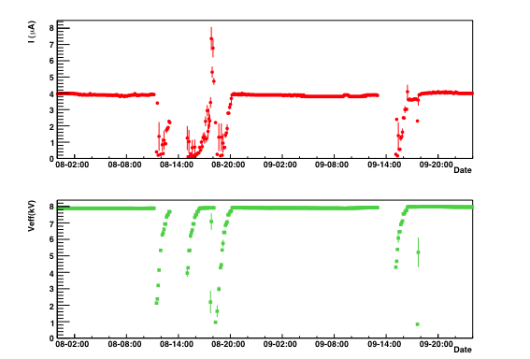
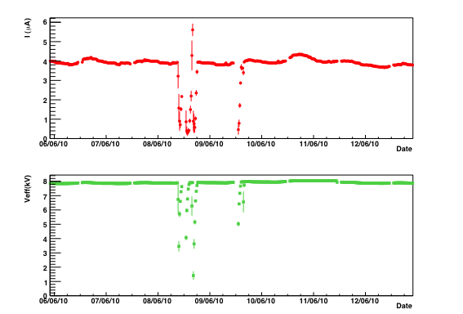
200z/cm² @GIF

Slide 25
Current (μA)
Bulk resistivity (10¹⁰Ω.cm)
Current (μA)
Bulk resistivity (10¹⁰ Ω.cm)
The glass was applied with 1000V for about 32days, integrated charge: 1 C/cm²

Slide 26
