Slide 1
FCPPL… what’s next?
Nanjing, March 28th, 2013

Slide 2
FCPPL achivements
Over 6 years of running (2007-2013)
25-30 projects funded each year
Over the 25 projects in 2013
7 since 2007-> FCPPL stability
10 from FCPPL network -> synergy & renewall
~200 members (300+ cumulated)
32 FCPPL doctors + 27 PhD students
(5-10 new/year, application succes ratio ~ 80%)
100-130 participants at each FCPPL workshop
(40% vistors / 60% hosts)
200+ publications whith specific FCPPL contrib

Slide 3
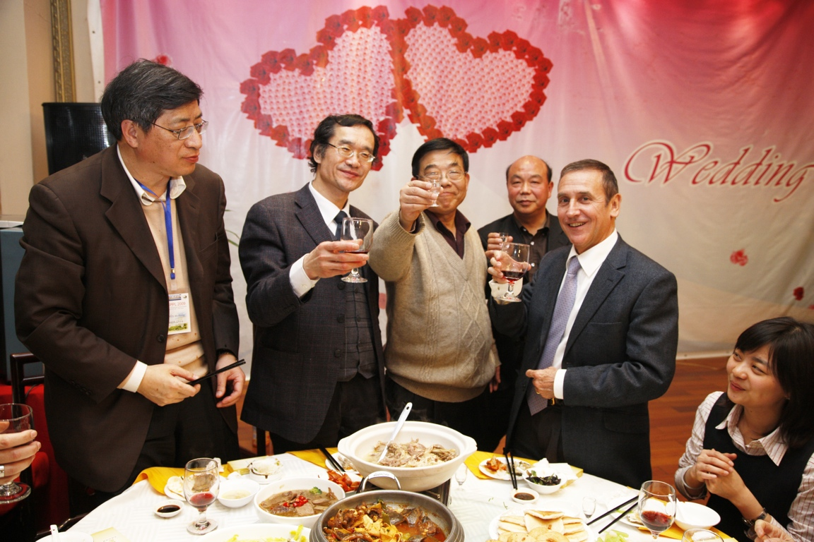
FCPPL is working well!
Thank you!

Slide 4
FCPPL legal status
FCPPL is an International Associate Lab (LIA), a (flexible) tool proposed by CNRS for international collabs
Official duration is 8 years…
ending in 2 years from now!
What shall we do next?
General agreement that we want to keep this community alive

Slide 5
Post-FCPPL : LIA again?
Several LIAs? -> Not favored (community/network issues)
Renew LIA a 3rd time?
Possible?
Several issues:
Funding level reached a critical point
Better identification on Chinese side
Better involvment of French Universities
(focus on Master/PhD level exchanges)

Slide 6
Post-FCPPL : Research consortium?
International platform with entrance ticket for institutions wishing to participate. Ex: LIAMA
See Vania Joloboff’s talk

Slide 7
Post-FCPPL – UMI?
Mixt International Unit: stand-alone lab
Legal body in China with permanent French staff with independant budget
Key aspect: has to serve a purpose (e.g. large structuring project in China in which France gets involved)

Slide 8
Post-FCPPL
Other aspects
European dimension?
Other sollutions?
Session program
Wang Yifang (IHEP Director)
Vania Joloboff (LIAMA European Director)
Lu Xiaofeng (CAS International Relations)

