Slide 1
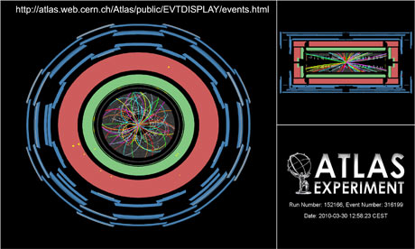




W polarization and ttbar spin correlation study
B. Li, L. Chen , E. Monnier, C. Zhu, L. Shan

Slide 2
introduction
Introduction
Data/MC comparison
Unfolding method
W polarization and ttbar spin result

Slide 3
W polarization in top decay
W polarization in SM
Standard Model
 | 0.695 | 0.304 | 0.001
Longitudinal W⁺ (F₀)
Left-handed W⁺ (F_{L})
Right-handed W⁺(F_{R})
by measuring angular distribution of charged lepton in W rest frame
1/N dN/dcosΨ
^{ν}
b
W⁺
Angle between:
lepton in W rest frame and
W in top rest frame
t
Ψ
1/2
1/2
1
spin
l⁺
cosΨ

Slide 4
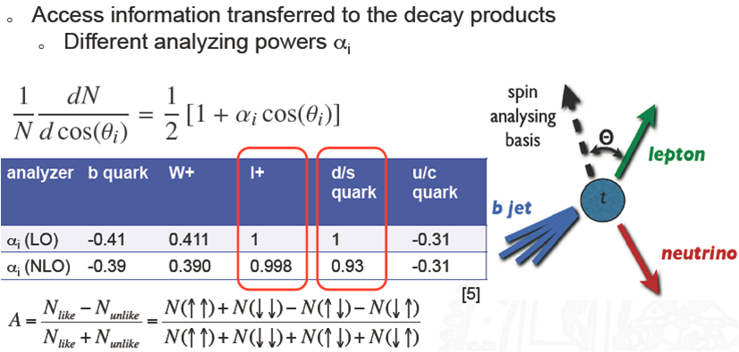
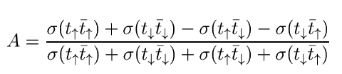
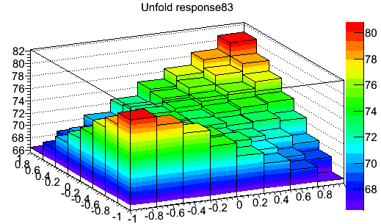
Spin correlation introduction
Introduction
is the spin analyzing power.
is the angle between the direction of flight in top rest frame and the direction of the top polarization.
SM prediction @NLO level:
A = 0.326 at CM 7TeV and helicity basis.

Slide 5
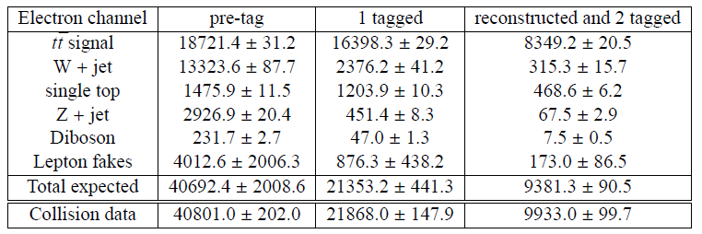
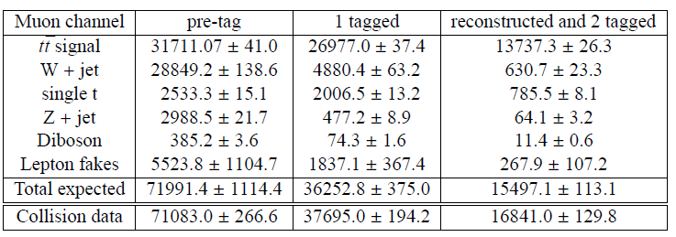
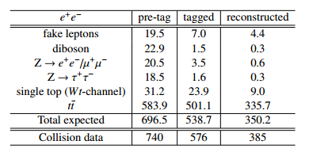
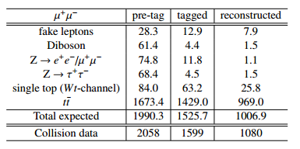
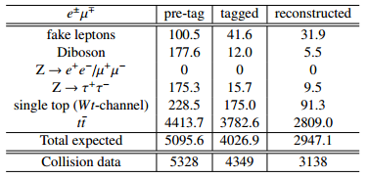
Event yield in semi-lepton and di-lepton
All 2011 data : 4655.74 pb-1
Follow the top common object selection twiki
TopRootCoreRelease-11-00-07
Lepton Scale factors , smearing, scale , met correction, pileup reweighting, Btag SF
e+jet
mu+jet
ee
mumu
emu
Good agreement for the Data/MC comparison

Slide 6
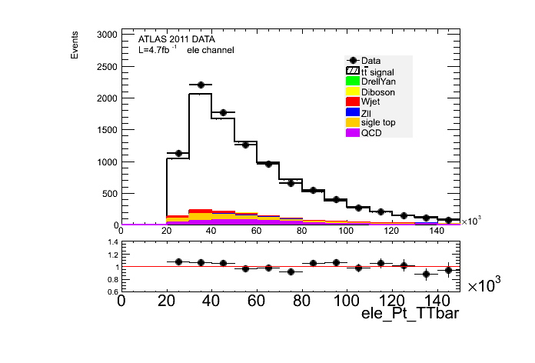
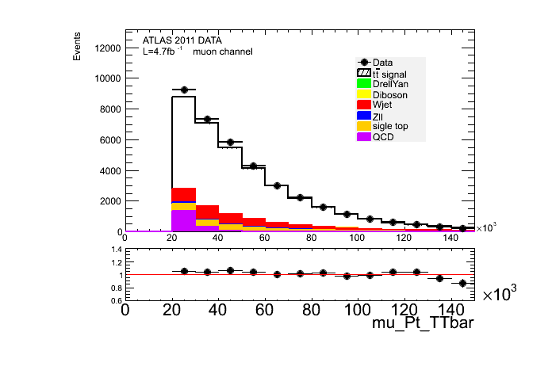
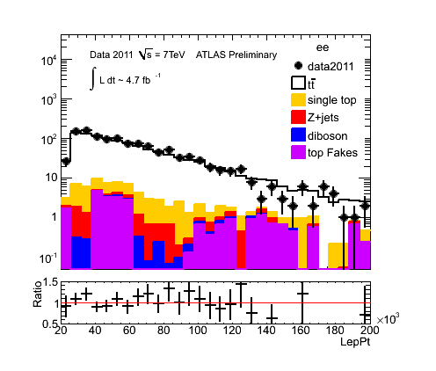
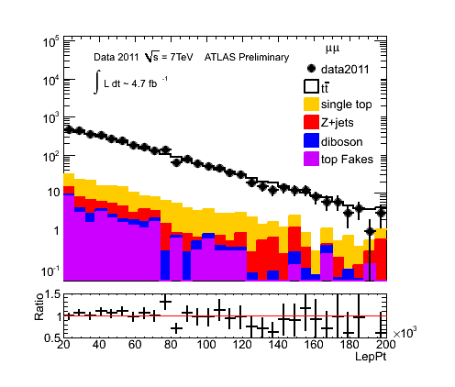
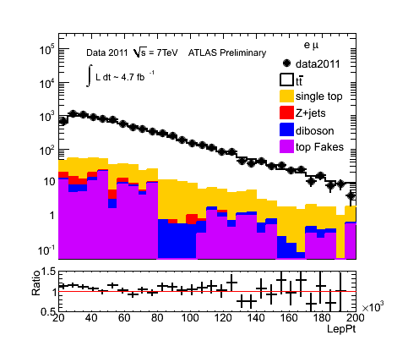
Control plots
e+jet
mu+jet
ATLAS work in progress
ee
mumu
emu

Slide 7
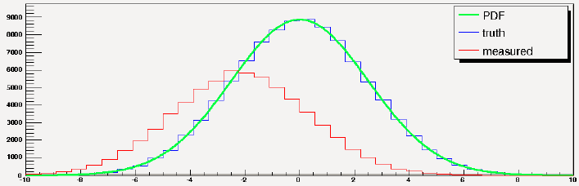

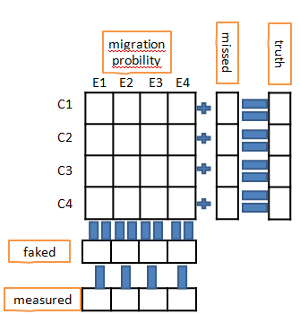

Unfolding
Given a “true” PDF in μ , that is corrupted by detector effects, described by a response matrix, R, we measure a distribution in ν. For a binned distribution
It would be possible to recover the original PDF by inverting the response matrix
The migration prob matrix for data is taken from MC, with statistical and systematical difference

Slide 8
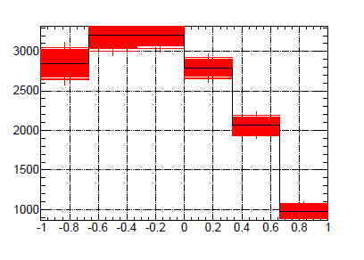
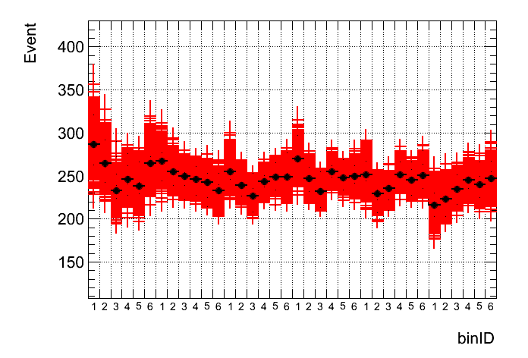
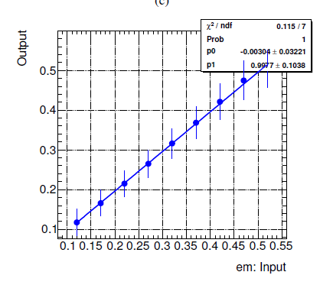
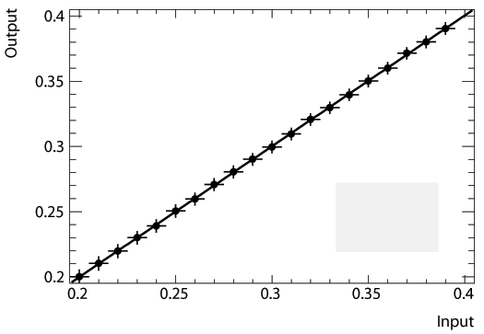

Validation of unfolding
W pol
Spin value
Unbias test
I/O test
Closure test

Slide 9
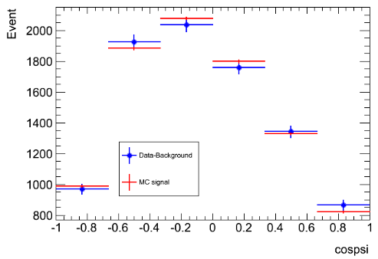
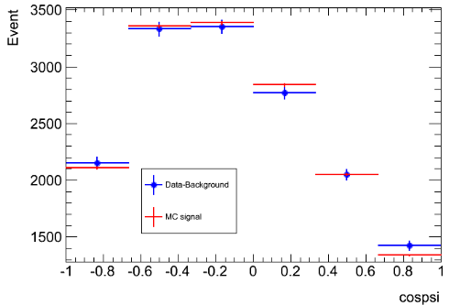
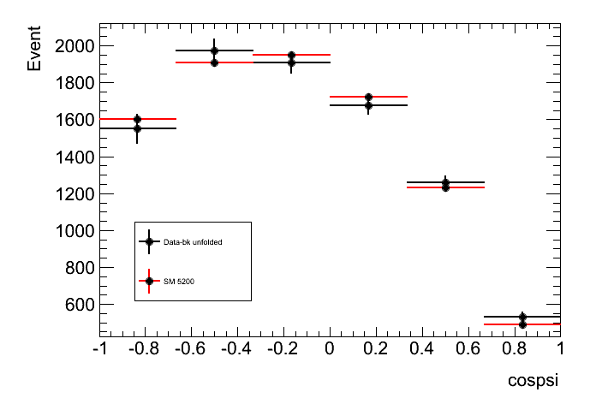
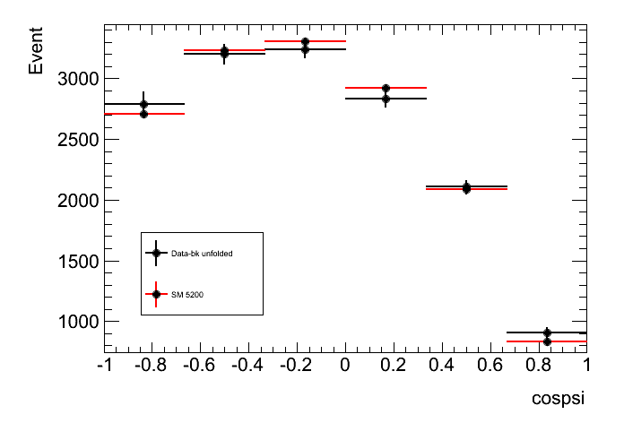
W pol differential result in semi-lepton
ATLAS work in progress
ele
muon
bins 1 : 1566.4 +/-77.5
bins 2 : 1974.7 +/-62.3
bins 3 : 1900.6 +/-52.1
bins 4 : 1658.7 +/-44.6
bins 5 : 1239.3 +/-38.3
bins 6 : 560.9 +/-29.7
bins 1 : 2835.7 +/-94.9
bins 2 : 3205.6 +/-78.3
bins 3 : 3218.7 +/-70.7
bins 4 : 2783.9 +/-61.7
bins 5 : 2056.5 +/-53.5
bins 6 : 980.4 +/-42.4

Slide 10
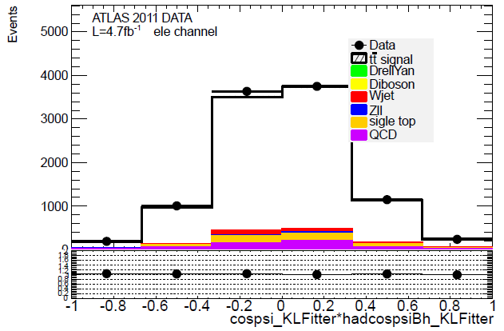
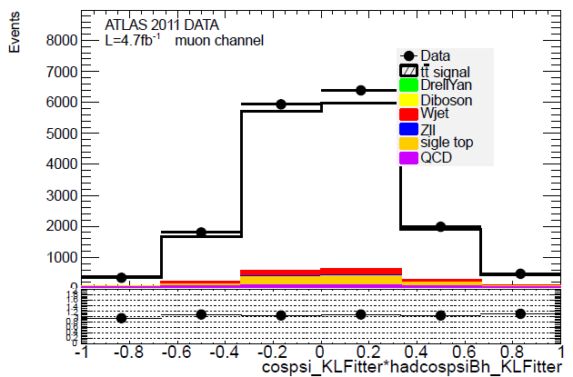
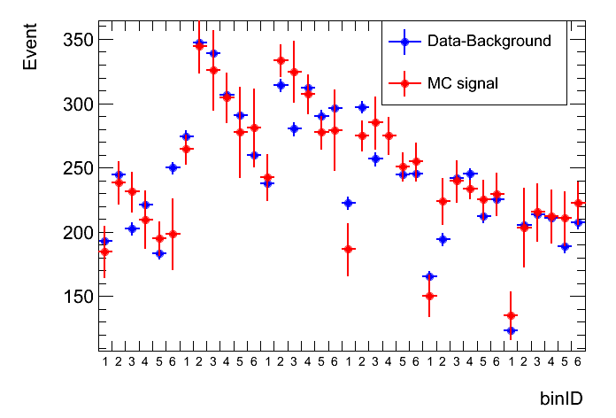
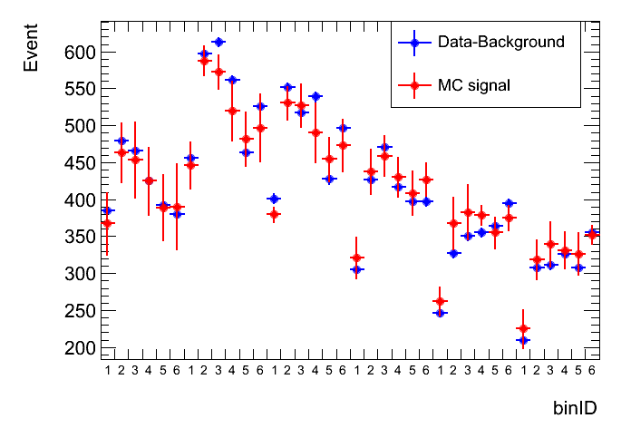
Spin cos(lepton) cos(had_bjet)
ATLAS work in progress
2D plots transfer to 1D to shows the agreement between Data/MC

Slide 11
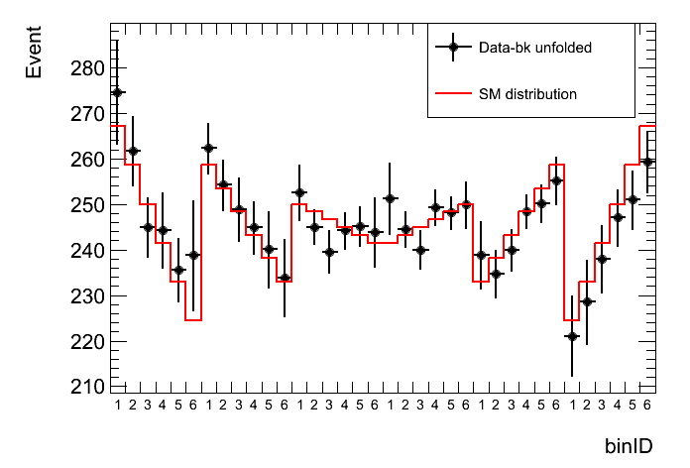
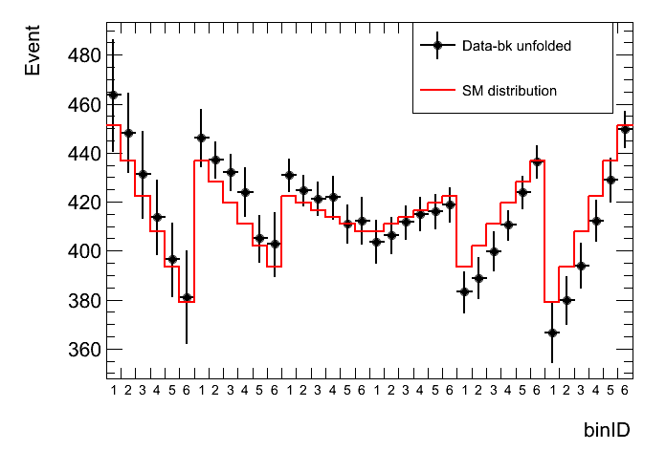
Unfolding result on real data
before unfolding
ele
muon
ATLAS work in progress
After unfolding

Slide 12
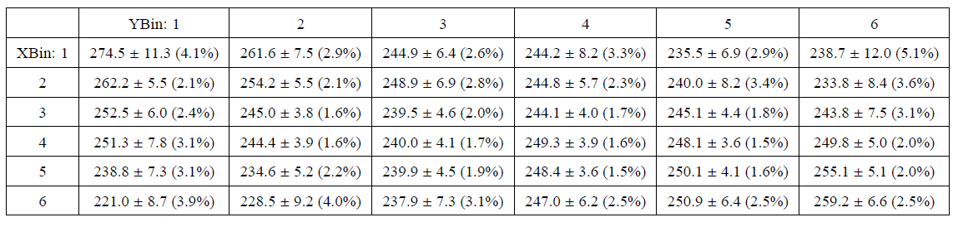
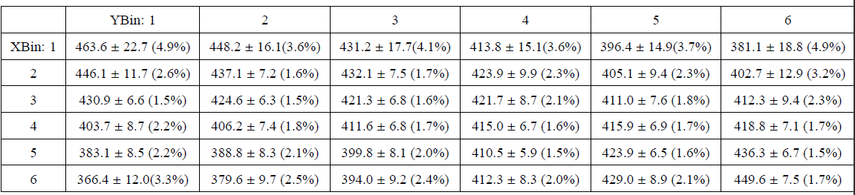
Spin differential result in semi-lepton

Slide 13
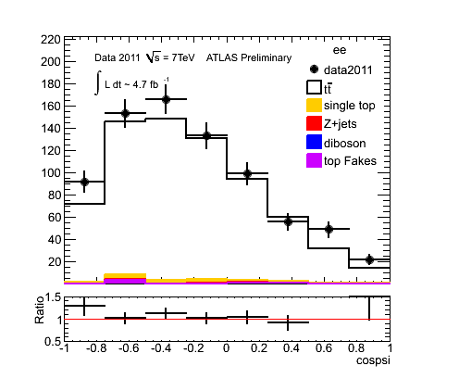
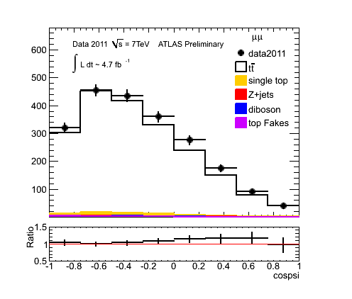
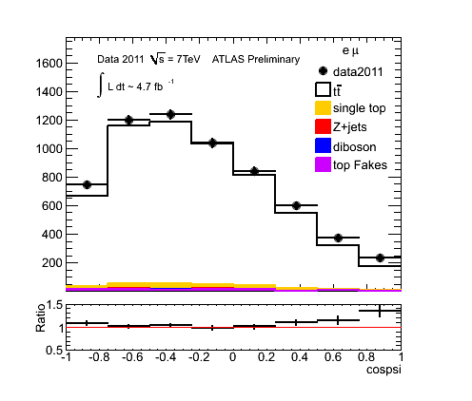
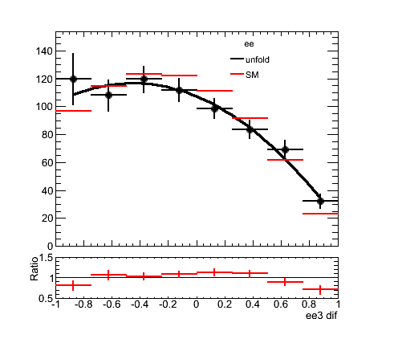
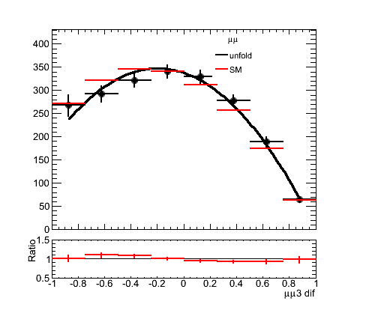
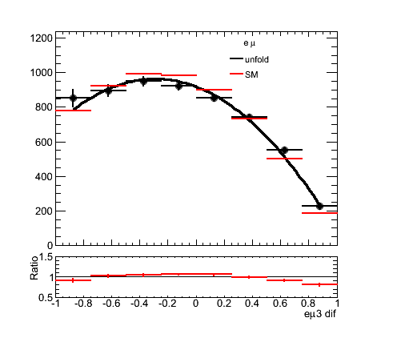
Wpol in di-lepton
before unfolding
ATLAS work in progress
After unfolding

Slide 14
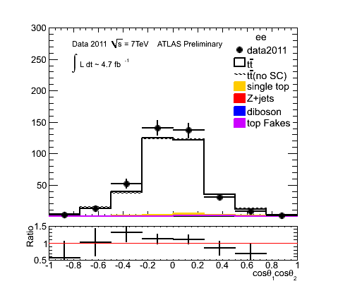
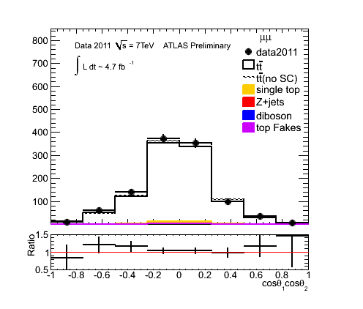
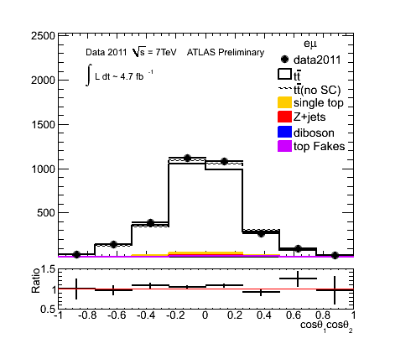
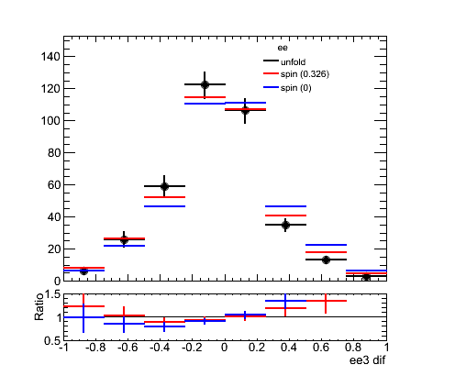
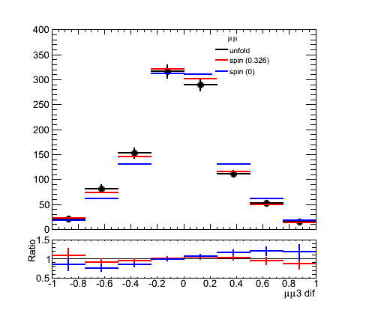
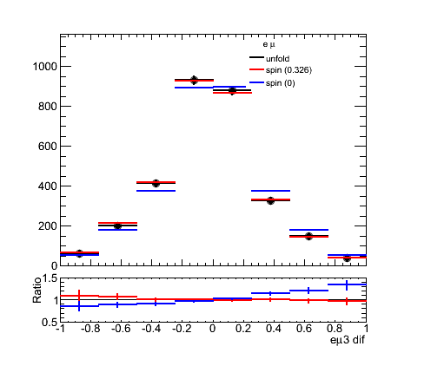
Spin value in di-lepton
ATLAS work in progress

Slide 15
Spin results in di-lepton
Differential result
binID : content +/- error. (percentage) 1 : 6.54 +/- 2.00 (30.58%)
2 : 26.02 +/- 5.09 (19.56%)
3 : 58.92 +/- 6.97 (11.83%)
4 : 122.34 +/- 8.31 (6.79%)
5 : 106.18 +/- 7.79 (7.34%)
6 : 34.91 +/- 4.21 (12.06%)
7 : 13.27 +/- 2.38 (17.94%)
8 : 2.84 +/- 0.94 (33.10%)
binID : content +/- error. (percentage)
1 : 20.99 +/- 3.89 (18.53%)
2 : 81.87 +/- 8.98 (10.97%)
3 : 153.12 +/- 9.90 (6.47%)
4 : 316.72 +/- 13.26 (4.19%)
5 : 290.31 +/- 12.43 (4.28%)
6 : 111.68 +/- 6.71 (6.01%)
7 : 52.08 +/- 5.27 (10.12%)
8 : 15.26 +/- 2.65 (17.37%)
ee
mumu
binID : content +/- error. (percentage)
1 : 60.98 +/- 7.60 (12.46%)
2 : 200.42 +/- 12.92 (6.45%)
3 : 413.68 +/- 16.09 (3.89%)
4 : 929.90 +/- 22.20 (2.39%)
5 : 878.68 +/- 21.38 (2.43%)
6 : 327.74 +/- 12.14 (3.70%)
7 : 148.08 +/- 8.54 (5.77%)
8 : 38.88 +/- 3.18 (8.18%)
emu

Slide 16
Summary
Good agreement for the Data/MC comparison
Unfolding method works as expected
W pol and spin result are given by unfolded real data
Sys study is on going
Study is under completion and a paper is ongoing
Wpol note for di-lepton , semi-lepton
  ATL-COM-PHYS-2012-655 https://cdsweb.cern.ch/record/1451310/
  ATL-COM-PHYS-2013-070 https://cds.cern.ch/record/1507677
Spin note for di-lepton , semi-lepton
  ATL-COM-PHYS-2012-1065 http://cdsweb.cern.ch/record/1462276
  ATL-COM-PHYS-2013-333 http://cds.cern.ch/record/1529842

Slide 17
Back up slides

Slide 18
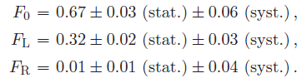
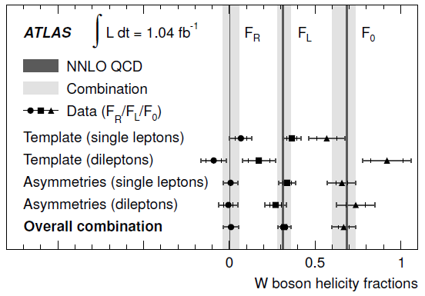
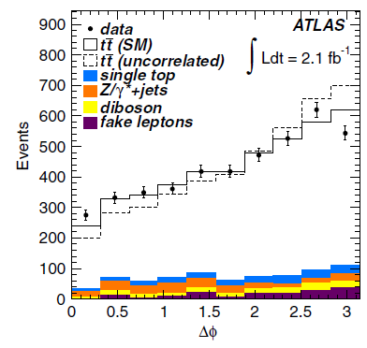
ATLAS published : W pol and Spin results
Measurement of W boson polarization in top quark decays with the ATLAS detector
Observation of spin correlation in ttbar events from pp collisions at √s = 7 TeV using the ATLAS detector

Slide 19
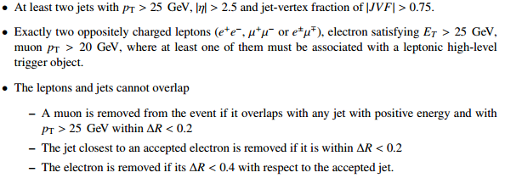
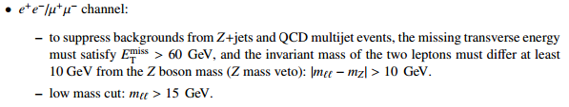

Di-lepton selection

Slide 20
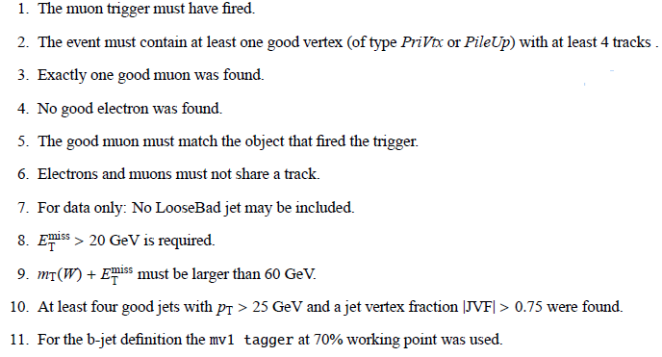
Semi-lepton selection

Slide 21



Control plots
Pre-tag
>=1btag
>=2btag
Ele channel
muon channel

Slide 22






Jet pt
Pre-tag
>=1btag
>=2btag
Ele channel
muon channel

Slide 23






met
Pre-tag
>=1btag
>=2btag
Ele channel
muon channel

Slide 24
Control plots in di-lepton

Slide 25






Control plots (>=1btag)
Jet Mult.
Jet Pt

Slide 26



Control plots (>=1btag)
Lep Pt
Met

