Slide 1
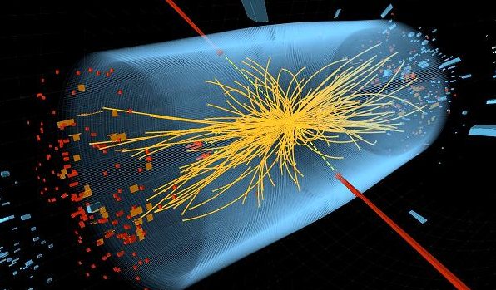
Overview of CMS H→γγ analysis and the IHEP/IPNL contributions
J. Tao for the CMS H→γγ group and IHEP/IPNL collaboration subgroups
2013.03.27 FCPPL

Slide 2
Contents
I am not going to tell you anything that you possibly don’t know already
All results shown are public/CMS approved
Milestone on July 2012
Motivation, analysis strategy and crucial points of H→γγ
ECAL performance and vertex determination
Photon identification
Di-Photon selection
Event classification
Background and signal modeling
Latest results of H→γγ with all 7+8TeV data
Summary

Slide 3
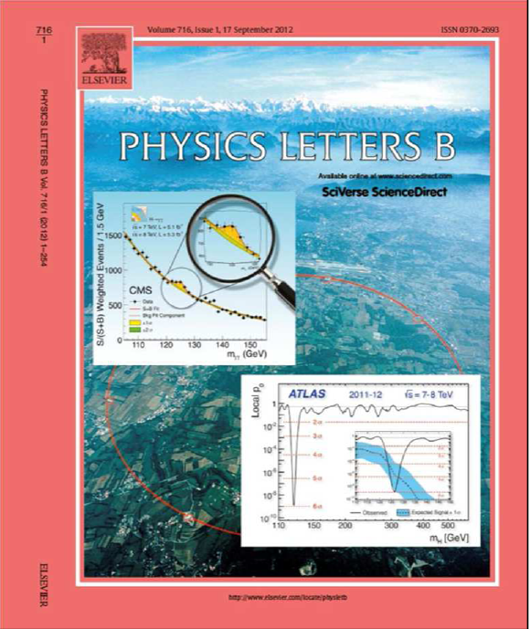
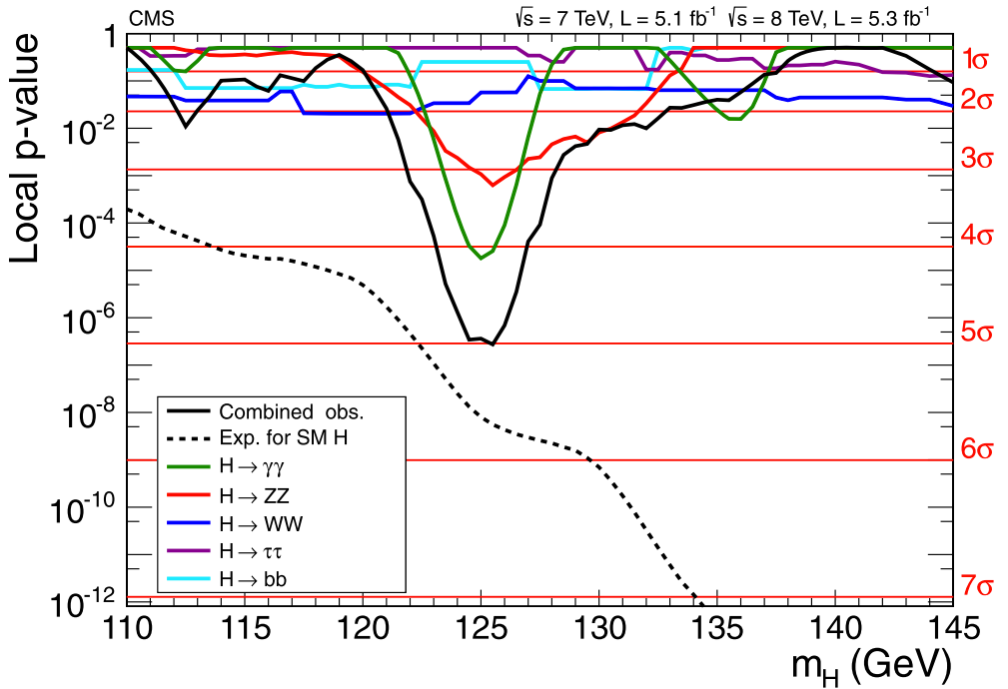
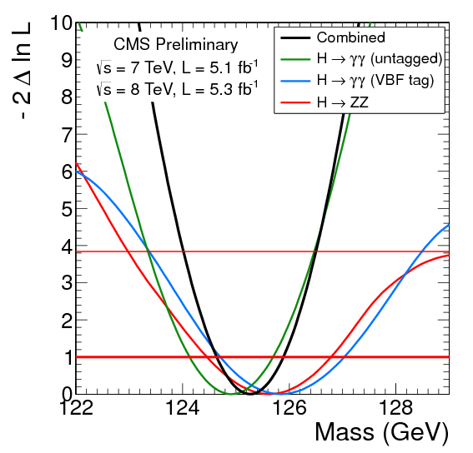
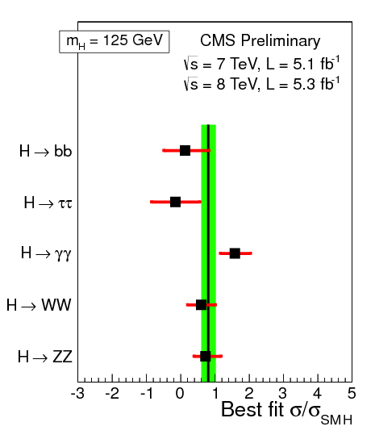
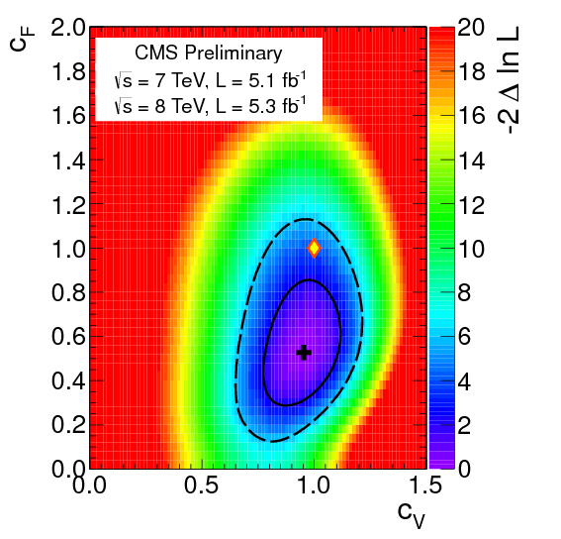
Higgs-like discovery @ LHC
[ July, 2012 ]
5.0σ observed.
mX = 125.3 ±0.6 GeV.
At 125 GeV:
σ/σ_{SM}=0.80 ±0.20.
“Couplings” compatible with SM.
CMS
only
H→γγ
H→ZZ

Slide 4
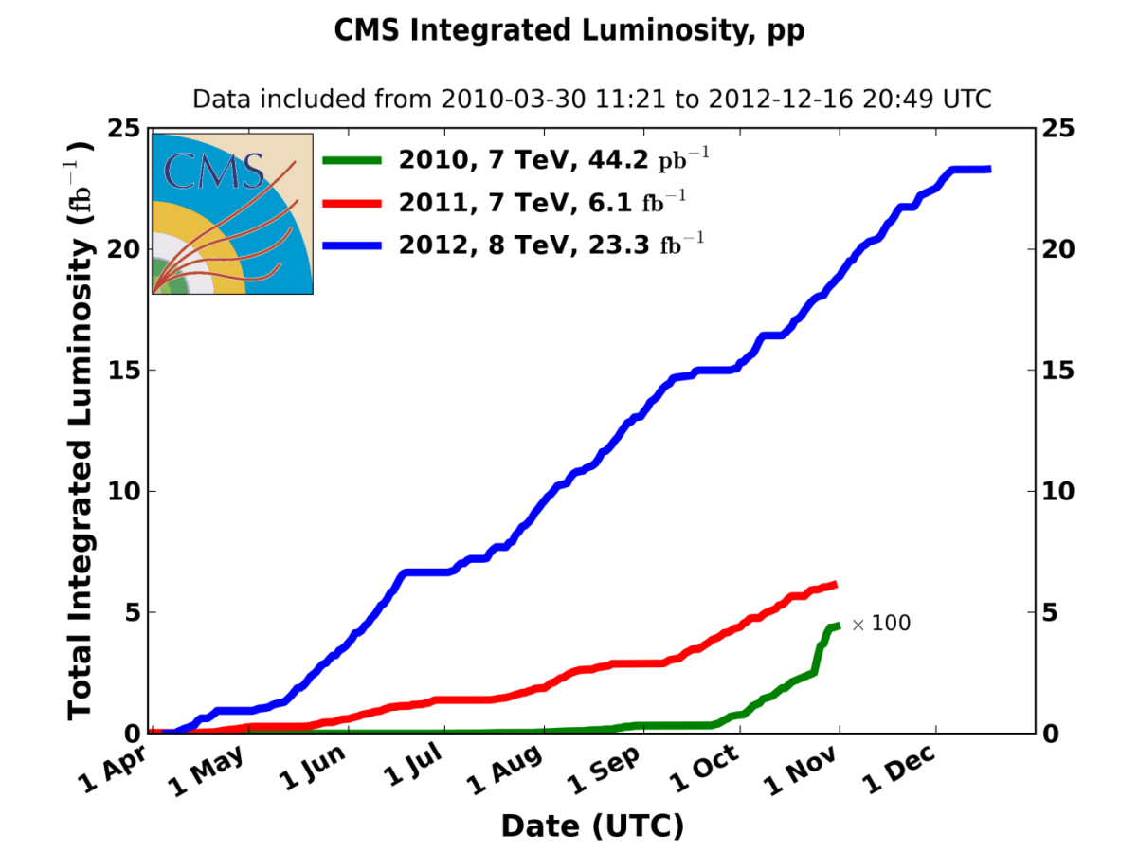
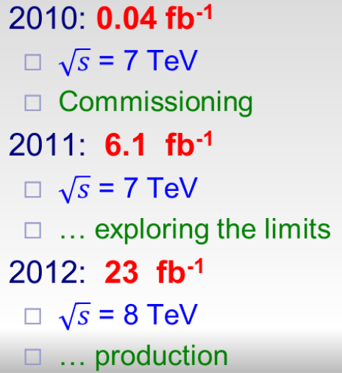
Now…..
July 2012: 7TeV ~5.1/fb
+ 8TeV ~5.3/fb
Combined results?
Coming soon
Good luminosity can used now for H→γγ @ CMS:
7TeV 5.1fb⁻¹ and 8TeV 19.6 fb⁻¹.

Slide 5
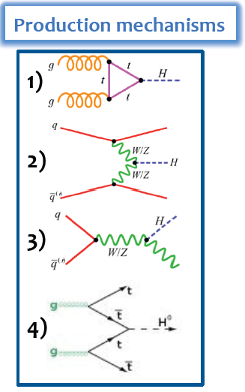
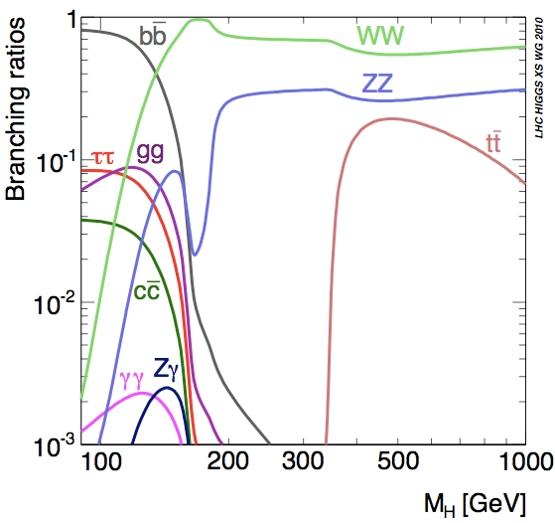
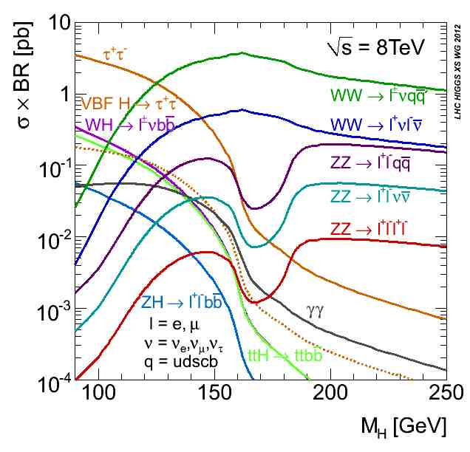
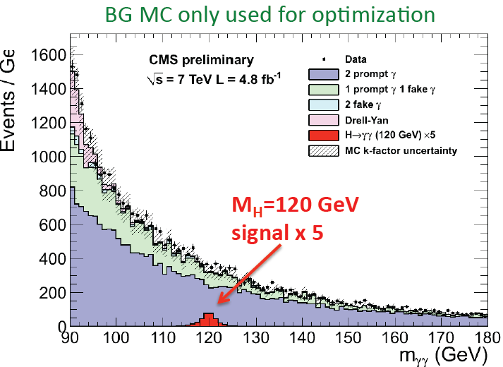
Motivation:
H→γγ for low mass
Overall small signal
BR between 0.14% and 0.23% for 100<M_{H}<150 GeV
→ Clean final-state topology: two isolated and high-Pt photons
→ Small narrow mass peak on large continuous background: very good mass resolution ~1-2%

Slide 6
H→γγ analysis strategy
Two different analyses:
1. Cut-based analysis in categories
– Simple and robust
– 4 event classes based on photons pseudorapidity/shower shape (R9) for the remaining events
– Event selection via cuts on isolation and shower shape defined for each category (Cuts in Categories – “CiC”)
2. Multivariate(MVA) analysis
– Event selection and categorization using a di-photon MVA
– Inputs: Event-by-event mass resolution, photon id discriminant, di-photon kinematic variables and vertex probability combined using boosted decision tree (BDT)
Baseline result: MVA approach (~15% better expected sensitivity)
Selected events are separated in “tagged” exclusive categories enriched in VBF and VH signal production and “untagged” inclusive categories, with different S/B and mass resolution
– Improve the sensitivity of the analysis for the coupling measurements
– The categorization proceeds in the following order:

Slide 7
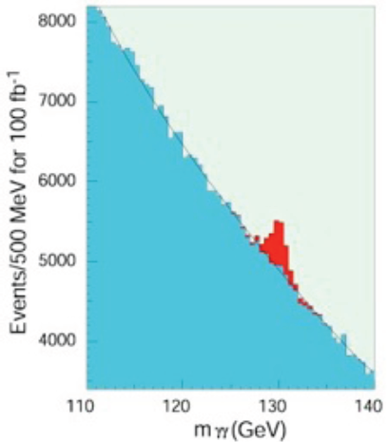
Crucial points
Small narrow mass peak on large continuous background
Event categorization(inclusive/exclusive channels)
Probe different production process (gg, VBF, VH) and exploit the different S/B and/or different resolution to achieve the best sensitivity

Slide 8
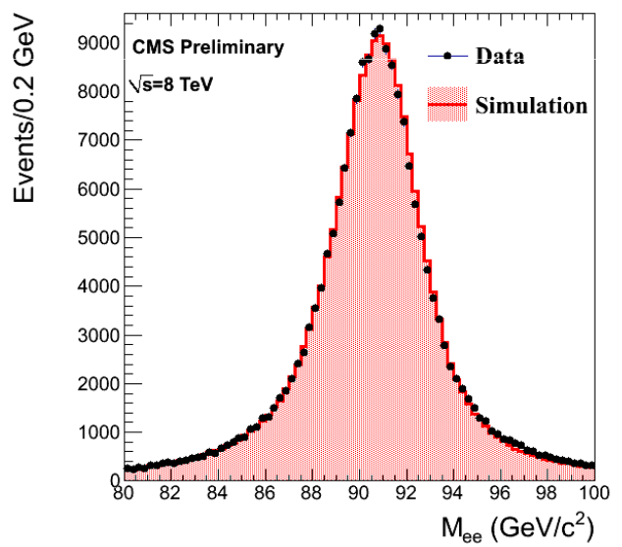
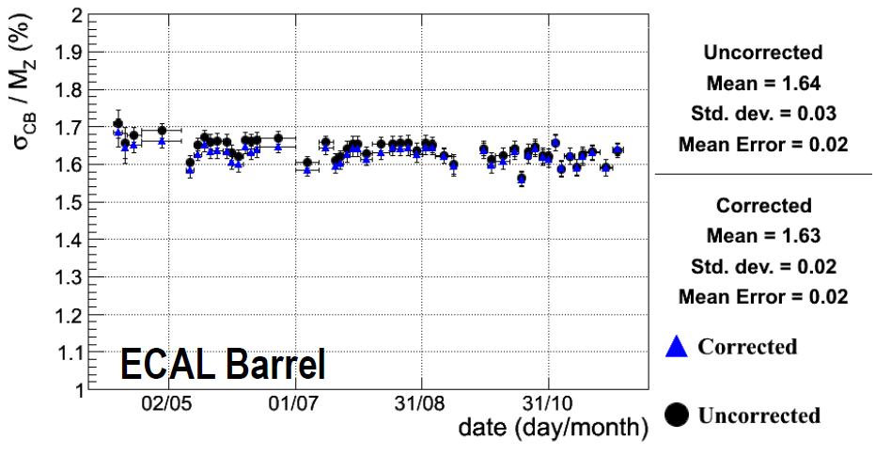
ECAL Performance
Improved ECAL calibration on the first 5.3 fb⁻¹ 2012 data (after publication)
Very good ECAL performance in 2012
Z→ee mass resolution is better than 1.2% for electrons with low bremsstrahlung in the barrel.
Stable performance already using promptly reconstructed data
Z→ee lineshape: good agreement
between data/MC
Z mass resolution as a function of time after
application of analysis level corrections (energy scale)
Both electrons in ECAL Barrel with low bremsstrahlung

Slide 9
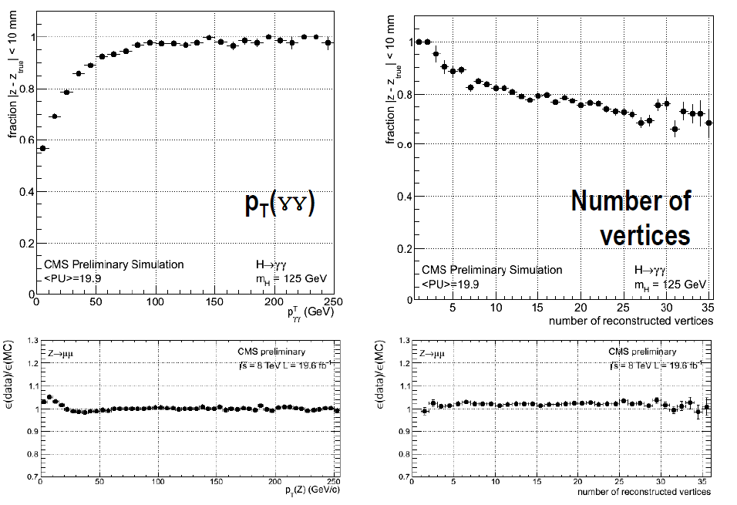
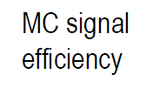
Vertex selections
Higgs production vertex is selected using a Boosted Decision Tree (BDT)
→ Inputs: ΣpT2 of vertex tracks, vertex recoil wrt diphoton system, pointing from converted photons.
An additional BDT is used to estimate the per-event probability to identify the correct vertex.
Control samples: Z→μμ (removing mu-tracks) for unconverted photons, γ+jets for converted photons

Slide 10
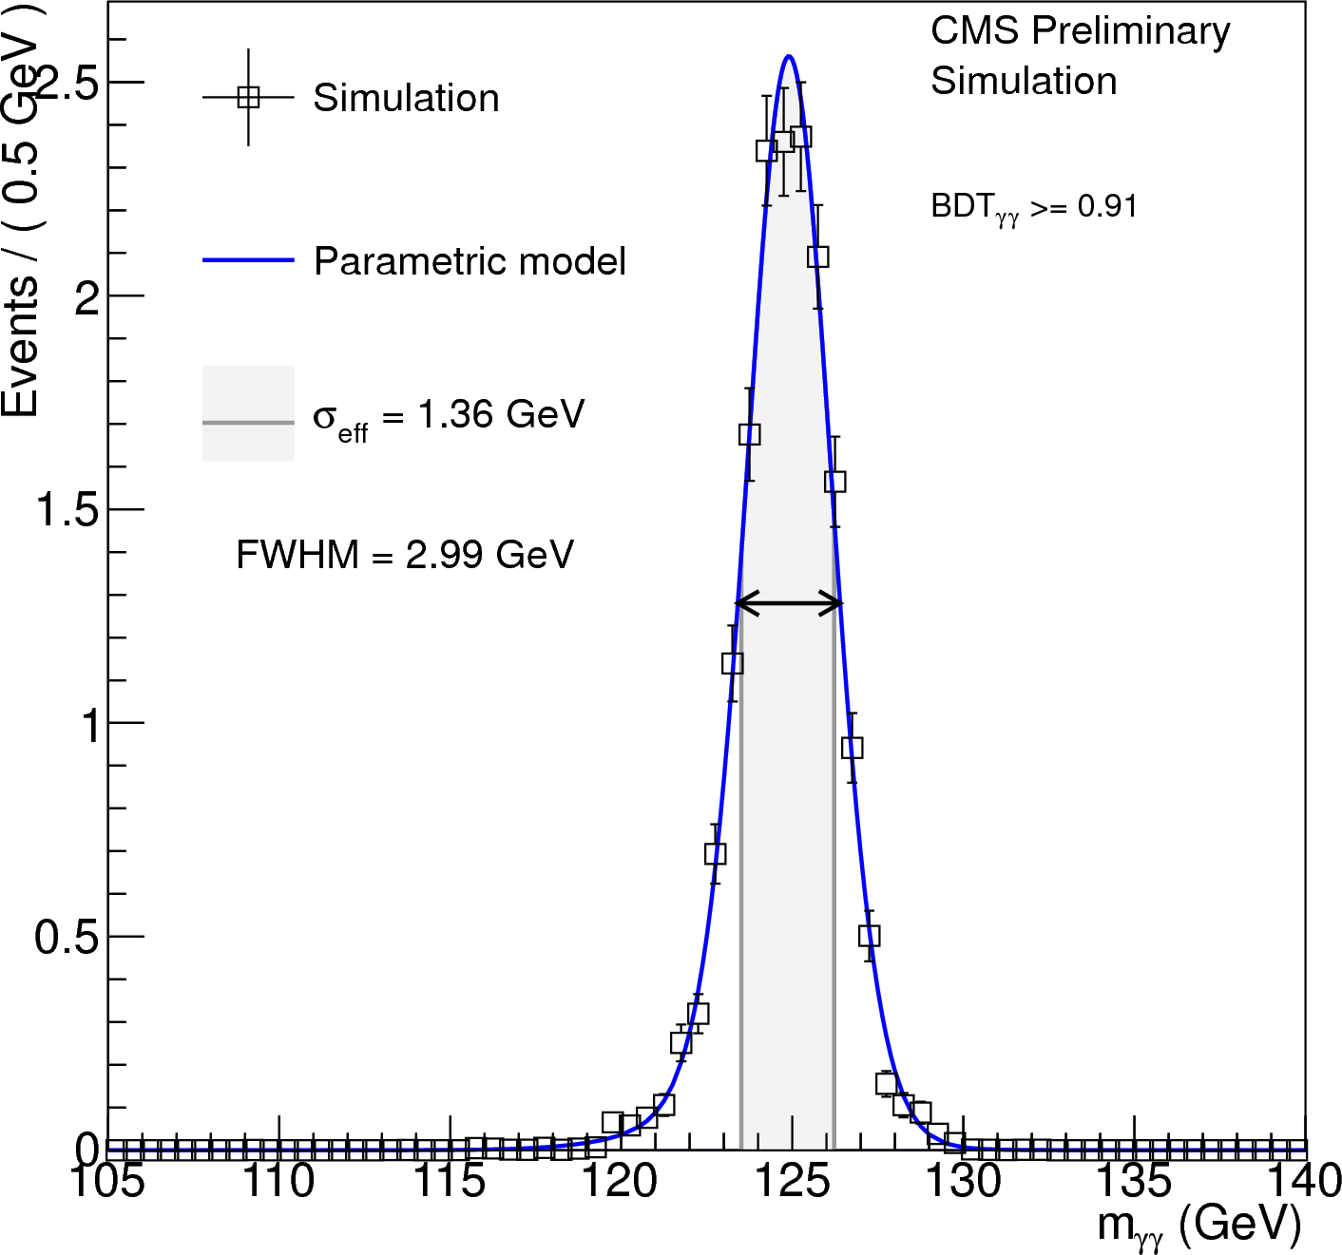
Mass resolution of MC signal
With the stable ECAL performance and the selected vertex
The best resolution of one of the diphoton MVA categories : ~1.1%
The resolutions are from ~1% to ~2%, for different event categories

Slide 11
Photon identification
Photon ID MVA:
Separate prompt photons from π⁰/η
Shower shape, isolation variables, η, per-event density
Trained on simulated γ+jet events
Validated on Z→e⁺e⁻ and Z→μμγ
Changes wrt 2011:
Particle-based isolation used for 2012 instead of subdetector-based isolation
More show shape variables
Measurable improvement in the suppressing of fake photons
Systematic uncertainty decrease from 2% to 1%
IHEP/IPNL CONTRIBUTION
Photon ID MVA output from Z→e⁺e⁻
1% systematic uncertainty

Slide 12
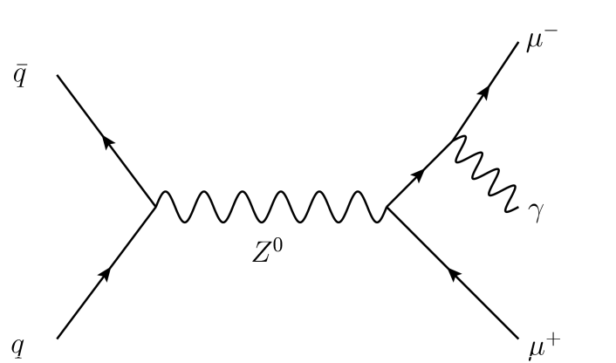
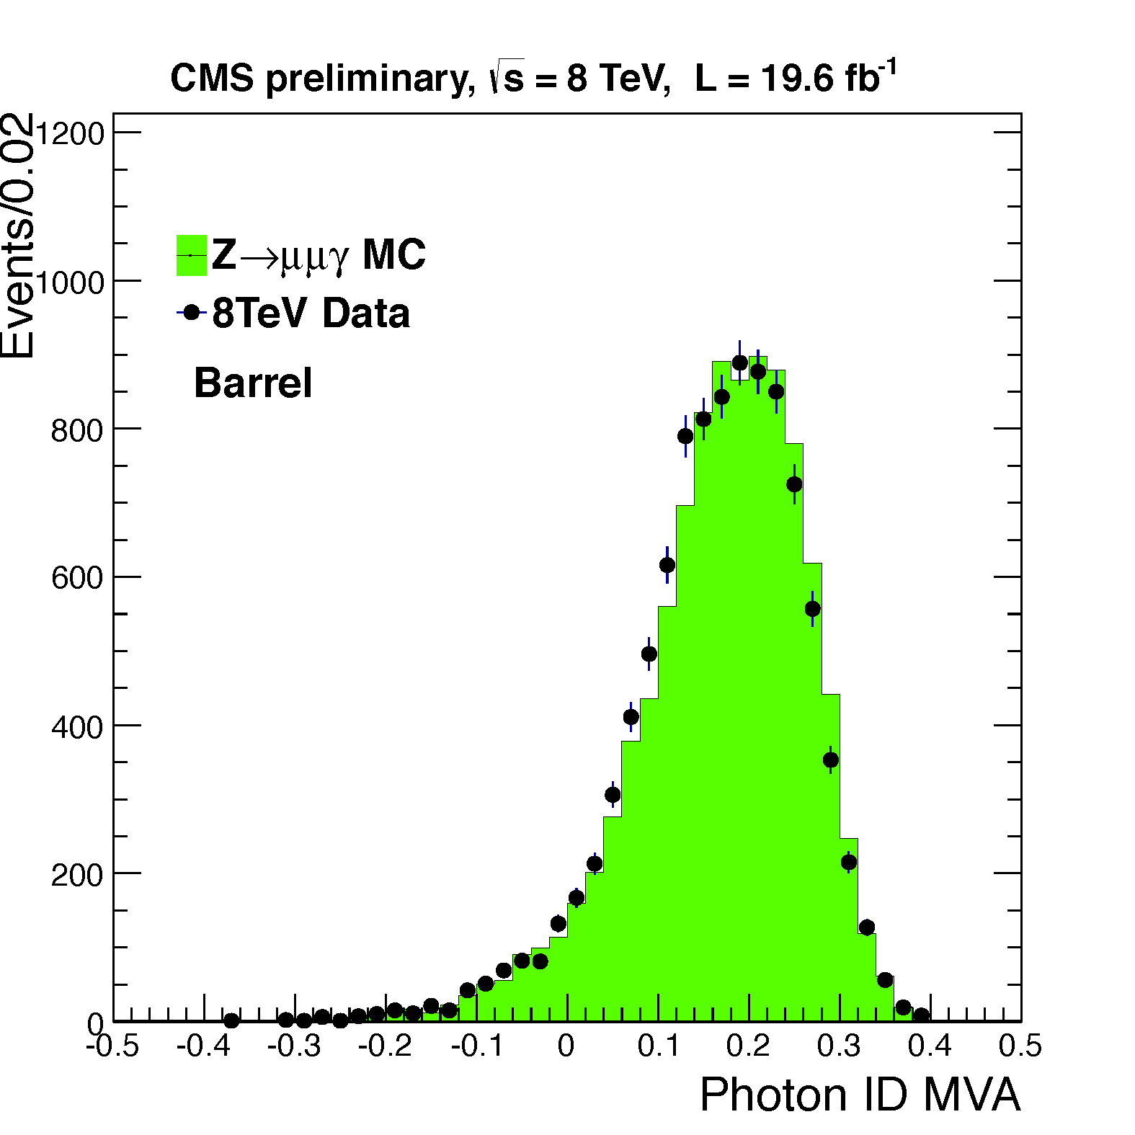
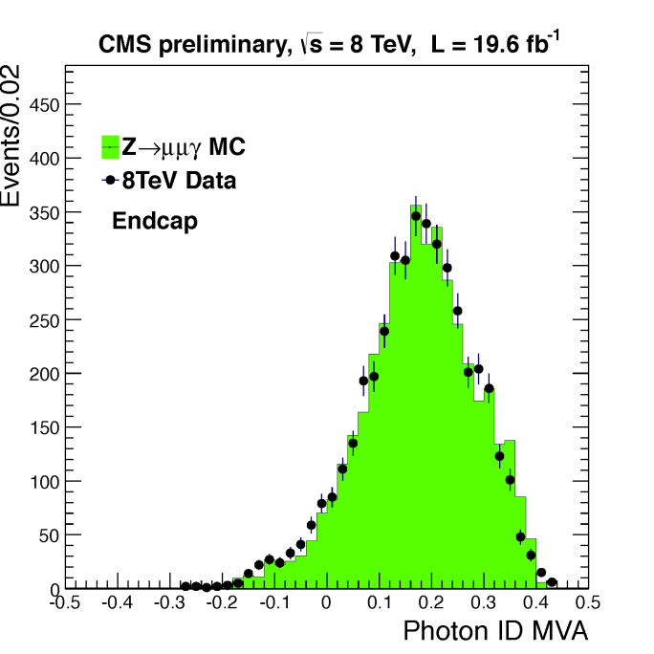
Photon ID MVA validation with Z→μμγ
Photon ID MVA was validated with final state radiated photons from Z→μμγ
Selections: see Jiawei Fan’s presentation
IHEP/IPNL CONTRIBUTION
Good agreement between data and MC, on the photon ID MVA output

Slide 13
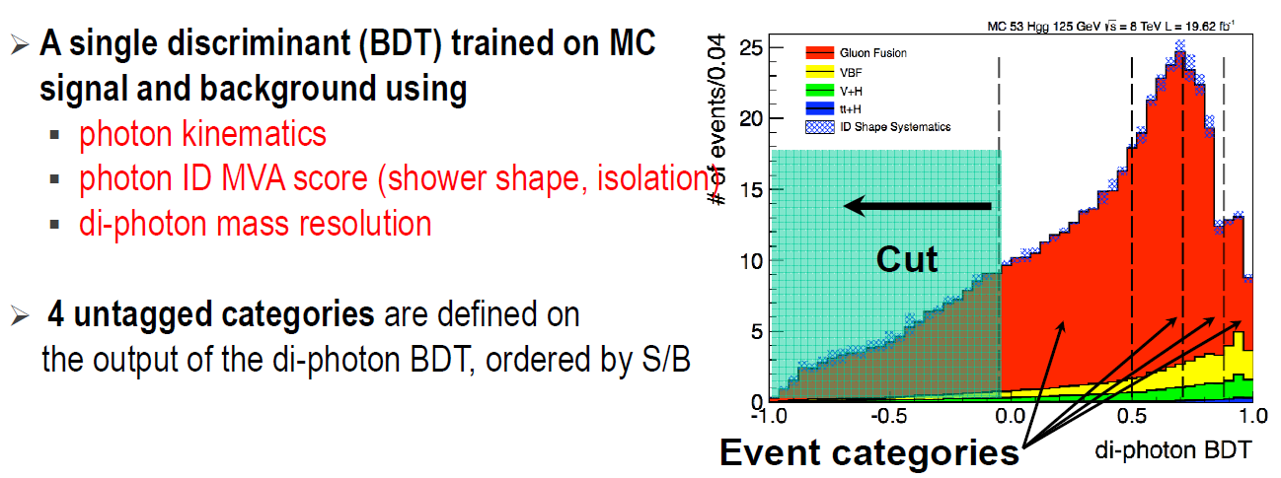
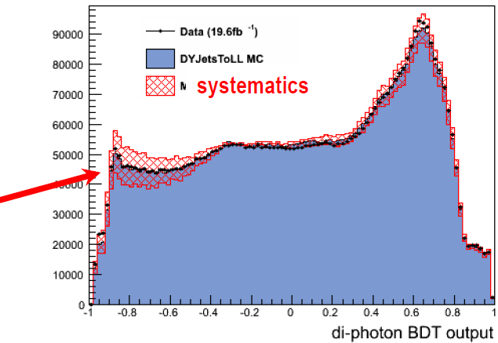
Di-photon MVA selection
Output of the MVA validated using Z→ee (where e are reconstructed as γ) with corrected inputs after the MC rescaling.
IHEP/IPNL CONTRIBUTION

Slide 14
Cut-based analysis
IHEP/IPNL CONTRIBUTION

Slide 15
Exclusive categories

Slide 16
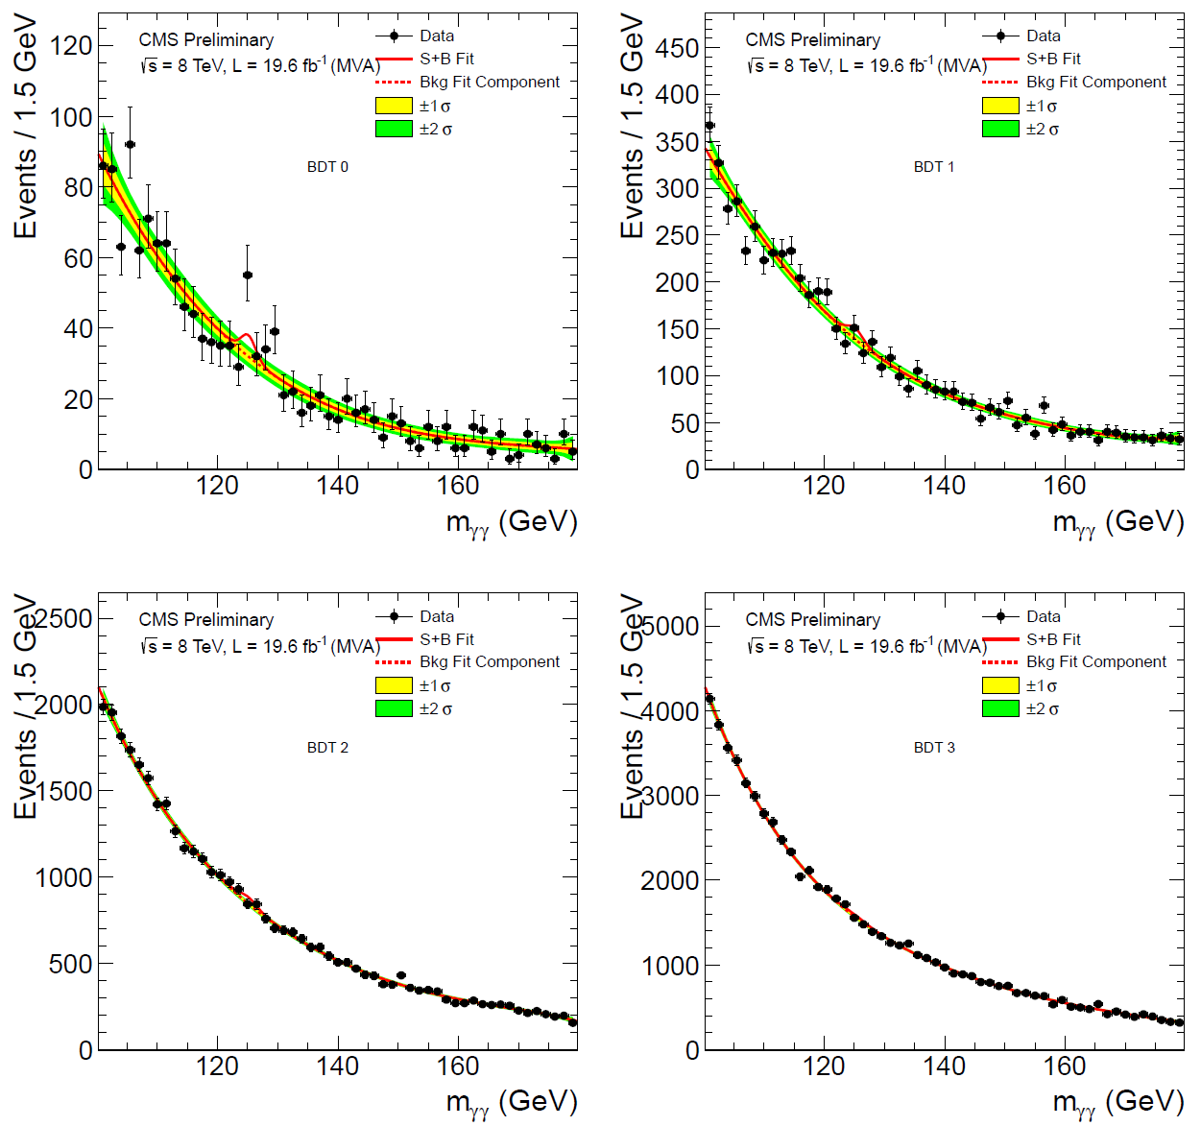
Background modeling
MVA untagged categories
Background is measured from data
Highest MVA score
Background modeling:
Polynomial shape with order from 2 to 5
Potential bias from background model is negligible
→ Less than 20% of statistical uncertainty

Slide 17
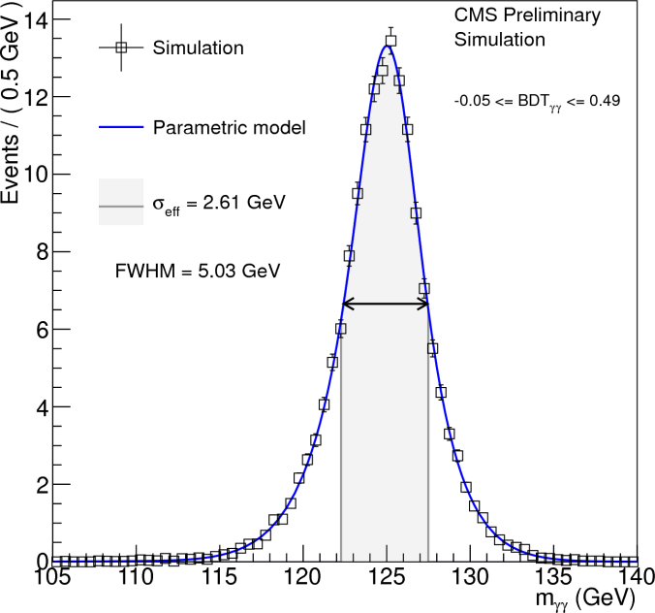
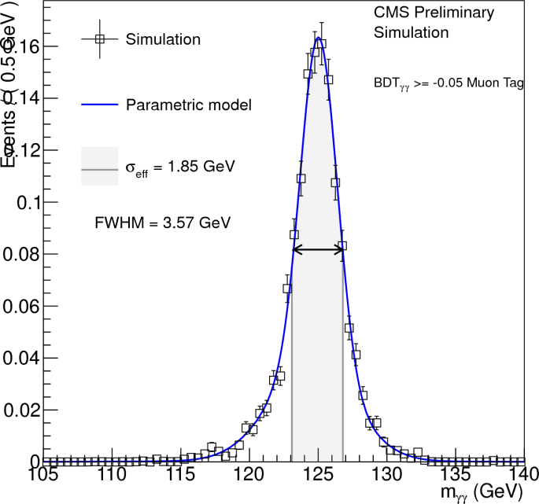
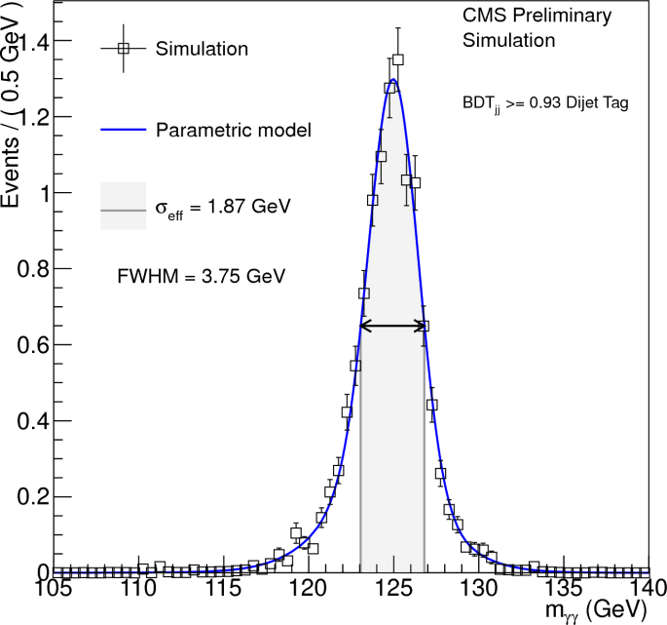
Signal modeling
Parametric signal model:
Obtained from MC simulation using the next-to-leading order (NLO) matrix-element generator POWHEG after reweighting to the HQT
(NNLO+NNLL) spectrum
Constructed with the sum of two or three Gaussians
Untagged diphoton MVA category with best mass resolution
Untagged diphoton MVA category with worst mass resolution
Mu tagged diphoton MVA category
Dijet loose tagged diphoton MVA category

Slide 18
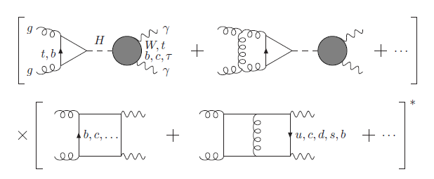
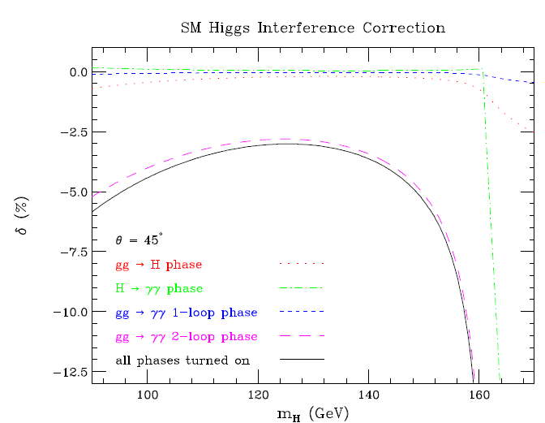
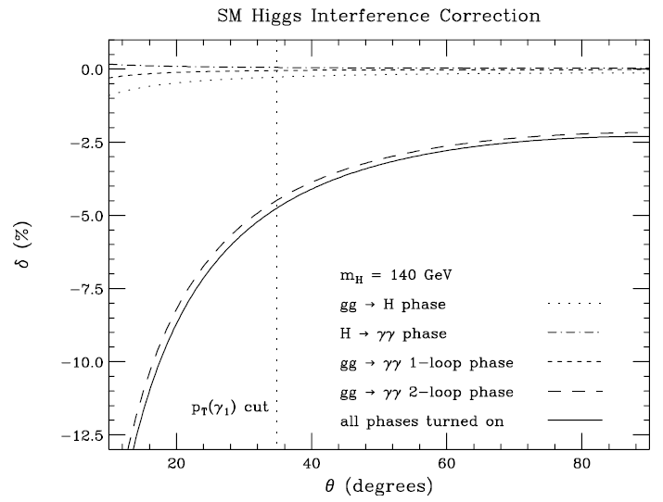
Interference of gg→H→γγ signal and gg→ γγ
Destructive interference between gg Fusion resonance gg→H→γγ and continuum gg→ γγ (box) background processes
Not considered in 2011
We studied the effect with the CMS MC samples: θ*>30degrees
The average effect on the signal strength is about
-2.5% used for the discovery result and the later analysis.
IHEP/IPNL CONTRIBUTION
L. Dixon and S. Siu, hep-ph/0302233
Notes:
cite

Slide 19
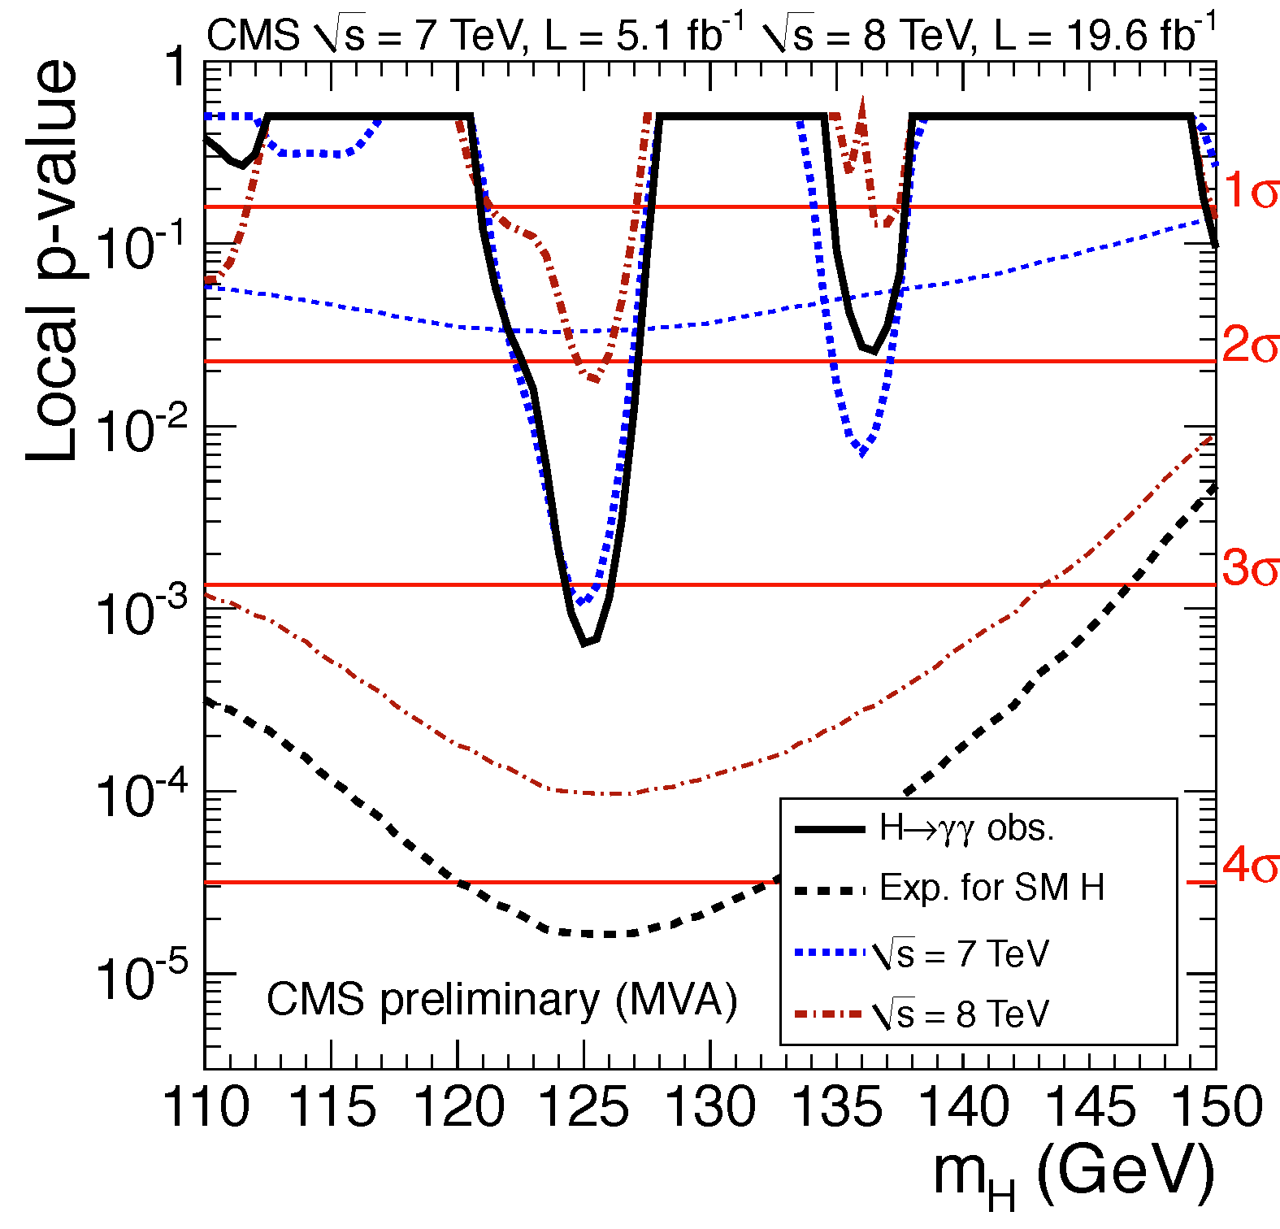
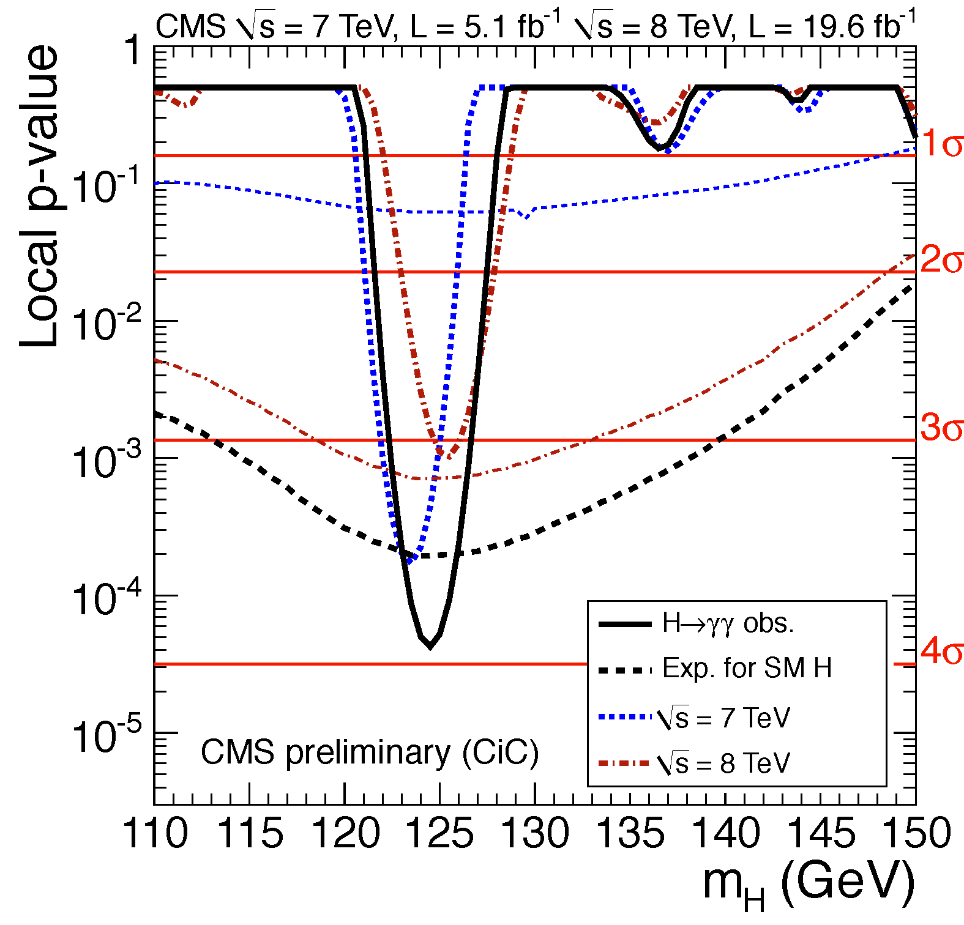
Results: p-values
p-value for the background hypothesis, using full 2011+2012 dataset
MVA Cut-based
Significance @ 125.0 GeV:
3.2σ (4.2σ expected)
Significance @ 124.5 GeV:
3.9σ (3.5σ expected)

Slide 20
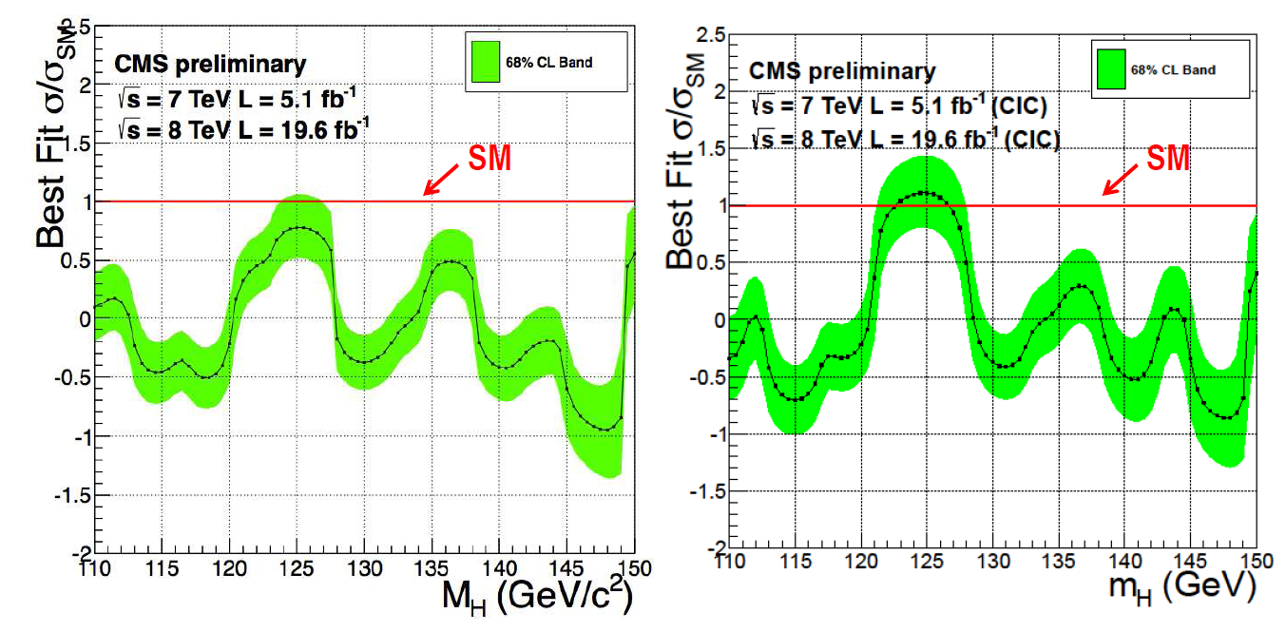
Results: signal strength
MVA Cut-based
Measurements are compatible with SM within 1σ uncertainties at ~125GeV

Slide 21
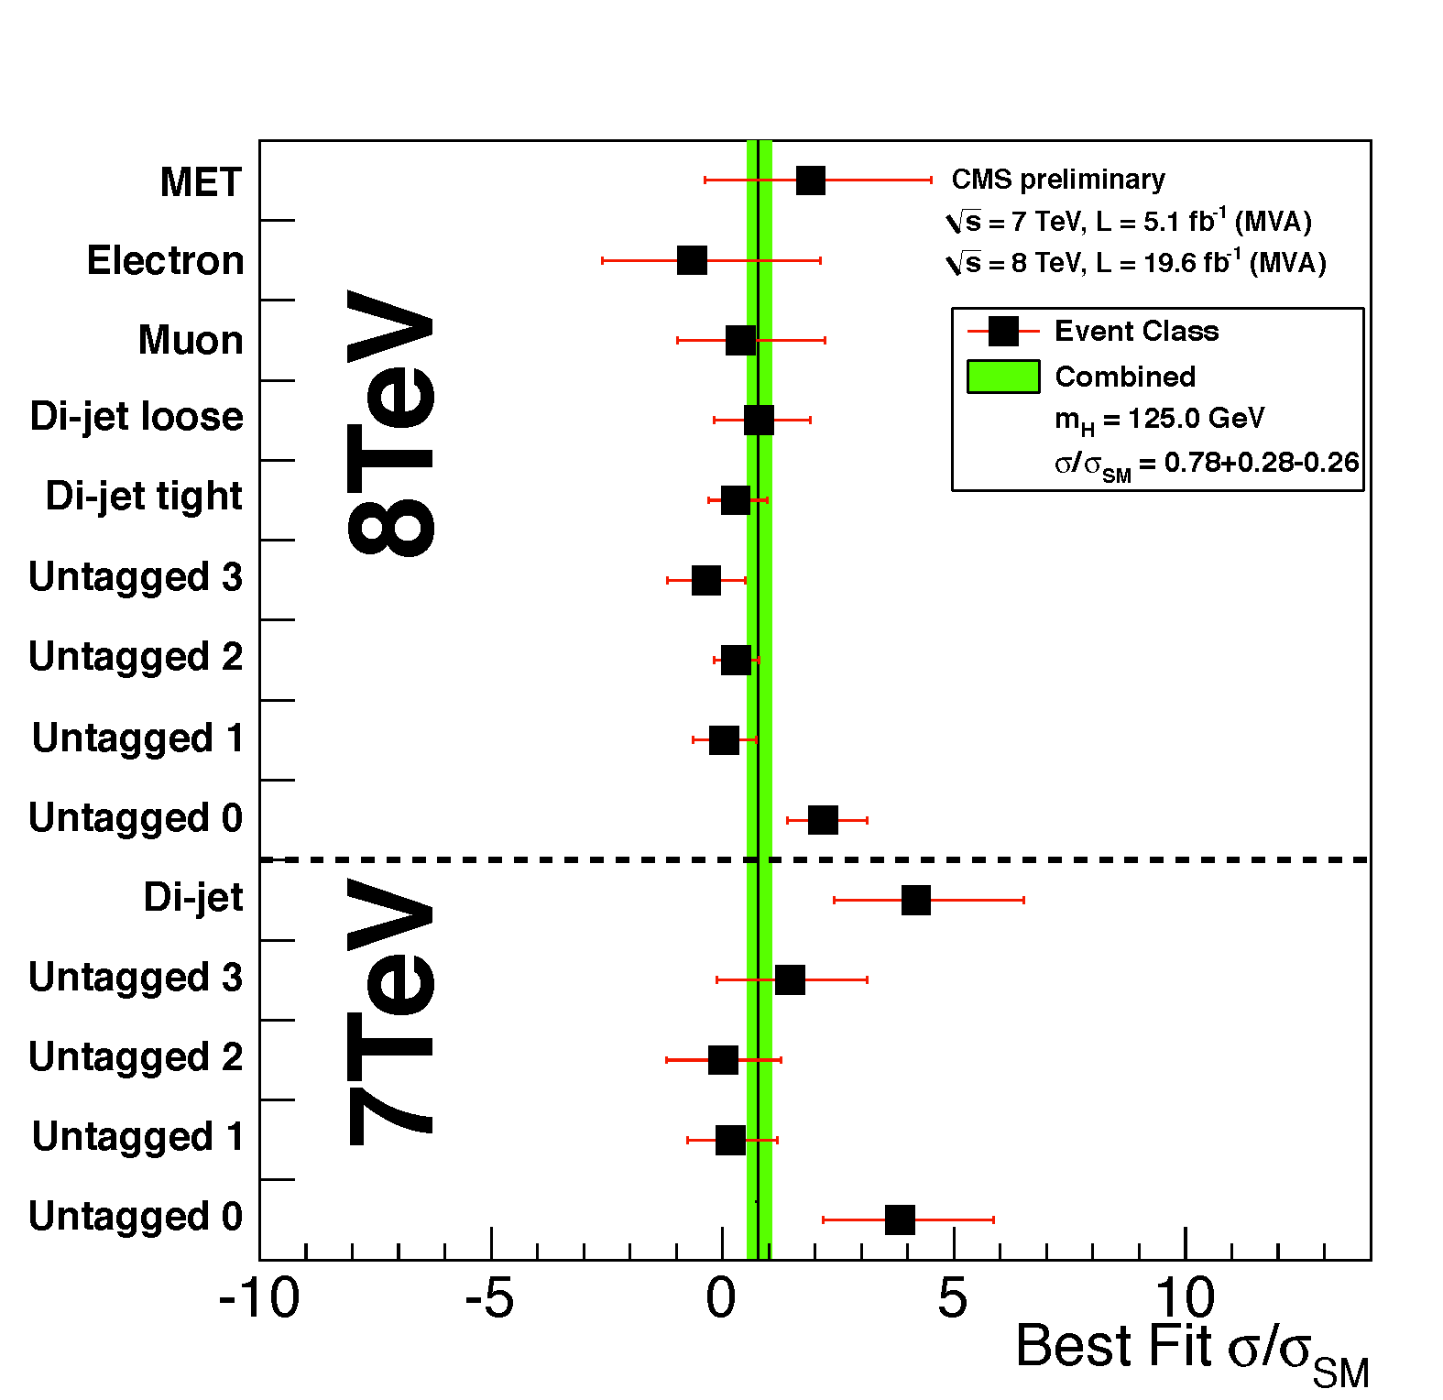
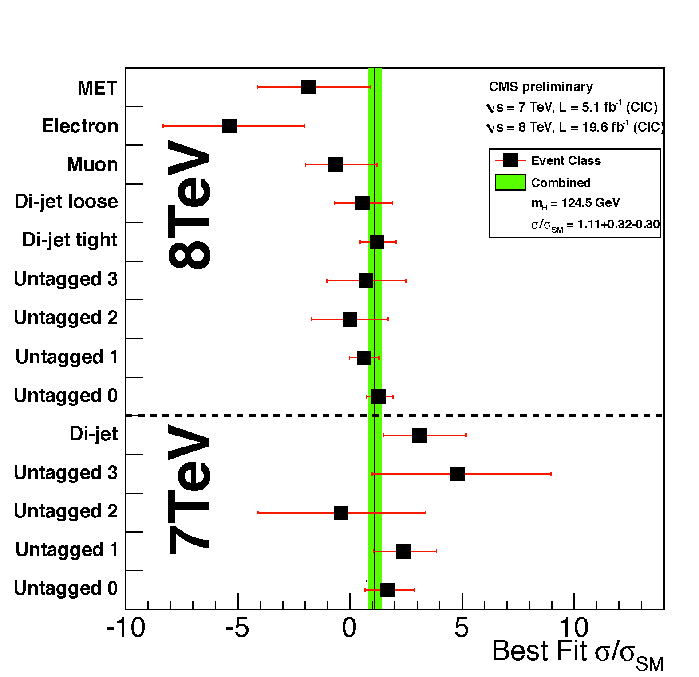
Results: channel compatibility
MVA Cut-based
Despite the same names, the untagged categories in MVA and Cut-based are not equivalent

Slide 22
Compatibility among the two analyses
Low signal-to-background ratio is a fundamental feature of this channel
→ Uncertainty on signal strength driven by statistical fluctuations of the background
→ Analysis changes can lead to statistical changes due to fluctuations in selected events
and their mass
The correlation coefficient between the MVA and cut-based signal strength measurements is found to be r=0.76 (estimated using jackknife techniques)
Observed changes in results and differences between analyses are all statistically compatible to better than 2σ

Slide 23
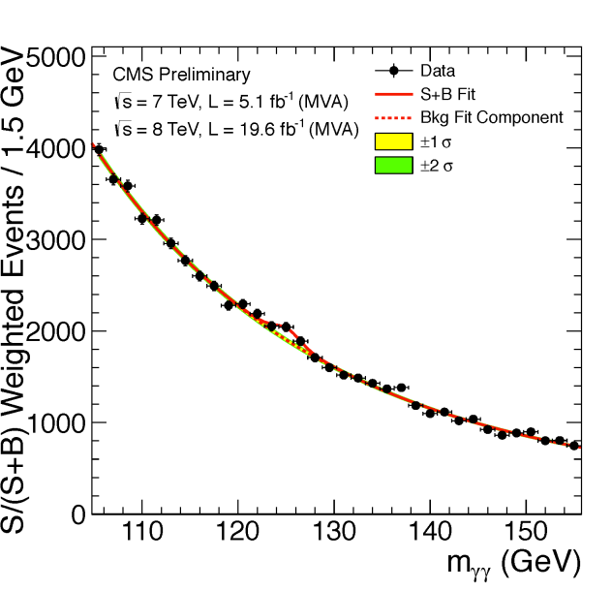
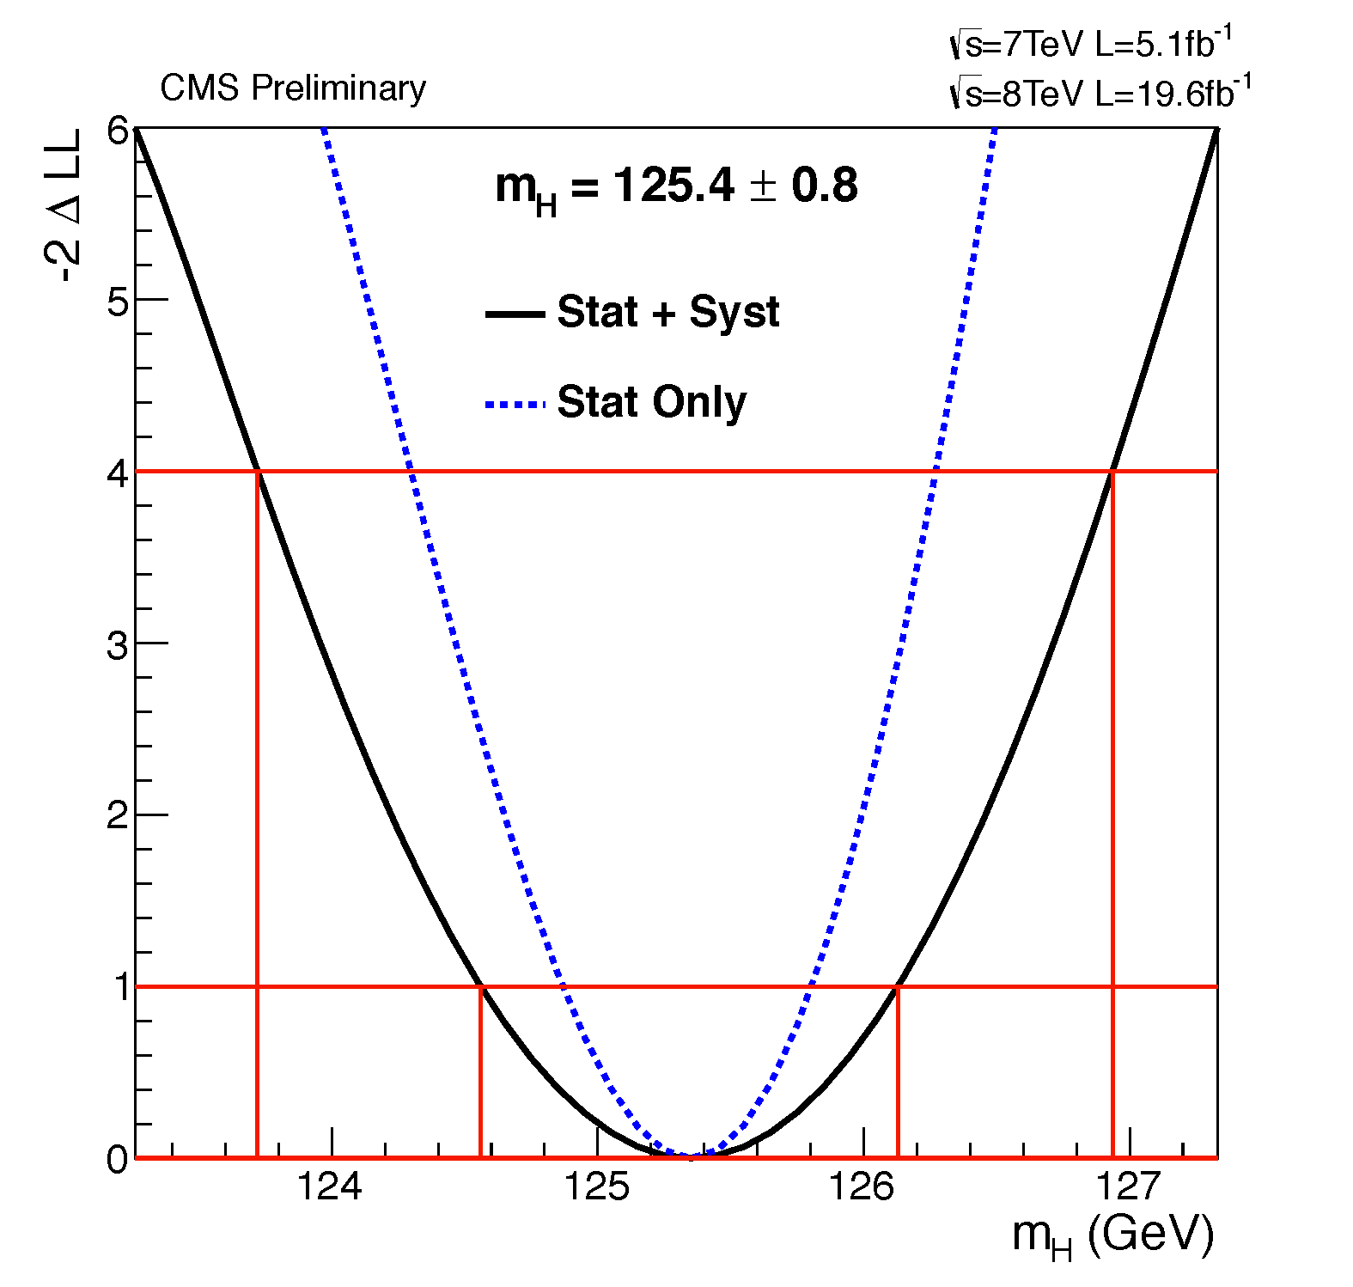
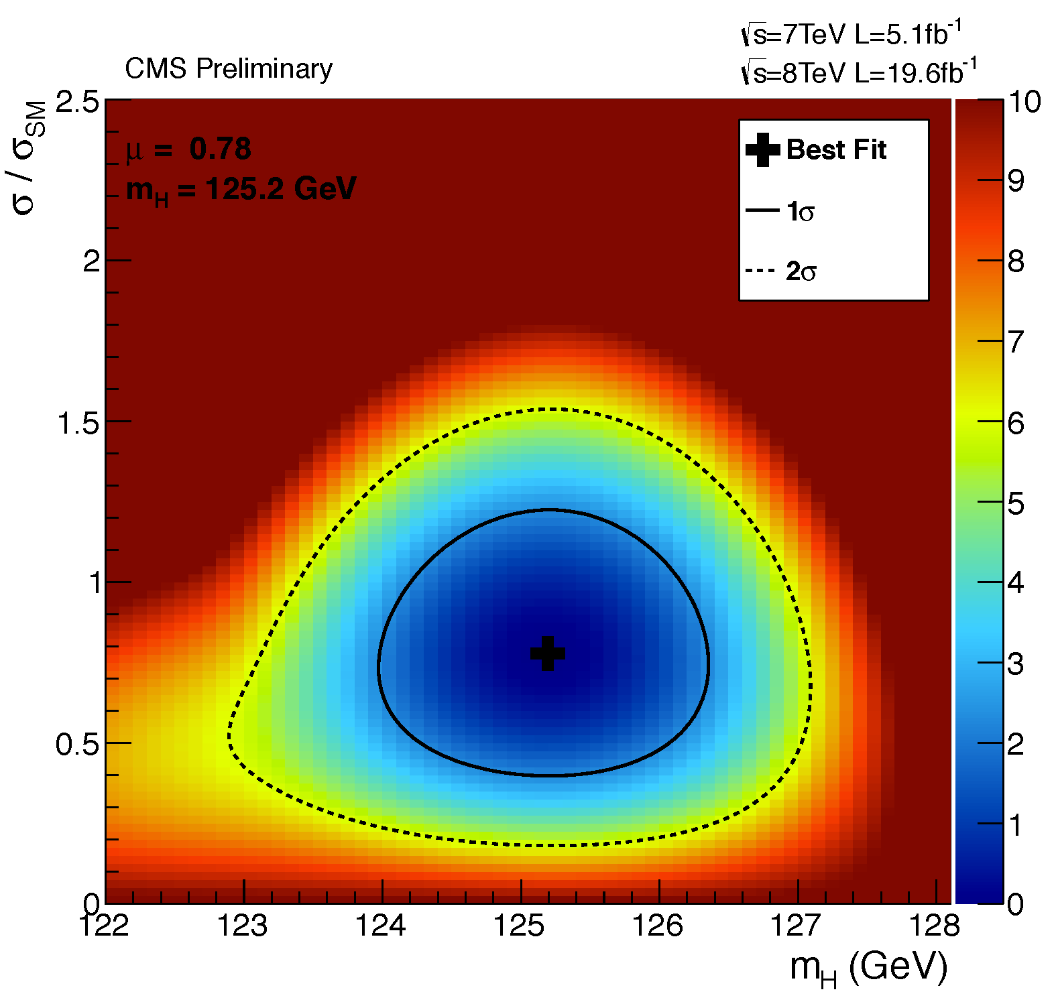
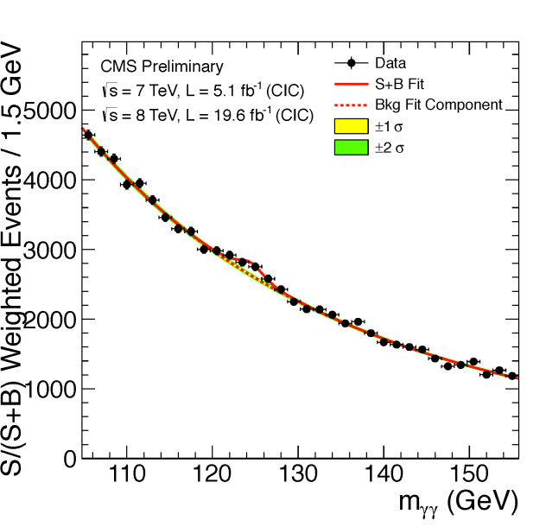
Results: mass
MVA
1D test statistic:
–2lnQ vs mH
2D test statistic:
–2lnQ for the signal strength, σ/σ_{SM}, versus mH
68% CL interval
Cut-based
95% CL interval
Each event weighted by the S/(S+B) value of its category

Slide 24
Summary
The latest results of H→γγ are shown, combining all the available data, 5.1fb⁻¹ at 7TeV and 19.6 fb⁻¹ at 8TeV.
The IHEP/IPNL groups collaborating together have contributed to the Higgs-like boson discovery and ongoing analysis in H→γγ channel : photon ID MVA; Photon ID MVA validation and energy scaling with Z→μμγ; Interference ; MC Shower shape rescaling …. and the ongoing efforts.
We are thankful to the support from the FCPPL which has made these contributions possible, and we will be able to continue to strengthen and enlarge our collaboration with your continued support.

Slide 25
Backup slides

Slide 26
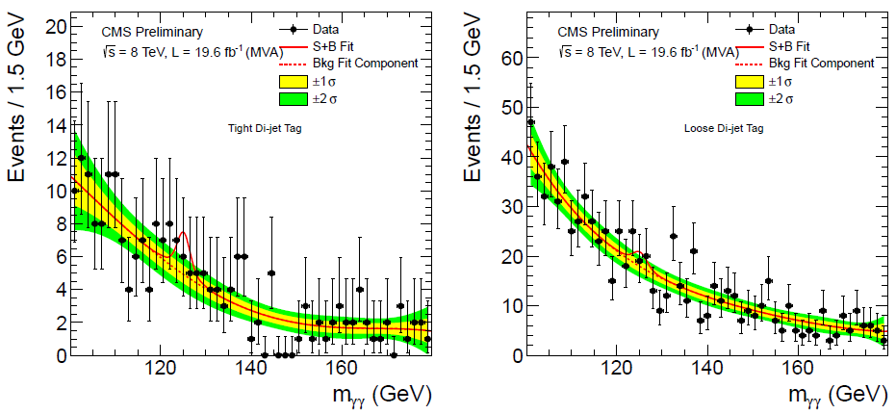
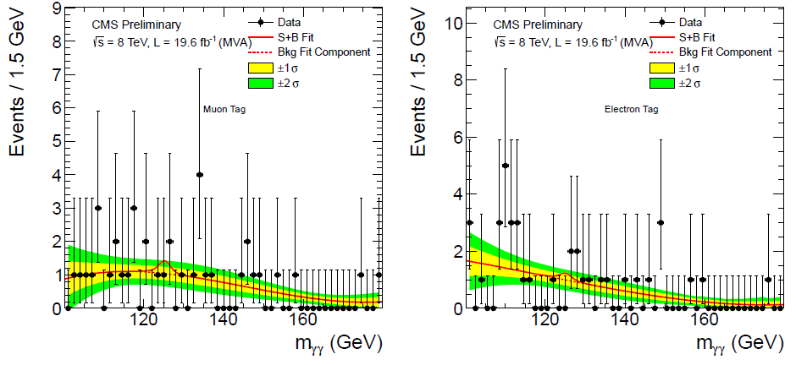
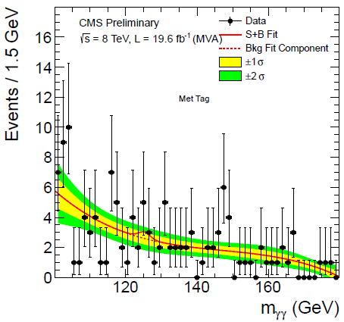
Background modeling: exclusive channel
MVA: 5-5-5-5- 4-4-3-3-3
CiC: 5-5-5-5- 3-3-3-3-2

Slide 27
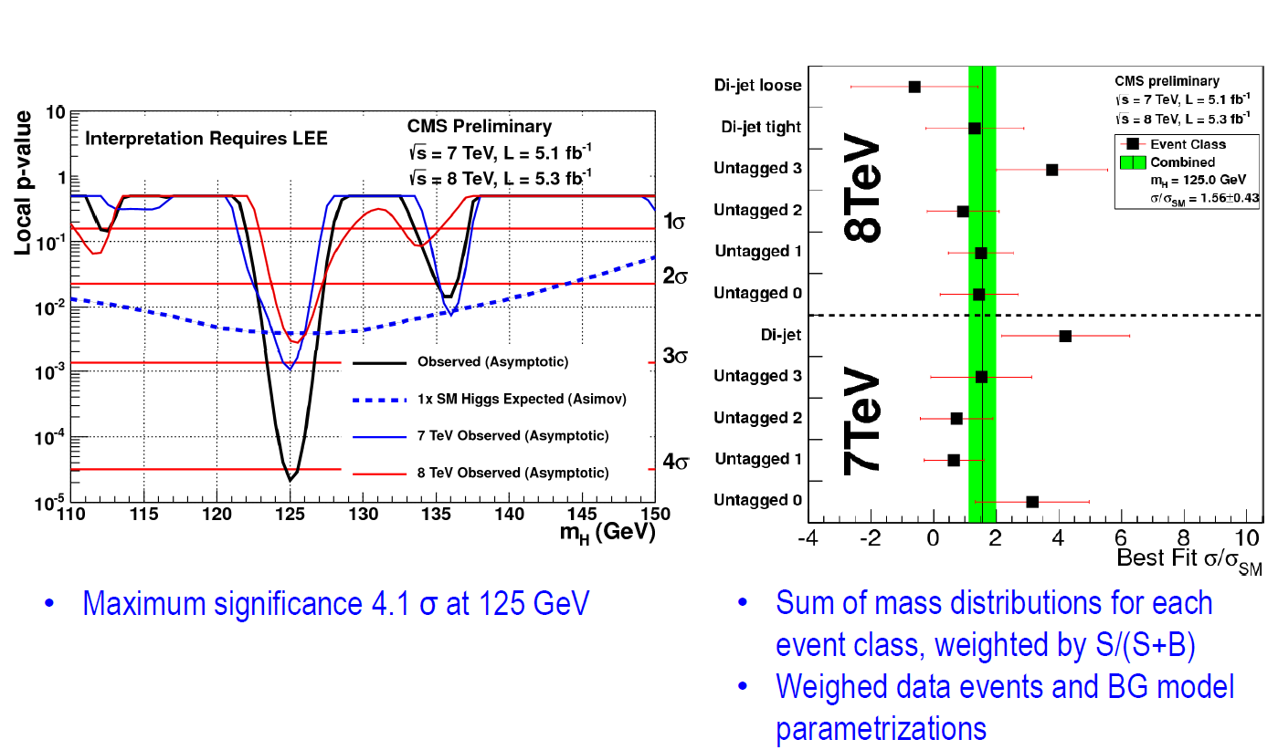
H→γγ: published results

Slide 28
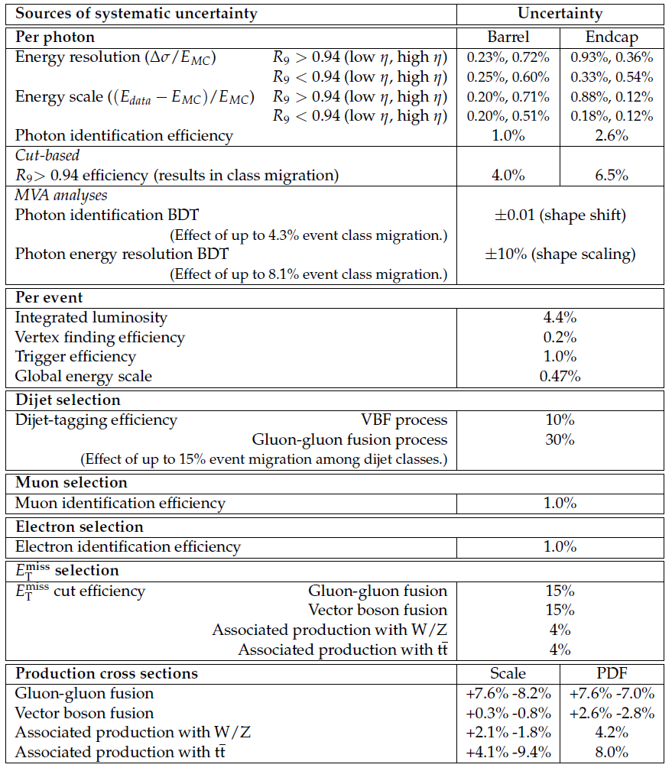
Systematic Uncertainties

Slide 29
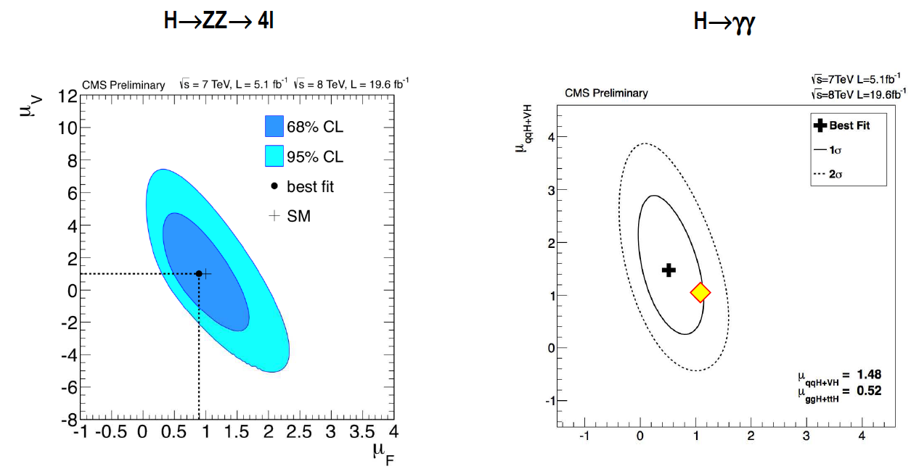
Production Mechanisms
Measurements are compatible with SM within <1 sigma

Slide 30
H→ZZ→4l: J^{PC} Analysis

Slide 31
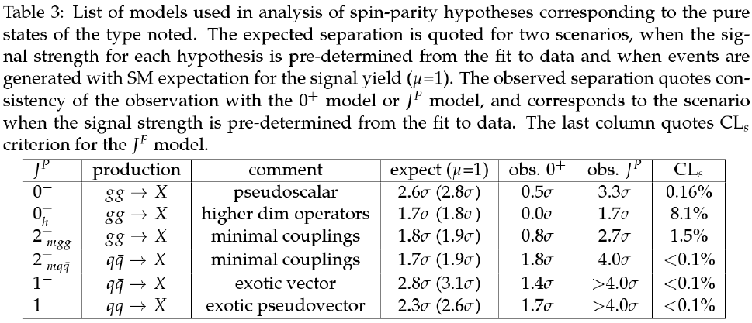
H→ZZ→4l: J^{PC} Analysis Result

Slide 32
ECAL noise

