Slide 1
Shape-phase transitions in very neutron-rich nuclei from ₄₀Zr to ₄₆Pd
Hiroshi Watanabe
The 7th International Symposium on Chiral Symmetry in Hadrons and Nuclei
Beihang University, Beijing, China, 27-30 October, 2013

Slide 2
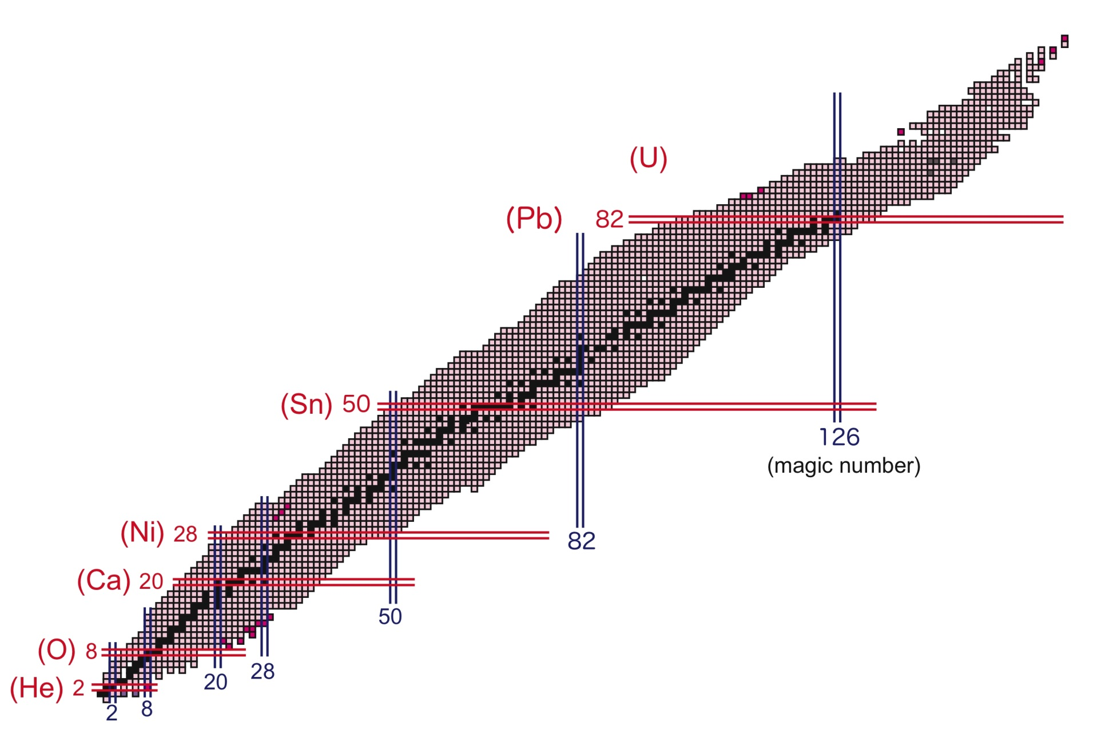
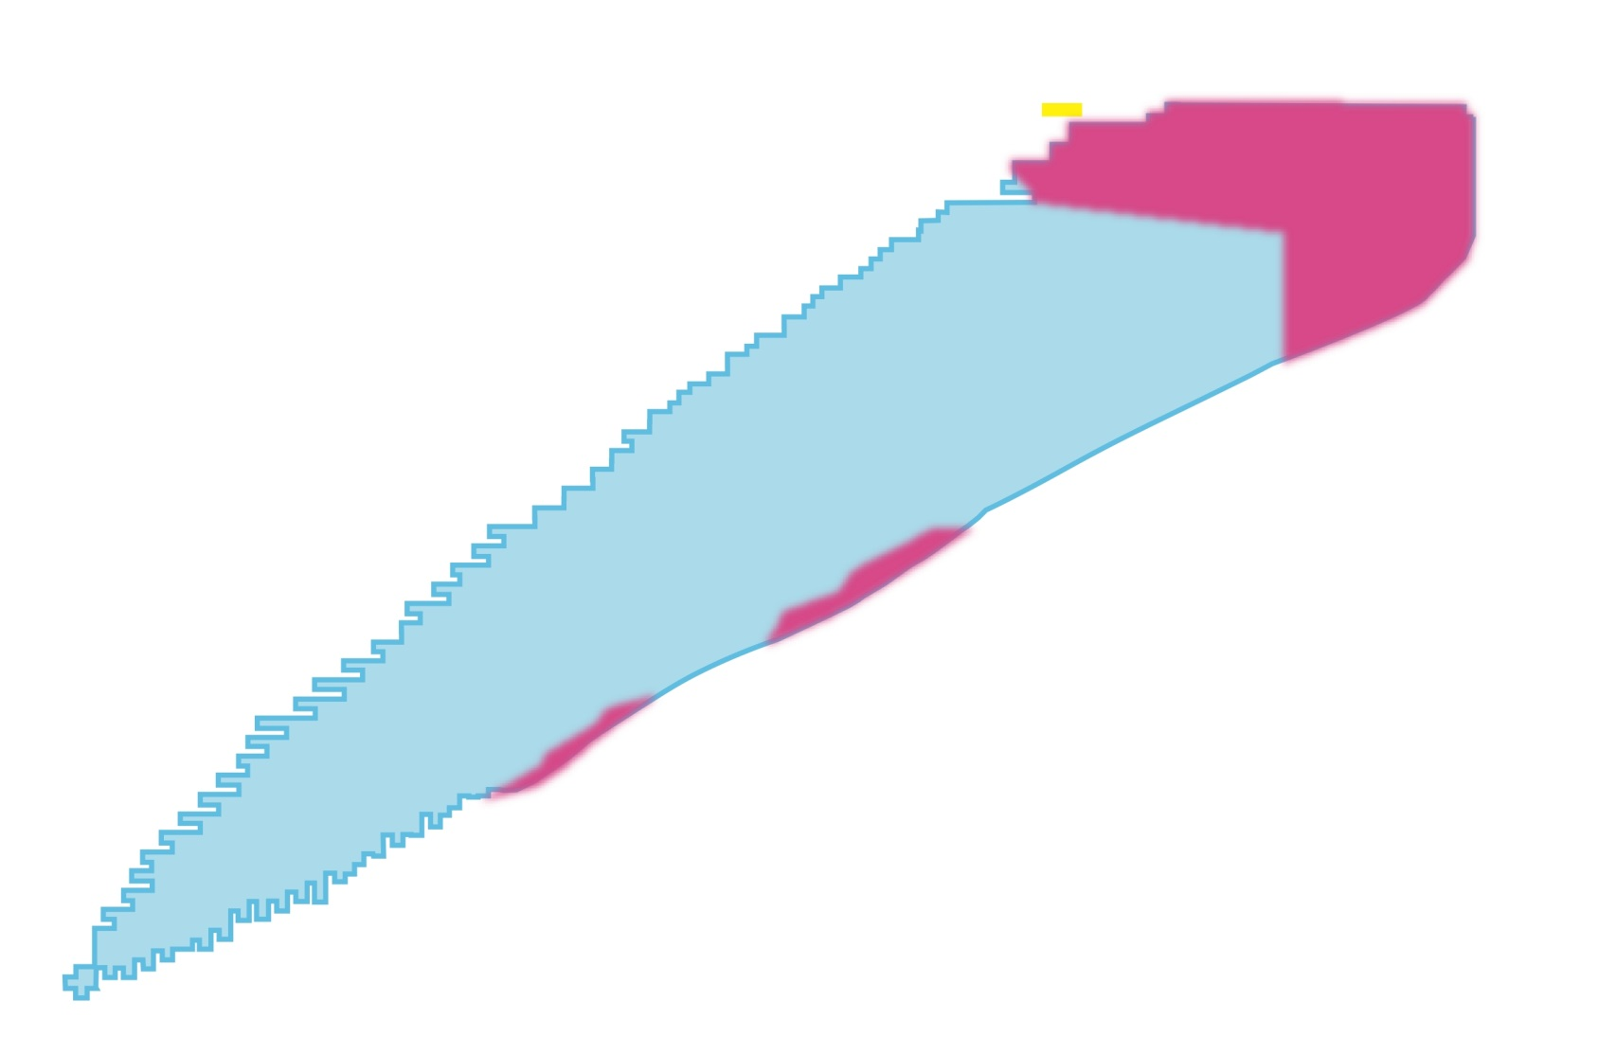
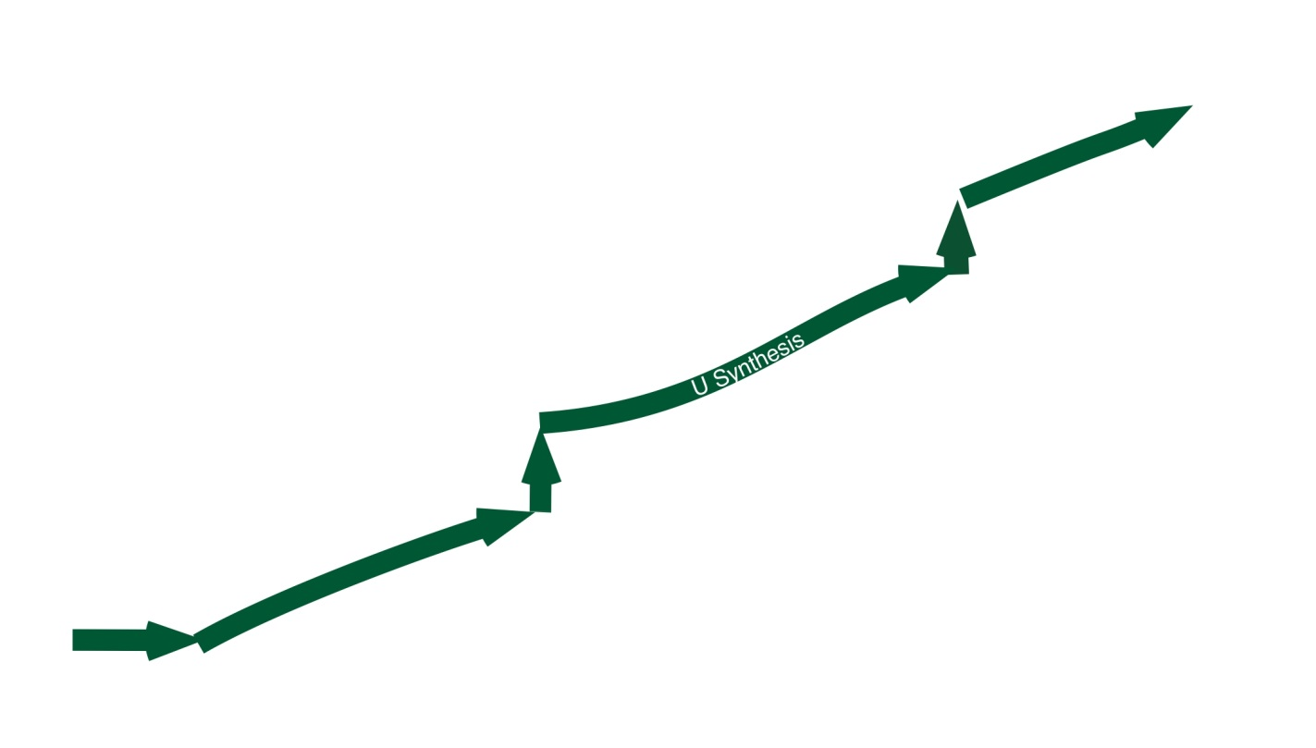
Exploration of the New Frontier in Nuclear Physics
Stable nuclei ~270
Unstable nuclei produced in laboratories ~3000
Unstable nuclei predicted by theories ~6000
Limit of heaviest element
Proton drip line
Proton
Neutron drip line
Neutron
Projectile fragmentation
In-flight U fission & fragmentation

Slide 3
Exploration of the New Frontier in Nuclear Physics
Limit of heaviest element
Proton-rich nuclei
Proton-neutron pairing
Isospin symmetry
Proton radioactivity
rp-process
Superheavy nuclei
Island of stability
Proton drip line
Structural evolution within these boundaries
Monopole shift of single-particle energies
Shape-phase transitions
Proton
Neutron drip line
Neutron-rich nuclei
Shell quenching
New magic numbers
Neutron halo/skin
Loosely bound neutrons
r-process
Neutron

Slide 4
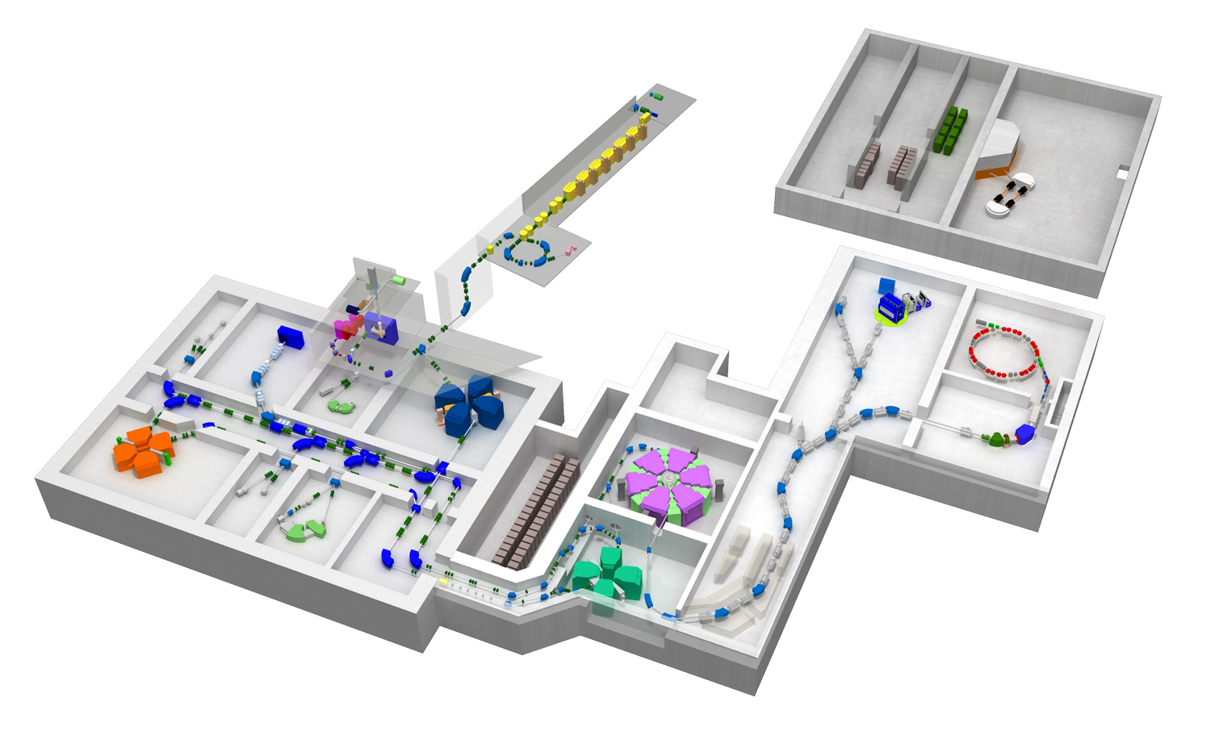
Radioactive-Isotope Beam Factory (RIBF) at RIKEN
RILAC
RILACⅡ
AVF
RRC
SRC
fRC
BigRIPS
²³⁸U beam at 345 MeV/nucleon
Intensity ≧ 10 pnA (May, 2013)
IRC
4000 species to be produced at RIBF
(More than 1000 new isotopes)
1 pμA (Goal)

Slide 5
Decay spectroscopy
~ Useful tool for nuclear structure and nuclear astrophysics ~
Energy of yrast and non-yrast levels
β-decay half-life and energy
β-delayed neutron/proton emission
Isomeric state
Level lifetime
Parent
τ_{β}, J_{β}
β
neutron
S_{n}
Isomer
τ_{IT}, J_{IT}
Nuclear structure
Single-particle level
Collectivity
Shape transition
Magic number (shell gap)
Q_{β}
J”
γ
J’
J”
γ
Non-yrast
J’
Nuclear astrophysics
Waiting point
Decay back to stability
Input for synthesis simulation
J
Yrast
Daughter

Slide 6
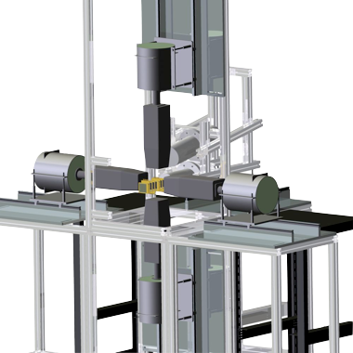
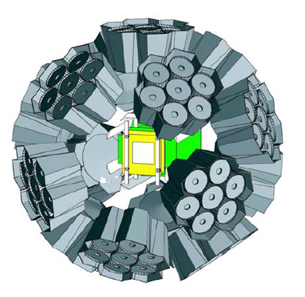
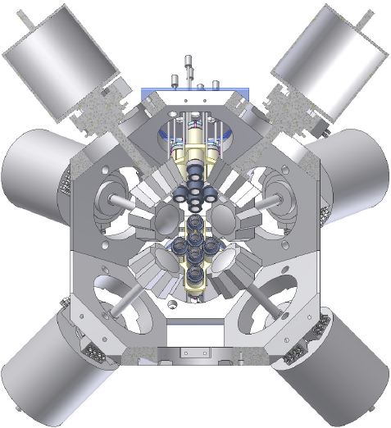
Decay spectroscopy experiments at RIBF
2009
2012
2013
2014
First decay
spectroscopy
EURICA project
EURICA upgrade
(Fast timing)
4 Clovers (16 Ge crystals)
9 DSSDs (16×16 strips)
12 Clusters (84 Ge crystals)
8 DSSDs (60×40 strips)
21 LaBr₃ detectors
Plastic scintillators for β ray
added to EURICA
¹¹⁰Zr region
PLB 696, 186 (2011)
PRL 106, 052502 (2011)
PRL 106, 202501 (2011)
PLB 704, 270 (2011)
¹³²Sn region
PRL 111, 152501 (2013)
PRC 88, 024301 (2013)
Neutron-rich Sb~Nd
Revisit ¹¹⁰Zr region
⁷⁸Ni region
Neutron-rich Fe,Co
¹⁰⁰Sn region
U beam
intensity
0.3 pnA
12 pnA

Slide 7
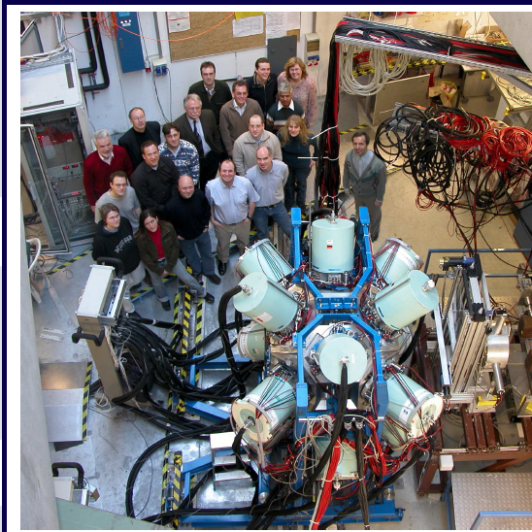
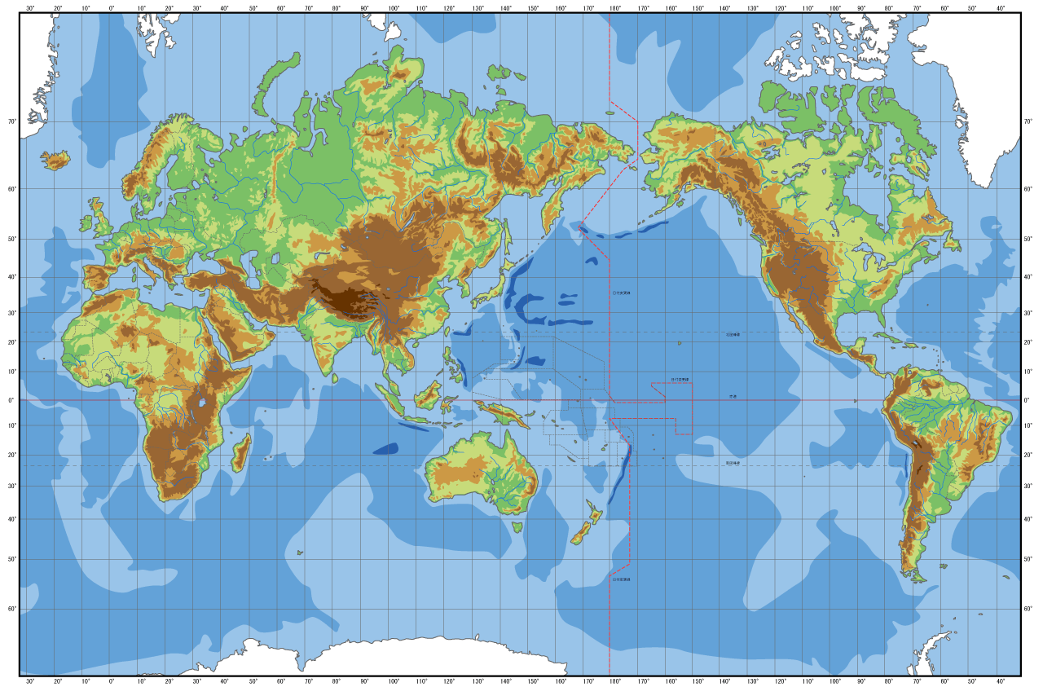
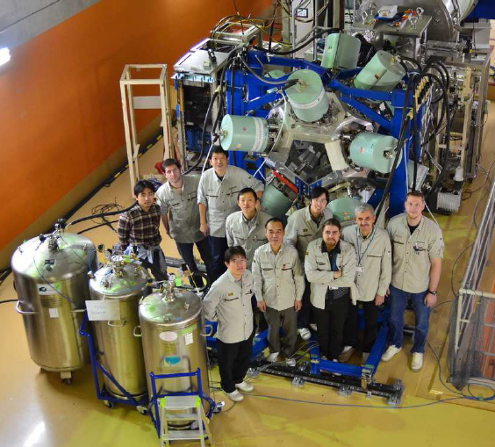
The EURICA (EUROBALL-RIKEN Cluster Array) project
In collaboration with
Gammapool for 12 Cluster detectors
RISING/PreSPEC for support structure and electronics

Slide 8
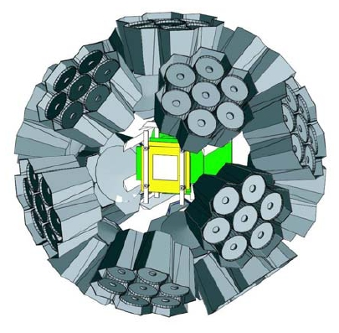
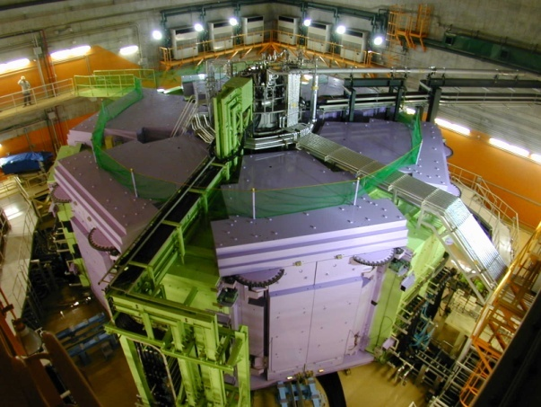
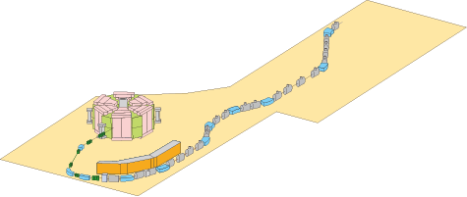
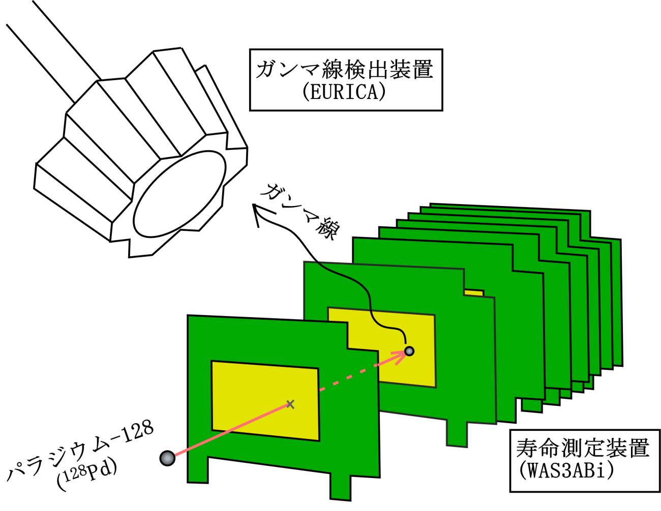
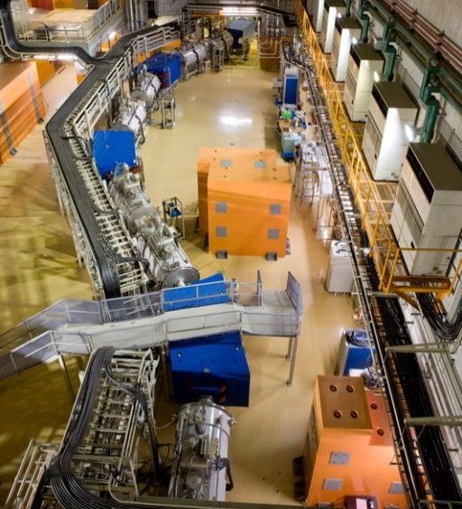
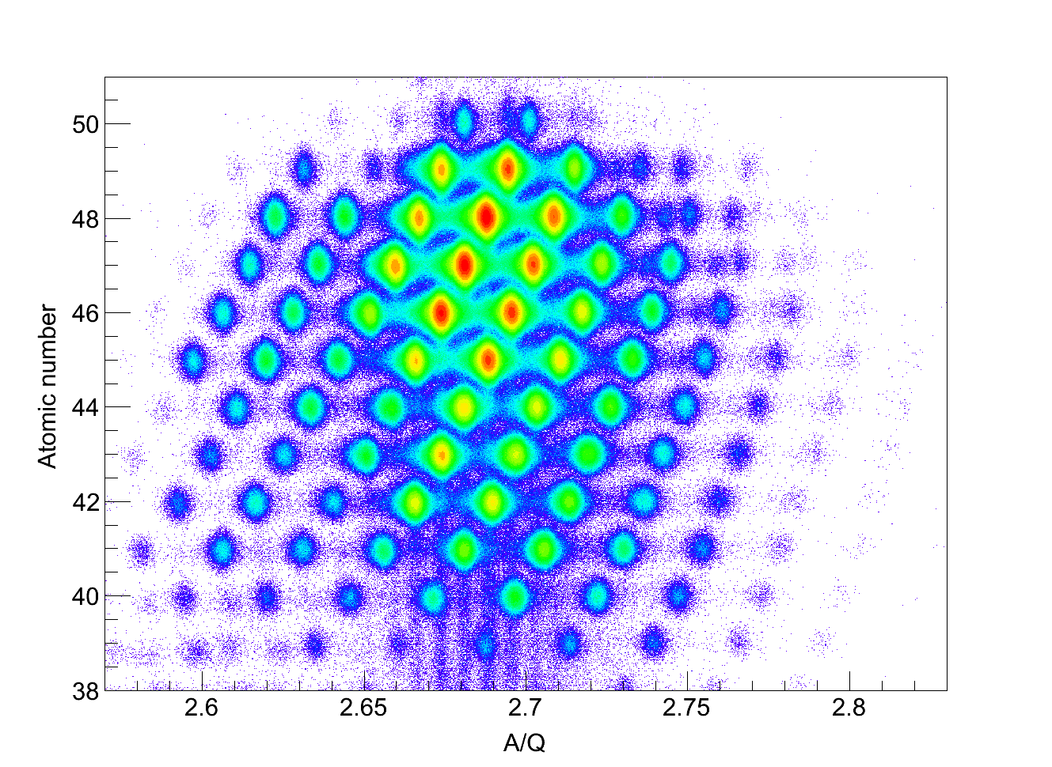
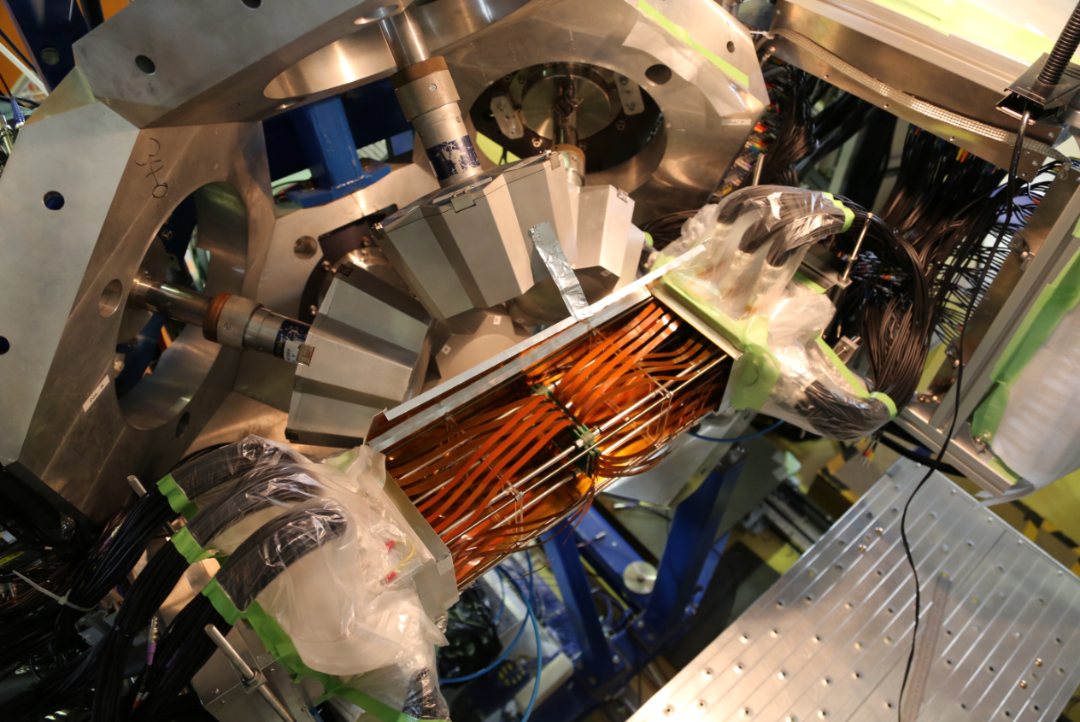
Layout of entire experimental setup
12 Clusters
(7 Ge each)
“EURICA”
SRC
BigRIPS
8 DSSSDs
(60×40 each)
“WAS3ABi”
²³⁸U beam
(345 AMeV)
Identification and
further separation
γ
β
Be target
Separation of RI beam
RI
Z
A/Q

Slide 9
Neutron-rich ₄₀Zr and ₄₂Mo isotopes around A = 110
Experimental results obtained in the first decay spectroscopy in 2009

Slide 10
Structural evolution in the neutron-rich A ≈ 110 region
M.V. Stoitsov, et al.,
PRC 68, 054312
(2003)
A=110
Large deformation in ₃₈Sr, ₄₀Zr, ₄₂Mo isotopes beyond N = 60
Predicted prolate-oblate shape transitions around N = 70

Slide 11
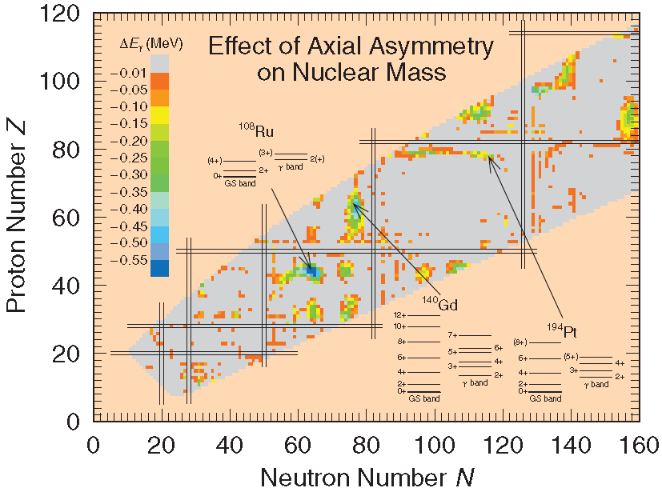
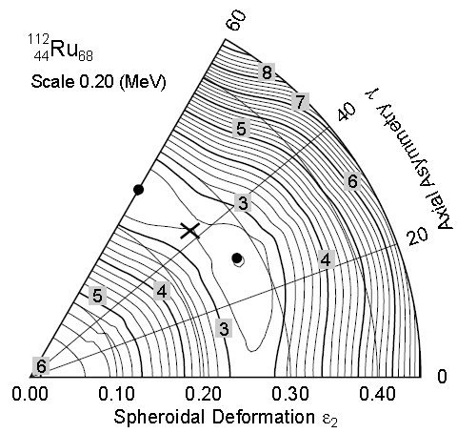
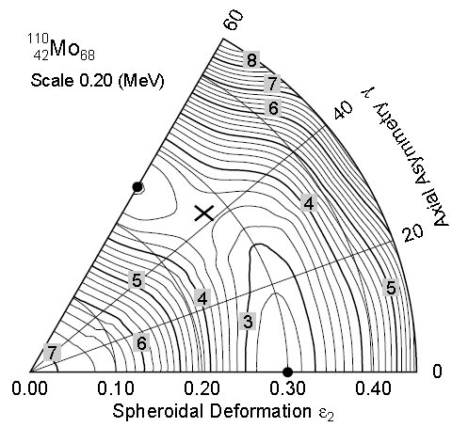
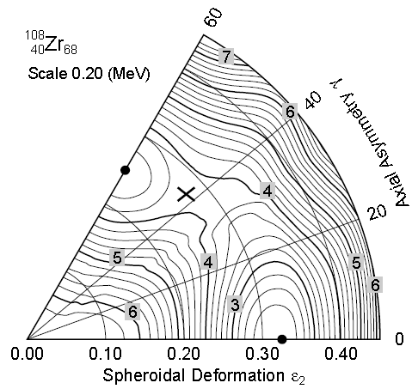
Structural evolution in the neutron-rich A ≈ 110 region
¹¹²Ru₆₈
A=110
¹¹⁰Mo₆₈
P. Möller, et al.,
At. Nucl. Data Table
¹⁰⁸Zr₆₈
Large deformation in ₃₈Sr, ₄₀Zr, ₄₂Mo isotopes beyond N = 60
Predicted prolate-oblate shape transitions around N = 70
Enhanced axial asymmetry (triaxial or γ soft) for Z > 40

Slide 12
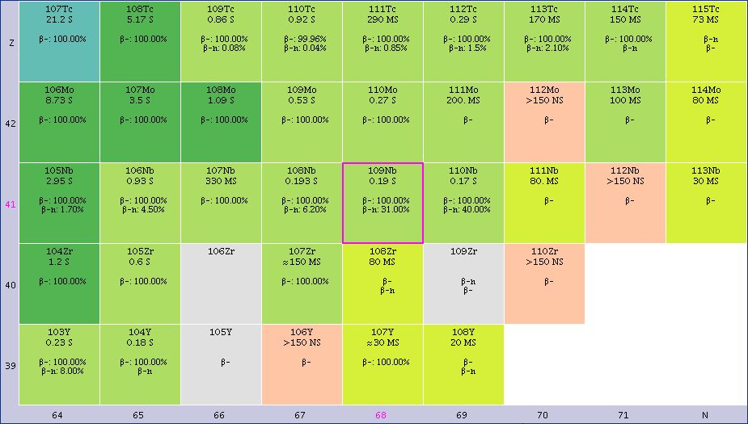
Decay spectroscopy of ^{106,108}Zr
β decay of ¹⁰⁶Y
Isomeric state in ¹⁰⁸Zr
β-

Slide 13
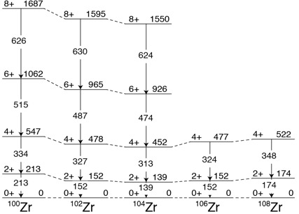
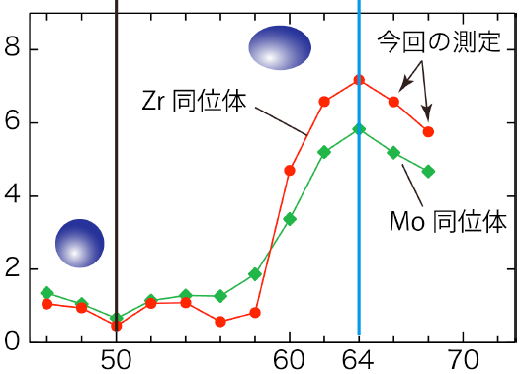
¹⁰⁶Y β- decay
Present work
¹⁰⁸Zr isomeric decay
Maximally
deformed
Spherical
Our work
T. Sumikama et al.,
PRL 106, 202501 (2010)
₄₀Zr
1/E(2⁺) [MeV⁻¹]
₄₂Mo
Grodzin’s estimate
Neutron number

Slide 14
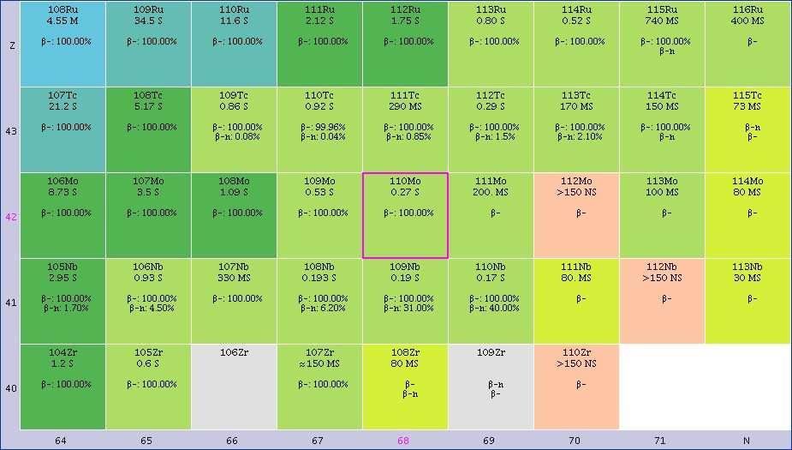
Decay spectroscopy of ¹¹⁰Mo
β decay of ¹¹⁰Nb
β-

Slide 15
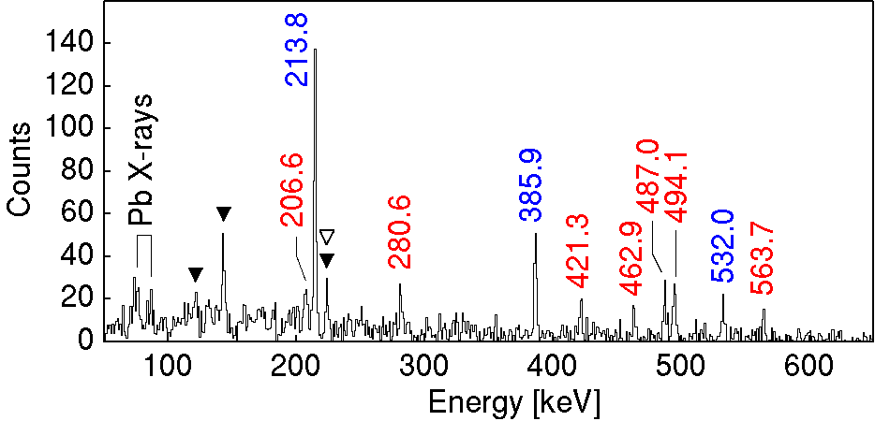
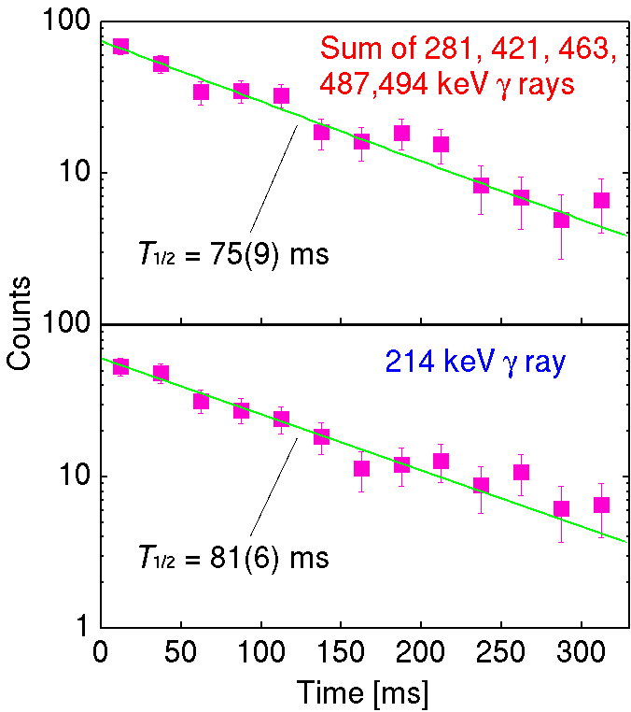
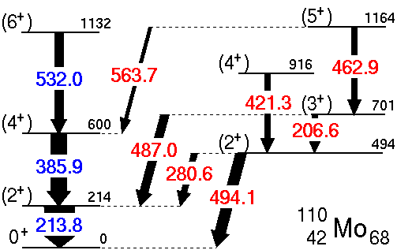
β decay of ¹¹⁰Nb
▾ ¹¹⁰Tc (granddaughter)
▿ ¹⁰⁹Mo (β-n daughter)
Level energies
Energy matching
γ-ray intensity
Spin-parity assignment
Systematic behavior
Moment of inertia
log ft
H. Watanabe, et al., PLB 704 (2011) 270

Slide 16
β decay of ¹¹⁰Nb
▾ ¹¹⁰Tc (granddaughter)
▿ ¹⁰⁹Mo (β-n daughter)
The second 2⁺ state
is proposed at 494 keV
The band head of the quasi-γ band
H. Watanabe, et al., PLB 704 (2011) 270

Slide 17
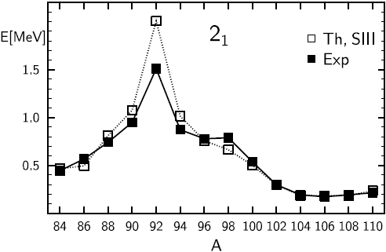
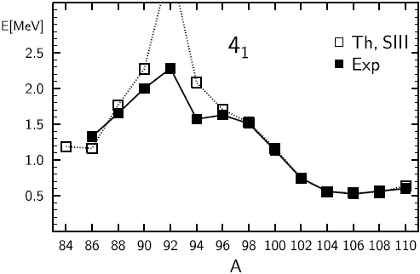
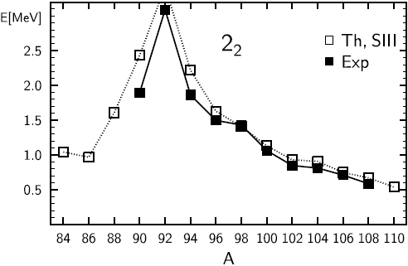
Low-lying levels in even Mo isotopes
2⁺₁
2⁺₂
₄₂Mo
Present
work
E_{ex} [MeV]
4⁺₁
4⁺₁
2⁺₁
Neutron number
General Bohr Hamiltonian method
based on the HFB method with
the Skyrme interaction
2⁺₂
Present
work
The 2⁺₂ state in ¹¹⁰Mo is predicted
at 538 keV
Courtesy of L. Próchniak

Slide 18
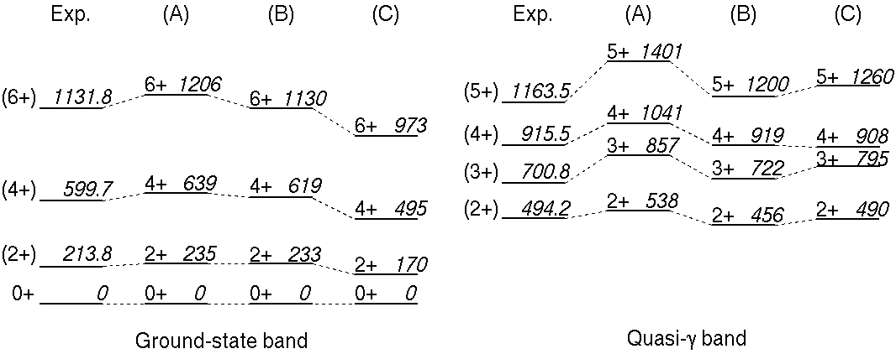
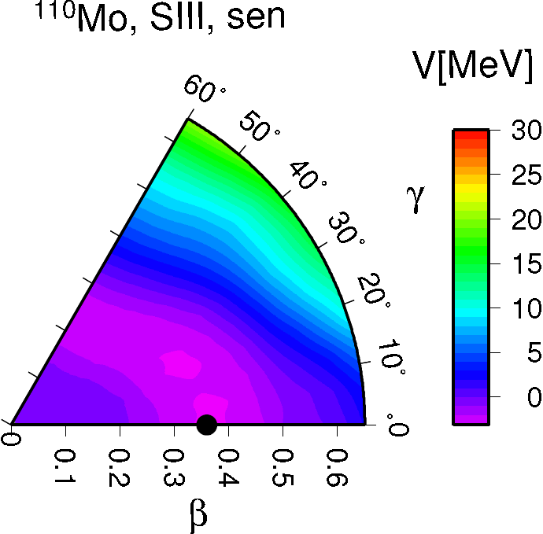
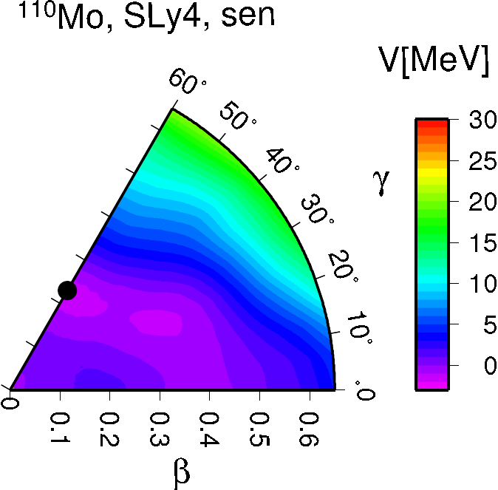
¹¹⁰Mo
E(4⁺₁) > E(2⁺₂)
 | Hamiltonian | Mass parameter
(A) | SIII | Inglis-Belyaev (IB)*
(B) | SLy4
(C) | P+Q | LQRPA
Microscopic calculations
based on the general
Bohr Hamiltonian approach
*corrected with a factor of 1.3
SIII
SLy4
The level structure of
¹¹⁰Mo is ascribed to its
γ-soft nature rather than
the rigid deformation

Slide 19
Neutron-rich ₄₆Pd isotopes towards N = 82
Experimental results obtained in
the EURICA campaign in 2012

Slide 20
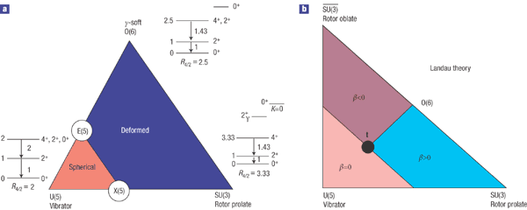
Shape-phase transitions in neutron-rich ₄₆Pd isotopes
The 2⁺₂ states are lower in energy
than the 4⁺₁ states for a wide range
of neutron number in even-even
Pd isotopes
The 2⁺₂ states are important to
quantifying structural evolutions
R.F. Casten,
Nature Physics
(2006)
Symmetric rotor (well-deformed)
⇒
Spherical vibrator
⇒
Axial asymmetry (γ-softness)
⇒

Slide 21
Shape-phase transitions in neutron-rich ₄₆Pd isotopes
The 2⁺₂ states are lower in energy
than the 4⁺₁ states for a wide range
of neutron number in even-even
Pd isotopes
The 2⁺₂ states are important to
quantifying structural evolutions
R.F. Casten,
Nature Physics
(2006)
Shape transition
⇒ Prolate, Oblate, Spherical?
⇒ Triaxial, γ-soft?
Shell evolution
⇒ Quenching of N=82?
⇒ New magicity at N=70?

Slide 22
Level structure of very neutron-rich ₄₆Pd isotopes
¹¹⁸Pd₇₂
¹²⁰Pd₇₄
¹²²Pd₇₆
¹²⁴Pd₇₈

Slide 23
Level structure of very neutron-rich ₄₆Pd isotopes
under preparation for publication
¹¹⁸Pd₇₂
¹²⁰Pd₇₄
¹²²Pd₇₆
¹²⁴Pd₇₈
Revised excited 0⁺ states in ¹¹⁸Pd
New levels besides the 2⁺₁ and 4⁺₁ states in ¹²⁰Pd
Brand-new level schemes of ¹²²Pd and ¹²⁴Pd

Slide 24
Shape transitions in very neutron-rich Pd isotopes
Filled symbols: Known
Open symbols: Present work
R.F. Casten,
Nature Physics
(2006)

Slide 25
Shape transitions in very neutron-rich Pd isotopes
Filled symbols: Known
Open symbols: Present work
R.F. Casten,
Nature Physics
(2006)
O(6)
A=112-118

Slide 26
Shape transitions in very neutron-rich Pd isotopes
Filled symbols: Known
Open symbols: Present work
R.F. Casten,
Nature Physics
(2006)
Phase transition between
γ-soft and spherical vibration
E(5)
A=122-124
New candidate for
E(5) critical point ?

Slide 27
Summary
γ-ray spectroscopy following β- and isomeric decays at RIBF
First decay spectroscopy in 2009, aiming at neutron-rich A～ 110 nuclei
Structural evolution in ^{106,108}Zr_{66,68}
Enhanced γ softness in ¹¹⁰Mo₆₈
The EURICA project
12 seven-element Cluster-type HPGe detectors from EU
Approved BT more than 100 days
²³⁸U-beam campaign in Nov.-Dec., 2012
Shape transition in neutron-rich Pd isotopes

Slide 28
Collaborators of decay spectroscopy experiment in 2009
RIKEN Nishina Center S. Nishimura, Z. Li, H. Sakurai, H. Baba
M. Nishimura, T. Isobe, H. Scheit , P. Doornenbal,
D. Steppenbeck
Tokyo Univ. Science T. Sumikama, J. Chiba, K. Yoshinaga, Y. Miyashita,
T. Nakano, K. Sugimoto, S. Takano
Osaka Univ. K. Yamaguchi, A. Odahara, A. Takashima, Y. Ito,
K. Tajiri
RCNP Osaka Univ. H.J. Ong
Tokyo Inst. Tech. N. Kobayashi, Y. Kawada, Y. Kondo
CNS Tokyo Univ. E. Ideguchi, S. Go, S. Ota, S. Kubono, H. Yamaguchi
T. Hashimoto, S. Hayakawa
JAEA Y.Wakabayashi
Kyushu Univ. T.Teranishi
MSU G. Lorusso
TU München C. Hinke, K. Steiger, R. Krücken
INFN O. Wieland, N. Blasi
Milano A. Bracco, F. Camera
Surrey Z. Podolyák, P. Walker
LBNL J. Berryman
Peking Univ. Y.Shi, F.R. Xu

Slide 29
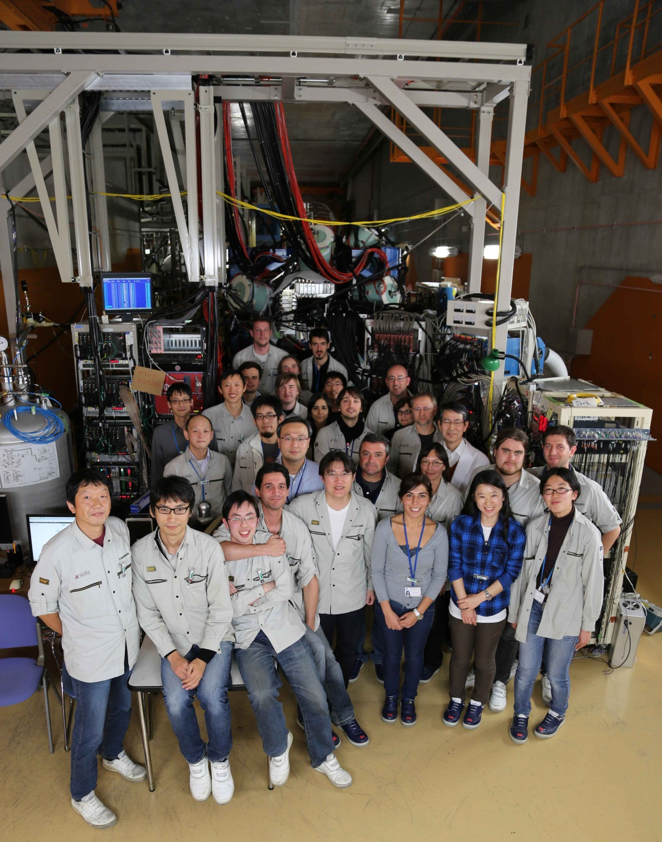
Collaborators of EURICA campaign in 2012
H. Baba, G. Benzoni, F. Browne, P. Doornenbal, N. Fukuda, G. Gey, N. Inabe, T. Isobe,
H-S. Jung, A. Jungclaus, D. Kameda, I. Kojouharov, F.G. Kondev, T. Kubo, S. Kubono,
N. Kurz, G.J. Lane, Z. Li, G. Lorusso, A. Montaner, C-B. Moon, K. Moschner, F. Naqvi,
M. Niikura, H. Nishibata, S. Nishimura, D. Nishimura, A. Odahara, Z. Patel, Z. Podolyak,
E. Sahin, H. Sakurai, H. Schaffner, Y. Shimizu, G. Simpson, P.A. Söderström, K. Steiger,
T. Sumikama, H. Suzuki, H. Takeda, J. Taprogge, Z. Vajta, H. Watanabe, J. Wu, Z. Xu,
A. Yagi, K. Yoshinaga
RIKEN Nishina Center, Biehang University, INFN, University of Brighton,
University of Joseph Fourier, Chung-Ang University, University of Madrid,
GSI, Argonne National Laboratory, Australian National University,
Peking University, Instituto de Fisica, Hoseo University, University of Koeln,
Yale University, University of Tokyo, Osaka University, Tokyo University of Science,
University of Surrey, University of Oslo, Grenoble, TU Munich, Tohoku University,
University of Debrecen

Slide 30
Backup slides

Slide 31
Identification of the excited 0⁺₂ and 2⁺₂ levels
0⁺
High J
¹²⁰Ru₇₆
Gate on 436 keV in ¹²⁰Pd
Low J
Decay from ¹²⁰Rh
¹²⁰Rh₇₅
¹²⁰Pd₇₄
Decay from ¹²⁰Ru
Two β-decaying states in odd-odd Rh
High spin : J = 6~8
Low spin : J = 1~3
Even-even Ru (0⁺) likely feed the low-spin
state in Rh, leading to the population of
the 0⁺ and 2⁺ levels in Pd isotope

Slide 32
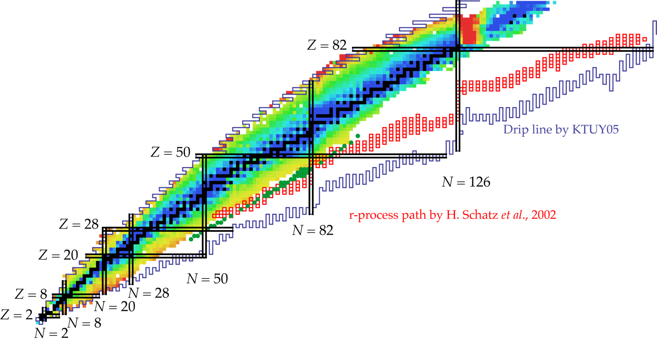
Decay spectroscopy programs with EURICA
¹⁰⁰Sn and its vicinity
Shape transitions near mid²-shell
K-isomers
Isomers below ¹⁰⁰Sn
Structual evolution beyond ¹³²Sn
Two-proton decay
Seniority isomers in ^{136,138}Sn
T_{z}=-2 β decay
Shapes and isomers below ¹³²Sn
T_{1/2}, Q_{β}, P_{n} in the vicinity of ¹²⁸Pd
Exotic shapes near ¹¹⁰Zr
Single-neutron states in ^{79,81}Zn and ⁷⁷Ni
r-process interest around ⁷⁸Ni
N=34 sub-shell in ⁵⁴Ca
Deformation in ^{70,72}Fe
Approved BT with Grade A or higher: ~100 days

Slide 33
Sum of 3 beam settings
¹²⁷Pd, ¹²³Rh, ¹¹⁵Nb
Known T_{1/2}
> 100 events
¹²⁸Pd₈₂
~1200
β-γ parent nuclei to be studied
Daughter unknown
Daughter known (isomer/in-beam)
²³⁸U beam intensity
7~12 pnA

Slide 34
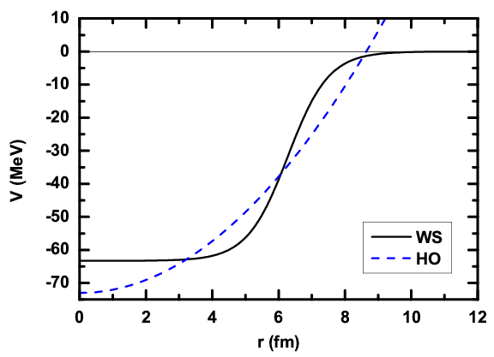
Shell evolution in exotic nuclei
Approaching
neutron drip line
Weak binding
Large diffuseness
Change of mean-field potential (e.g. WS → HO)
Pairing-induced coupling between bound orbits and low-ℓ continuum
Reduced surface effect
ℓ･s
spin-orbit splitting reduced
high-ℓ orbitals (e.g. h_{11/2})
low-ℓ orbitals (e.g. d_{3/2})
ℓ²
J. Dobaczewski, et al., PRC 53, 2809 (1996)

Slide 35
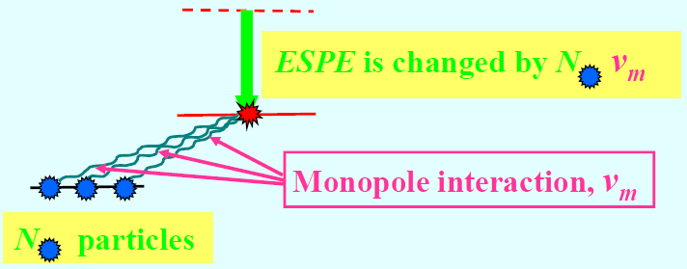
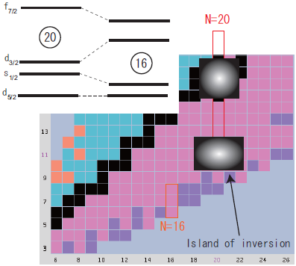
Shell evolution in exotic nuclei
Angular averaged
interaction
Shift of particular orbitals due to the monopole part of the NN interactions
⇒ Both proton and neutron-rich nuclei
Monopole part of the NN interaction
Central force
reflecting radial overlap
strong with the same nodes
attractive within ~1 fm
Tensor force
depending on relative momentum
both attractive and repulsive
influential on shell structure

Slide 36
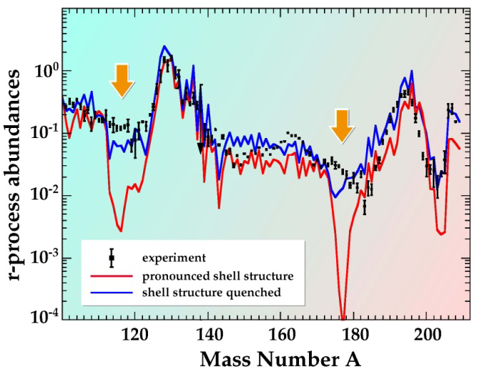
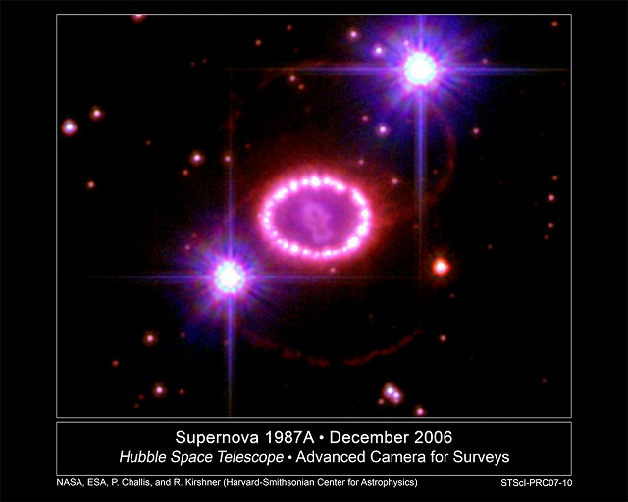
Influence of shell quenching on r-process nucleosynthesis
1987A
A correct understanding of r-process nucleosynthesis requires
Knowledge of nuclear structure far from β-stability
Information on decay properties of neutron-rich nuclei
Detailed description of the possible astrophysical environments
Type-Ⅱ supernovae (SNⅡ)
Neutron star mergers (NSM)

Slide 37
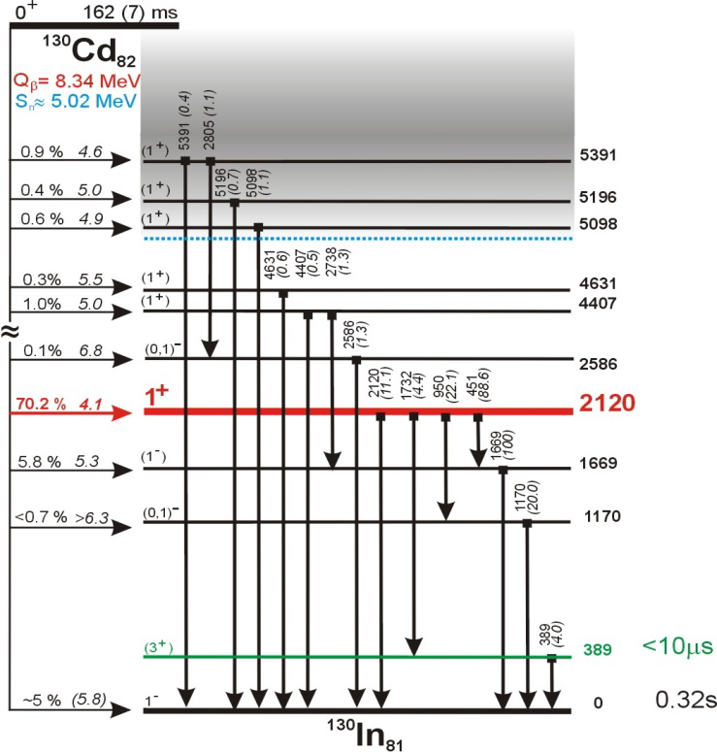
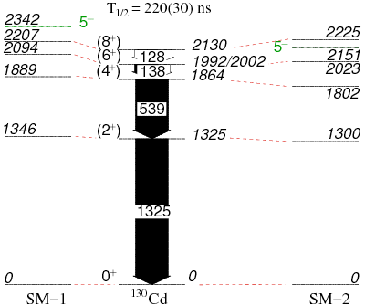
Spectroscopic study for N=82 shell quenching
β-decay of ¹³⁰Cd
A high Q_{β} value consistent with
mass-model predictions assuming
a shell quenching at N=82
I. Dillmann et al., Phys. Rev. Lett. 91, 16 (2003)
Yrast levels below the (8⁺) isomer in ¹³⁰Cd
Interpreted in a shell-model framework
that does not consider excitations
across the shell gaps
No evidence for the shell quenching
A. Jungclaus et al., PRL 99, 132501 (2007)

Slide 38
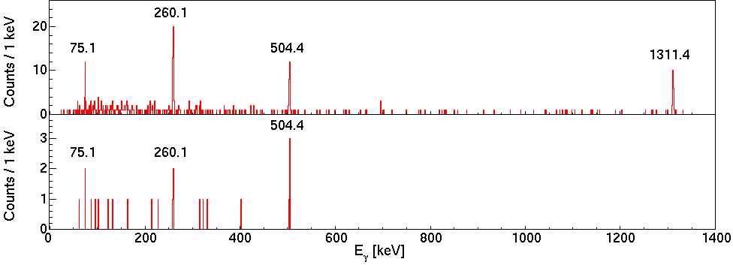
Isomer in ¹²⁸Pd
Delayed coin. with ¹²⁸Pd ions
(Δt=0.15-25 μs)
γ-γ coin. with a gate on 1311 keV
Four γ rays unambiguously observed
Mutual coincidence
Consistent time behavior
One isomeric state: T_{1/2} = 5.8(8) μs
Relative intensity
α_{T}(75 keV) = 2.6(17)
cf. α_{T} = 3.88 for E2
¹²⁸Pd₈₂

Slide 39
Seniority isomers as evidence for robust shell closures
E(4⁺)/E(2⁺)
50
82
g_{9/2}
₅₀Sn
₄₈Cd
₄₆Pd
₄₄Ru
₄₂Mo
₄₀Zr
d_{5/2}
g_{7/2}
s_{1/2}
d_{3/2}
h_{11/2}
¹²⁸Pd₈₂
¹³⁰Cd₈₂
π(g_{9/2})⁻² multiplet with ν=2
Seniority scheme in a single-j shell
(semi-magic, spherical nucleus)
Energy
E_{ex} independent of occupation
0
2
4
6
8
Spin

Slide 40
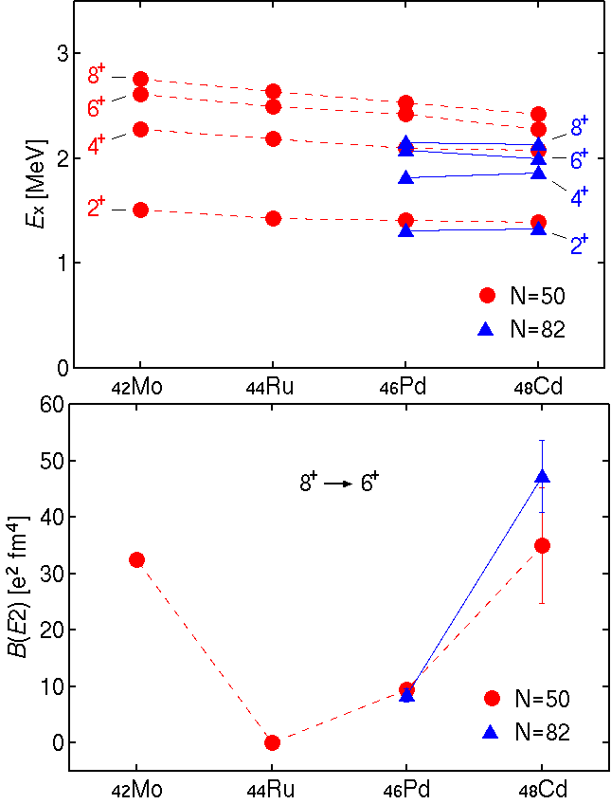
Seniority isomers as evidence for robust shell closures
E(4⁺)/E(2⁺)
50
82
g_{9/2}
₅₀Sn
₄₈Cd
E_{ex}
₄₆Pd
₄₄Ru
₄₂Mo
B(E2;8⁺→6⁺)
₄₀Zr
d_{5/2}
g_{7/2}
s_{1/2}
d_{3/2}
h_{11/2}
Seniority scheme in a single-j shell
(semi-magic, spherical nucleus)
Good seniority in the well
isolated πg_{9/2} subshell
E_{ex} independent of occupation
Small B(E2) near half-filling
Robust shell closure at N=82,
as well as N=50

Slide 41
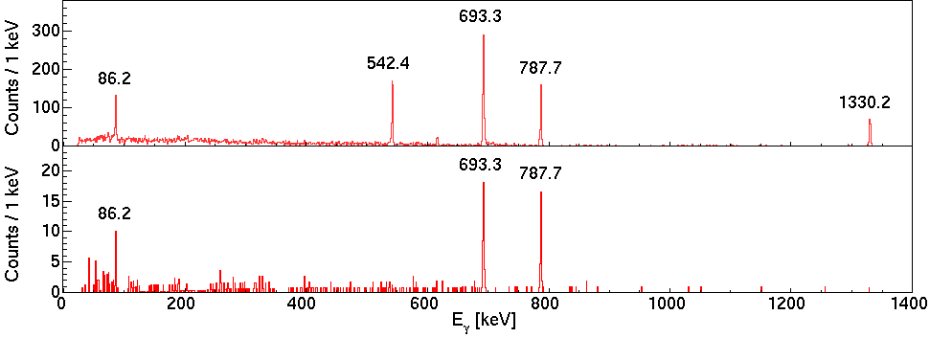
Isomers in ¹²⁶Pd
Delayed coin.
with ¹²⁶Pd ions
(Δt=0.15-5 μs)
γ-γ coin. with a gate
on 542 keV
Time relative to beam
Time difference
Two isomers lie at 2110 and 2023 keV
¹²⁶Pd₈₀

Slide 42
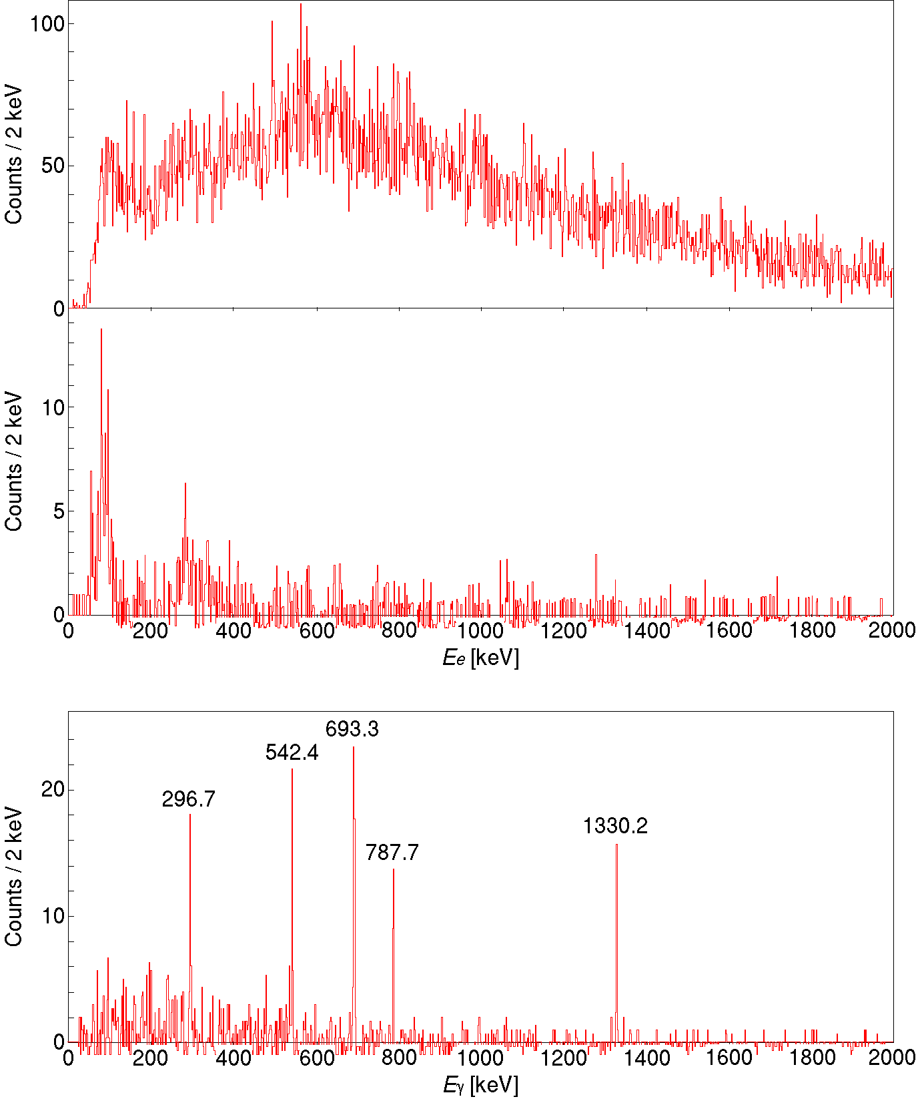
Isomers in ¹²⁶Pd
Electron energy spectra
¹²⁶Pd implantation
(Δt=100 ms)
IC of 86 keV
Gate on γ rays
below the (7⁻)
isomer
IC of 297 keV
(10⁺)
2407 24(2) ms
β
296.7
gate
Long-lived (10⁺) isomer at 2407 keV
via both internal and external decays
¹²⁶Pd₈₀

Slide 43
Shift of the h_{11/2} neutron orbital
N=80 isotone
7⁻ : ν(h_{11/2}⁻¹d_{3/2}⁻¹)
10⁺ : ν(h_{11/2})⁻²
ΔE(10⁺-7⁻)
N=81 isotone
3/2⁺ : νd_{3/2}⁻¹
11/2⁻ : νh_{11/2}⁻¹
ΔE(11/2⁻-3/2⁺)
?
ΔE(10⁺-7⁻) seems to correlate with ΔE(11/2⁻-3/2⁺)
11/2⁻ (hole) state keeps decreasing in energy?
⇒ h_{11/2} orbital rises upward relative to d_{3/2}
Implication for monopole shift or diffused potential?

Slide 44
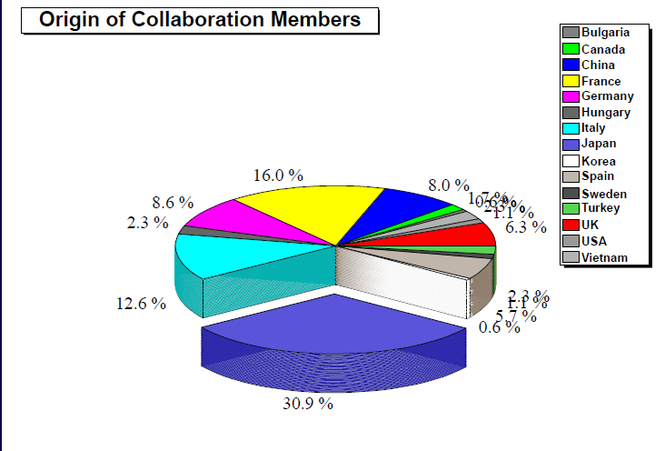
EURICA Collaboration ( > 170 people, >47 Inst./Univ.)

