Slide 3
„The T violating phase is only associated to the heavy quark sector, and no T-violation is expected to be seen in low energy nuclear interactions. (…) It is the only model of T-violation that arises naturally within the context of already known physics.”
Barry R. Holstein „Weak interactions in nuclei” Princeton Series in Physics (1989)

Slide 6
To measure sin() in the fast decaying cascade of levels the
Measurement of circular polarization is needed.

Slide 7
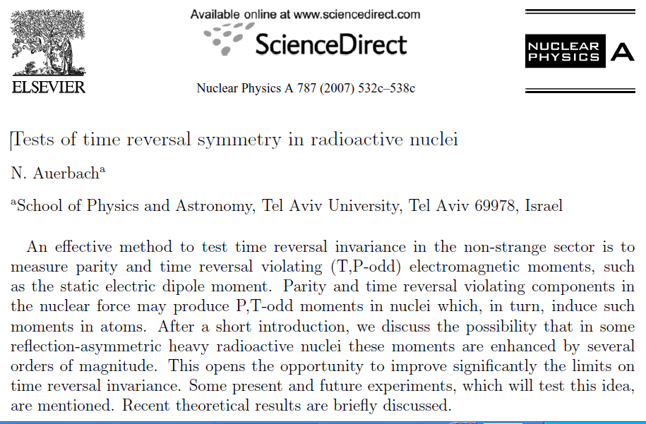
Time reversal – quest for EDM

Slide 8
Time reversal – quest for EDM
Axial symmetry
IMK quantum naumbers
Lab states with opposite parity
Nucleus not oriented in LAB
T-symmetry breakig
- mixing K quantum number
(none of the states is a true
parity eigenstate)
I
K=In
K
Supprisignly nucleus starts to rotate along its symmetry axis.
Laboratory orientation is formed.
EDM becomes nonzero value

Slide 9
Nuclear microscope for T-symmetry
Quest for parity violation
Barry R. Holstein „Weak interactions in nuclei” Princeton Series in Physics (1989)
Doublet states as a magnifier of the fundamental T-symmetry breaking.
In contrast to electric dipole moment
The magnetic one will not be shielded
By the electronic shells.

