Slide 1
CHIRAL2013, 27-31 Oct., 2013
Future Project at J-PARC
H. Noumi（RCNP, Osaka University）
Outline:
1. J-PARC Hadron Exp. Facility
2. High Momentum Beam Line (New)
3. Charmed Baryon Spectroscopy at J-PARC
4. Summary

Slide 2
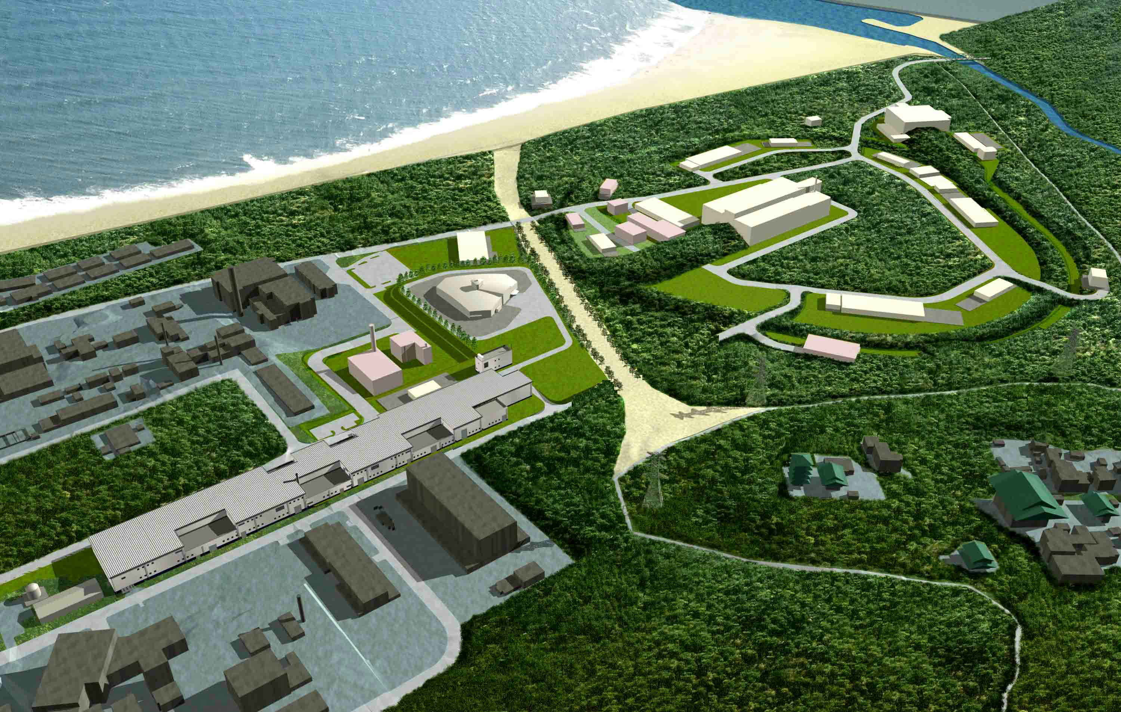
J-PARC Facility
Hadron Experimental Facility
Materials and Life Science
Experimental Facility
ADS: Nuclear Transmutation
(Phase 2)
５００ｍ
Neutrino to Kamiokande
3 GeV Rapid Cycle Synch. (25 Hz, 1MW)
50 GeV Main Ring (0.75 MW)
Linac
(330m)
J-PARC = Japan Proton Accelerator Research Complex
Joint Project between KEK and JAEA since 2001
3

Slide 3
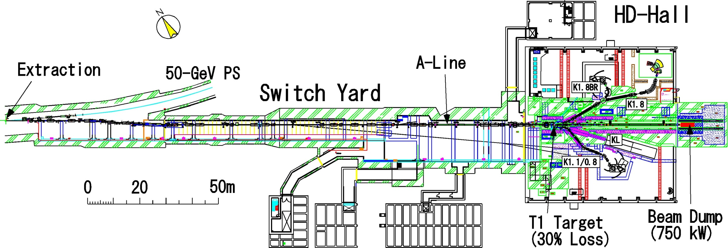
HADRON BEAM LINE FACILITY
Slow Extraction (SX) Beam :
  Currently, the accelerator is operated at 30 GeV.
  1st phase: A design goal is 9μA (270 kW, 3.4x10¹⁴ /6s spill)
  SX Beam: step by step operation to increase extracted power
  1st Beam in 2009.
  ~3 kW (Feb. 2011)
  ~6 kW (June, 2012)
  ~15 kW in 2012
  >30 kW in 2013
  ~100 kW
99.6% Extraction efficiency is achieved!
- The World Highest Score -
T1 accident at 24 kW

Slide 4
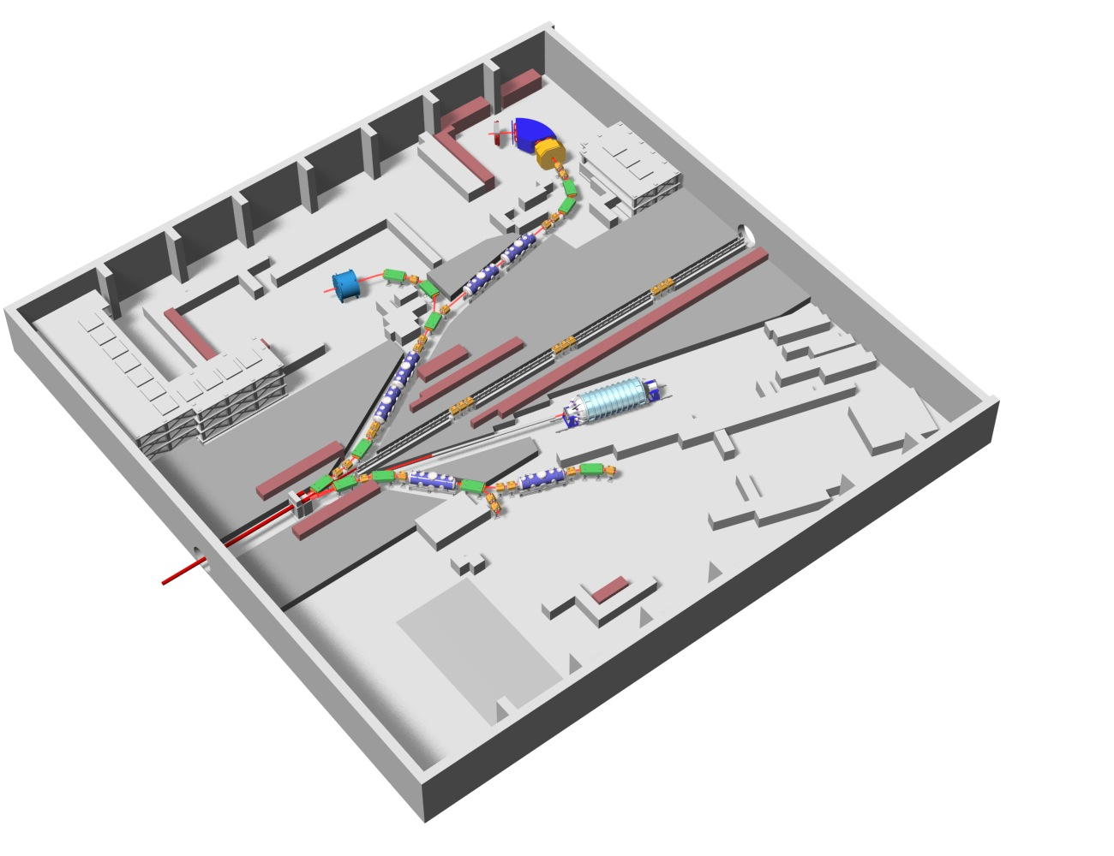
Hadron Exp. Hall
K1.8
Current
K1.8BR
58 m
K0
T1
K1.1(u.c.)
K1.1BR
30 GeV
Proton
Beam
56 m
Notes:
At present, 3 separated charged beam lines and 1 neutral KL beam line are in operation. K1.1 is under construction.

Slide 5
Hadron Exp. Hall
Nuclear/Hadron Physics Programs
K1.8
Strangeness Nuclear Physics
  Precision Spectroscopy of S=-1, -2 Hypernuclei
    Ξ hypernuclei,(E05) ΛΛ hypernuclei (E07)
    Hypernuclear γ-ray spectroscopy (E13), Ξ-Atomic X ray (E03)
    Neutron-rich Λ hypernuclei (E10), ΣΝ scattering (E40)
  Deeply Bound Kaonic Nuclear System
    ³He(K-,n)”K-pp”(E15), K-He X ray (E17), d(π⁺,K⁺)”Λ∗p” (E27)
Hadron Physics
  Hadron Spectroscopy, including “Exotics”
    Θ⁺ via p(π⁻,K⁻) (E19)
    Λ(1405) via d(K⁻,n) (E31)
    H-dibaryon via (K⁻,K⁺) (E42)
    Baryon resonances (E45)
  Mass modification of Vector Meson in Medium
    φ->e+e- in A (E16), _{φ}A via (p^{bar},φ) (E29), ω->π⁰γ in A (E26)
K1.8BR
K0
T1
K1.1(u.c.)
K1.1BR
30 GeV
Proton
Beam
Notes:
This is a summary of the specification of the beam lines.
Beam tunings in some beam lines are still under way to extract their maximum performances. But, they already have shown good performances.
If we have 100-kW level of primary beam, we can expect more than
1 mage kaons per spill at each kaon beam line

Slide 6
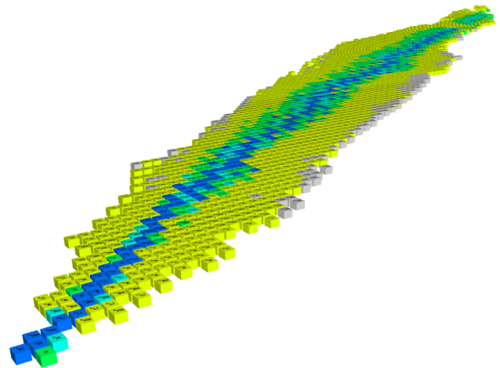
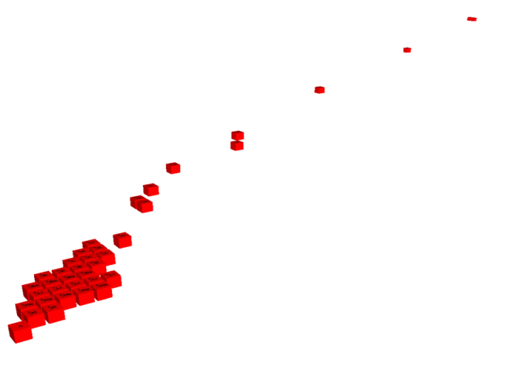

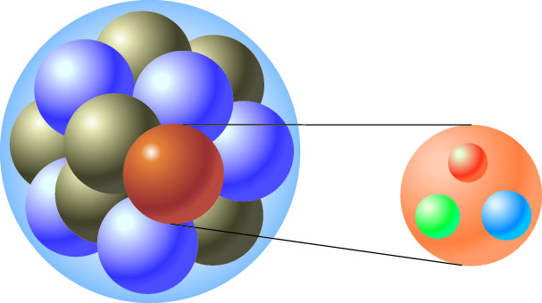
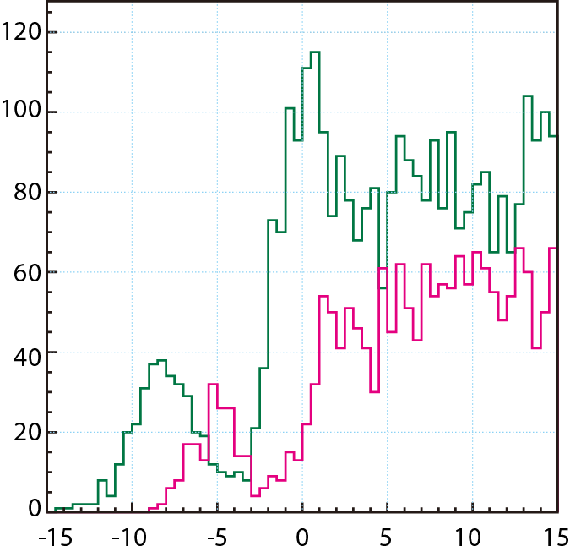
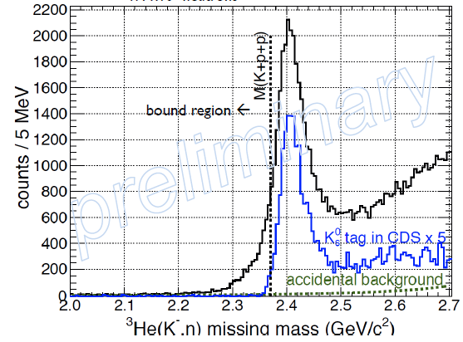
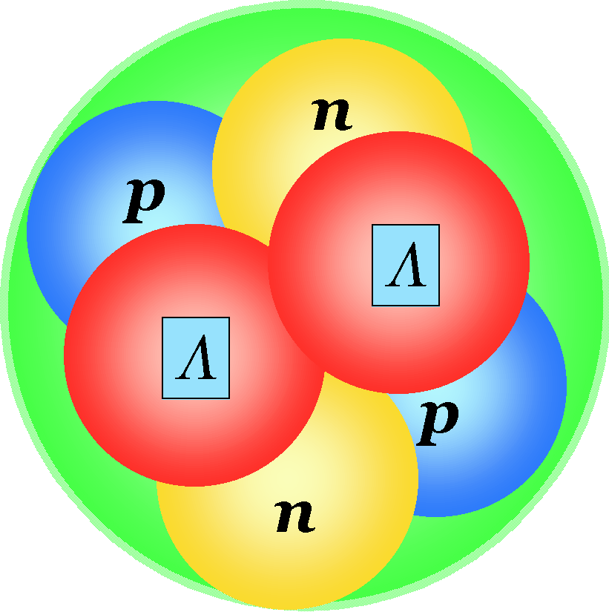
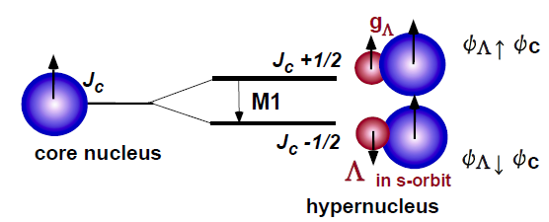
Hadron Exp. Hall
K1.8
Hypernuclei
Strangeness
BB Int. in Medium
Current
ΛΛ, Ξ Hypernuclei
K1.8BR
Z
-2
Λ, Σ Hypernuclei
-1
Λ,Ξ
N
0
¹²C(K-,K+)¹²_{Ξ}Be
³He(K-,n)X
[counts/0.5MeV]
K1.1(u.c.)
_{ΛΛ}He
⁶
-B_{Ξ} [MeV]
πΣ
d(K-,n)Λ(1405)
‾ＫＮ
Notes:
Studies of hadrons in nuclei is related to the problem of the chiral symmetery.
Hypernuclei are studied in order to understand the BB int. in nuclear medium further in the framework of flavor SU(3) symmetry,
where, we can investigate behaviors of hyperon in nuclear medium.
Double-strangeness hypernuclei are main subjects at K1.8.
Modification of the magnetic moment of Lambda in nuclear medium is quite interesting subject, which can be measured through the B(M1) measurement in hypernuclear gamma ray spectroscopy. Mu-lam is proportional to the inverse of “constituent quark mass”, where constituent quark behaves a dirac particle. If the chiral symmetry is restored in the nuclear medium, the magnetic moment may be modified.
Studies of kaon deeply bound states are interesting, which is strongly related to the nature of L(1405), which is thought to be KbarN bound state. Chiral unitery model claimed that it may consist of two poles below the KbarN threshold.

Slide 7
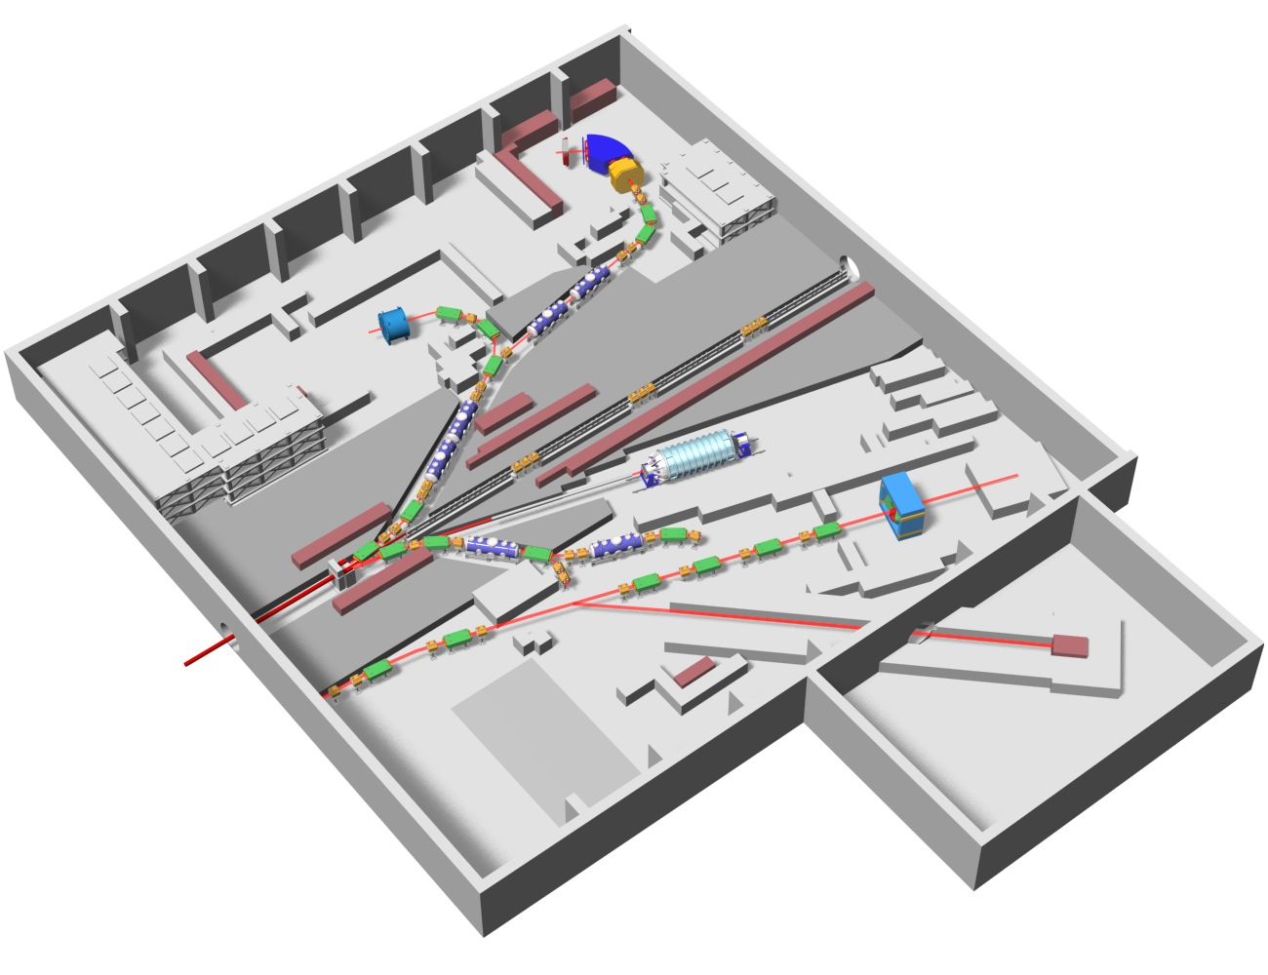
Hadron Exp. Hall
High-p BL:
to be constructed by
the end of 2015
Coming in Near Future
High-p
COMET
branched at upstream
of the primary Beam Line

Slide 8
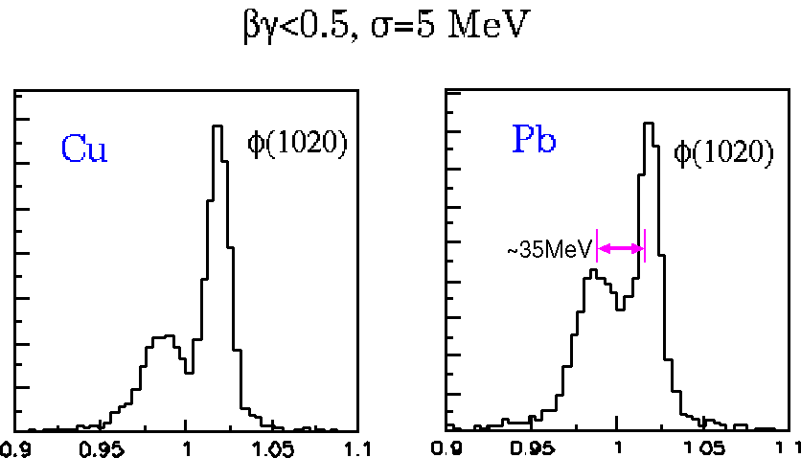
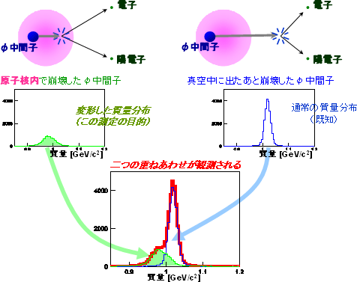
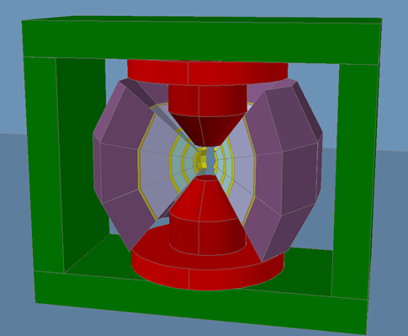

Hadron Exp. Hall
Origin of Mass
Coming in Near Future
Quark
E16
pA → “φ”X
Free quarks
Bound quarks
Why are bound quarks heavier？
High-p
e⁻
e⁺
e⁻
e⁺
e⁺
Notes:
In High-p beam line, E16 experiment is going to measure mass modification of phi meson in nuclei. Phi is created by primary proton in a nucleus

Slide 9
A New project at the High-Momentum Beam Line
Charmed Baryon Spectroscopy

Slide 10
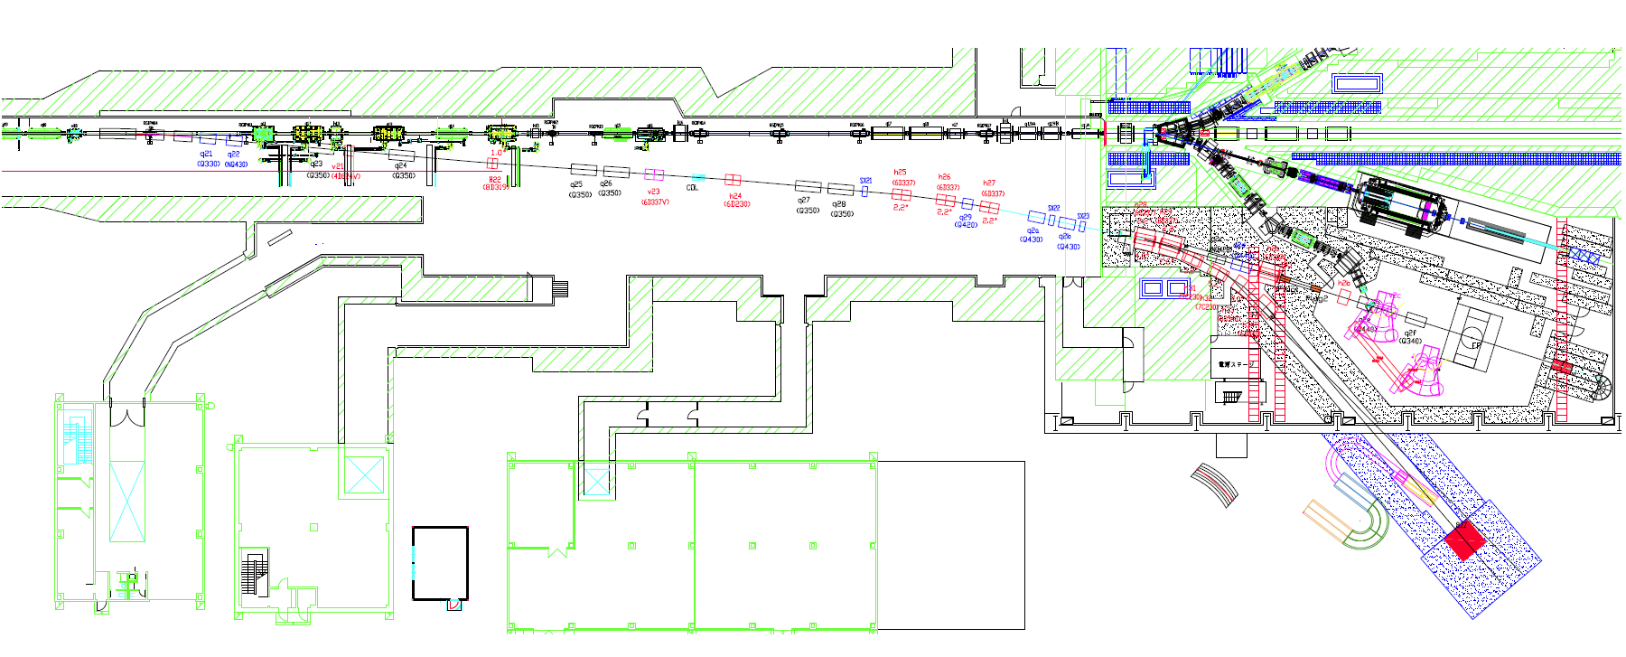
High-res., High-momentum Beam Line
High-intensity secondary Pion beam
  1.0 x 10⁷ pions/sec @ 20GeV/c
High-resolution beam: Δp/p~0.1%
30 GeV
proton beam
Spectrometer
Production
Target
T1
Pion Beam
Up to 20 GeV/c
Notes:
Let me start from this naive question in hadron physics;
“What are good building blocks of hadrons?”
We know that a constituent quark is a very good building block of hadrons,
which successfully describes hadron properties, such as masses, classifications based on spin/flavor symmetry, and even magnetic moments. This is good for ground state hadrons.
However, the constituent quark model sometimes fails in resonance states.
Hadrons can be good building blocks, as recently Meson-meson and Meson-Baryon molecular states are intensively discussed. Here, they are all color singlet states.
“Diquark” is considered as a building block of baryons.
Although this object is discussed for a long time. it has not been settled yet.

Slide 11
What are essential D.o.F. of baryons?
q
Constituent Quark
͞q
q
q
q
Hadron properties
  Classification based on Spin/flavor symmetry
  Mass Relations, Magnetic Moments
Failure in Resonant States
  Missing Resonances
  Exotics
Notes:
Let me start from this naive question in hadron physics;
“What are good building blocks of hadrons?”
We know that a constituent quark is a very good building block of hadrons,
which successfully describes hadron properties, such as masses, classifications based on spin/flavor symmetry, and even magnetic moments. This is good for ground state hadrons.
However, the constituent quark model sometimes fails in resonance states.

Slide 12
What are essential D.o.F. of baryons?
q
Constituent Quark
͞q
q
q
q
͞q
q
hadron (colorless cluster)
q
q
q
[qq]
Diquark?
(Colored cluster)
q
Notes:
“Diquark” is considered as a building block of baryons.
Although this object is discussed for a long time. it has not been settled yet.

Slide 13
What are essential D.o.F. of baryons?
q
Most fundamental question
Interaction btwn quarks
Diquark correlations
q
q
qq
→ Charmed baryon
to close up diquark correlations
Weak Color Magnetic Interaction with a heavy Quark
Q
Notes:
“How to form hadrons” is the most fundamental question.
To answer this, we need to understand the interaction between quarks, in particular, diquark correlations.
In light baryons, where suf(3) symmetry seems to work rather well, 3 [qq] pairs are expected to be correlated each other.
So, extraction of a diquark correlation may not be easy.
Charmed baryons provide unique opportunities to study diquark.
Due to weak CMI with a heavy quark since it is proportional to the inverse of a constituent quark mass. In charmed baryon, one expects that [qq] is well singled out.

Slide 14
Level Structure of charmed baryons
λ and ρ motions split
σ_{q}σ_{q}, SO
ρ
Λ_{c}(1/2-, 1/2-,3/2-,
3/2-, 5/2-)
q-q
Σ_{c}(1/2-,3/2-)
P-wave
ρ mode
Q
Σ_{c}(1/2-, 1/2-,3/2-,
3/2-, 5/2-)
q
q-q
q
λ
Λ_{c}(1/2-,3/2-)
λ mode
q
Q
Σ_{c}( 1/2+,3/2+)
G.S.
Λ_{c}(1/2+)
chiral partners of “qq” states appear.
14
Notes:
This nature is expected to be reflected in the level structure of charmed baryons…

Slide 15
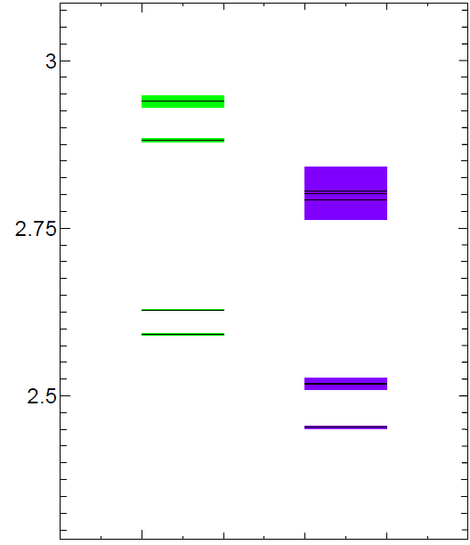
Limited # of Charmed Baryons have been observed.
(GeV/c²)
Λ_{c}(2940) ??
D*N
2.9
Σ_{c}(2800) ??
Λ_{c}(2880) 5/2⁺
DN
2.7
Λ_{c}(2625) 3/2⁻
2.6
πΣ_{c}
Λ_{c}(2595) 1/2⁻
Σ_{c}(2520) 3/2⁺
<−ρ mode
Σ_{c}(2455) 1/2⁺
<−λ mode
πΛ_{c}
2.4
Λ_{c} 1/2⁺
2.3

Slide 16
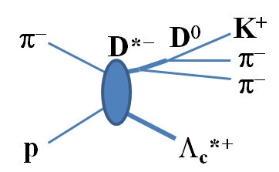
Charmed Baryon Spectroscopy
Using Missing Mass Techniques
Inclusive p(π⁻,D*⁻) Y_{c}*⁺
(Target)
p(π)
p(π⁻,D*⁻x)
Y_{c}^{*+}
D⁰(Y_{c}’)
qq
inclusive (π⁻,D*⁻) spectrum
  Level structure of Y_{c}*
  Production Rate
+ Decay Particles
  Decay Width/Decay Branching Ratios
  Spin, Parity
Q
Notes:
Then we proposed charmed baryon spectroscopy by using the missing mass techniques.
We will measure the level structure of the excited charmed baryons and the production rate in the inclusive (pi-,D*-) spectrum.
Decay productions will be also measured to assist the missing mass spectroscopy.
In reality, there two main issues:
One is How large the CS is
And
The other is how large the BG is and how to reduce the BG.

Slide 17
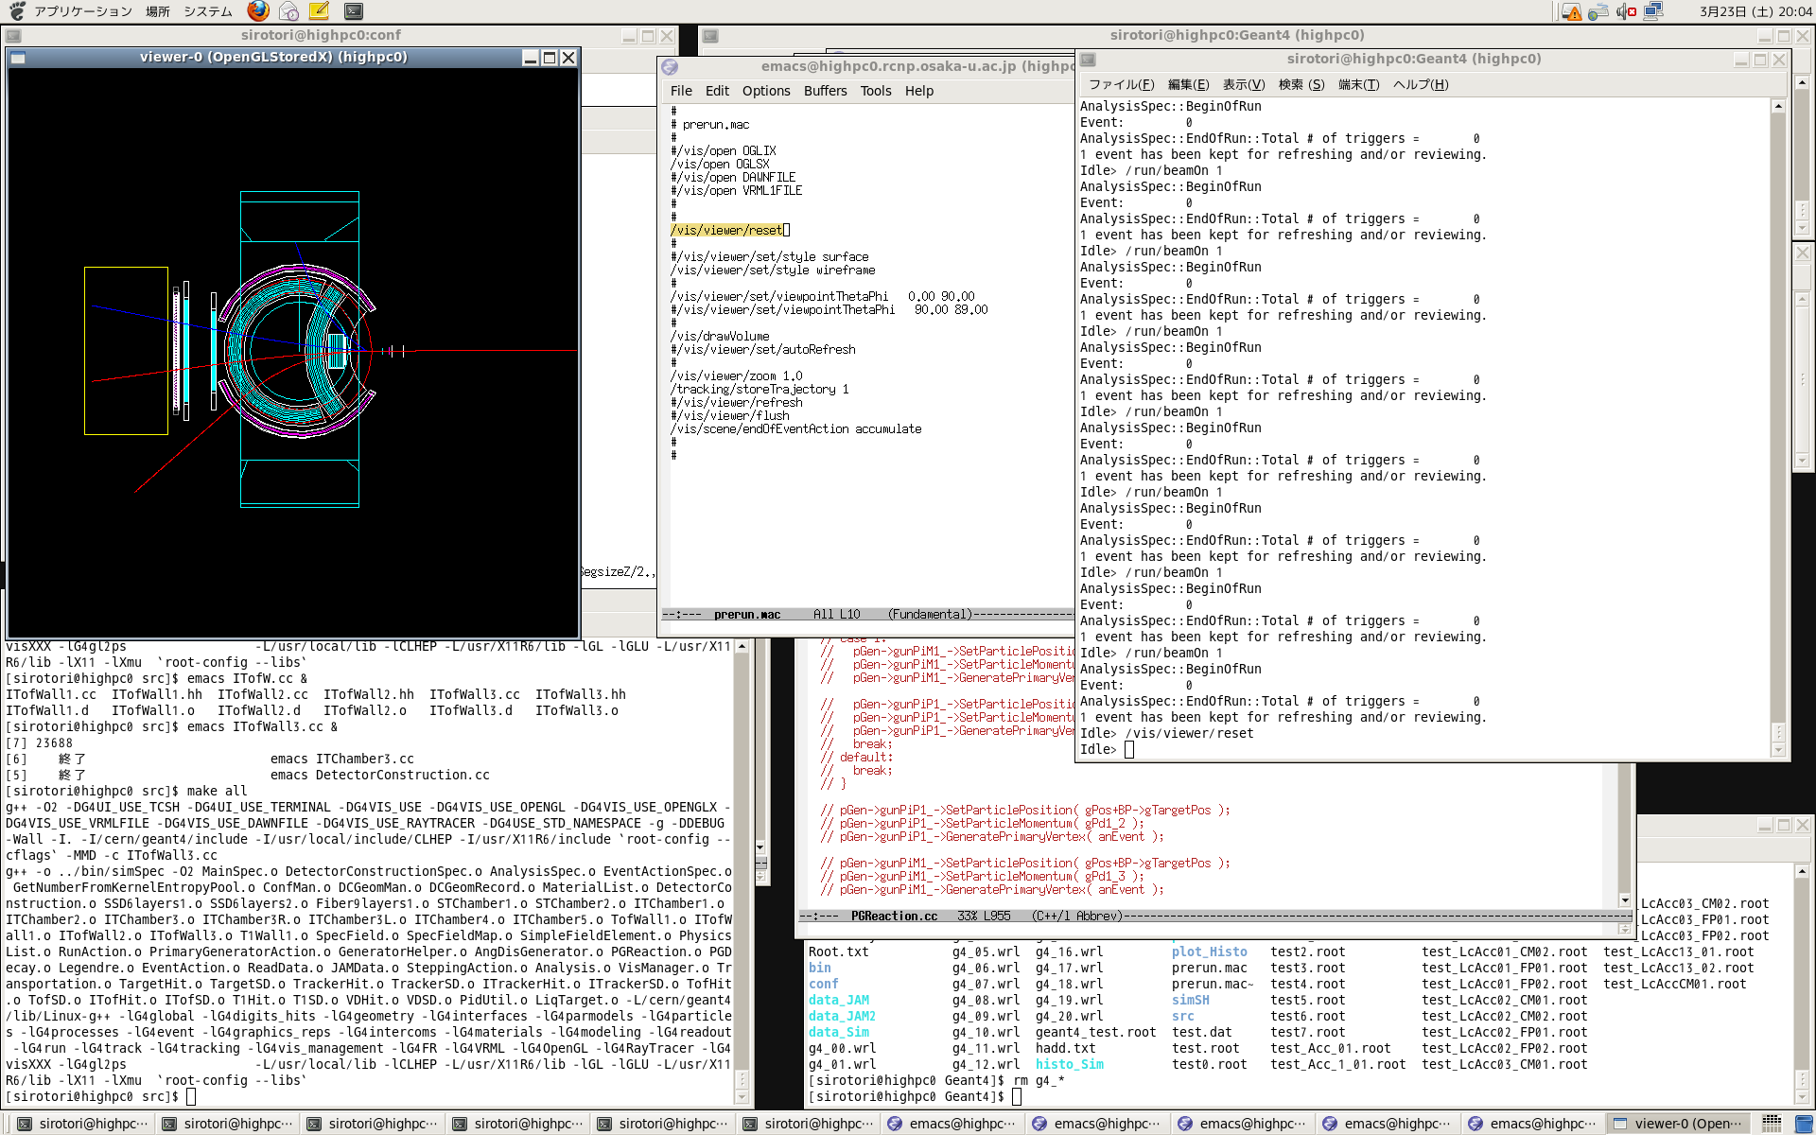
Charmed Baryon Spectrometer
2m
Internal TOF
FM magnet
Ring Image
Cherenkov
Counter
π_{s}⁻
Internal DC
LH₂-target
π⁻
Beam GC
Beam π⁻
SSD
Κ⁺
Fiber tracker
Decay π⁺
TOF wall
DC
Internal TOF
Large acceptance ~ 60% (for D*), Δp/p~0.2% at ~5 GeV/c
Notes:
Then we proposed charmed baryon spectroscopy by using the missing mass techniques.
We will measure the level structure of the excited charmed baryons and the production rate in the inclusive (pi-,D*-) spectrum.
Decay productions will be also measured to assist the missing mass spectroscopy.
In reality, there two main issues:
One is How large the CS is
And
The other is how large the BG is and how to reduce the BG.

Slide 18
Production Cross Section
Regge Theory: Binary Reaction at High E is well described
Normalized to strangeness production, p(π⁻,K^{*0})Λ
Charm production: ~10⁻⁴ of strangeness production
→ σ (p(π⁻⁻,D*⁻)Λ_{c}) ~ a few nb at p_{π}=20 GeV/c
exp.
p(π⁻,K*)Λ
σ (μb/sr)
<7nb
at BNL
p(π⁻,D*)Λ_{c}
10 nb
A.B. Kaidalov, ZPC12, 63(1982)
V.Yu. Grishina et al., EPJA25, 141(2005)
p_{π}=20 GeV/c
s/s₀

Slide 19
Production Rate
Production Rates are determined by the overlap of WFs
π⁻
D^{*−}
D* (q: mom. transfer)
u
c
L
and depend on:
1. Spin/Isospin Config. of Y_{c}
2. Momentum transfer (q_{eff})
“ud”
“ud”
p
Y_{c}⁺
Spin/Isospin Factor
t-channel D* EX
at a forward angle
A: (baryon size parameter)⁻¹
Notes:
Next, we considered a t-channel D* exchange at a forward angle, in order to estimate the production rate of excited Yc relative to the ground state Lambda-c.
Here, a “u” quark in a proton is converted to a “c” quark.
Residual diquark is a spectator.
The production rate is expressed as overlapping of initial and final baryon wfs,
Which depends on the spin/isospin configurations of charmed baryons
This formula is nothing but the fourier transformation of the wave function density.
As a result, the production rate is decomposed into 2 parts.
The production rate is proportional to the momentum transfer.
The absolute strength is reduced much by the factor of the exponential func.
One we take the ratio of the L state to the ground state.
The quantity does not depend very much on the orbital angular momentum L.

Slide 20
Calculated production rates
p_{π}=20 GeV/c | Mass (GeV/c) | “ud” isospin factor | Y_{c}* Spin factor | q_{eff} (GeV/c) | Rate (Relative)
Λ_{c}^{1/2+} | 2286 | 1/2 | 1 | 1.33 | 1
Σ_{c}^{1/2+} | 2455 | 1/6 | 1/9 | 1.43 | 0.03
Σ_{c}^{3/2+} | 2520 | 1/6 | 8/9 | 1.44 | 0.20
Λ_{c}^{1/2-} | 2595 | 1/2 | 1/3 | 1.37 | 1.17
Λ_{c}^{3/2-} | 2625 | 1/2 | 2/3 | 1.38 | 2.26
Σ_{c}^{1/2-} | 2750 | 1/6 | 1/27 | 1.49 | 0.03
Σ_{c}^{3/2-} | 2820 | 1/6 | 2/27 | 1.50 | 0.06
Σ_{c}^{1/2- ’} | 2750 | 1/6 | 2/27 | 1.49 | 0.07
Σ_{c}^{3/2- ’} | 2820 | 1/6 | 56/135 | 1.50 | 0.33
Σ_{c}^{5/2- ’} | 2820 | 1/6 | 2/5 | 1.50 | 0.31
Λ_{c}^{3/2+} | 2940 | 1/2 | 2/5 | 1.42 | 0.85
Λ_{c}^{5/2+} | 2880 | 1/2 | 3/5 | 1.41 | 1.55
L=0
L=1
L=2

Slide 21
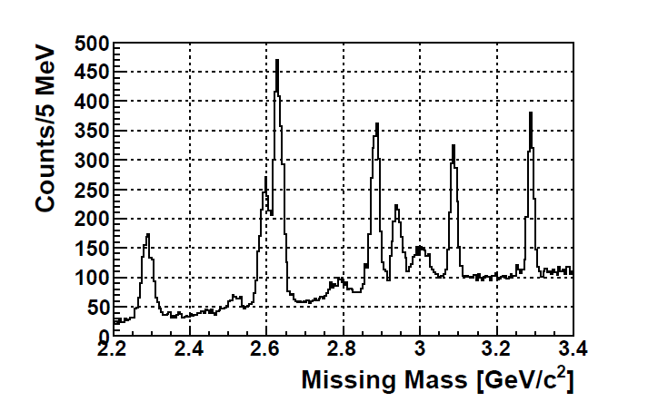
Expected spectra: σ_{GS} = 1 nb
N(Yc*)~1000 events/1nb/100 days
Sensitivity: ~0.1 nb (3σ, Γ∼100 MeV)
If there are
Λ_{c}(2625)
Λ_{c}(2595)
Λ_{c}(2880)
Λ_{c}*
Λ_{c}(2940)
Λ_{c}*
Σ_{c}(2800)
Λ_{c}
Λ_{c}(2765)
Λ_{c*}
Σ_{c}(2520)
Σ_{c}(2455)
Notes:
The BG: level shown here is based on the following BG studies…

Slide 22
Structure and Decay Partial Width
Illustrated
by Hosaka
ρ mode (qq)
λ mode [qq]
Λ(1520) -> Γ(NK)>Γ(πΣ), similarly Λ(1820), Λ(2100)
Possible explanation of narrow widths of Charmed Baryons

Slide 23
Decay Products
Inclusive p(π⁻,D*⁻) Y_{c}*⁺
p(π⁻,D*⁻p)D⁰
(Target)
p(π)
( p(π⁻,D*⁻π)Y_{c}’ )
Y_{c}^{*+}
D⁰(Y_{c}’)
* Decay products can be measured by means of missing mass tech..
Notes:
We can measure the decay products
In the missing mass spectra with additional light particles,
the decay products are clearly seen.

Slide 24
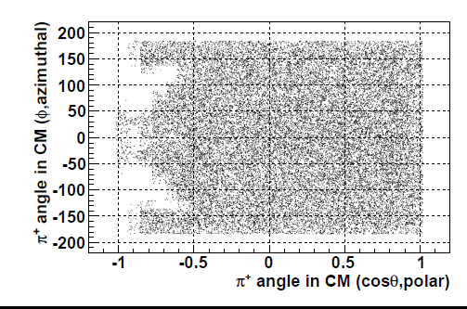
Acceptance for decay particles: ∼85 %
a wide range of the azimuthal (φ_{CM}) and polar (θ_{CM}) angles
Coverage for decay π
(Λ_{c} (2940)−>Σ_{c}⁰π⁺)
φ_{CM} [deg.]
Beam
Target
cosθ_{CM}
* Decay products can be measured efficiently.
Notes:
Acceptance for decay π : ~85 % of two body decay events from Y*c
wide region of azimuthal and polar angle

Slide 25
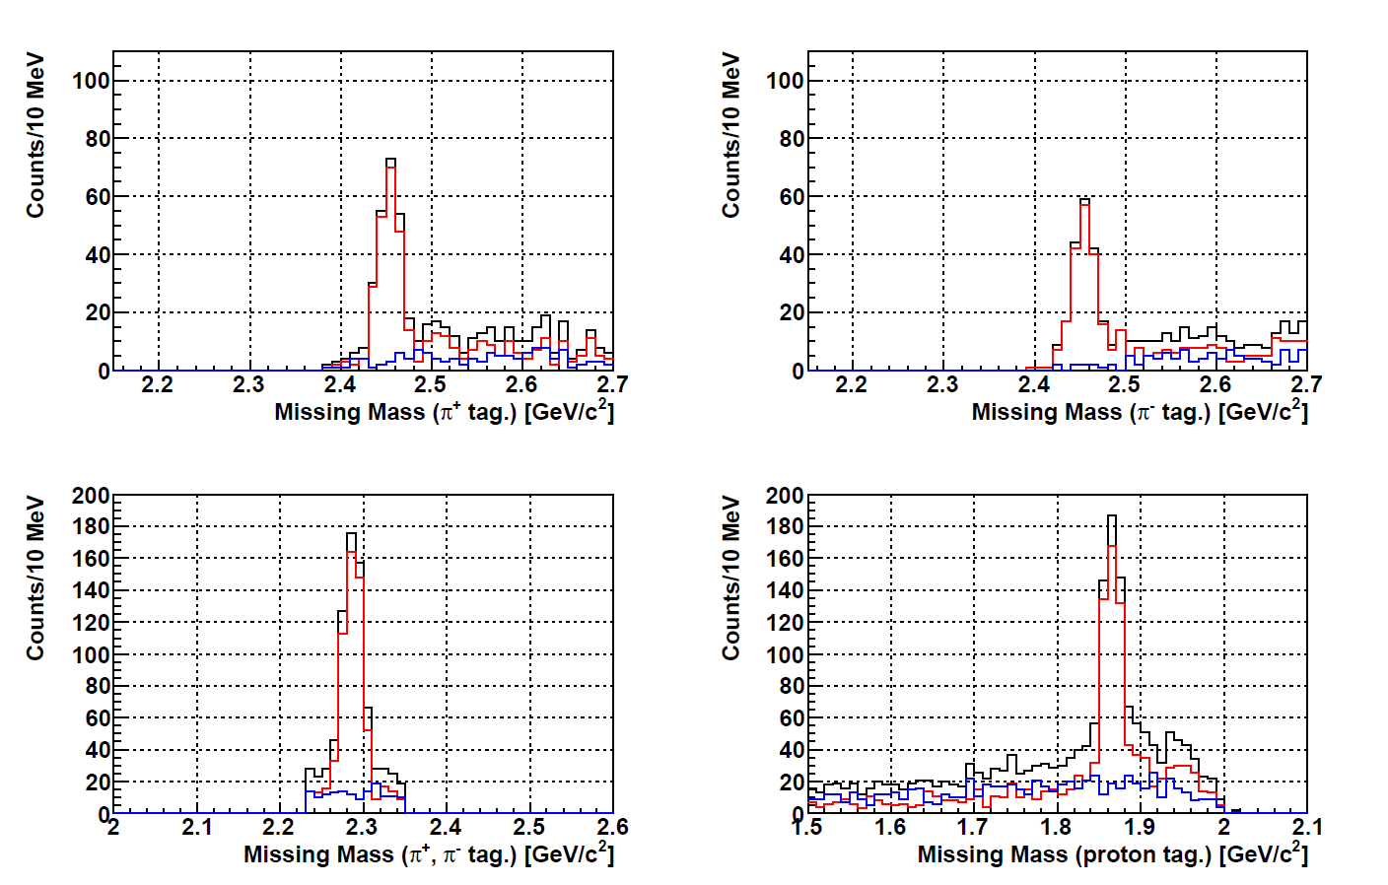
Decay Products
Λ_{c}(2940)−>Σ_{c}⁰ π⁺
Λ_{c}(2940)−> p D⁰
with Λ_{c}⁺ π⁺ π⁻ selected
N_{πΣc} ~ 200
N_{pD} ~ 320
D⁰
Σ_{c}⁺⁺ π⁻
N_{πΣc} ~ 200
SUM
(BR_{πΣc} =13%)
Σ_{c}⁰
(BR_{pD} =20%)
Signal
Σ_{c}⁺⁺
Main BG
* Decay meas. strongly assists the missing mass spectroscopy.
  Branching ratios: Diquark corr. affects Γ(Λ_{c}*->pD)/Γ(Λ_{c}*->Σ_{c}π).
  Angular distribution: Spin, Parity
Notes:
We can measure the decay products
In the missing mass spectra with additional light particles,
the decay products are clearly seen.

Slide 26
Summary
J-PARC Hadron Facility provides opportunities to study Hadron and Nulcear Physics.
Upgrade plans of the Hadron Facility:
  A high-momentum beam line is under construction.
  Extension of the Hadron Hall is planning.
  A project of charmed baryon spectroscopy via the (π⁻,D*⁻) reaction:
    Systematic studies on charmed baryon spectrum, production rate, and decays provide information on quark-quark dynamics in baryons.

Slide 27
Backup

Slide 28
Hadron Exp. Hall
 | K1.8 | K1.8BR | K1.1 | K1.1BR | KL
Design
Max. p (GeV/c) | 2.0 | 1.1 | 1.1 | 1.1 | ~2 (#) (0~5)
Prod. angle | -6 deg. | -6 deg. | +6 deg. | +6 deg. | +16 deg.
Length | 45.8 m | 31.4 m | 27.9 m | 21.5 m | 20.6 m
Acceptance | 1.5 msr・% | 2.0 msr・% | 1 msr*% | 5.0 msr・% | 7.8 μsr
Separator Max. Field | 6 m x 2 80 kV/cm | 6m x 1 80 kV/cm | 2 m x 2 50 kV/cm | 2 m x 1 50 kV/cm | -
Measured performance | ES1:50kV/cm ES2:40kV/cm | ES1:50kV/cm | Under Const’n | ES1:40kV/cm
Kaon Intensity /10¹⁴ proton on Pt 6cm | K- (1.8GeV/c) 1.3E+6 ($) | K- (1GeV/c) 8.1E+5 | - | K+ (1 GeV/c) 1.6E+6 | KL: 2.1E+7
K/all | 0.15 | 0.23 | - | 0.47
K1.8
K1.8BR
K0
T1
K1.1(u.c.)
K1.1BR
30 GeV
Proton
Beam
($) Mass Slits was closed about half of designed.
(#) typical mean value
Notes:
This is a summary of the specification of the beam lines.
Beam tunings in some beam lines are still under way to extract their maximum performances. But, they already have shown good performances.
If we have 100-kW level of primary beam, we can expect more than
1 mage kaons per spill at each kaon beam line

Slide 29
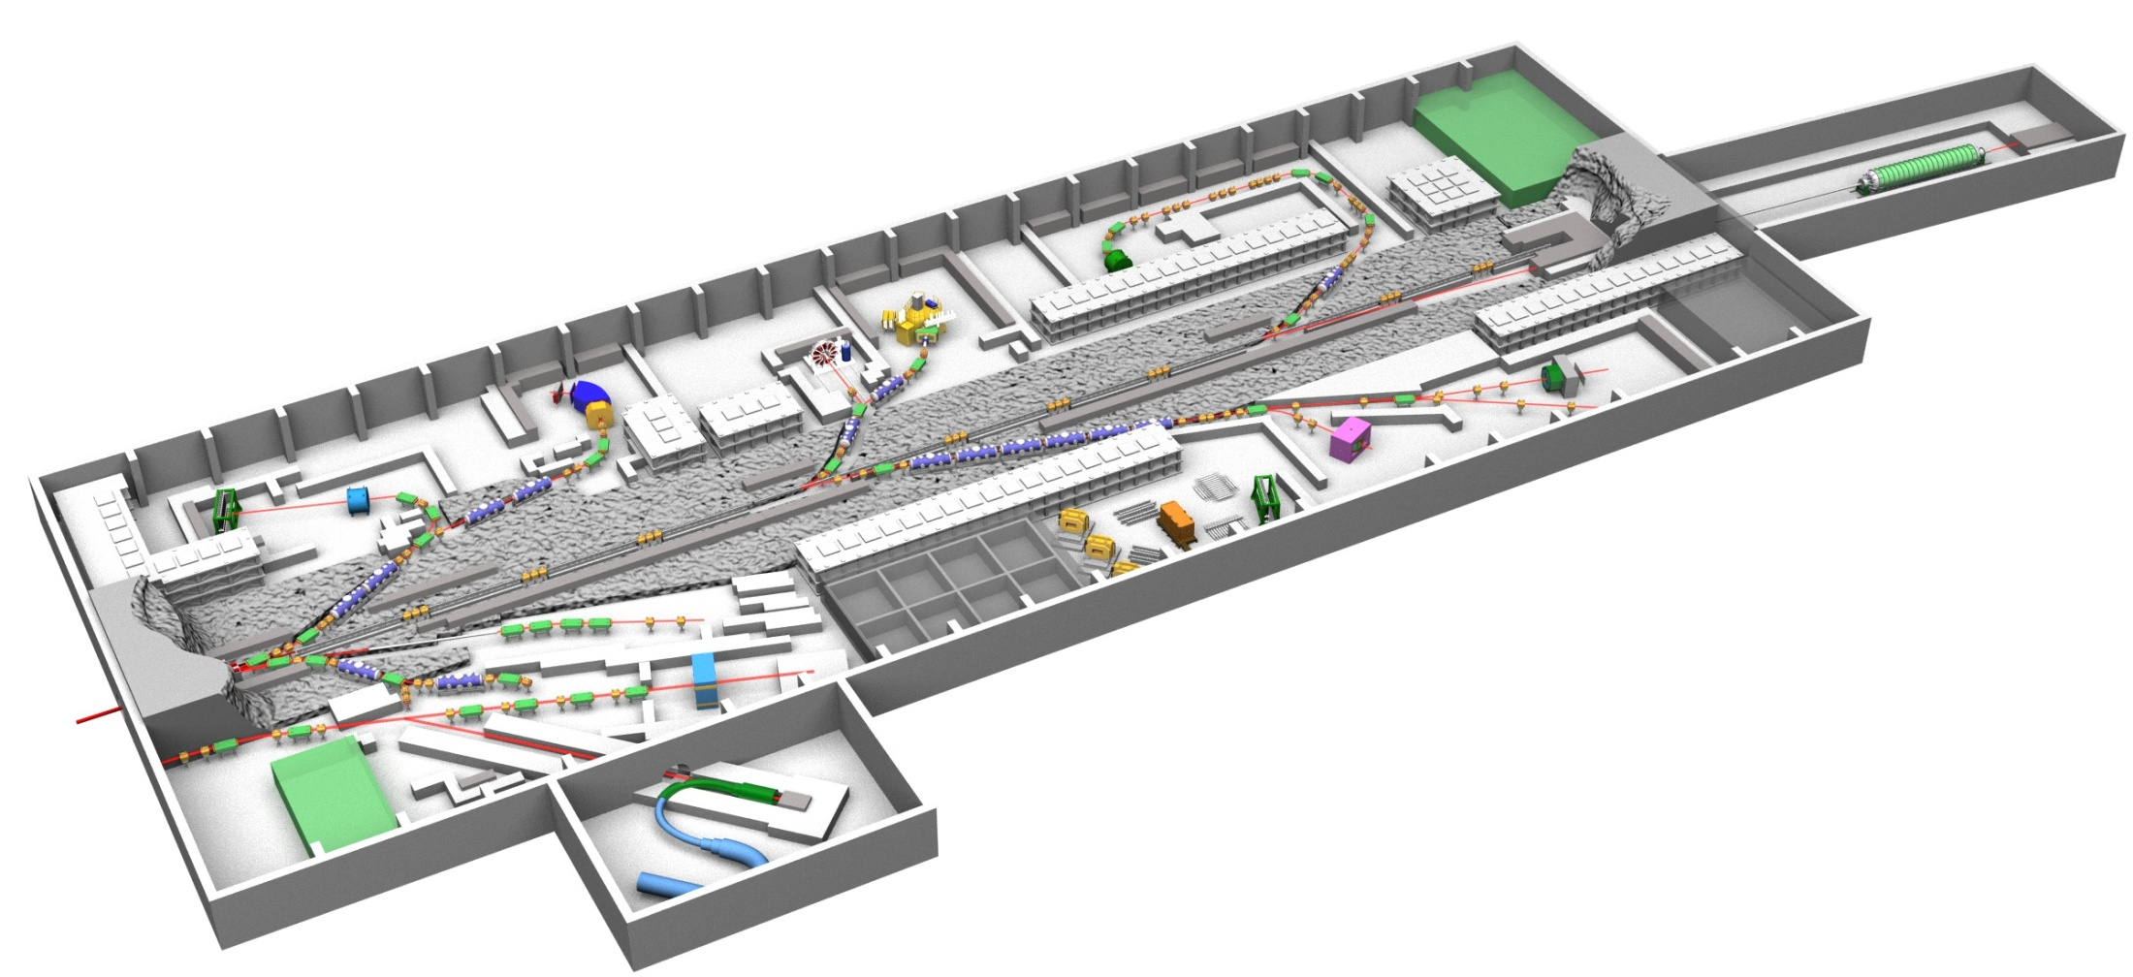
Extension of Hadron Exp. Hall (in planning)
  increase of new physics opportunities w/ unique beam lines
Ultra-High Int. pion Beam
Δp/p~0.01%
ΔE~200 keV A(π,K⁺)
by Momentum Matching Tech.
Separated Kaon Beam
0.5 - 1.1 GeV/c
HIHR
K1.1
KL-II
T3
T2
Neutral Kaon
Prod. at 5 deg.
K10
T1
Separated Kaon/Pbar Beam
up to 10 GeV/c
Baryon-Baryon interaction (γ-ray from Hyp.Nucl., YN scat., Σ-A)
Hadron Property in Nuclear Medium (Λ Mag. Moment in A)
Quark-Gluon Dynamics in Hadron/Medium (Ξ*, Ω*, Exotics, D off A)
Mechanism of Dynamical mass generation (σ, φ, η’, J/ψ, multi-K in A)

Slide 30
Summary
We have clarified the following features:
Signals
  σ(p(π⁻⁻,D*⁻)Λ_{c}) ~ a few nb seems plausible.
  Higher L states are abundantly produced.
Background
  The background level is well reproduced by JAM.
  Background reduction is studied
  Signal sensitivity of 0.1 nb for Γ~100 MeV is achieved.
Notes:
We would like to open a spectroscopic study of charmed baryons by means of missing mass techniques.

Slide 31
Charmed Baryon Spectroscopy
Using Missing Mass Techniques
Inclusive p(π⁻,D*⁻) Y_{c}*⁺
(Target)
p(π)
p(π⁻,D*⁻x)
Y_{c}^{*+}
D⁰(Y_{c}’)
Dispersive
Focal Plane
Hydrogen
Target
π⁻
π⁻
20 GeV/c
π⁻ Beam
p
Κ⁺
High-res., High-mom. Beam Line
D*⁻ Spectrometer
Notes:
Then we proposed charmed baryon spectroscopy by using the missing mass techniques.
We will measure the level structure of the excited charmed baryons and the production rate in the inclusive (pi-,D*-) spectrum.
Decay productions will be also measured to assist the missing mass spectroscopy.
In reality, there two main issues:
One is How large the CS is
And
The other is how large the BG is and how to reduce the BG.

Slide 32
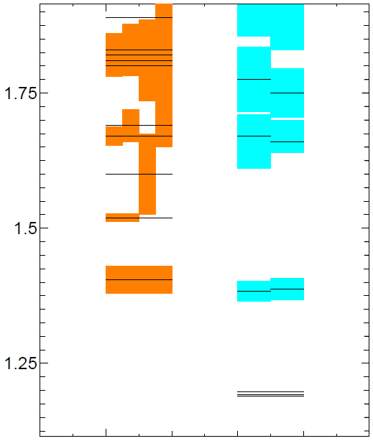
Baryon Spectra upto ~1 GeV Excitation Energy
(GeV/c²)
(GeV/c²)
Κ∗Ν
Λ_{c}(2940) ??
Σ(1775) 5/2⁻
D*N
2.9
Σ_{c}(2800) ??
Λ(1690) 3/2⁻
Σ(1750) 1/2⁻
Λ_{c}(2880) 5/2⁺
Σ(1670) 3/2⁻
DN
Λ(1670) 1/2⁻
Σ(1660) 1/2⁺
Λ(1600) 1/2⁺
2.7
Λ_{c}(2625) 3/2⁻
Λ(1520) 3/2⁻
2.6
ΚΝ
πΣ_{c}
Λ_{c}(2595) 1/2⁻
Σ_{c}(2520) 3/2⁺
Λ(1405) 1/2⁻
Σ(1385) 3/2⁺
Σ_{c}(2455) 1/2⁺
πΣ
πΛ_{c}
πΛ
2.4
Λ_{c} 1/2⁺
Λ 1/2⁺
Σ 1/2⁺
2.3
Difference and Similarity in s- and c-sector are of interest
Notes:
This flash again the baryon spectra in charm section together w strange sector.
Chiral partner appear at EX~500 MeV. It is interesting where chiral partner apears in c-sector.
Baryon near particle threshold is intersting, as is the case of L(1405).

Slide 33
Estimation of cross sections
Experiment
  σ(πp→D*Λ_{c})<7 nb at p_{π}=13 GeV/c [BNL, ’85]
  σ(πN→J/ψX)=(3±0.6) nb at p_{π}=22 GeV/c [BNL, ’79]
  σ(γp→Λ_{c}D^{bar}X)= (44±7⁺¹¹₋₈) nb at E_{γ}=20 GeV [SLAC, ’86]
Theory
  Regge Model
    Production rate of charm relative to strangeness
  t-channel D* exchange model
    The model independent ratio of the production cross section
Notes:
Experimental data is little available. But which indicates the signal level of a few nb.
We have discussed with theorists intensively on this matter.
Ordinary t-channel PS meson exchange model suggests that the D*Lc production cross section is reduced a order of 2 to 3 compared with the K*L production cross section.
We also discussed if the pQCD calculates the cross section.
However, it is quite difficult to make an reliable estimation at this moment because non-perturbatie effect are sizable at small t.
Therefore, we concluded the regge model is relatively reliable, which well describes the high-energy binary reaction.
Particularly, the model reproduces the typical s dependence of sigma and
Forward peaking pattern of the differential CS.

Slide 34
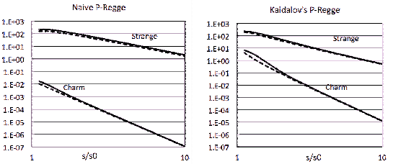
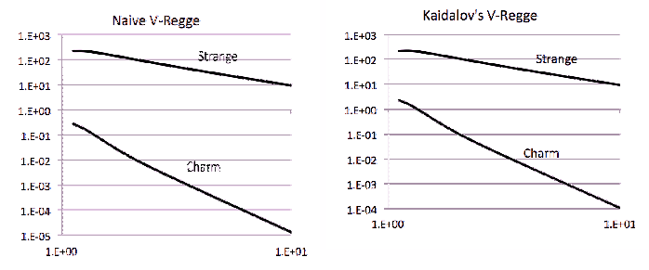
Regge Theory
calculated by A. Hosaka
PS(K,D)-Regge (Top): s/c-prod: ~10⁻⁵(Naïve), ~3x10⁻⁵(Kaidalov)
V(K*,D*)-Regge (Bottom): s/c-prod.: ~10⁻⁴(Naïve), ~3x10⁻⁵(Kaidalov)
Scale Parameter
 | s₀ (GeV²)
Naïve K*Λ K*Λ_{c} | 4.02 18.46
Kaidalov K*Λ K*Λ_{c} | 1.66 4.75
σ (arb.)
p_{π}=20 GeV/c
p_{π}=20 GeV/c
s/s₀
s/s₀
Regge Trajectory
σ (arb.)
 | α(0) | γ | T^{1/2} (GeV)
K | -0.151 | 3.65 | 2.96
D | -1.611 | 3.65 | 4.16
K* | -0.414 | 3.65 | 2.58
D* | -1.020 | 3.65 | 3.91
p_{π}=20 GeV/c
p_{π}=20 GeV/c
s/s₀
s/s₀

Slide 35
Production Rate
π
D*
“D*”
u
c
“ud”
“ud”
Y_{c}
p
t-channel D* EX
at a forward angle
quark-diquark picture

Slide 36
The production rates depend on the spin/isospin configurations of baryons.
π
D*
“D*”
u
c
“ud”
“ud”
Y_{c}
p
t-channel D* EX
at a forward angle
quark-diquark picture
u
c
J=L+S
L
ud
S=s_{c}+s_{qq}
qq
Notes:
Then, we can extract the spin/isospin configuration of the charmed baryons from the production rate.

Slide 37
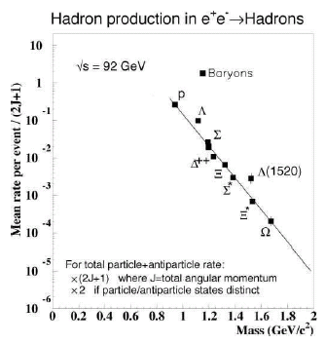
The production rates provide
p_{π}=20 GeV/c | Mass (GeV/c) | γ | C | Q_{eff} (GeV/c) | R (Relative)
Λ_{c}^{1/2+} | 2286 | 1/2 | 1 | 1.33 | 1
Σ_{c}^{1/2+} | 2455 | 1/6 | 1/9 | 1.43 | 0.03
Σ_{c}^{3/2+} | 2520 | 1/6 | 8/9 | 1.44 | 0.20
Λ_{c}^{1/2-} | 2595 | 1/2 | 1/3 | 1.37 | 1.17
Λ_{c}^{3/2-} | 2625 | 1/2 | 2/3 | 1.38 | 2.26
Σ_{c}^{1/2-} | 2750 | 1/6 | 1/27 | 1.49 | 0.03
Σ_{c}^{3/2-} | 2820 | 1/6 | 2/27 | 1.50 | 0.06
Σ_{c}^{1/2- ’} | 2750 | 1/6 | 2/27 | 1.49 | 0.07
Σ_{c}^{3/2- ’} | 2820 | 1/6 | 56/135 | 1.50 | 0.33
Σ_{c}^{5/2- ’} | 2820 | 1/6 | 2/5 | 1.50 | 0.31
Λ_{c}^{3/2+} | 2940 | 1/2 | 2/5 | 1.42 | 0.85
Λ_{c}^{5/2+} | 2880 | 1/2 | 3/5 | 1.41 | 1.55
L=0
L=1
No reduction at higher L states,
depending on spin/isospin configuration of Quark-Diquark in Y_{c}.
L=2
Calculated by A. Hosaka

Slide 38
Charmed Baryon Spectroscopy
Using Missing Mass Techniques
Inclusive p(π⁻,D*⁻) Y_{c}*⁺
σ~a few nb?
Signal
(Target)
p(π)
p(π⁻,D*⁻x)
Y_{c}^{*+}
D⁰(Y_{c}’)
K⁺
Possible
Fake “D*⁻” events
π
R
π⁻
BG
π⁻
p
π⁺
BG estimation
σ~3.4 mb
X
Notes:
Then we proposed charmed baryon spectroscopy by using the missing mass techniques.
We will measure the level structure of the excited charmed baryons and the production rate in the inclusive (pi-,D*-) spectrum.
Decay productions will be also measured to assist the missing mass spectroscopy.
In reality, there two main issues:
One is How large the CS is
And
The other is how large the BG is and how to reduce the BG.

Slide 39
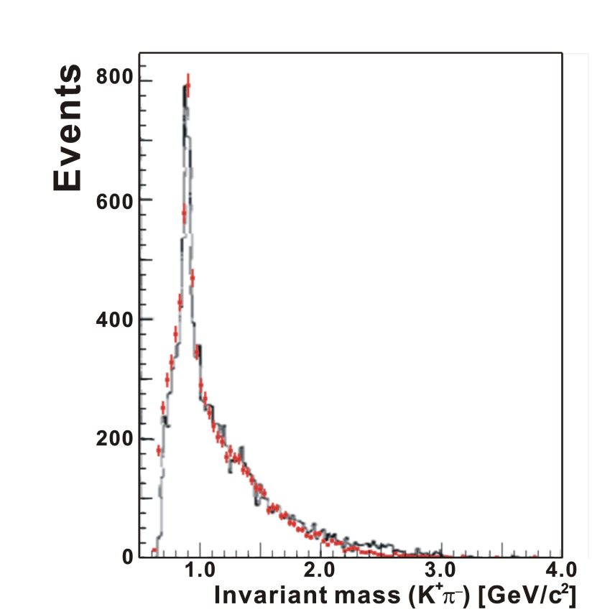
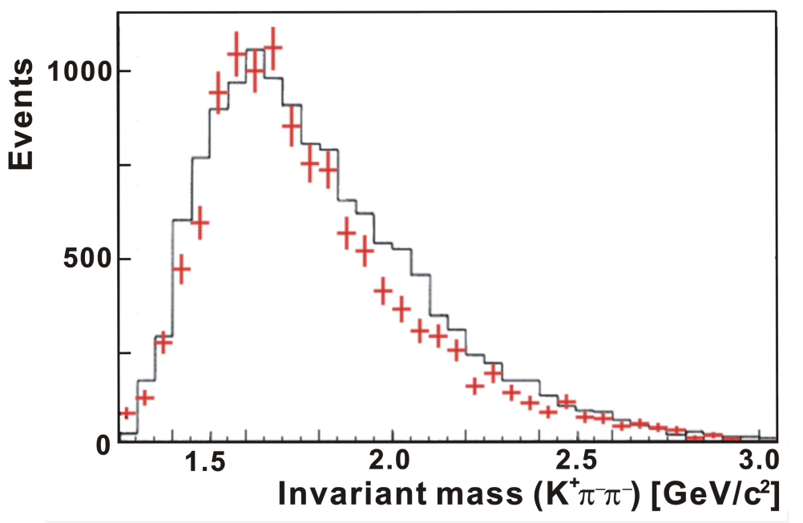
BG simulation by JAM
CERN, 19 GeV/c Data
BNL, 13 GeV/c Data
+ JAM
− Data
D*
+ JAM
− Data
D⁰
M(K⁺π⁻π⁻) [GeV/c²]
BGs of the past exp’s were well reproduced.
* Smooth BG shapes are seen in the D*/D mass region.
Notes:
Our simulation reproduced the past experimental data at BNL and CERN
Taking detector acceptances into account.
Not only the shape but also the absolute strength within 30 % or so.
Bump around D*? We cannot say it is a signal…
Within the exp. resolution (2 bins), it seems ~20 nb, which is consistent with reported upper limit.
Improving the background reduction, as shown next, we can easily observe peaks if the signal level is as it is…

Slide 40
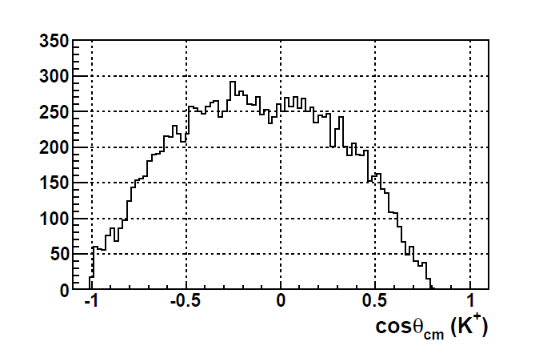
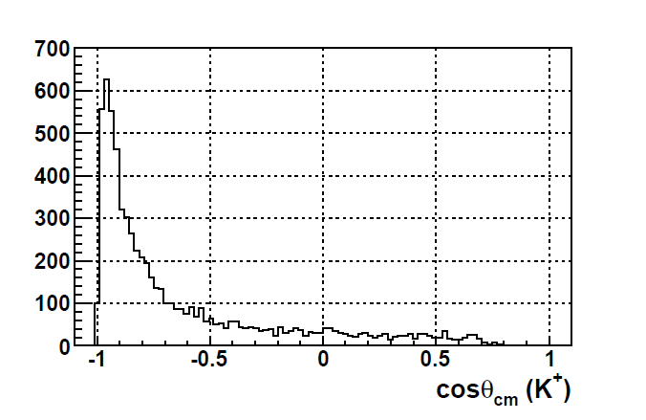
Background reduction
S/N improvement:
  Mass resolution: x4
  Decay angle cut: x2
  Production angle cut x4 (depends on dσ/dt)
Signal
Background
p_{K}
K⁺
p_{K}
K⁺
“True D⁰”
mass
“Fake D⁰”
mass
π⁻
p_{π}
p_{π}
π⁻
K⁺ scattering angle in CM
K⁺ scattering angle in CM
Acceptance
= 0.58
Reduction
= 3.8
Signal
Simulation
w/ acceptance
JAM
Simulation
w/ acceptance
Notes:
We have improved the S/N by mass reconstruction resolution by a factor 4.
In true events, K,pi is much ligher than D0, both K/pi are energetic.
As a result, both K/pi momenta are balanced.
In this case, the CM angle of one particle is rather isotropic.
On the other hand, in fake events, K pi may originally come from ligher particles.
To make heavier mass, one of the two particles are tend to be energetic.
In this case, the slower particle seems to be emitted backwards in the CM system.

Slide 41
Considered BG for BG reduction
Main background
  Strangeness production including the (K⁺, π⁻, π_{s}⁻) final state
Wrong particle identification
  Dominant cases: (π⁺, π⁻, π_{s}⁻), (p, π⁻, π_{s}⁻)
    PID miss-identification of π/p as K⁺: ~3%
    Productions of π and p are ~10 times higher than K.
  Contribution of other combinations are negligible.
    (K⁺, K⁻, π_{s}⁻), (K⁺, π⁻, Κ_{s}⁻), (π⁺, K⁻, π_{s}⁻), (p, K⁻, π_{s}⁻), …
  Semi-leptonic decay channels: (K⁺, μ⁻, π_{s}⁻) (K⁺, e⁻, π_{s}⁻)
    D⁰ mass cannot be reconstructed.
Associated charm production: Including D*⁻
  D** production: D**^{0, −}→D*⁻ + π^{+,0}
  D^{0,+} + D*⁻, D*^{0,+} + D*⁻ pair production
  Hidden charm meson (J/ψ, ψ, χ_{c}) production: Decay to D*⁻
3.4 mb
JAM (PRC61 (2000) 024901）
26 mb
Very Small and No peak structure：shoulder at ~2.45 GeV/c²

Slide 42
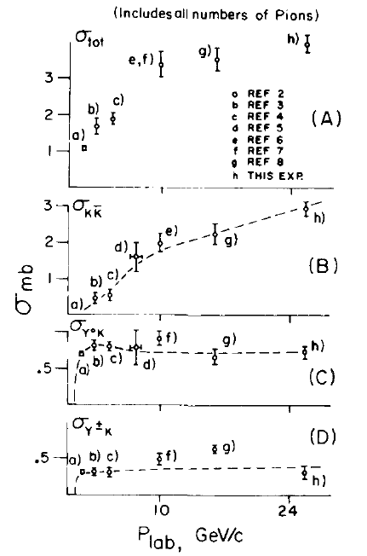
Main background
All events including K⁺, π⁻, π⁻
  ＊Less information from old experiments
  σ _{Total} of π⁻ p @ 16 GeV/c : 25.7 mb
  ⇔ Strangeness production: 3.4 mb
⇒ A few mb
  More than 10⁶ times
  higher than Y_{c}* signals (1 nb)
Background source
  K*⁰(→K^{+,} π⁻) + π⁻
  KK_{bar} (K*K*_{bar}) production + π⁻
  Y K⁺ + π⁻
  Non-resonant multi-meson production
  ＊No special channel contributes to background
Background generation Y. Nara et.al. Phys. Rev. C61 (2000) 024901
  JAM (Jet AA Microscopic transport model)
    Use K⁺ and π⁻ distribution from π⁻ p reaction at 20 GeV/c
      σ = 2.4 mb for (K⁺, π⁻, π⁻)
    ss_{bar} production multiplicity: ~1 (2 K⁺event: ~3%)
Strangeness production C.S.
π⁻ p reaction
@ 16 GeV/c
J. W. Waters et al, NPB17 (1970) 445

Slide 43
String model for JAM
String model region in JAM: 4 GeV <√s < 10 GeV (~6.2 GeV for 20 GeV/c)
String production by hadron-hadron collision
  String(hadron) + String(hadron)→st(qq_{bar}) + st(qqq) + st(qq_{bar}) + …
String collision
  Not considered: Hadronization at first ⇒ Hadron-hadron collisions
  Color flux between strings was not also considered.
Hadronization model: Lund model
qqbar production rate: uu_{bar}: dd_{bar} : ss_{bar}: cc_{bar} = 1 : 1 : 0.3 : 10⁻¹¹
Input of production rate not obeyed to the spin (³S₁, ¹S₀) statistics
  ρ/(π+ρ) = 0.5, K*/(K+K*)=0.6, D*/(D+D*)=0.75
＊Almost same as of PYTHIA
Difference from PYTHIA
  String collision: Used simplified input model
  Hadronization process: Input parameters of resonances are different.
  Hard process
⇒To be checked by experimental data

Slide 44
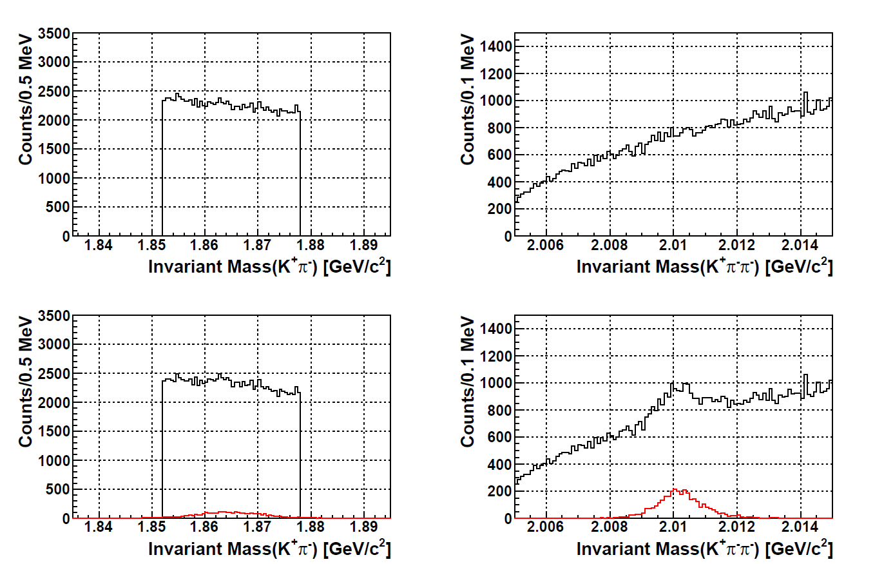
D⁰, D*⁻ spectrum
BG only
BG only
BG + Signal
BG + Signal
1/7 event, 12 nb in total: ~ 3200 events
D⁰ cutでD*⁻のpeakが確認できる

Slide 45
Decay measurement
Internal tracker
Magnet pole
Beam
Beam
Target
Target
Magnet pole
Surrounding TOF wall
Pole PAD TOF wall
Method: Mainly Forward scattering due Lorentz boost (θ < 40°)
  Horizontal direction: Internal tracker and Surrounding TOF wall
  Vertical direction: Internal tracker and Pole PAD TOF detector
Mass resolution: ~ 10 MeV(rms)
  Only internal detector tracking at the target downstream
PID requirement: TOF time difference (π & K) ⇒ ΔT > 500 ps
  Decay particle has slow momentum: < 1.0 GeV/c

Slide 46
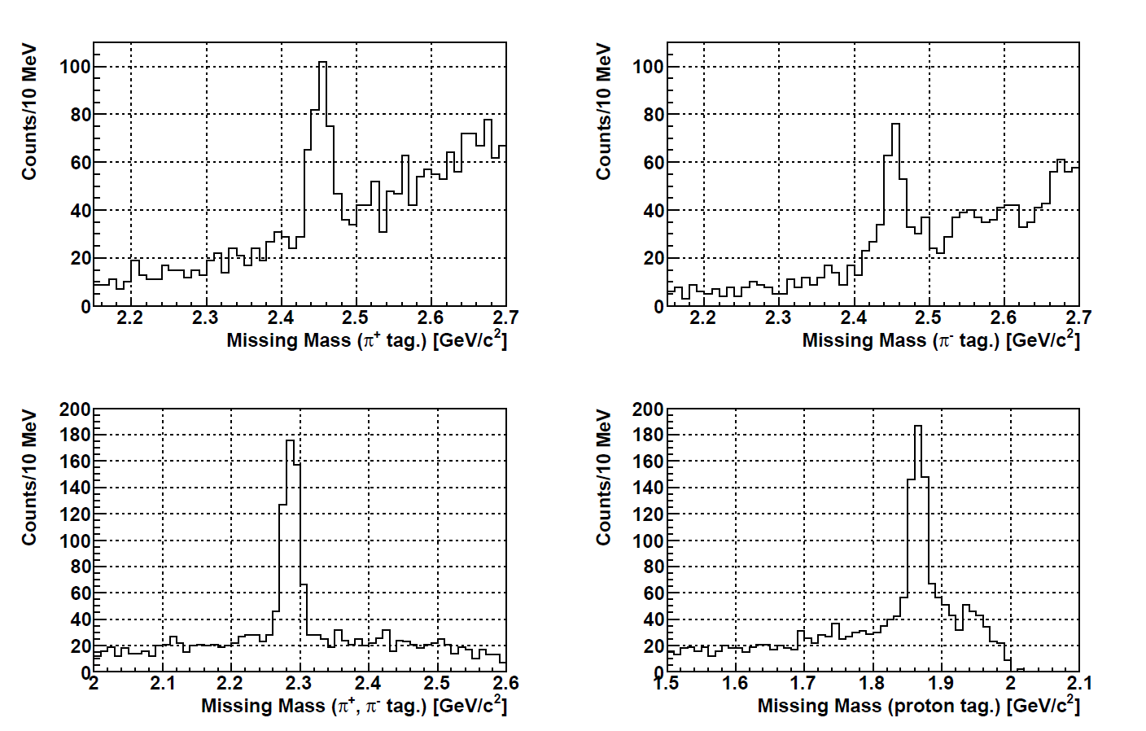
Decay missing mass spectrum: SUM
Σ_{c}⁰ π⁺
Σ_{c}⁺⁺ π⁻
Σ_{c}⁰
Σ_{c}⁺⁺
Λ_{c}⁺ π⁺ π⁻
p D⁰
D⁰
Λ_{c}⁺
＊Full event w/ background/ No “Λ_{c}⁺ π⁺ π⁻ gated”
Continuum background shape around Σ_{c} mass region
Background events from Λ_{c} were the same as of (K⁺π⁻π⁻)
Better S/N of π⁻ tag. event than π⁺ tag.

Slide 47
Study condition
Assumed decay mode for Λ_{c}*⁺(J^{P} = 3/2⁺, M = 2.94 GeV/c²)
  N + D: Γ = 0.4 ⇒ p D⁰: 0.2, n D⁺ :0.2
  Σ_{c} + π: Γ = 0.4 ⇒ Σ_{c}⁺⁺ π⁻: 0.4/3, Σ_{c}⁺ π⁰: 0.4/3, Σ_{c}⁰ π⁺: 0.4/3
    Decay to Σ_{c}(2455) assumed
  Λ_{c} + π + π: Γ = 0.2 ⇒ Λ_{c}⁺ π⁺ π⁻: 0.1, Λ_{c}⁺ π⁰ π⁰: 0.1
Yield estimation @ 1 nb case (~1900 counts)
  p D⁰: 0.2 ⇒ 1900×0.2×0.8 = ~300
  Σ_{c}^{++,0} π^{−,+}: 0.4/3 ⇒ 1900×0.4/3×0.8 = ~200
    Forward scattering of protons
    Wider scattering angle of pions
    Combined with 4-body D⁰ decay mode: 3 times larger yield
      D⁰→K⁺ π⁻ (B.R.= 3.88%, acceptance = ~60%)
      + D⁰→ K⁺ π⁻ π⁺ π⁻ (B.R.= 8.07%, acceptance=~50%)
      Background level of 4-body case is larger. But, it can be combined.

Slide 48
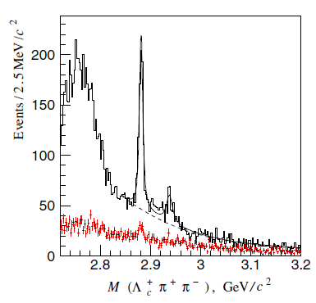
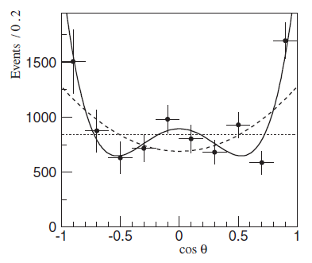
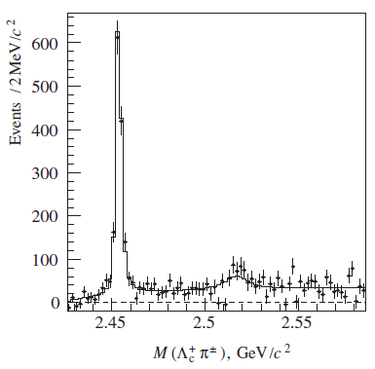
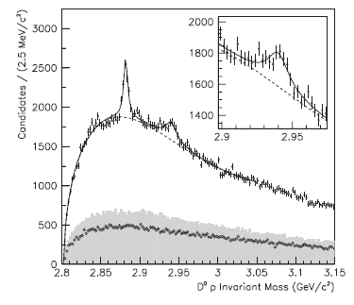
Λ_{c}(2765)?
Λ_{c}(2880)
Λ_{c}(2880)->πΣ_{c}(2455)
Lc(2880)Belle,
PRL98, 262001(’07)
Λ_{c}(2940)
Λ_{c}(2880)->pD⁰
Σ_{c}(2455)
(Λ_{c}(2880)->πΣ_{c}(2455))
Λ_{c}(2940)->pD⁰
(Λ_{c}(2880)->πΣ_{c}(2520))
Σ_{c}(2520)
Babar, PRL98, 012001(’07)

Slide 49
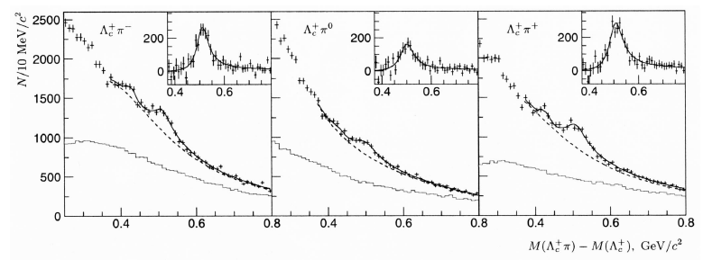
Σ_{c} (2800) -> Λ_{c} + π
Σ_{c}⁰
Σ_{c}⁺
Σ_{c}⁺⁺
注）0.4GeV付近のピークはΛ_{c} (2880) -> Λ_{c}ππの影響
Belle, PRL94, 122002(’05)

