Slide 1
Overview of the Jiangmen Underground Neutrino Observatory (JUNO)
Yu-Feng Li
Institute of High Energy Physics
2013-9-5
PIC 2013 (Beijing)

Slide 2
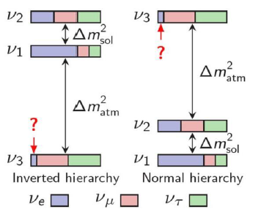
1. Introduction
After the discovery of non-zero theta(13), the neutrino mass hierarchy (MH) and lepton CP violation (CPV) are the central concerns in neutrino oscillation experiments.
The neutrino MH can in principle be determined in the oscillations of accelerator neutrinos, reactor neutrinos and atmospheric neutrinos.
JUNO, short for Jiangmen Underground Neutrino Observatory, is designed to determine the neutrino MH using reactor neutrino oscillations.

Slide 3
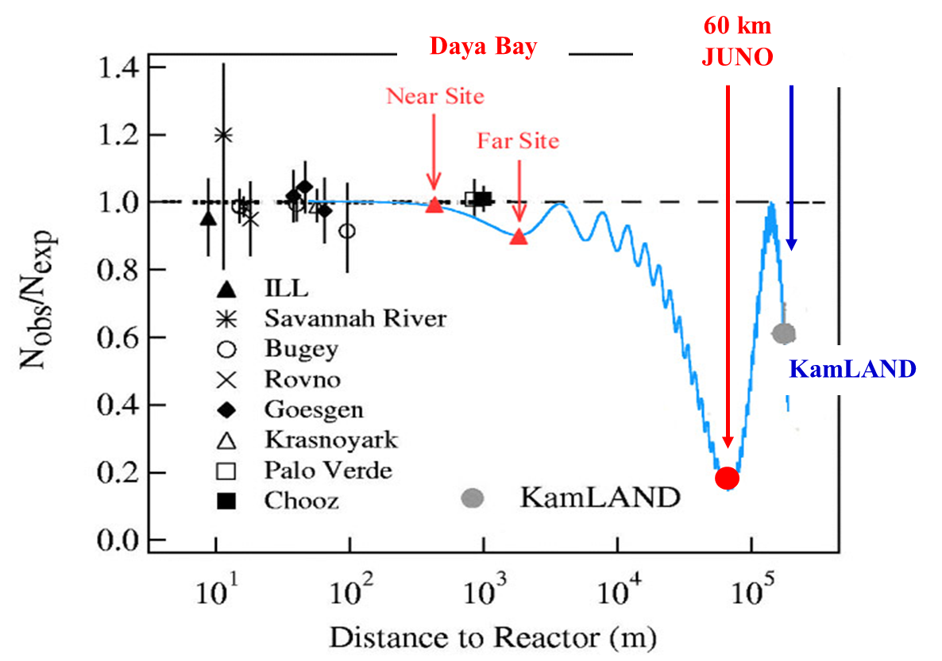
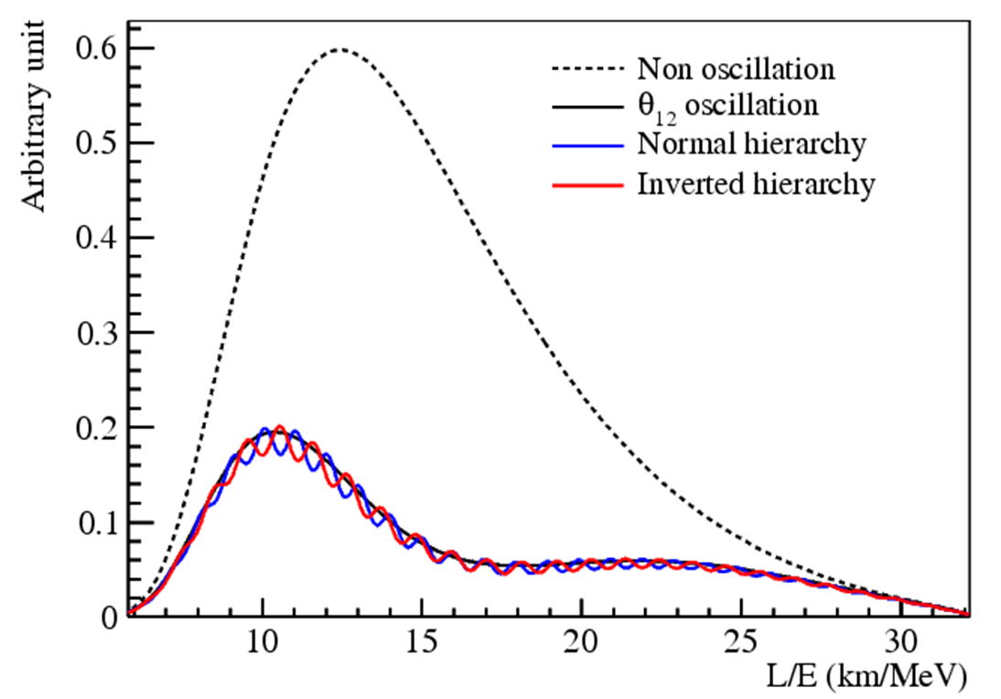
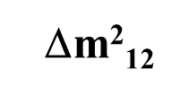
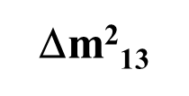
2. Baseline
The optimum baseline is required to be at the oscillation maximum of , where the fine structure of oscillations is used to determine the MH.

Slide 4
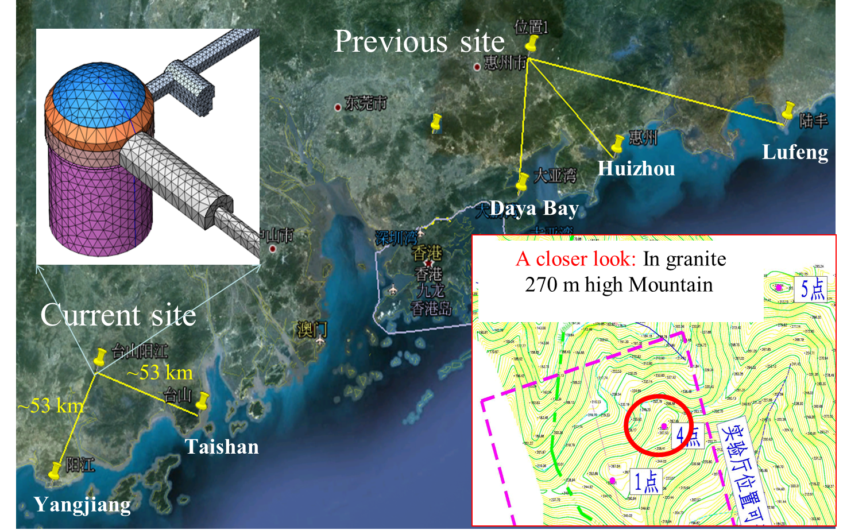
3. Experiment Site
Interference effects due to baseline differences are crucial.
Baseline difference from reactor cores should be < 500 m.
the current site is better than the previous one.
Kaiping, Jiangmen

Slide 5
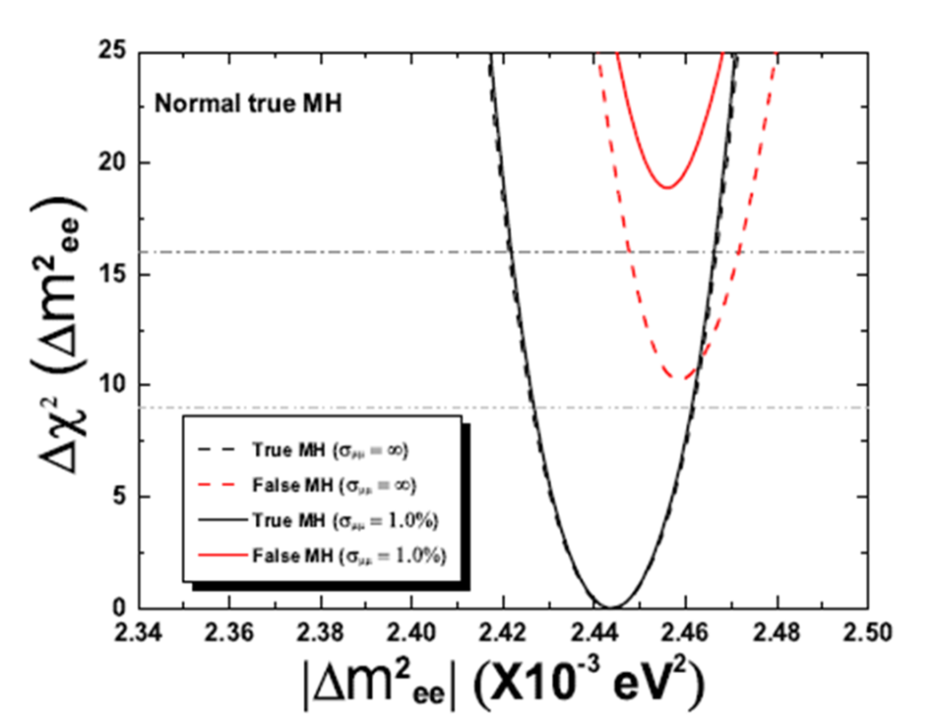
4. Physics Potential
Nominal setups:
20 kton Liquid Scintillator (LS) detector
3% energy resolution
52-53 km baselines
36 GW and 6 years
MH sensitivity for JUNO:
3σ (Δχ²>10) with the relative measurement,
4σ including the absolute Δm² measurement,
the spread of reactor cores,
reactor neutrino flux,
energy scale and non-linearity
Other physics:
Precision measurement (<1%)
Supernova neutrinos
Solar neutrinos
Geo-neutrinos etc.

Slide 6
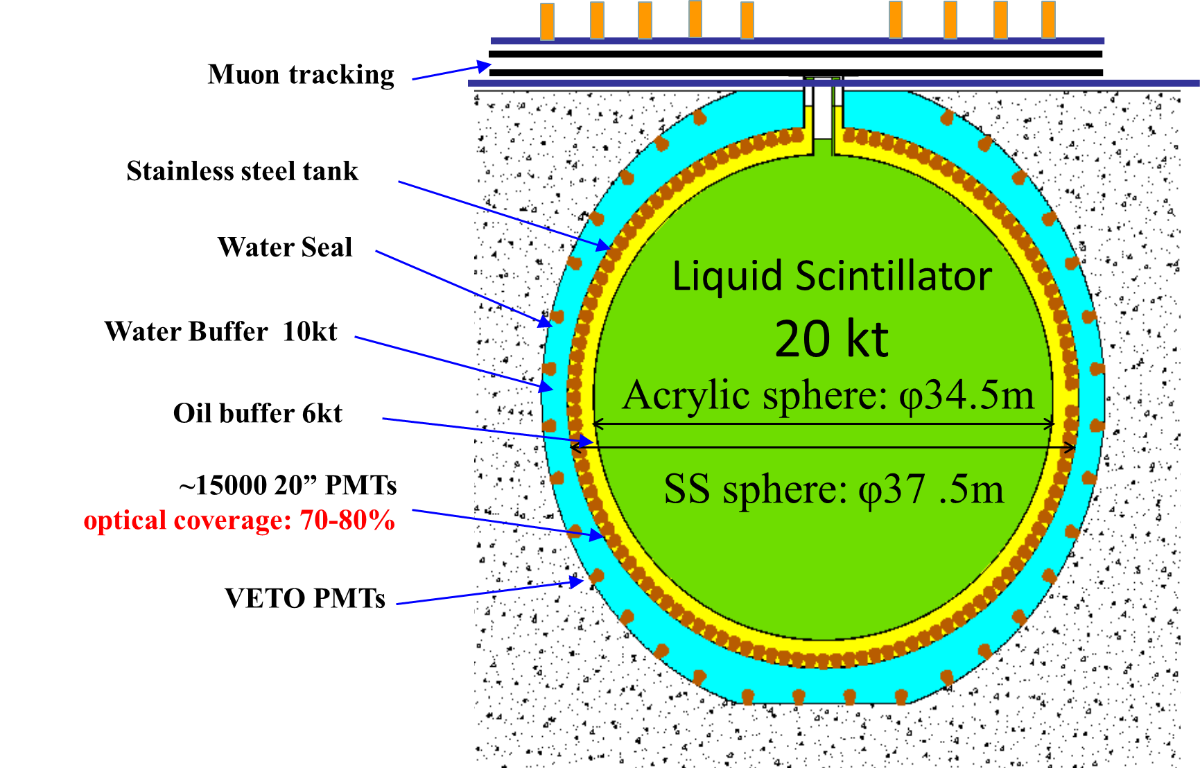
5. Detector Concept
Other options:
a)No steel tank
b)Acrylic box
c)Balloon
d)Steel tank only
It is extremely difficult to build both the stainless steel tank and the acrylic tank.
R&D are still ongoing for all these options.

Slide 7
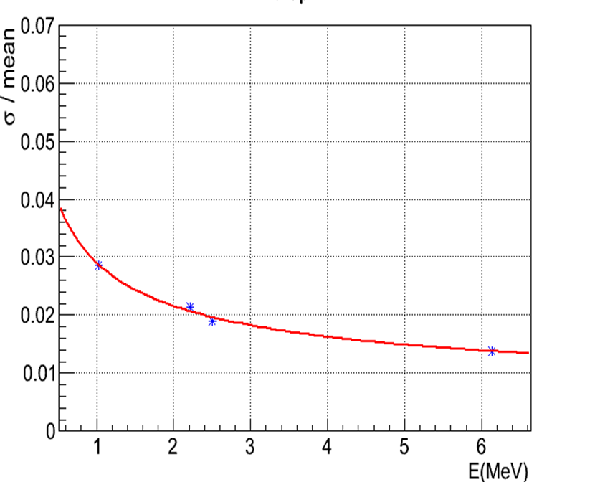
6. Technical Challenges
Requirements:
Large detector: 20 kt LS
Energy resolution:
3%/√E → 1200p.e./MeV
Ongoing R&D:
Low cost, high QE “PMT”
Highly transparent LS: 15m → 30m
More Photoelectrons – PMT:
(a) High QE photocathode
(b) MCP PMT with reflection photocathode
(c) More coverage
More Photoelectrons – LS:
(d) Longer attenuation length (purification, e.g., Al₂O₃)
(e) Higher light yield

Slide 8
7. Project Status

Slide 9
8. Conclusion
(1)JUNO is designed to determine the neutrino MH and measure 4/6 of the oscillation parameters by using reactor neutrinos. It can also detect the neutrino sources from astrophysics and geophysics.
(2)The idea of JUNO was proposed in 2008, now boosted by the large theta(13). Funding is approved from CAS.
(3)JUNO has strong physics potential, meanwhile contains significant technical challenges.

Slide 10
Thanks

Slide 11
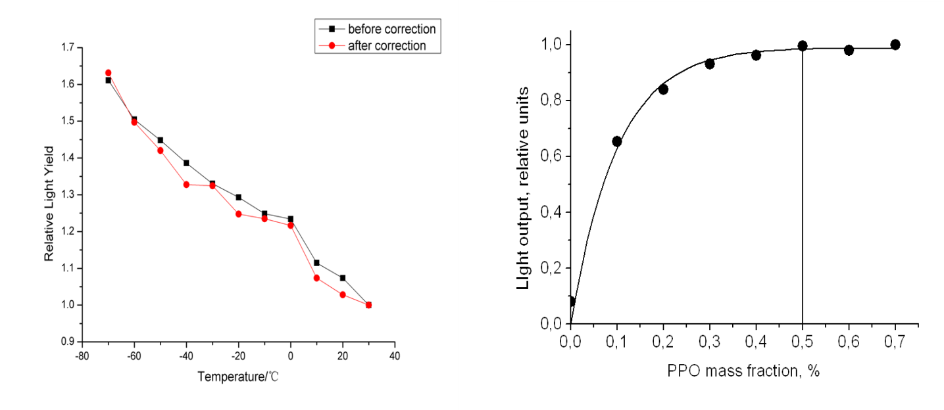
6. Technical Challenges (2)

