Slide 1


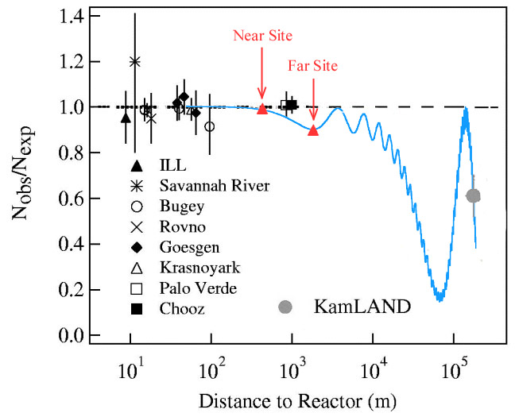
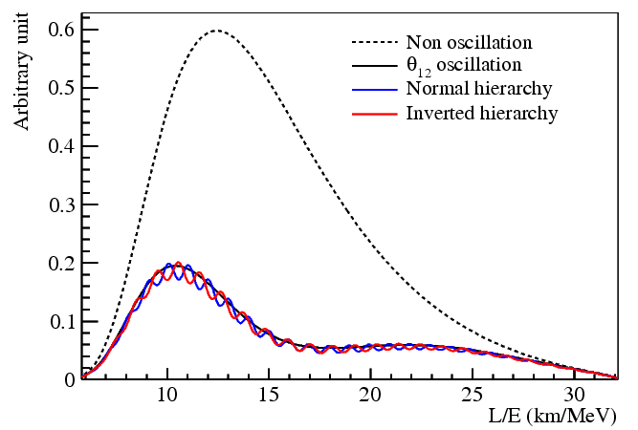
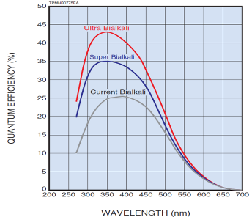
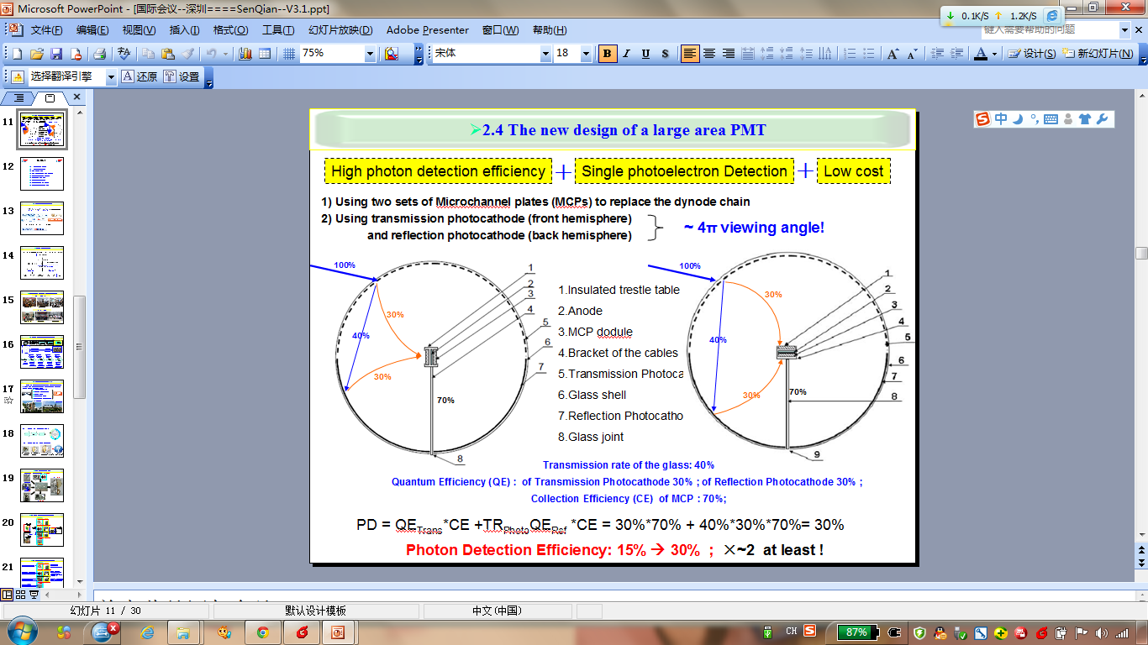
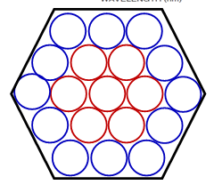
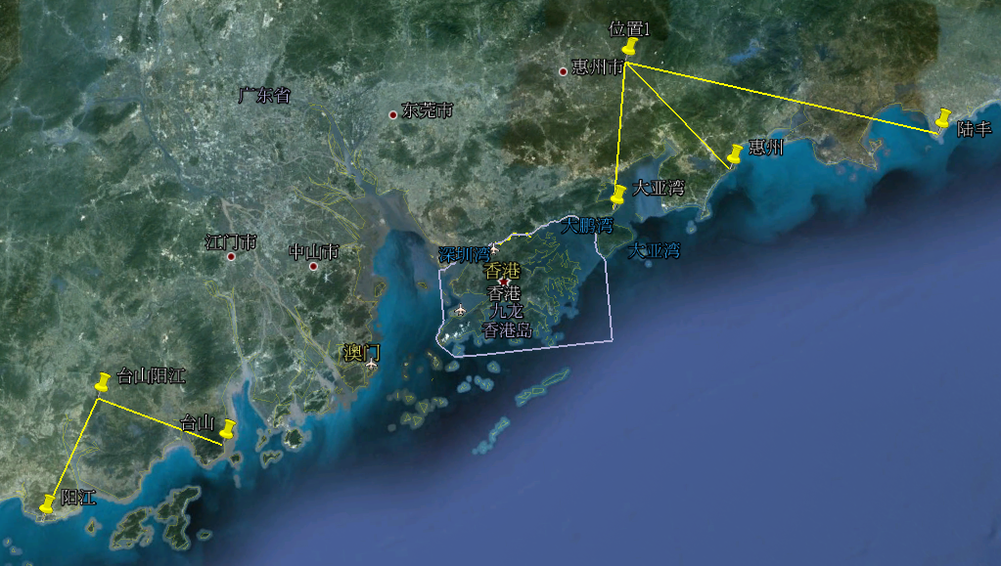

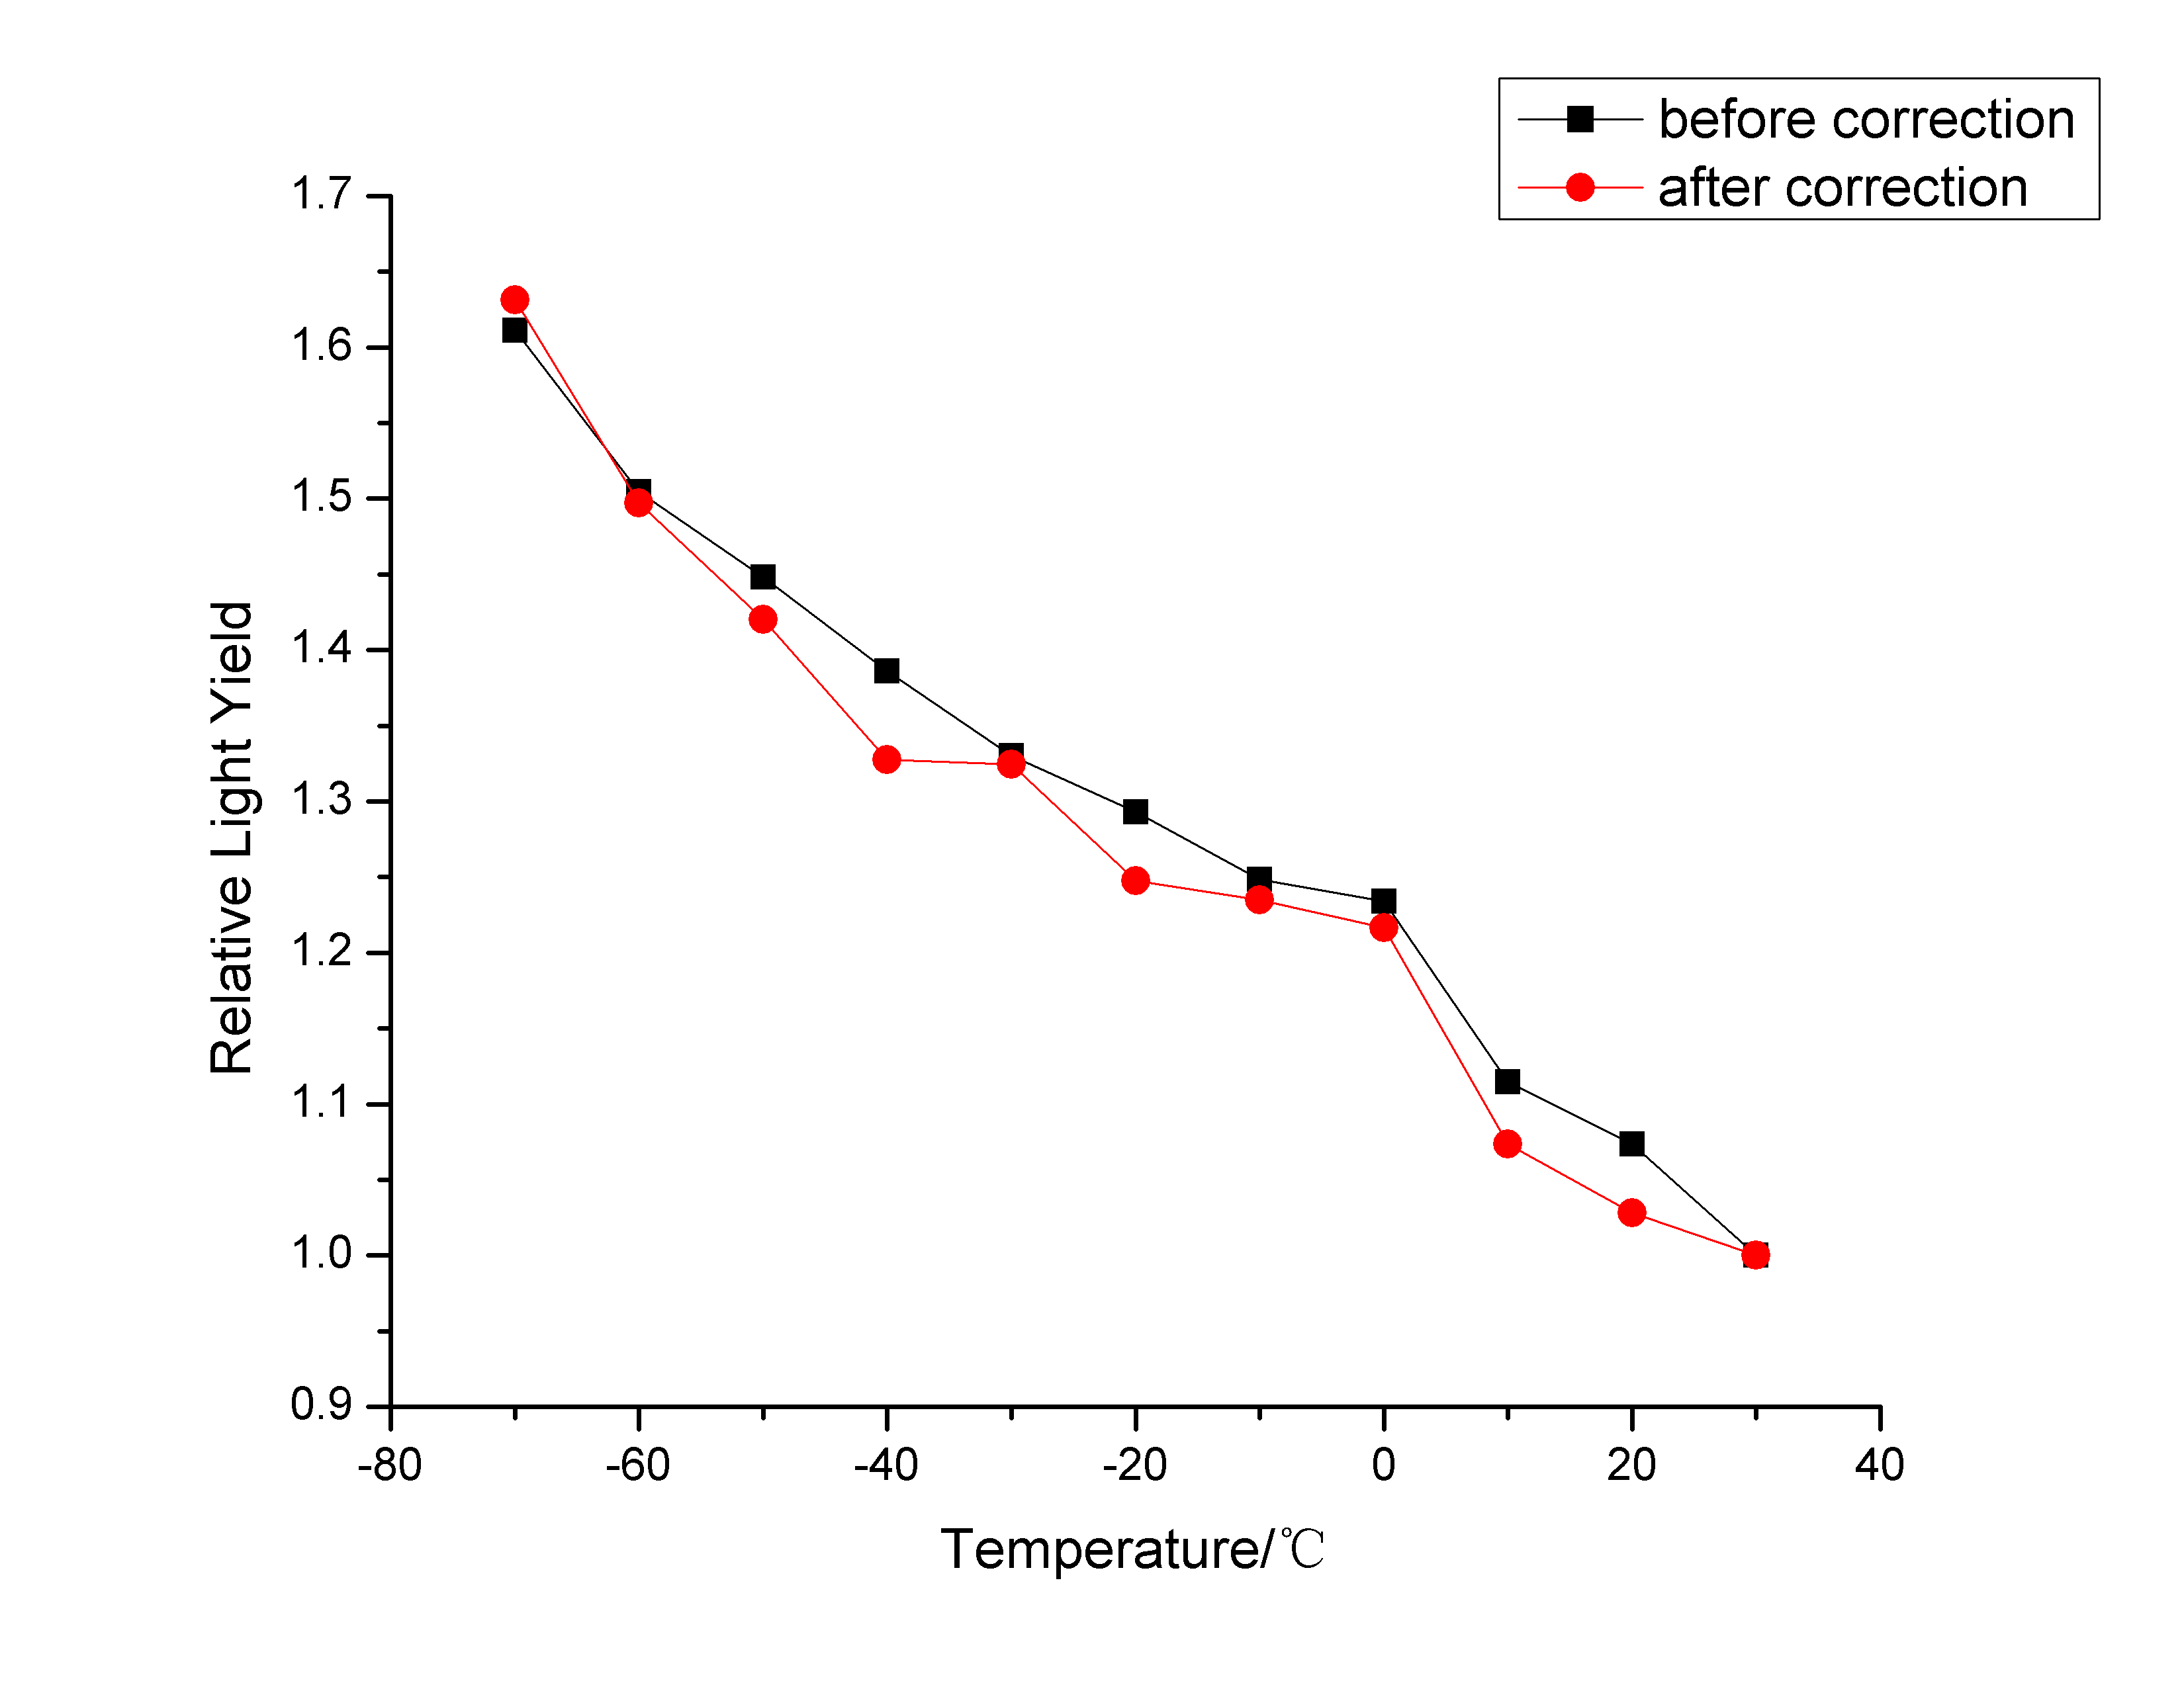
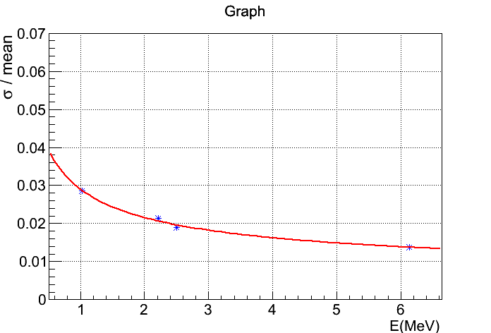
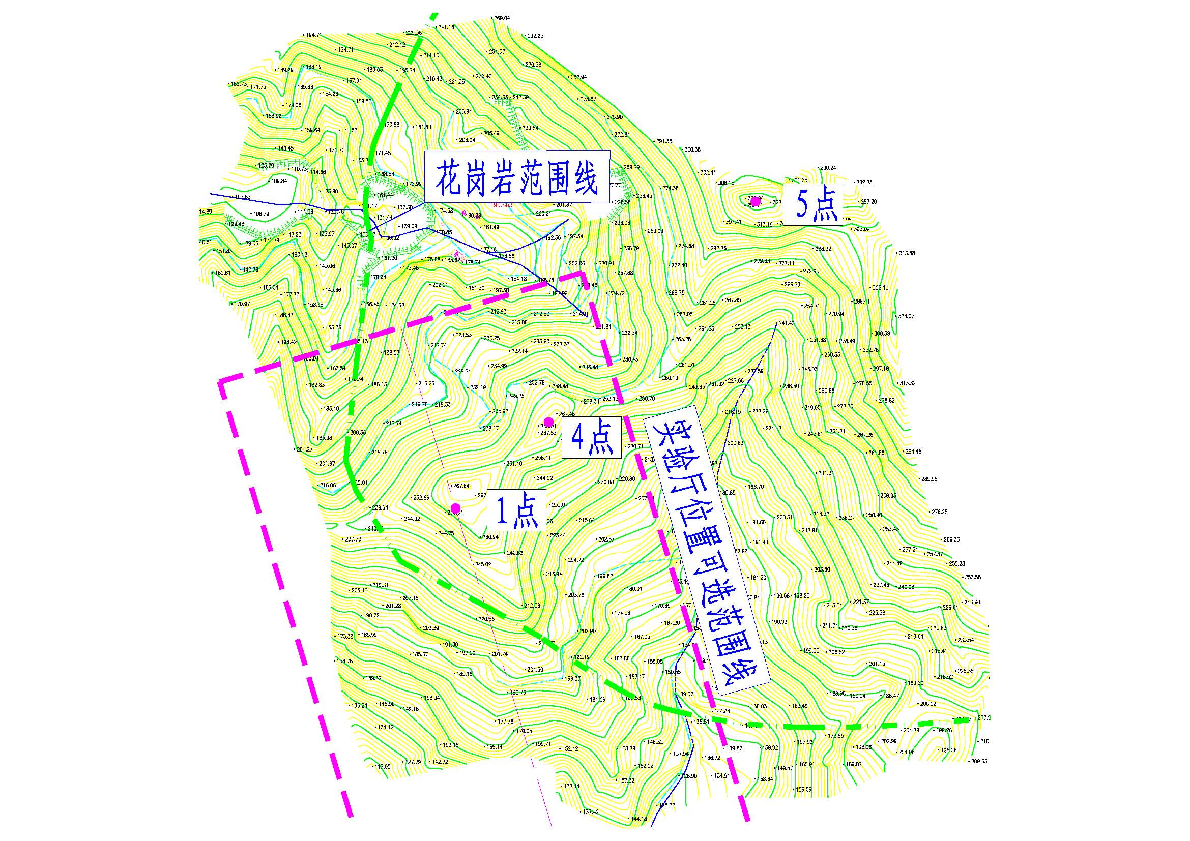
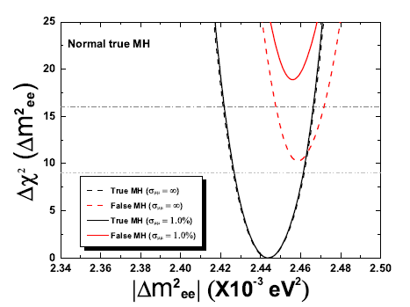
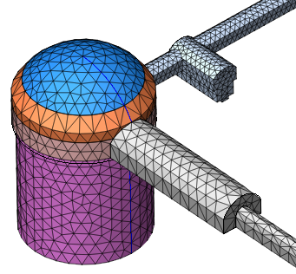
Overview of the Jiangmen Underground Neutrino Observatory (JUNO)
Yu-Feng Li (李玉峰)
Experiment Physics Center, Institute of High Energy Physics, Chinese Academy of Sciences,
YuQuan Road 19B, 100049, Beijing, P. R. China
Email: liyufeng@ihep.ac.cn
1. Introduction
5. Detector Concept (one option)
After the discovery [PRL 108, 171803 (2012)] of non-zero theta(13) in the Daya Bay Reactor Neutrino Experiment, the neutrino mass hierarchy (MH) and lepton CP violation (CPV) are the central concerns in neutrino oscillation experiments.
The neutrino MH is crucial for the measurements of CPV, the neutrinoless double beta decay and the supernova neutrinos. The neutrino MH is also fundamental to distinguish among different neutrino mass models.
The neutrino MH can in principle be determined in the oscillations of accelerator neutrinos, reactor neutrinos and atmospheric neutrinos.
The Jiangmen Underground Neutrino Observatory (JUNO), which is located at Kaiping, Jiangmen in South China, is designed to determine the neutrino MH using reactor neutrino oscillations [PRD 78, 111103 (2008)].
Muon tracking
It is extremely difficult to build both the stainless steel tank and the acrylic tank.
There are other options:
(a) No steel tank
(b) Acrylic box
(c) Balloon
(d) Steel tank only
R&D are still ongoing for these options.
Stainless steel tank
Water Seal
Liquid Scintillator
20 kt
Water Buffer 10kt
Acrylic sphere: φ34.5m
Oil buffer 6kt
SS sphere: φ37 .5m
~15000 20” PMTs
optical coverage: 70-80%
VETO PMTs
2. Baseline
6. Technical Challenges
Daya Bay
60 km
JUNO
Requirements:
Large detector: 20 kt LS
Energy resolution: 3%/√E → 1200p.e./MeV
Ongoing R&D:
Low cost, high QE “PMT”
Highly transparent LS: 15m → 30m
 | KamLAND | JUNO
LS mass | ~1 kt | 20 kt
Energy Resolution | 6%/√E | 3%/√E
Light yield | 250 p.e./MeV | 1200 p.e./MeV
More Photoelectrons – PMT:
High QE photocathode
MCP PMT with reflection photocathode
(c) More coverage
KamLAND
The optimum baseline is required to be at the oscillation maximum of ,
where the fine structure of oscillations is used to determine the MH.
Δm²₁₃
Δm²₁₂
3. Experiment Site
 | Daya Bay | Huizhou | Lufeng | Yangjiang | Taishan
Status | Operational | Planned | approved | Under construction | Under construction
Power | 17.4 GW | 17.4 GW | 17.4 GW | 17.4 GW | 18.4 GW
More Photoelectrons – LS:
(d) Longer attenuation length (purification, e.g., Al₂O₃)
(e) Higher light yield
(Low temperature or fluor concentration optimization)
Previous site
The interference oscillation effects due to baseline differences are crucial.
Baseline differences from reactor cores should be less than 500 m.
Therefore, the current site is better than the previous one [PRD 88, 013008 (2013)] .
Daya Bay
Huizhou
Lufeng
Current site
  A closer look: In granite
  270 m high Mountain
~53 km
~53 km
Taishan
Yangjiang
7. Project Status
4. Physics Potentials
Nominal setups:
20 kt liquid scintillator (LS) detector
3% energy resolution
52-53 km baselines
36 GW and 6 years
MH sensitivity with 6 years' data of JUNO [PRD 88, 013008 (2013)]：
3σ with relative measurement, 4σ with absolute Δm² measurement
(if accelerator neutrino experiments can measure Δm² to ~1% level),
after taking into account the spread of reactor cores, the uncertainties in reactor neutrino fluxes and from the energy scale and non-linearity.
Other physics:
Precision measurement
Supernova neutrinos
Solar neutrinos
  Geo-neutrinos etc.
(1) Funding
Great support from CAS: “Strategic Priority Research Program”
Approved on Feb.1, 2013
(2) Brief schedule
Construction: 2013-2019
Filling & data taking: 2020
(3) Collaboration
Two get-together meetings in Jan. and Jul. 2013
Next meeting in Jiangmen (experimental site), Jan. 2014.
Welcome collaborators
 | Current | JUNO
Δm²₁₂ | ~3% | ~0.6%
Δm²₂₃ | ~5% | ~0.6%
sin²θ₁₂ | ~6% | ~0.7%
sin²θ₂₃ | ~20% | N/A
sin²θ₁₃ | ~14%→ ~4% | ~ 15%
8. Conclusion
(1) JUNO is designed to determine the neutrino MH and measure 4/6 of the oscillation parameters by using reactor neutrinos. It can also detect the neutrino sources from astrophysics and geophysics.
(2) The idea of JUNO was proposed in 2008, now boosted by the large theta(13). Funding is approved from CAS.
(3) JUNO has strong physics potentials, meanwhile contains significant technical challenges.

