Slide 1
Muon g-2/EDM at J-PARC
Tsutomu Mibe (IPNS, KEK)
for the J-PARC g-2/EDM collaboration
NuFact 2013, August 20, 2013

Slide 2
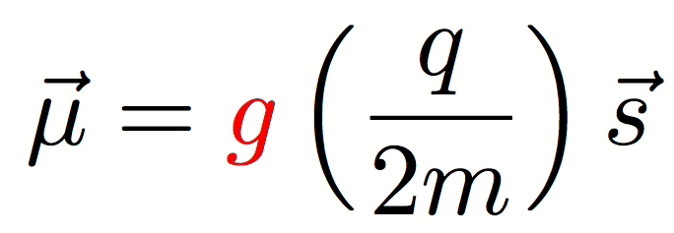
Lepton dipole moments
Interactions with static B and E-fields:
Magnetic Dipole Moment
Electric Dipole Moment
Transition Dipole Moments
cLFV process with photon radiation (e.g. μ→eγ )

Slide 3
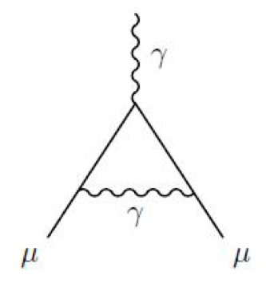
Anomalous magnetic moment
The Lande’s g factor is 2 in tree level (Dirac equation)
In quantum field theory, g factor gets corrections:
Anomalous magnetic moment
g = 2 ( 1 + a_{μ})

Slide 4
Anomalous magnetic moment
All interactions, including ones we don’t know,
appear in quantum loops, and add up to contribute a_{μ}

Slide 5
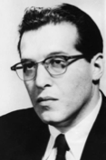
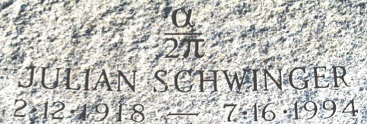
QED contributions to a_{μ}
Leading order correction
(Schwinger term,1948)
From Lepton Moments (World Scientific, 2010)
Julian Schwinger

Slide 6
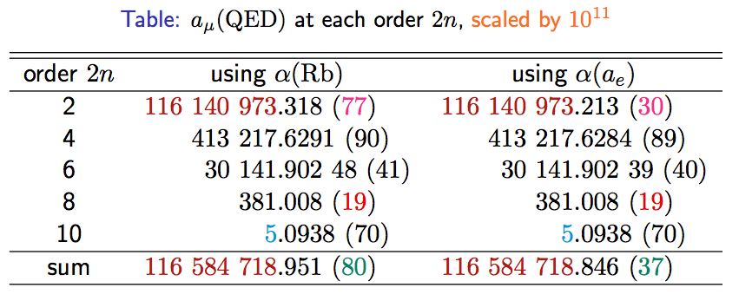
QED contributions to a_{μ} (cont.)
M. Hayakawa (tau2012)
NEW!

Slide 7
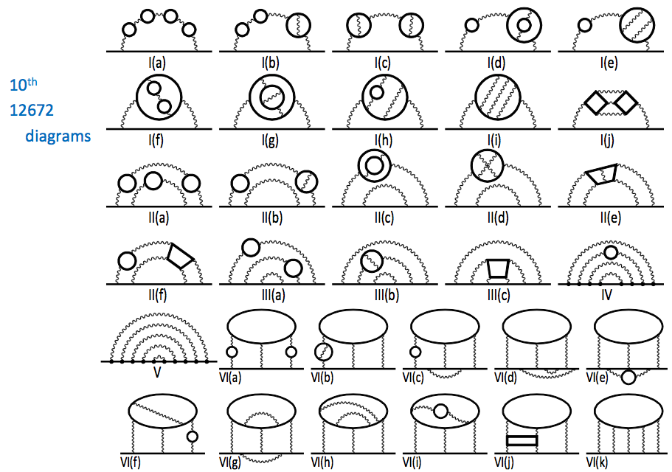
QED contributions to a_{μ} (cont.)
T. Aoyama, M. Hayakawa,
T. Kinoshita, M. Nio (PRL, 2012)

Slide 8
Prof. T. Kinoshita giving a lecture at KEK on 10th order QED corrections
S. Kanda (Ph.D student)
Prof. T. Kinoshita

Slide 9
Hadronic contributions to a_{μ}
An example of
Leading order
hadronic term
π⁻
π⁺
Theory requires inputs to photon-hadron coupling
Accurate data on
“e+e- →γ*→ hadrons” data (VEPP, BaBar, Belle, KLOE…)
has been used.

Slide 10
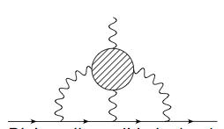
Hadronic contributions to a_{μ}
Lattice efforts making progress by Tom Blum et. al and other groups (UKQCD, ETMC, Mainz).
Lattice is especially important for evaluation of light-by-light term, which no measurement can be done.
Courtesy
Tom Blum

Slide 11
Electro-Weak contributions
Leading order
Electro-Weak loop
Relevant couplings have been accurately measured by the LEP experiments.
Contributions from Higgs-loop appears only in higher order.

Slide 12
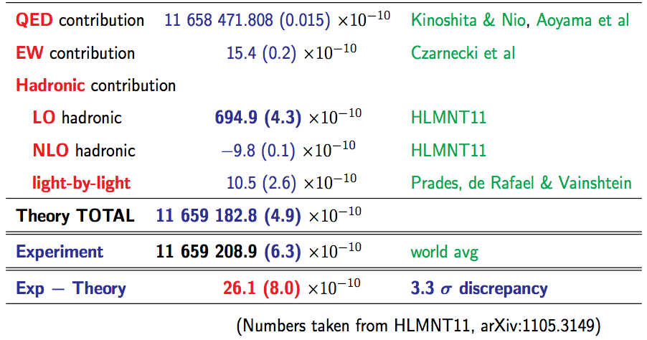
Standard Model prediction for a_{μ}
D. Nomura (tau2012)
in consistent with
DHMZ10
HLMNT11 : J.Phys.G38:085003,2011

Slide 13
Comparison with experiments
D. Nomura (tau2012)
in consistent with
DHMZ10
〜BNL E821 (0.5ppm)
HLMNT11 : J.Phys.G38:085003,2011

Slide 14
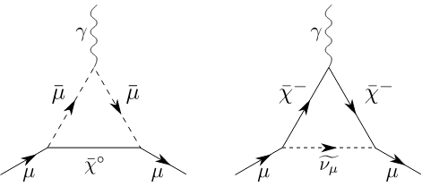
Beyond the standard model
Contributions from SUSY particles
Present uncertainty (exp + SM) : Δa_{μ} = 80 x 10⁻¹¹

Slide 15
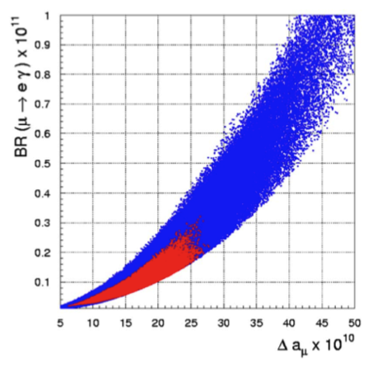
g-2, EDM and cLFV in SUSY
Large g-2 → Large cLFV
G. Isidori, F. Mescia, P. Paradisi, and D. Temes, PRD 75 (2007) 115019
Excluded by MEG
g-2 (BNL E821)
deviation from SM (g-2)

Slide 16
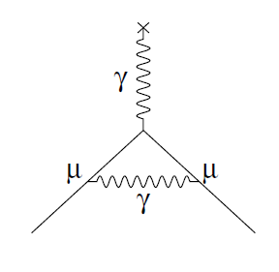
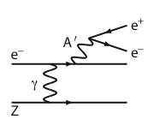
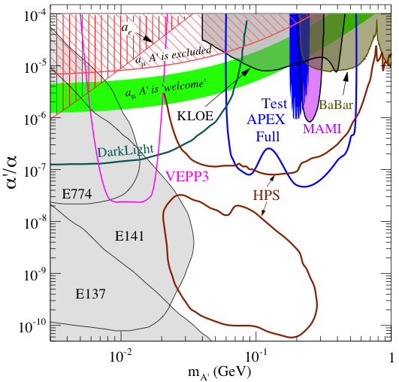
R.D. McKeown, NuFact2012
New Opportunity: Search for A’ at Jefferson Lab
BNL “g-2” expt: Δa_{μ}(expt-thy) = (295±88) x 10⁻¹¹ (3.4 σ)
No evidence for SUSY at LHC (yet)
Another solution: A’, a massive neutral vector boson
- also useful for dark matter models
3 Jefferson Lab proposals:
g – 2 preferred!
APEX test run (Hall A) – published
HPS test run (Hall B) – complete
DarkLight test run (FEL) – July 2012

Slide 17
Scales of CP-odd sources and EDM
Pospelov, Ritz
d_{τ}
d_{μ}
Lepton EDM directly proves CP-odd phases at TeV scale (and beyond?)

Slide 18
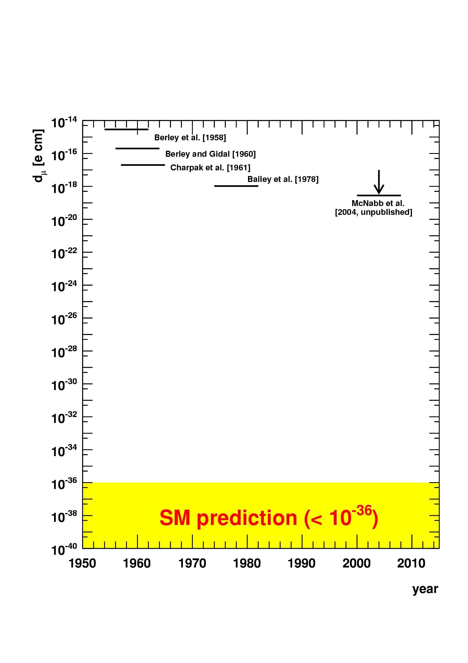
History of muon EDM searches
BNL [2008]
J-PARC
FNAL g-2
17 orders unexplored
target
sensitivity
electron EDM limit from YbF
scaled linearly by m_{μ} / m_{e}
Hudson et al. (Nature 2011) Kara et al. (NJP 14, 103051, 2012)
Is it worth the effort?

Slide 19
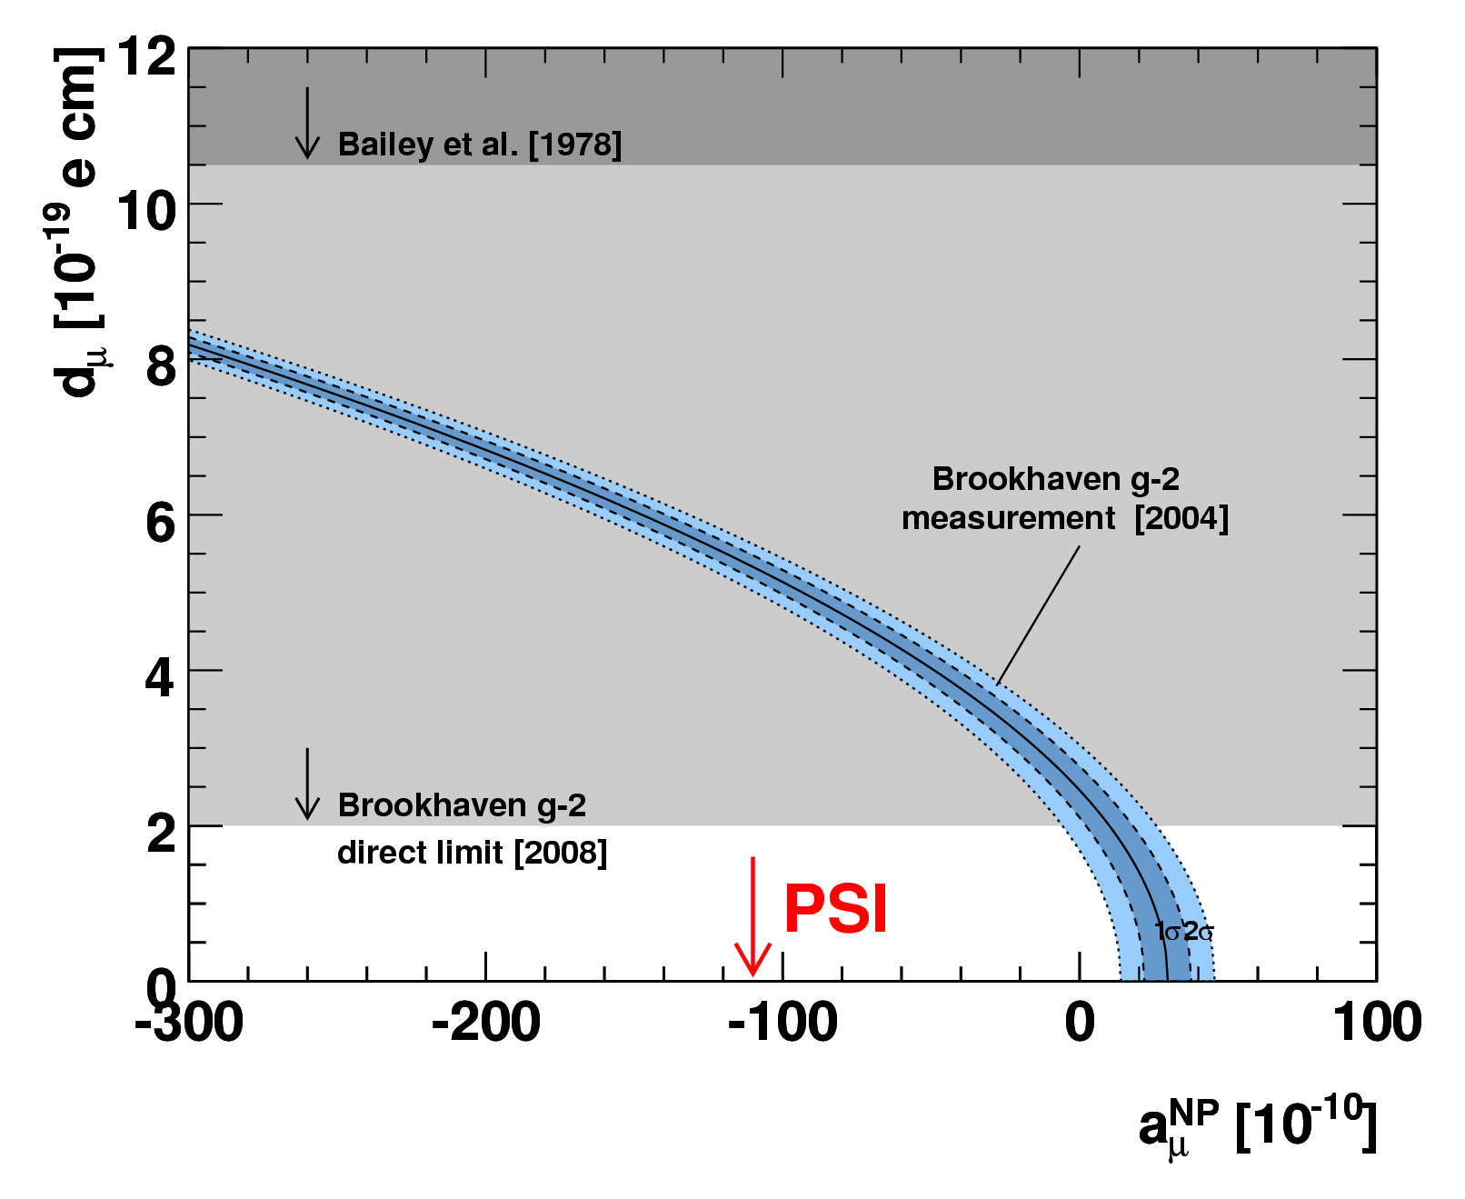
g-2 anomaly isn’t?
If the current deviation is fully from EDM?
J.L.Feng, K. T. Matchev, Y. Shadmi, NP B613 (2001) 366
Present limit is not strong enough to rule out this scenario.

Slide 20
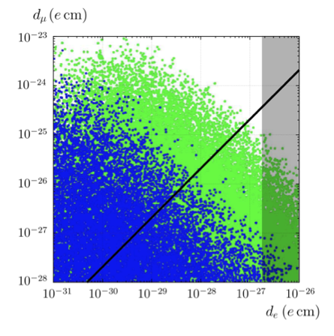
Mass scaling of lepton EDMs
Lepton universality predicts linear mass scaling:
d_{l} ∝ m_{l}
MSSM
J. Hisano, Nagai, Paradisi
muon EDM
Plenty possibilities for non-linear mass scaling:
d_{l} ∝ m_{l}^{n}
K.S. Babu, B. Dutta, R.N. Mohapatra, Phys. Rev. Lett. 85 (2000) 5064
K.S. Babu, S.M. Barr, I. Dorsner, Phys. Rev. D 64 (2001) 053009
J.L. Feng, K.T. Matchev, Y. Shadmi, Nucl. Phys. B 613 (2001) 366
A. Romanino, A. Strumia, Nucl. Phys. B 622 (2002) 73
A. Pilaftsis, Nucl. Phys. B 644 (2002) 263
K.S. Babu, J.C. Pati, Phys. Rev. D 63 (2003) 035004
A. Bartl, W. Majerotto, W. Porod, D. Wyler, Phys. Rev. D 68 (2003) 053005
G. Hiller, K. Huitu, J. Laamanen, T. Rüppell, Phys. Rev. D 82 (2010) 093015
linear mass scaling (m_{μ}/m_{e})
Br(μ→eγ)<10⁻¹¹
Br(μ→eγ)<10⁻¹³
electron EDM
list by G. Onderwater (ETC* 2012)

Slide 21
EDM experimental reach and physics
excluded (90%CL) by BNL [2008]
g-2 anomaly isn’t?
cubic
J-PARC/FNAL
quadratic
target sensitivity
10⁻²¹ e cm
general dipole op.
estimated from Δa_{μ}
linear
scaled electron EDM limit
Standard model < 10⁻³⁶ ecm
Main motivation driven by g-2 anomaly (from BNL E821).
→ The g-2 anomaly should be checked as well as EDM search

Slide 22
muon g-2/EDM measurements
In uniform magnetic field, muon spin rotates ahead of momentum due to g-2 = 0
a_{μ} (= (g-2)/2 ) is deduced from this residual rotation (precession). In general, spin also rotates due to B_{eff} = β×E and EDM.
general form of spin precession vector:
BNL E821 approach
γ=30 (P=3 GeV/c)
J-PARC approach
E = 0 at any γ
Continuation at FNAL with 0.1ppm precision
Proposed at J-PARC with 0.1ppm precision

Slide 23
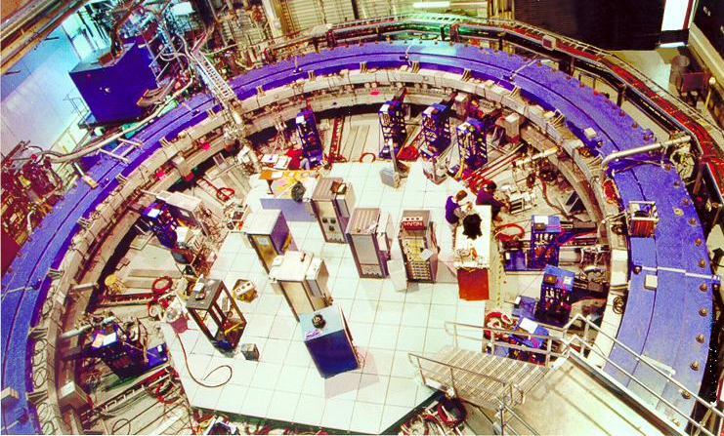
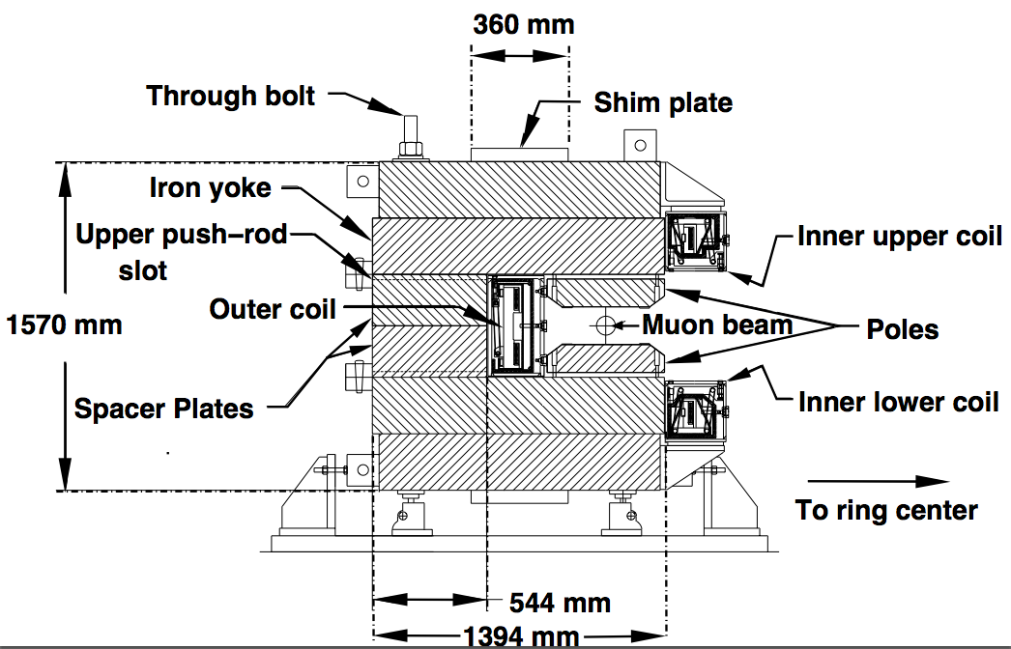
The Experiment at BNL

Slide 24
E821 Experimental Technique
25ns bunch of 5 X 10¹² protons from AGS
x_{c} ≈ 77 mm
θ ≈ 10 mrad
B·dl ≈ 0.1 Tm
Pions
Inflector
p = 3.1GeV/c
Target
(1.45T)
Injection orbit
Muon polarization
Muon storage ring
injection & kicking
focus with Electric Quadrupoles
24 electron calorimeters
Central orbit
Storage
ring
Kicker
Modules
R=711.2cm
d=9cm
R
R
θ
Electric Quadrupoles
x_{c}

Slide 25
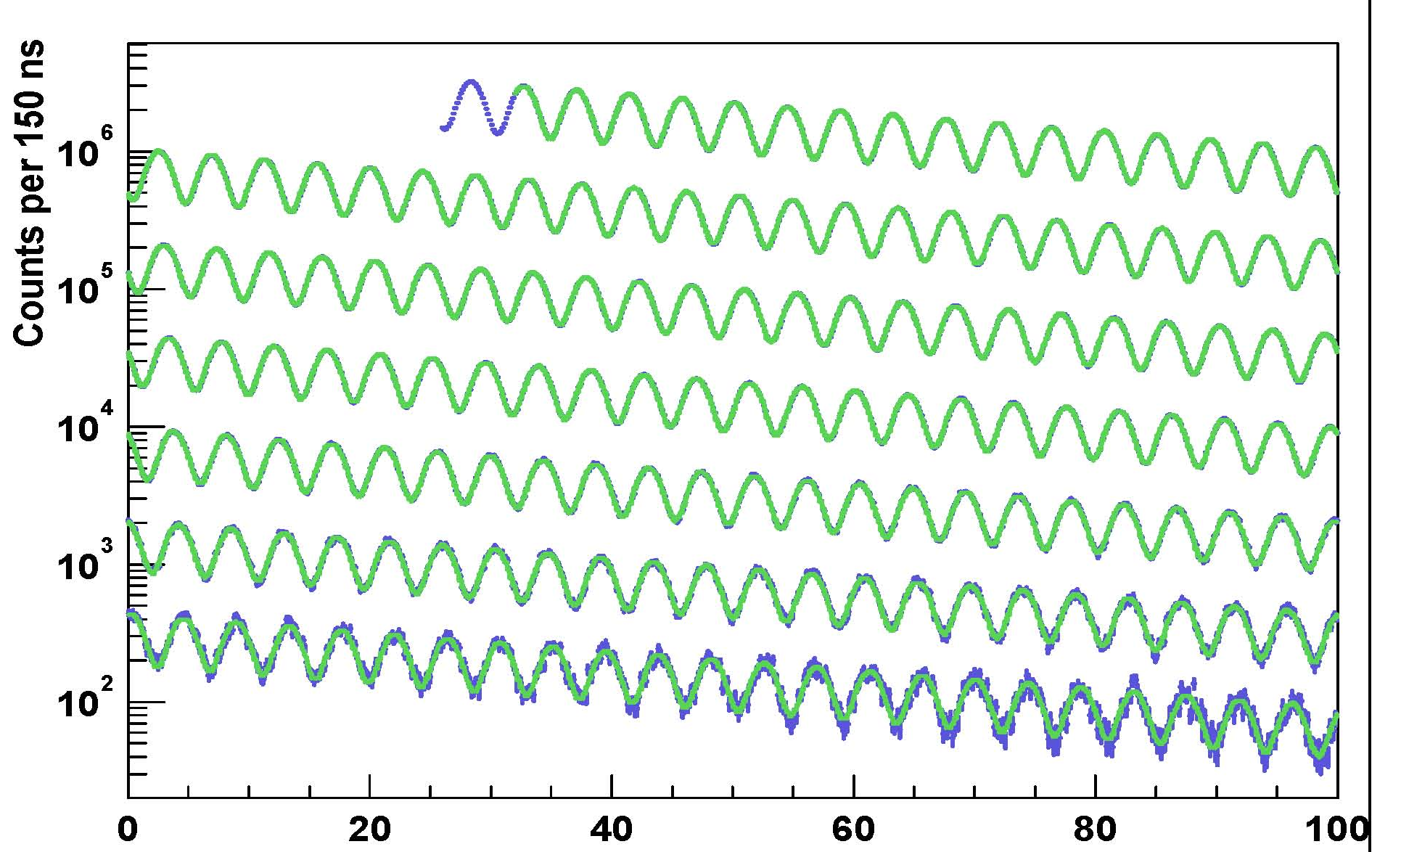
Arrival time spectrum
γτ
0 – 100 μs
100 – 200 μs
200 – 300 μs
300 – 400 μs
400 – 500 μs
500 – 600 μs
600 – 700 μs
Time modulo 100 μs

Slide 26
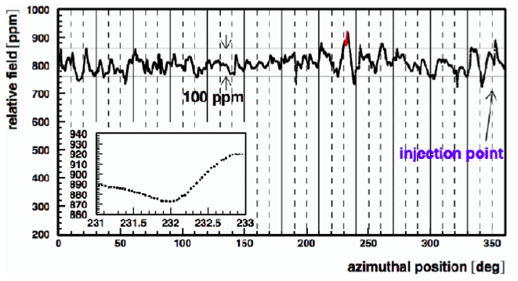
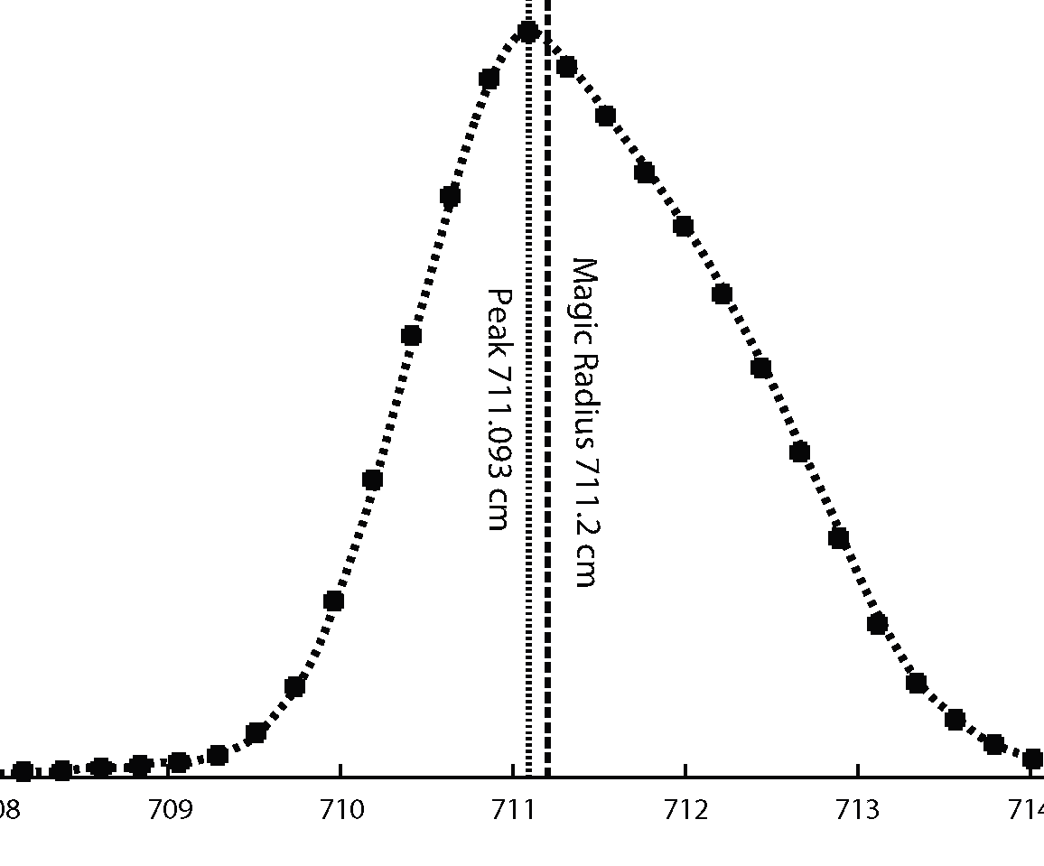
Average field uniformity ± 1 ppm
0.5 ppm contours
dist. of μ equil. radii

Slide 27
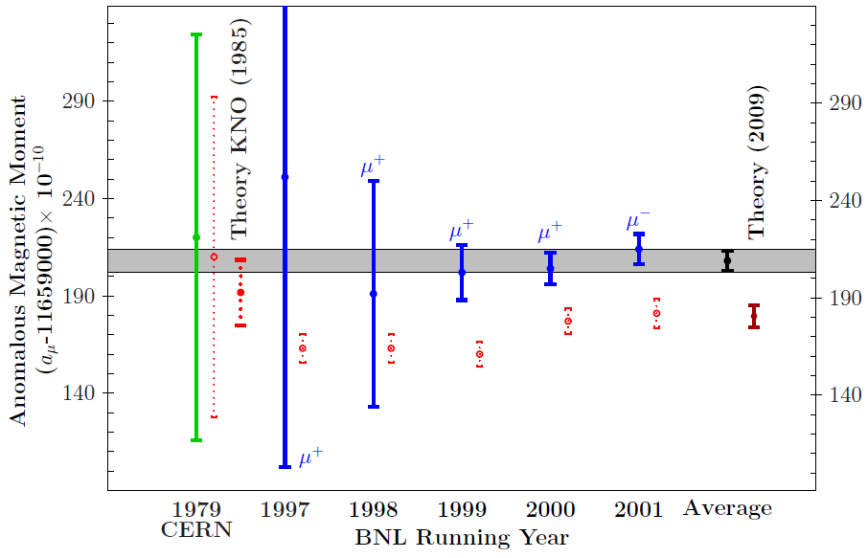
History of g-2 measurements
+e⁺e⁻ data
Experiment
Courtesy F. Jergerlehner, arXiv:0902.3360

Slide 28
muon g-2/EDM measurements
Anomalous magnetic moment (g-2)
a_{μ}= (g-2)/2 = 11 659 208.9 (6.3) x 10⁻¹⁰ (BNL E821 exp) 0.5 ppm
11 659 182.8 (4.9) x 10⁻¹⁰ (standard model)
Δa_{μ}= Exp - SM = 26.1 (8.0) x 10⁻¹⁰ 3σ anomaly
In uniform magnetic field, muon spin rotates ahead of momentum due to g-2 = 0
general form of spin precession vector:
BNL E821 approach
γ=30 (P=3 GeV/c)
J-PARC approach
E = 0 at any γ
Continuation at FNAL with 0.1ppm precision
Proposed at J-PARC with 0.1ppm precision

Slide 29
BNL effort continues at FNAL…
Matsue, Japan August 9 (2013)
Our ring has just transported to FNAL!

Slide 30
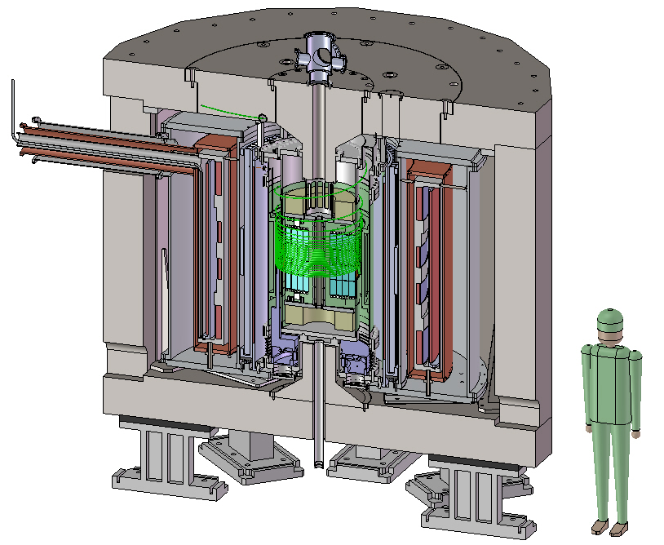
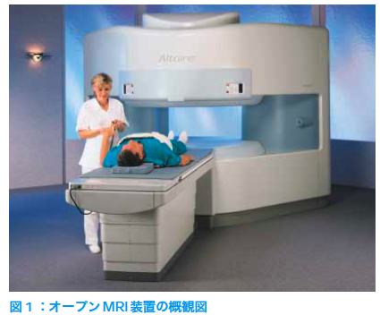
A compact muon g-2/EDM experiment
Advantages
Suited for precision control of B-field
Example : MRI magnet , 1ppm local uniformity
Possibility of spin manipulation
Effective to cancel various systematics
Completely different systematics than the BNL E821 or FNAL
BNL E821 / FNAL
J-PARC
66cm
14m
P= 3.1 GeV/c , B=1.45 T
P= 0.3 GeV/c , B=3.0 T
Hitachi co.

Slide 31
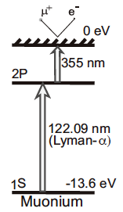
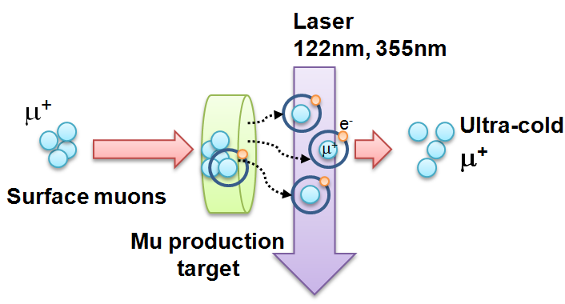
Ultra-cold Muon
Requirement for zero E-field:
Muons should be kept stored without E-focusing
→ Beam with ultra-small transverse dispersion,
i.e. Δp_{T}/p ~0
Laser resonant ionization of Mu (μ⁺e⁻)
re-acceleration
p =
28MeV/c
3 keV/c
300 MeV/c
Δp_{T}/p ~3 keV / 300 MeV =1E-5

Slide 32
Comparison of experiments
 | BNL-E821 | Fermilab | J-PARC
Muon momentum | 3.09 GeV/c |  | 0.3 GeV/c
gamma | 29.3 |  | 3
Storage field | B=1.45 T |  | 3.0 T
Focusing field | Electric quad |  | Very weak magnetic
# of detected μ+ decays | 5.0E9 | 1.8E11 | 1.5E12
# of detected μ- decays | 3.6E9 | - | -
Precision (stat) | 0.46 ppm | 0.1 ppm | 0.1 ppm

Slide 33
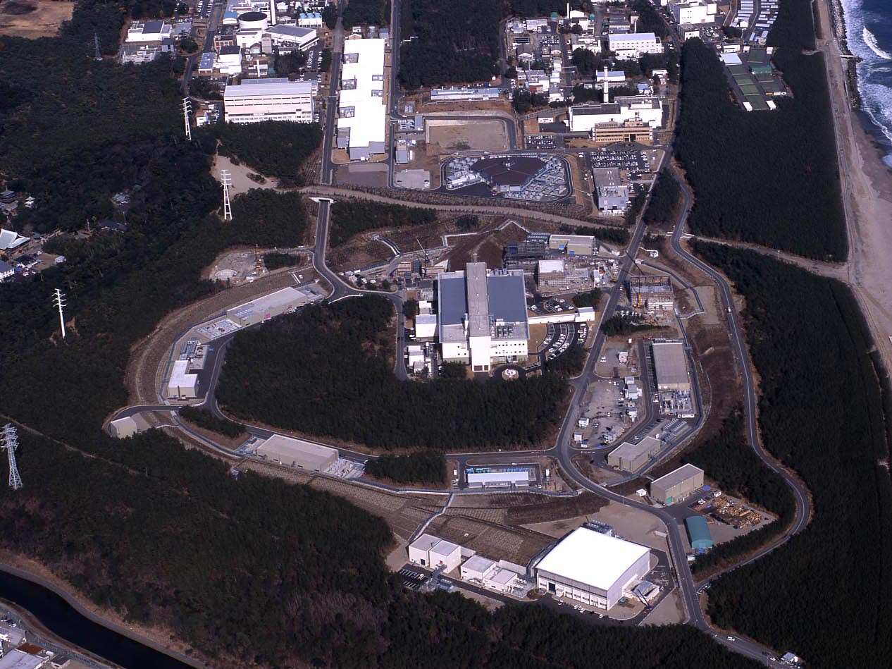
J-PARC Facility
(KEK/JAEA)
LINAC
3 GeV
Synchrotron
Neutrino Beam
To Kamioka
Material and Life Science
Facility
Main Ring
(30 GeV)
Hadron Hall
Bird’s eye photo in Feb. 2008

Slide 34
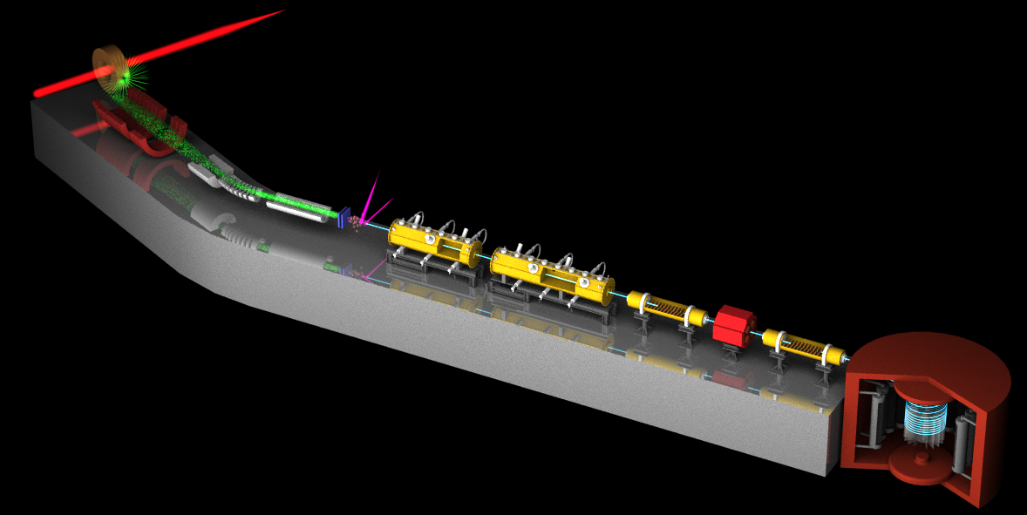
New Muon g-2/EDM Experiment at
J-PARC with Ultra-Cold Muon Beam
3 GeV proton beam
( 333 uA)
Graphite target
(20 mm)
Surface muon beam
(28 MeV/c, 4x10⁸/s)
Muonium Production
(300 K ~ 25 meV⇒2.3 keV/c)
Surface muon
Ultra Cold μ+ Source
Muon
storage
Resonant Laser Ionization of Muonium (~10⁶ μ⁺/s)
Muon LINAC (300 MeV/c)

Slide 35
New Muon g-2/EDM Experiment at
J-PARC with Ultra-Cold Muon Beam
Silicon
Tracker
3 GeV proton beam
( 333 uA)
Graphite target
(20 mm)
Surface muon beam
(28 MeV/c, 4x10⁸/s)
66 cm
Muonium Production
(300 K ~ 25 meV⇒2.3 keV/c)
Surface muon
Super Precision Storage Magnet
(3T, ~1ppm local precision)
Ultra Cold μ+ Source
Muon
storage
Resonant Laser Ionization of Muonium (~10⁶ μ⁺/s)
Muon LINAC (300 MeV/c)

Slide 36
Expected time spectrum of μ→e⁺νν decay
Muon spin precesses with time.
→ number of high energy e⁺ changes with time by the frequency :
p>200 MeV/c
0.1ppm statistical uncertainty
ω
e⁺ decay time (sec)

Slide 37
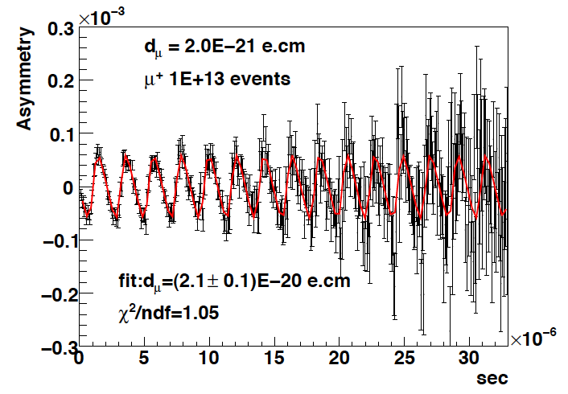
Expected time spectrum of μ→e⁺νν decay
EDM tilts the precession axis.
This yields an up-down decay asymmetry in number of e+
(oscillates with the same frequency ω)
p>200 MeV/c
current upper limit
by BNL E821
1.8 10⁻¹⁹ e・cm
d_{μ}=2E-20 e・cm
Up-down asymmetry
ω
∝EDM
e+ decay time (sec)

Slide 38
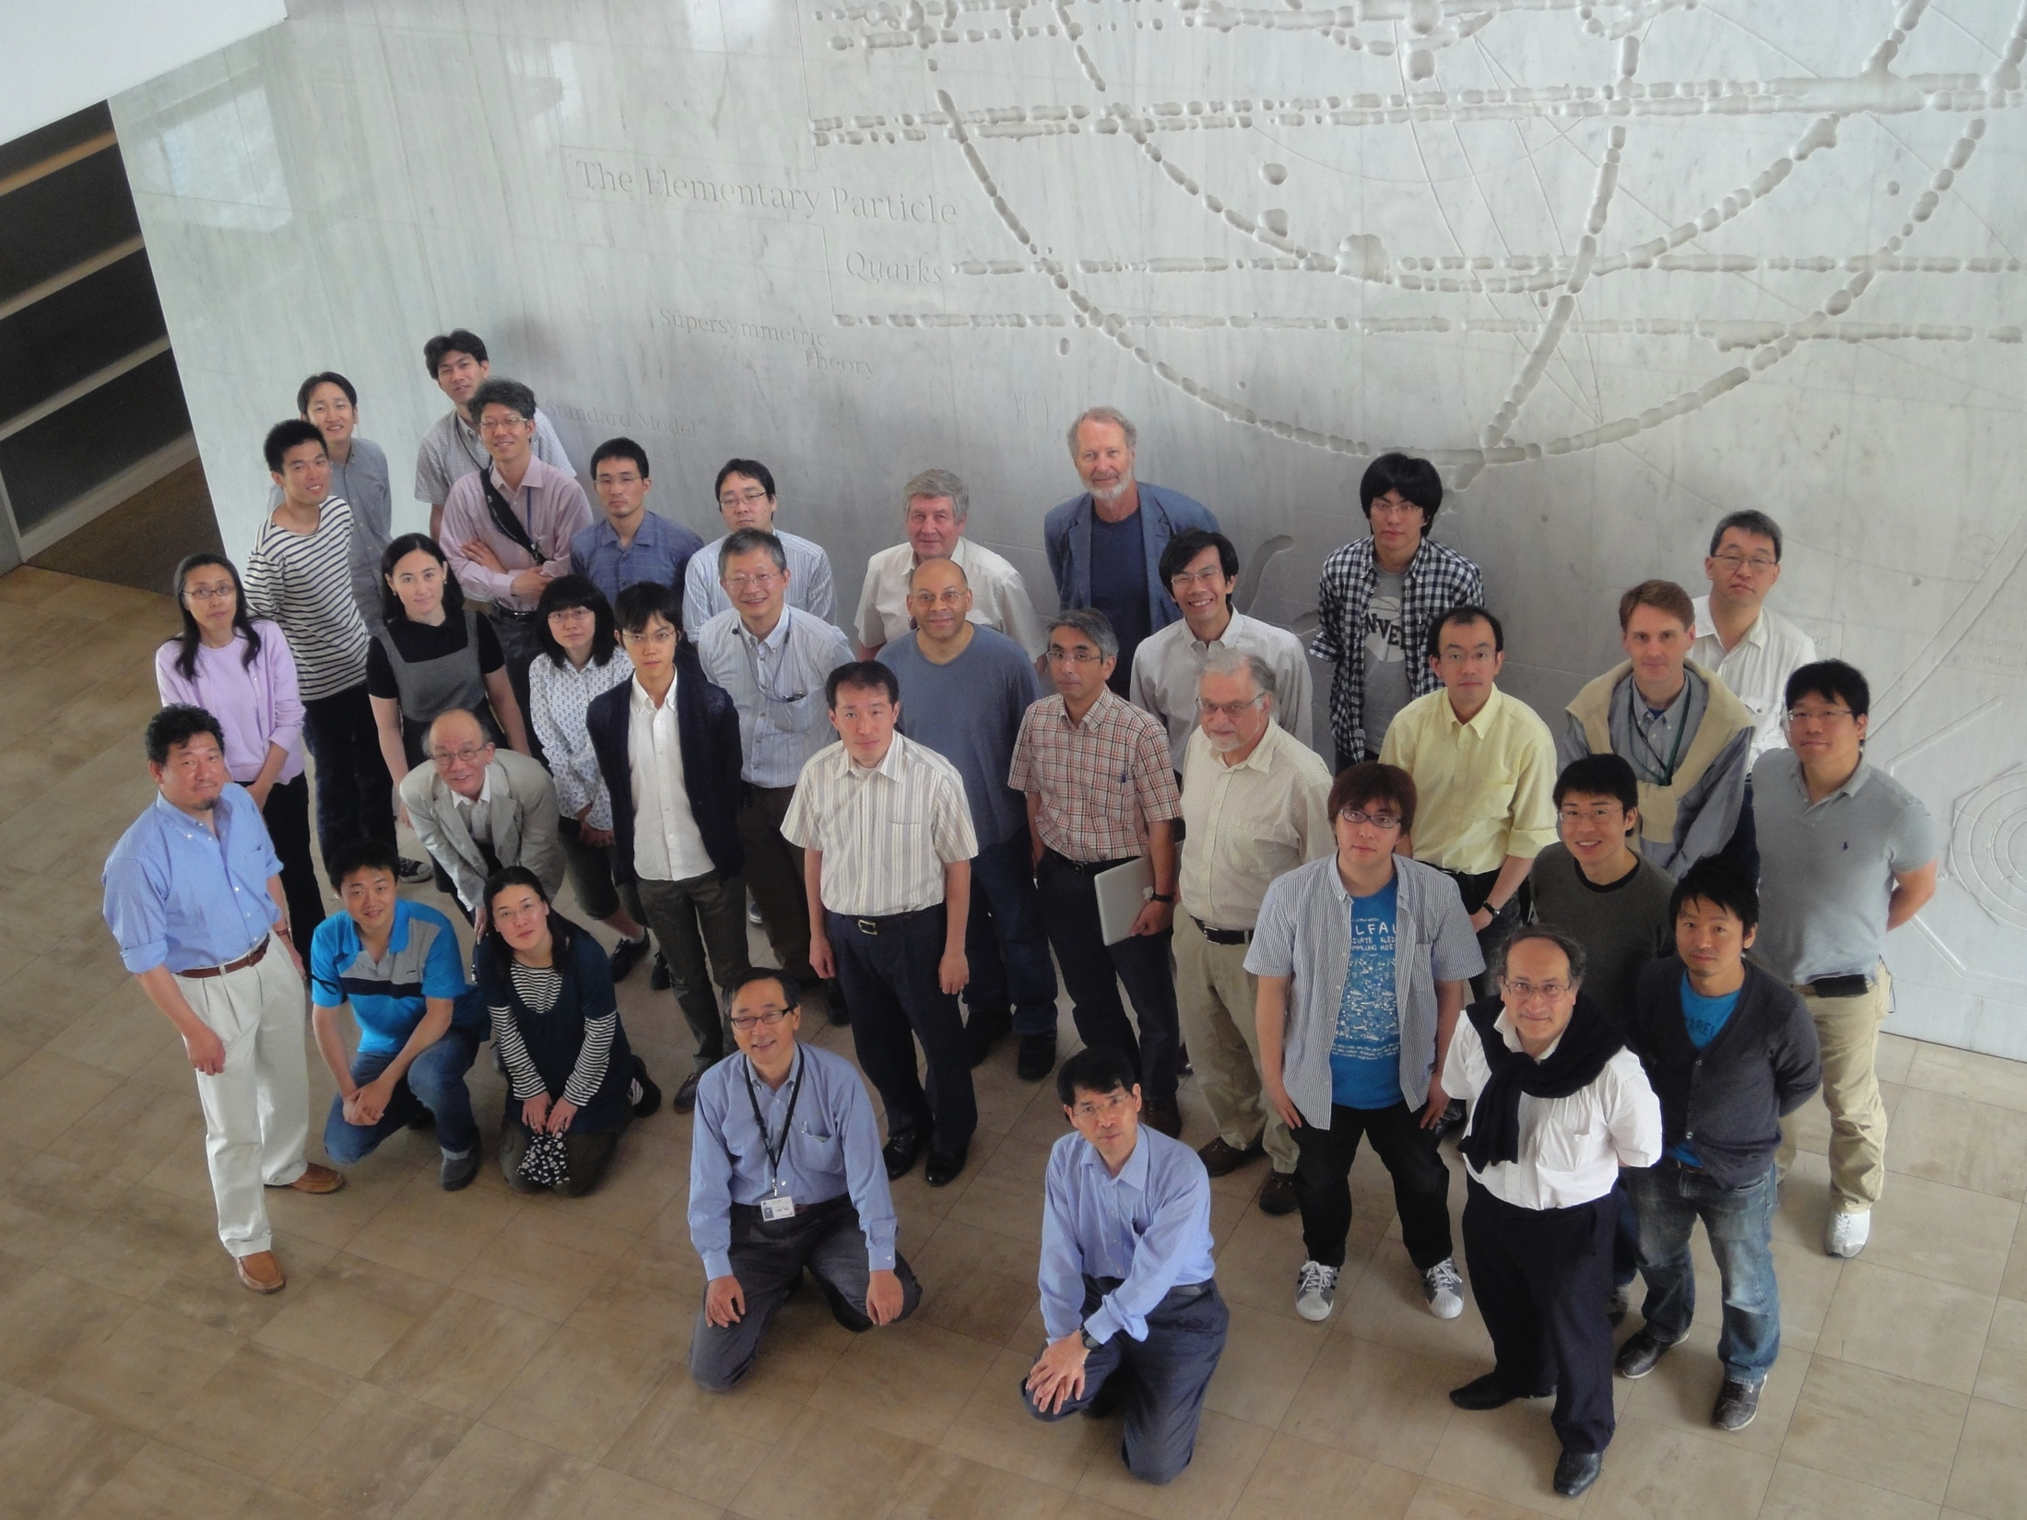
The collaboration
92 members ( …still evolving)
25 Institutions: KEK, RIKEN, U-Tokyo, TRIUMF, BNL, PMCU, CYCRC-Tohoku, Osaka, Rikkyo, TITech, SUNYSB, RAL, UCR, UNM, Victoria
7 countries: Czech, USA, Russia, Japan, UK, Canada, France
Dec 2009 : Proposal submitted
Dec 2012 : CDR submitted
Jan 2013 : Stage-1 status granted from PAC (IMSS,IPNS)
P34 →E34

Slide 39
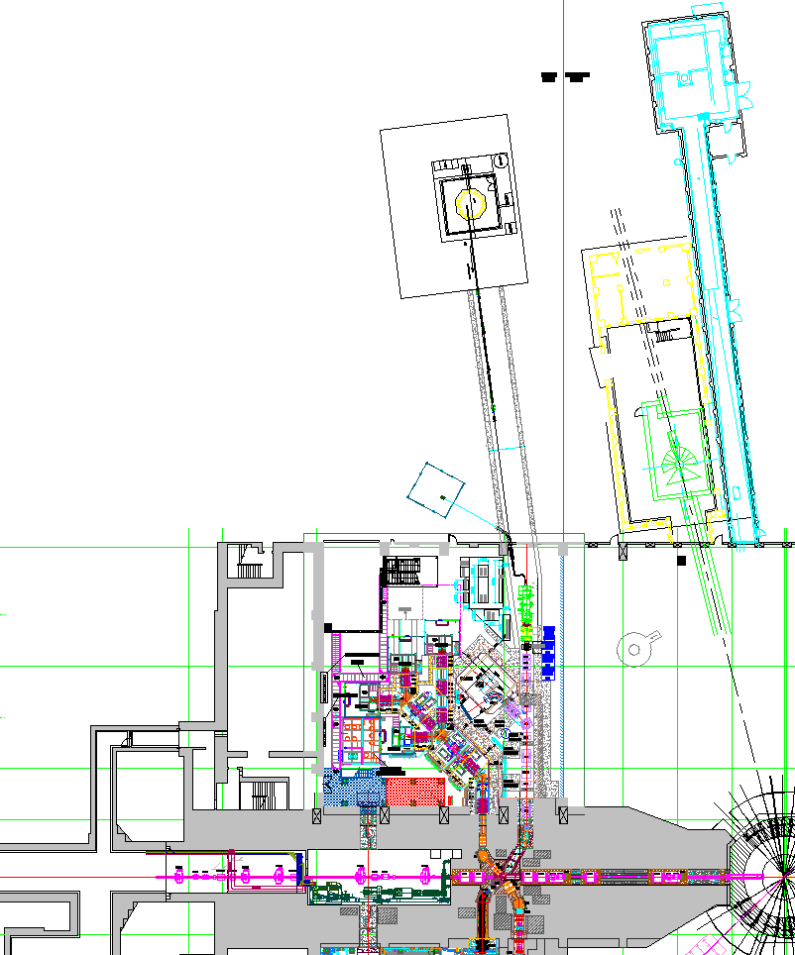
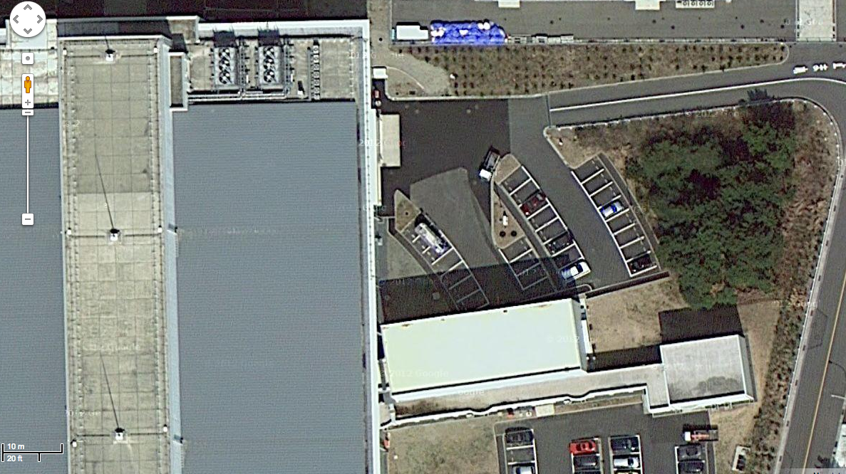
Proposed experimental site
Material and Life science Facility
Parking lot
g-2/EDM
storage magnet
muon linac
muon
production
target
sparation neutron
source

Slide 40
3 GeV proton beam
( 333 uA)
Graphite target
(20 mm)
Surface muon beam
(28 MeV/c, 1-2x10⁸/s)
Muonium Production
(300 K ~ 25 meV⇒2.3 keV/c)
Surface muon
Ultra Cold μ+ Source
Muon
storage
Resonant Laser Ionization of Muonium (~10⁶ μ⁺/s)
Muon LINAC (300 MeV/c)

Slide 41
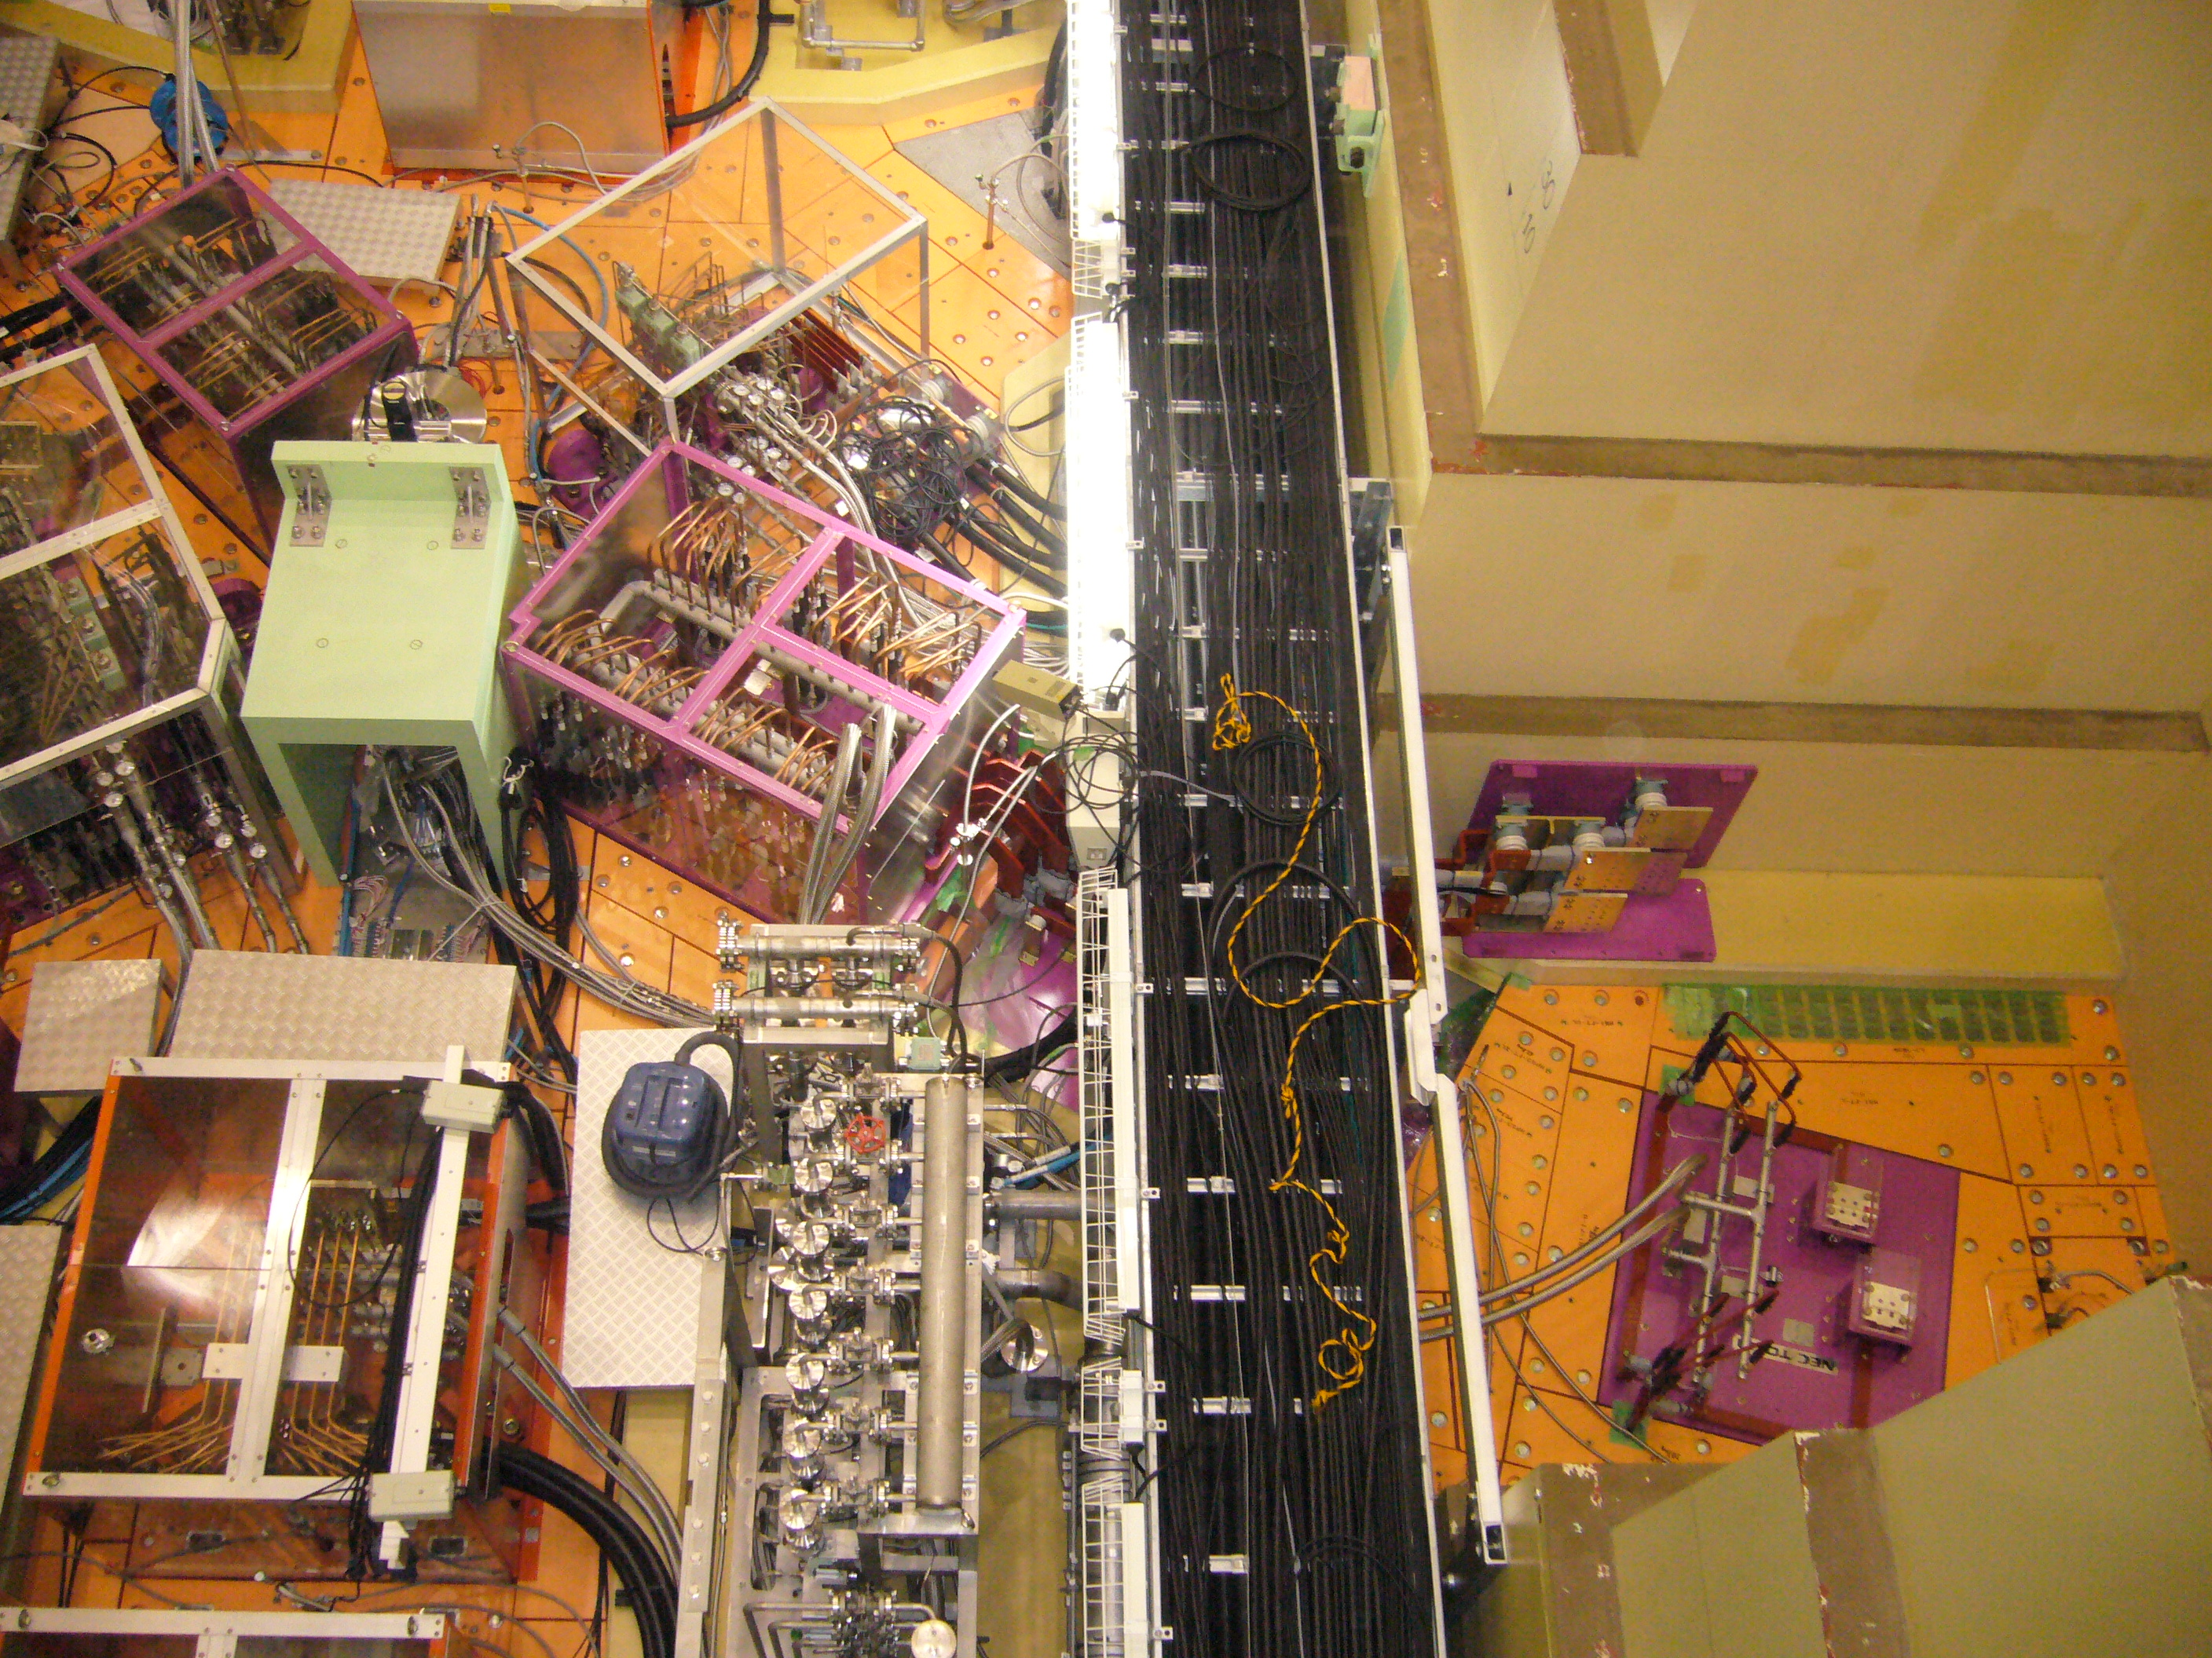
H-Line construction at J-PARC
proton
beam
Muon
Production
Target
Capture
solenoids
H-Line
Muon production
target (graphite)
Bending
magnet
Capture solenoids and bending magnet were successfully installed by the MUSE group.
→ Detail in next talk by K. Shimomura

Slide 42
3 GeV proton beam
( 333 uA)
Graphite target
(20 mm)
Surface muon beam
(28 MeV/c, 4x10⁸/s)
Muonium Production
(300 K ~ 25 meV⇒2.3 keV/c)
Surface muon
Ultra Cold μ+ Source
Muon
storage
Resonant Laser Ionization of Muonium (~10⁶ μ⁺/s)
Muon LINAC (300 MeV/c)
Efficient production of Mu in vacuum is crucial.

Slide 43
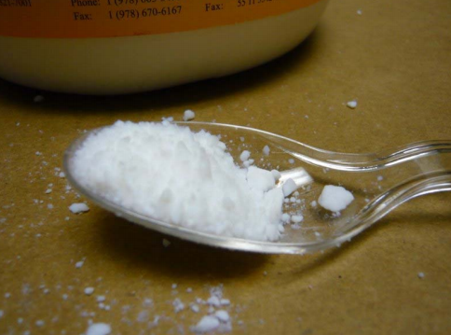
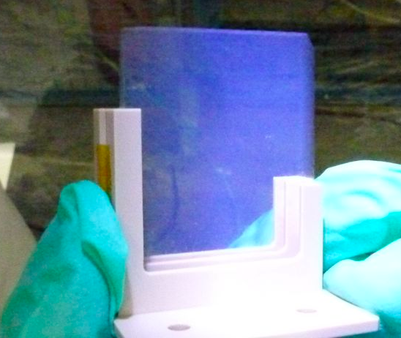
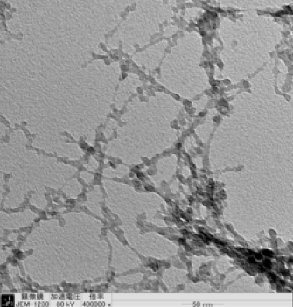
Room-temperature muonium emitter
Silica powders (SiO₂)
Structure : network of SiO₂ grain (~10nm diameter)
→ Large surface area (200-400 m²/g)
(Jannisen, PRA 90)
Known to be a good Mu emitter at room temp.
(Beer PRL 85, Marshall Phys Lett.A 78, Woodle Z.Phys 88)
Not self-standing → difficulty in laser ionization.
Silica aerogel
Self-standing!
Similar structure of SiO₂ grain-network
→SEM/TEM/HEIM all show consistent images
→Measured surface area 500 m²/g
Control of density and thickness
Only few (and old) data available
photo by G. Marshall
HEIM (NIMS)
TEM (RIKEN)
fragment
SEM (U. Vic)

Slide 44
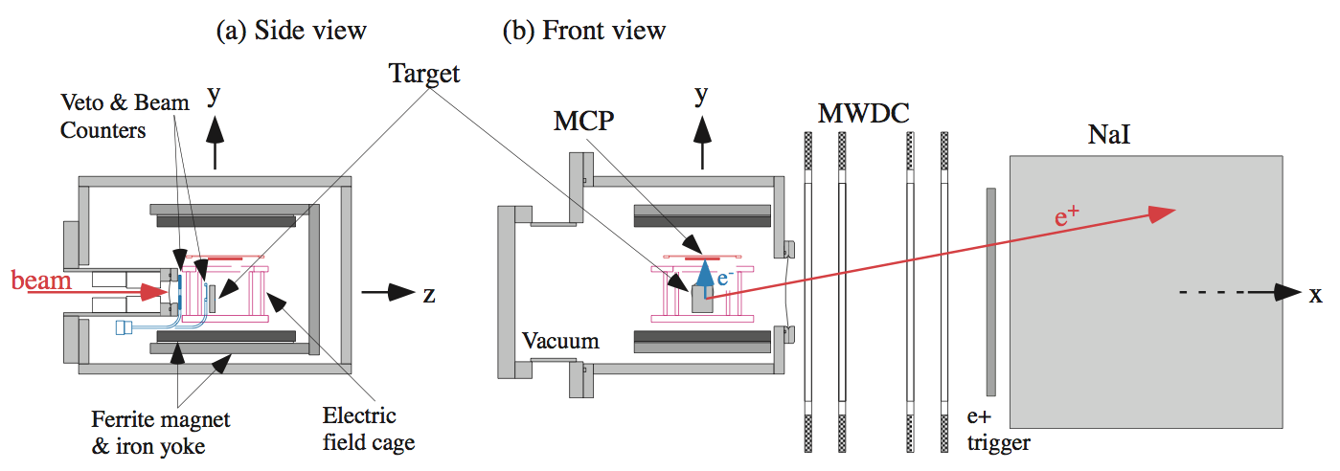
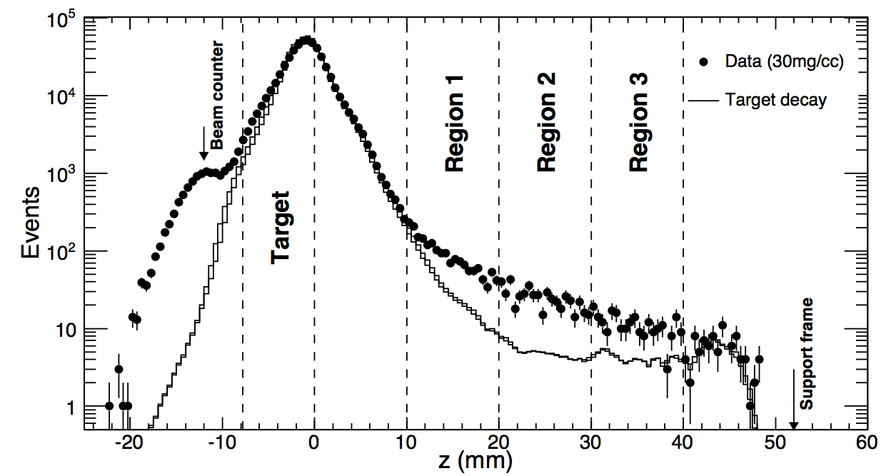
Measurement of Mu in vacuum
arXiv:1306.3801 (to be published in PTEP)
Set up
e+ trackback position onto x=0 (beam)
e⁺ tracks were reconstructed from MWDCs and NaI info.
A thin silica plate (0.1mm) was used to determine target decay.
Excess over the target decay distribution was observed from silica aerogel data.

Slide 45
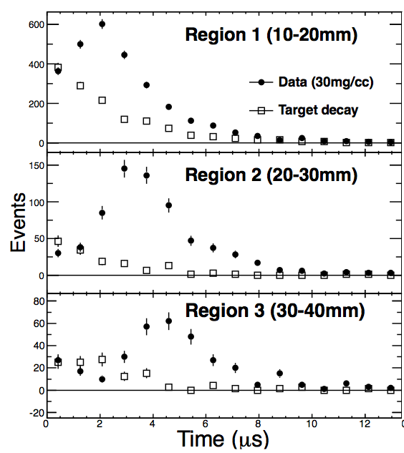
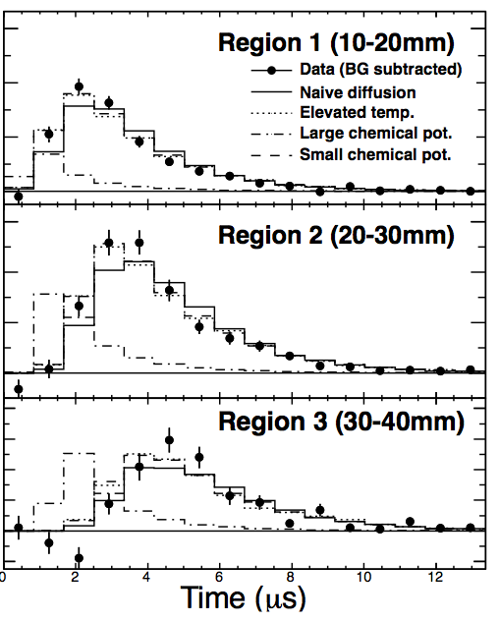
Space-time distribution of Mu
arXiv:1306.3801 (to be published in PTEP)
Position of e+ trackback
Time spectrum after BG subtraction
Mu diffused out from aerogel with thermal velocity.
Vacuum yield (region1-3) = 3x10⁻³ per muon stop
Expected conv. efficiency at J-PARC ~10⁻³ (>10⁻² required)

Slide 46
Relevant processes and scales
Mu diffusion to vacuum
Muon stop
Scale of μ range straggling
> 1 mm
(determined by this experiment)
<<
Scale of diffusion
< 0.1 mm

Slide 47
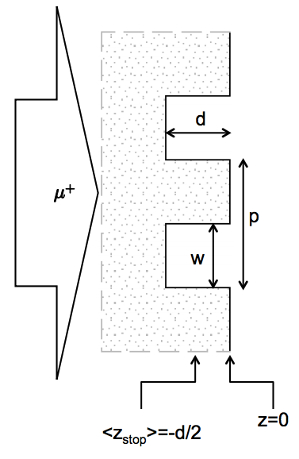
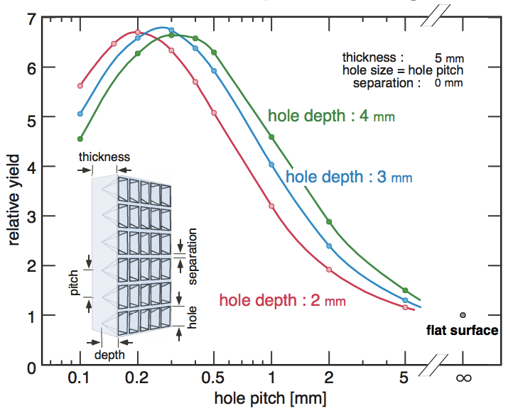
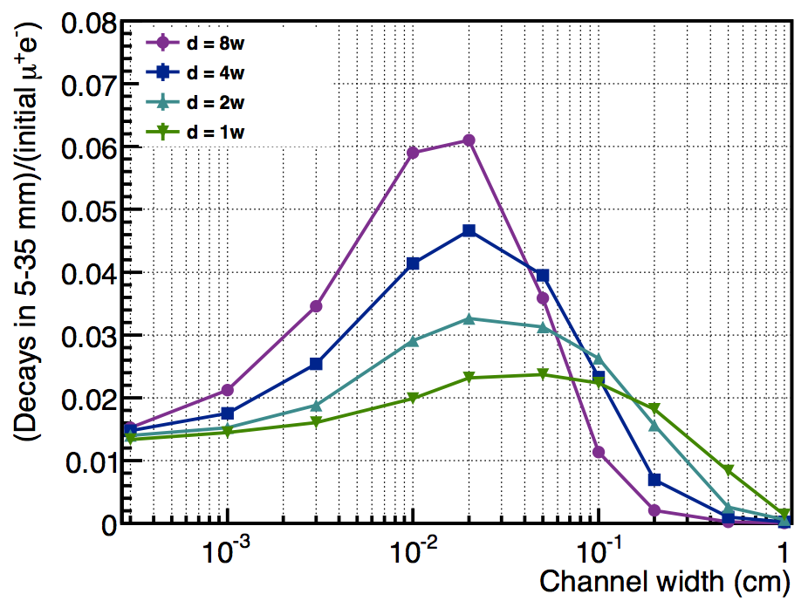
Aerogel with sub-mm structure
The vacuum yield would increase if more muons stop near the surface (<0.1mm). Introduction of sub-mm structure would increase surface area, thus enhance the vacuum yield.
Channels
Holes
simulation (M. Iwasaki)
simulation (G. Marshall)
p was fixed to 2w
A factor of 5~7 enhancement with sub-structures

Slide 48
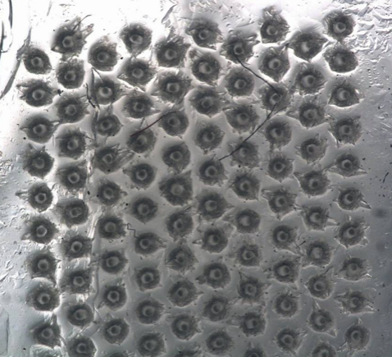
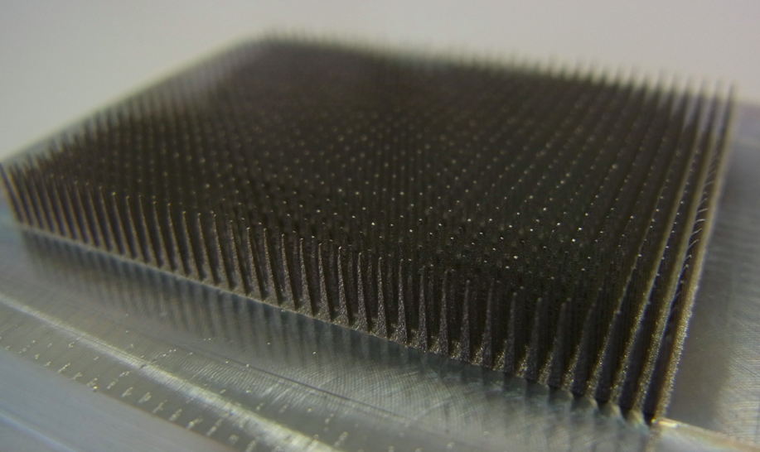
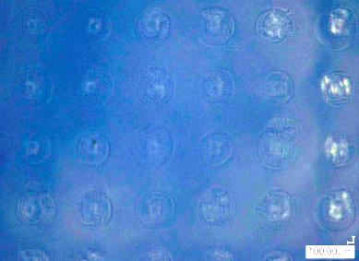
Structured aerogels (in preparation)
100μm holes
1mm holes
channels
Laser drilling
Metal push pins
thin-film
200μm
1mm
1mm-thickness
by M. Tabata (Chiba/JAXA)
by M. Tabata (Chiba/JAXA)
+ KEK engineering center
by Y. Oishi (RIKEN)
→To be tested at TRIUMF in October

Slide 49
3 GeV proton beam
( 333 uA)
Graphite target
(20 mm)
Surface muon beam
(28 MeV/c, 1-2x10⁸/s)
Muonium Production
(300 K ~ 25 meV⇒2.3 keV/c)
Surface muon
Ultra Cold μ+ Source
Muon
storage
Resonant Laser Ionization of Muonium (~10⁶ μ⁺/s)
Muon LINAC (300 MeV/c)
New Muon g-2/EDM Experiment at
J-PARC with Ultra-Cold Muon Beam

Slide 50
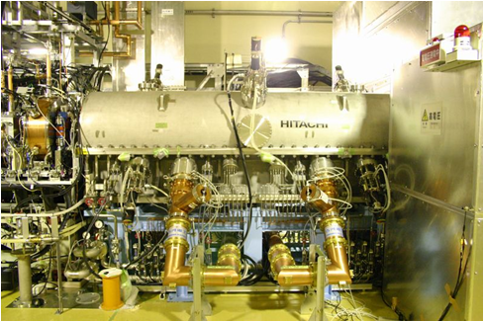
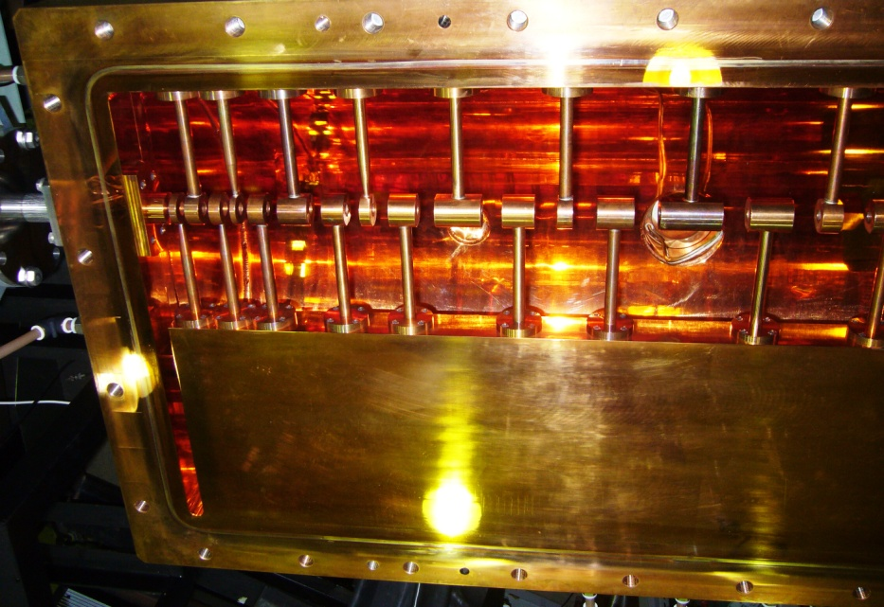
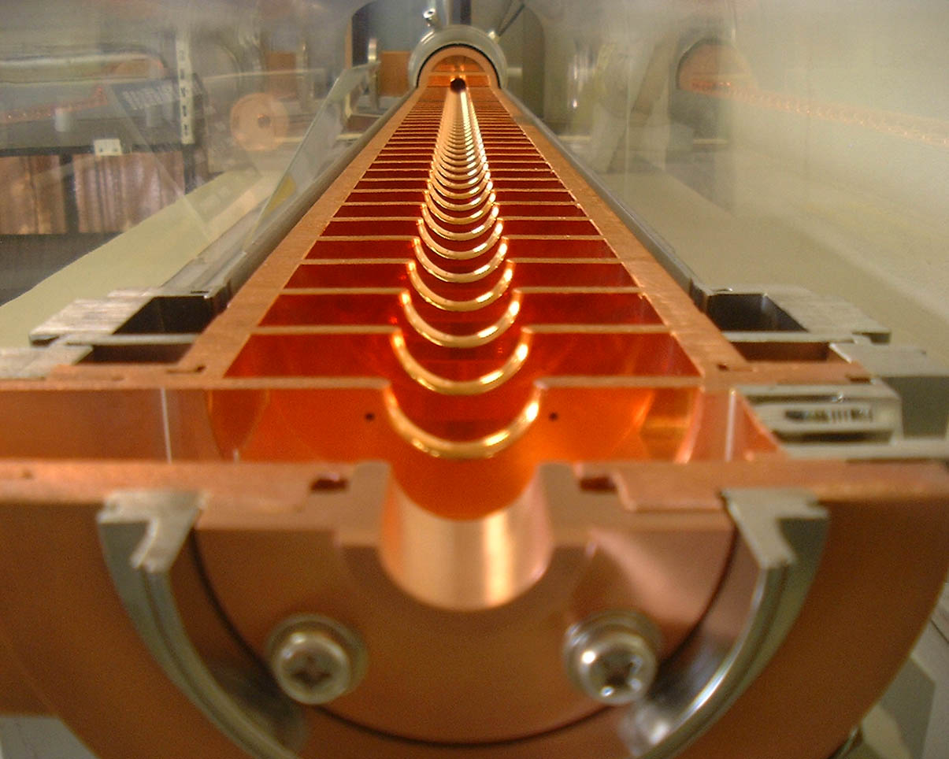
Muon acceleration
0.34 MeV
β≈0.08
1.2
β≈0.15
5.1
β≈0.3
13.8
β≈0.46
42.3 MeV
β≈0.7
200 MeV
β≈0.94
μ⁺ →
RFQ
IH
IH
(IH, CDS, DAW … ?)
Disk loaded structure
Initial Acc.
Low-β
Middle-β
High-β
RFQ
IH linac
Disk loaded structure
J-PARC proton RFQ
IH structure (TITech)
KEKB electron linac
KEKB/J-PARC accelerator group + TITech + Kyoto
Beam simulations in progress. Muon acceleration test being planned at J-PARC

Slide 51
3 GeV proton beam
( 333 uA)
Graphite target
(20 mm)
Surface muon beam
(28 MeV/c, 1-2x10⁸/s)
Muonium Production
(300 K ~ 25 meV⇒2.3 keV/c)
Surface muon
Ultra Cold μ+ Source
Muon
storage
Resonant Laser Ionization of Muonium (~10⁶ μ⁺/s)
Muon LINAC (300 MeV/c)
New Muon g-2/EDM Experiment at
J-PARC with Ultra-Cold Muon Beam

Slide 52
Muon storage magnet and detector
Iron yoke
Cryogenics
Muon storage orbit
2900 mm
e+ tracking
detector
Super conducting coils
666 mm

Slide 53
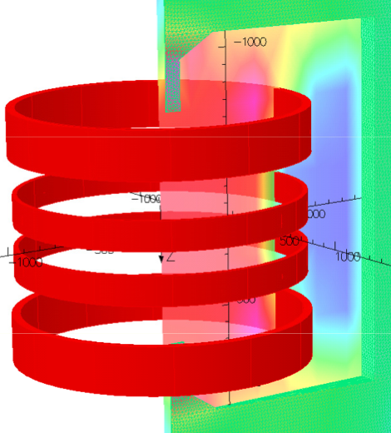
Storage Magnet
B_{r}
Injection region
z (m)
storage
region
r
Consists of four super-conducting coils surrounded by correction coils and iron yoke.
main field : B = 3 T (local uniformity 1ppm)
injection field : B_{r} > 0 (z > 5 cm )
focusing field : B_{r}/B₀ = 10ppm/cm (n=1E-4) ( |z| < 5 cm )

Slide 54
Injection and pulsed kicker system
z
Muons are injected into the storage magnet with a spiral orbit.
A vertical kick (8mrad) is introduced to stop muon beam at the storage region.
B_{r} ~ 1.5 Gauss
T ~ 200 nsec
Performance of pulsed power supply and coil is being evaluated with a test coil.
r
Kicker test coil
B_{r}
B_{r}
H. Nakayama
H. Iinuma
kick
Two pairs of single-turn coils with opposite current direction

Slide 55
Pulsed kicker system
Kicker test coil
Current and B-field waveform
2012/8/3
Current transformer
Inner and outer coils
300nsec
Signal from pickup coil
(differential amplifier+ integrator)
pickup
coil
Plots by H. Iinuma

Slide 56
Vibration and mechanical displacement
Plots by K. Sasaki

Slide 57
Muon storage magnet and detector
Iron yoke
Cryogenics
Muon storage orbit
2900 mm
Radial tracking vanes (Silicon strip)
e+ tracking
detector
Super conducting coils
Positron track
μ decay
vertex
666 mm
57
57
57
p(e+) > 200 MeV/c

Slide 58
Silicon strip tracker
Detector module
Tracking e+ from muon decay (p = 200-300 MeV/c)
No contamination of B-field (< 1ppm) and E-field (<10mV/cm) in the muon storage region.
Efficient and stable over ~5 lifetime (33μs)
Instantaneous rate changes by two orders of magnitude.
Frontend
electronics
Silicon sensors
400mm
G4 simulation
K. Ueno
Efficiency of
single track finding
● Exact match
● Partial match
Number of vanes: 24-48
Elapsed time (μs)

Slide 59
Silicon-strip detector development
Test detector module
Studies on rate effects
Silicon sensor
Optimal strip pitch determined (Nishimura)
Test sensor being produced by HPK
Frontend ASICs
Prototype under development
(Tanaka, Uchida, Ikeno, Ueno, + Kyushu-U)
59

Slide 60
Studies on B-field measurement
DC-NMR with sweep coil
NMR sample : H₂O + MnCl
Super-sonic motors : axial(z) and radial (r) movement
System developed by Ken’ichi Sasaki (KEK)
Error field by Tungsten cylinder
MRI magnet (1.6 T)
NMR
probe
ΔB/B (ppm)
r
Sample
stage
z
r [mm]
Bore : 80cm
Length : 200cm

Slide 61
Measured magnetic moment of detector components
ΔB/B @100mm
10ppm
1ppm
0.1ppm

Slide 62
Summary
Muon g-2/EDM measurement with ultra-cold muon is in preparation at H-Line/J-PARC.
Stage-1 status is granted by J-PARC PAC.
Frontend magnets were installed at H-line.
R&Ds for all components are in progress.
→ Technically driven schedule to start running ~ 4-5 years
Related talk
J-PARC MUSE → Talk by K. Shimomura
Mu HFS → Talk by K. Tanaka
COMET → Talk by Y. Yuan

