Slide 1
A Muon-based Accelerator Staging Scenario (MASS)
J.P.Delahaye/SLAC
On behalf of the MAP/MASS working group

Slide 2
MASS members

Slide 3
A large number of projects
J. Hewett
Summary Intensity Frontier
Snowmass on the Mississippi

Slide 4
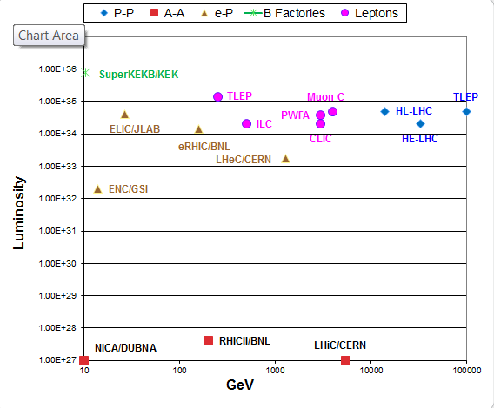
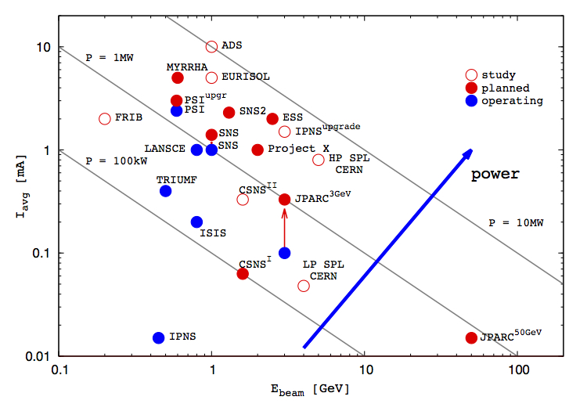
A even larger number of Projects
Energy Frontier
Intensity Frontier
Hadrons
Hadrons
B Factory
Leptons
Protons
E-/Hadrons
Muon Collider
Ions
J.P.Delahaye
ICHEP10 updated
Paris, July, 2010
M.Lindroos
European Strategy
Krakow Sept, 2012

Slide 5
CERN, a success story
Staged
approach
Multi-purpose

Slide 6
Principles of an ideal project scenario
Series of STAGED facilities
physics interest at each stage
Technology with increasing complexity progressively developed and validated
Possibly MULTIPURPOSE
maximizing supported physics community and funding!
Affordable steps (<750M$) from one facility to next
Stage built-on previous stage with additional facilities
Taking advantage of existing facilities
synergy between present and future program

Slide 7
Unique opportunity of Muon based accelerators to enable facilities at both High Energy and High Intensity Frontiers in a staged approach
at High Intensity Frontier
at High Energy Frontier

Slide 8
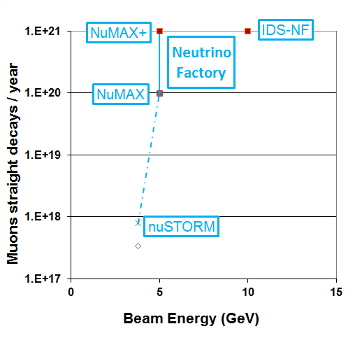
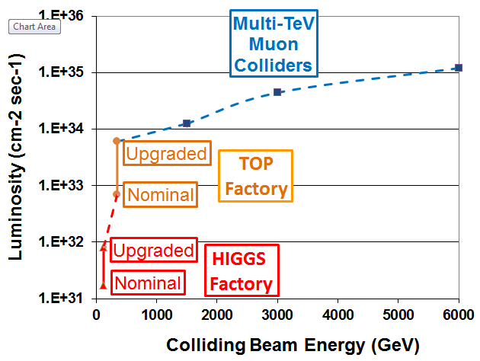
Muon Accelerators Staging Study (MASS) Physics interest at each stage
Intensity Frontier
Energy Frontier
Beyond Standard Model
Precision ν Physics
CP violation
Top properties
Sterile ν
ν cross sections
Higgs properties
Direct mass&width

Slide 9
Muon based facilities in FNAL context
Taking advantage of and leveraging FNAL future projects:
NuSTORM, ProjectX, LBNE
NuSTORM an ideal start facility and an asset for MAP:
Build-up experience of muon based facilities
As muon source (10¹⁰/pulse) for R&D platform
ProjectX as proton driver
ProjectX phase 2 with 1MW @ 3 GeV for an early and realistic start (beam power, target…..)
Upgradable to 4MW @ 8 GeV of ProjectX phase4 when available
Sanford Underground Research Facility (SURF) as location of long distance detector of a Neutrino Factory
Great synergy with LBNE about detector and facility
Neutrino Factory energy of 5 GeV compatible with 1300 km distance of FNAL to Sanford

Slide 10
An attractive Neutrino route at the intensity frontier in FNAL context
nuSTORM
10¹⁷ straight muons decays/year @ 3.8 GeV
Great interest for Physics: sterile neutrinos and cross sections
Available technology and proton beam power: could (should) be launched now
NeUtrinos from Muon Accelerators at ProjectX (NuMAX) as first stage
Neutrino Factory with 10²⁰ straight muons decays/year @ 5 GeV
Great interest for Physics: Precision CP measurements,
Neutrino ring at 5 GeV pointing towards Sanford
A 10kT MIND or magnetized LAr detector upgraded from LBNE
Without any cooling for reduced risk and early start
Phase 2 project X with 1MW@3 GeV as proton driver
Upgrade to full luminosity NuMAX+: 10²¹ straight muons decays/year@5 GeV
Similar Physics performance as IDS-NF
Add 4D cooling : muons flux X 2
Upgrade proton driver to 3MW (PX2) and later 4 MW@8GeV of PX4 : muon flux X 5
Target station upgrade to larger beam power
Upgrade Sanford detector: Larger magnetized detector (34kT)?

Slide 11
NuSTORM: Neutrinos from Stored Muons
3.8 GeV/c
stored μ
A.Bross
August 24
Fermilab P-1028
An entry-level NF?
200kW
DOES NOT
Require the
Development of
ANY
New Technology
Stage I approval requested at last weeks
Fermilab PAC meeting
NuSTORM Workshop held Sept 21-22 @ FNAL:
(https://indico.fnal.gov/conferenceDisplay.py?confId=5710)

Slide 12
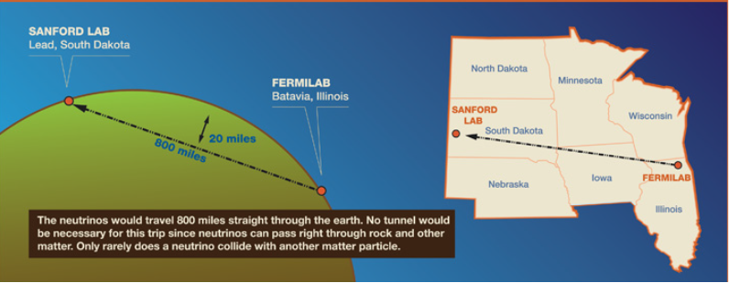
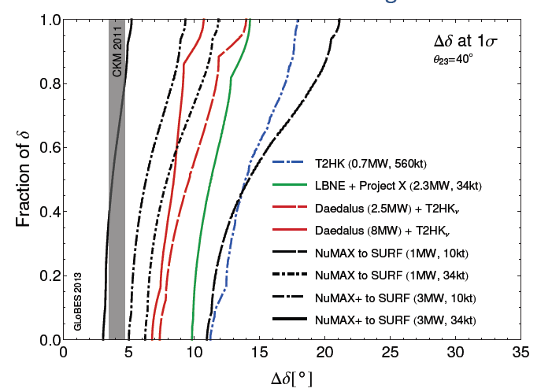
A Staged Neutrino Factory with far detector at SURF
courtesy of P. Huber
No cooling
4D cooling

Slide 13
The Muon Collider path at the energy frontier
Low Energy Muon Collider built in stages:
Energy and luminosity defined by Physics
Possibly a Higgs (and Top?) factory if still useful at the time
Allowing direct Higgs mass and width measurements (exquisite momentum spread at S channel).
Increasing proton beam driver on target: 4MW@8GeV
Adding 6D cooling but no final cooling
Evolving towards Multi-TeV Muon Collider
Excellent luminosity spectrum due to absence of beamstrahlung
Covering a broad energy range up to 10TeV (limited by radiation on site) for Physics Beyond Standard Model
Adding Final Cooling (30T solenoids)
More acceleration stages
High energy collider ring

Slide 14
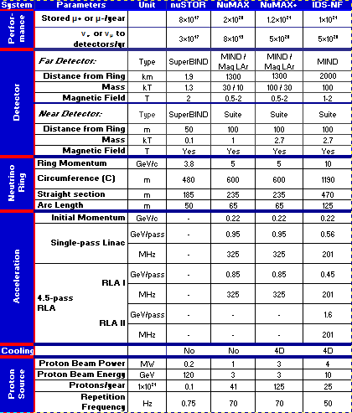
Staged Neutrino Factory and Muon Colliders main parameters
Neutrino Factory based on ProjectX ph2
Muon Collider based on ProjectX ph4

Slide 15
R&D platform at each Physics stage
P.Snopok
Principle:
MAP novel technologies to be validated in test facilities
Dedicated test facilities usually very expensive and not useful for Physics
Novel concept of test facility integrated into actual Facility stage aiming at development & validation of technology required by next stage
NuSTORM as R&D platform for 6D cooling at moderate intensity
Source of 10¹⁰ muons per pulse
6D cooling validation for HIGGS factory and/or Muon Collider
NuMAX as R&D platform for 4D cooling
Source of 10¹¹ muons per pulse
complementary to 4D cooling @ MICE at (very) low intensity
4D cooling validation for NuMAX+
NuMAX+ as R&D platform for 6D cooling at high intensity
Source of 10¹² muons per pulse
6D cooling validation for HIGGS factory and Muon Collider
HIGGS factory as R&D platform for final cooling
Final cooling validation for Muon Collider

Slide 16
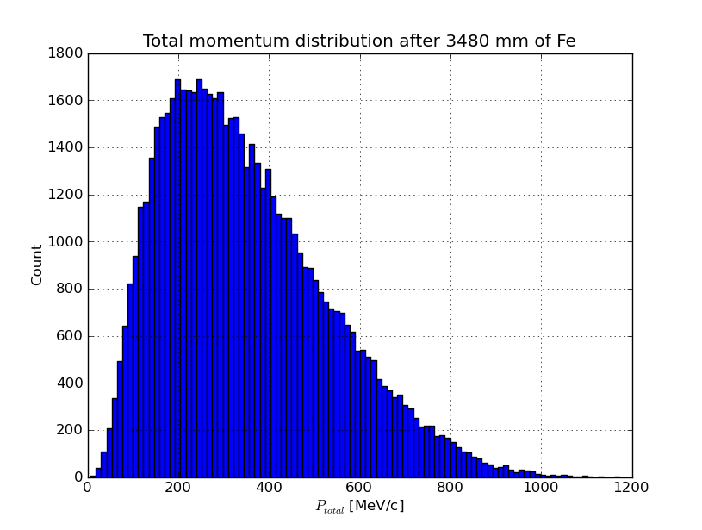
nuSTORM as an R&D platform
High-intensity pulsed muon source
100<p_{μ}<300 MeV/c muons
Using extracted beam from ring
10¹⁰ muons per 1 μsec pulse
Beam available simultaneously with
physics operation
Sterile ν search
ν cross interaction physics program
nuSTORM provides opportunity
to design, build & test:
decay ring instrumentation (BCT, momentum spectrometer, polarimeter) to measure & characterize the circulating muon flux
6D cooling of high intensity muon beam

Slide 17
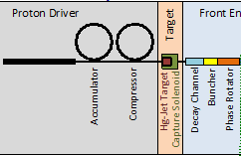
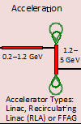
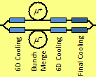
NuMAX->NuMAX+->HF->MC
PX4
(8 GeV, 4 MW)
Higgs Factory
+ 4MW@8GeV p+driver
+ 6D cooling
+ further acceleration
+ Collider ring
Test facility: final cooling
NuMAX+
+ 3 MW@3GeV p+ driver
+ 4D cooling
Test facility: 6D cooling
NuMAX
1 MW@3GeV p+ driver
No cooling
Test facility: 4Dcooling
Muon Collider
+ final cooling(30T solenoids)
+ further acceleration
+ high energy Collider Ring
μ Storage Ring
4D Cooling
No 6D Cooling
6D Cooling
No final Cooling
No Cooling
Final Cooling
ProjectX, ph2
3 GeV, 1 MW
ProjectX, ph4
8 GeV, 4 MW
ProjectX, ph2
3 GeV, 3 MW
Rapid
Cycling
Synchro
(RCS)
4D Cooling R&D
Test bench
Final Cooling
R&D Test bench
6D Cooling R&D
Test bench
μ collider

Slide 18
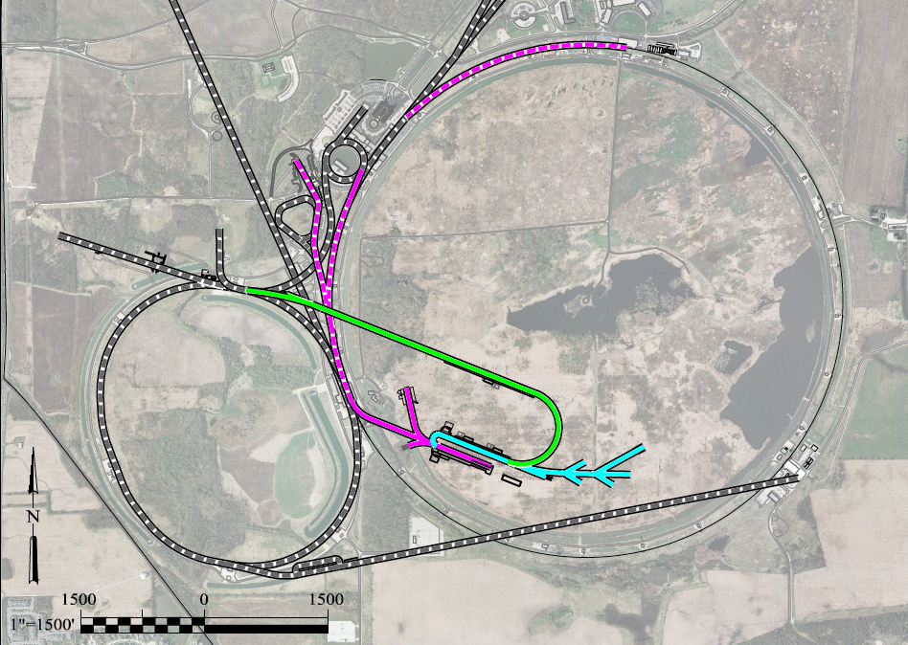
Preliminary
(collab. project X)
To Far Detector in
Sanford (1300km)
LBNE
Buncher/
Accumulator
Rings & Target
RLA to 63 GeV +
300m Higgs Factory
5 GeV
NF Decay Ring:
νs to Sanford
Front End+4D+6D
Project X Stage III
Linac + RLA
SC 325MHz
to ~5 GeV
Project X Stage II
Project X Stage I
Later upgradable to a
Muon Collider with
Tevatron size at 6 TeV
νSTORM + Muon Beam R&D Facility

Slide 19
R&D timeline
Best estimate
at the time
Feasibility assessment & principle of cooling
4D&6D cooling
demonstration
Proton driver
3MW@3GeV
Proton driver
4MW@8GeV
Major issues on critical path
Muon Accelerator feasibility
4D Cooling (NF) & 6D Cooling
Proton beam power

Slide 20
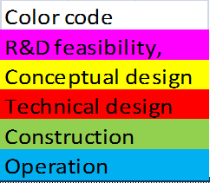
Critical paths and (very) tentative technically limited schedules
Informed decision
NuMAX
Muon Collider
1MW
3MW
4MW

Slide 21
R. Tschirhart
Fermilab Users
June 13th 2013
Twenty
Ten-Year Goals for Fermilab
1. Fermilab is the world leader on the Intensity Frontier
2. Fermilab is a world leader on the Energy Frontier and the Cosmic Frontier
3. Fermilab plays a leadership role in developing the technology for next generation accelerator facilities and in advancing basic understanding
4. Fermilab plays a leadership role in developing the technology for next generation detectors and computing facilities
5. Fermilab plays a leading role in applying technologies to society’s problems
and the (Lepton) Energy Frontier

Slide 22
Conclusion
Large number of ambitious (and expensive) future projects
Tough competition through budget limitations
New projects realistically built in stages
Series of facilities with reasonable budget and risk at each stage
Integrated R&D platform at each stage for validation of novel technology
Informed decision on following stages with risk mitigation
Flexibility of adaptation to physics requirements
Unique opportunity of Muon based Accelerators allowing;
Attractive staged approach
Enabling facilities at both High Intensity and High Energy Frontiers
Neutrino Factory does not delay but builds foundation to Muon Collider
Specially appealing at FNAL taking advantage & leveraging of projects or then existing facilities: ProjectX, LBNE
ProjectX and nuSTORM = primary enablers
should be given top priority

Slide 23
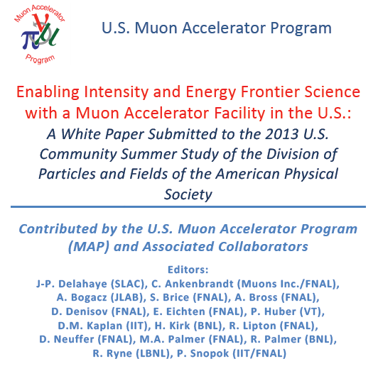
arXiv:1308.0494
FERMILAB-CONF-13-307-APC

