Slide 1
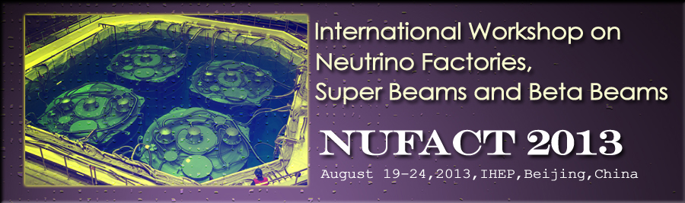

Future Muon Accelerators
Mark A. Palmer
August 21, 2013

Slide 2
Perhaps this should have been called…
The Potential of
High Intensity Muon Beams

Slide 3
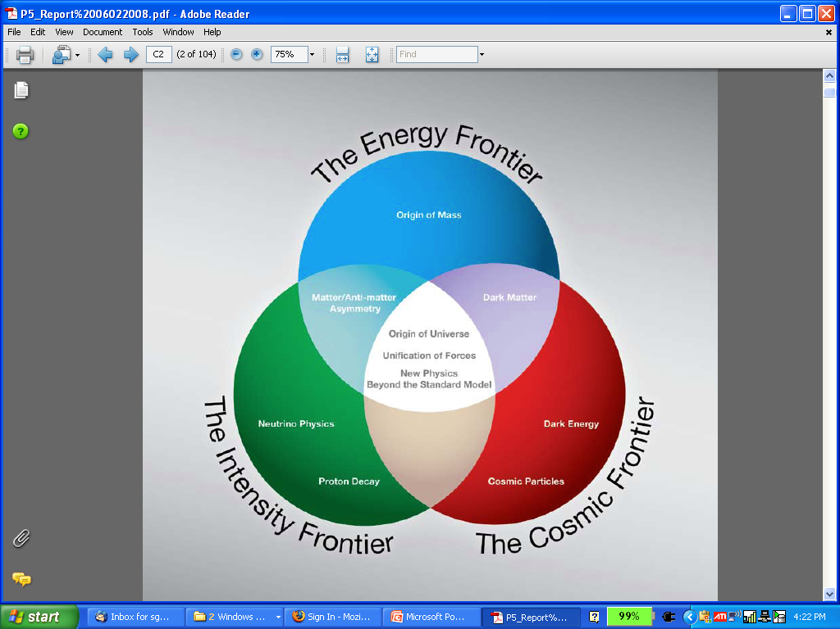
The Aims of the Muon Accelerator Program
  The MAP accelerator R&D effort is focused on developing a facility that can address critical questions spanning two frontiers…
  The Intensity Frontier:
  with a Neutrino Factory producing well-characterized ν beams for precise, high sensitivity studies
  The Energy Frontier:
  with a Muon Collider capable of reaching multi-TeV CoM energies
  and
  a Higgs Factory on the border between these Frontiers
The unique potential of a facility based on muon accelerators is physics reach that SPANS 2 FRONTIERS

Slide 4
Why Muon Accelerators?
Muon beams offer unique potential for high energy physics
  Tests of Lepton Flavor Violation
  Anomalous magnetic moment a hints of new physics (g-2)
  Can provide equal fractions of electron
  and muon neutrinos at high intensity for
  studies of neutrino oscillations –
  the Neutrino Factory concept
  Muon collisions offer a large coupling
  to the “Higgs mechanism”
  As with an e⁺e⁻ collider, a μ⁺μ⁻ collider would offer a precision probe of fundamental interactions

Slide 5
Why Muon Accelerators?
Of course the potential applications for high intensity muon sources go beyond high energy physics
  Muon radiography
  Atomic and nuclear physics
  applications, for example…
    Catalysis of atomic and molecular reactions
    Nuclear reactions
    Muon capture studies of radiological materials
  Among others…

Slide 6
The Issues - I
μ – an elementary charged lepton:
  200 times heavier than the electron
  2.2 μs lifetime at rest
The large muon mass strongly suppresses synchrotron
radiation
  Muons can be accelerated
  and stored using rings at
  much higher energy than
  electrons
  a Colliding beams can be of
  higher quality with reduced
  beamstrahlung
3 TeV
Beamstrahlung in
any e+e- collider
δE/E ∝ γ²

Slide 7
The Issues - II
Impacts of the short muon lifetime
  Acceleration and storage time of a muon beam is limited
  Collider a a new class of decay backgrounds must be dealt with
For a collider, beam energy measurement by g-2 method a precision Higgs mass/width determination
Muon beams produced as tertiary beams:
  Offers key accelerator challenges…

Slide 8
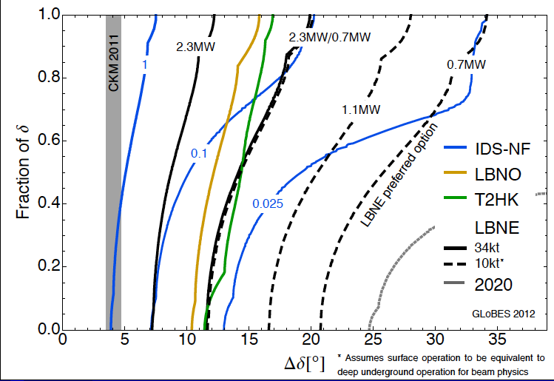
HEP Motivations: Neutrinos
CP violation physics reach of various facilities
Can we probe
the CP violation
in the neutrino
sector at the
same level as in
the CKM Matrix?
Measurement sensitivity
in the quark sector
0.025 IDS-NF:
700kW target,
no cooling,
2×10⁸ s running time
10-15 kTon detector
P. Coloma, P. Huber, J. Kopp, W. Winter

Slide 9
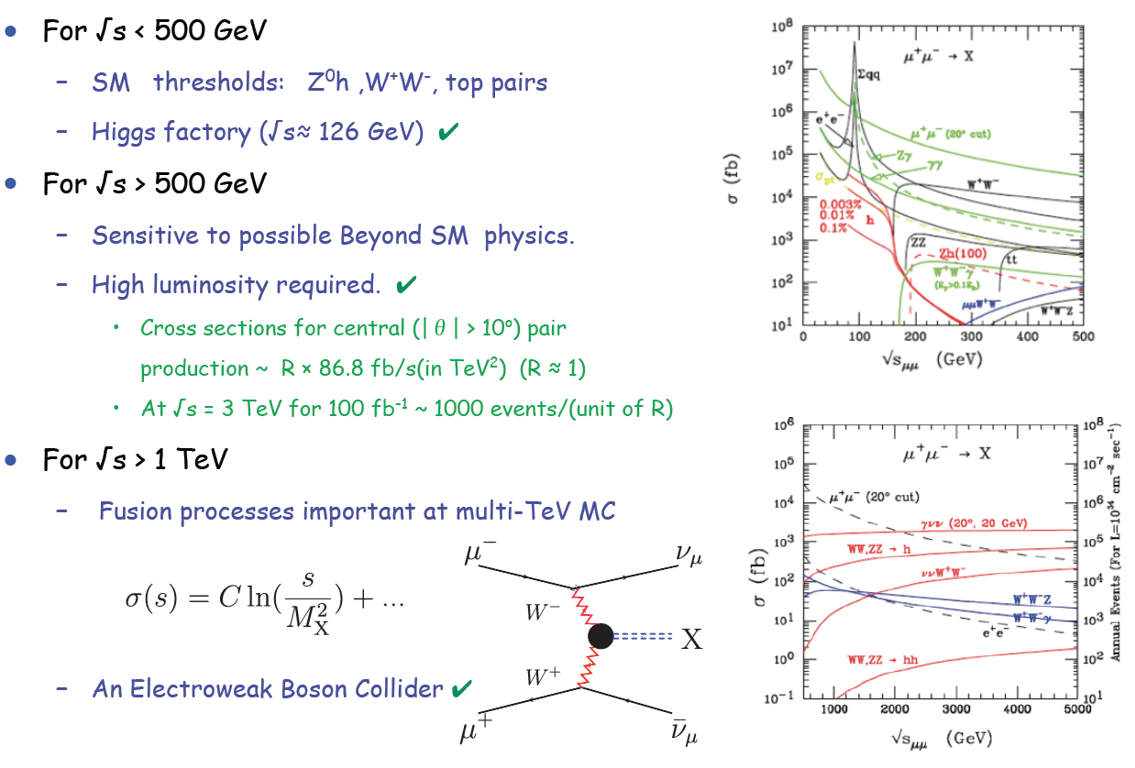
HEP Motivations: Colliders
A ~10 TeV muon collider provides discovery potential for BSM processes in the EW sector that can exceeds that of a 100 TeV pp machine
E. Eichten

Slide 10
The Muon Accelerator Program R&D Effort

Slide 11
The Muon Accelerator Program
By the end of this decade:
To deliver results that will permit the high-energy physics community to make an informed choice of the optimal path to a high-energy lepton collider and/or a next-generation neutrino beam facility
As well as…
To explore the path towards a facility that can provide cutting edge performance at both the Intensity Frontier and the Energy Frontier
To validate the concepts that would enable the Fermilab accelerator complex to support these goals

Slide 12
The U.S. Muon Accelerator Program

Slide 13
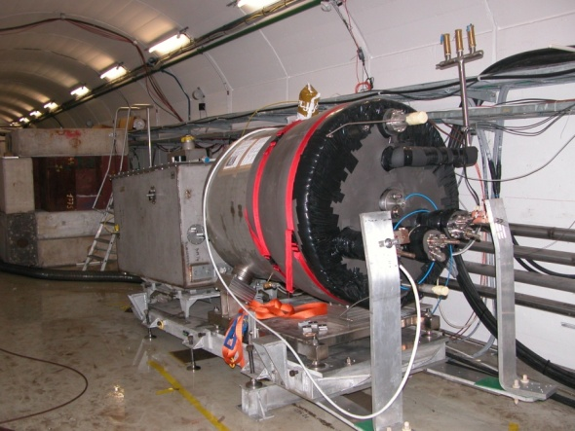

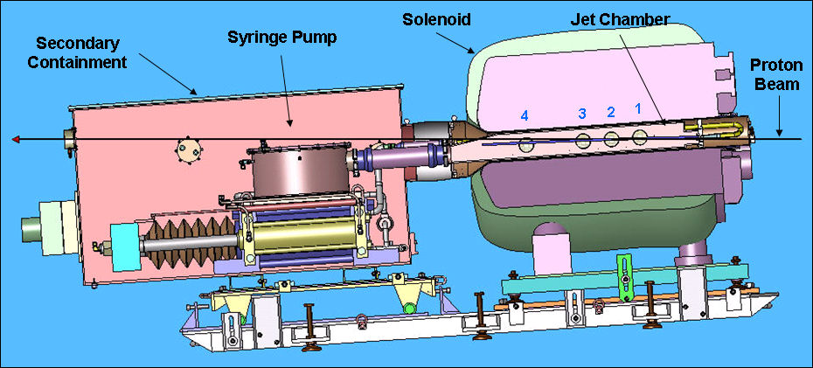
Key Technologies - Target
D. Kaplan (Tues - Plenary)
K. McDonald (Tues – WG3)
The MERIT Experiment at the CERN PS
  Demonstrated a 20m/s liquid Hg jet injected
  into a 15 T solenoid and hit with a
  115 KJ/pulse beam!
  Jets could operate with beam powers up to
  8 MW with a repetition rate of 70 Hz
MAP staging aimed at initial 1 MW target
1 cm
Hg jet in a 15 T solenoid
with measured disruption length ~ 28 cm

Slide 14
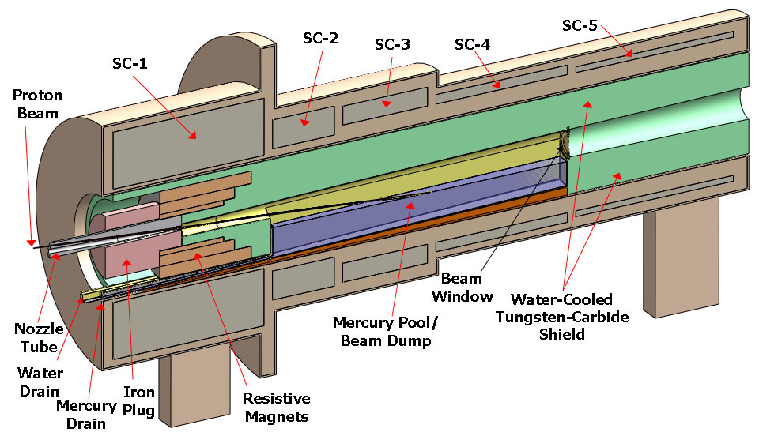
TechnoIogy Challenges – Capture Solenoid
A Neutrino Factory and/or Muon Collider Facility requires challenging magnet design in several areas:
  Target Capture Solenoid (15-20T with large aperture)
  E_{stored} ~ 3 GJ
  O(10MW) resistive
  coil in high radiation
  environment
  Possible application
  for High Temperature
  Superconducting
  magnet technology
K. McDonald (Tues – WG3)
H. Sayed (Tues – WG3)

Slide 15
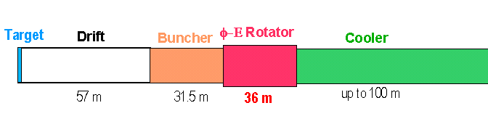
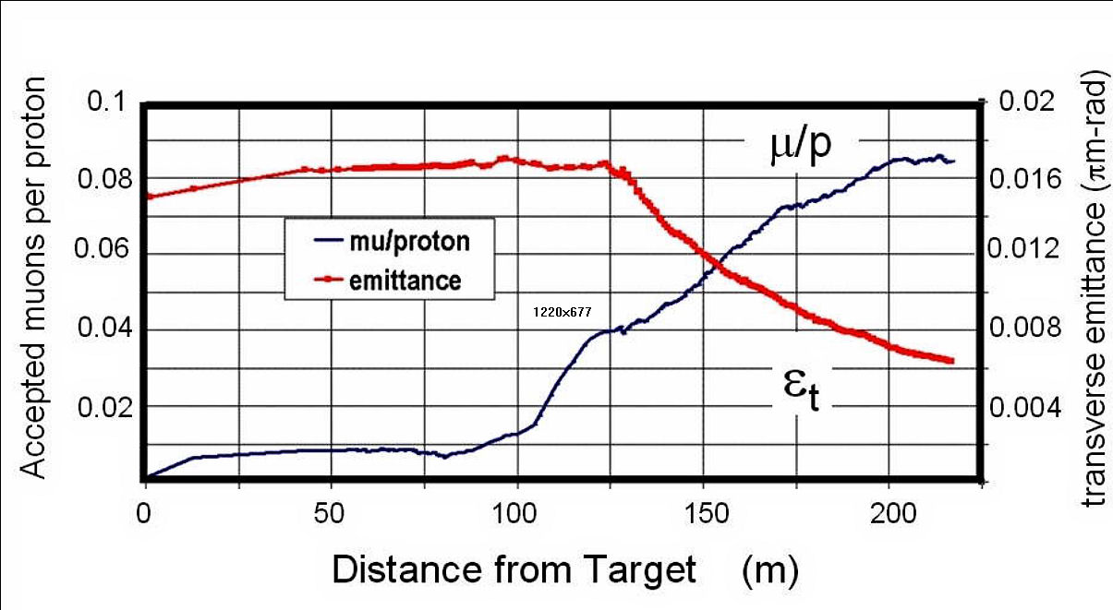
Technology Challenges – Tertiary Production
Neuffer
D. Neuffer (Tues – WG3)
A multi-MW proton source, e.g., Project X, will enable
O(10²¹) muons/year to be produced, bunched and cooled to fit within the acceptance of an accelerator.

Slide 16
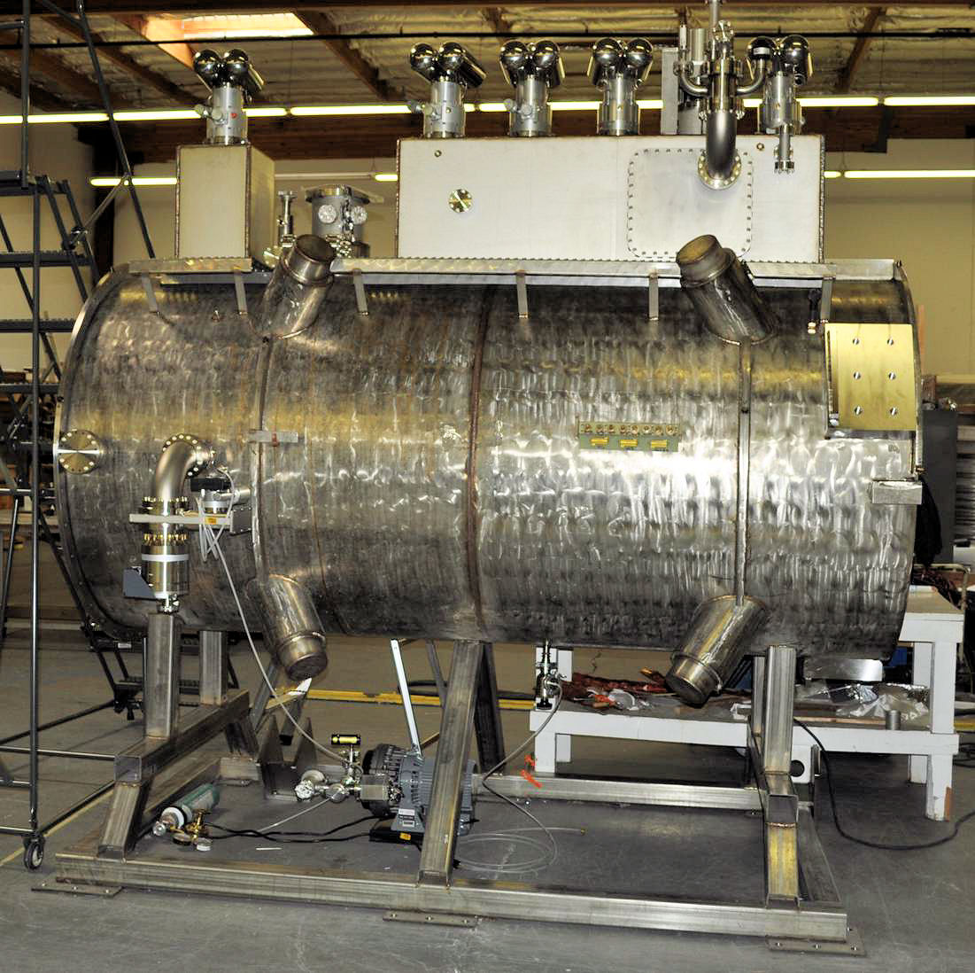
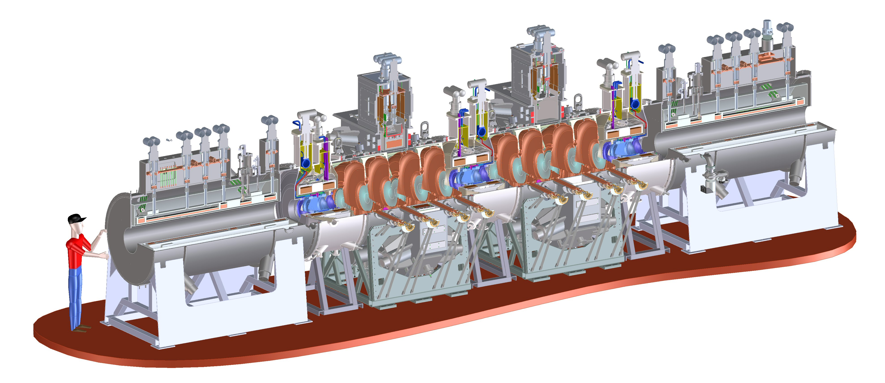
Technology Challenges - Cooling
Tertiary production of muon beams
  Initial beam emittance intrinsically large
  Cooling mechanism required, but no
  radiation damping
Muon Cooling a Ionization Cooling
    dE/dx energy loss in materials
    RF to replace p_{long}
MICE
  The Muon Ionization
  Cooling Experiment:
  Demonstrate the
  method and validate
  our simulations
RF-Coupling
Coil (RFCC)
Units
D. Adey, D. Kaplan
(Wed – WG3)
Spectrometer
Solenoids

Slide 17
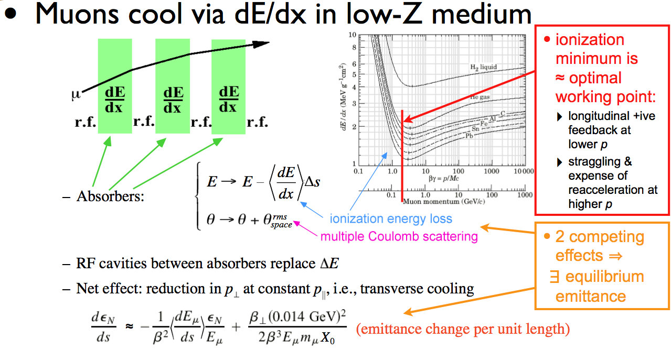
Ionization Cooling
D. Kaplan

Slide 18
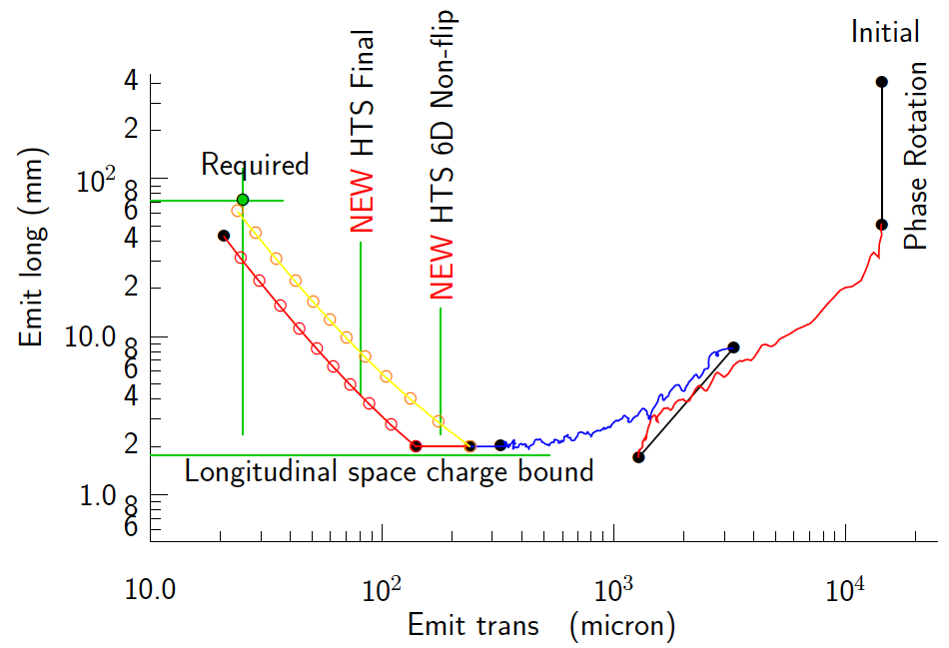
Technology Challenges - Cooling
Development of a cooling channel design to reduce the 6D
phase space by a factor of O(10⁶) → MC luminosity of O(10³⁴) cm⁻² s⁻¹
R. Palmer
Emittance Reduction
via Ionization Cooling
Some components beyond state-of-art:
  Very high field HTS solenoids (≥30 T)
  High gradient RF cavities operating in multi-Tesla fields
The program targets critical magnet and cooling cell technology demonstrations within its feasibility phase.
D. Stratakis (Wed – WG3)
R. Palmer, K. Yonehara, D. Neuffer (Thu – WG3)

Slide 19
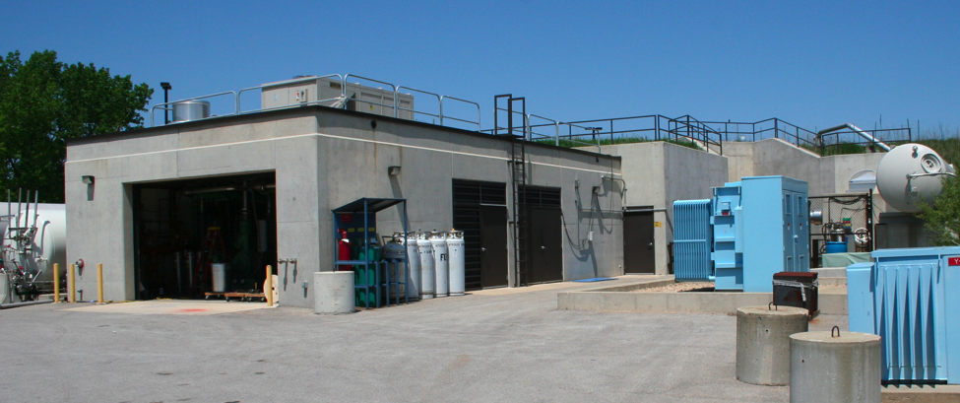
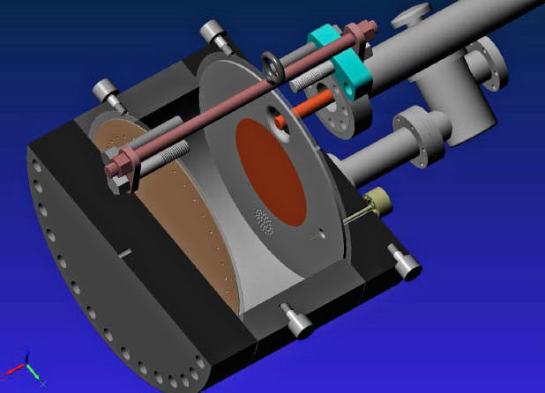
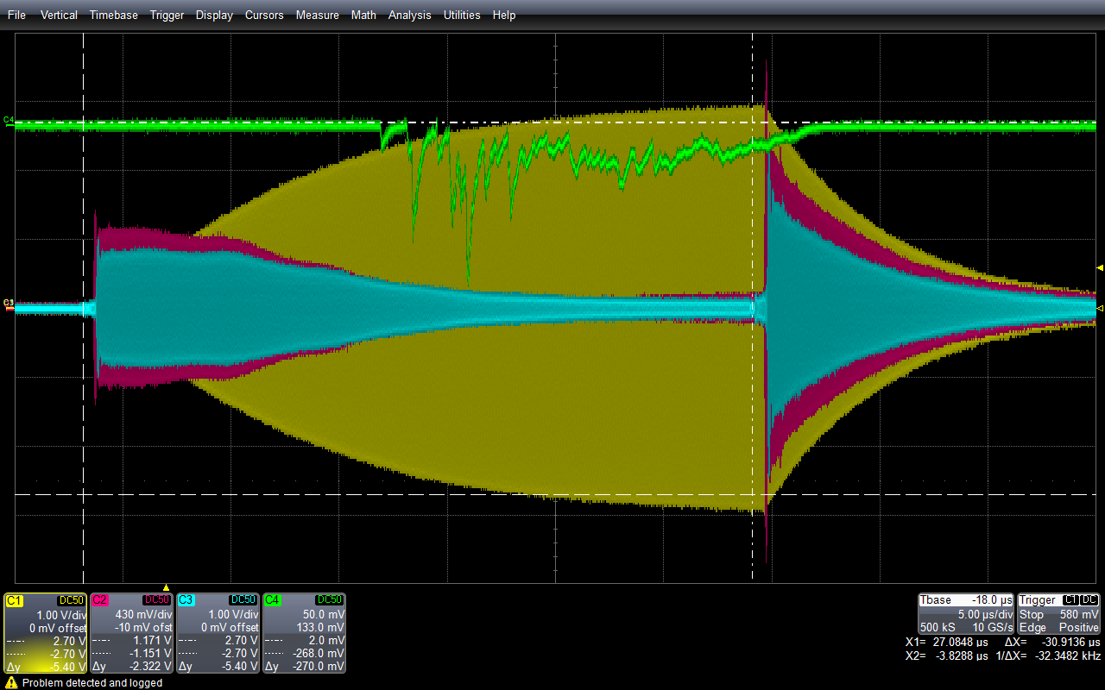
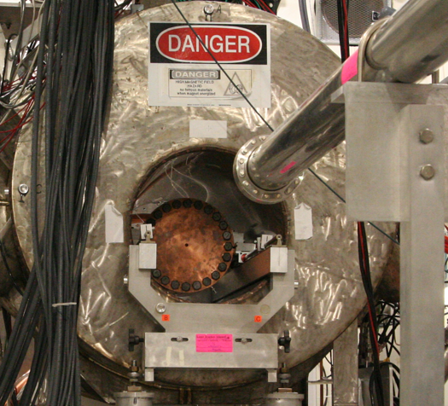
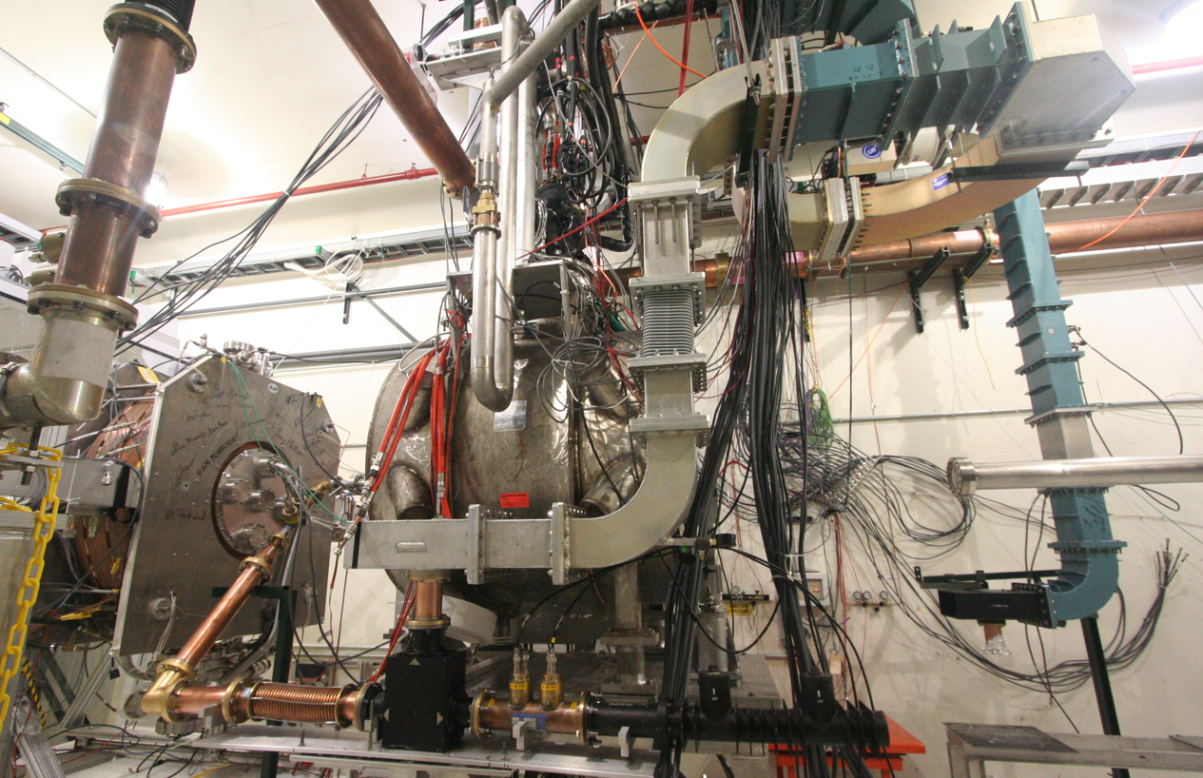
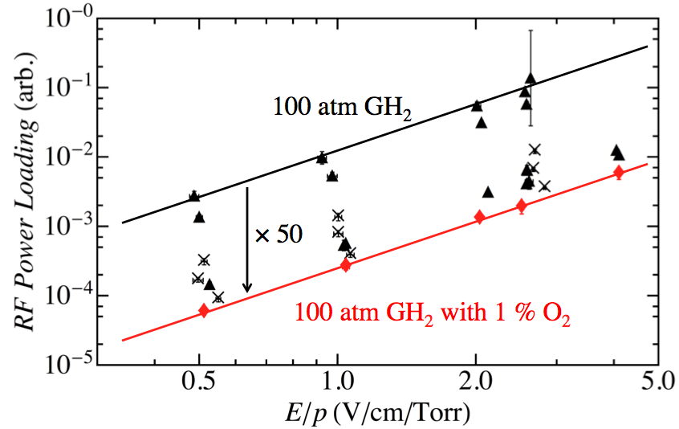
Elements of the R&D Program
MuCool Test Area
Entrance of MTA
exp. hall
Vacuum
RF Cavity
Compressor + refrigerator room
400 MeV
H⁻ Beam
20 MV/m in 3 Tesla
MTA Hall
Gas-Filled RF cell
201 MHz cavity
SC magnet
400 MeV H⁻ beam

Slide 20
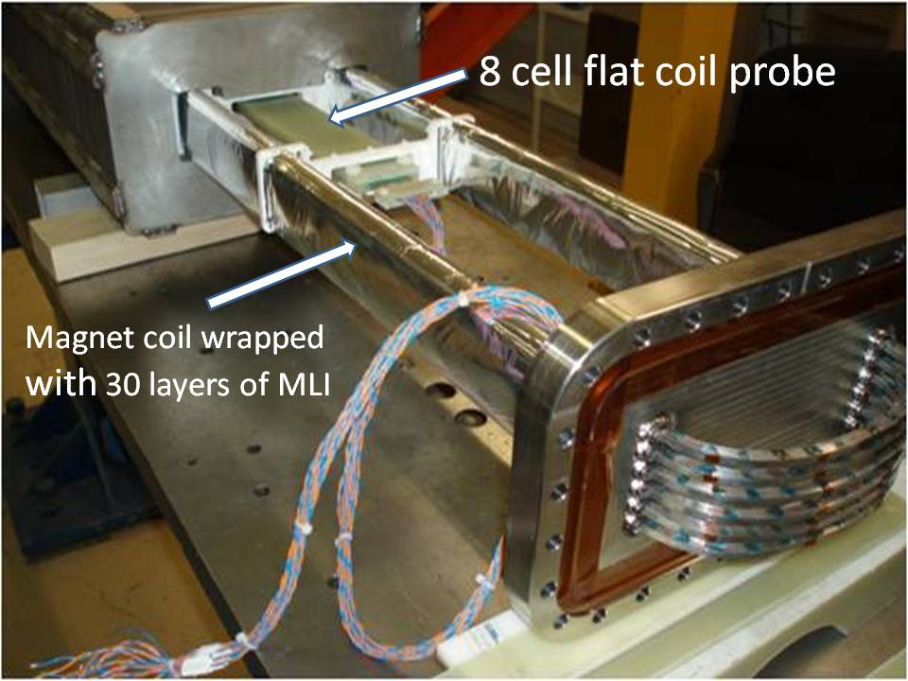
Technology Challenges - Acceleration
Muons require an ultrafast accelerator chain
a Beyond the capability of most machines
Solutions include:
  Superconducting Linacs
  Recirculating Linear Accelerators (RLAs)
  Fixed-Field Alternating-Gradient (FFAG) Machines
  Rapid Cycling Synchrotrons (RCS)
  RCS requires
  2 T p-p magnets
  at f = 400 Hz
  (U Miss & FNAL)
EMMA – FFAG
JEMMRLA Proposal:
JLAB Electron Model of
Muon RLA with Multi-pass
Arcs

Slide 21
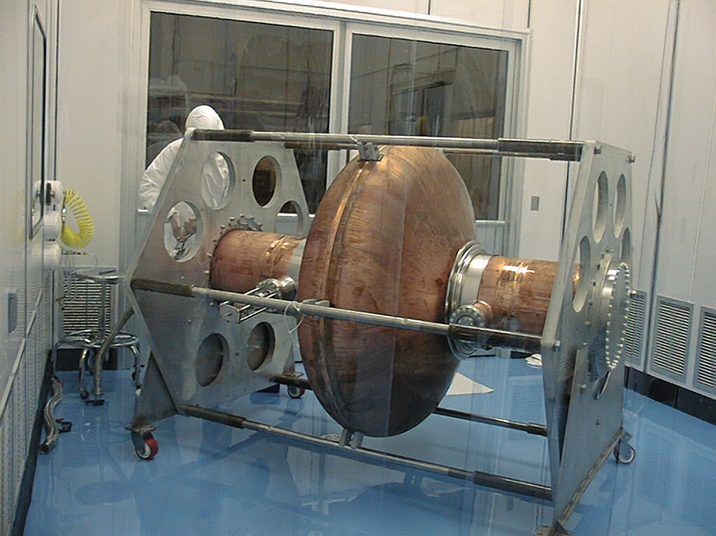
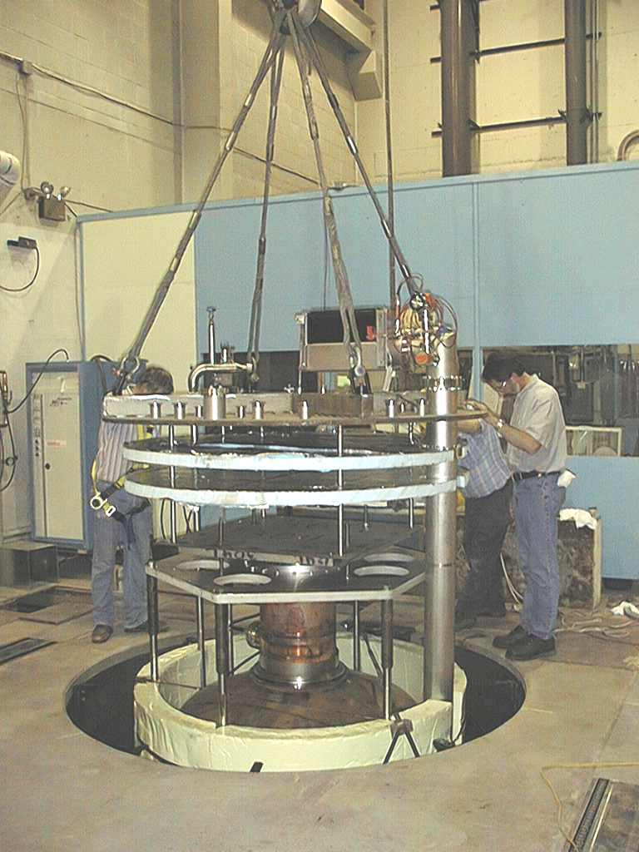
Superconducting RF Development
201 MHz SCRF R&D
Major dia.: 1.4 m
Cavity going into test pit
in Newman basement
(Cornell University)
400mm BT
Cavity length: 2 m
Pit: 5m deep X 2.5m dia.

Slide 22
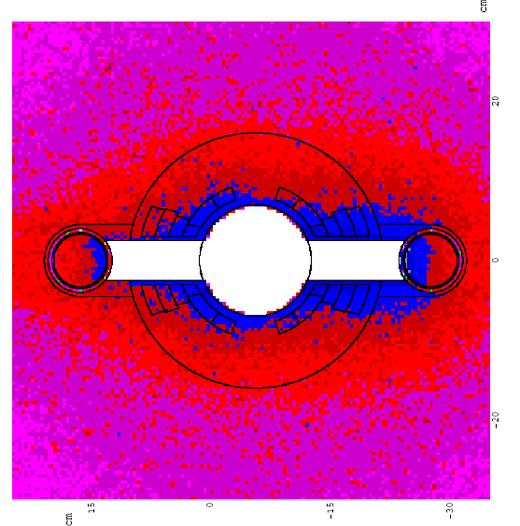
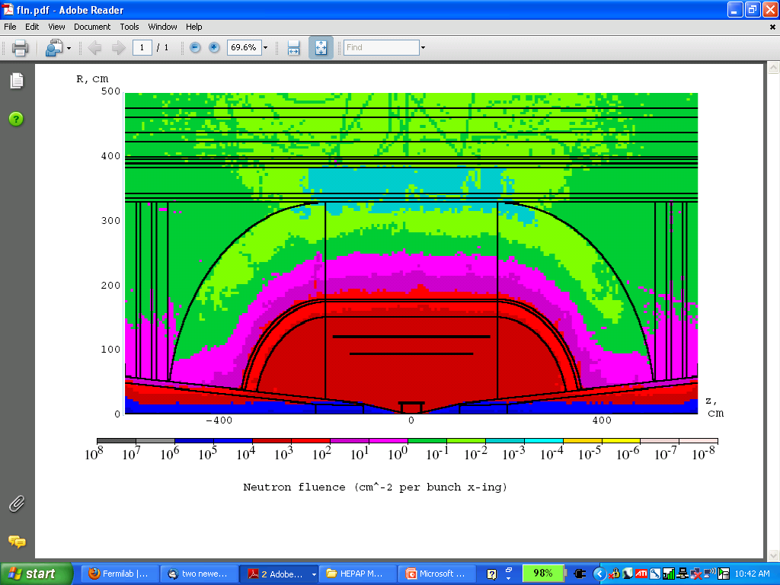
Technology & Design Challenges – Ring, Magnets, Detector
Emittances are relatively large, but muons circulate for ~1000 turns before decaying
  Lattice studies for 126 GeV,
  1.5 & 3 TeV CoM
High field dipoles and
quadrupoles must operate
in high-rate muon decay
backgrounds
  Magnet designs under study
Detector shielding & performance
  Initial studies for 126 GeV, 1.5 TeV, and
  3 TeV using MARS background simulations
  Major focus on optimizing shielding
  configuration
MARS energy deposition map for 1.5 TeV collider dipole

Slide 23
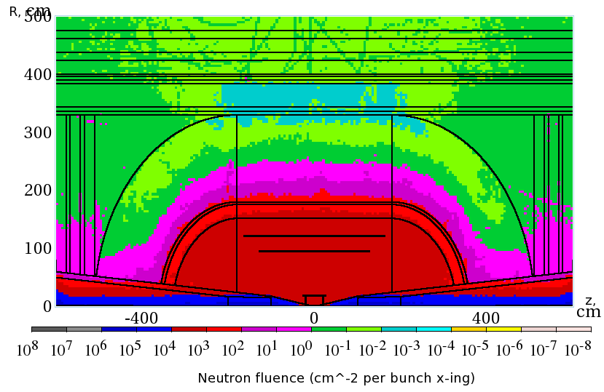
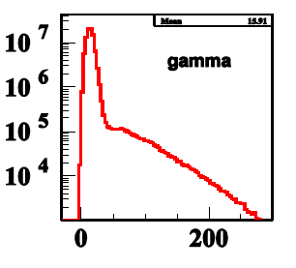
Backgrounds and Detector
Much of the background is soft and out of time
Nanosecond time resolution can reduce backgrounds by three orders of magnitude
Requires a fast, pixelated tracker and calorimeter.
Non-ionizing background ~ 0.1 x LHC
But crossing interval 10μs/25 ns 400 x
 | Cut | Rejection
Tracker hits | 1 ns, dedx | 9x10⁻⁴
Calorimeter neutrons | 2 ns | 2.4x10⁻³
Calorimeter photons | 2 ns | 2.2x10⁻³
GeV/c
ns

Slide 24
Recent Highlights in Cooling Channel Technology R&D

Slide 25
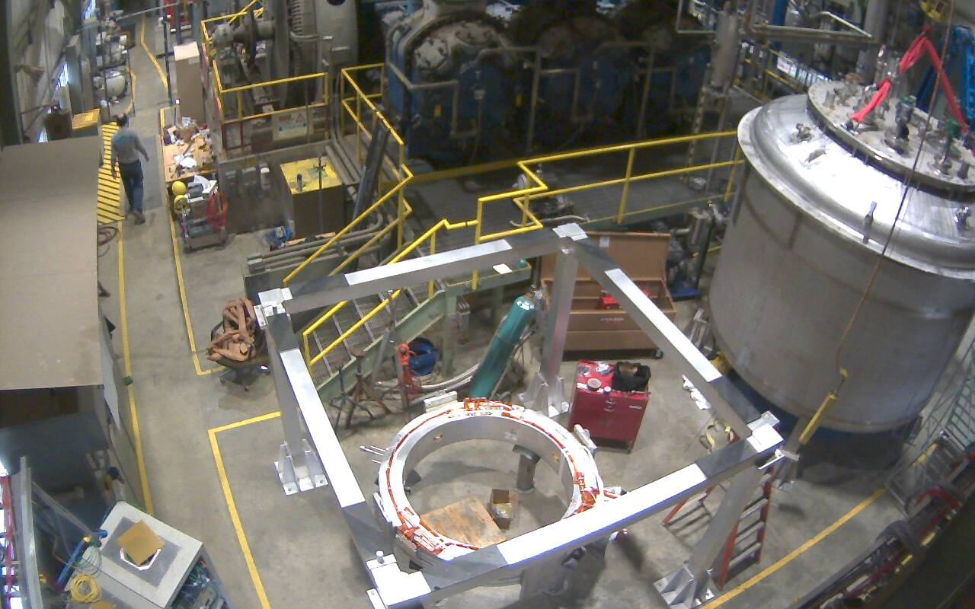
Recent Progress I - MICE
First Coupling Coil Cold Mass
Being Readied for Training
First Spectrometer Solenoid
Now Commissioned!
Fermilab Solenoid Test Facility
Currently preparing for MICE Step IV
Includes:
  Spectrometer Solenoids
  First Focus Coil
Provides:
  Direct measurement of interactions with absorber materials
  Important simulation input
MICE
RF-Coupling
Coil (RFCC)
Units
Spectrometer
Solenoids

Slide 26
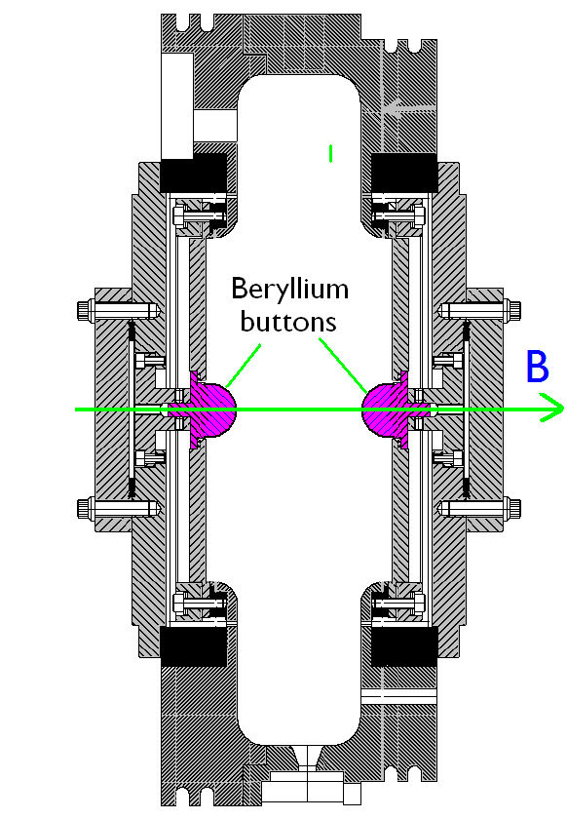
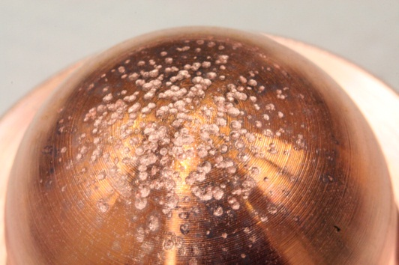
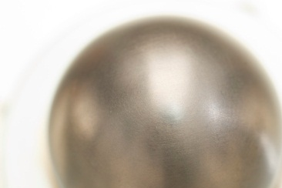
Recent Progress II – Cavity Materials
Breakdown tests with Be and Cu Buttons
Both reached ~31 MV/m
Cu button shows significant pitting
Be button shows minimal damage
a Materials choices offer the possibility of more robust operation in mangetic fields
Cu
Be

Slide 27
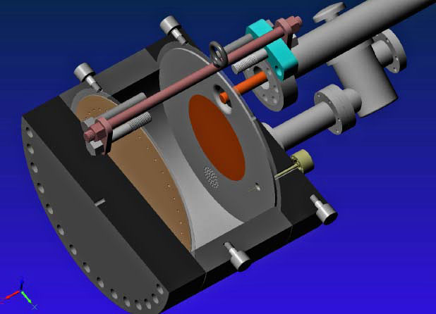
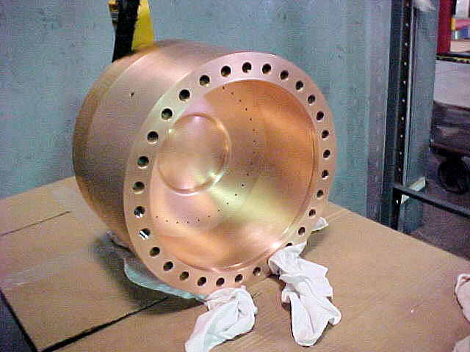
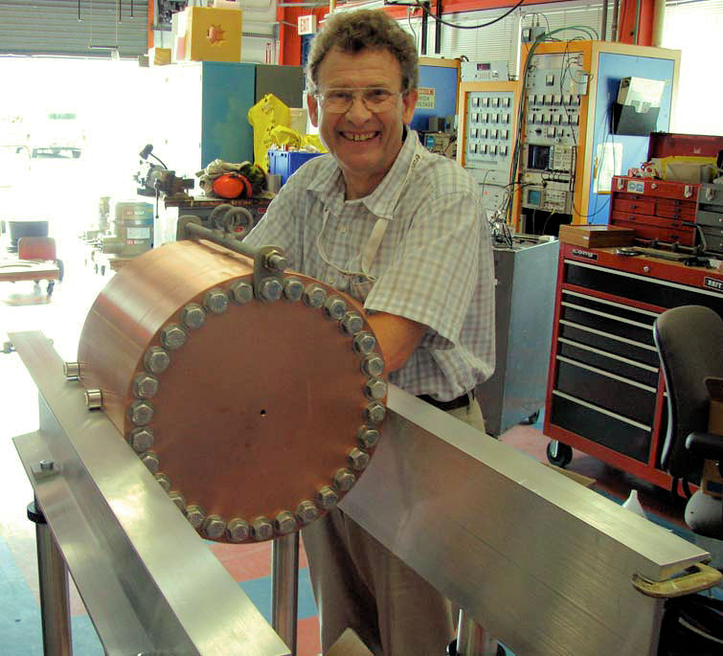
Recent Progress III – Vacuum RF
All-Seasons
Cavity
(designed for both
vacuum and high
pressure operation)
Vacuum Tests at B = 0 T & B = 3 T
  Two cycles: B₀ a B₃ a B₀ a B₃
No difference in maximum stable operating gradient
  Gradient ≈ 25 MV/m
Demonstrates possibility of successful operation of vacuum cavities in magnetic fields with careful design

Slide 28
Recent Progress IV: High Pressure RF
Gas-filled cavity
  Can moderate dark current and breakdown currents in magnetic fields
  Can contribute to cooling
  Is loaded, however, by beam-induced plasma
Electronegative Species
  Dope primary gas
  Can moderate the loading effects of beam-induced plasma by scavenging the relatively mobile electrons
1% Dry Air (0.2 % O2) in GH2
Pure GH2
1% Dry Air
(0.2 % O2)
in GH2 at
B = 3 T
Beam on
~50× change in
RF dissipation
5/22/12
E₀ = 25 MV/m
28
E₀ = 25 MV/m

Slide 29
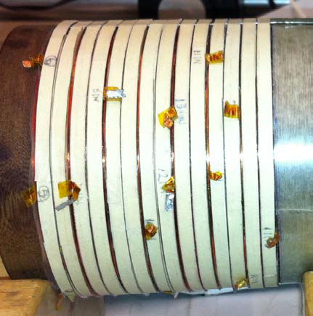
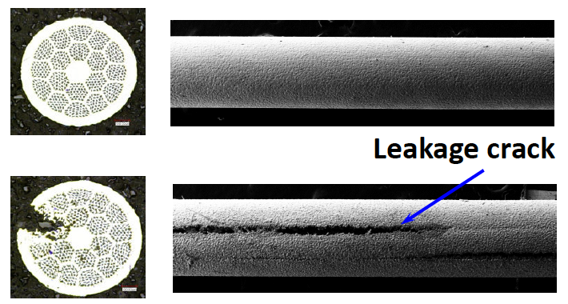
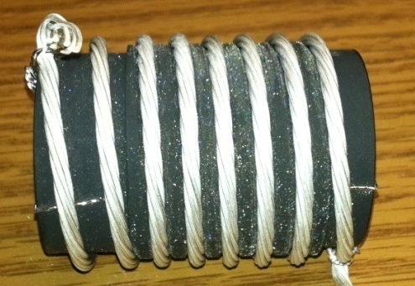
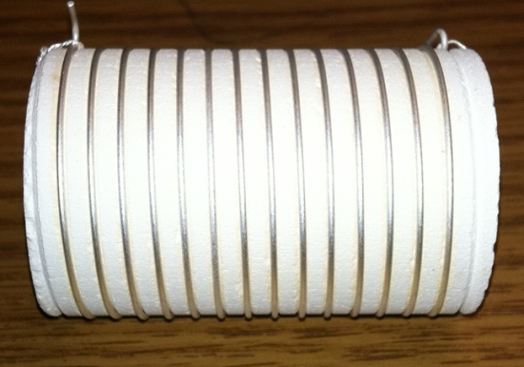
Recent Progress V: High Field Magnets
Progress towards a demonstration of a final
stage cooling solenoid:
Demonstrated 15+ T (16+ T on coil)
  ~25 mm insert HTS solenoid
  BNL/PBL YBCO Design
  Highest field ever in HTS-only solenoid (by a factor of ~1.5)
BSCCO-2212 Challenge:
Damage to wire during
reaction
Hyperbaric reaction now a
proven solution
BSCCO-2212 Cable -
Transport measurements show that FNAL cable attains 105% J_{c} of that of the single-strand
Multi-strand cable utilizing chemically compatible alloy and oxide layer to minimize cracks

Slide 30
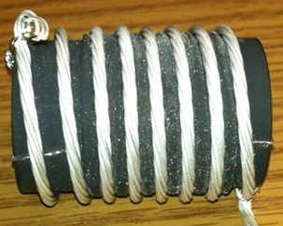
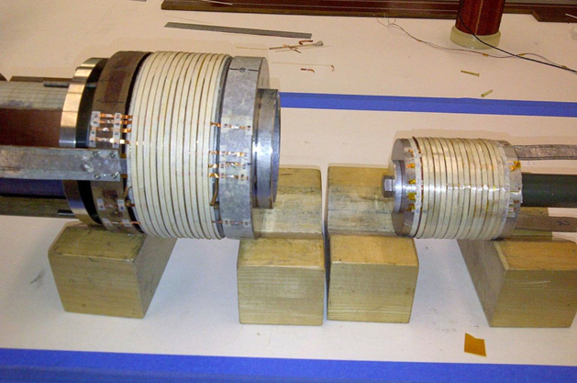
MAP: Recent Technology Highlights
Successful Operation of 805 MHz “All Seasons” Cavity in 3T Magnetic Field under Vacuum
MuCool Test Area/Muons Inc
World Record
HTS-only Coil
15T on-axis field
16T on coil
PBL/BNL
Demonstration of High Pressure RF Cavity in 3T Magnetic Field with Beam
Extrapolates to
μ-Collider Parameters
MuCool Test Area
Breakthrough in HTS Cable Performance with Cables Matching Strand Performance
FNAL-Tech Div
T. Shen-Early Career Award
The Path to a Viable
Muon Ionization
Cooling Channel
1% Dry Air (0.2% O2) in GH2
Pure GH2
1% Dry Air
(0.2 % O2)
in GH2 at
B = 3T
~50X reduction in
RF power dissipation
E₀ = 25 MV/m

Slide 31
The Muon Accelerator Staging Study (MASS) and MAP Timelines
Also see next talk by J.-P. Delahaye

Slide 32
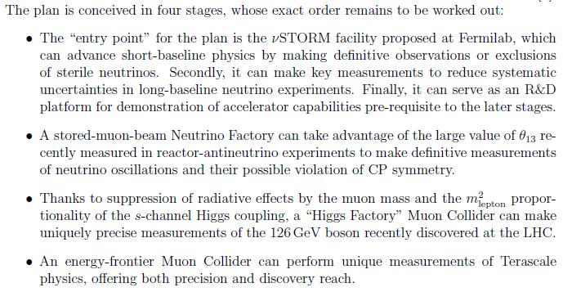
A Staged Muon-Based Neutrino and Collider Physics Program

Slide 33
Muon Accelerators
And Potential Staging Steps
Program Baselines

Slide 34
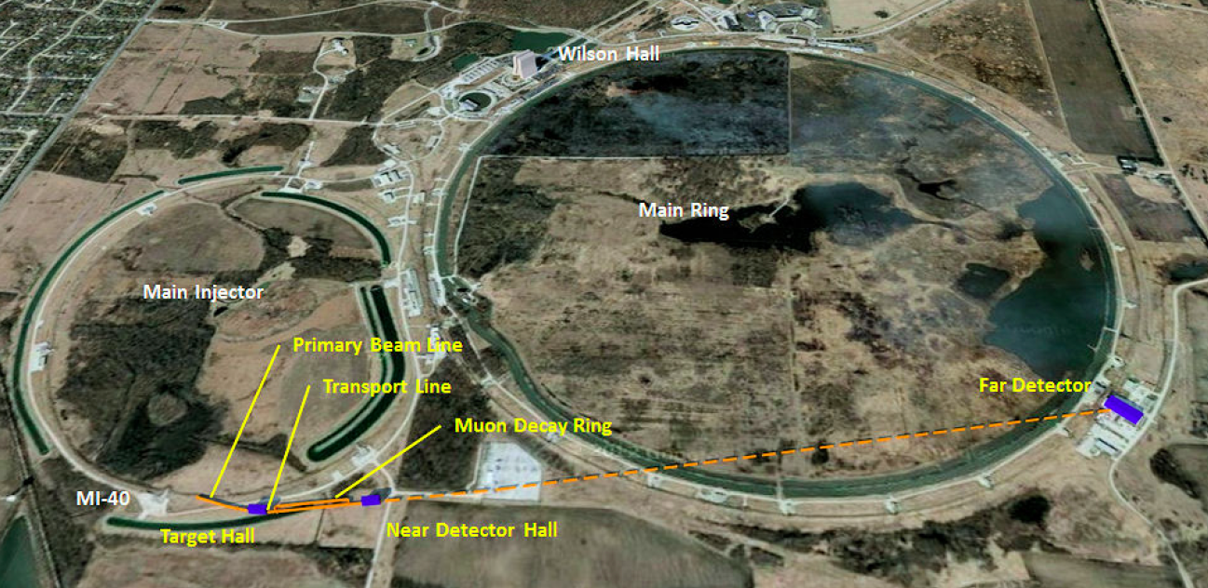
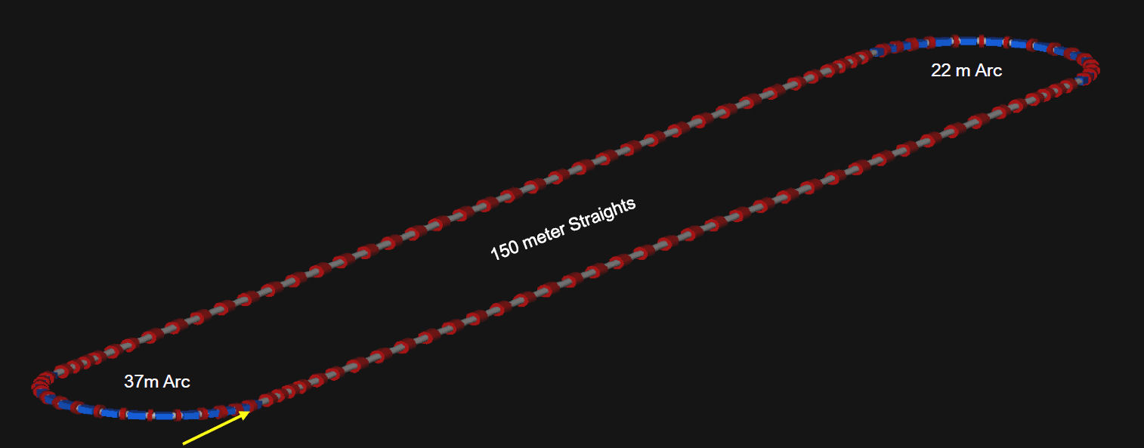
All proposed muon-based accelerators would easily fit at Fermilab
νSTORM (entry level Neutrino Factory)
Intensity Frontier Neutrino Factory
νSTORM would provide important physics output and critical R&D leverage
The IDS-NF Options

Slide 35

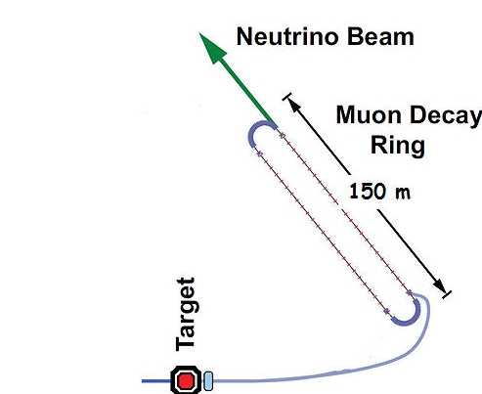
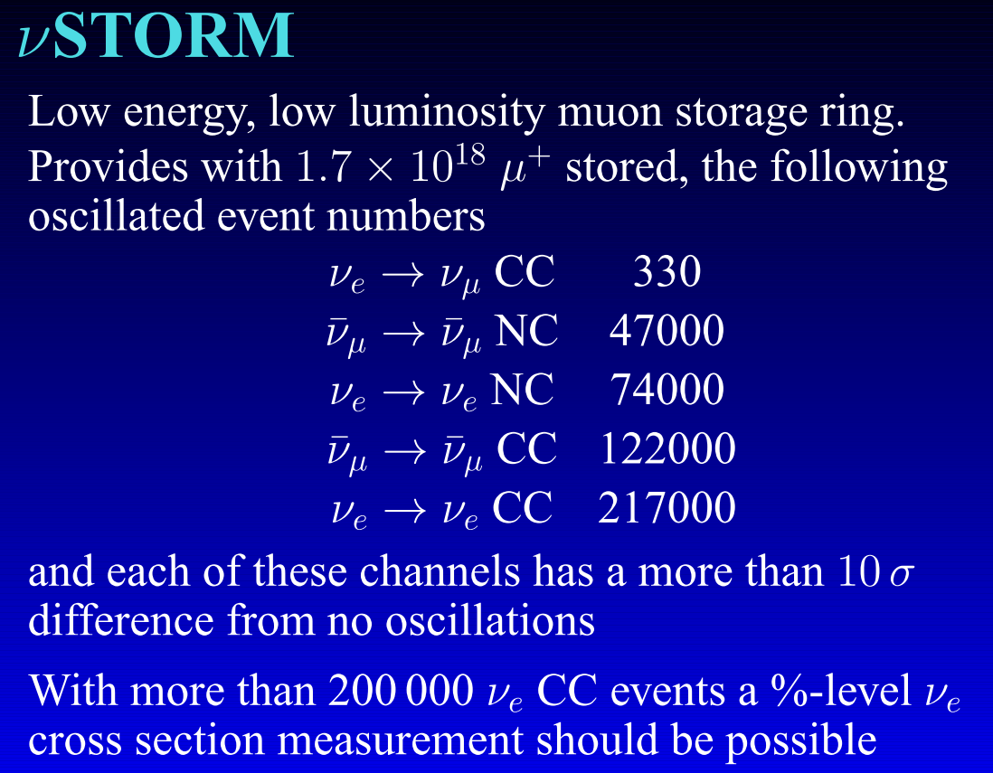
Neutrinos from Stored Muons
(arXiv: 1206.0294 (LOI), Fermilab P-1028)
An entry-level NF?
A.Bross
NuFACT12
DOES NOT
Require the
Development of
ANY
New Technology
3.8 GeV/c
stored μ
10-100kW

Slide 36
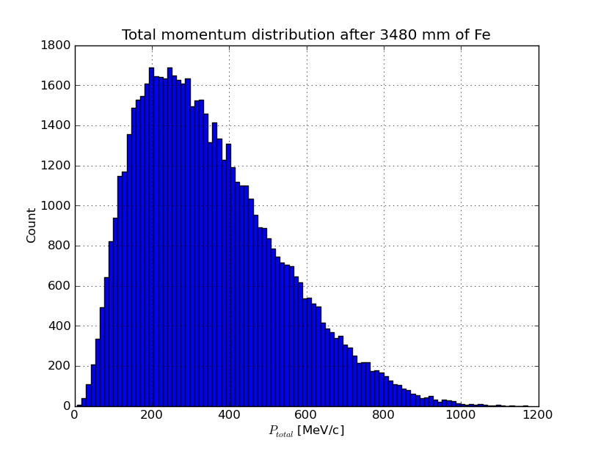
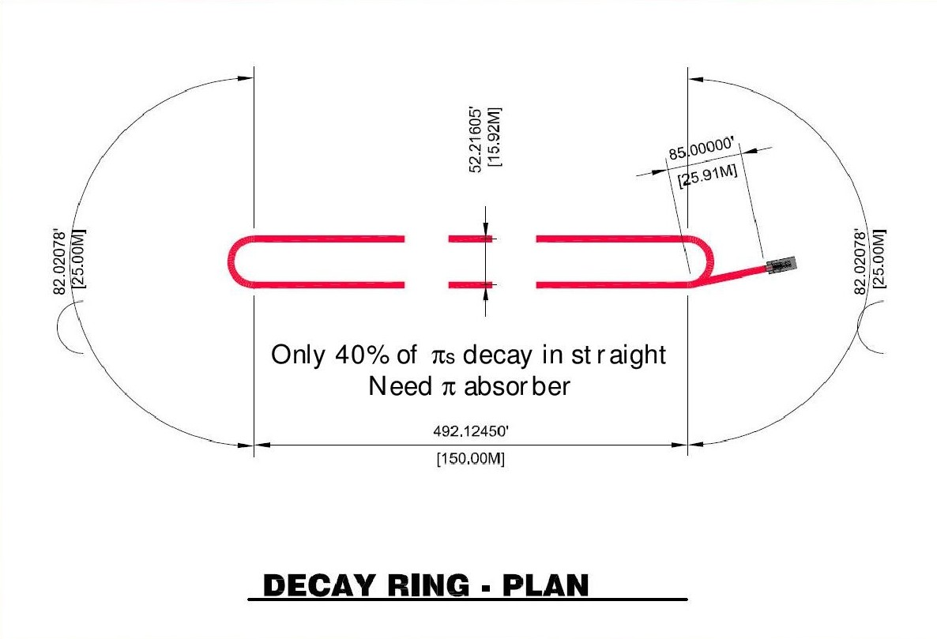
νStorm as an Accelerator R&D Platform
A high-intensity pulsed muon source
100<p_{μ}<300 MeV/c muons
  Using extracted beam from ring
  10¹⁰ muons per 1 μsec pulse
Beam available simultaneously with physics operation
  Sterile ν search
  ν cross section measurements needed for ultimate precision in long baseline measurements
νSTORM also provides the opportunity to design, build and test decay ring instrumentation (BCT, momentum spectrometer, polarimeter) to measure and characterize the circulating muon flux.
D. Neuffer, J.-B. Lagrange, A. Bross
(Wed – WG3)
J. Morfin (Wed – WG2)
A. Bross (Sat – Plenary)

Slide 37
The ν Sector and NuMAX
We want to provide
the option to get here

Slide 38
Neutrino Factory Staging (MASS)
Preliminary Staging Plan Based on
Project Stage 2
* supports multiple detector technologies

Slide 39
How Could the Staged NF to Homestake Perform?
What if we send beam to LBNE?
1 MW, no muon cooling
a 3 MW, w/cooling
a 4 MW, w/cooling
What if we were able to have a magnetized LAr detector?
Gray bands represent range of possible
detector performance per arXiv:0805.2019
Plots courtesy of P. Huber
Plots assume
100 kt-years

Slide 40
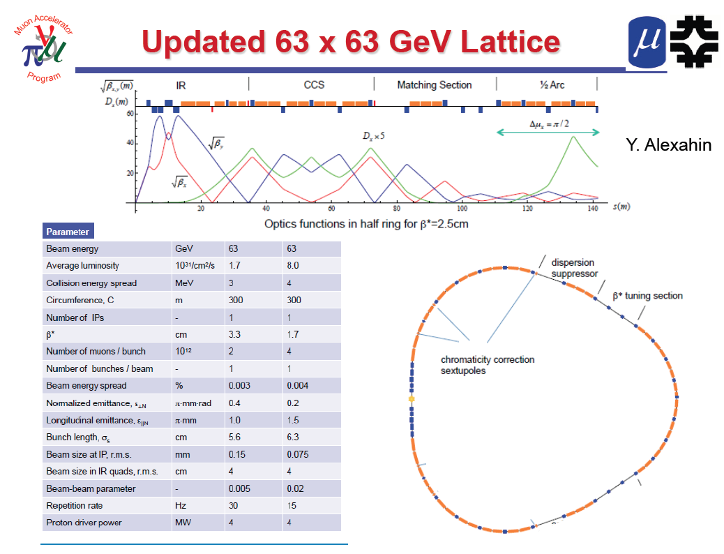
Next: Possibly a muon-based Higgs Factory or Energy Frontier Muon Collider
One IP in
the latest
design

Slide 41
Multi-TeV Collider – 1.5 TeV Baseline
Y. Alexahin
Parameter | Unit | Value
Beam energy | TeV | 0.75
Repetition rate | Hz | 15
Average luminosity / IP | 10³⁴/cm²/s | 1.1
Number of IPs, N_{IP} | - | 2
Circumference, C | km | 2.73
β* | cm | 1 (0.5-2)
Momentum compaction, α_{p} | 10⁻⁵ | -1.3
Normalized r.m.s. emittance, ε_{⊥N} | π⋅mm⋅mrad | 25
Momentum spread, σ_{p}/p | % | 0.1
Bunch length, σ_{s} | cm | 1
Number of muons / bunch | 10¹² | 2
Number of bunches / beam | - | 1
Beam-beam parameter / IP, ξ | - | 0.09
RF voltage at 800 MHz | MV | 16
Larger chromatic function (Wy) is corrected first with a single sextupole S1, Wx is corrected with two sextupoles S2, S4 separated by 180° phase advance.

Slide 42
Muon Collider Parameters
Exquisite Energy Resolution
Allows Direct Measurement
of Higgs Width
Success of advanced cooling
concepts a several × 10³²
Site Radiation mitigation with depth and lattice design: ≤ 10 TeV

Slide 43
MAP Timeline
 | 2010 |  | ~2020 |  | ~2030
Muon Accelerator R&D Phase
Proton Driver Implementation – Project X @ FNAL
Intensity Frontier
Energy Frontier
MAP Feasibility Assessment
Advanced Systems R&D
Muon Ionization Cooling Experiment (MICE)
Indicates a date when an informed decision should be possible
Pr X Stage I
Pr X Stage II
Pr X Stage III & IV
IDS-NF RDR
At Fermilab, critical physics production could build on Stage II of Project X
Proposed Muon Storage Ring Facility (νSTORM)
Evolution of Long Baseline ν Factory
Collider Conceptual ➔ Technical Design
Collider Construction ➔
Physics Program

Slide 44
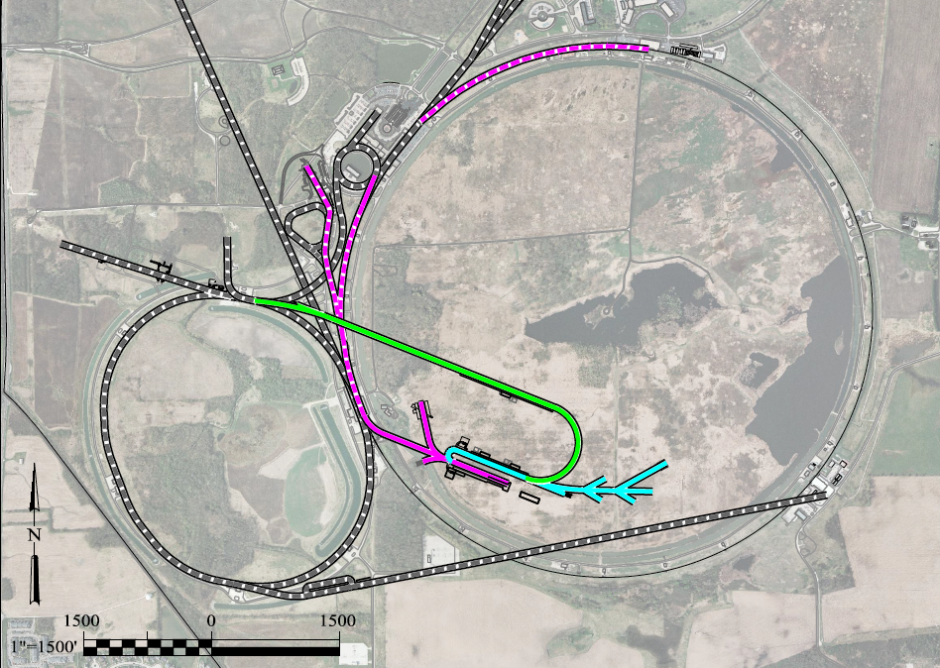
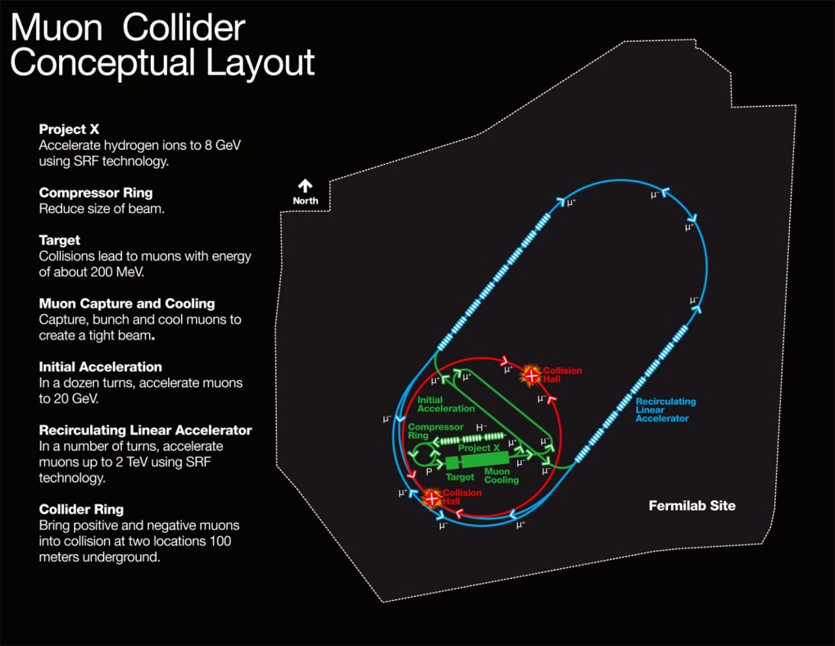
A Muon Accelerator Facility for Cutting Edge Physics on the Intensity and Energy Frontiers
Based on Project X Stage II
A TeV-scale Collider
at Fermilab
To SURF
LBNE
RLA to 63 GeV +
300m Higgs Factory
Buncher/
Compressor
Rings
NF Decay Ring:
νs to SURF
And other potential applications for high quality μ beams in the MeV to TeV energy range
Front End+4D+6D
Linac + RLA to ~5 GeV
Project X
Stage II
Project X
Stage I
A 1.5 TeV collider
would fit within the
Tevatron ring
ft
νSTORM + Muon Beam
R&D Facility
ft
44

Slide 45
Concluding Remarks

Slide 46
Some Thoughts…
The unique feature of muon accelerators is the ability to provide cutting edge performance on both the Intensity and Energy Frontiers
  This is well-matched to the direction specified by the P5 panel for Fermilab
  The possibilities for a staged approach make this particularly appealing in a time of constrained budgets
  νSTORM would represent a critical first step in providing a muon-based accelerator complex
World leading Intensity Frontier performance could be provided with a Neutrino Factory based on Project X Stage II
  This would also provide the necessary foundation for a return to the Energy Frontier with a muon collider on U.S. soil
A Muon Collider Higgs Factory
  Would provide exquisite energy resolution to directly measure the width of the Higgs. This capability would be of crucial importance in the MSSM doublet scenario.
  The first collider on the path to a
  multi-TeV Energy Frontier lepton machine?

Slide 47
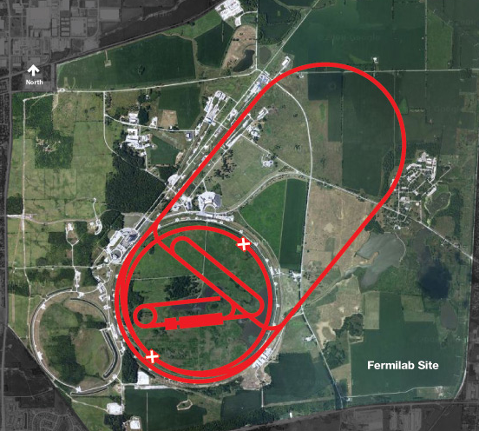
Conclusion
Through the end of this decade, the primary goal of MAP is demonstrating the feasibility of key concepts needed for a neutrino factory and muon collider
a Thus enabling an informed decision on the path forward for the HEP community
Muon Collider Concept
A promising R&D program is in progress!

Slide 48
Muon Accelerator Program Contacts
MAP Web-Site: http://map.fnal.gov/
MAP Management Team:
Mark Palmer, Director: mapalmer@fnal.gov
Robert Ryne, L1 Manager for Design and Simulation:
rdryne@lbl.gov
Harold Kirk, L1 Manager for Technology Development:
hkirk@bnl.gov
Daniel Kaplan, L1 Manager for Systems Demonstrations:
kaplan@iit.edu
Alan Bross, L1 Manager for MICE Construction:
bross@fnal.gov
Ron Lipton, L1 Manager for Detectors and Physics:
lipton@fnal.gov
US HEP Community Planning Effort
Jean-Pierre Delahaye, Muon Accelerator Staging Study
jpd@slac.stanford.edu

Slide 49
Acknowledgments
I would personally like to thank Steve Geer, Mike Zisman, Bob Palmer as well as the MAP L1 & L2 managers for their help in familiarizing me with the program since I took over as director just over a year ago
The MAP Effort -
Labs: ANL, BNL, FNAL, JLAB, LBNL, ORNL, SLAC
Universities: Chicago, CMU, Cornell, ICL, IIT, Princeton, SUNY-SB, UC-Berkeley, UCLA, UC-Riverside, UMiss, VT
Companies: Muons, Inc; Particle Beam Lasers

