Slide 1

Neutrinos from Stored Muons nuSTORM
physics with a μ storage ring
Great things Big & Small

Slide 2
Outline
Introduction
Physics motivation
Current facility design status
Moving forward and Conclusions

Slide 3
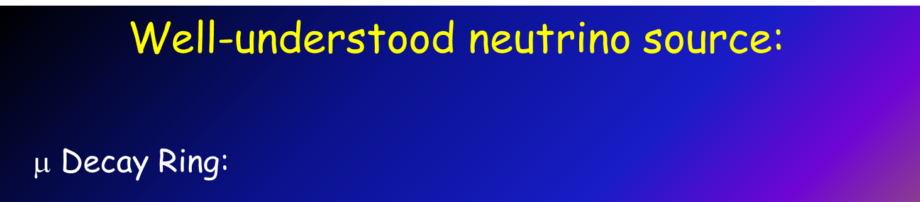
Introduction
For over 30 years physicists have been talking about doing ν experiments with νs from μ decay
Flavor content fully known
Energy spectrum known to a few parts in 10⁴
“Near Absolute” Flux Determination is possible in a storage ring
  Beam current, polarization, beam divergence monitor, μ_{p} spectrometer
Overall, there is tremendous control of systematic uncertainties with a well designed facility

Slide 4
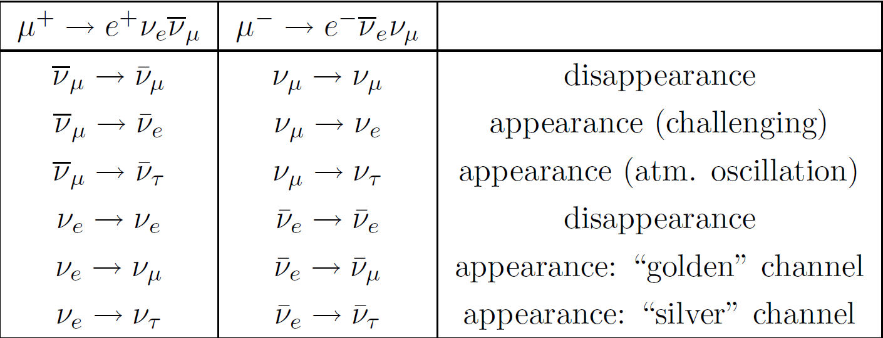
ν physics with a μ storage ring –
Neutrino Factory
12 channels accessible
if E_{ν} is above the τ threshold

Slide 5
NuFact2013 - #15
Well, “we” have been taking about it within this venue for 15 years!
This meeting has evolved over the last 1½ decades.
  Some say it has lost focus (de-evolved?)
What has been somewhat lost is the focus on “A New Way to do Neutrino Physics”
  Although detector & accelerator technology has advanced, where we are headed relies on concepts that existed when NuFact started.
    Now moving to more intensity & Bigger – much Bigger
  To paraphrase James Carville – “It is the beam stupid.”
Paul will give overview of our “holy grail” – the NF
  But we now realize it is difficult and expensive
What I will discuss (nuSTORM) is a real option to take the first step along this long journey and do great physics
  We can do it now.

Slide 6
nuSTORM is an “affordable” μ-based ν beam “First Step”
It is a near-term facility
  Because, technically, we can do it now
Addresses the SBL, large δm² ν-oscillation regime
  I will show it can convincingly resolve the question
Provides a beam for precision ν interaction physics
Accelerator & Detector technology test bed
  Potential for intense low energy muon beam
  Provides for μ decay ring R&D (instrumentation) & technology demonstration platform
  Provides a ν Detector Test Facility

Slide 7
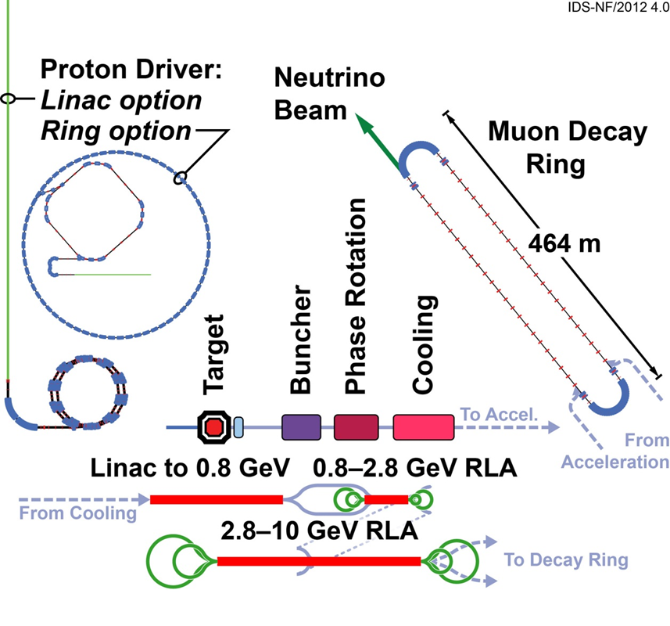
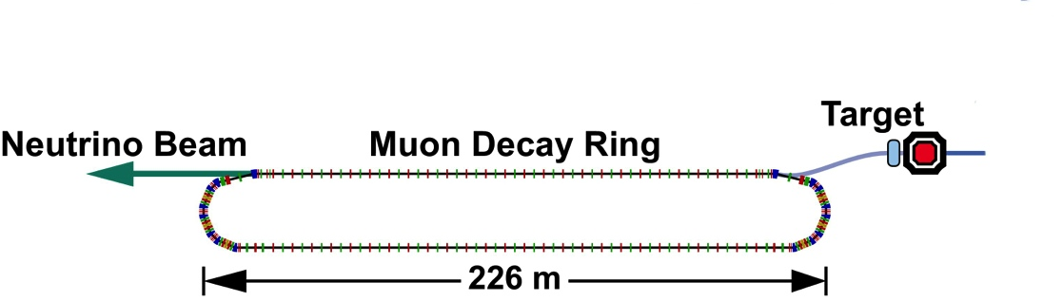
This is what we want to do near-term:
Neutrinos from STORed Muons, nuSTORM
Status of the Neutrino Factory design: IDS-NF
This
is the simplest
implementation
of the NF
3.8 GeV/c
And
DOES NOT
Require the
Development of
ANY
New Technology

Slide 8
Physics motivation &
Theoretical Considerations
Beyond the νSM

Slide 9
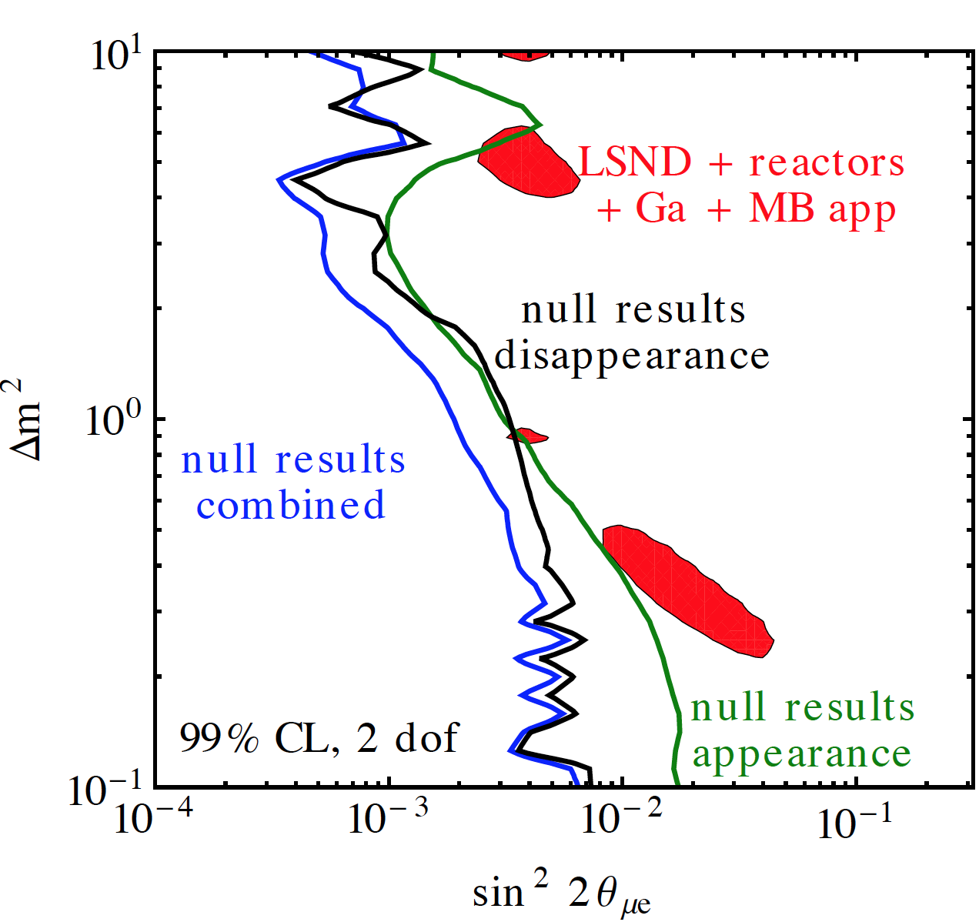
Short-baseline ν oscillation studies
Sterile neutrinos arise naturally in many extensions of the Standard Model.
  GUT models
  Seesaw mechanism for ν mass
  “Dark” sector
Usually heavy, but light not ruled out.
Experimental hints
  LSND
  MiniBooNE
  Ga
  Reactor “anomaly”
3+1
Kopp, Machado, Maltoni & Schwetz: arXiv:1303.3011".

Slide 10
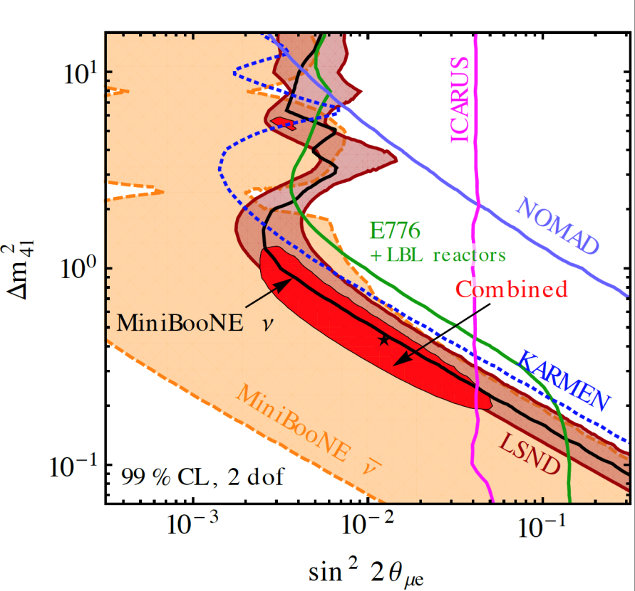
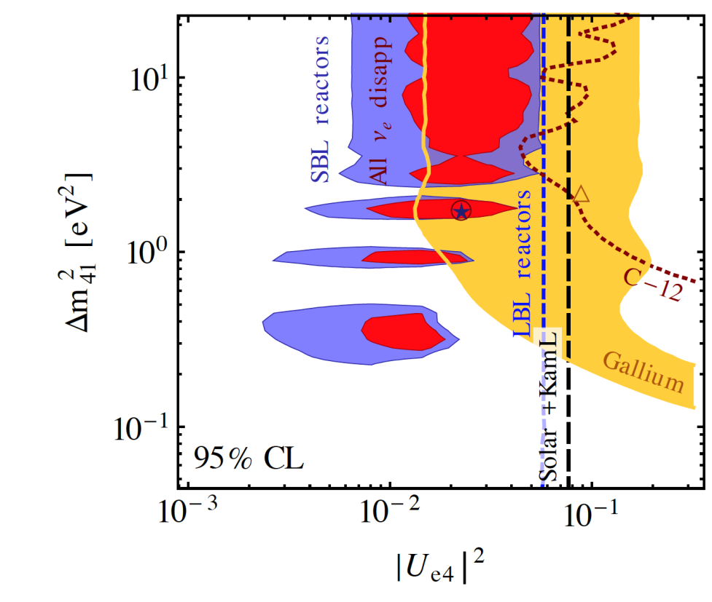
Appearance & disappearance
Subsets of appearance and disappearance data are found to be consistent,
and it is only when they are combined and when, in addition, exclusion limits on
ν_{μ} disappearance are included, that tension appears.

Slide 11
Steriles?
We conclude that, given the current experimental situation:
  It is impossible to draw firm conclusions regarding the existence of light sterile neutrinos.
  An experiment searching for short-baseline neutrino oscillations with good sensitivity and well-controlled systematic uncertainties has great potential to clarify the situation.
  But a truly definitive experiment for both the muon appearance and muon disappearance channels is required to reach a convincing conclusion on the existence of light, sterile neutrinos.

Slide 12
ν Interaction Physics

Slide 13
ν Interaction Physics
A partial sampling
ν_{e} and ν_{e}-bar x-section measurements
  A UNIQUE contribution from nuSTORM
  Essentially no existing data
π⁰ production in ν interactions
  Coherent and quasi-exclusive single π⁰ production
Charged π & K production
  Coherent and quasi-exclusive single π⁺ production
Multi-nucleon final states
ν-e scattering
ν-Nucleon neutral current scattering
  Measurement of NC to CC ratio
Charged and neutral current processes
  Measurement of ν_{e} induced resonance production
Nuclear effects
Semi-exclusive & exclusive processes
  Measurement of K_{s}⁰, Λ & Λ-bar production
New physics & exotic processes
  Test of ν_{μ} - ν_{e} universality
  Heavy ν
  eV-scale pseudo-scalar penetrating particles
Over 60 topics (thesis)
accessible at nuSTORM

Slide 14
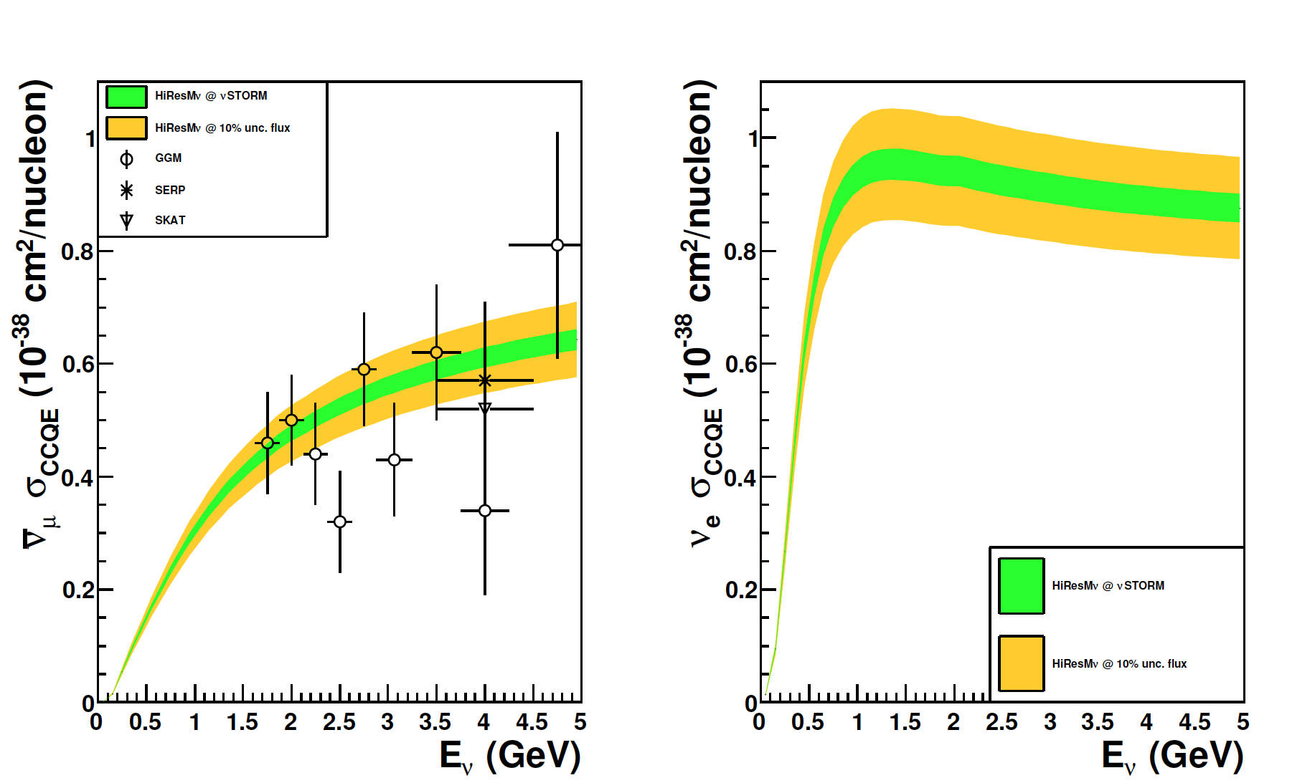
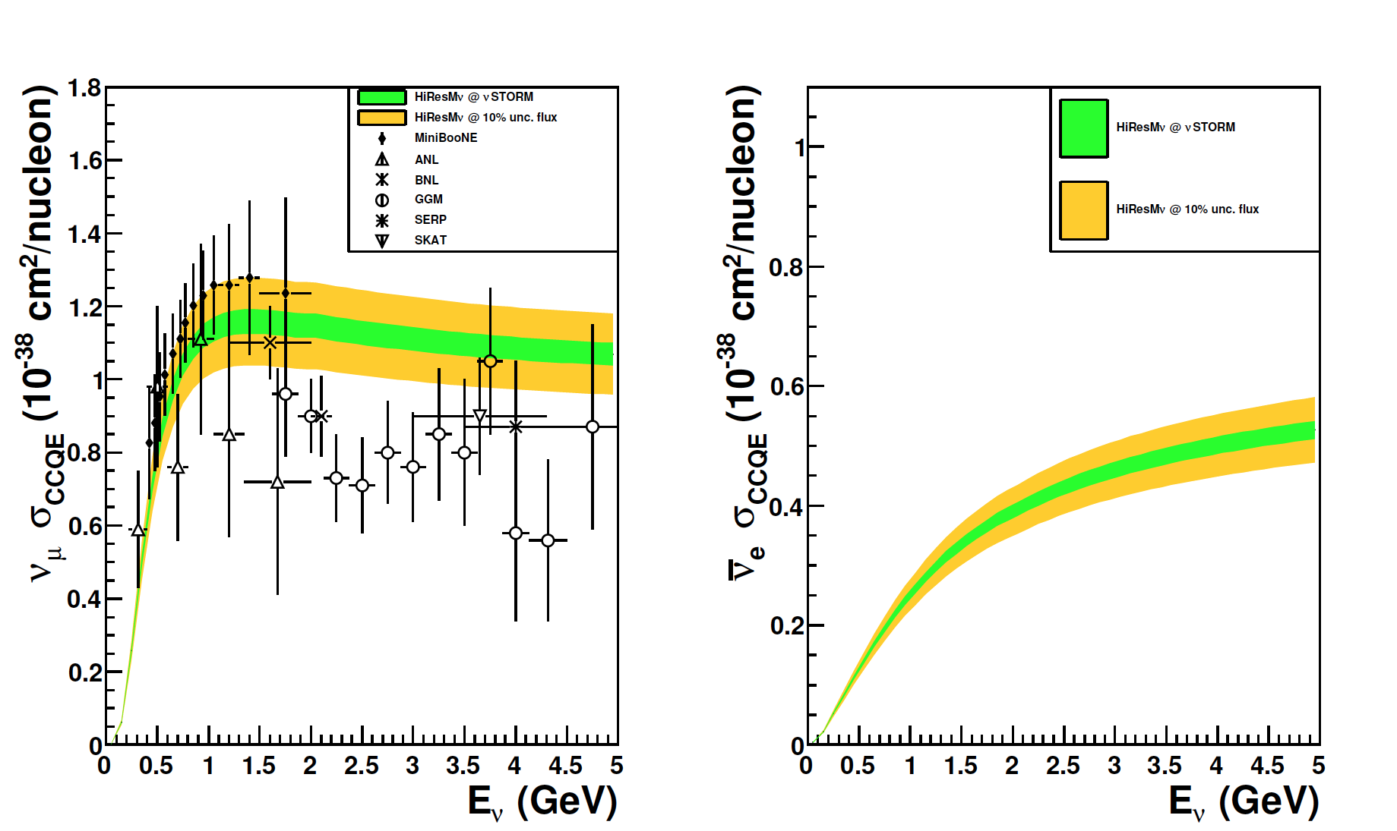
Cross section measurements
Edward Santos
Imperial
μ⁻
μ⁺
HIRESMν – systematics only

Slide 15
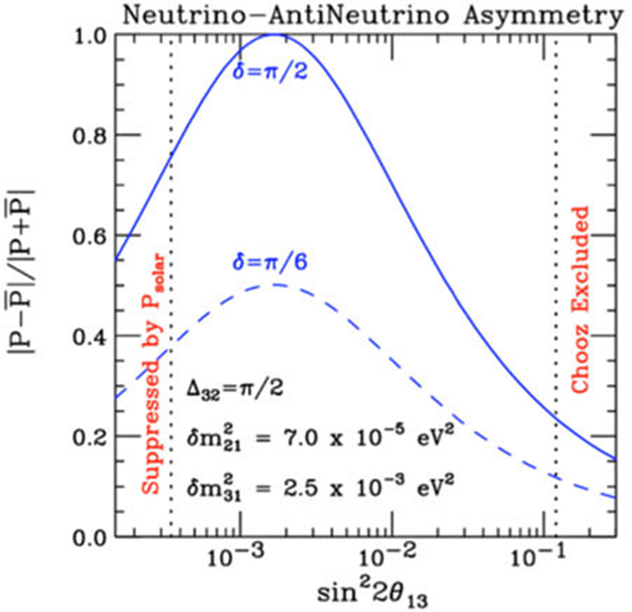
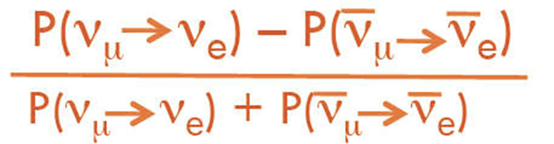
ν Cross-section measurements
Cross-section measurements
  μ storage ring presents only way to measure ν_{μ} & ν_{e} & (nu and anti-nu) x-sections in same experiment
    Supports future long-baseline experiments
Important to note that with θ₁₃ large, the asymmetry you’re trying to measure is small, so:
  Bkg content & uncertainties start to become more important
  A “better” understanding of ν/νbar cross-sections beneficial

Slide 16
The Facility

Slide 17
Baseline
~ 100 kW Target Station (designed for 400kW)
  Assume 120 GeV proton
    Fermilab PIP era
  Carbon target
    Inconel
  Horn collection after target
Collection/transport channel
  Stochastic injection of π
Decay ring
  Large aperture FODO
    Also considering RFFAG
  Instrumentation
    BCTs, mag-Spec in arc, polarimeter
3.8 GeV/c

Slide 18
μ-base ν beam:
Oscillation channels
8 out of 12 channels potentially accessible

Slide 19
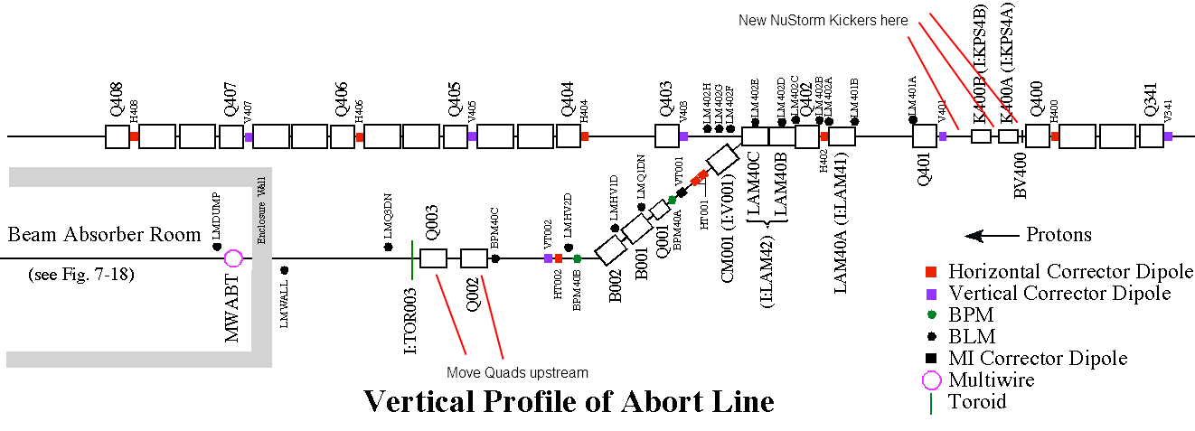
Extraction from MI
The devil in is the details

Slide 20
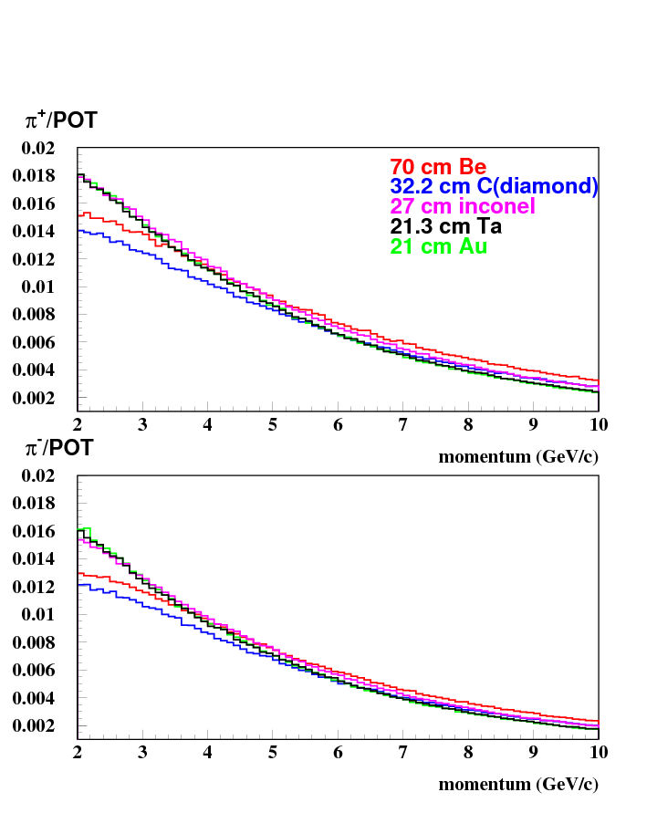
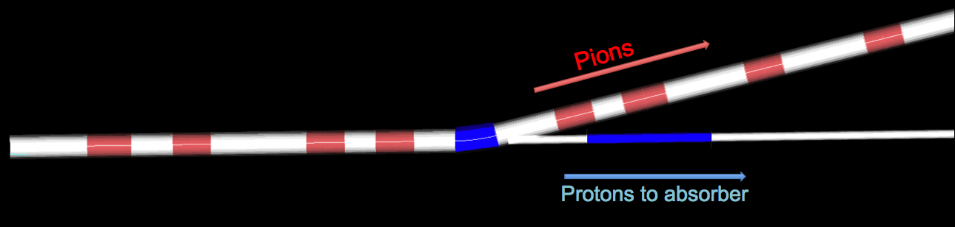
π Production, Capture
& Transport
Sergei Striganov
Ao Liu
Fermilab
In momentum range
4.5 < 5.0 < 5.5
obtain ≈ 0.09 π±/POT
within decay ring acceptance.
With 120 GeV p & NuMI-style horn 1
Carbon target
Target/capture optimization ongoing

Slide 21
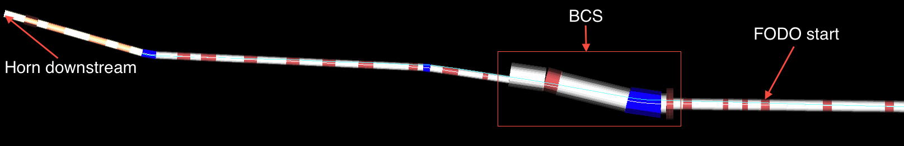
π Transport & Decay ring

Slide 22
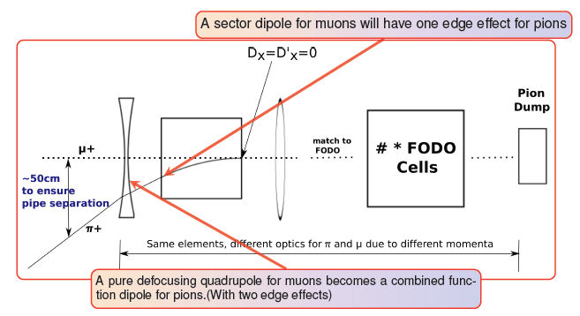
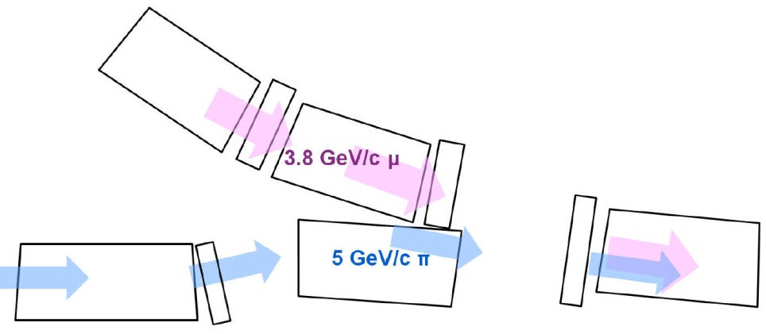
Injection scheme
π’s are on an injection orbit
  separated by chicane
μ’s are in ring circulating orbit
  lower p ~3.8 GeV/c
~30cm separation between
Concept works for FODO lattice
  Now detailed by Ao Liu
Beam Combination Section (BCS)
David Neuffer’s original
concept from 1980

Slide 23
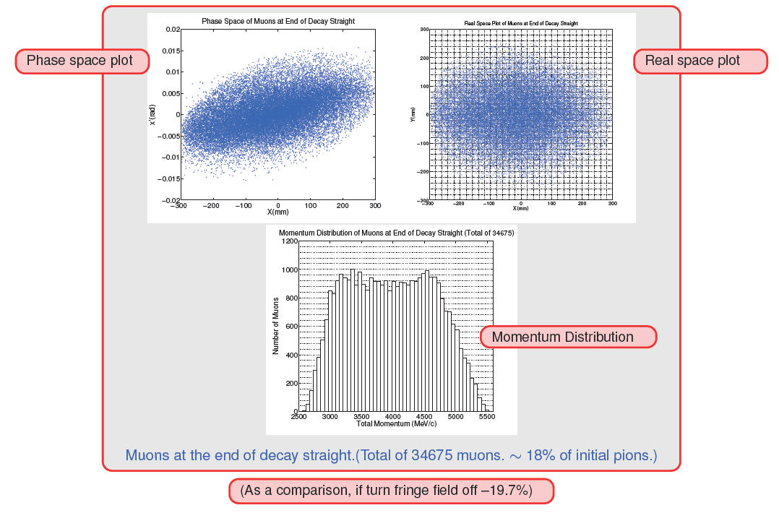
μs at end of first straight
Ao Liu
Fermilab
  8 X 10⁻³ muons/POT
  (3.8 ± 10%) GeV/c
  at end of first straight

Slide 24
Racetrack FFAG Decay Ring
JB Lagrange & Y. Mori: Kyoto
J. Pasternak: Imperial
A. Sato: Osaka
Scaling FFAGs have special properties, which makes them ideal for large momentum spread and large emittance beams
  Tune chromaticity is automatically zero
    Stable optics for very large momentum spread
    Allows good working point with a large acceptance avoiding dangerous resonances
  Beta chromaticity is negligible (strictly zero in the current racetrack)
    Allows to remove the beta beat for off-momentum particles
  This allows to design the ring with quasi-zero beam loss
    Good performance for nuSTORM facility!
Initial FFAG design
  Confirmed the large acceptance
  Assumed initially muon injection with a kicker (not preferred currently)
  Assumed only normal conducting magnets
    Large ring size
    Tight space in the arc -> Difficult Stochastic Injection
Recent FFAG design
  Based on superferric magnets (up to 3T) in the arc and normal conducting ones in the straight
    Reduction of the ring size and the cost!
  Compact Arc (71m)
    Allows to incorporate the dispersion matching
  Stochastic injection is now possible
    Thanks to a smooth dispersion transition and empty drifts in the compact arc.
  Ring performance with respect to acceptance is very good!

Slide 25
Recent FFAG Decay Ring design
Table of parameters with FODO for comparison here?
Parameter | FODO | FFAG with normal conducting arcs | FFAG with SC arcs
L _{Straight} (m) | 185 | 240 | 192
Circumference [m] | 480 | 706 | 527
Dynamical acceptance A_{dyn} | 0.6 | 0.95 | 0.95
Momentum acceptance | ±10% | ±16% | ±16%
π/POT within momentum acceptance | 0.094 | 0.171 | 0.171
Fraction of π decaying in the straight (F_{S}) | 0.52 | 0.57 | 0.54
Ratio of L _{Straight} to the ring Circ. (Ω) | 0.39 | 0.34 | 0.36
A_{dyn} × π/POT × F_{S} × Ω | 0.011 | 0.031 | 0.033
Layout of the FFAG
Decay Ring with SC Arc

Slide 26
nuSTORM’s Physics performance

Slide 27
Assumptions
N_{μ} = (POT) X (π/POT) X μ/π X A_{dynamic} X Ω
  10²¹ POT @ 120 GeV integrated exposure
  0.1 π/POT
  Muons/POT at end of first straight (8 X 10⁻³)
    =(π/POT) X (μ/π) within the 3.8 ± 10% GeV/c momentum acceptance
  A_{dynamic} = 0.6 (FODO)
    Fraction of muons surviving 100 turns
  Ω = Straight/circumference ratio (0.39) (FODO)
This yields ≈ 1.9 X 10¹⁸ useful μ decays
Note: nuSTORM will be limited to 10²⁰ POT/yr

Slide 28
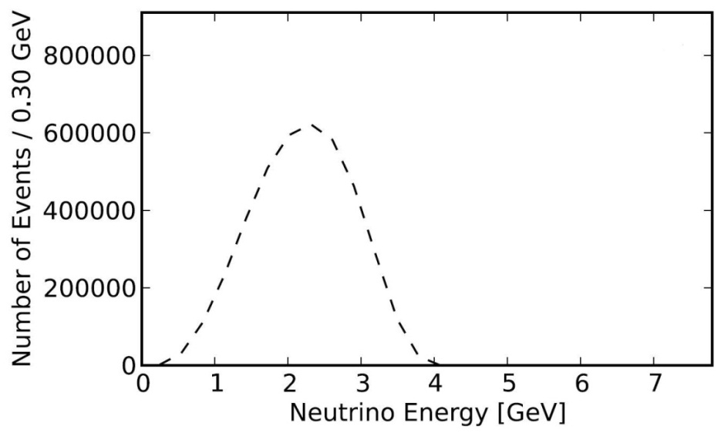
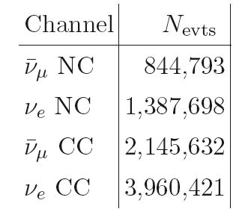
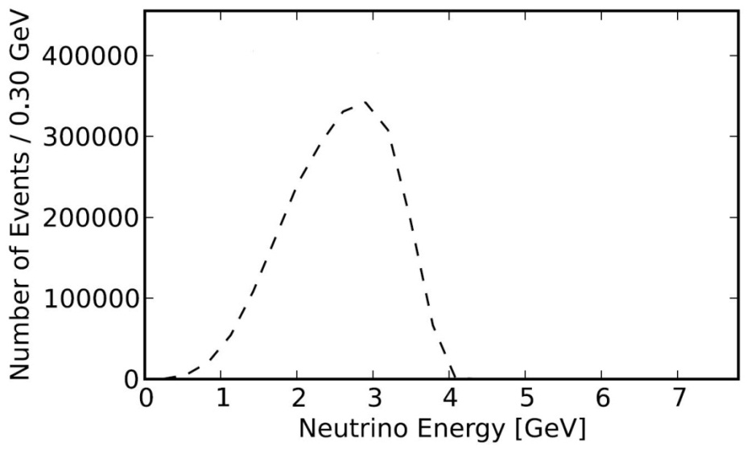
E_{ν} spectra (μ⁺ stored)
ν_{e}
Event rates/100T
at ND hall 50m
from straight with
μ⁺ stored
for
10²¹ POT exposure
ν_{μ}-bar

Slide 29
SBL oscillation searches
Appearance
The Golden channel

Slide 30
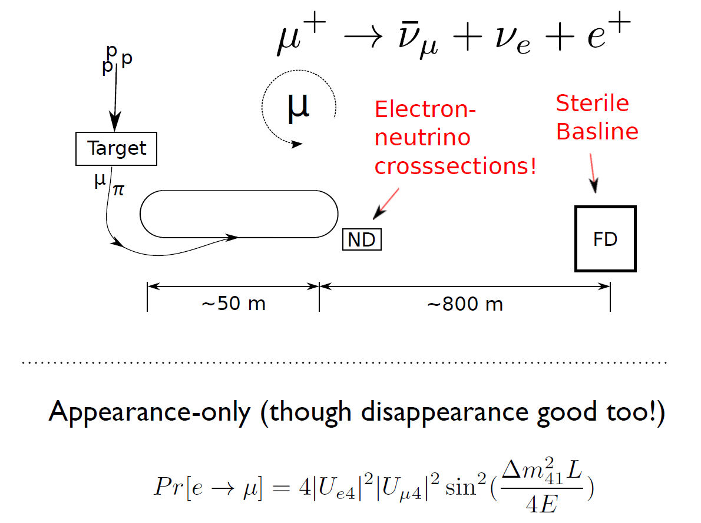
Experimental Layout
Chris Tunnell
Oxford*
Appearance
Channel:
ν_{e} → ν_{μ}
Golden Channel
Must reject the
“wrong” sign μ with
great efficiency
185
~ 1900 m
Why ν_{μ} → ν_{e}
Appearance Ch.
not possible
* Now at NIKHEF

Slide 31
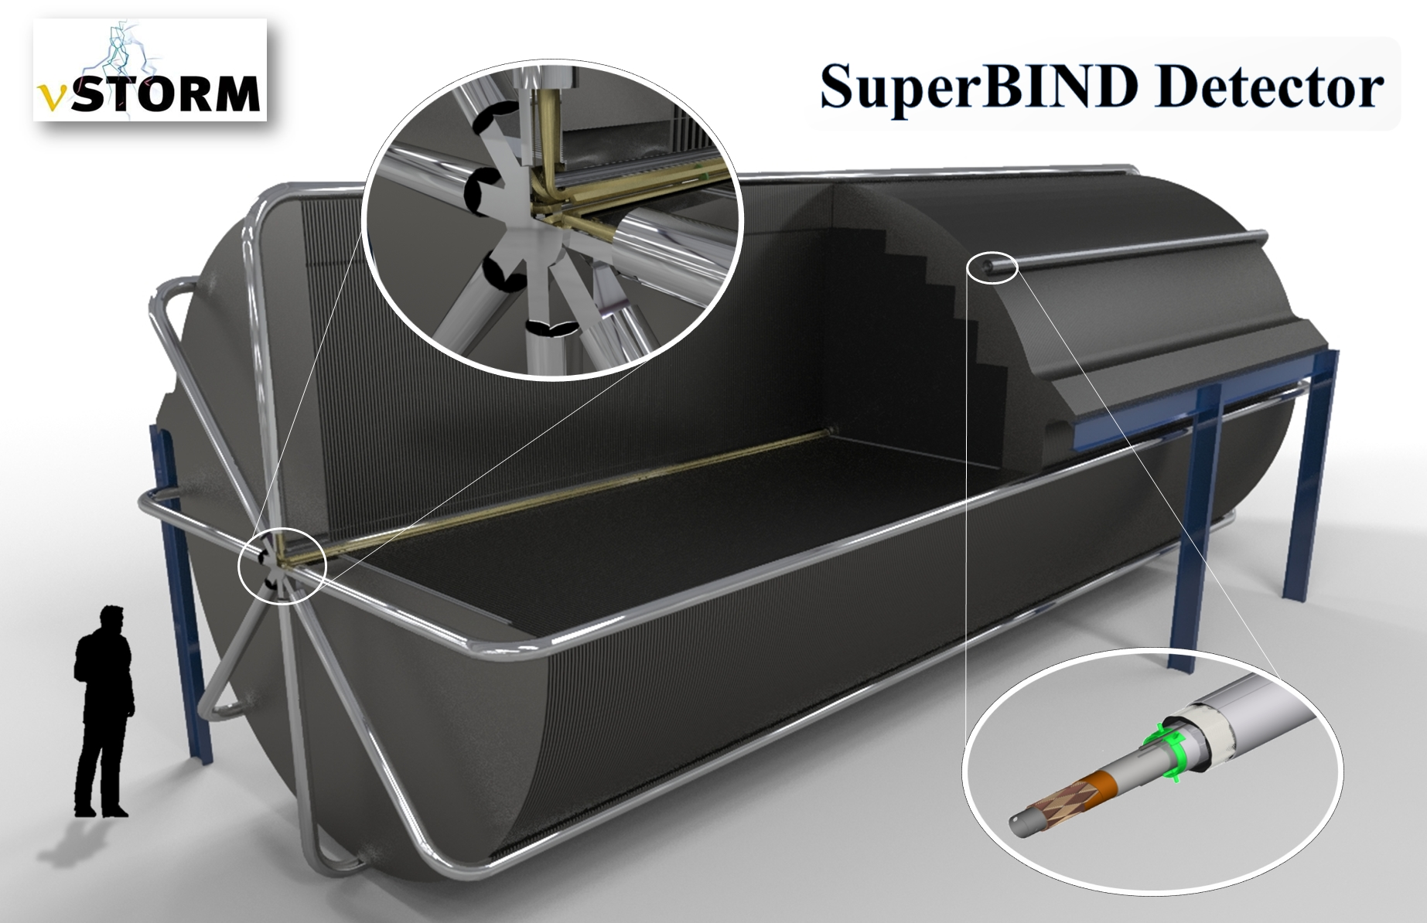
SuperBIND

Slide 32
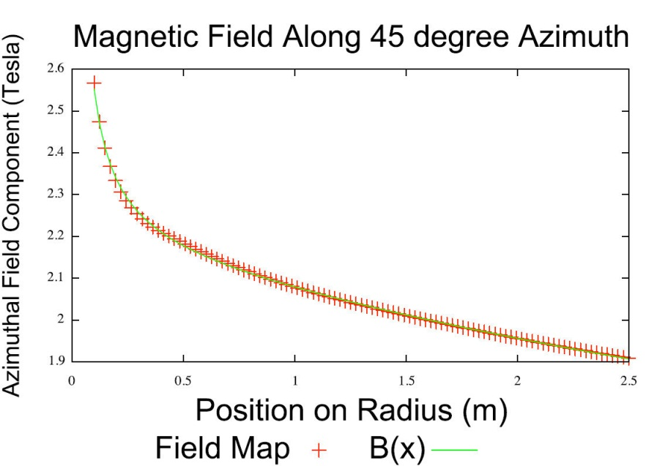
Simulation – ν_{μ} appearance
Ryan Bayes
Steve Bramsiepe
Glasgow
Full GEANT4 Simulation
  Extrapolation from ISS and IDS-NF studies for the MIND detector
  Uses GENIE to generate the neutrino interactions.
  Involves a flexible geometry that allows the dimensions of the detector to be altered easily (for optimization purposes, for example).
  Have not used the detailed B field map, but parameterized fit is very good
  Event selection/cuts
  Multivariate analysis

Slide 33
Event reconstruction efficiency & Backgrounds
Signal efficiency
Background efficiency
Boosted Decision Tree (BDT) analysis

Slide 34
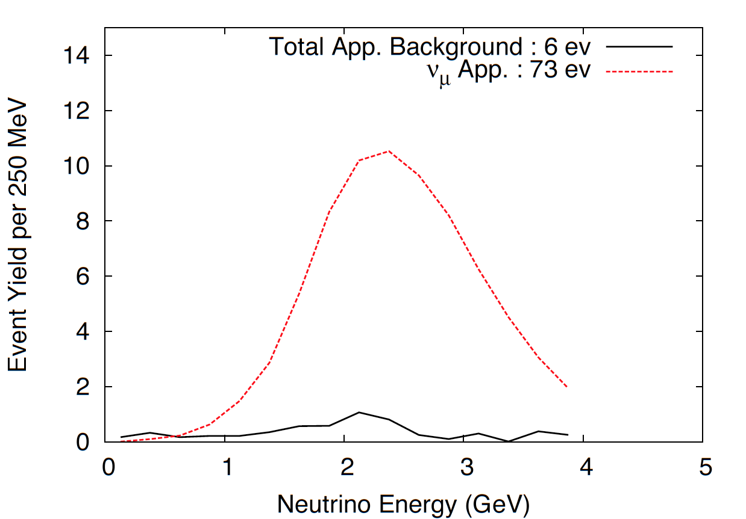
ν_{e} → ν_{μ} appearance
CPT invariant channel to LSNDMiniBooNE
S:B = 12:1

Slide 35
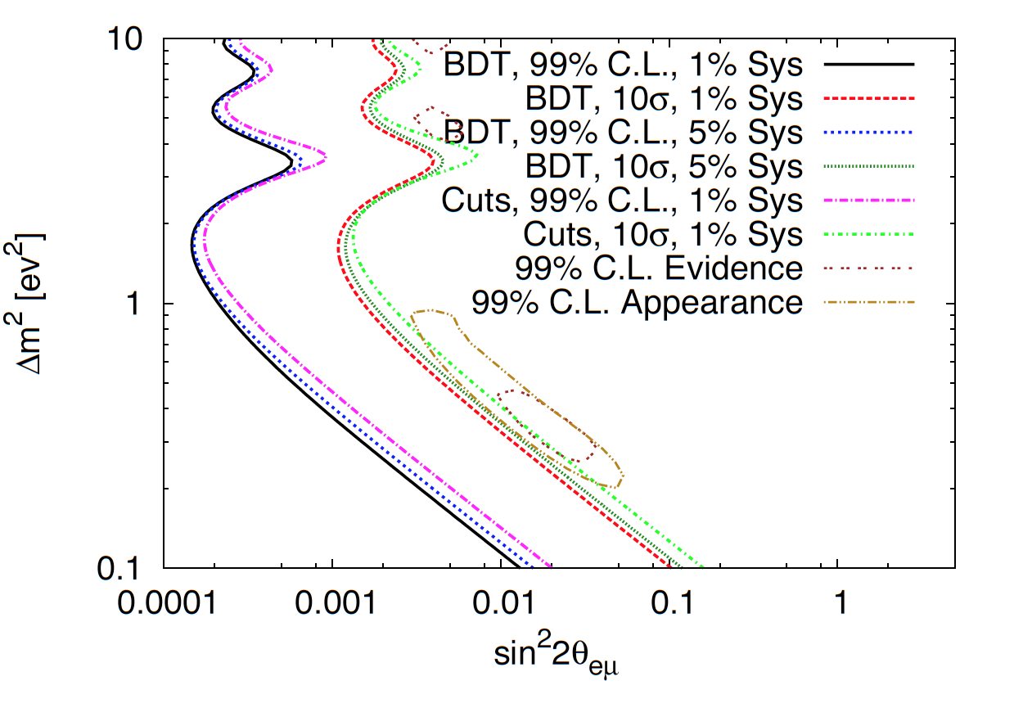
Appearance
Exclusion contours

Slide 36
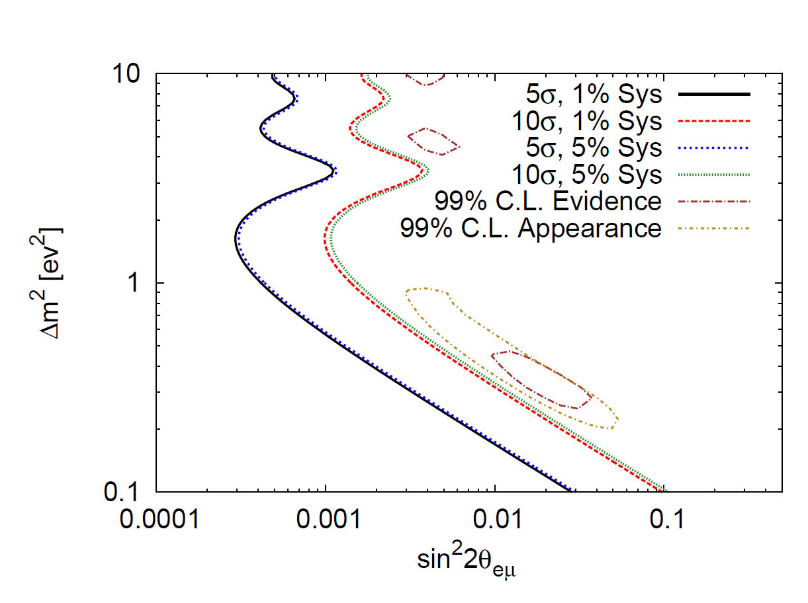
“Robustness” of appearance search
Bkg uncertainty:
10% → 50%

Slide 37
Disappearance searches

Slide 38
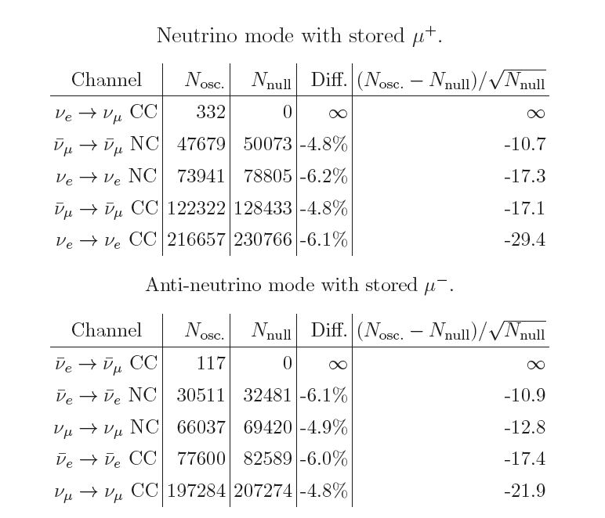


Raw Event Rates
μ dis. channels follow
naturally from μ appear.
ν_{e} channels will take
more work
Tremendous
Statistical
Significance
3+1
Assumption
Appearance channels

Slide 39
Accelerator R&D
Looking Forward

Slide 40
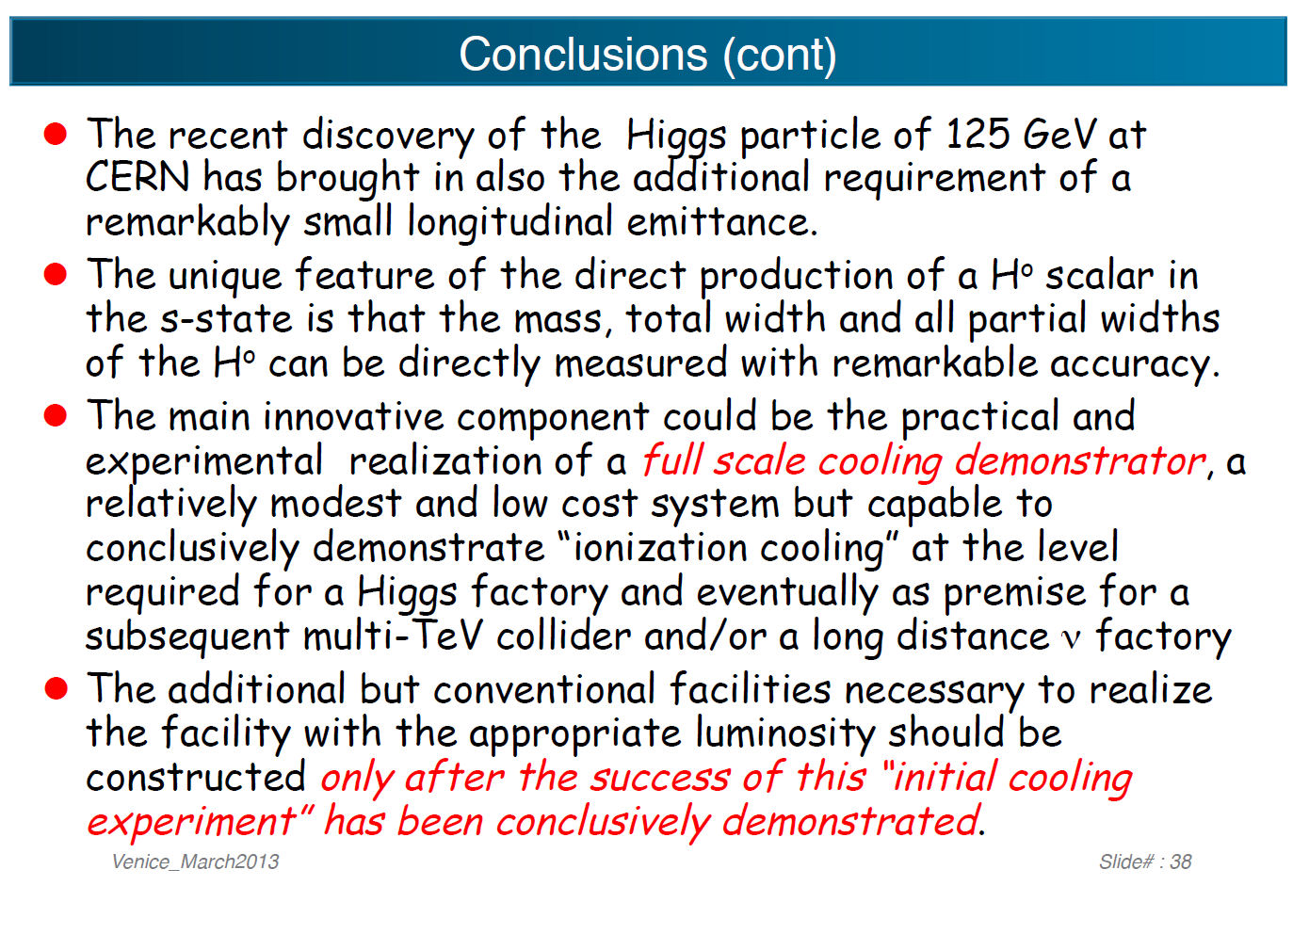
Looking Forward: Beyond ν physics
Friends in High Places
C. Rubbia, Neutrino Telescopes 2013

Slide 41
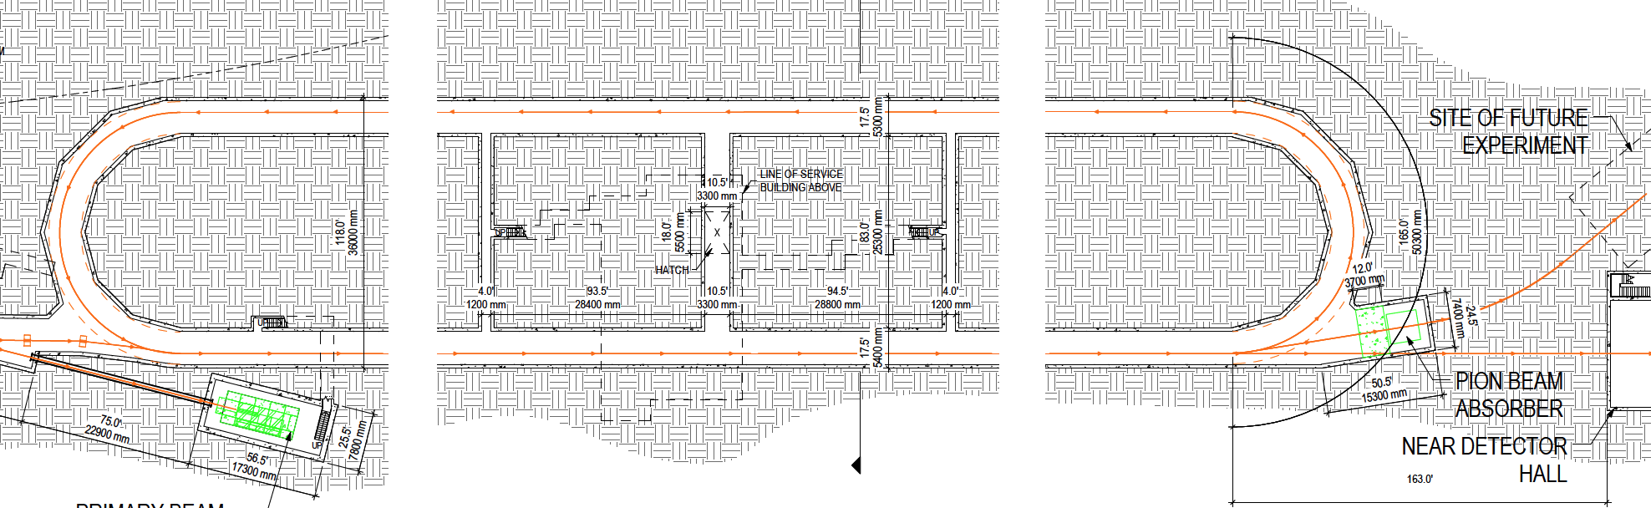
nuSTORM
Setting the stage for the next step
Only ~50% of πs decay in straight
Need π absorber

Slide 42
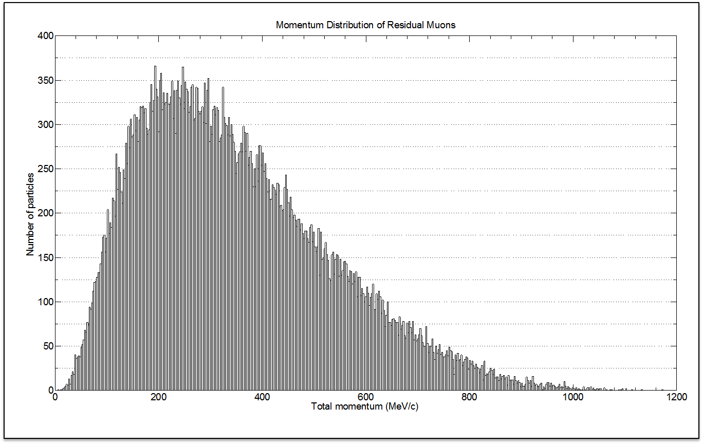
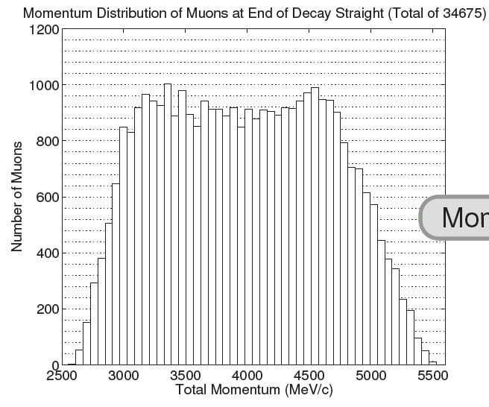
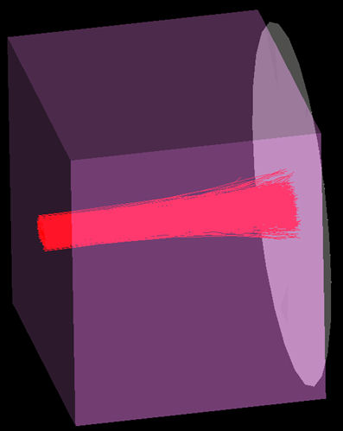
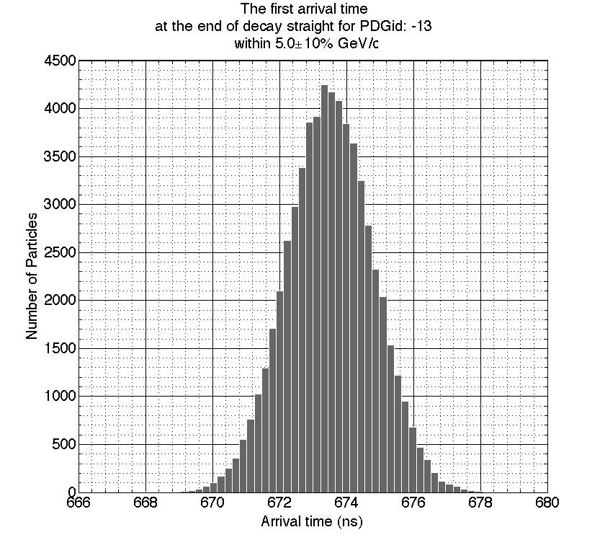
Low Energy μ beam
At end of straight we
have a lot of πs, but
also a lot of μs with
4.5 < P(GeV/c) < 5.5
After 3.48m Fe, we have ≈
10¹⁰ μ/pulse in 100 < P(MeV/c) < 300
≈ 1.5 ns FWHM
(preliminary)

Slide 43
Siting at Fermilab

Slide 44
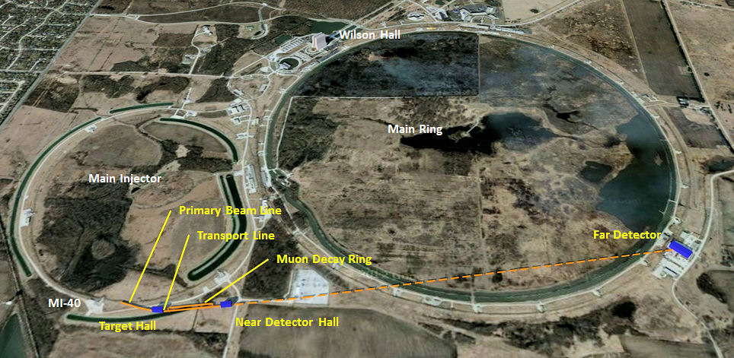
Siting Plan
Steve Dixon
Fermilab FESS

Slide 45
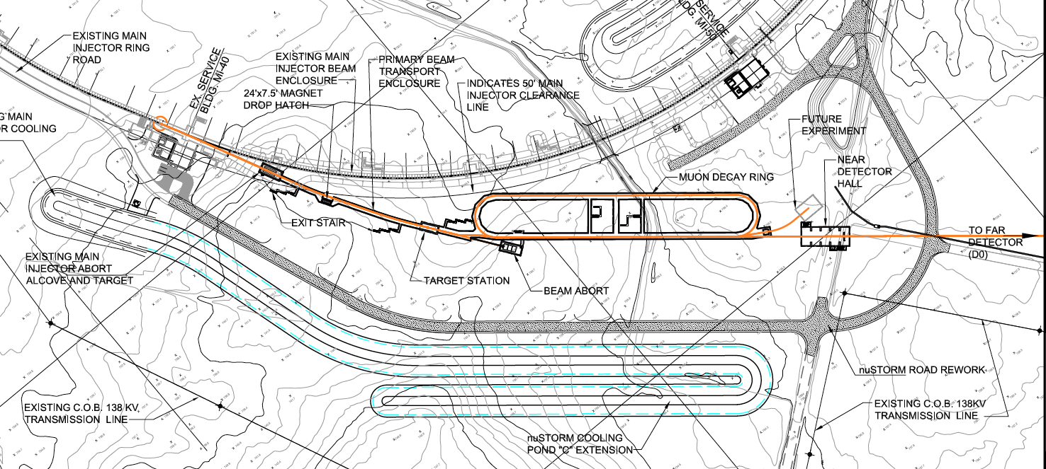
Site schematic
226 m

Slide 46
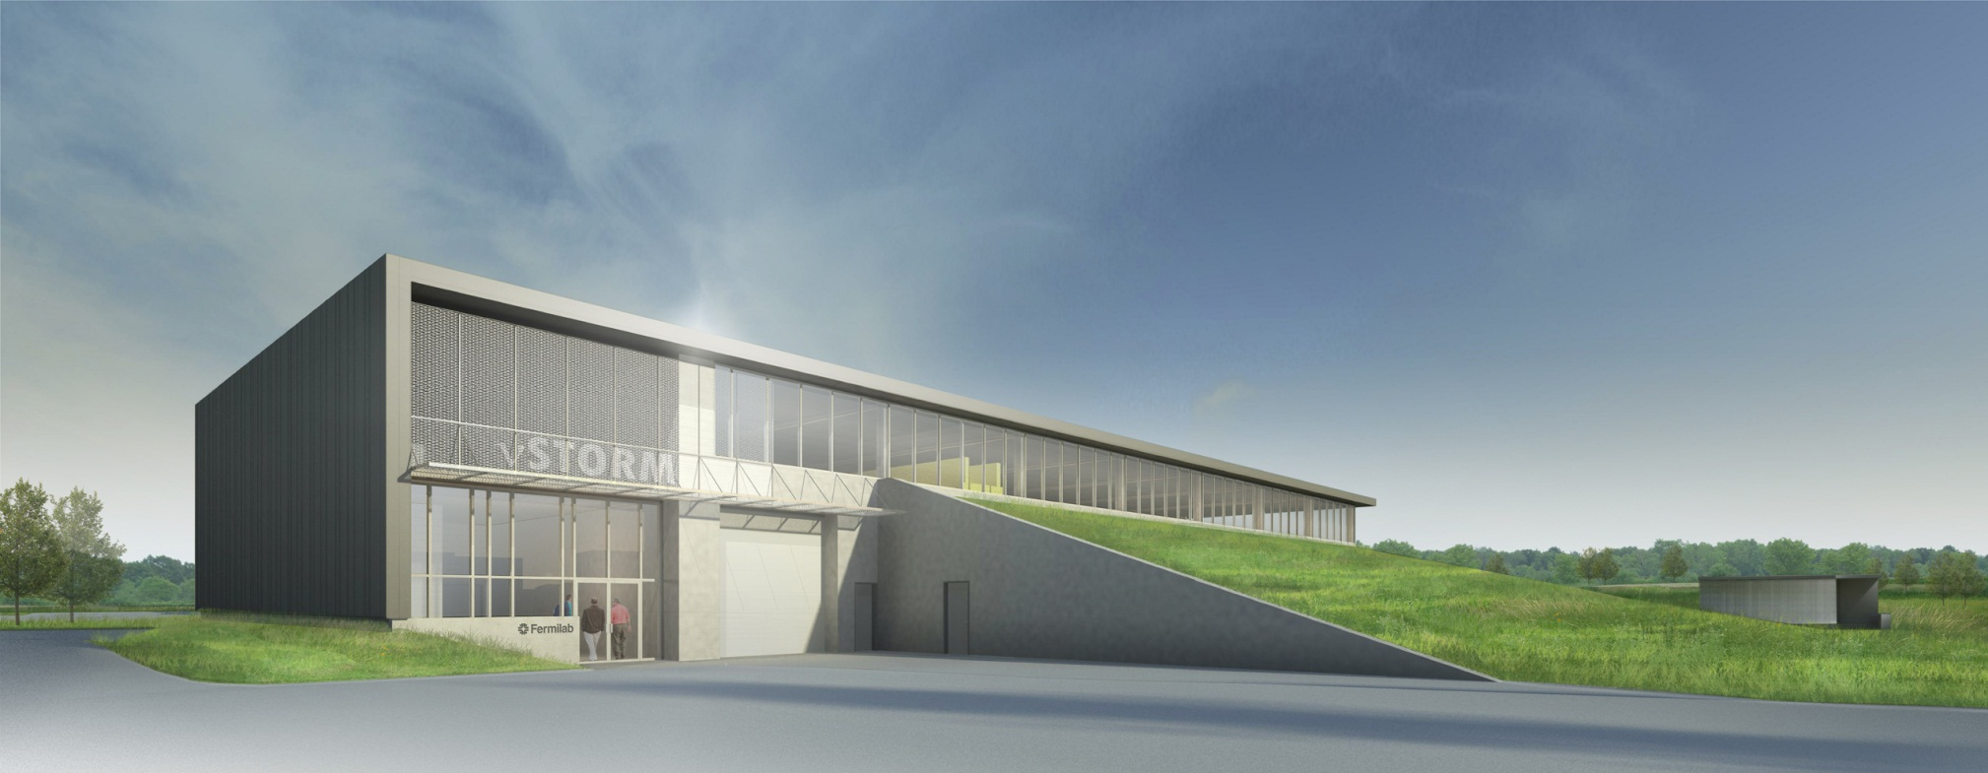
Target Station

Slide 47
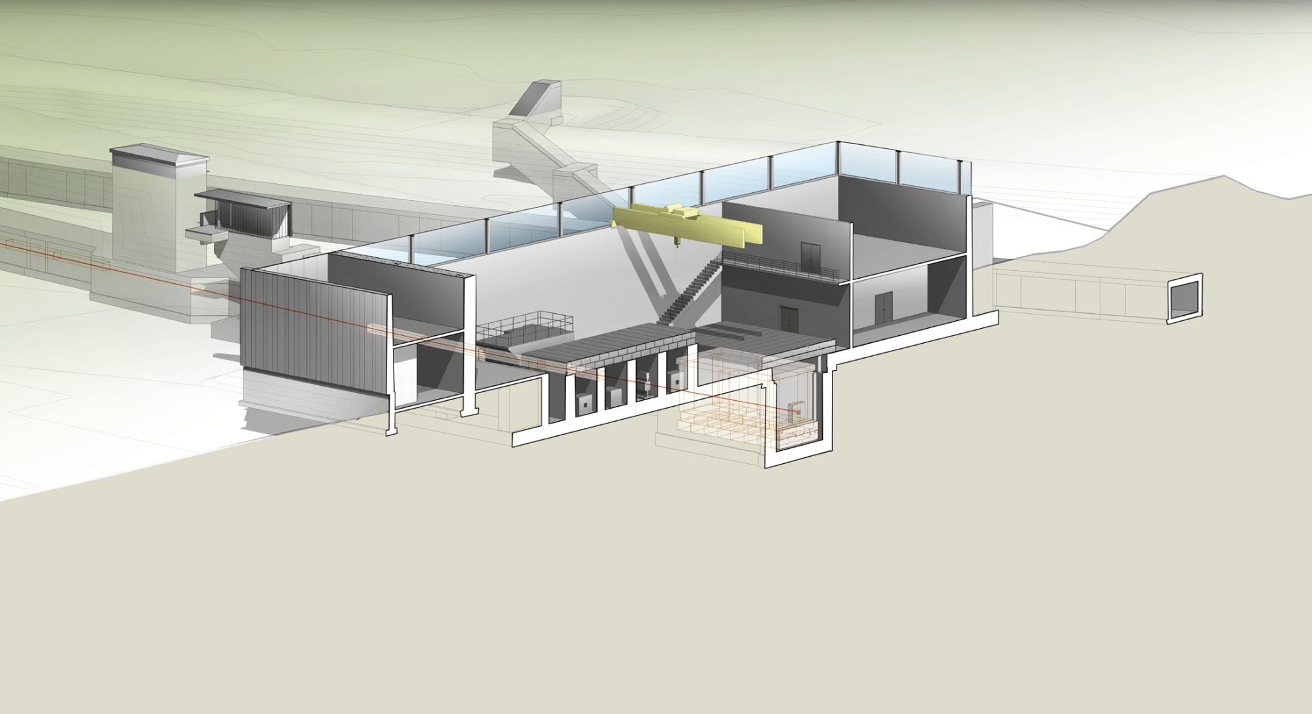
TS section

Slide 48
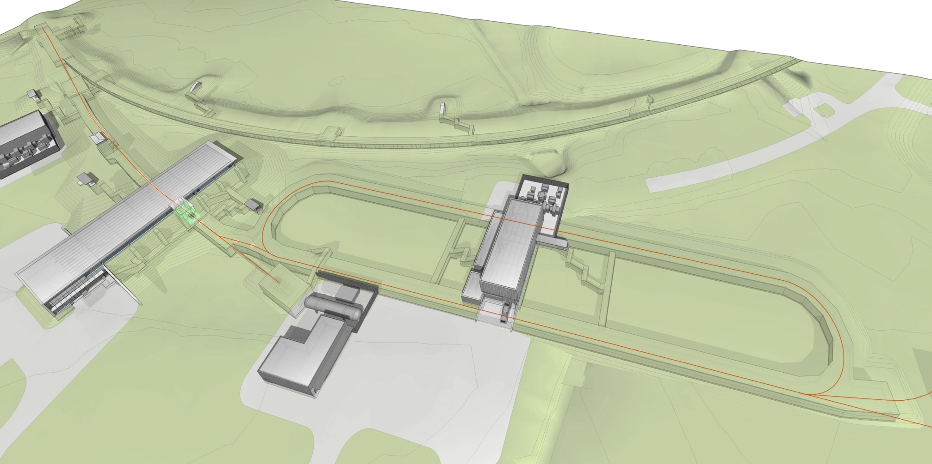
Decay ring

Slide 49
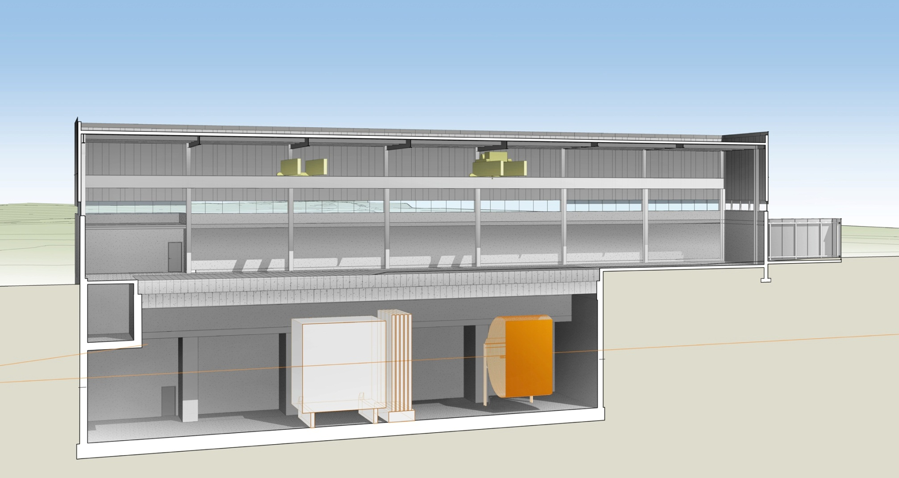
Near detector hall

Slide 50
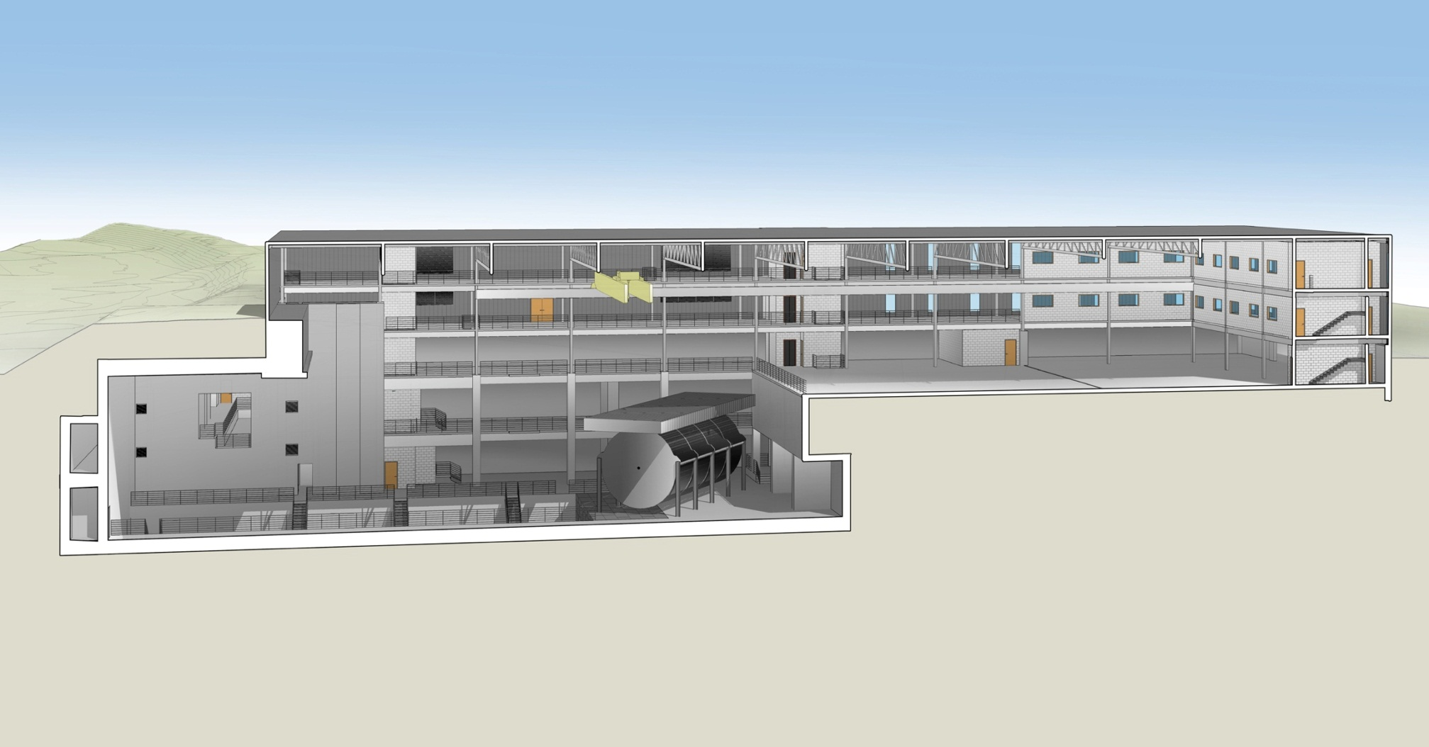
Far Detector Hall
D0 Assembly Building

Slide 51
Cost:
Sorry Sir, we don’t take
American Express

Slide 52
nuSTORM Costing
Sub System | Cost M$
Primary Beam Line | 28.5
Target Station | 37.9
Transport Line | 16.5
Decay Ring | 135.2
Near Hall | 23.5¹
SuperBIND | 27.1²
Site work | 27
Other | 2.5
Sub Total | 298.2
Management | 37.1³
Total | 335.3
Total contingency – 45%
¹Near Hall sized for multiple experiments & ND for SBL oscillation physics
²1.3kT Far + .2kT Near & include DAB work
³Assumes LBNE estimates: Proj. Office (10%), L2 (9.4%), L3 (4%)

Slide 53
Moving Forward

Slide 54
nuSTORM
Twin-Track Approach
  Develop International support at the Laboratory level for the concept
    Already Bottom-up (grass roots), now add Top-down
  LOI to Fermilab (June 2012), EOI to CERN (April 2013), Proposal to Fermilab (June 2013)
Has produced significant increase in the size of the collaboration
  From 38 at time of Fermilab LOI to 110 now (single collaboration)
Full Proposal submitted to Fermilab PAC in June
  nuSTORM has been given Stage I Approval
EOI to CERN presented at June SPSC meeting. Requested support to:
  Investigate in detail how nuSTORM could be implemented at CERN; and
  Develop options for decisive European contributions to the nuSTORM facility and experimental program wherever the facility is sited
It defines a roughly two-year program which culminates in the delivery of a Technical Design Report.

Slide 55
nuSTORM: Conclusions
The Physics case:
Simulation work indicates we can confirm/exclude at 10σ (CPT invariant channel) the LSND/MiniBooNE result
  ν_{μ} and (ν_{e} ) disappearance experiments delivering at the <1% level look to be doable
    Systematics need careful analysis
    Detailed simulation work on these channels has not yet started
ν interaction physics studies with near detector(s) offer a unique opportunity & can be extended to cover 0.2<GeV< E_{ν}< 4 GeV
  Could be “transformational” w/r to ν interaction physics
  For this physics, nuSTORM should really be thought of as a facility: A ν “light-source” is a good analogy
    nuSTORM provides the beam & users will bring their detector to the near hall

Slide 56
Conclusions II
The Facility:
Presents very manageable extrapolations from existing technology
  But can explore new ideas regarding beam optics and instrumentation
  First step to the NF and potentially is stagable.
    Parts of nuSTORM reused
  Provides μ beam for advanced 6D cooling studies
    Key element with regard to a return to the EF via μ⁺μ⁻
  nuSTORM connects the Intensity & Energy Frontiers
Has considerable flexibility in its implementation that allows siting at either Fermilab or CERN
  Just need the protons

Slide 57
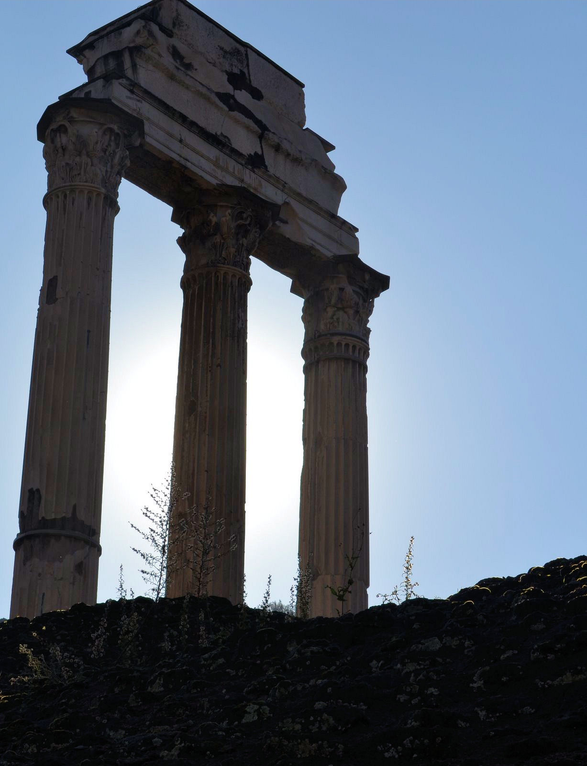
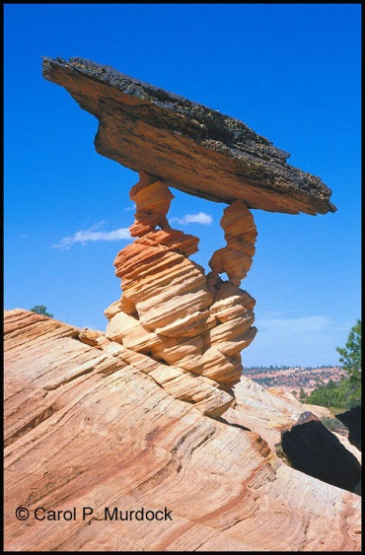
Three Pillars of nuSTORM
Delivers on the physics for the study of sterile ν
  Offering a new approach to the production of ν beams setting a 10 σ benchmark to make definitive statement w/r LSND/MiniBooNE
Can add significantly to our knowledge of ν interactions, particularly for ν_{e}
  ν “Light Source”
Provides an accelerator & detector technology test bed
  First step towards full NF

Slide 58
Thank you

Slide 59
Back Ups

Slide 60
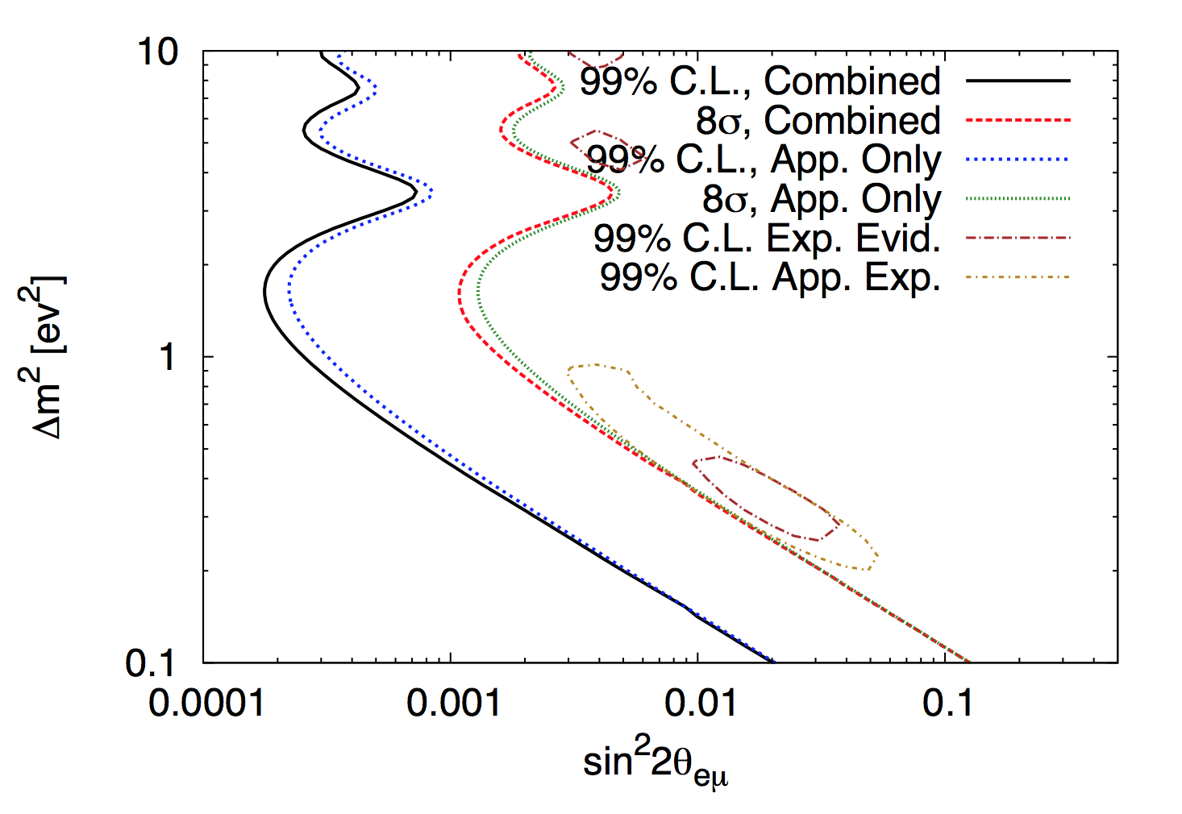
“Robustness” of appearance search II
Approach to recover:
  DR higher-order correction
    A_{dynamic} .6 -> .9 [1.5]
  Target optimization
    Medium-Z [1.5]
X2.25
Assuming 10²⁰ POT/yr. for 5 years, 10σ contour becomes 8σ

Slide 61
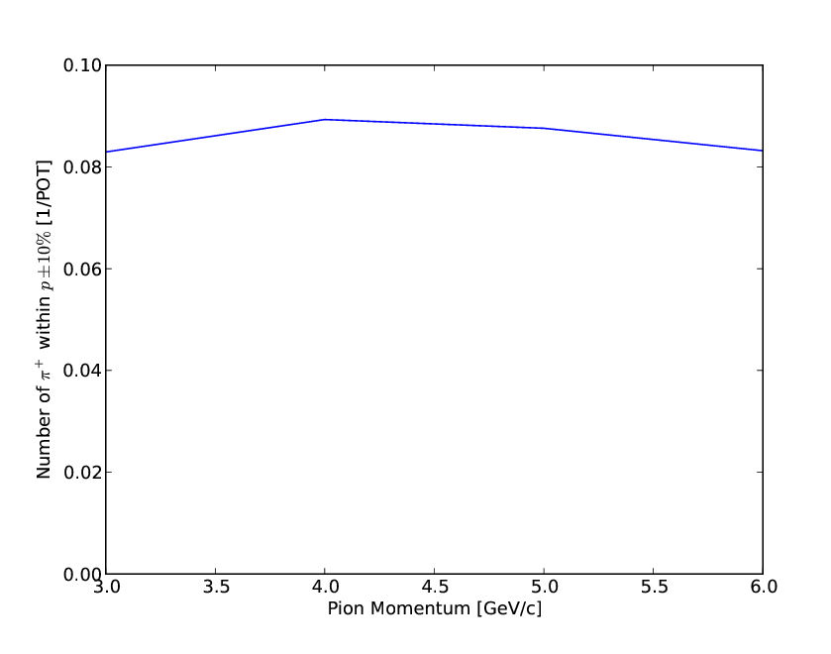
π collection
# within p ± 10%
Retune line
(with some loss in efficiency)
to cover 0.3<E_{ν}<4 GeV
&
Resultant extension in L/E
X2-2.5 from lattice
considerations

Slide 62
Detector Issues

Slide 63
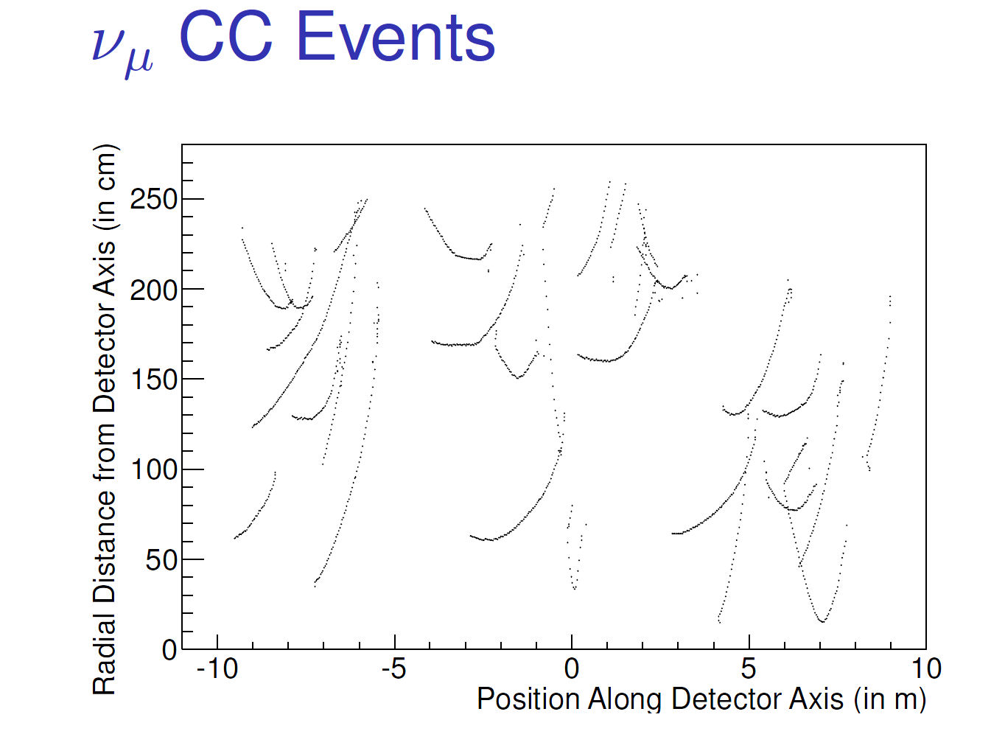
Event Candidates in SuperBIND
Hits
R vs. Z

Slide 64
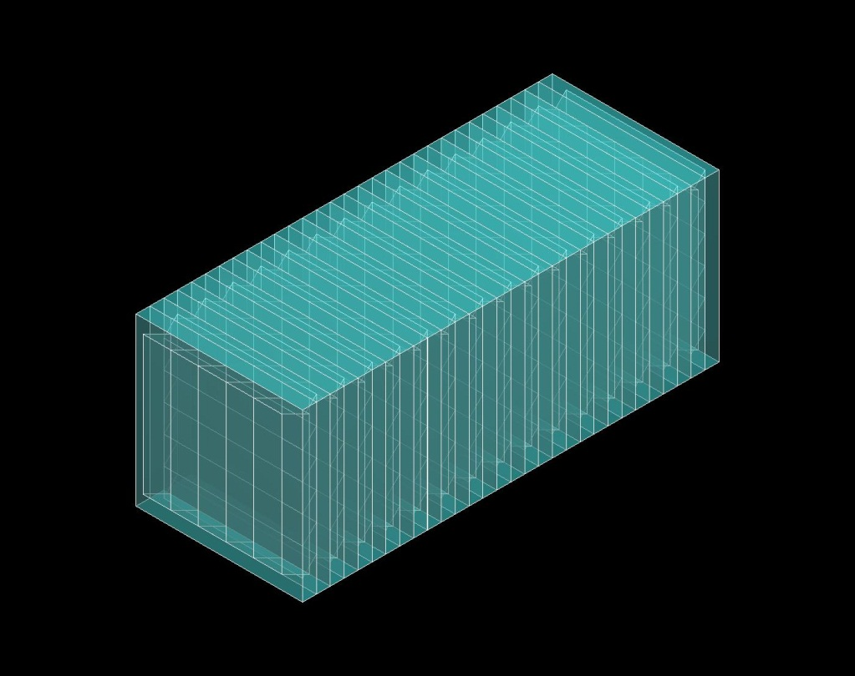
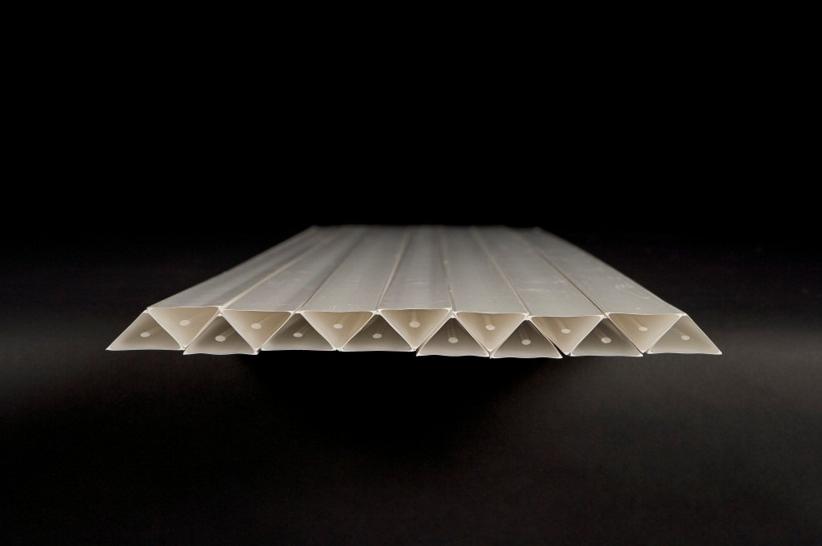
Fine-Resolution Totally Active Segmented Detector (IDS-NF)
Simulation of a Totally Active Scintillating Detector (TASD) using Noνa and Minerνa concepts with Geant4
  3333 Modules (X and Y plane)
  Each plane contains 1000 slabs
  Total: 6.7M channels
150 m
15 m
15 m
1.5 cm
15 m
3 cm
35 kT Total Mass
Momenta between 100 MeV/c to 15 GeV/c
Magnetic field considered: 0.5 T
Reconstructed position resolution ~ 4.5 mm
B = 0.5T

Slide 65
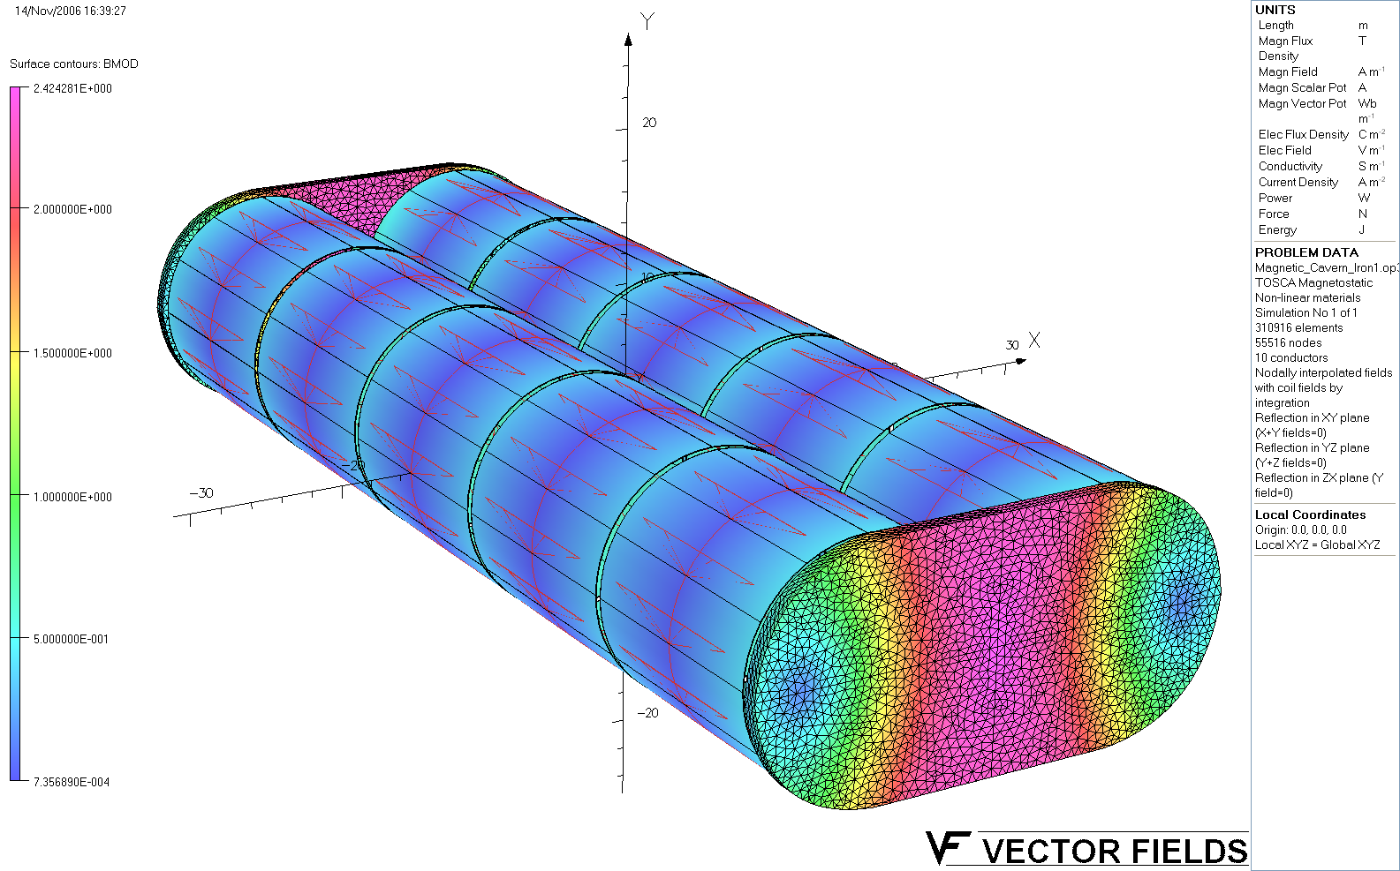
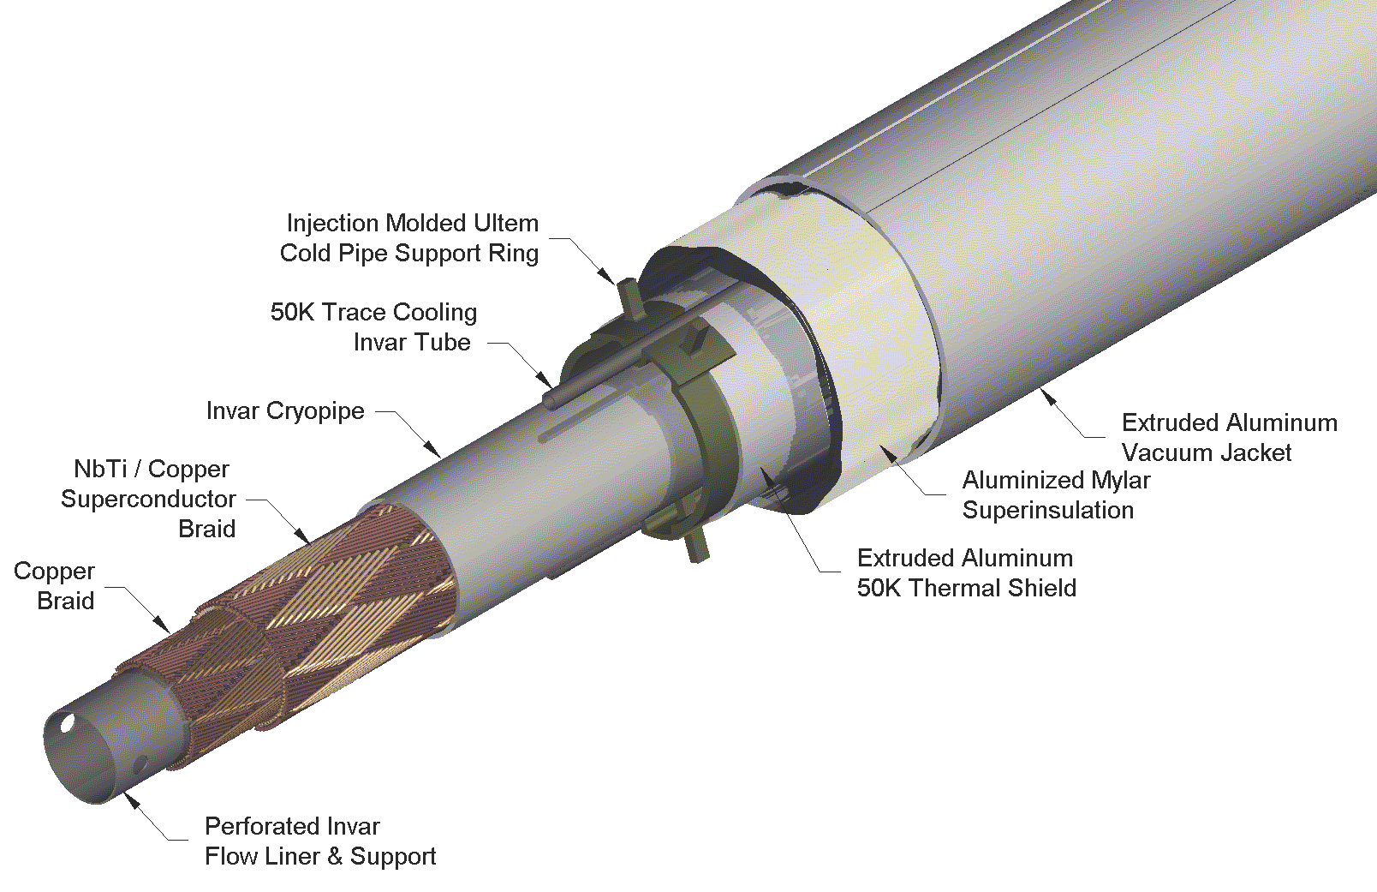
Magnet- Concept for IDS-NF
VLHC SC Transmission Line
  Technically proven
  Affordable
1 m iron wall thickness.
~2.4 T peak field in the iron.
Good field uniformity
R&D to support concept
Has not been funded

Slide 66


TASD Performance
ν Event Reconstruction ε
Muon charge mis-ID rate
Excellent σ_{E}

Slide 67
NF Physics & 3+n Models

Slide 68


3 + 3 Model
A 3+3 model has recently been shown to better fit all available data
J.M. Conrad, C.M. Ignarra, G. Karagiorgi, M.H. Shaevitz, J. Spitz (arXiv:1207.4765v1)

Slide 69


3 + 3 Model II
Appearance Data
All Data
Lesson: Have access to as many channels as possible and cover as much of
the parameter space as possible

Slide 70


L/E dependence
Very different L/E dependencies for different models
Experiments covering a wide range of L/E regions are required.

Slide 71
Future sterile searches

Slide 72
S:B for Appearance Channel
Past and Future(?)
Experiment | S:B
LSND | 2:1
MiniBooNE | 1:1 → 1:2
ICARUS/NESSiE | ≈1.5:1 / 1:4
LAr-LAr | 1:4
K⁺ DAR | ≈4:1
LSND Reloaded | 5:1
oscSNS | 3:1
nuSTORM | 11:1 → 20:1
Note: There are a number of experiments with megaCi to petaCi sources next to large detectors that have an exquisite signature of steriles (# evts/unit length displays oscillatory behavior in large detector) and have large effective S:B
  SNO+Cr, Ce-Land, LENS, Borexino, Daya Bay
  IsoDAR
  A number of very-short baseline reactor experiments

Slide 73
ν Interaction Physics
Preliminary studies

Slide 74

E_{ν} spectra (μ⁺ stored)
Event rates/100T
at ND hall 50m
from straight with
μ⁺ stored
for
10²¹ POT exposure
ν_{e}
ν_{μ}-bar

Slide 75

A detector for ν interaction physics
One Example
Sanjib Mishra
HiResMν
  Evolution of the NOMAD experiment
  One of the concepts considered for ND for LBNE
  Studied as ND for NF
Capabilities
  High resolution spectrometer
  Low density
  PID & tracking
  Nuclear targets

Slide 76
Disappearance channels

Slide 77
ν_{μ} disappearance analysis
Efficiency
Background

Slide 78

ν_{μ} disappearance

Slide 79



Preliminary ν_{e} work
David Adey
Fermilab
SuperBIND is not the ideal detector for ν_{e} interaction physics or for the study of NC.
However, SuperBIND’s aggressive design does provide opportunity to study ν_{e} disappearance.
  CC-NC distinction required for these types of events could also provide an option to study NC disappearance.
ν_{e} CC
NC
Cuts-based analysis lacks discrimination power.
MVA approach needed

