Slide 1


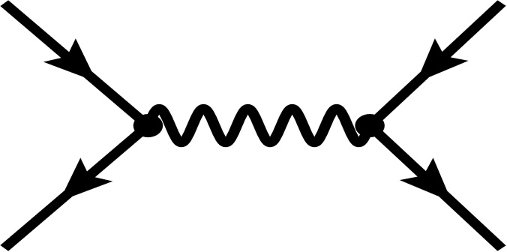
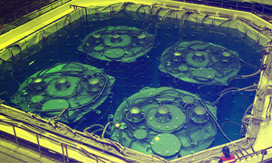
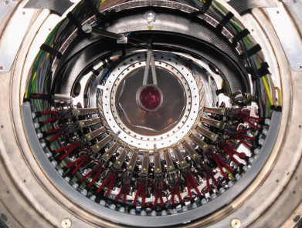
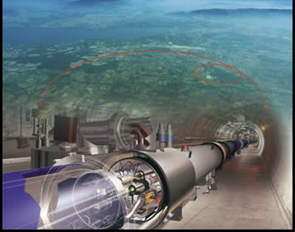
cLFV in Seesaw Models
(after LHC12, θ and MEG13)
13
FILIPE R. JOAQUIM
IST Physics Department and CFTP
Lisboa, Portugal
CFTP
With:
A. Rossi
A. Brignole
M. Hirsch
A. Vicente
NUFACT 2013
International Workshop on Neutrino Factories, Super beams and Beta Beams
19-24 August, IHEP, Beijing, China

Slide 2
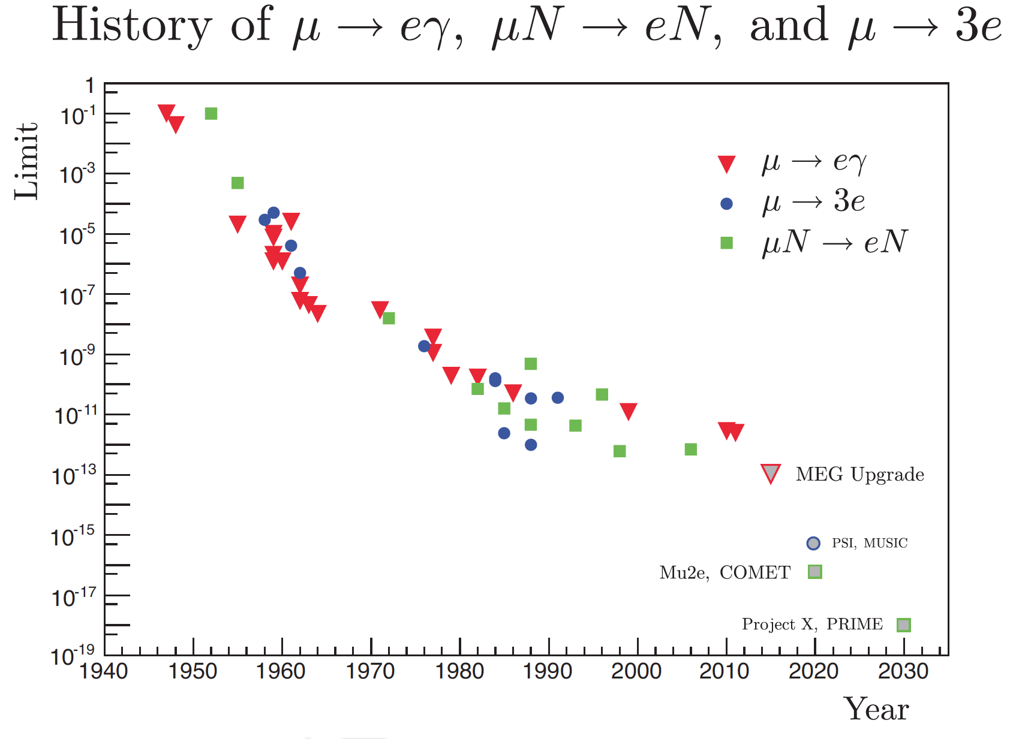
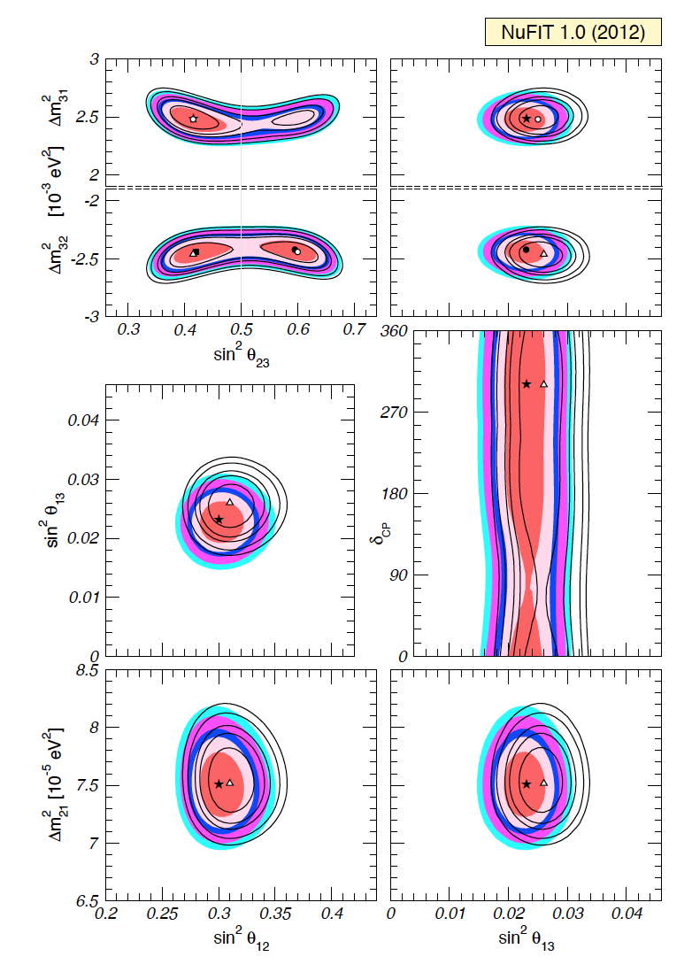
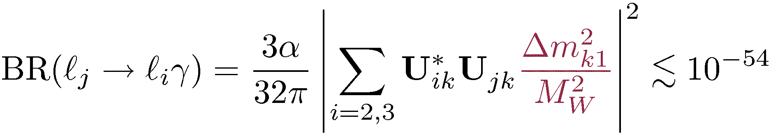
NO vs cLFV
LFV in the neutrino sector
Neutrino Oscillations
What about the charged LFV ?
Bernstein & Cooper’ 13
SM + Neutrinos masses:
Gonzalez-Garcia, Maltoni & Schwetz’ 12
Cheng, and Li 1977; Petcov, 1977; Marciano and Sanda ,1977; Shrock and Lee, 1977.
Observation of LFV decays NEW PHYSICS

Slide 3
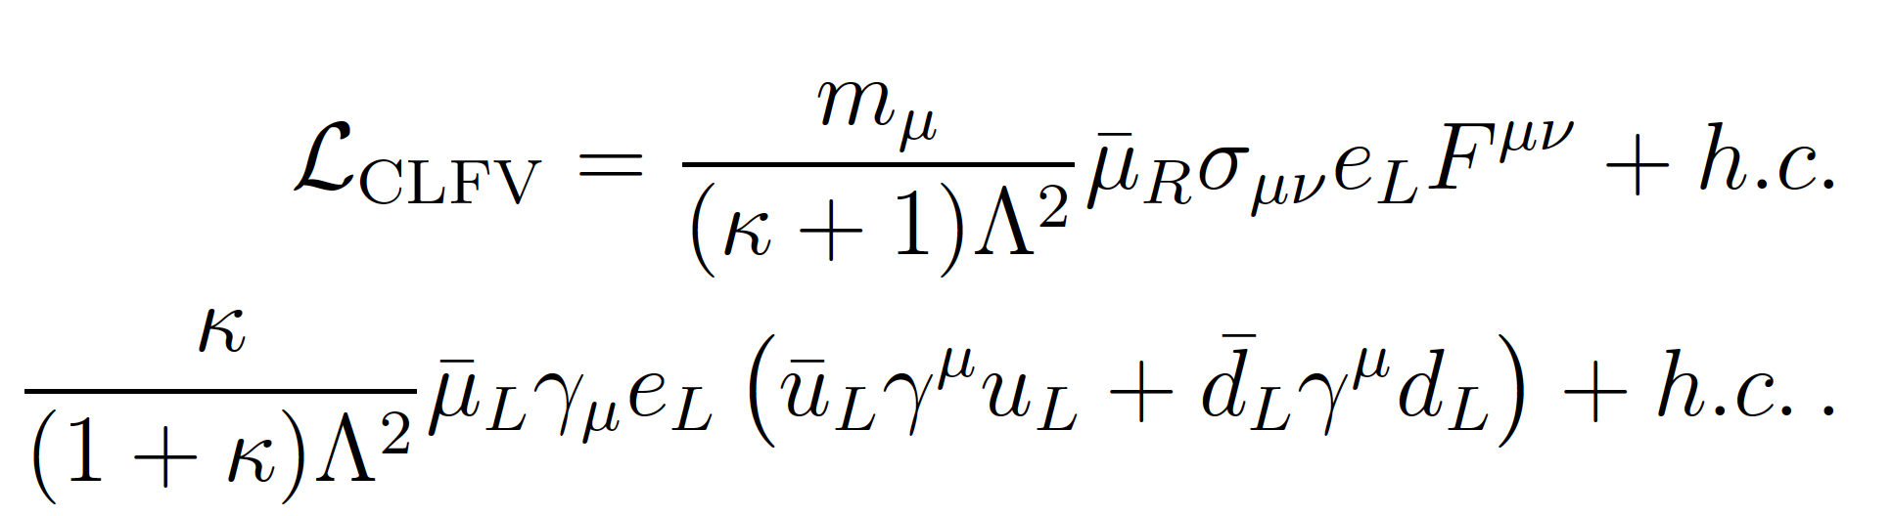
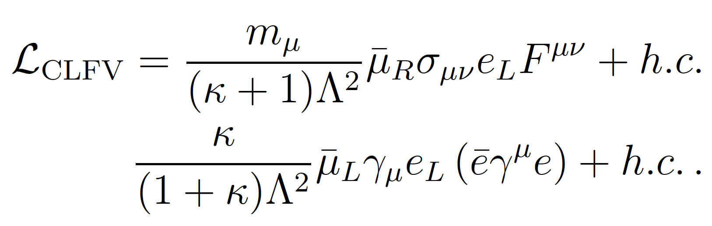
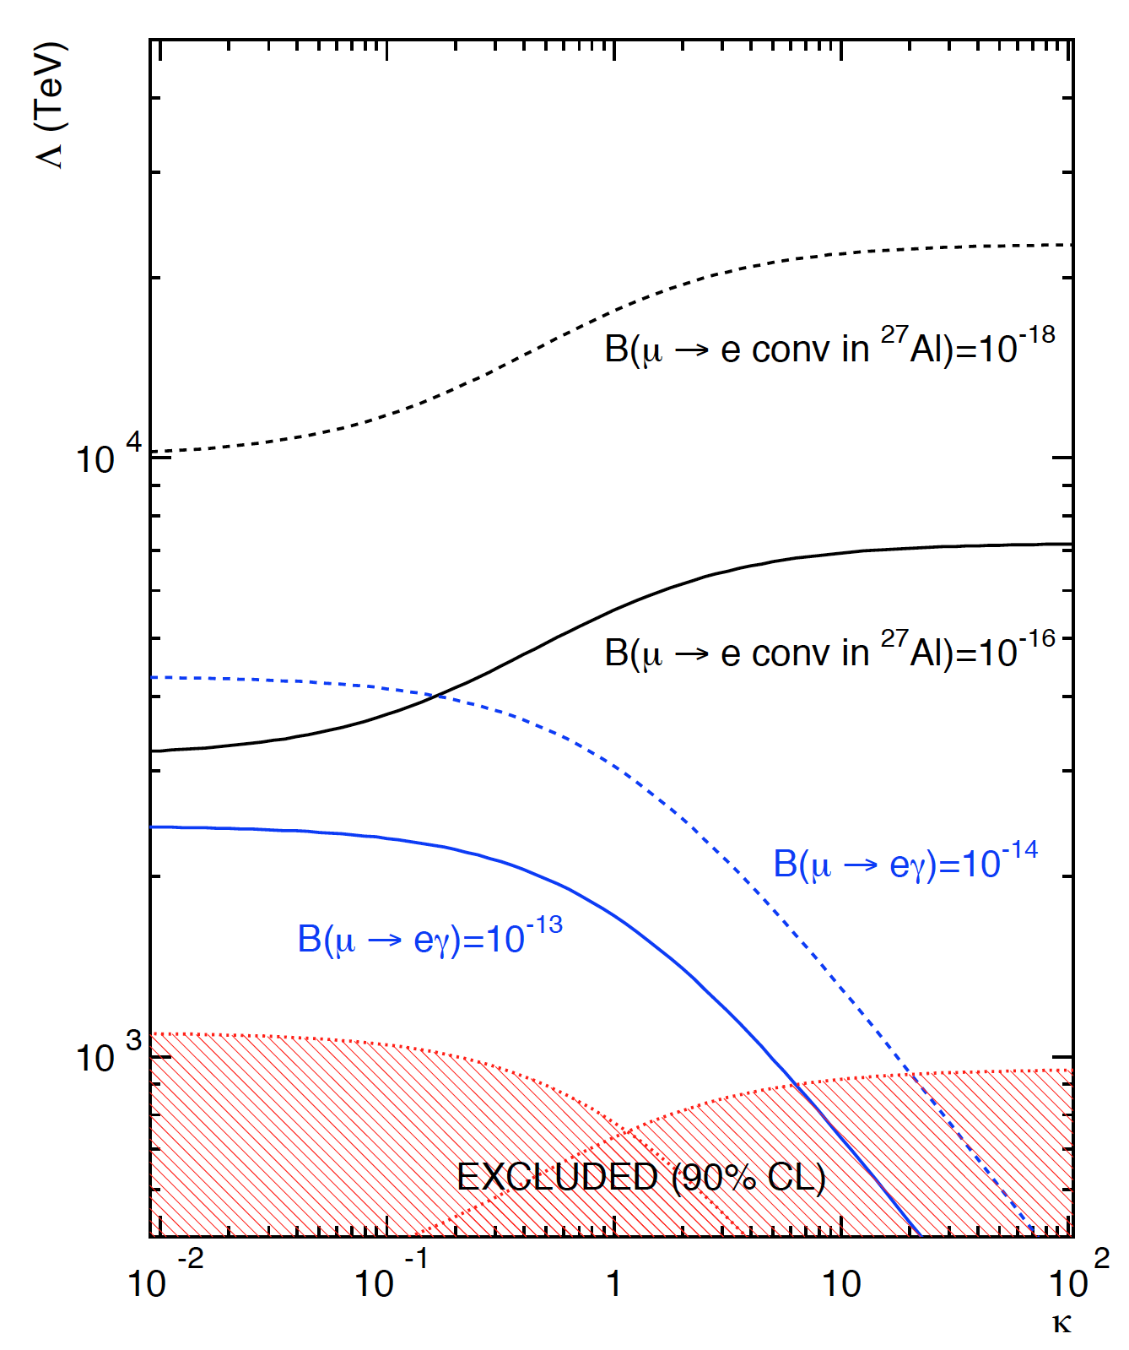
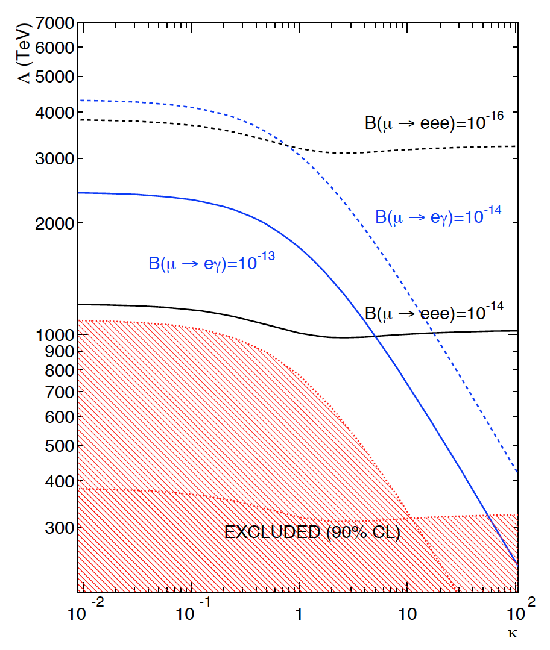
Constraints on Λ – Effective operators
NP
De Gouvea & Vogel’ 13
De Gouvea & Vogel’ 13

Slide 4
PLAN
DISCUSS SOME CONNECTIONS BETWEEN NEUTRINO MASSES AND cLFV
Framework: SEESAW

Slide 5
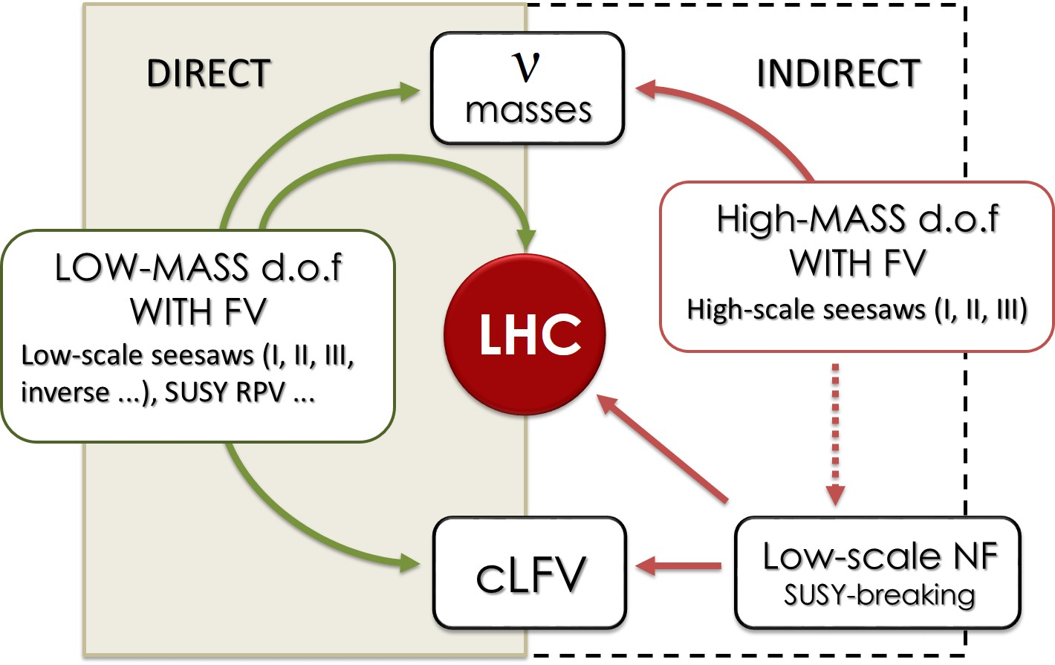

cLFV and neutrino masses – Direct and indirect
$$ββ0ν$$
ν
oscillations
Direct ν mass, cosmology,...

Slide 6
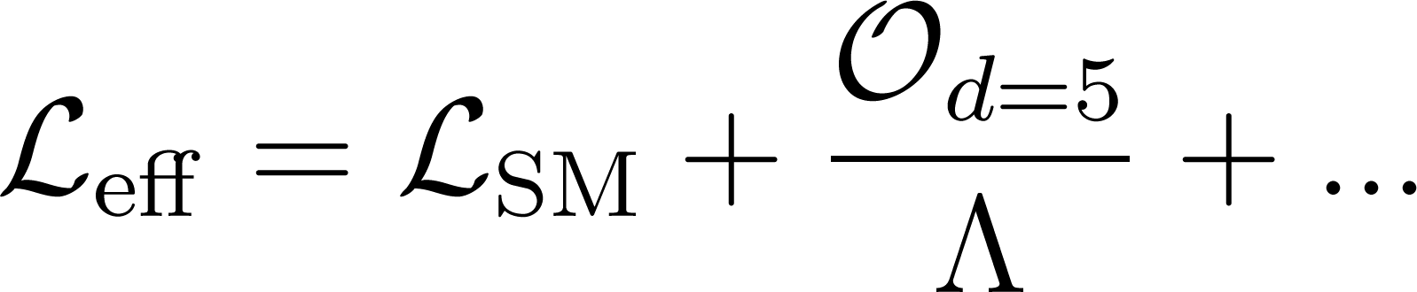
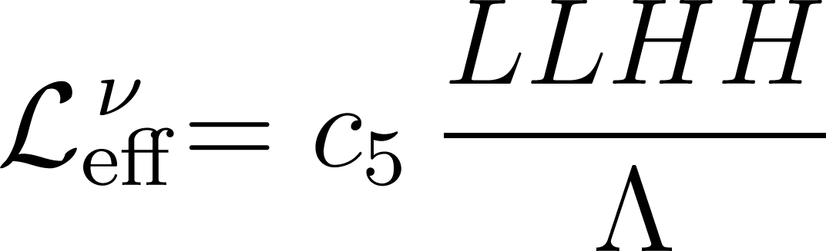
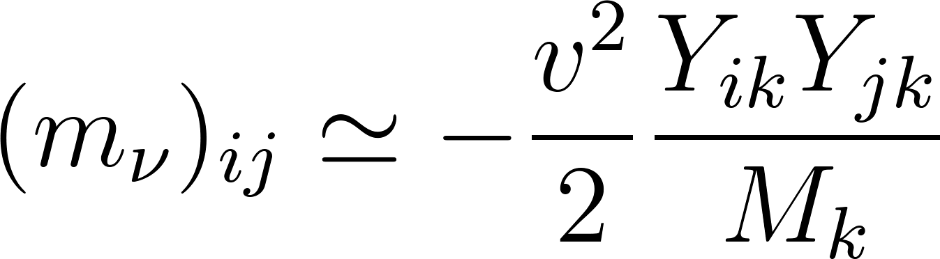
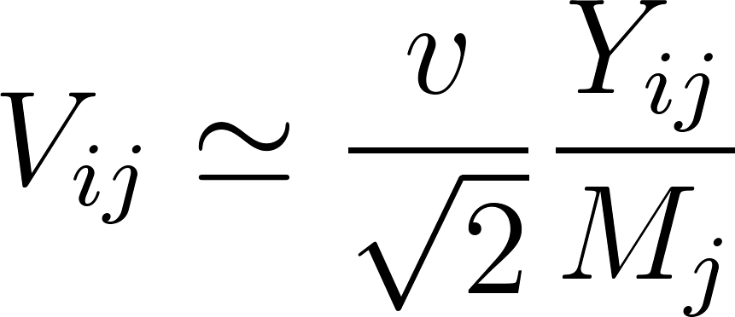
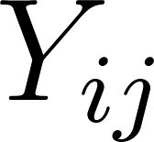
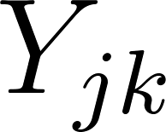

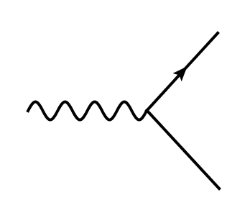
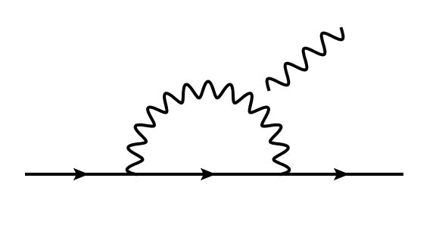



Neutrino masses – The seesaw paradigm
THE SM AS AN EFFECTIVE THEORY:
SEESAW MECHANISM
TYPE I, III
Neutrino masses:
Heavy-light mixing:

Slide 7



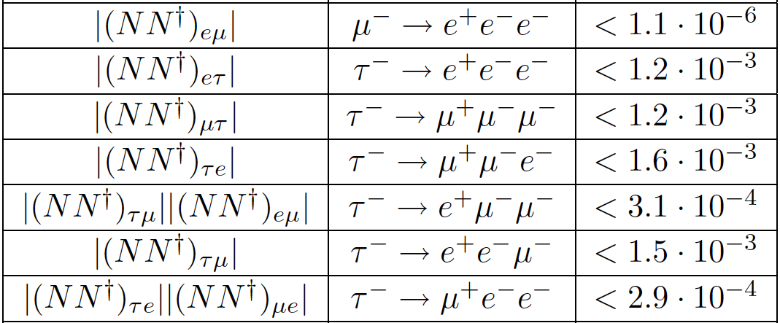
cLFV and seesaws I and III (direct)
TYPE I:
Petcov, Cheng, Li, Bilenky, Pontecorvo,
Marciano, Sanda, Shrock, Pakvasa,
Sugawara...’77
TYPE III:
Abada et al.’2008
TYPE I
TYPE III
Abada et al.’2008
and conversion at tree-level in type III
From
conversion

Slide 8
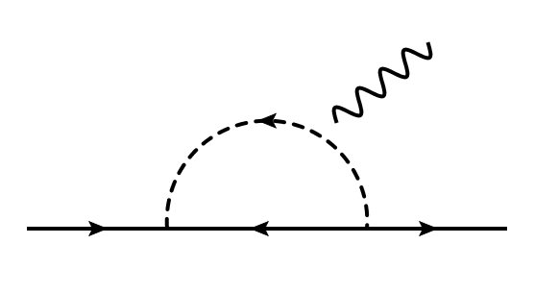
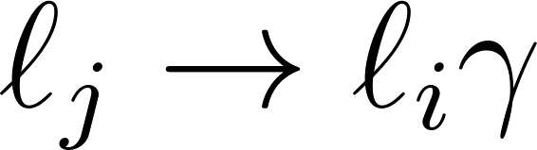





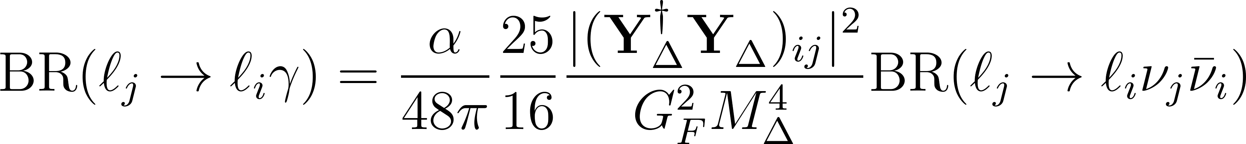
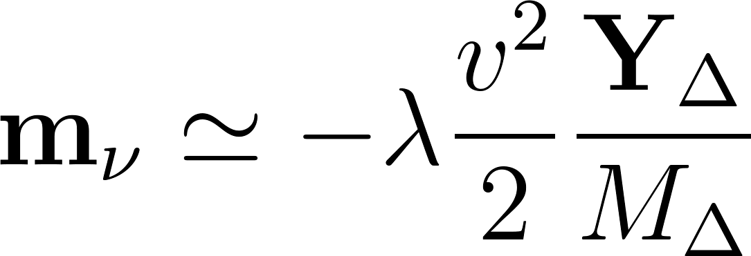

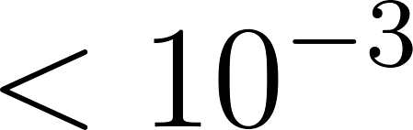
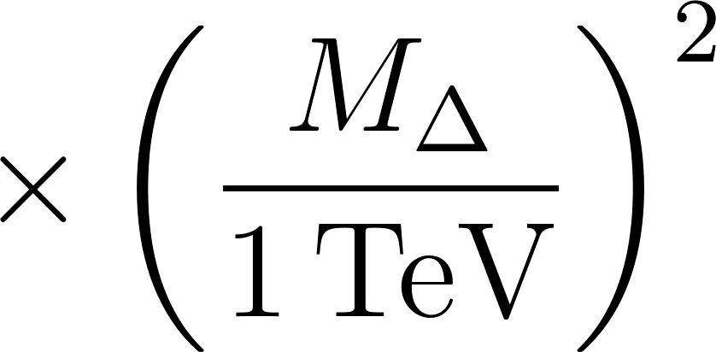
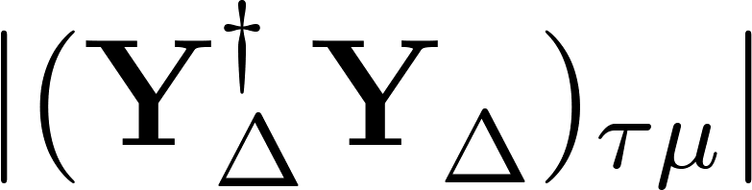
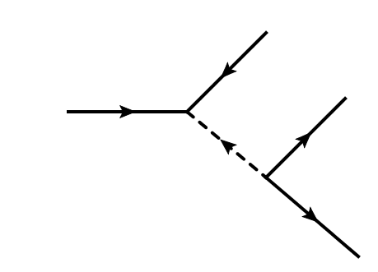



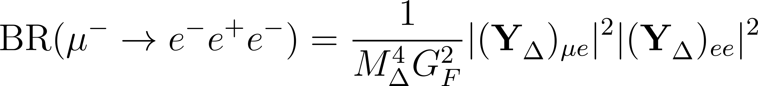

cLFV and seesaw II (direct)
TYPE II
RICH PHENOMENOLOGY
Pich & Santamaria’86;
Bilenky & Petcov’ 87;
Mohapatra’ 92
Neutrino masses:
P.B. Pal’83

Slide 9


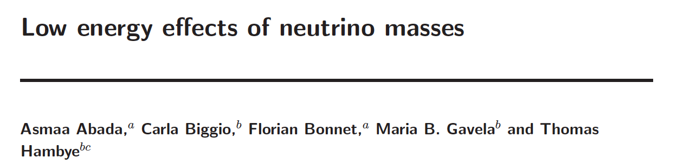
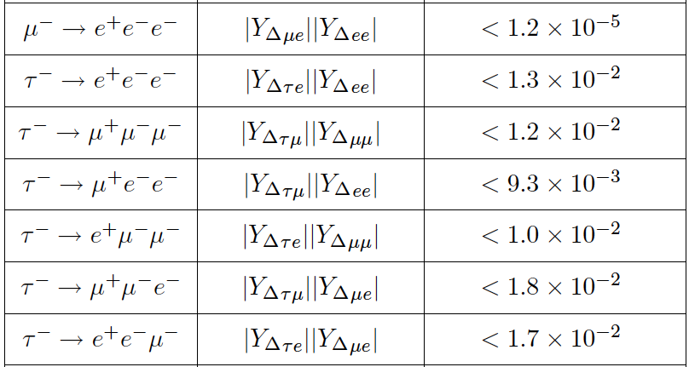
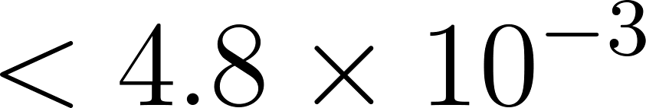
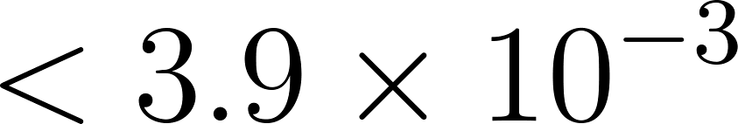
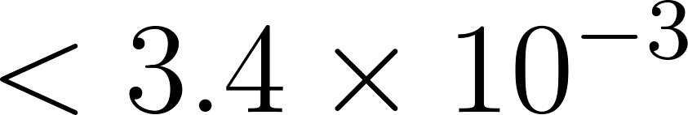
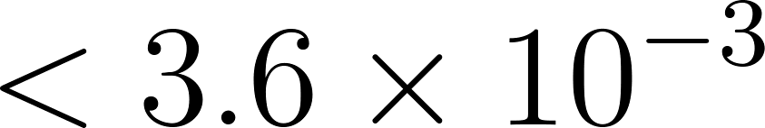
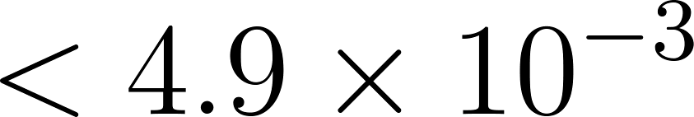
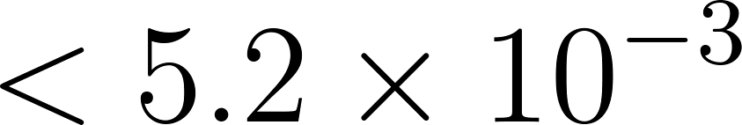
cLFV and seesaw II (direct)
2007
2013

Slide 10
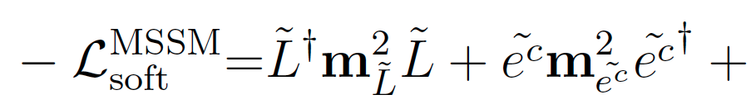



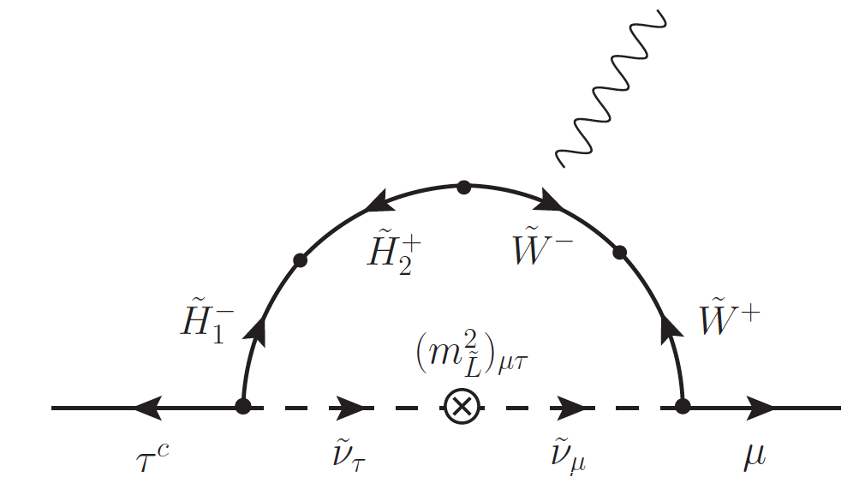

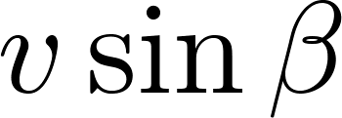


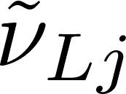
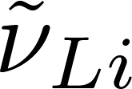
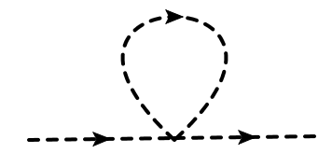
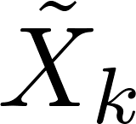
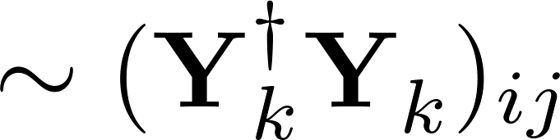


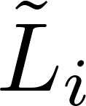
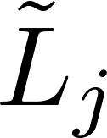
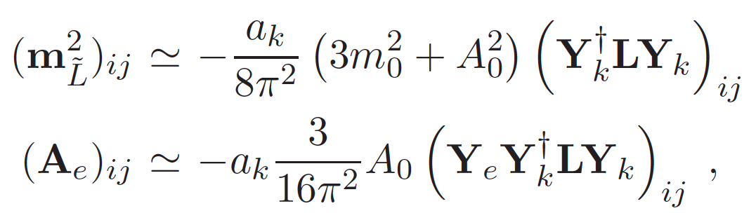
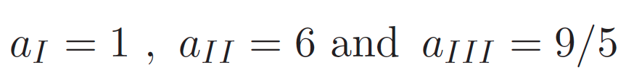

cLFV and SUSY seesaws (indirect)
WHAT IS THE ORIGIN OF ?
STANDARD APPROACH: Consider flavour-blind SSB terms @ a high-scale Λ>M and rely on RGE effects to generate sLFV
cv
cv
cv
For type I, II and III:
Masiero, Borzumati, Rossi, ...

Slide 11

cLFV and SUSY seesaws (indirect)
Roughly:
Soft masses will scale in a (almost) trivial way with Yukawas
4
Type I and III – 10 (M’s): 100 (BR’s) , Type II: – 10 (M): 10 (BRs)
Relations among different LFV decays
One gets rid of the non-flavoured parameter dependence.

Slide 12


cLFV and SUSY seesaw I and III (indirect)
Shortcoming of type I and III seesaws:
HARD to disentangle the flavour structure of the couplings
in the neutrino sector
IN A MODEL-INDEPENDENT WAY
*
Just count the parameters... Or (Casas & Ibarra’01)
ALL R’s LEAD TO THE SAME
FOR SUSY LFV THE RELEVANT COMBINATION IS:
WHICH IS NOT UNIQUELY DEFINED
* Not to say impossible...

Slide 13
cLFV and SUSY seesaw I and III (indirect)
Several approaches: FLAVOUR SYMMETRIES, GUTS, TEXTURES, R-MATRIX…
“Randomizing” R may hide away many possible scenarios
(maybe even the most interesting)
A very simple example:
OR
IT IS DANGEROUS TO DRAW CONCLUSIONS BASED ON “RANDOMIZATION”

Slide 14


cLFV and SUSY seesaw I and III (indirect)
NUFACT’13
NUFACT’13
PRELIMINARY
PRELIMINARY
EXCLUDED BY MEG13
EXCLUDED BY MEG13
NEUTRINO PARAMETERS TAKEN FROM GLOBAL FITS
Assumptions: no CP phases, M /M = M /M = 10, NH (m ~ 0)
3
2
2
1
1

Slide 15



cLFV and SUSY seesaw I, III (indirect)
TYPE I AND THE SUSY PARAMETER SPACE.
ASSUMPTIONS: R=1, degenerate RH neutrinos, NH (m ~ 0) , no CP
1
Hirsch, FRJ & Vicente, JHEP 1211 (2012) 105

Slide 16


cLFV and SUSY seesaw I, III (indirect)
TYPE III AND THE SUSY PARAMETER SPACE.
ASSUMPTIONS: R=1, degenerate RH neutrinos, NH (m ~ 0) , no CP
1
Hirsch, FRJ & Vicente, JHEP 1211 (2012) 105

Slide 17


cLFV and SUSY seesaw II (indirect)
Superpotential (Rossi’02):
LFV slepton masses (taking universal boundary conditions):
Gauge
SUSY
Messenger sector
SUSY
Observable sector
Yukawa
FRJ, Rossi; PRL’06, NPB’07; Brignole, FRJ, Rossi; JHEP’10
Dependence on low-energy parameters:

Slide 18

cLFV and SUSY seesaw II (indirect)
Normal ordering:
Inverted ordering:
Dependence on low-energy parameters:

Slide 19

cLFV and SUSY seesaw II (indirect)
Situation before θ measurement:
13
FRJ, JHEP 1006 (2010) 079

Slide 20

cLFV and SUSY seesaw II (indirect)
Situation before θ measurement:
13
FRJ, JHEP 1006 (2010) 079

Slide 21



cLFV and SUSY seesaw II (indirect)
FRJ, NUFACT’13
Which CONCRETE conclusions can we take from this plot ?
Let me remind you the assumptions:
PRELIMINARY
Flavour-blind SUSY-breaking mechanism;
Only one triplet-pair;
No relevant RGE effects which
could spoil
Nearly degenerate slepton masses
CONCLUSION:
Observation of a τ LFV decay @ Super B factory would exclude type II.

Slide 22

cLFV and SUSY seesaw II (indirect)
DO THESE RESULTS SURVIVE THROUGH THE DESERT?
FRJ, JHEP 1006 (2010) 079

Slide 23


cLFV and SUSY seesaw II (indirect)
STABILITY IN THE SUSY PARAMETER SPACE
FRJ, JHEP 1006 (2010) 079

Slide 24


cLFV and SUSY seesaw II (indirect)
SOME RECENT EXAMPLES
Hirsch, FRJ & Vicente, JHEP 1211 (2012) 105

Slide 25





One slide on other LFV decays
WITH DIPOLE DOMINANCE:
FOR A LARGE CLASS OF SUSY MODELS THIS RELATIONS ARE VALID

Slide 26

A couple of slides on other LFV decays in SUSY
FRJ & Rossi’06

Slide 27

A couple of slides on other LFV decays in SUSY
FRJ & Rossi’06

Slide 28
CONCLUSIONS
COMPLEMENTARITY analyses between neutrino data and CLFV searches are of extreme importance to get some hints on possible connections.
LOW-ENERGY neutrino mass models are “cleaner” in what respects LFV.
HIGH-ENERGY neutrino mass models need low-energy LFV mediators (e.g. SUSY)
SUSY SEE-SAWS (I and III) based connections between neutrinos and cLFV require model-dependent assumptions.
SUSY Type II is less dependent on the flavour origin. Still, is a HE framework.

Slide 29
CONCLUSIONS
RELATIONS among different-flavour decay channels of the same type.
RELATIONS among same-flavour decays of different type.
谢谢!
Thank you!

Slide 30
Some limits on cLFV

