Slide 1
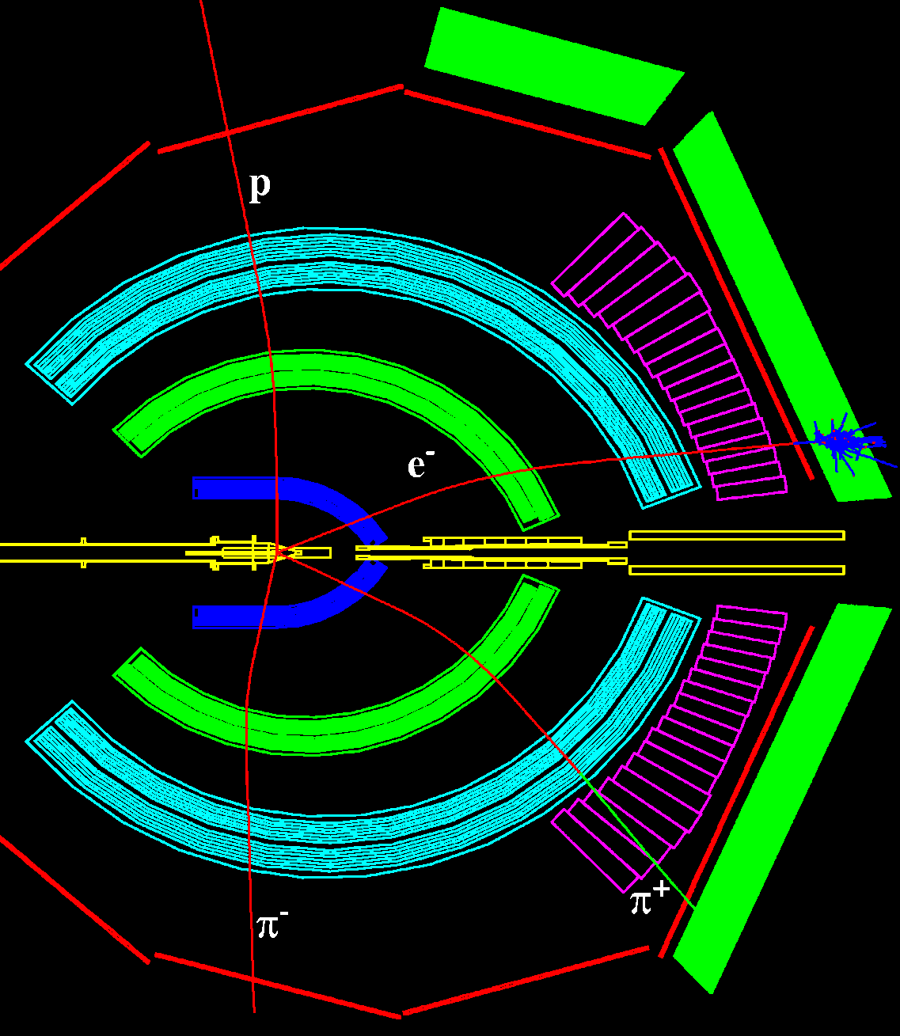
eA pion production at CLAS aimed at neutrinos
S. Manly & Hyupwoo Lee
University of Rochester
Department of Physics and Astronomy
NUFACT 2013
August 19-24, 2013
Beijing, China
Representing the CLAS (EG-2) collaboration

Slide 2
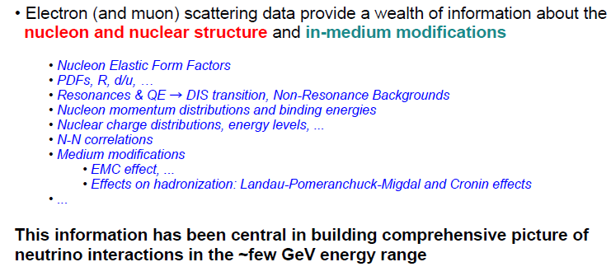
Motivation – why eA?
High statistics.
Control over initial energy and interaction point – gives kinematic constraints and ability to optimize detector.
Summary slide from talk by Costas Andreopolos at NUINT 2009
“Electron scattering data and its use in constraining neutrino models”
S. Manly, University of Rochester

Slide 3
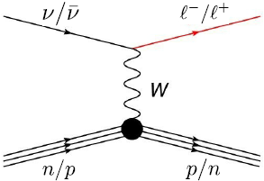
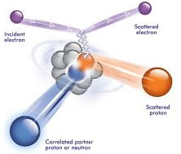
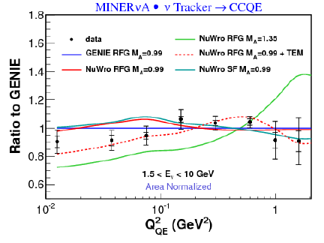
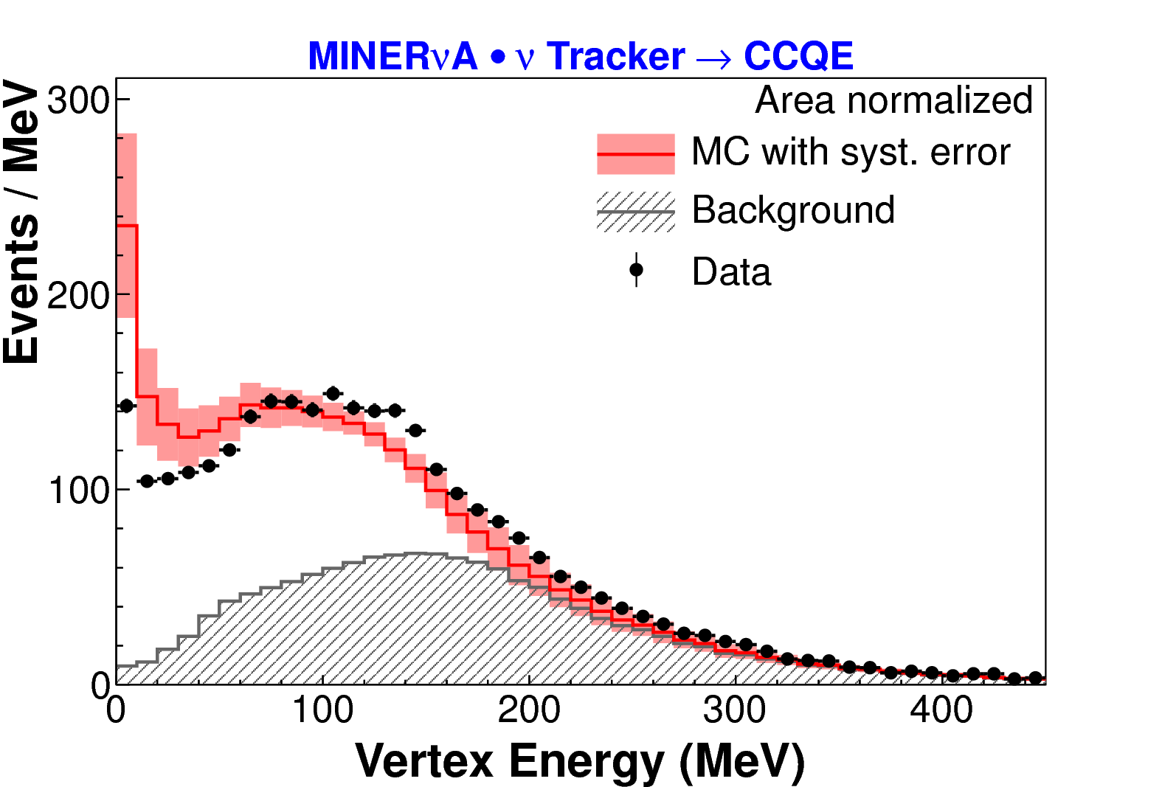
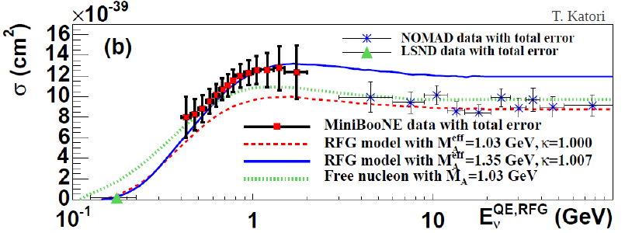
Why eA? – Discussions at NUFACT
Much of the conversation here at NUFACT regarding oscillations/cross sections has centered around the fact that interactions are on nuclei rather than nucleons
R. Subedi et al., Science 320, 1476 (2008)
Input from eA has been important in helping us understand the potential effects of SRC and MEC, for example

Slide 4
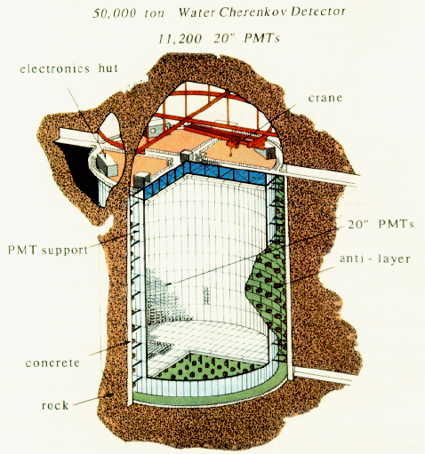
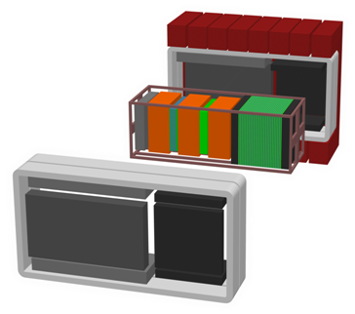
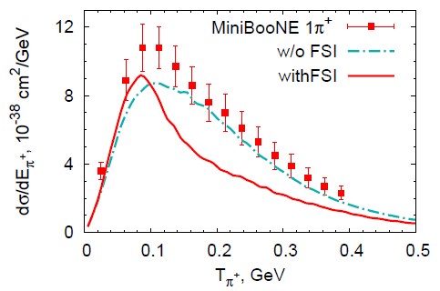
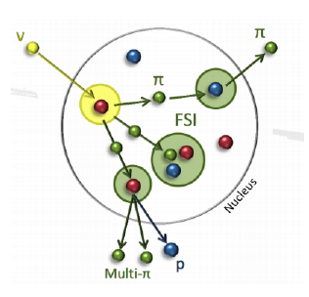
Why eA? – This work
Neutrino beam
Long baseline
Model
Even more important if near and far detectors are not the same material
Measure flux and backgrounds in near detector and propagate to far detector and the uncertainties “cancel out”
Cross-sections, nuclear effects and backgrounds don’t cancel simply/completely, even in the limit of identical detectors.
e,
GIBUU, Lalakulich and Mosel, NUINT 2012

Slide 5
Why eA? – This work
This work aims to produce high statistics, multidimensional, differential, charged pion production measurements on different nuclei. The hope is that this will be useful for learning about and tuning models for FSI.
e,

Slide 6
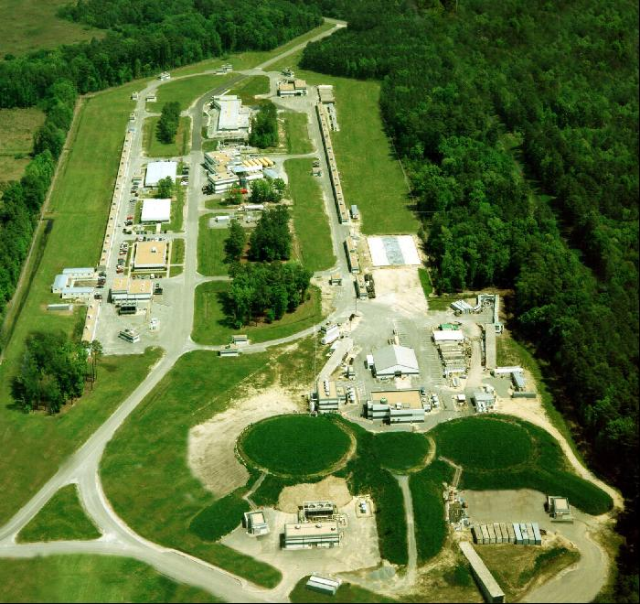
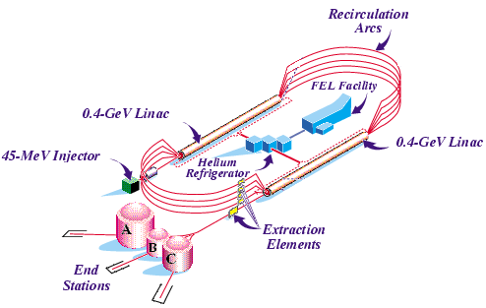
Jefferson Lab (Newport News, Virginia)
12 GeV upgrade underway
E_{max} ~ 6 GeV
I_{max} ~ 200 μA
Duty Factor ~ 100%
σ_{E}/E ~ 2.5 10⁻⁵
Beam P ~ 80%
CLAS

Slide 7
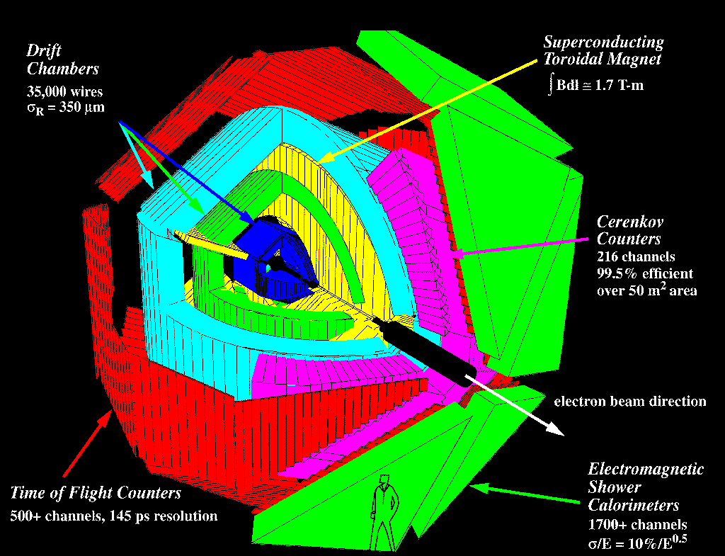
CLAS: CEBAF Large Acceptance Spectrometer (Hall B)

Slide 8

CLAS Single Event Display
Charged particle angles 8º-144º
Neutral particle angles 8º-70º
Momentum resolution ~0.5% (charged)
Angular resolution ~0.5 mr (charged)
Identification of p, π⁺/π⁻, K⁺/K⁻, e⁺/e⁻, etc.

Slide 9
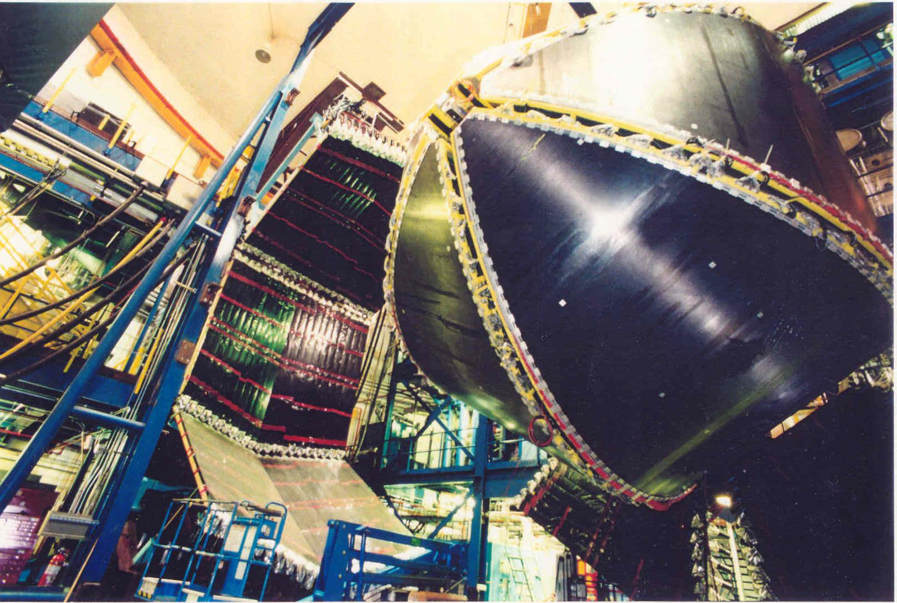
CLAS - International collaboration of ~230 scientists
  Physics data-taking started in May of 1997
  Wide variety of run conditions: e-/γ beams, 0.5<E<6 GeV (polarized), ^{1,2}H, ^{3,4}He, ¹²C, ⁵⁶Fe, etc.
EG2 running period for JLab experiments E02-104 (Quark propagation through cold QCD matter) and E02-110 (Q² dependence of nuclear transparency for incoherent rho electroproduction)
  deuterium, carbon, lead, tin, iron, aluminum
  3 running periods: Sept. 2003, Dec. 2003 and Jan. 2004

Slide 10
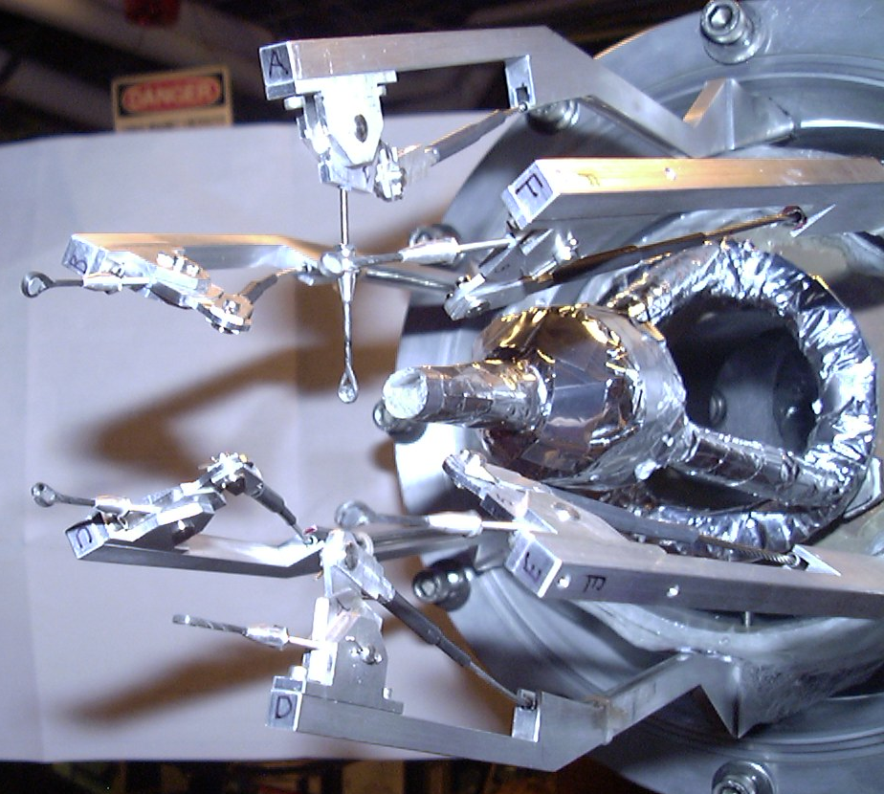
CLAS EG2
Targets
Two targets in the beam simultaneously
2 cm LD2, upstream
Solid target downstream
Six solid targets:
  -Carbon
  -Aluminum (2 thicknesses)
  -Iron
  -Tin
  -Lead

Slide 11
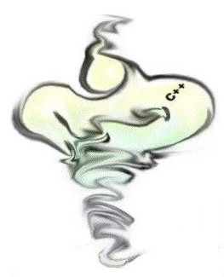
GENIE eA
Using GENIE version 2.5.1 in eA mode with Q²>0.5
for acceptance calculations and comparison
C. Andreopoulos: GENIE eA mode is a “straightforward adaptation of the neutrino generator”
Use charged lepton predictions of cross-section models: Rein-Sehgal, Bodek-Yang, etc.
Transition region handled as in neutrino mode.
Nuclear model (Bodek-Ritchie, Fermi-Gas) same as in neutrino mode.
Intranuclear cascade (INTRANUKE/hA) same as in neutrino mode.
Small modifications to take into account probe charge for hadronization model and resonance event generation.
In-medium effects to hadronization same as in neutrino mode.
S. Manly, University of Rochester
11

Slide 12
Samples
EG-2 data sample size (E_{beam}=5.015 GeV):
Deuterium + C/Fe/Pb raw events 1.1/2.2/1.5 (×10⁹)
D2/C/Fe/Pb events passing all cuts 28.1/5.0/7.6/2.5 (×10⁶)
Simulated sample size (Genie MC + detector simulation):
D2/C/Fe/Pb generated events (4)×1.0×10⁸
D2/C/Fe/Pb events passing all cuts 7.9/6.4/5.5/4.8 (×10⁶)
S. Manly, University of Rochester
NUFACT 2013, Beijing, China August 19-24, 2013
12

Slide 13
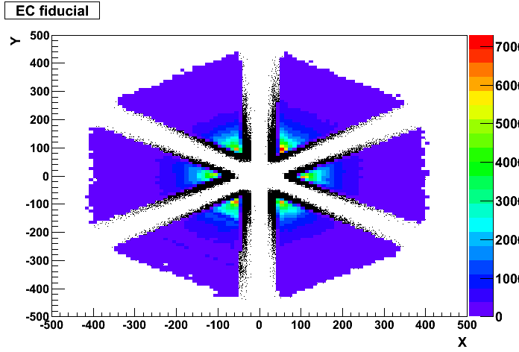
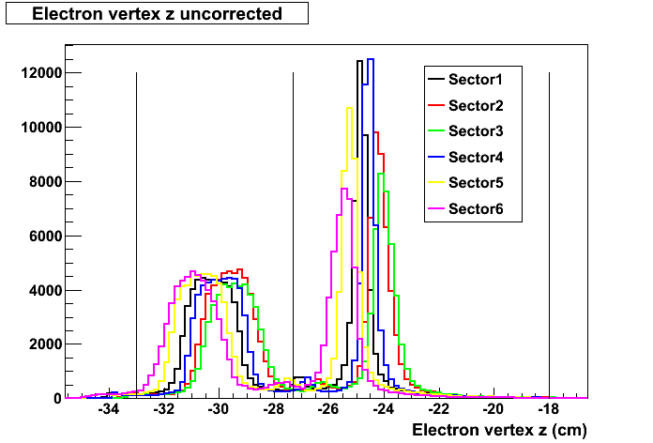
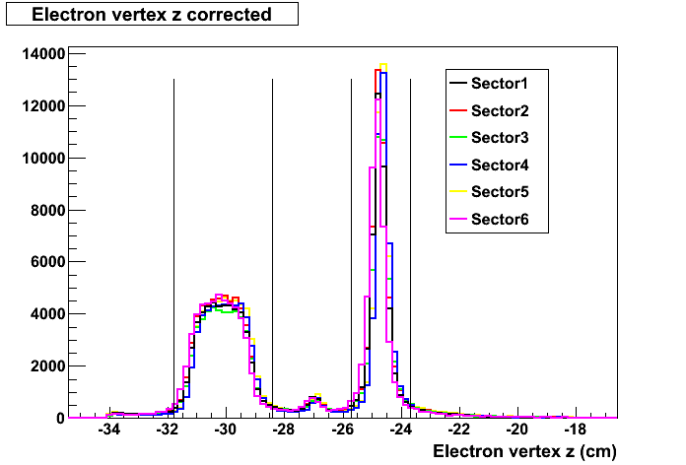
Analysis cuts
Demand electron enter calorimeter safely away from edges
Demand energy deposit as function of depth in ECAL be uneven
Adjust vertex Z position for sector-by-sector beam offset
Demand momentum of outgoing e-: p>0.64 GeV (or y<0.872) (removes bias due to electromagnetic energy threshold in trigger)
Implement “relatively” easy to model cuts in W, Q², θ for the electron and p_{π}, θ_{π} for the pion
S. Manly, University of Rochester
NUFACT 2013, Beijing, China August 19-24, 2013
13

Slide 14
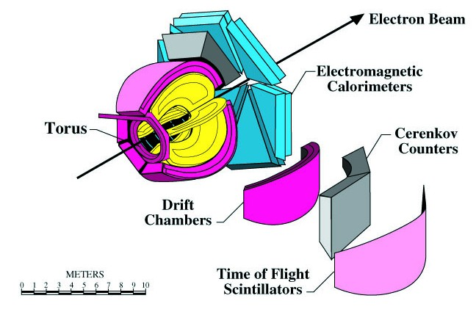
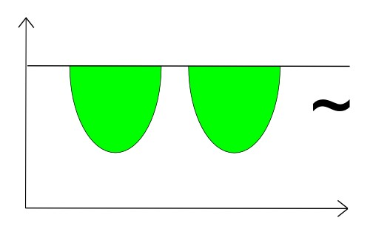
Fiducial volume complications
Six azimuthal regions of angular acceptance that are a function of θ, p, charge
Angle with respect to beam
Azimuthal angle
The optimal fiducial regions for the detector are not conveniently modeled for comparison to calculations
S. Manly, University of Rochester
NUFACT 2013, Beijing, China August 19-24, 2013
14

Slide 15
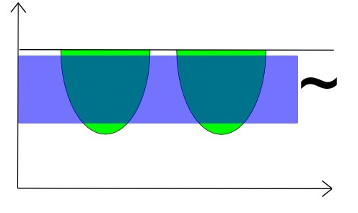
Fiducial volume complications
Angle with respect to beam
Azimuthal angle
Report results with geometric correction to be azimuthally symmetric
Implement “relatively” easy to model cuts in W, Q², θ for the electron and p_{π}, θ_{π} for the pion
S. Manly, University of Rochester
NUFACT 2013, Beijing, China August 19-24, 2013
15

Slide 16
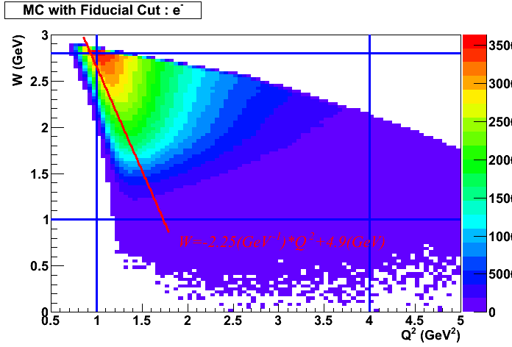
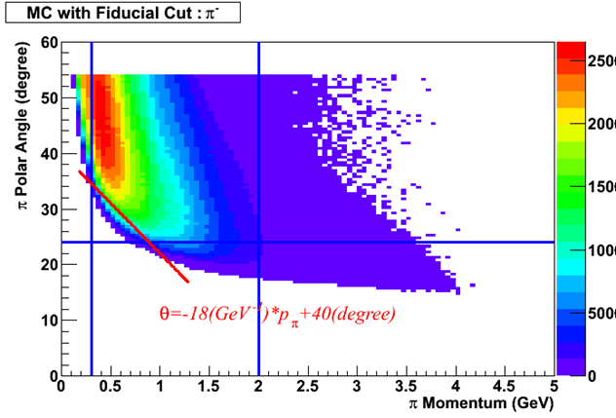
For e⁻
y>0.872
1GeV²<Q²<4 GeV²
1 GeV<W<2.8 GeV
red line shown
W = -2.25(GeV⁻¹)×Q² + 4.9(GeV)
For π⁻ (π⁺ has distinct but similar cuts)
0.3<p_{π}<2
24º<θ_{π}<54º
red line shown
Θ = -18(GeV-1)×pπ + 40(degrees)
NUFACT 2013, Beijing, China August 19-24, 2013

Slide 17
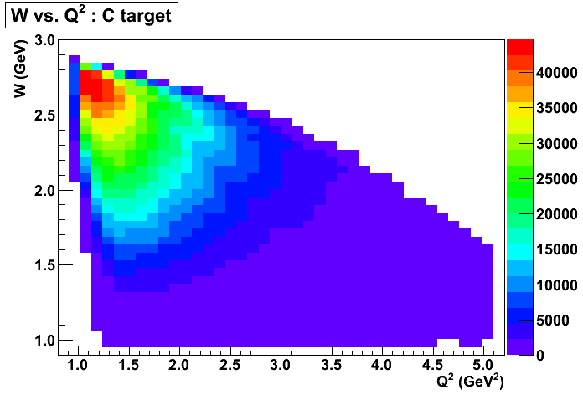
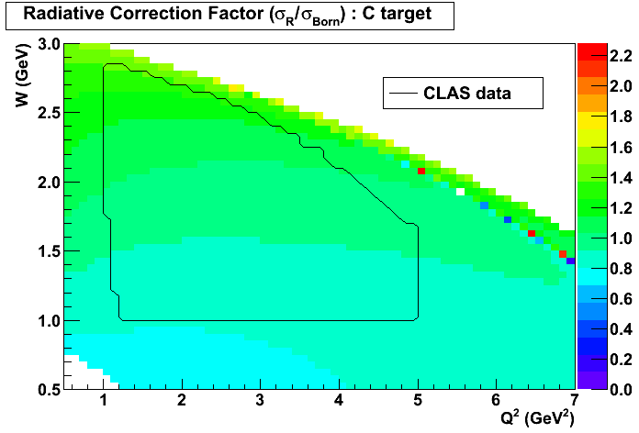
Radiative corrections
Use “externals_all” routine designed for EG1-DVCS experiment (P. Bosted, EG1-DVCS technical note 5, 2010)
Calculate differential cross sections (W, Q²) with and without QED radiative effects in the process.
Remove (quasi-)elastic contribution (since we demand a pion be present)
Only consider leptonic side (in neutrinos we don’t typically worry about the radiative corrections on the hadronic side)
NUFACT 2013, Beijing, China August 19-24, 2013

Slide 18
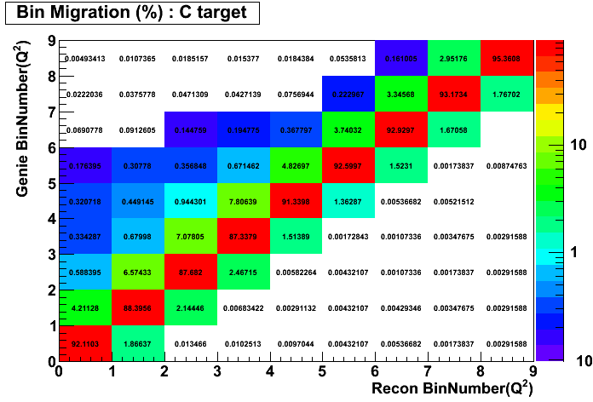
Acceptance and bin migration
Work in 4-dimensional space (W, Q², p_{π}, θ_{π})
Multi-dimensional acceptance correction and bin migration correction from MC (<10%, typically smaller)
Non-acceptance corrected GENIE distributions look very similar to the data distributions – reasonable to use the GENIE samples for the acceptance corrections.
Require at least one π± reconstructed, take leading pion as the analysis pion
MC indicates single π± sample to originate from ~40% percent single π± with most of the rest from multiple π events.
Missing mass analysis improves single-π purity with a big loss in statistics. Not using for current results.
NUFACT 2013, Beijing, China August 19-24, 2013

Slide 19
Caveats
All results shown here are preliminary
The errors shown are statistical only
Systematic errors are under investigation
Expectation/goal is to hold the systematic errors to <10%
Vast amount of differential data. Only sampling shown here.
Ask if you want to see preliminary result on something I do not have time to show here.
S. Manly, University of Rochester
NUFACT 2013, Beijing, China August 19-24, 2013
19

Slide 20
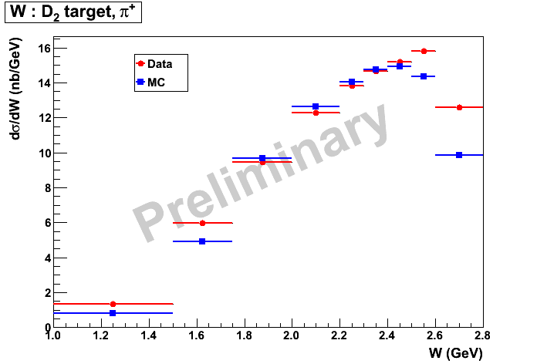
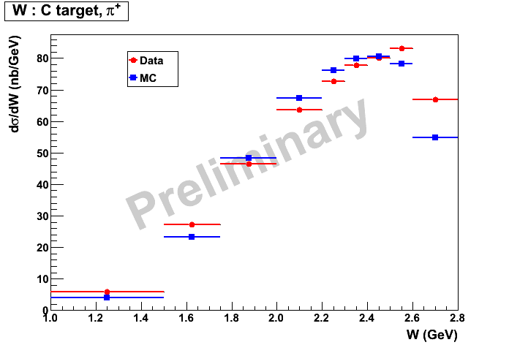
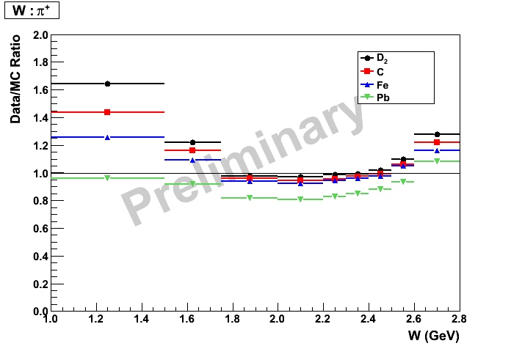
Data-MC comparison
(Comparison friendly fiducial region, corrected for acceptance and radiative effects, only statistical errors shown , three variables integrated over)
W, π⁺
Data/MC ratio, all targets
NUFACT 2013, Beijing, China August 19-24, 2013

Slide 21
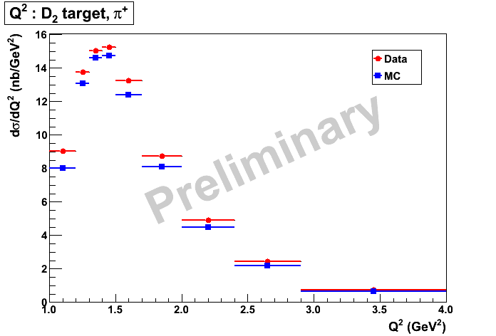
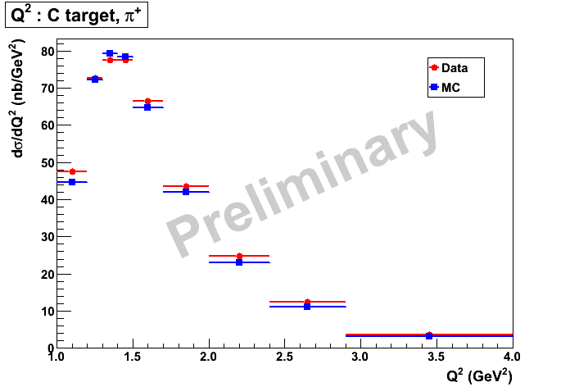
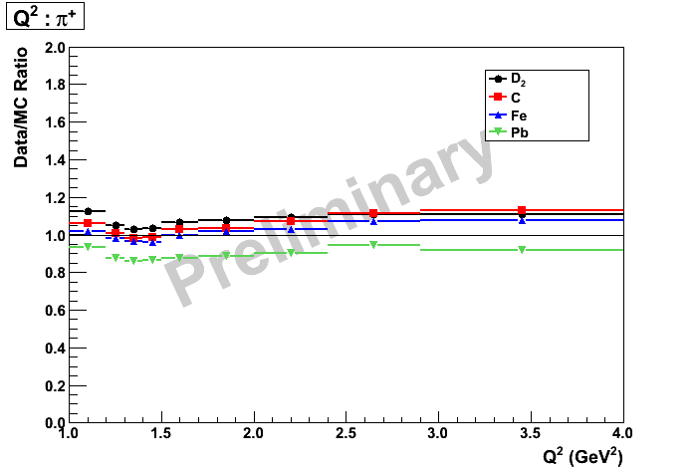
Data-MC comparison
(Comparison friendly fiducial region, corrected for acceptance and radiative effects, only statistical errors shown , three variables integrated over)
Q², π⁺
Data/MC ratio, all targets
NUFACT 2013, Beijing, China August 19-24, 2013

Slide 22
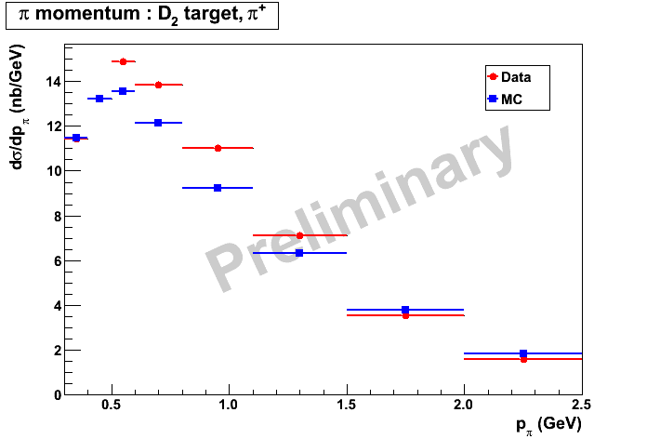
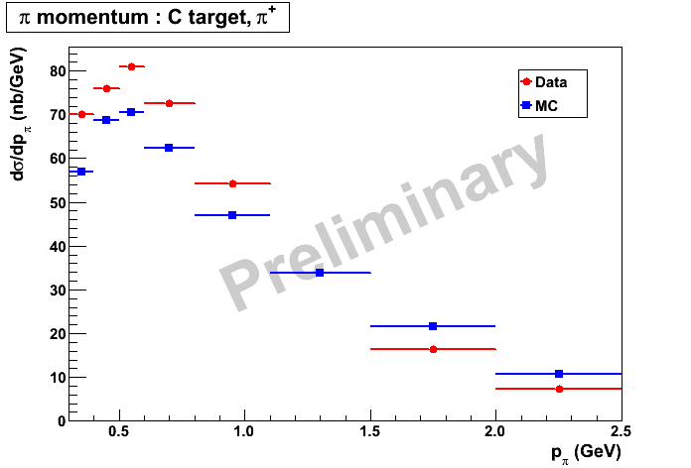
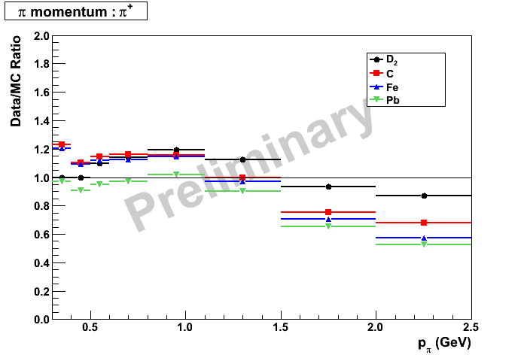
Data-MC comparison
(Comparison friendly fiducial region, corrected for acceptance and radiative effects, only statistical errors shown , three variables integrated over)
p_{π}, π⁺
Data/MC ratio, all targets
NUFACT 2013, Beijing, China August 19-24, 2013

Slide 23
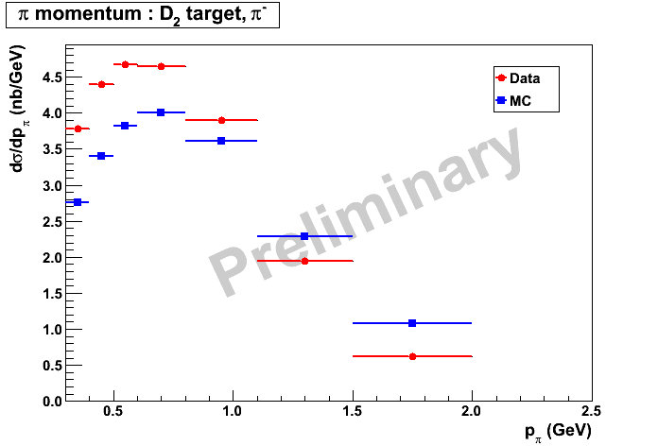
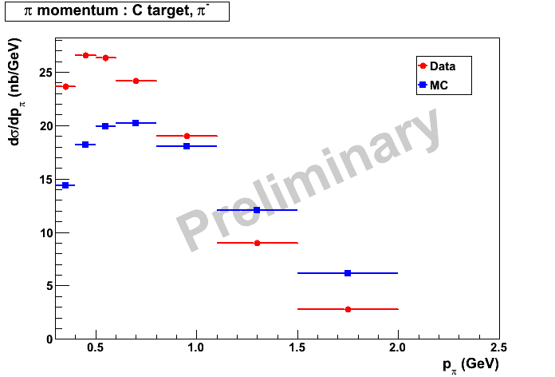
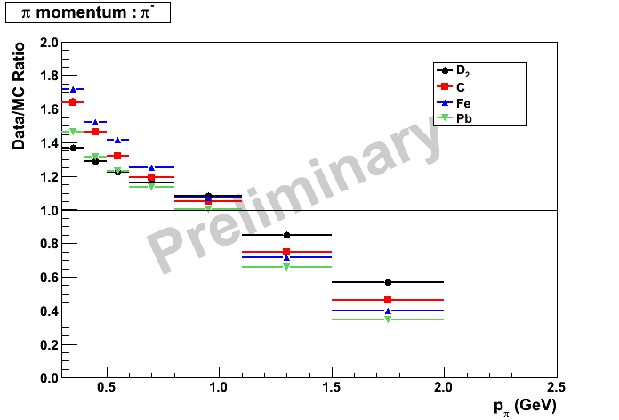
Data-MC comparison
(Comparison friendly fiducial region, corrected for acceptance and radiative effects, only statistical errors shown , three variables integrated over)
p_{π}, π⁻
Data/MC ratio, all targets
NUFACT 2013, Beijing, China August 19-24, 2013

Slide 24
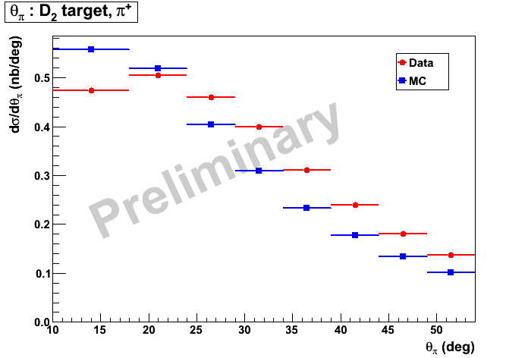
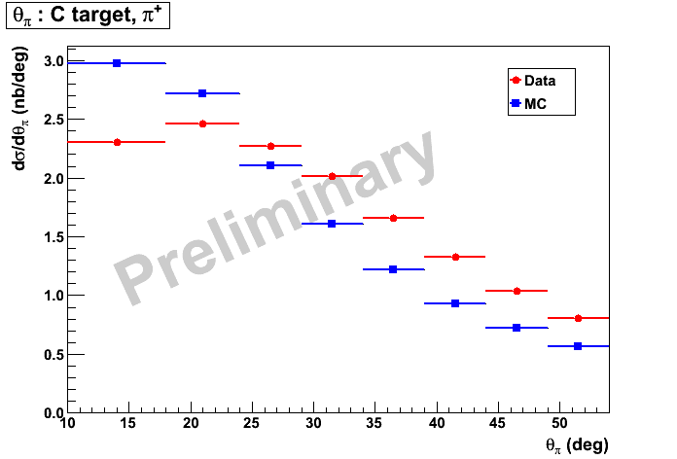
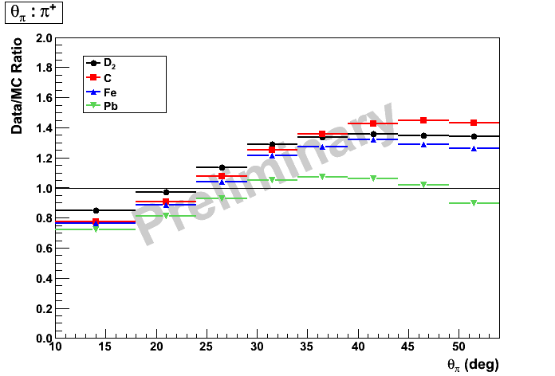
Data-MC comparison
(Comparison friendly fiducial region, corrected for acceptance and radiative effects, only statistical errors shown , three variables integrated over)
θ_{π}, π⁺
Data/MC ratio, all targets
NUFACT 2013, Beijing, China August 19-24, 2013

Slide 25

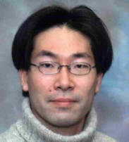
High precision neutrino results are a product of many pieces carefully fit together
CLAS/EG2 is making significant progress toward releasing multi-dimensional precision π± production cross-sections on different nuclei in a region of phase space relevant for the current precision neutrino physics program. We hope for final results to be released in the next year.
Let’s finish this up. I need to graduate!

Slide 26
Backup slides

Slide 27
Motivation – why eA?
Not a free nucleon in general
Assume quasielastic kinematics to determine E_{ν}
Well-known “disagreement” calls into question the completeness of our model, perhaps need meson exchange currents and nucleon correlations

Slide 28
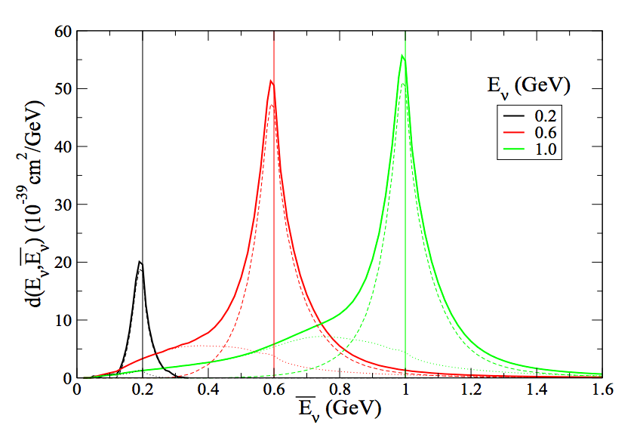
Motivation – why eA?
Multinucleon events reconstructed as quasielastic
Genuine quasielastic events
R. Subedi et al., Science 320, 1476 (2008)
Short-range correlations between nucleons might change the kinematics and affect ability to identify/reconstruct quasielastic events
Martini et al. arXiv:1211.1523
Also:
J. Sobczyk arXiv:1201.3673,
Lalakulich et al. arXiv:1208.367
Nieves et al. arXiv:1204:5404

Slide 29


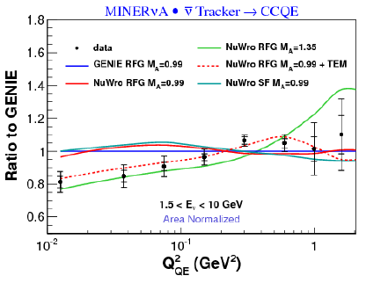


Motivation – why eA?
G.A. Fiorentini et al., PRL 111, 022502 (2013)
L. Fields et al., PRL 111, 022501 (2013)
Shape-only ratio
TEM: emperical, adjust magnetic form factors of bound nucleons to reproduce enhancement in the transverse cross-section in eA scattering attributed to meson exchange currents in the nucleus

Slide 30
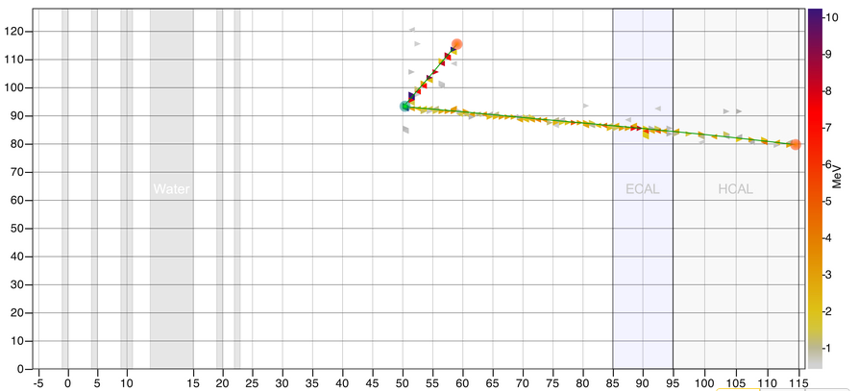
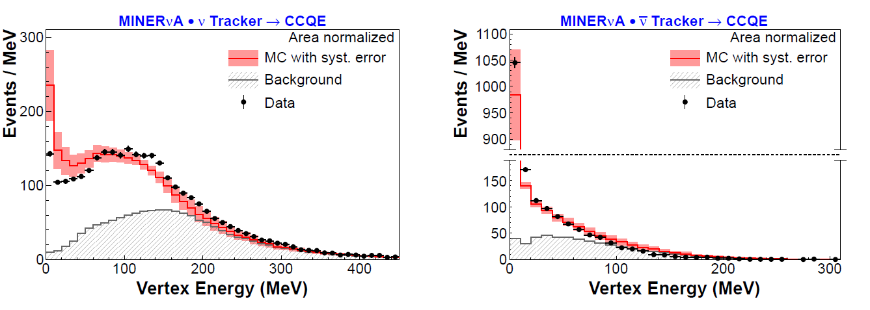
Motivation – why eA?
MINERνA event display
Vertex Energy
G.A. Fiorentini et al., PRL 111, 022502 (2013)
L. Fields et al., PRL 111, 022501 (2013)
Consistent with expectation from eA scattering that correlated pairs dominated by np

Slide 31
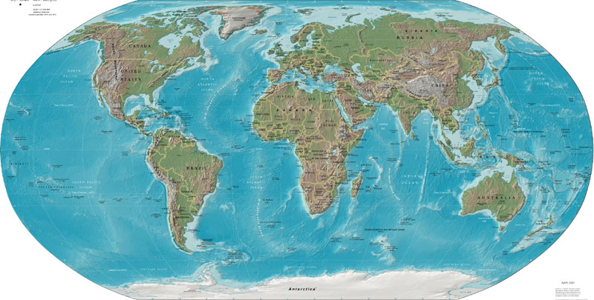












The CLAS Collaboration
Arizona State University, Tempe, AZ
University of California, Los Angeles, CA
California State University, Dominguez Hills, CA
Carnegie Mellon University, Pittsburgh, PA
Catholic University of America
CEA-Saclay, Gif-sur-Yvette, France
Christopher Newport University, Newport News, VA
University of Connecticut, Storrs, CT
Edinburgh University, Edinburgh, UK
Florida International University, Miami, FL
Florida State University, Tallahassee, FL
George Washington University, Washington, DC
University of Glasgow, Glasgow, UK
Idaho State University, Pocatello, Idaho
INFN, Laboratori Nazionali di Frascati, Frascati, Italy
INFN, Sezione di Genova, Genova, Italy
Institut de Physique Nucléaire, Orsay, France
ITEP, Moscow, Russia
James Madison University, Harrisonburg, VA
Kyungpook University, Daegu, South Korea
University of Massachusetts, Amherst, MA
Moscow State University, Moscow, Russia
University of New Hampshire, Durham, NH
Norfolk State University, Norfolk, VA
Ohio University, Athens, OH
Old Dominion University, Norfolk, VA
Rensselaer Polytechnic Institute, Troy, NY
Rice University, Houston, TX
University of Richmond, Richmond, VA
University of South Carolina, Columbia, SC
Thomas Jefferson National Accelerator Facility, Newport News, VA
Union College, Schenectady, NY
Virginia Polytechnic Institute, Blacksburg, VA
University of Virginia, Charlottesville, VA
College of William and Mary, Williamsburg, VA
Yerevan Institute of Physics, Yerevan, Armenia
Brazil, Germany, Morocco and Ukraine,
as well as other institutions in France and in the USA,
have individuals or groups involved with CLAS,
but with no formal collaboration at this stage.

Slide 32
Hall B Side View
NUFACT 2013, Beijing, China August 19-24, 2013

Slide 33
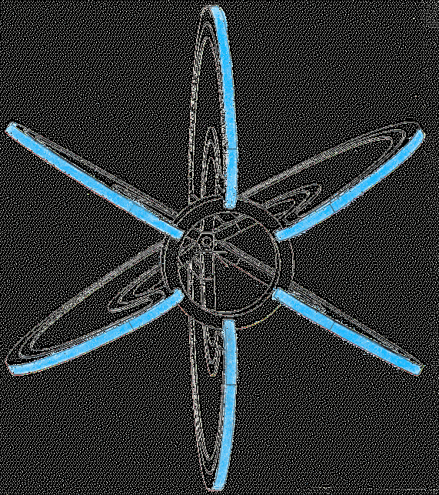

Super-conducting toroidal magnet with six kidney-shaped coils
  5 m diameter, 5 m long, 5 M-Amp-turns, max. field 2 Tesla

Slide 34
From Will Brooks at NUINT02
H target with E_{beam} = 4 GeV illustrates the power of CLAS

Slide 35

Analysis cuts
Remove events with even energy depostion in the two layers of the ECAL
Stay away from edges
Mostly pions and muons
Calorimetric fiducial and ID cuts on outgoing e⁻
S. Manly, University of Rochester
NUFACT 2013, Beijing, China August 19-24, 2013
35

Slide 36

Analysis cuts
Momentum of outgoing e-: p>0.64 GeV (or y<0.872)
Removes bias due to electromagnetic energy threshold in trigger.
Also reduces sensitivity to radiative effects.
S. Manly, University of Rochester
NUFACT 2013, Beijing, China August 19-24, 2013
36

Slide 37


Data-MC comparison
(no acceptance corrections, detector optimized fiducial definition)
GENIE events run through CLAS detector simulation (GSIM) with EG2 target geometry and same analysis chain as data
Require single π± reconstructed
Deuterium
Carbon
Preliminary
Preliminary
W distribution (other variables integrated over)
NUFACT 2013, Beijing, China August 19-24, 2013
37

Slide 38


Data-MC comparison
(no acceptance corrections, detector optimized fiducial definition)
Deuterium
Carbon
Preliminary
Preliminary
Q² distribution (other variables integrated over)
S. Manly, University of Rochester
NUFACT 2013, Beijing, China August 19-24, 2013
38

Slide 39


Data-MC comparison
(no acceptance corrections, detector optimized fiducial definition)
Deuterium
Carbon
Preliminary
Preliminary
Momentum of π in the lab frame
(other variables integrated over)
S. Manly, University of Rochester
NUFACT 2013, Beijing, China August 19-24, 2013
39

Slide 40


Data-MC comparison
(no acceptance corrections, detector optimized fiducial definition)
Deuterium
Carbon
Preliminary
Preliminary
Angle of π with respect to the beam direction
(other variables integrated over)
S. Manly, University of Rochester
NUFACT 2013, Beijing, China August 19-24, 2013
40

