Slide 1
Muon Cooling Scenario Study
Cooling 1983
David Neuffer
August 2013

Slide 2
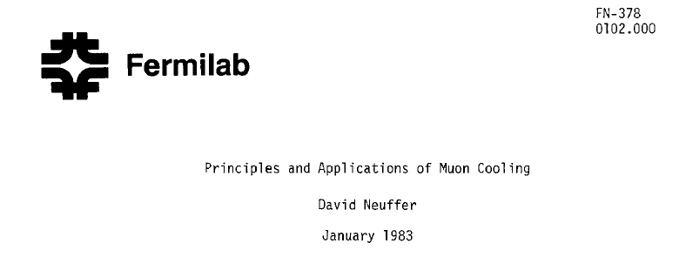
Outline
Introduction
  motivation
    nuSTORM
Cooling Equations
  comments
Applications
  Front end
  RFOFO
  HCC
References
  Particle Accelerators 14,75 (1983)
  NIM A532, 26 (2004)
  NIM A532, 260 (2004)
  CERN 99-13 (1999)
  PRSTAB 8, e041002 (2005)

Slide 3
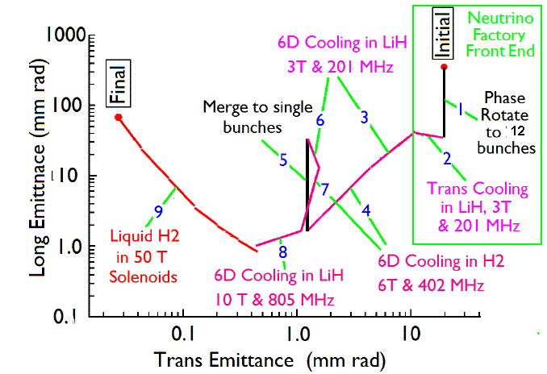
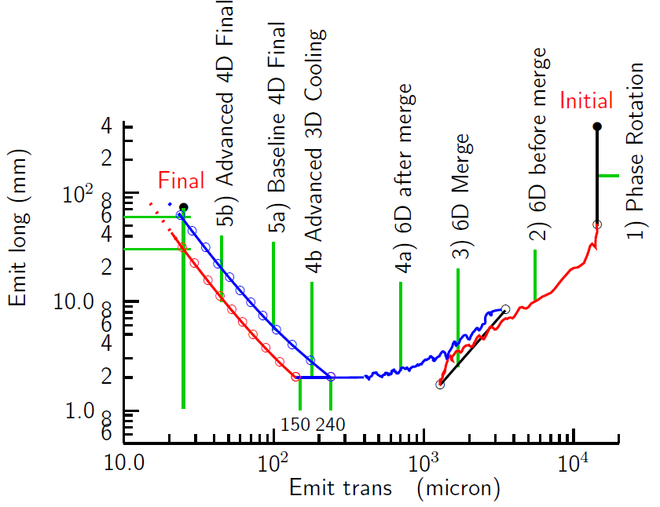
Emittance Evolution
ν Factory ➔ Higgs Factory ➔ Multi-TeV Collider
HE MC
in 40 T
For Higgs Factory stop cooling where the longitudinal emittance is at minimum:
ε_{⊥N} =0.2π⋅mm⋅rad, ε_{||N} =15π⋅mm⋅rad

Slide 4
Toward a Complete cooling channel
Goal: Each simulated section should be directly compared with rms cooling equations
  need g_{t}, g_{L}, β_{t,} β_{L} for each segment
  segment length
    ε_{in}, ε_{out}
    x and y are so tightly coupled with solenoid focusing there is no need for separate entities (?)
  IF cooling is not near rms predictions; cooling is not good enough
    there is very little margin for error for a collider,.

Slide 5
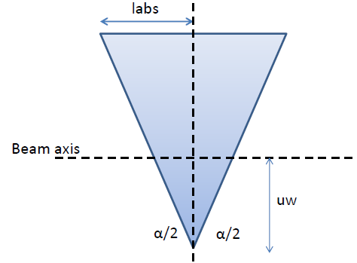
Partition Numbers, δE-δt cooling
Energy cooling occurs if the derivative :
∂(dE/ds)/∂E= g_{L}(dp/ds)/p > 0
g_{L}(E) is negative for P < ~ 0.35 GeV/c
and only weakly positive for P > ~ 0.35 GeV/c
With emittance exchange the
partition numbers change:
The sum of the cooling partition numbers
(at P = P_{μ} ) remains constant:

Slide 6
Transverse cooling
Transverse Cooling – equilibrium emittance
Want materials with small multiple scattering (large L_{R}),
but relatively large dE/ds, density (ρ)
Want small β⊥ at absorbers => strong focusing
- equilibrium emittances (/β⊥) smallest for low-Z materials

Slide 7
Longitudinal cooling
Longitudinal conventions are less established
  use ct-dE/mc² units
    or (β)ct - δp/p ⋅βγ
  ε_{L} is in m, normalized
At 200 MeV/c, g_{L}= -0.29 (antidamping)
  need emittance exchange to cool
  Scenarios tend to be careless in longitudinal cooling
Beam Loss (scraping) can look like damping

Slide 8
Comments on Cooling …
Matching into cooling sections is not as hard as it looks …
  Strong amplitude / momentum correlations
    cooling of beam distorted by losses …
  However beam from front end has developed the needed correlations
Mismatches are damped by ionization cooling
    (unlike emittance damping there is no heating term)
    damps to matched values
  In solenoid-dominated focusing x-y mixing is strong
    Need field flips to avoid establishing angular momentum
    x, y, z → r, θ, z ?
Complication (Kim & Wang):
  Mixing of straggling and scattering by dispersion:
    want η< ~β⊥ (and η’< 1)
    want η< β_{L}/3 (and η’< 1/3)

Slide 9
Cooling Quality
“Quality factor”:
But L ∝ N²/ (ε_{x} ε_{y})^{1/2}
  need Q > 6 to break even …
I like g_{eff}
  g_{eff} < 2-δg_{L}
  good cooling: g_{eff} > ~1
    but often: g_{eff} <0.5
Cooling length also important
  Should be < 100m
    (<0.1 decay length)

Slide 10
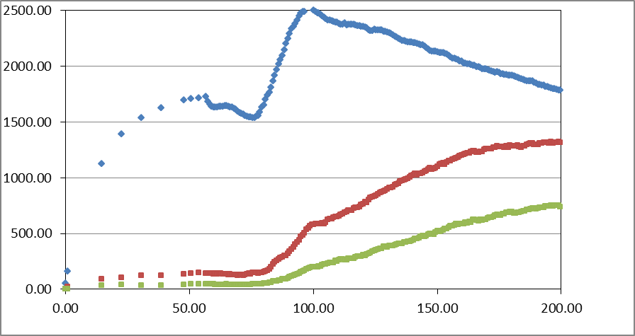
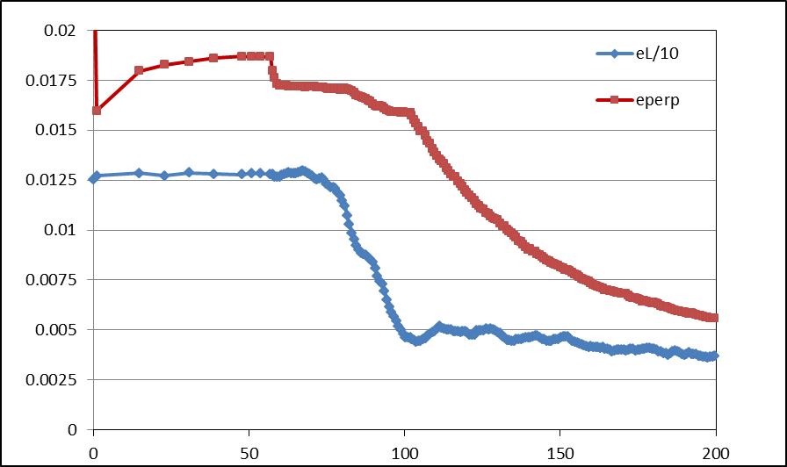
Example:Front End
Simulation obtains
  ~0.125 μ/p within acceptances
  with ~60m Cooler
  shorter than baseline NF
But
  uses higher gradient
  shorter than baseline NF
  325 MHz – less power
  more bunches in bunch train
N :0.15<P<0.35 MeV/c
N: ε_{T}<0.03; A_{L}<0.2
N: ε_{T}<0.015; A_{L}<0.2
Useful
cooling

Slide 11
Compare with expected cooling
Parameters:
  g_{t} =1 – no long. cooling
  P_{beam} = 250 MeV/c
  Absorber is Li H
    2 *1.5cm / 0.75m cell (=f)
    ICOOL: ρ=0.693
    dE/dx=1.4 MeV/cm
    L_{R}=115cm, I=40eV
    β_{t}=0.8m
  L_{cool}=40m
  ε_{N,eq}=0.0051m
Transverse cooling agrees closely with this
  ε_{i} =0.0142m (end of match)
  cools to ε_{t} =0.0077m in 50m
    would only use this cooler for 40--50m

Slide 12
Cooling (continued)
Longitudinal Emittance growth is obscured by particle loss
  loss is mostly longitudinal; rf buckets are ~full
  ~15% loss where emittance should increase by 15%
~50m cooling system performance is
  4D cool by factor of ~3.5
  6D cool by factor of ~3
  good agreement with rms cooling equations
  g_{eff} = Ln[3]/1.25=0.88
Cooling system parameters
P_{μ} | 250 | MeV/c
g_{x},g_{y,}g_{L} | 1,1,-0.14
Cooling L (p/(dp/ds)) | 40 | m
β_{t} | 0.8 | m
β_{L} | 0.5 | m
ε_{t,0} | 0.0051 | m
ε_{L,0} | 0.0004/g_{L} | m
ε_{t,initial} | 0.015 | m
ε_{Linitial} | 0.05 | m
Length of cooler | 50 | m

Slide 13
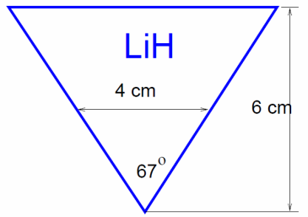
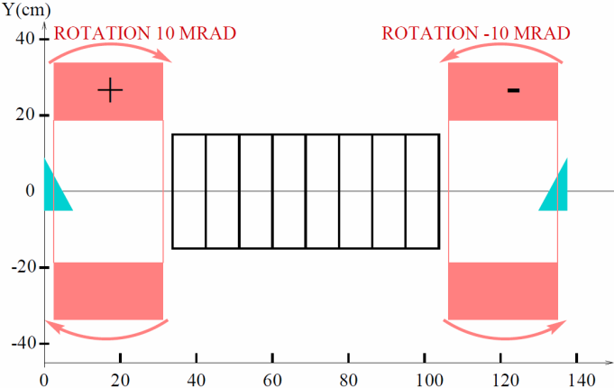
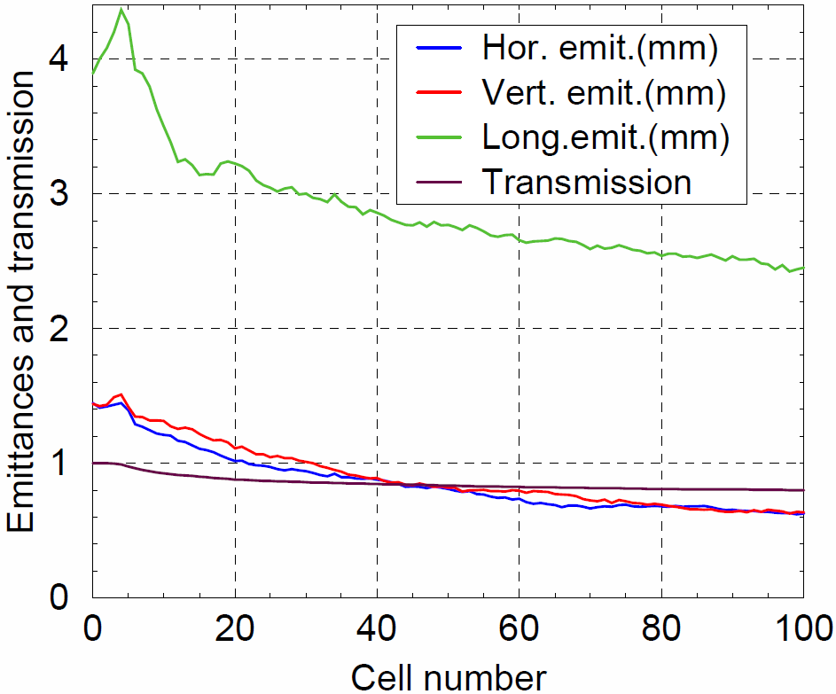
Another example:
RFOFO (Balbekov)
  β= 0.082m, η=0.01m,P=240 MeV/c
g_{L}= 0.33 - 0.18= ~0.15
  weak longitudinal cooling
  rf -~ 22 MV/m*2/3, 805 MHz
g_{T} =0.83
Cooling parameters
  L_{T,COOL}= 52m
  L_{L,cool}= ~300m
  ε_{eq, T}=0.0006m
  ε_{eq, L}=0.0016m
Use with ?
  ε_{T,o} = 0.0025
  ε_{L,o} = 0.003
    60m: ε_{T} = 0.0012; ε_{L}=0.00275
    Cool by factor 0f 4.7
    g_{eff} = 1.34

Slide 14
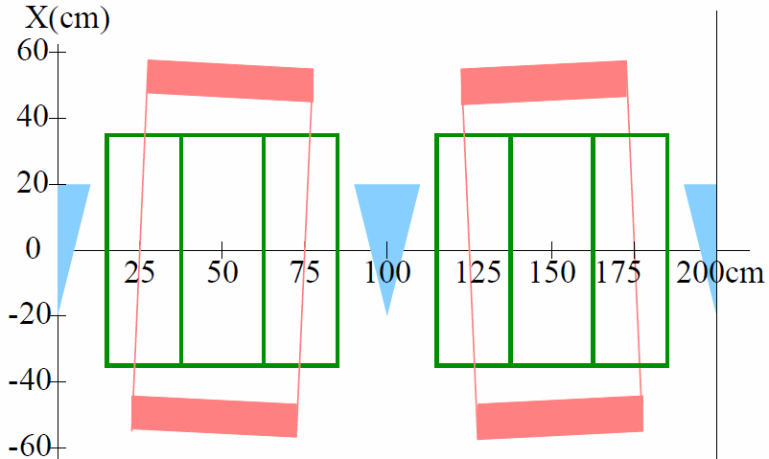
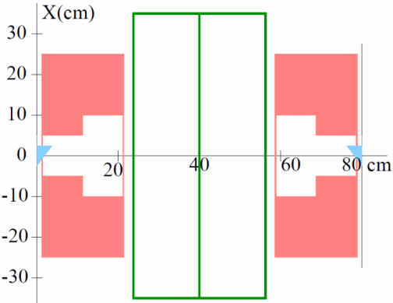
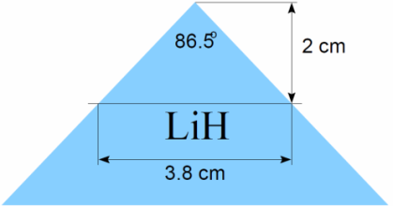
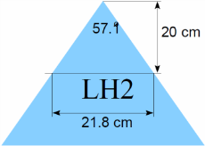
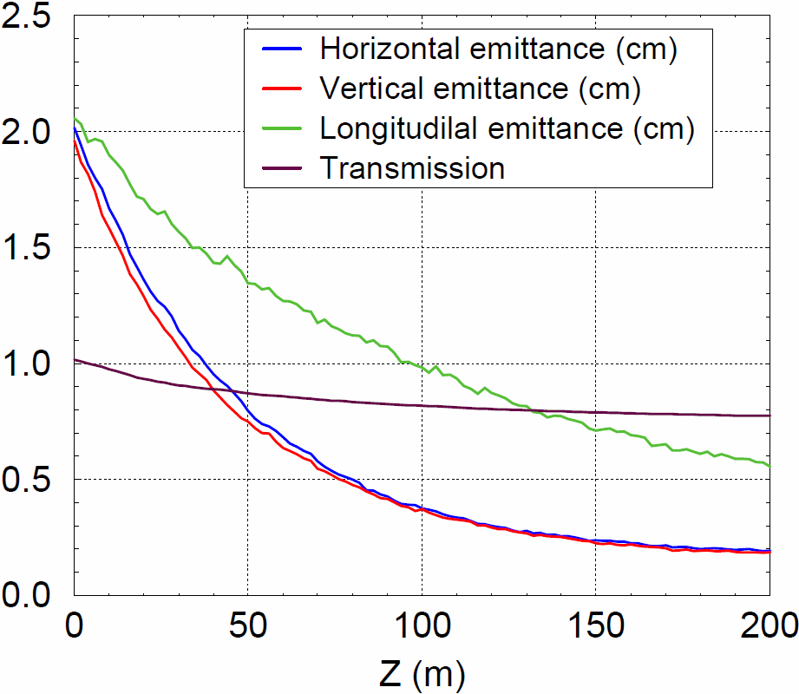
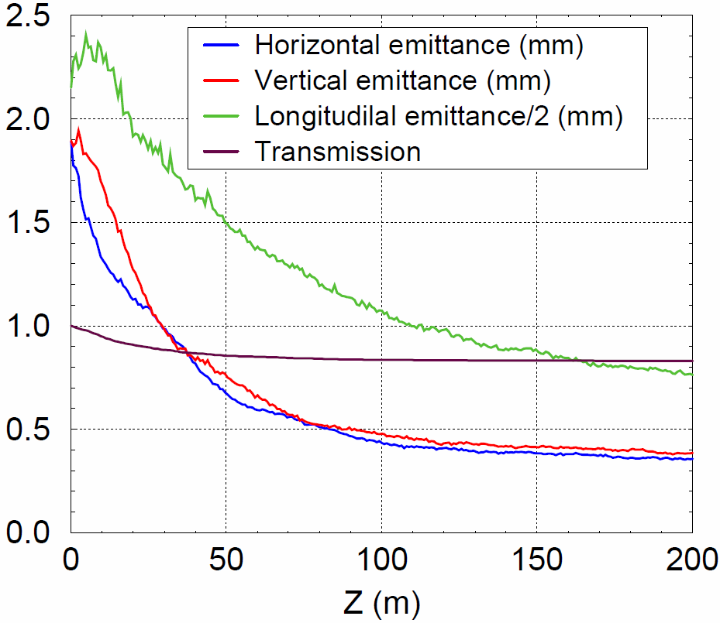
More RFOFO (Balbekov)
β_{t}=0.4m, η=8.5cm
β_{L} ~0.5m
β_{t}=0.045m, η=1.3cm
β_{L} ~0.7m
g_{L} = -0.27 + 0.43=0.16; g_{t} = 0.78
L_{cool}= 25/g_{i} m
g_{eff} = 0.8 (~1.0 in first 100m)
ε_{t,0} = 1.8mm; ε_{L,0} = 1.5 mm
g_{L} = -0.28 + 0.65=0.37; g_{t} = 0.68
L_{cool}= 23/g_{i} m
g_{eff} = 0.5 (~0.8 in first 100m; 0.24 in last 100m)
ε_{t,0} = 0.36mm; ε_{L,0} = 0.8 mm

Slide 15
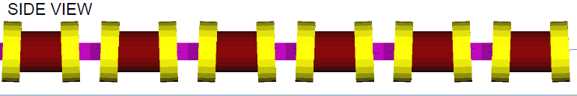
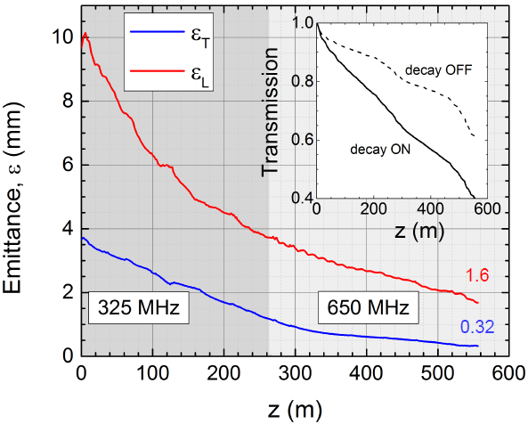
Guggenheim → RFOFO
Diktys/ new RFOFO
  16 stages, P =204 MeV/c
  β_{min} = 40cm→4cm
  η=6cm→0.6cm
g_{L} = η/uw – 0.277
  for η δ < uw
  u_{w} 12.5 → 2.7 cm
  α : 100→ 115⁰
  g_{L} : ~0.2 → 0.4
H₂ Cooling Length ~55/g_{i} m
g_{eff} = ~0.4
  varies from 0.2 to 0.8
  ε_{t} : 3.6, 3.4, 3.2, 2.9, 2.4, 2.2, 1.7, 1.4, 1.2, 1.0, 0.7, 0.6, 0.5, 0.46, 0.4, 0.33
  ε_{t,eq}:2.6, 2.4, 2.1, 1.5, 1.6, 1.1, 1.0, 0.9,0.7,0.5,0.4,0.4,0.32, 0.27

Slide 16
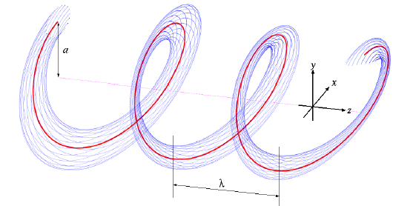
Helical Cooling Channel
~ more complicated beam dynamics
  tilted dynamics (z/s ambiguity…)
  PRSTAB analytic treatment
    ε_{L}, ε₊, ε₋ variables
    → ε_{L}, ε_{t} ?
      ε₊, ε₋ not separable
      too closely coupled
    Follows rms cooling
    But β_{t} not clearly defined ?
Advantages of HCC
  6-D cooling without wedges
  broad range of tuneable parameters
  Longitudinal motion can be ~isochronous: β_{L}→ 0

Slide 17
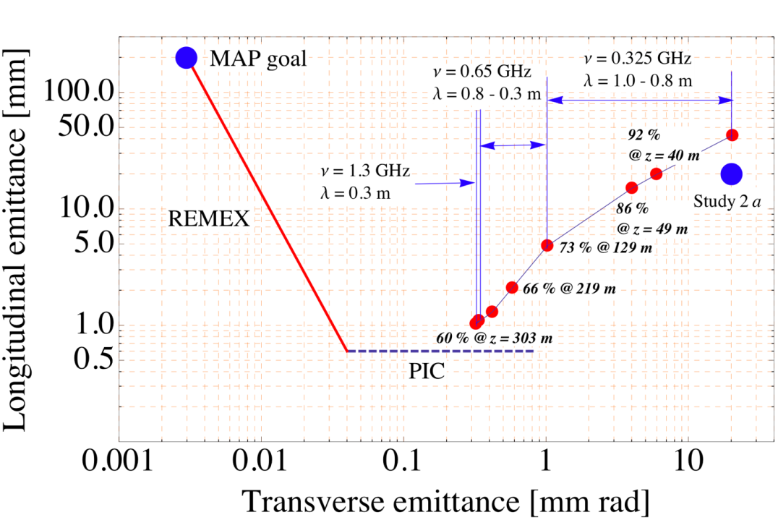
HCC cooling channel (IPAC’13, TUPFI060)
 | Z | b | b’ | b_{z} | λ | β_{T} | D | ν | ε_{T,eq} | ε_{T} | ε_{L} | ε_{T}² ε_{L} | g_{eff} | ε_{6D} | ε
unit | m | T | T/m | T | m | cm | m | GHz |  | mm rad | mm |  |  | mm3 | Trans- mission
0 | 0 | 1.3 | -0.5 | -4.2 | 1.0 | 12 |  | 0.325 | 1.0 | 20.4 | 42.8 | 17800 |  | 12900
1 | 40 | 1.3 | -0.5 | -4.2 | 1.0 | 12 | 0.3 | 0.325 | 1.0 | 5.97 | 19.7 | 702 | 1.65 | 415.9 | 0.92
2 | 49 | 1.4 | -0.6 | -4.8 | 0.9 | 10.0 |  | 0.325 | 0.9 | 4.01 | 15.0 | 241 | 2.43 | 108 | 0.86
3 | 129 | 1.7 | -0.8 | -5.2 | 0.8 | 8.6 |  | 0.325 | 0.8 | 1.02 | 4.8 | 4.99 | 0.986 | 3.2 | 0.73
4 | 219 | 2.6 | -2.0 | -8.5 | 0.5 | 5.4 |  | 0.65 | 0.45 | 0.58 | 2.1 | 0.706 | 0.443 | 2.0 | 0.66
5 | 243 | 3.2 | -3.1 | -9.8 | 0.4 | 4.4 |  | 0.65 | 0.3 | 0.42 | 1.3 | 0.229 | 0.96 | 0.14 | 0.64
6 | 273 | 4.3 | -5.6 | -14.1 | 0.3 | 3.3 | 0.1 | 0.65 | 0.24 | 0.32 | 1.0 | 0.104 | 0.54 | 0.08 | 0.62
7 | 303 | 4.3 | -5.6 | -14.1 | 0.3 | 3.3 |  | 1.3 |  | 0.32 | 1.0 | 0.104 | 0 | 0.07 | 0.60
κ=1.0, equal cooling
GH2 pressure = 160 atm
60 μm Be RF window
6.20*2^{1/2} =8.68MeV/m
E_{rf} ~ 27 MV/m
L_{cool,z}=20.4/g_{i}
A big mismatch due to RF frequency change
Fixed in more recent version
Last stage does not cool

Slide 18

Talk summary

