Slide 1
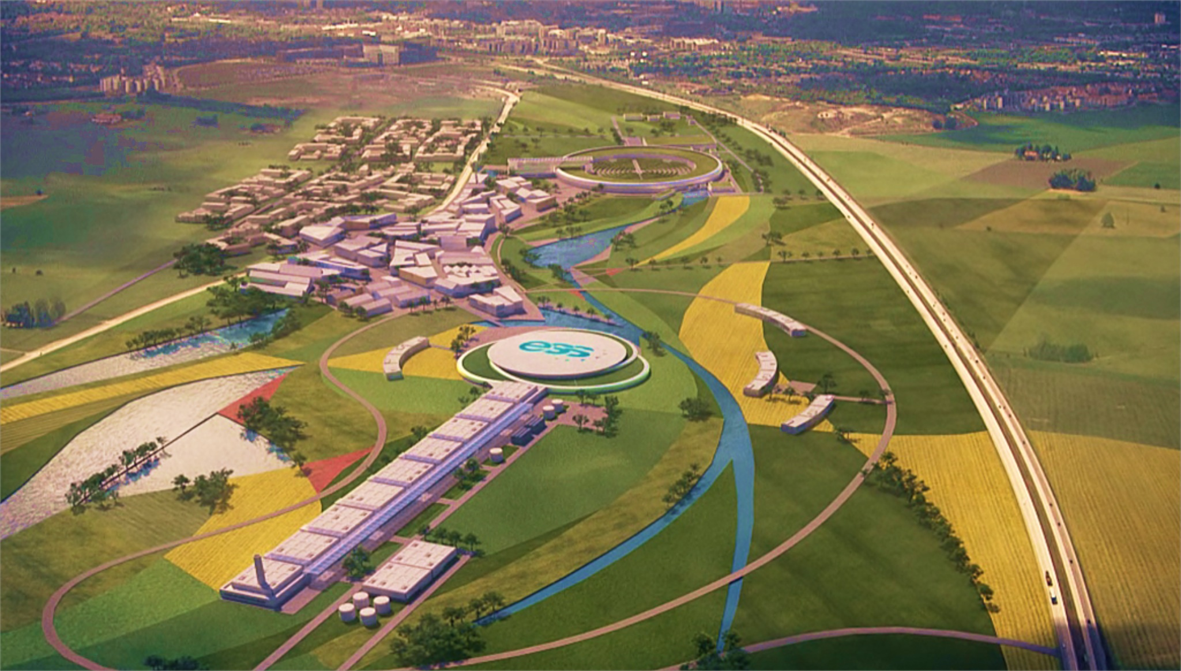
ESS based neutrino Super Beam for CP Violation discovery
Marcos DRACOS
IPHC-IN2P3/CNRS Strasbourg

Slide 2
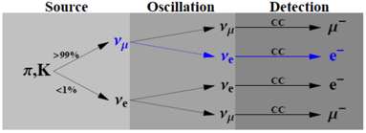
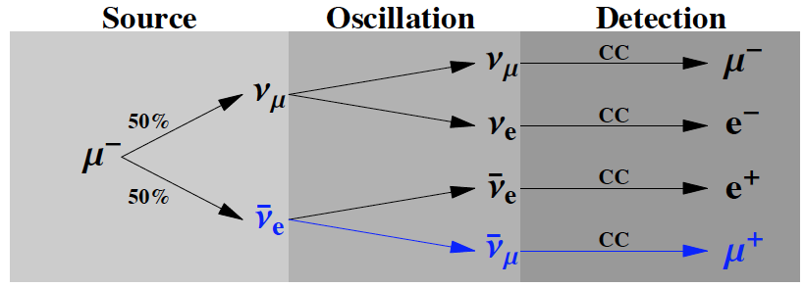
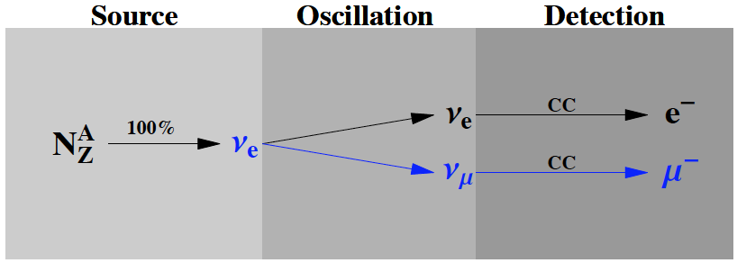
EUROnu Projects (beam facilities)
5 GeV?, 4 MW
SPL Super-Beam
proton driver
Accumulator
ring + bunch
compressor
p
Neutrino Factory
SPL 3.5-5 GeV, 4 MW
Magnetic
capture
proton driver
Accumulator
ring
Target
Ionization
cooling
Drift
Magnetic
horn capture
(collector)
p
Phase rotation
Target
Linac → 2 GeV
ν, μ
hadrons
decay tunnel
Recirculating
Linacs 2 → 50 GeV
~300 MeV ν_{μ} beam to far detector
Decay ring – 50 GeV
≈2000 m circumference
Existing at CERN
ν beam to far detector
EURISOL
DECAY
RING
Proton
driver
ν beam to near detector
Isol target
& ion source
SPS
B = 5T
Beta-Beam
L=6880 m
New RFQ
Linac
PSB
PS
⁶He for ν_{e} and ¹⁸Ne for ν_{e}

Slide 3
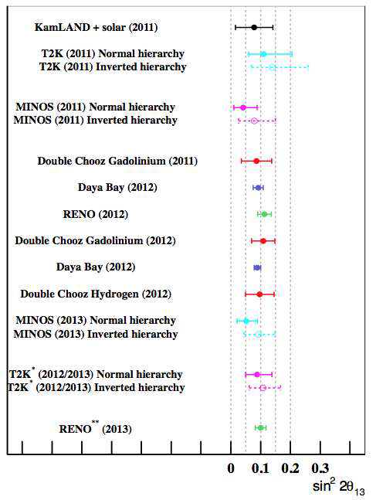
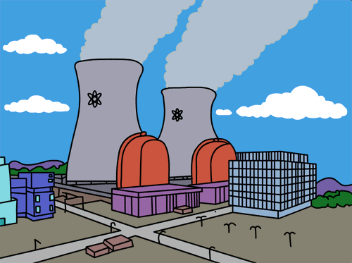
θ13 is large!!!
measurements
reactor experiments discovered the 1→3 oscillation
year
proposed facilities have to be readjusted…
now, the name of the game is CPV

Slide 4
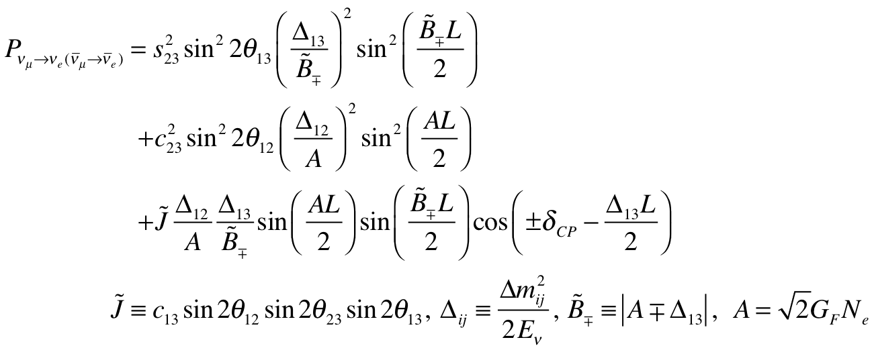
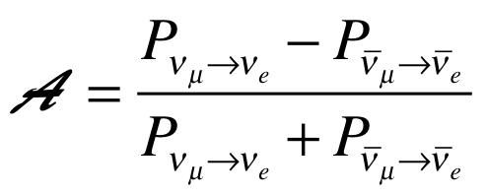
CP Violating Observables (and MH)
atmospheric
Non-CP terms
solar
interference
CP violating
matter effect
⇒ accessibility to mass hierarchy
⇒ long baseline
≠0 ⇒ CP Violation
be careful, matter effects also create asymmetry

Slide 5
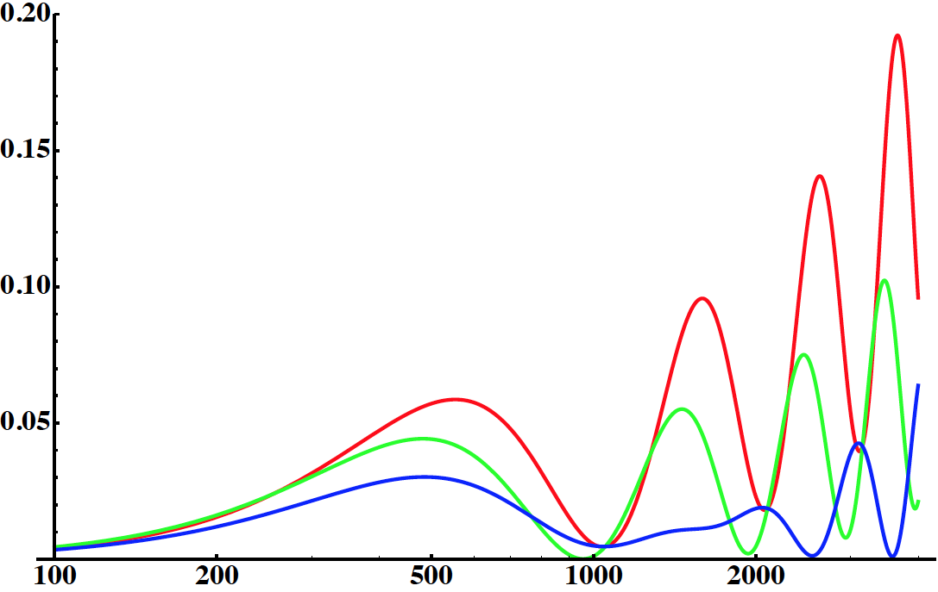
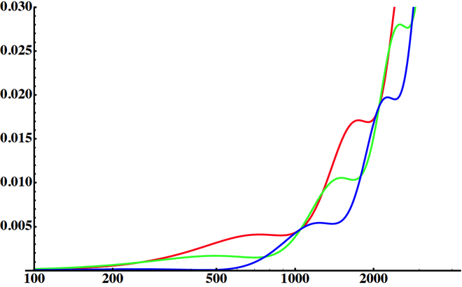
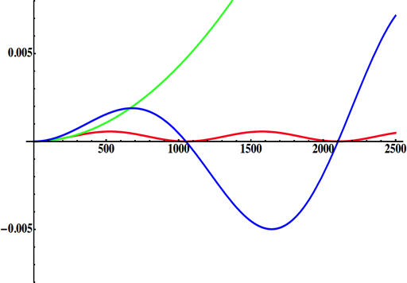
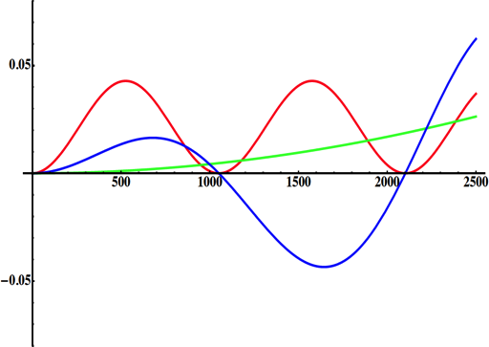
Neutrino Oscillations
2nd oscillation maximum
P(ν_{μ}→ν_{e})
1st oscillation maximum
θ₁₃=1º
δ_{CP}=-90
δ_{CP}=0
δ_{CP}=+90
θ₁₃=8.8º
L/E
solar
for "large" θ₁₃ 1st oscillation maximum is dominated by atmospheric term, 2nd oscillation maximum is better
atmospheric
for small θ₁₃ 1st oscillation maximum is better
atmospheric
solar
CP interference
θ₁₃=1º
CP interference
θ₁₃=8.8º
(arXiv:1110.4583)

Slide 6
SPL not any more part of LHC upgrades
Any other intense proton source in Europe?
(in the context of European Strategy for Particle Physics)
f) Rapid progress in neutrino oscillation physics, with significant European involvement, has
established a strong scientific case for a long-baseline neutrino programme exploring CP violation and the mass hierarchy in the neutrino sector. CERN should develop a neutrino programme to pave the way for a substantial European role in future long-baseline experiments. Europe should explore the possibility of major participation in leading neutrino projects in the US and Japan.

Slide 7
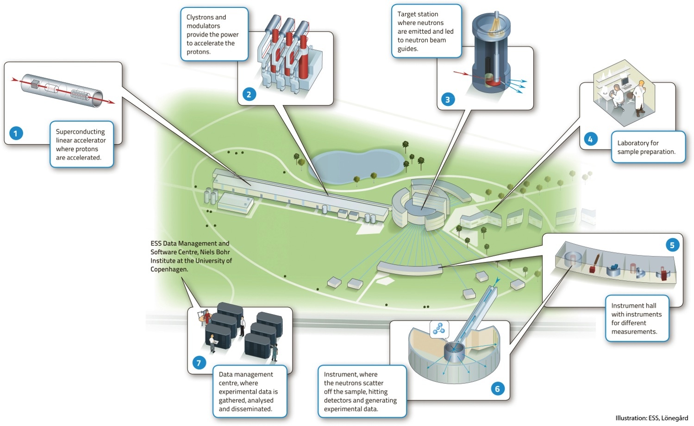
European Spallation Source
under construction
(~1.5 B€ facility)

Slide 8
ESS proton linac
The ESS will be a copious source of spallation neutrons
5 MW average beam power
125 MW peak power
14 Hz repetition rate (2.86 ms pulse duration, 10¹⁵ protons)
2.5 GeV protons (up to 3.0 GeV with linac upgrades)
>2x10²³ p.o.t/year

Slide 9
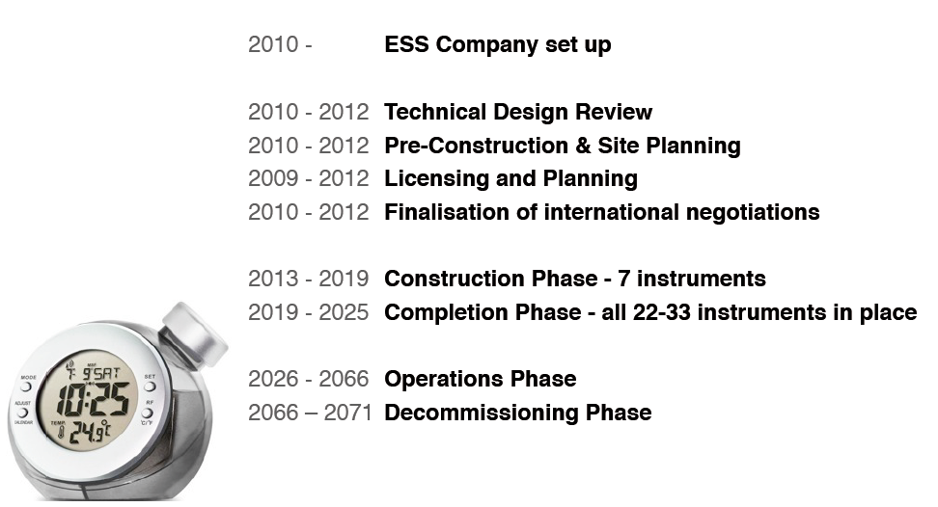
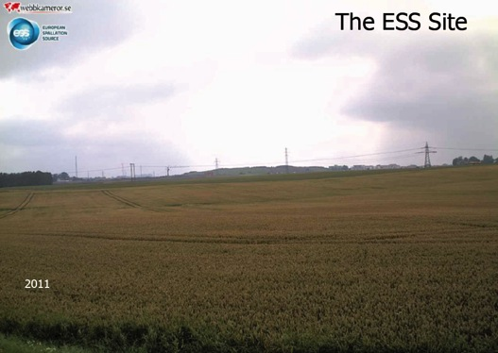
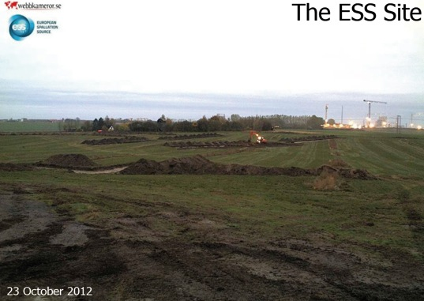
ESS Schedule
1st beam before the end of the decade
5 MW by 2023

Slide 10
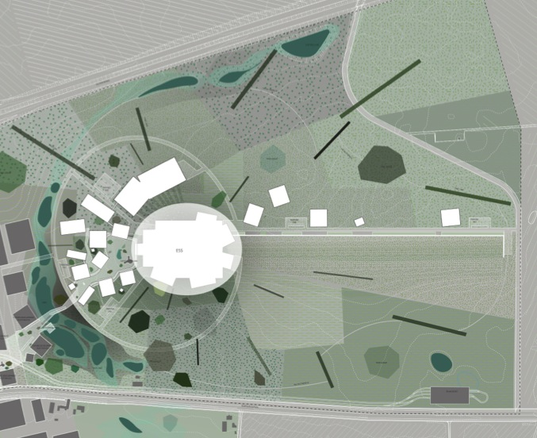
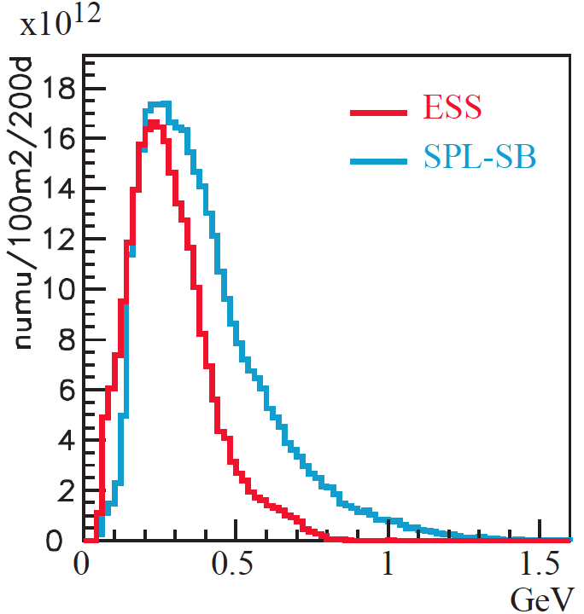
How to add a neutrino facility?
We must not affect the neutron program and if possible be synergetic
Linac modifications: double the rate (14 Hz → 28 Hz)
Accumulator (ø 143 m) needed to compress to few μs the 2.86 ms proton pulses, affordable by the magnetic horn (350 kA, power consumption, Joule effect)
H⁻ source (instead of protons)
space charge problems to be solved
Target station (studied in EUROnu)
Underground detector (studied in LAGUNA)
~300 MeV neutrinos
Linac and accumulator could be the first step towards the Neutrino Factory
accumulator
target/horn station
flux at 100 km
(http://lanl.arxiv.org/abs/1212.5048)

Slide 11
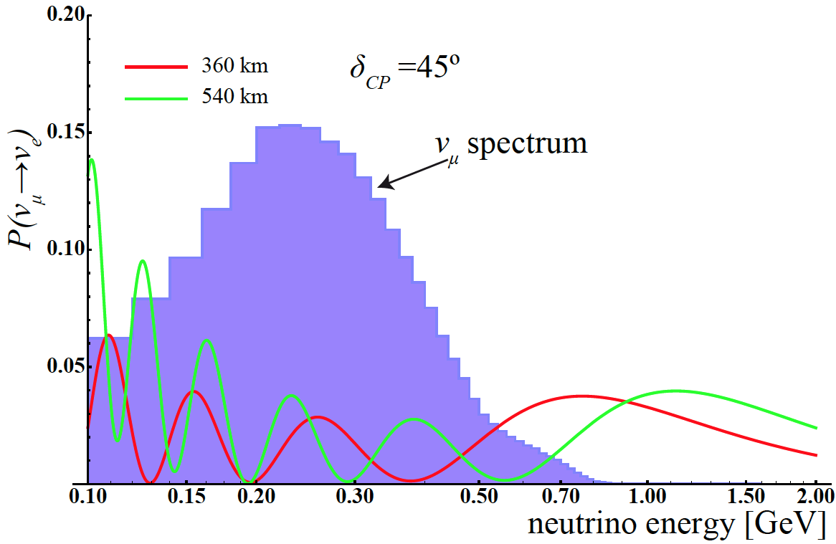
Neutrino Oscillations
(2.5 GeV)

Slide 12
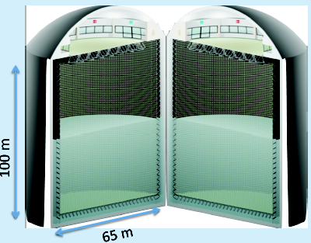
The MEMPHYS Detector (Water Cherenkov) (LAGUNA)
Mainly to study:
Proton Decay (GUT)
up to ~10³⁵ years lifetime
Neutrino properties and Astrophysics
Supernovae (burst + "relics")
Solar neutrinos
Atmospheric neutrinos
Geoneutrinos
neutrinos from accelerators (Super Beam, Beta Beam)
Water Cerenkov Detector with total fiducial mass: 500 kt:
2 Cylindrical modules 100x65 m
Readout: 22.2k 8” PMTs, 30% geom. cover.
(arXiv: hep-ex/0607026)

Slide 13
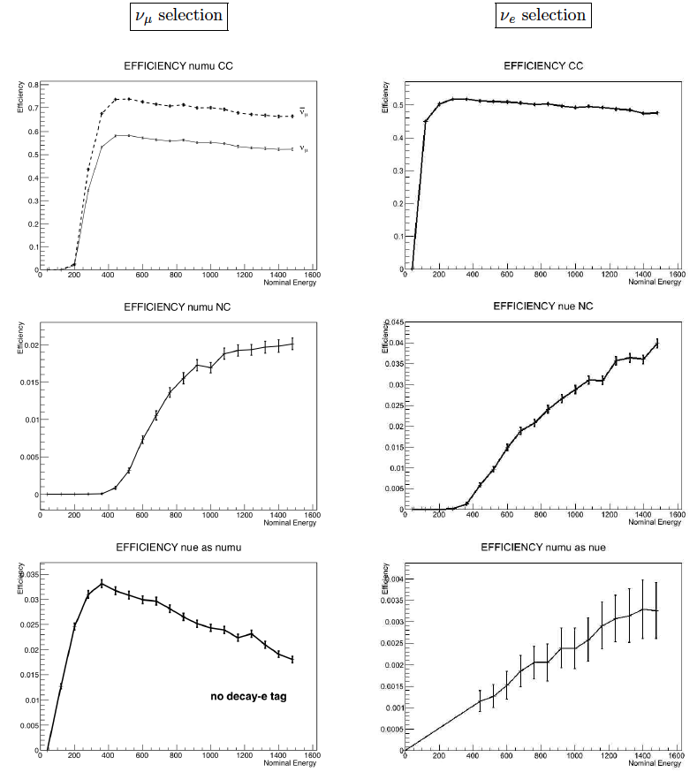
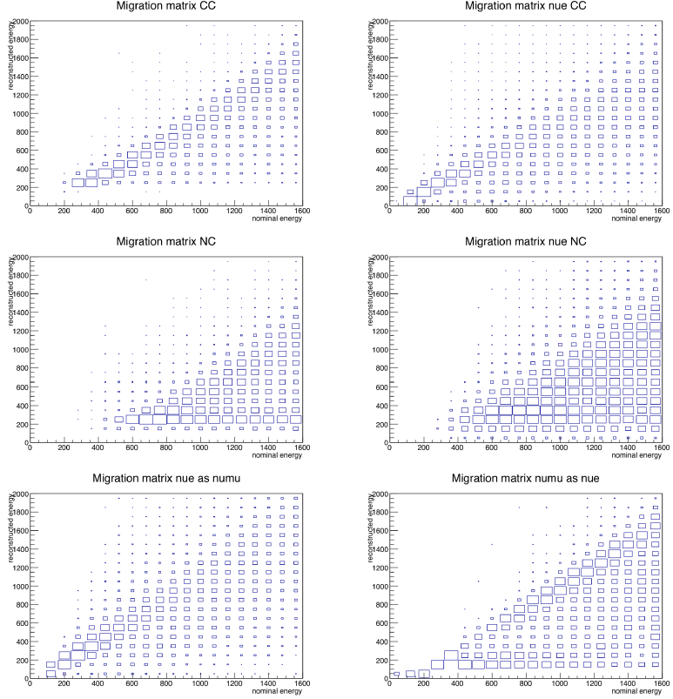
MEMPHYS Parameters
migration matrices
detection efficiency

Slide 14
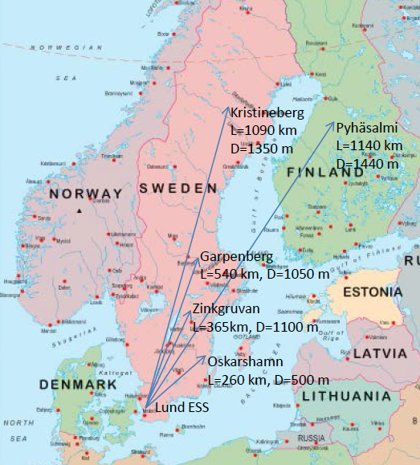
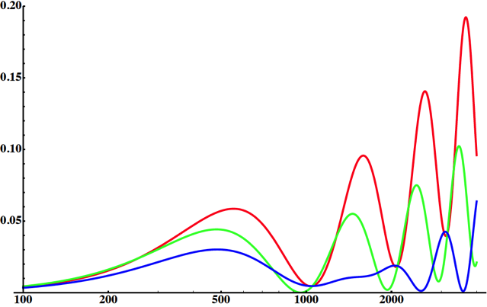
Possible Detector Locations
Many mines (active or not) are available in Sweden
What is the optimal position for CPV?
How this project could help for MH?
Δm²_{sun}=7.5x10⁻⁵ eV²
Δm²_{atm}=2.4x10⁻³ eV²
θ₂₃=41.4°
θ₁₂=33.6°
θ₁₃=8.8°
E~290 MeV
δ_{CP}=-90
δ_{CP}=0
δ_{CP}=+90
p(ν_{μ}→ν_{e})
L/E (km/GeV)

Slide 15
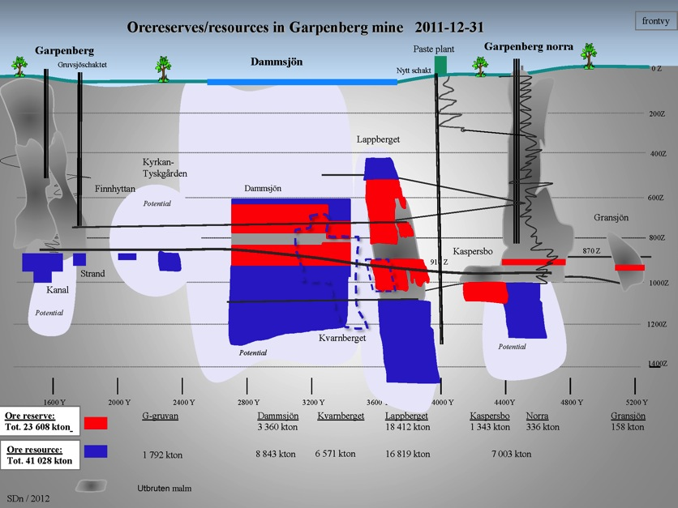
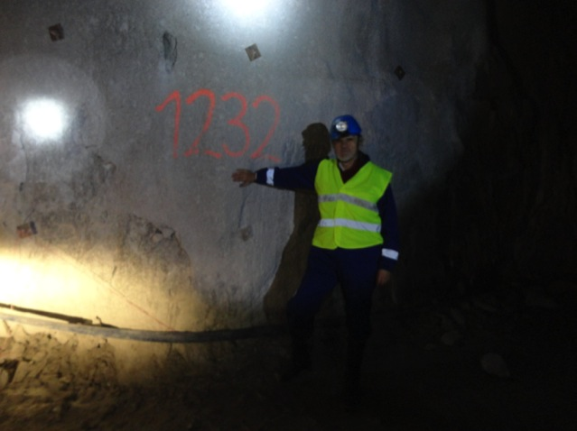
Garpenberg Mine (Boliden)
Distance from ESS: 540 km
Depth: 1232 m
Truck access tunnels
Two ore hoist shafts
A new ore hoist shaft is planned to be ready in 3 years, leaving the two existing shafts free for other uses

Slide 16
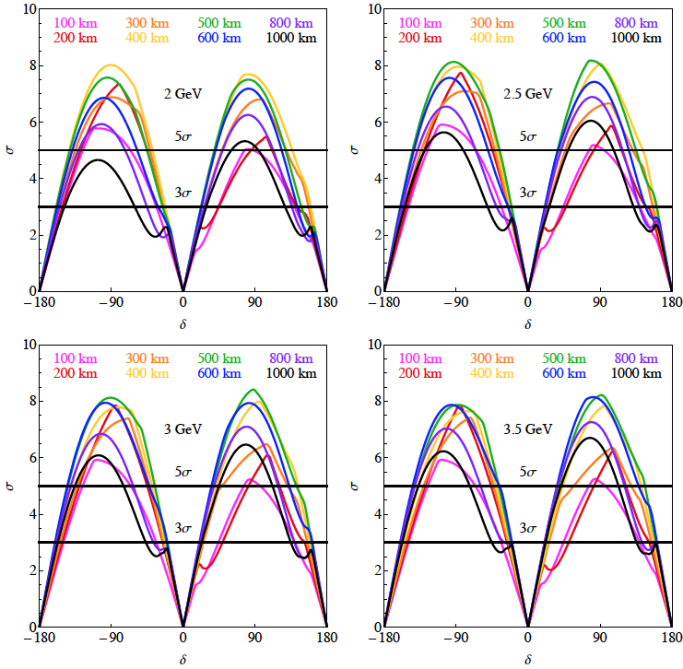
Which baseline?

Slide 17
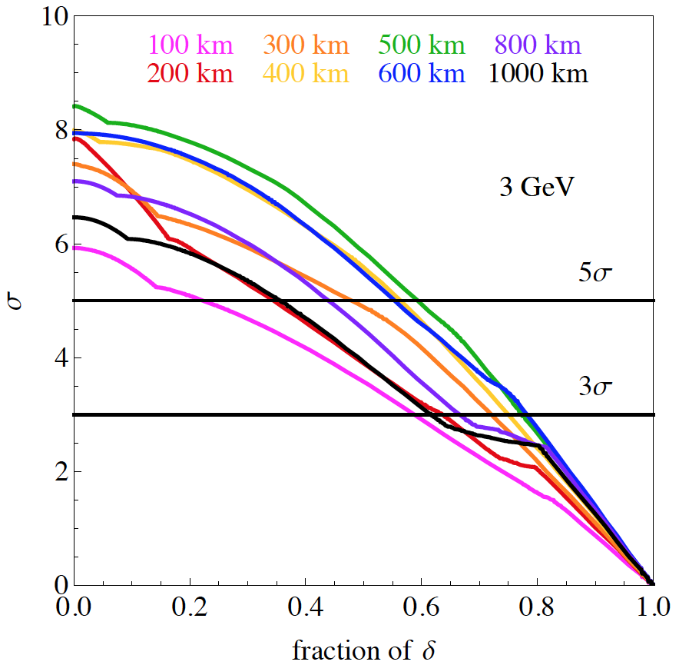
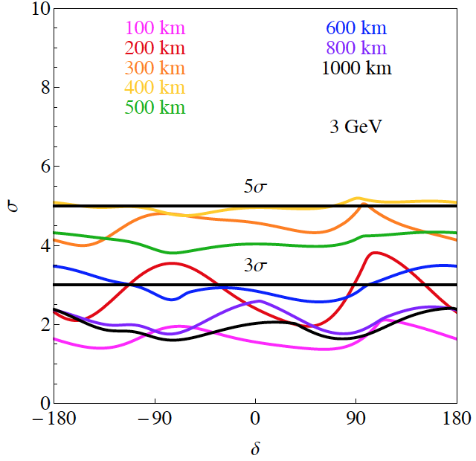
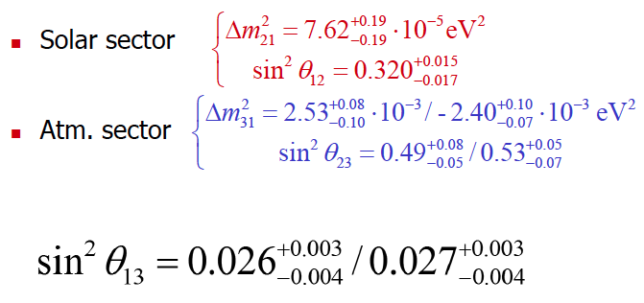
Physics Performance (Enrique Fernantez)
CPV
MH
without adding yet atmospheric neutrinos
Very preliminary
Very preliminary
fraction
fraction
EUROν parameters without particular optimization
1 Mton WC detector (440 kton fiducial), 5%/10% syst.
3.0 GeV protons
5 MW proton beam
10 years (200 days/year)

Slide 18
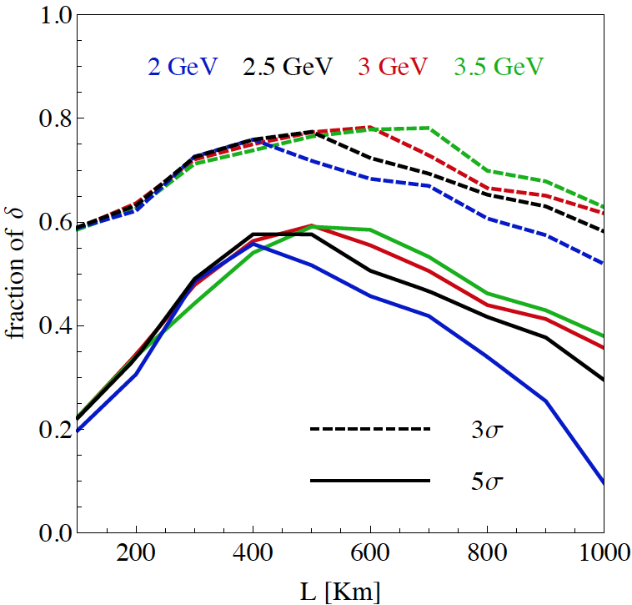
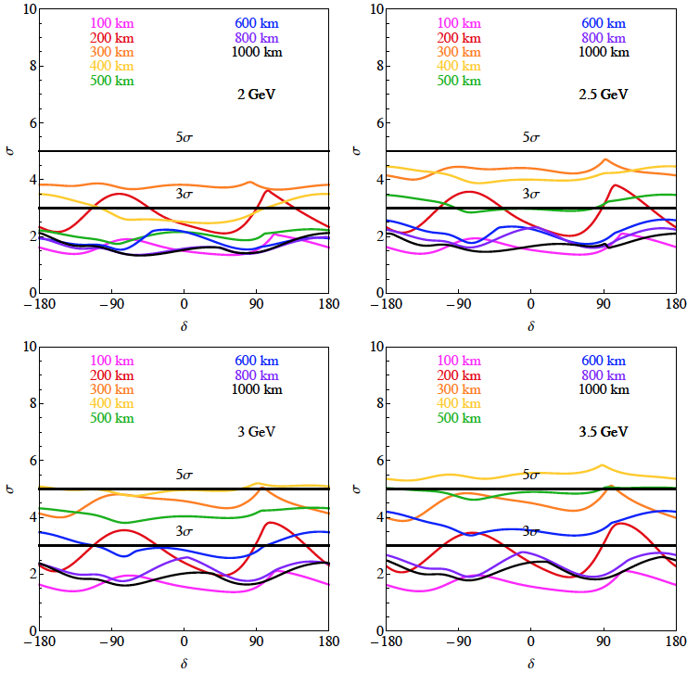
Which baseline?
CPV
MH
Garpenberg
Zinkgruvan
Zinkgruvan is better for 2 GeV
Garpenberg is better for > 2.5 GeV
Zinkgruvan is better
atmospheric neutrinos are needed (at least at low energy)

Slide 19
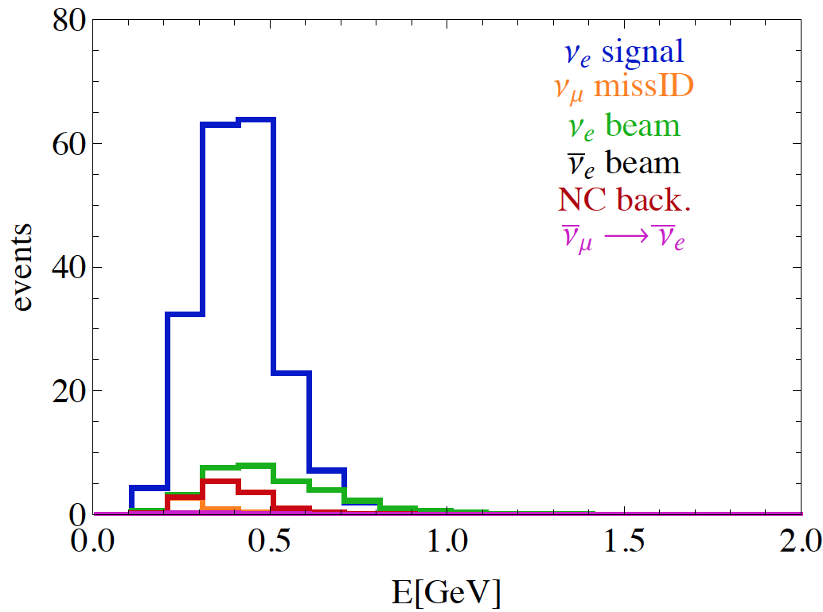
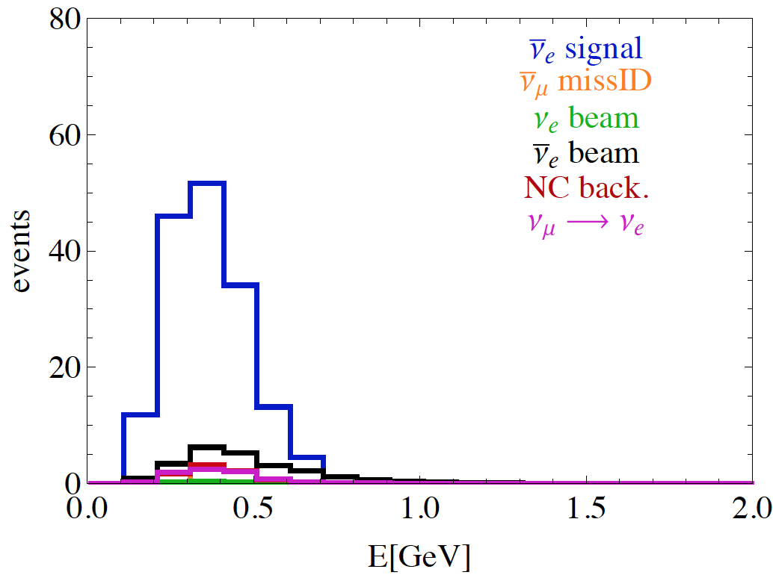
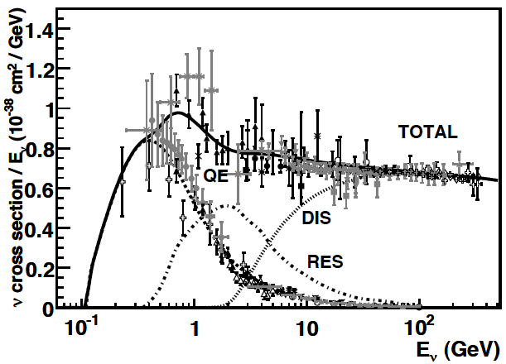
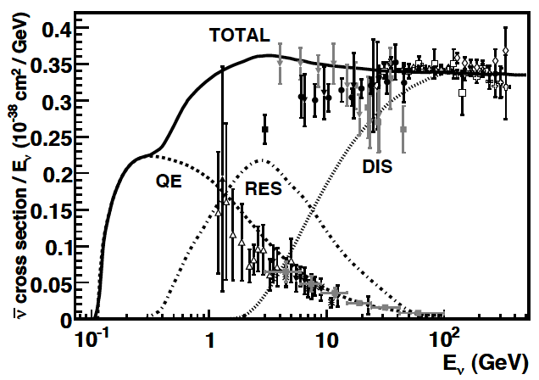
Neutrino spectra
540 km (2 GeV)
below ν_{τ} production

Slide 20
Neutrino spectra
neutrinos
-
-
-
 | ν_{μ}→ν_{e} | ν_{μ} (miss-ID) | ν_{e} (beam) | ν_{e} (beam) | ν_{NC} | ν_{μ}→ν_{e}
T2HK | 3560 | 35 | 880 |  | 649 | 46
ESS 540 km | 196.7 | 4.6 | 33.3 | 0.04 | 13.7 | 0.9
ESS 360 km | 303.3 | 10.7 | 70.8 | 0.08 | 29.2 | 1.4
anti-neutrinos
-
-
-
-
 | ν_{μ}→ν_{e} | ν_{μ} (miss-ID) | ν_{e} (beam) | ν_{e} (beam) | ν_{NC} | ν_{μ}→ν_{e}
T2HK | 1959 | 23 |  | 878 | 678 | 380
ESS 540 km | 162.9 | 2.8 | 1.1 | 23.5 | 8.2 | 7.8
ESS 360 km | 246.1 | 6.1 | 2.4 | 50.6 | 17.4 | 13.3
ESS: 2 years neutrinos, 8 years anti-neutrinos, 200 days/year (almost no kaon contamination)
T2HK: neutrinos: 2.25 MW x 10⁷ s, anti-neutrinos: 5.25 MW x 10⁷ s

Slide 21
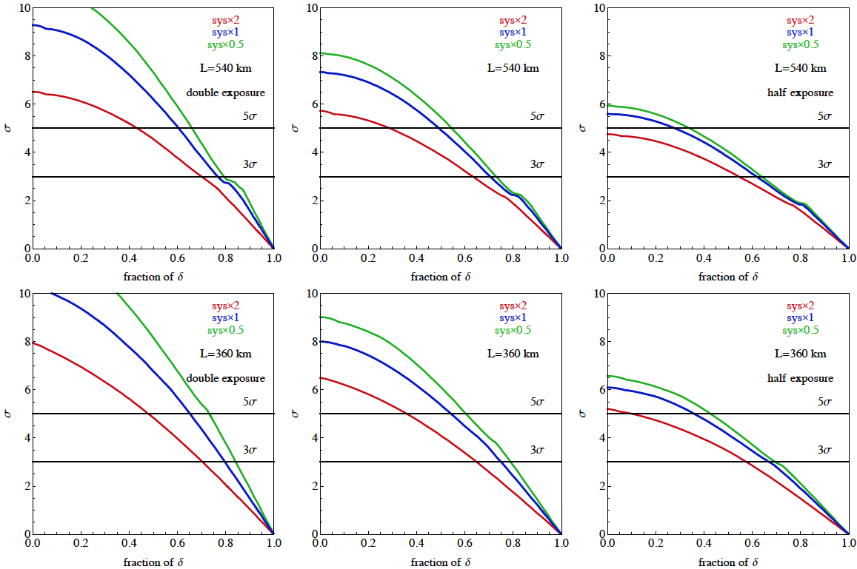
Statistics/Systematics
CPV (2 GeV protons)
x2
"nominal"
x0.5
x2
"nominal"
x0.5

Slide 22
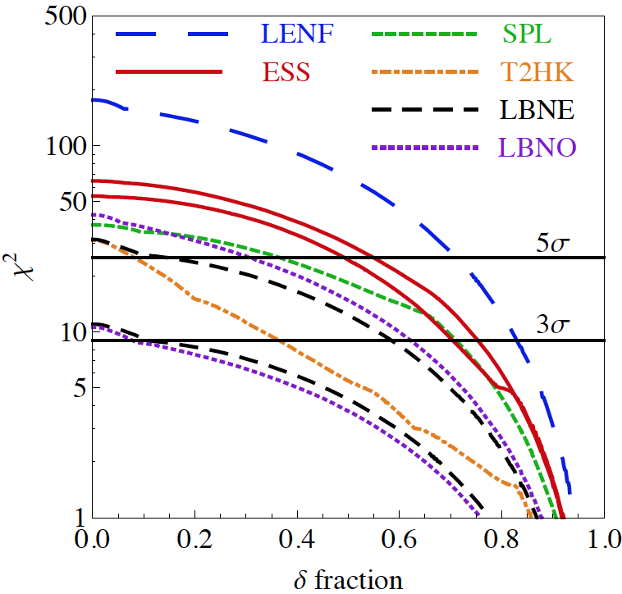
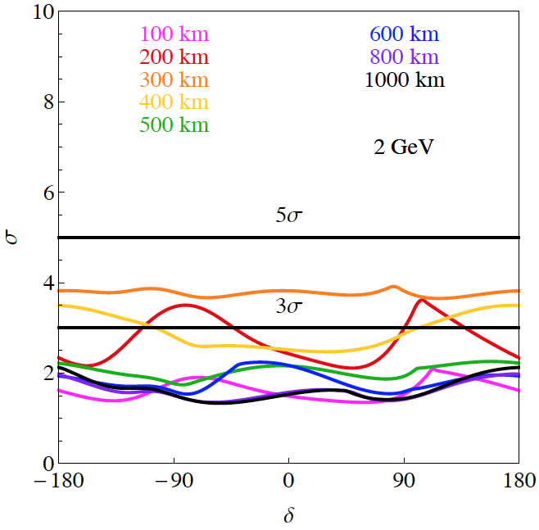
Physics Performance for Future SB projects (Enrique Fernantez)
CPV
MH (unknown)
360 km
540 km
unknown MH
LBNE: 5+5 years, 0.7 MW, 10/35 kt LAr
T2HK: 3+7 years, 0.75 MW, 500 kt WC (5%/10% syst. errors)
SPL: 2+8 years, 4 MW, 500 kt WC (130 km, 5%/10% syst. errors)
ESS: 2+8 years, 5 MW, 500 kt WC (2 GeV, 360/540 km, 5%/10% syst. errors)
C2Py: 20/100 kt LAr, 0.8 MW, 2300 km

Slide 23
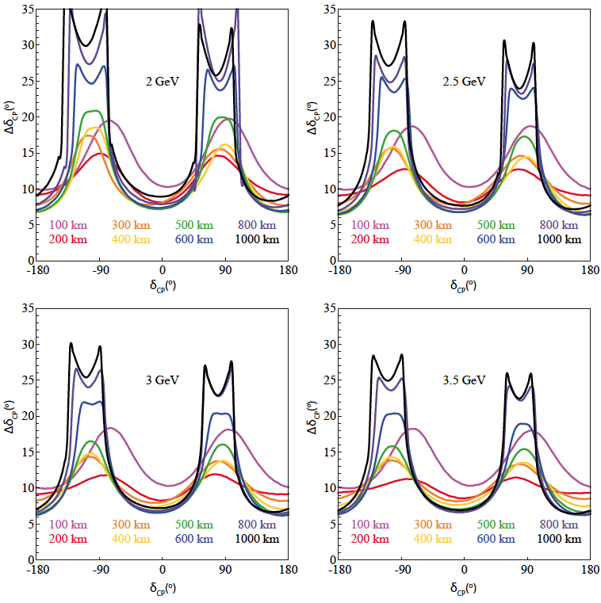
Physics Performance for Future SB projects (Enrique Fernantez)
for 2 GeV
optimum 300-400 km
for 3.5 GeV
optimum 500-600 km
but the variation is small

Slide 24
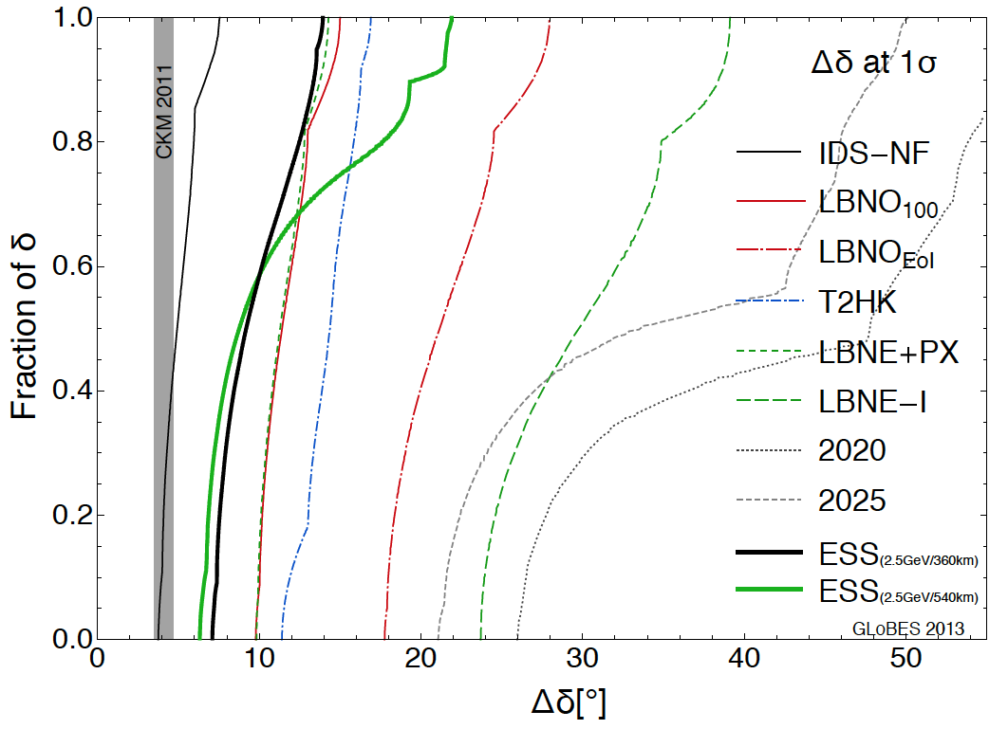
δCP accuracy performance (snowmass)

Slide 25
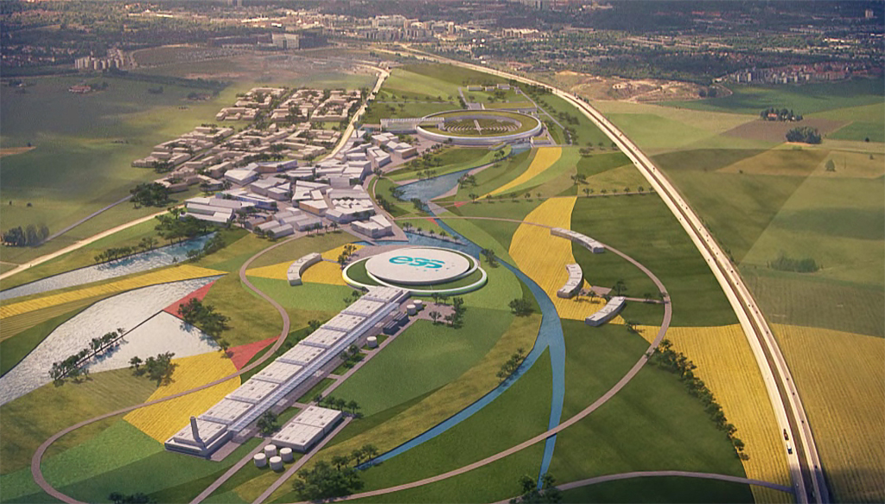
Conclusions
ESS is under construction
very intense source of protons, 5 MW, 2-3 GeV
more than 2x10²³ protons/year
well defined schedule
Modifications are needed to transform ESS to neutrino facility
Double the rate
Add an accumulator
Add a target station
Underground detector (MEMPHYS), mines available
Very promising physics performance using EUROnu optimizations:
CPV: coverage up to 60%
MH: could reach 5 σ combining atmospheric neutrinos
First ESS beam 2019, full power/energy by 2023.
could be the first step towards the Neutrino Factory

Slide 26
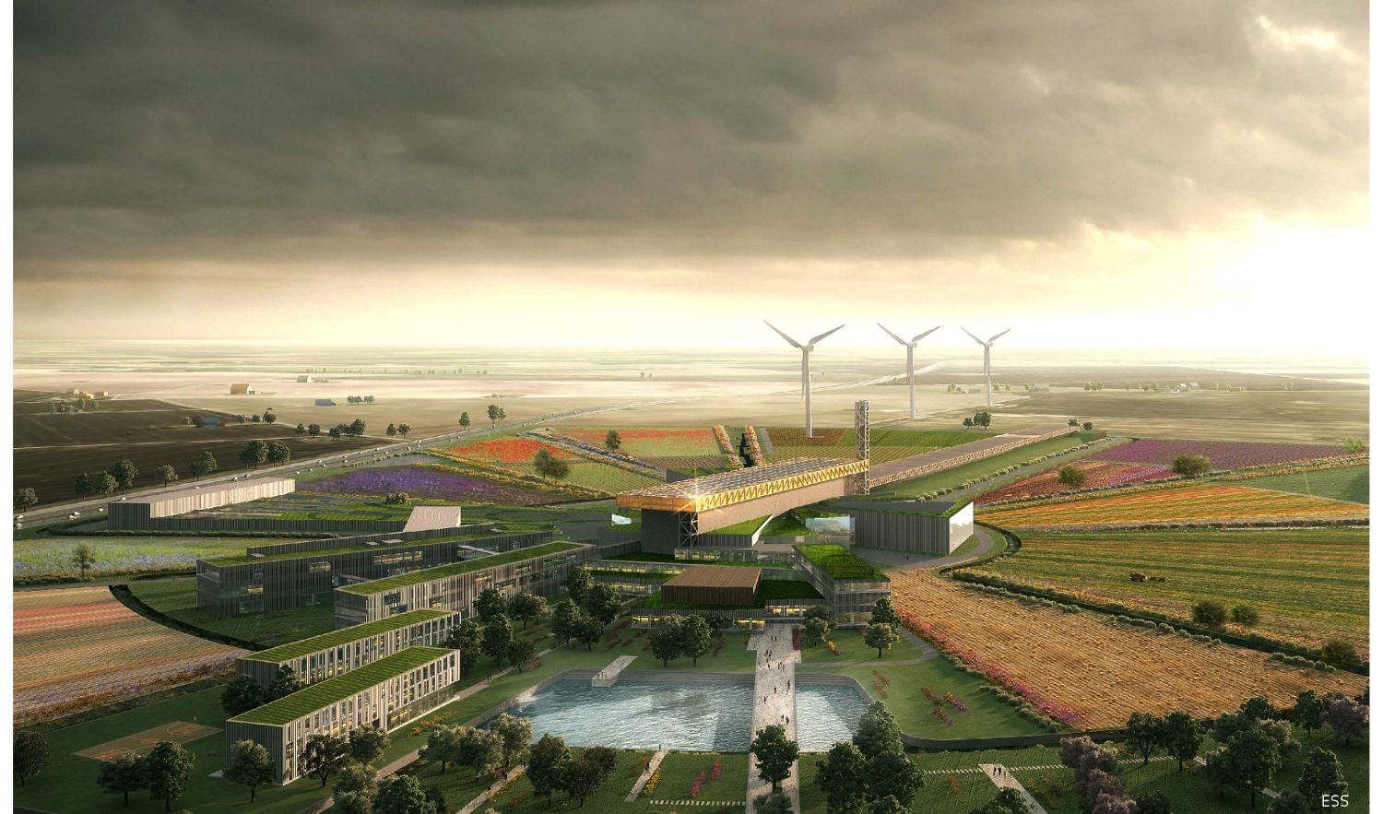
Collaborators are welcome… (just email tord.ekelof@physics.uu.se, marcos.dracos@in2p3.fr )

Slide 27
Backup

Slide 28
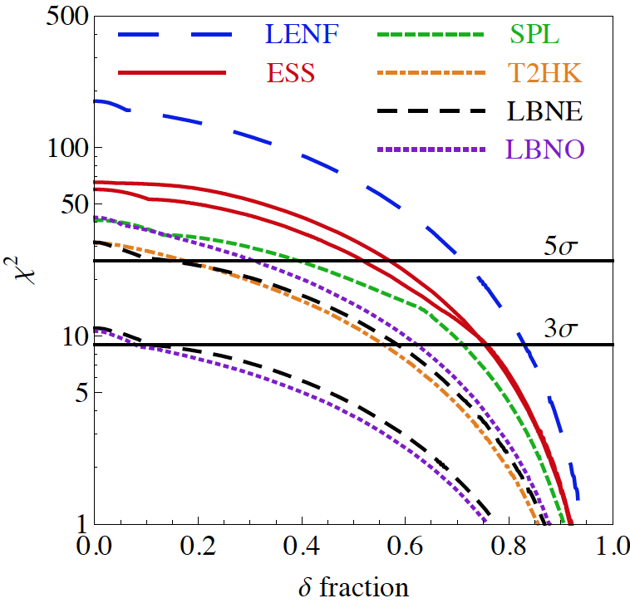
Which baseline?
known MH
360 km
540 km

Slide 29
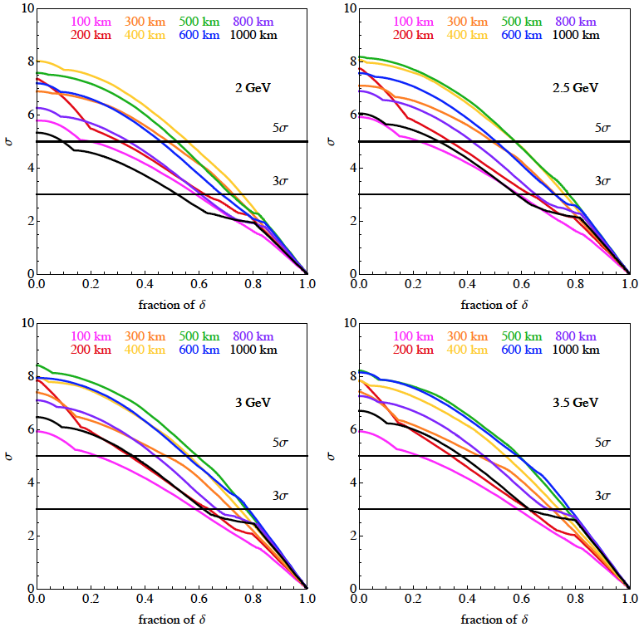
Which baseline?

Slide 30
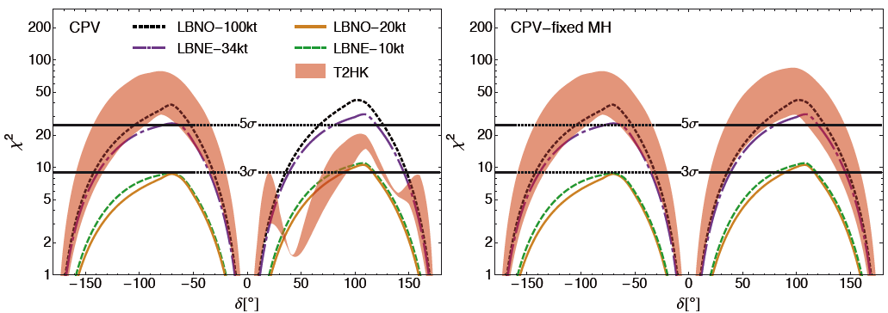
Physics Performance for Future SB projects (Enrique Fernantez)

Slide 31
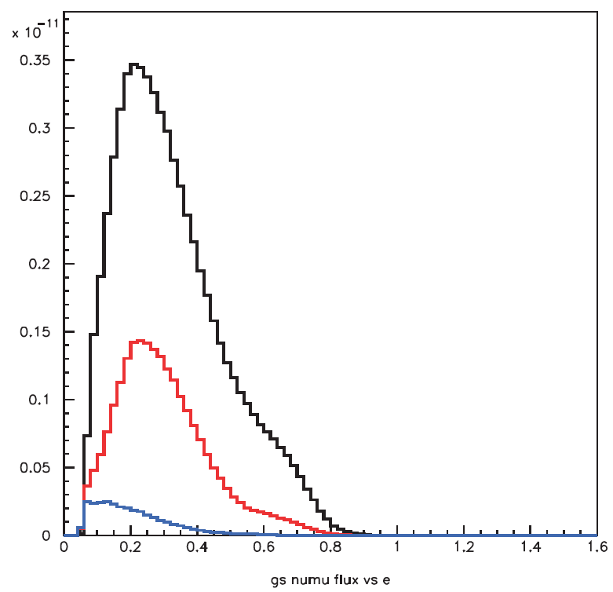
Horn Optimization
perfect focusing
for 2.5 GeV
/proton/0.02GeV/m²
present focusing
no focusing
GeV

Slide 32
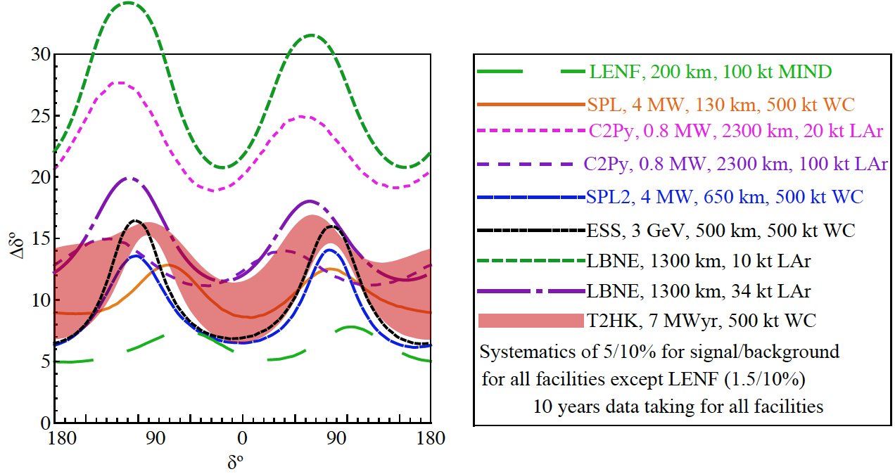
Physics Performance for Future SB projects (Enrique Fernantez)

