Slide 1

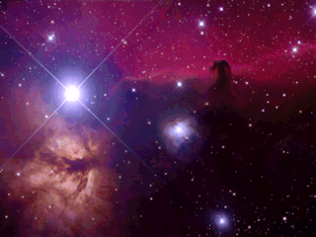


Long-Baseline Neutrino Experiment
LBNE-doc-7688
Jim Strait
Fermilab
for the LBNE Collaboration
ν
ν
ν
ν
ν
ν
ν
NuFact 2013
IHEP Beijing
20 August 2013

Slide 2
Overview
Scientific Motivation
LBNE Collaboration
LBNE Science
LBNE Design Status
Towards a World Class Facility
  Summary

Slide 3
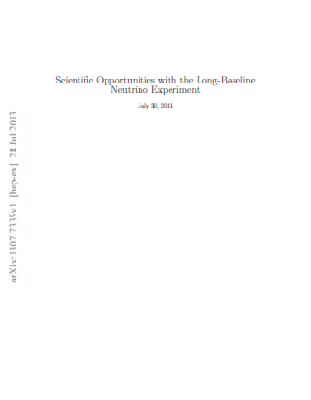
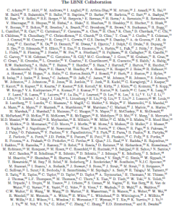
Scientific Motivation
  CP Violation in neutrino sector?
  Neutrino Mass Hierarchy
Testing the Three-Flavor Paradigm
  Precision measurements of known
  fundamental mixing parameters
  New physics -> non-standard interactions,
  sterile neutrinos… (with beam + atmospheric ν sources)
  Precision neutrino interactions studies (near detector)
Other fundamental physics enabled by massive detectors
  Baryon-Number Violation
  Astrophysics: Supernova ν burst flux
Further details: “Science Opportunities w/ LBNE,” arXiv:1307.7335.

Slide 4
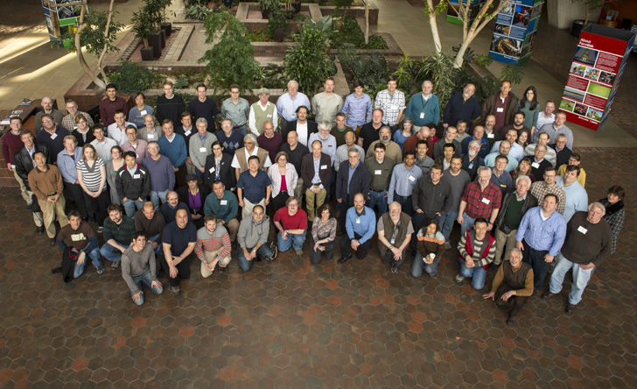
LBNE Collaboration
NGA
New Mexico
Northwestern
Notre Dame
Oxford
Pennsylvania
Pittsburgh
Princeton
Rensselaer
Rochester
Sanford Lab
Sheffield
SLAC
South Carolina
South Dakota
South Dakota State
SDSMT
Southern Methodist
Sussex
Syracuse
Tennessee
Texas, Arllington
Texas, Austin
Tufts
UCLA
Virginia Tech
Washington
William and Mary
Wisconsin
Yale
Alabama
Argonne
Boston
Brookhaven
Cambridge
Catania
Columbia
Chicago
Colorado
Colorado State
Columbia
Dakota State
Davis
Drexel
Duke
Duluth
Fermilab
Hawaii
Indian Group
Indiana
Iowa State
Irvine
Kansas State
Kavli/IPMU-Tokyo
Lawrence Berkeley NL
Livermore NL
London UCL
Los Alamos NL
Louisiana State
Maryland
Michigan State
Minnesota
MIT
372 members, 61 institutions, 5 countries (April 2013)
Applications from 16 institutions and >50 members (and one new country) being prepared or submitted
Co-spokespersons Milind Diwan (BNL), Bob Wilson (CSU)
Deadwood, SD 25-28 May 2010
Fermilab, March 2013

Slide 5
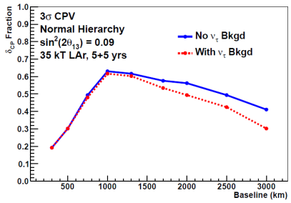
Baseline Optimization
Detailed calculation with horn based realistic beam optimization at each baseline and assumption of liquid argon TPC of 35 kt. Assume 120 GeV protons at 700kW.
Mass Hierarchy
CP Violation
The LBNE design with a 1300 km, 120 GeV proton beam, on-axis LArTPC
far detector is economical for a comprehensive oscillation program
Any other choice will necessitate larger detector or higher beam intensity
Full scientific paper in preparation.

Slide 6
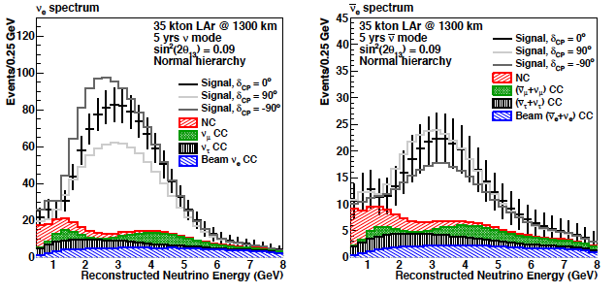
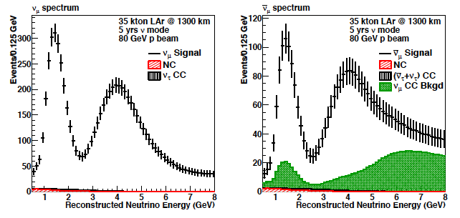
LBNE 34 kt Spectra
ν (5 yrs)
ν (5 yrs)
Appearance
180 evts
(272 IH)
750evts
(330 IH)
Disappearance
w/o osc: 20,000
w/ osc:
7,000
w/o osc: 6,700
w/ osc: 2,200

Slide 7
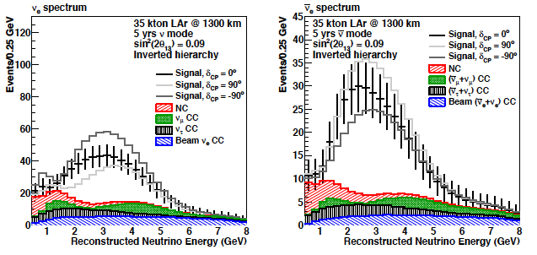
LBNE Spectra-Mass Hierarchy
34 kt fid.
Normal
180 evts
750 evts
Difference due to mass ordering
Inverted
272 evts
330 evts
Notes:
Spectra from 2010/11 PWG report w/ sin2theta13=0.1, later slides show sensitivities from improved 80 GeV beam and latest osc.params.

Slide 8
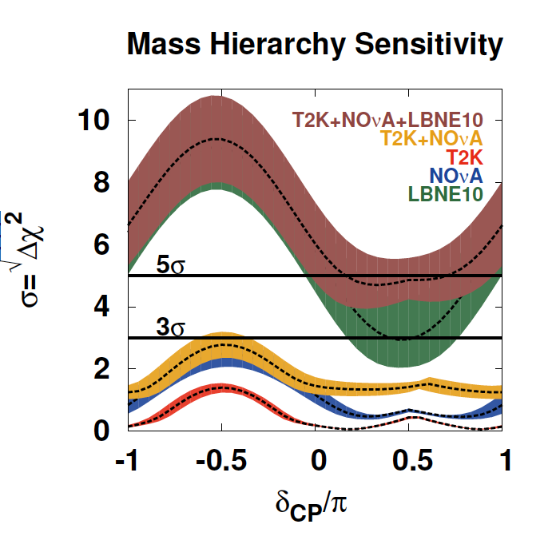
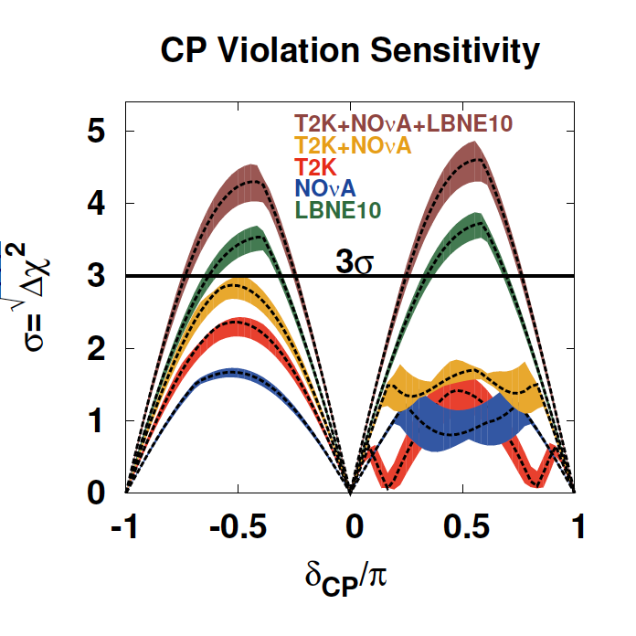
Just 10 kt LArTPC Would be a Major Advance
Significance for δ≠0, π
True Normal
Hierarchy not
known
*Improved over CDR 2012 120 GeV MI proton beam
Bands: 1σ variations of θ₁₃, θ₂₃, Δm₃₁² (Fogli et al. arXiv:1205.5254v3)
LBNE10 does much better than full program for existing experiments
Notes:
See docDB 7199 (M. Bass) for description.
◮ Oscillation parameter values based on Fogli et al, arXiv:1205.5254v3
◮ sin^2(θ_12) = 0.307
◮ sin^2(2θ_13) = 0.094 (1σ range: 0.0845 − 0.1036)
◮ sin^2(θ_23) = 0.386 (1σ range: 0.370 − 0.431)
◮ ∆m^2_21 = 7.54 × 10−5 eV2
◮ ∆m^2_31 = 2.47 × 10−3 eV2 (1σ range: 2.37 − 2.53)
◮ Simple normalization systematics:
◮ T2K: 5%, 10% appearance, 5%, 10% disappearance
◮ NOvA: 5%, 10% appearance, 5%, 10% disappearance
◮ LBNE10: 1%, 5% appearance, 5%, 10% disappearance

Slide 9
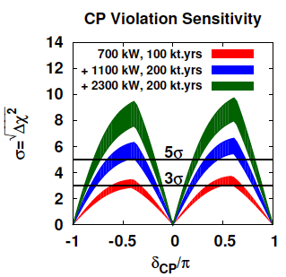
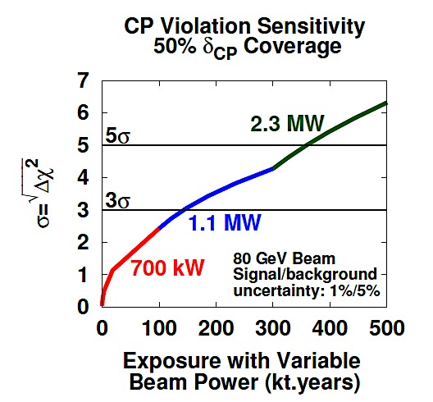
LBNE + Project X (1.1-2.3 MW) =
Comprehensive Global Science Program
Bands: Beam design range
With 80 GeV MI protons source
Long-range program in tandem with near detector neutrino interactions and non-accelerator physics
Notes:
CP violation sensitivity as a function of exposure (far detector mass times run time) at the indicated proton beam power (which corresponds to a Project X development scenario). Significance of non-zero value of d_{CP} over the full d_{CP} range (left); CP violation sensitivity for 50% coverage of the full d_{CP} range (right).

Slide 10
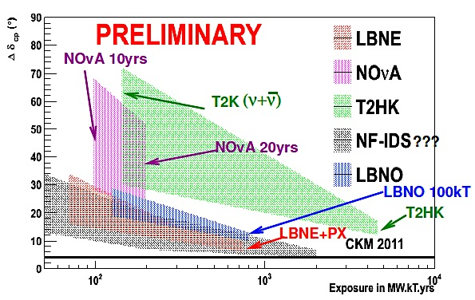
Global Context
Bands: Range of δ_{CP} (best-worst case)
NF-IDS entry has assumptions about conversion from muon rate to POT and beam power
Δδ_{CP} (^{ₒ})
Exposure (MW kt yrs)
LBNE+Project X will ultimately approach CKM level of precision
Notes:
Resolution on δ_{CP} as a function of exposure (beam power x detector mass x time) for various potential experiments, the bands correspond to the best and worst case δ_{CP} value.

Slide 11
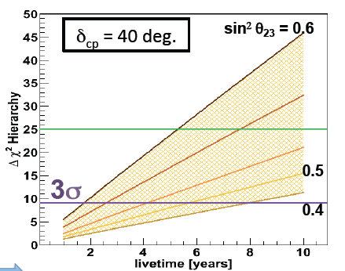
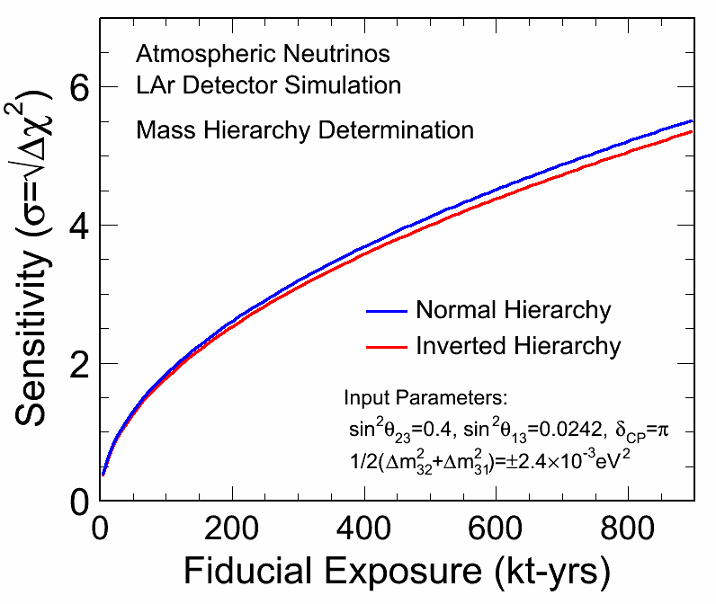
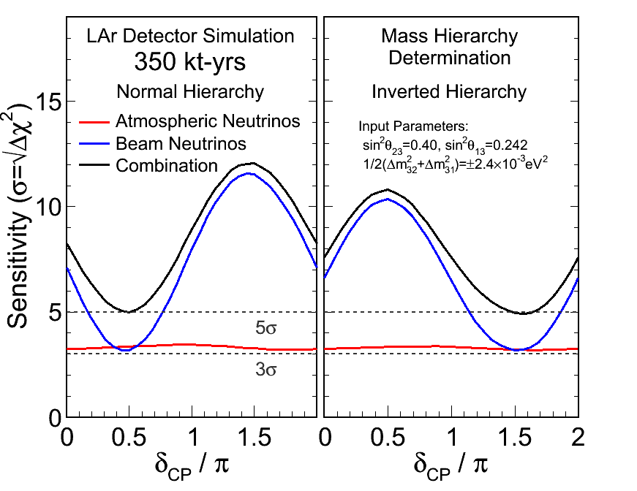
Atmospheric Neutrinos
275
kt-yrs
4000 kt-yrs
LBNE MH Sensitivity
HyperK MH Sensitivity
(H. Gallagher + A. Blake*)
(C. Walter*)
HyperK and LBNE have comparable sensitivity to the MH with atmospheric neutrinos!
LBNE’s higher resolution of event energy and direction makes up for smaller mass.
*ISOUPs, May 2013

Slide 12
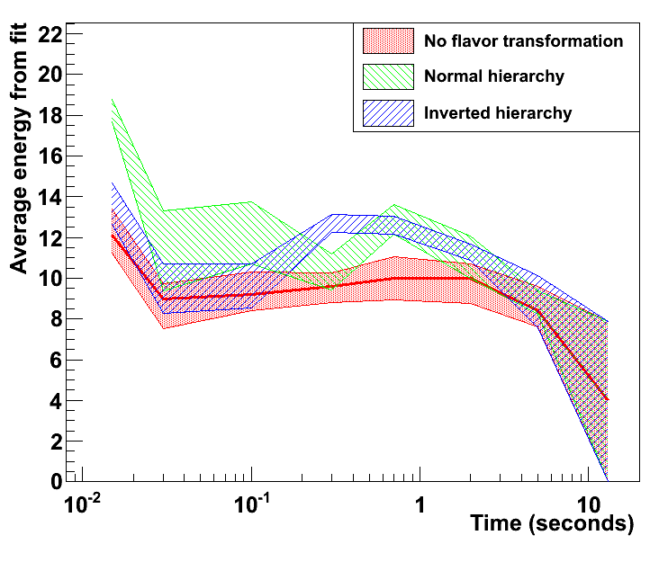
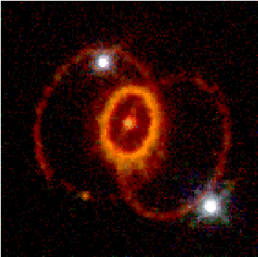
Supernova Burst Neutrinos
When a star's core collapses ~99% of the gravitational binding energy of the proto-neutron star goes into ν’s
SN at galactic core ⇒ 1000’s interactions in 20 kt LArTPC in tens of seconds (ν_{e} detection complementary to WCD)
Measuring SN ν_{e} temperature vs. time
Preliminary: work in progress
SN 1987A observation of
~20 events → ~800 publications!
10 kpc spectra from A. Friedland/JJ Cherry/H. Duan smeared w/ SNOwGLoBES response, fit to pinched thermal spectrum
Based on Keil, Raffelt, Janka spectra, astro-ph/0208035, w/ collective oscillations (NH & IH)

Slide 13
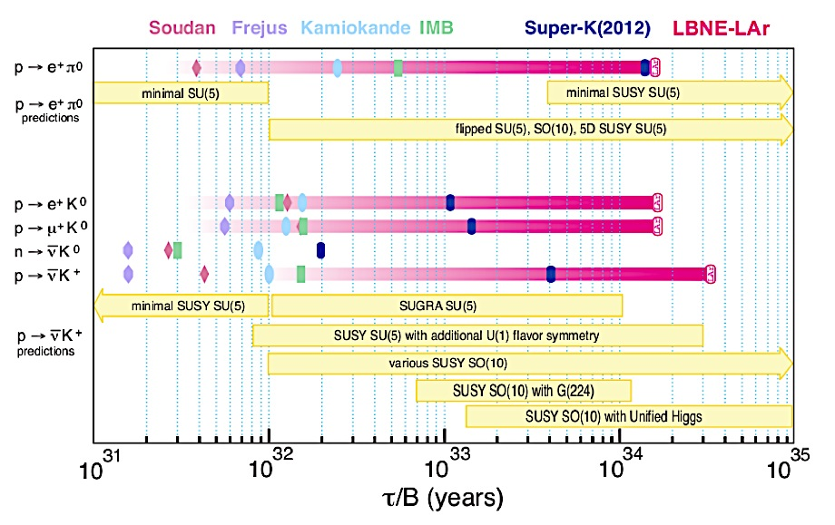
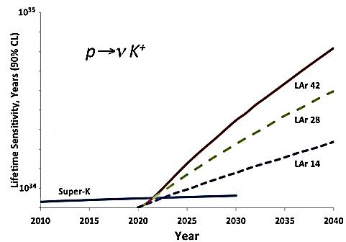
Proton Decay
LBNE
LAr TPC high efficiency for kaon modes
Especially interesting if SUSY
discovered at LHC
Adapted from a plot by E. Kearns

Slide 14
LBNE Design Status
LBNE has a well-developed design for the complete project:
  Neutrino beam at Fermilab for 700 kW operation, upgradeable to 2.3 MW
  Highly-capable near neutrino detector on the Fermilab site
  34 kt fiducial mass LAr far detector at
  - A baseline of 1300 km
  - A depth of 4300 m.w.e. at the Sanford Underground
  Research Facility (SURF) in the former Homestake
  Mine in Lead, South Dakota

Slide 15
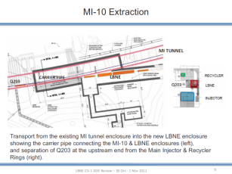
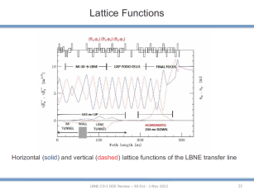
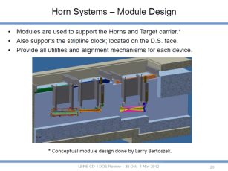
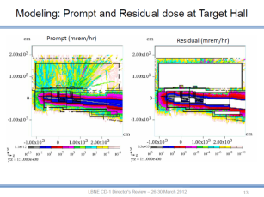
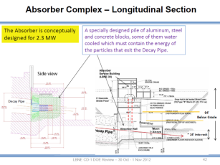
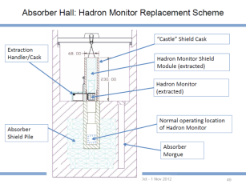
  LBNE Neutrino Beam at Fermilab
  700 kW operation, upgradeable to 2.3 MW

Slide 16
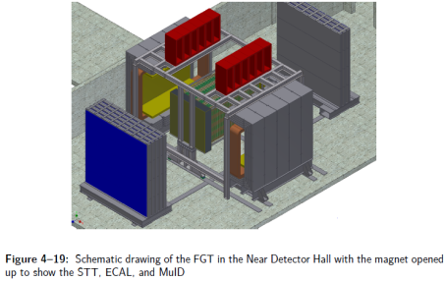
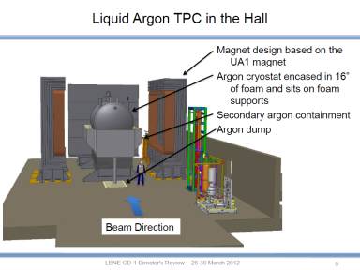
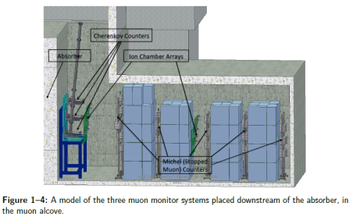
Highly-Capable Near Detector System on the Fermilab Site

Slide 17
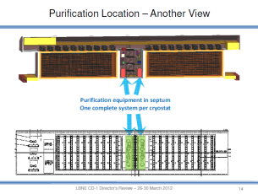
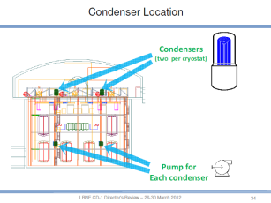
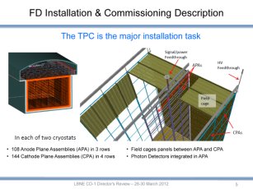
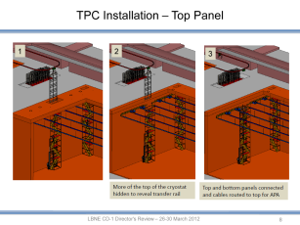
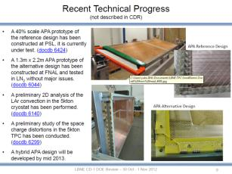
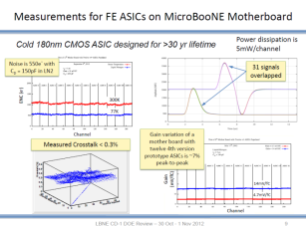
34 kt LAr Far Detector @ 4300 mwe Depth, 1300 km baseline

Slide 18
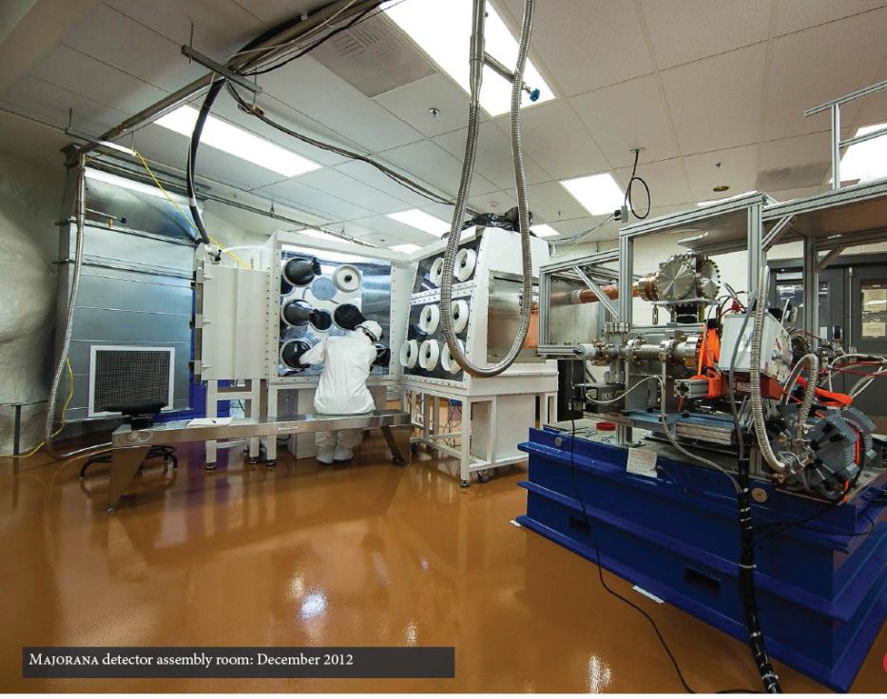
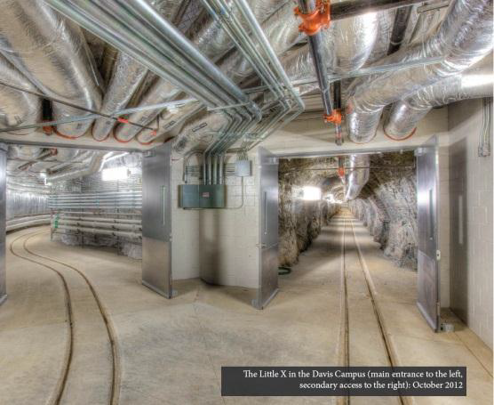
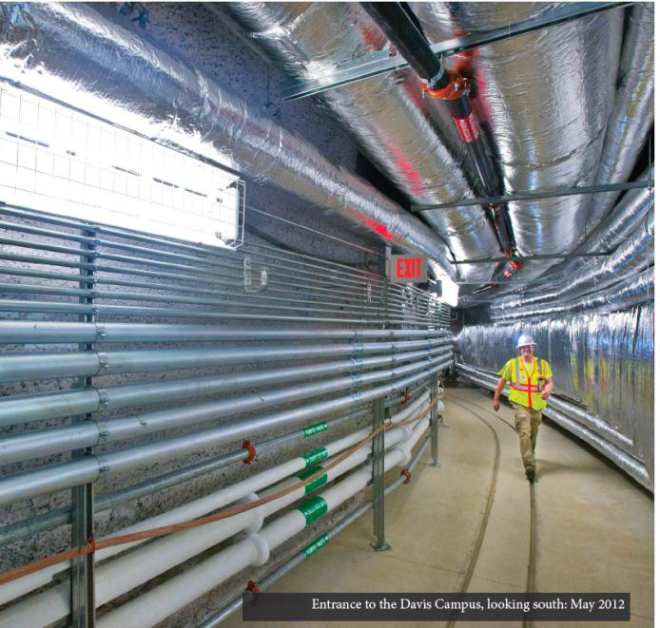
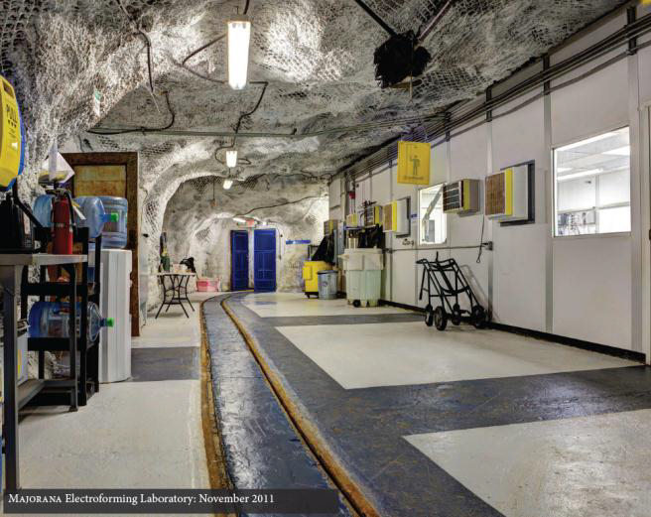
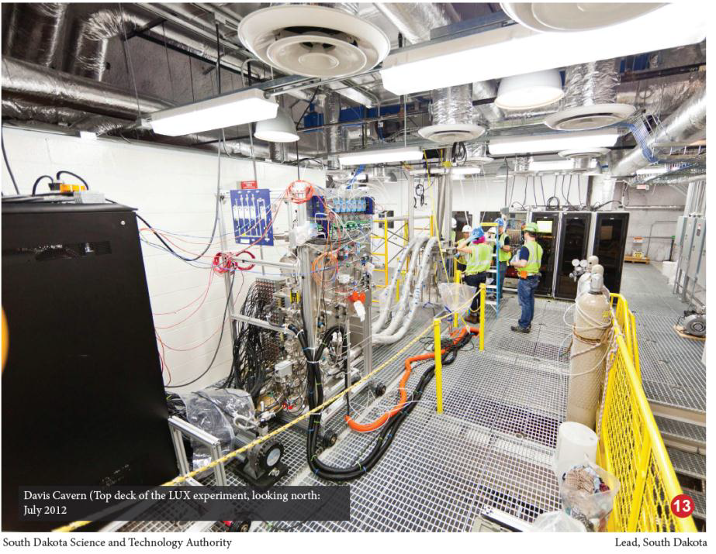
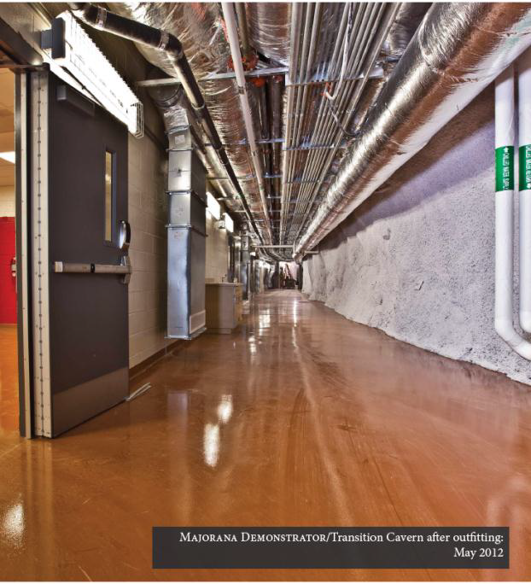
Sanford Underground Research Facility (Homestake)
Facilities at 4300 mwe depth
18

Slide 19
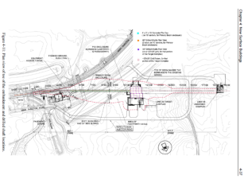
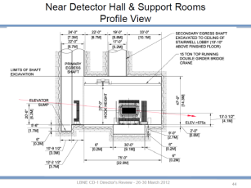
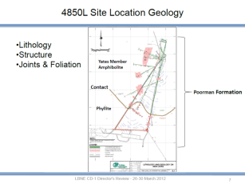
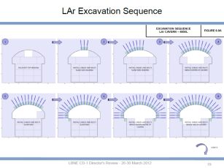
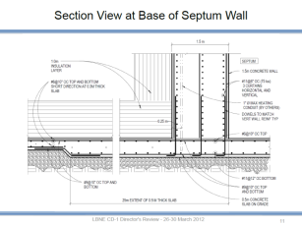
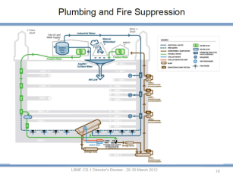
Civil Engineering for Beam, Near Detector and
Deep Far Detector

Slide 20
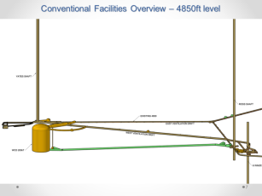
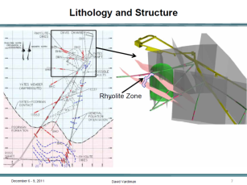
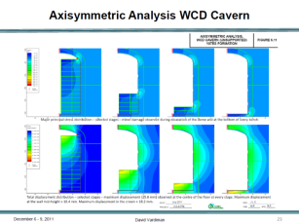



And …. we also have a design for
a 200 kt (fiducial) Water Cherenkov Detector
Space for several 200 kt modules

Slide 21


Complete Design of LBNE was Independently
Reviewed and Found to be Sound

Slide 22
However…
Last year US funding agency (DOE) asked us to stage LBNE construction and gave us a budget of $867M for the first phase
  They also encouraged us to develop new partnerships to maximize the scope of the first stage.
We chose to proceed with emphasis on the most important aspects of the experiment: 1300 km baseline and the full capability beam
  With just the DOE budget, the far detector would be 10 kt LAr TPC at the surface.
An external review panel recommended this phase 1 configuration.
DOE approved “CD-1” in December 2012 for this phase-1 scope.
Our plan continues to be to build the full scope originally planned, and are working with domestic and international partners to make the first phase as close as possible to the original goal.

Slide 23



DOE CD-1 Approval Document
http://lbne2-docdb.fnal.gov/cgi-bin/RetrieveFile?docid=6681;filename=LBNE%20CD-1%20appr.pdf

Slide 24

Planning for Underground Location
We have launched geotechnical investigation of the LBNE detector site at the 4850 level, which is on critical path.

Slide 25
Goal for LBNE Phase 1
Together with additional partners, build:
  - Neutrino beam for 700 kW, upgradeable to 2.3 MW
  - Highly-capable near neutrino detector
  - >10 kt fiducial mass LAr far detector at
  A baseline of 1300 km
  A depth of 4300 m.w.e.
The world-wide community can build upon the substantial investment planned by the US to make LBNE a world facility for neutrino physics, astrophysics, and searches for non-conservation of baryon number.
Together we can do more than we can do separately.

Slide 26
International Discussions
We are in discussion with a number of potential non-US partners, both physics groups and funding agencies, in:
- Brazil - India
- Italy - UK
LBNE and LAGUNA-LBNO have established a working group to explore joining forces
Italian ICARUS groups in the process of joining LBNE
We have initiated preliminary discussions with:
- CERN - Dubna
We are hoping to engage others potential partners:
- Japan - China
- Additional countries in the Americas, Asia and Europe
Also exploring how to engage domestic US funding agencies beyond the DOE

Slide 27


Slide 28


Slide 29

European Strategy and CERN
European Strategy for Particle Physics:
Rapid progress in neutrino oscillation physics, with significant European involvement, has established a strong scientific case for a long-baseline neutrino programme exploring CP violation and the mass hierarchy in the neutrino sector.
CERN should develop a neutrino programme to pave the way for a substantial European role in future long-baseline experiments. Europe should explore the possibility of major participation in leading long-baseline neutrino projects in the US and Japan.
Formally adopted at the special European Strategy Session of the Council in Brussels on 30 May 2013.
The role of CERN will be key. The next step is for CERN to establish a platform from which European groups can participate in long-baseline physics. ... hopefully in the US!

Slide 30
Summary
CP violation parameter, mass hierarchy, non-standard interactions likely inaccessible to current generation experiments
  Need longer baseline and very large instrumented targets for a comprehensive program
Large detectors also probe physics not accessible any other way
  Proton decay (Grand Unified Theories)
  Supernova burst neutrinos from intra-galactic distances
LBNE has received approval to begin this program
  It will be a major US HEP facility for the 2020’s
  With a budget of $867M we are proceeding with the most important aspects in the first phase and actively working with partners to expand the scope
LBNE will develop into a world center for neutrino physics to complement those for hadron/lepton colliders

Slide 31
Back Up

Slide 32
Why 1300 km: Baseline Optimization
Mary Bishai
Matter
effect
only
CP
asymmetry
in vacuum
Optimum is achieved when the asymmetry due to the matter effect is larger than the largest CP effect, but does not saturate the total asymmetry.
At the first maximum at the optimum baseline there is no degeneracy.

Slide 33

Just 10 kt LArTPC Would be a Major Advance
Significance for δ≠0
True Normal
Hierarchy not
known
Assumes known (Normal) Mass Hierarchy
Bands: 1σ variations of θ₁₃, θ₂₃, Δm₃₁²
(Fogli et al. arXiv:1205.5254v3)
*Improved over CDR 2012 120 GeV MI proton beam
Notes:
See docDB 7199 (M. Bass) for description.
◮ Oscillation parameter values based on Fogli et al, arXiv:1205.5254v3
◮ sin^2(θ_12) = 0.307
◮ sin^2(2θ_13) = 0.094 (1σ range: 0.0845 − 0.1036)
◮ sin^2(θ_23) = 0.386 (1σ range: 0.370 − 0.431)
◮ ∆m^2_21 = 7.54 × 10−5 eV2
◮ ∆m^2_31 = 2.47 × 10−3 eV2 (1σ range: 2.37 − 2.53)
◮ Simple normalization systematics:
◮ T2K: 5%, 10% appearance, 5%, 10% disappearance
◮ NOvA: 5%, 10% appearance, 5%, 10% disappearance
◮ LBNE10: 1%, 5% appearance, 5%, 10% disappearance

Slide 34

LBNE + Project X (1.1-2.3 MW) =
Comprehensive Global Science Program
Final reactor error expectation
Current reactor error
Notes:
Resolution on δ_{CP} as a function of exposure (beam power x detector mass x time) for various potential experiments, the bands correspond to the best and worst case δ_{CP} value.

Slide 35
DOE Critical Decisions
CD-0 (“Mission Need”) approves the need for the project.
CD-1 (“Alternative Selection and Cost Range”) approves overall design, cost and schedule.
CD-2 (“Performance Baseline”) approves the precise technical design, cost and schedule.
CD-3A (“Approve Long-Lead Item Procurements”) approves early start of selected parts of the project.
CD-3 (“Start of Construction”) approves the start of construction.
CD-4 (“Project Completion”) approves transition to operations.
Jan 2010
Dec 2012
(for phase 1)
Early 2017
Early 2016
Late 2017
2023

Slide 36

LBNE DOE Schedule (CD-1 Review)
12
Affected

Slide 37
Flexibility in DOE Project Management System
The DOE Project Management System (“CD process”) has more flexibility than is generally understood or used.
DOE management has encouraged us to
- first make a plan with international partners that makes
sense for LBNE, and
- then to work with them to make the DOE system work
to support the plan.
Examples of potential flexibility include the ability to:
- Change detailed scope between CD-1 and CD-2
- Delay CD-2 until ready
- Stagger CD-2/3/4 for different parts of the project,
e.g. beam vs. far detector

Slide 38

LBNE Reference Beam Design

Slide 39

Costs for the options have been developed

