Slide 1
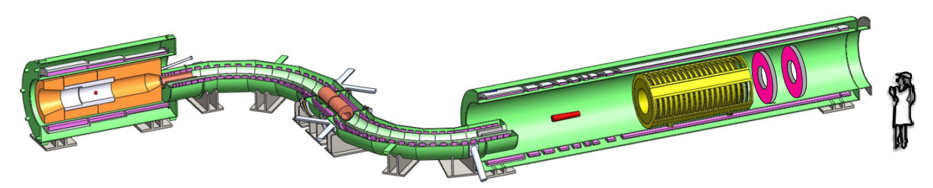
The Mu2e experiment
Zhengyun You
University of California, Irvine
(for the Mu2e Collaboration)
08/21/2013

Slide 2
Outline
Physics
  CLFV
  Muon-to-electron conversion
The Mu2e experiment at Fermilab
    Detector setup
    Signal & background
    Sensitivity
Schedule and Future
Summary

Slide 3
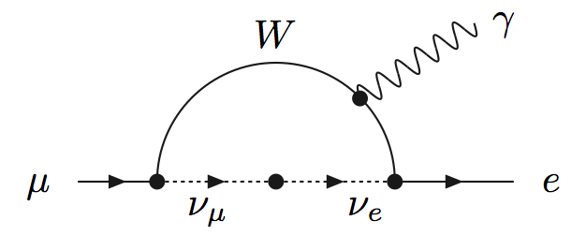
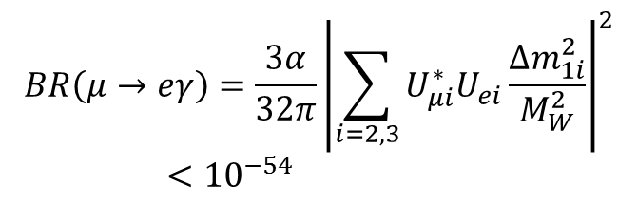
Charge Lepton Flavor Violation (CLFV)
Lepton flavor is violated in neutrino mixings
Charged lepton mixing is strongly suppressed in the Standard Model, un-observably small
Any observation of CLFV would be new physics Beyond Standard Model (BSM)

Slide 4
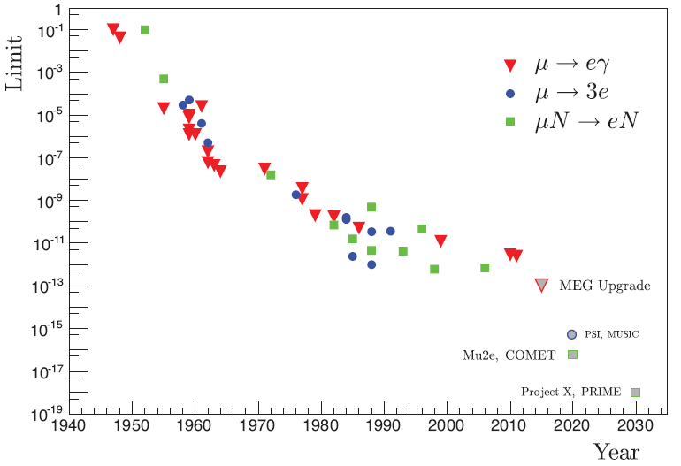
CLFV history in muon to electron
Current best limits
BR(μ→eγ) < 5.7 x 10⁻¹³ MEG 2013
BR(μ→3e) < 1 x 10⁻¹² SINDRUM-I 1988
R_{μe} < 7 x 10⁻¹³ SINDRUM-II 2006
R_{μe} = few x 10⁻¹⁷
Mu2e goal
R. H. Bernstein et. al. arXiv:1307.5787

Slide 5
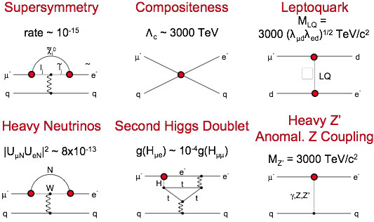
New Physics in μ→e Conversion
Flavor physics of leptons and dipole moments, arXiv:0801.1826

Slide 6
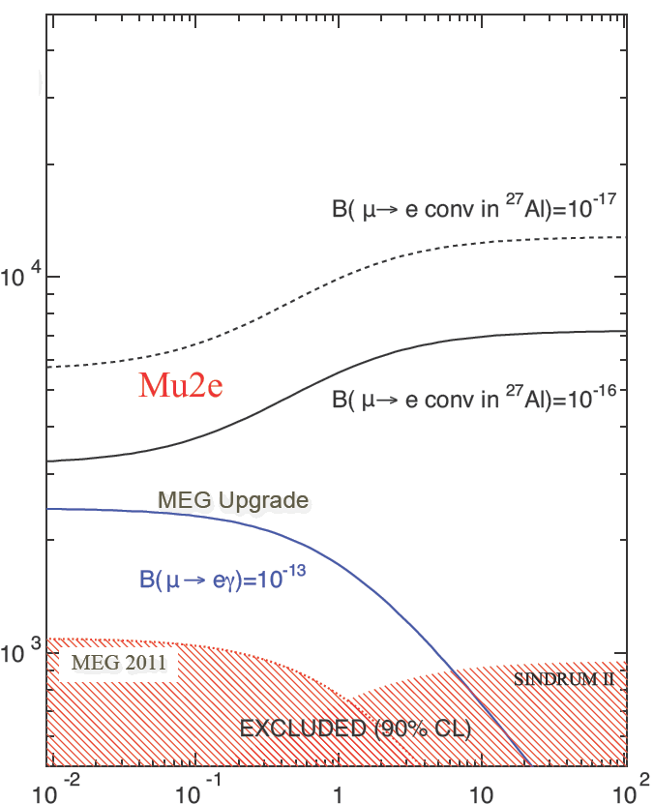
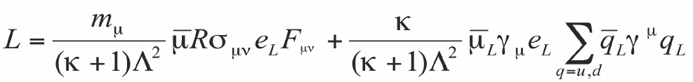
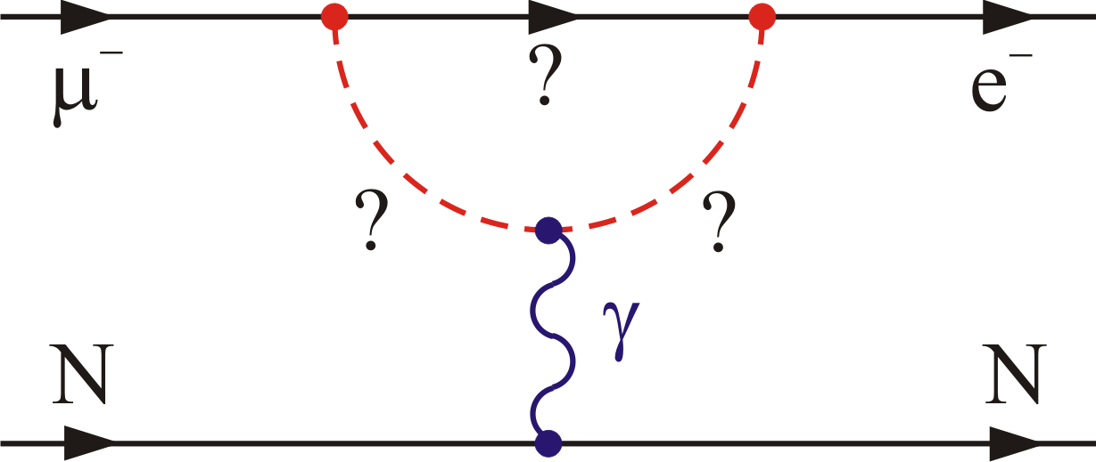
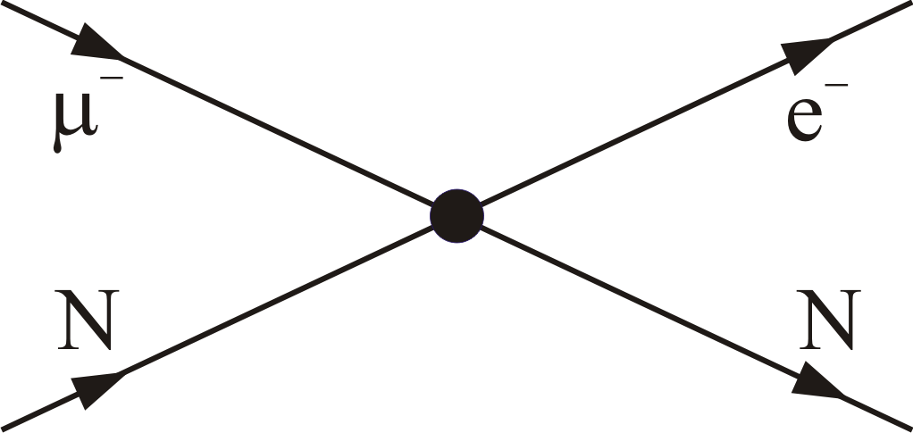
Probing new physics with CLFV
Loops
Contact terms
Λ (TeV)
Effective Lagrangian
Contact κ, mass scale Λ
‘Loops’, charged Higgs model, κ<<1, can be probed by μ→eγ
‘Contact terms’, direct coupling between quarks and leptons, κ>>1, only accessible by μN→eN
Probe mass scales Λ 2000~10000 TeV, significantly above the direct reach of LHC
κ
Andre De Gouvea

Slide 7
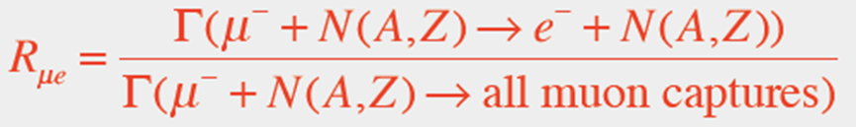
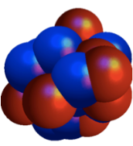
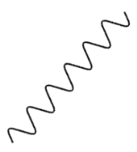


μN→eN Conversion
What we measure
The ratio of muon to electron conversions to conventional muon captures
Signal: Neutrinoless conversion of a muon to electron in the field of a nucleus
Experimental signature
  Mono-energetic electron
  E_{e} = m_{μ} – E_{bind} – E_{recoil}
  For Al, E_{e} = 104.97 MeV
Al
e
μ

Slide 8
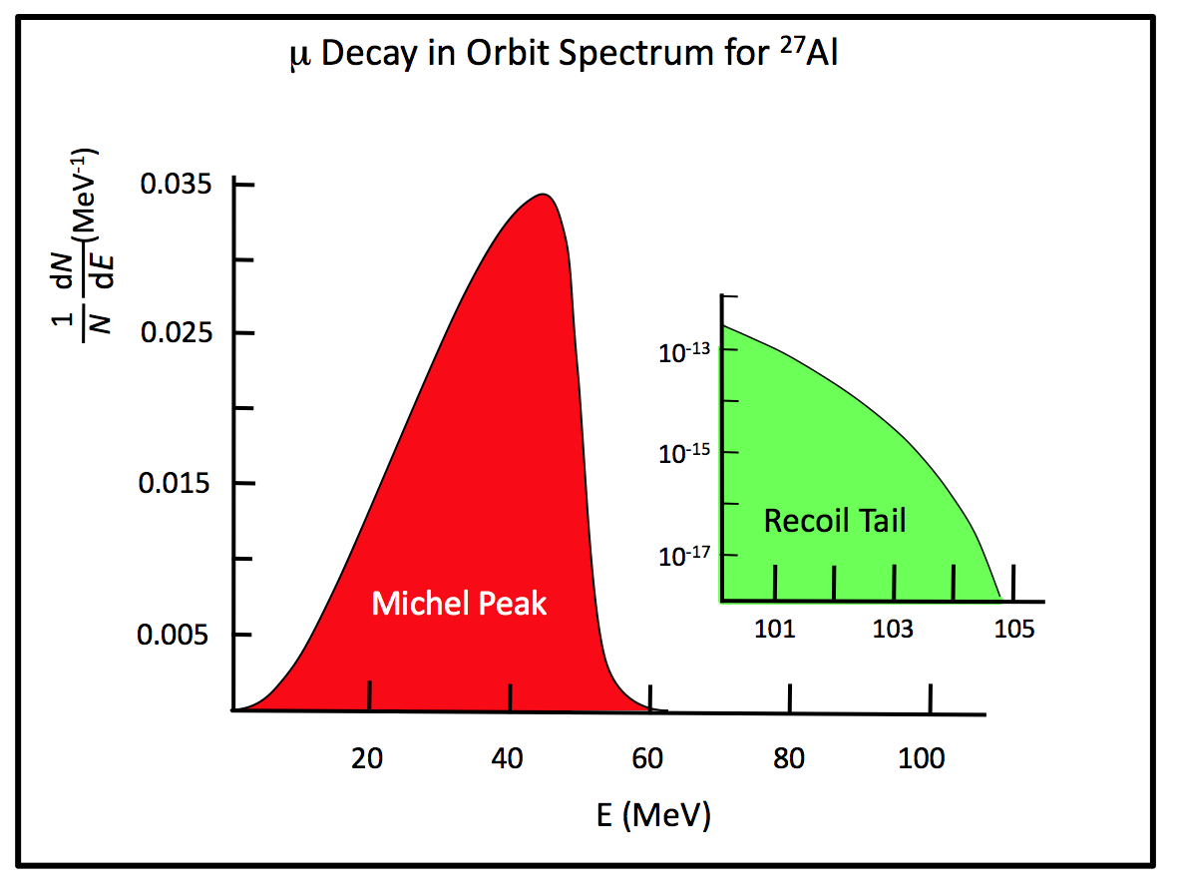
Measurement : Electron energy spectra
Signal
  Conversion electrons with energy at Decay in Orbit (DIO) endpoint
  104.97 MeV
Background
  Muon decay in orbit
  Radiative muon capture
  Radiative pion capture
  Antiprotons annihilation gamma
  Pion/muon decay in flight
  Electrons from beam
  Electrons from Cosmic rays
(E_{conv} - E_{e})⁵
Conversion
signals
E_{e} (MeV)
Czarnecki et al., Phys. Rev. D 84, 013006 (2011) arXiv:1106.4756v2

Slide 9
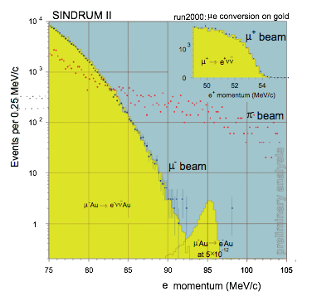
Current Best Measurement in μN→eN
Current best limits
  R_{μe} (Ti) < 4.3 x 10⁻¹²
  R_{μe} (Au) < 7 x 10⁻¹³
Simulated signal at DIO tails
Au target: different electron energy endpoint than Al
Simulated signal
W. Bertl et al, Eur. Phys. J. C 47, 337-346 (2006)

Slide 10
Process and Beam Selection
μ→eγ
Signal particles ≤ 53 MeV
  high background region
Signal: combination of particles
  Bkg rejection: cuts on combination
  Accidental coincidences limit usable muon rate
Continuous beam
μ+
  Capture rates: Γ_{μ+} = 0
μN→eN
Signal particle at 105 MeV
  Away from Michel peak
Signal: single track
  Fewer handles to reject background
  Coincidences not a problem
Use pulsed beam
  suppress background between pulses
Need cosmic ray veto
μ-
  Capture rates: Γ_{μ-} ~ Z⁴
  Potential background

Slide 11
The Mu2e Experiment
Goal: To search for the conversion of μN→eN in the field of Aluminum nucleus
Sensitivity of Branching Fraction
  Single event sensitivity: R_{μe} = 2.5 x 10⁻¹⁷ (6 x 10⁻¹⁷ @ 90% C.L.)
Statistics
  Requires ~10¹⁸ stopped muons
  Requires ~3.6 x10²⁰ protons on target
  3 years data taking
Requires background events to be negligible (<1)
Location: Fermi National Acceleratory Laboratory (FNAL)
Schedule: expect to start commissioning & data taking in 2020

Slide 12

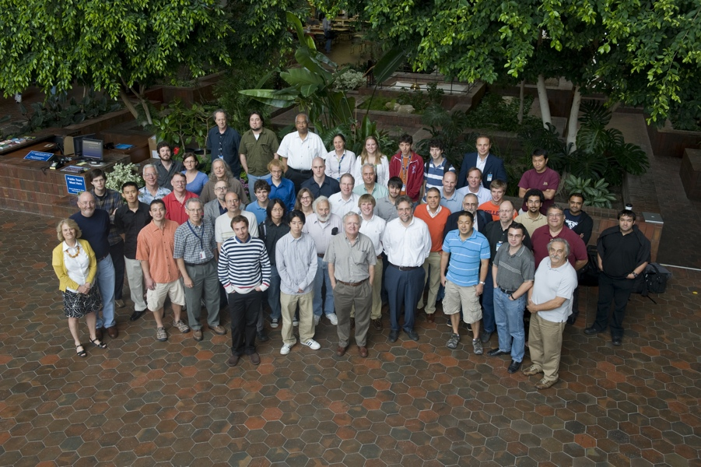


The Mu2e Collaboration
Boston University
Brookhaven National Laboratory
Lawrence Berkeley National Laboratory &
University of California, Berkeley
University of California, Irvine
California Institute of Technology
City University of New York
Duke University
Fermi National Accelerator Laboratory
University of Houston
University of Illinois, Urbana-Champaign
Lewis University
University of Massachusetts, Amherst
Muons, Inc.
Northern Illinois University
Northwestern University
Pacific Northwest National Laboratory
Rice University
University of Virginia
University of Washington
INFN Lecce/Università del Salento
INFN Lecce/Università Marconi
INFN Pisa
Universita di Udine, Udine
Laboratori Nazionali di Frascati
Institute for Nuclear Research, Moscow
Joint Institute for Nuclear Research, Dubna
26 institutions
~140 collaborators

Slide 13
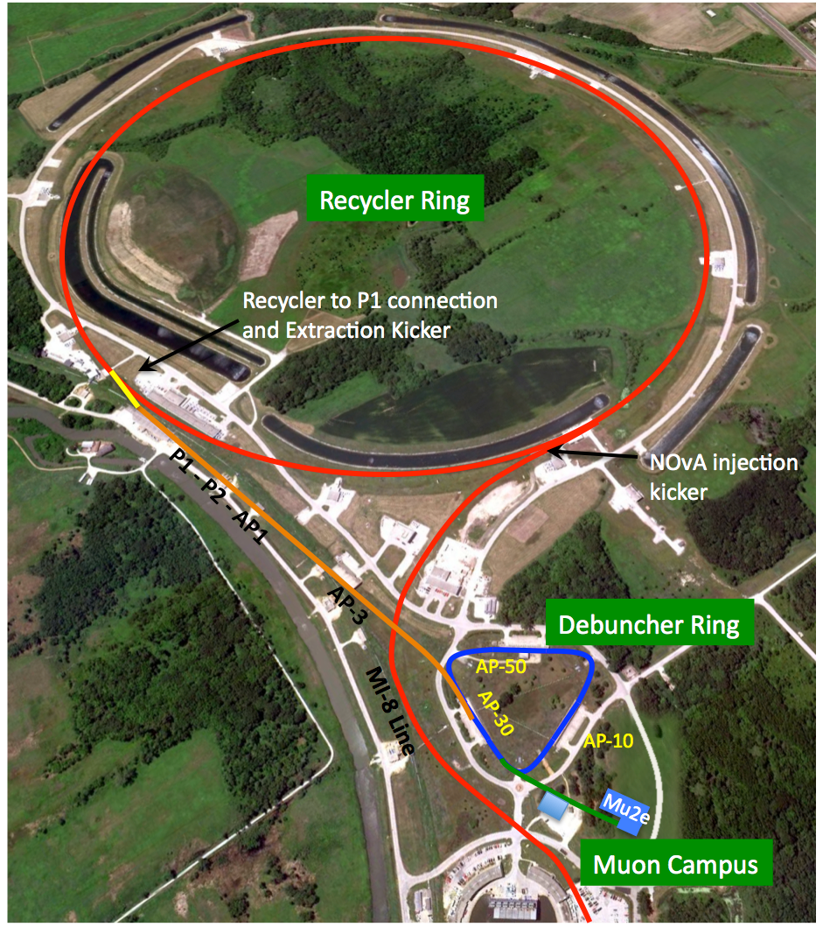
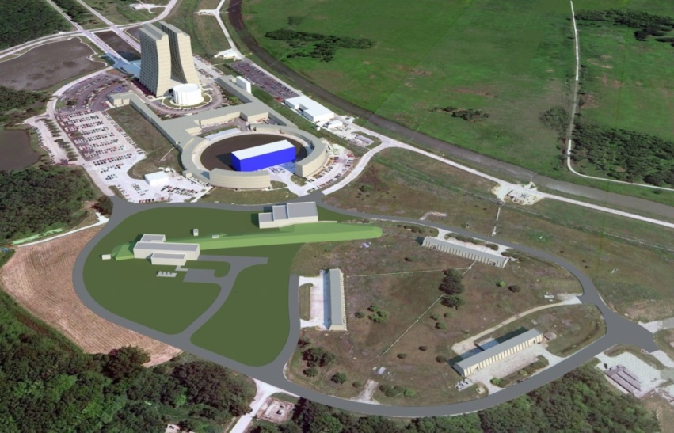
Proton Delivery & Muon Campus
8 GeV proton beams
3x10⁷ protons per bunch
Bunch spacing 1.7 μs
30% duty factor
Run after g-2
Shared with NOVA
g-2
Mu2e

Slide 14
Overview of Mu2e Design
Production Solenoid
Proton Beam
Calorimeter
Tracker
4.6 T
2.0 T
2.5 T
1.0 T
Production Target
Detector Solenoid
Transport Solenoid
Production Solenoid / Target
  Protons hitting target and produce pions
  Solenoid reflect slow forward μ/π and contains backward μ/π
Transport Solenoid
  Filter low momentum μ⁻
Stopping Target, Detector Solenoid and Detectors
  Stop μ⁻ on Al foils and wait for them to decay
  Events reconstructed by tracker and calorimeter, optimized for 105MeV.

Slide 15
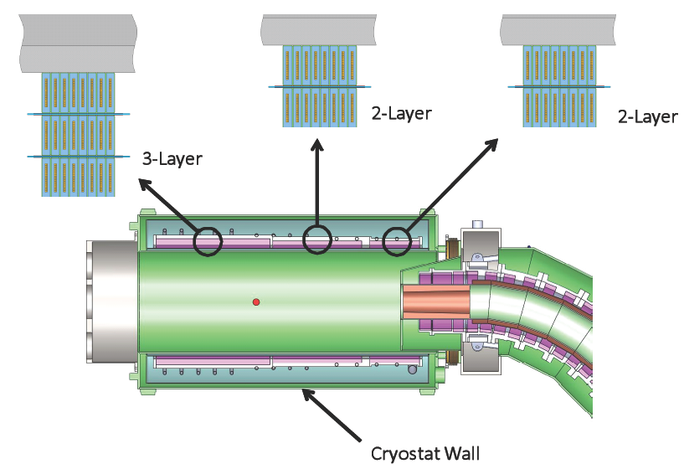
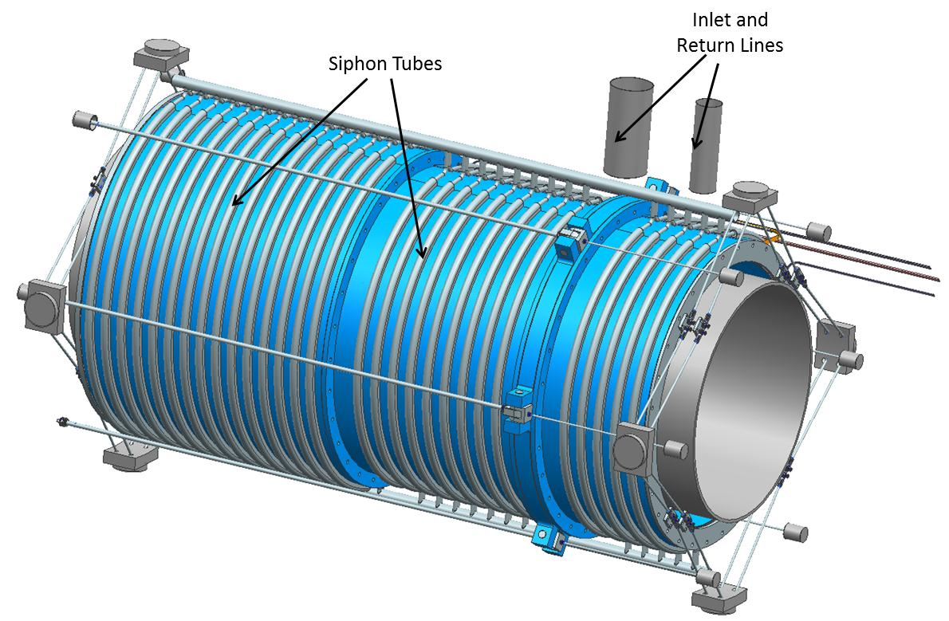
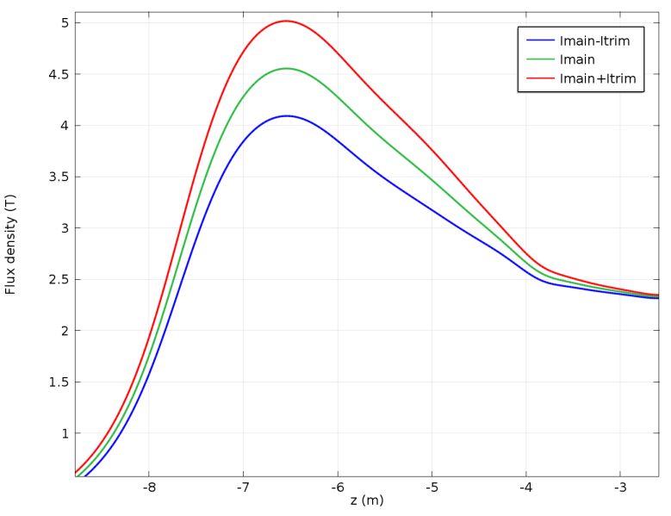
Production Solenoid
To maximize muon yield
The axially graded magnetic field reflects slow pions/muons towards the TS direction
3 coils with 2 or 3 layers
Field [ T ]
Z [m]

Slide 16
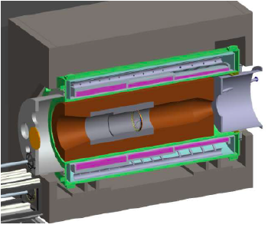
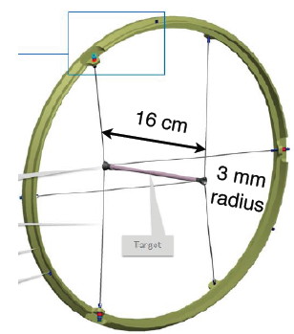
Target and Heat Radiation Shield
Production Target
  Protons striking target produce pions, which decay into muons
  High A and high density material Tungsten to maximize muons production
  High melting temp, radiative cooling (~1600ºC), with 8kW beam (700w in target)
Heat Radiation Shield
  To protect superconductor of PS and upstream TS
  To limit heat load and radiation damage
  ~25 tons of Bronze

Slide 17
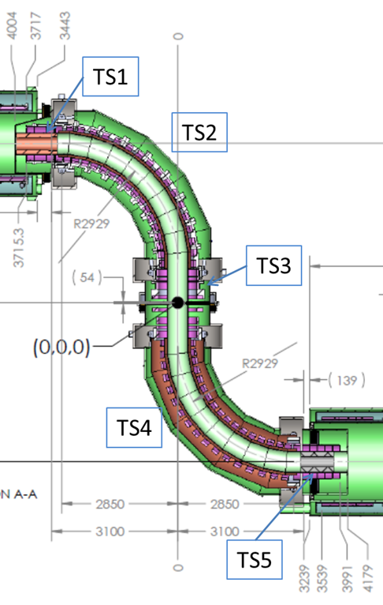
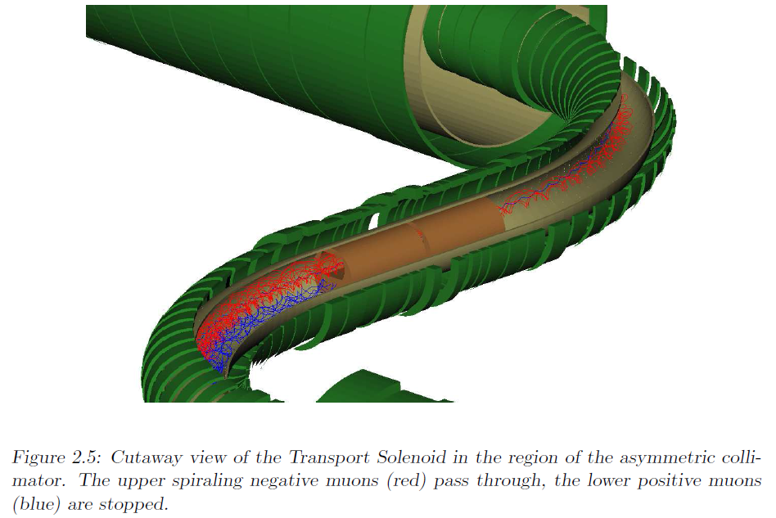
Transport Solenoid
Gradient magnetic field from 2.5 T to 2.0 T
S-shaped magnetic channel to transmit low-momentum negatively charged particles in helical trajectories
D-shaped collimators to remove positively charged and high-momentum particles

Slide 18
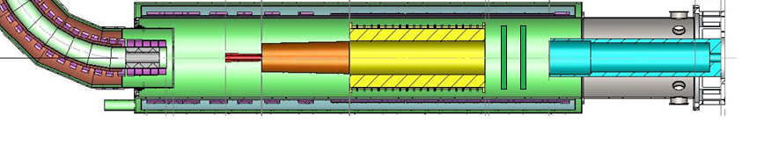
Detector Solenoid
Proton Absorber
μ absorber
μ Stopping target
Tracker
EM Calorimeter
Stopping target to stop muons
Graded magnetic field from 2 T to 1 T, captures conversion electrons with bigger acceptance, shifts the pitch of beam particles to reduce background
Tracker and Calorimeter in a uniform field to reconstruct and identify electrons
Vacuum in DS to limit background from muons stopped on gas atoms

Slide 19
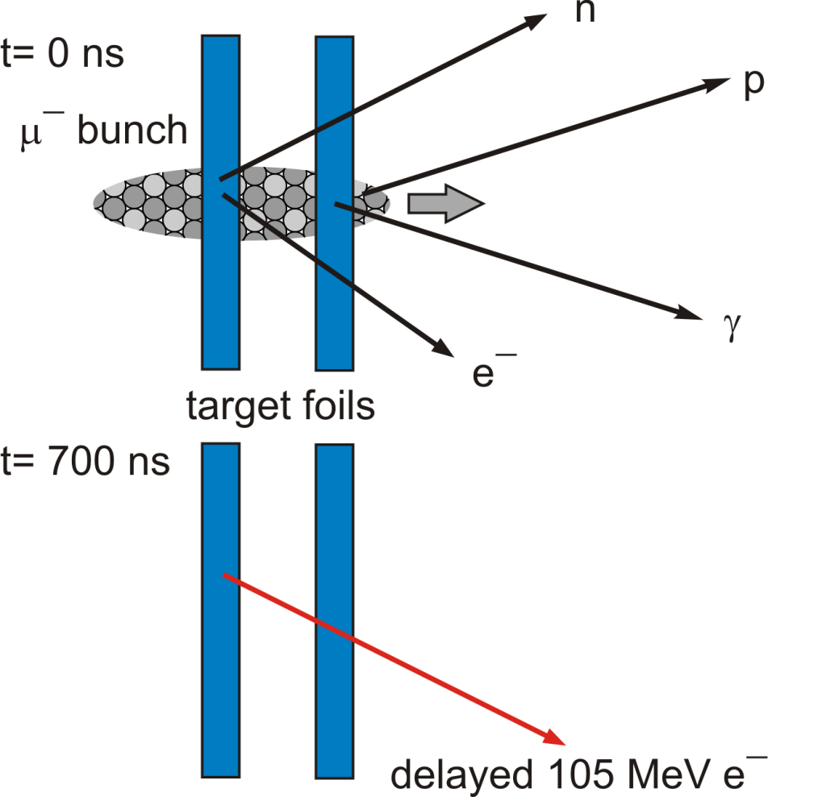
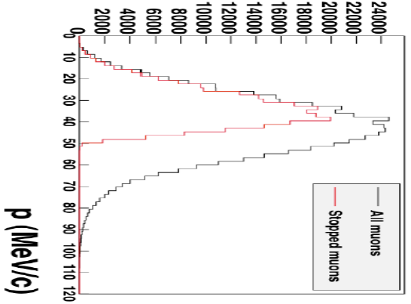
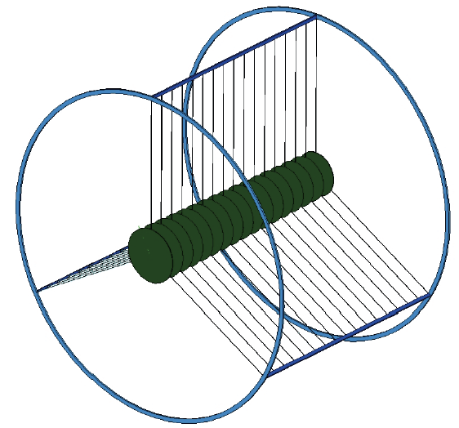
Stopping Target
μ⁻ stopped in thin foils and form muonic atoms
μ⁻ in Al, life time = 864 ns
Conversion electrons signal energy ~105 MeV
17 circular aluminum foils
200 μm thick, spaced 50 mm
Currently stop ~49% muons
Geometry under optimization

Slide 20
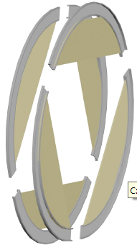
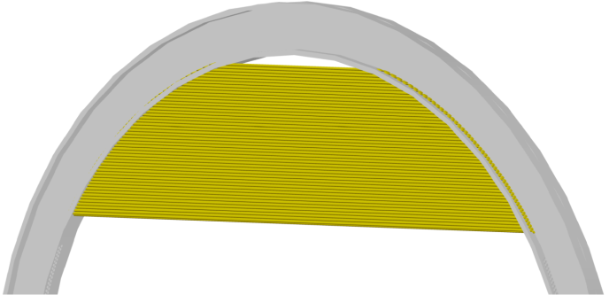
Tracker
Tracker Structure
One station
Straw tubes on a panel
3 m
1.4m
From two designs: T tracker / I tracker, T tracker is selected
3 m long, 1.4 m diameter, in a uniform 1 T magnetic field
Made of 21,600 straw drift tubes, 18 stations, 2 planes/station
Each straw 5 mm diameter, 25 μm sense wire, 15 μm mylar walls
Custom ASIC for Time Division Readout, Δt resolution < 50 ps
ADC for dE/dx capability to separate highly ionizing protons.

Slide 21
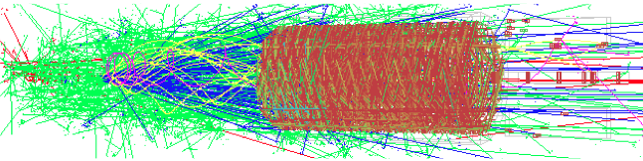
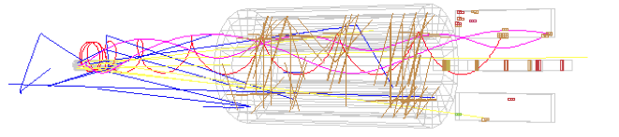
Tracks in one pulse
all tracks in search window of a proton pulse
±50 ns around conversion electron
Quite challenging to find the conversion electron
Good tracker performance and pattern recognition algorithm critical

Slide 22
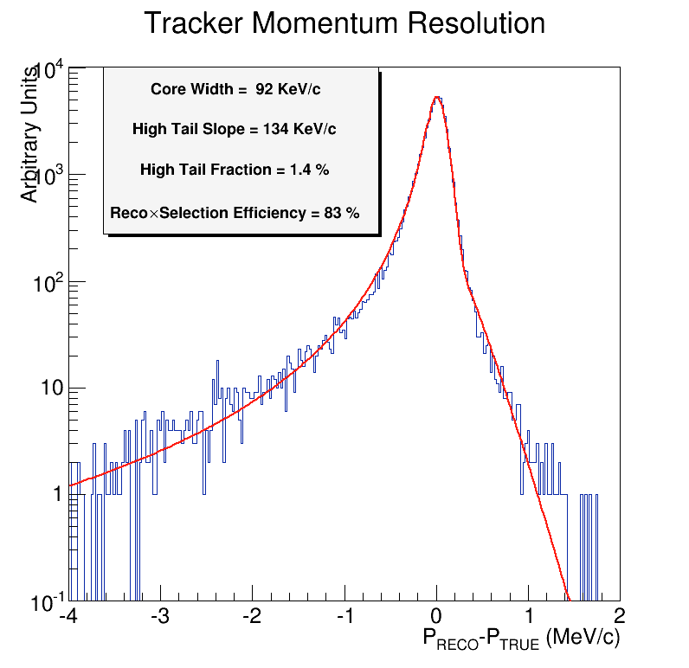
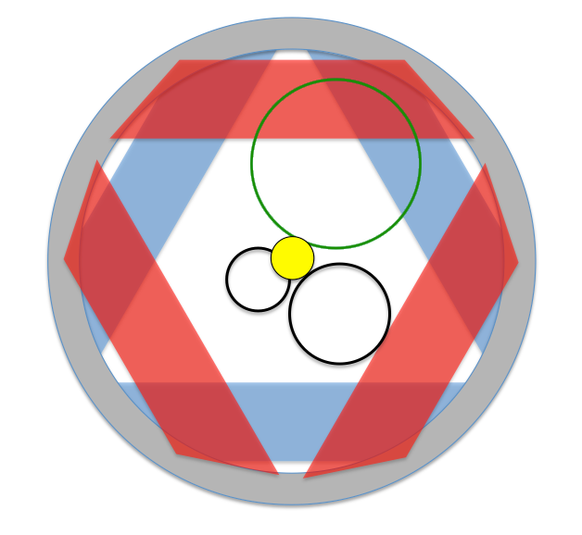
Track Reconstruction
105 MeV Conversion electrons
DIO electrons
Measure trajectories of conversion electrons, most low-momentum DIO electrons curl in the field and pass through the hole in DS
Find tracks using time clustering plus pattern recognition algorithm
Fit Track using Kalman filter

Slide 23
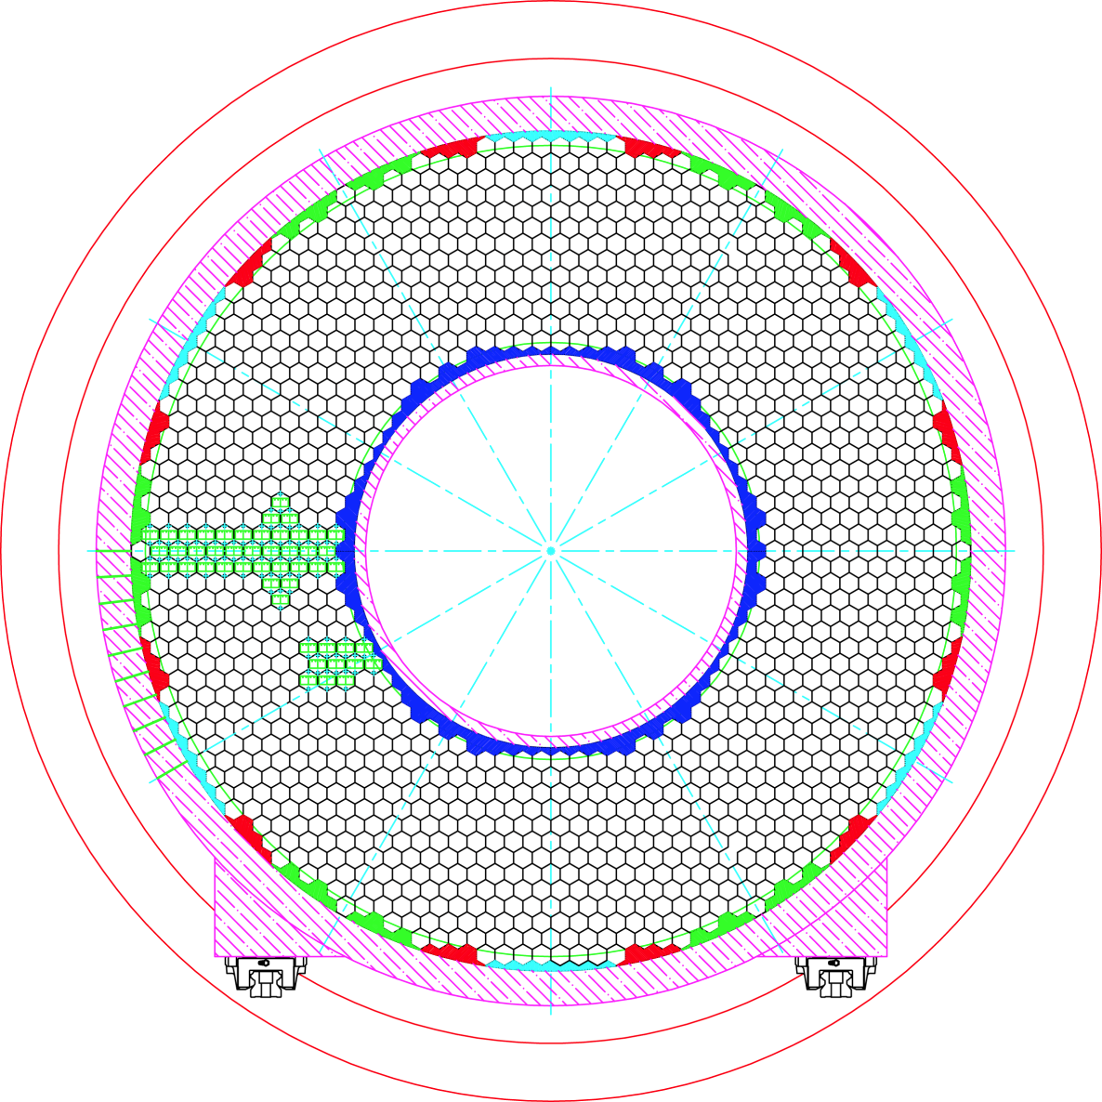
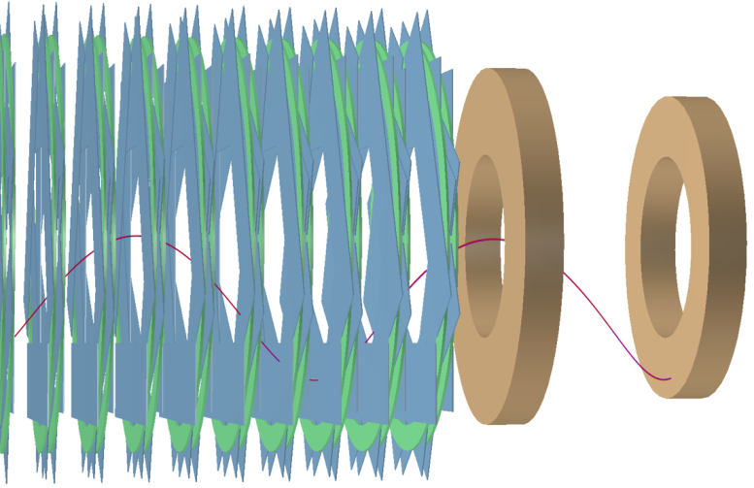
Calorimeter
Provides independent energy, time and position measurements
Helps to eliminate backgrounds and provides a cross check to verify the validity of signal events.
Disk structure is selected from two designs: Vane / Disk
Two disks composed of hexagonal LYSO crystals
Charge symmetric, can measure μ⁻ N → e⁺ N’

Slide 24
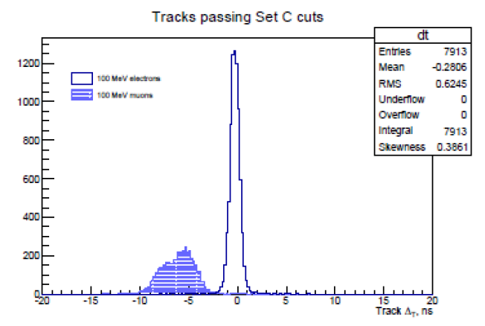
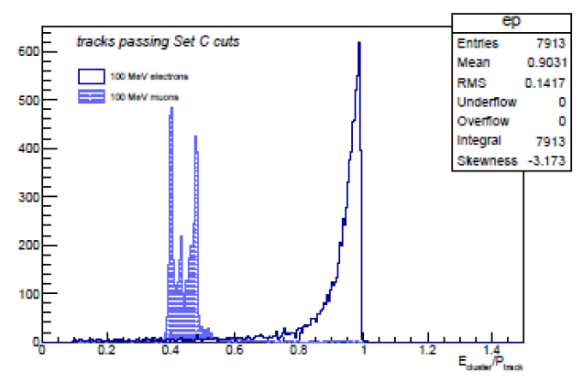
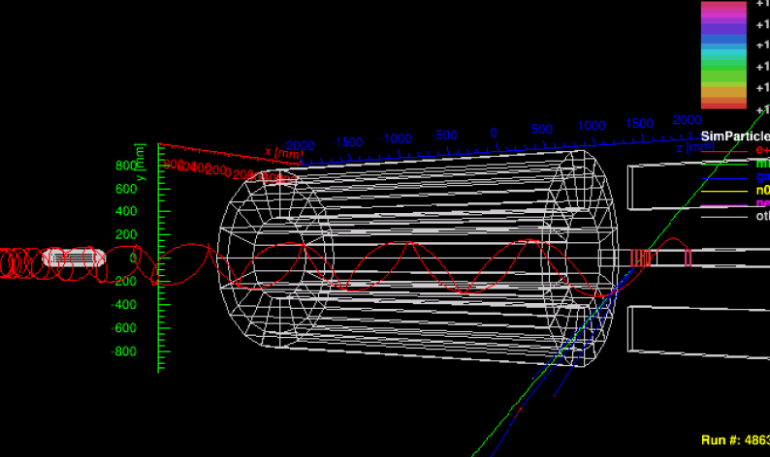
Calorimeter
Particle Identification
  Geometrical acceptance for events passing tracker cuts >95%
  Combine distribution in ΔT and E/P to build a particle ID likelihood
  Calorimeter + Tracker PID
    Electron efficiency >99%
    Muon rejection in the range 10² – 10³
To reject cosmic background
Provides alternative seed for track finding algorithm
Provide independent trigger, reducing requirements on DAQ
e
μ
Track Δt [ns]
μ
e
E _{cluster} / P _{track}
A cosmic event

Slide 25
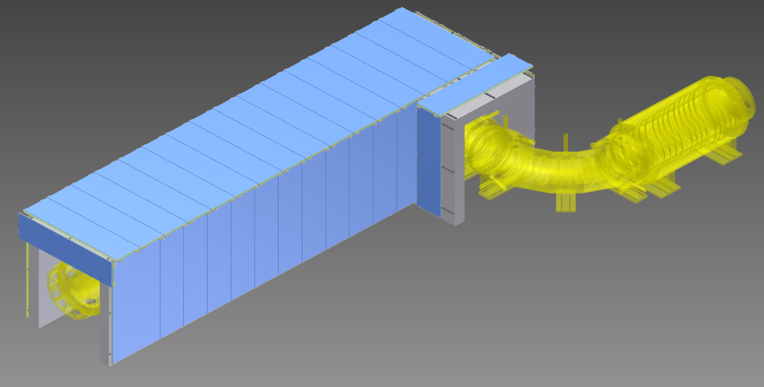
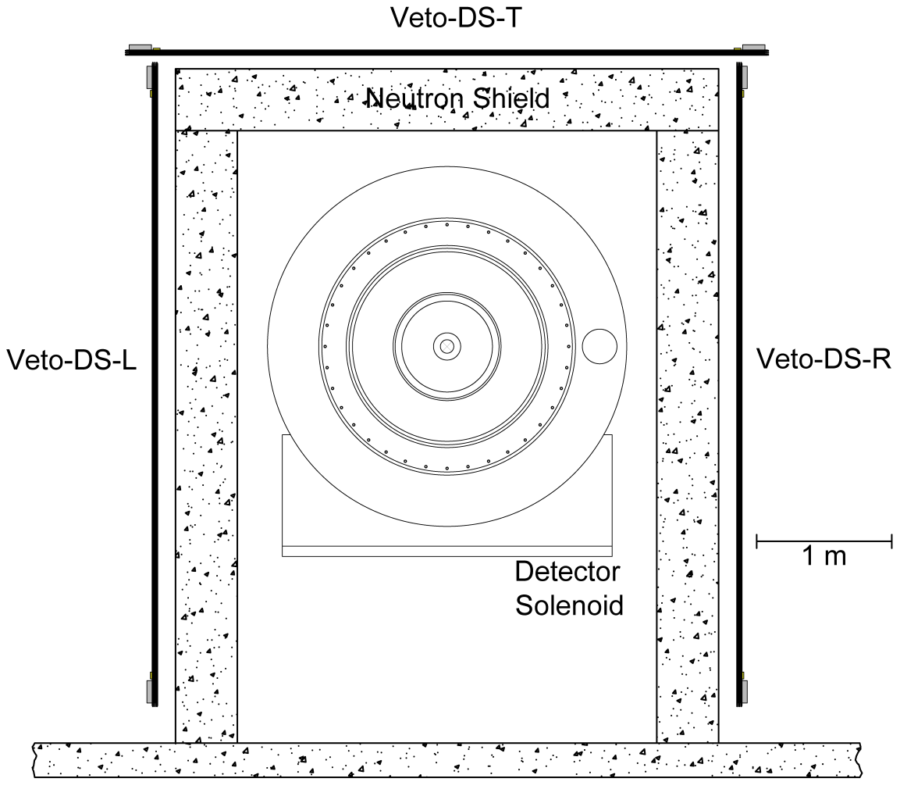
Cosmic Ray Veto
TS-R
DS-R
TS-T
DS-T
TS-L
DS-L
DS-D
Cosmic rays is a major sources of background
  Muons hitting stopping target or DS materials, generating delta rays
  Muons decay into electrons
CRV are composed of 3 layers overlapping scintillators, placed around DS and part of TS area
Requires 0.9999 efficiency to achieve proposed background rejection

Slide 26
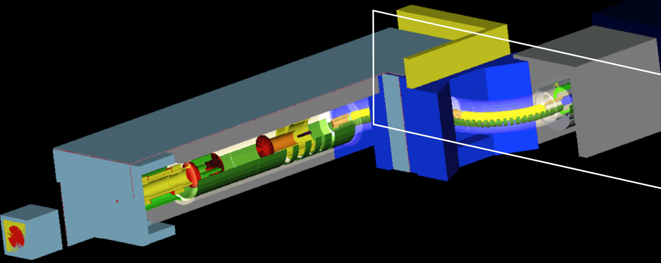

Neutron and Photon Background
Barite Concrete
Neutrons can be produced in production target, HRS, collimators…
Neutrons have radiation damages to SIPMs and make fake hits on detectors
Neutrons get thermalized, captured and produce gammas
Shielding with Barite loaded concrete, polyethylene in TS and DS area
Geometry under optimization

Slide 27
Calibration
Calibration tools provide cross check and corrections for detector description (magnetic field, material, geometry, alignment, …)
Tracker Calibration
Requires absolute momentum (Δ<100KeV/c) to separate DIO background from conversion electrons
Calibrate with π⁺→e⁺ν_{e} events at ~70 MeV/c
Calibrate by fitting the Michel edge with μ⁺→e⁺ν_{e}ν_{μ} events at ~53 MeV/c
Both requires special beam, detector and magnetic field configuration
Calibrate by fitting DIO spectrum and cosmic electron resolution study
Calorimeter Calibration
Requires energy precision δ_{E}<2% at 100 MeV
Source calibration system with 6.13 MeV photons
Calibration with cosmic ray muons
DIO events give a very precise calibration and can be compared with tracker, if enough data has been taken.
_

Slide 28
Timing in Mu2e measurement
Selection Window
at the detector
A proton beam bunch hits on production target
Generate pulsed beam of low momentum μ⁻
μ⁻ captured on stopping target to form muonic atoms
Wait for prompt backgrounds to decay
Select tracks in search window, when π⁻ disappear

Slide 29
Proton beam extinction
In pulse
between pulses
In pulse
Selection Window
at the detector
Beam extinction = (# protons between pulses ) / (# protons in pulses)
Protons produced between two pulses generate additional background
Important for beam related background rejection

Slide 30
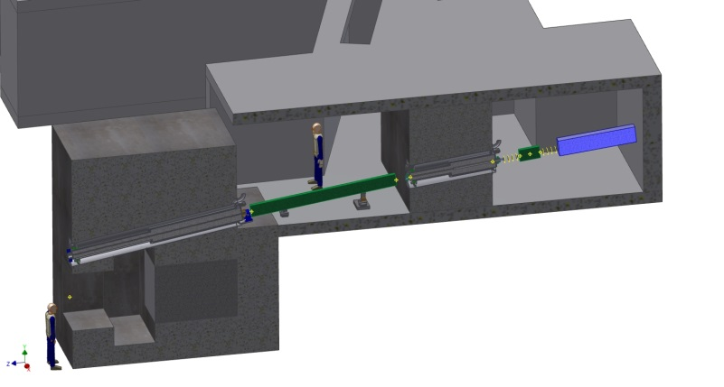
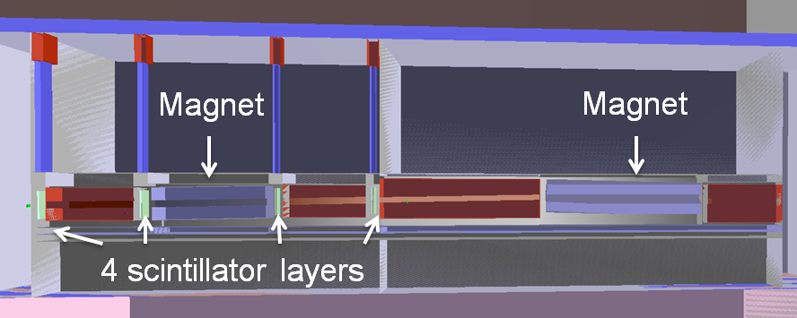
Extinction Monitor Design
Scintillator based
Silicon pixel detector based
4 layers scintillator counters
Detect particles ~ 1GeV/c
Measure time of flight for different particles
Track reconstruction from time of flight between layers
8 planes pixel detectors
Detect particles 3~4 GeV/c
Measure track hits position and reconstruct
Selected for Mu2e
More details in next talk

Slide 31
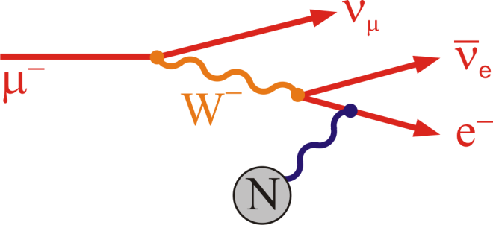
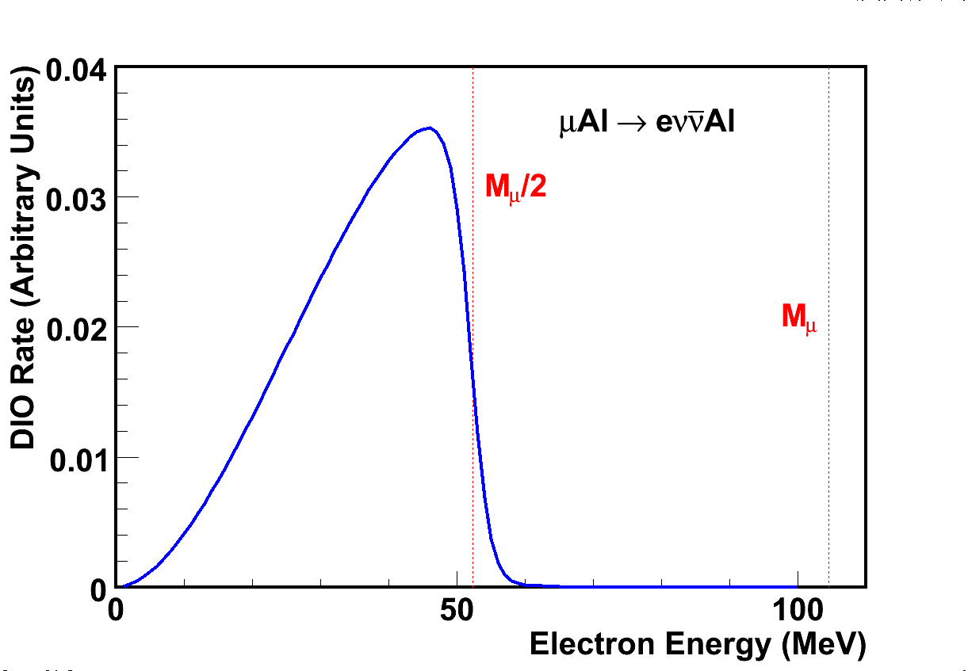
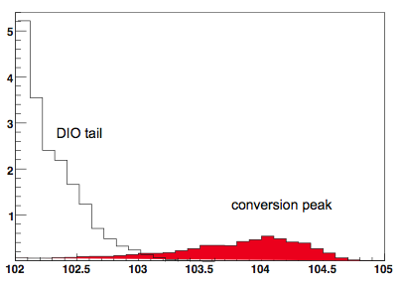
Dominant Background
Muon Decay-in-orbit (DIO)
  Electron energy E_{μe} = m_{μ} - E_{b} - E_{rec}
    Binding energy E_{b} ~ Z²α²m_{μ}/2
    Nuclear Recoil energy E_{rec} ~ m²_{μ}/(2m_{N})
  DIO Rate ∼ (E_{MAX} - E_{e})⁵, E_{MAX} ~105 MeV
  Requires good energy resolution
M_{μ}/2
“Perfect” Signal
M_{μ}
DIO tail
Signal with energy loss and resolution.

Slide 32
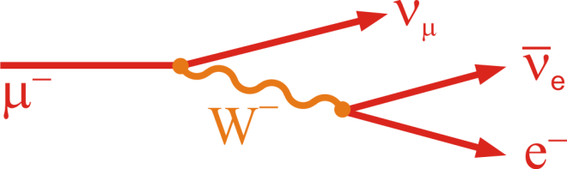

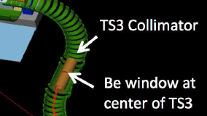
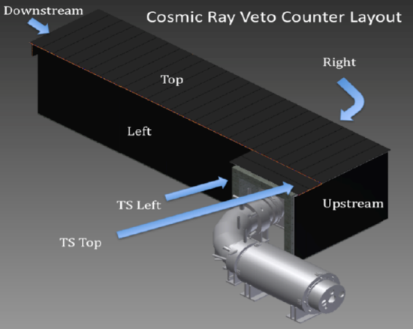
Other Backgrounds
Beam Related Background
  μ/π free decay in flight
  Radiative π- capture
  Beam electrons
  Beam extinction monitor to suppress protons between pulses < 10⁻¹⁰
Extinction
Monitor
Anti-protons annihilation
  Thin Be-window placed at TS center to stop anti-protons
Background from cosmic rays
  Electrons generated by cosmic μ interaction
  Time window and shielding from overburden & side
  Cosmic ray veto with inefficiency < 10⁻⁴
CRV

Slide 33

Reconstructed Signal and Background
Assuming R_{μe}=1 x 10⁻¹⁶
expect 4 events in signal window
Reconstructed e⁻ Momentum
Full Geant4 simulation, background overlay and reconstruction

Slide 34
Background & Sensitivity
Category | Source | Events | Error
Muon-Induced | μ decay in orbit | 0.20 | ±0.06
 | radiative π capture | 0.04 | ±0.02
Prompt | Beam electrons | 0.001 | ±0.001
 | μ decay in flight | 0.01 | ±0.005
Miscellaneous | Anti-proton induced | 0.10 | ±0.05
 | Cosmic ray induced | 0.05 | ±0.013
Total |  | 0.4 | 0.1
Preliminary Values
Backgrounds for 3 years run
Single event sensitivity R_{μe} = 2.5 x 10⁻¹⁷
90% C.L. (if no signal) R_{μe} < 6 x 10⁻¹⁷

Slide 35
Mu2e Schedule
Start construction in 2015
Start running in 2020

Slide 36

Project X
A proposed new high intensity proton linac at Fermilab
3 phases, compelling physics opportunities at each stage:
  Neutrinos, Kaons, Muons, nucleons, and atomic probes
Programmable pulse structure for many experiments

Slide 37


Mu2e at Project X
If signal:
Change target to study Z dependence of nucleus
Pb
K. Konepfel et. al. arXiv:1307.1168
Al
Ti
V^{Z}
Project X beams will provide 10x muons (10¹¹μ/s)
  Higher intensity, narrower pulse…
If no signal:
  Increase sensitivity by another 100x to R_{μe} < 10⁻¹⁸
  Reuse most of Mu2e apparatus to achieve the first factor of 10
V²
Rμe(Z) / Rμe(Al)
V^{γ}
D
S
Z
V. Cirigliano et al., PRD 80 (2009) 013002

Slide 38
Summary
CLFV is a good window to probe new physics beyond Standard Model with energy scale up to thousands of TeV
Mu2e will search for CLFV in the process of μN→eN
  The goal is to achieve SES R_{μe} = 2.5 x 10⁻¹⁷
  4 orders of magnitude improvement to current limit
The Mu2e project is well on-going
  Conceptual design completed (DOE CD-1 in 7/2012)
  Technical design to be completed in 2014
  Start construction in 2015
  Expect to start running in 2020
  Project X could further improve the study in CLFV.

Slide 39
For Further Information
Home page: http://mu2e.fnal.gov
CDR: http://arxiv.org/abs/1211.7019
Document Database:
  http://mu2e-docdb.fnal.gov/cgi-bin/DocumentDatabase
  Conference presentations
Project X:
  Accelerator Reference Design: physics.acc-ph:1306.5022
  Physics Opportunities: hep-ex:1306.5009
  Broader Impacts: physics.acc-ph:1306.5024

Slide 40
Thank you !

