Slide 1
A medium baseline superbeam facility in China
Jingyu Tang for the group
Institute of High Energy Physics, CAS
NuFact2013, August 19-24, 2013, Beijing, China

Slide 2
Outline
Introduction
  World-wide need for neutrino facilities for CP measurements
  China’s proposal – a medium baseline facility
Proton driver: CW superconducting proton linac
Target and pion/muon collection
Muon transport and decay channel
Neutrino flux and possible detector
Summary

Slide 3
Introduction
- World-wide need for neutrino facilities for CP measurements
Neutrino physics experiments at Daya Bay
  Measurements in θ13
  Jiangmen (JUNO, or DYB-II) and other experiments
  Measurements in Mass Hierarchy and other mixed parameters
A good superbeam machine to measure CP phase, before NF becomes possible

Slide 4
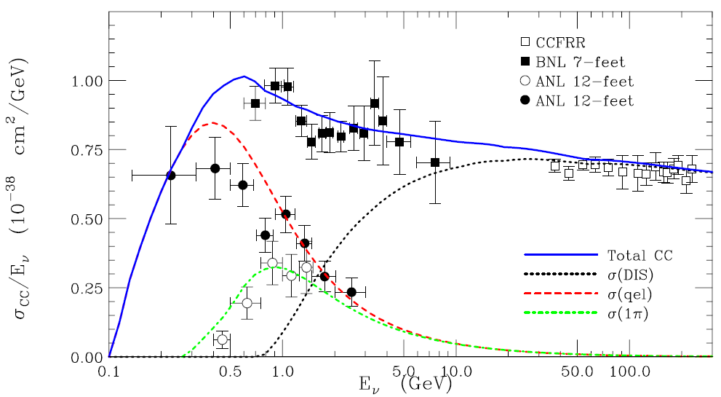
What is the best neutrino energy for CP ?
At IPAC13, Yifang Wang proposed: ~ 300 MeV ➔ baseline = 150 km
Although we loose some statistics due to the lower cross section, but we gain by being background free from π⁰

Slide 5
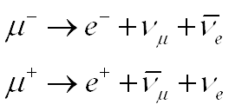
Introduction
- China’s proposal: A medium baseline superbeam facility
Using a CW proton linac as the proton driver
  Simplified design from the China-ADS linac
  1.5 GeV, 10 mA ➔ 15 MW in beam power
  Mercury jet target in high-field SC solenoid
  Collection of pions and muons
Muon transport and decay channel
  Pure μ+ or μ- decay
High neutrino flux at a detector of >50 km

Slide 6
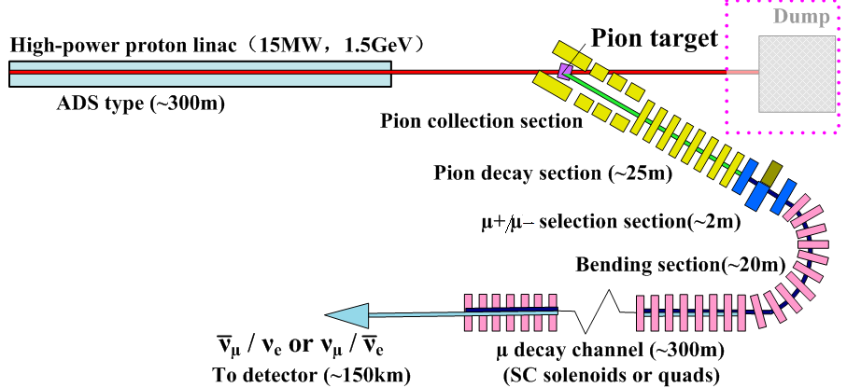
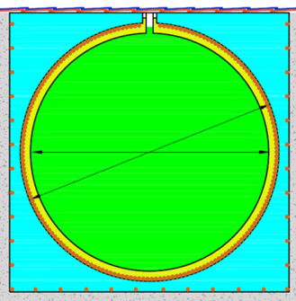
China Superbeam Facility
JUNO detector
A possible detector: JUNO detector
(distance between CSNS and JUNO: ~150 km)

Slide 7
Proton Driver
China-ADS project has been launched in beginning 2011, with a long-term goal to drive a subcritical reactor with 12-15 MW proton beam
One of the main goals in the China-ADS R&D phase is to solve the technical problems with the SC proton linac working in CW mode
If R&D successful in CW linac, e.g. 250 MeV in 2020, the accumulated experience will allow us to build a proton driver based on the similar CW linac in GeV but with much lower requirement on reliability

Slide 8


China-ADS Roadmap
Phase IV (2023-2032)
Phase III (201X-2022)
Phase I (2011-2015)
Phase II (2016-201X)
Injector 1
Injector 2
10 MeV
5~10 MW_{t}
100 MW_{t}
≥1 GW_{t}
2013
~5 MeV
2015
25~50 MeV
201X
~250 MeV
~2022
0.6~1 GeV
~2032
1.2~1.5 GeV
key tech. R&D
Acc. & target & reactor prototype
Research Facility
Exp. Facility
Demo Facility
Notes:
8

Slide 9
Design scheme for the proton driver
Design goal:
  Beam energy: 1.5 GeV
  Beam current: 10 mA
Simplified design scheme from the China-ADS design
  Much less redundancy wrt China-ADS
  3.2-MeV RFQ (room-temperature)
  Three sections SC spoke cavities (160 MeV)
  Two sections SC elliptical cavities (1.5 GeV)
  In total, 195 SC cavities in 52 cryostats, linac length: ~ 300 m
Details:
Z.H. Li’s talk

Slide 10
Lattice of the linac

Slide 11
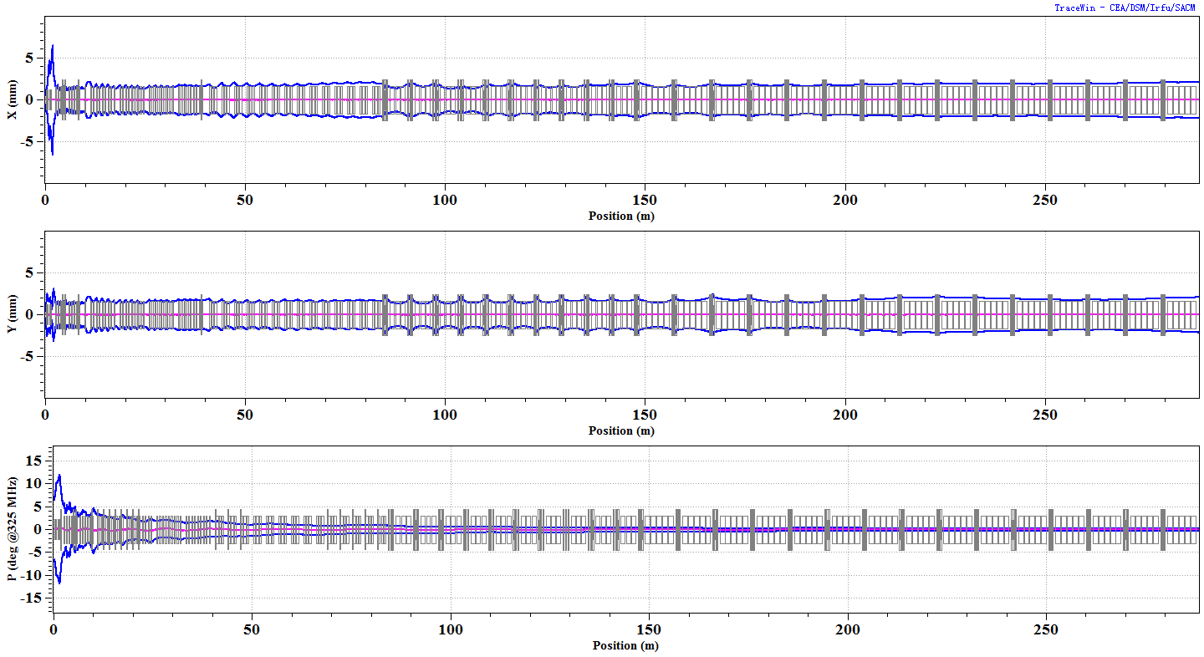
Envelope along the linac

Slide 12
Higher proton energy?
Study shows that neutrino yield per proton is slightly more than proportional to beam energy
If beam power keeps unchanged, neutrino flux will increase slightly with increasing proton energy
  More benefit in the pion beam core
  Pion energy spectrum shifts towards higher
Anyway, alternative proton driver schemes with higher energy have also been studied.

Slide 13
Alternative schemes
Design goal
  Beam energy/current: 2.0 GeV /7.5 mA, 2.5 GeV / 6 mA
  Lower current is relatively easier for the beam dynamics
Two options
  Using more Ellip082 cavities to cover up to 2.0, 2.5 GeV
  Using a new type Ellip093 cavities to cover 1.0-2.5 GeV only with 2.5 GeV (beta=0.96)

Slide 14
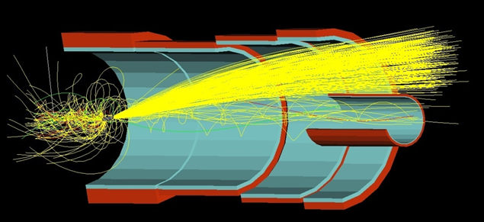
About HEBT
Beam transport line from the linac to the target is relatively adaptable, according to the general layout
Proton beam impinges into the target horizontally, with a small angle with respect to the target length
Strong focusing before the target to form a small spot
Horizontal bending to avoid back-streaming neutrons to harm the linac and most part of the beam line
It is very difficult but very interesting to guide the used proton beam (much worse beam quality) to an external beam dump instead of dumping it inside the target region

Slide 15
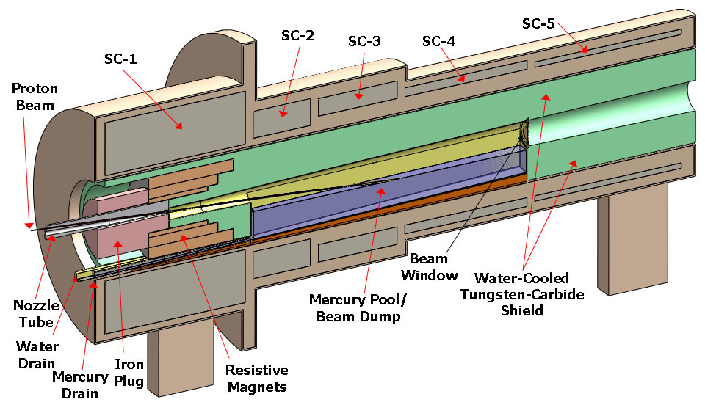
Target and pion/muon collection
- Target
Mercury jet target (similar to NF design, MERIT)
  Higher beam power: heat load, radioactivity
  On the other hand, easier to some extent due to CW proton beam

Slide 16
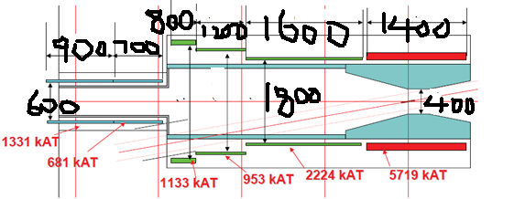
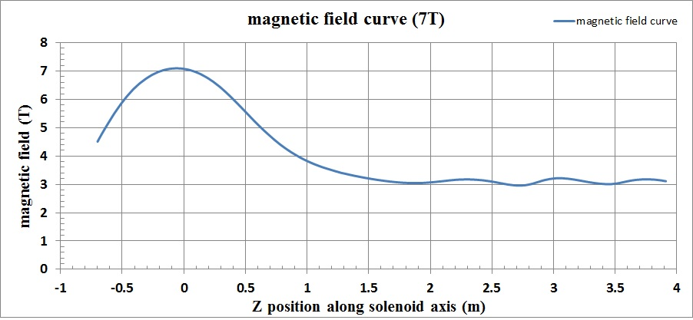
Magnetic field of main SC solenoid: 7 T
Target: radius - 4 mm, effective length – 30 cm
Pion production ratio: 0.077 π/p @1.5 GeV
Similar field configuration as at COMET

Slide 17
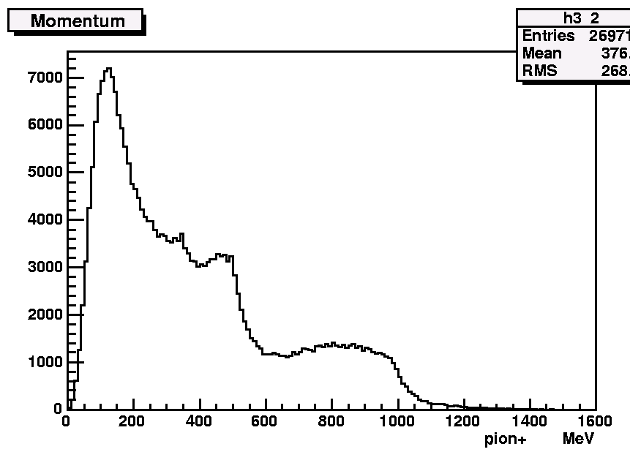
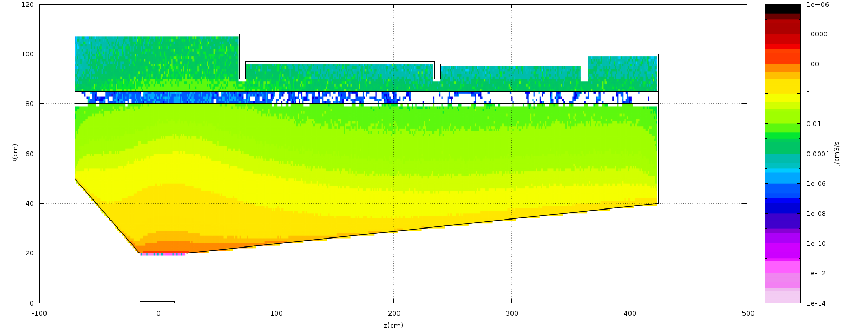
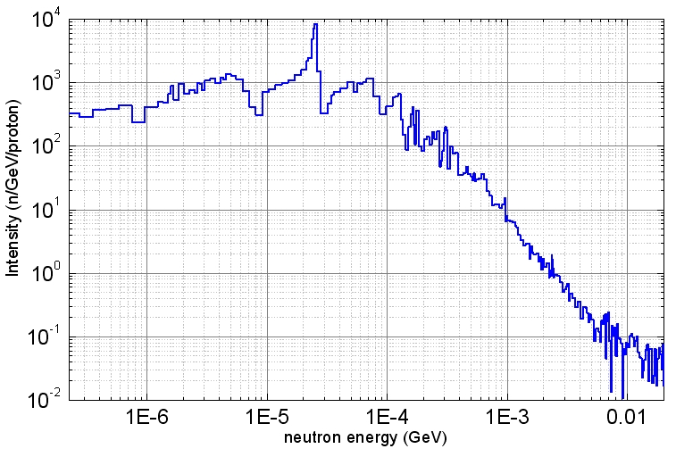
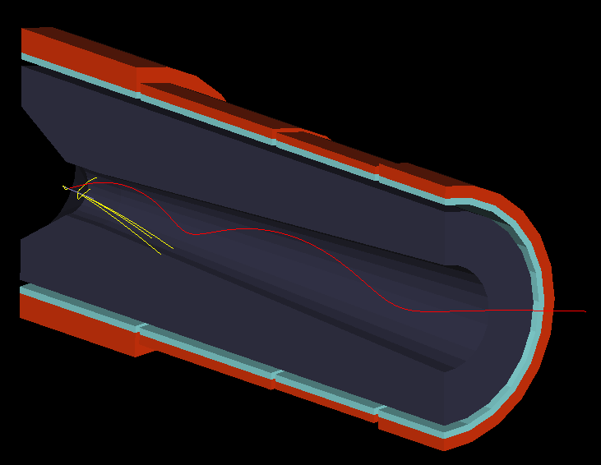
Large heat deposit and irradiation in SC solenoids
Pion energy spectrum at exit (4 m from target center)
0.8kW
0.15kW
0.06kW
0.05kW
In coils: 3.1 X 10¹⁵ n/m²/s

Slide 18
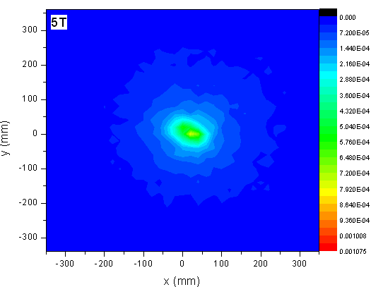
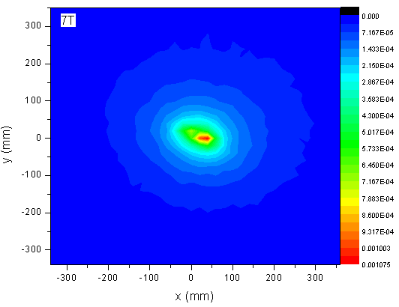
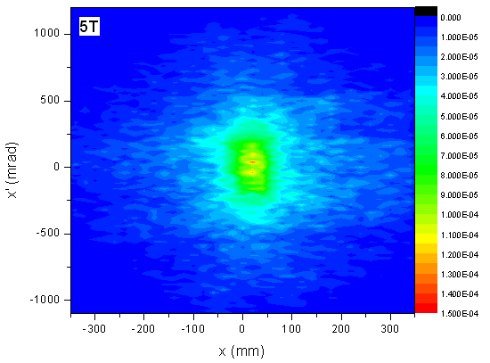
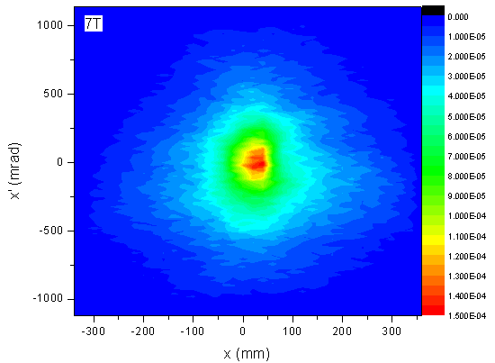
Higher main solenoid field helps
Distribution in pion spot
(Left: 5T; Right 7 T)
Distribution in (X-X’). (Left: 5T; Right 7 T)
Higher field increases the core density significantly

Slide 19
Target and pion/muon collection
A straight section in SC solenoids of about 25 m to match the SC solenoids at the target, and for the pions to decay into muons
  Very large emittance and momentum spread
  Pions with lower energy decay faster
Similar beam rigidity assures that pions and muons can be transported in the same focusing channel
  Momentum and emittance of pions most preserved in muons

Slide 20
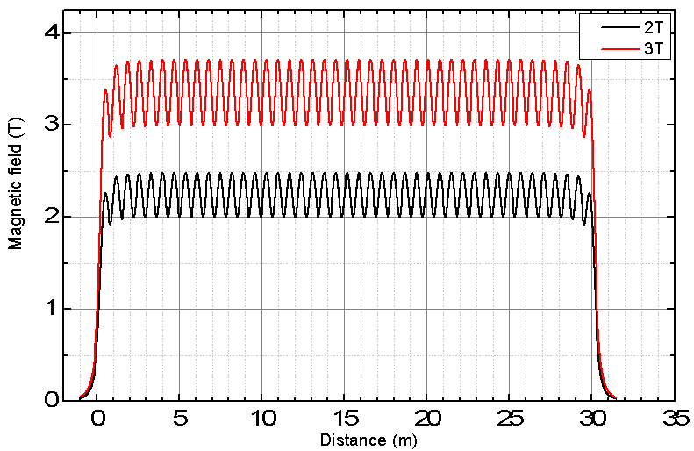
Modest acceptance for channels
  40-60 πmm-rad
  Higher field for π decay and μ transport channel, lower field for μ decay channel
Aperture /mm | Acceptance (πmm-rad) X: in mm; X’: in mrad
 | B – 1 T | B – 2 T | B – 3 T
400 | 14.8 (x: 190, x’: 78) | 27.7 (x: 175, x’: 158) | 40.0 (x: 170, x’: 235)
500 | 22.8 (x: 235, x’: 97) | 43.9 (x: 225, x’: 195) | 62.4 (x: 215, x’: 290)
600 | 33.0 (x: 280, x’: 118) | 63.5 (x: 270, x’: 235) | 91.0 (x: 260, x’: 350)

Slide 21
Collection and transport efficiency
  About 0.0052 μ+/proton for 50 πmm-rad at entrance of muon decay channel
  Emittance limitation is acceptable
7 T
 | muon/proton | Portion（%）
No limit on emittance | 9.48E-03 | 100
Emittance: 100 πmm-rad | 8.04E-03 | 85
Emittance: 80 πmm-rad | 7.31E-03 | 77
Emittance: 50 πmm-rad | 5.22E-03 | 55
Emittance limit in both (X-X’) and (Y-Y’)

Slide 22
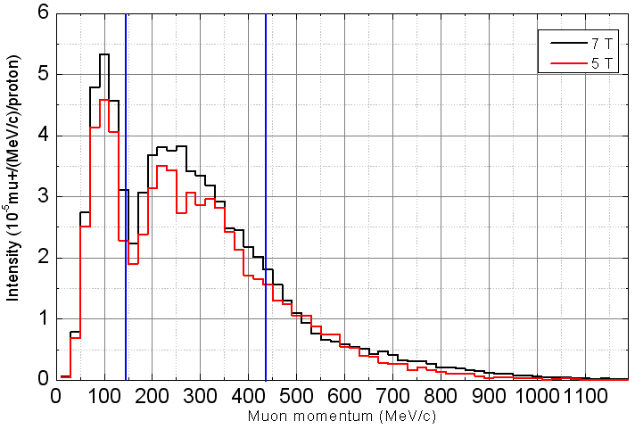
Try to transport large momentum range π/μ
Expected: ±50% centered at 291MeV/c
Muon momentum spectrum at the entrance of the bending section (Red: 5 T for main solenoid; Black: 7 T)

Slide 23
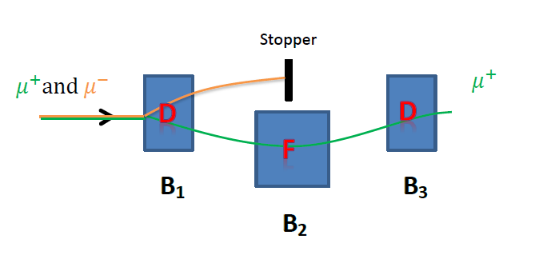
A selection section of about 2 m (length) to select π+/μ+ from π-/μ-, as either μ+ beam or μ- beam is used for producing the required neutrinos
  For very large emittance, a group of three SC dipoles with strong gradient (similar as an DFD FFAG focusing) is used for bending (e.g., 40 ° /-80 ° /40 °) and focusing
  Reverse the fields when changing from μ+ to μ-

Slide 24
Muon transport and decay
- Muon bending section
A bending section is required before the muon decay channel, to suppress the background of pion-decayed neutrinos at the detector
  Bending angle is adaptable according to the general layout
  More energetic pions continue to decay in the section
Many short SC solenoids aligned with increased angle displacement to bend and focus the beam simultaneously
  Short solenoids helps reduce beam centroid excursion (aperture, beam loss)
  Alternate reverse SC field also helps reduce the excursion, and emittance coupling
  A small vertical field component is also helpful to reduce the excursion and for momentum selection

Slide 25
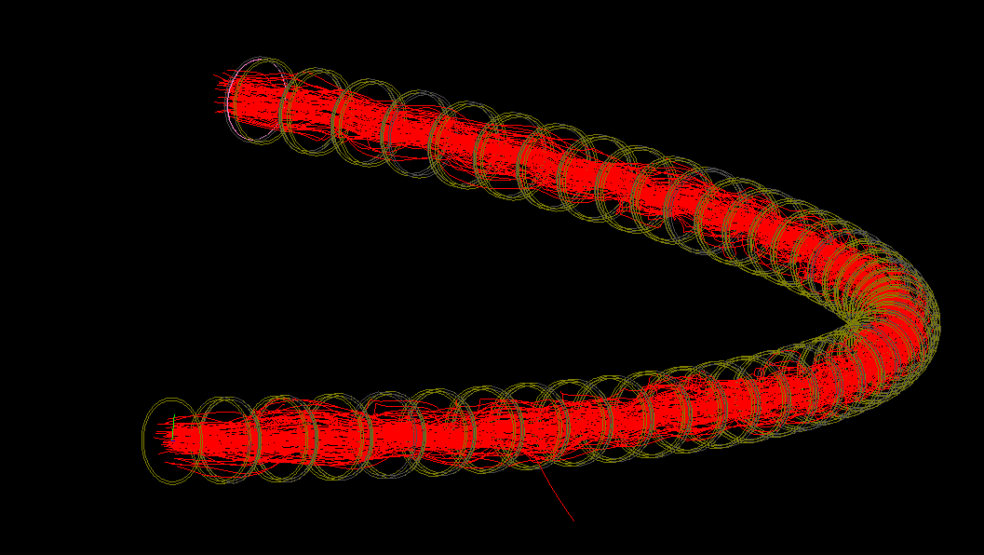
Beam tracking simulated by G4beamline
Bending section by slanted solenoids (39*2°=78°) has very good momentum acceptance, e.g. Δp/p=±50%
Θ=2°
Θ=5°
Beam centroid along solenoid units for different slanted angle for each solenoid

Slide 26
Muon transport and decay
- Muon decay channel
A long decay channel of about 300 m is designed for production of neutrinos
  About 16% for 291 MeV/c
Important to have smaller divergent angle
  Neutrino energy spectrum at detector related to the angle
  Modest beam emittance and large aperture
Minimize remained pions (those quite energetic) in the section:
  Modest acceptance of the bending section and with B_{y}
  Longer pion decay section before the bending

Slide 27
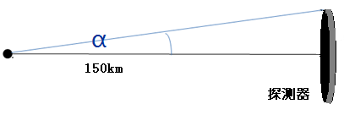
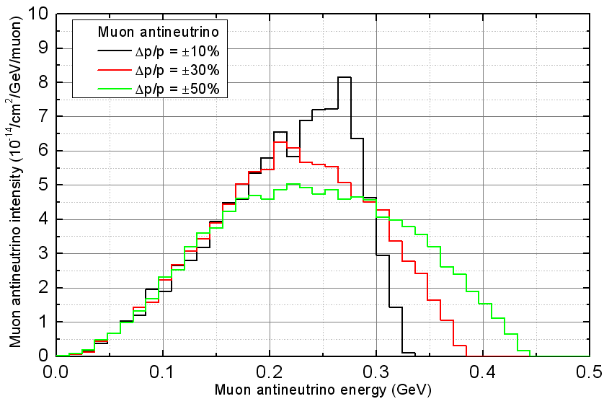
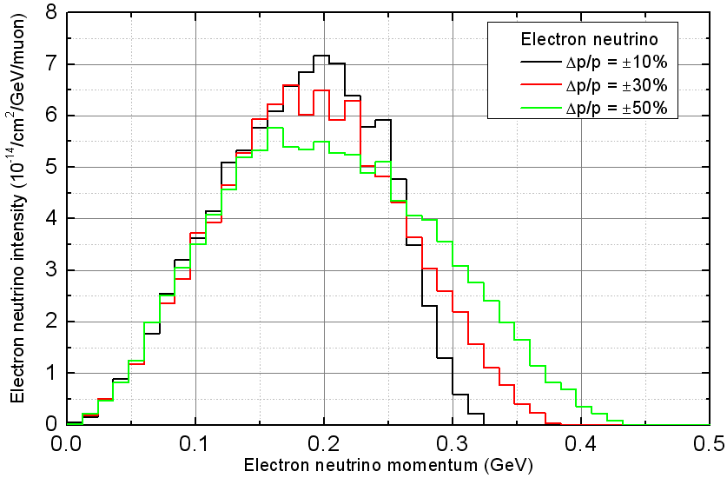
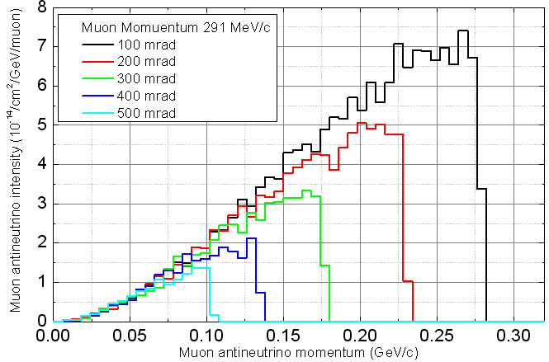
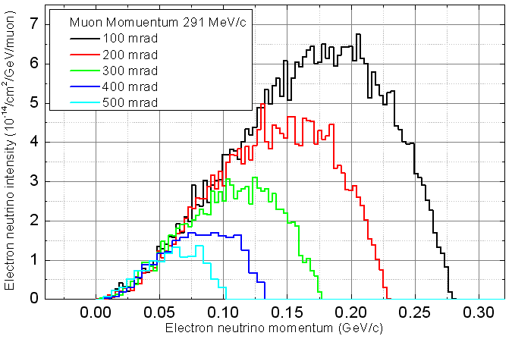
Neutrino energy spectra dependent on muon momentum and divergent angle

Slide 28
Modest acceptance for channels
  40-60 πmm-rad
  Higher field for π decay and μ transport channel, lower field for μ decay channel
Aperture /mm | Acceptance (πmm-rad) X: in mm; X’: in mrad
 | B – 1 T | B – 2 T | B – 3 T
400 | 14.8 (x: 190, x’: 78) | 27.7 (x: 175, x’: 158) | 40.0 (x: 170, x’: 235)
500 | 22.8 (x: 235, x’: 97) | 43.9 (x: 225, x’: 195) | 62.4 (x: 215, x’: 290)
600 | 33.0 (x: 280, x’: 118) | 63.5 (x: 270, x’: 235) | 91.0 (x: 260, x’: 350)

Slide 29
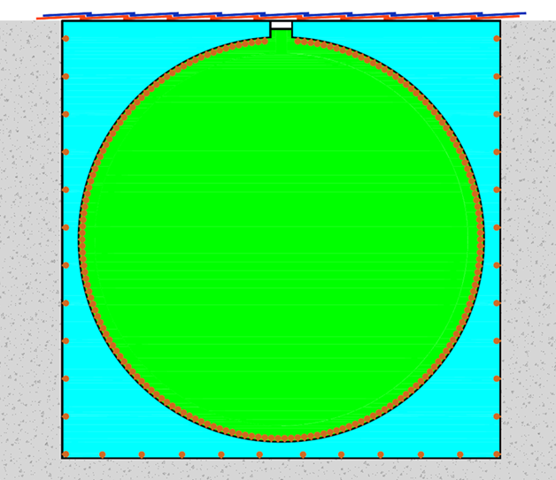
Neutrino flux and possible detector
A possible detector is JUNO detector
  150 km from the target/source
  35 m in diameter
  20 kt Liquid Scintillator or 23 kt Gd-doped water
Other detector solution is also under consideration
Water buffer
20-kt LS
or
23-kt Gd-doped water

Slide 30
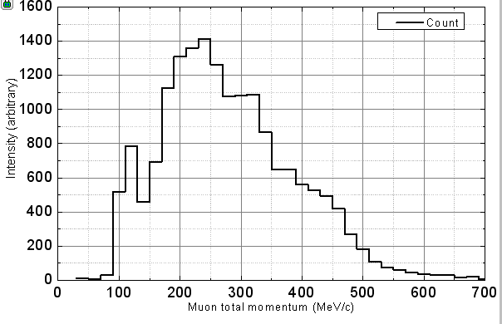
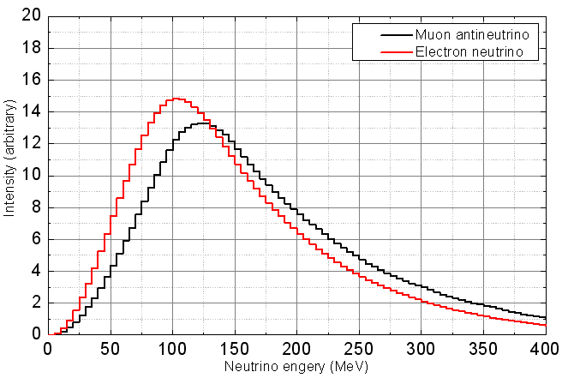
Decayed muons and neutrinos
Momentum spectrum of decayed muons
Momentum spectra of neutrinos at JUNO detector

Slide 31
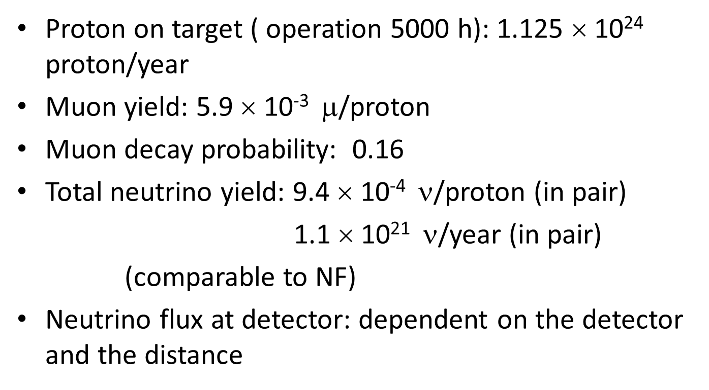
Estimate of neutrino flux
Proton on target ( operation 5000 h): 1.125 × 10²⁴ proton/year
Muon yield: 5.9 × 10⁻³ $$/proton
Muon decay probability: 0.16
Total neutrino yield: 9.4 × 10⁻⁴ ν/proton (in pair)
1.1 × 10²¹ ν/year (in pair)
(comparable to NF)
Neutrino flux at detector: dependent on the detector and the distance

Slide 32
Summary
Preliminary study of the superbeam facility looks competitive
  Muon-decayed neutrinos (CW protons➔ DC neutrinos)
  High neutrino flux with neutrino energy: 100-300 MeV
Following studies will focus on
  Detector and baseline distance
  Try higher field for the main solenoid
  Transport/decay channel: shift up neutrino energy spectrum
Technical difficulties
  Proton driver: to be solved by China-ADS
  Target: collaboration and R&D
  Pion/muon transport: looks technically feasible
  Detector: to be identified

Slide 33
Thank you for attention!

