Slide 1
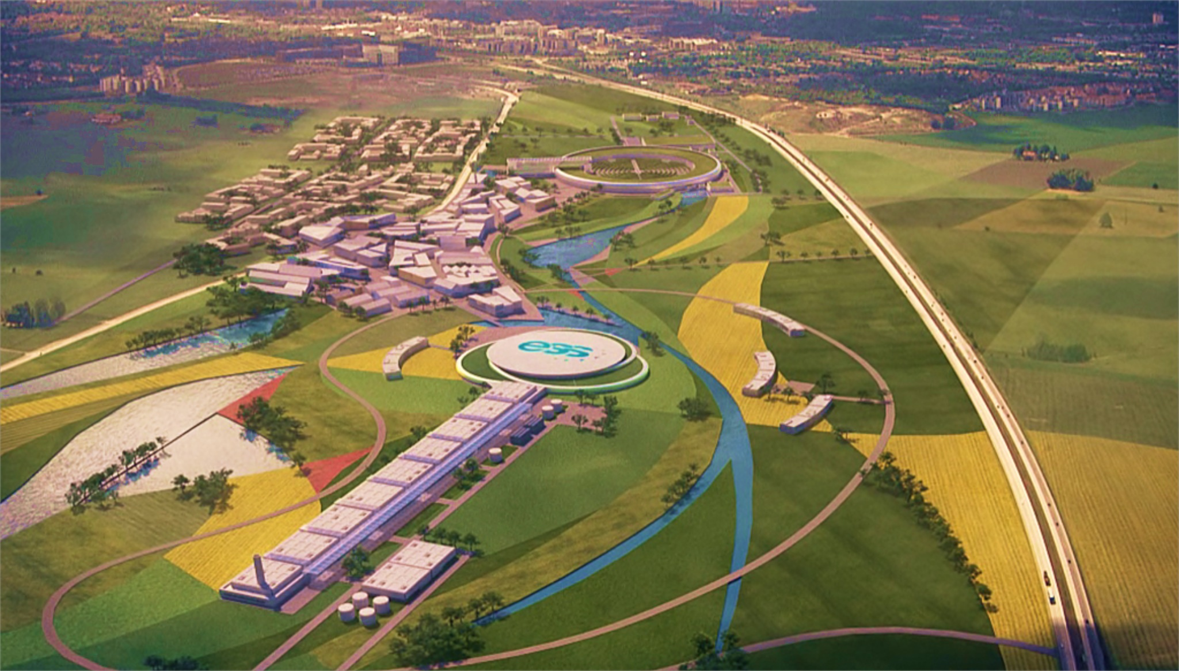
Modifications on ESS for neutrino Super Beam
Marcos DRACOS
IPHC-IN2P3/CNRS Strasbourg
(E. Wildner, T. Ekelof)

Slide 2

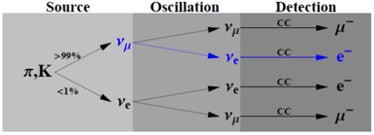
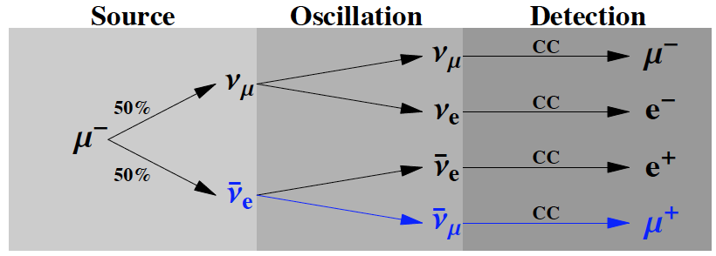
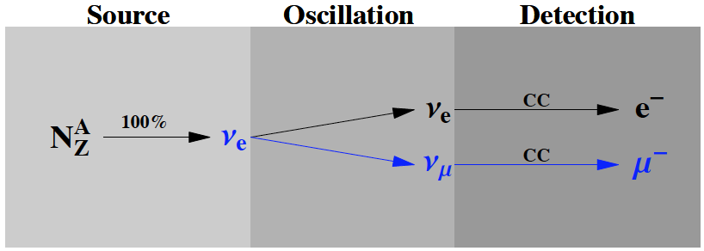
EUROnu Projects
(beam facilities)
5 GeV?, 4 MW
SPL Super-Beam
proton driver
Accumulator
ring + bunch
compressor
p
Neutrino Factory
SPL 3.5-5 GeV, 4 MW
Magnetic
capture
proton driver
Accumulator
ring
Target
Ionization
cooling
Drift
Magnetic
horn capture
(collector)
p
Phase rotation
Target
Linac → 2 GeV
ν, μ
hadrons
decay tunnel
Recirculating
Linacs 2 → 50 GeV
~300 MeV ν_{μ} beam to far detector
Decay ring – 50 GeV
≈2000 m circumference
Existing at CERN
ν beam to far detector
EURISOL
DECAY
RING
Proton
driver
ν beam to near detector
Isol target
& ion source
SPS
B = 5T
Beta-Beam
L=6880 m
New RFQ
Linac
PSB
PS
⁶He for ν_{e} and ¹⁸Ne for ν_{e}

Slide 3
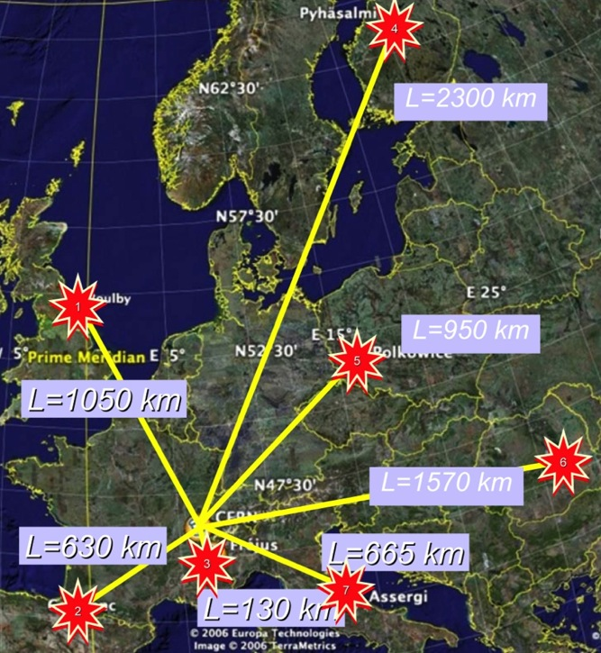
European Long Baseline
Super Beam Projects
Studied by LAGUNA

Slide 4
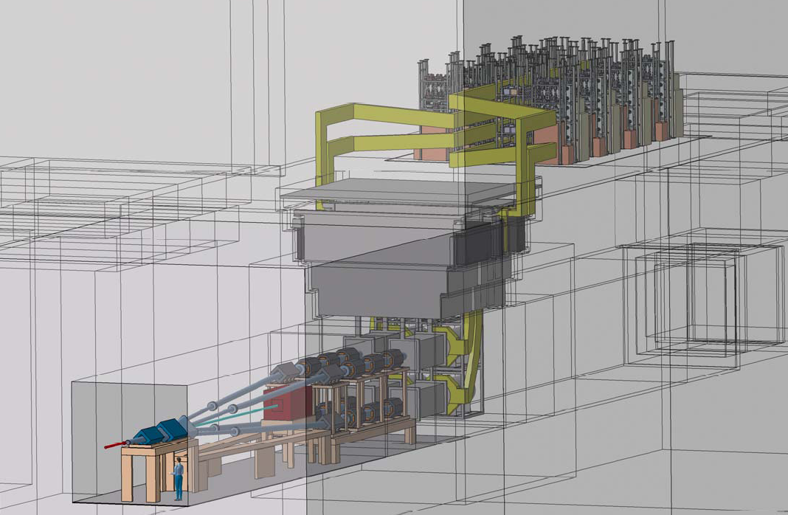
Target Station (EUROν)
horn power supply
strip lines
decay tunnel
beam switchyard
targets/horns

Slide 5
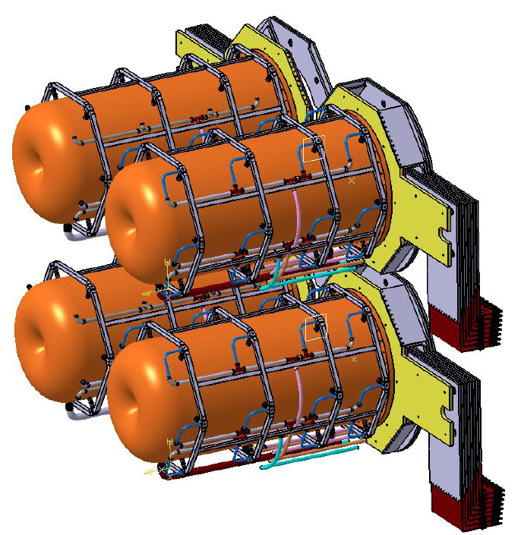
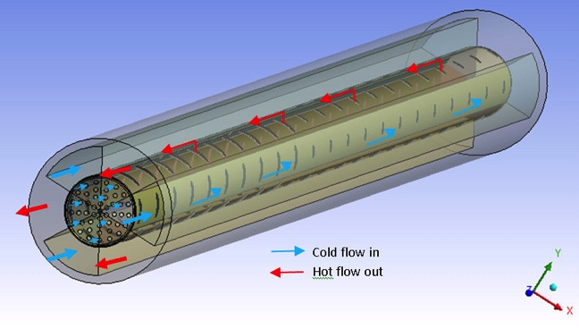
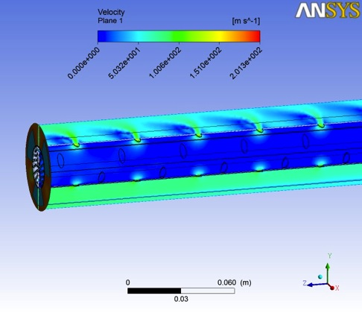
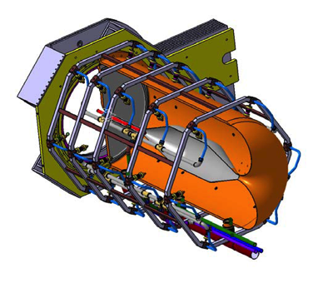
4-Target/Horn system (EUROnu)
Packed bed canister in symmetrical transverse flow configuration (titanium alloy spheres)
Helium Velocity
Maximum flow velocity = 202m/s
Maximum Mach Number < 0.2
Helium Gas Temperature
Total helium mass flow = 93 gr/s
Maximum Helium temperature = 584°C
Helium average outlet Temperature = 109°C
First tests with beam in the new HiRadMat@SPS facility at CERN in 2014
Helium Flow

Slide 6
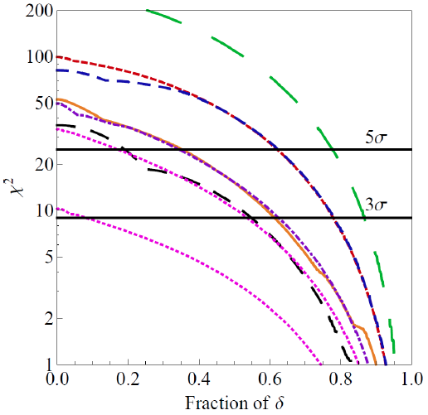
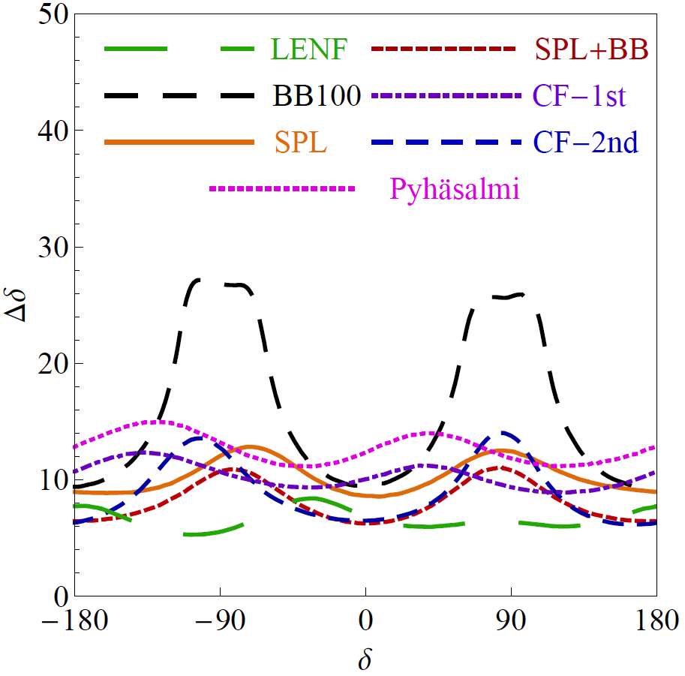
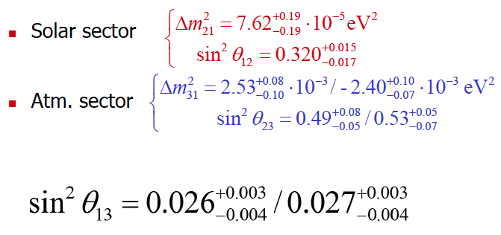
Physics Performance (CPV)
(Enrique Fernantez et al.)
100 kt Lar (0.75 MW)
100 kt LAr
20 kt LAr
SPL: CERN to Fréjus (130 km)
CF-1st: CERN to Canfranc (650 km) 1st max.
CF-2nd: CERN to Canfranc 2nd max.
1 Mton WC detector (440 kton fiducial), 5%/10% syst.

Slide 7
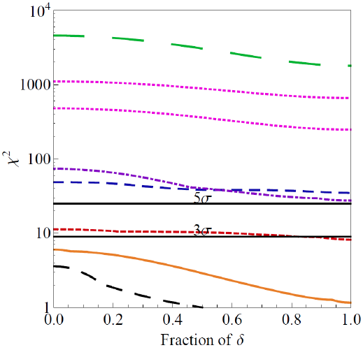
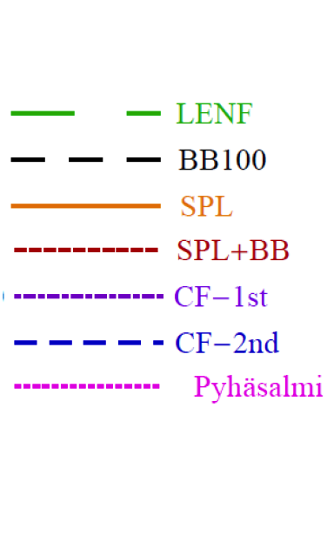
Physics Performance (MH)
without adding atmospherics
SPL: CERN to Fréjus (130 km)
CF-1st: CERN to Canfranc (650 km) 1st maximum
CF-2nd: CERN to Canfranc 2nd maximum
1 Mton WC detector (440 kton fiducial), 5%/10% syst.

Slide 8
SPL not any more part of LHC upgrades
Any other intense proton source in Europe?
(in the context of European Strategy for Particle Physics)
f) Rapid progress in neutrino oscillation physics, with significant European involvement, has
established a strong scientific case for a long-baseline neutrino programme exploring CP violation and the mass hierarchy in the neutrino sector. CERN should develop a neutrino programme to pave the way for a substantial European role in future long-baseline experiments. Europe should explore the possibility of major participation in leading neutrino projects in the US and Japan.

Slide 9

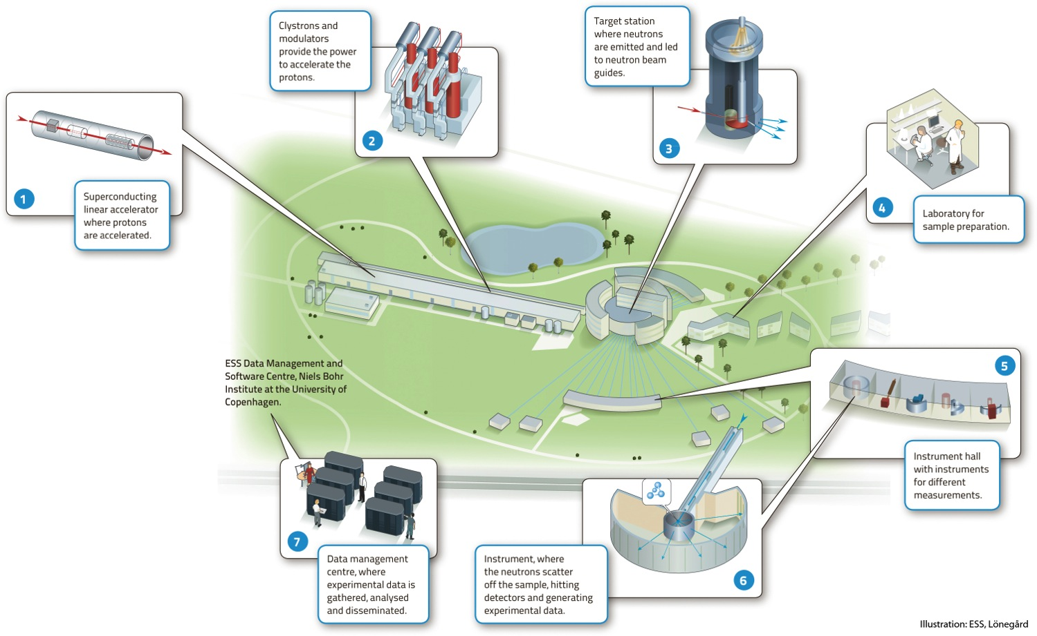



European Spallation Source
under construction
(~1.5 B€ facility)

Slide 10
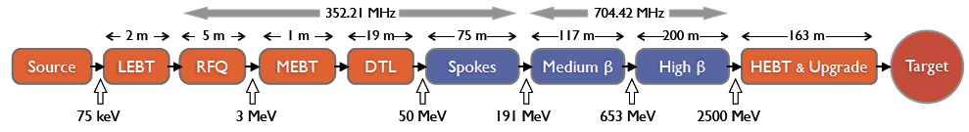
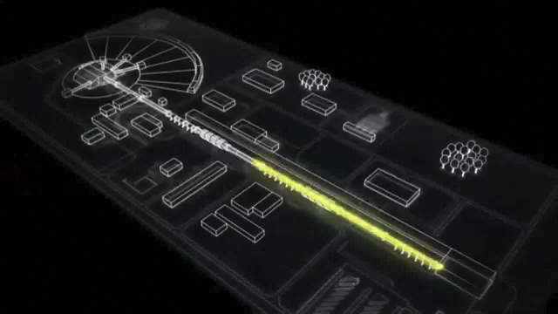
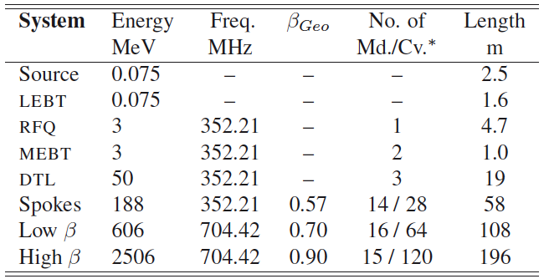
ESS proton linac
The ESS will be a copious source of spallation neutrons
5 MW average proton beam power
125 MW peak power
14 Hz repetition rate (2.86 ms pulse duration, 10¹⁵ protons)
4% duty factor
linac mostly (>97%) superconducting
2.5 GeV protons (up to 3.0 GeV with linac upgrades)
>2x10²³ p.o.t/year

Slide 11
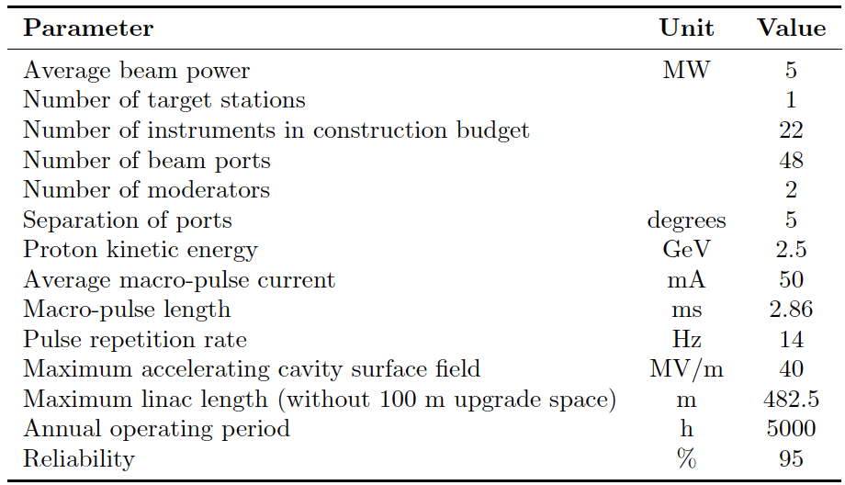
ESS parameters
2 GeV at the beginning
62.5
enough to go up to 3 GeV
198 days
ESS Technical Design Report
April 23, 2013
ESS-doc-274
http://europeanspallationsource.se/documentation/tdr.pdf

Slide 12





Linac Sharing
Ion source : Istituto Nazionale di Fisica Nucleare (INFN) – Catania, Italy
Radio Frequency Quadrupole (RFQ): Commissariat à l'énergie atomique (CEA) – Saclay, France
Medium Energy Beam Transport (MEBT): ESS-Bilbao, Spain
Drift tube Linac (DTL): Istituto Nazionale di Fisica Nucleare (INFN) – Legnaro, Italy
Spoke cavities: Institut de Physique Nucléaire (CNRS) – Orsay, France
Elliptical cavities: Commissariat à l'énergie atomique (CEA) – Saclay, France
High Energy Beam Transport: Aarhus University, Denmark
Spoke RF sources: Uppsala University, Sweden
RF regulation: Lund University, Sweden

Slide 13
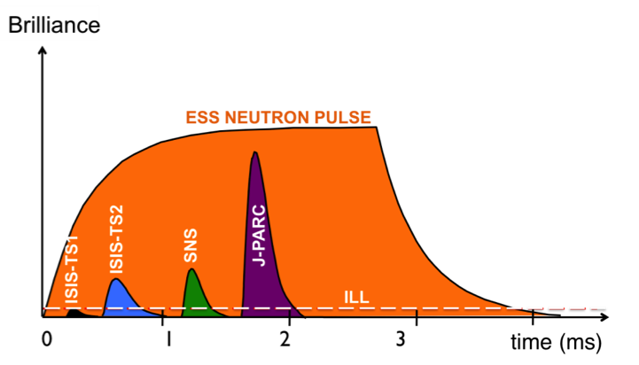
What is different from SNS?
The average proton beam power will be 5 MW
  Average neutron flux is proportional to average beam power
  5 MW is five times greater than SNS beam power
The total proton energy per pulse will be 360 kJ
  Beam brightness (neutrons per pulse) is proportional to total proton energy per pulse
  360 kJ is over 20 times greater than SNS total proton energy per pulse

Slide 14
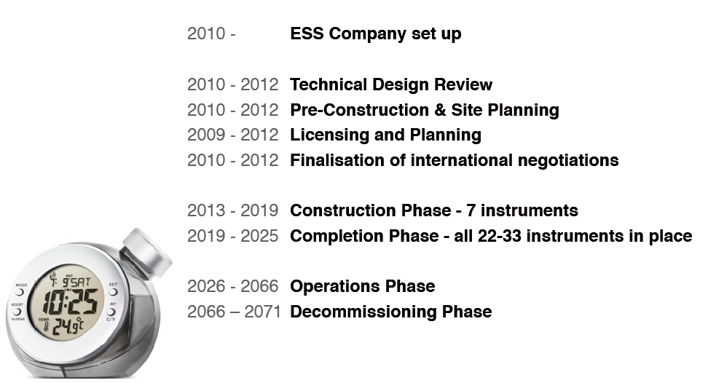
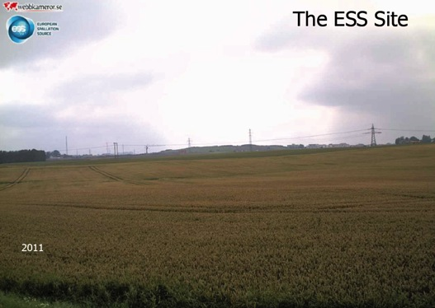
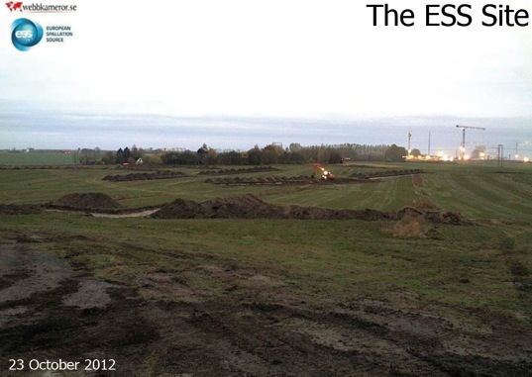
Well defined ESS Schedule
1st beam before the end of the decade
5 MW by 2023

Slide 15
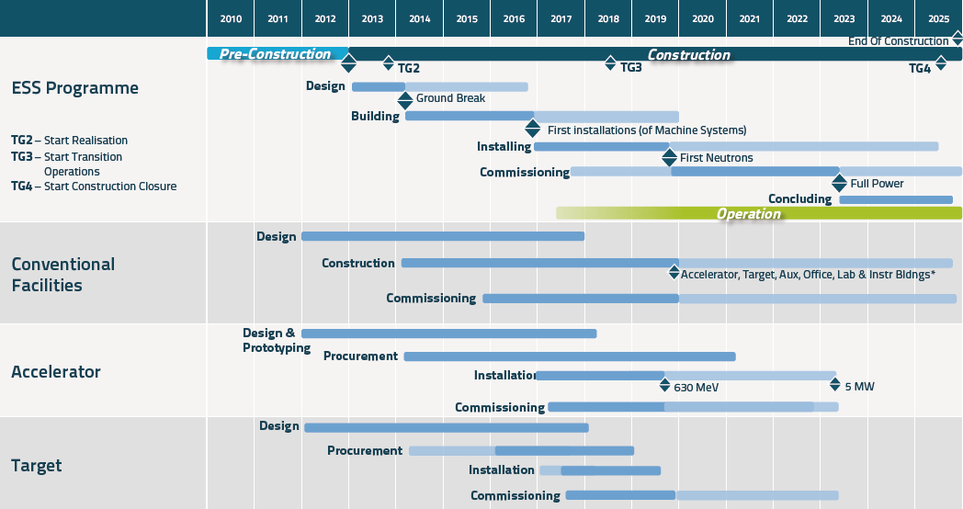
ESS Schedule

Slide 16
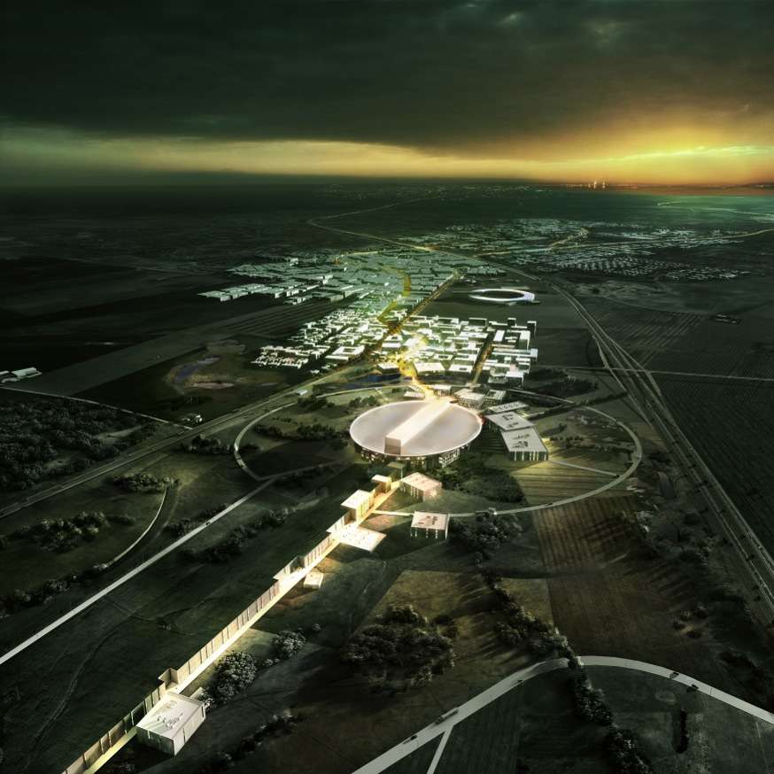
Requirements for adding a neutrino facility
We must not affect the neutron program.
Follow their schedule.
Use as much as possible neutron facilities.
For anything added, be synergetic when possible.
Moderate cost.
Kindly ask them to keep their choices compatible with neutrino needs (if this doesn't increase the neutron budget).

Slide 17
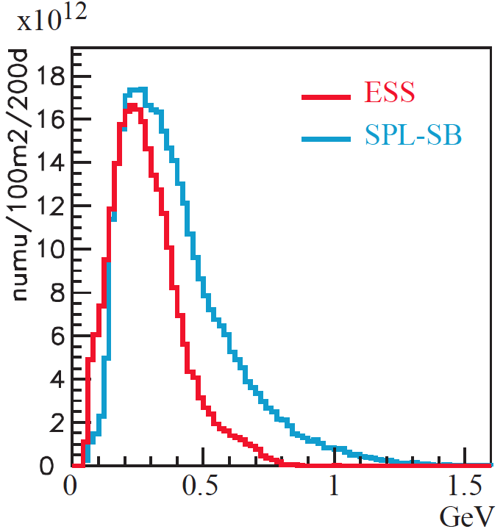
How to add a neutrino facility?
with 2.5 GeV proton: ~300 MeV neutrinos
Linac modifications: double the rate (14 Hz → 28 Hz)
  one pulse for neutrinos and one pulse for neutrinos (5 MW each)
additional RF power to drive the two beams (neutron production and neutrinos)
  upgradable power sources
  or double the power sources (free space has to be foreseen since now)
2.5 GeV protons
flux at 100 km

Slide 18
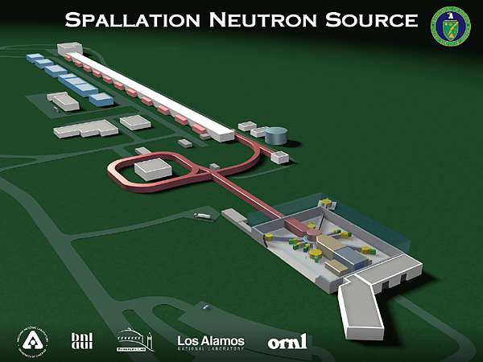
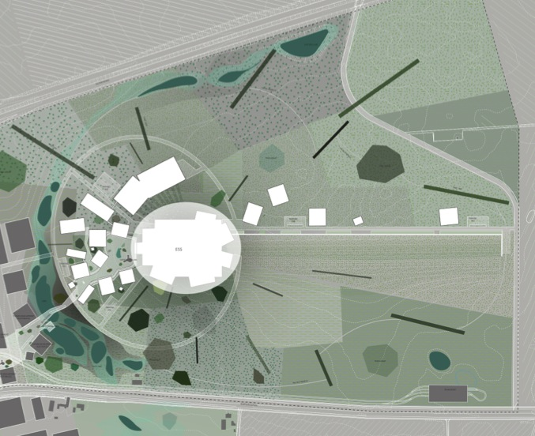
How to add a neutrino facility?
Accumulator (ø 143 m) needed to compress to few μs the 2.86 ms proton pulses, affordable by the magnetic horn (350 kA, power consumption, Joule effect)
  H⁻ source (instead of protons)
  space charge problems to be solved
Neutron users have also expressed an interest for the accumulator (increase of neutron brightness).
Other neutrino users using pions (from neutron target) decaying at rest need short pulses.
Target station (studied in EUROnu)
Underground detector (studied in LAGUNA)
Linac and accumulator could be the first step towards the Neutrino Factory
Linac
Storage Ring
Target and Instruments
accumulator
target/horn station
(http://lanl.arxiv.org/abs/1212.5048)

Slide 19
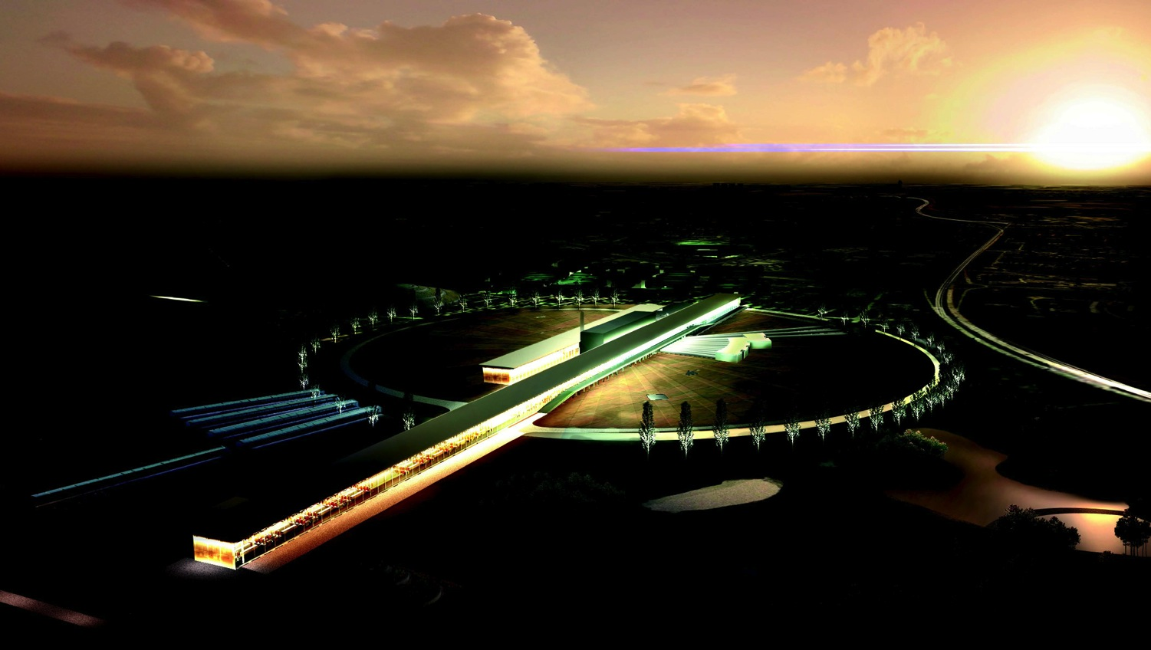
Existing expertise

Slide 20
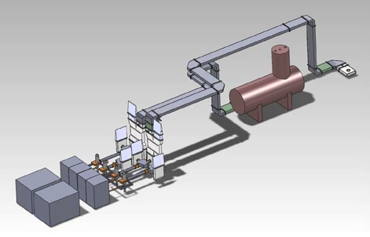
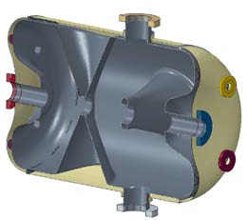
Linac and RF power source tests
A prototype 352 MHz spoke cavity for the ESS linac will be tested in the FREIA Laboratory at Uppsala University already as from July 2014 in a cryostat at 14 Hz pulse frequency and at the full instantaneous power required for ESS proton acceleration.
As part of this neutrino project, the power supplied to the 352 MHz power source would be doubled and the pulse frequency raised to 28 Hz, thus doubling the average power to the cavity.
The influence of this higher power on the operation of the cavity and on the capacity to cool the cavity itself and, in particular, its RF coupler will be studied.
Layout of the 352 MHz RF
source, wave guides and test
cryostat in the FREIA hall
ESS Spoke 352 MHz
Accelerating Cavity

Slide 21
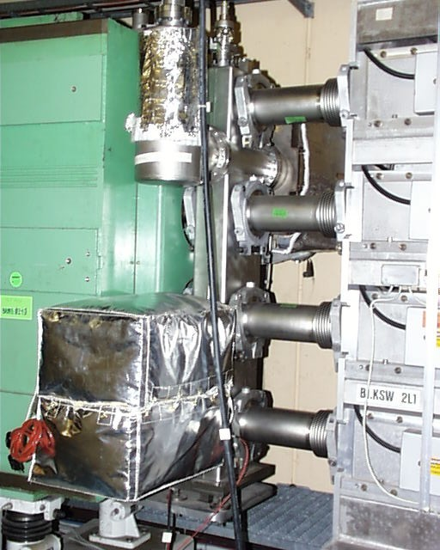
Accumulator
A problem with the enormous amount of protons stored at comparatively low energy in the accumulation ring is the space charge which leads to a defocusing of the stored beam.
For a charge of 10¹⁵ protons stored for 2.86 ms in 450 m circumference storage ring, this defocusing effect is critical.
A way to alleviate this problem is to divide the stored charge on four accumulation rings, thereby reducing the defocusing effect by a factor 4.
Neutron community very interested about this new device.
This trick is already used for the CERN PS Booster ring.
The 4 rings of the CERN PS Booster (1972)

Slide 22
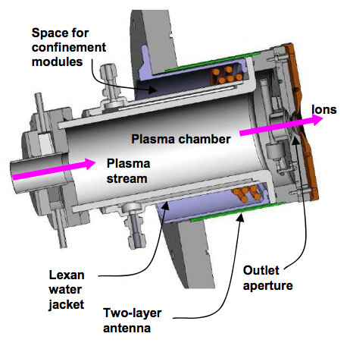
H⁻ Source
Parameter | Unit | ISIS | SNS | BNL | CERN, L4 | ESS ν | SPL
Beam Energy | keV | 16-35 | 65 | 35,40 | 45 | 75 | 45
Pulse duration | ms | 0.5 | 1 | 0.8 | 0.4 | 3 | 1.2
Repetition Rate | Hz | 50 | 60 | 6.6 | 1 | 14 | 50
H⁻ current | mA | 35 | 60 | 65 | 80 | 62.5 | 80
H⁻ production mode |  | Cs-Arc | Cs-Surf. | Cs-Surf. | Cs-Surf. | Cs-Surf. | Cs-Surf.
Plasma Heating
Emmittance In RFQ Norm RMS | mmmrad |  | 0.25 |  | 0.25 | 0.20
Cs-consumption | mg/day | 100 | 0.4 | 12
Operation MTBM | weeks | 5 | 6 | 36 | 52
There exist sources that could give the required performance for EUROSB
Courtesy: J. Lettry

Slide 23

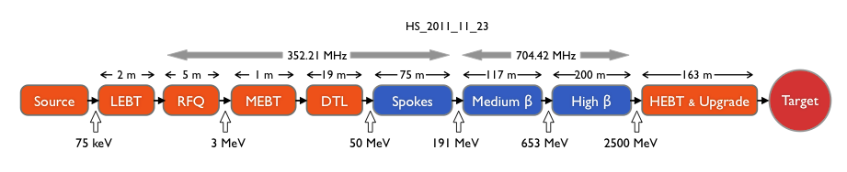
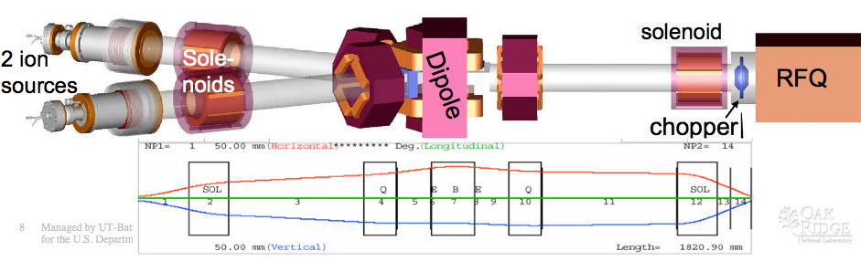
The LEBT
EUROSB Specific
Or ?
At SNS:
two sources one RFQ !
Could we use the same RFQ for ESS and EUROSB ?
Constraints on RFQ phase?
ESS: 0.2 mmmrad 4D norm Waterbag distribution at entrance RFQ

Slide 24
Source-LEBT
The Source is feasible (cmp existing developments)
  Estimate price by scaling from existing source developments
  SNS source is close to EUROSB requirements
  Get measurements from existing sources for simulations (SNS, CERN … )
Simulations of LEBT including RFQ
  Can the RFQ work for interleaved H- and H+ pulses (i.e. use of same RFQ)?
  If so, simulation of separate RFQ and common RFQ
  Must not influence neutron performance (Powered dipole only for H-)
  Measurement of the Linac 4 source and of the SPL cavities, exploiting the tools developed in the context of the SLHC-PP project to take into account RF imperfections should be included in the simulations
LEBT Chopper requirements
  Chop unstable part of source pulse
  Ion source rise/fall time 50 ms and RFQ 100 ns
  Gives time for RFQ stabilization

Slide 25
MEBT
Chopper in MEBT
  Prepare structure of beam for later (ejection of beam from accumulator)
  Advantageous to chop beam at lower energy
  Fast: 2 ns rise-time for 352 MHz
MEBT functions
  Optics of MEBT may cause emittance growth
  However useful for instrumentation, steering, optics tuning…
  Collimation
  Matching of RFQ and DTL in all three planes (10 quadrupoles and three 352.21 MHz buncher cavities)
  MEBT contains a dump for tests i.e. for upgrade work

Slide 26
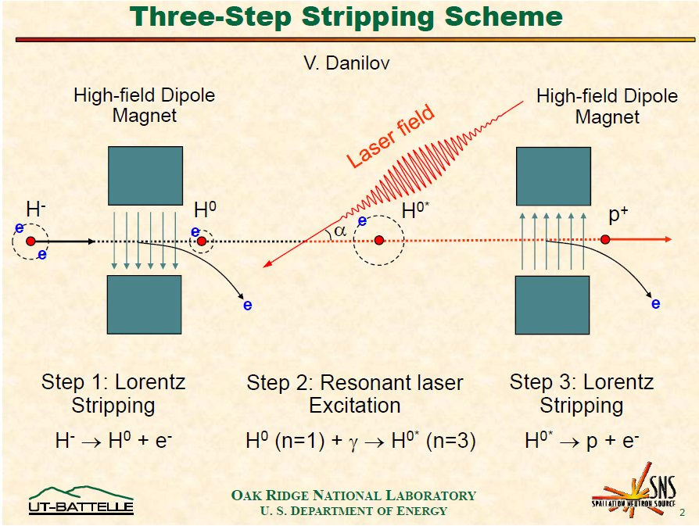
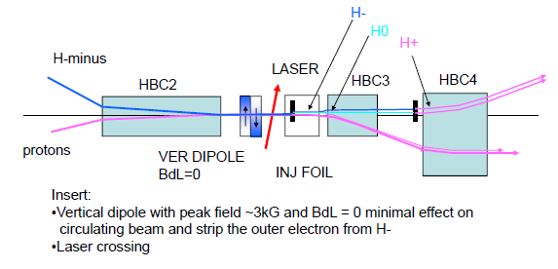
Stripping
foil stripping not possible due to the high beam intensity
Laser stripping necessary
Promising tests at SNS

Slide 27
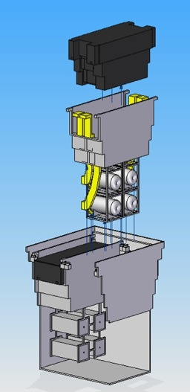
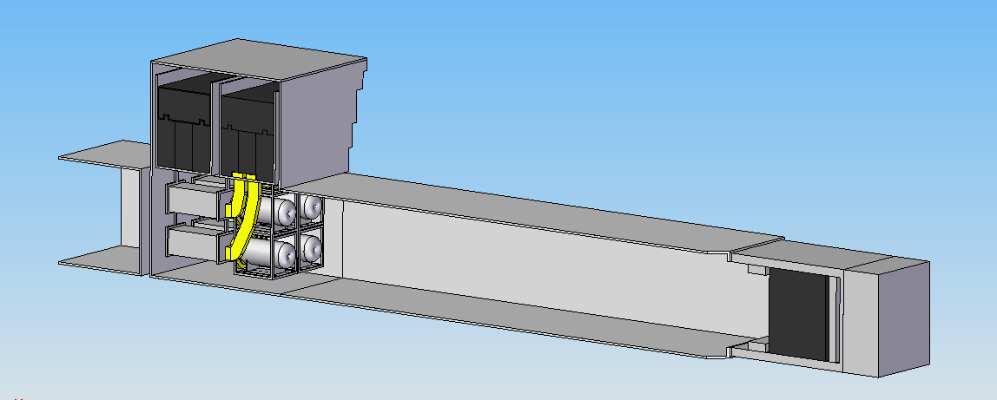
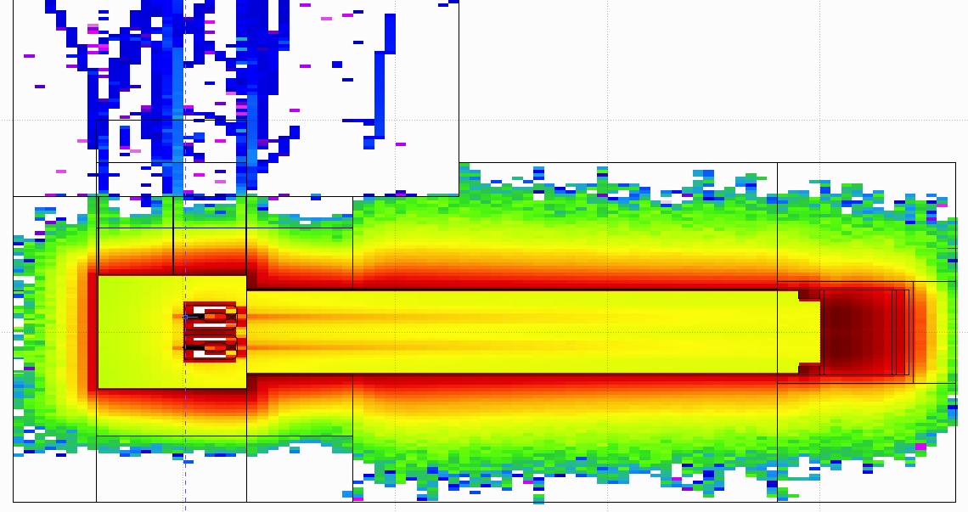
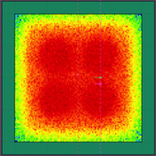
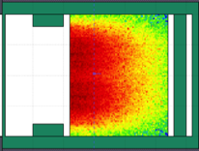
Target Station
General Layout
Shield Blocks
Horn Support Module
Split Proton Beam
Horns and Targets
Collimators
Decay Volume (He, 25 m)
Neutrino Beam Direction
Beam Dump

Slide 28
Possible Operation Timing
neutrino
if only users of the accumulator
neutron
28 Hz
35.7 ms
2.86 ms
ring filling
empty 2nd ring
empty 3rd ring
empty 4th ring
1.5 μs
refilling
2.86/4 ms
17.85 ms
(71.4/4 ms)
17.135 ms
56 Hz neutrino beam (1.25 MW/target)
(50 Hz for SPL, 1 MW/target)
empty 1st ring

Slide 29
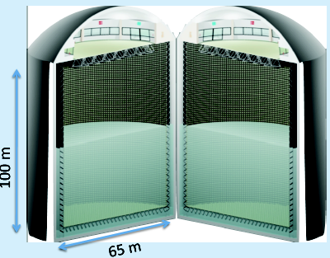
The MEMPHYS Detector (Water Cherenkov)
(LAGUNA)
Mainly to study:
Proton Decay (GUT)
  up to ~10³⁵ years lifetime
Neutrino properties and Astrophysics
  Supernovae (burst + "relics")
  Solar neutrinos
  Atmospheric neutrinos
  Geoneutrinos
  neutrinos from accelerators (Super Beam, Beta Beam)
Water Cerenkov Detector with total fiducial mass: 500 kt:
2 Cylindrical modules 100x65 m
Readout: 22.2k 8” PMTs, 30% geom. cover.
(arXiv: hep-ex/0607026)

Slide 30
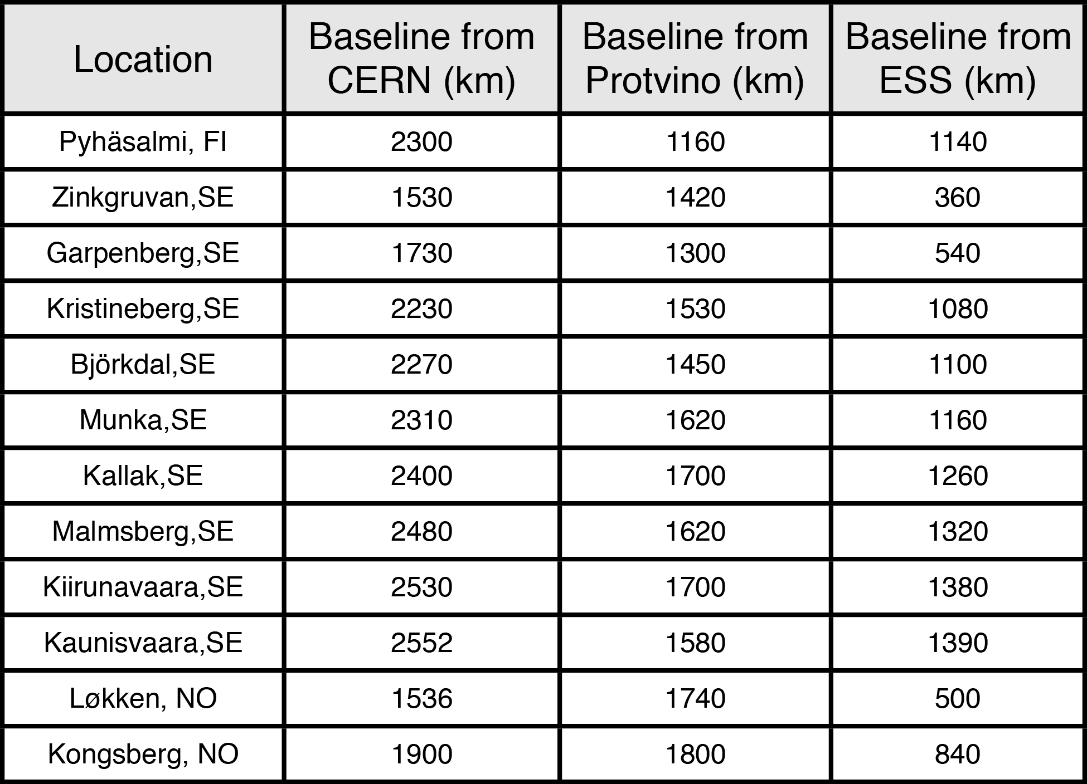
Detector location (LAGUNA)
ESS
CERN

Slide 31
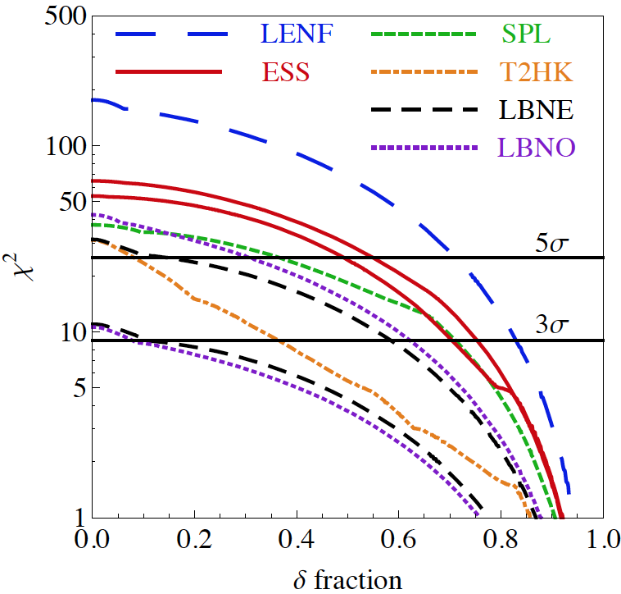
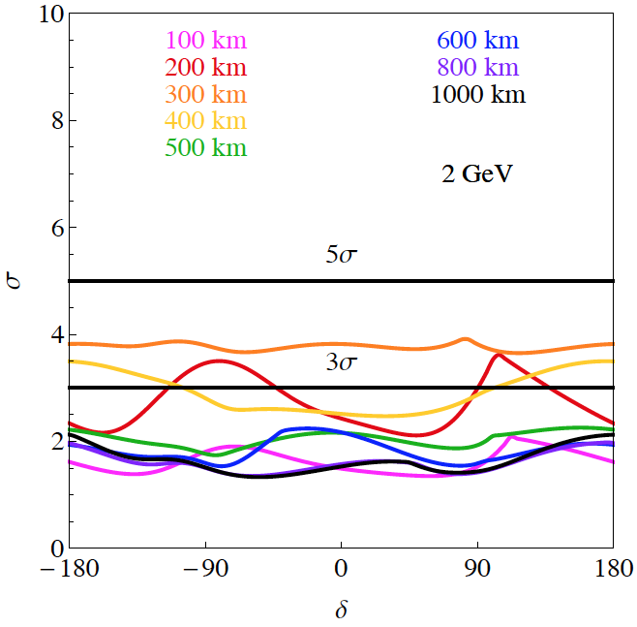
Physics Performance for Future SB projects
(Enrique Fernantez)
CPV
MH
360 km
540 km
unknown MH
LBNE: 5+5 years, 0.7 MW, 10/35 kt LAr
T2HK: 3+7 years, 0.75 MW, 500 kt WC (5%/10% syst. errors)
SPL: 2+8 years, 4 MW, 500 kt WC (130 km, 5%/10% syst. errors)
ESS: 2+8 years, 5 MW, 500 kt WC (2 GeV, 360/540 km, 5%/10% syst. errors)
C2Py: 20/100 kt LAr, 0.8 MW, 2300 km

Slide 32
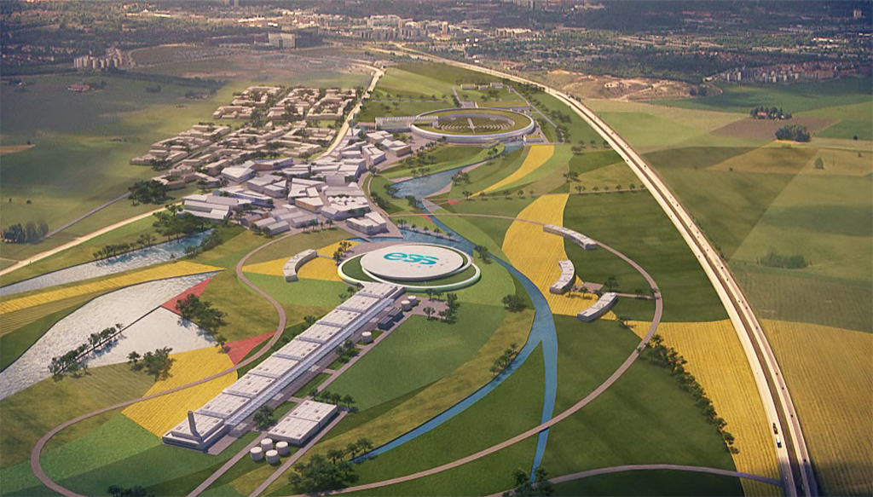
Conclusions
ESS is under construction
  very intense source of protons, 5 MW, 2-3 GeV
  more than 10²³ protons/year
  well defined schedule
Modifications are needed to transform ESS to neutrino facility
  Double the rate
  Add an accumulator
  Add a target station
  Underground detector (MEMPHYS), mines available
Very promising physics performance using EUROnu optimizations:
  CPV: coverage up to ~60%
  MH: could reach 5 σ combining atmospheric neutrinos
First ESS beam 2019, full power/energy by 2023.
could be the first step towards the Neutrino Factory

Slide 33
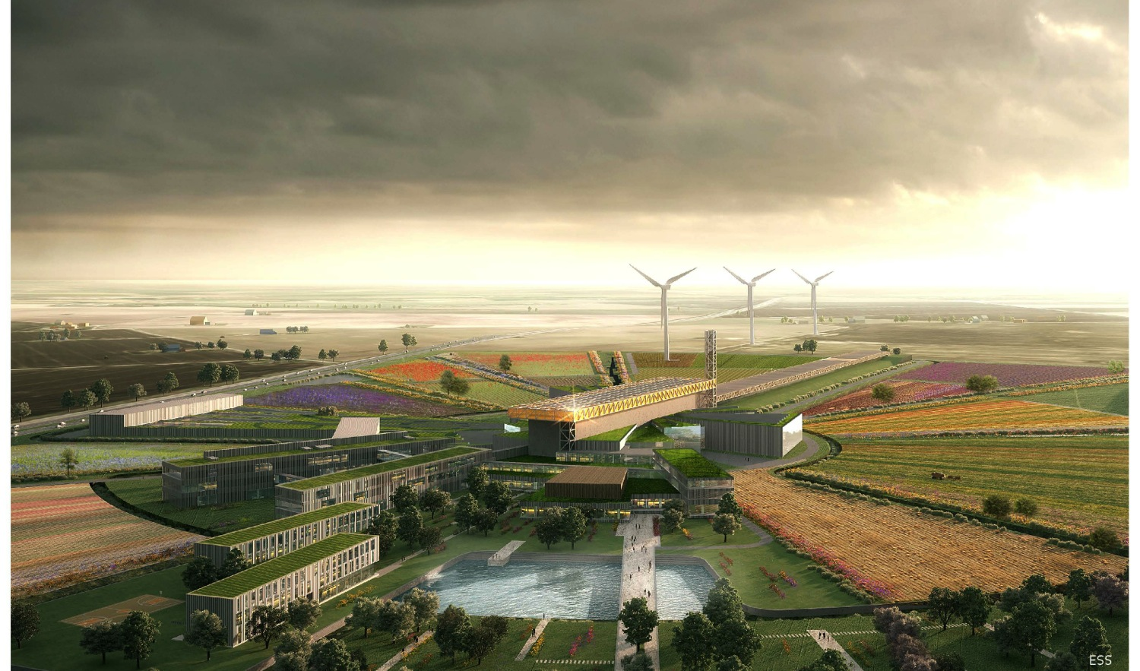
Collaborators are welcome…
(just email tord.ekelof@physics.uu.se, marcos.dracos@in2p3.fr )

Slide 34
Backup

Slide 35
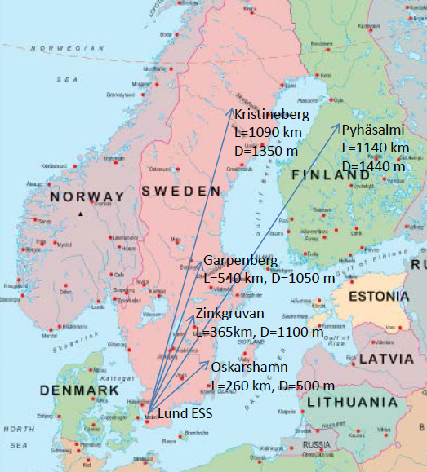

Possible Detector Locations
Many mines (active or not) are available in Sweden
What is the optimal position for CPV?
How this project could help for MH?
Δm²_{sun}=7.5x10⁻⁵ eV²
Δm²_{atm}=2.4x10⁻³ eV²
θ₂₃=41.4°
θ₁₂=33.6°
θ₁₃=8.8°
E~290 MeV
δ_{CP}=-90
δ_{CP}=0
δ_{CP}=+90
p(ν_{μ}→ν_{e})
L/E (km/GeV)

Slide 36
ESS proton linac
Source: ion (H- ) source, surface-plasma source (magnetron), semi-planatron, surface-plasma source with Penning discharge (Dudnikov-type source), RF volume source, etc. Multi-turn injection from a linac to an accumulator ring.
LEBT: low energy beam transport, matching section between the ion source and the RFQ
RFQ: pre-accelerator, Cockcroft-Walton or RFQ
Chopper: to chop the beam so that it can properly fit into the RF bucket structure in an accumulator. This would greatly reduce the injection loss caused by RF capture.
MEBT: Medium energy beam transport
DTL: Drift tube linac. Low energy part (below 100 MeV, β < 0.4)
Spokes: Spoked Resonator Cavity section
Medium β: Medium energy part (100 MeV - 1 GeV, 0.4 < β < 0.9)
High β: High energy part (above 1 GeV, β > 0.9)
HEBT: Medium energy beam transport
Upgrade: spare space for future upgrades to go up to 3 GeV.

Slide 37


Spoke Cavities
ESS will transition to superconducting cavities at 88 MeV
ESS will be the first accelerator to use 352 MHz double spoke cavity resonators
Twenty-eight cavities with an accelerating gradient of 8 MV/m are required.
Each cavity will operate at a nominal peak power of 320 kW
What type of power source to choose?
  Tetrode
  Klystron
  IOT
  Solid State

Slide 38


Elliptical Cavities
Universal Cryomodule
  Cryomodules are expensive and difficult to fabricate
  Pick cavity β_{g} and number of cells
    Optimize power transfer
    Optimize length
  Power in couplers is limited to 1200 MW (peak)
    Medium Beta β_{g} = 0.67
  6 cell cavities
  Cavity length = 0.86 m
  32 cavities packaged in 8 cryomodules
  Maximum peak RF power = 800kW
    High Beta β_{g} = = 0. 86
  5 cell cavities
  Cavity length = 0.92 m
  88 cavities packaged in 22 cryomodules
  Maximum peak RF power = 1100kW

Slide 39

Elliptical RF System Layout
One cavity per klystron
Two klystrons per modulator
16 klystrons per stub

Slide 40

Horn Optimization
perfect focusing
/proton/2GeV/m²
for 2.5 GeV
the horn is needed
(x7.4 on the ν flux)
present focusing
no focusing
GeV

