Slide 1




My personal perspective:
Historic review of Higgs searches
-The long journey to the Higgs discovery
Sau Lan Wu
University of Wisconsin-Madison
August 12, 2013
Invited Talk, International Symposium on Higgs Physics
IHEP, Beijing, August 12-16, 2013

Slide 2
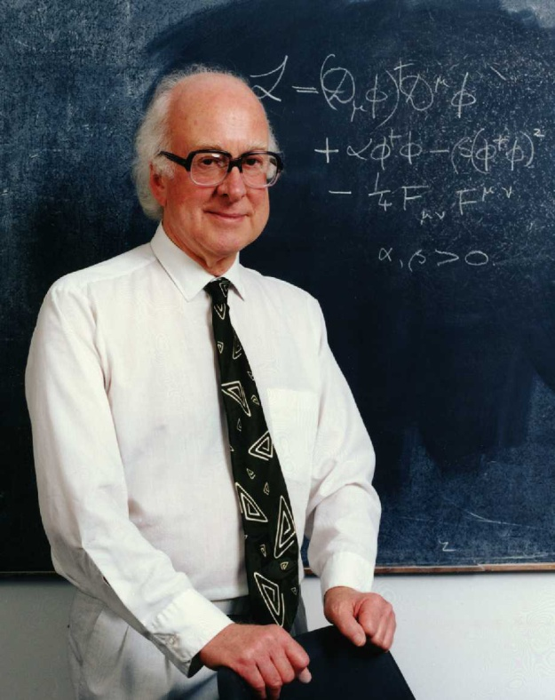
The Higgs Particle
In their famous 1964 papers, Professors Robert Brout, François Englert and Peter Higgs proposed a new, massive boson of spin zero to explain how elementary particles – the building blocks of the Universe – get their masses
In the universe, there is a Higgs “field” that pervades all of space, turning mass-less particles moving through it into the massive ones
1964: Englert and Brout,
Higgs
Guralnik, Hagen and Kibble

Slide 3
The Discovery of the Higgs Boson
Armed with 5σ significance independently from the ATLAS and CMS experiments, the Director General of CERN, Rolf Heuer, declared:
“I think we have it”
“We have now found the missing cornerstone of particle physics. We have a discovery. We have observed a new particle that is consistent with a Higgs boson.”
July 4, 2012,
discovery announcement

Slide 4
The Discovery of the Higgs Boson
The discovery of the Higgs particle at LHC, announced on July 4, 2012, was the result of two decades of work by the ingenious LHC machine physicists and by many thousands of ATLAS and CMS experimental physicists who built and now operate the detectors, defined and manage a computer system that distributes data around the world, created novel hardware and computer software to identify the most interesting collisions, and wrote the algorithms that dig out the most pertinent events from the great morass of data being recorded. They all worked feverishly, anticipating a discovery.
It has been a long journey to the Higgs discovery:
More than 30 years!!

Slide 5
THE PRE-LEP ERA
(up to 1990)
PRE-LEP ERA

Slide 6

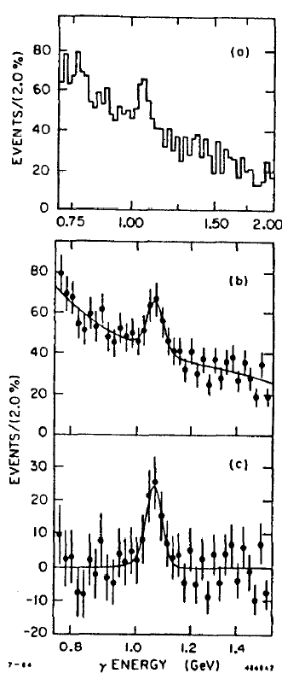
PRE-LEP ERA: a false signal: 1984
b
H
ϒ
b
b
γ
Crystal Ball collaboration at the DORIS
e⁺e⁻ storage ring at DESY was looking for low-mass Higgs in upsilon decay: ϒ→H+γ
Early in 1984, a peak in γ energy spectrum was seen, corresponding to a resonance with mass 8.32 GeV. High signal significance: >5σ
Reported at ICHEP 1984 in Leipzig, Germany ; production rate ~2 orders of magnitude larger than SM Higgs prediction
Signal not confirmed at Cornell CESR; with more DORIS data in late 1984, Crystal Ball signal disappeared
Top: inclusive γ spectrum
Bottom: bkg-subtracted spectrum

Slide 7
PRE-LEP ERA: First experimental Higgs limits (late ‘80s, early ‘90s)
CUSB collaboration at CESR searched in channel ϒ → H + γ
90% CL exclusion in range 211 MeV < m_{H} < 5 GeV (1989)
Proceedings of ICHEP 1988
SINDRUM experiment at the Paul Scherrer Inst. proton cyclotron searched for Higgs in pion decays: π⁺→ e⁺+ν_{e}+H, H→e⁺e⁻
90% CL exclusion in range 10 MeV < m_{H} < 110 MeV (1989)
Measurement of the decay π⁺→e⁺ν_{e}e⁺e⁻ and search for a light Higgs boson, Phys. Lett. B 222, 533
CLEO collaboration at CESR searched in channel
B → K + H⁰, H⁰ → pair of muons, pions or kaons
90% CL exclusion in range 0.2 GeV < m_{H} < 3.6 GeV (1990)
Search for a neutral Higgs boson in B-meson decay
Phys. Rev. D. 40, 712

Slide 8
THE LEP-1 ERA
(from 1989 to 1995)
LEP -1 ERA

Slide 9
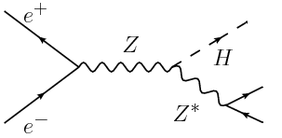
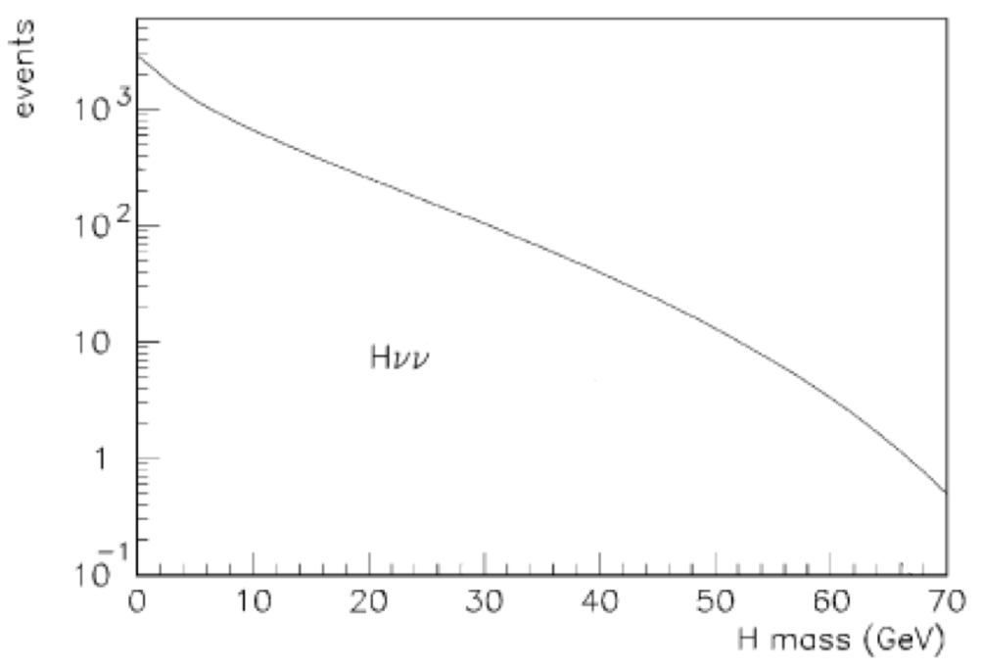
LEP-1 ERA Preparation for LEP-1
On July 14, 1989, the 200th anniversary of the French revolution, the first particles went around LEP (the Large Electron Positron collider), a 27-km (17-mile) ring, at CERN
Plans to search for the Higgs boson
at LEP were underway in the early
1980s with the ALEPH, DELPHI, L3
and OPAL detectors. LEP-1 was to
operate at the Z pole
(M_{Z} = 91.188 ± 0.002 GeV)
Search in the Higgsstrahlung
channels:
e⁺e⁻ → Z → Hl⁺l⁻ and Hvv
Number of Higgs bosons expected to
be produced per 10⁶ Z decays at LEP-1
(~100 events at m_{H}=30 GeV)
v, l⁻
v, l⁺
_
Events
H_{vv}
Hvv
m_{H} (GeV)

Slide 10
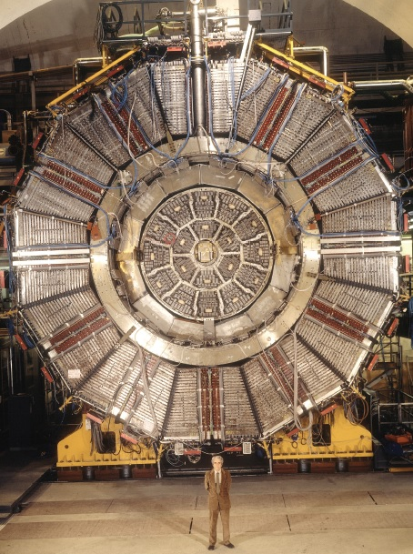
The founder of the ALEPH experiment at LEP and first Spokesman
Jack Steinberger, promoter of physicists from China

Slide 11
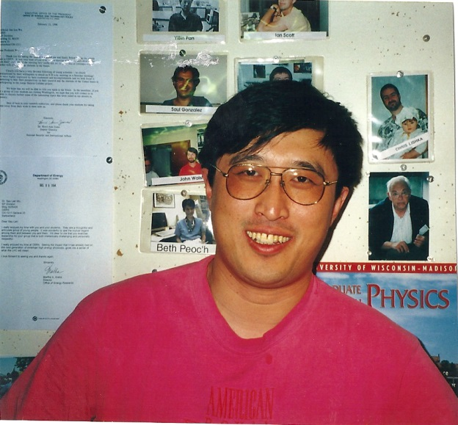
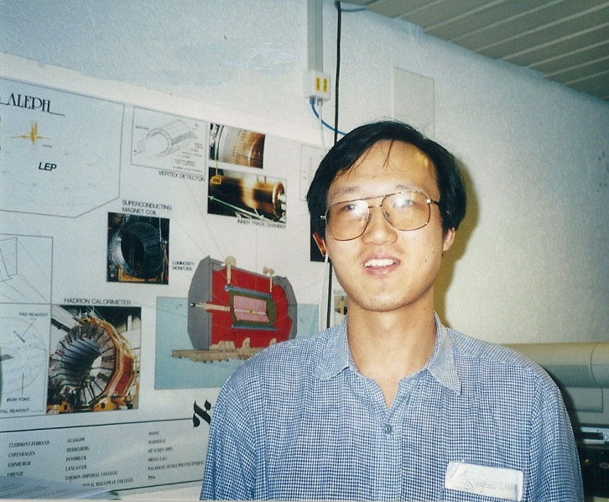

Thanks to my former Wisconsin members
Prominent Professors in China
Prof. Yuanning Gao
(Tsinghua University)
Prof. Hongbo Hu (IHEP)
Former Wisconsin members who worked in ALEPH at LEP on Higgs searches
Prof. Shan Jin(IHEP)

Slide 12




Thanks to my recent former Wisconsin members
Prominent Professors in China
Prof. Yaquan Fang (IHEP)
Prof. Haibo Li (IHEP)
Prof. Haiping Peng
(USTC)
Prof. Lianliang Ma (Shandong University)

Slide 13
LEP-1 ERA Question 6 from LEPC (1983)
Michael Mermikides
Haimo Zobernig
Sau Lan Wu
(Wisconsin Group)
December 21, 1983
The process e⁺e⁻ → Z⁰ → H⁰e⁺e⁻
(answer to question 6 from LEP Committee)
Question 6
What strategy with respect to data acquisition and analysis would you follow to search for Higgs in Z⁰ decay? Suppose one needs 10⁷ Z⁰ decays to observe 10 events of the type Z⁰ → e⁺e⁻ H, H→hadrons, m_{H}=50 GeV.
Answer / conclusion
Starting with 10⁷ Z⁰ events and by matching the TPC hits in the pad rows to the electromagnetic showers …, we reduce the 10⁷ Z⁰ events to 3 x 10⁴ events with 80% efficiency for the Higgs events at Higgs mass of 50 GeV … . Full reconstruction of these 3x10⁴ events for physics is expected to be 20-30 sec CPU of IBM 370/168 per event.

Slide 14
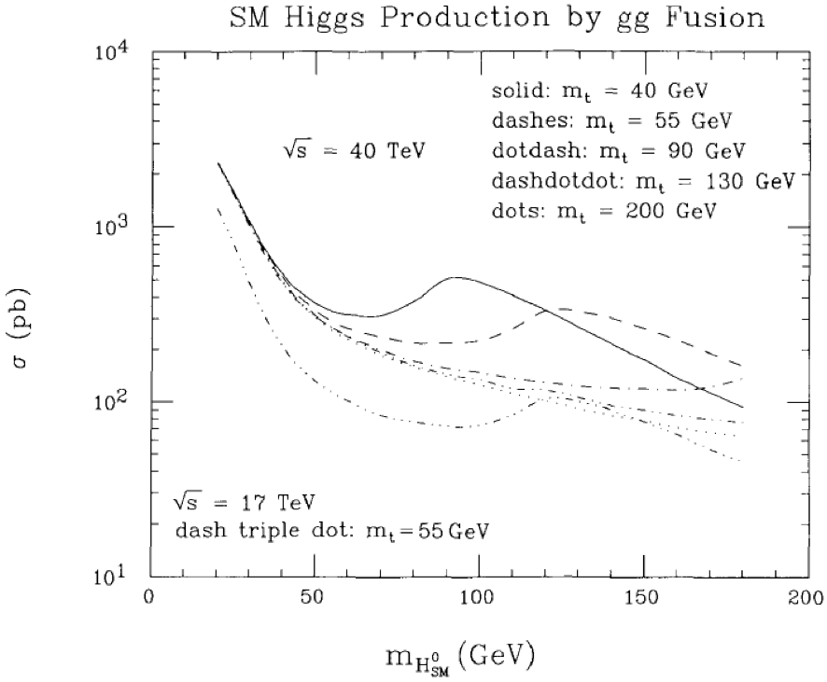
Higgs discovery potential of the SSC
SM Higgs Production by gg fusion
Nucl. Phys., B299 231
(J. F. Gunion, G. L. Kane and J. Wudka, 1987)
Major construction began in 1991
40 TeV center-of-mass energy - SM Higgs discovery reach over entire mass range up to 1 TeV
γγ, ZZ → 4l, ττ, bb decay modes studied - not WW, presumed unfeasible
SSC funding withdrawn in October 1993 - and that was that !
√s = 40 TeV
m_{t} = 200 GeV
σ (pb)
m_{H} (GeV)
LHC (125GeV @ 8 TeV): 19.5 ± 3 [pb]
For 8 TeV at LHC, cross section of m_{H} = 125 GeV only a factor of 5 below SSC at 40 TeV

Slide 15
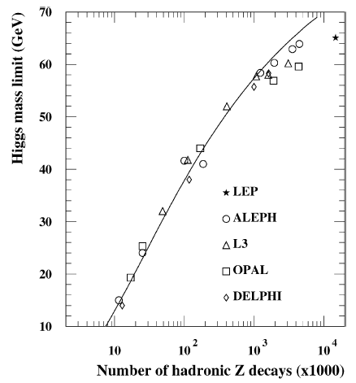
LEP-1 ERA Final Higgs combination
SM Higgs excluded at 95% CL for m_{H} < 65.6 GeV
Number of Z decays collected by the LEP-1 experiments, and 95% CL Higgs exclusions (with full LEP-1 integrated luminosity):
LEP
Expected sensitivity
Tightened selection
 | Data sample | Had. Z decays [10⁶] | Mass limit [GeV]
ALEPH | 1989 - 1995 | 4.5 | 63.9
DELPHI | 1990 - 1993 | 1.6 | 58.3
L3 | 1990 - 1994 | 3.1 | 60.1
OPAL | 1990 - 1995 | 4.4 | 59.6
Higgs physics at LEP-1, Andre Sopczak Physics Reports 359 (2002) 169,
pages 206, 207.
Evolution of LEP-1 Higgs limits with increasing dataset

Slide 16
THE LEP-2 ERA
(1995-2000)
LEP -2 ERA

Slide 17

LEP -2 ERA

Slide 18
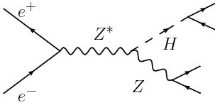
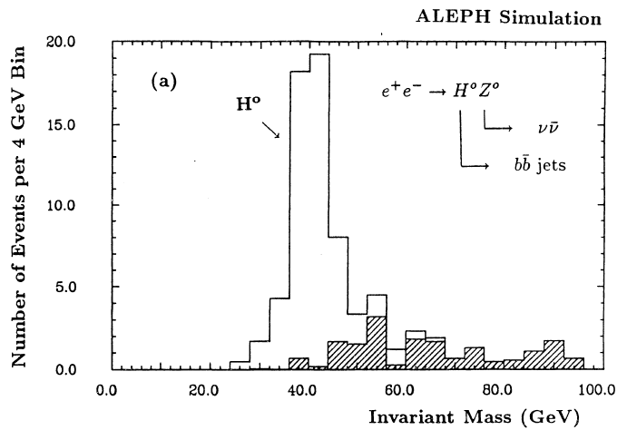
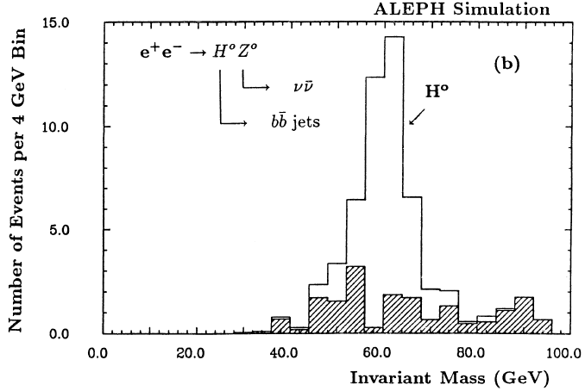
LEP-2 ERA Preparation for LEP-2
b
b
_
LEP-2 was to operate at energy up to~200 GeV
Search for SM Higgs predominantly in
e⁺e⁻→ZH, with Z→qq/ll/νν, H→bb
In qqbb, llbb or ννbb, hunt for bump in bb invariant mass distributions
“Search for neutral Higgs at LEP200”, Presented by Sau Lan Wu at the ECFA Workshop, vol. II, page 312 (1986)
v, q, l⁻
v, q, l⁺
_
_
－
Lumi: 500 pb⁻¹
Lumi: 500 pb⁻¹
E_{cm} = 200 GeV
E_{cm} = 200 GeV
Number of events per 4 GeV Bin
Number of events per 4 GeV Bin
m_{H} = 40 GeV
exp signal, bkg
m_{H} = 60 GeV
exp signal, bkg
Background:
WW, ZZ, QCD
Invariant Mass (GeV)
Invariant Mass (GeV)

Slide 19
b
b
LEP-2 ERA LEP-2 up to 1999
_
v, q, l⁻
v, q, l⁺
LEP-2 started in 1995 at √s=130 GeV,
going up to 202 GeV by 1999
Most data collected in 1998-99. Total: 2461 pb⁻¹ (sum of 4 experiments)
Higgs search in 4 final states
4-jet channels in ALEPH (and later DELPHI) were the most sensitive
No indication of Higgs production was found up to 1999
- 95% CL limit: 107.9 GeV (CERN-EP-2000-055) (ALEPH, DELPHI, L3, OPAL)
It was decided to push the machine to even higher CM energies
_
_
The Searches for Higgs Bosons at LEP, M. Kado,
C. Tully, Annu. Rev. Nucl. Part. Sci. 2002.52:65(2002)
missing energy + bb
llbb (l = e,μ)
ττ
_
4-jet
_
_
q q
q q
v v
l⁺ l⁻
Z
H
_
_
_
b b
b b
τ⁺ τ⁻
b b

Slide 20
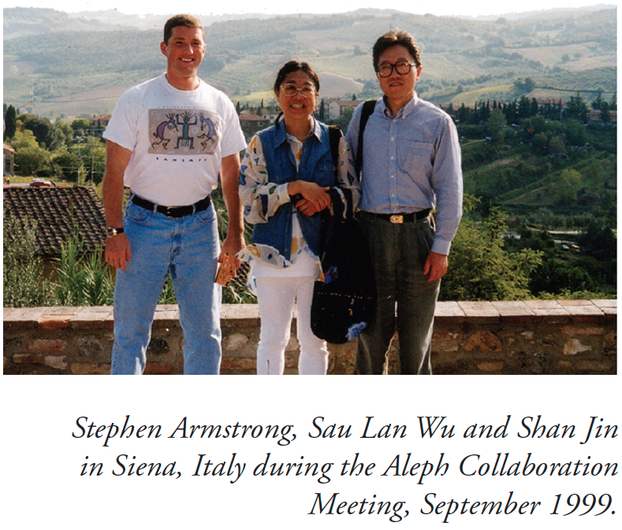
Photo from Higgs Story (1980 - 2002) of The ALEPH ‘Experience’

Slide 21
LEP-2 ERA LEP operation in 2000
To maximize Higgs search, 6 machine upgrades were implemented
Sensitivity to Higgs masses of up to 115 GeV for center-of-mass energy up to 209 GeV
Promising candidates started showing up!
In late June 2000, ALEPH found the first candidate in the 4-jet channel: the so-called candidate (c) (at a center-of-mass energy of 206.6 GeV )
- reconstructed mass of 114 GeV
- found by both cut-based and neural network analyses
Data collected by LEP-2 experiments in 2000 (in pb⁻¹)
Experiment | ALEPH | DELPHI | L3 | OPAL | TOTAL
Dataset | 130 | 138 | 139 | 129 | 536

Slide 22
LEP-2 ERA …and then there were more
Early July: ALEPH candidate (e) at ~115 GeV
End of July: ALEPH candidate (b) at 113 GeV
August: ALEPH candidates (a) and (d) at 110 GeV and 115 GeV
Observation of an excess in the search for the Standard Model Higgs boson at ALEPH, Phys. Lett. B 495 (2000) 1-17.
  “An excess of 3σ beyond the background expectation is found, consistent with the production of the Higgs boson with a mass near 114GeV”
‘Forget about limits…watch that bump!’

Slide 23
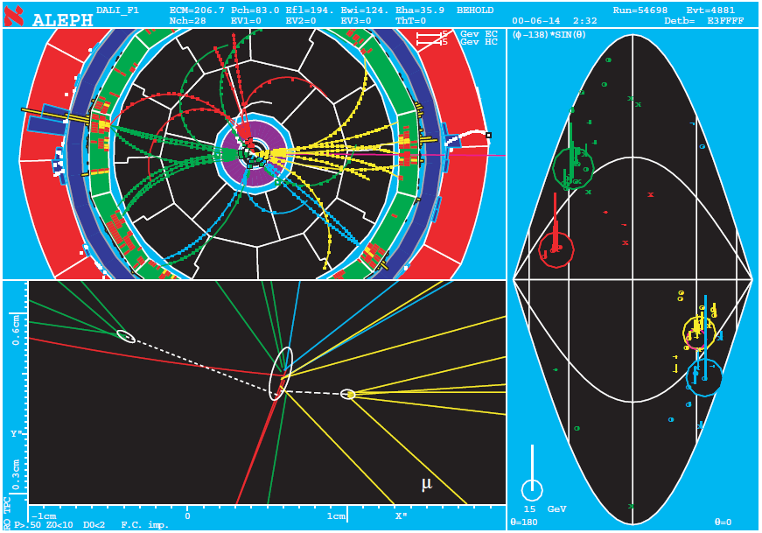
LEP-2 ERA ALEPH candidate (c) 54698 4881 M=114.3GeV E_{cm} = 206.7 GeV

Slide 24
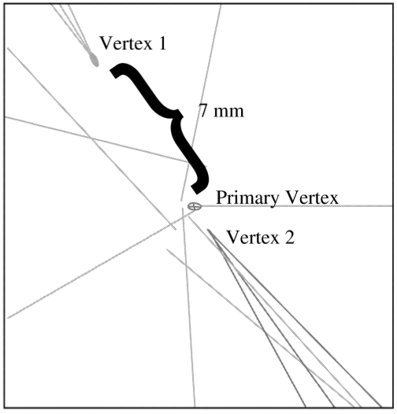
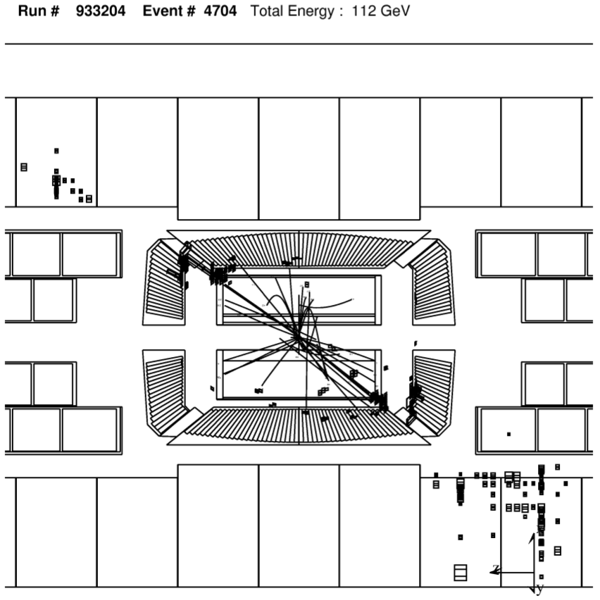
LEP-2 ERA L3 candidates
L3:
Higgs candidates in e⁺e⁻ interactions at √s = 206.6 GeV,
Phys. Lett. B 495 (2000) 18-25
Phys. Lett. B 517 (2001) 319-331
m=115 GeV
Hνν candidate: m=115 GeV

Slide 25
LEP-2 ERA …while time was running out
LEP was scheduled to shut down in September 2000 to allow start of LHC construction
In early September, DELPHI found a 4-jet Higgs candidate upon re-analyzing their data with an ALEPH-like analysis
Based on these results, the LEP-2 run was extended by 6 weeks
The L3 candidate in the missing energy (ννbb) channel was found during the extension
On November 3, 2000 the LEP Higgs working group made a request to LEPC for 4-6 months extension in 2001
LEP was shut down in the first week on November after delivering 11 years of great physics
Very disappointing for those of us who believed we were really close to a discovery
- but in retrospect, no complaints!

Slide 26
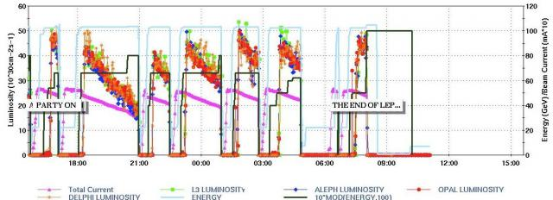
The end of LEP. CERN press release.
The measurements taken of LEP's final beam. The accelerator was switched off for the last time at 8:00 am on 2 November. (Image: CERN)
“After extended consultation with the appropriate scientific committees, CERN 's Director-General Luciano Maiani announced today that the LEP accelerator had been switched off for the last time. LEP was scheduled to close at the end of September 2000 but tantalising signs of possible new physics led to LEP's run being extended until 2 November.”

Slide 27
LEP-2 ERA Publications
After the end of data taking at LEP (November 2000), each collaboration published one paper in Physics Letters B:
ALEPH: ‘Observation of an excess in the search for the SM Higgs boson at ALEPH’. Phys.Lett. B 495, 1 (2000), link
Abstract: An excess of 3σ beyond the background expectation is found, consistent with the production of the Higgs boson with a mass near 114GeV/c². Much of this excess is seen in the four-jet analyses, where three high purity events are selected. (link)
DELPHI: ‘Search for the SM Higgs boson at LEP in the year 2000’. Phys. Lett. B 499, 23 (2001), link
Abstract: No evidence for a Higgs signal is observed in the kinematically accessible mass range, and a 95% CL lower mass limit of 114.3 GeV/c² is set (link)

Slide 28
LEP-2 ERA Publications
L3: ‘SM Higgs boson with the L3 experiment at LEP’. Phys. Lett. B 517, 319 (2001), link.
Abstract: A lower limit on the mass of the standard model Higgs boson of 112.0 GeV is set at the 95% confidence level. The most significant high mass candidate is a Hνν event. It has a reconstructed Higgs mass of 115 GeV and it was recorded at √s = 206.4 GeV. (link).
OPAL: ‘Search for the SM Higgs boson in e+e- collisions at √s≈192-209 GeV’. Phys. Lett. B 499, 38 (2001), link.
Abstract: A lower bound of 109.7 GeV is obtained on the Higgs boson mass at the 95% confidence level. At higher masses, the data are consistent with both the background and the signal-plus-background hypotheses (link).
Primarily based on data from 2000, when √s was increased from 200 to 209 GeV
Almost all candidates ~115 GeV from √s=205 to 209 GeV

Slide 29
LEP-2 ERA Final result from LEP
Combining the final results from the four LEP experiments, ALEPH, DELPHI, L3 and OPAL, a lower bound of 114.4 GeV/c² is set on the mass of the Standard Model Higgs boson at the 95% confidence level.
  Search for the Standard Model Higgs boson at LEP, Phys. Lett. B 565 (2003) 61-75
The accelerator was switched off for the last time at 8:00 AM on 2 November 2000.

Slide 30
Higgs mass constraints from precision electroweak fits
First precision EW fits using data collected by LEP-1 experiments at the Z-pole, circa 1991
Fits prior to top discovery used assumptions on m_{H} to predict top mass
Following the top discovery, use of measured top mass makes a very significant improvement in Higgs mass prediction
  As does the use of W mass and W width
18 input measurements are used:
  Hadronic vacuum polarization, 14 Z-pole results, m_{t}, m_{W}, Γ_{W}

Slide 31
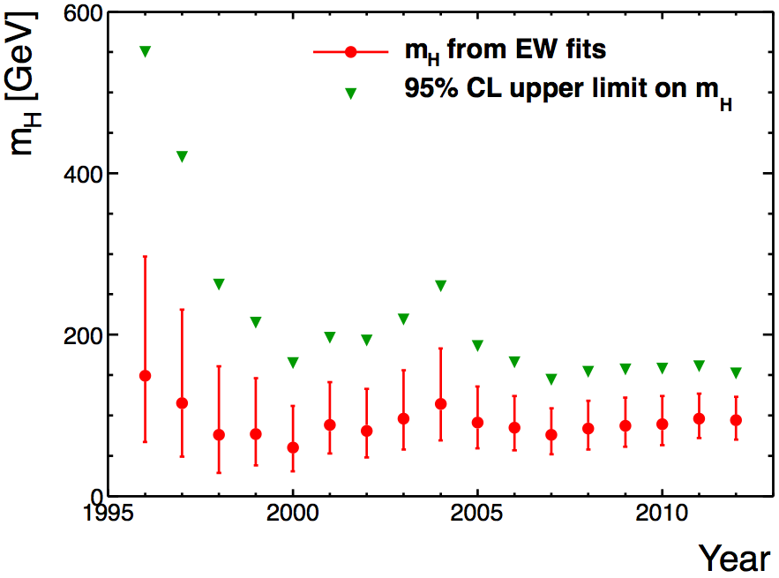
Higgs mass constraints from precision electroweak fits
Best fit and upper limit on the Higgs mass using the available measurements of the 18 inputs at the time
Example: in 2010, the electroweak fit gave
With the 95%CL upper limit of 158 GeV

Slide 32
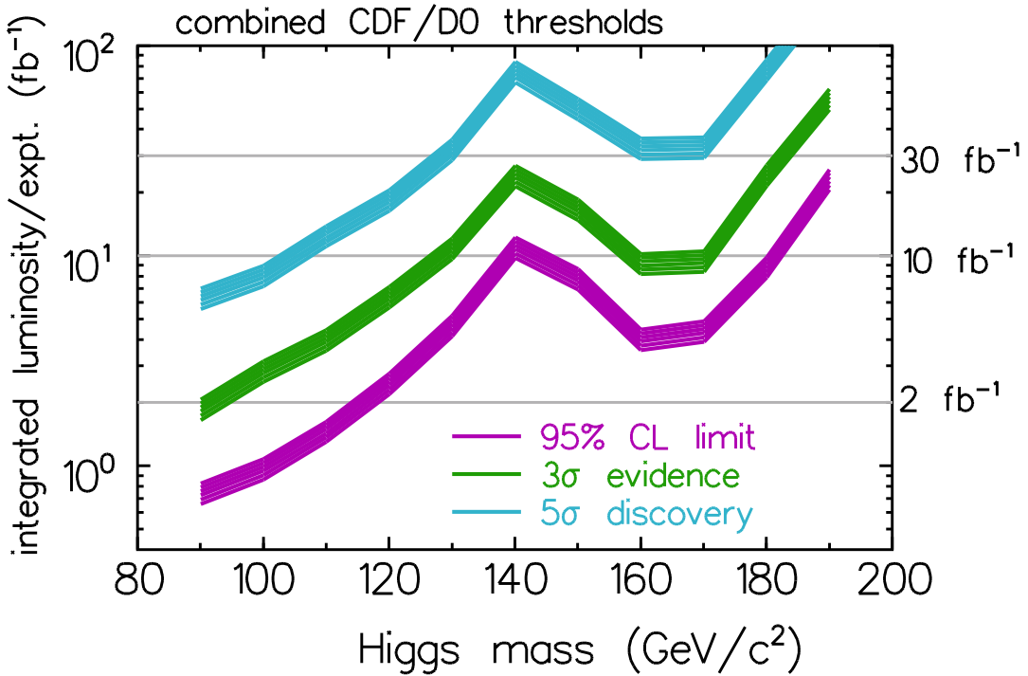
TEVATRON Summer 2006
For details on Tevatron results, see talk by Weiming Yao
Mid-2005: first fb⁻¹
2006: first CDF+D0 limits:
Run I: 1987, 1.8 TeV
Run II: 2001, 1.96 TeV
Projection (2000):
For 5σ @125GeV need 25fb⁻¹/expt.
Combined CDF/D0 thresholds
Integrated luminosity / expt. (fb⁻¹)
D0 | 260 – 950 pb⁻¹
CDF | 360 – 1000 pb⁻¹
Higgs mass (GeV/c²)
Limits: 10.4 (3.8) times SM
@ m_{H}=115(160) GeV
CDF Note 8384, D0 Note 5227
Report of the Higgs WG of the Tevatron Run 2 SUSY/Higgs Workshop
http://arxiv.org/abs/hep-ph/0010338

Slide 33
TEVATRON 2009: First exclusion
Winter 2009: First mass range excluded after LEP
(at 95%CL): 160<m_{H}<170 GeV arXiv:0903.4001 [hep-ex]
Press release on March 13, 2009 (link)
D0 | 0.9 – 4.2 fb⁻¹
CDF | 2.0 – 3.6 fb⁻¹
For more on Tevatron Higgs searches, see next talk by Weiming Yao
_
_
_
Channels:
Production: qq→W/ZH, gg→H, qq→q’q’H (VBF)
Decay: H→bb, H→W⁺W⁻, H→τ⁺τ⁻, H→γγ
_

Slide 34
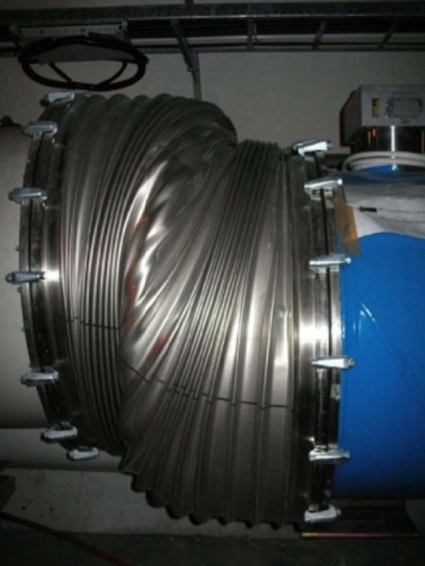
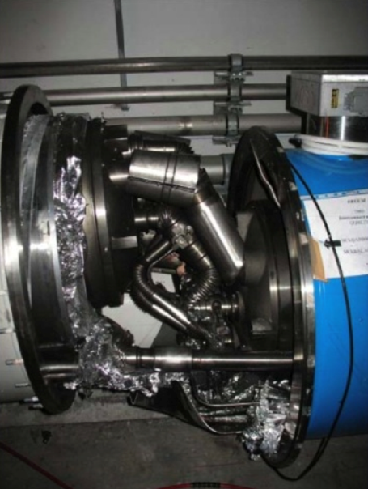
LHC ERA September 2008: LHC on hold
First protons around full ring on September 10, 2008
But on Sept 19, an electrical fault triggered a major setback
cause: faulty electrical connection between two of the accelerator’s magnets; this resulted in mechanical damage and release of tons of liquid helium
Lashkar Kashif (on shift at the time) sent this email to the Harvard group:
LHC E-log: Fire alarm in point 3 and point 4. Firebrigade going there together with RP. Massive quench in S34, Helium released in the tunnel.
This had to happen on my shift, of course. No beam for at least a week.
Actually: no beam for over a year; low energy beams circulated in Nov 2009 for the first time since the accident

Slide 35
LHC ERA The path to Higgs discovery
EPS-HEP 2011 (July)
Lepton-Photon 2011 (August)
CERN 2011 December Council Meeting
Moriond 2012 (March)
ICHEP 2012 (July)
Discovery publications, July 2012 (submitted)
HCP 2012 (November)
CERN 2012 December Council Meeting
Moriond QCD 2013 (March) (ATLAS)
EPS 2013 (July) Spin, parity and Couplings measured.
5 σ !
ATLAS
CMS
> 10 σ!

Slide 36
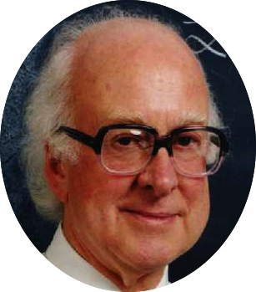
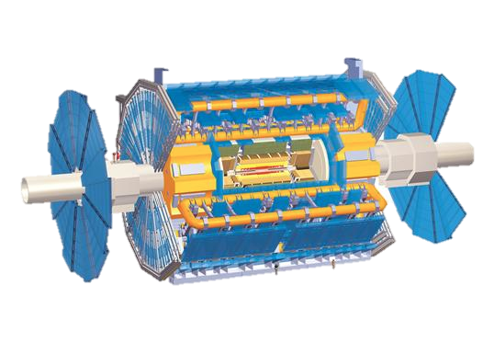

How to discover the Higgs particle at LHC
The Higgs particle is not stable
The only way we can observe it is to detect its decay products
Higgs decays into
2 photons,
or 4 leptons,
or other “channels”
1600 high-tech
superconducting magnets
LHC
proton
proton
gluon
gluon
ATLAS detector
About one Higgs every minute

Slide 37
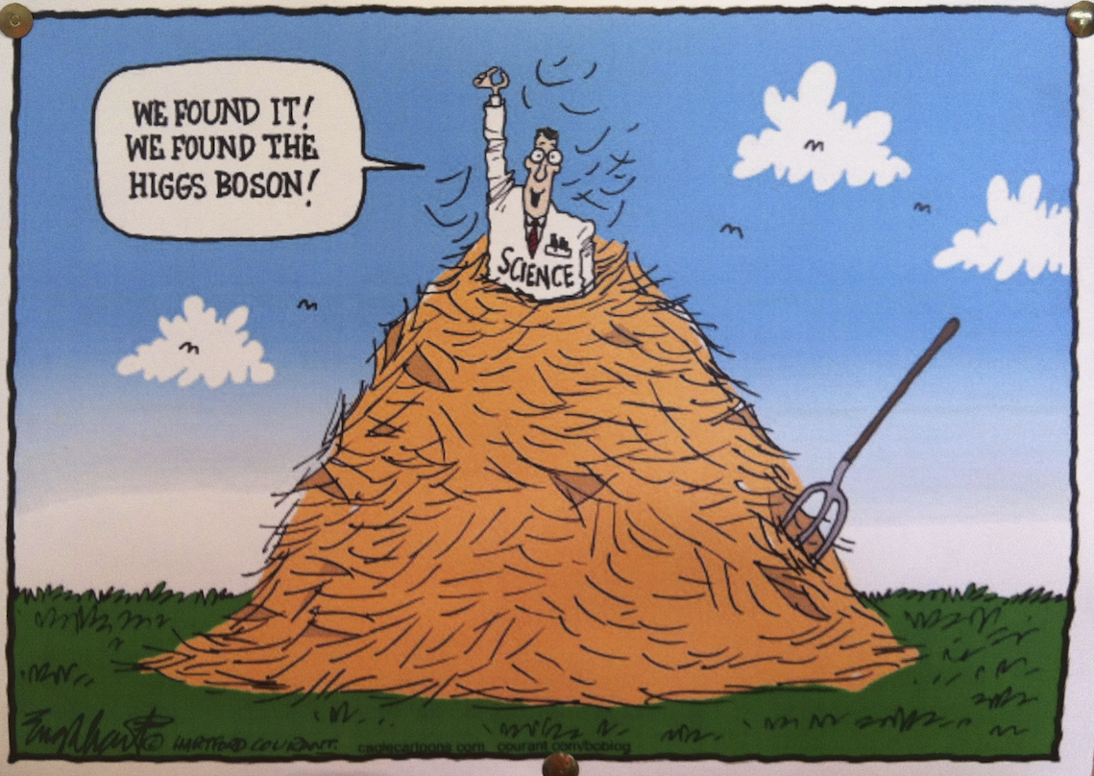
How to search for a Higgs particle?
Not so easy!
Needles in a haystack
In ATLAS, up to July 4, 2012:
A million billion collisions
4.2 billion events analyzed
240,000 Higgs particles produced
~350 diphoton Higgs events detected
~8 four-lepton Higgs events detected
~540k
~900
~21

Slide 38
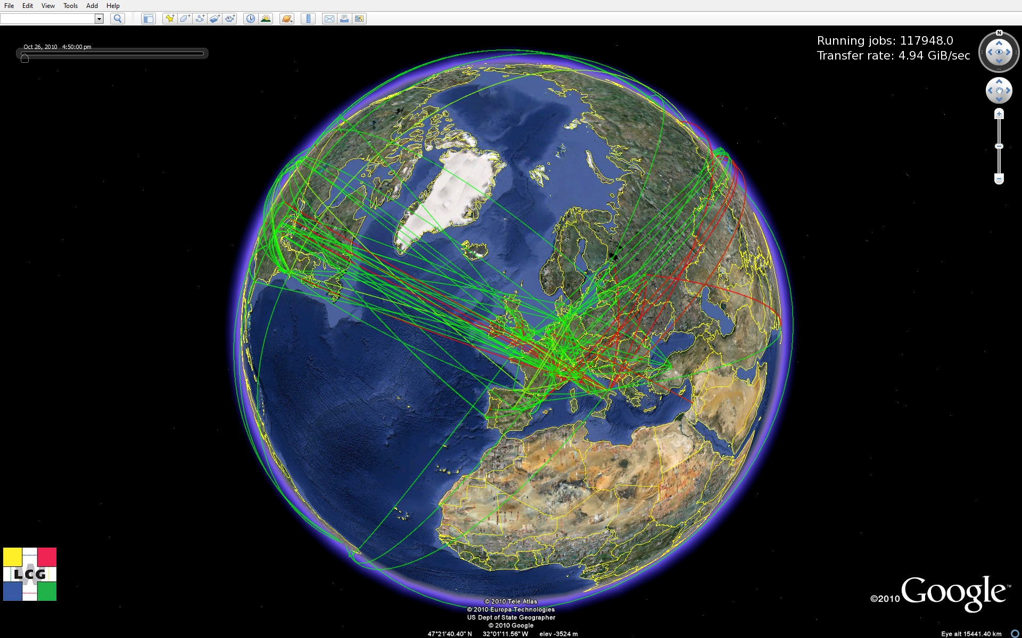
With the Help of the Worldwide LHC Computing Grid
The Worldwide LHC Computing Grid combines the computing resources of more than 100,000 processors from over 170 computing centers in 36 countries, producing a massive distributed computing infrastructure that provides
more than 8000
physicists around the
world with near
real-time access
to LHC data,
and the power
to process it.
~170 computing
Centers
~36 countries
~250K cores
~100 million
gigabytes
of disk
(10 million DVDs)
Lessons learned in managing, securing and linking up on this global scale have driven innovation in computing grids all over the world. Grids are being used in the fight against disease, climate change, air pollution, etc.

Slide 39
TEVATRON EPS-HEP 2011 (July)
http://arxiv.org/abs/1107.5518
_
_
_
Production: qq→W/Z H, gg→H, qq→q’q’H (VBF)
Decay: H→bb, H→W⁺W⁻, H→ZZ, H→τ⁺τ⁻, H→γγ
165 final states (71 CDF, 94 D0)
Channels:
_
Excess in 125<m_{H}<155 GeV (approx. 1 sigma)
95% CL exclusion: 156-177 GeV (expected: 148-180 GeV)

Slide 40
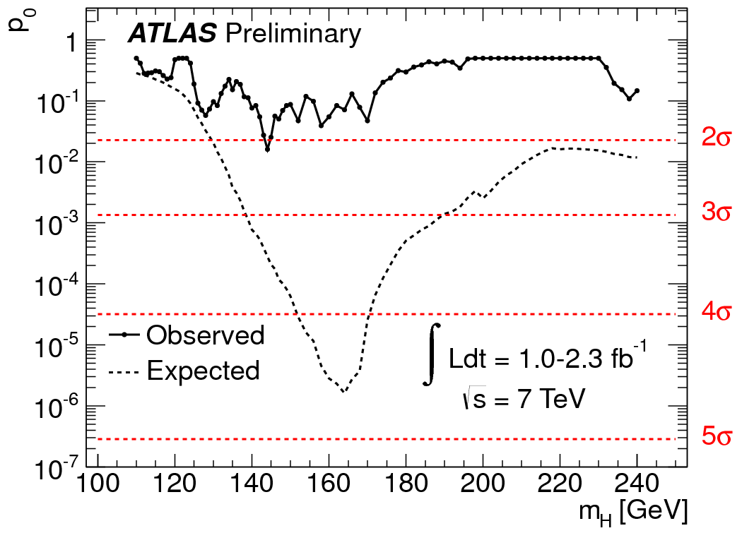
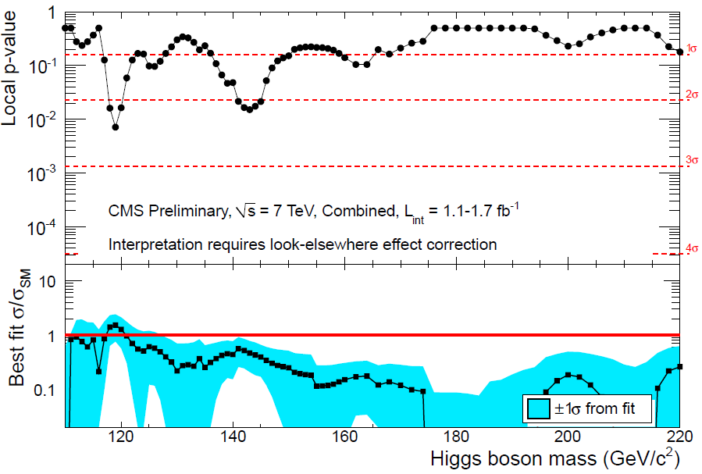
EPS-HEP 2011 (July)
Lepton-Photon 2011 (August)
LHC ERA
At EPS both ATLAS and CMS see >2σ excess at low mass in H→WW→lvlv channel
p₀: probability that the background fluctuates to the observed data (or higher)
p₀ = Local p-value
ATLAS H→γγ, ττ, WW(lvlv), ZZ(4l, llvv, llqq)
H→γγ, bb, ττ, WW(lvlv), ZZ(4l, llττ, llvv, llqq)
ATLAS (LP11)
largest local excess: 2.1σ at 145 GeV
CMS (LP11)
largest local excess: 2.3σ at 120 GeV

Slide 41
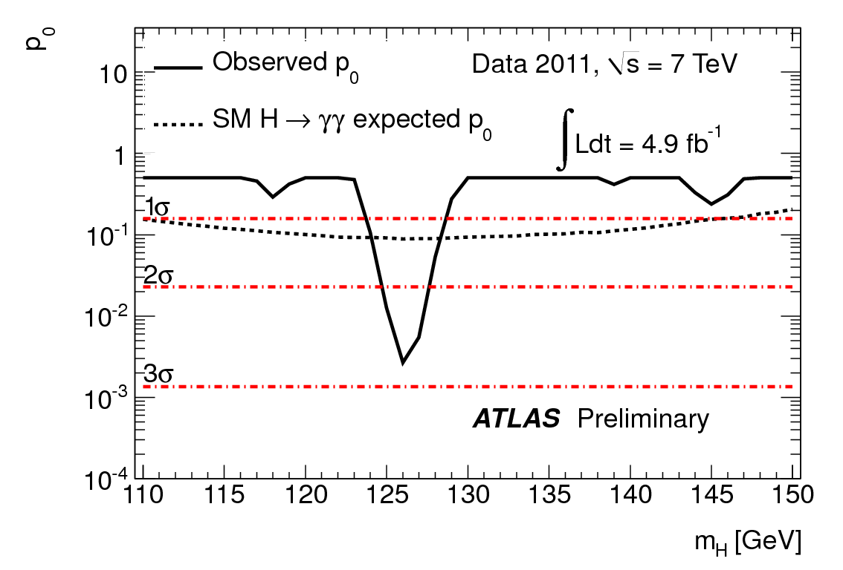
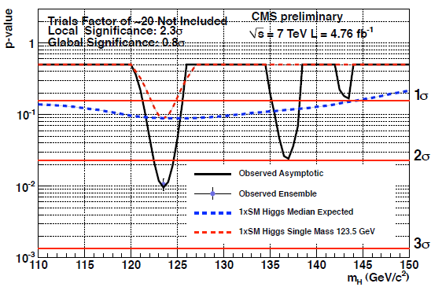
LHC ERA CERN Council Meeting (Dec 2011) H→ γγ
This was the point at which a major excitement started building up
ATLAS: γγ , ZZ → 4l updated with ~5 fb⁻¹ of 7 TeV data
CMS: all channels updated with ~5 fb⁻¹ of 7 TeV data
Lowest p₀: m_{H}=126 GeV
Lowest p₀: m_{H}=123.5 GeV
p₀
2.8σ
2.3σ
ATLAS γγ only
CMS γγ only
Both experiments see large excesses at similar m_{H}

Slide 42
LHC ERA CERN Council Meeting (Dec 2011) H→4l
2.1σ
2.7σ
ATLAS 4-leptons only
CMS 4-leptons only
Largest local excess:
2.1σ at ~125 GeV
Largest local excess:
2.7σ at ~120 GeV

Slide 43
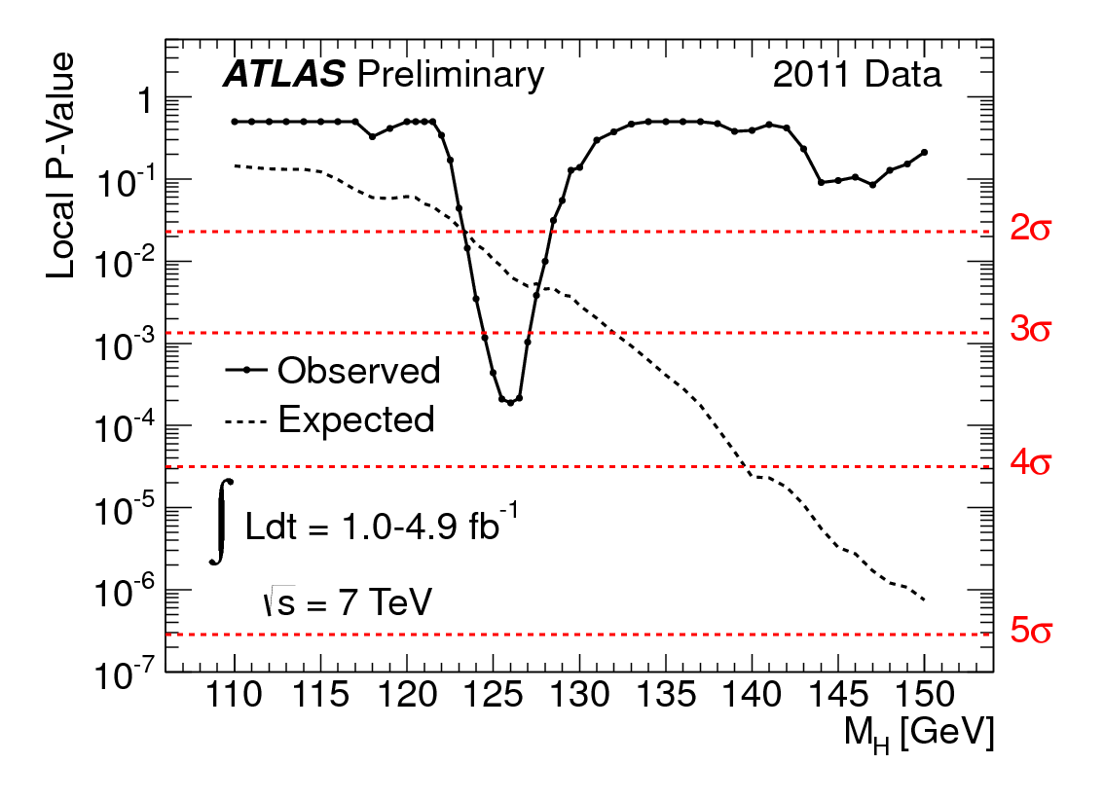
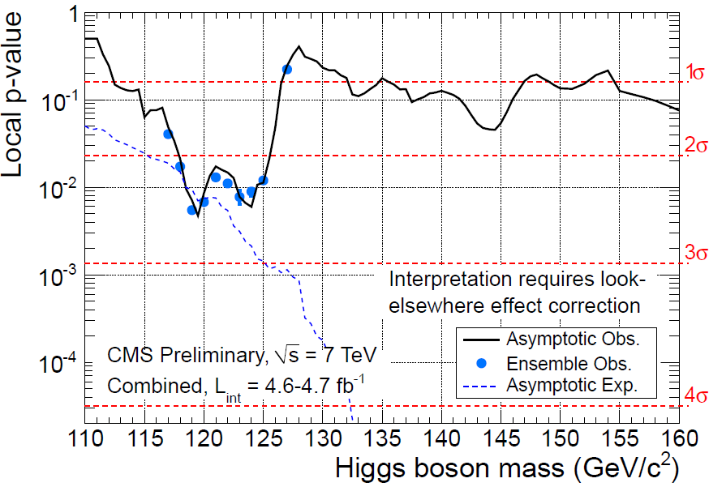

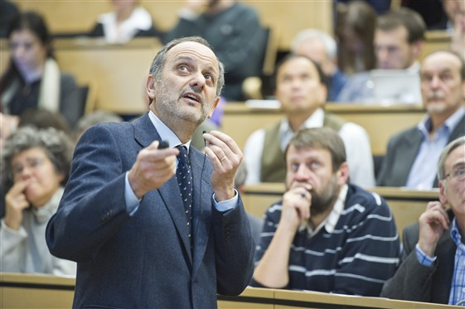
LHC ERA CERN Council (Dec 2011) Higgs combined
ATLAS
H→γγ, ττ, WW(lvlv, lvqq), ZZ(4l, llvv, llqq, llbb)
red: 5fb⁻¹ green: 1fb⁻¹, black: 2 fb⁻¹
CMS
H→γγ, bb, ττ, WW(lvlv), ZZ(4l, llττ, llvv, llqq)
3.6σ
2.6σ
Largest local excess: 3.6σ at 126 GeV
Largest local excess:
2.6σ at ~120 GeV
“Tantalizing hints”
Guido Tonelli
Fabiola Gianotti

Slide 44
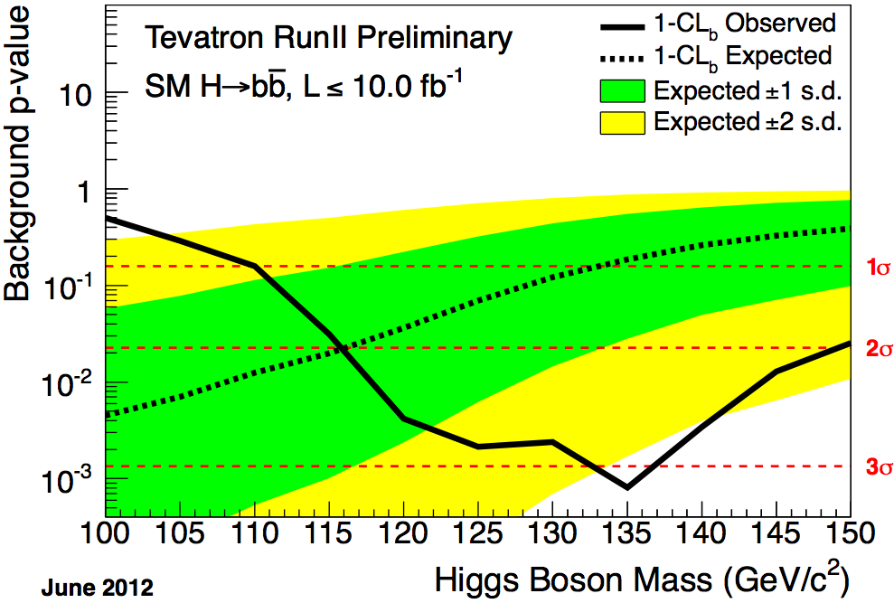
TEVATRON ICHEP 2012 (July)
Exclusion: 100-103, 147-180 GeV (expected: 100-120, 139-184 GeV)
Excess in 115<m_{H}<140 GeV; @120GeV: p=1.5x10⁻³ (3.0σ)
FERMILAB-CONF-12-318-E (July 2, 2012)
Excess concentrated in the
H to bb channel
  global (115-150): 3.1σ
  @m_{H}=125GeV: (2.8σ)
Phys. Rev. Lett. 109, 071804 (2012)
_
_
_
Production: qq→W/Z H, gg→H, qq→q’q’H (VBF)
Decay: H→bb, H→W⁺W⁻, H→ZZ, H→τ⁺τ ⁻, H→γγ
_
For details on Tevatron results, see talk by Weiming Yao

Slide 45
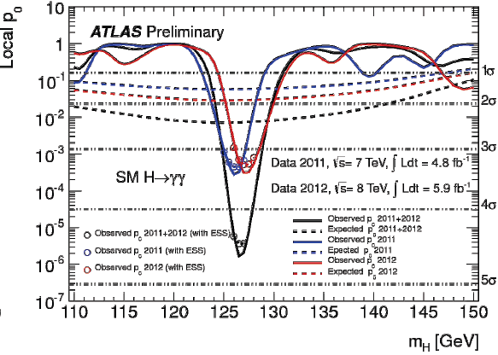
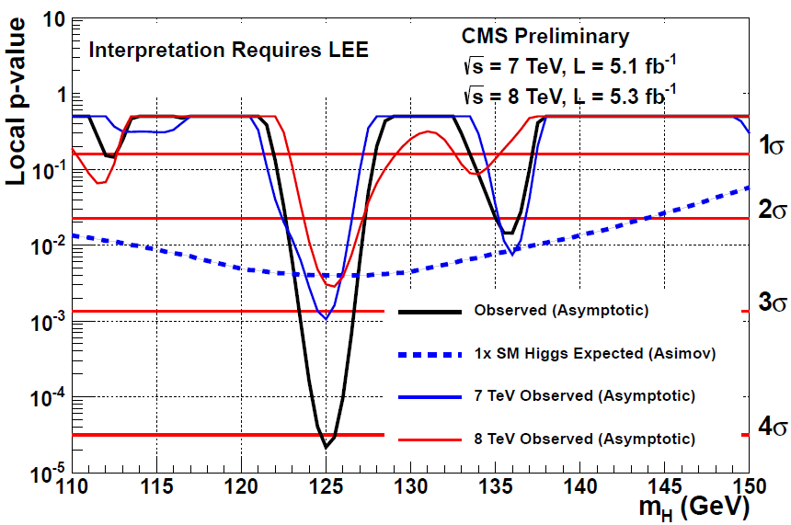
LHC ERA July 4, 2012 and ICHEP 2012 H→ γγ
‘This is it!’ : discovery of Higgs-like resonance
- independently by the two experiments, each with two channels
ATLAS γγ only
CMS γγ only
4.5σ
4.1σ
Largest local excess:
4.5σ at m_{H}= 126.5 GeV
Largest local excess:
4.1σ at m_{H}= 125 GeV

Slide 46
LHC ERA July 4, 2012 and ICHEP 2012 H→4 leptons
- independently by the two experiments, each with two channels
ATLAS 4 leptons only
CMS 4 leptons only
2σ
1σ
2σ
3.2σ
3σ
3σ
3.4σ
4σ
4σ
Largest local excess:
3.4σ at m_{H}= 125 GeV
Largest local excess:
3.2σ at m_{H}= 125.5 GeV

Slide 47
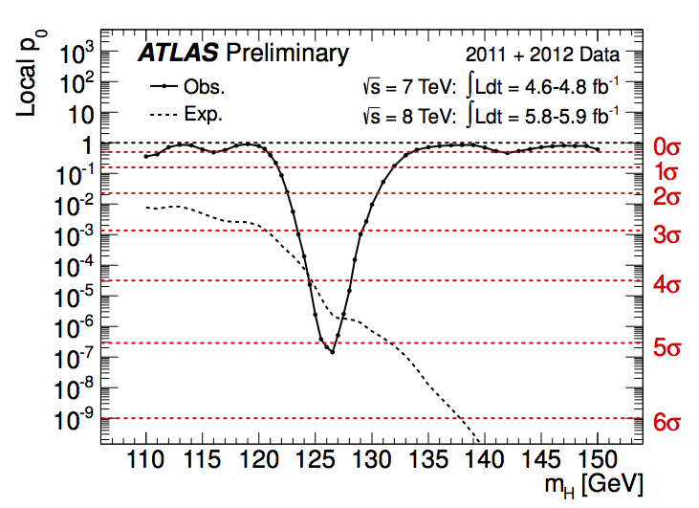
LHC ERA The moment of 5σ discovery
Combining the results of the two discovery channels
H→2 photons and H→4 leptons (2011+2012 datasets):
(plus 2011 data from less strong channels H→WW, H→ττ, H→bb)
(July 4, 2012)
p₀: probability that the background fluctuates to the observed data (or higher)
The chances that the events observed were due to random fluctuations are less than one in three million – corresponding to the stringent “five sigma” gold standard particle physicists insist on to claim a discovery.
p₀ (5σ) = 2.87 x 10⁻⁷
5σ

Slide 48
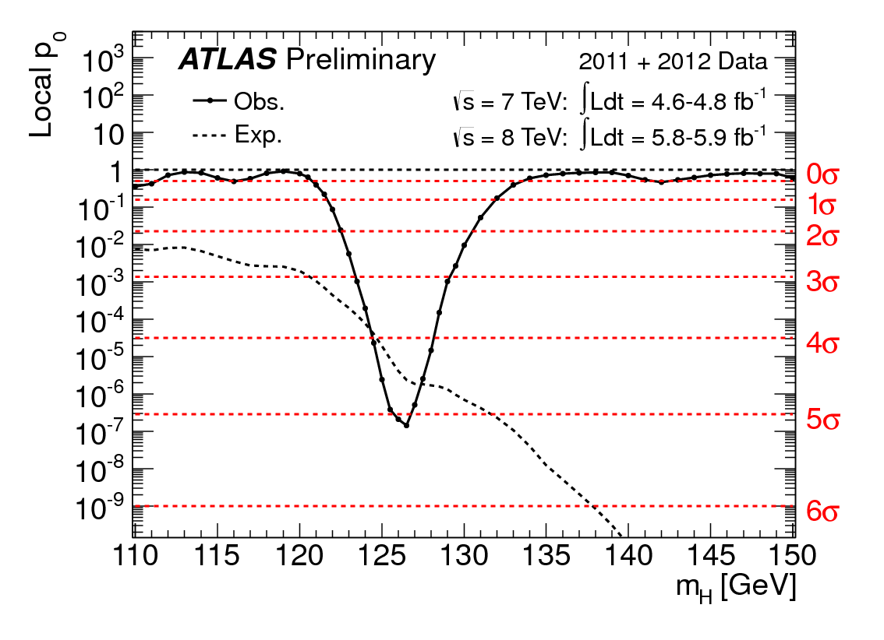
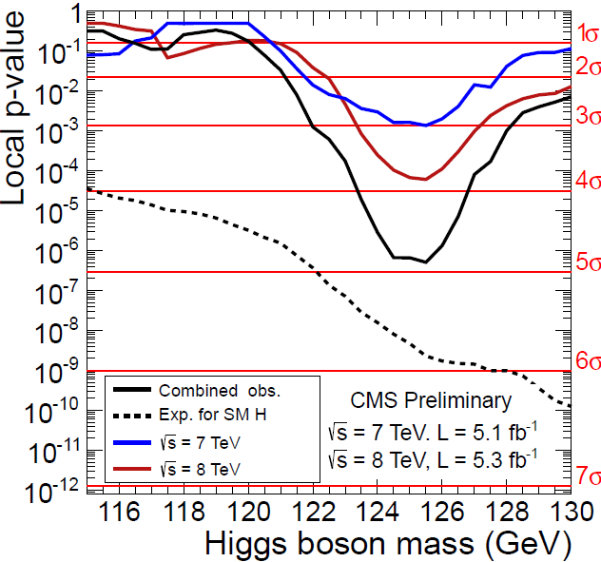
LHC ERA July 4, 2012 and ICHEP 2012 Higgs combined
ATLAS
γγ, 4l updated with
~6 fb⁻¹ of 8 TeV data
All channels updated with ~5 fb⁻¹ of 8 TeV data
CMS
4.9σ
5σ
Largest local excess:
4.9σ around m_{H}= 125 GeV
(using H→γγ and H→4l: 5.0σ)
With LEE in 110 < m_{H} < 145 GeV,
global significance: 4.4σ
Largest local excess:
5σ at m_{H}= 126.5 GeV
With LEE in 110 < m_{H} < 150 GeV,
global significance: 4.3σ

Slide 49
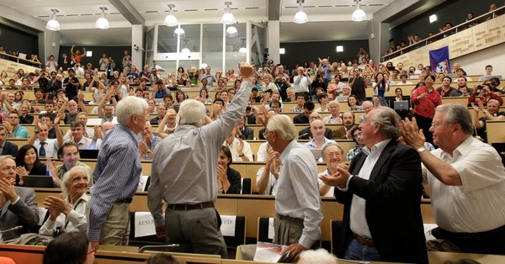
LHC ERA The discovery of the Higgs boson
July 4 2012, “Discovery!”

Slide 50

LHC ERA July 4, 2012
The day of the CERN public announcement of the discovery
On July 4, 2012 the Higgs working group had a celebratory drink. Everyone is watching the corks of the champagne bottles flying up to the ceiling.

Slide 51
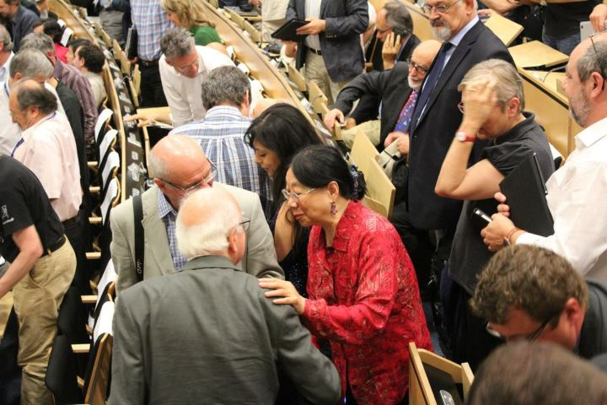
LHC ERA July 4, 2012
The day of the CERN public announcement of the discovery
Professor
Englert
Professor
Higgs
On July 4, at the end of the CERN seminar I went to shake hands with Prof. Higgs. I told him “I have been looking for you for over 20 years”. He replied “now, you have found me”.

Slide 52



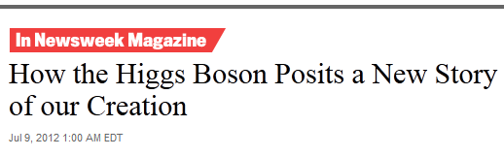

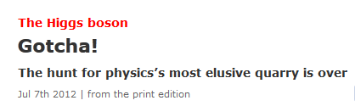
JULY 4, 2012
JULY 9, 2012
JULY 7, 2012

Slide 53

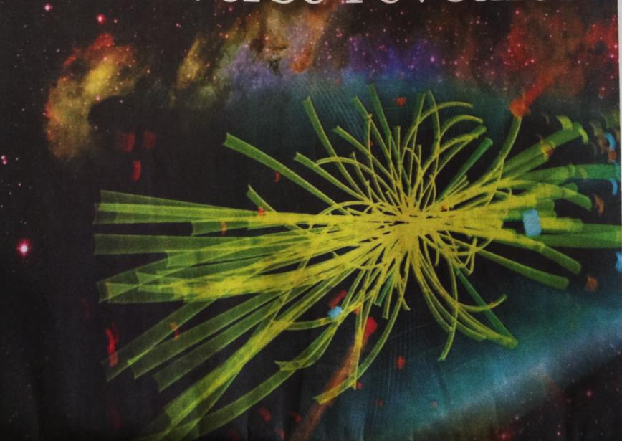





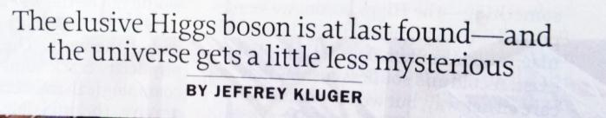


JULY 5, 2012
JULY 5, 2012
JULY 4, 2012
JULY 4, 2012

Slide 54
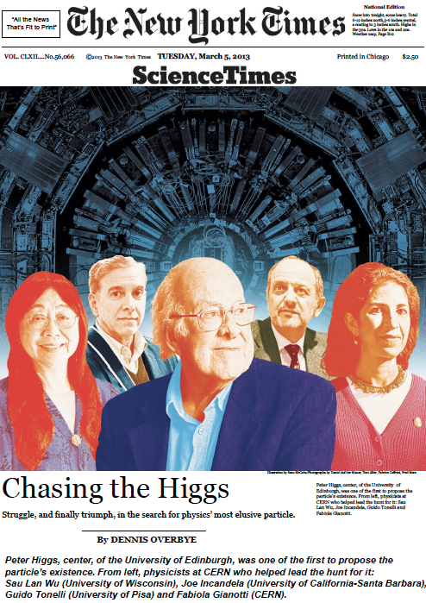
New York Times, March 5, 2013

Slide 55


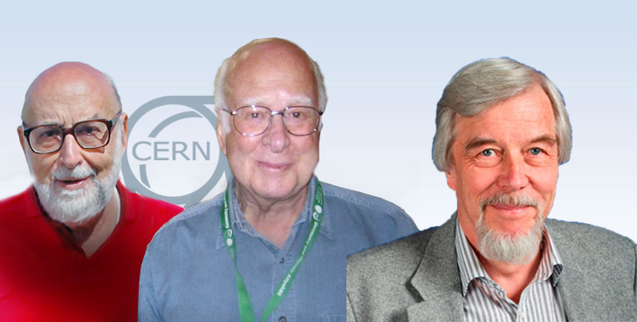
Prince of Asturias Award for Technical &
Scientific Research 2013
H. R. H. the Prince of Asturias
Honorary President
of the Foundation
Peter Higgs, François Englert and CERN
“For the theoretical prediction and experimental detection of the Higgs boson.”

Slide 56
EPS Prize

Slide 57
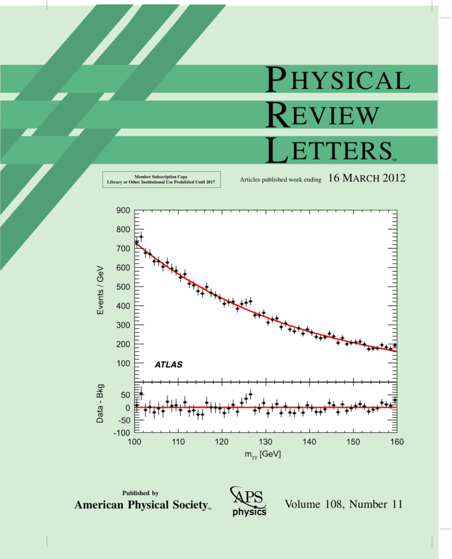
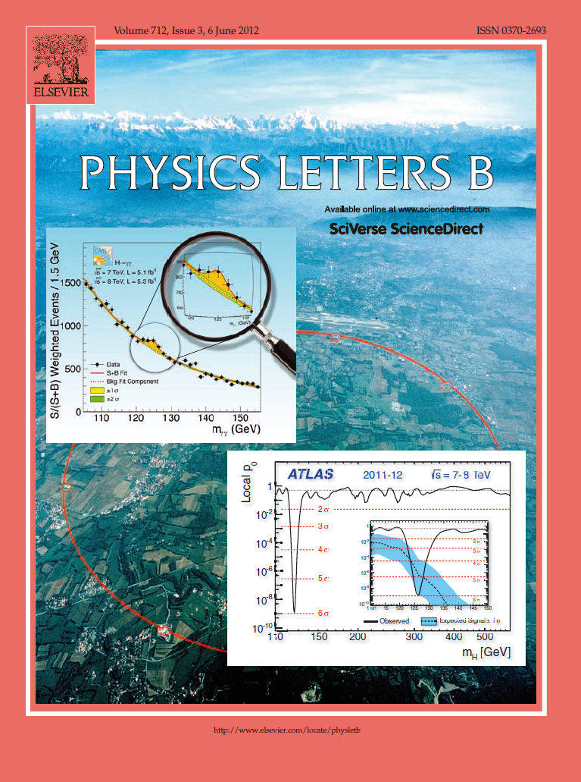
Higgs Combination Discovery publication
2011 data
2011+2012 data
Significance: 2.9σ at 126.5 GeV

Slide 58
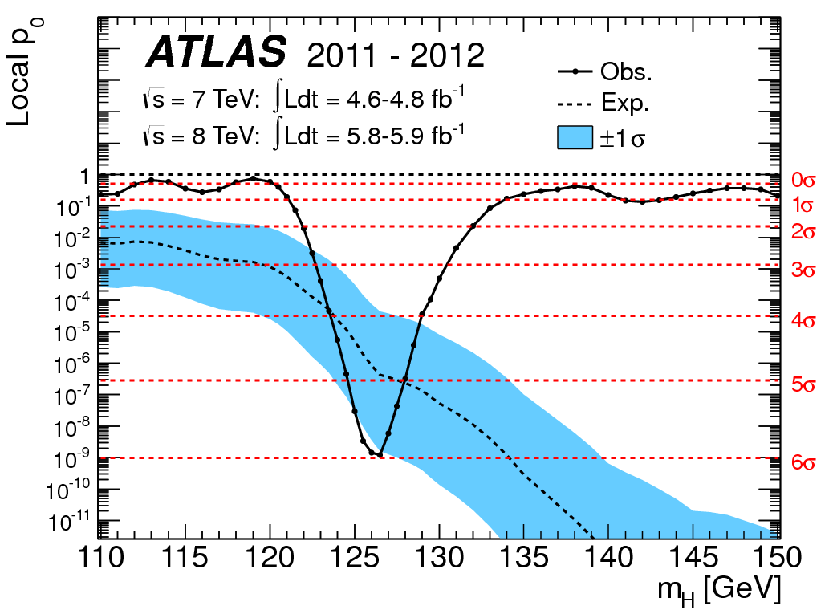
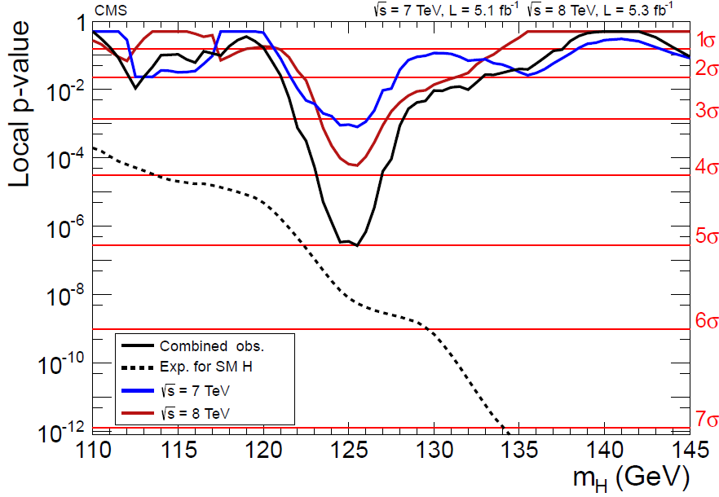
LHC ERA July 2012 publications
On July 31, 2012
ATLAS and CMS submitted papers to Physics Letters B.
ATLAS added 2012 data to the H→WW channel → at m_{H} = 126.5 GeV
5.9σ
5.0σ
5.9σ
ATLAS PLB 716 (2012) 1-29,Sept 17 (2012)
CMS PLB 716 (2012) 30-61,Sept 17 (2012)
Largest local excess:
5.9σ at m_{H}= 126.5 GeV
Largest local excess:
5.0σ at m_{H}= 125.5 GeV
H→γγ, bb, ττ, WW(lvlv, lvqq), ZZ(4l, llvv, llqq)
H→γγ, bb, ττ, WW(lvlv), ZZ(4l, llττ, llvv, llqq)

Slide 59


LHC ERA HCP Nov 2012: significance and mass (CMS)
Update (CMS only)
All channels updated to ~12fb⁻¹ of 8TeV data, except γγ
CMS combination
6.9σ
CMS
CMS
Largest local excess:
6.9σ at m_{H}= 125 GeV
Mass:
125.8 + 0.4 (stat) + 0.4 (syst) GeV

Slide 60


LHC ERA CERN Council Meeting (Dec 2012)
Update (ATLAS only)
ATLAS: γγ, ZZ→4l updated with 13 fb⁻¹ of 8 TeV data
- single-channel discovery: 6.1σ significance in γγ
6.1σ
4.1σ
ATLAS γγ only
ATLAS 4-leptons only
H→ γγ channel alone can declare the Higgs discovery

Slide 61


LHC ERA CERN Council Meeting (Dec 2012)
7.0σ
ATLAS 4l mass distribution
ATLAS Higgs combined
In 120<m_{4l}<130 GeV:
Expected background: 8.3±0.3
Expected signal: 9.9±1.3
Observed: 18
Wider than in previous versions
because of the mass-scale systematic uncertainties.
4.1σ

Slide 62

LHC ERA How we got there (animation)
H→ γγ (Moriond EW 2013 )
ATLAS

Slide 63

LHC ERA How we got there (animation)
H→4 leptons (Moriond EW 2013 )
ATLAS

Slide 64

LHC ERA From excess to discovery (ATLAS)
Local p₀: probability that the background fluctuates to the observed data (or higher)
~10σ

Slide 65
LHC ERA
I shall finish this talk on Historic Review briefly up to EPS (July 2013).
See talks by Bing Zhou (ATLAS) and
Greg Landsberg (CMS)

Slide 66


LHC ERA ATLAS New Results
(Submitted to PLB on July 2013)
H→ γγ
expected
H→4 leptons
expected
7.4σ (4.3σ)
6.6σ (4.4σ)
m_{H}= 126.8±0.2(stat) ±0.7(syst) GeV
μ = 1.57±0.22(stat) (syst) (theory)
at m_{H} =126.8 GeV
+0.6
-0.5
+0.5
-0.3
m_{H}= 124.3 (stat) (syst) GeV
μ = 1.7 at m_{H} =124.3 GeV
+0.17
-0.13
+0.17
-0.12
+0.5
-0.4
Between 120 and 130 GeV: exp. signal: ~16, exp bg.: ~11, data: 32
In 90% window: Exp. signal: ~500, exp bg.: ~15.7k, data: ~16.5k
Mass difference: 2.4σ (1.5%), or 8% for different treatment of ESS

Slide 67


LHC ERA CMS New Results (EPS 2013)
H→ γγ
expected
H→4 leptons
expected
3.2σ (4.2σ)
6.7σ (7.2σ)
m_{H} =125.4±0.5(stat)±0.6(syst) GeV
μ = 0.78±0.27 at m_{H} =125 GeV
m_{H} =125.8±0.5(stat)±0.2(syst) GeV
μ = 0.91 at m_{H} =125.8 GeV
+0.30
-0.24
Between 110 and 160 GeV: exp. signal: ~20, exp bg.: ~47, data: 71

Slide 68
Property measurements in ATLAS and CMS
 | ATLAS | CMS
Mass | 125.5 ± 0.2(stat) ± 0.6(syst) | 125.7 ± 0.3(stat) ± 0.3(syst)
Data favors 0+ vs
0- | 97.8% CL | 99.8% CL
spin 1 | 99.7% CL | 99.9% CL
2+ | 99.9% CL | 99.4% CL (100%gg)
Each experiment:
  Couplings to gauge bosons determined at the 10% level
  Rejecting zero couplings to fermions at >5σ
Observation of
  VBF production at 3.3σ (ATLAS)
  VBF+VH production at 3.2σ (CMS)

Slide 69
Looking forward
Before the discovery, all known elementary particles had either spin 1 or spin ½.
The Higgs boson has spin 0, so it is not only a new particle, but a new type of elementary particle
  For this reason, many see the discovery as the most important step forward in physics in the last half a century: it opens a new era of physics
Can we make any guess about this new area of physics?
  First, it is tempting to speculate that the Higgs particle is not the ONLY spin-0 particle

Slide 70


Higgs Excitement has just begun
Secondly, If the large signal strength (μ) for H→ γγ from ATLAS (μ = 1.57 at m_{H} =126.8 GeV)* is sustained with higher statistics, then new physics will surface.
In the SM, the most important Higgs production process in pp interactions is gluon fusion through a top triangle.
If the SM is not the whole story, the situation becomes quite interesting: additional heavy particles could contribute to these triangles:
  New particles with color would contribute to the production triangle
  New particles with charge would contribute to the decay loop
The presence of such new particles may enhance Higgs production and its decay into two photons.
+0.32
-0.28
W, t
production
W, t
decay
W, t
* CMS: μ = 0.78±0.27 at m_{H} =125 GeV

Slide 71
Looking forward
Combining these two points, we speculate that there are NEW spin-0 particles
What can the additional spin-0 particles be? Of course they remain to be discovered
Simplest guess:
there are spin-0 quarks and spin-0 leptons
i.e., scalar quarks and scalar leptons
How do they behave?
  Similar to ordinary quarks and leptons, they are likely to decay into each other through the emission of W+ and W-, either real or virtual
  Unlike ordinary quarks and leptons, they are certainly quite heavy, more than half of the mass of the Z (this is an immediate consequence of the measured width of the Z)

Slide 72
Looking forward
Speculating further:
How many spin-0 quarks and leptons may be expected?
Simplest guess: as many as ordinary quarks and leptons.
  If this is true, when these are observed in the future, we may envisage some sort of symmetry between fermions (ordinary quarks and ordinary leptons) and bosons (scalar quarks and scalar leptons)
  Is this supersymmetry? Maybe, maybe not.
There are many, many interesting and challenging problems to think about and look into – for both experimentalists and theorists.

Slide 73
Conclusion
It is THE Higgs, and not just Higgs-like
It has been a long journey to the Higgs discovery, in a truly international effort
This particle opens up a fabulous new era of particle physics
The glory of the Higgs discovery is to be shared by the entire Higgs community, which has been chasing after the Higgs for over thirty years
Congratulations to all !

Slide 74
BACKUP SLIDES

Slide 75
LEP 2 ERA

Slide 76

LEP-2 ERA ALEPH candidate (b) 56065 3253 m=112.9 GeV E_{cm} = 206.7 GeV

Slide 77


ALEPH Higgs Candidates
Event weight of each candidate as a fuinction of the Higgs boson mass ALEPH candidates with weight>0.4 (NN stream)
Candidates:
  Solid: four-jet
  Dashed: lepton pair
  Dotted: tau pair
E_{cm}
206.6
206.7
206.7
206.5

Slide 78

LEP-2 ERA Request on Nov 3, 2000
Document for LEP Committee (LEPC)
by the LEP Higgs Working Group:
Standard Model Higgs Boson at LEP:
Results with the 2000 Data, Request for Running in 2001 (link)
“The data collected after the September 5th LEPC are consistent with the reference sample analysed prior to the LEPC, and with the production of a standard model Higgs boson with mass 115 GeV/c2. … an additional sample of ~200pb-1 … would be enough to increase the statistical significance from ~3σ to ~5σ and to claim a discovery. It should be feasible with a four-to-six month running period of LEP in 2001.”

Slide 79
RECENT LHC RESULTS

Slide 80
LHC ERA ATLAS New results (EPS 2013)
_
H→γγ (4.8fb⁻¹ 7TeV + 20.7fb⁻¹ 8TeV)
H→4 lepton (4.6fb⁻¹ 7TeV + 20.7fb⁻¹ 8TeV)
H→ττ , bb (4.8fb⁻¹ 7TeV + 13fb⁻¹ 8TeV)
H→WW (4.6fb⁻¹ 7TeV + 20.7fb⁻¹ 8TeV)
Channel |  | Mass (GeV)
H→γγ | 7.4σ (4.3σ) | 126.8+0.2(stat)+0.7(sys)
H→4 leptons | 6.6σ (4.4σ) | 124.3+0.6(stat)+0.4(sys)
H→WW | 3.8σ (3.8σ) at 125 GeV
Higgs Combination ~10σ
Signal Significance
observed (expected)
Combined mass of measurement from H→γγ and H→ZZ ⃰→4 leptons
m_{H}= 125.5 + 0.2(stat) + 0.5/-0.6(syst) GeV
m_{H}= 2.3 +0.6/-0.7(stat) + 0.6(syst) GeV
Compatibility(2.3σ)

Slide 81

LHC ERA ATLAS New results (Submitted to PLB)
Signal strength (µ) =
(signal rate from fit to data) / (expected SM signal rate at given m_{H} )
m_{H} = 125.5GeV
+0.17
-0.13
+0.17
-0.12
1.57 + 0.22(stat) (syst) (theory)
at m_{H} =126.8GeV
+0.5
-0.4
1.7 at m_{H} =124.3GeV
1.33+ 0.2 at m_{H} =125.5GeV
For H→4 leptons, a spin-parity analysis is performed on events with m_{4l} between 115 and 130GeV. The 0⁺ state is favored over 0 ̄ ,1⁺,1 ̄ ,and 2⁺ and 2 ̄.
States 0 ̄ and 1⁺ are excluded at 97.8% CL or higher in favor of 0⁺.

Slide 82
LHC ERA CMS Results (EPS HEP 2013)
Channel | Signal Significance Observed (expected) | Mass(GeV) | Signal Strength at m_{H}= 125GeV | Integrated Luminosity fb⁻¹ 7TeV + 8TeV
H→γγ | 3.2σ(4.2σ) | 125.4+0.5(stat) +0.6(syst) | 0.78+0.27 | 5.1+19.6
H→4 leptons | 6.7σ(7.2σ) | 125.8+0.5(stat) +0.2(syst) | 0.91 | 5.1+19.6
H→WW | 4.0σ(5.1σ) |  | 0.76+0.21 | 4.9+19.5
H→ττ | 2.85σ(2.62σ) |  | 1.1+0.4 | 4.9+19.4
H→bb | 2.1σ(2.1σ) |  | 1.0+0.5 | 5+19
+0.30
-0.24
(at 125.8 GeV)

Slide 83

LHC ERA CMS New results (April 2013)
Signal strength (µ) =
(signal rate from fit to data) / (expected SM signal rate at given m_{H} )
m_{H} = 125.7 ± 0.3(stat) ± 0.3(syst) GeV
For H→4 leptons, a spin-parity analysis is performed. The 0⁺ state is found to be favored over the 0 ̄ ,1⁺,1 ̄ ,and 2⁺ states at 98.6% confidence level or better.
Spin-parity analysis also performed in H→WW. The 0⁺ state is found to be favored over 2⁺.
0.80 ± 0.14 at m_{H} =125.7GeV

