Slide 1
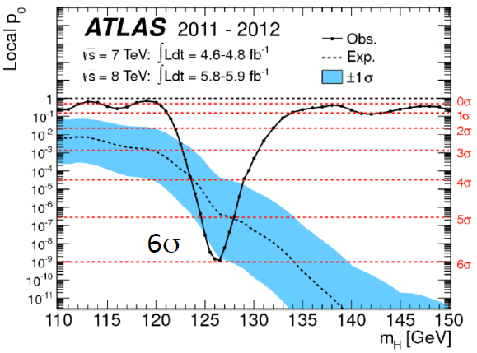
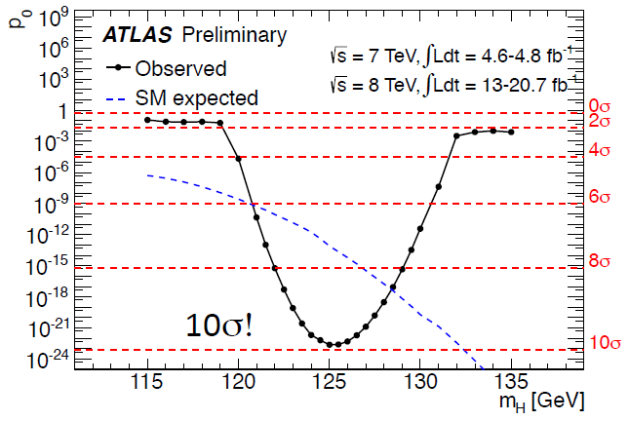
Summary of Higgs Results from ATLAS
Bing Zhou
On behalf of the ATLAS Collaboration
At International Symposium on Higgs Physics
Beijing, August 12, 2013
July 4th 2012 Discover Higgs-like boson
July 2013 SM Higgs boson

Slide 2
July 2012 – Revolution in Particle Physics

Slide 3
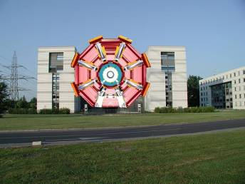
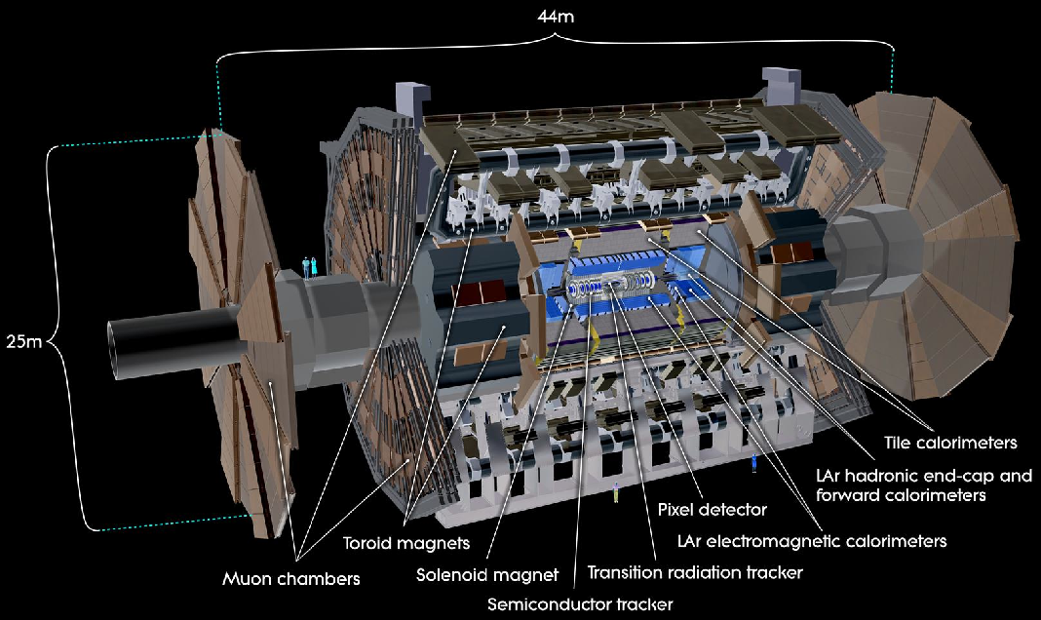
Muon Spectrometer (|η|<2.7) : air-core toroids with muon chambers (tracking and trigger) to measurement with momentum resolution < 10% up to E_{μ} ~ 1 TeV
38 Countries
174 Institutions
3000 Scientists 1000 Students
ATLAS Detector
Length : ~ 44 m
Radius : ~ 12 m
Weight : ~ 7000 tons
~10⁸ electronic channels
3000 km of cables
Inner Detector (|η|<2.5, B=2T):
Si Pixels, Si strips, Transition Radiation detector (straws)
Precise tracking and vertexing,
e/π separation
Momentum resolution:
σ/p_{T} ~ 3.8x10⁻⁴ p_{T} (GeV) ⊕ 0.015
3-level trigger
reducing the rate
from 40 MHz to
~300 Hz
HAD calorimetry (|η|<5): segmentation, hermeticity
Fe/scintillator Tiles (central), Cu/W-LAr (fwd)
Trigger and measurement of jets and missing E_{T}
E-resolution: σ/E ~ 50%/√E ⊕ 0.03
EM calorimeter: Pb-LAr Accordion
e/γ trigger, identification and measurement
E-resolution: σ/E ~ 10%/√E

Slide 4
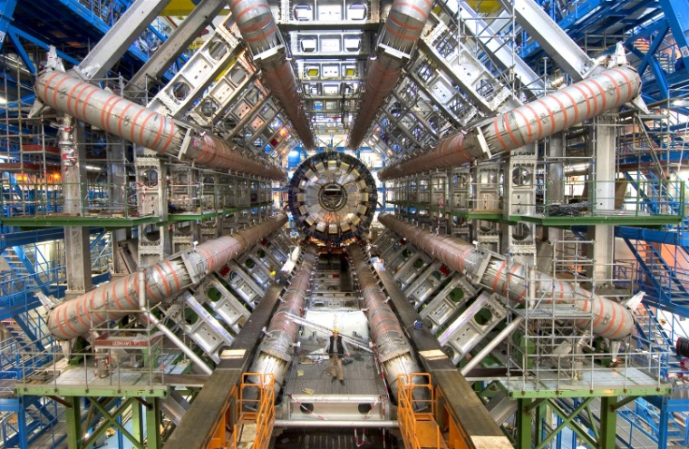
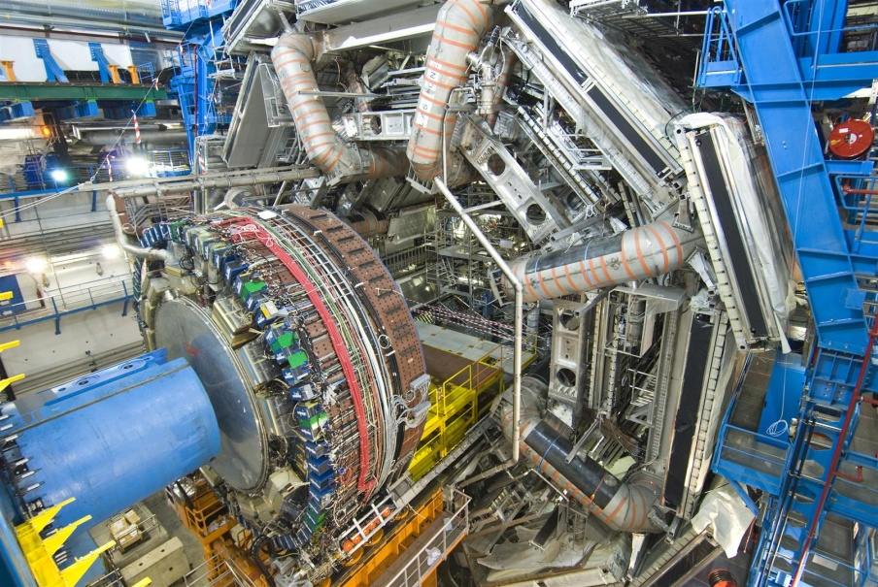
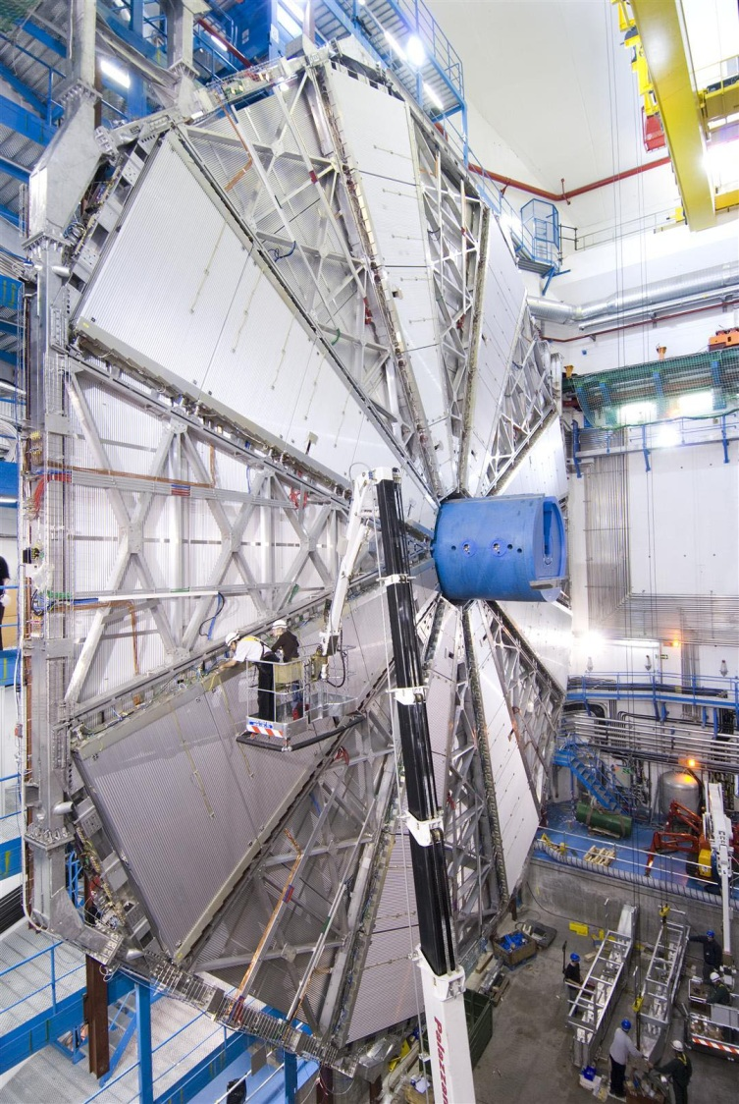
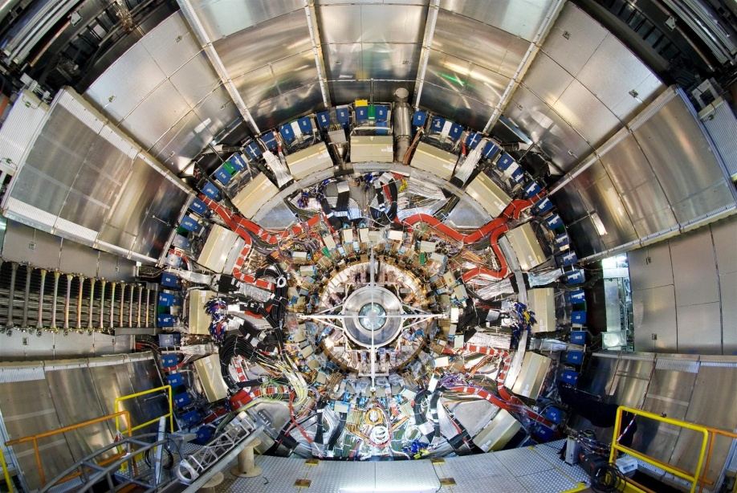
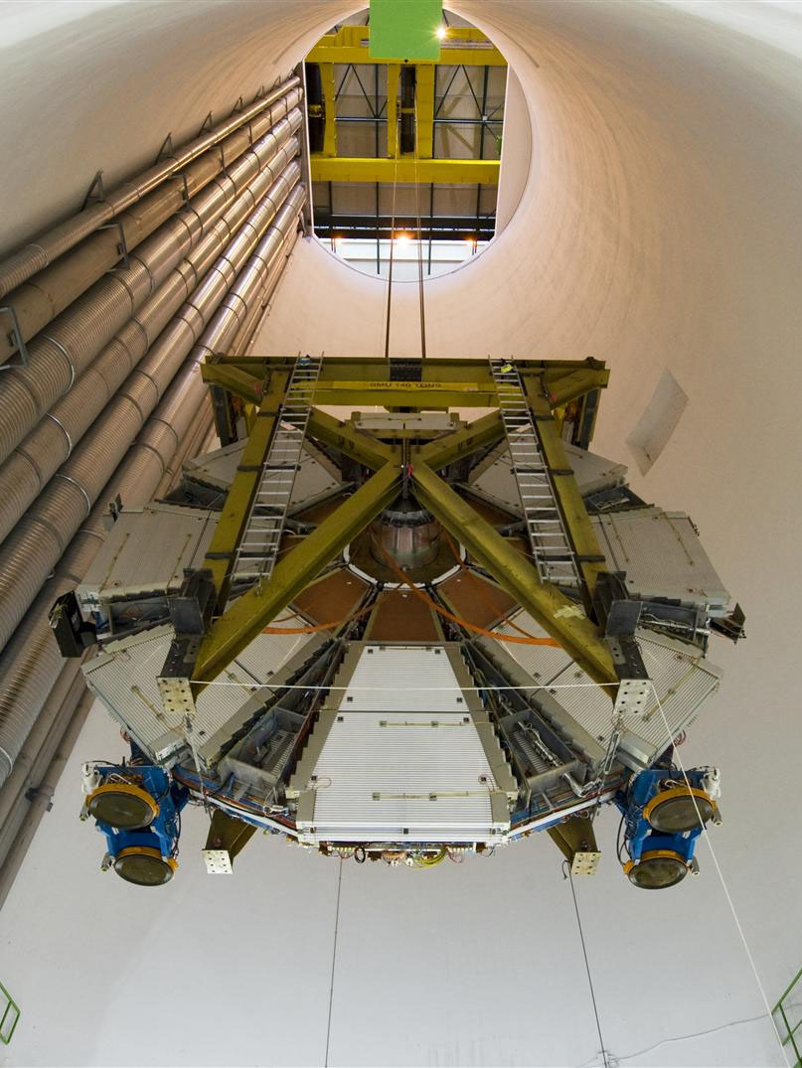
Barrel toroid
Calorimeter
Muon Big Wheel
ATLAS Detectors > 10 years to design, build
Install inner detector
2008
Muon Small Wheel

Slide 5
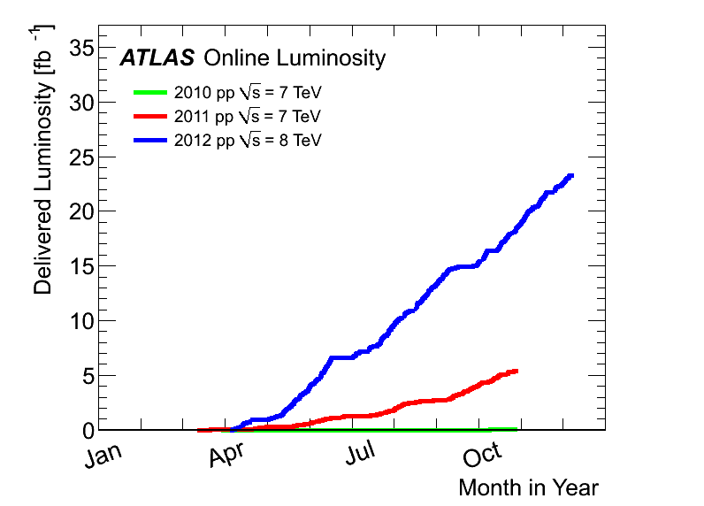
LHC Delivered Luminosity to ATLAS
~ 5 billion events recorded
in total (2010-2012)
~ 120 PB of data (including
real and simulated data)
as of today
2012:
23 fb⁻¹
at 8 TeV
The most powerful particle factory in world to produce
massive particles in proton-proton collisions
> 2,000,000,000 W
> 700,000,000 Z
> 8,000,000 top pair
> 600,000 Higgs
4th July seminar
and ICHEP
2011
5.6 fb⁻¹
at 7 TeV
2010
0.05 fb⁻¹
at 7 TeV
Major experimental challenge: pileup!
~<25? interactions in each bunch cross in 2012

Slide 6
Key to Success Excellent ATLAS Performance
The ATLAS detector has performed remarkably well through the hard work of the collaboration to keep working at top shape

Slide 7
Re-establish SM at the LHC
→ the steppingstone for discoveries
σ(H) = 22.28 pb
σ(H→γγ) = 0.05 pb
σ(H→ZZ)= 0.59 pb
H Production | gg→ H | VBF→H | W/Z+H | tt+H
σ at 8TeV (pb) | 19.5±15% | 1.57 ±5% | 1.08±5% | 0.13±15%
H decays | γγ | ZZ→4l | WW→lνlν | ττ | bb
BR (M_{H}=125GeV) | 0.23% | 0.012% | 1.04% | 6.3% | 57.7%

Slide 8
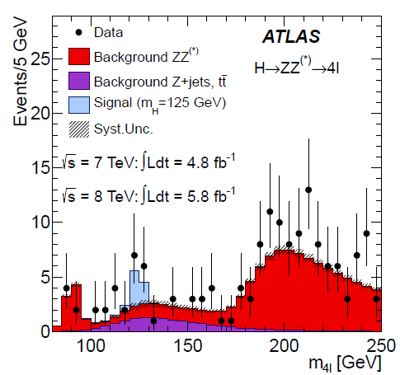
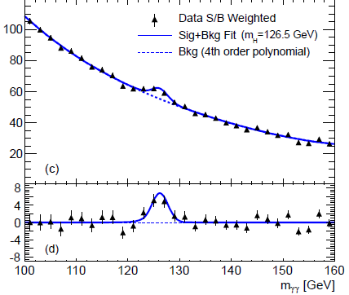
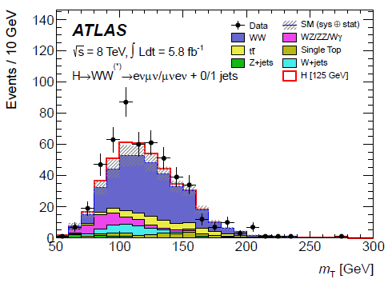
Breakthrough in Science
July 31,2012
Phys. Lett. B 716 (2012)1-29
ATLAS
H→ZZ
~7 events, 3.4σ
H→γγ
~70 events, 4.5σ
H→WW
~20 events, 2.8σ
Combined significance: 5.9 σ

Slide 9
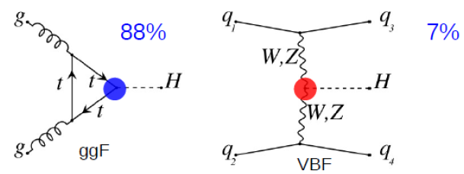
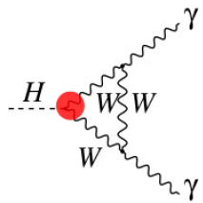
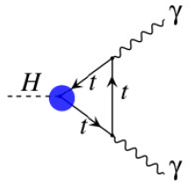
Is the New Boson The SM Higgs?
Higgs production (m_{H} = 125 GeV)
Higgs decays
W, Z
f
H
H
W, Z
f
Couplings (new force!)
g_{F} (Yukawa coupling) =√2 x m_{F}/ν
g_{V} (Gauge coupling) = 2m_{V}²/ν
(ν is the vacuum expectation value)
Spin-Parity

Slide 10
New -- After the Higgs Discovery
New ATLAS Higgs Papers
arXiv:1307.1427 Sub. Phys. Lett. B (Mass, Couplings)
arXiv:1307.1432 Sub. Phys. Lett. B
(Spin-parity)
New ATLAS Higgs Pub Notes
ATLAS-CONF-2013-012 (γγ)
ATLAS-CONF-2013-013 (ZZ*)
ATLAS-CONF-2013‐031 (WW*)
ATLAS-CONF-2013-040 (Spin)
ATLAS-CONF-2013-079 (VH → bb)
ATLAS-CONF‐2012‐160 (H → ττ)
ATLAS-CONF-2013‐075 (WW*)
ATLAS-CONF-2013-029 (γγ)
ATLAS-CONF-2013-009(Zγ)
ATLAS-CONF-2013-010(μμ)
ATLAS-CONF-2013-067(HMH→WW)
ATLAS-CONF-2013-072 (diff σ H→γγ)
ATLAS-CONF-2013-075(VH→WW)
ATLAS-CONF-2013-080(tt +H→γγ)
ATLAS-CONF-2013-081(t→cH)
H→ γγ, ZZ*, WW* analysis updates based on full 2011-2012 dataset (4.6 fb⁻¹ @ 7TeV, 20.7 fb⁻¹ @ 8TeV)
Higgs mass from H→γγ and H→ZZ*→ 4l
Signal strengths (μ = σ/σ_{SM})
Sensitivity to vector boson fusion (VBF)
Comparison of decay rates
Couplings
Spin and parity
Searches in rare decay modes
Property measurement
Searches

Slide 11
Update on H→ VV ZZ*, γγ, WW*, Zγ

Slide 12
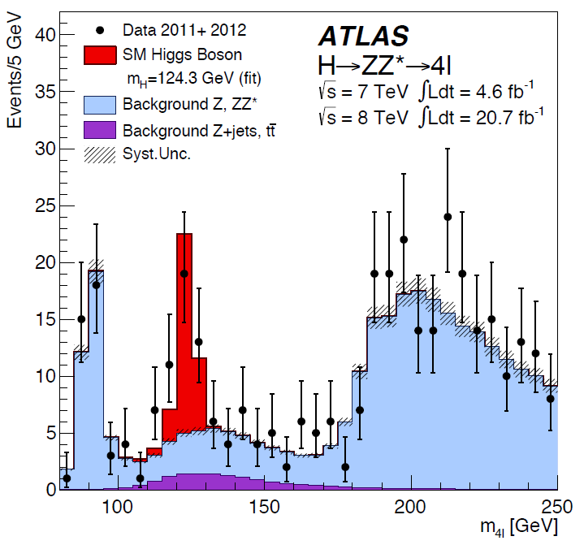
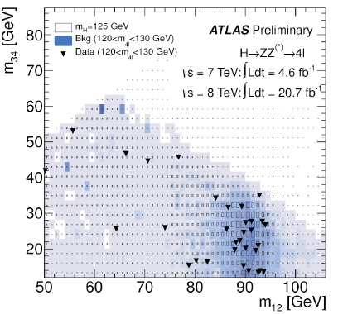
H→ ZZ*→ 4l
arXiv:1307.1427
BR (H→ZZ*) = 2.63% (M_{H}= 125 GeV). Total ~65 H→ ZZ*→ 4l events produced at LHC
DataSet | Production | background | Exp. Signal | S/B
~25 fb⁻¹ | ggF, (VBF,VH) | ZZ*, Z+X, tt | ~16 | ~1.4
Events in 3 categories: VBF(jets), VH(lepton) and ggF-like (the rest)
Huge effort on lepton ID efficiencies, and calibration of mass scale for m_{ll} and m_{4l}

Slide 13
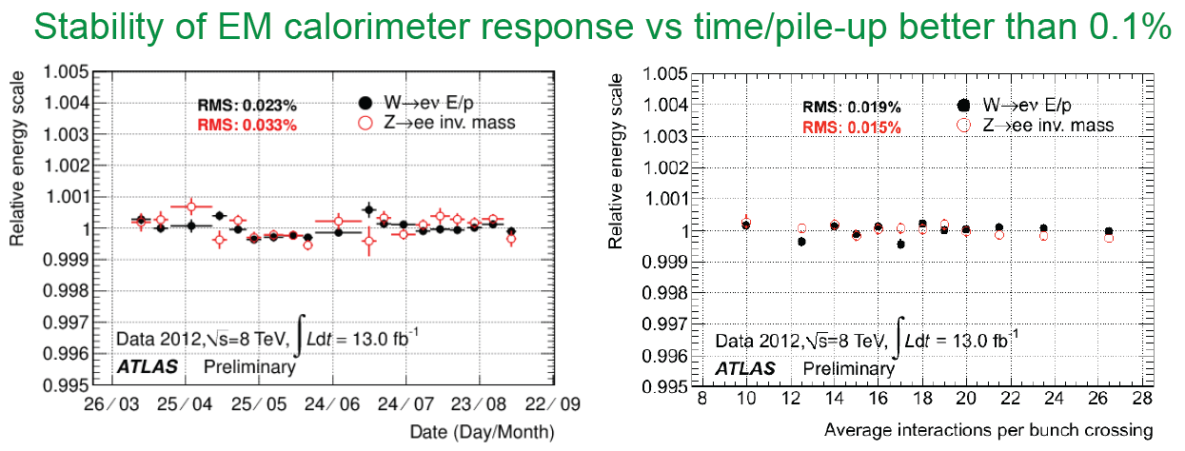
Lepton Energy/Momentum Calibration
Nice validation
Z→4μ
Muons
Electrons

Slide 14
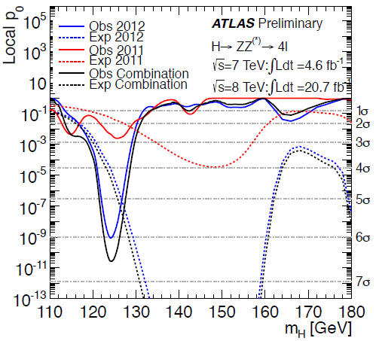
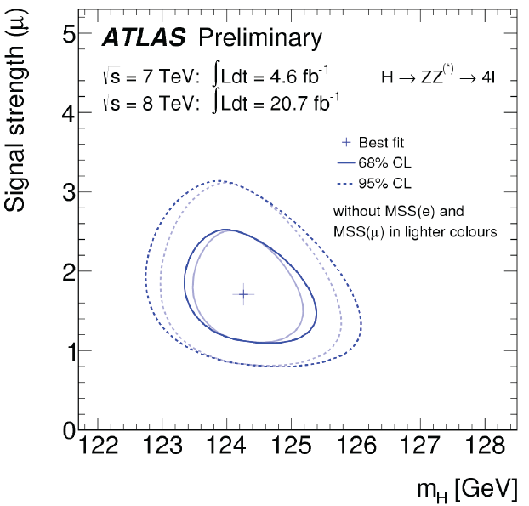
H→ ZZ*→ 4l
arXiv:1307.1427
Signal Significance :
6.6σ (4.4σ expected)
Exceeding discovery criteria
Signal strength:
μ = 1.7^{+0.5}_{-0.4}
at mass = 124.3 GeV

Slide 15
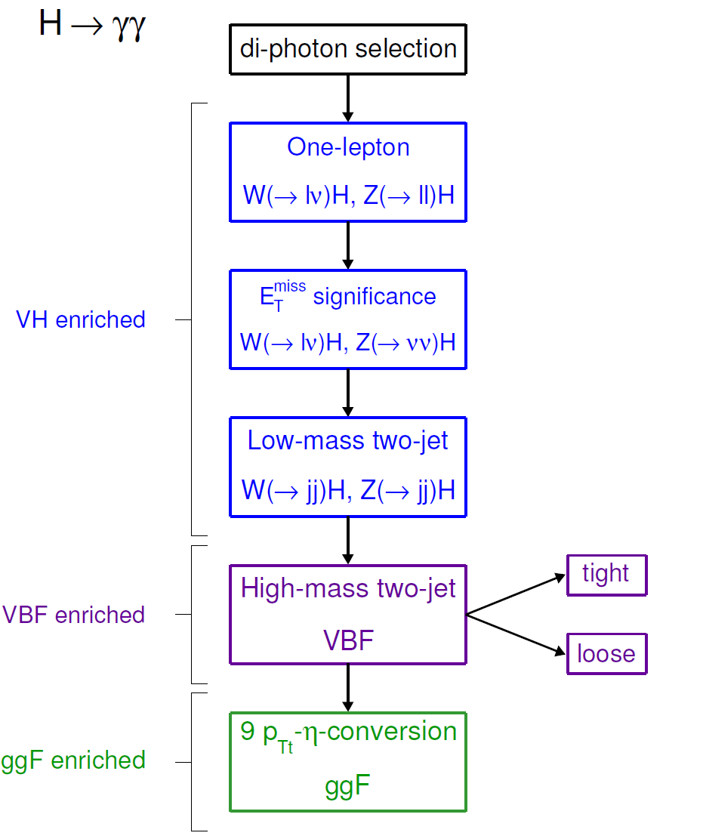
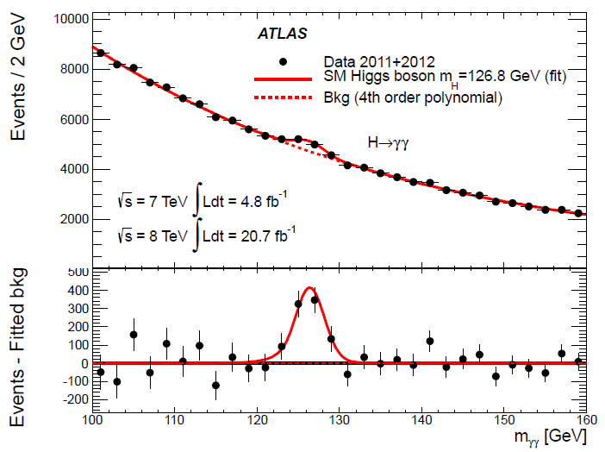
H→ γγ
arXiv:1307.1427
Simple signature: two high-p_{T} isolated photons - E_{T} (γ₁, γ₂) > 40, 30 GeV (√s=8 TeV)
Events divided into 14 categories based on production mode and S/B ratio in different detector region (increase sensitivity, also for coupling measurements )
Main channel with sensitivity to VBF production

Slide 16
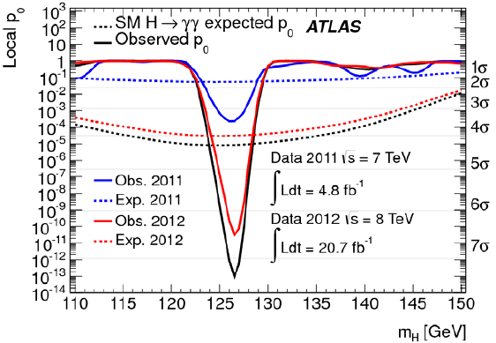
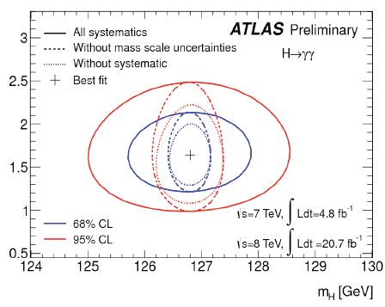
H→ γγ
arXiv:1307.1427
Signal Significance :
7.4σ (4.3σ expected)
Exceeding discovery criteria
Signal strength
μ = 1.57±0.24(stat) ±0.22(syst)
at mass = 126.8 GeV
Obs (√s=8 TeV, m_{H}^{rec} = 126.8 GeV ±2σ) | Expected purity s/s+b (√s=8 TeV) | Main backgrounds
13931 | 370/13575 = 2.7% | γγ,γj and jj

Slide 17
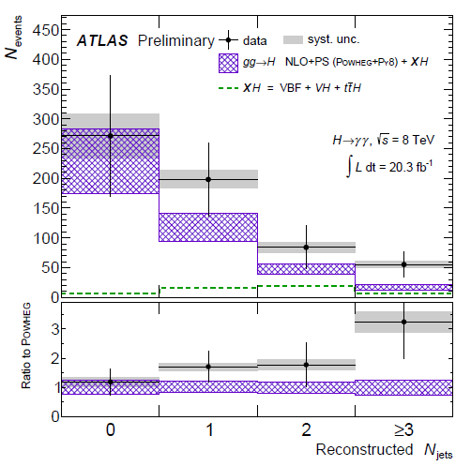
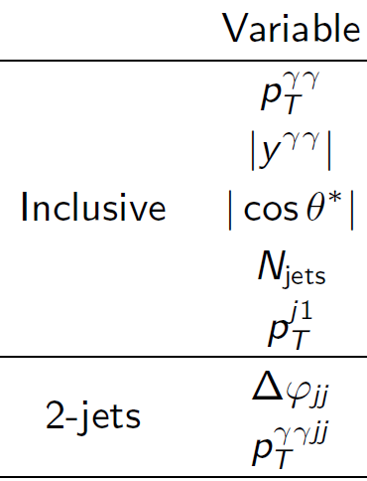
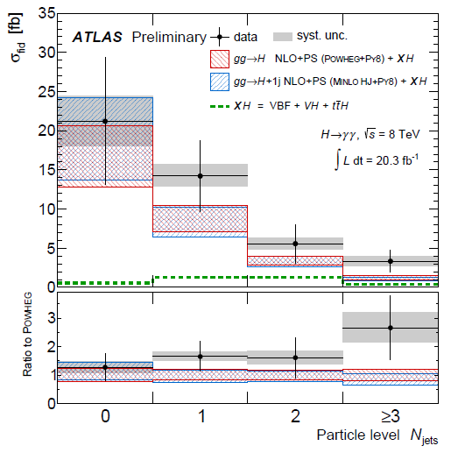
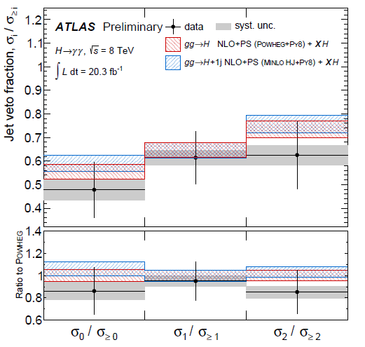
H→ γγ Differential Cross-Sections
ATLAS-CONF-2013-072
Study the kinematic distributions of H→ γγ events
Recon. level
To unfold the experimental measured distributions to particle level distributions (differential dσ/ dx )
Particle level
Bin events in interest variables
Background estimations from the mγγ side-bend fit
in each bin
Estimate the systematics
Background subtraction in each bin
Unfold the reconstructed distributions to truth
distributions (→ differential cross-sections)
Cross-Section ratio

Slide 18
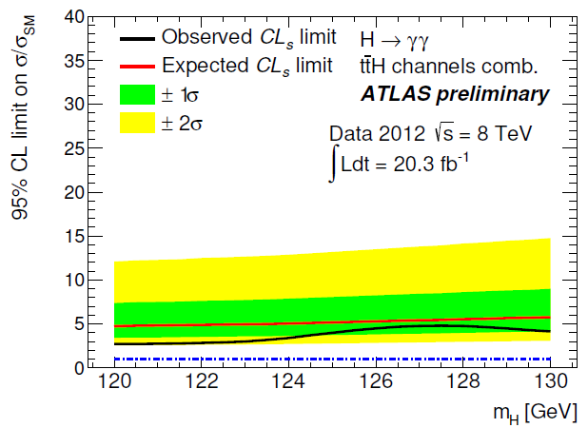
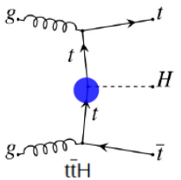
ttH(→γγ)
ATLAS-CONF-2013-080
Two analysis categories:
Leptonic: N_{lep} ≥ 1, MET > 20 GeV, N_{b} ≥1
Hadronic: N_{jet} ≥ 6, N_{b} ≥ 2
95% CL Limit
(m_{H} = 126.8 GeV):
σ/σ_{SM} < 5.3

Slide 19
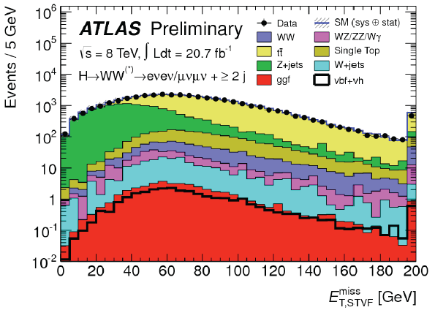
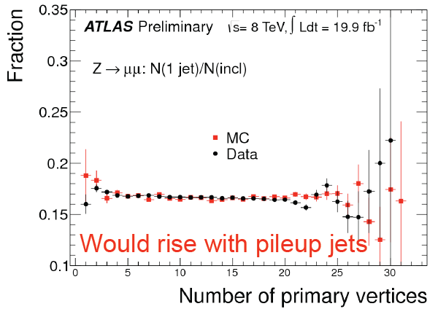
H→WW*→lνlν
arXiv:1307.1427
ee,eµ,μμ + 2ν final state: two isolated opposite-sign leptons, large E_{T}^{miss}
N_{jet} classification (0,1, >= 2 jet) to separate ggF and VBF processes
Main backgrounds: WW, Wt, top, W+jets, Z+jets
~80% of overall significance from eμ channel (large DY background for ee and μμ channels)
Experimental challenge in measurements: E_{T}^{miss}, Njet (JES)
Observed (N_{jet} = 0, 1, >=2) ~25 fb⁻¹ | Expected purity s/s+b (√s=8 TeV)
831, 309, 55 | 152/1188 = 12.8%

Slide 20
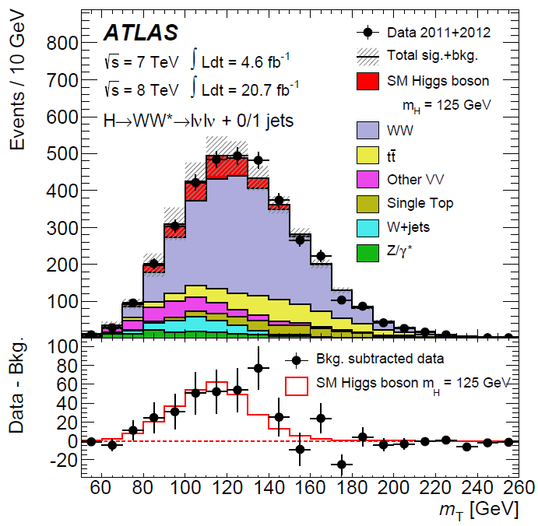
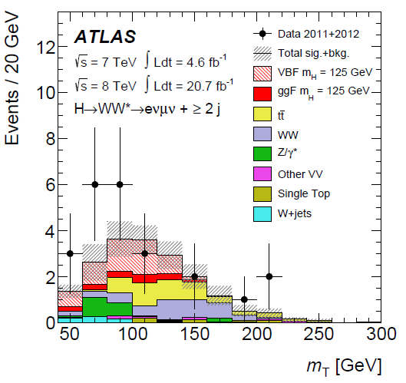
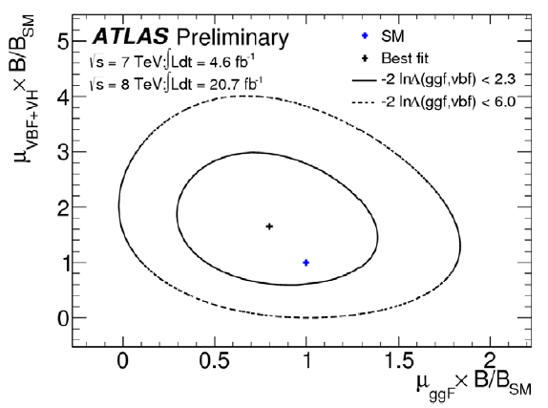
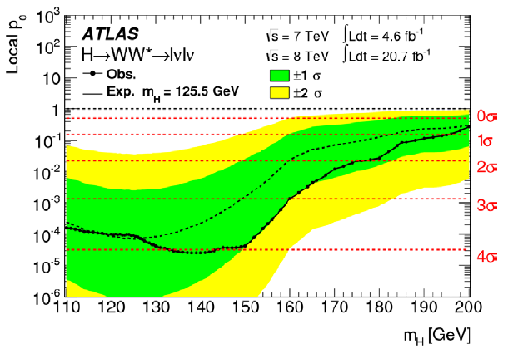
H→WW*→lνlν
arXiv:1307.1427
The final discriminant
Njet =0,1
Njet = 2
Best fit
SM
3.8σ (3.8σ expected at 125.5)

Slide 21
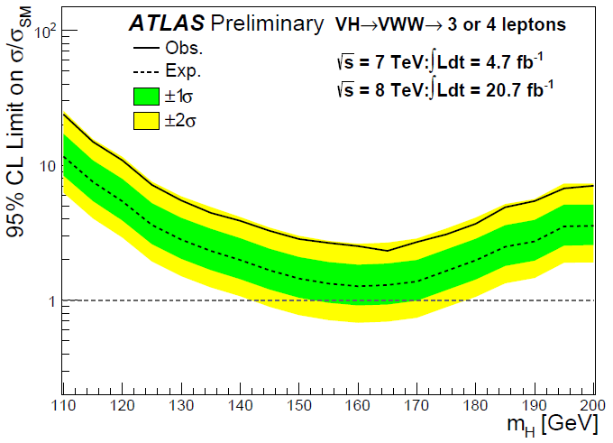
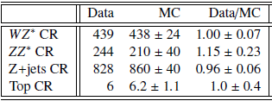
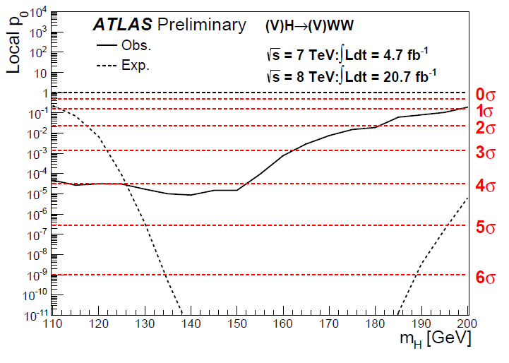
Z/W (→ll/lν) + H (→WW*→lνlν)
ATLAS-CONF-2013-075
3l analysis Data/MC, Total WWW contribution
~5.1 events
Combined limit
4l analysis Data/MC, ZWW contribution ~0.6 events
95% C.L. observed (expected) upper limit on the rate/SM at 125 GeV:
7.5 (4.0) for WH and 14.3 (9.6) for ZW
Observed small excess at 125 GeV:
1.7σ (WH→ww), 1.5σ (ZH→WW)

Slide 22
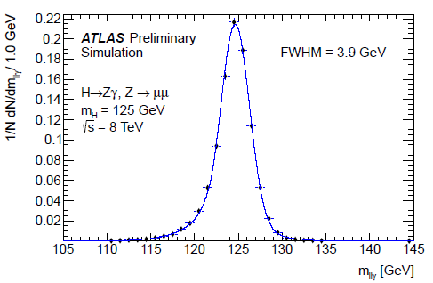
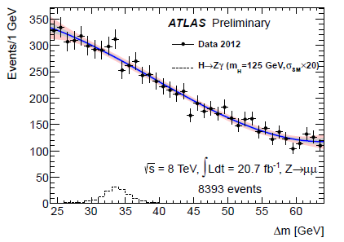
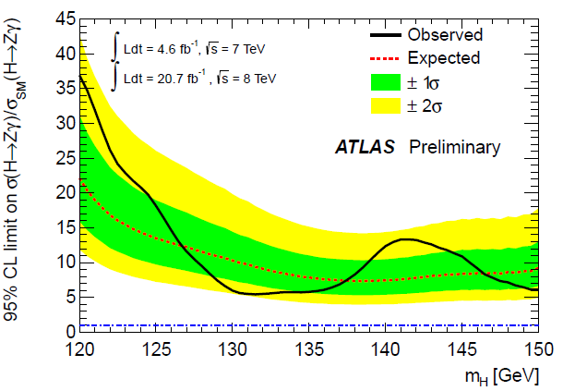
H→Zγ → llγ
ATLAS-CONF-2013-009
H→Zγ is another high resolution channel
Sensitive to new particles through loops
For SM Higgs with mass = 125 GeV:
M_{Zγ}
H→Zγ

Slide 23
H→ ττ, bb, μμ

Slide 24
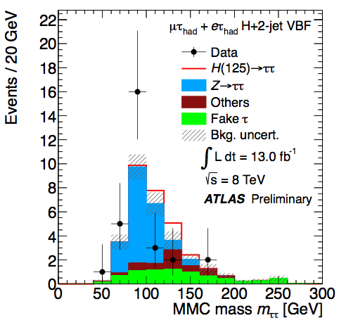
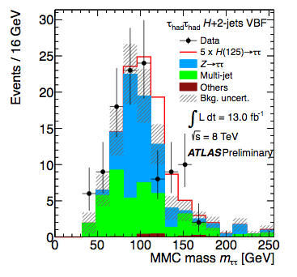
H→ ττ
BR(H→ ττ) = 6.3% (M_{H}=125 GeV)
Search in exclusive categories: lep-lep, lep-had, had-had and jets: 0, 1 (boosted or not), 2 (VBF, VH)
Most powerful channel VBF
ATLAS-CONF-2012-160
μ(125) = 0.7 ± 0.7
95% CL limit (125): 1.9 [ exp: 1.2 ] × SM
Significance (125): 1.1σ [ exp: 1.7σ ]
Update will come soon !
τ_{l}τ_{l}
τ_{l}τ_{h}
τ_{h}τ_{h}
Signal (SM) | Production | 7 TeV & 8 TeV | Signal purity s/b | Main backgrounds
~330 (BR=6.3%) | VBF, Hgg, VH | 4.9 & 13 fb⁻¹ | 0.3% - 30% | ZZ, Z+jets, top

Slide 25
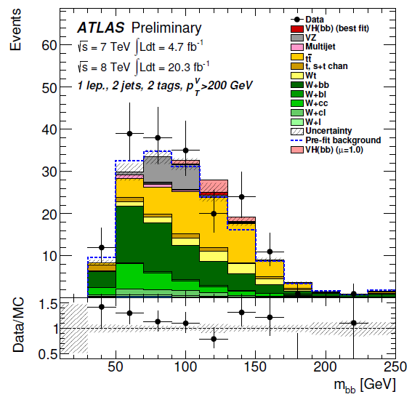
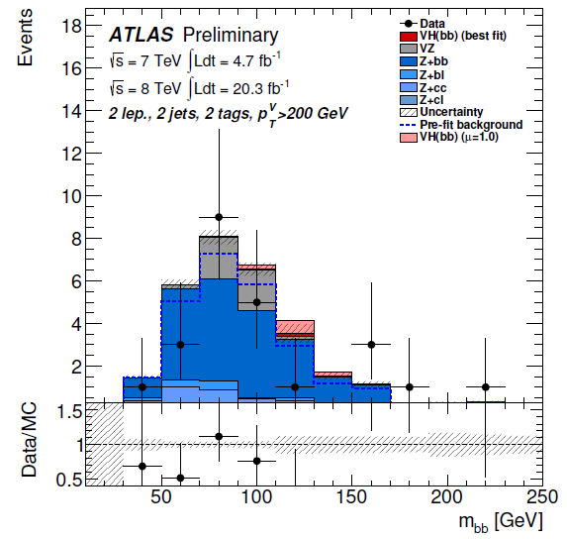
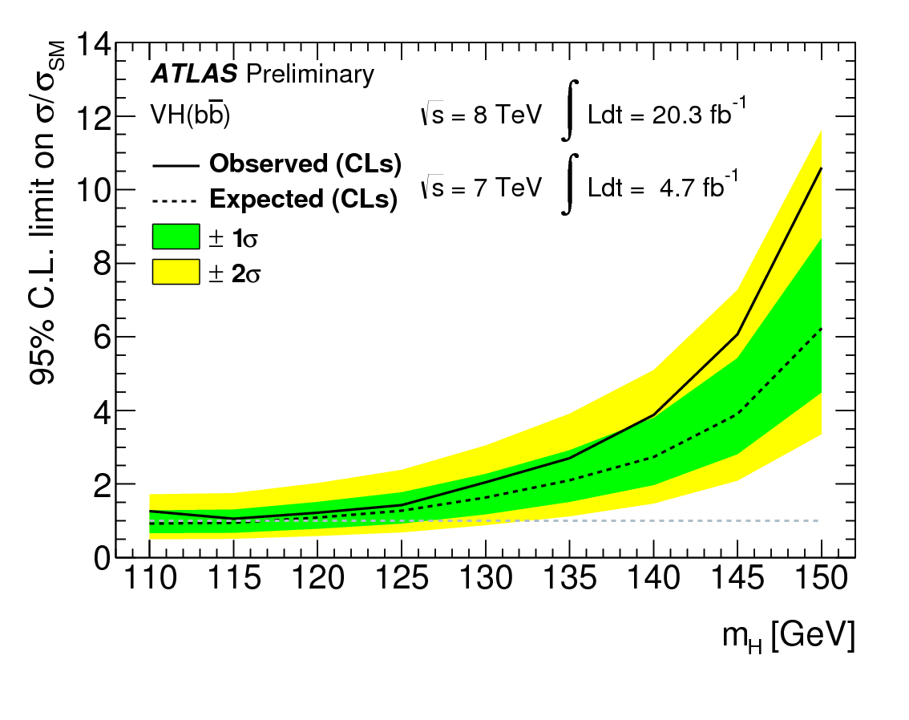
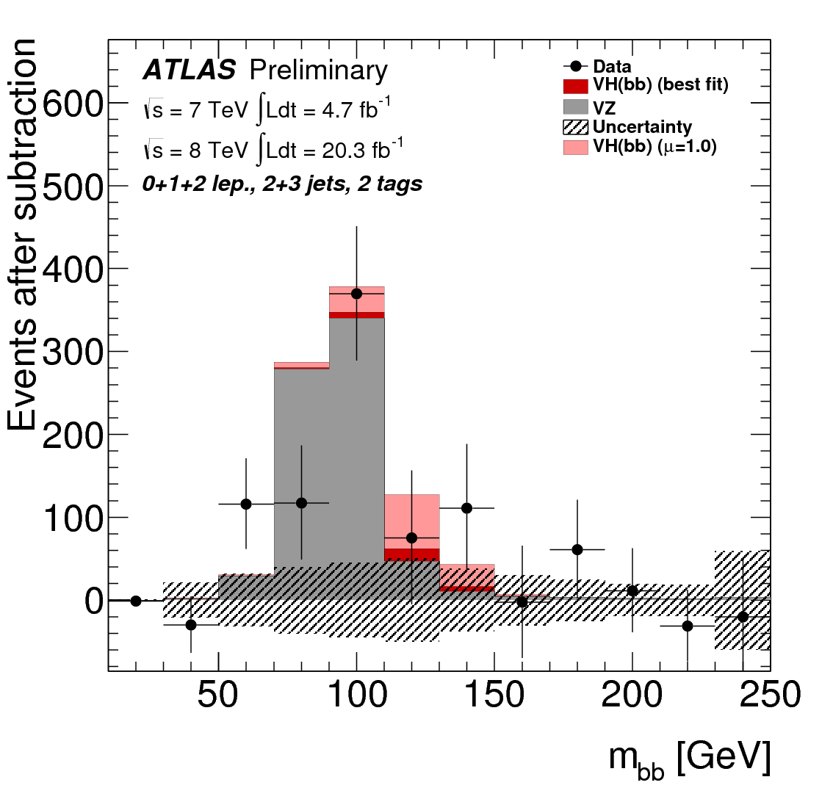
Z/W+H→ bb
ATLAS-CONF-2013-079
Also 7 TeV analysis of tt+H, with H → bb [ATLAS-CONF-2012-135]
BR(H→bb): 57.8%
Large background
with fully data-driven
Search for peak
in m_{bb} spectra (3 ch)
Validation using
VZ(→bb)
Systematic: JES,
b-tagging
Z→bb
H→bb
Combined limit 1.4 x SM

Slide 26
Signal Strength of H→ bb
μ (125 GeV) = 0.2 ± 0.5(stat) ± 0.4(syst)

Slide 27
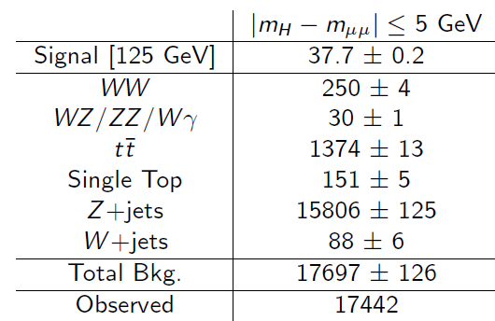
H→ μμ
ATLAS-CONF-2013-010
Z→ μμ
H→ μμ

Slide 28
Properties Measurements Mass, Couplings, Spin-Parity

Slide 29
Mass Combination (4l, γγ)
Prob. to observe Δm≥2.3 GeV ~ 1.5% (2.4σ)

Slide 30
Coupling Measurements
Coupling strengths κ_{i} & ratio: κ_{F} =g_{F}/g_{F,SM}, κ_{V} =g_{V}/g_{V,SM}, λ_{ij} = κ_{i} /κ_{j}
Example H → γγ
κ_{g} , κ_{γ}: loop coupling scale factors
κ_{H} is the total Higgs width scale factor
(8)

Slide 31
Higgs Signal Strength
Signal strength μ = σ/σ_{SM}
Combination of diboson final states
H → γγ
H → ZZ(*) → 4l
H → WW(*) → lνlν
measured at combined m_{H}=125.5 GeV
Variation due to m_{H} uncertainty: ±3%
Compatibility with SM (μ=1): 7%
Largest deviation μ_{γγ}: 1.9 σ
Including preliminary μ_{bb}, μ_{ττ}: μ=1.23 ± 0.18
ATLAS also sets preliminary (95%CL) limits:
H → μμ: μ<9.8 (20.7 fb⁻¹)
H → Zγ: μ<18.2 (4.6 fb⁻¹ + 20.7 fb⁻¹)
μ = 1.33 ± 0.14 (stat) ± 0.15 (sys) ± 0.11 (theo)
SM

Slide 32
VBF vs. ggF Production
μ_{VBF+VH} vs μ_{ggF+ttH} potentially modified by B/B_{SM}
3.3σ evidence
SM
μ_{VBF+VH} / μ_{ggF+ttH} = 1.4+0.4-0.3(stat)+0.6-0.4(sys)

Slide 33
Vector vs Fermion Couplings
2-parameter benchmark model:
κ_{V} = κ_{W}=κ_{Z} (>0)
κ_{F}=κ_{t}=κ_{b}=κ_{c}=κ_{τ}=κ_{g}
(Gluon coupling are related to top, b, and their interference in tree level loop diagrams)
Assume no BSM contributions to loops: gg→ H and H→γγ, and no BSM decays (no invisible decays)
κ_{F} = 0 is excluded (>5σ)
Double minimum from interference between vector(W) and fermion(top) in H→γγ

Slide 34
W vs Z Coupling (custodial symmetry)
λ_{WZ} consistent with SM
Indirect indication “Higgs-like” boson is EW doublet (since λ_{WZ} = 0.5 for triplet)
Best fit
SM prediction

Slide 35
Studies on Spin-Parity
Spin 1 hypothesis strongly disfavored by Landau-Yang theorem, main interest is to test the SM 0⁺ hypothesis against 2⁺: start with spin 2 tensor with minimal couplings to SM particles (2⁺_{m})
Spin 2⁺_{m} discrimination is tested for possible mixtures of gluon and quark initiated production
H→ ZZ*→4l analysis is also testing other spin parity states, as 0+ vs 0- etc. with gluon-fusion production
Spin studies in three different decay modes
H→ γγ: fully reconstructed, however only
production angle θ* available
H→ZZ*: fully reconstructed, decay of Z bosons
provides full information on the Z decay planes
5 decay angles as shown, and m_{Z1}, and m_{Z2}
H→WW*: direct calculation of decay angles not
possible, use other kinematic distributions

Slide 36
Spin Analysis with H→ γγ
Polar angle θ* of the photon decay in Collines-Soper frame, along with m_{γγ}
Z_{CS} bisects angle between the momenta of colliding hadrons
CS
data
0⁺
data
2⁺

Slide 37
2⁺ Hypothesis Exclusion
Method
Binned likelihood using discriminants
e.g. m_{γγ} and |cos θ*|
Poisson probability given a signal S scaled by strength μ and background B with nuisance parameters θ and constraints from auxiliary
measurements A for each channel
Ratio of likelihoods test statistic
q = log(L (0⁺)/L (J^{P}_{alt}))
with μ fixed for a given J^{P}
Exclusion using (1 - CL_{S} )
CL_{S} = p₀ (J^{P}_{alt}) / (1-p₀(0⁺))
Observed 2⁺ exclusion 99.3% (1-CL_{S})
observed
p₀(0⁺)
p₀(2⁺)

Slide 38
Spin Analysis with H→ ZZ*→ 4l
0⁻
0⁺
MVA: m_{Z1}, m_{Z2} + decay angles
0⁺
0⁻
BDT analysis variables:
m_{Z1}, m_{Z2} from Higgs --> ZZ* →4l
+ production and decay angles
Exclusion (1-CL_{s} ):
Observed 0⁻ exclusion 97.8%
Observed 1⁺ exclusion 99.8%

Slide 39
Spin Analysis With H→ WW*
BDT discriminant
2⁺
0⁺
Observed 2⁺ (qq=100%) exclusion 99.96%
Exclusion (1-CL_{s} ):
Observed 2⁺ (qq = 0%) exclusion 95.2%

Slide 40
Combined Spin-Parity Results
0⁻ hypothesis excluded at 97.8% CL in
favor of 0⁺ by H→ ZZ*→ 4l analysis
1⁺ and 1⁻ excluded at 99.7% CL,
respectively by WW and ZZ analysis
2⁺ excluded at 95.2% to 99.96% CL
Combine:
ZZ
ZZ, WW
ZZ, WW, γγ
Data is in favor of J^{p} = 0⁺ → SM-like Higgs!

Slide 41
Constraints on BSM Loops
New heavy particles may contribute to loops
Introduce effective κ_{g}, κ_{γ} to allow heavy BSM particles contribute to the loops
Tree-level couplings: κ_{W},κ_{Z,}κ_{t},κ_{b}, κ_{τ} etc set to 1
Absorb all difference into loop couplings
Indirectly fixed normalization of Higgs width
κ_{g} =1.04 ± 0.14
κ_{γ} =1.20 ± 0.15
SM
Couplings tested for anomalies w.r.t.
fermion and boson, W/Z and vertex loop
contributions at ±10-15% precision
2D Compatibility with SM: 14%

Slide 42
Limit on Invisible Decay BR_{inv}
ATLAS-CONF-2013-34
Consider effective loop couplings: κ_{γ}, κ_{g}
Fix the SM Higgs couplings for κ_{V} and κ_{f}
Define the invisible branching ratio BR_{inv}
Γ_{H} = Γ_{SM} + Γ_{inv} BR_{inv} = Γ_{inv}/Γ_{H}
Three fitted parameters:
κ_{γ ,} κ_{g} + BR_{inv}
Parameterization on modified Higgs width:
BR_{inv} < 58% at 95% C.L.

Slide 43
Direct Search For Invisible Higgs
ATLAS-CONF-2013-011
Signature:
Z(→ll) + invisible (E_{T}^{miss})
Select events
Z→ ll
Large missing ET
Recoiling against Z boson
95% CL
65%
Results
No excess of events over wide mass range
BR limit (m_{H}= 125 GeV) :
BR_{inv} < 65% at 95% CL
σxBR limit:
10 – 30 fb (115 – 300 GeV)

Slide 44
Search for t→ cH
ATLAS-CONF-2013-081
Benchmark model:tt → (Wb) + (cH)
Models
t→ cH
H→ γγ
Expected event yield for BR(t→cH) = 1%
t→ Wb
W→ lν
ATLAS FCNC limit:
t → cH(γγ): BR(t→cH) < 0.8% @ 95% CL (exp. 0.5%)

Slide 45
Search for High Mass H→ ZZ, WW
ATLAS-CONF-2013-067
Extend the Higgs search to high mass assume SM-like width, and decay to
WW*→ lνlν
ZZ*→ 4l
ZZ
95% C.L. exclusion of a SM-like heavy Higgs up to ~ 650 GeV

Slide 46
What Has Been Learned From LHC Run I
Standard Model gauge sector re-established at the LHC
Discovered a SM-like Higgs Boson with mass ~ 125 GeV, which
couples to Bosons and Fermions – a breakthrough in Standard
Model electroweak symmetry break sector
No other new physics has been observed in data

Slide 47
Exciting Physics in Run II, III
LHC Run II, II: 14 TeV; 300 fb⁻¹, 3000 fb⁻¹
Precision Higgs physics
Establish fermion decay signals
Precision coupling measurements
Observe rare decay modes, including Higgs self interactions
Study of vector boson scattering – key processes to connect EWSB
Continue to search for BSM Higgs – if there are more scalar particles?
Dark Matter signature ?
Suppersymmetry (still highly motivated)
Weakly produced new physics
Significantly increase chargino-neutralino mass sensitivity from ~350 GeV to ~ 1TeV
Explore unknown at 14 TeV!

Slide 48
Spare slides

Slide 49
Experimental Challenge --Pileup
Continue update on
Trigger
Reconstruction
Particle ID
Event selection
MC simulation
Major impact on
E_{T}^{miss} reconstruction
Tau identification
Trigger rates
Computing

Slide 50
Energy Scale and Resolution
Muon energy scale and resolution corrections and systematic uncertainties determined from large Z, J/ψ and Y samples
Resolution correction (0.2-1.3%), scale correction ( < 0.1%)
Independent measurements from Muon Spectrometer and inner tracker
Probe global and local scale biases, overall uncertainty on 4μ scale 0.2%
Calibration using Z→ 4μ mass peak

Slide 51
EM Colorimeter Calibration
In-situ energy calibration results and their stability checked with different methods
(E/P with W→ eν, J/ψ → ee)
Uncertainty on the diphoton mass scale 0.6%, largely contributions
Material effects (separately for volumes for |η| < 1.8, and |η| > 1.8)
Uncertainty on the in-situ calibration method

Slide 52
Photon Energy Calibration
MC based calibration at cluster level tuned in test beams
Need accurate material description for e→ g extrapolation
(Cross checked with EM shower shapes, photo conversions, hadronic interactions and e/p,…)
Energy scale corrections from Z decay to electrons. Cross checked at the lower energy
spectrum with radiative Z decays

Slide 53
Model tests
Test various benchmark models using the profile likelihood ratio, Λ(κ)
Assumptions
Only modify the coupling strength
Only one Higgs with narrow Γ_{H}
Rate_{i,j} = σ_{i}* Γ_{j} / Γ_{H} (i = production mode, j = decay mode)
Signal Strength: μ_{i,j} = Rate_{i,j} /Rate_{i,j}(SM) = κ_{i}² * κ_{j}²/ κ_{H}²

