Slide 1
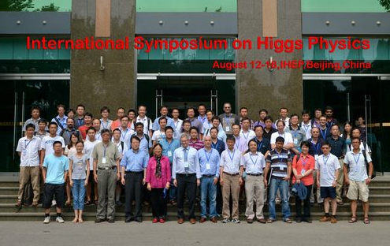
Higgs study status and the forward looking of LHC
方亚泉
中国科学院高能物理研究所
Report from
International Symposium on Higgs Physics

Slide 2
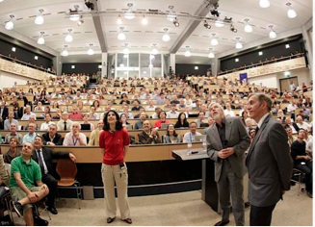
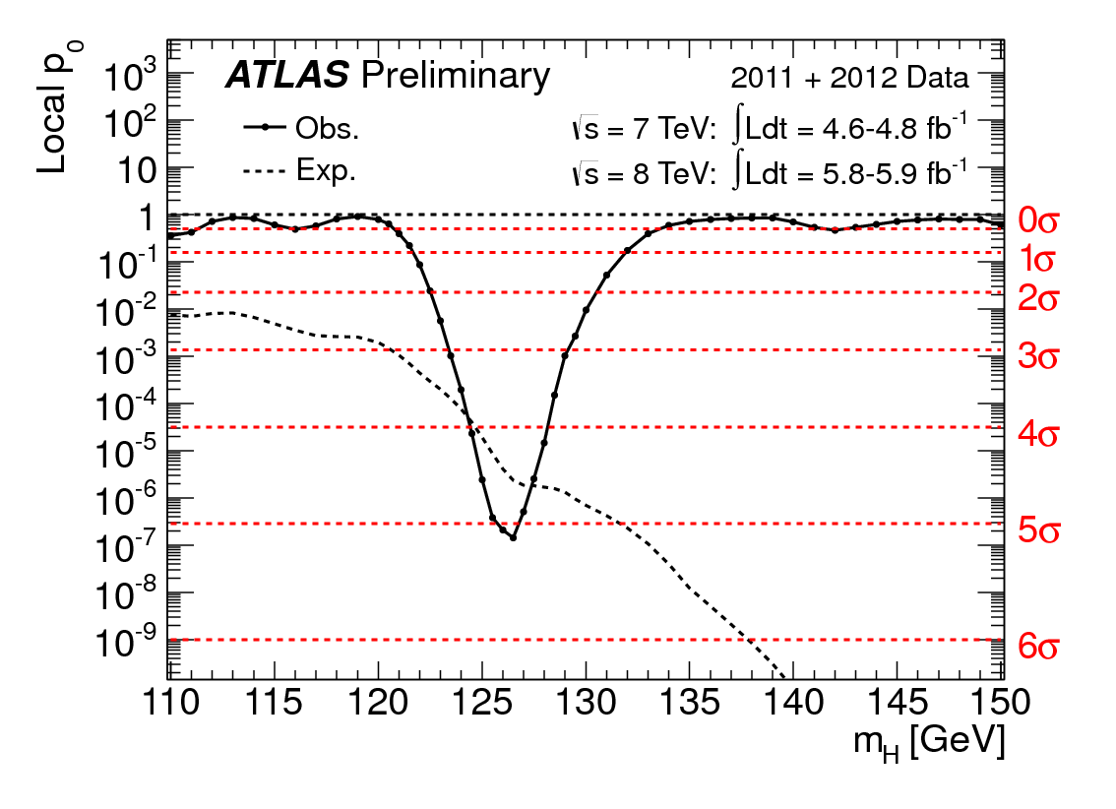
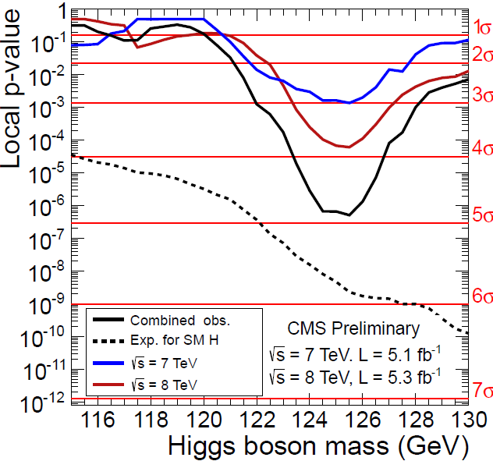
The discovery on July 4th, 2012
5σ
A milestone discovery announced in
July, 2012.
Both ATLAS and CMS observed a new
particle with ~5σ evidence .
Will the signal be confirmed in the
additional 2012 data? SM Higgs?
Properties, future?
4.9σ

Slide 3
Outline
the latest result from ATLAS/CMS/Tevatron.
Current sensitivity, measurement of signal coupling, spin
Evidence of the VBF process
The status of LHC
The status of the running
Some experiences
Forward looking

Slide 4
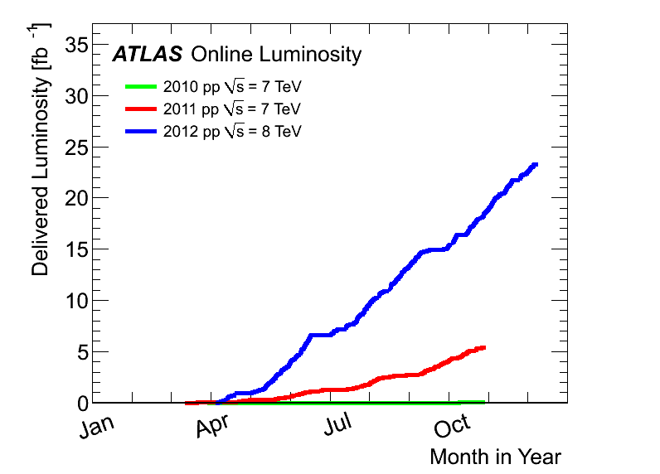
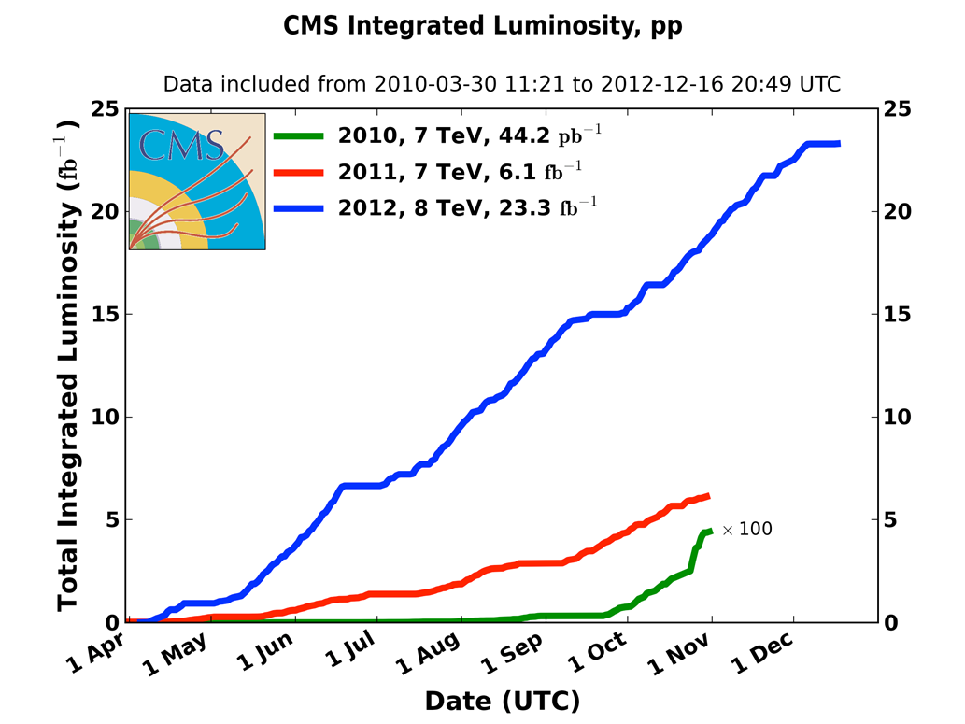
Data collection with ATLAS/CMS
2012:
23 fb⁻¹
at 8 TeV
4th July seminar
and ICHEP
2011
5.6 fb⁻¹
at 7 TeV
2010
0.05 fb⁻¹
at 7 TeV
The most powerful particle factory in world to produce
massive particles in proton-proton collisions (ATLAS)
> 2,000,000,000 W
> 700,000,000 Z
> 8,000,000 top pair
> 600,000 Higgs

Slide 5
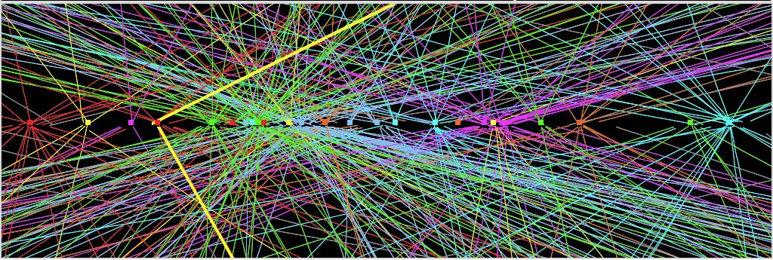
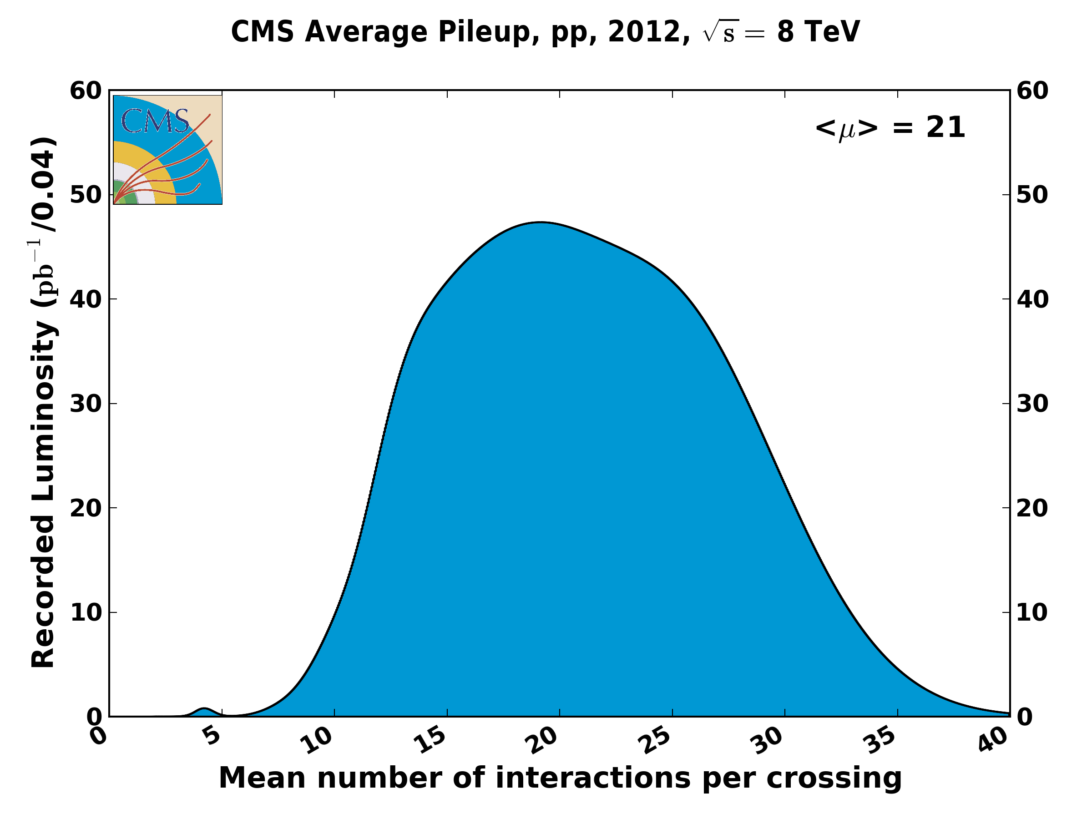
Challenge : Pile up
Z→ μμ event from 2012 data with 25 reconstructed vertices
Huge efforts over last months to prepare for high lumi and pile-up expected in 2012:
optimized trigger and offline algorithms (tracking, calo noise treatment, physics objects)
→ mitigate impact of pile-up on CPU, rates, efficiency, identification, resolution
in spite of x2 larger CPU/event and event size → we do not request additional computing
resources (optimized computing model, increased fraction of fast simulation, etc.)
Z→ μμ
5
pile up will increase
at higher energy:
Experiments request 25 ns operation in 2015 from current 50 ns.

Slide 6
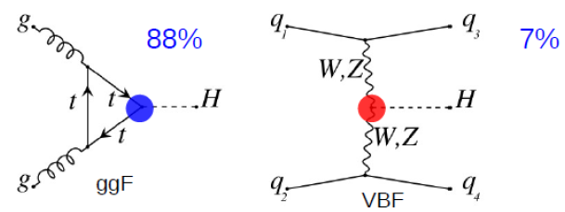
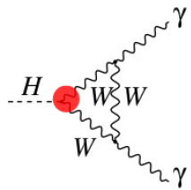
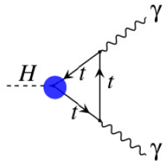
Is the New Boson The SM Higgs?
Higgs production (m_{H} = 125 GeV)
Vector Boson Fusion
Higgs decays
W, Z
f
H
H
W, Z
f
Couplings
g_{F} (Yukawa coupling) =√2 x m_{F}/ν
g_{V} (Gauge coupling) = 2m_{V}²/ν
(ν is the vacuum expectation value)
Spin-Parity

Slide 7
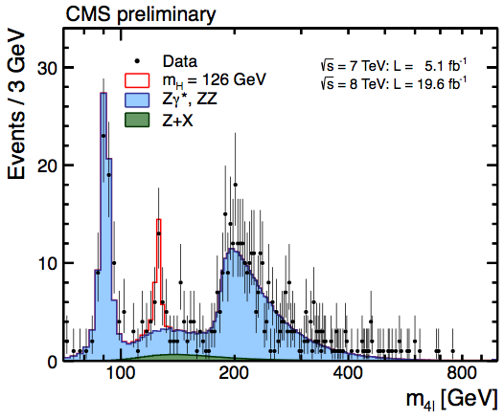
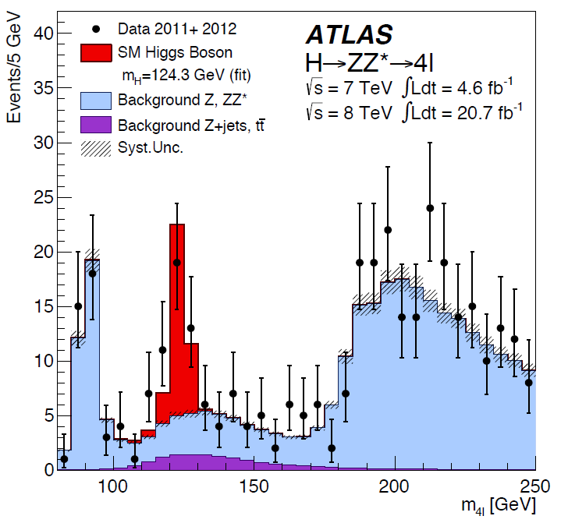
H→ ZZ*→ 4l
BR (H→ZZ*) = 2.63% (M_{H}= 125 GeV). Total ~65 H→ ZZ*→ 4l events produced at LHC
Events in 3 categories: VBF(jets), VH(lepton) and ggF-like (the rest)
DataSet | ~25 fb⁻¹
Exp. Signal (ATLAS) | ~16
S/B | ~1.4

Slide 8
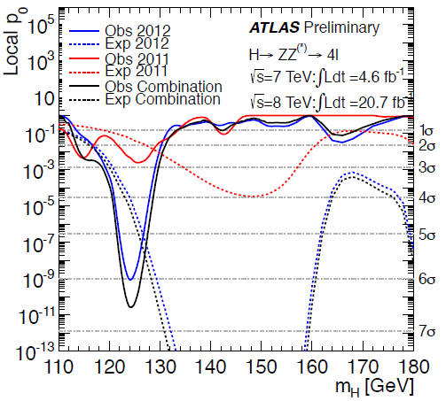
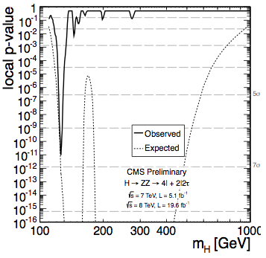
H→ ZZ*→ 4l
arXiv:1307.1427
HIG-13-002-pas
ＡＴＬＡＳ Signal Significance :
6.6σ (4.4σ expected)
CMS Signal Significance :
6.7σ (7.2σ expected)

Slide 9
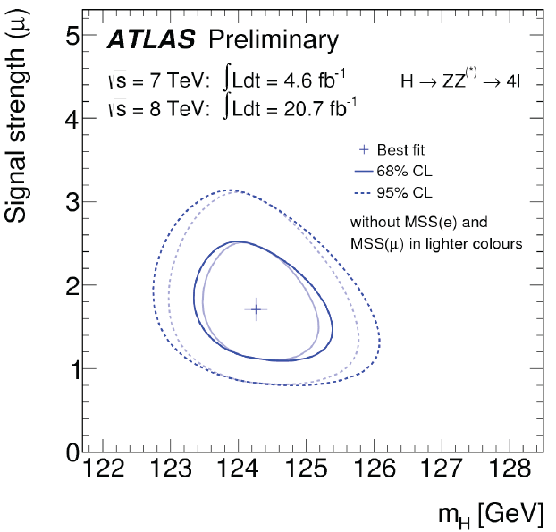
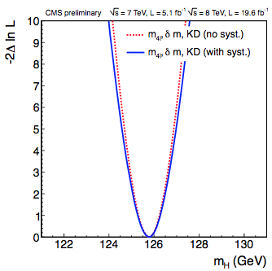
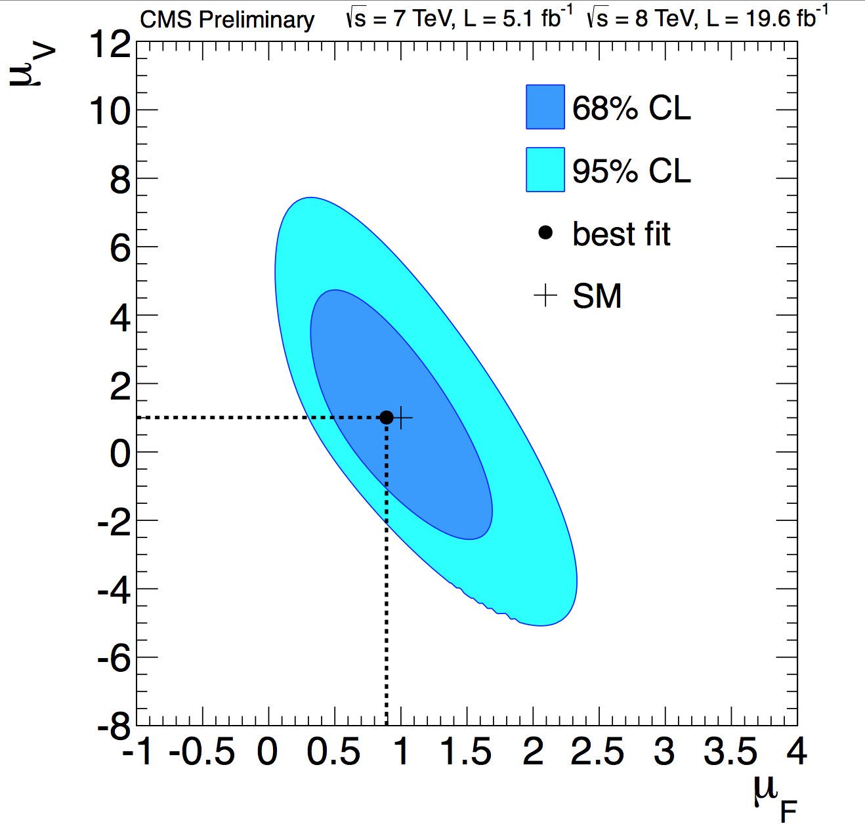
H→ ZZ*→ 4l
Signal strength:
μ = 1.7^{+0.5}_{-0.4}
at mass = 124.3+^{0.6}_{-0.5}^{+0.5}_{-0.3} GeV
Signal strength:
μ = 0.91^{+0.30}_{-0.24}
at mass = 125.8^{＋0.5}_{-0.5} GeV

Slide 10
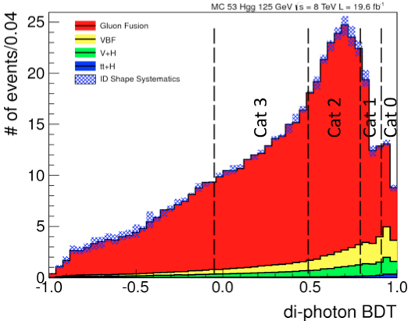
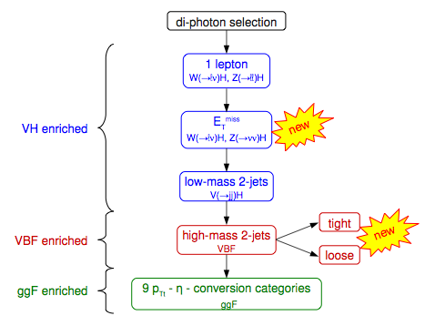
H→ γγ
arXiv:1307.1427
ATLAS
CMS
(MVA)
Most analyses for ATLAS are cut-based except VBF.
CMS uses full multivariate analyses (MVA).
Both ATLAS and CMS adapt MVA as baseline
analsysis for 2-jets.

Slide 11
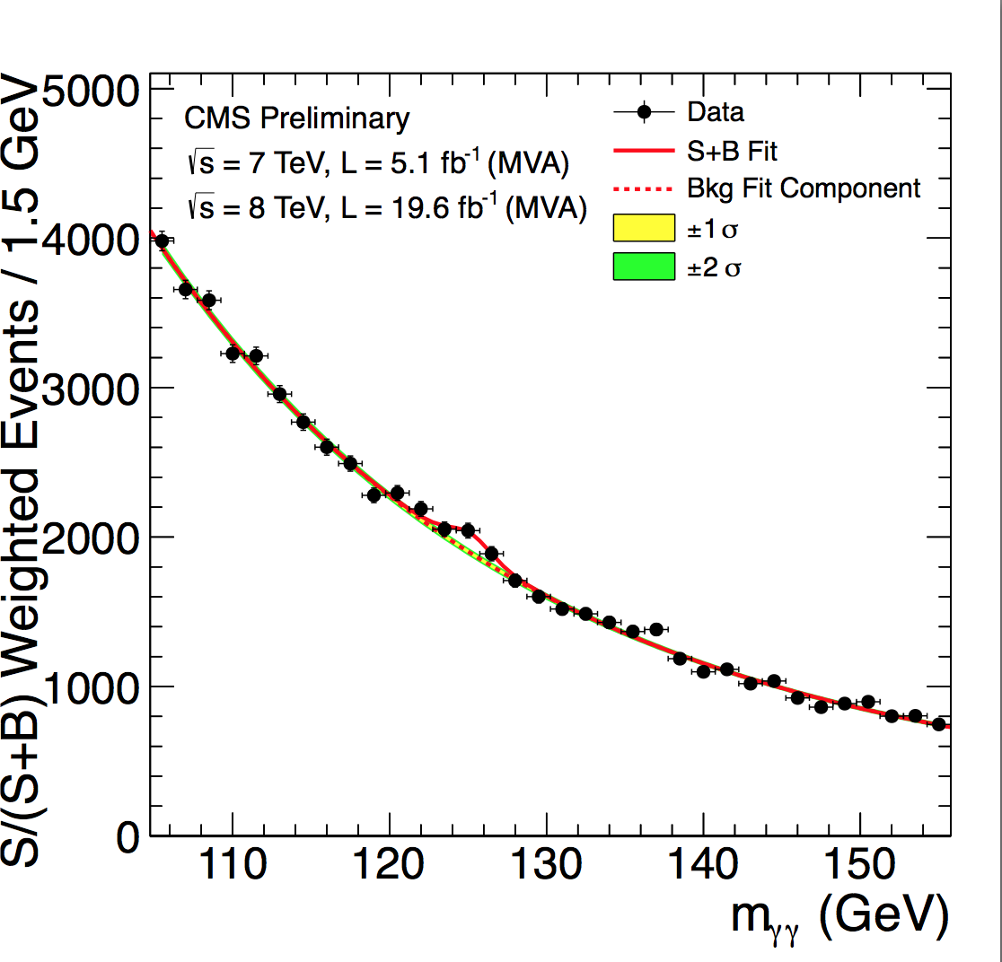
Mass distribution for H→ γγ

Slide 12
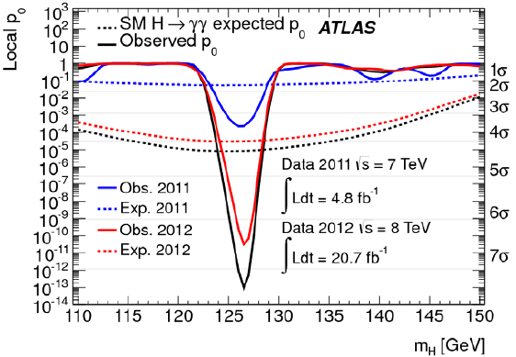
H→ γγ
arXiv:1307.1427
HIG-PAS-13-001
Signal Significance :
7.4σ (4.3σ expected)
Signal Significance :
3.2σ (4.2σ expected)

Slide 13
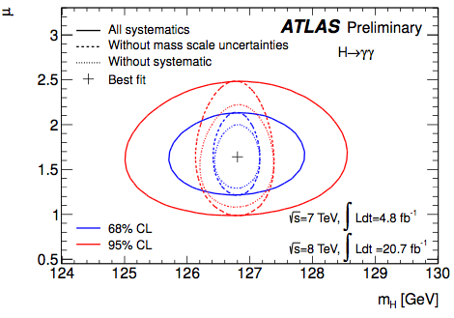
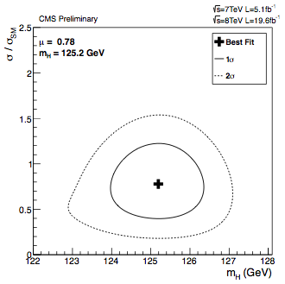
H→ γγ: mass and signal strength
Signal strength
μ = 1.57±0.33
at mass = 126.8±0.7 GeV
Signal strength
μ = 0.78^{+0.28} _{-0.26}
at mass = 125.4±0.8 GeV

Slide 14
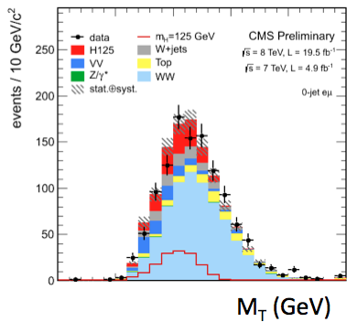
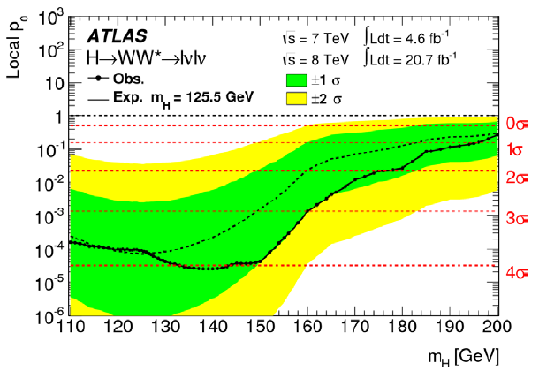
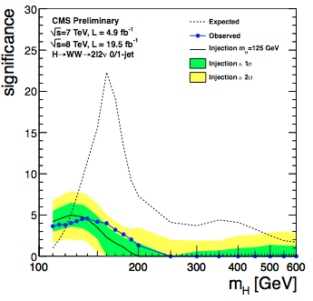
H→WW(→lvlv):
ATLAS: 3.8σ (3.8σ expected at 125.5 GeV)
No mass peak can be observed due
to missing ET.
Instead :
CMS: 5.1σ(4.0σexpected at 125 GeV)

Slide 15
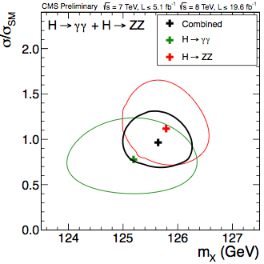
Combination: Mass
M_{H}=125.5±0.2(stat) ±0.6(sys) GeV
M_{H}=125.7±0.3(stat) ±0.3(sys) GeV
Since the other channels don’t provide the peak to reconstruct the mass,
only di-photon and ZZ are included here.

Slide 16
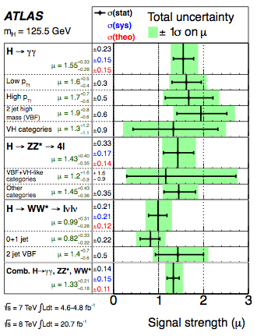
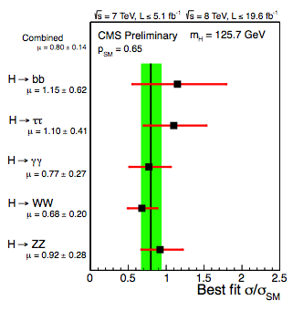
Combined signal strength
μ= 0.80±0.14
μ= 1.33^{+0.21}_{-0.16}
Consistent with SM prediction within 2σ.
Systematic and theoretical uncertainties become more and more
important.

Slide 17
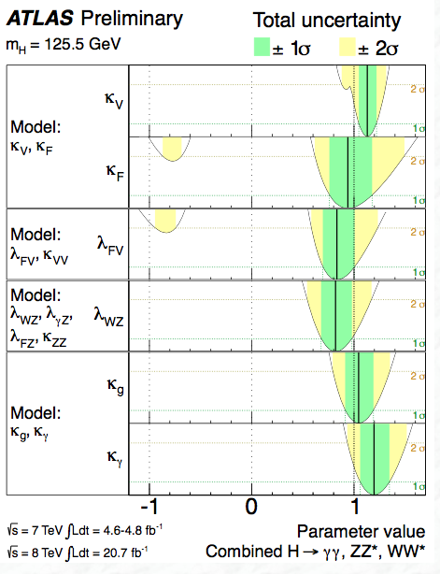
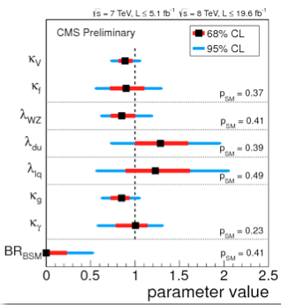
Coupling Measurements
Coupling strengths κ_{i} & ratio: κ_{F} =g_{F}/g_{F,SM}, κ_{V} =g_{V}/g_{V,SM}, λ_{ij} = κ_{i} /κ_{j}
CMS
Agree with SM within 2σ.

Slide 18
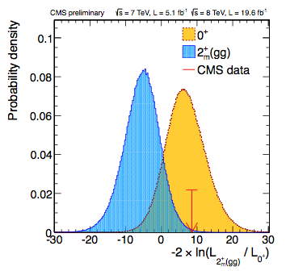
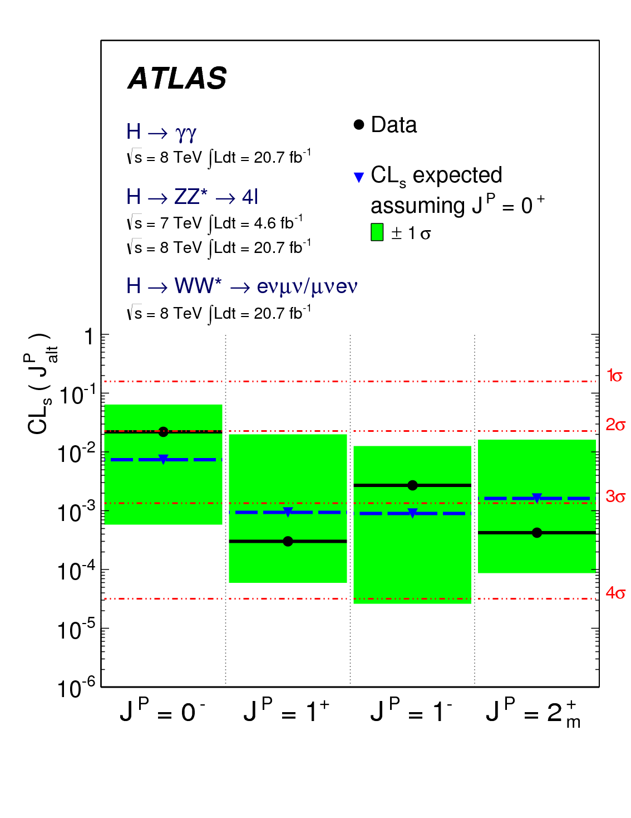
Summary results for Spin study
0⁻ hypothesis excluded at 97.8% CL in
favor of 0⁺ by H→ ZZ*→ 4l analysis
1⁺ and 1⁻ excluded at 99.7% CL,
respectively by WW and ZZ analysis
2⁺ excluded at 95.2% to 99.96% CL
Excluded at
99.4% CL
Spin 1 is strongly disfavored with the
observation of H→γγ.
Data favor the SM Higgs 0⁺

Slide 19
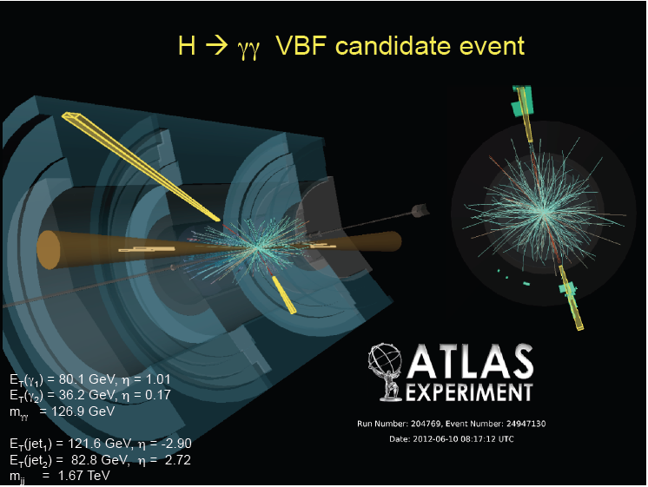
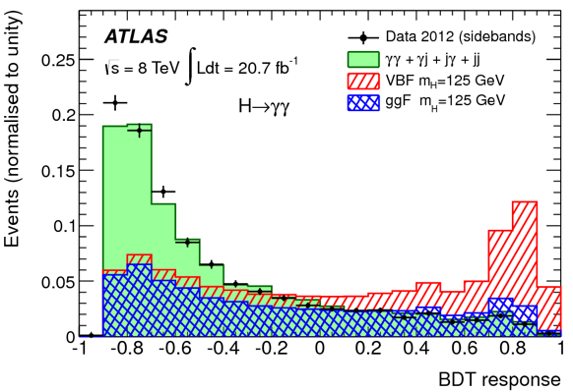
VBF H→ γγ
VBF process has the event signature with 2 forward jets and no much jet activity in the central region.
MVA can maximize the discriminating power
of the signal from the background.
Improvement is above 10-20% w.r.t cut based one.

Slide 20
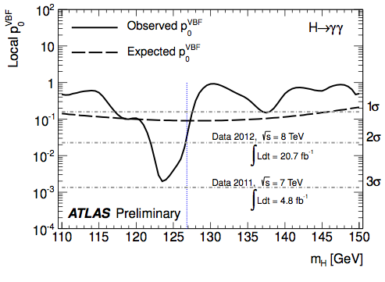
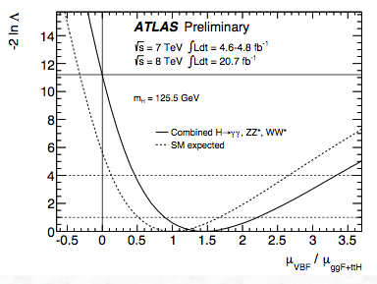
3σVBF Higgs Evidence
3.3σevidence
First 3σVBF Higgs evidence has been seen with ATLAS detector
The most important contribution to the 125.5 GeV VBF Higgs is from H→ γγ

Slide 21
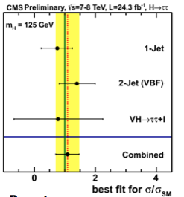
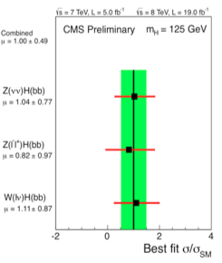
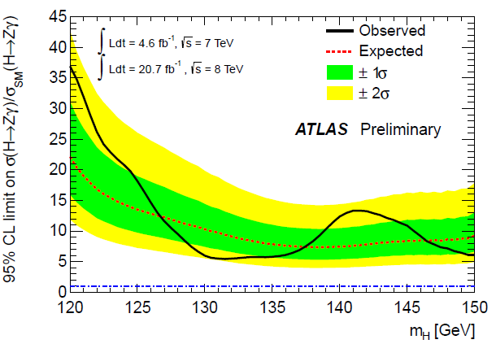
Other Higgs results
Η→ ττ : μ(125) = 0.7 ± 0.7
Significance (125): 1.1(1.7)σ obs.(exp)
μ(125) = 1.1 ± 0.4,
sig = 2.9(2.6) σ obs.(exp)
CMS
2.1σ
ATLAS
μ(125) = 1.0 ± 0.5,
sig = 2.1(2.1) σ obs.(exp)
Η→ bb: μ (125 GeV) = 0.2 ± 0.5(stat) ± 0.4(syst)
CMS
ATLAS
h→Zγ

Slide 22
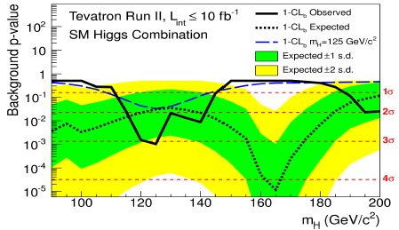
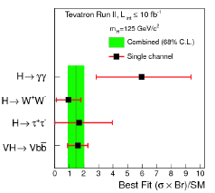
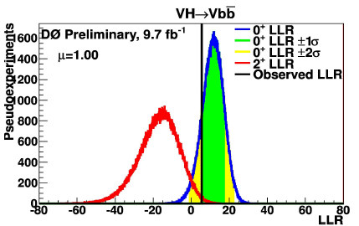
Tevatron result
Tevatron obserses 3σHiggs as well.
The main contribution is from VH(bb).
Spin 2 Higgs is excluded with 99.95%
CL.
2+ is excluded with 99.95% CL

Slide 23
LHC status and forward looking

Slide 24
short LHC history
1983 LEP Note 440 - S. Myers and W. Schnell propose
twin-ring pp collider in LEP tunnel with 9-T dipoles
1991 CERN Council: LHC approval in principle
1992 EoI, LoI of experiments
1993 SSC termination
1994 CERN Council: LHC approval
1995-98 cooperation w.Japan,India,Russia,Canada,&US
2000 LEP completion
2006 last s.c. dipole delivered
2008 first beam
2010 first collisions at 3.5 TeV beam energy
2015 collisions at ~design energy (plan)
>30 years!
now is the time to plan for ~2040

Slide 25
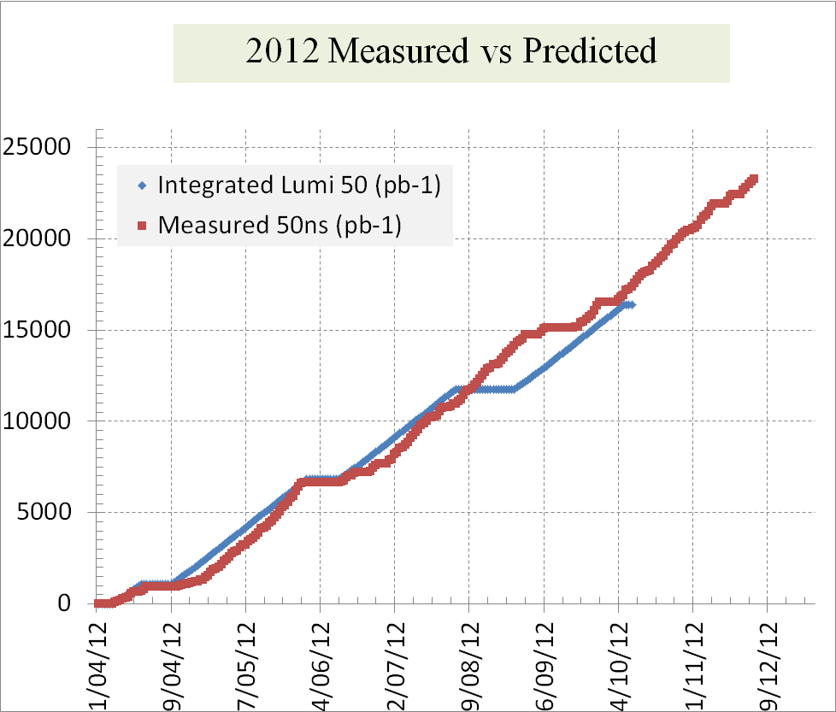
reliable luminosity forecasts

Slide 26
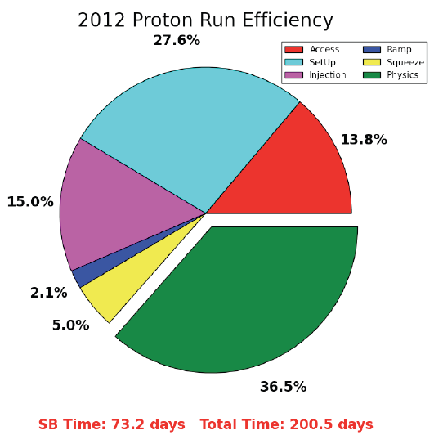
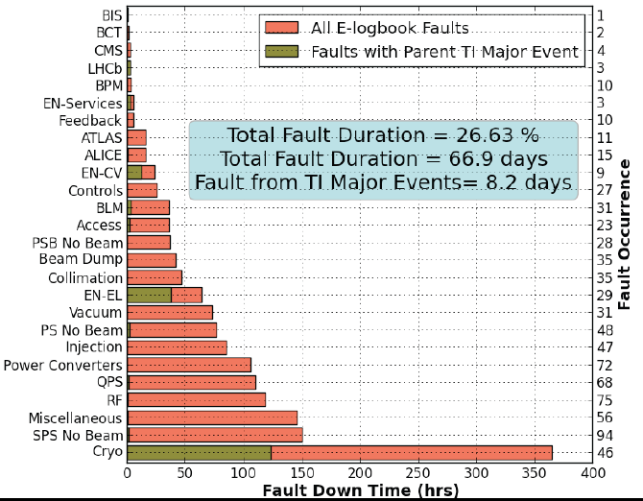
availability
“There are a lot of things that can go wrong – it’s always a battle”
Pretty good availability considering the complexity and principles of operation
Cryogenics availability in 2012: 93.7%

Slide 27
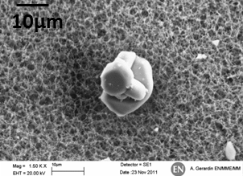
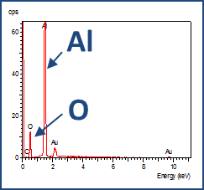
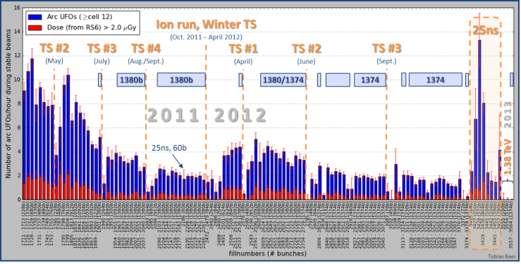
some issues in 2011-12 operation
Beam induced heating
Local non-conformities (design, installation)
injection protection devices
sync. Light mirrors
vacuum assemblies
UFOs
20 dumps in 2012
time scale 50-200 µs
conditioning observed
worry about 6.5 TeV and 25 ns spacing
Radiation to electronics
concerted program of mitigation measures (shielding, relocation…)
premature dump rate down from 12/fb⁻¹ in 2011 to 3/fb⁻¹ in 2012
T. Baer

Slide 28
another issue in 2011-12 operation
Electron cloud
beam induced multipactoring process, depending on secondary emission yield
LHC strategy based on surface conditioning (scrubbing runs)
worry about 25 ns (more conditioning needed) and 6.5 TeV (photoelectrons)
25-ns scrubbing in 2011 – decrease of SEY
25-ns scrubbing in 2012 – conditioning stop?
G. Iadarola, G. Rumolo

Slide 29
example LHC time line – next ten years

Slide 30
LHC luminosity forecast
~30/fb at 3.5 & 4 TeV
~400/fb at 6.5-7 TeV
~3000/fb at 7 TeV
2012 DONE
2021 goal (?)
2035 goal (??)
to obtain 3000/fb by 2035
we need the HL-LHC

Slide 31
Exciting Physics in the future
LHC :14 TeV; 400 fb⁻¹, 3000 fb⁻¹
Precision Higgs physics
Establish fermion decay signals
Precision coupling measurements
Observe rare decay modes, including Higgs self interactions
Study of vector boson scattering – key processes to connect EWSB
Continue to search for BSM Higgs – if there are more scalar particles?
Dark Matter signature ?
Suppersymmetry (still highly motivated)
Weakly produced new physics
Significantly increase chargino-neutralino mass sensitivity from ~350 GeV to ~ 1TeV
Explore unknown at 14 TeV!

Slide 32
Conclusion
The Higgs particle around 125 GeV was announced in 2012 at LHC experiments.
The additional 2012 data confirm the discovery.
Tevatron result is supportive as well.
The new particle is consistent with the expectations from the Standard Model Higgs boson within current uncertainty.
Coupling strengths, production rates…
First observation of the VBF Higgs production has been seen with ATLAS detector.
Favor spin-0 particle.
LHC has a successful run in the past 2 years (with a lot experience).
Run 2 will aim at 7 TeV /25 ns with a few hunderd fb⁻¹ data.
HL-LHC will achieve ~3000 fb⁻¹ data
There will be exciting time to study the Higgs boson with high precision and new physics at LHC experiments.

Slide 33
backup

Slide 35
ggFusion and VBF

Slide 37
Pile up in proposed colliders

