Slide 1
BESIII data taking plan for
2013-14 running year
Changzheng Yuan (苑 长 征)
IHEP, Beijing
2nd workshop on XYZ particles

Slide 2
Plan
R scan from 3.85 GeV to 4.60 GeV
(105 points in about 2 months)
See what energy BEPC2 can reach (4.5+? GeV).
Sit at the highest energy BEPC2 can reach for 500pb⁻¹ data
(~ 1 month)
Sit at 4.42 GeV for 1000 pb⁻¹ data (~2 months)
--------------------------------------------------------------------------------------
Sit at 4.17GeV for 200 pb⁻¹
1-2 energy points between 4.42-4.5x GeV [each for 200pb⁻¹ ]
-------------------------------------------------------------------------
Physics run will be started from Nov. 14, 2013 [delayed!]
Expect to have 6.5 months for data taking

Slide 3
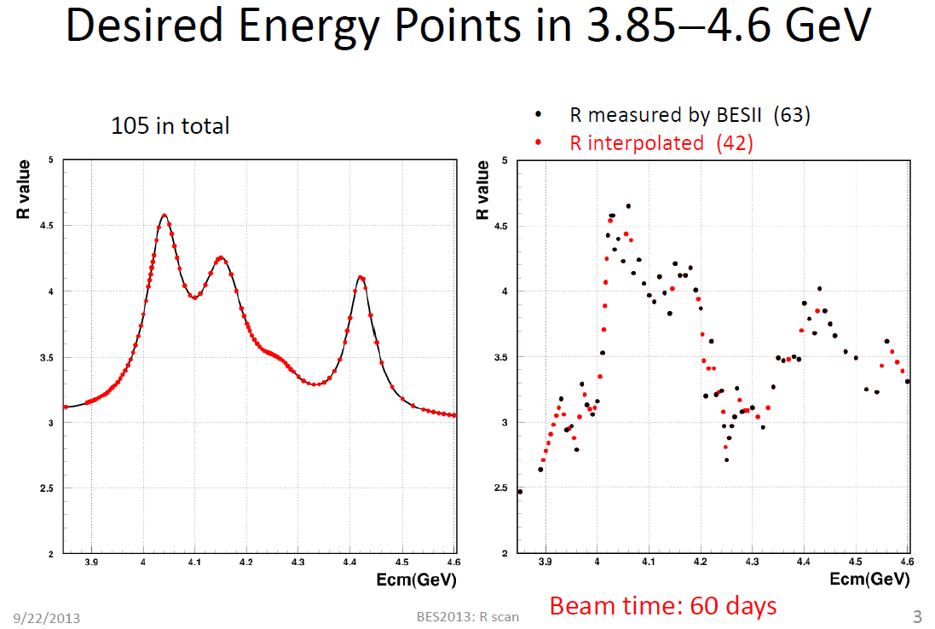
R scan plan from R-group + data for XYZ study
5-8 pb⁻¹ per energy point; [100xBESII statistics]
200pb⁻¹
1000pb⁻¹
200pb⁻¹
+200pb⁻¹
500pb⁻¹
R from Guangshun Huang

Slide 4
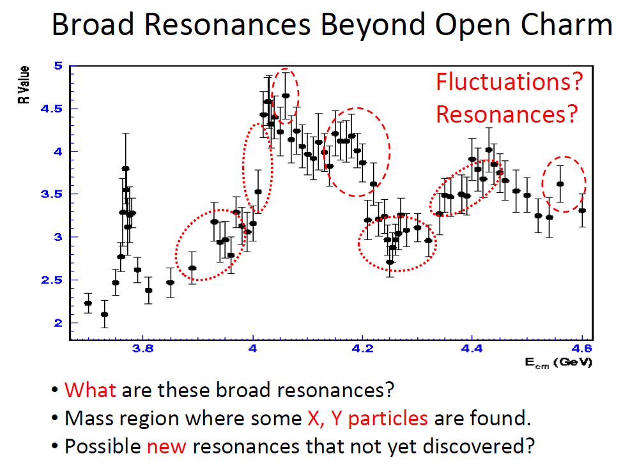
From Guangshun Huang

Slide 5
Cross section
-compare to ππJ/ψ
From Yuping Guo
Local maximum around 4.23 GeV
Broad structure at high energy region? Need more data at high energies

Slide 6
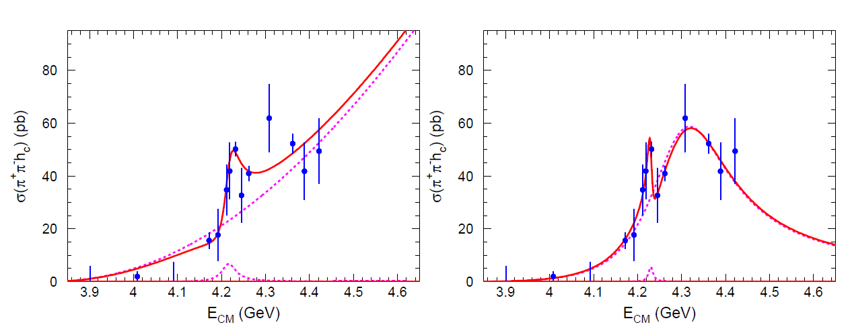
Structure in e⁺e⁻→ π⁺π⁻h_{c} ?
PS+Y(4220): 7.1σ
Y(4290)+Y(4220): 4.5σ
Common sys. errors not included in these fits! (cf. arXiv:1310.2190)
Narrow structure at 4.22 GeV? More data at around 4.22 GeV!
Broad structure at 4.29 GeV? More data at above 4.4 GeV!
CZY: arXiv:1310.0280: fit to BESIII and CLEOc data

Slide 7
backup

Slide 8
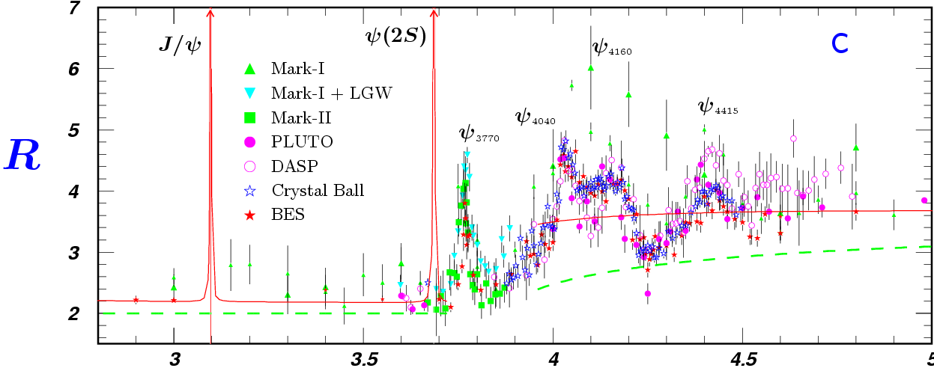
R values/ψ states/Y states
From PDG
Information between 4.5 & 4.6 GeV is very limited!

Slide 9
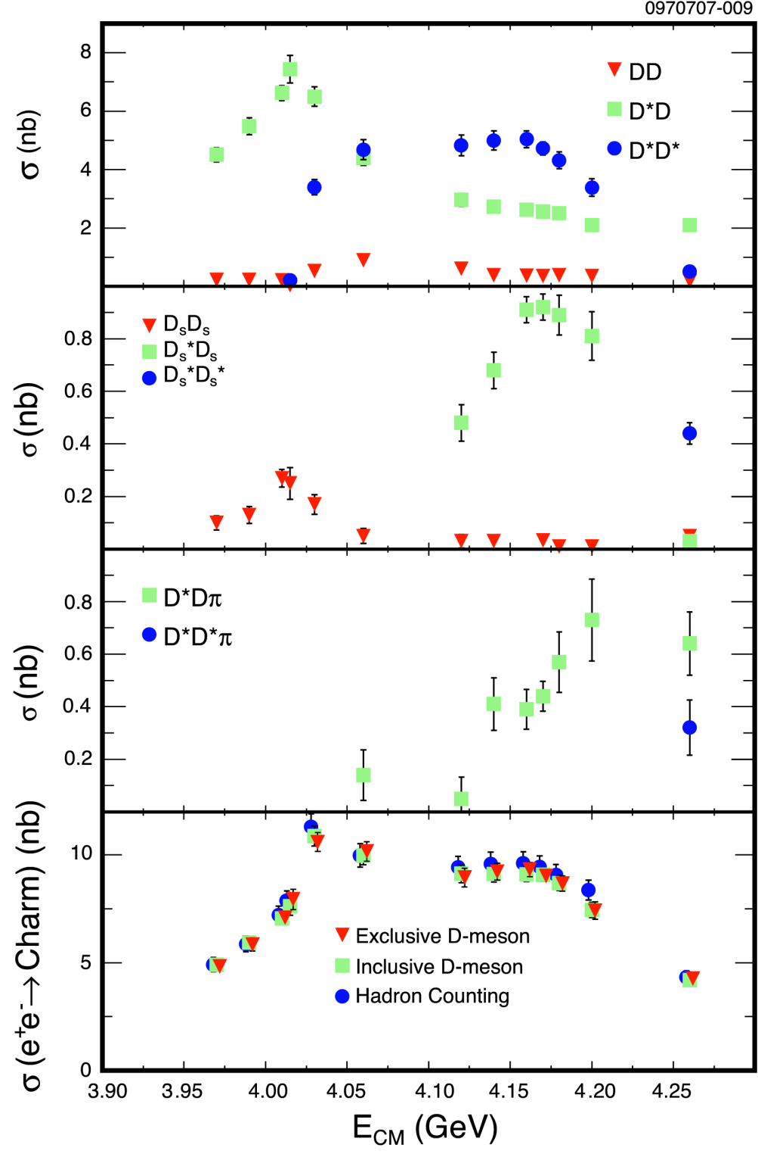
Charm via
Scan
CLEOc
PRD80, 072001 (2009)
Very limited energy range
Limited precision for 3-bodies!

Slide 10
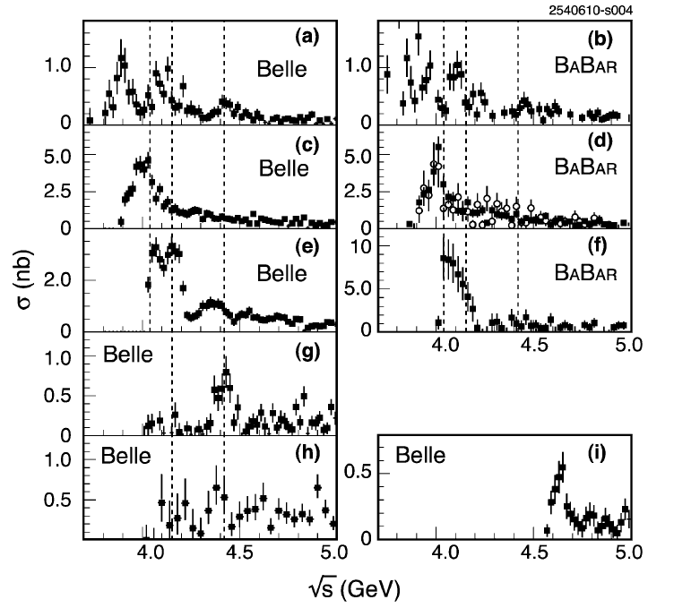
Charm from
ISR
a/b: ‾DD
c/d: ‾DD*
e/f: ‾D*D*
g: ‾DDπ
h: ‾DD*π
i: Λ⁺_{c}Λ⁻_{c}
Errors large!

Slide 11
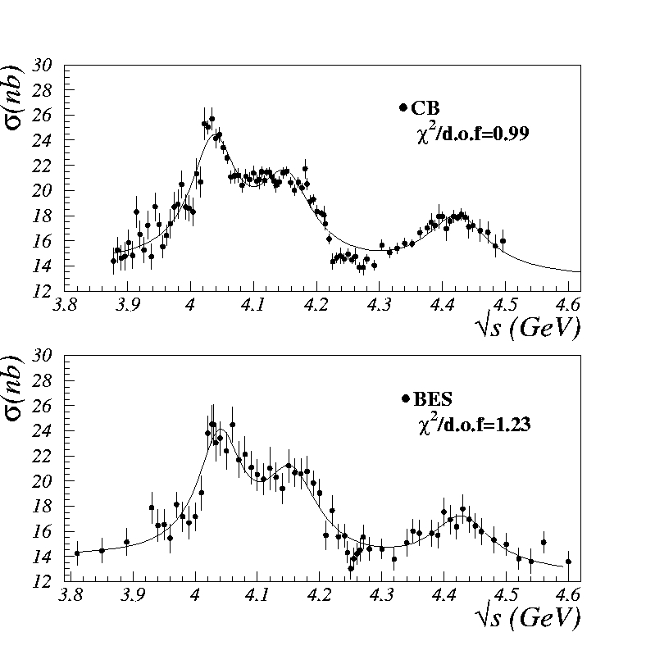
Total Xsection
σ(e⁺e⁻ → hadrons)
~1000 hadrons/point
6-7% error
Structures not clear!

Slide 12
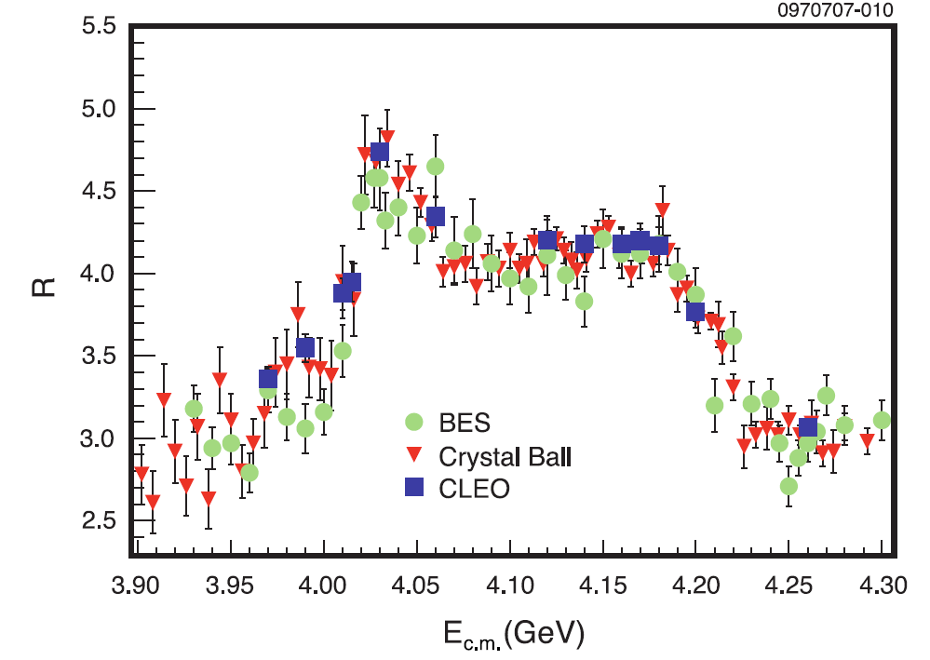
Total Xsection
Difference between CLEO & BES/CBAL?

Slide 13
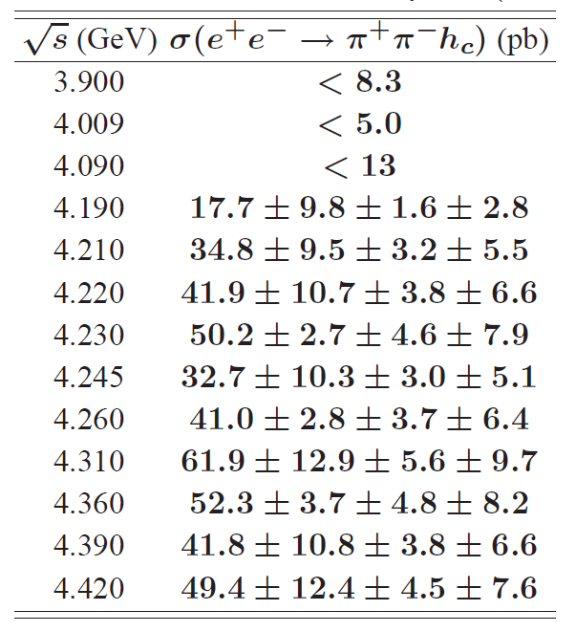
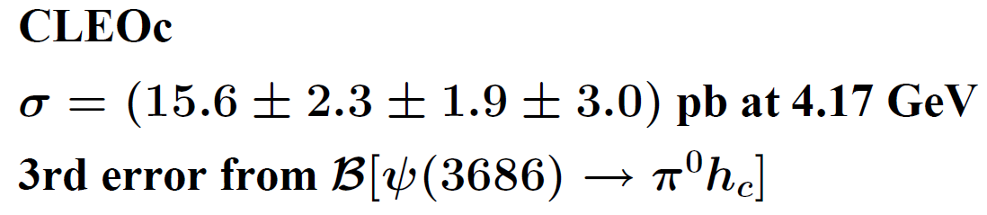
Data of e⁺e⁻→ π⁺π⁻h_{c}
BESIII: arXiv:1309.1896

Slide 14
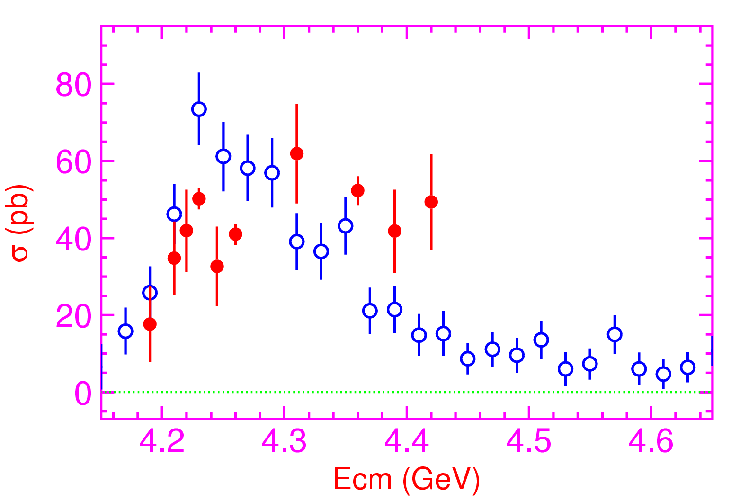
Comparison of e⁺e⁻→ π⁺π⁻h_{c} and π⁺π⁻J/ψ
Open circles: Belle e⁺e⁻→ π⁺π⁻J/ψ
Solid dots: BESIII e⁺e⁻→ π⁺π⁻h_{c}
Broad structure at ~4.4 GeV? Need more data at high energies to complete the line shape measurement.

Slide 15
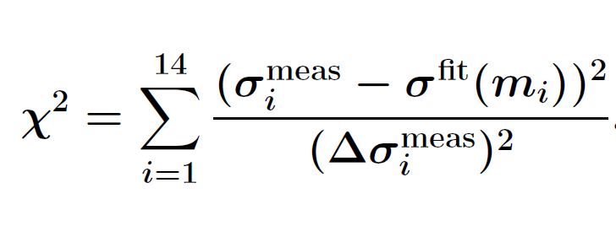
χ² fit
Common errors?

Slide 16
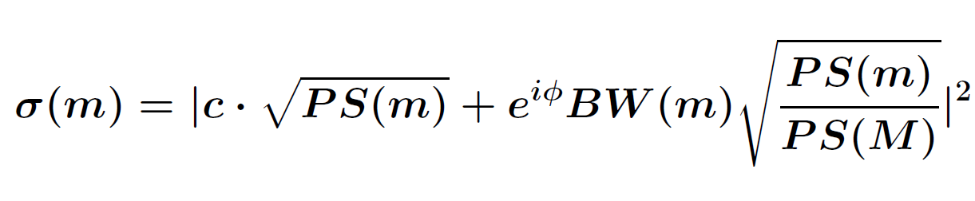
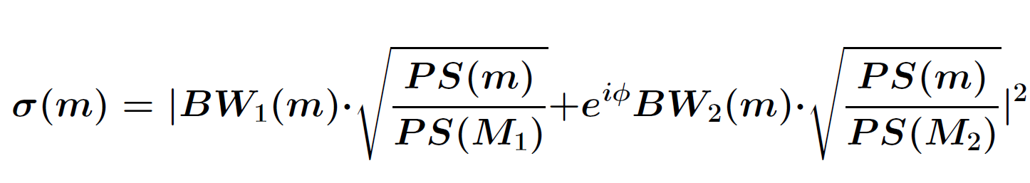
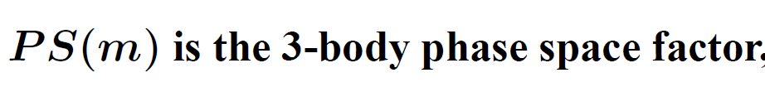
Parameterization

Slide 17
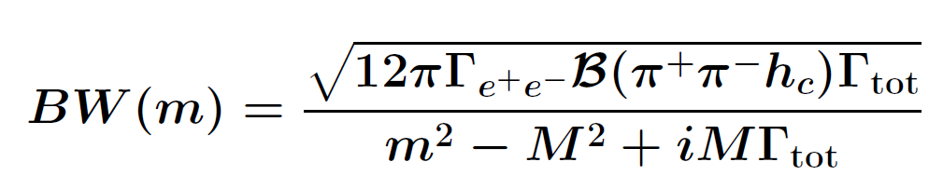
Parameterization

Slide 18
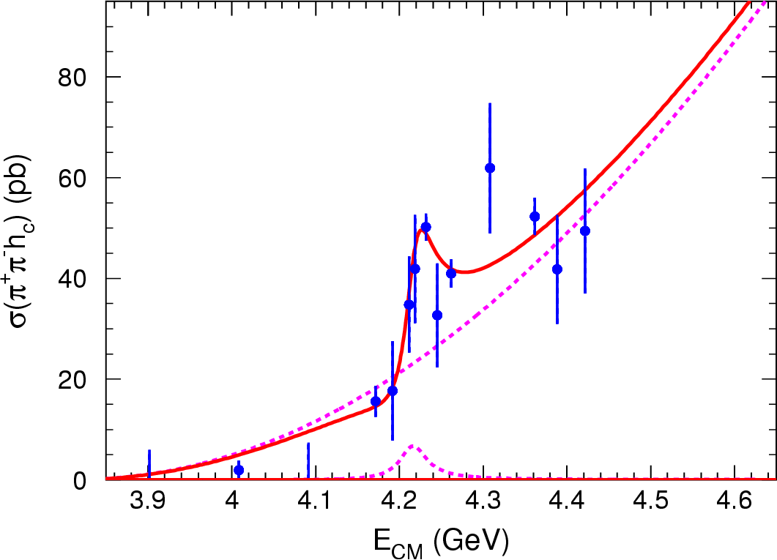
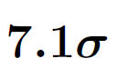
Results

Slide 19
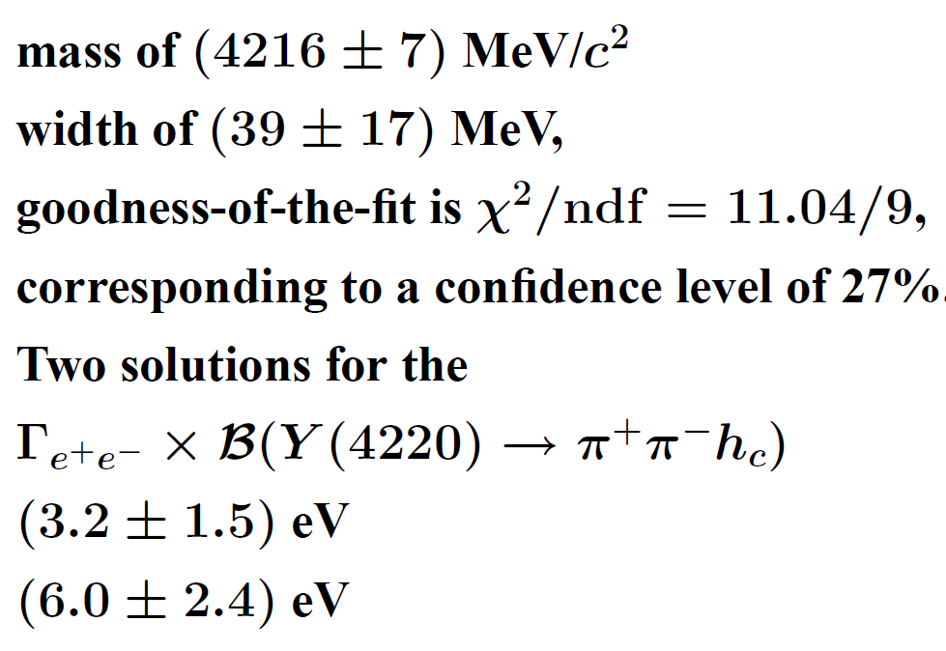
Results

Slide 20
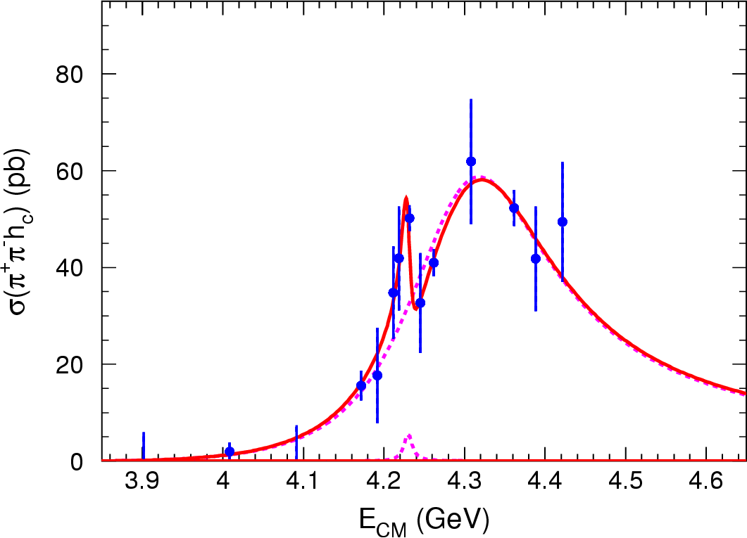

Results

Slide 21
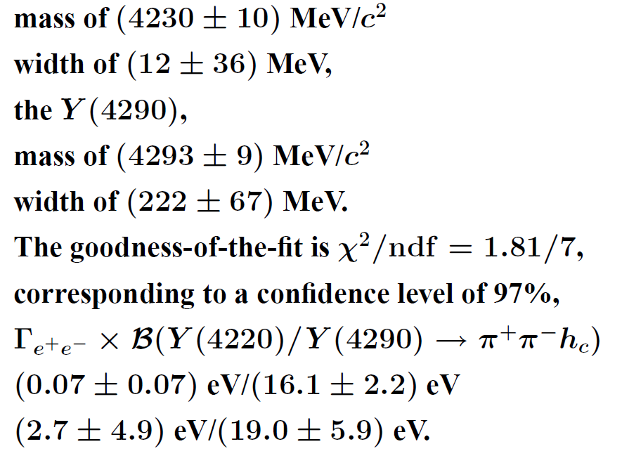
Results

Slide 22
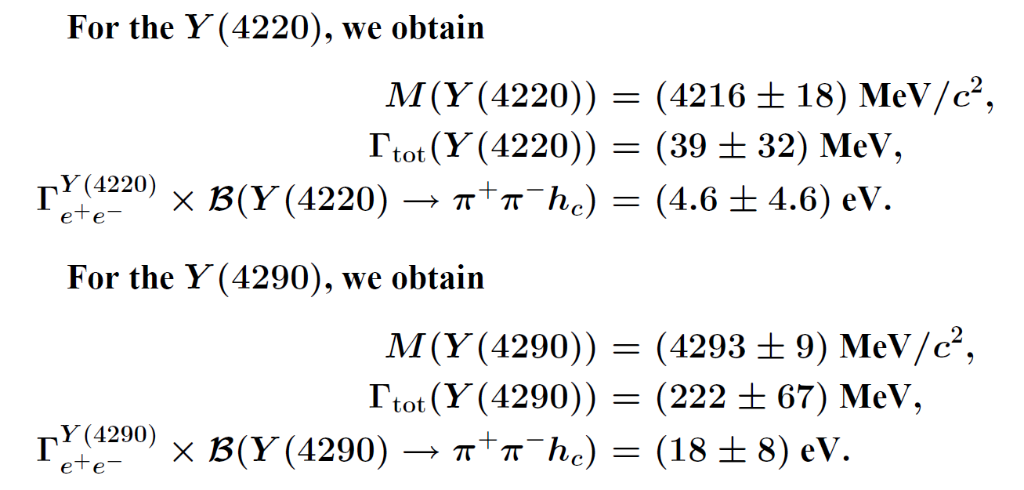
Results

Slide 23
Cross section
Cross section of π⁺π⁻h_{c} consistent with CLEO-c, same order of magnitude as those of π⁺π⁻J/ψ
Cross section of πZ_{c}(4020) around 10 pb, uniform at the three energy points

