Slide 1
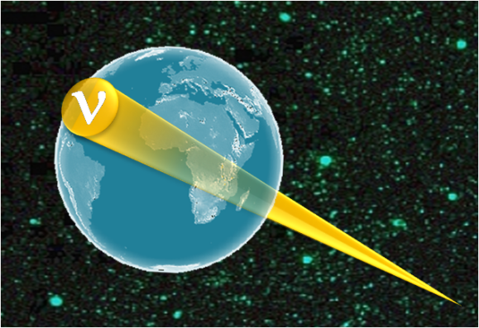
Ultra High energy cosmic neutrino experiments
Part 2
J. Carr
Centre de Physique de Particules de Marseille
IN2P3/ CNRS France

Slide 2
Content : part 2
Technique of deep water/deep ice ν detection
History of projects
AMANDA/ICECUBE
ANTARES
Future

Slide 3
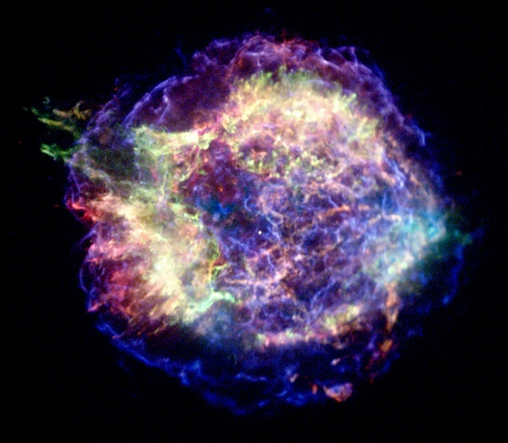
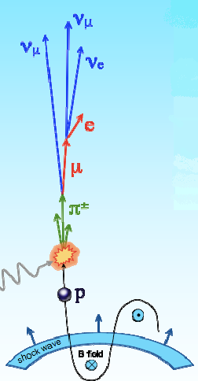
Neutrino production in source
Neutrinos produced in hadronic interactions of
high energy protons or nuclei
p/A + p/γ → π⁰ + π± + ...
↓ ↓
γ γ ν_{μ} μ → ν_{μ} ν_{e} e
proton accelerated
in shock wave
by “Fermi process”
Flux energy spectrum:
Φ_{p}∝ E⁻²

Slide 4
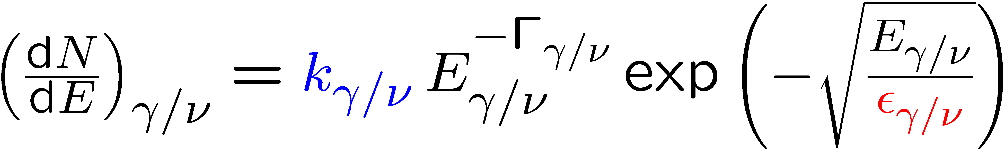
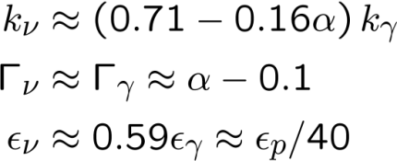
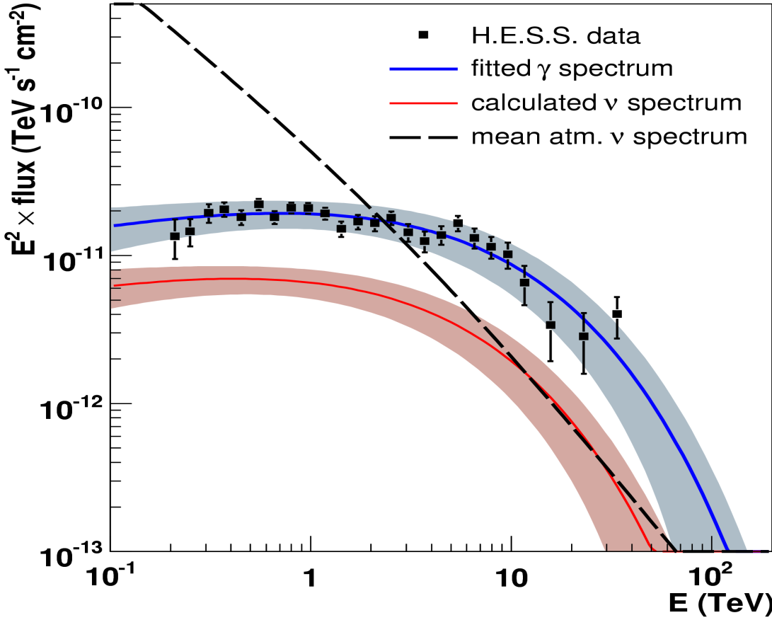
ν flux related to γ flux
Norm:
Index:
Cut-off:
Neutrino and γ-Ray Spectra for RX J1713.7-3946 (SNR)
measured
γ-ray flux
(H.E.S.S.)
expected
neutrino
flux

Slide 5
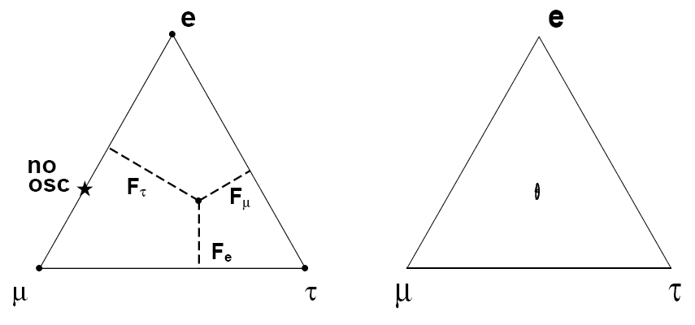
Neutrino Flavour Ratio
at source ν_{e} : ν_{μ} : ν_{τ} ≈ 1 : 2 : 10 ⁻⁵
p/A + p/γ → π⁰ + π± + ...
↓ ↓
γ γ ν_{μ} μ → ν_{μ} ν_{e} e
Neutrino Oscillations
P(ν₁ → ν₂ )= sin²2θ sin²(1.27 Δm²L /E)
Over cosmic distances
π⁺ → µ⁺ ν_{µ} 99.99%
µ → e ν_{e} ν_{µ} ≈ 100%
2 ν_{µ} : 1 ν_{µ}
K⁺ → µ⁺ ν_{µ} 64%
→ π⁺ π⁰ 21%
Small correction
→ π⁺ π⁺ π⁻ 6%
→ π⁰ e⁺ ν_{e} 5%
D_{S}⁺ → τ⁺ ν_{τ} 7%
ν_{τ} < 10 ⁻⁵
at Earth ν_{e} : ν_{μ} : ν_{τ} ≈ 1 : 1 : 1

Slide 6
Neutrino interaction in Earth
Interaction length of neutrinos vs. energy
10⁹
Neutrino interaction length
(km water equivalent)
10⁶
Equivalent Earth diameter
10³
1
10³
10⁶
E _{ν} (TeV)
Earth transparent up to E_{ν} = 100 TeV

Slide 7

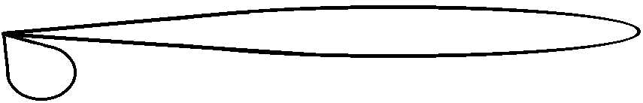
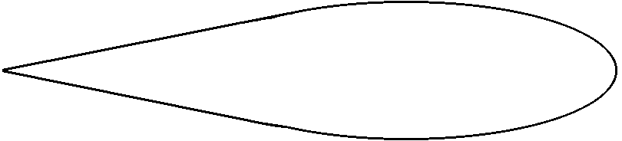
Neutrino Interactions in water
ν_{μ} → μ X
μ leaves detector
ν_{e} → e X
e showers
ν_{τ} → τ X
τ decays
τ → X
ν → ν X
ν scatters
Detector optimised for ν_{μ} → μ X, other modes have lower detection efficiency

Slide 8
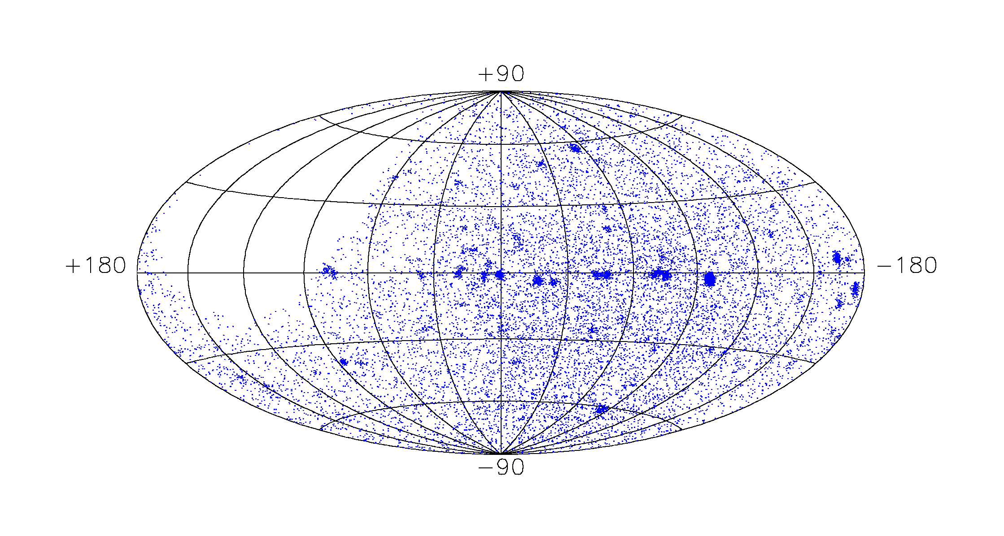
Neutrino Telescope principle
Muon very close
to direction
of neutrino
μ
ν
Map of µ directions close to ν directions

Slide 9
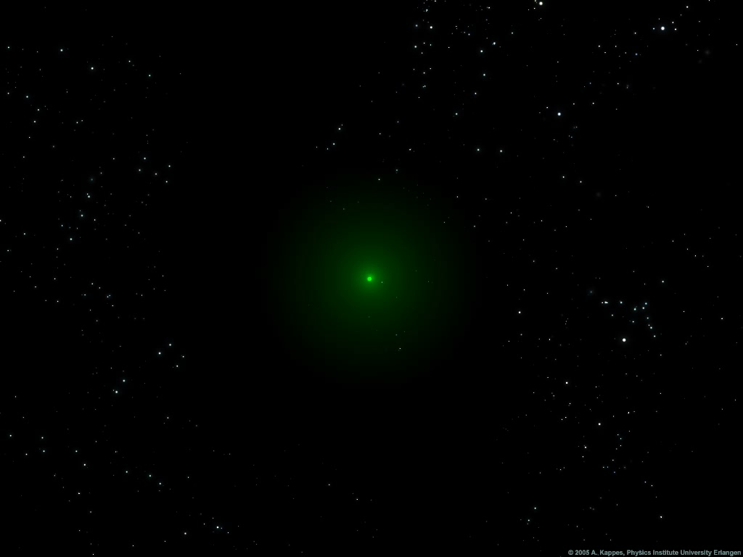
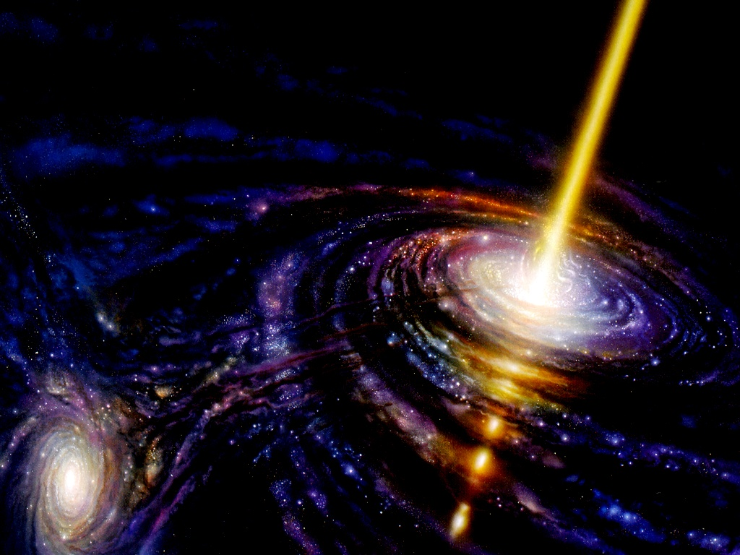
Neutrino arriving at detector

Slide 10
Detector event rates
Number events detected = Φ_{ν} × A_{ν}
A_{ν}
ν
μ
detector
Φ_{ν}
R_{μ}
P_{earth}
σ_{ν}
A_{μ}
Φ_{ν} : Flux of neutrinos arriving at earth
A_{ν} : Effective area for neutrinos
= P_{earth} × σ_{ν} × N_{target}
P_{earth} : Transmission of neutrinos through earth
σ_{ν} : Neutrino cross-section / nucleon
N_{target} : Number of target nucleons = ρ × N_{Avagadro} × R_{μ} × A_{μ}
R_{μ} : Muon average range
A_{μ} : Effective detection area for muons

Slide 11
Absorption in Earth
P_{earth}
θ = 80°
θ
ν
θ = 60°
Earth absorbs above 100 TeV
large angles pass
θ = 0°
E_{ν} GeV

Slide 12
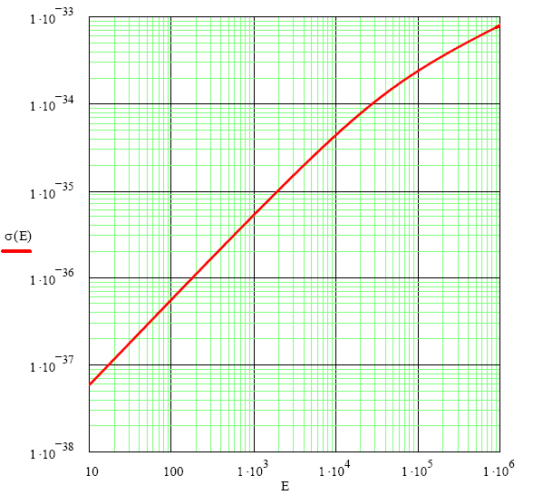
Neutrino cross-section
σ_{ν} cm²
σ_{ν}
E_{ν} GeV

Slide 13
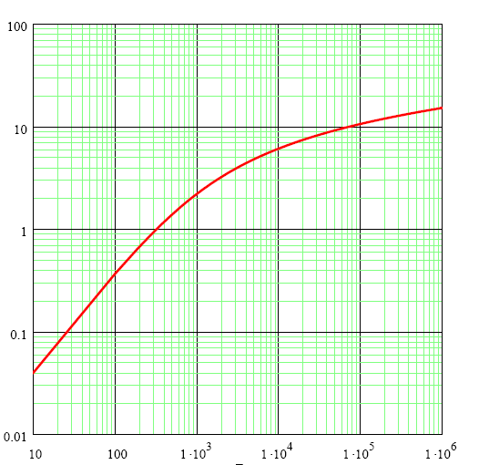
Muon Range
Average muon range :R_{μ}
R_{μ} km
E_{ν} GeV

Slide 14
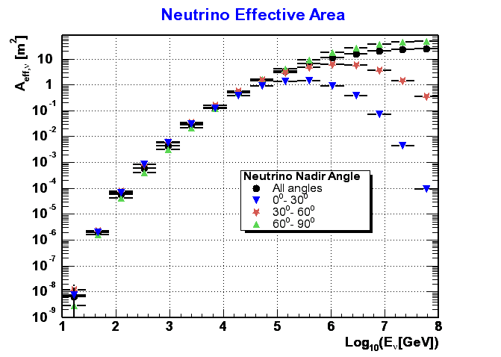
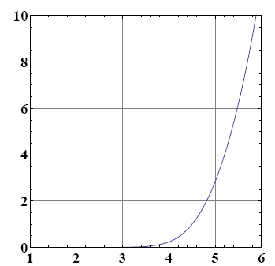
Neutrino Effective Area (ANTARES)
100 GeV ~1 cm²
1 PeV ~10 m²
A_{ν} m²
A_{ν} m²
Log₁₀ (E_{ν} /GeV)
Log₁₀ (E_{ν} /GeV)

Slide 15
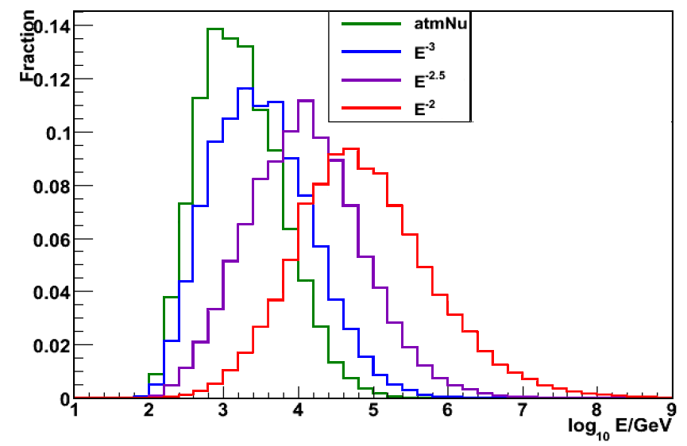
Energy distribution of events
Atmospheric ν flux
Φ_{ν} ∝ E⁻³
Φ_{ν} ∝E^{−2.5}
Φ_{ν} ∝ E⁻²

Slide 16

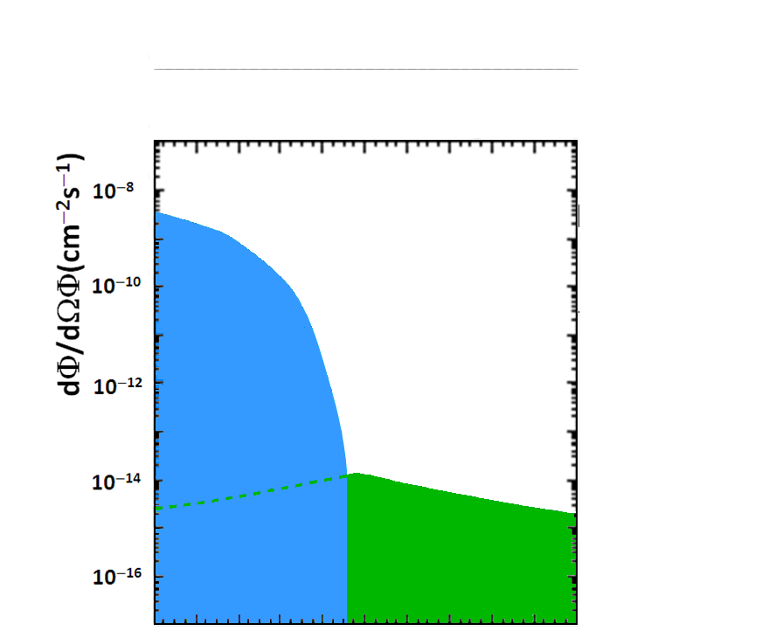
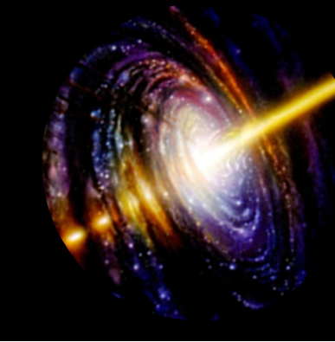

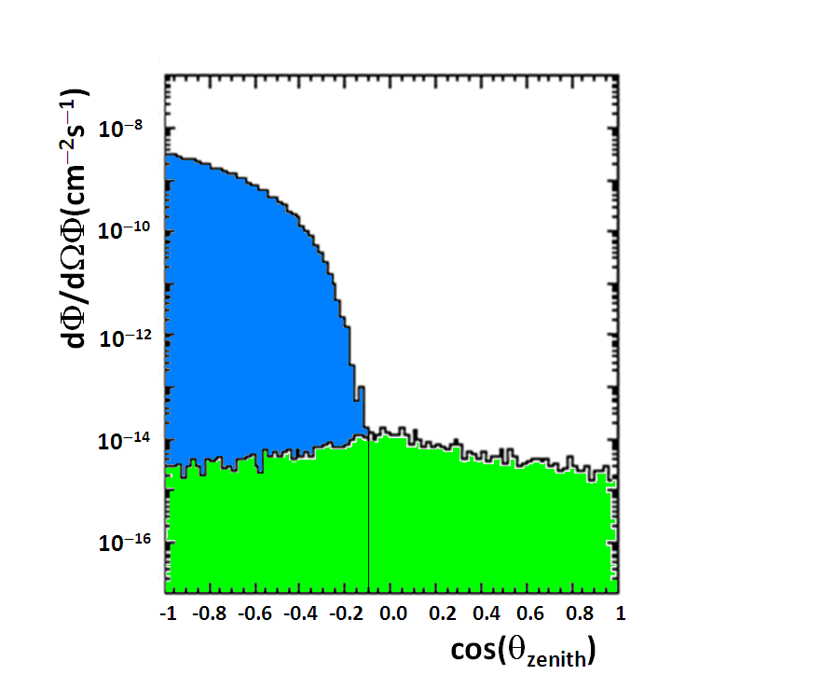
Backgrounds
ν background
µ
µ
p
p
µ
Atmospheric muons
Atmospheric
neutrinos
ν signal
Spill down of
badly reconstructed
atmospheric muon
events
19 Sept 2008
Ultra High Energy Cosmic Neutrino Experiments, J. Carr
16

Slide 17
Neutrino Telescope projects
Early projects:
- DUMAND
- NESTOR
Completed Neutrino Telescopes
- BAIKAL
- AMANDA
- ICECUBE (partly built)
- ANTARES
Future projects
- GVD
-KM3NeT

Slide 18
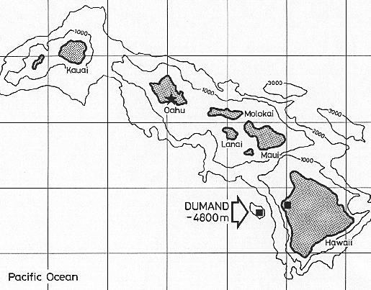
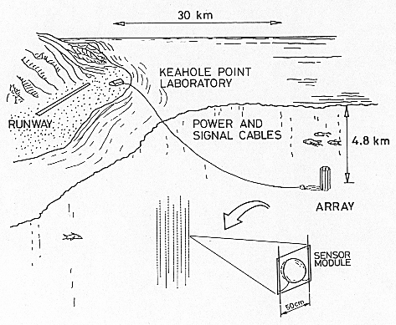
DUMAND: the first project
Hawaii
1976 - 1995

Slide 19
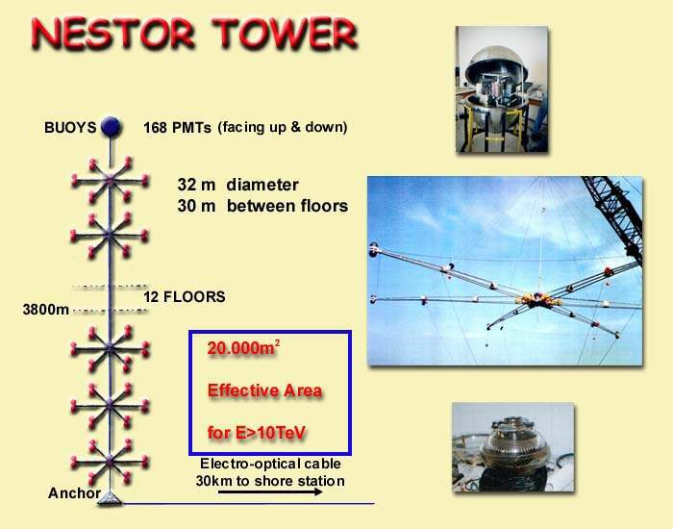
NESTOR: first in Mediterranean sea

Slide 20
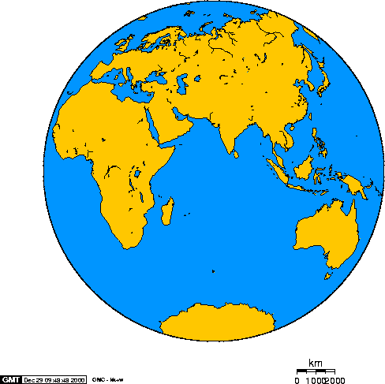
Current Neutrino Telescopes
ANTARES: France
NEMO: Italy
BAIKAL: Siberia
AMANDA/ICECUBE: South Pole

Slide 21
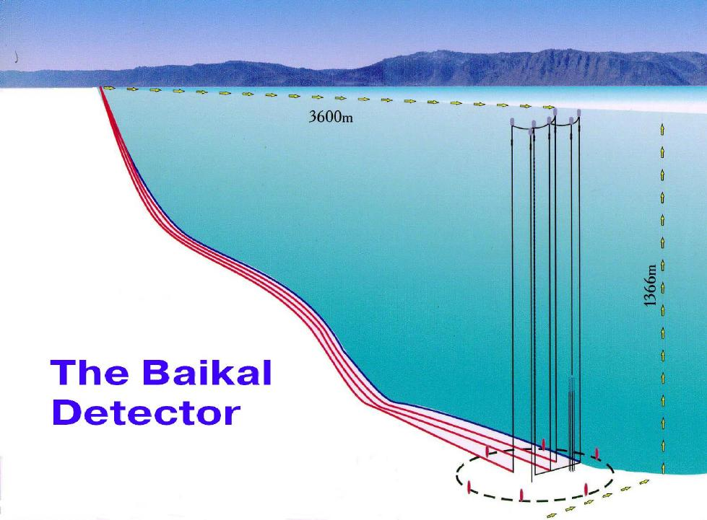
BAIKAL
Russian collaboration + DESY-Zeuthen
Ice stable for 6-8 weeks/year:
Maintenance & upgrades
Winch

Slide 22
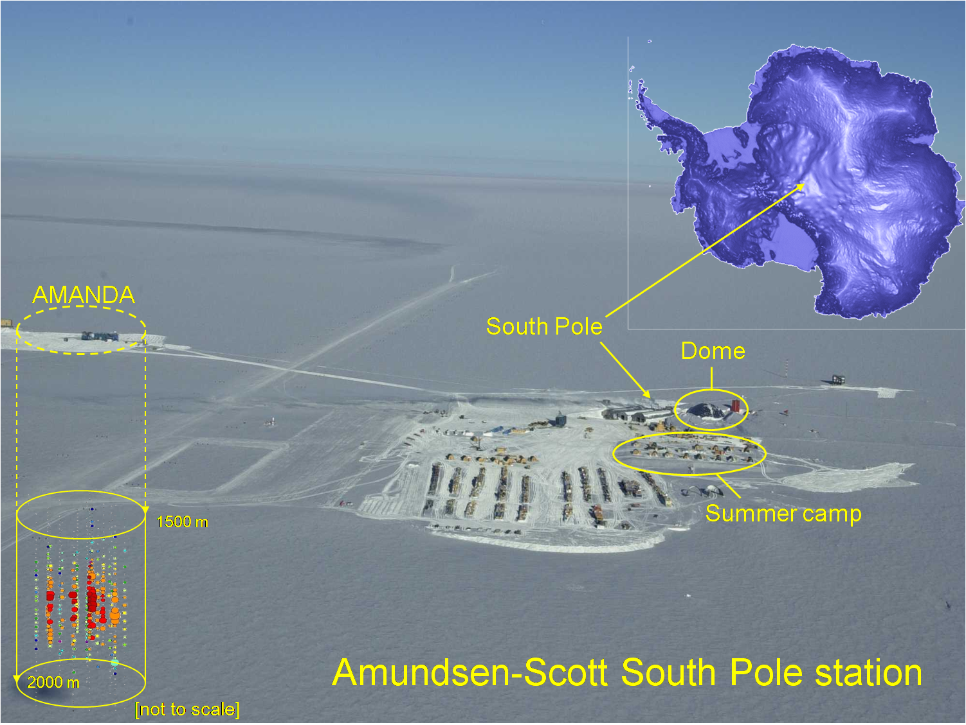
AMANDA/ICECUBE
2000 AMANDA II
2008 ¼ ICECUBE
2011 ICECUBE

Slide 23
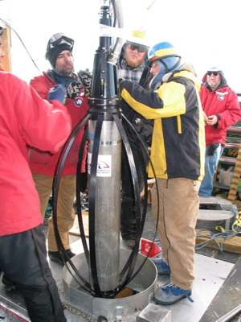
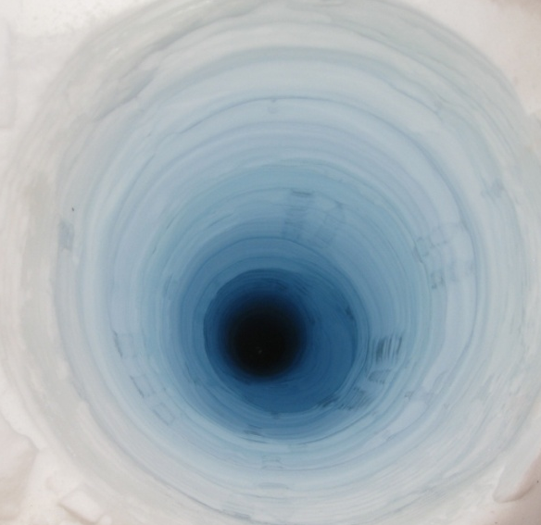
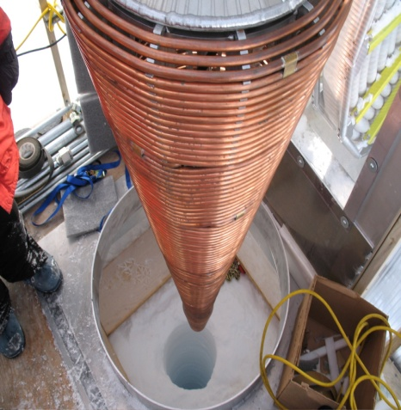
Ice drilling with hot water
Hot water heaters
-50 m
-55 C
-2450 m
-25 C

Slide 24
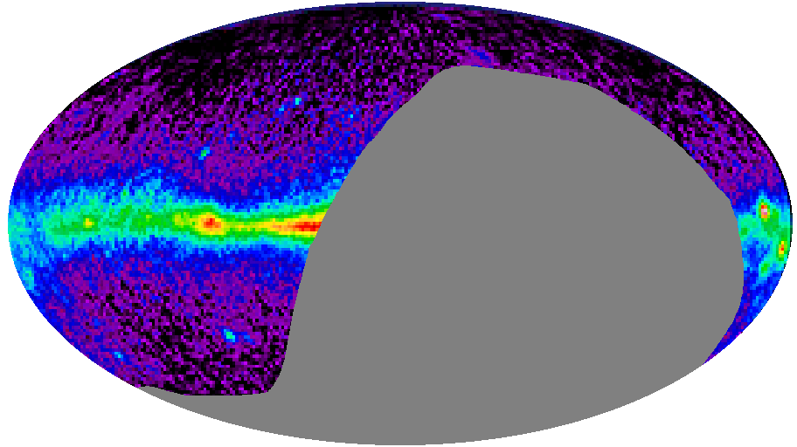
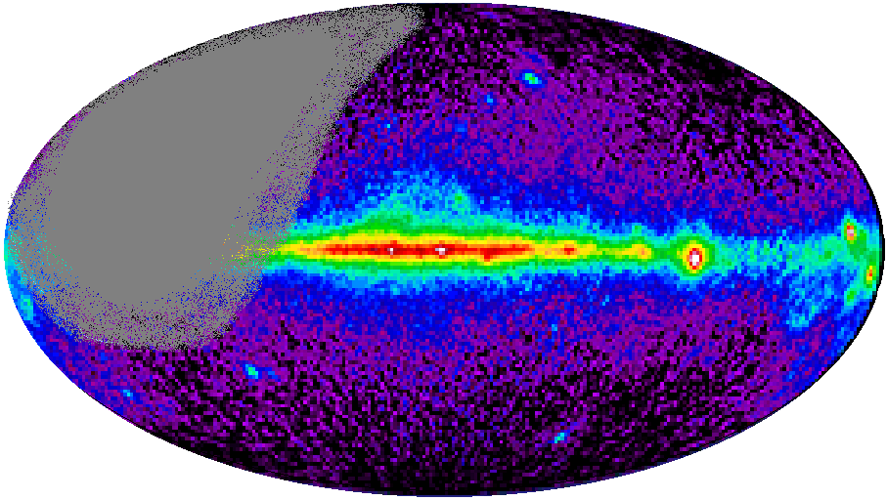
Complementary Sky Coverage
Mkn 421
South Pole
AMANDA
ICECUBE
CRAB
SS433
Mediterranean
ANTARES
KM3NeT
Cen A
RX J1713.7-39
CRAB
SS433
GX339-4
VELA
Galactic
Centre
Indicative sky coverage
assuming 100% efficiency
in downward hemisphere

Slide 25
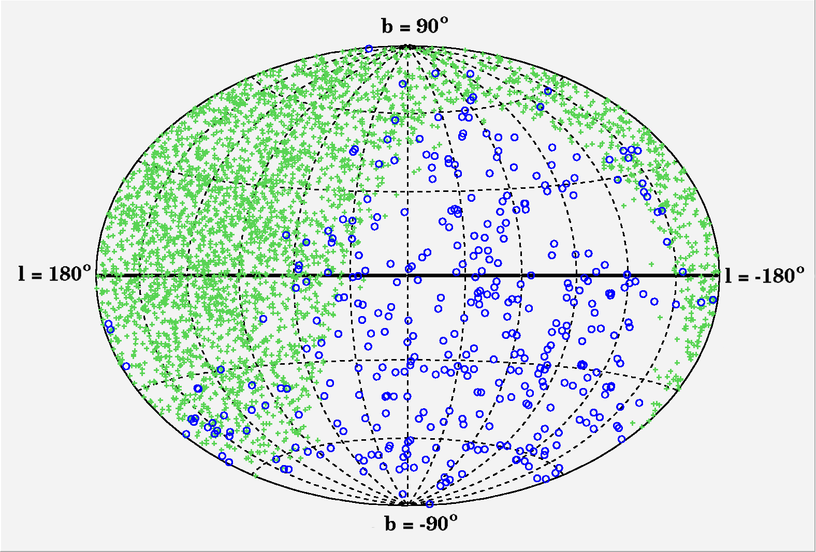
Data from AMANDA and BAIKAL
Lake Baikal
Sky map of
neutrino events
South Pole
Baikal: 372 events in 1038 days
AMANDA: 4282 events in 1001 days

Slide 26
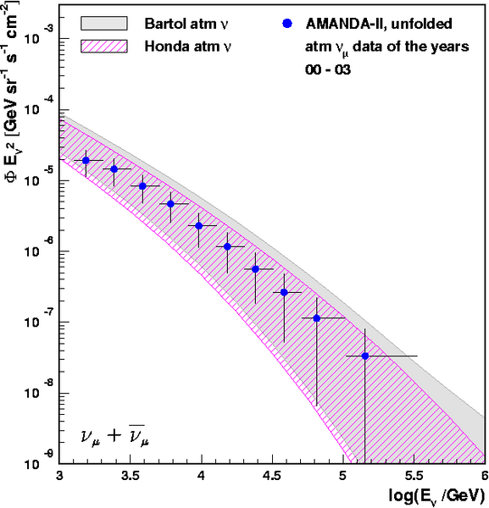
AMANDA energy spectrum of ν
AMANDA II
4 years of data

Slide 27
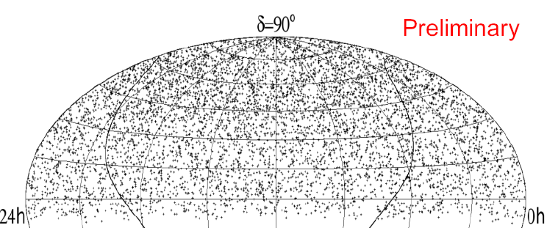
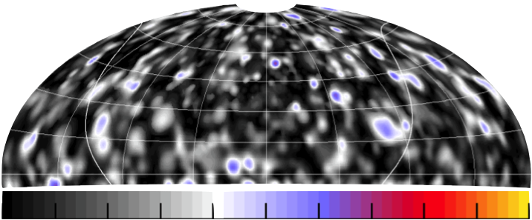
Search for point sources of ν
7 years AMANDA II (6595 events)
δ=90º
Max significance
3.38σ
0h
RA=24h
No significant excess:
No evidence for point sources of neutrinos yet

Slide 28
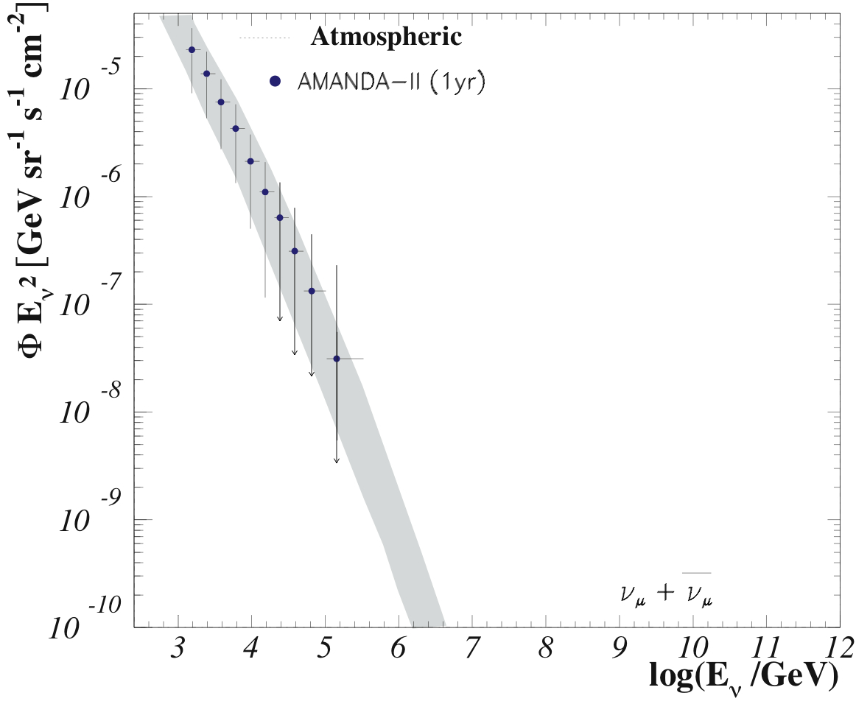
Limit on diffuse flux
AMANDA II
High energy analysis
Baikal
AMANDA II
IceCube muons,
1 year
Icecube,
muons & cascades
4 years
GRB (WB)

Slide 29
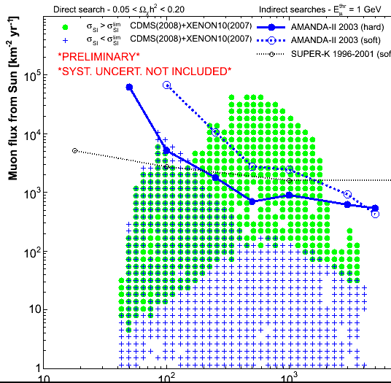
Limits on Dark Matter
10 100 1000 10000 M_{χ} (GeV/c²)

Slide 30
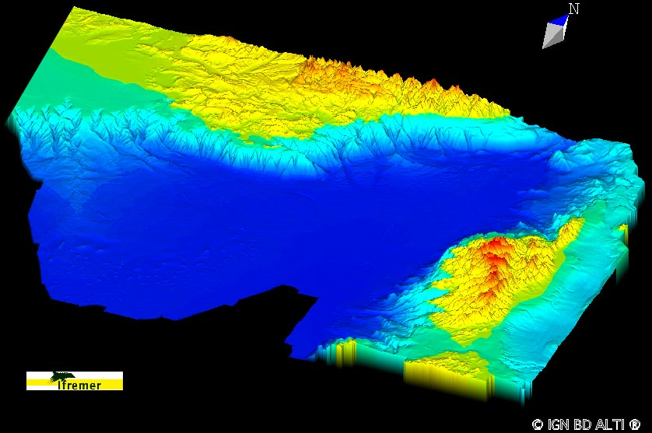
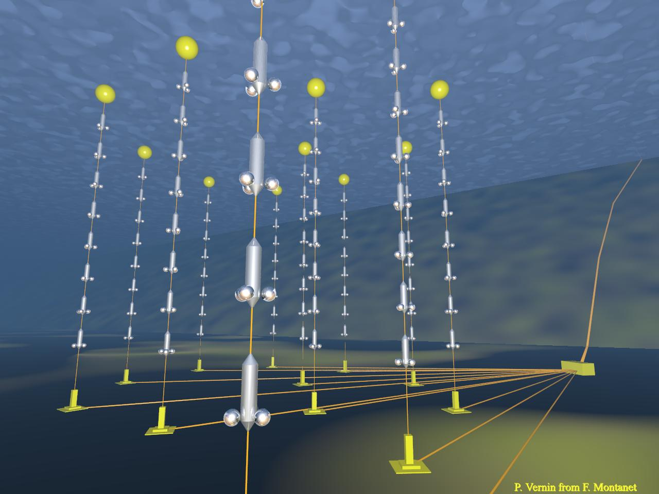
ANTARES
Marseille
Nice
Toulon
Corsica

Slide 31
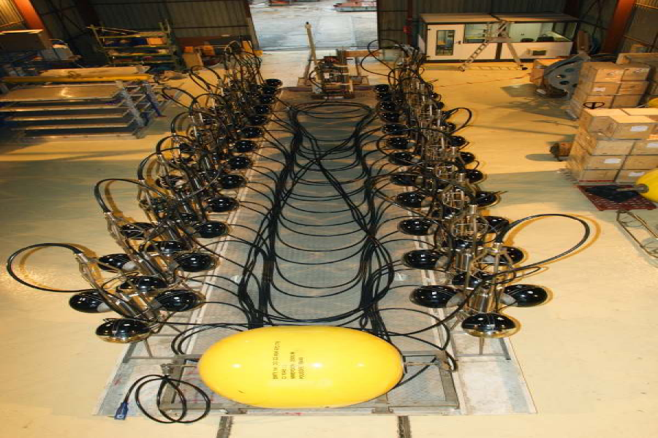
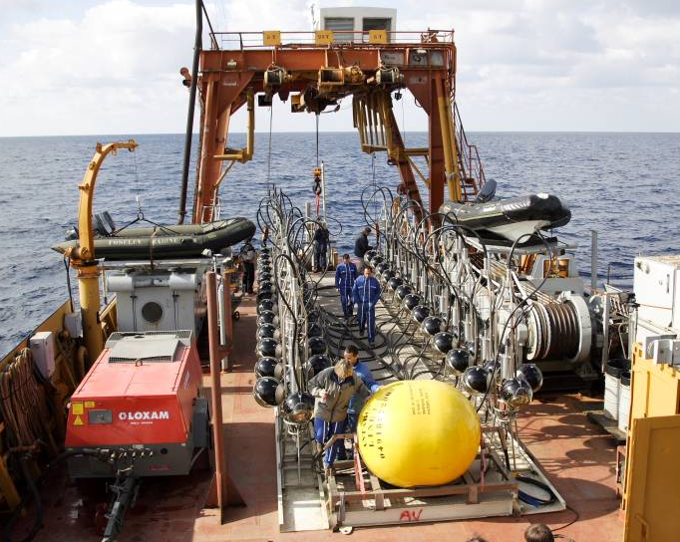
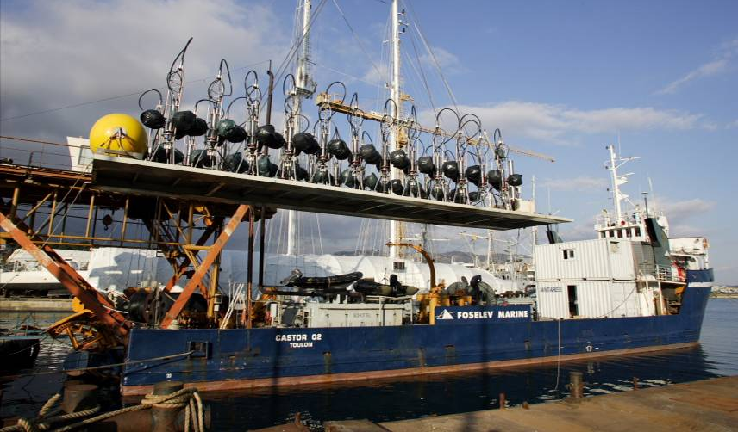
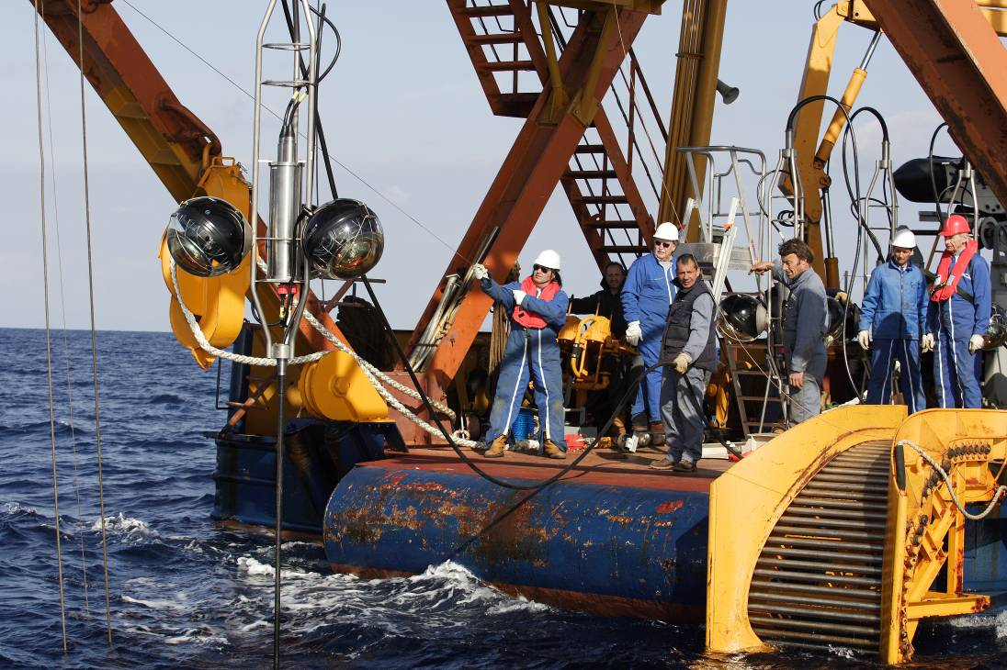
Line deployment

Slide 32
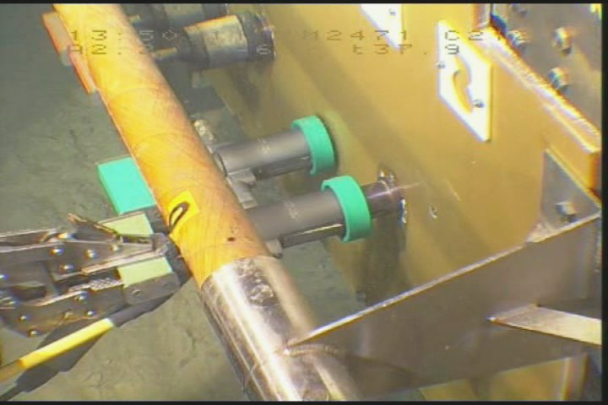
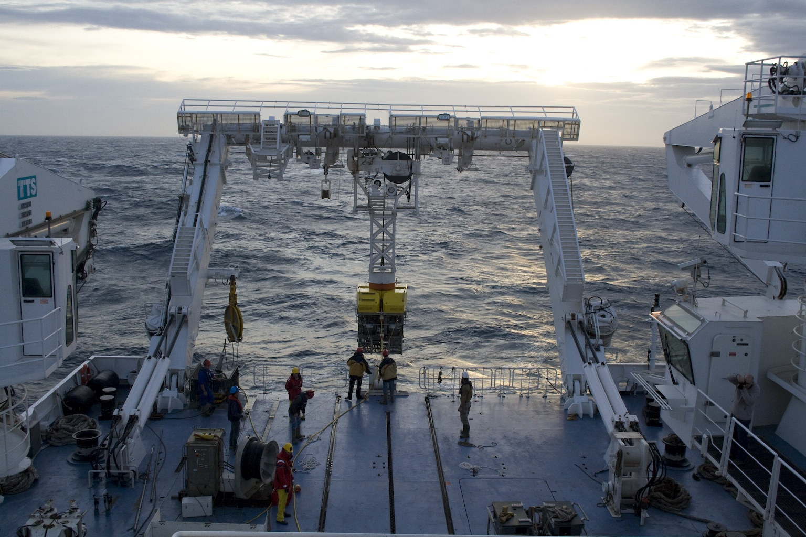
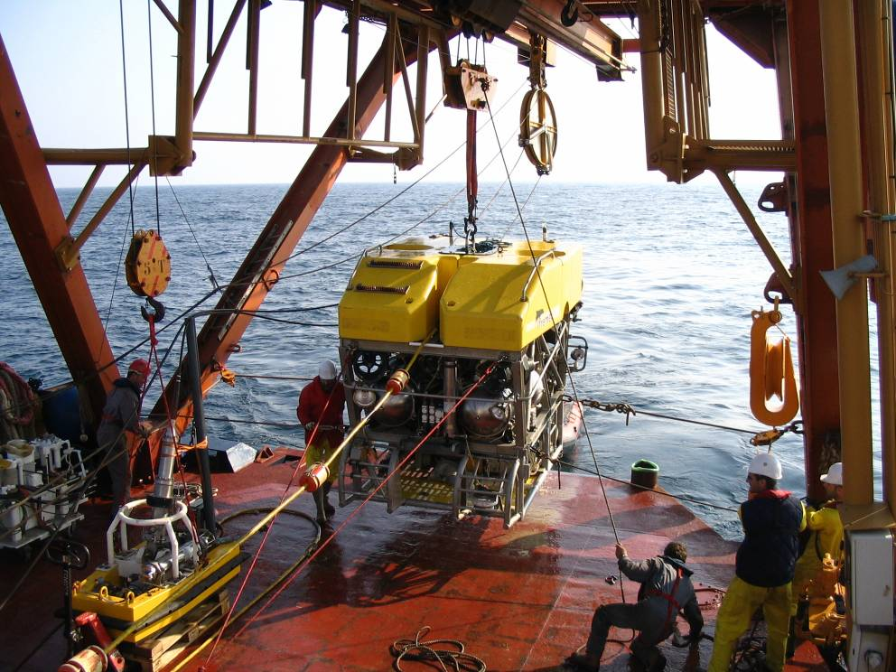
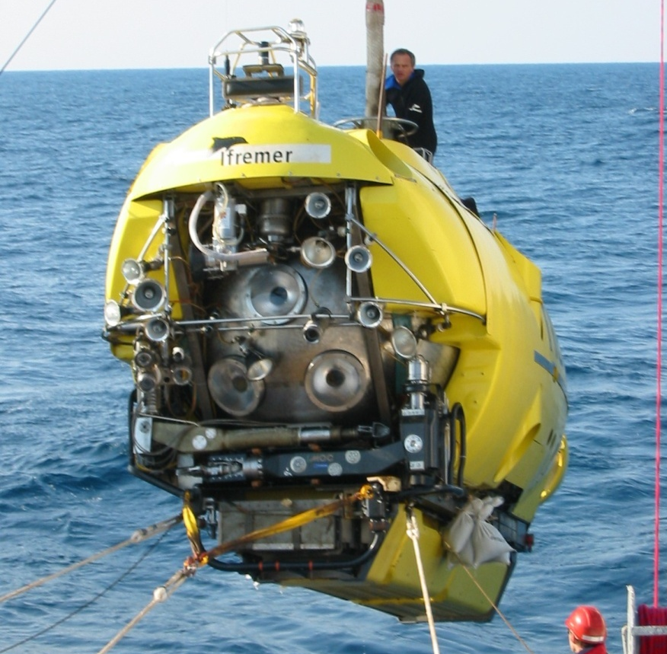
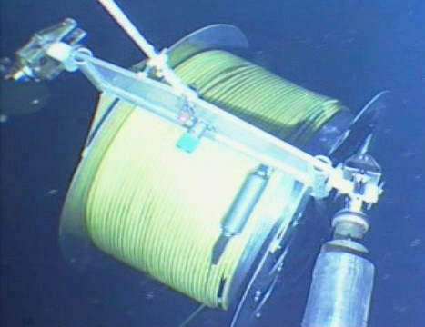
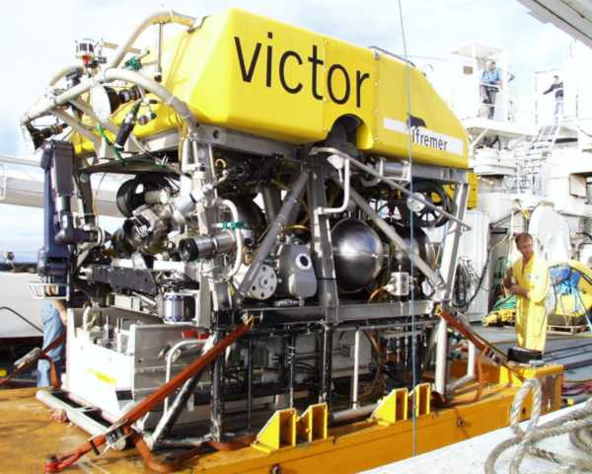
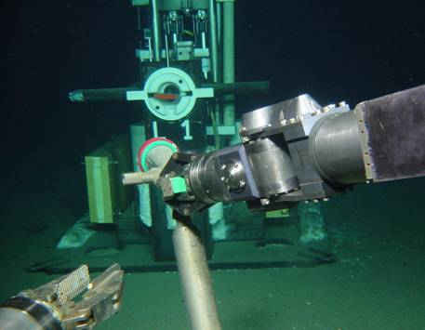
Line connections
Manned submarine Nautile
Robot submarine Victor

Slide 33









Detector on seabed
Junction Box
N
100 m
Line storeys
Line bases
IL07
L1
L5
L2
L3
L9
L4
L7
L6
L8
L11
L10
Submarine
cable
to shore
L12
seismometer
Junction box

Slide 34

Event Reconstruction
Original algorithm:
optimal association of hits
Online algorithm:
robust association of hits
Pattern recognition :
significant in background noise hits from ⁴⁰K and bioluminescence
( typically 70 kHz 30% occupancy in 4µs window)

Slide 35





Example ANTARES events
Neutrino candidate
upward
downward
muon bundle event

Slide 36

Zenith angle distribution
Upward going
neutrinos
Downward going
cosmic ray muons

Slide 37





Water versus Ice
Deployment
Ice gives solid platform to install detector
Sea experiments need boats/ platforms
Ice detectors worked first (Baikal deploys from ice)
Angular Resolution
Light scattering much less in water
AMANDA : ~ 3° (real detector)
ANTARES : ~ 0.2 ° (simulations)
ANTARES /NEMO/NESTOR
KM3NeT
Uniformity of Detector response
Water homogeneous
Ice has dust layers, bubbles
Knowledge of efficiency simpler in water
BAIKAL / GVD
Noise Backgrounds
Water: ⁴⁰K /bioluminescence ~ 60kHz / PMT
Ice: only dark tube noise ~ 500Hz / PMT
AMANDA / ICECUBE

Slide 38



Optical properties
Mediterranean
sea water
South Pole
glacial ice
absorption
scattering
absorption
scattering
Ice non-homogeneous due to dust layers
associated with global climate variations

Slide 39

Comparison ANTARES : AMANDA
ANTARES 10 months 10/12 of detector
AMANDA II 4 years
neutrinos
Zenith range | ANTARES | AMANDA
Cos θ >0.0 | 300 | 560
−0.2<Cos θ <0.0 | 460 | 26000
Better properties of water detector can lead
to higher efficiency and lower background

Slide 40


2007-2008: 18 strings
2006-2007:
13 strings deployed
IceTop
IceCube
Current configuration
- 22 strings
- 52 surface tanks
Air shower detector
80 pairs of ice Cherenkov tanks
Threshold ~ 300 TeV
2005-2006: 8 strings
2004-2005 : 1 string
1450m
IceCube
Goal of 80 strings of 60
optical modules each
17 m between modules
125 m string separation
AMANDA-II
19 strings
677 modules
2450m
Completion by 2011.

Slide 41


ICECUBE Point Source Search
9 Strings
“IC9”
No evidence
for sources
22 Strings
“IC22”
?

Slide 42

ICECUBE Deep Core
Improves low energy performance

Slide 43

BAIKAL : GVD
NT200+
Km3 Baikal Project

Slide 44




NEMO : R&D for Mediterranean NT
Shore laboratory, Port of Catania
25 km E offshore
Catania (test site)
2000 m depth
NEMO mini-tower
(4 floors, 16 OM)
Buoy
e.o. connection
e.o. cable
from shore
e.o. cable
10 optical fibre, 6 conductors
TSS Frame
Junction Box
Junction Box
Mini-Tower compacted

Slide 45




KM3NeT
Combined Mediterranean Neutrino Telescope projects
ANTARES
NEMO
NESTOR

Slide 46
Summary
Neutrino Astronomy is a unique way to observe the Universe
Need a detector large enough to do this frontier science
Extensive international efforts needed in this field

