Slide 1
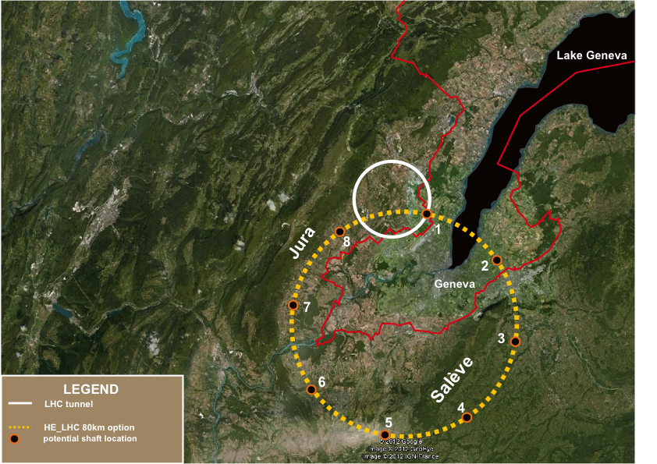
Tera-Z, Oku-W, Mega-Higgs and Mega-tops
Precision Physics at the Electroweak scale
FCC/TLEP Design Study :
http://tlep.web.cern.ch
First look at the physics case of TLEP:
arXiv:1308.6176v3

Slide 2
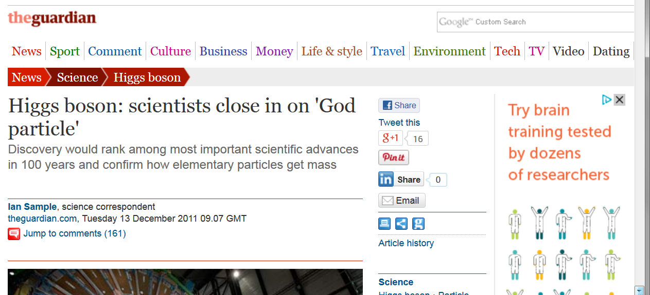
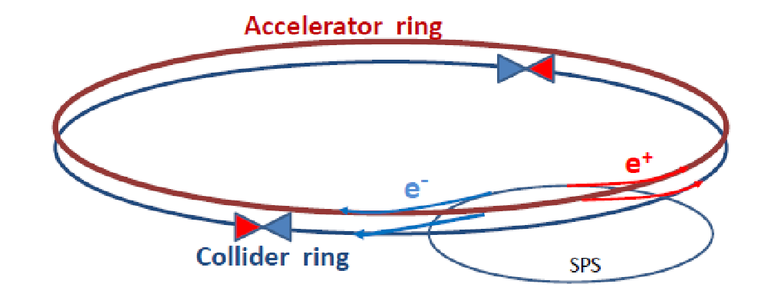
Two years with a Higgs!
13 Dec. ’11: LHC sees hint of
lightweight Higgs boson

Slide 3
LHC is only beginning!
LHC will study the Higgs boson H(126) up to a certain level of precision
which is assumed to be a few percent for many couplings,
bb, tt, WW, ZZ, γγ, ττ, μ μ... +estimates for Zγ and cc
and better results for ratios of branching ratios.
The self coupling will probably remain at precision of ~30%, and the invisible
decay may be probed at 5-10% level.
New physics is expected to show up at any level of precision, but it is
generally accepted that a precision of a few permil is needed to discover (5σ)
TeV scale new physics.
Invisible decays are of particular interest as
any invisible decay width is a potential sign of dark matter

Slide 4
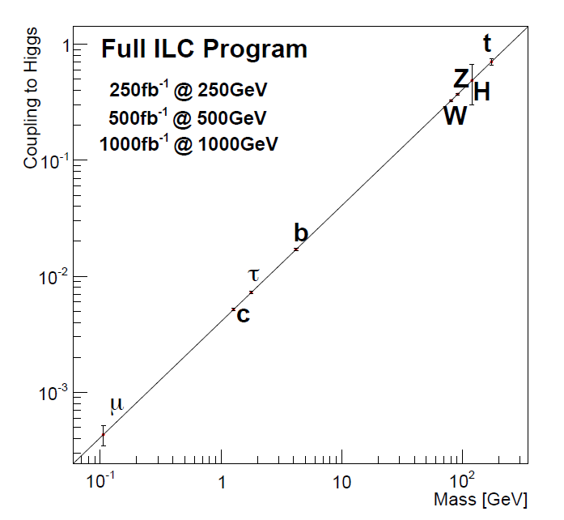
t
Full HL-LHC
H
Z
W
b
τ
μ

Slide 5
e+ e- colliders
ILC CLIC Circular (LEP3, TLEP, CEPC ...)
main differences:
-- luminosity vs energy dependence
-- high energy reach
-- upgrade path
-- resolution and precision in center-of-mass energy
-- ILC is linear and «ready»
-- circular machines begin design study
main quality: e+e- → Z H (Higgs tag by recoil mass to Z decay)

Slide 6
Hvv advantageous for ILC & CLIC as L ∝ E_cm

Slide 7
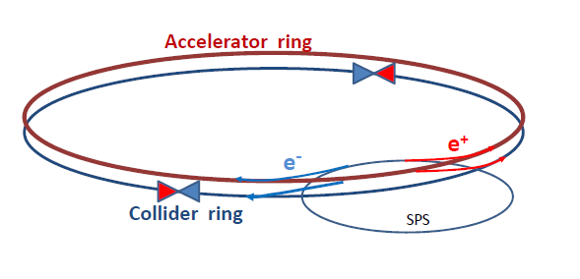
What about a circular machine? LEP2 was not that far after all.
One year of LEP2 ➔ ~200pb⁻¹ x 4 exp. need 100fb⁻¹!
How can one increase over LEP 2 (average) luminosity by a factor 500
without exploding the power bill?
Answer is in the B-factory design: a very low vertical emittance ring with
higher intrinsic luminosity
electrons and positrons have a much higher chance of interacting
➔ much shorter lifetime (few minutes)
➔ feed beam continuously with a ancillary accelerator

Slide 9
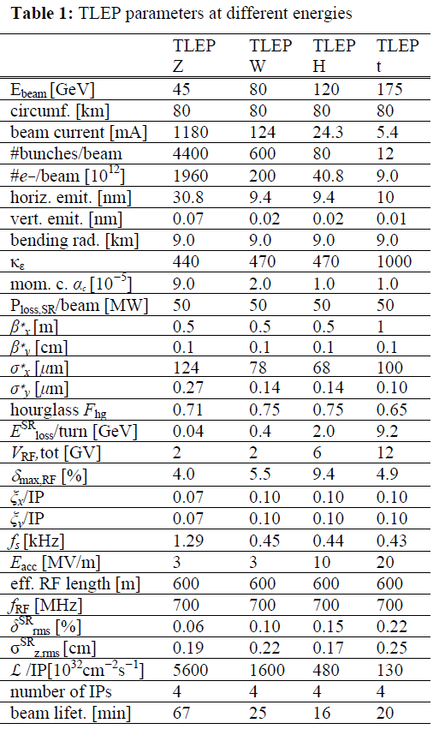
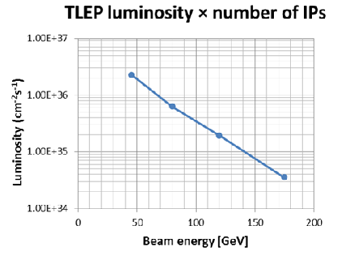
http://arxiv.org/abs/1305.6498.
CONSISTENT SET OF PARAMETERS FOR TLEP
TAKING INTO ACCOUNT BEAMSTRAHLUNG
new parameter set to be produced by Jan’14

Slide 10
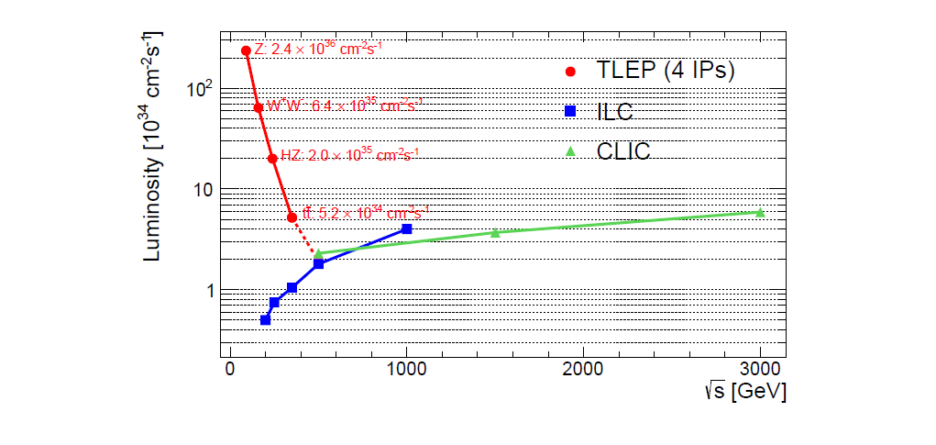
Goal performance of e+ e- colliders
complementarity
Luminosity : Crossing point between circular and linear colliders ~ 4-500 GeV
As pointed out by H. Shopper in ‘The Lord of the Rings’ (Thanks to Superconducting RF…)
Combined know-how {LEP, LEP2 and b-factories} applied for large e+e- ring collider
High Luminosity + Energy resolution and Calibration ➔ precision on Z, W, H, t

Slide 11
STATISTICS (e⁺e⁻ → ZH, e⁺e⁻ →W⁺W⁻, e⁺e⁻ → ZH,[e⁺e⁻→ t$\overline{t}]$ )
 | TLEP-4 IP, per IP | statistics
circumference | 80 km
max beam energy | 175 GeV
no. of IPs | 4
Luminosity/IP at 350 GeV c.m. | 1.3x10³⁴ cm⁻²s⁻¹ | 10⁶‾tt pairs
Luminosity/IP at 240 GeV c.m. | 4.8x10³⁴ cm⁻²s⁻¹ | 2 10⁶ ZH evts
Luminosity/IP at 160 GeV c.m. | 1.6x10³⁵ cm⁻²s⁻¹ | 10⁸ WW pairs
Luminosity/IP at 90 GeV c.m. | 5.6 10³⁵ cm⁻²s⁻¹ | 10¹² Z decays
at the Z pole repeat the LEP physics programme in a few minutes…

Slide 12
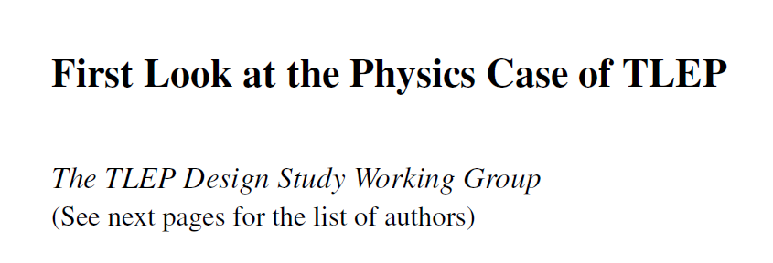
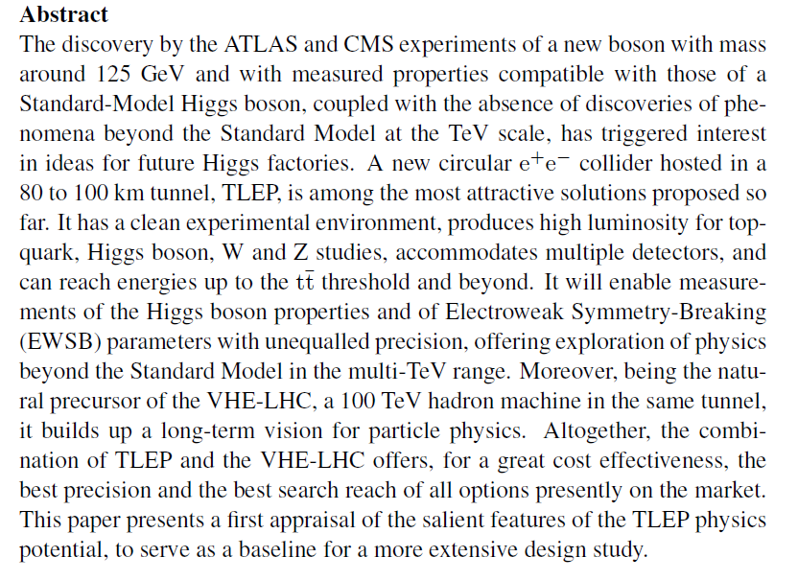
to appear in JHEP

Slide 13
Higgs production mechanism
In e⁺e– the Higgs is produced by “higgstrahlung” close to threshold
Production xsection has maximum near threshold ~200 fb
10³⁴/cm²/s ➔ 20’000 HZ events per year.
H – tagging
by missing mass
to Z decay
a « beam of Higgs »
e⁻
H
Z*
e⁺
Z
For a Higgs of 125GeV, a centre of mass energy of ~240GeV is best
➔ kinematical constraint near threshold for high precision in mass, width, selection purity

Slide 14
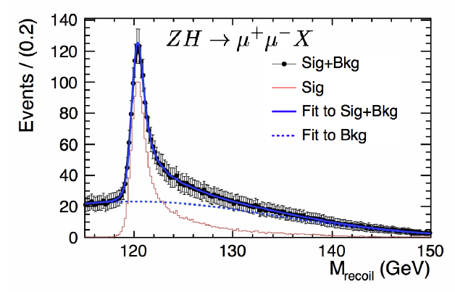
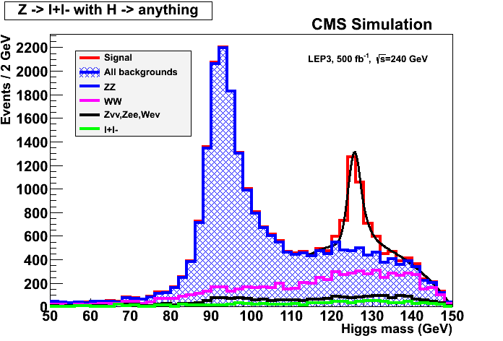
ILC
Z – tagging
by missing mass
total rate ∝ g_{HZZ}²
ZZZ final state ∝ g_{HZZ}⁴/ Γ_{H}
➔ measure total width Γ_{H}
empty recoil = invisible width
‘funny recoil’ = exotic Higgs decay
easy control below theshold
e⁻
H
Z*
e⁺
Z

Slide 15
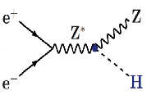
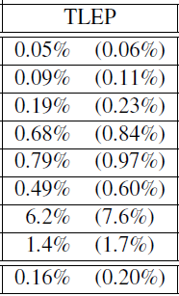
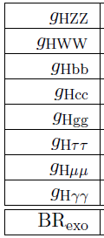
best-of FCC/TLEP #1: Higgs factory
(constrained fit
including ‘exotic’)
4 IPs
(2 IPs)
2 10⁶ ZH events in 5 years
«A tagged Higgs beam».
Best across the board
sensitive to new physics in loops
invisible width = (dark matter?)
also (but better done at the
hadron colliders HL-LHC, VHE-LHC:
total width
HHH
Htt
0.6%
28%
13%
from effect on HZ threshold
arXiv:1312.3322v1
from effect on‾tt threshold

Slide 16
Higgs Physics with e⁺e⁻ colliders above 350 GeV?
TLEP in 100 km tunnel can in principle go to 500 GeV (not studied)
1. Similar precisions to the 250/350 GeV Higgs factory for W,Z,b,g,tau,charm, gamma and total width. Invisible width best done at 240-250 GeV.
2. ttH coupling possible with similar precision as HL-LHC (4%)
3. Higgs self coupling also very difficult… precision
~30% at 1 TeV similar to HL-LHC prelim. estimates
10-20% at 3 TeV (CLIC)
➔ 100 TeV pp machine only can go below 10%. (8%?)
➔ For the study of H(126) alone, and given the existence of HL-LHC, an e+e- collider with energy above 350 GeV is not compelling w.r.t. one working in the 240 GeV – 350 geV energy range.
➔ The stronger motivation for a high energy e+e- collider will exist if new particle found (or inferrred) at LHC, for which e+e- collisions would bring substantial new information

Slide 17
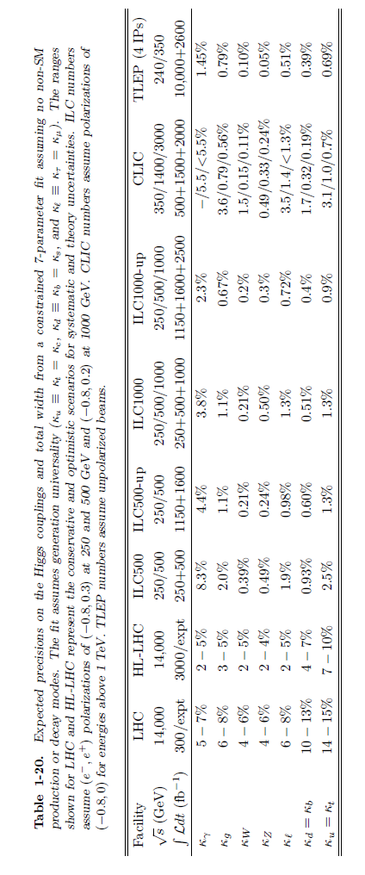
The ILC
TLEP
NB : this is not a very good comparison with LHC as correlation between channels
➔ some ratios of BRs being can be more precise observables than the couplings themselves.

Slide 18
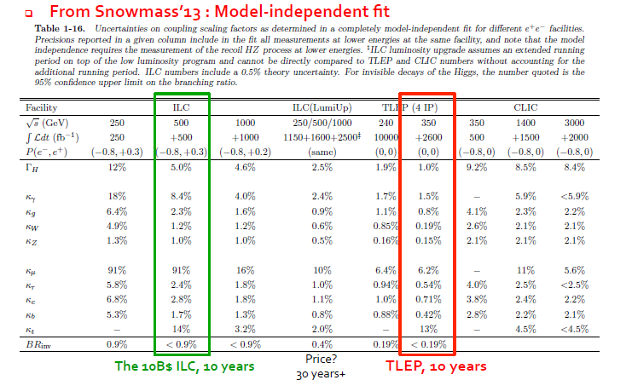

Slide 19
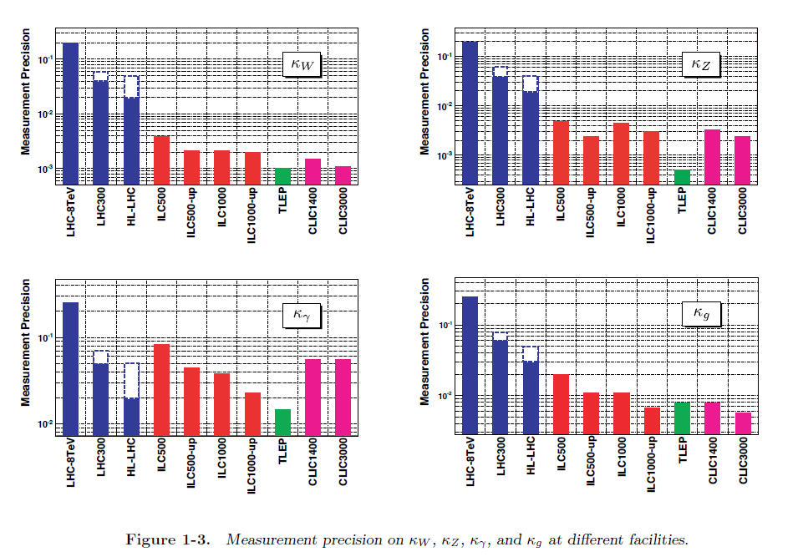

Slide 20
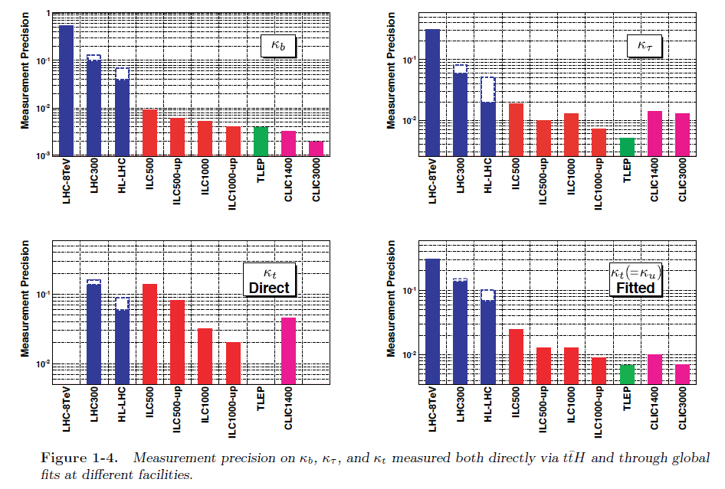

Slide 21
TERA-Z and Oku-W
Precision tests of the
closure of the Standard Model

Slide 22
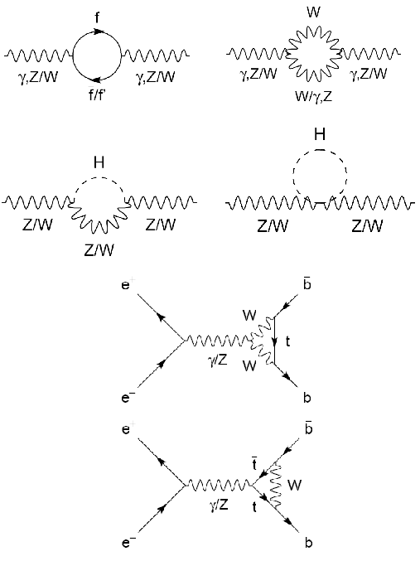
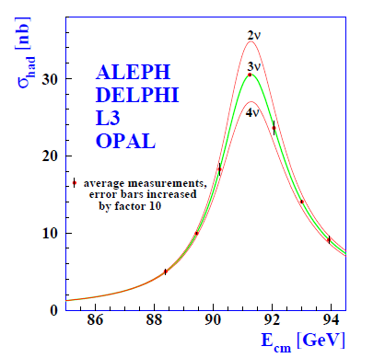
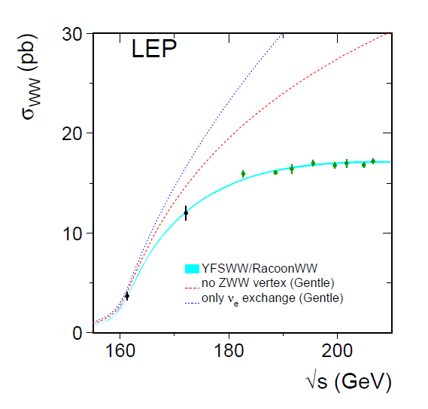
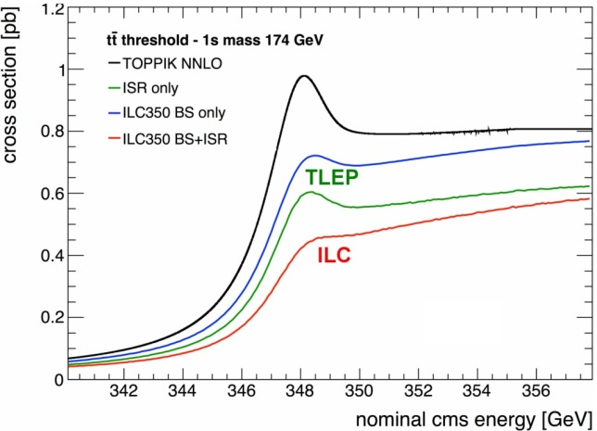
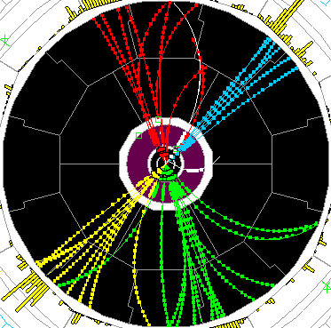
Precision tests of EWSB
Z pole ssymmetries, lineshape
WW threshold scan
tt threshold scan
-
TLEP : Repeat the LEP1 physics programme every 15 mn
Transverse polarization up to the WW threshold
Exquisite beam energy determination (10 keV)
Longitudinal polarization at the Z pole
Measure sin²θ_{W} to 2.10⁻⁶ from A_{LR}
Statistics, statistics: 10¹⁰ tau pairs, 10¹¹ bb pairs, QCD and QED studies etc…

Slide 23
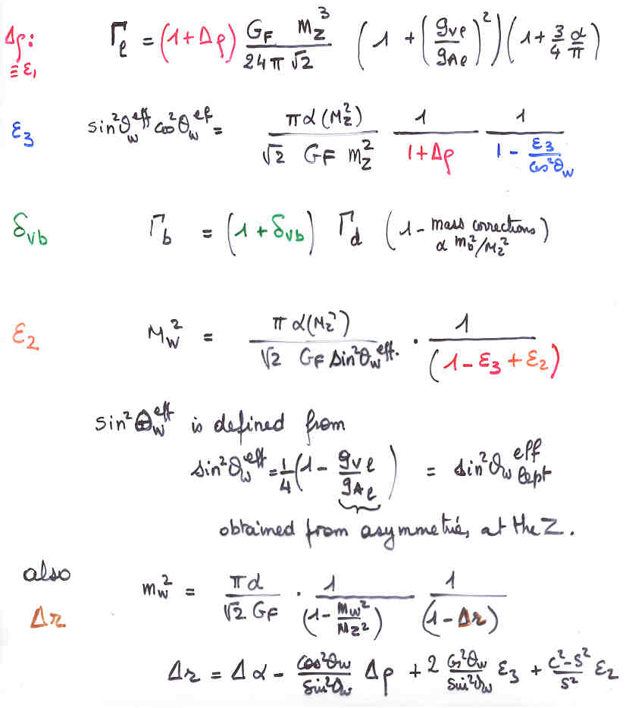
EWRCs
relations to the well measured
G_{F} m_{Z} α_{QED}
at first order:
Δρ = α /π (m_{top}/m_{Z})²
- α /4π log (m_{h}/m_{Z})²
ε₃ = cos²θ_{w} α /9π log (m_{h}/m_{Z})²
δ_{νb} =20/13 α /π (m_{top}/m_{Z})²
complete formulae at 2d order
including strong corrections
are available in fitting codes
e.g. ZFITTER , GFITTER
Will need to be improved
for TLEP!

Slide 24
Example (from Langacker& Erler PDG 2011)
Δρ =ε₁=α(M_{Z}) . T
ε₃=4 sin²θ_{W} α(M_{Z}) . S
Δρ today = 0. 0004+0.0003−0.0004
-- is consistent with 0 at 1σ
-- is sensitive to non-conventional Higgs bosons (e.g. in SU(2) triplet with ‘funny v.e.v.s)
-- is sensitive to Isospin violation such as m_{t} ≠ m_{b} or ibid for stop-sbottom
Present measurement implies
Most e.g. SUSYmodels
have these symmetries
embedded from the start
Similarly:

Slide 25
Words of caution:
1. TLEP will have 5.10⁴ more luminosity than LEP at the Z peak, 5.10³ at the
W pair threshold.
Predicting achievable accuracies with statistical errors decreasing by
250 is very difficult. The study is just beginning.
2. The following table are ‘plausible’ precisions based on my experience
and knowledge of the present limitations, most of which from higher order QED
corrections (ex. production of additional lepton pairs etc..).
Many can have experimental cross-checks and errors may get better.
3. The most serious issue is the luminosity measurement which relies on the
calculations/modeling of the low angle Bhabha scattering cross-section.
This dominates the measurement of the hadronic cross section at the Z peak thus
the determination of N_{v} (test of the unitarity of the PMNS matrix)
4. The following is only a sample of possibilities. With 10¹² Z decays, there are
many, many more powerful studies to perform at TERA-Z
e.g. flavour physics with 10¹¹ ‾bb, ‾cc , 10¹⁰ ττ etc…

Slide 26
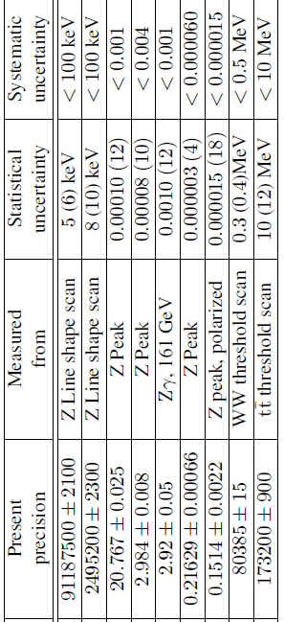
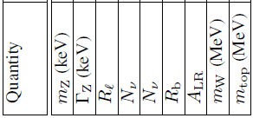
best-of FCC/TLEP #2: Precision EW measts
Asset: -- high luminosity (10¹² Z decays + 10⁸ Wpairs + 10⁶ top pairs ) -- exquiste energy calibration up and above WW threshold
target precisions
Also -- Δsin² θ_{W} ≈10⁻⁶
-- Δα_{S}= 0.0001 from W and Z hadronic widths
-- orders of magnitude on FCNCs and rare decays etc. etc.
Design study to establish possibility of corresponding precision theoretical calculations.

Slide 27
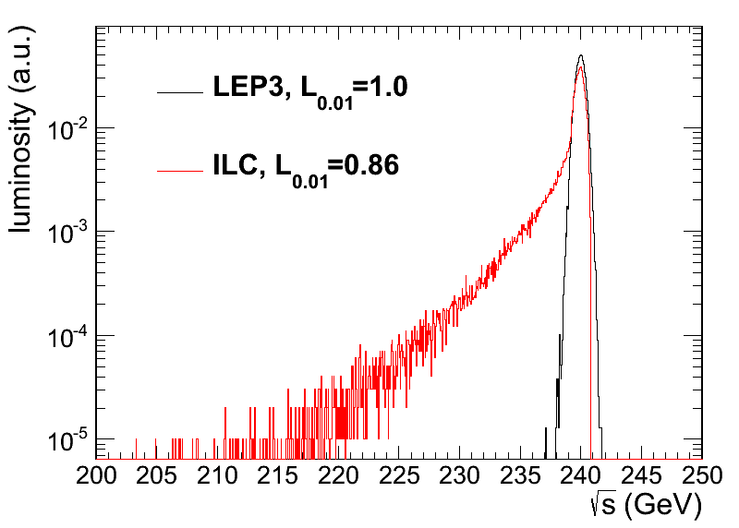
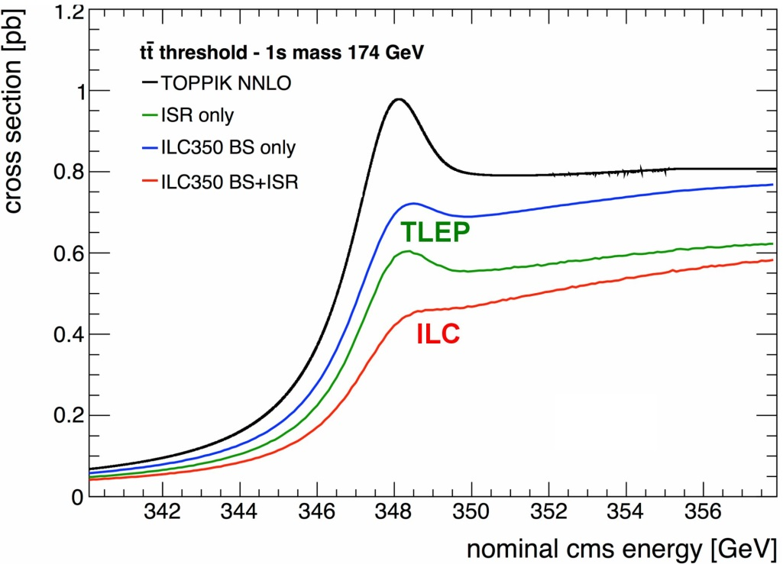
BEAMSTRAHLUNG
Luminosity E spectrum
Effect on top threshold
➔
TLEP operates at Beamstrahlung limit, this is a dominant factor for accelerator design.
Beamstrahlung @TLEP is benign for physics: particles are either lost or recycled on a synchrotron oscillation
➔ some increase of energy spread
but no change of average energy
Little EM background in the experiment.

Slide 28
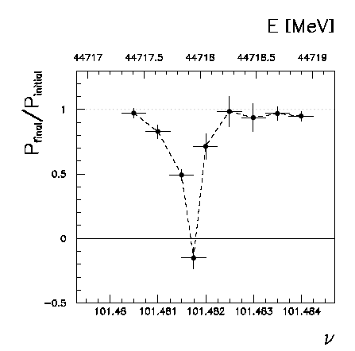
Beam polarization and E-calibration @ TLEP
Precise meast of E_{beam} by resonant depolarization
~100 keV each time the meast is made
At LEP transverse polarization was achieved routinely at Z peak.
instrumental in 10⁻³ measurement of the Z width in 1993
led to prediction of top quark mass (179+- 20 GeV) in March 1994
Polarization in collisions was observed (40% at BBTS = 0.04)
At LEP beam energy spread destroyed polarization above 60 GeV
σ_{E} ∝ E²/√ρ ➔ At TLEP transverse polarization up to at least 80 GeV
to go to higher energies requires spin rotators and siberian snake
TLEP: use ‘single’ bunches to measure the beam energy continuously
no interpolation errors due to tides, ground motion or trains etc…
<< 100 keV beam energy calibration around Z peak and W pair threshold.
Δm_{Z} ~0.1 MeV, ΔΓ_{Z} ~0.1 MeV, Δm_{W} ~ 0.5 MeV

Slide 29
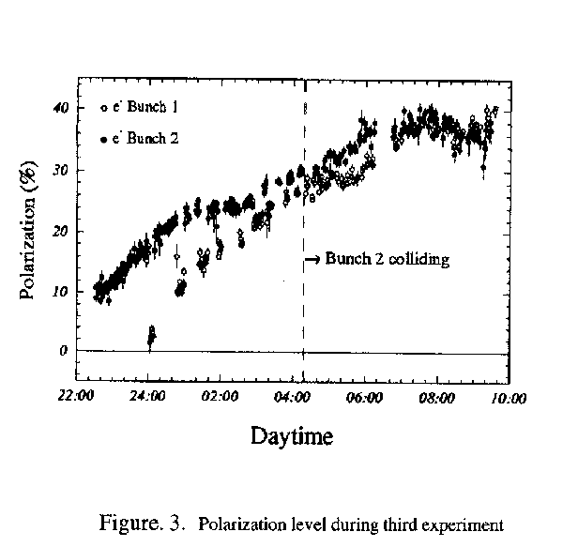
PAC 1995
This was only tried 3 times!
Best result: P = 40% , ξ*_{y}= 0.04 , one IP
Assuming 4 IP and ξ*_{y}= 0.01 ➔
reduce luminositiy somewhat, 10¹¹ Z @ P=40%

Slide 30
Measurement of A_{LR}
Verifies polarimeter with experimentally measured cross-section ratios
statistics
ΔA_{LR} =
ΔA_{LR} = 0.000015 with 10¹¹ Z and 40% polarization in collisions.
Δsin²θ_{W}^{eff} (stat) = O(2.10⁻⁶)

Slide 31
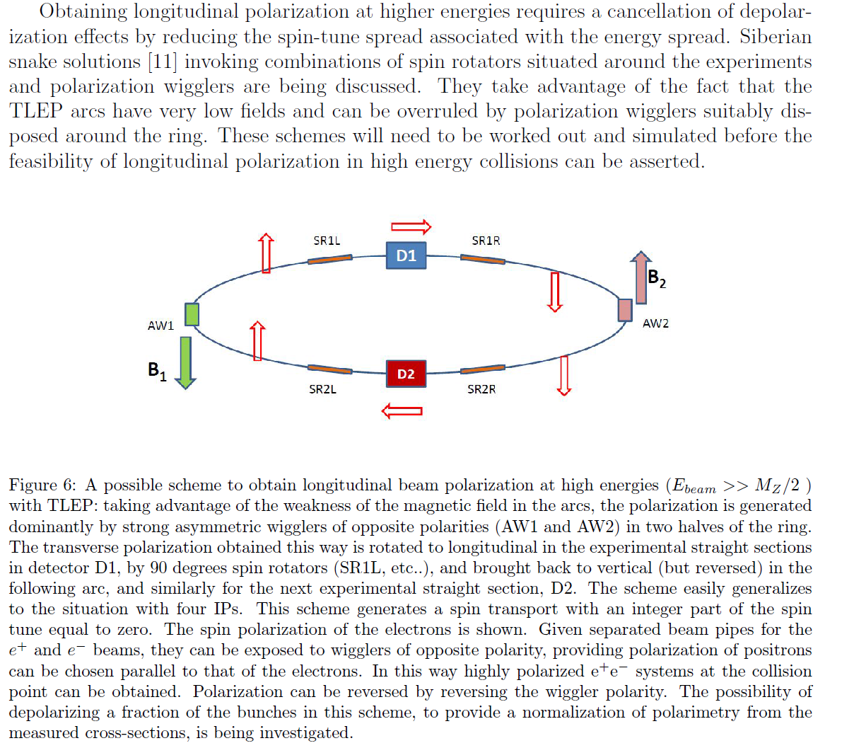
AB, U. Wienands)

Slide 32
NEUTRINO CONNECTIONS
The only known BSM physics at the particle physics level is the existence of neutrino masses
-- There is no unique solution for mass terms: Dirac only? Majorana only? Both?
-- if Both, the existence of (2 or 3) families of massive right-handed (sterile) Ν_{i} ,‾Ν_{i}
neutrinos is predicted («see-saw» models) but masses are unknown (eV to 10¹⁰GeV)
-- mixing with active neutrinos leads to various observable consequences
-- if very light (eV) , possible effect on neutrino oscillations
-- if mixing in % or permil level, possibly measurable effects on
-- PMNS matrix unitarity violation and deficit in Z invisible width
-- occurrence of Higgs invisible decays H→ ν_{i}‾Ν_{i}
-- violation of unitarity and lepton universality in W or τ decays
-- etc etc..
-+- many more examples

Slide 33
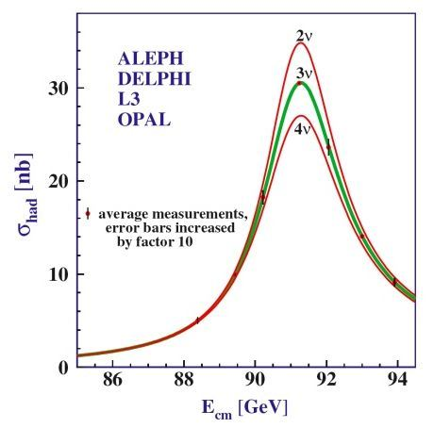
At the end of LEP:
Phys.Rept.427:257-454,2006
N_{ν} = 2.984 ±0.008
- 2 σ :^) !!
This is determined from the Z line shape scan
and dominated by the measurement of the
hadronic cross-section at the Z peak maximum ➔
The dominant systematic error is the theoretical
uncertainty on the Bhabha cross-section (0.06%)
which represents an error of ±0.0046 on N_{ν}
Improving on N_{ν} by more than a factor 2 would require a large effort
to improve on the Bhabha cross-section calculation!

Slide 34
Neutrino counting at TLEP
given the very high luminosity, the following measurement can be performed
$$N_{v}=\frac{\frac{γZ(inv)}{γZ→ee,μμ}}{ \frac{Γν}{Γe,μ} \left(SM\right) }$$
The common γ tag allows cancellation of systematics due to photon selection, luminosity
etc. The others are extremely well known due to the availability of O(10¹² ) Z decays.
The full sensitivity to the number of neutrinos is restored , and the theory uncertainty
on $\frac{Γν}{Γe} \left(SM\right)$ is very very small.
A good measurement can be made from the data accumulated at the WW threshold
where σ (γ Z(inv) ) ~4 pb for |cosθ_{γ}| <0.95
161 GeV (10⁷ s) running at 1.6x10³⁵/cm²/s x 4 exp ➔ 3x10⁷ γ Z(inv) evts, ΔΝ_{ν} =0.0011
adding 5 yrs data at 240 and 350 GeV ............................................................ ΔΝ_{ν} =0.0008
A better point may be 105 GeV (20pb and higher luminosity) may allow ΔΝ_{ν} =0.0004?

Slide 35
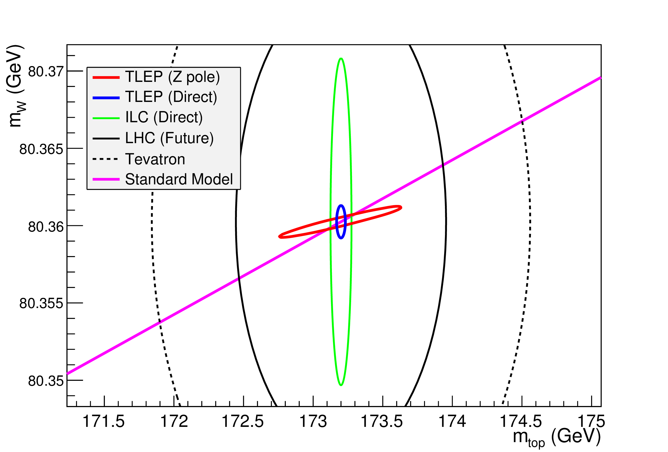
NB without TLEP the SM line would have a 2.2 MeV width
in other words .... Δ(Δρ)= ± 610⁻⁶ +several tests of same precision

Slide 36
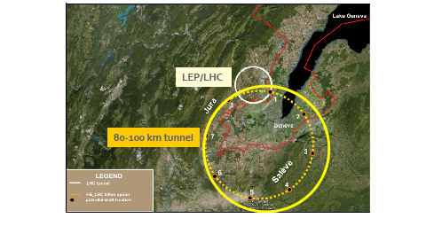
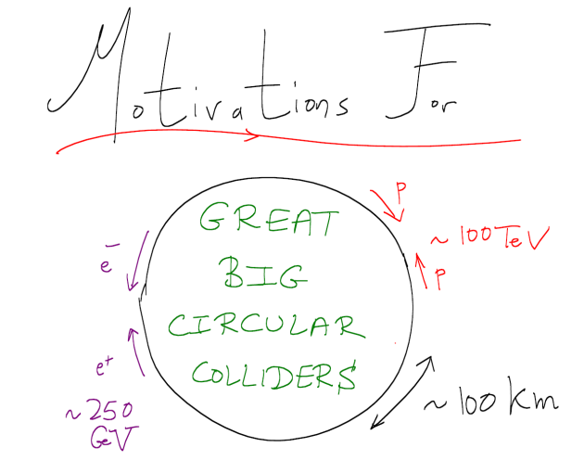
December 2011:
2 authors
132 authors
September 2013:
December 2013:
Next steps?

Slide 37
Michael
Benedikt
The two pillars: pp and e+e-
mandate is to deliver full CDR for both machines
with an extended cost review

Slide 38
FCC Calendar
2014 Jan 6, 20 , 3 Feb etc... TLEP VIDYO
6 January = physics
2014 Feb. 12-15 FCC Kick-off meeting
Next TLEP workshops TBD in April 2014
THERE IS SO MUCH TO BE DONE!
14:00 GMT

Slide 39
The combination of CEPC and the SppC offers, for a great cost effectiveness, the best precision and the best search reach of all options presently on the market.
The combination of TLEP and the VHE-LHC offers, for a great cost effectiveness, the best precision and the best search reach of all options presently on the market.
First look at The Physics Case of TLEP
arXiv:1308.6176v2 [hep-ex] 22 Sep 2013

