Slide 1
Welcome to Beijing

Slide 2
Particle Physics in China：a Possible Future
BESIII construction
BESIII physics
CEPC+SppC
ATLAS & CMS construction
ATLAS & CMS physics
ILC
Daya Bay construction
Daya Bay physics
JUNO
Dark matter exp.: PandaX, CDEX, …
ASγ & ARGO physics
LHAASO
HXMT construction
HXMT physics
AMS construction
AMS physics
HERD
2010
2015
2020

Slide 3
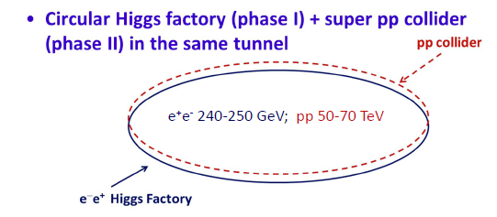
CEPC+SppC
We are looking for a machine after BEPCII
A circular Higgs factory fits our strategic needs in terms of timing, science goal, technological & economical scale, manpower reality, etc.
Its life can be extended to a pp collider: great for the future
Circular Higgs factory is complementary to ILC
Push-pull option
Low energy vs high energy
We hope to collaborate with anyone who is willing to host this machine. Even if the machine is not built in China, the process will help us to build the HEP in China

Slide 4
CEPC+SppC
Why (scientifically):
This workshop and the follow-up’s
Physics white paper by 2014
How:
Pre-CDR by 2014
International collaboration:
Joint effort by international community: welcome all
CFHEP ➔ International Lab
Collaboration with CERN FCC ➔ joint international effort
Community support and outreach
Organized efforts to bring everybody together:
just starting: IB, Steering committee, project office, coordinators
Scientific, economical, industrial benefit
Education

Slide 5
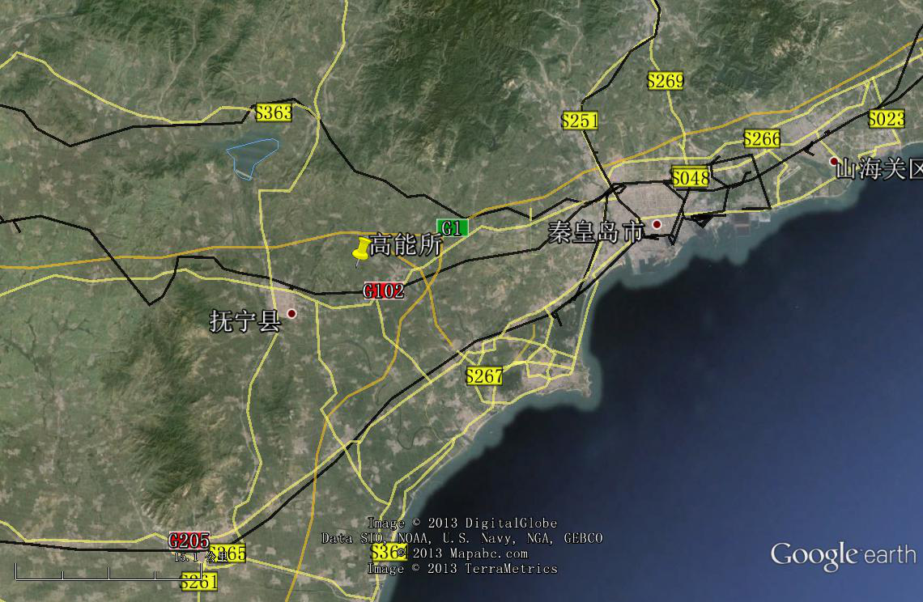
CEPC+SppC
Where(if in China):
For example, Qin-Huang-Dao

Slide 6
CEPC+SppC
When(dream):
CPEC
Pre-study, R&D and preparation work
Pre-study: 2013-15
R&D: 2015-2020
Engineering Design: 2015-2020
Construction: 2021-2027
Data taking: 2028-2035
SPPC
Pre-study, R&D and preparation work
Pre-study: 2013-2020
R&D: 2020-2030
Engineering Design: 2030-2035
Construction: 2035-2042
Data taking: 2042 -

Slide 7
It is difficult
Probability is small
But very exciting
Even if it is not in China, it is still very beneficial to our field and Chinese community
Let’s work together for our dreams

