Slide 1
Discussion on Detectors for
1. Circular e+e- EW Factory
2. 50-100 TeV pp collider
3. e-p options?
My slides concentrate on TLEP/CepC

Slide 2
1. e+e- TLEP/CepC specifics
-- physics aims and requirements ➔
Z peak : many!!!
-- very small systematics on e.g. R_{l} = $\frac{Γ_{l}}{Γ_{had}}$ , R_{b,c} = $\frac{Γ_{\text{b}\text{,}\text{c}}}{Γ_{had}}$ ,
-- luminosity measurement
-- search for rare decays like Z→ μτ
-- flavour physics
➔ emphasis on hermiticity, trigger redundancy, well defined fid region
➔ PID_0=e/mu/tau/hadron/b/c
WW (invariant masses using hadronic systems)
ZH all of the above!
ttbar all of the above!
rare events (single or multi photon states) EMCAL resoluton
do we need p/K/pi particle ID or is PID_0 enough?
is there more physics (two-photon)?
trade offs? (granularity vs resolution) etc...

Slide 3
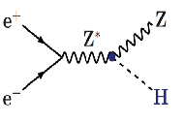
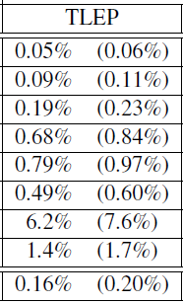
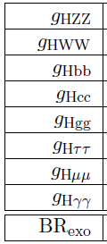
best-of FCC/TLEP #1: Higgs factory
(constrained fit
including ‘exotic’)
4 IPs
(2 IPs)
2 10⁶ ZH events in 5 years
«A tagged Higgs beam».
Best across the board
sensitive to new physics in loops
invisible width = (dark matter?)
also (but better done at the
hadron colliders HL-LHC, VHE-LHC:
total width
HHH
Htt
0.6%
28%
13%
from effect on HZ threshold
arXiv:1312.3322v1
from effect on‾tt threshold

Slide 4
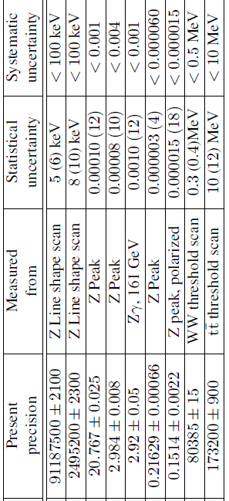
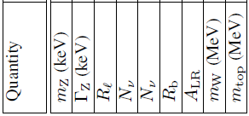
best-of FCC/TLEP #2: Precision EW measts
Asset: -- high luminosity (10¹² Z decays + 10⁸ Wpairs + 10⁶ top pairs ) -- exquiste energy calibration up and above WW threshold
target precisions
Also -- Δsin² θ_{W} ≈10⁻⁶
-- Δα_{S}= 0.0001 from W and Z hadronic widths
-- orders of magnitude on FCNCs and rare decays etc. etc.
Design study to establish possibility of corresponding precision theoretical calculations.

Slide 5
Low angle region
--- need to understand Machine Detector Interface (MDI)
-- size and location of final focus elements, L*
-- synchrotron radiation masks, residual levels
-- EM radiation from Beamstrahlung
-- beam pipe size
-- physics need in hermiticity in detection, measurement or veto
➔ simulation ←→ design
list tasks to undertake:

Slide 6
TLEP/CepC Time structure and data rate
-- higher rate than LEP but events similar
-- (CW) time structure with varirable bunch spacing
-- varying from Z factory to top factory (~ 300 μs/4400 bunches = 75ns)
more like LHC!
-- radiation levels (small?)
-- not a pulsed machine like ILC /CLIC
→ cannot use pulsed electronics but does not need to be hadron rad-hard as in LHC
➔ data rate can go as high as 50kHz (check) to write on tape
list tasks to undertake:

Slide 7
Similarities and differences wrt LEP and ILC detector designs
-- physics requirements different than ILC
(how well do we need to separate WW from ZZ at ?)
-- do we need the extreme segmentation of ILC/CLIC or do we prefer high energy resolution on photons? (trade off) (ref. H→ γγ )
-- cannot pulse electronics; consequences?
list tasks to undertake:

Slide 9
VHE-LHC/SppC detectors
-- is it just LHC (ATLAS, CMS) x (100 TeV/14 TeV) = 7 ?
-- specialized detectors (VLHC_b, VLHC_t, VLHC_H)?
-- how well do they do for the e+e- physics?
list tasks to undertake:

Slide 10
e-p detectors
-- I’d bet that the pp detector can do the e-p physics
-- what are the specific requirements?

