Slide 1
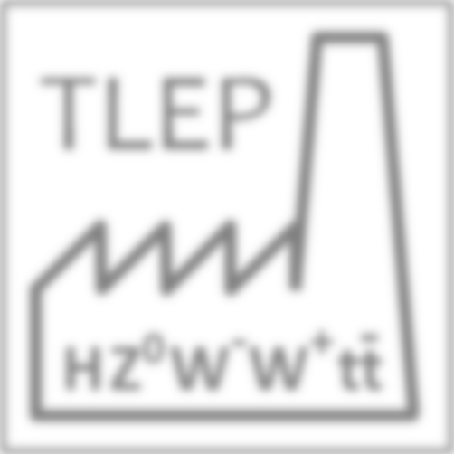
Input to the accelerator discussion:
Circular colliders: advantages and challenges
M. Koratzinos
Univ. of Geneva
16 December 2013
International workshop on future high energy circular colliders,
IHEP, Beijing, December 16-17 2013

Slide 2
Circular collider challenges
Top up: bypass needs to be designed early on, extra ‘small’ RF system
RF: gradient is not a challenge, but power requirement is
High energies (120GeV and higher): Beanstrahlung – a new challenge not present at LEP
Biggest problem comes from the fact that the machine should operate both in high current/ low energy (at the Z) and low current/high energy (at the ZH and ttbar). Each of the machines has reasonable complexity, but the combination makes for a challenging machine
Low energy: many bunches (O(10⁴) relatively high emittances, small RF gradient but 100MW power, two beam pipes, polarization
High energy: fewer bunches (O(10 to 100), as low emittance as possible, O(10GV) of RF voltage, one beam pipe possible

Slide 3
Circular collider pros
We have a very good base to build on: LEP. In many cases, TLEP/CEPC can be reached adiabatically from LEP
superKEKB: a TLEP/CEPC demonstrator, with beam commissioning scheduled for 2015

Slide 4
Luminosity & lifetime
There is no free lunch, but on the other hand you eat what you pay for: Luminosity linearly depends on circumference, power consumption, beam-beam, 1/beta*
Beamstrahlung limits beam lifetimes: only important at high energies. Mitigation:
Very flat beams
High momentum acceptance
Frequent top-up – every O(10sec)
Should aim for beam lifetimes of 100 to 1000s

Slide 5
A note on power consumption
The figure of merit for an accelerator is physics output per energy unit, not power unit
TLEP is using ~280MW while in operation and probably ~80MW between physics fills. So for 1×10⁷ sec of operation and 1×10⁷ sec of stand-by mode, total electricity consumption is ~1TWh
CERN is currently paying ~50CHF/MWh
TLEP yearly operation corresponds to ~50MHF/year
This should be seen in the context of the total project cost (less than 1% of the total cost of the project goes per year to electricity consumption)
A 100MW machine is more efficient than a 50MW machine running twice as long. We should aim for highest acceptable power consumption

Slide 6
Extra slides

Slide 7
Circular colliders
In the next few slides I would like to overview the parameters that affect circular collider performance.
I will then show what can reasonably be achieved in terms of luminosity.
The following is not TLEP specific; it can apply to any circular machine (CEPC?)

Slide 8
Major limitations
The major limitations of circular colliders are:
Power consumption limitations that affect the luminosity
Tunnel size limitations that affect the luminosity and the energy reach
Beam-beam effect limitations that affect the luminosity
Beamstrahlung limitations that affect beam lifetimes (and ultimately luminosity)

Slide 9
Energy reach
In a circular collider the energy reach is a very steep function of the bending radius. To make a more quantitative plot, I have used the following assumptions:
RF gradient: 20MV/m
Dipole fill factor: 90% (LEP was 87%)
I then plot the energy reach for a specific ratio of RF system length to the total length of the arcs
$E_{loss}[GeV]=8.85×{10}^{−5}\frac{E^{4}}{r_{bend}}$ and $L_{RF} [m]=\frac{E_{loss}}{20MeV}$

Slide 10
Energy reach
Assumptions: 20mV/m, 90% dipole fill factor.
What is plotted is the ratio of RF length to total arc length
TLEP175 sits comfortably below the 1% line
LEP2 had a ratio of RF to total arc length of 2.2%

Slide 11
Luminosity of a circular collider
Luminosity of a circular collider is given by
$$ℒ=\frac{f_{rev}n_{b}N_{b}^{2}}{4πσ_{x}σ_{y}}R_{hg}$$
Which can be transformed in terms of
$$ξ_{y}=\frac{N_{b}^{}r_{e}β_{y}^{∗}}{2πγσ_{x}σ_{y}}$$
and
$P_{loss,total}=\frac{4π}{3}\frac{r_{e}}{{m_{e}}^{3}}E^{4}\frac{f_{rev}n_{b}N_{b}}{ρ}$
to:

Slide 12
Luminosity of a circular collider
$$ℒ=\frac{3}{8π}\frac{{\left(m_{e}c^{2}\right)}^{2}}{{r_{e}}^{2}}P_{tot} \frac{ρ}{{E_{0}}^{3}}ξ_{y}\frac{R_{hg}}{β_{y}^{∗}}$$
The maximum luminosity is bound by the total power dissipated, the maximum achievable beam-beam parameter (the beam-beam limit), the bending radius, the beam energy, $β_{y}^{∗}$, and the hourglass effect (which is a function of σ_{z} and $β_{y}^{∗}$)

Slide 13
Total power
Luminosity is directly proportional to the total power loss of the machine due to synchrotron radiation.
In our approach, it is the first parameter we fix in the design (the highest reasonable value)
Power loss is fixed at 100MW for both beams (50MW per beam)

Slide 14
Machine radius
The bending radius of the collider also enters linearly in the luminosity formula
The higher the dipole filling factor, the higher the performance
[there is a small dependance on the maximum beam-beam parameter since smaller machines for the same beam energy can achieve higher beam-beam parameters]

Slide 15
Beam-beam parameter
The maximum beam-beam parameter is a function of the damping decrement:
${ξ_{y}}^{max}=f(λ_{d})$ where
$$λ_{d}=\frac{1}{f_{rev} τ{ n}_{IP}}$$
Or, more conveniently:
$$λ_{d}=\left(\frac{U_{0}}{E}\right)\frac{1}{{ n}_{IP}} or{ λ}_{d}∝\frac{{E_{0}}^{3}}{ρ { n}_{IP}}$$
The damping decrement is the fractional energy loss from one IP to the next.
Therefore, for a specific machine,${{ ξ}_{y}}^{max}$ for 1IP is generally higher than for 2IPs

Slide 16
Maximum beam-beam
It is not trivial to predict what can be achieved in terms of beam-beam parameter at TLEP or other machines.
LEP is a good yardstick to use
LEP achieved ${{ ξ}_{y}}^{max}=0.045$ at 45GeV and run up to 0.08 at 100GeV without reaching the beam-beam limit
Going up in energy increases the damping decrement (and therefore ${{ ξ}_{y}}^{max}$ )
Values between 0.05 and 0.1 should be achievable with relative ease at future circular colliders. At beam energies of 120GeV or higher, higher values might be possible

Slide 17
Beta* and hourglass
We are opting for a realistic β*_{y} value of 1mm. σ_{z} beam sizes vary from 1mm to 3mm. In this range the hourglass effect is between 0.9 to 0.6
Self-consistent σ_{z} at different energies for TLEP

Slide 18
Luminosity of a circular collider
Single IP luminosity of a circular collider of 9000m bending radius as a function of beam energy.
Power loss is 100MW.
ξy between 0.05 and 0.1.
β*_{y} = 1mm.
$R_{hg}$ =0.75

Slide 19
Beamstrahlung
Beamstrahlung is the interaction of an incoming electron with the collective electromagnetic field of the opposite bunch at an interaction point.
Main effect at circular colliders is a single hard photon exchange taking the electron out of the momentum acceptance of the machine.
If too many electrons are lost, beam lifetime is affected
[the beamstrahlung effect at linear colliders is much larger and it increases the beam energy spread]

Slide 20
Beamstrahlung (2)
The beamstrahlung limitation was introduced by Telnov*
It depends on $η\frac{σ_{x}σ_{z}}{N_{b}}$ where $η$ is the momentum acceptance, $σ_{x}σ_{z}$ the beam sizes in x and z (note no $σ_{y}$ dependence!) and $N_{b}$ is the number of electrons per bunch
It has a γ² dependence, so it is only important at high energies (>~120GeV per beam)
It is mitigated by high momentum acceptance, small emittances and very flat beams
*: arXiv:1203.6563

Slide 21
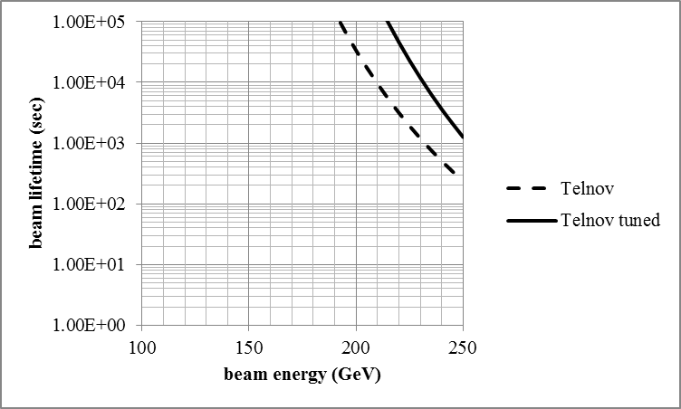
Beamstrahlung limitation
Plot on left is if we run with a value of the beam-beam parameter of 0.1
Above ~180 GeV is difficult to run without opting for a more modest beam-beam parameter value (which would reduce the luminosity)
TLEP Latest parameter set, mom. acceptance 2.2%
Can even run at 250GeV with a beam-beam parameter of 0.05

Slide 22
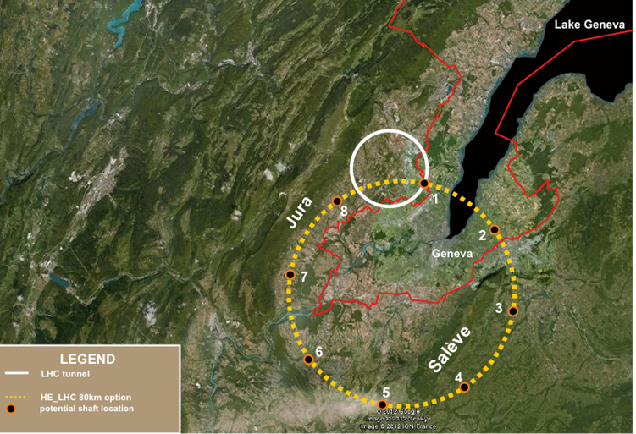
A specific implementation: TLEP
A study has been commissioned for an 80-km tunnel in the Geneva area.
For TLEP we fix the radius (conservatively 9000m) the power (100MW) and try to have beams as flat at possible to reduce beamstrahlung.
Our arc optics design (work in progress) conservatively uses a cell length of 50m, which still gives a horizontal emittance of 2nm at 120GeV
We assume that we can achieve a horizontal to vertical emittance ratio of 500-1000 (LEP was 200)
LHC
Possible TLEP location

Slide 23
Other tunnel diameters
…but of course other tunnel diameters and locations are equally good
Many other proposals floating, but I would like to mention the Circular Electron-Positron Collider in China (CEPC) – certainly the tunnel can be built more cheaply in China
Performance scales with tunnel size, but in case no funds are available for a new tunnel, the LHC tunnel can be used after the end of the LHC physics programme (a project we call LEP3)

Slide 24
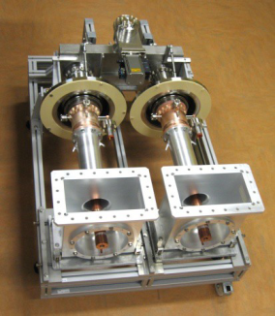
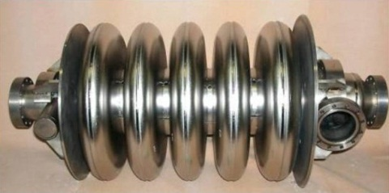
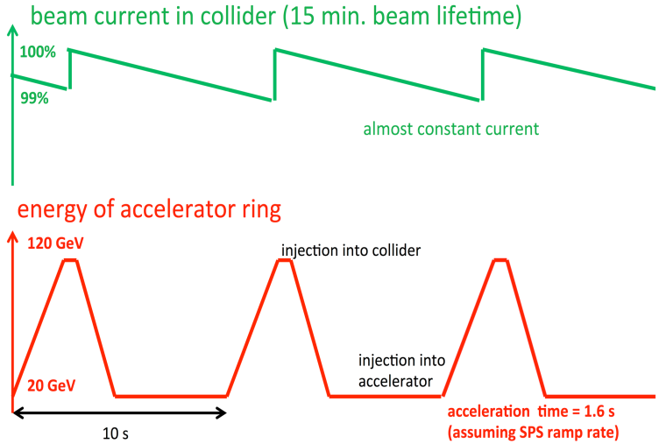
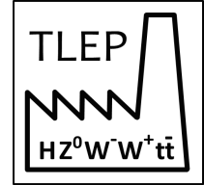
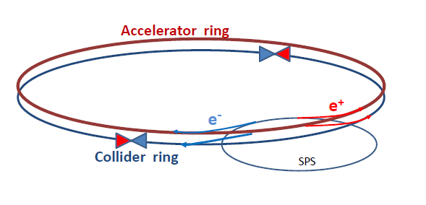
TLEP implementation
At 350 GeV, beams lose 9 GeV / turn by synchrotron radiation
Need 600 5-cell SC cavities @ 20 MV/m in CW mode
Much less than ILC (8000 9-cell cavities@ 31 MV/m)
Length ~900 m, similar to LEP (7 MV/m)
200 kW/ cavity in CW : RF couplers are challenging
Heat extraction, shielding against radiation, …
Luminosity is achieved with small vertical beam size : σ_{y} ~ 100 nm
A factor 30 smaller than at LEP2, but much more relaxed than ILC (6-8 nm)
TLEP can deliver 1.3 × 10³⁴ cm⁻²s⁻¹ per collision point at √s = 350 GeV
Small beam lifetime due to Bhabha scattering (~ 15 min) + beamstrahlung
Need efficient top-up injection
BNL 5-cell 700 MHz cavity
RF Coupler
(ESS/SPL)
A. Blondel
F. Zimmermann

Slide 25
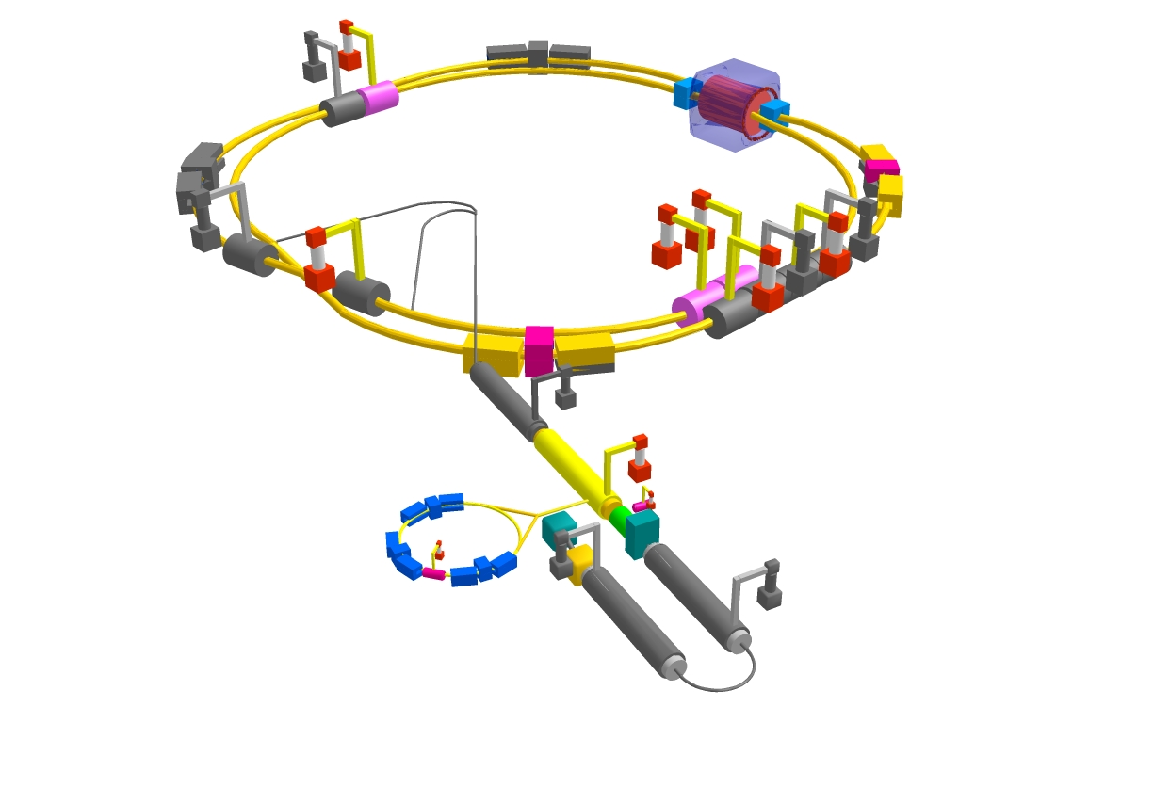
SuperKEKB: a TLEP demonstrator
SuperKEKB will be a TLEP demonstrator
Beam commissioning starts early 2015
Some SuperKEKB parameters :
Lifetime : 5 minutes
TLEP : 15 minutes
β*_{y} : 300 μm
TLEP : 1 mm
σ_{y} : 50 nm
TLEP : ~100 nm
ε_{y}/ε_{x} : 0.25%
TLEP : 0.20%-0.10%
Positron production rate : 2.5 × 10¹² / s
TLEP : < 1 × 10¹¹ / s
Off-momentum acceptance at IP : ±1.5%
TLEP : ±2.0 to ±2.5%

Slide 26
TLEP Cost (Very Preliminary) Estimate
Cost in billion CHF
As a self-standing project :
Same order of magnitude as LHC
As an add-on to the VHE-LHC project :
Very cost-effective : about 2-3 billion CHF
Cost per Higgs boson : 1 - 3 kCHF / Higgs
(ILC cost : 150 k$ / Higgs) [ NB : 1CHF ~ 1$ ]
Cost for the 80 km version : the 100 km version might be cheaper.
Bare tunnel | 3.1 ⁽¹⁾
Services & Additional infrastructure (electricity, cooling, service cavern, RP, ventilation, access roads …) | 1.0⁽²⁾
RF system | 0.9 ⁽³⁾
Cryo system | 0.2 ⁽⁴⁾
Vacuum system & RP | 0.5⁽⁵⁾
Magnet system for collider & injector ring | 0.8⁽⁶⁾
Pre-injector complex SPS reinforcements | 0.5
Total | 7.0
Absolutely Preliminary
Not endorsed by anybody
Note: detector costs not included – count 0.5 per detector (LHC)
(1): J. Osborne, Amrup study, June 2012
LEP/LHC
(2): Extrapolation from LEP
(3): O. Brunner, detailed estimate, 7 May 2013
(4): F. Haug, 4th TLEP Days, 5 April 2013
80-100 km tunnel
(5): K. Oide : factor 2.5 higher than KEK,
estimated for 80 km ring
(6): 24,000 magnets for collider & injector;
cost per magnet 30 kCHF (LHeC);

Slide 27
Power consumption
Highest consumer is RF:
 | TLEP 120 | TLEP 175
RF systems | 173-185 MW
cryogenics | 10 MW | 34 MW
top-up ring | 3 MW | 5 MW
Total RF | 186-198 MW | 212-224 MW
Limited by Klystron CW efficiency of 65%. This is NOT aggressive and we hope to be able to do better after dedicated R&D
Total power consumption for 350GeV running:
Power consumption | TLEP 175
RF including cryogenics | 224MW
cooling | 5MW
ventilation | 21MW
magnet systems | 14MW
general services | 20MW
Total | ~280MW
CERN 2010 power demand:
Full operation 220MW
Winter shutdown 50MW
IPAC13 TUPME040, arXiv:1305.6498 [physics.acc-ph]

Slide 28
A note on power consumption
The figure of merit for an accelerator is physics output per energy unit, not power unit
TLEP is using ~280MW while in operation and probably ~80MW between physics fills. So for 1×10⁷ sec of operation and 1×10⁷ sec of stand-by mode, total electricity consumption is ~1TWh
CERN is currently paying ~50CHF/MWh
TLEP yearly operation corresponds to ~50MHF/year
This should be seen in the context of the total project cost (less than 1% of the total cost of the project goes per year to electricity consumption)
A 100MW machine is more efficient than a 50MW machine running twice as long. We should aim for highest acceptable power consumption

Slide 29
TLEP parameter set
 | TLEP Z | TLEP W | TLEP H | TLEP t
E_{beam} [GeV] | 45 | 80 | 120 | 175
circumf. [km] | 80 | 80 | 80 | 80
beam current [mA] | 1180 | 124 | 24.3 | 5.4
#bunches/beam | 4400 | 600 | 80 | 12
#e−/beam [10¹²] | 1960 | 200 | 40.8 | 9.0
horiz. emit. [nm] | 30.8 | 9.4 | 9.4 | 10
vert. emit. [nm] | 0.07 | 0.02 | 0.02 | 0.01
bending rad. [km] | 9.0 | 9.0 | 9.0 | 9.0
κ_{ε} | 440 | 470 | 470 | 1000
mom. c. α_{c} [10⁻⁵] | 9.0 | 2.0 | 1.0 | 1.0
P_{loss,SR}/beam [MW] | 50 | 50 | 50 | 50
β∗_{x} [m] | 0.5 | 0.5 | 0.5 | 1
β∗_{y} [cm] | 0.1 | 0.1 | 0.1 | 0.1
σ∗_{x} [μm] | 124 | 78 | 68 | 100
σ∗_{y} [μm] | 0.27 | 0.14 | 0.14 | 0.10
hourglass F_{hg} | 0.71 | 0.75 | 0.75 | 0.65
E^{SR}_{loss}/turn [GeV] | 0.04 | 0.4 | 2.0 | 9.2
V_{RF},tot [GV] | 2 | 2 | 6 | 12
d_{max,RF} [%] | 4.0 | 5.5 | 9.4 | 4.9
ξ_{x}/IP | 0.07 | 0.10 | 0.10 | 0.10
ξ_{y}/IP | 0.07 | 0.10 | 0.10 | 0.10
f_{s} [kHz] | 1.29 | 0.45 | 0.44 | 0.43
E_{acc} [MV/m] | 3 | 3 | 10 | 20
eff. RF length [m] | 600 | 600 | 600 | 600
f_{RF} [MHz] | 700 | 700 | 700 | 700
δ^{SR}_{rms} [%] | 0.06 | 0.10 | 0.15 | 0.22
σ^{SR}_{z,rms} [cm] | 0.19 | 0.22 | 0.17 | 0.25
$ℒ$ /IP[10³²cm⁻²s⁻¹] | 5600 | 1600 | 480 | 130
number of IPs | 4 | 4 | 4 | 4
beam lifet. [min] | 67 | 25 | 16 | 20
Too pessimistic! 2nm @120GeV or lower should he easy
By definition, in a project like TLEP, from the moment a set of parameters is published it becomes obsolete and we now already have an improved set of parameters.
The new parameter set contains improvements to our understanding, but does not change the big picture.
Revised (taking into account BS) but similar
IPAC13 TUPME040, arXiv:1305.6498 [physics.acc-ph]

Slide 30
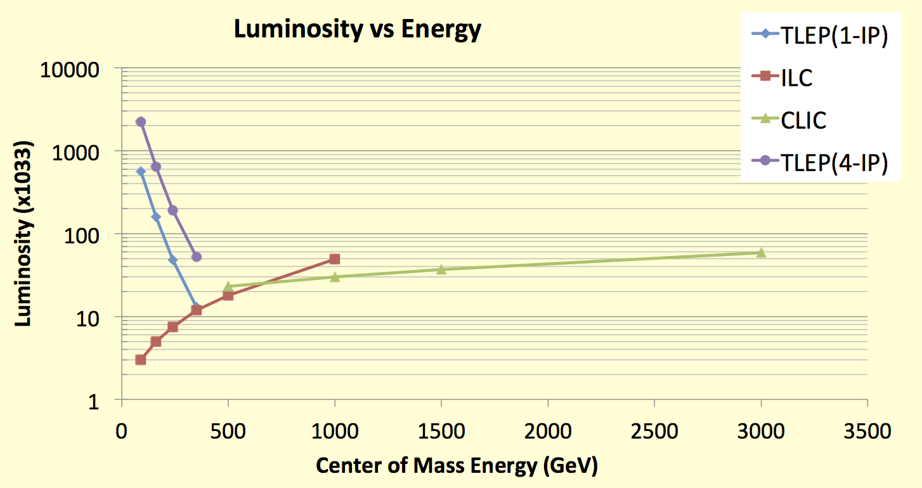
Luminosity of TLEP
Z, 2.10³⁶
TLEP : Instantaneous lumi at each IP (for 4 IP’s)
Instantaneous lumi summed over 4 IP’s
WW, 6.10³⁵
HZ, 2.10³⁵
tt , 5.10³⁴
Why do we always quote 4 interaction points?
It is easier to extrapolate luminosity from the LEP experience. Lumi of 2IPs is larger than half the lumi of 4IPs
According to a particle physicist: “give me an experimental cavern and I guarantee you that it will be filled”

Slide 31
Upgrade path
TLEP offers the unique possibility to be followed by a 100TeV pp collider (VHE-LHC)
Luminosity upgrade: a study will be launched to investigate if luminosity can be increased by a significant factor at high energies (240 and 250GeV E_{CM}) by using a charge-compensated scheme of four colliding beams. We will aim to gain a factor of 10 (to be studied and verified)

Slide 32
Thank you
end

Slide 33
Extra extra slides

Slide 34
Beamstrahlung
I am using the approach of Telnov throughout*
The energy spectrum of emitted photons during a collision of two intense bunches (usual bremstrahlung formula) is characterized by a critical energy
Where ρ is the radius of curvature of the affected electron which depends on the field he sees
And the maximum field can be approximated by
$$E_{c}=\frac{ħ3{γ_{0}}^{3}c}{2ρ}$$
$$ρ=\frac{γ_{0}mc^{2}}{eB}$$
$$B_{max}=\frac{2eN_{b}}{σ_{x}σ_{z}}$$
*: arXiv:1203.6563

Slide 35
Beamstrahlung
constants
So, the critical energy turns out to be
for the maximum field (it would be smaller for a smaller field)
Telnov’s approximation:
10% of electrons see maximum field
90% of electrons see zero field
$$E_{c}=E_{0}\frac{3{r_{e}^{}}^{2}γ_{0}N_{b}}{ασ_{x}σ_{z}}$$

Slide 36
Beamstrahlung
Electrons are lost if they emit a gamma with an energy larger than the momentum acceptance, η: $E_{γ}≥ ηE_{0}$
We define $u=η\frac{E_{0}}{E_{c}}$ or otherwise $u=\frac{α}{3γ{r_{e}}^{2}}η\frac{σ_{x}σ_{z}}{N_{b}}$
The number of photons with $E_{γ}≥ ηE_{0} :$
$$n_{γ}=\frac{α^{2}η\frac{σ_{z}}{2}}{\sqrt{6π}r_{e}γu^{3/2}}e^{−u}$$
So we see that η can directly be traded off by $\frac{N_{b}}{σ_{x}σ_{z}}$
Going up in energy aggravates the effect

Slide 37
Beamstrahlung energy dependence
For a specific ring, power consumption, emittances and ξ:
Number of particles per bunch scales with gamma:
And u scales with γ². This produces a steep drop in lifetime with increased energy
$$N_{b}=ξ_{y}\frac{2πγσ_{x}σ_{y}}{r_{e}{β^{∗}}_{y}^{}}$$

Slide 38
The TLEP tunnel
Standard size tunnel boring machines dictate a larger tunnel size of 5.6m diameter (LHC: 3.8m)
Maximize boring in ‘molasse’ (soft stone)
80km design necessitates a bypass tunnel to avoid very deep shafts at points 4 and 5
A larger tunnel might actually be cheaper
This is only the beginning of the geological study

