Slide 1


CMS detector and SM Higgs searches
Junquan Tao
Institute of High Energy Physics, Chinese Academy of Sciences
19 Oct 2013,
IHEP, Beijing, China

Slide 2
Outline
LHC experiment and CMS detector
    CMS subdetectors and performance
Search results from bosonic decay channels at low Mass
    Properties of Higgs: mass, spin, …
Results from Fermionic decay channels at ~125GeV
High mass Higgs boson searches
Summary

Slide 3

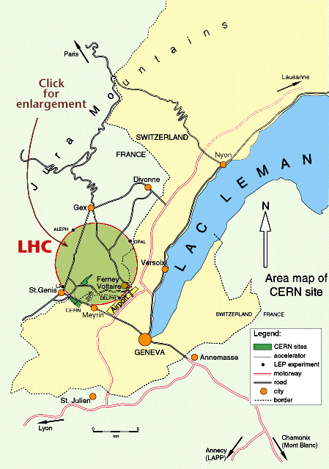



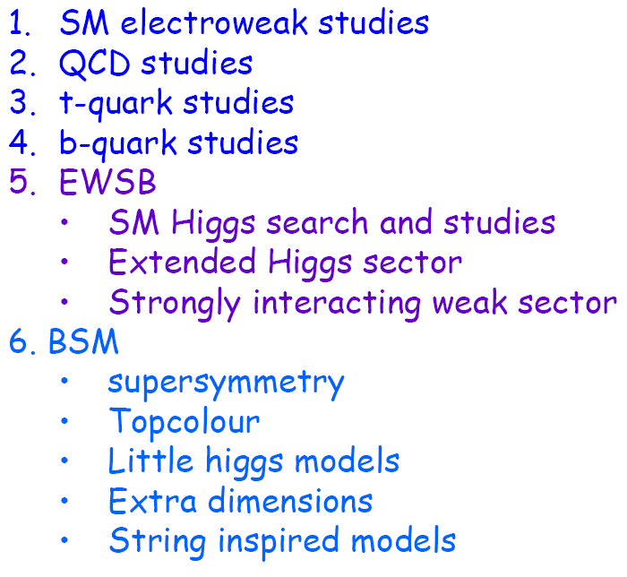
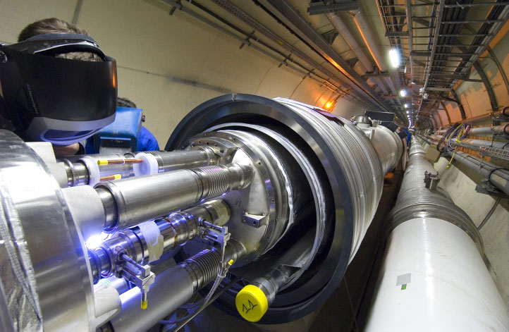
LHC experiment
Lager Hadron Collider at Centre Europeen pour la Recherche Nucleaire (Geneva, Swiss)
Exploration of a new energy frontier
Proton-proton Collisions at ECM = 14 TeV
Heavy Ion Collisions: Energy/nucleon = 2.75 TeV/u
10^9 pp interactions/s
100m underground
LHC Physics: mainly Higgs
LHC ring:
27 km circumference
IHEP, Beijing/ January 2010
3
Notes:
3

Slide 4

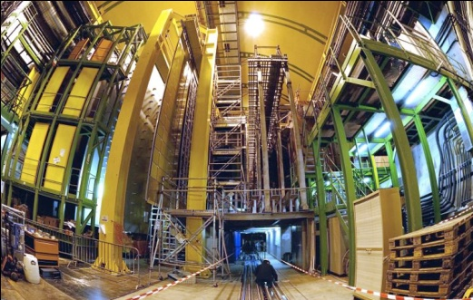
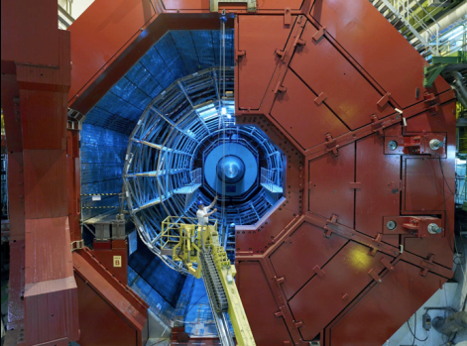

Four detectors at LHC
2 general detectors: Compact Muon Solenoid, A Toroidal LHC ApparatuS
CMS
LHCb
LHCb: measure CP violation of heavy particles containing bottom quarks (why is there more matter than antimatter)
ALICE
ALICE: A Large Ion Collider Experiment
Pb Pb collision study quark-gluon plasma
ATLAS
4

Slide 5


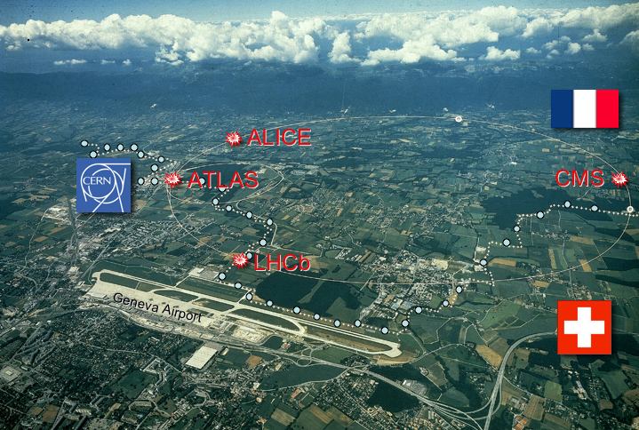


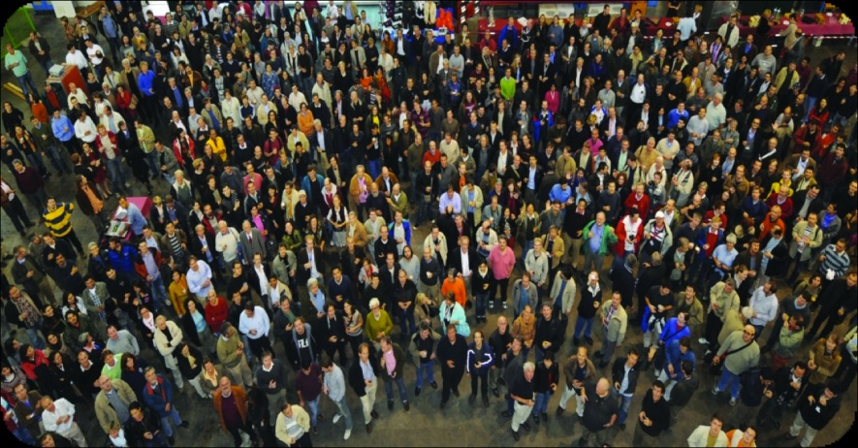

Chinese Involvement in LHC Experiments
Chinese Institutes are involved in all 4 LHC experiments
3 Institutes
Inst. of Atomic Energy, Beijing
Hua-Zhong Normal Univ., Wuhan
Hua-Zhong Univ. STC, Wuhan
LHC
5 Institutes
IHEP Beijing
Nanjing Univ.
Shangdong Univ.
Shanghai Jiaotong Univ.
USTC Hefei
2 Institutes
IHEP Beijing
Peking Univ.
CMS has ~4300 Scientists (including 800 PhD students), Engineers
and technicians from 41 Countries and 190 institutes
1 Institute
Tsinghua University, Beijing
Hardware contributions
physics analysis
LCG: Tier-2 at IHEP

Slide 6
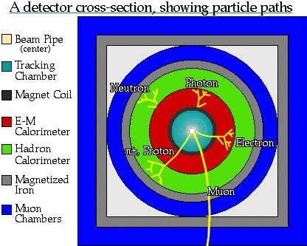
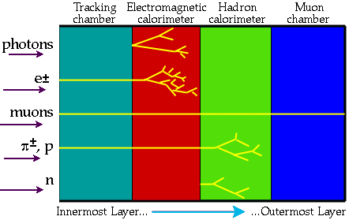
Particles propagation and detection
Final stable particles (>10⁻⁸s):
γ 、e±、μ± 、 π± 、 κ± 、n 、 p
Notes:
Cross section of a dectector- Again make note of the calorimeters and muon detectors
Inner detector-The Inner Detector begins a few centimetres from the proton beam axis, extends to a radius of 1.2 meters, and is seven meters in length along the beam pipe. Its basic function is to track charged particles. Particles are tracked to 0.01 mm.
Calorimeter-The calorimeters are situated outside the solenoidal magnet that surrounds the inner detector. Their purpose is to measure the energy from particles by absorbing it. (note two types of calorimeters)
Muon Detector-The muon spectrometer is an extremely large tracking system, extending from a radius of 4.25 m around the calorimeters out to the full radius of the detector (11 m). This is designed to measure the momentum of muons
Source: http://en.wikipedia.org/wiki/Atlas_detector

Slide 7
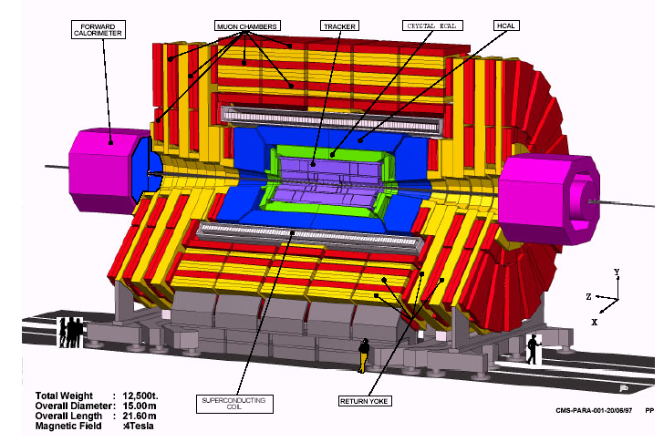
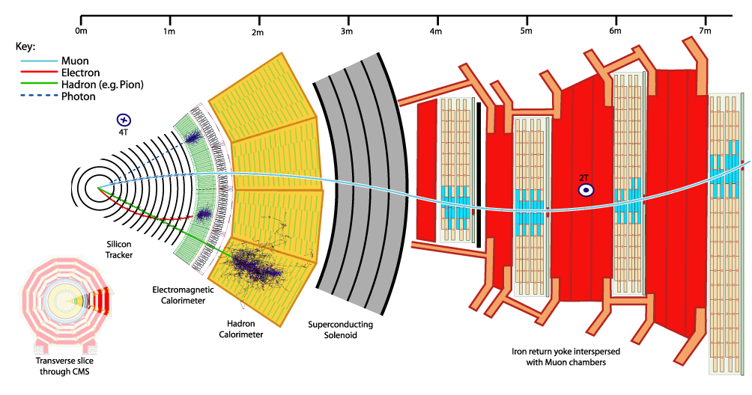
CMS Detector
Muon 探测器
硅径迹室
强子量能器 HCAL
电磁量能器
ECAL
超导螺线管 (4T)
磁场轭铁

Slide 8
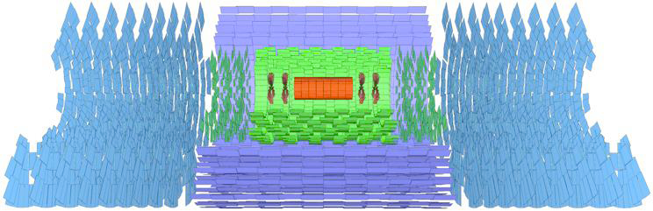
CMS Sub-Detector: Inner Tracking System
Provide precise measurements of track trajectories and secondary vertices.
Silicon Pixel detector: 3 barrel layers, 2 disks each side ~ 2m², 66 M channels (radius 4.3 - 10.2 cm)
Silicon Strip detector: 4+6 barrel and 3+9 endcap layers, 198m², 9.3 M channels, (radius 20 - 116 cm)
Acceptance |η|<2.5, 200 m² silicon area, 1440 pixel and 15148 strip modules.
pixel: 100x150 μm²; Inner silicon: 10cm x 80μm; outer silicon: 25cm x 180 μm

Slide 9
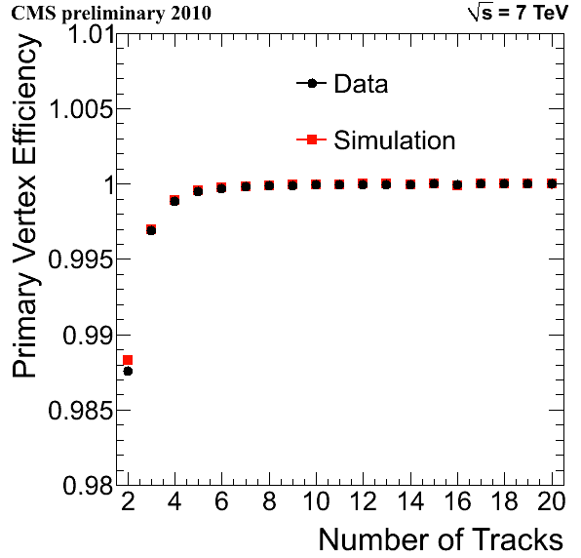
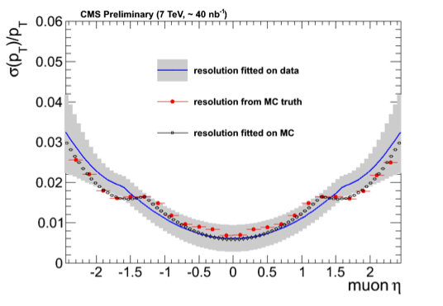
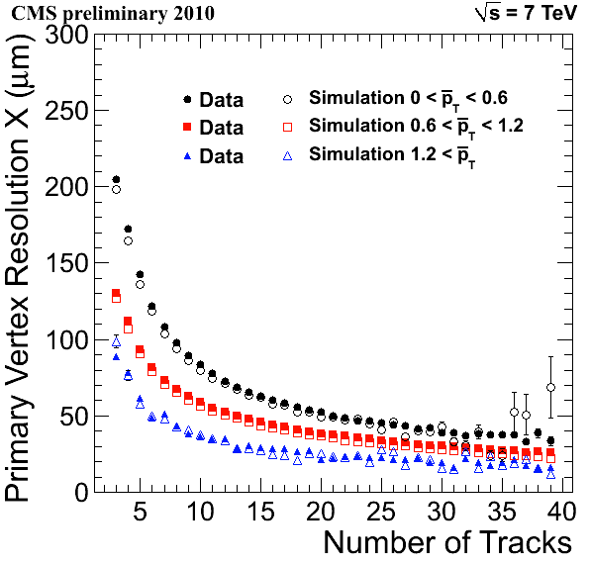
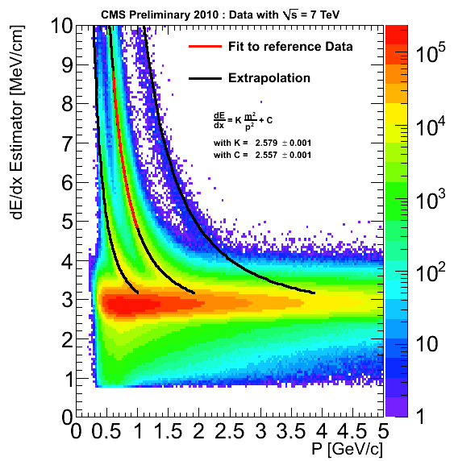
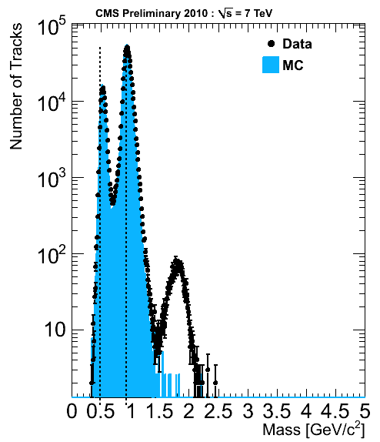
CMS Sub-Detector: Tracker performance
Δp/p<1% @ ~100GeV
Primary vertex finding efficiency above 99.5% for
>2 charged tracks.
Transverse momentum
For PV with more than 10 tracks with average pT>1.2 GeV: close to 20 μm
Particle identification possible up till 1 GeV
Deuterons are missing
in simulation
K p d

Slide 10
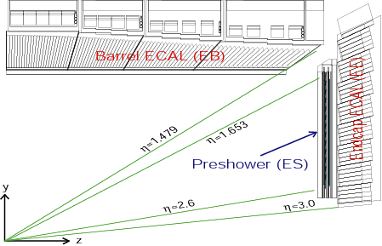
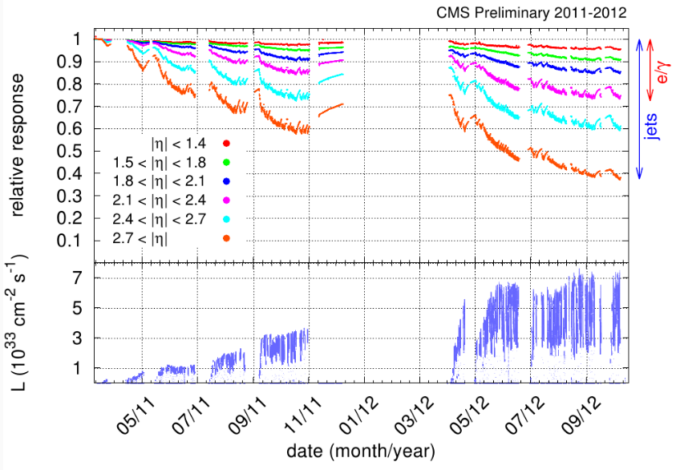
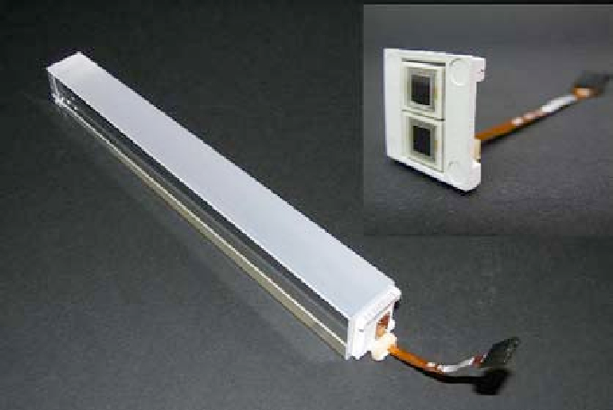
CMS Sub-Detector: ECAL
High granularity, extremely good resolution, low noise, good uniformity/intercalibration
Lead-tungstate (PbWO4) scintillating crystals
optically coupled to Avalanche Photo-Diodes
(Barrel) and Vacuum Photo-Triodes (Endcaps):
• High density (ρ=8.3 g/cm3)
• Short radiation length (X0=0.89 cm)
• Small Molière radius (RM=2.2 cm)
• Fast response (80% in 25 ns @ 425 nm)
Radiation-hard (need transparency monitoring)
Two lead radiators (2 and 1 radiation lengths thick), each followed by a layer of Si microstrip detectors, instrument both Endcaps, acting as as preshower
Calorimeters.
Energy resolution: (~ 0.5% @ ET ~ 50 GeV)

Slide 11
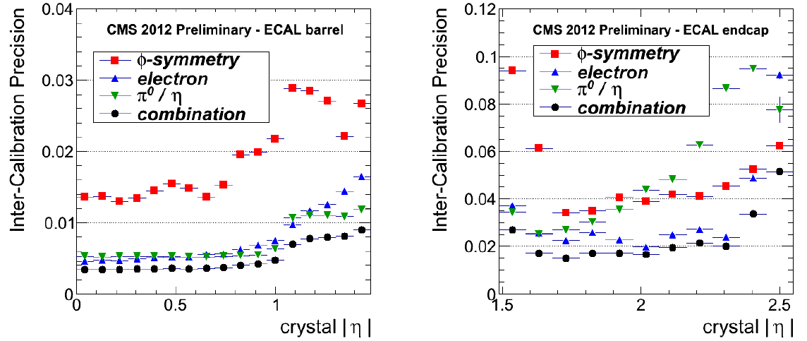
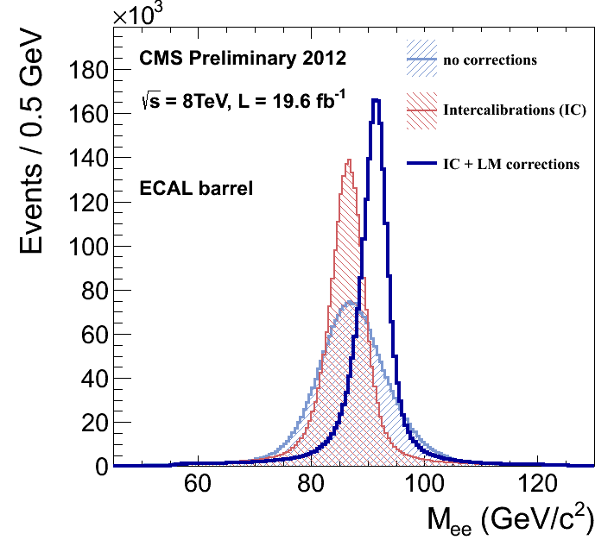
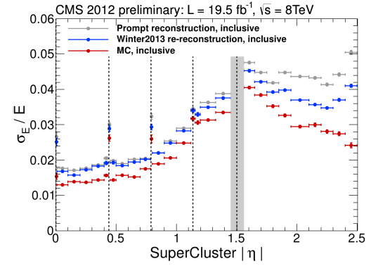
CMS Sub-Detector: ECAL performance
ECAL energy calibration
Overall effect of single channel intercalibration and transparency corrections on the Z -> ee invariant mass peak in the ECAL Barrel
2012 inter-calibration
EB: <1%
EE: ~2%
ECAL energy resolution with Zee
EB: ~2%
EE: ~4%

Slide 12
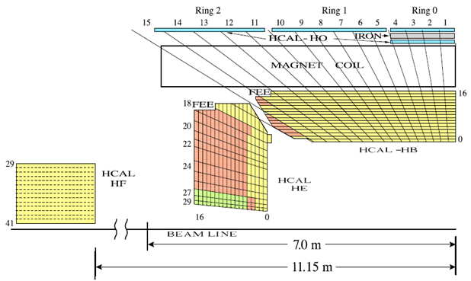
CMS Sub-Detector: HCAL
Compact & hermetic calorimeter, good segmentation and coverage (|η|<5.2)
Important for the measurement of hadron jets and MET (neutrinos)
Sampling Calorimeter:
Scintillator(active) & Brass (passive)
Barrel: 2 half barrels,18 wedges of 20º in Phi each.
Endcap: 2 plugs, 18 endcap wedges each
17 active plastic scintillator tiles / layers.
Total 20916 tiles
1368 Megatiles
(sheets of scintillator)
Δη x Δφ = 0.087 x 0.087)
Few additional layers, the outer barrel (HO), tail catcher sitting outside the coil, ensuring no energy leaks out the back of the HB undetected.
2 forward calorimeters (HF) positioned at either end of CMS, measuring high pseudorapidity range.
(Steel absorbers with quarz fibers)
Jet angular resolution ~ 20 (30) mrad
in φ (θ) at ET ≥ 100 GeV

Slide 13
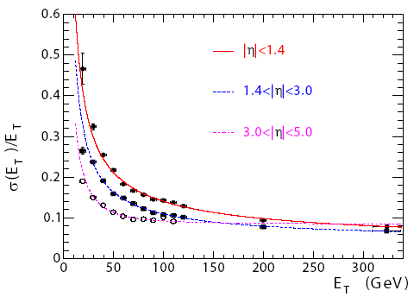
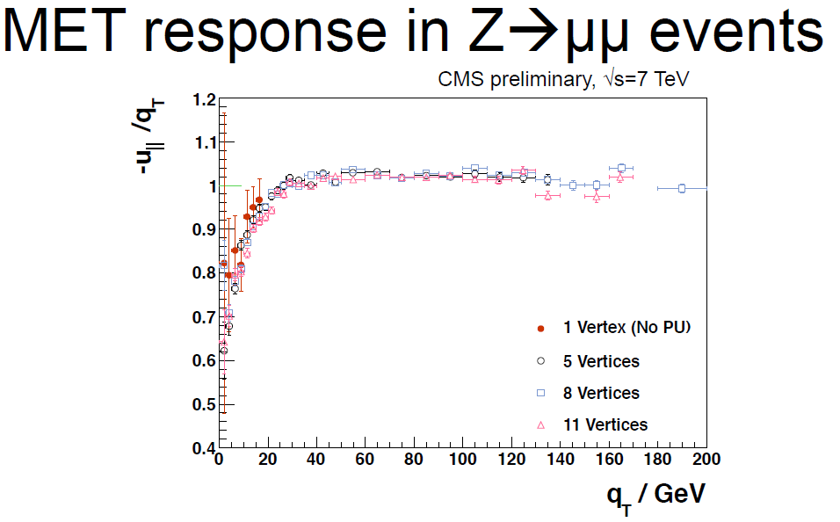
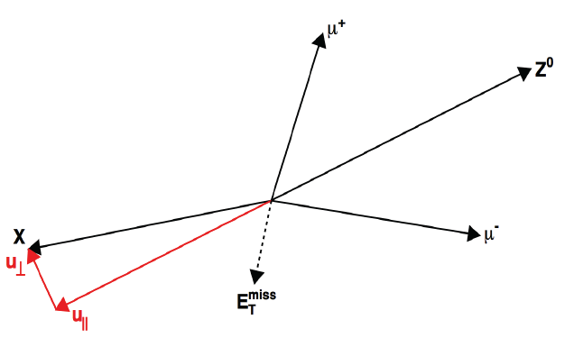
CMS Sub-Detector: HCAL performance
Jet energy resolution
~10%
MET response is close to unity after Type 1 MET corrections

Slide 14
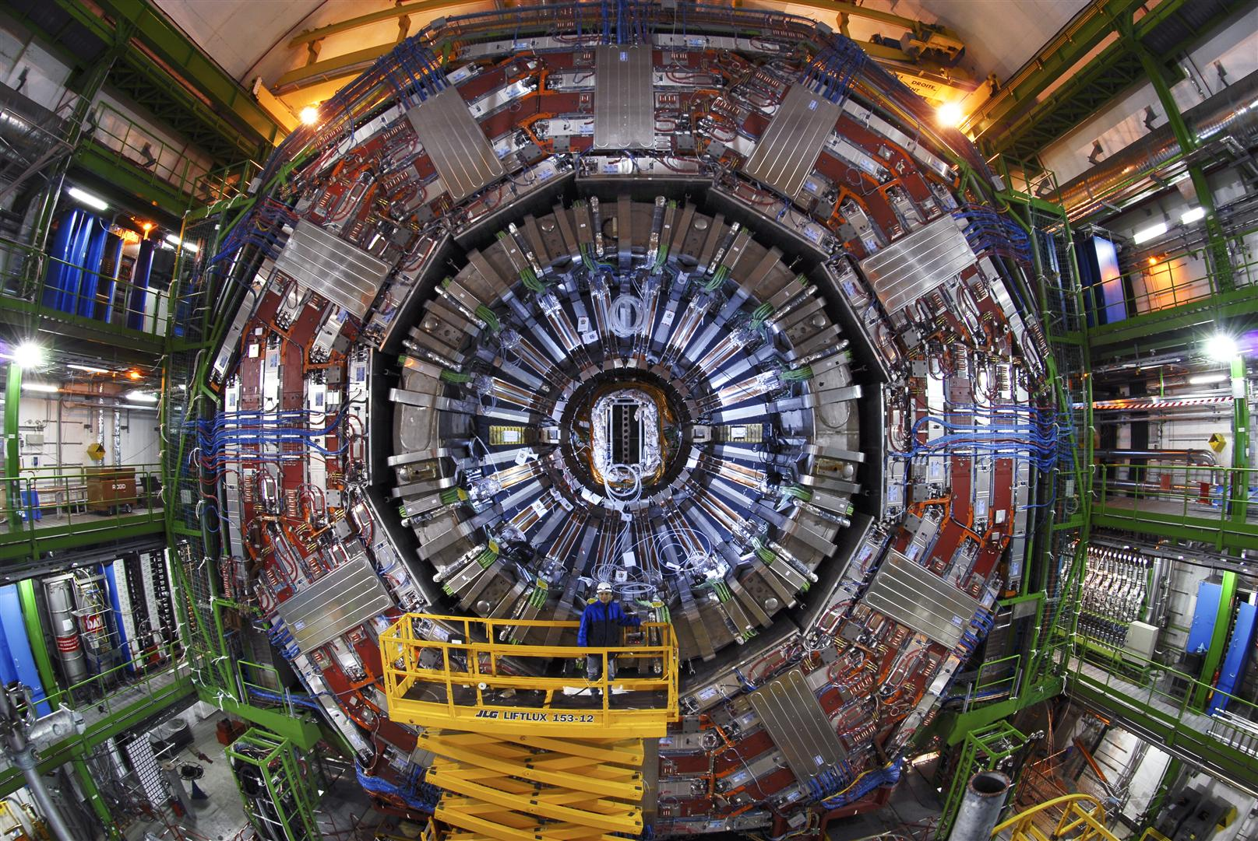
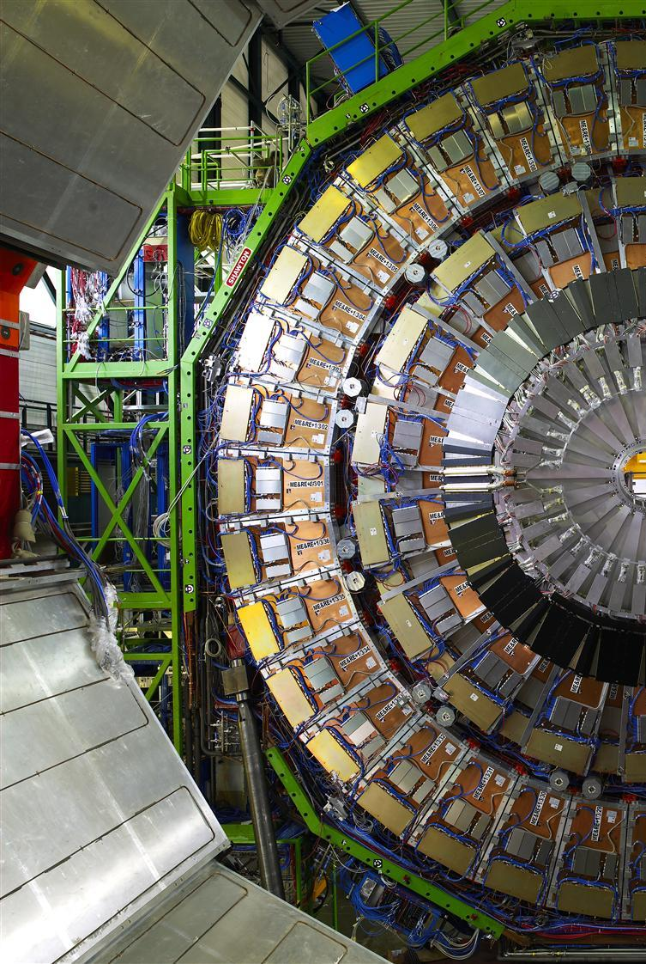
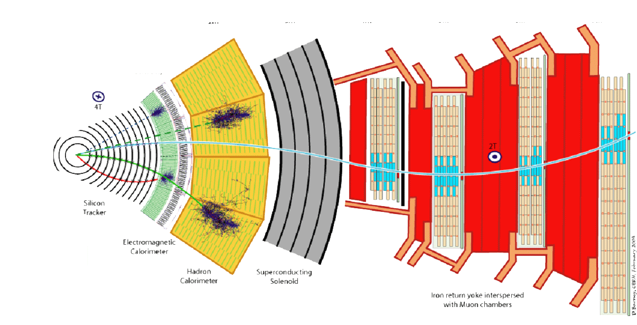
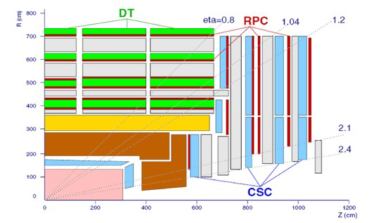
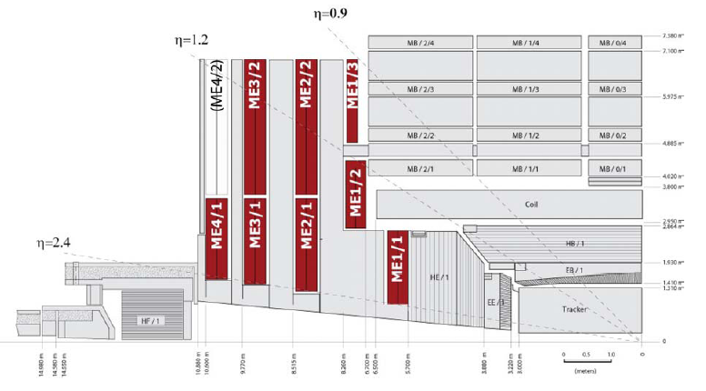
CMS Sub-Detector: muon system
ENDCAP
BARREL
Efficient muon identification
Precise muon pt measurement
(improves tracker based results above 200-300 GeV/c)
Provide effective standalone trigger capabilities
Detectors interleaved with the magnet yoke steel layers
Drift Tubes (DT) used in barrel (tracking detector / self triggering / able to perform bunch crossing id.)
4 stations in the barrel
(|η| < 1.2)
Cathode Strip Chambers (CSC) used in endcaps
(tracking detector / self triggering / performs bunch crossing id. / able cope with large rates magnetic filed inhomogeneities)
4 stations in the endcaps
(0.9 < |η| < 2.4)
IHEP:
72 ME1/2
72 ME1/3
Resistive Plate Chambers (RPC) in barrel/endcaps
(excellent timing resolution / mostly used for triggering

Slide 15
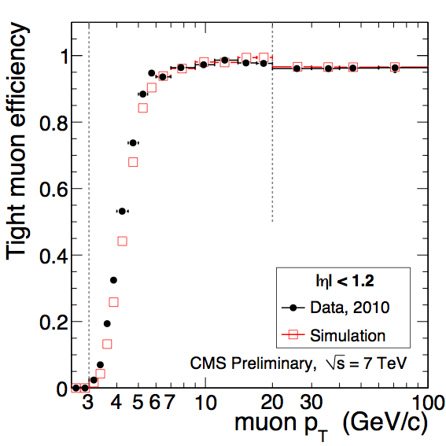
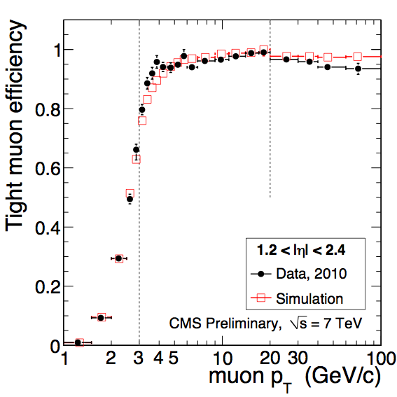
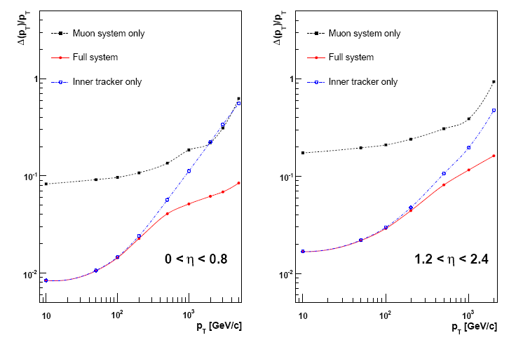
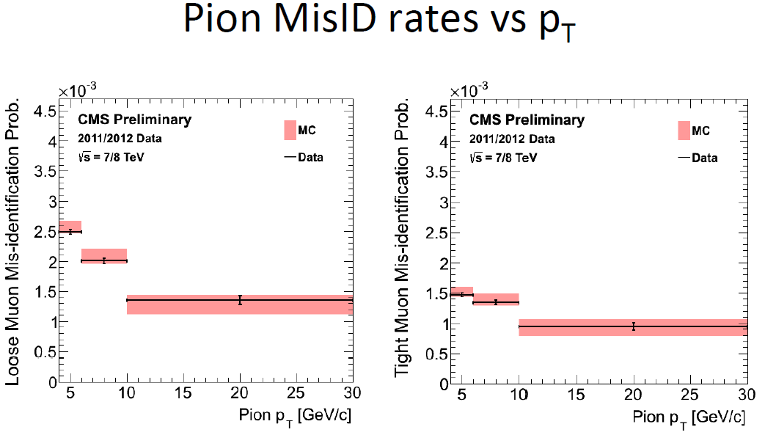
CMS Sub-Detector: Muon performance
Muon reconstruction efficeincy
Expected pT resolution
    Efficiency estimated using Tag & Probe for PF muons passing tight selection criteria
EB: ~1%
EE: ~2%
pT>~5GeV, ε>~90%
~0.2%

Slide 16
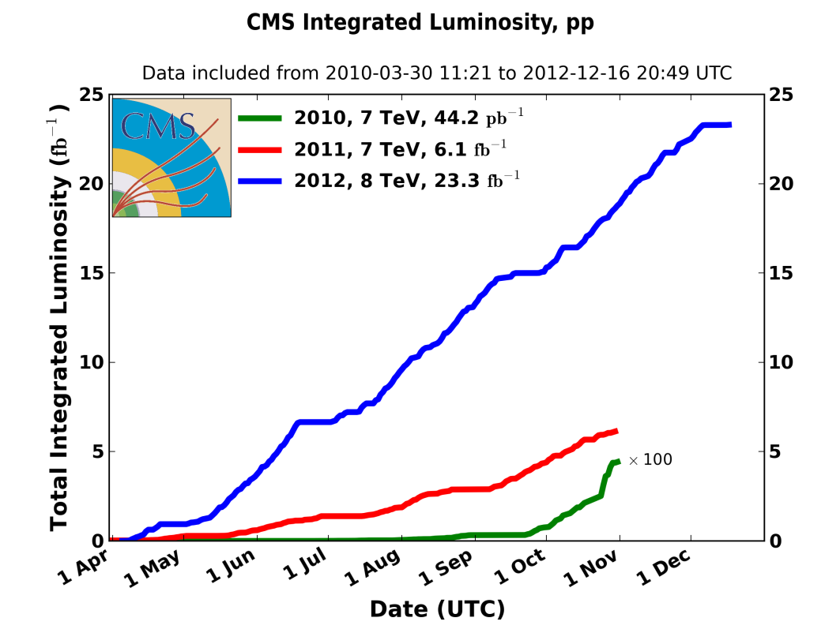
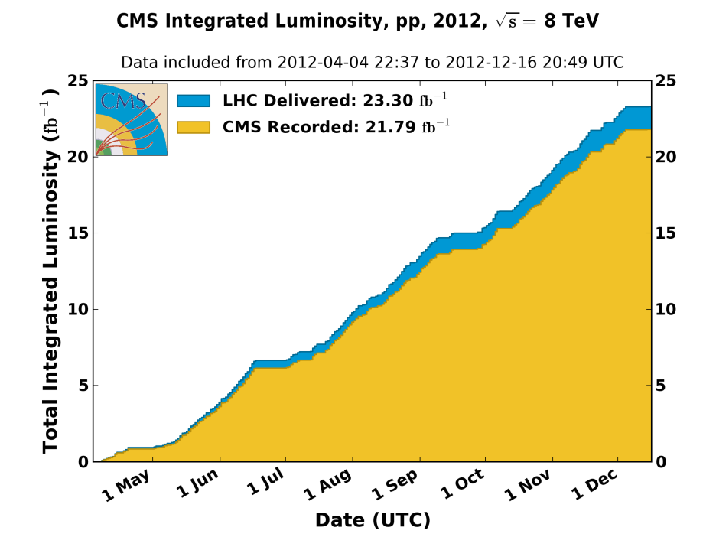
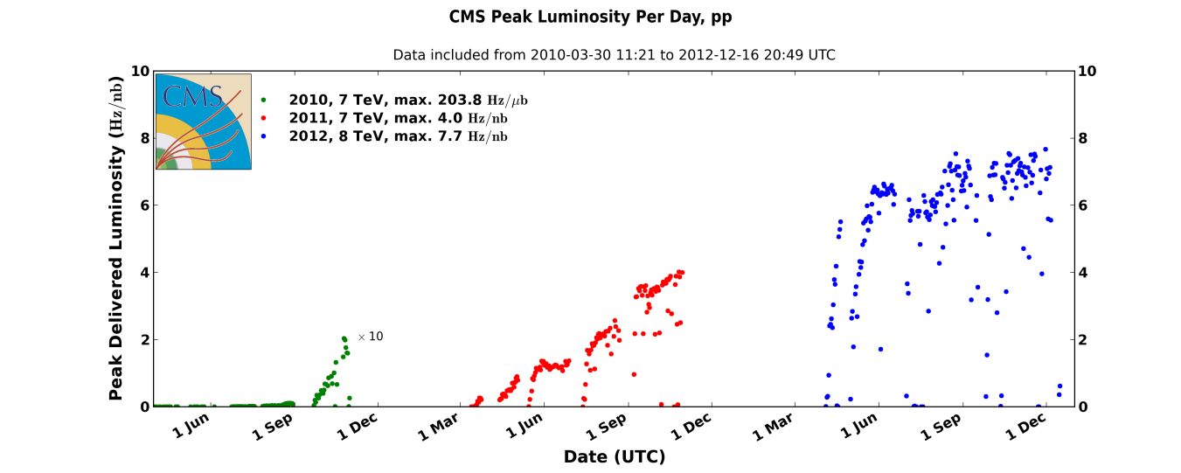
CMS data collections at 7 and 8 TeV
Excellent performance of LHC and CMS in 2010, 2011 and 2012
25 fb⁻¹ IntL pp collisions collected until now at 7 and 8 TeV CM energy
Data taking efficiency >90%
Peak luminosity 7.7 x 10³³ cm⁻²s⁻¹

Slide 17
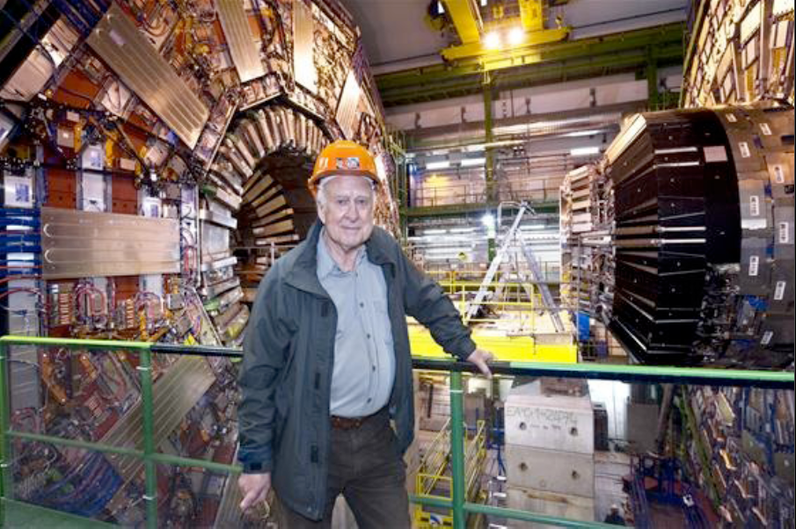
Higgs @ CMS

Slide 18
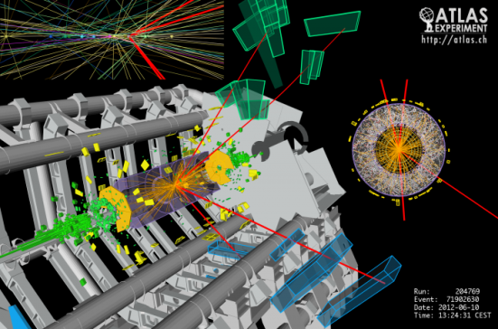

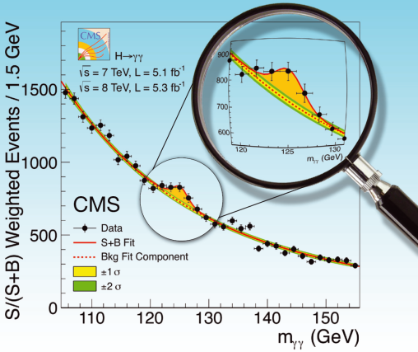
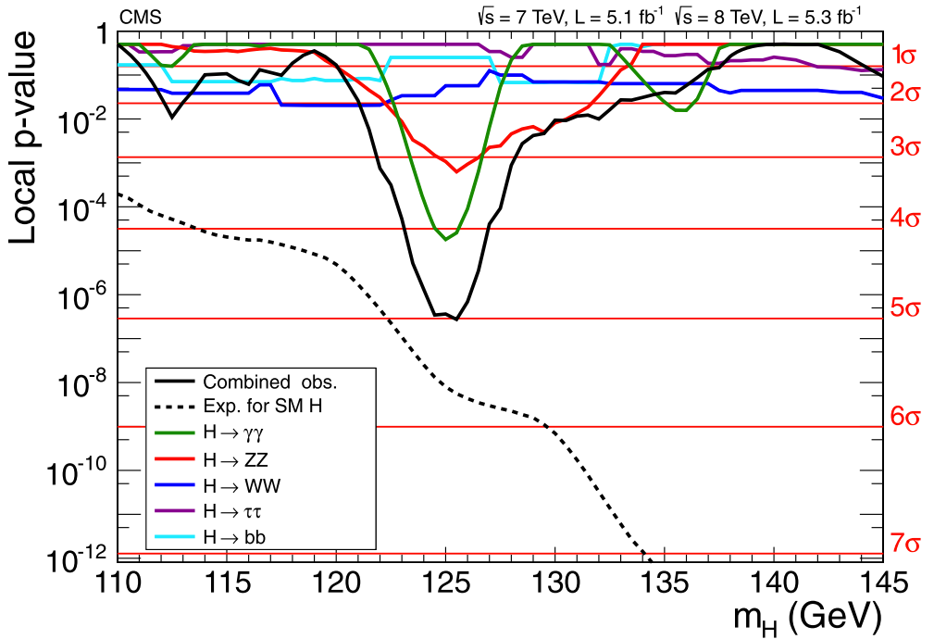
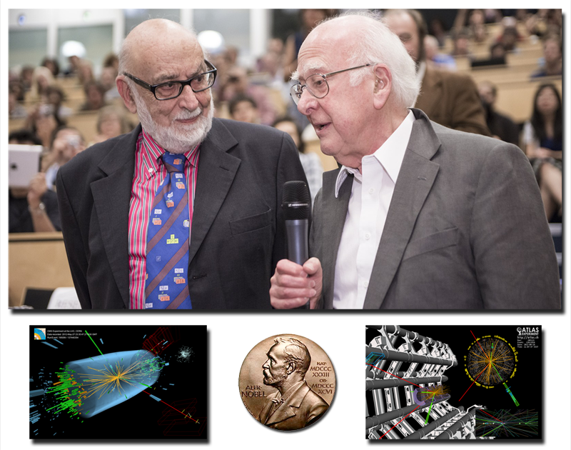
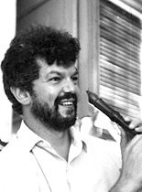

Discovery of Higgs
Higgs theory：1964
LHC design：1984
Machine construction：1998
Higgs-like discovery on 4th July 2012
CMS only:
5.0σ observed.
mX = 125.3 ±0.6 GeV.
At 125 GeV:
  σ/σ_{SM}=0.80 ±0.20.
  “Couplings” compatible with SM.
EBH
Peter Higgs
(1929-)
François Englert
(1932–)
Robert Brout
(1928–2011)

Slide 19
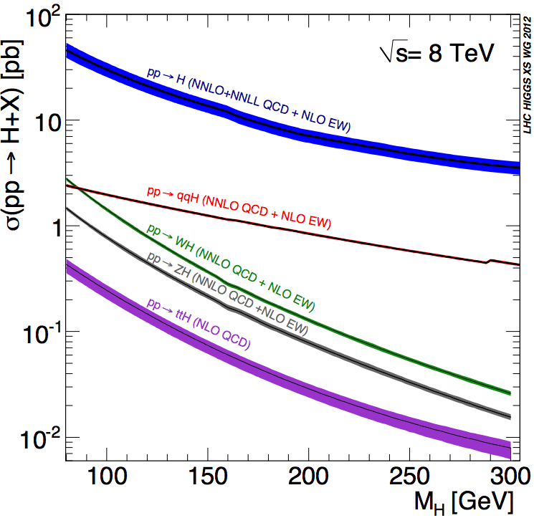
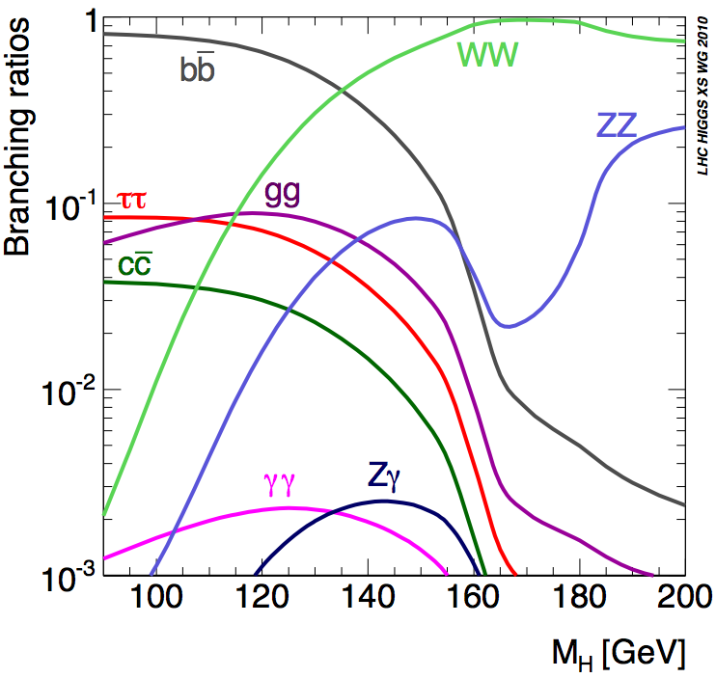
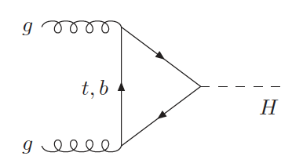
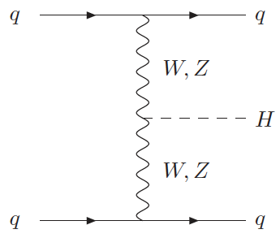
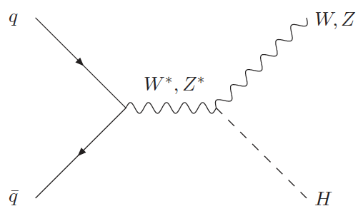

SM Higgs production and decay
ggH
VBF
VH
ttH
Exploit all four production modes

Slide 20

Bosonic search channels at 125 GeV
Channel | Int Luminosity 7 + 8 TeV (fb⁻¹) | Mass resolution | Expected sensitivity | Observed error on σ/σ_{SM}
γγ | 5.1 + 19.6 | 1% | 4.2 σ | 0.27
ZZ->4l | 5.1 + 19.6 | 1.5% | 6.9 σ | 0.26
WW->2l2ν | 4.9 + 19.5 | 20% | 5.1 σ | 0.21
Zγ | 5.0 + 19.6 | ~2% | Tiny for SM | ~5
2 channels with excellent mass resolution (1-2%)
  γγ and ZZ -> 4l, search for mass peak over the BG (large for γγ, small for ZZ) (IHEP involved)
1 channel with worse mass resolution (~20%)
  WW -> 2l2ν, most sensitive channel around 2xM_{W}
  gives the smallest error on μ @ 125GeV
Zγ has good mass resolution but lower sensitivity:
- Cross section similar to γγ, but use Z->ee and Z->μμ (reduce cross section)
- Large BG from Drell Yan with ISR
Studied production processes In various
decay channels
Results: Mass, p-values, signal strengths, spin …

Slide 21



Mass spectrum
S/(S+B) weighed
data events and BG model
parametrizations
H125
ZZ continuum
Z->4l
H→γγ
H→ZZ→4l
H→γγ :A small mass peak over large and smooth background
  Irreducible: 2γ QCD production
  Reducible: γ+jet with 1 additional fake photon, QCD with 2 fake photons, DY with electrons faking photons
Mass peak over the BG (large for γγ, small for ZZ)

Slide 22



Significance: p-values
H→γγ
H→ZZ→4l
H→WW→2l2ν
At ~125 GeV
Local significance 3.2 σ
Expected significance 4.2 σ
At ~125.8 GeV
expected significance: 7.2σ
observed significance: 6.7σ
Broad excess around 125GeV
  expected significance: 5.1 σ
  observed significance: 4.0 σ

Slide 23



Signal strength
H→γγ
H→ZZ→4l
H→WW→2l2ν
  +0.28
-0.26
  +0.30
-0.24
Fitted σ/σ_{SM} at 125 GeV: 0.78
Fitted σ/σ_{SM} = 0.91
Fitted σ/σ_{SM} = 0.76 ± 0.21
Agreement with the SM within ~1σ uncertainties!

Slide 24





Mass and width
Mass
Width
H→γγ
H→ZZ→4l
2D scan μ vs mass
1D scan: mass
M_{H} = 125.4 ± 0.5(stat.) ± 0.6(syst.) GeV
  Energy scale calibrated with Z->ee
  Dominant systematic errors related to energy extrapolation from Z to H and electron-photon difference
Γ_{H} < 6.9 (expected 5.9) GeV at 95% CL
M_{H} = 125.8 ± 0.5(stat.) ± 0.2(syst.) GeV
m(4e) = 127.0 -2.3/+1.9 GeV
m(4μ)=125.2 -0.6/+0.5 GeV
m(2e2μ)=127.2 -0.8/+0.8 GeV
Mass can be measured with higher precision with γγ and ZZ
M_{H} = 125.7 ± 0.3(stat.) ± 0.3(syst.) GeV

Slide 25





Spin-parity
Consider graviton-like hypothesis 2⁺
Production can be gg fusion or qq annihilation
Sensitivity still rather low
current data cannot exclude this particular model of spin-2 whilst the data are compatible with the Standard Model Higgs at the 2σ level
H→WW→lνlν:
Use 0-jet and 1-jet bins
Limited sensitivity (expected < 2σ)
Observed result disfavours 2⁺_{min} hypothesis at 12-14% probability
CMS strongly prefer SM prediction (J^{P} = 0⁺) over the alternatives
H->ZZ->4l

Slide 26

Fermionic decay channels at 125 GeV
Hff programs at CMS
• VBF H(bb) CMS-HIG-13-011
• VH(bb) CMS‐HIG-13-012
• Hττ CMS‐HIG-13-004, CMS-HIG-12-053
• ttH(ττ/bb) CMS-HIG-13-019
Final states: Jets, b-tagged jet, τ_{h}, (l+)MET
CMS Results: each channel

Slide 27

VH→bb results
μ=1.0±0.5

Slide 28



VBF H→bb results
@~125GeV:
Limit
  expected 3.0xSM
  observed 3.6xSM
Significance
  Observed 0.29σ
  Expected 0.70σ
Best fit
μ=0.43±1.37

Slide 29



H→ττ results
significance
Observed (expected) significance = 2.9(2.6)σ around 125GeV
• Combined best fit μ=1.1±0.4 at 125GeV
Signal strength

Slide 30






ttH→ττ/bb results

Slide 31





Combination of ttH results:
ττ+bb +γγ+WW+ZZ
Coupling of the Higgs particle to vector bosons (k_{V}) and fermions (k_{f})
Observed
68% CL
95% CL

Slide 32


High mass searches for SM-like Higgs
High mass: WW and ZZ decays
  add WW→lνqq, ZZ→2l2ν, ZZ→2l2q, ...
Published results:
  SM-like Higgs boson excluded at 95% CL in the mass range 127 – 710 GeV
EPJC 73 (2013) 2469.
Expected and observed combined
Observed in different channels

Slide 33


H→ZZ→llνν updated results
Most sensitive channel for high mass search
  BR 6 times larger than ZZ→4l
Mass resolution 7%
Main backgrounds
  ZZ (irreducible), Z+jets, tt, WZ
CMS PAS HIG-13-014
H->ZZ->llνν candidate
No signal observed with full dataset
Excluded at 95% CL mass range 248 – 930 GeV

Slide 34




Summary
LHC and CMS performed extremely well during the last three years and the full data set has been analyzed
After the discovery of the H(125) Higgs boson we measured its properties
  Branching ratios and couplings are found to be in general agreement with the SM
  Angular distributions are consistent with the J^{P} 0⁺ hypothesis and confirm that H(125) is a Higgs boson
No evidence of high mass SM–like Higgs bosons, M_{H}<930 GeV excluded at 95% C.L.
M_{H} = 125.7 ± 0.3(stat.) ± 0.3(syst.) GeV
σ/σ_{SM} = 0.80±0.14
Compatible with SM within 1σ
CMS strongly prefer SM prediction (J^{P} = 0⁺) over the alternatives

Slide 35
BACKUP SLIDES

Slide 36


Nobel Prize in Physics 2013
Robert Brout
(1928–2011)
François Englert
(1932–)
Peter Higgs
(1929-)
The Nobel Prize in Physics 2013 was awarded jointly to François Englert and Peter W. Higgs "for the theoretical discovery of a mechanism that contributes to our understanding of the origin of mass of subatomic particles, and which recently was confirmed through the discovery of the predicted fundamental particle, by the ATLAS and CMS experiments at CERN's Large Hadron Collider"

Slide 37



Slide 38






Slide 39



Slide 40

Proton-proton (pp) physics at the LHC
Corresponds to conditions around here
Heavy Ion physics at the LHC corresponds
to conditions around here
40

Slide 41



XS @ LHC

Slide 42




CMS Sub-Detector: ECAL performance (cont)
Noise evolution of the APD signal in EB
Noise evolution of the VPT signal in EE

Slide 43


Slide 44











Jets and Jet Energy Corrections

Slide 45

Pileup
Multiple interactions occur for each bunch crossing (in-time and out-of-time pileup)
Mean PU ~10 events in 2011 and ~20 events in 2012
Effects of pileup:
  Slightly deteriorates energy resolution for electrons and photons and jets
    Apply corrections event by event for photons and jets
  Adds energy in isolation cones
    corrected for pileup energy estimated event by event
  PU jets affect central jet veto and VBF jet tagging
    Try to reject PU jets (wider and with tracks coming from different PV)
Typical jet
Typical Pileup jet

Slide 46


Ingredients of the H→γγ Analysis
Photon Selection
  MVA, based on isolation, shower shape and electron rejection
  Also cut-based optimized in different categories with different BG levels
    Barrel/endcap
    Converted/unconverted identified with shower shape in ECAL
Primary Vertex Identification
  Primary Vertex is identified using tracks from recoiling jets and underlying event + conversion
  Found correct in ~80% of cases for pileup in analyzed sample
Mass resolution
  Most important aspect of analysis
  ECAL response calibrated with π⁰ → γγ, W → eν (E/p), Z → ee
  Laser corrections measuring transparency loss are applied
σ_{M}/M ~ 1%
46

Slide 47


H→γγ analysis
4 event classes based on a diphoton Boosted Decision Tree (BDT) output
BDT inputs:
  Kinematic information, photon Id classifier, estimated mass resolution
Additional exclusive classes for VBF and VH
Cat 3
Cat 1
Cat 3
Cat 2
Cat 1
Cat 0
Cat 0
Cat 2

Slide 48

H→γγ exclusive channels
Add exclusive categories to address specific production processes:
  VBF -> dijet selection (dijet BDT)
  VH -> lepton and MET tag to address W->lν, Z->ll and Z->νν decays
VBF candidate
M_{γγ} = 121.9 GeV
M_{jj} = 1460 GeV

Slide 49


ttH H→γγ
CMS PAS HIG-13-015
  +2.4
- 1.9
  μ_{ttH} = -0.2

Slide 50





H → ZZ Use other kinematical variables: K_{D}
MELA: Matrix Element Likelihood Analysis:
uses kinematic inputs for
signal to ZZ background discrimination
{m₁,m₂,θ₁,θ₂,θ*,Φ,Φ₁}
M_{4l} = 121.5 – 130.5 GeV

Slide 51


H → ZZ → 4l: fit
Add a dijet category – to have sensitivity to VBF
Use a 3D method
  Inclusive: Mass – K_{D} – P_{t4l}
  dijet category: Mass – K_{D}– V_{D} (VBF discriminant)
M_{4l} = 121.5 – 130.5 GeV

Slide 52



H → ZZ → 4l: results
Consistent results obtained with 2D and 3D fits
Number of event candidates observed :mass range from 110 to 160 GeV

Slide 53


Slide 54

H→WW→lνlν
Most sensitive channel around 2xM_{W}
  Also at 125 GeV it gives the smallest error on μ
No narrow mass peak (mass resolution ~20%)
Two high p_{T} isolated leptons + MET
Main backgrounds
  WW (irreducible)
  Z+jets, WZ, ZZ, tt, W + jets
BG estimation is crucial
  Main BG estimated from data
H->WW->eμνν candidate
μ P_{T}
32 GeV
e P_{T}
34 GeV
Scalar Higgs boson +
V-A structure of W decay
favors small opening angle
between the 2 charged leptons
(tend to have small Δφ)
ME_{T}
47 GeV

Slide 55

WW→lνlν analysis strategy
0 Jets (SHAPE)
1 Jet (SHAPE)
2 Jets (Cuts)
Different flavour (eμ)
0 Jets (Cuts)
1 Jet
(Cuts)
2 Jets (Cuts)
Same flavour (ee, μμ)
Same flavour has larger BG that is harder to model (cut based analysis used)
2 jet bin corresponds to VBF or VH dijet tag
0 and 1 jet different flavour (most sensitive) use 2D shape analysis in M_{ll}, M_{T} variables
M_{T} =

Slide 56




2012 data: cut based analysis at 8 TeV
0-jet bin
combined
M_{ll} (GeV)
M_{ll} (GeV)
1-jet bin
combined
M_{T} (GeV)
M_{T} (GeV)

Slide 57




WW→lνlν 2D analysis (0 jet bin)
MC Background
Higgs signal at 125 GeV
aaa
Data
BG subtracted data
Signal
region

Slide 58



H→Zγ
Cross section similar to γγ
Use Z->ee and Z->μμ (reduce cross section)
Large BG from Drell Yan with ISR
Models exist with
BR(Zγ) >100 x SM
while BR(γγ) is SM-like
arXiv:1307.5515

Slide 59



Exclusion at low mass
<1: excluded by SM @ 95%CL (CLs<0.05)

Slide 60


Slide 61


Slide 62


Slide 63


Slide 64


Slide 65


Slide 66


Slide 67




Slide 68


