Slide 1
Particle Physics
Together to the Next Frontier
Nigel S. Lockyer
ICFA Seminar Beijing
8/31/2014

Slide 2
The Particle Physics Primary Challenge
Where are the particles beyond the standard model?
What is dark matter?
Neutrinos…..more to learn and more surprises?
What is the cosmos telling us?
What do we do next to prepare for the future?

Slide 3
Concern growing that no new particles found at LHC….
Last 30 years we looked for particles we expected to find
Very different situation today…what are we looking for?
Now we are not sure what the scale of new physics is…..
Signatures seem to be more elusive…by definition… because we have not found anything new
Is theory doing enough to help?

Slide 4
Scales of New Physics….unknown today
E.g. scale of SUSY?
E.g. scale of flavor physics?...mass and flavor all mixed up
E.g. scale(s) of neutrino masses

Slide 5
Not quite ready to say what we need to do for future
Higgs…big success…1st scalar …no hints of anything unusual
  We should study with as much precision as possible
LHC higher energy run will be enlightening (and exciting)
Dark matter…..could be around the corner
  Neutrino floor requires advances in detector technology
We are potentially on the edge of an important discovery
We are living in exciting times & this continues for one to two decades…..then we reach the future

Slide 6

Three Regions in World: Europe, Americas & Asia
Global design in particle physics: representation from each region
We will have to solve problems together and be well coordinated
ICFA has an important role to play

Slide 7
Higgs discovery has dramatically changed the landscape…
Higgs discovery motivates a precision Higgs factory…not going to make three….what is the right direction?
China wants to build a Higgs factory
Europe wants to build a Higgs factory
ILC higher energy (500 GeV), both beams polarized, mature design & machine ready to go technically e.g., Euro-XFEL~500 cavities built…together 3 regions can build ILC
  (significant energy increase possible with further R&D on Nb3Sn)
Strategy for FCC and CECP is however attractive
Neither FCC or CECP as high energy as Linear Collider(s) but have an attractive growth path just as LEP grew into LHC.

Slide 8
Setting the Future Stage…it will be Global
Europe is looking to lead the FCC
China is looking to lead at the CEPC-SPPC
Japan is looking to lead the ILC
The US focus on neutrinos now and R&D to help FCC/SPPC
Plan: Start together and develop technology together
Plan: Reduce the cost per country?....more countries helps but technology breakthroughs will be cost driver

Slide 9
Strategy going forward
Search for new particles @ LHC next run & HL-LHC
Dark matter detectors bigger and more sensitive
Neutrinos are a good bet for surprises
Keep exploring the cosmos
Push the limits on rare processes....very high energy probes
The combined regions plans are following this path (we are not globally planning our field but close)

Slide 10
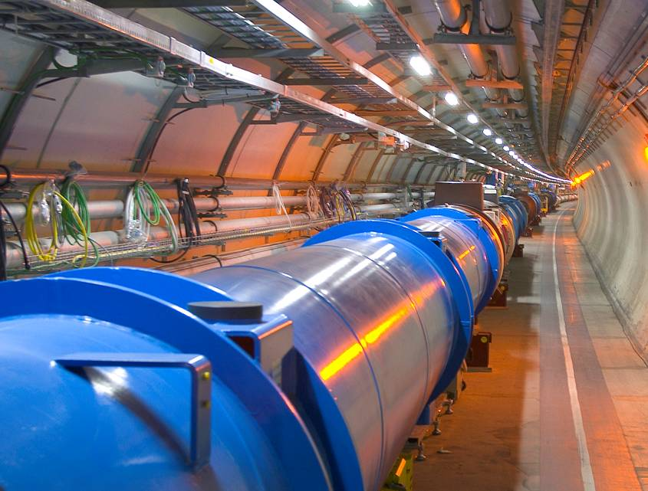
European Strategy
Highest priority is exploitation of the LHC including luminosity upgrades

Slide 11
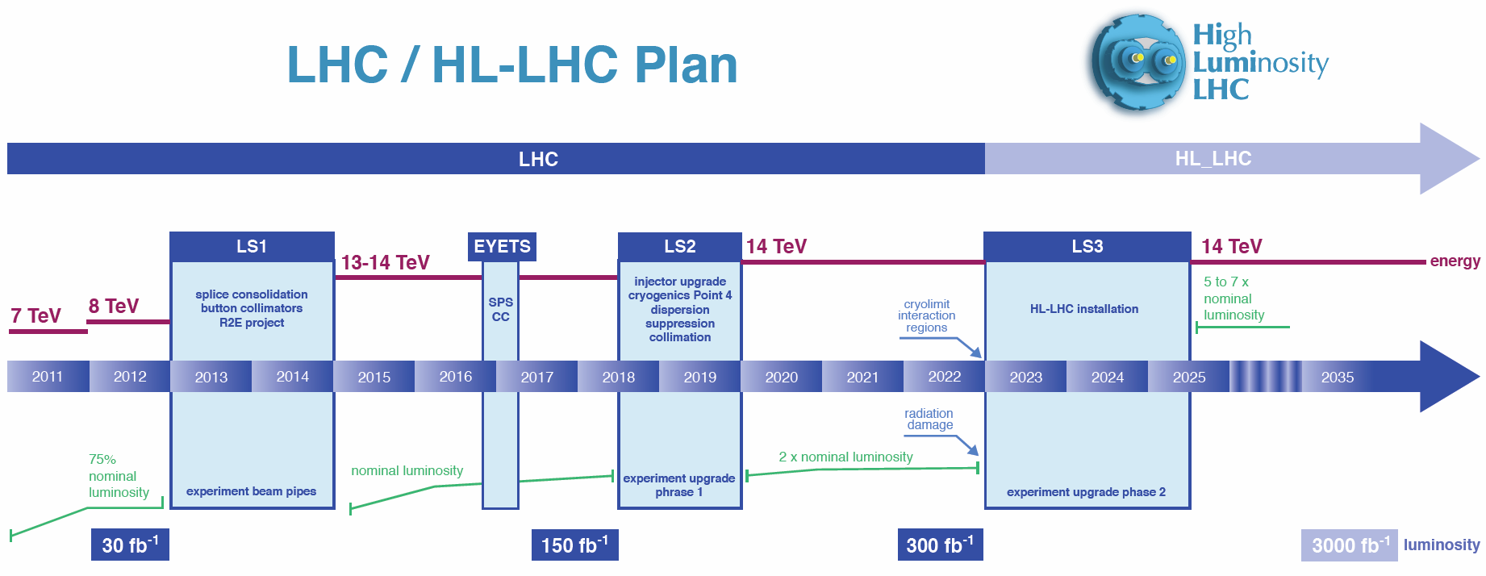

Slide 12
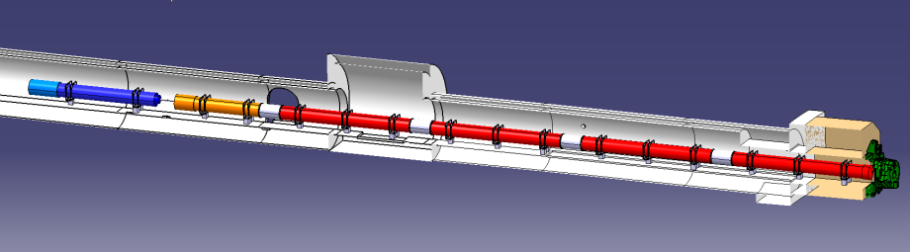






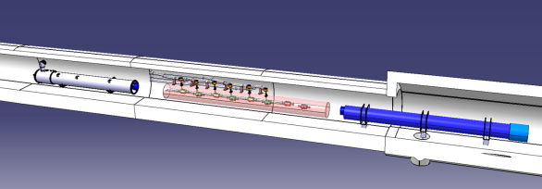


Good Example of International Collaboration
D1
Cor
Q3
Q2b
Q2a
Q1
ATLAS
CMS
Q4
CC
D2
Baseline design of HL-LHC Interaction Region (Bordry)

Slide 13
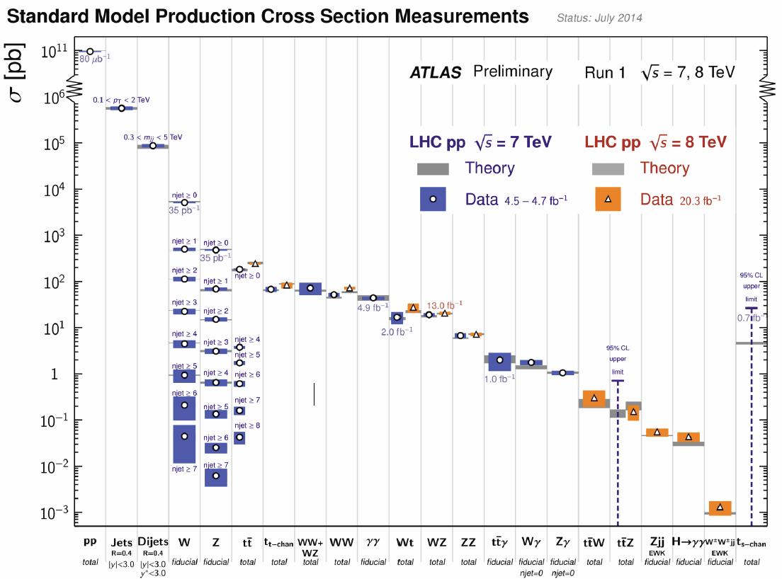
LHC – Standard Model Deepest Tests

Slide 14
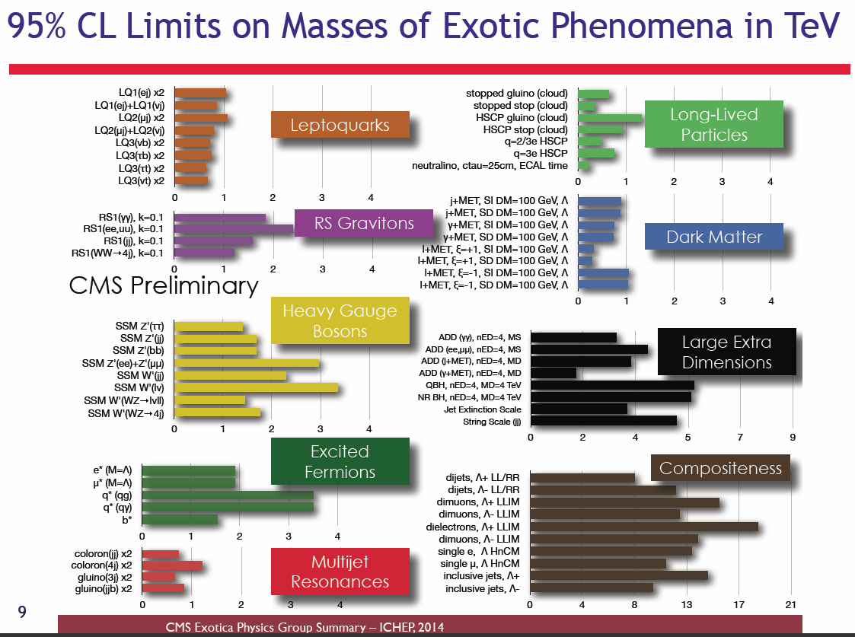
No Hints of New Physics in Run 1

Slide 15
LHC Run 2…13 TeV
Energy step implies potential for discovery is high
Super-partners could show up quickly
New territory after 1-5 fb-1.
Cross section for 1350 GeV gluinos up by factor of 30!
Cross section for 750 GeV squarks up by factor of 9!
Signals grow much faster than background
Very exciting time and will not be repeated for a long time

Slide 16
P5 likes Particle Astrophysics
Five science drivers:
  Higgs boson
  Neutrino mass
  Dark matter
  Cosmic acceleration
  Explore the unknown
Particle Astrophysics experiments address all but the first
Many experiments address more than one
Report supports expanded dark matter program, new cosmic surveys, and a new multi-agency program in CMB

Slide 17
WIMPS are preferred dark matter candidates
Three ways to find WIMPS….all three being pursued
  Produced in colliders
  Direct detection
  Indirect detection from annihilation

Slide 18
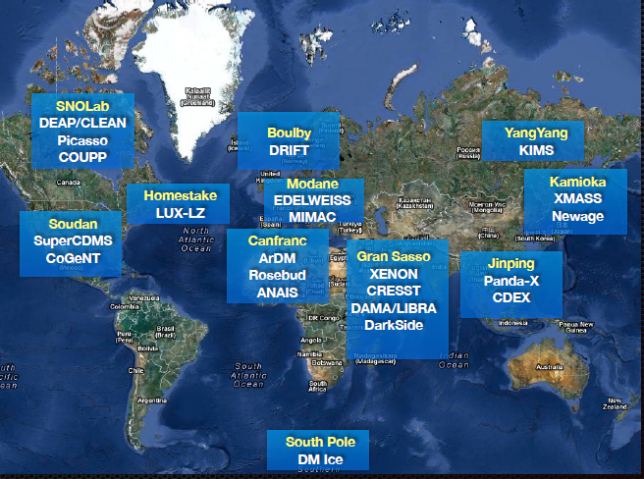
Worldwide WIMP Searches(slides thanks to Elena Aprile)

Slide 19
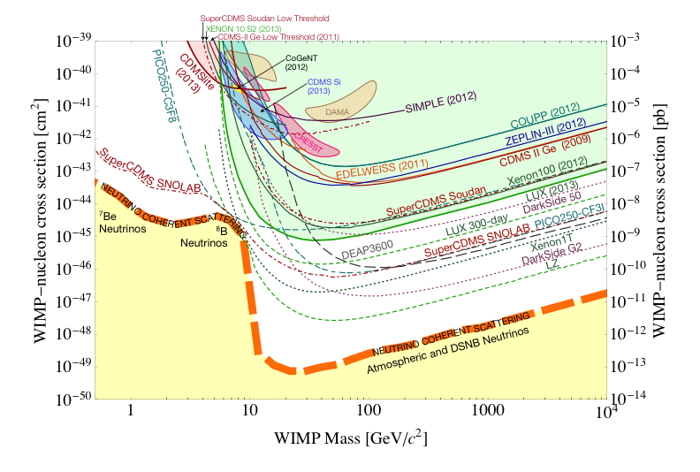
The WIMP Landscape Today

Slide 20
US: Dark Matter after P5 and G2 “Downselect”
DOE and NSF released their G2 plans on July 7
  Responds to P5 recommendation of expanded G2 program Expanded funding not yet available
SuperCDMS and LZ are selected for (slow start) construction
ADMX (axion search) is approved; now operating
PICO/COUPP and DarkSide: no construction funds
  Operations of current G1 experiments will be supported; importance to G3 is recognized
  There may be an R&D program leading to G3, but not yet funded

Slide 21
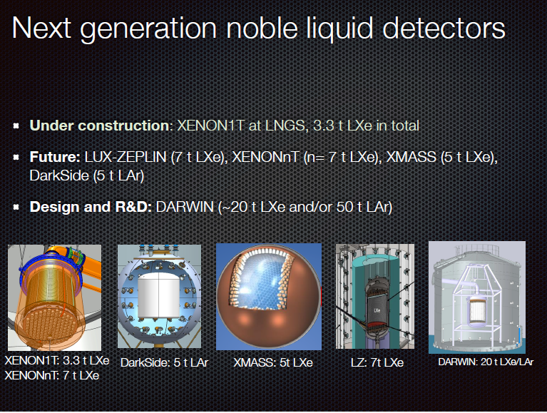

Slide 22
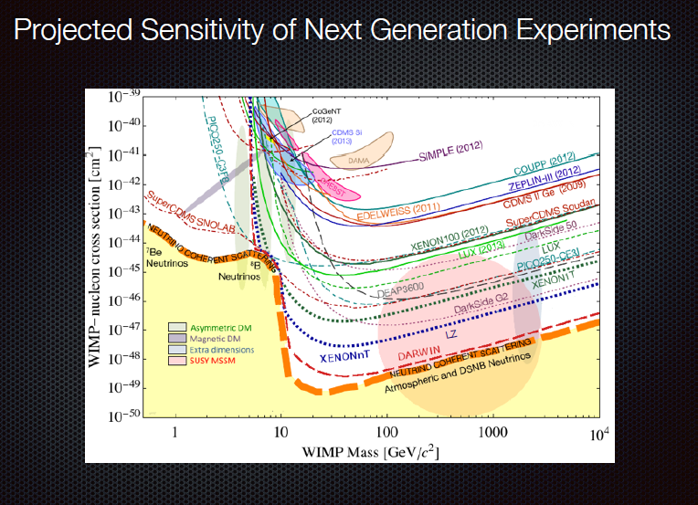

Slide 23
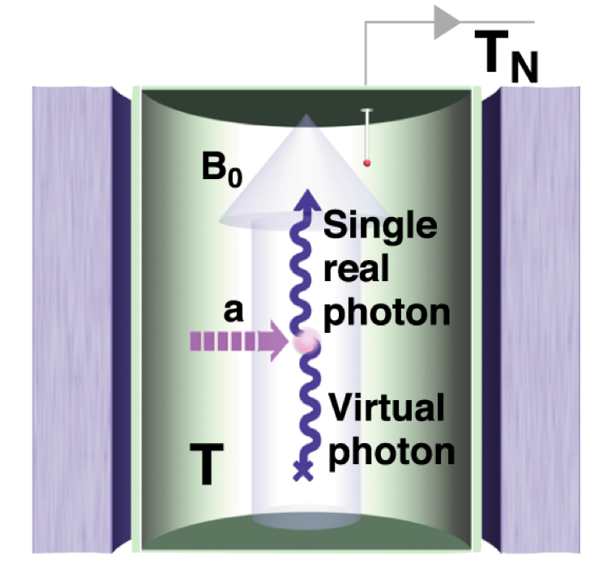
Peccei-Quinn solution for the strong CP problem also predicts axion dark matter.
To detect axions, use a strong magnetic field as the scattering target to intercept the dark matter flux.
Scattering on the B field generates single RF photons with frequency equal to the axion mass.
Tune the radio receiver using a resonant cavity/amplifier.
Scan through frequencies to search for the axion mass peak.

Slide 24
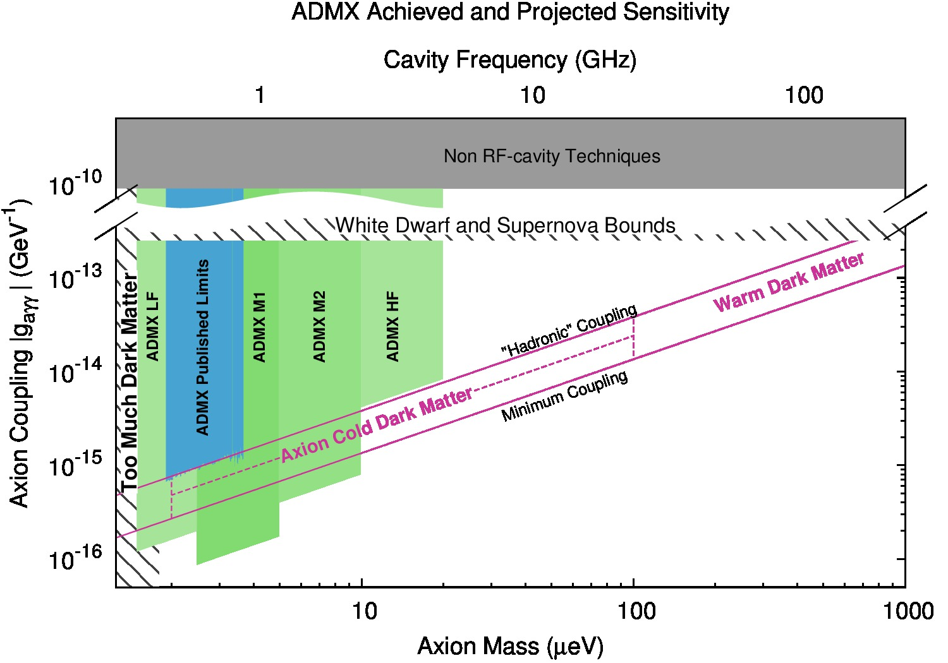
Axion Dark Matter Experiment
Goal: cover preferred axion mass region from 500 MHz – 10 GHz
Gen3 experiment?
ADMX Gen2 2015-2019

Slide 25

Could the AMS positrons be a signal from dark matter?
What is AMS telling us?
AMS detects high energy electrons and positrons coming in from space
The positron fraction is rising with energy
During the past year, a huge amount of theoretical effort trying to understand this

Slide 26
DESI (Dark Energy Spectroscopic Instrument)
Science goal: measure the cosmic distance scale over nearly the entire age of the Universe, constrain neutrino masses and inflation.
Technical challenge: 1m diameter lenses, 5000 robotic fiber positioners
FY14 highlights: 1st Spectrograph ordered, optical design finalized, 1st lens orders placed, fiber positioner selected, passed CD-1 review
Partnerships (currently forming):
DOE Labs: LBNL,FNAL,SLAC,ANL,BNL
US Universities: 21
International Institutions: 19

Slide 27
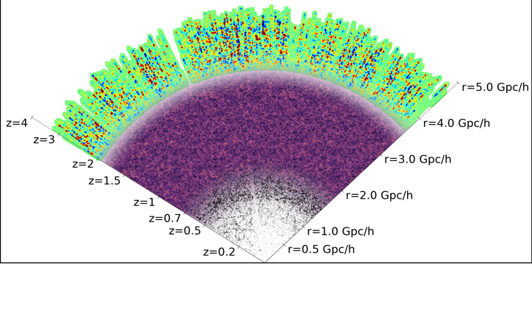
Dark Energy Spectroscopic Instrument in context
The largest spectroscopic survey for dark energy
SDSS ~2h⁻³Gpc³ BOSS ~6h⁻³Gpc³ DESI 50h⁻³Gpc³
2 million QSOs
23 million ELGs
4 million LRGs

Slide 28

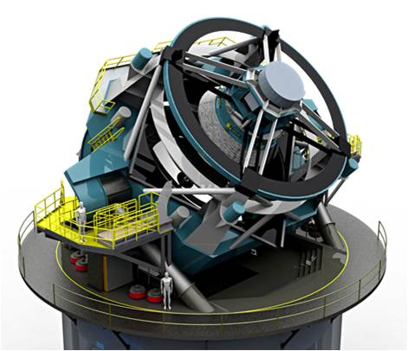
LSST…moving ahead
Like DES but with 10x survey speed, 100x total size
Received DOE CD3a, NSF MREFC approval
Project is starting; expect operations to begin in 8 years

Slide 29
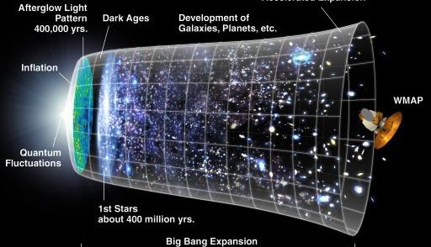
New in P5: Cosmic Microwave Background (CMB)
“Support CMB experiments as part of the core particle physics program. The multidisciplinary nature of the science warrants continued multiagency support.”
Program will map anisotropy of polarization in primordial radiation at high resolution over wide area of sky

Slide 30
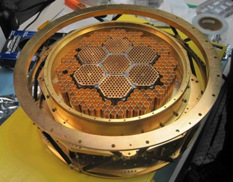
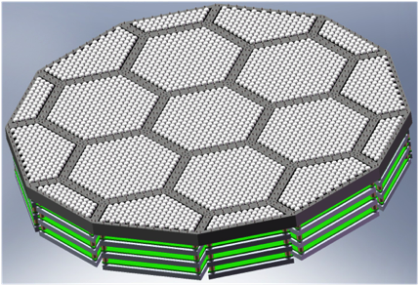
CMB from SPTpol to SPT-3G to Stage-4
Currently under development: SPT-3G; wide-angle, high-resolution, multi-band survey of CMB polarization anisotropy
Primary technical challenge: increase survey speed with bigger superconducting detector arrays and cameras
Stage-2
2012: SPTpol
1600 detectors
Stage-4
2020+: CMB-S4
~500,000 detectors
75mm
wafers
Stage-3
2016: SPT-3G
15,200 detectors
150mm
wafers

Slide 31
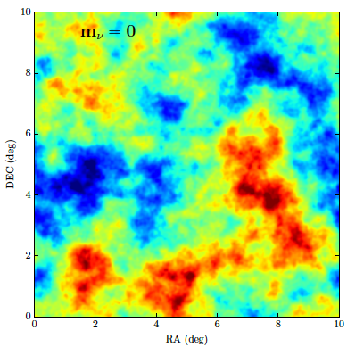
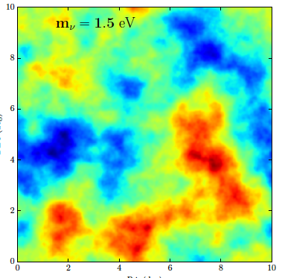
Neutrinos Matter to the Energy Budget
Simulated maps of the gravitational potential that will be made by observing the distortions produced by gravitational lensing of relic radiation. Massive neutrinos produce a universe with shallower gravitational potential wells

Slide 32
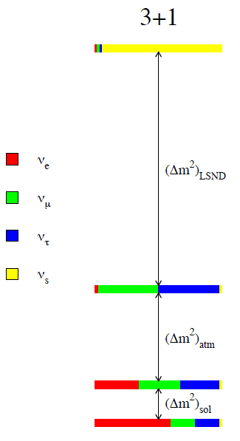
Sterile Neutrinos…changes gravitational shape of universe

Slide 33
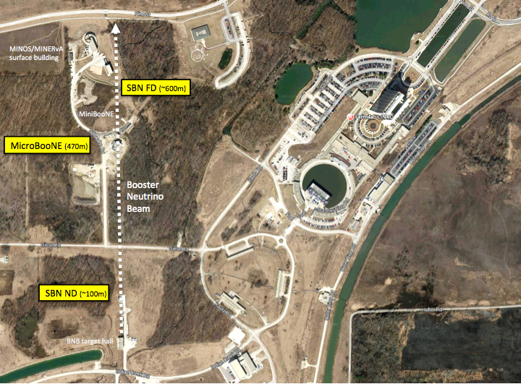
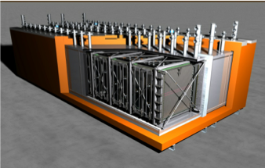

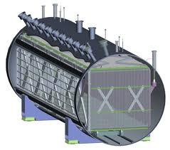


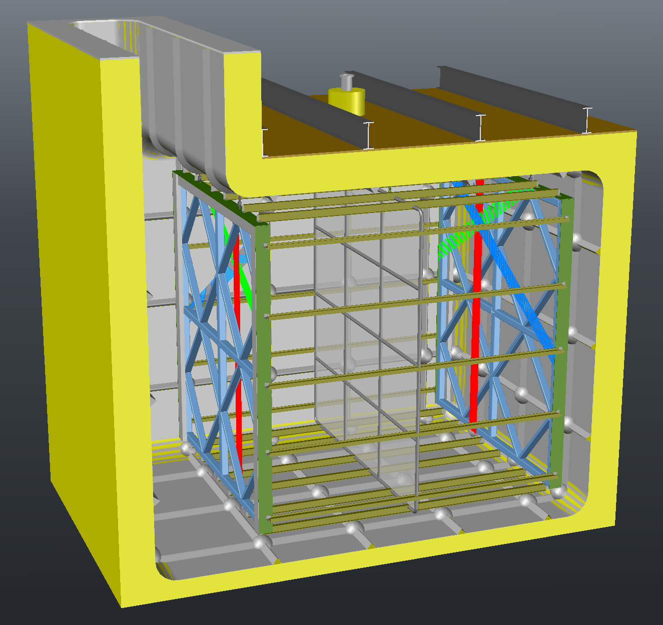
ICARUS T600
MicroBooNE
LAr1-ND

Slide 34
Puzzling: Neutrino and Quark Mixing and Masses
Neutrino Masses < 2 eV
Quark Masses = 3x10⁶ eV
to 1.7x10¹¹ eV
Very different
No idea why, but it is probably important

Slide 35
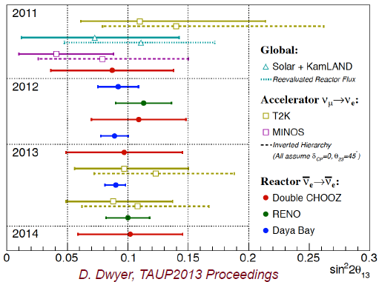
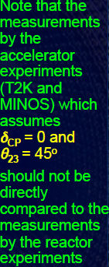
Summary of theta_13 Measurements
Notes:
What don’t we know about this picture?
Delta CP
Mass ordering of neutrinos
Are there more neutrinos than this?

Slide 36
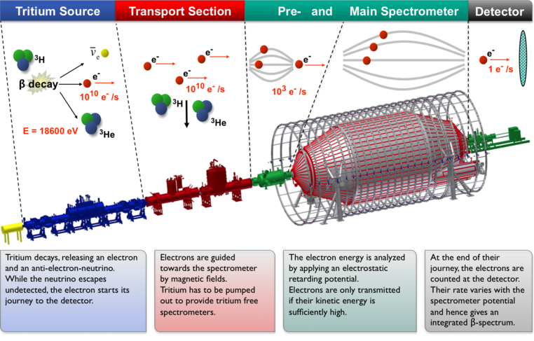
Neutrino masses: what we know and don’t know
KArlsruhe TRItium Neutrino
Experiment (KATRIN)
Notes:
This giant detector was built to continue to search for proton decay, observe neutrinos from the sun, and explore this mystery of the atmospheric neutrinos. It was extremely successful.

Slide 37
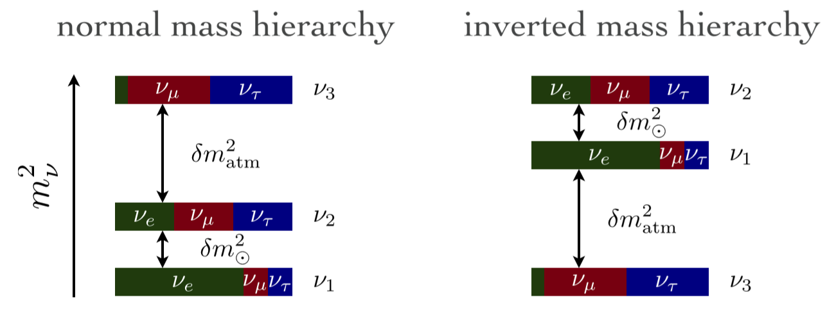
Neutrino masses: what we know and don’t know
A major goal of experimental physics is to resolve this issue
Notes:
This giant detector was built to continue to search for proton decay, observe neutrinos from the sun, and explore this mystery of the atmospheric neutrinos. It was extremely successful.

Slide 38
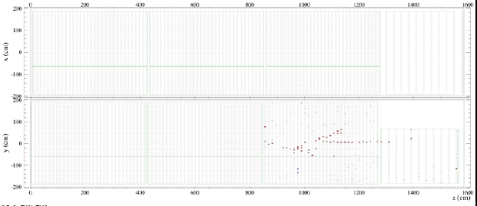
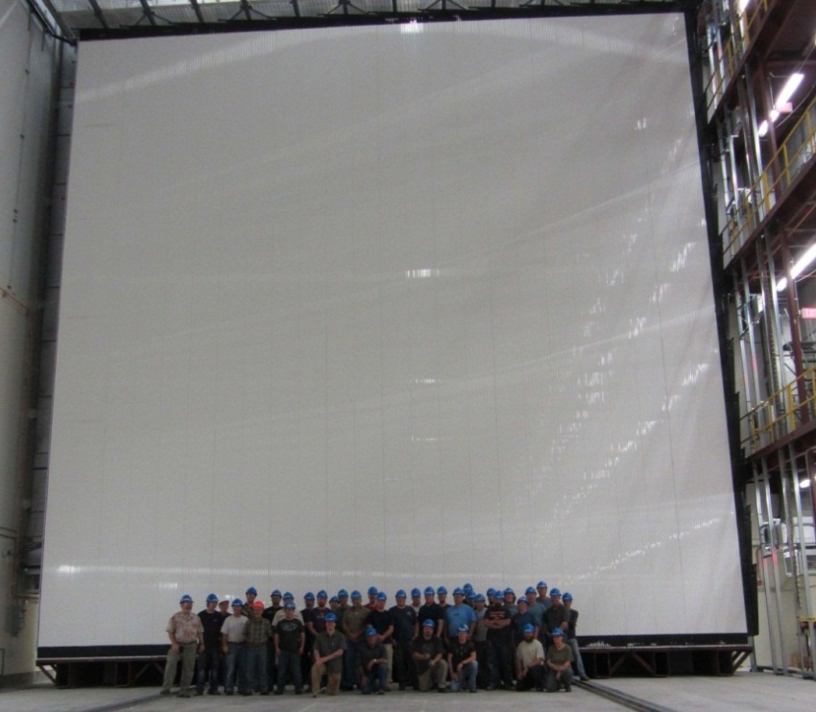
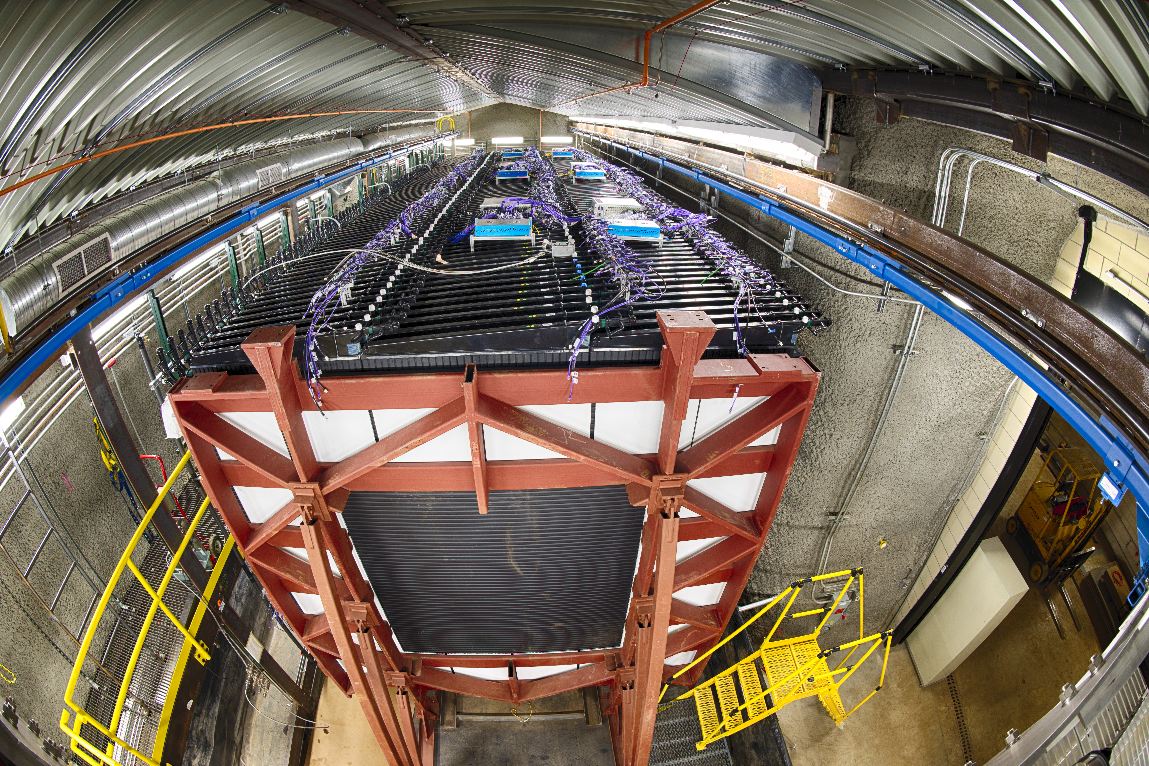
Near & Far Detector up and running : NOvA
Data taking data started
  Working toward 700 kW for neutrinos

Slide 39
Mass Hierarchy Beyond NoVA

Slide 40
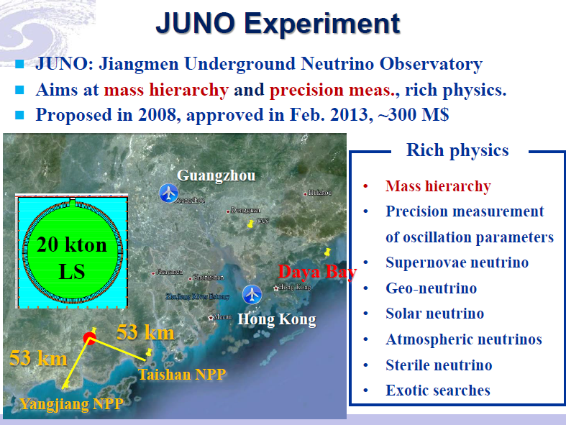

Slide 41
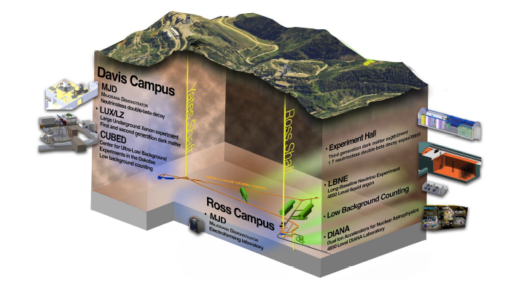
Detector deep underground at the Sanford facility

Slide 42
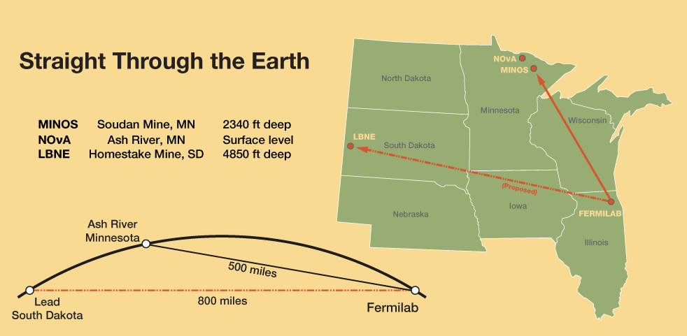
40 fiducial tons liquid argon
deep underground

Slide 43
LBNE, LBNO & others coming together …long baseline
Following recommendations of European strategy and P5 reports a new collaboration is forming with Fermilab as host
Building upon CD-1 of LBNE
Physics goals: CP, mass hierarchy, supernova neutrino detection, proton decay, precision atmospheric studies and three neutrino paradigm precision studies
Interim Board formed and has “met” twice
PI meetings planned for Dec 5 at CERN and Dec 12 at FNAL
New collaboration forms after that
LOI to Jan. ’15 PAC for review if all goes well
CDR to PAC in summer ‘15

Slide 44
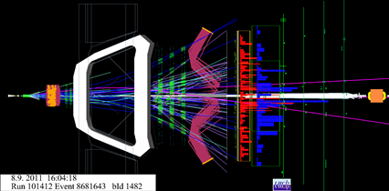
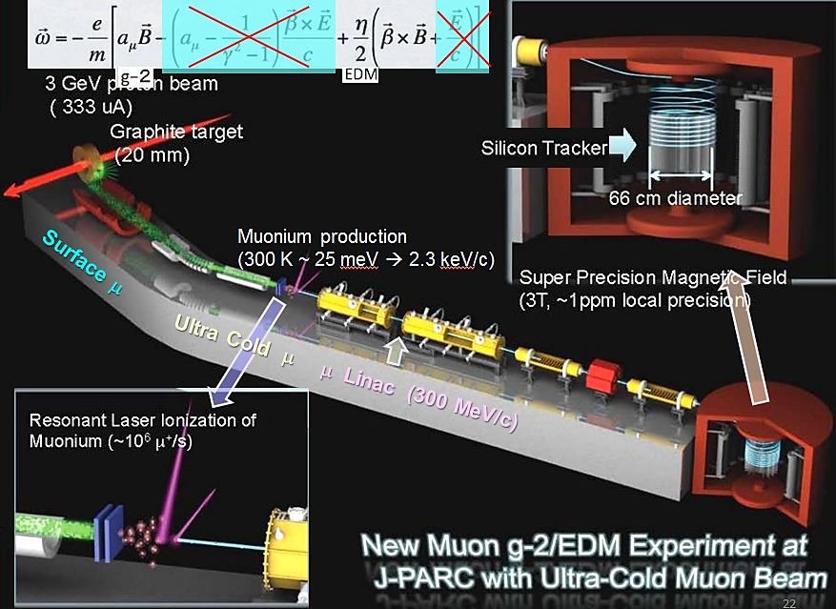
Rare processes: Flavor Physics
Mu2e & Muon g-2 @ Fermilab and JPARC
LHCb at LHC
Belle II at KEK
BES III at IHEP
LHCb event display
G-2 at JPARC

Slide 45
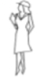
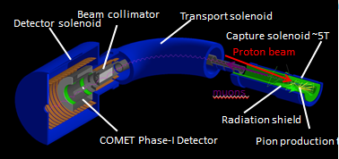
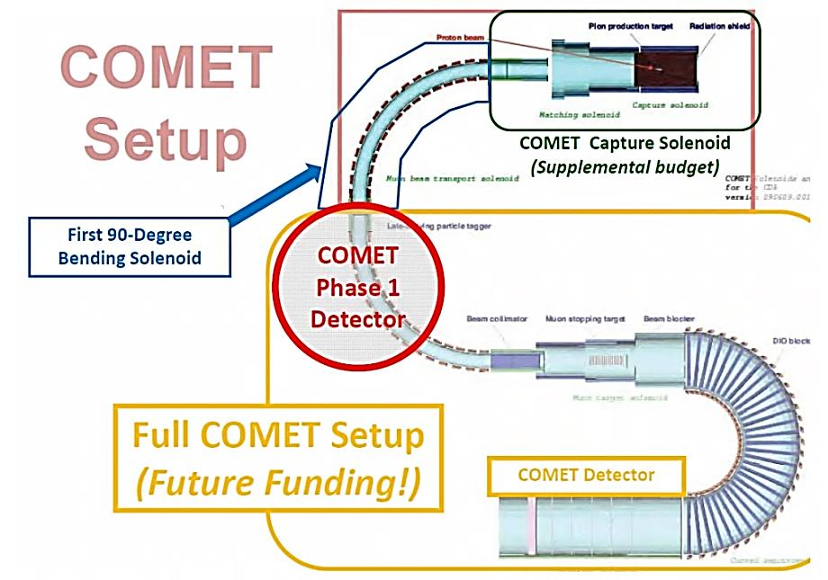
Mu2e & COMET Experimental Apparatus
Production
Solenoid
Transport
Solenoid
Detector
Solenoid
COMET: μ → e Conversion
Signal : μ- + (A,Z) → e- + (A,Z)

Slide 46
ICFA: Global HEP Strategy
ICFA statement in February, 2014 at DESY
ICFA encouraged the two studies (FCC and CEPC-SPPC) to work as close together as possible, with the following statement:
ICFA supports studies of energy frontier circular colliders and encourages global coordination.
ICFA statement in July, 2014 at Valencia
ICFA endorses the particle physics strategic plans produced in Europe, Asia and the United States and the globally aligned priorities contained therein. Here, ICFA reaffirms its support of the ILC, which is in a mature state of technical development and offers unprecedented opportunities for precision studies of the newly discovered Higgs boson. In addition, ICFA continues to encourage international studies of circular colliders, with an ultimate goal of proton-proton collisions at energies much higher than those of the LHC.

Slide 47
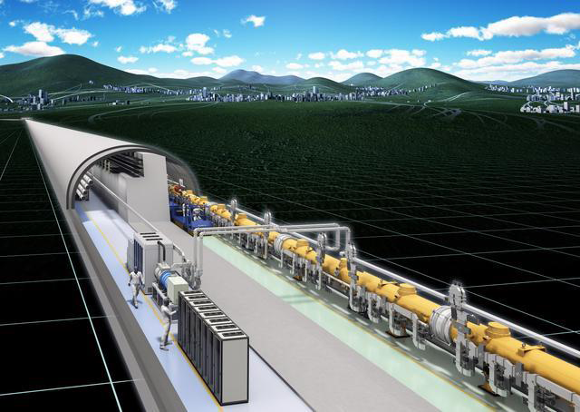
ILC Status

Slide 48
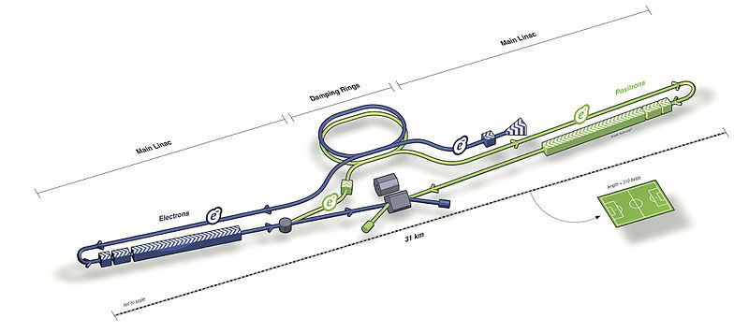
International Linear Collider
ILC or International Linear Collider is e⁺e⁻ linear collider with the following main parameters
  Center of mass energy 500 GeV – upgradable to 1 TeV
  Luminosity >10³⁴ cm⁻²s⁻¹
No synchrotron radiation, but long tunnel to accelerate to ~250 GeV/beam
  Colliding point-like particles

Slide 49
P5 Recommendation on ILC
As the physics case is extremely strong, we plan in all Scenarios for ILC support at some level through a decision point within the next five years.
  – If the ILC proceeds, there is a high-priority option in Scenario C to
  enable the U.S. to play world-leading roles.
  – Even if there are no additional funds available, some hardware
  contributions may be possible in Scenario B, depending on the
  status of international agreements at that time.
  – If the ILC does not proceed, then ILC work would terminate and
  those resources could be applied to accelerator R&D and advanced
  detector technology R&D.
Recommendation 11: Motivated by the strong scientific importance of the ILC and the recent initiative in Japan to host it, the U.S. should engage in modest and appropriate levels of ILC accelerator and detector design in areas where the U.S. can contribute critical expertise. Consider higher levels of collaboration if ILC proceeds.

Slide 50
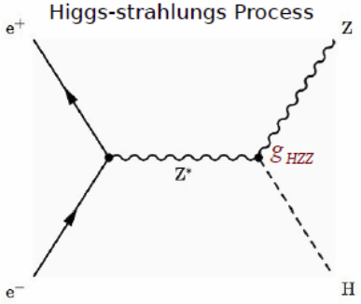
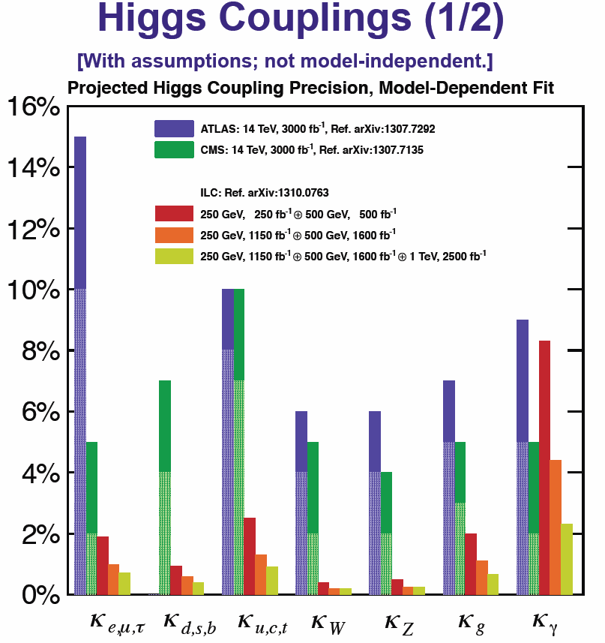
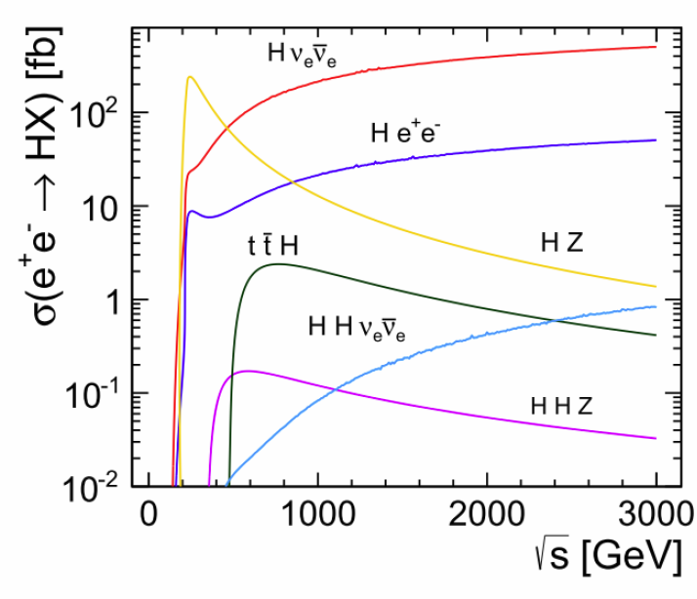
Higgs Studies at the ILC
The precision couplings measurements at HL-LHC in the 2—10% range can be reduced at the ILC by an order of magnitude, while providing a model independent determination of Higgs partial widths

Slide 51
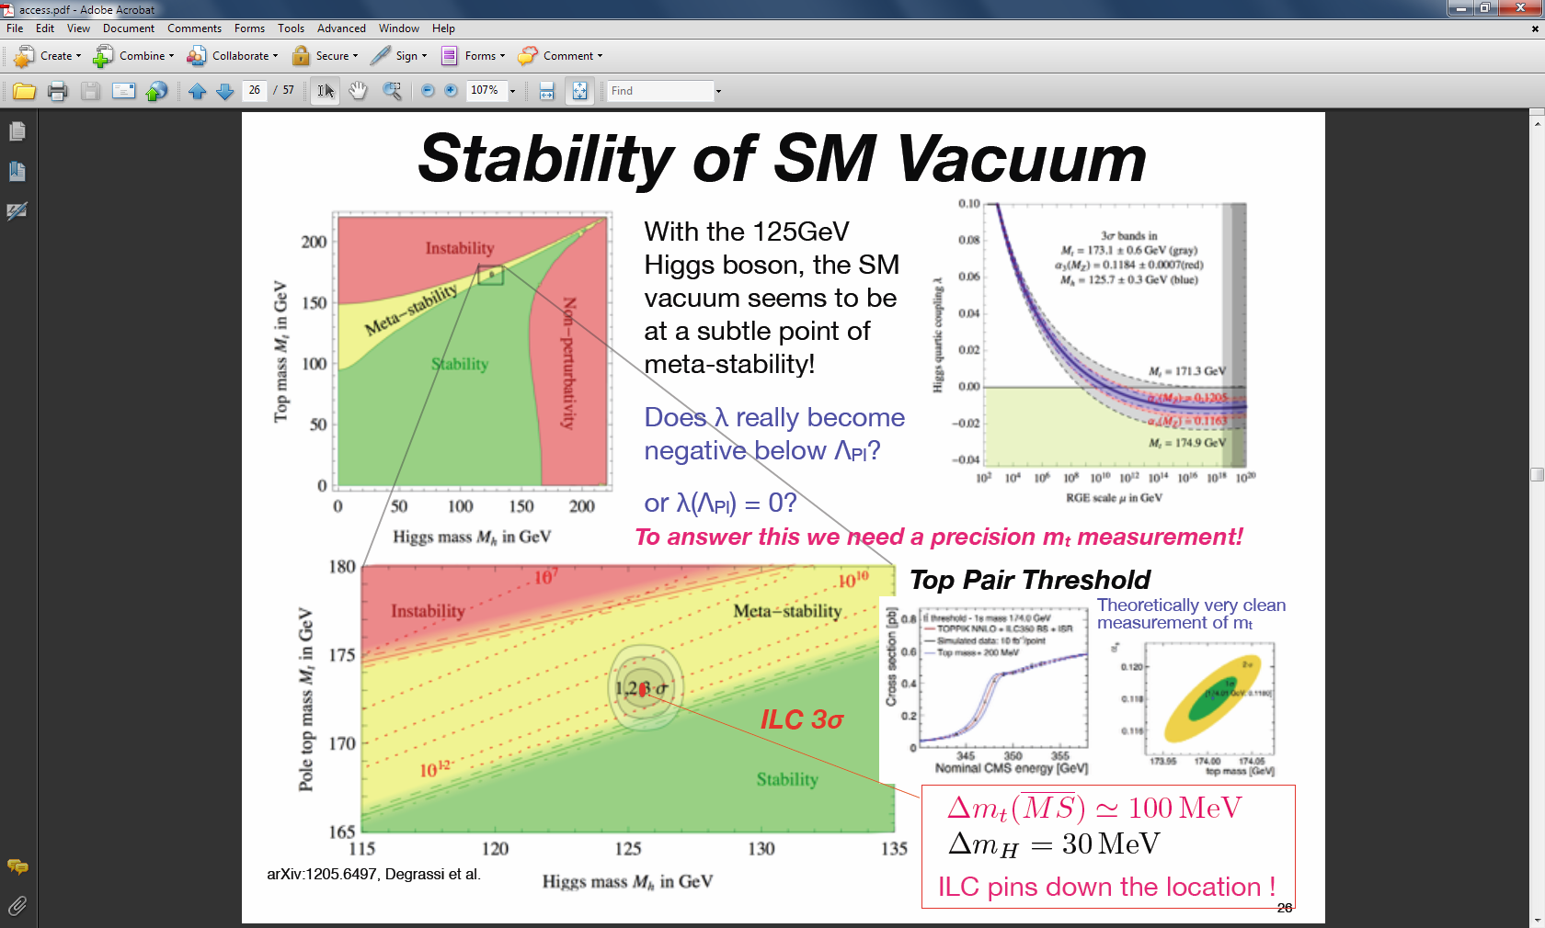
Top Quark Precision Studies at the ILC

Slide 52
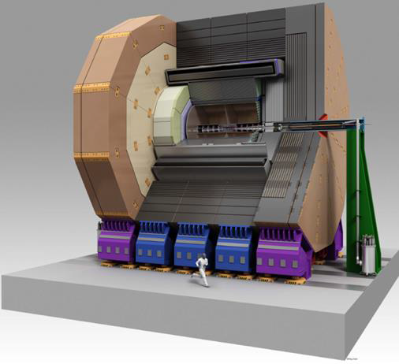
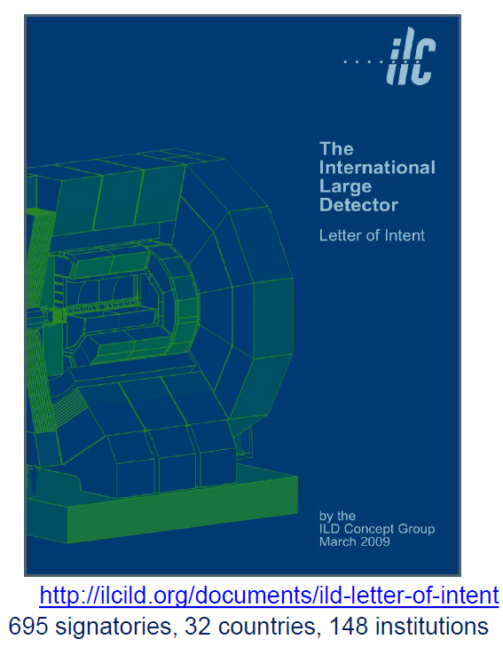
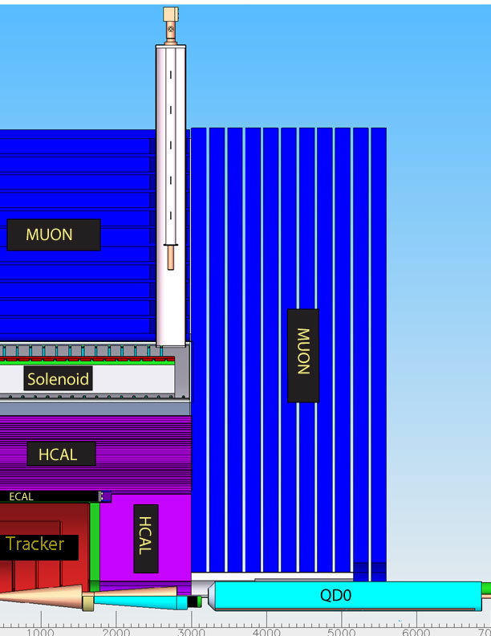
ILD - International Large Detector, SiD

Slide 53
Nitrogen doping: a breakthrough in BCS resistance (Q)
Record after nitrogen doping – up to 4 times higher Q!
Injection of small nitrogen partial pressure at the end of 800C degassing, followed by EP-> drastic increase in Q
Demonstrated on many 1-cell and 9-cell 1.3 GHz cavities
Standard state-of-the art preparation
This was the highest Q possible up to last year
1.3 GHz
A. Grassellino et al, 2013 Supercond. Sci. Technol. 26 102001 (Rapid Communication) – selected for highlights of 2013

Slide 54
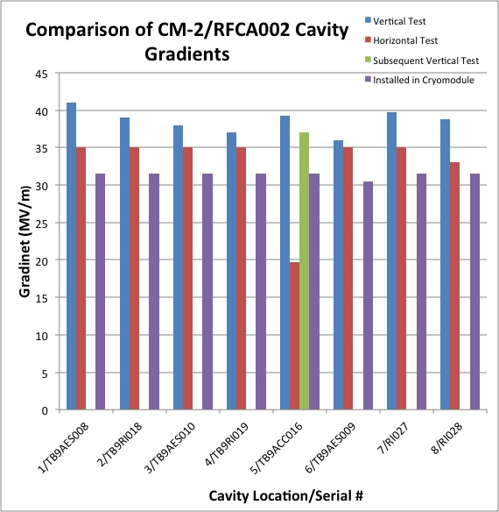
Fermilab CM=> Operates at full ILC gradient
ILC Milestone = 31.5 MV/m

Slide 55
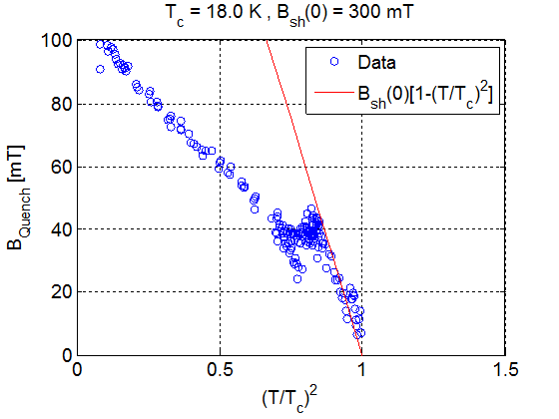
Long-term goals R&D program: 60 MV/m → 90MV/m
Using high power RF (MW) with short pulses, Cornell recently demonstrated (for T>6K) Nb3Sn follows the expected superheating field of the 18K superconductor.
When extrapolated to 2K this leads to surface magnetic fields of 300 mT as compared to Nb superheating field of 200 mT.
These results suggest that a well prepared Nb3Sn cavity with optimal shape will capable of reaching 80-90 MV/m and high Q (due to higher Tc of Nb3Sn)
With intense R&D, such new materials can outperform Nb.
Heating at defect takes over

Slide 56



European Strategy
Approved by CERN council, ESFRI roadmap
Identified four highest priorities:
Highest priority is exploitation of the LHC including luminosity upgrades
Europe should be able to propose an ambitious project at CERN after the LHC
  Either high energy proton collider (FCC-hh)
  Or high energy linear collider (CLIC)
Europe welcomes Japan to make a proposal to host ILC
Long baseline neutrino facility

Slide 57

FCC Overview
FCC-hh hadron collider with 100TeV proton cms energy
FCC-ee a lepton collider as a potential intermediate step
FCC-eh lepton hadron option
International collaboration
Site studies for Geneva area
CDR for EU strategy update in 2018
M. Benedikt
~16 T ⇒ 100 TeV pp in 100 km
~20 T ⇒ 100 TeV pp in 80 km

Slide 58


FCC Kick-off Meeting
341 registered participants

Slide 59

From BEPC to BEPCII (J. Gao)
BEPC was completed in 1988 with luminosity 1×10³¹cm⁻²s⁻¹ @1.89GeV
BEPC II was completed in 2009 with Luminosity reached: 7×10³²cm⁻²s⁻¹ @1.89GeV
After BEPCII what is the next high energy collider?
Notes:
59

Slide 60


Slide 61


CEPC-SppC Project Timeline (dream)
CEPC
 |  | 2015 |  |  |  |  | 2020 |  |  |  |  | 2025 |  |  |  |  | 2030 |  |  |  |  | 2035
Pre-studies (2013-2015)
R&D Engineering Design (2016-2020)
Construction (2021-2027)
Data taking (2028-2035)
1st Milestone: pre-CDR (by the end of 2014) → R&D funding request to Chinese government in 2015 (China’s 13th Five-Year Plan 2016-2020)
SppC
 |  | 2020 |  |  |  |  |  |  | 2030 |  |  |  |  |  |  |  |  | 2040
R&D (2014-2030)
Engineering Design (2030-2035)
Construction (2035-2042)
Data taking (2042-2055)

Slide 62

CEPC – Site Investigation
300 km from Beijing
3 hours by car; 1 hours by high speed train
Y. F. Wang

Slide 63
Three main Accel R&D directions for HEP
Future Energy Frontier Hadron Colliders (~100 TeV class)
  Main Issue: COST → need R&D
    Cheap high-field magnets, radiation, SR and vacuum, collimation, beams
Future Intensity Frontier Accelerators (500 kT-MW-year)
    Main Issue: PERFORMANCE vs COST → need R&D
      MWs of protons on target, instabilities and loss control, new rings
Future Energy Frontier Lepton Colliders (~ TeV class)
    Main Issue: COST and PERFORMANCE → need R&D
      Competing energy and luminosity reach complementing hadron colliders

Slide 64
Roles of Regions in the Accelerator R&D [Plan]
R&D towards Future Energy Frontier Hadron Colliders
  Europe & Asia to lead, US supports (e.g. high-field magnet R&D)
R&D Towards Future Intensity Frontier Accelerators
    US/Asia to lead, Europe to support (e.g. SRF, Beam Dynamics, Targets)
R&D Towards Future Energy Frontier Lepton Colliders
    Asia (Europe) to lead, US supports (?)

Slide 65
R&D Goal: SC Magnets
Long-term research and development toward significant (~3-4) cost reduction of high-field accelerator quality magnets
In coordination with the US and global:
  Accelerator design teams (to understand and meet the specs)
  Magnet design and development teams (to avoid duplication of efforts)
Key areas :
  further develop Nb₃Sn technology, new magnet designs, quench & splice engineering, better materials & conductors, etc

Slide 66
Summary
Our field is very exciting now and for next 2 decades
Anticipation is high for breakthrough discoveries
Future pp machines being discussed but we are uncertain what to build…..more data needed…time to define energy… etc.
Preparing now for a future pp machine is critical because development times are decades
Magnet tech & materials must advance to bring cost down substantially for pp colliders
ICFA has encouraged the world to organize & work together
China has emerged onto the world particle physics scene
R&D for future machines a chance to train next generation

Slide 67

……thank you….the future has begun
Thanks to:
Freddy Bordry
Chang Kee Jung
Joe Lykken
Greg Bock
Craig Hogan
Bonnie Fleming
Elena Aprile
J. Gao
B. Sadoulet
Daniel Schulte
and colleagues at Fermilab
Thank you to our hosts at IHEP!
Notes:
Any questions?

