Slide 1
Accelerators for Industry
Nigel S. Lockyer
ICFA Seminar Beijing
10/29/2014

Slide 2
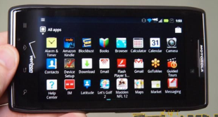
Despite their impact on science, most accelerators that have been built are used for other purposes
About 30,000 accelerators are in use world wide
Sales of accelerators > $ 2 B /yr and growing
Accelerators touch over $ 500B/yr in products
Major Impact on our economy, health, and well being
Some Products:
Shrink wrapped food
Radial Tires
Aircraft
Digital Electronics

Slide 3
Current Accelerator Applications

Slide 4
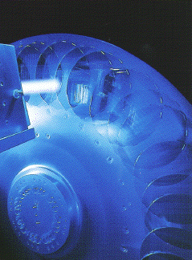
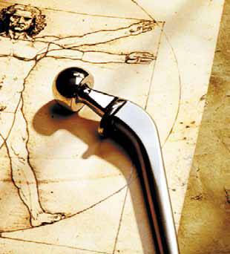
Accelerators: Essential Tools in Industry
Ion Implantation
Accelerators can precisely deposit ions modifying materials and electrical properties (boron, phosphorous)
Semi Conductors
CMOS transistor fabrication of essentially all IC’s
CCD & CMOS imagers for digital cameras
Cleaving silicon for photovoltaic solar cells
Typical IC may have 25 implant steps
Metals
Harden cutting tools
Reducing friction
Biomaterials for implants
Ceramics and Glasses
Harden surfaces
Modify optics
Color in Gem stones!
N2 ions reduce wear and corrosion in this artificial femur

Slide 5
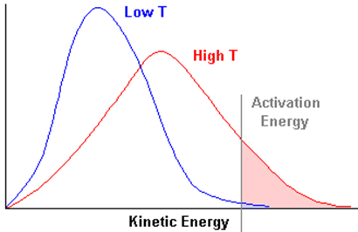
Accelerator Driven Chemistry
Radiation energy is different from Thermal energy !
Thermal energy is very strongly
coupled to Translational,
Rotational and Vibrational
modes of the energy absorber.
Ionization, bond rupture and
other processes leading to
chemical reactions occur
only in the high energy region
of the Maxwellian tail.
Ionizing radiation is almost entirely absorbed by the electronic structure of absorber, which increases the energy level of its orbital electrons.
Activation
Energy
Ionizing radiation
Energy in the form of large quanta have more pronounced chemical effects than energy in the form of small quanta (ie processes can occur at lower temperatures ➔more efficient!)
.Effective & efficient generator of reactive species

Slide 6
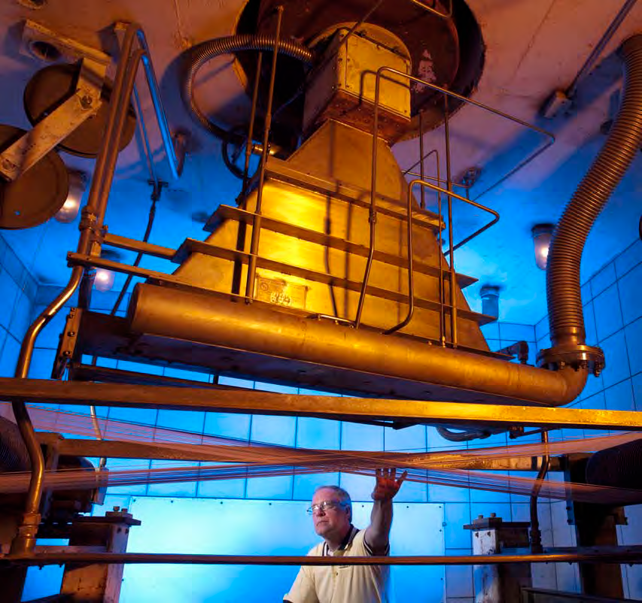
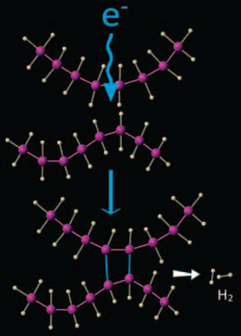
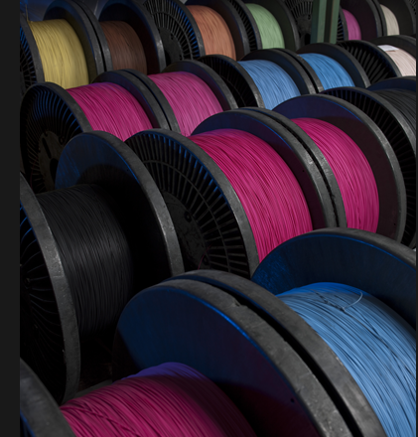
Accelerators: Essential Tools in Industry
A wide-range of industrial applications makes use of low-energy beams of electrons to drive chemistry
0.1-10 MeV up to MW beam power electrostatic, linac, betatron accelerators
Electron Beam Irradiation
Improved heat resistance of coatings, wire and cable, crosslinking polymers, radial tires, etc)
1500 dedicated facilities worldwide

Slide 7
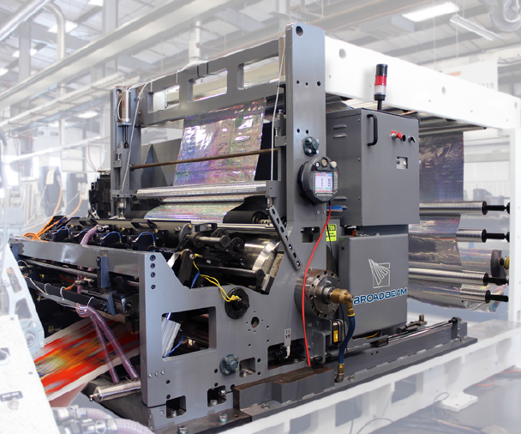
Accelerators: Essential Tools in Industry
Electron beam printing
Conventional printing requires use of enormous amounts of solvents that are created, evaporated, and must be disposed of … all with significant environmental impact
EB printing can print 12 colors at 600 M/min with water based inks
EB’s also enables new packaging methods for food (foil-glue-foil)
Your milk carton or potato bag may have been manufactured with this technology
Electron Beam Packaging

Slide 8
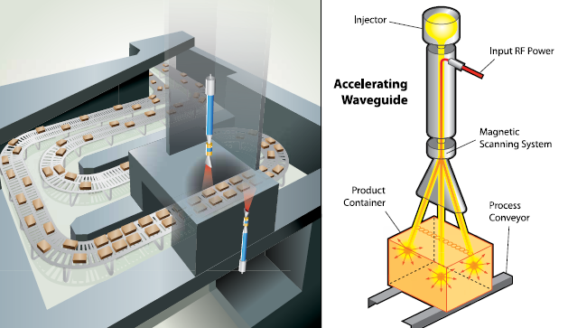
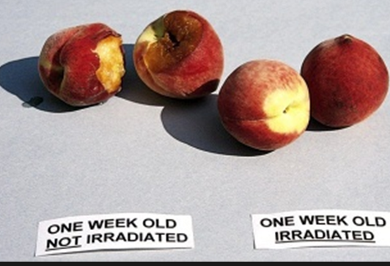
Accelerators: Food Preservation
Low-energy beams of electrons can help beat food-borne Illness
~60 people die from food-borne illness in the U.S. each week
Food poisoning is estimated to cost the US $152 billion a year.
Electron beams and/or X-rays can kill bacteria like E. coli, Salmonella, and Listeria.
Currently in use for: Spices, fruit, lettuce, ground beef, milk, juice, military rations…
Many more opportunities exist
Barriers = cost & public acceptance
Radura symbol indicates irradiated food

Slide 9
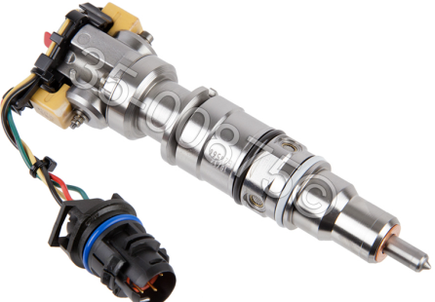
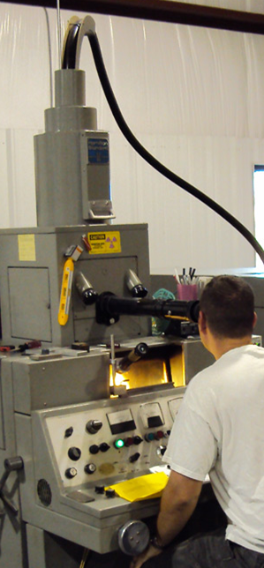
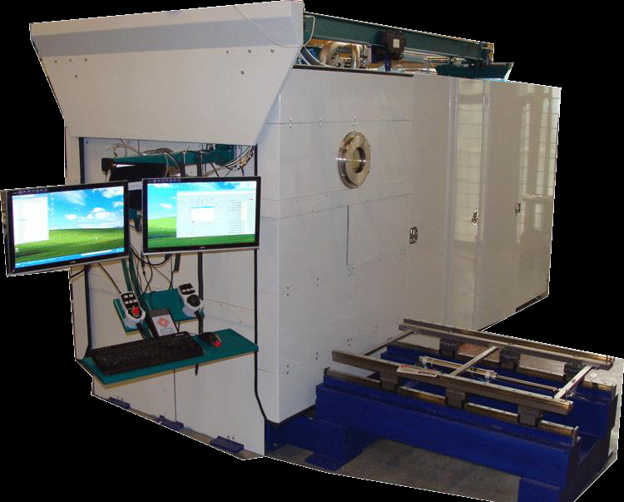
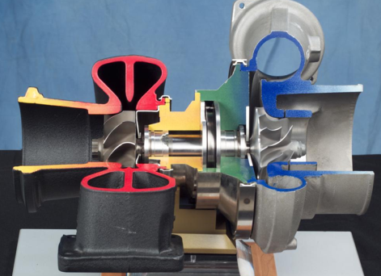
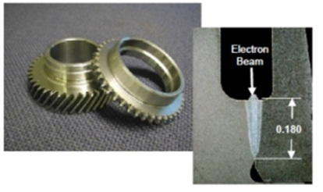
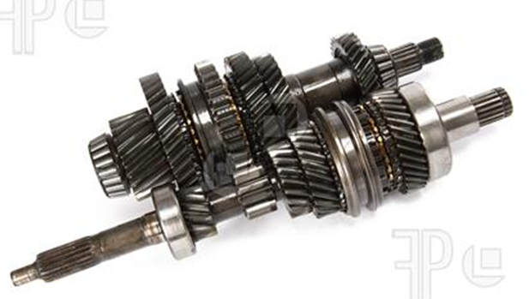
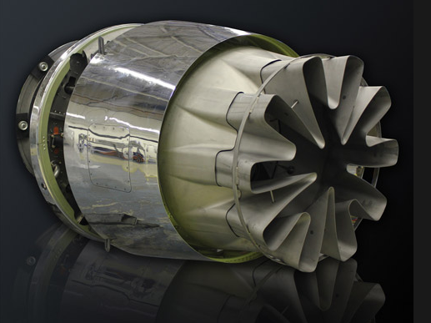
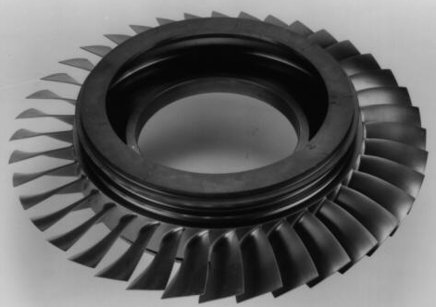
Accelerators for Industrial Processes
Electron Beam Welding and Machining
Deep welds, low weld shrinkage
Dissimilar or refractory metals, etc
Widely used in automotive and aerospace industry
Drill 3000 holes/sec!
Fuel injectors
PAVAC Energy Corp
Turbo chargers
Weld gear boxes
Harden gears
Jet engines & Gas turbines

Slide 10
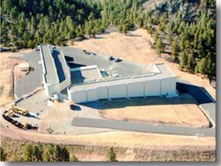
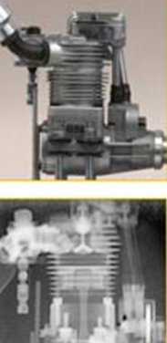
Accelerators for Defense
Dual Axis Radiographic Hydrodynamic Test Facility, Los Alamos Nat. Lab
Stockpile stewardship
Materials characterization
Radiography: Imaging materials in motion using x-ray and particle beams (remarkable capability!)

Slide 11
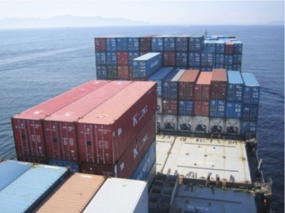
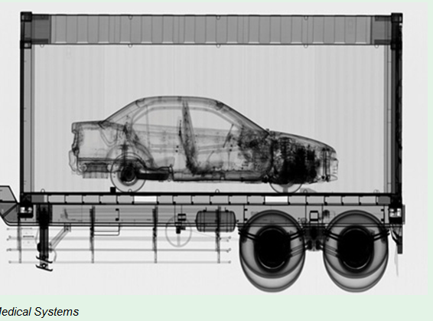
Accelerators for National Security
More than two billion tons of cargo pass through U.S. ports and waterways annually.
Accelerators are used for cargo scanning and “active interrogation” to detect special materials

Slide 12
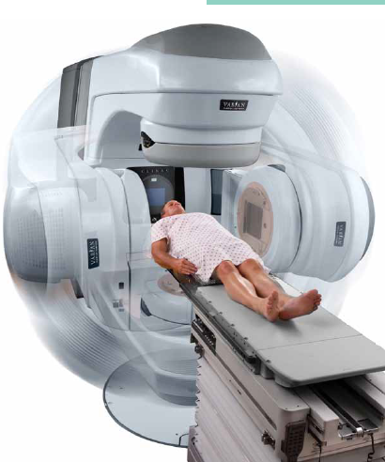
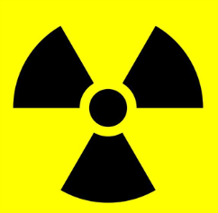
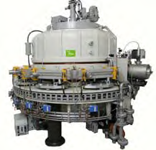
Accelerators in Medicine
Electron accelerator
Based X-Ray facility
For cancer treatment
(Varian Medical systems)
Rhodotron, commercial
electron beam accelerator used
For sterilization of medical devices

Slide 13
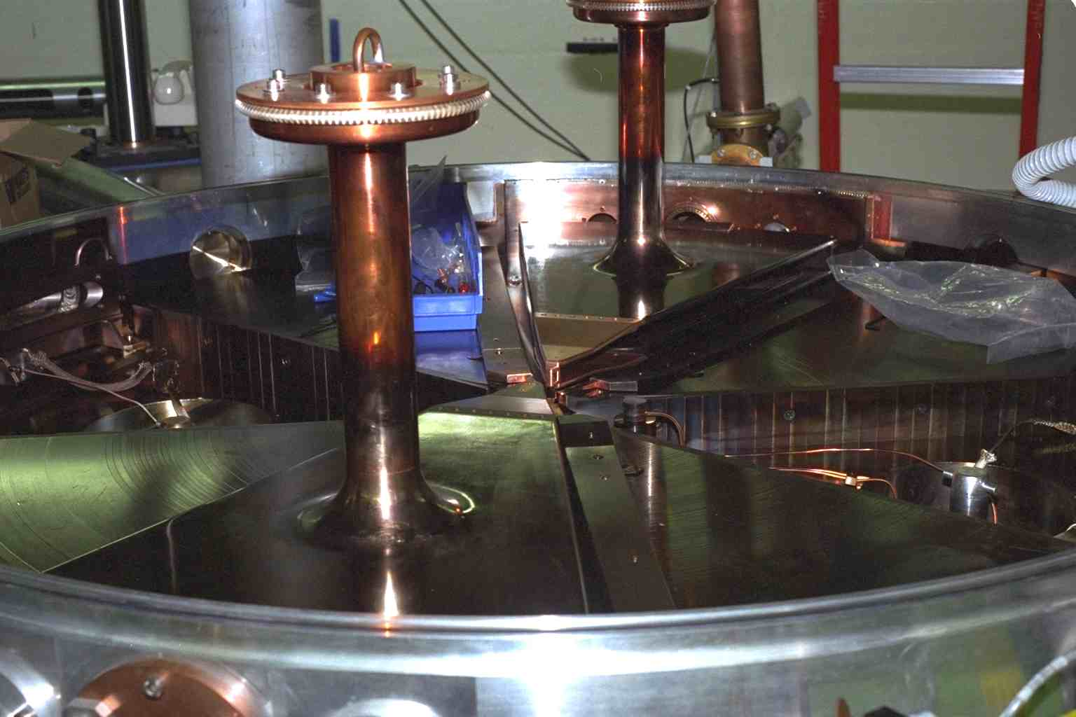
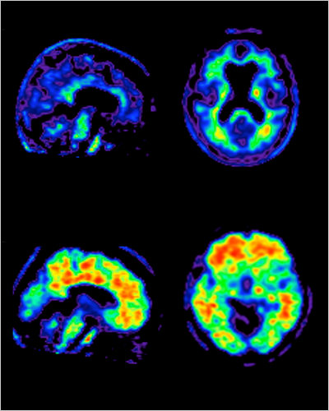
Cyclotrons for the Medical Isotopes
Nordion Advanced Cyclotron
Systems TR30
@ TRIUMF
PET scan for Alzheimer’s
“Turn key” cyclotrons produced by industry used to produce short lived radio-pharmacy isotopes for molecular imaging (¹⁸F, ¹¹CO₂ ¹¹CH4, ¹³N, ¹⁵O, etc)

Slide 14
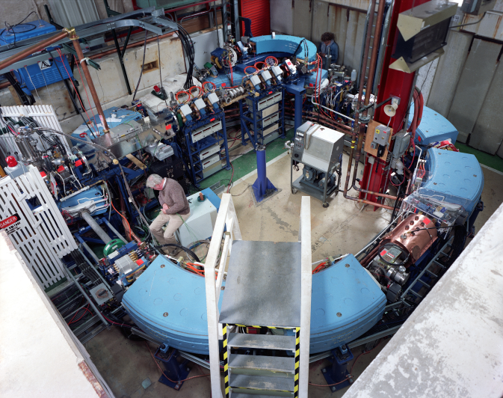
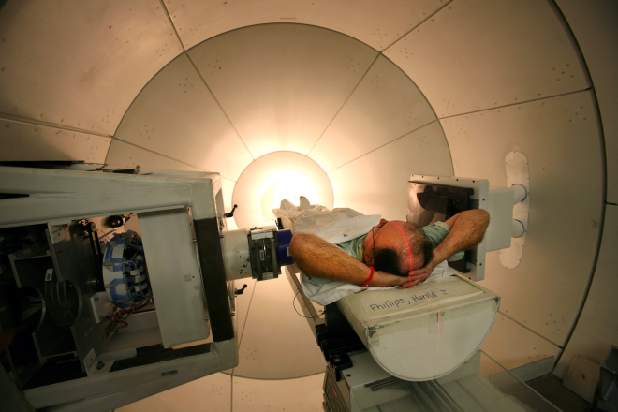
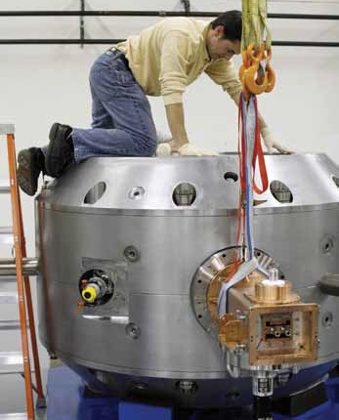
Accelerators in Medicine Proton Cancer Therapy
Loma Linda Proton Therapy and Treatment Center
World’s 1st proton accelerator built specifically for proton therapy
Designed and built at Fermilab
Technology
Demonstration
Industry
New compact SC magnets (another HEP technology!)➔ smaller size/ costs

Slide 15
Future Accelerator Applications

Slide 16
Many Opportunities!
Sector | Opportunities
Energy and Environment | Flue gas treatment Gas to liquids conversion and flare gas recovery Upgrade of heavy oils Superconducting wind generators Accelerator driven power plants, Nuclear waste destruction Waste Water and sludge treatment
Industrial | Next generation semiconductor fabrication Food preservation and safety Improved welding and fabrication (3D metal printing) Improved Highway construction Materials transformation/processing Industrial isotopes as wear indicators, etc
Medical | Accelerator-driven medical isotope production Particle beam cancer therapy
Safeguards and Security | Non-invasive and stand-off inspection
Some of these new applications will create entire new industries
A bit more on some of these…

Slide 17
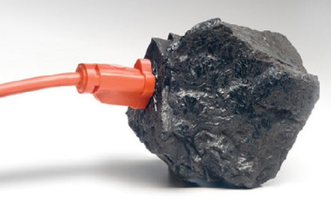
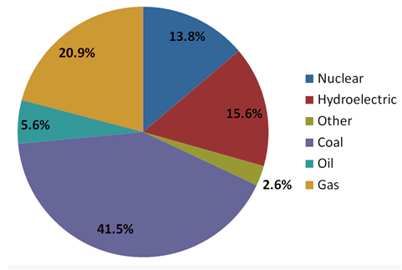
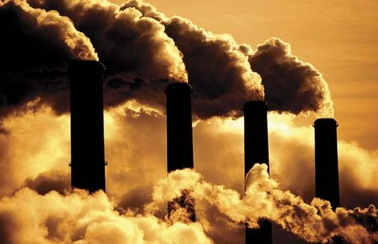
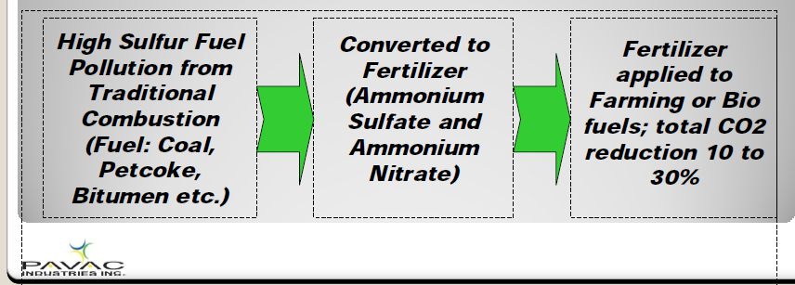
Accelerators for the Environment: Coal
41% of all electrical power worldwide is generated by burning coal
China and India are ramping up use of coal for electrical power generation..
US EPA regulations will reduce coal
Nevertheless, emission of NOx and SOx is a serious environmental issue
Accelerators can treat flue gas turning NOx and SOx into fertilizer
1st step towards sequestration of CO₂

Slide 18
Accelerators for the Environment: Coal
Current economics favor natural gas vs coal so the U.S. closed 3% of its “worst” coal fired plants last year.
Likely due to both economics and 2015 EPA regulations many more plants will close before 2016
Nevertheless use of coal is projected to stabilize and remain a significant source of U.S. & world electrical power
New EPA emissions standards favor adoption of EBFGT
Fermilab has teamed with PAVAC Energy Corp to develop EB Flue Gas Treatment
PAVAC = Vancouver B.C. & Batavia, IL
PAVAC is funded by Canadian sources to locate an test accelerator on a coal fired plant in Saskatchewan

Slide 19
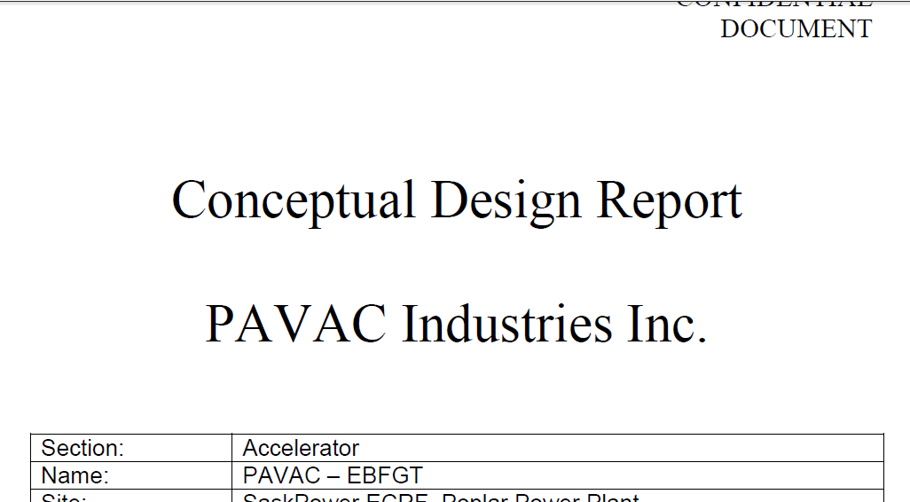
Accelerators for the Environment: Coal
Under proprietary contract from PAVAC:
Fermilab designed a 500 KW, linac
Pulsed RF Cu linac; solid state PS
High beam loading allows high efficiency
Fabrication is in progress at PAVAC. (attention to costs!)
Fermilab will participate in commissioning
Fermilab and PAVAC are currently seeking funding to build an EBFGT development and test facility at IARC
Goals are optimized accelerator efficiency and reliability as well as basic process improvements

Slide 20
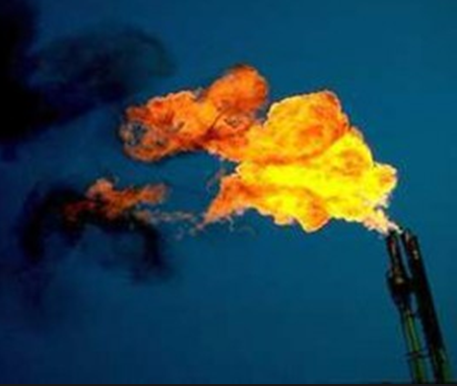
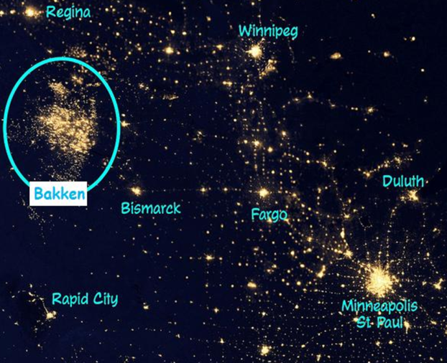
Accelerators for the Environment: Flare Gas
Many wells produce both oil and natural gas, but not all gas is recoverable
Remote, so pipelines are not economical
Produce a burst of gas for only a few years
Methane is a powerful green house gas… so most companies “Flare” stranded gas at the well
World wide $ 30 B/yr of gas is flared
Equal to 25% of the natural gas usage of U.S.
Adds CO₂ with no useful work for mankind
“Fischer-Tropsch” can convert gas to liquid hydrocarbons but requires large plants for high temperature/pressure reactions
Mobile accelerators could in principle break C-H bonds to efficiently convert stranded gas to liquid hydrocarbons at the well head, could also lower viscosity of heavy oils
Gas flares in ND

Slide 21
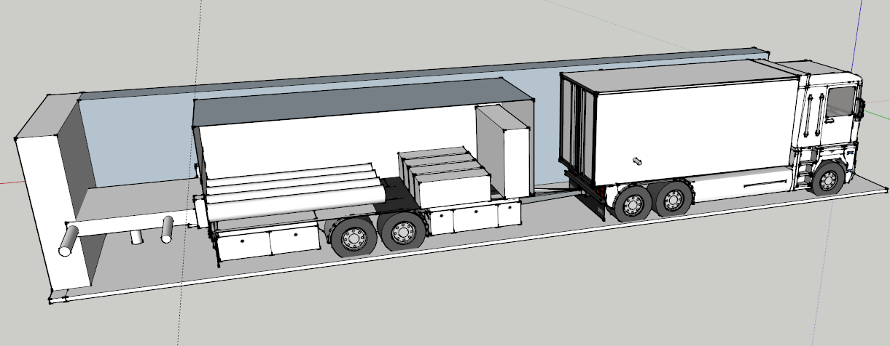
Accelerators for the Environment: Flare Gas
Trailer mounted high power electron accelerators
Natural gas turbines provide the local electrical power
Liquid hydrocarbons created can be mixed and collected with crude oil produced by the well
Potential high revenues!
1 well flares ~ $ 5 M/yr for 1-2 yrs
Accelerator and RF Power
Gas turbine generator
Unconverted Nat Gas + Hydrogen drives gas turbine for power
Nat Gas
+ heavy
oils
Liquid hydrocarbons

Slide 22
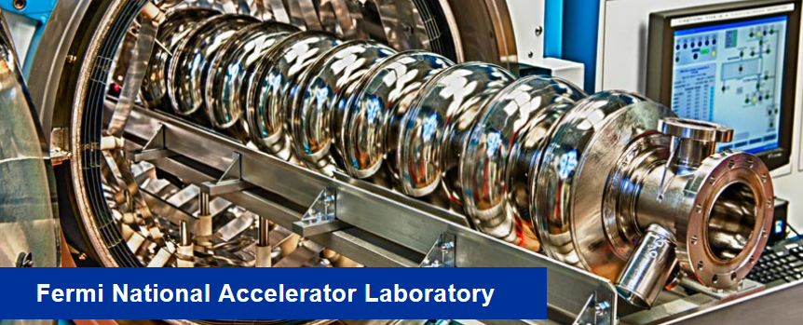
Accelerators for the Environment: Water/Sludge
Electron accelerators are effective for
Destroying pesticides, organics,
pharmaceuticals, etc in water
Treating industrial/municipal water/sludge
Sewage Sludge Sterilization
However, despite R&D demonstrations the market penetration of this technology is limited
Why?
Value added is small ➔ users not motivated to finance R&D
Deployment likely to be regulatory driven (tricky for business)
Reliable, compact, high power (MW class), efficient (wall plug to EB power), cost effective accelerators are needed.
Turn key MW Accelerator development requires $ + extensive infrastructure… who will fund deployment? SRF?
1 M
SRF is Compact!
400 KW = 10 MeV, 40 mA
Q₀ = 7 x 10¹⁰ @2K
10/28/2014

Slide 23
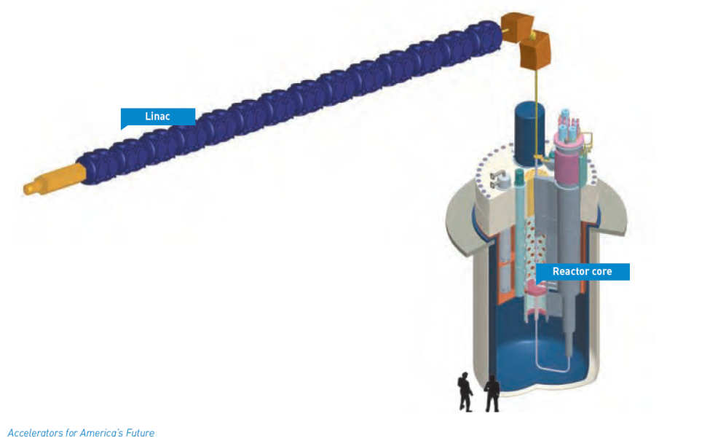
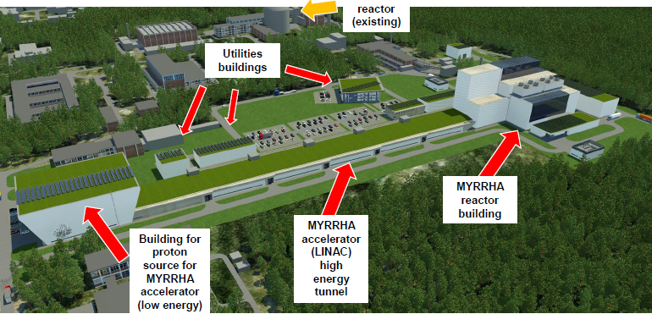
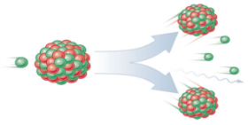
Accelerators for Energy: ADS
Accelerator Driven Subcritical Reactors can transmute nuclear waste so it is much safer and simpler to store, while at the same time generating electrical power
Subcritical reactors ➔ Safety… Accelerator off ➔ reaction stops…no run away reactions !
Requires very high beam power (>10 MW) and very high reliability
This technology is actively pursued in Europe, China, India
MYRRHA Accelerator Driven Reactor Project, Mol, Belgium
An proton accelerator hits a target to provide the excess neutrons to sustain the reaction
10/28/2014

Slide 24
Accelerators for Energy: ADS
Accelerator based transmutation combined with geological disposal has the potential to make nuclear power, a zero carbon energy source, acceptable to society
ADS can also potentially make use of non-fissile fuels like Thorium
Superconducting RF Linac’s can provide high beam power & efficiency
Molten salt sub critical reactors may make this even more attractive
10/28/2014

Slide 25
Accelerators for the Environment: Highway Life Extension
Realization # 1: New technology allows the construction of compact, high power, high energy, high efficiency electron linacs
Realization # 2: It is possible to make these high power EB sources mobile allowing new applications
Realization # 3: EB treatment can significantly improve the materials properties (e.g. toughness, low temperature performance) by crosslinking
1-3 mean that that field crosslinking of building materials is now feasible “in principle”

Slide 26
Accelerators for the Environment: Highway Life Extension
2.2 million miles of paved roads in the U.S.
94% are constructed from asphalt
The U.S. Spends approximately $ 80 B/yr on road construction.
Materials/techniques have changed little in the last 100 yrs
Average road must undergo major repair, crack and pothole repairs every 1-3 yrs and must be completely rebuilt every 5-8 yrs depending on the climate
The heavy machinery used to rebuild asphalt highway creates a huge carbon foot print.
1 yr extension of life of a road would save enormous amounts of diesel fuel each year and many 10’s of $B/yr
Solution: Crosslink binder (bitumen+?) in situ with mobile accelerator
increase strength and toughness.
Assume this requires 100 kGray (conservative)

Slide 27
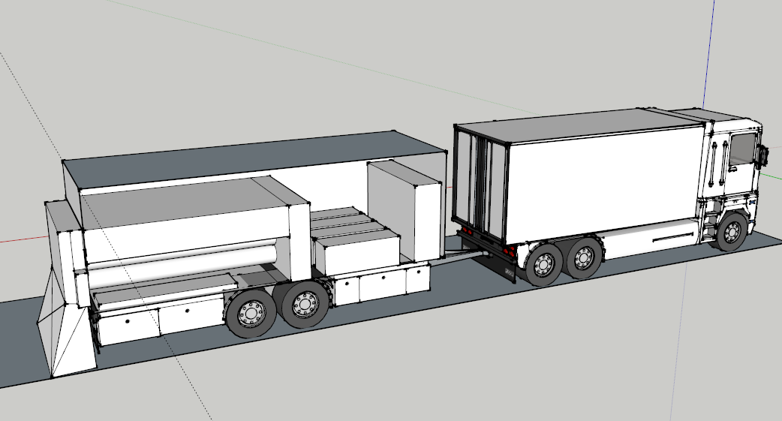
Mobile EB to extend lifetime of highways
4 accelerators: 1400 KW ➔ 2 lane-miles per 8 hr shift
Cost of 1 lane-mile interstate highway = $ 2.4 - 6.9 M
Huge value added ~ $ 500 K- $1.4 M per shift (1 yr extension)
$ 5-8 M capital cost ➔ very short payback period!

Slide 28
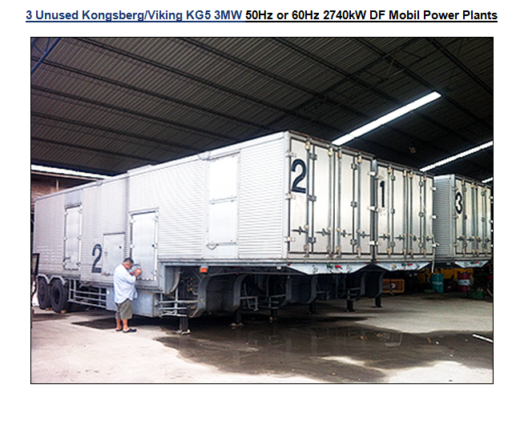
Can one generate the required power with a mobile generator?
Yes: diesel or gas turbine based generators > 5 MW fit into a standard over the road trailer
New 3 MW units ~ $2-3 M, used ~$ 500 K

Slide 29
Accelerators for the Environment: Highway Life Extension
Status:
Fermilab has filed for patent
Developing designs for the required accelerators
Shielding is a challenge, but simulation ➔ solvable
Engaged in process development using commercial irradiation facilities including examination of the benefits of various additives to bitumen vs alternatives
Goal is to be able to use all current road building equipment and treat the new asphalt before first use.
Longer term
Team with large industrial partner
Fermilab’s site contains many miles of asphalt roads and can serve as an ideal testing ground (e.g. no permits required)

Slide 30
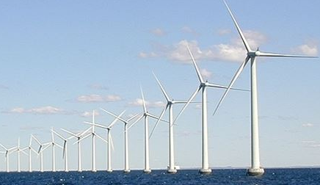
Accelerator Technology Applied to Wind Turbines
Superconducting Magnet Technology developed for high performance accelerator magnets is being applied to create novel SC generators for wind turbines

Slide 31
Accelerator Technology Applied to Wind Turbines
Why is Accelerator Technology Relevant?
The size of wind turbines is currently limited by the “head weight” of the gearbox and conventional generators.
Current production devices are in the 2-5 MW range
Gearbox reliability is an important issue
SC generators can have much higher power densities and require NO gearbox.
This can allow wind turbines in the 10-25 MW range
Bigger Higher towers = more wind, steadier wind
Ideal for Off Shore applications
Operation at 4 K with NbTi conductors looks practical using current technology

Slide 32
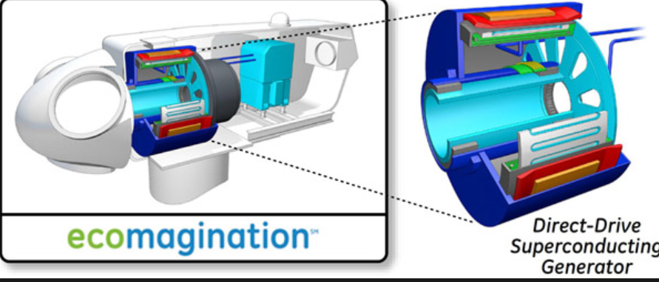
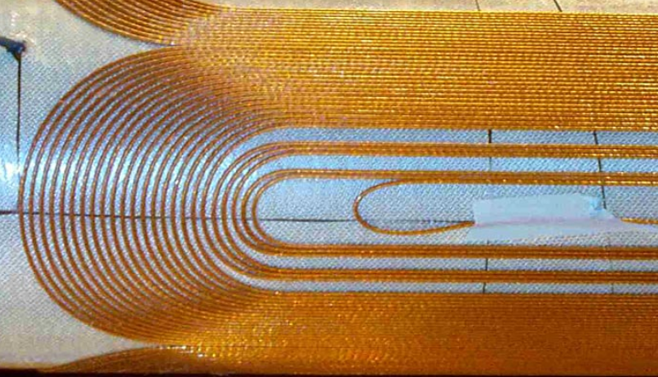
Accelerator Technology Applied to Wind Turbines
Generators built with new technology based on high temperature superconductors like Nb₃Sn have great promise
allow operation at higher temperatures simplifying designs and making them lighter and more efficient (e.g. 10 K operation)
Cryogen free (e.g. closed cryocoolers) Self starting
Conductor, Coil designs, insulation and curing technology, etc developed for High Energy Physics can be directly applied
HTS may eventually allow operation at LN2 temperatures

Slide 33
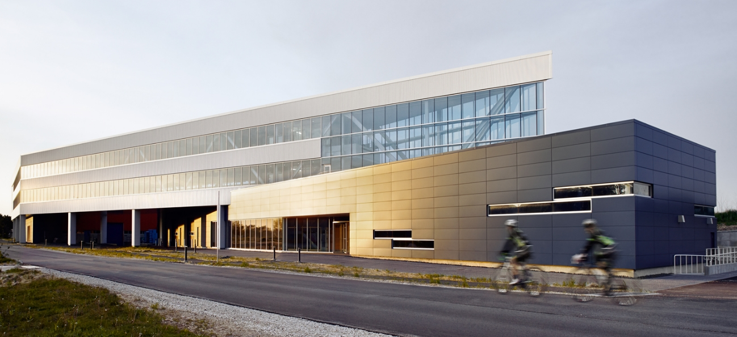
Illinois Accelerator Research Center
Modern Design: Architects = Ross Barney
LEED Gold: Designed for Energy Efficiency

Slide 34
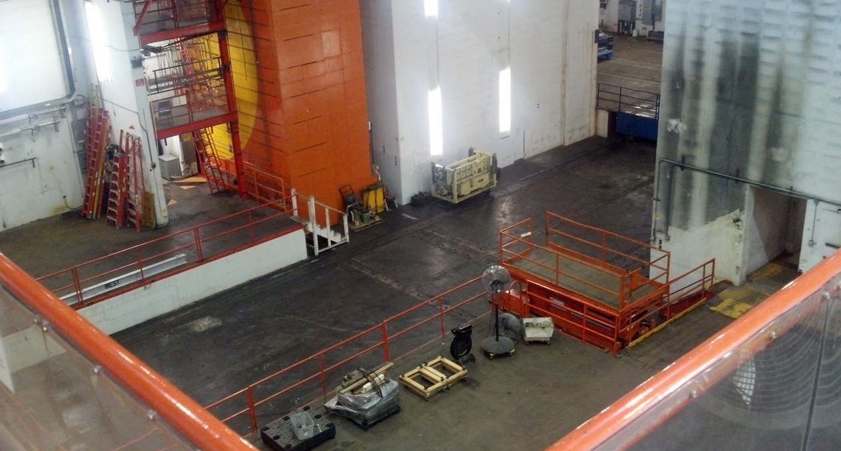
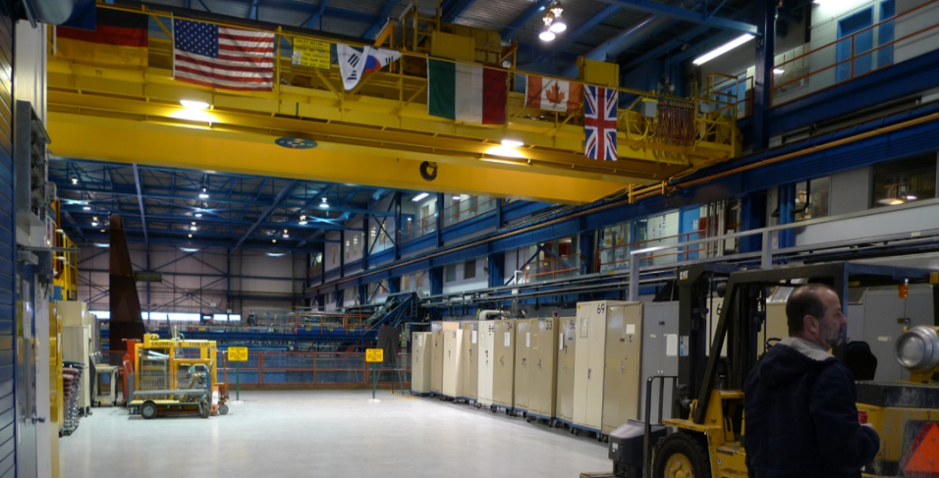
What Industry Really Gets Excited About
Building refurbishment in progress, available mid 2015
34

Slide 35
Summary
Fermilab is actively engaged in accelerator R&D in support of its basic science mission
Much of the technology we develop can have applications beyond High Energy Physics
With the completion of IARC, we plan to launch a program of cooperative work with industry
Many of these applications can have transformative impacts on the way mankind generates energy, and manufactures new materials.
They can also have very positive effects on the environment for benefit of all mankind …. Our goal is all of this…
AND to create new industries and jobs…

Slide 36
Thank you
Special thanks to:
Bob Kephart
Cherri Schmidt
Charlie Cooper
Thomas Kroc
& Fermilab Colleagues

