Slide 1
Advanced Technologies for Detectors
ICFA Seminar (Beijing)
Phil Allport
(Liverpool University)
Tracking Detectors
  Silicon Vertex Detectors
  Silicon Tracking Detectors
  Gaseous Detectors (Trackers and Muon Spectrometers)
  Scintillating Fibre Tracking
Calorimeters
  ILC/CLIC R&D
  HL-LHC R&D
Particle Identification Techniques and Fast Timing
Read-out and Triggering
Instrumenting Very Large Volumes
  Neutrino Detectors
  Dark Matter and 0ν2β Decay Searches
Conclusions

Slide 2
Tracking Detector Challenges
Vertex detectors require minimal scattering material (for e⁺e⁻, the ultimate low mass target is 0.15% X₀/layer, using advanced engineering and integration)
For hadron colliders, fine granularity over large areas and minimal mass are targeted consistent with constraints of very high radiation environment, very high hit and data rates, cooling, plus complex event triggering capabilities
For e⁺e⁻ colliders precision time-stamp (~ns for CLIC) and ≤ 5µm spatial resolution are needed
ILC/CLIC trackers target momentum resolution δ(1/p_{T}) ≈ 2-5×10⁻⁵ GeV⁻¹
Low mass cooling and compact, radiation-hard, optical+electrical links with HV/LV multiplexing are required (very large numbers of channels running at LV drawing high currents → big potential power loss in cables)
Muon detectors need improved spatial resolution and enhanced rate capability: often using advanced micro-pattern gas detectors
Large area detector construction necessitates very close links with industry to develop designs and processes for mass production
Scintillating fibres (LHCb) and straws (NA62, Mu2e) provide excellent alternatives for several key applications
10/29/2014
Phil Allport
2

Slide 3
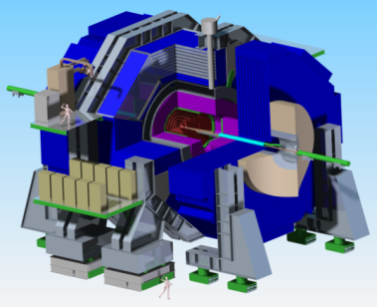
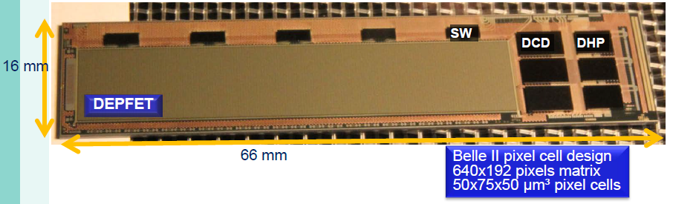
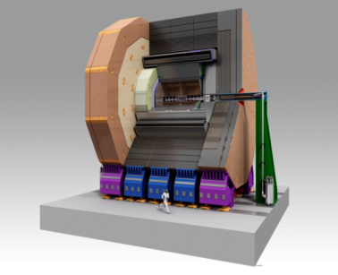
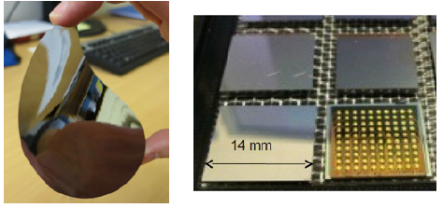
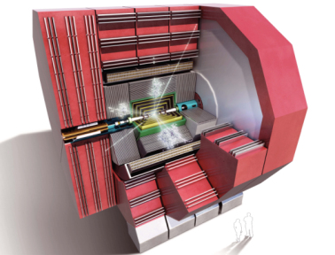
Silicon Vertex Detector R&D for ILC/CLIC
CMOS (MAPS) for STAR
Technology choices include MAPS (fully monolithic devices with integrated read-out), very small pixel CCDs, various hybrid devices with sensors having intrinsic built-in amplification, as well as more conventional passive pixel/strips plus read-out.
Interconnects using flip-chip (bump bonding) or various 3D integration technologies
(SLID, ICV, …).
Challenges of spatial precision, extremely low material and time-stamping given accelerator bunch train time structures
ILC (2820 at 308ns every 200ms) CLIC (312 at 0.5ns every 20ms)
→ Different on-detector data storage options, integration technologies and powering schemes
SiD
DEPFET for Belle II
ILD
CLIC (hybrid pixels):
thin Si-sensor +Timepix
CLIC

Slide 4
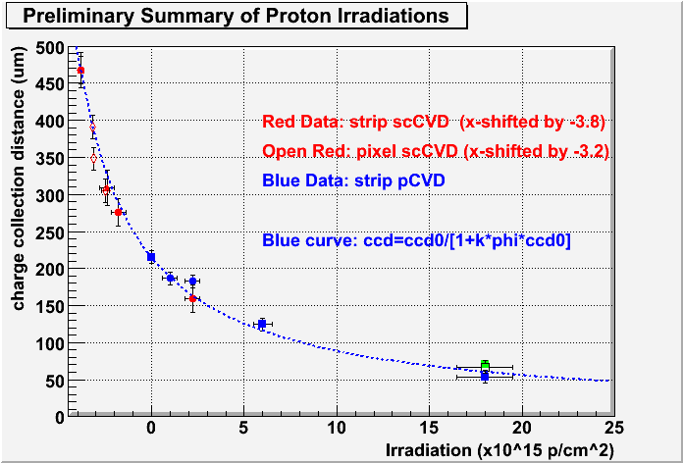
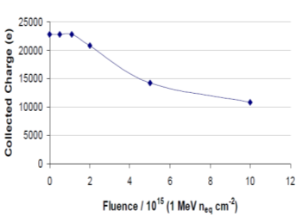
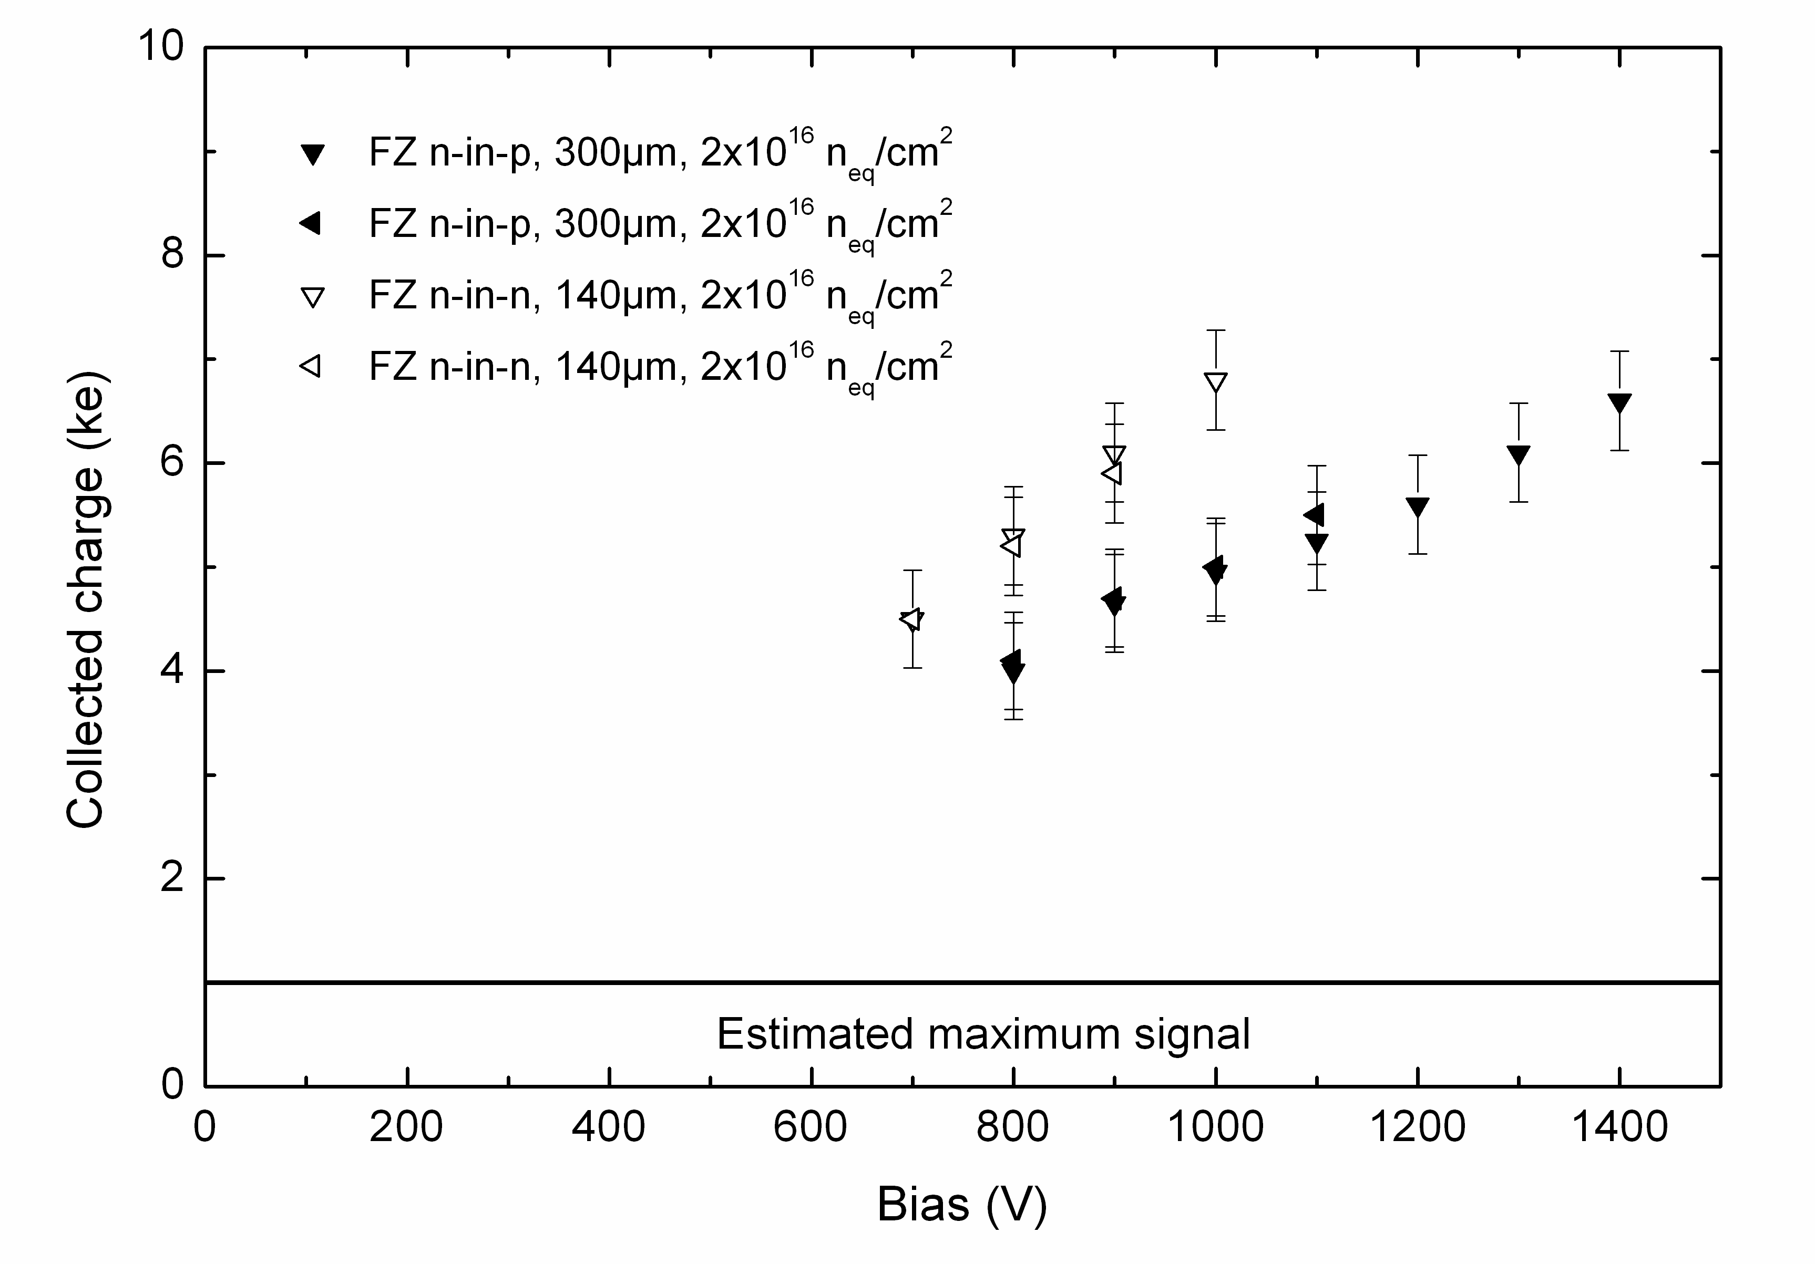
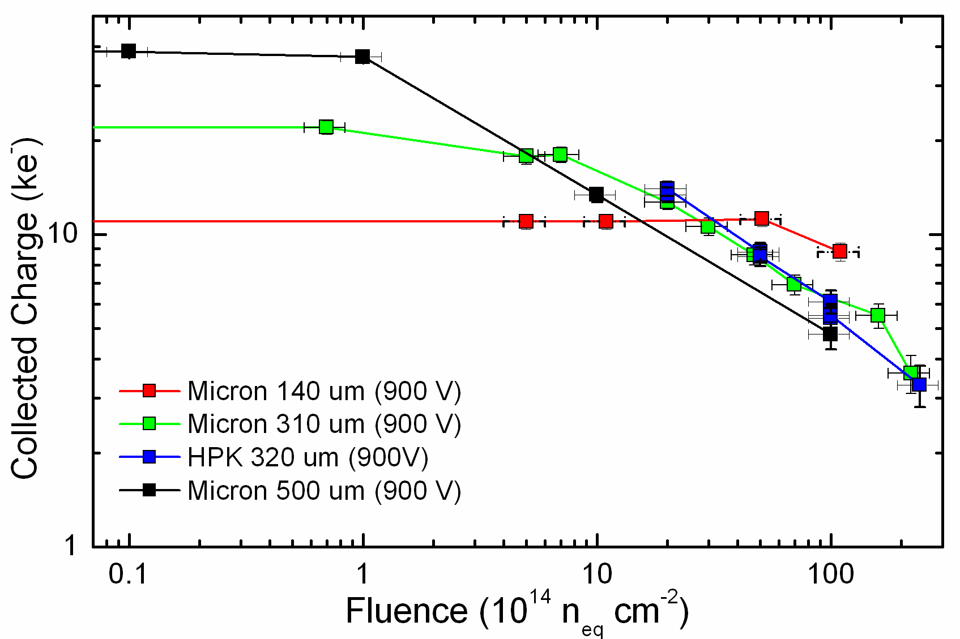
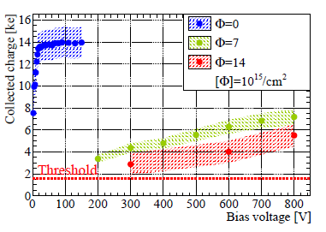
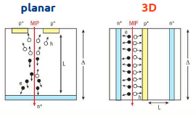
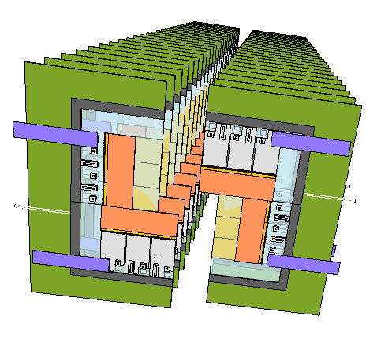
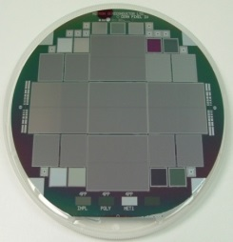
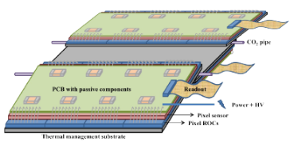
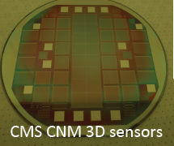
Hybrid Pixel Detector R&D for LHC Upgrades
(ECFA 13/284 https://cds.cern.ch/record/1631032)
HL-LHC (3000fb⁻¹) implies doses up to 2×10¹⁶n_{eq}/cm² and 1Grad (also up to 200 collisions per beam crossing). However n-in-n, n-in-p planar, 3D and diamond sensors are useable after such doses
ATLAS
FE-I4 R/O Planar
3D at 150V
(RD50)
Thin
Planar (RD50)
Diamond
(RD48)
(RD50)
→ The mechanisms leading to larger than expected signals (also seen in 3D sensors) is mostly understood and is even now being exploited (doping profile, trenches) to enhance the signals after radiation
Propose to use 65nm CMOS ASIC technology to allow pixel sizes of 55µm×55µm (LHCb VeLoPIX 130nm) or ~50µm×50µm (RD53)
Large format sensors needed to tile larger areas and examples have been prototyped with a number of potential suppliers
(3D sensors installed in ATLAS IBL)
26 planes of sensor 5.1mm to beam
LHCb VeLoPix Module
Design
ATLAS
4cm×4cm 150µm thick planar sensors
CMS Phase-II Pixel Module Concept

Slide 5
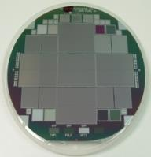
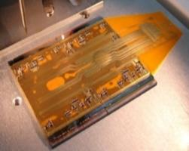
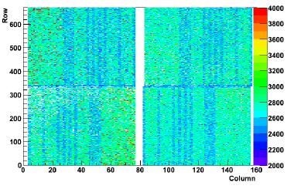

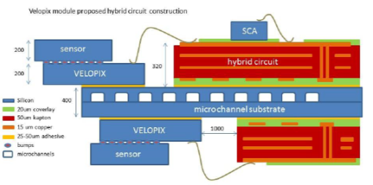
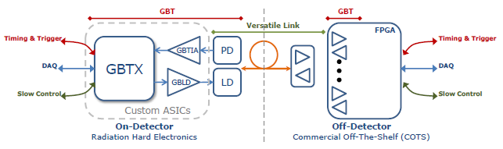
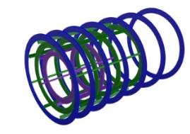
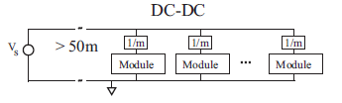
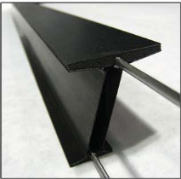
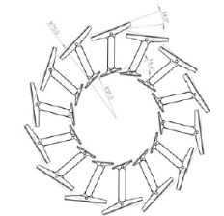
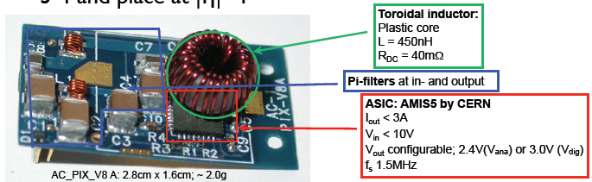
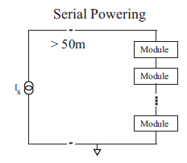
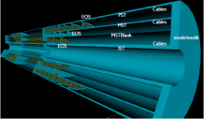
Hybrid Pixel Detector R&D for LHC Upgrades
(ECFA 13/284 https://cds.cern.ch/record/1631032)
Irradiated single and quad n-in-p pixel modules (for higher radii) studied in test-beam with excellent performance
Micro-channel in-silicon cooling (NA62, ALICE, LHCb)
Need custom rad-hard, low power, fast opto-electronics
Noise in 107,520
250µm×50µm
irradiated pixels
(5×10¹⁵n_{eq} cm⁻²)
FE chip
ATLAS Quad
FE-I4 Module
sensor
Conventional bump-bonding
LHCb VeLoPix Module
→ lpGBTx, + VTTx
(up to 10 Gbit/s and versatile link)
Low mass structures, services (electrical link to optical for innermost layers), LV (serial powering for innermost layers, DC/DC elsewhere), CO₂ cooling…
ATLAS
DC to DC converter to step down 10V→2.5V
ATLAS Phase-II Prototype Barrel Pixel Supports
Forward Pixels
ATLAS Phase-II
Pixel Services

Slide 6
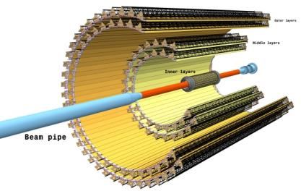
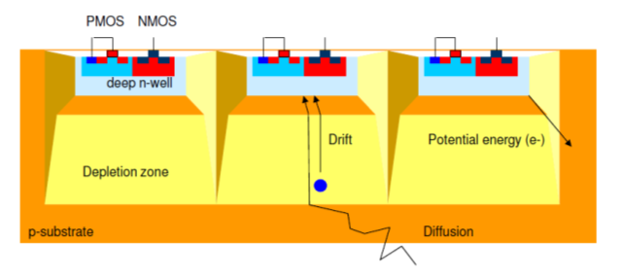
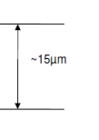
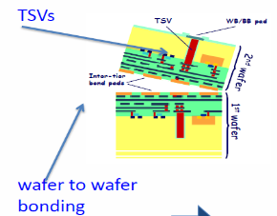
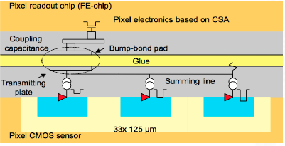


MAPS/CMOS Detector R&D for LHC Upgrades
MAPS for ALICE Priority is ultra-low radiation length due to the low p_{T} of the decay products of interest.
  Target:
  Pb-Pb up to 13 nb⁻¹
  → 8 x 10¹⁰ events
  pp ≥ 6 pb⁻¹
  →14 x 10¹⁰ events
  Read-out all
  Pb-Pb (50 kHz)
  (L = 6 x 10²⁷ cm⁻¹s⁻¹)
In HV-CMOS a deep n-well surrounds the
electronics of
every pixel
100 V
In HR/HV-CMOS charge collection through drift greatly improves radiation hardness and speed - use at pp collision rates → HL-LHC Upgrades?
Can consider pixels with CMOS-based pixel electronics either monolithic or capacitively coupled pixel detectors (CCPDs) based on sensor implemented as a smart
diode array with wafer
bonding or glued to
ASICs (no bumps)
Wafer Bonding
Mean X/X0 = 0.282%
Some key fundamental issues around
HV/HR-CMOS sensors are not yet fully
understood, in particular the charge
collection and efficiencies (especially after
irradiation) which all need further R&D. Also a reasonable sized detector still needs to be demonstrated in particle beams
MAPS installed at STAR (RHIC)

Slide 7
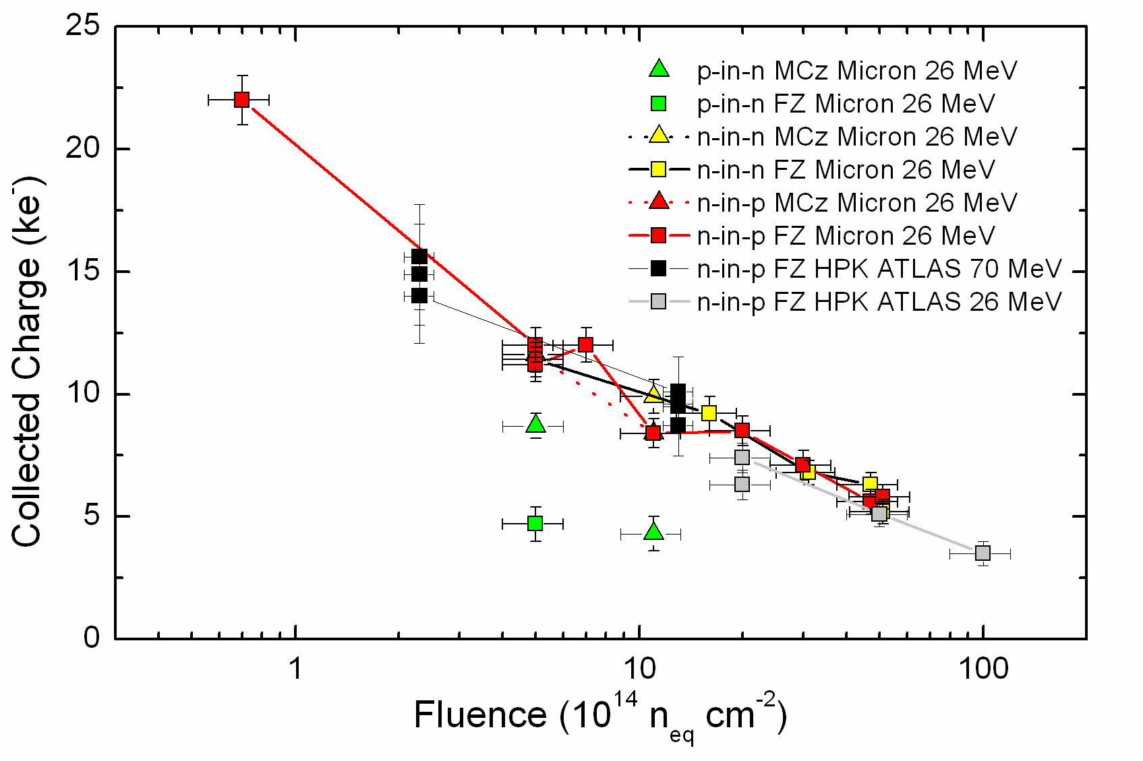

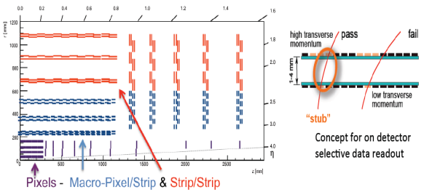
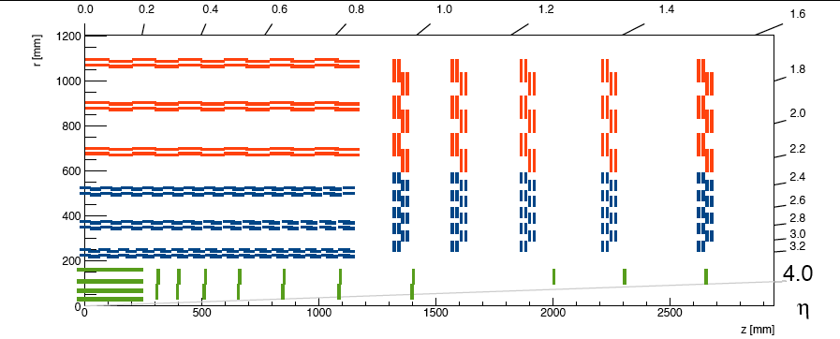
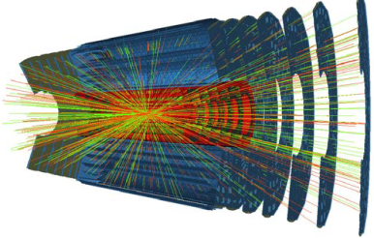
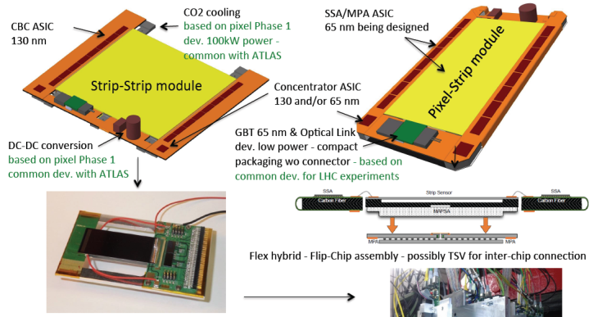
Silicon Strip Detectors for Large Area Tracking
(ECFA 13/284 https://cds.cern.ch/record/1631032)
HL-LHC Need radiation hardness of current n-in-n pixel sensors at fraction of the cost
→ n-in-p technology
Many
large area
prototypes
produced
10cm×10cm
4×1280 strip
n-in-p sensor
Interest in larger (8”) wafers particularly for forward regions
RD50
(p-in-n)
ATLAS
CMS proposes paired layers for fast track p_{T}
selection for input to level-1 trigger
~200m² strip ~10m² pixel
      ATLAS uses paired strip modules with small angle stereo (for z determination) around a central structure with embedded cooling
      (Trigger: Level-0 trigger objects from calorimeter and muon systems plus tracker information available to level-1 trigger)
CMS
Strip-Strip Module Prototype
10/29/2014
Phil Allport
7

Slide 8
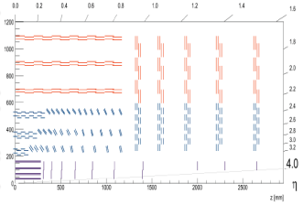
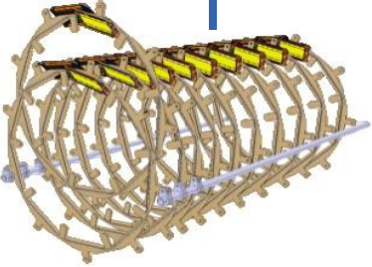
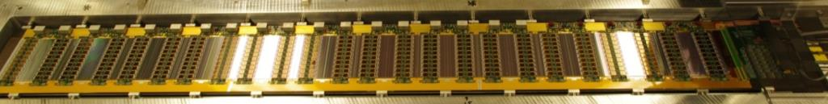
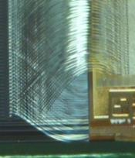
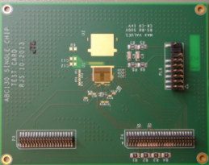
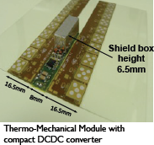
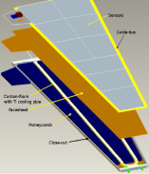
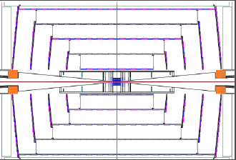
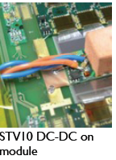
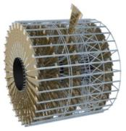
Silicon Strip Detectors for Large Area Tracking
(ECFA 13/284 https://cds.cern.ch/record/1631032)
HL-LHC Need radiation hardness of current n-in-n pixel sensors at fraction of the cost
→ n-in-p technology
Many
large area
prototypes
produced
10cm×10cm
4×1280 strip
n-in-p sensor
RD50
(p-in-n)
12 module ATLAS prototype stave: 61440 channels ~600e noise
1.3m
CMS
possible
ring layout
Powering (DC/DC or Serial), HV multiplexing, CO₂ embedded cooling, low mass modular supports & services
256 Channel ASIC in 130nm
CMOS
with
L0/L1 functionality
ATLAS
Wedges
and Discs
4 row wire bonds
Module with on-board
DC-DC
converter
For ILC/CLIC strip concepts (eg SiD) developing large area thin sensors
10/29/2014
Phil Allport
8

Slide 9
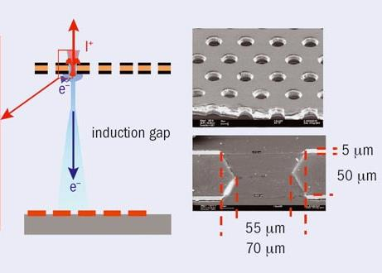
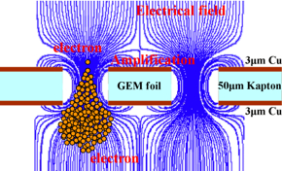
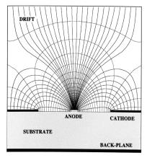





Gaseous Tracking Detector R&D
Main R&D activities for ATLAS and CMS are for new muon chambers in the forward directions.
  Increase rate capabilities and radiation hardness
  Improved resolution (online trigger and offline analyses)
  Improved timing precision (background rejection)
Technologies
  Gas Electron Multiplier detectors (LHCb now, ALICE TPC - CMS forward chambers)
  Micro-Megas and Thin Gap Chambers
  (TGCs) (ATLAS forward chambers)
  Resistive Plate Chambers (RPCs) - low resistivity glass for rate capability - multi- gap precision timing (CMS forward chambers)
GEM stack for ALICE TPC R/O
4 layer stack to target Ion backflow < 1% given continuous readout at 50kHz
CERN RD51 common micro-pattern gas detector R&D
Need to develop commercial large-scale production capabilities
2.4m×1m
Micro-Megas prototype
for ATLAS New “Small” muon Wheel (1280m²)
ILD TPC
4.6m×1.8m radius
Micro-Pattern Gas Detector
Micro-Megas Principle

Slide 10





    Scintillating Fibre Tracker R&D
(ECFA HL-LHC Summary https://indico.cern.ch/event/252045/other-view?view=standard)
Large scale SciFi tracker for LHCb
SiPM readout
3 stations of X-U-V-X scintillating
fibre planes (≤5° stereo). Every
plane is made of 5 layers
of 2.5 m long
Ø250 μm fibres,.
SiPM
location
F_{n} = 6·10¹¹ cm⁻²
fibre ends
mirrored
SiPM readout
2 x ~ 2.5 m
4 layer proto mat
Challenges
Large size – high precision
O(10,000 km) of fibres
Operation of SiPM at -40°C
2 x ~3 m
250 μm pitch
N_{pe}
SiPM array (HPK)
3 million (SCSF-78 MJ baseline) scintillating fibres with up to 30kGy non-uniform exposure
Σ = ∼10-20 pe
ch. #
10/29/2014
Phil Allport
10

Slide 11
Challenges for Calorimetry, Timing and Particle ID
Major upgrade of HL-LHC calorimeter electronics to stream all data off detector at 40MHz to give ultimate trigger flexibility (GBT links)
For scintillator based systems, target higher light yield and better transparency (also for wavelength shifting fibres) after irradiation
→ Crucial development is advanced commercial photo-detector technologies with high sensitivity, radiation tolerance, high granularity and low cost
Major challenge for particle flow in calorimeters (very high granularity requirements over very large areas) is cost optimisation with many options for sensing components - plus need for extreme radiation hardness of all components if used at HL-LHC for forward regions
Fast timing detectors for PID/ToF and vertex ambiguity reduction (at hadron colliders). Need very fast photo-detectors ≤ 10-50ps (≈few mm)
→ Low cost, large area, fine granularity timing detector R&D needed
10/29/2014
Phil Allport
11

Slide 12







PFA Calorimeter R&D for ILC/CLIC
Particle Flow Calorimetry (CALICE)
Particle flow analysis: need to associate energy deposits with charged particles
→ drives granularity requirements
Allows “tracking” of neutrals
FCAL (BeamCal) sensors
AHCAL
AHCAL
Si-ECAL
σ/E ≈45%/$\sqrt{E}$ ⊕ 1.7 ⊕0.18/E
Si-ECAL: σ/E ≈17%/$\sqrt{E}$ ⊕ 1.7

Slide 13





R&D for Sampling Calorimeters at HL-LHC
  LHC Upgrades:
  ALICE new forward calorimeter (FoCal)
    R&D on Tungsten-Silicon sampling Electromagnetic Calorimeter
  LHCb minor replacement in central part of ECAL due to radiation damage
  ATLAS investigating replacement of forward calorimeter (LAr) with greater granularity
  CMS need to replace ECAL and HCAL end-cap calorimeters due to radiation damage
DREAM (RD52): Simultaneous readout of scintillator and Cherenkov signal signals using 2 types of fibres embedded in tungsten or brass.
Limitation mostly from loss of transparency with radiation
  LYSO or CeF₃ offer very high light yield. One CMS proposal for ECAL is a compact W+LYSO/ CeF₃ Shashlik using quartz capillary with WLS core and readout using GaInP
CMS scintillator-based HCAL with 30% of volume replaced by finger tiles to reduce optical path and attenuation
HE
Shashlik
EE

Slide 14









R&D for Sampling Calorimeters at HL-LHC
CMS PFA Upgrade Option high granularity calorimeter
  CMS need to replace ECAL and HCAL end-cap calorimeters due to radiation damage
Silicon-W/Pb/Cu ECAL (25 X₀, 1λ)
and silicon-brass front HCAL (3.5 λ) 8.7 M channels, pad sizes 0.9 cm² or 0.45 cm² depending on η
Scintillator-brass backing HCAL (5.5 λ, lower radiation zone)
420 + 250 m² Silicon :
e/γ resolution ∼20%/$\sqrt{E}$ + ≤ 1%
Silicon pads to withstand doses up to 10¹⁶n/cm² and several MGy

Slide 15











    Particle ID and Timing Detectors
Also Time Of internally
Reflected CHerenkov (TORCH) ~15ps/track
LHCb RICH system needs upgrades for triggerless operation at higher rates: $𝓛$=2×10³³cm⁻²s⁻¹
LHCb RICH new MaPMTs
Multi-channel plate
Imaging Time of Propagation (iTOP) needs <50ps rad-hard single photon sensitivity in 1.5T field → 512 MCP-PMT
Other technologies: high doped silicon (RD50), diamond (RD42), MG RPC,..
For 140 PU and “crab kissing”, HL-LHC can deliver
down to 0.7 event/mm and up to 1.45ns bunch length
→ Use 20-30ps timing to better associate high p_{T} objects to vertices
CMS crystal calorimeter shows 150ps in operation (test beam down to 20ps)
10/29/2014
Phil Allport
15

Slide 16

HL-LHC Read-out and Triggering
The challenge for the machine is to feed the experiments with as much useable
integrated luminosity as possible while the challenge of the experiments
is to swallow and digest it.

Slide 17




HL-LHC Read-out and Triggering
The challenge for the machine is to feed the experiments with as much useable
integrated luminosity as possible while the challenge of the experiments
is to swallow and digest it.
At times the proposed offering can look a little daunting
$$H𝓛−𝓛HC$$
CMS 140 PU
Major pile-up of events in every 25ns bunch
crossing is an unavoidable consequence of high
luminosity operation which challenges all aspects of the experiment.
We expect <µ>=140 at $𝓛$=5×10³⁴cm⁻²s⁻¹ but need to extend studies well beyond this.

Slide 18

HL-LHC Read-out and Triggering
Use of 65nm feature size ASICs for ~10Gb/s electrical+optical links based on custom devices on-detector (low mass, compact and radiation-hard)
Also need ever more powerful and more complex FPGAs for data handling
Where possible send digitized data off-detector for every bunch crossing (40MHz at LHC) leading to ~10⁵ Gb/s total bandwidths
LHCb full triggerless (40MHz) operation, all data shipped to data acquisition
HL-LHC operation 6-8 × 10⁹ interactions per second in 25ns bunch crossings
ATLAS & CMS hardware (L1) trigger → maintain low trigger thresholds
  Track information for high momentum resolution - isolation - vertexing
      → Reduce rates of lepton triggers by a factor ∼ 10
  Increased L1 bandwidth up to 400kHz in ATLAS and up to 750kHz in CMS
  Increased L1 latency 10 - 30 µs
  (CMS - ATLAS) - improved algorithms
  R&D on improved pattern recognition Associative Memories ASICs and use of advanced FPGAs to achieve fast track fitting for L1
ATLAS L0/L1 Scheme
10/29/2014
Phil Allport
18

Slide 19

HL-LHC Read-out and Triggering
Use of 65nm feature size ASICs for ~10Gb/s electrical+optical links based on custom devices on-detector (low mass, compact and radiation-hard)
Also need ever more powerful and more complex FPGAs for data handling
Where possible send digitized data off-detector for every bunch crossing (40MHz at LHC) leading to ~10⁵ Gb/s total bandwidths
LHCb full triggerless (40MHz) operation, all data shipped to data acquisition
HL-LHC operation 6-8 × 10⁹ interactions per second in 25ns bunch crossings
ATLAS & CMS hardware (L1) trigger → maintain low trigger thresholds
  Track information for high momentum resolution - isolation - vertexing
      → Reduce rates of lepton triggers by a factor ∼ 10
  Increased L1 bandwidth up to 400kHz in ATLAS and up to 750kHz in CMS
  Increased L1 latency 10 - 30 µs
  (CMS - ATLAS) - improved algorithms
  R&D on improved pattern recognition Associative Memories ASICs and use of advanced FPGAs to achieve fast track fitting for L1
10/29/2014
Phil Allport
19

Slide 20






Neutrino Detectors
The issue of scale associated with current and future neutrino experiments introduces a very different set of challenges (NOνA as an example)
Single Cell
To APD Readout
Far Detector (14 kT)
2012-2014
NOνA
Totally active, liquid scintillator, surface detector
Scintillation Light
Near Det
(Nigel Lockyer)
896 alternating X-Y planes 16mx16mx55m
“Largest Plastic Structure built by man”
15.5m
Hyper-Kamiokande at 48m×54m×248m (1 Mton water Cherenkov detector) illustrates the scale of detector to be instrumented with photo-detectors in the future: 100,000 if 1 per m²
Particle Trajectory
Waveshifting
Fiber Loop
(Talk by Masato Shiozawa)
3.9cm
6.6cm
→ Roughly half the total projected cost
10/29/2014
Phil Allport
20

Slide 21





Neutrino Detectors
R&D in close collaboration with major suppliers
Often distinct R&D for Near-detectors
10/29/2014
Phil Allport
21

Slide 22



Neutrino Detectors
Photo-detector costs are critical but in many cases the purity of the large volume detecting medium is just as challenging
LBNF: Liquid Argon TPC
Goal: ≥ 34 kton fiducial mass
Volume: 18m × 23m × 51m ×2
Total Liquid Argon mass: 50 kton
(See talk by Chang Kee Jung)
< 200 / 10¹² contamination for electron drift lifetime > 1.4ms (cf ICARUS τ_{electron} > 7 ms; ~40 / trillion [O₂]_{eq} ; see back-up slides)
Modular design with 80 2.5m × 7m anode plane assemblies and FE, ADC, FPGA operating in LAr with complex feed-through designs
LAr scintillation light complements TPC with timing information using plastic bars with WLS coating and SiPM R/O (600 channels)
10/29/2014
Phil Allport
22

Slide 23





Neutrino Detectors
But also the engineering challenges are unprecedented and a lot of highly innovative techniques are needed to deliver these vast arrays affordably
eg JUNO with multiple reactor experiment 20 kton liquid scintillator
~18,000 PMTs (talk by Jun Cao). Need 20m attenuation length and 35% QE PMTs
JUNO
Also INO 50-100kt: RPCs in magnetized iron
(Talks by Masato Shiozawa and Francis Halzen)
Much larger neutrino detector systems can observe using water or ice
(Cherenkov, radio, acoustic)
eg atmospheric neutrinos
to access mass hierarchy
Cosmic ray studies using the atmosphere as target
Upgrade to IceCube
10/29/2014
Phil Allport
23

Slide 24




Dark Matter and 0ν2β Decay
Huge variety of DM experiments with small and rare signals as ionisation, scintillation light, phonons or various combinations thereof. (See eg talk at ICHEP by Henrique Araújo) https://indico.ific.uv.es/indico/contributionDisplay.py?contribId=100&confId=2025
100Kg Liquid Xe
CUORE
Many techniques also for neutrinoless double-beta decay involving many different techniques (SuperNEMO, nEXO, LUMINEU, MAJORANA, KamLAND, NEXT, GERDA, SNO+, LUCIFER, CUORE, … but all with a requirement of high radio-purity and many needing isotope enrichment
741 kg
of TeO₂ in 988
bolometer modules
(Talk by Stefan Schönert)
10/29/2014
Phil Allport
24

Slide 25
Conclusions
Failed to do justice to many topics, especially but not only: fixed target, nuclear and lower energy, dark matter and astro-particle detector systems. Also missing are many developments in electronics, data acquisition, monitoring, alignment, global engineering, radiation protection …
Progress with detector technology is in general keeping pace with the requirements for future facilities but resources are an issue despite much better coordination of efforts between experiments
Sizeable and highly dedicated community engaged in detector R&D
Detector R&D in particle physics is an area where each sub-topic fills a conference series in itself, so this survey was very superficial. Some links to where recent material outside this conference can be found below:
ECFA HL-LHC (2013): https://indico.cern.ch/event/252045/
ACES 2014: https://indico.cern.ch/event/287628/other-view?view=standard
CALOR 2014 http://indico.uni-giessen.de/indico/conferenceTimeTable.py?confId=164#20140407.detailed
AWLC 2014: https://agenda.linearcollider.org/conferenceOtherViews.py?view=standard&confId=6301
Neutrino 2014: https://indico.fnal.gov/conferenceOtherViews.py?view=standard&confId=8022
RD50 (2014): https://indico.cern.ch/event/307015/other-view?view=standard
ECFA HL-LHC (2014): https://indico.cern.ch/event/315626/
10/29/2014
Phil Allport
25

Slide 26
Any Questions?

Slide 27
e⁺e⁻ Beam Parameters
ILC (500) CLIC (3 TeV)
Electrons/bunch 0.75 0.37 ×10¹⁰
Bunches/train 2820 312
Train repetition rate 5 50 Hz
Bunch separation 308 0.5 ns
Train length 868 0.156 us
Horizontal IP beam size 655 40 nm
Vertical IP beam size 6 1 nm
Longitudinal IP beam size 300 45 um
Luminosity 2 6 ×10³⁴

Slide 28



Challenges for ILC (0.25 – 1.0 TeV) / CLIC (0.5-3.0 TeV) Detectors
VERTEX “flavour tag, IP resolution” (H → bb, cc ττ)
~1/5 r_{beampipe},1/30 pixel size, ~1/10 resolution (ILC vs LHC)
vtx 1-2 cm (ILC) vs vtx 2-3 (CLIC)
TRACKING “recoil mass to Higgs” (e+e- → Zh → llX)
  ~1/6 material, ~1/10 resolution (ILC vs LHC)
  B = 3.5 – 5T (CLIC and ILC)
CALO “particle flow, di-jet mass resolution”
1000x granularity, ~1/2 resolution (ILC vs LHC);
Detector coverage down to very low angle
Recoil Mass to Z
(Higgs-strahlung):
W/Z → jj
reco
Key detector R&D technologies have been demonstrated with prototypes in test beams
Physics performance has been studies in full simulations
Major engineering R&D efforts and optimization of detector concepts are still needed

Slide 29


Tracking Systems – ILC Example
Low mass for tracking & vertexing
  Thin silicon sensors
    ~50 μm for pixel vertex detectors
  Light support structures
    e.g. advanced endplate for TPC
Central and forward
Si tracking system
Large TPC
R~1.8m
Z/2~2.0m
Vertex detector
Inner radius~1.6cm
Outer radius~ 6 cm

Slide 30






Vertex Detector System
State-of-the-art pixel technologies: CMOS MAPS, DEPFET, FPCCD, 3D, Chronopixel, SOI
Motivation:
high efficiency & purity flavor tagging (bottom, charm, tau, jet-flavor → e.g. b/c-quark separation for Higgs decays, b-quark charge measurement
Approach:
2-sided ladders concept, very low power
unprecedented granularity & material budget (ultra-thin ~ 50μm sensors)
A complex set of highly correlated issues:
pixel sensors
staves/ladders: thermo-mechanical
aspects and services
→ need careful thinking in terms of
material budget and power cycling,
besides the usual speed/resolution/
data flow requirement
CMOS MAPS: Spatial Resolution and Time Stamping
DEPFET: Mechanical ladder
tested for power pulsing
~ 3μm track resolution achieved:
Ultrathin ladder - PLUME
0.6%X₀ (0.35X₀ for ILC)

Slide 31







Central Tracking – Time Projection Chamber
ILCTPC with MPGD-Readout
→ spatial resolution < 100 μm @ 4T
(precise momentum: e+e-→ZH→llH)
Wet-etched triple GEMs
Laser-etched GEMs 100µm thick (“Asian”)
GEM + pixel readout
Resistive MM with dispersive anode
InGrid (integrated Micromegas grid with pixel readout)
Large TPC Prototype with versatile endplate @ DESY
Resistive Micromegas @ DESY Test-Beam:
Diameter 77cm
Resistive MM: B=1 T C_{d} = 94.2 µm/√cm (Magboltz)
Goal for final TPC
can be reached:
GEM / MM
performance similar
→ both extrapolate
to better than
100 µm at B=3.5 T &
drift length 2.25 m

Slide 32



Continuation of the R&D Support for the LHC Upgrades
MM for the ATLAS Muon System Upgrade:
GEMs for the CMS Muon System Upgrade:
R&D Started in 2007 within the RD51 collaboration:
Standard Bulk MM suffers from limited efficiency at
high rates due to discharges induced dead time
Solution: Resistive Micromegas concept
R&D Started in 2009 within the RD51 collaboration:
Single-mask GEM technology (instead of double-mask)
→ Reduces cost /allows production of large-area GEM
Self-stretching technique: assembly time reduction
from 3 days → 2 hours
2.4 x 1m²
MM resistive chamber constructed and characterized at CERN RD51 lab
Resolution for inclined
tracks (μTPC method)
better than 80 µm
MM can operate in
magnetic field
NSW Technical Design Report (TDR) approved
by LHCC (October 2013) →
~ 1280 m2 of resistive MM will be installed (LS2) in
ATLAS → the largest MM system, ever built
→ FOSTER INDUSTRIAL PRODUCTION NEEDS
Future work will focus on stability and uniformity
of GEMs, and development of electronics, …
During the LHC End-Year stop of 2016/2017, two GEM super-chamber demonstrators will be installed

Slide 33



Continuation of the R&D Support for the LHC Upgrades
ALICE TPC Upgrade
→ replace MWPC with GEM
Continuous TPC readout at 50 kHz
Physics requirement: IBF < 1%, energy:
σ(E)E < 12% achieved
TDR Baseline Solution: 4-GEM Stack
Also option under study: Micromegas + 2 GEM
4 GEM Stack Configuration
(to minimize IBF)
Energy resolution vs IBF (4-GEM detector):
4 GEM Stack
engineering design
Special ALICE TPC / RD51 workshop
will be organized on June 18th, 2014
(during the RD51 Collaboration Week)

Slide 34





RD51 – Development of Micro-Pattern Gaseous Detector Technologies
The main objective is to advance MPGD technological development and associated electronic-readout systems, for applications in basic and applied research”
A fundamental boost is offered by RD51: from
isolate MPGD developers to a world-wide net
1998
2014
http://rd51-public.web.cern.ch/rd51-public
World-wide Collaboration for the
MPGD Developments →
RD51 (91 institute, > 500 people):
Large Scale R&D program to advance MPGD Technologies
Access to the MPGD “know- how”
Foster Industrial Production
Advances in photolithography →
Large Area MPGDs (~ m² unit size)

Slide 35




State-of-the-Art in Calorimetry: Particle Flow
R&D in Calorimetry is an LC driven effort → a marriage with “Particle Flow Algorithm” (pioneering work) has delivered a proof of principle and been established experimentally
Goal is ΔE_{jet} /E_{jet}- 3-4% :
(separate hadronic W/Z decays)
PFA Algorithm (jet energy carried by …):
Charged particles (e±, h±,μ±)): ‏65 % - most precise measurement by tracker
up to 100 GeV
Photons: 25% - measurement by ECAL
Neutral Hadrons: 10% - measurement by HCAL and ECAL
Overlap between showers compromises correct assignment of calo hits (“Confusion Term”):
→ control by highly pixelised calorimeter readout
→ new technologies (Si, SiPM, MPGD,RPC, etc …)
Detector cost is driven by instrumented
area rather than channel count
ILD/SiD Calorimeter Concepts:

Slide 36





Calorimeter Technologies: Towards Final Systems
CALICE (SiW ECAL):
From first prototypes to full calorimeter systems
→ technological integration
(power pulsing, compact
design, scalability)
→ R&D oriented towards LC but
synergies with other projects
(e.g.CMS ECAL Endcap Upgrade)
Forward Calorimetry (FCAL):
Hadron Calorimetry (HCAL):
LumiCal provies integrated luminosity
measurement
BeamCal Provides instant luminosity
measurement and assists beam tuning
Large Scale
Prototypes:
Excellent hadronic energy resolution
by software compensation
BeamCal Sensors:
Sci tiles + SiPM:
1m³ abs.: steel or W

Slide 37


Slide 38
New LHC schedule beyond LS1
Only EYETS (19 weeks) (no Linac4 connection during Run2)
LS2 starting in 2018 (July) 18 months + 3months BC (Beam Commissioning)
LS3 LHC: starting in 2023 => 30 months + 3 BC
injectors: in 2024 => 13 months + 3 BC
Run 2
LS 2
Run 3
Phase-0 Upgrades (now)
Phase-I Upgrades
LS 3
Run 4
Phase-II Upgrades
LS 4
Run 5
LS 5
LHC schedule approved by CERN management and LHC experiments spokespersons and technical coordinators
Monday 2nd December 2013
38

Slide 39

CMS has a comprehensive plan for adjusting detector, where necessary, to cope with these challenges.
New Tracker
Radiation tolerant - high granularity - less material
Tracks in hardware trigger (L1)
Coverage up to η ∼ 4
Muons
Replace DT FE electronics
Complete RPC coverage in forward region (new GEM/RPC technology)
Investigate Muon-tagging up to η ∼ 3
Barrel ECAL
Replace FE electronics
Cool detector/APDs
New Endcap Calorimeters
Radiation tolerant
High granularity
Trigger/DAQ
L1 (hardware) with tracks and
rate up ∼ 750 kHz
L1 Latency 12.5 µs
HLT output rate 7.5 kHz
Other R&D
Fast-timing for in-time pileup suppression
Pixel trigger

Slide 40



ATLAS Phase-II Detector Upgrades
  Integrated radiation levels (up to 2-3×10¹⁶n_{eq}/cm²) and plan to cope with up to 200 interactions every 25ns
  Implications of this include:
  New Inner Detector (strips and pixels)
  Trigger and data acquisition upgrades
  L1 Track Trigger
  New LAr front-end and back-end electronics
  Possible upgrades of HEC and FCal
  New Tiles front-end and back-end electronics
  Muon Barrel and Large Wheel trigger electronics
  Possible upgrades of TGCs in Inner Big Wheels
  Forward detector upgrades
  TAS and shielding upgrade
  Various infrastructure upgrades
  Common activities (installation, safety, …)
  Software and Computing
FCal
Cold cover
40

Slide 41









ATLAS: New All-silicon Inner Tracker
Long Barrel Strips
Forward Strips
Short Barrel Strips
Barrel pixel
Microstrip Stave Prototype
RD50
Signal vs dose
(1 MeV n equivalent)
Baseline layout of the new ATLAS inner tracker for HL-LHC Aim to have at least 14 silicon hits everywhere (robust tracking)
Forward pixel
Quad Pixel
Module
Quad Pixel Sensor Wafer
41

Slide 42


HV/HR-CMOS R&D
Potential technologies under
study to bring some of the advantages of monolithic
active pixel sensor (MAPS) technology to the ITk.
Already installed at STAR (RHIC)
and proposed for ALICE and ILC
Could also envisage using the “smart diode” approach to propose a single-sided strip replacement with z encoding
Many technologies under investigation for potential use in pixel system at higher radii or allowing less expensive 5th layer
Cost evaluation depends critically on yield estimates for large format detectors
42

Slide 43

IBM announced (Feb 2014) foundries for sale
New CERN contract with TSMC until end 2017
Both 65 nm and 130 nm
Mixed signal design kit available for the 65 nm
2 metal stacks: 6+1 and 9+1
130 nm could be used as an alternative to IBM
Design kit being developed
Radiation hardness tests to be completed

Slide 44





New All-silicon Inner Tracker
Strip Detector
12 Module full length 250nm ASIC stave with 61440 channels

Slide 45



ATLAS Phase-II Split TDAQ L1 Scheme
Simulation studies show that including a track trigger complements muon and EM triggers
  Improves muon P_{T} resolution
  Improves EM identification by matching to track
Implemented as 2-level scheme to accommodate legacy electronics and reduce links from strip tracker → reuses Phase-I L1 trigger improvements for new L0
LOA scheme and buffering fully integrated in ABCn130 ASIC
FTK technology could be used to perform fast track fit in L0 defined Region of Interest (RoI)
Note this scheme impacts the electronics in all systems and provides possibilities to exploit the L0/L1 structure to have more extensive information from all sub-detectors at L1
45

