Slide 1
Super Flavor machines
Super-B, Super-τ/charm
Panda...
Y.Sakai, KEK
ICFA Seminar
2014.10.29

Slide 2
Outline
Introduction
Super B-Factory
Super tau/charm Factories
PANDA at HERS/FIAR
Many thanks to A.Bondar, Z.G.Zao, and S.Lange
for providing information

Slide 3
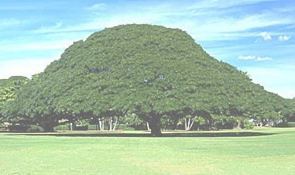
Rich Flavor Physics
SM/CKM
New Physics
Hadronic
Penguins
B⁰
Mixing
B±
CP violation
B_{s}
Semi-leptonic
decays
Tree
decays
Lifetime
D⁰
B_{c}
Radiative
Penguins
D_{s}
Pure-leptonic
decays
Λ_{b}
Electroweak
Penguins
D±
LFV
K⁰
New
resonances
μ ±
τ ±
K±
Production

Slide 4

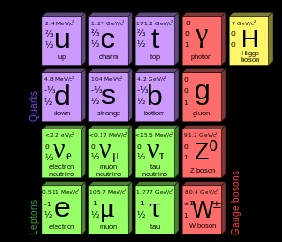
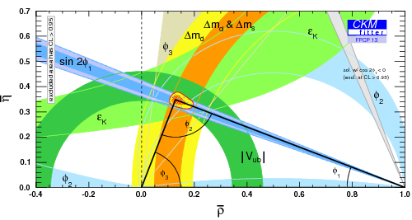
Discovery/Establish SM
Energy Frontier
Flavor Physics
1964: CPV in K
1974: J/ψ (c quark)
1975: τ lepton
Both Played
Important Role
1977: ϒ (b quark)
1983: W,Z
1987: B⁰-mixing
1995: t quark
2001: CPV in B
2004: Direct CPV
2007: D⁰-mixing
2012: Higgs
Next Target is Discovery of New Physics !

Slide 5
Approaches to BSM
Baryogenesis
SM is incomplete
Neutrino mass
Dark matter
Grand unification
Mass hierarchy
There must be New Physics @ TeV scale !!
Super-
symmetry ?
Extra-dimension ?
Composite
Higgs ?
But , or what?
Flavor physics : key to identify the theory
Direct Search
LHC, ILC
B
D
K
ν
τ
μ
…
Super Flavor machines

Slide 6
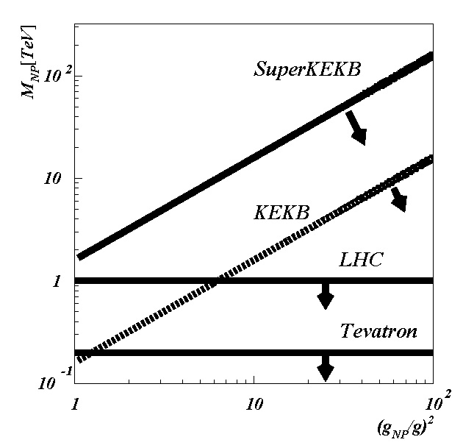
Energy Frontier vs Flavor Physics
Direct Production by High Energy Coll.
Virtual Production via Quantum Eff.
~
q
p
p
b
s
~
~
χ
γ
g
~
~
~
q
χ
ν
_
q
q
l⁻
Tunnel effect
Luminosity
Frontier
Energy Frontier
Diagonal terms
Off-diagonal terms
Higher Energy Scale
Can be searched
(even if LHC finds
no New Physics)

Slide 7
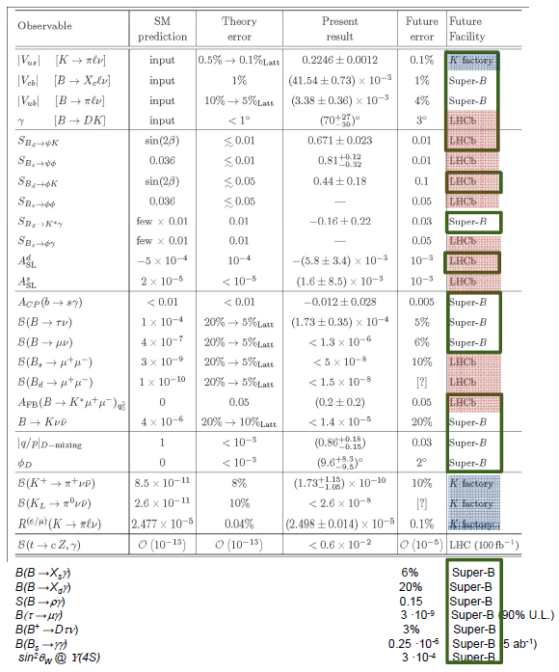
Prospects
New Physics in
Flavor Physics
,τ
LHC (huge prod. rates)
→ also Flavor factory
Competitive /
Complementary
K experiments
LHCb
Super τ/c factory
Super B factory
Unique !
Missing-E
Inclusive
(Neutrals)
Unique at
SuperKEKB,τ/c
G. Isidori et al.,
Ann.Rev.Nucl.Part.Sci. 60, 355 (2010)
+ report by B.Golob

Slide 8
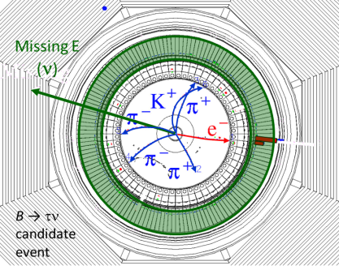
Pure(tagged) B/D meson Beam
Unique feature of e⁺e⁻ Flavor Factory
e⁺
ϒ(4S)
B⁻
B⁺
ν_{e}
ν_{τ}
B⁻→X
ν_{τ}
B⁺→τ⁺ν_{τ}
τ⁺→e⁺ν_{e}ν_{τ}
Tag-side: Full
reconstruction
also for
B → D^{(*)}τν
B → Kνν
Inclusive
Known momentum
Clean environment
Allow to reconstruct
decays with multiple ν’s
& inclusively
Coherent state with 1⁻ ⁻ : CP tag

Slide 9
Charm Physics: D⁰-mixing
Super-TCF
contribution
δx=0.74,δy=0.19(10⁻³)
δx=0.42,δy=0.17(10⁻³)
δx=0.20,δy=0.12(10⁻³)
Current WA (HFAG’14)
BF,CDF,LHCb,Cleo-c
δx=1.5,δy=0.8(10⁻³)
Super BF + Super-TCF
precise D⁰-mixing measurement

Slide 10
Hadron Spectroscopy
Discovery of X(3872) & “Exotic” hadrons
Flavor Factories =
Hadron Spectroscopy
machine
Heavy Quark hadrons:
very good test stand for
QCD; hadron formation,
exotic states
_
_
Clean (cc, bb) samples
Tagged Quarkonium:
ex) Y(2S) → π⁺π⁻Y(1S)
Further, antiproton-proton collision provide unique opportunity
to study glueball and gluon-hybrid state
→ PANDA at FAIR

Slide 11
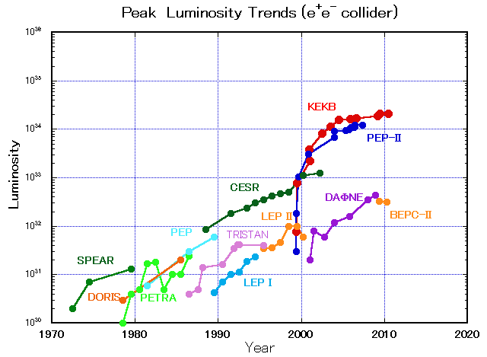
Super Flavor machines
SuperKEKB
8x10³⁵
40 times higher luminosity
KEKB
STCF
BEPC II
BEPC II

Slide 12
Strategy for High Luminosity
Lorentz factor
Geometrical reduction factors
due to crossing angle and
hour-glass effect
Classical electron radius
Beam size ratio
Increase beam current, I
Larger beam-beam par, ξ_{y}
Smaller β*_{y}
(+low emmittance)
Nano-beam scheme
Invented by Pantaleo Raimondi for SuperB
Adopted planned Super B and τ/c Factories

Slide 13
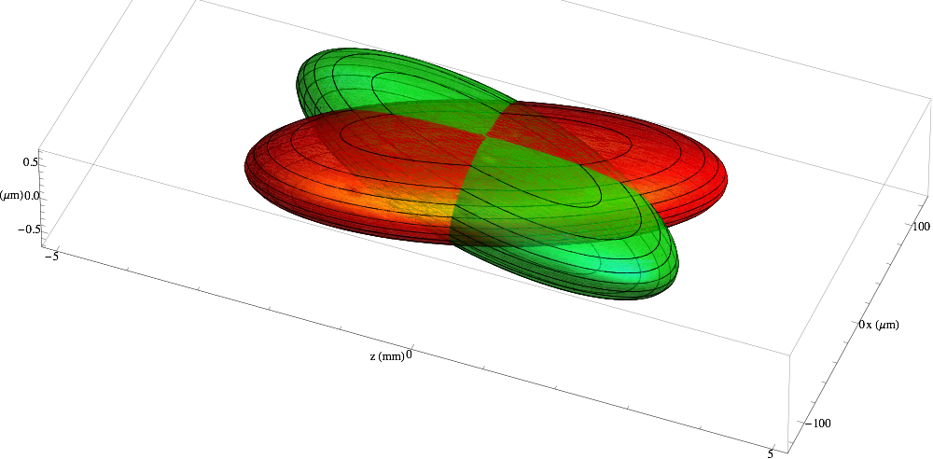
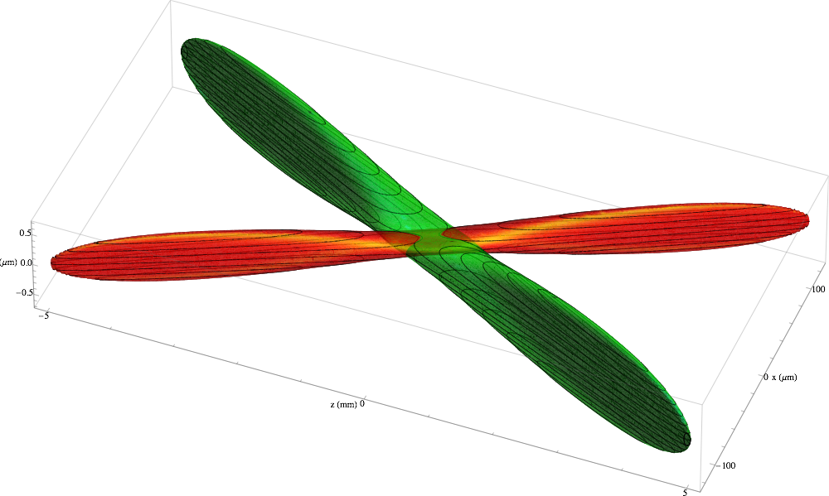
Nano-Beam Scheme
L
KEKB
(w/o crab)
Half crossing
angle: φ
22mrad
Hourglass condition:
βy*>~ L=σ_{x}/φ
1μm
SuperKEKB
100μm
5mm
~50nm
1μm
100μm
5mm
83mrad
Crab Waist : planned in Super τ/c

Slide 14
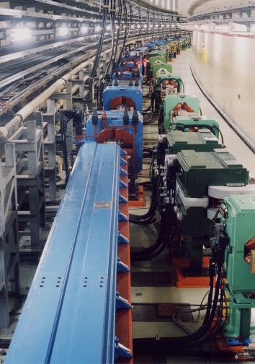
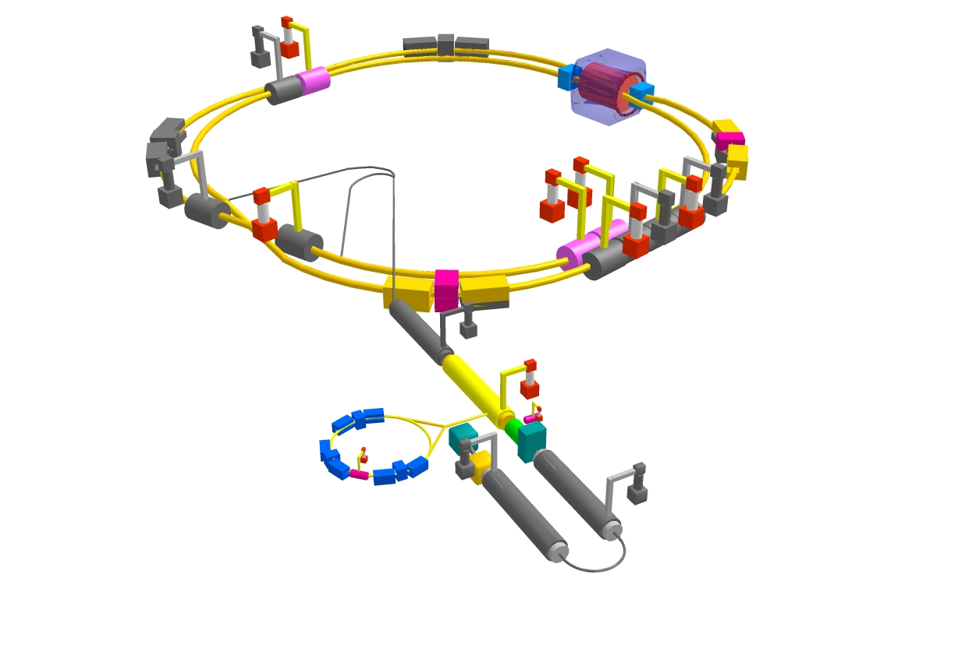


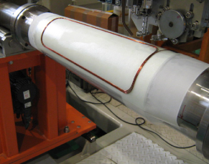
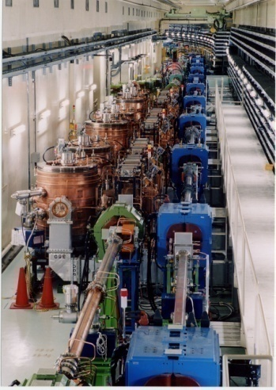


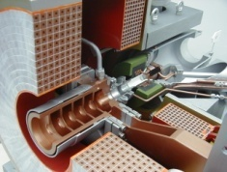
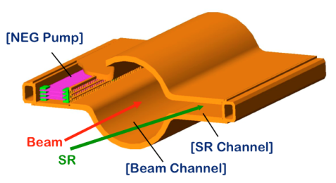
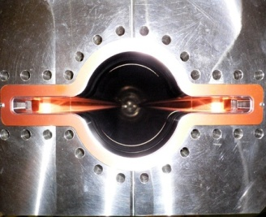

SuperKEKB
Colliding bunches
Belle II
New IR
e- 2.3 A
New superconducting /permanent final focusing quads near the IP
New beam pipe
& bellows
e+ 4.0 A
Replace short dipoles with longer ones (LER)
Add / modify RF systems for higher beam current
Low emittance positrons to inject
Positron source
Redesign the lattices of HER & LER to squeeze the emittance
Damping ring
New positron target / capture section
TiN-coated beam pipe with antechambers
Low emittance gun
Low emittance electrons to inject
L=8·10³⁵ s⁻¹cm⁻²
x 40 Gain in Luminosity

Slide 15

Machine parameters
parameters |  | KEKB(@record) |  | SuperKEKB |  | units
 |  | LER | HER | LER | HER
Beam energy | Eb | 3.5 | 8 | 4 | 7.007 | GeV
Half crossing angle | φ | 11 |  | 41.5 |  | mrad
# of Bunches | N | 1584 |  | 2500
Emittance Horizontal | εx | 18 | 24 | 3.2 | 4.6 | nm
Emittance ratio | κ | 0.88 | 0.66 | 0.27 | 0.28 | %
Beta functions at IP | βx*/βy* | 1200/5.9 |  | 32/0.27 | 25/0.30 | mm
Beam currents | Ib | 1.64 | 1.19 | 3.6 | 2.6 | A
beam-beam param. | ξy | 0.129 | 0.090 | 0.0881 | 0.0807
Bunch Length | σz | 6.0 | 6.0 | 6.0 | 5.0 | mm
Horizontal Beam Size | σx∗ | 150 | 150 | 10 | 11 | um
Vertical Beam Size | σy∗ | 0.94 |  | 0.048 | 0.059 | um
Luminosity | L | 2.1 x 10³⁴ |  | 8 x 10³⁵ |  | cm⁻²s⁻¹

Slide 16
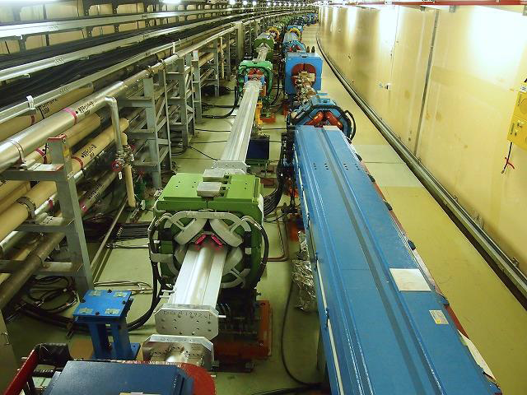
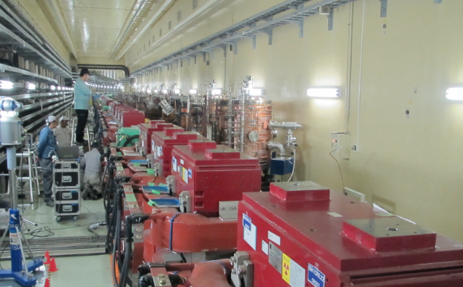
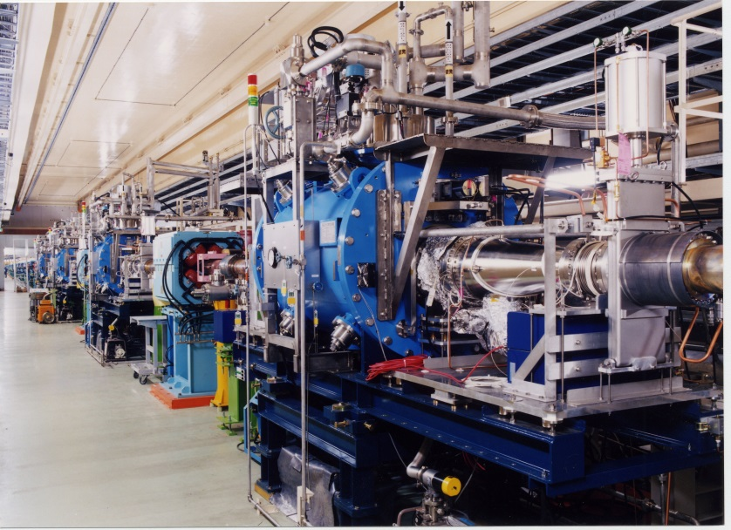
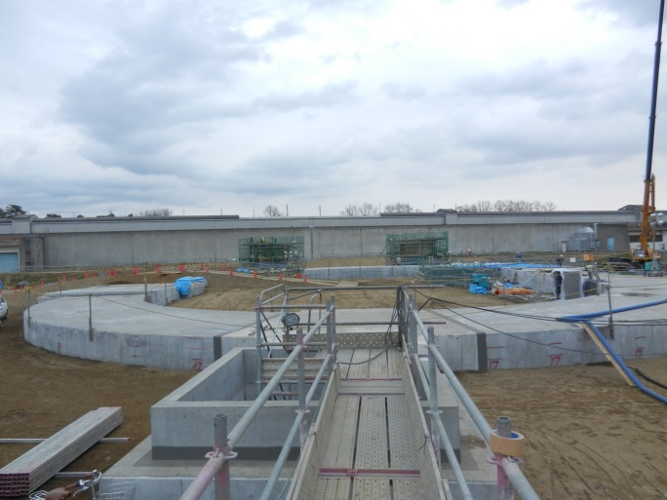
SuperKEKB Construction
Beam pipe and magnets
HER wiggler magnets
RF system (added/modified)
Linac RF gun
Damping ring tunnel: built!
(buried now)
Going on as ~planned

Slide 17
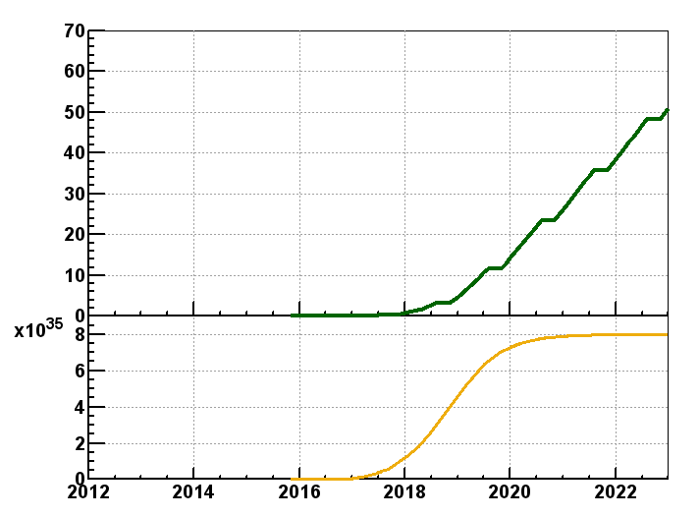
Luminosity Projection
Goal of Belle II/SuperKEKB
Integrated luminosity
(ab⁻¹)
9 months/year
20 days/month
Commissioning starts
in FY2015. Physics in FY2017
Shutdown
for upgrade
Peak luminosity
(cm⁻²s⁻¹)
Calendar Year

Slide 18

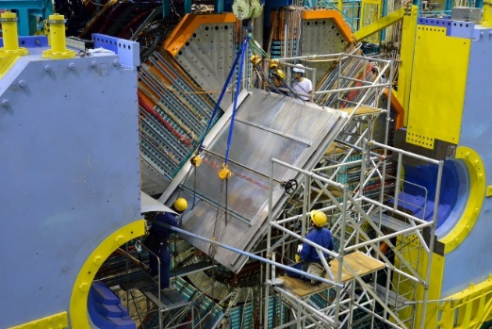
Belle II Detector Upgrade
Construction
In Progress

Slide 19
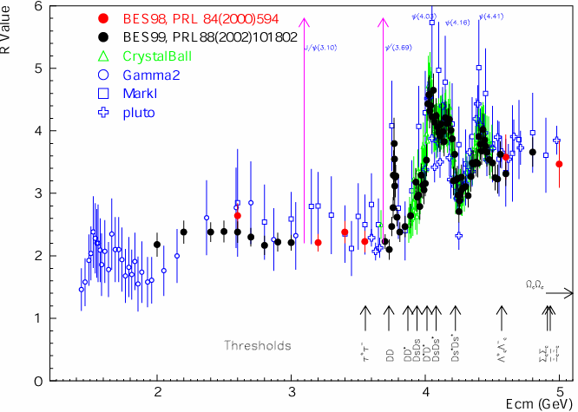
Super tau/charm Factories
BINP: VEPP → STCF; from early time
INFN: DAΦNE → [SuperB → STCF (2013) ]
China: BEPC I/II → STCF (recently)
τ production/decay properties (at ~threshold)
Beam polarization has important role
D⁰, D⁺, D_{s}⁺ decays: rare & precise measurements
~threshold: D_{(s)}D_{(s)} production in 1⁻ ⁻ state
Charmonium(-like) resonance
hadron spectroscopy & physics
_
R=σ(e⁺e⁻→hadron)/
σ(e⁺e⁻→μ⁺μ⁻)

Slide 20
STCF: Machine Parameters
 | INFN | BINP | China
Beam Energy, GeV | 1.0-2.3 | 1.0-2.5 | 1.0-3.5
Circumference, m | 340.7 | 813 | 992.8
Number of bunches | 530 | 390 | 540
Bunch Current, mA | 3.29 | 4.4 | 5
Beam Current, A | 1.0-1.745 | 1.7 | 2.7
Emittance Horiz, nm | 56.11-4.89 | 8 | 10
Emittance Vert, nm | 0.015-0.012 | 0.04 | 0.05
Bunch length, mm | 10.1-6.9 | 16-10 | 10
beta x (IP), cm | 7 | 4 | 100
beta y (IP), cm | 0.06 | 0.08 | 0.1
RF frequency, MHz | 476 | 508 | 500.06
Luminosity, cm⁻²s⁻¹ | 0.2-1x10³⁵ | 0.63-1x10³⁵ | 1.05x10³⁵

Slide 21
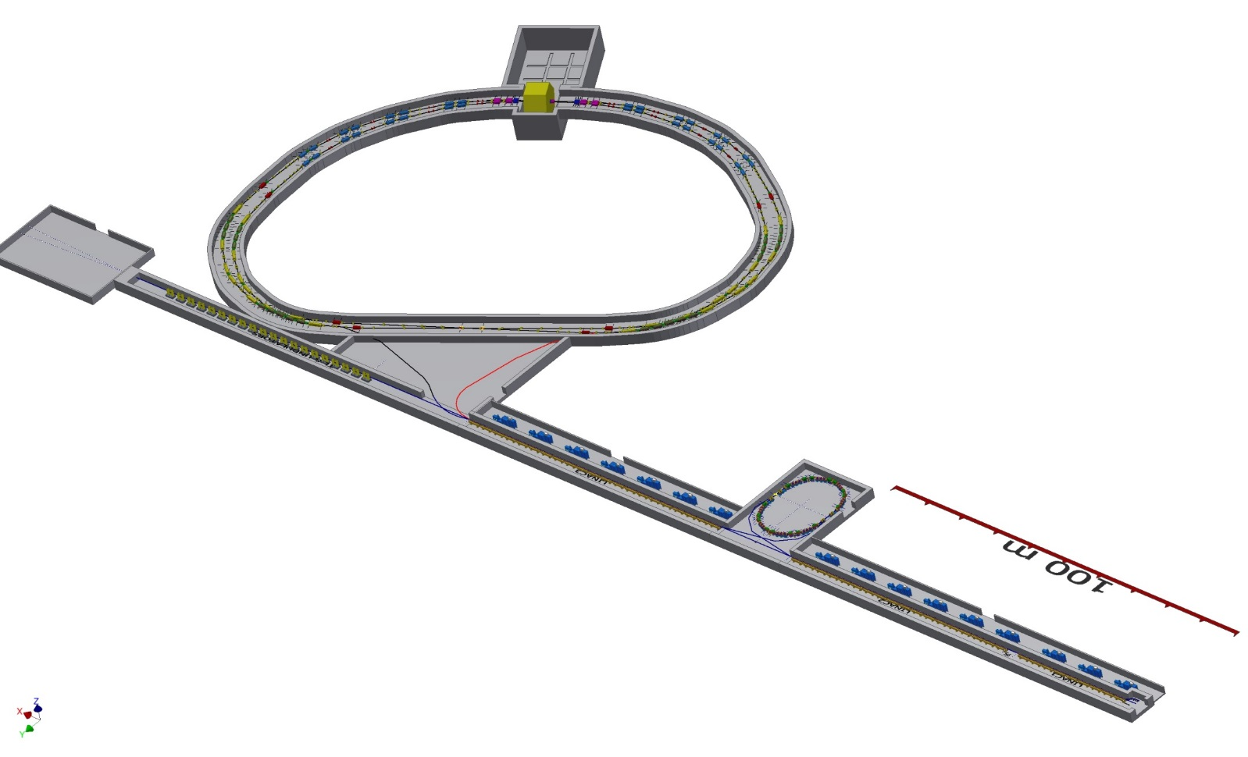
INFN STCF Proposal
Unfortunately, proposal was
not successful.
But, it stimulated
STCF design
Of the world
IP
Storage Rings
(preliminary)
FEL OPTION
Damping Ring
TLs
LINAC
Tau-Charm Layout @ Tor Vergata
arXiv:1310.6944

Slide 22
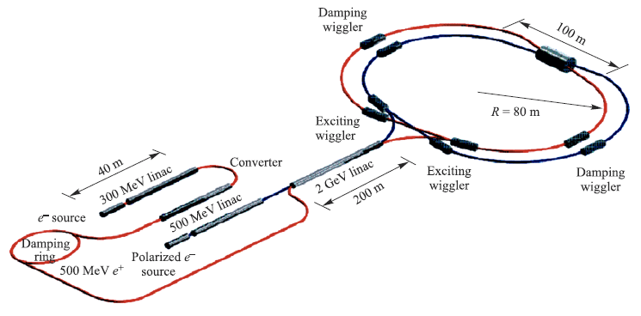
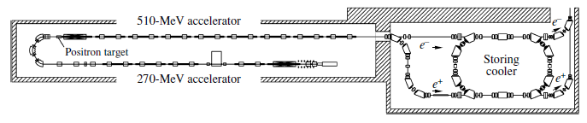
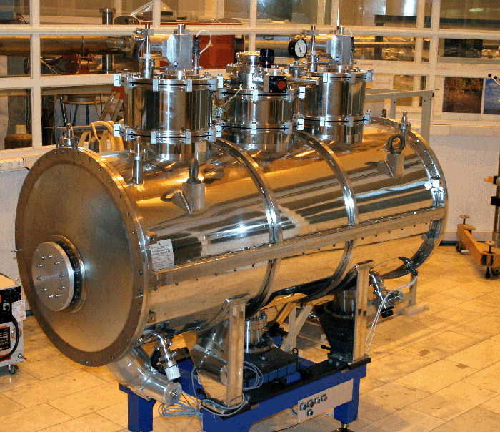
BINP Super tau/charm Factory
R = 90 m
Crab Waist scheme
Existing Positron Injector
Damping
wiggler prototype

Slide 23
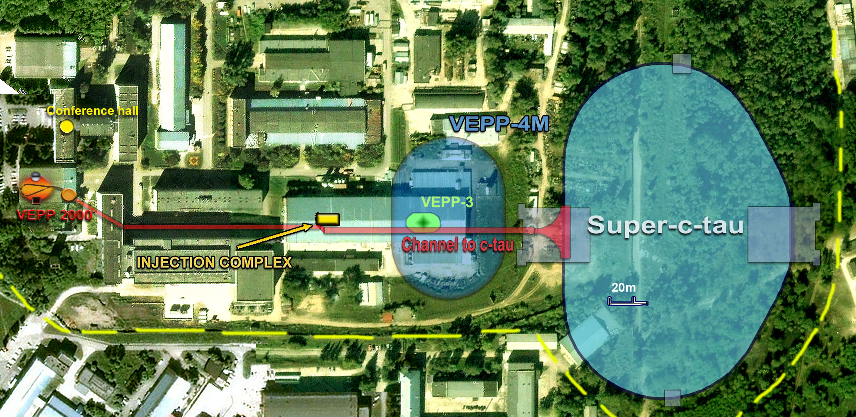
BINP STCF Site
Construction: ~6 years, International review
Total cost ~$400-440M€

Slide 24
BINP Super φ/τ/c Factory
Beam energy from 0.5 to 2.1 GeV
Peak luminosity is 10³⁵ cm⁻²s⁻¹ at 2 GeV and within as wide as possible energy range
Circumference 366 m to fit in the existent tunnel of VEPP4-M (R = 45 m)
Conform as much as possible
to existent infrastructure
Longitudinal polarization
at some energy points
Energy calibration by Compton
backscattering (~(5 − 10)×10⁻⁵)
Total cost ~$240M€

Slide 25
China: HIEPA
High Intensity Electron Positron Accelerator Facility
For tau-charm physics
3rd or 4th generation SRF
Potential for FEL study
992.8 m double ring
E_{cm} = 2 -7 GeV;
L = 1x10³⁵ cm⁻²s⁻¹
at 4 GeV

Slide 26
HIEPA: Study Time Line
2013 |  |  |  | 2014 |  |  |  | 2015 |  |  |  | 2016 |  |  |  | 2017
Q1 | Q2 | Q3 | Q4 | Q1 | Q2 | Q3 | Q4 | Q1 | Q2 | Q3 | Q4 | Q1 | Q2 | Q3 | Q4 | Q1 | Q2 | Q3 | Q4
Kick-off
collaboration forming
Workshops
Feasibility study
Review
CDR, R&D → TDR?
Site is not selected yet (Hefei ~USTC, Shangdong)
Total cost ~3.5 billion RMB (~$560M)

Slide 27



PANDA at FAIR
Facility for Antiproton
and Ion Research
Anti-proton
Production target
CR (Collector Ring)
RESR (Recuperated
Experimental Storage
Ring)
Anti-proton
Production target
HESR (High Energy
Storage Ring)

Slide 28
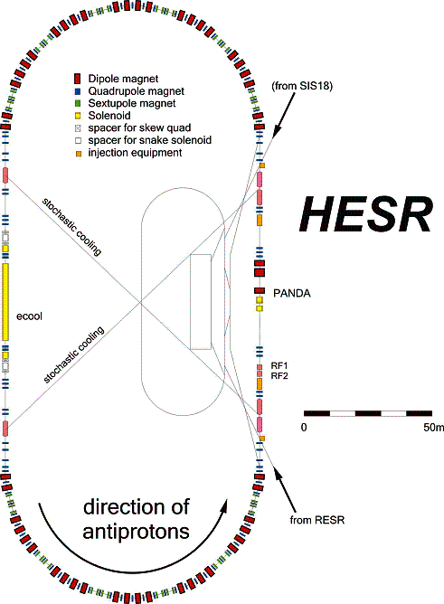
PANDA at FAIR
Production rate 2x10⁷/sec
P_{beam} = 1 - 15 GeV/c
N_{stored} = 5x10¹⁰ p
Internal Target
2.3 ≤ √s ≤ 5.5 GeV
_
High resolution mode
Internal Target
Detector
δp/p =4x10⁻⁵ (electron cooling)
Lumin. Up to 2x10³¹ cm⁻² s⁻¹
p
_
High luminosity mode
p
Lumin. = 2 x 10³² cm⁻² s⁻¹
δp/p = 2x10⁻⁴ (stochastic cooling)
From RESR

Slide 29
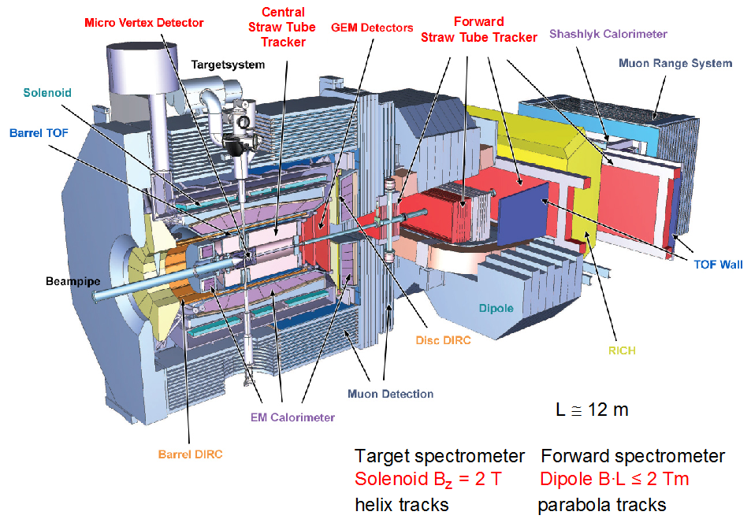
PANDA Detector
_
pp: Pellet or Cluster target
pA: wire target
_

Slide 30
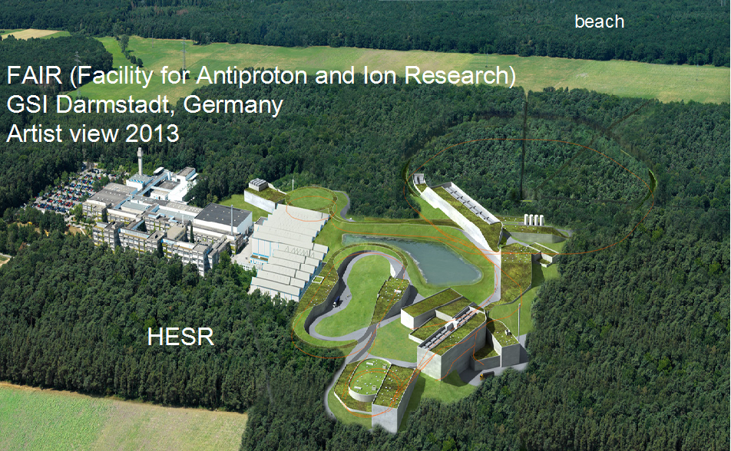
Panda Schedule
Dec-2018: Panda hall will be finished
Jan-2019: dipole magnets of HESR installed
Detector is constructed at Julich → GSI
hopefully some data in 2019

Slide 31
Summary
Flavor Physics has been important/complementary
driving force together with Energy Frontier in HEP/SM
Super Flavor machines will take such role in searching
and establishing New Physics
Clean environment, Pure (tagged) mesons
SuperKEKB is under construction (sole SBF in world)
↔ competition/complementary LHCb(LHC)
Super τ/charm Factory: (INFN), BINP, China “plan”
option: Super φ factory
Super Flavor Factory: also excellent Hadron Spectroscopy
Clean quarkonium data
FAIR/PANDA (pp collision): complementary
unique role for glueball/gluon-hybrid states

Slide 32
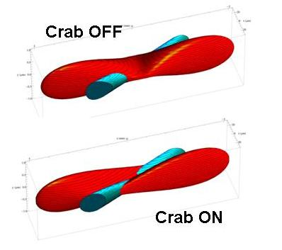
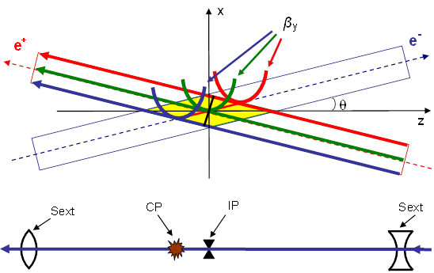
Crab Waist
Large Piwinski’s angle
(σ_{z}/σ_{x}∙θ)
Suppress betatron res.
(sextupoles in phase)

Slide 33
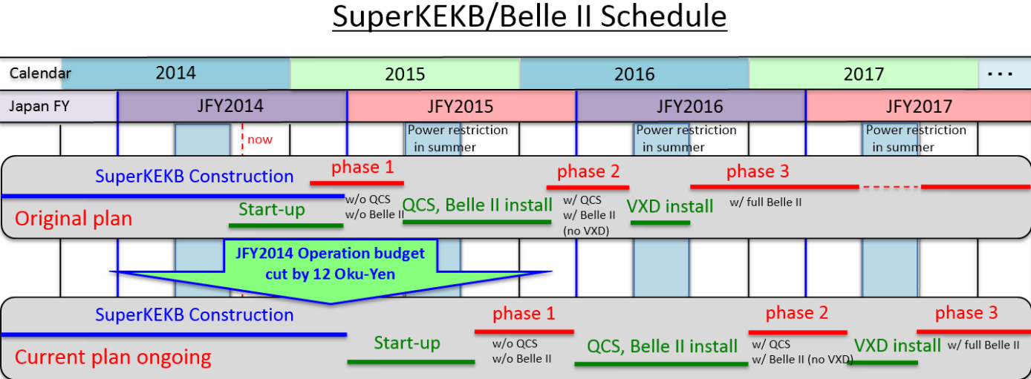
SperKEKB/Belle II Schedule
July
Jan.
A.Suzuki (27-Oct, ICFA2014)

Slide 34
New Physics via Flavor Physics
Flavor Physics
Intensity/Luminosity Frontier
New Physics: High mass scale → Small effect
Deviation from SM: High precision measurement
Forbidden in SM: Observe very rare phenomena
Huge sample of (Heavy) Flavor particles
Super High Luminosity accelerator → Super FF
Very high production rates
LHC is also “(Super) Flavor Factory” in some sense
Already significant contributions from LHCb, ATLAS/CMS

Slide 35
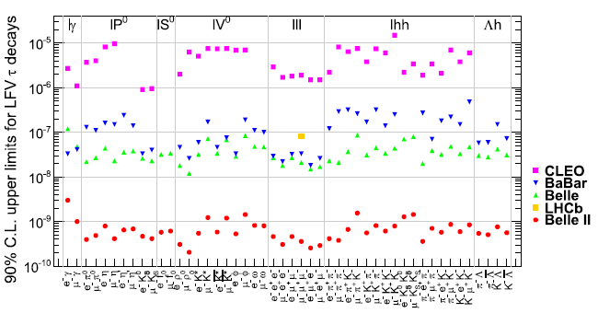
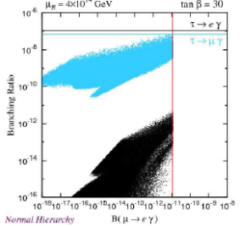
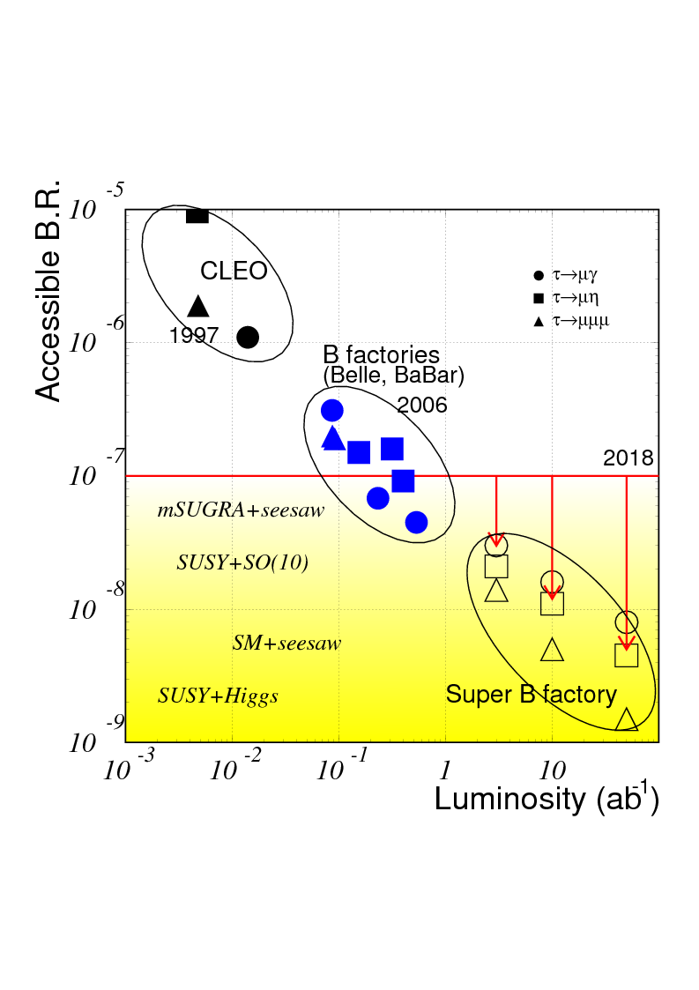
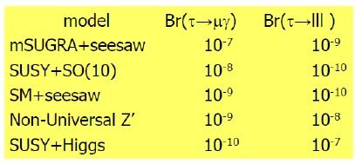
τ Physics: LFV decays
τ LFV decays
LFV = clear evidence of NP
STCF has advantage in
Background suppression
Polalization. ex) τ → μγ

Slide 36
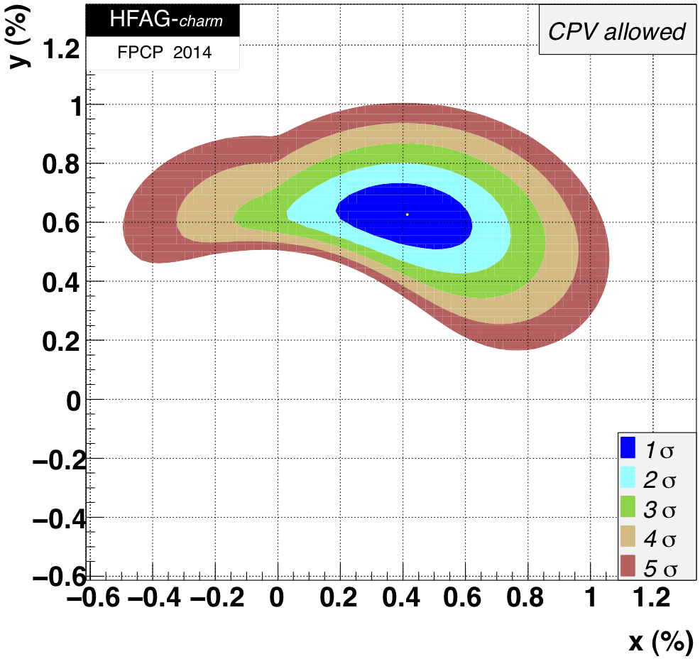
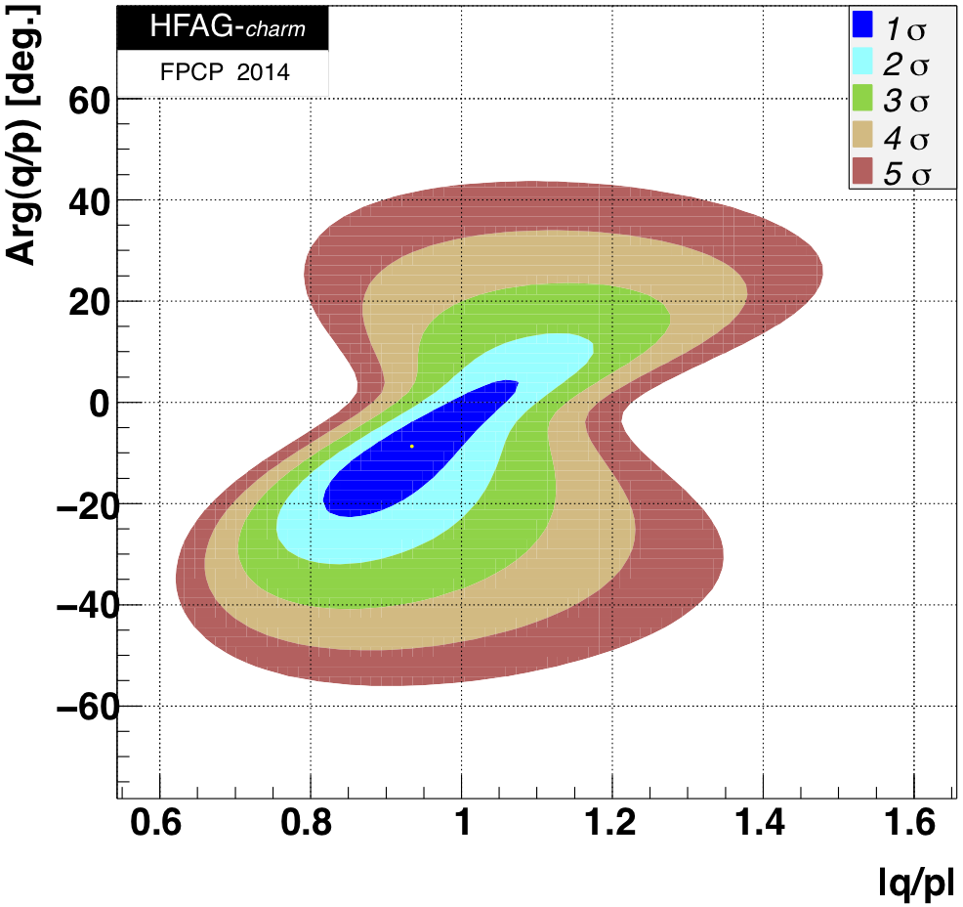
Charm Physics:
D⁰-mixing
50ab⁻¹
50ab⁻¹

Slide 37
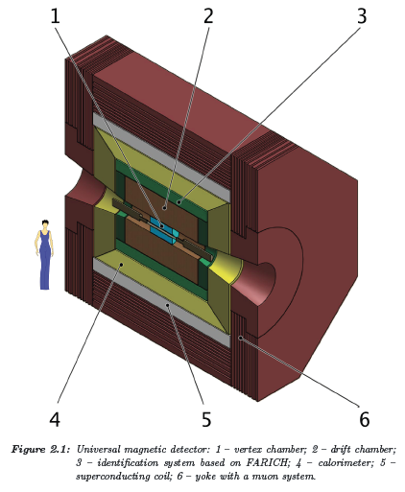
BINP STCF detector
A.Bondar,
PAN 76,1072(2013)

Slide 38
BINP STCF Parameters
Energy | 1.0 GeV | 1.5 GeV | 2.0 GeV | 2.5 GeV
Circumference | 780 m
Emittance hor/ver | 8 nm/0.04 nm @ 0.5% coupling
Damping time hor/ver/long | 30/30/15 ms
Bunch length | 16 mm | 11 mm | 10 mm | 10 mm
Energy spread | 10.1·10⁻⁴ | 9.96·10⁻⁴ | 8.44·10⁻⁴ | 7.38·10⁻⁴
Momentum compaction | 1.00·10⁻³ | 1.06·10⁻³ | 1.06·10⁻³ | 1.06·10⁻³
Synchrotron tune | 0.007 | 0.010 | 0.009 | 0.008
RF frequency | 508 MHz
Harmonic number | 1300
Particles in bunch | 7·10¹⁰
Number of bunches | 390 (10% gap)
Bunch current | 4.4 mA
Total beam current | 1.7 A
Beam-beam parameter | 0.15 | 0.15 | 0.12 | 0.095
Luminosity | 0.63·10³⁵ | 0.95·10³⁵ | 1.00·10³⁵ | 1.00·10³⁵
E.Levichev @Elba13

Slide 39
HIEPA Parameters
(Lattice and other related AP studies are under way)
Beam energy (GeV) | 3.0 | Revolution frequency (MHz) | 0.302
Circumference (m) | 992.8 | Harmonic number | 1656
Coupling factor | 0.005 | β_{x, y} @ IP (mm) | 1000, 1.0
Emittance (nm.rad) | 10 | Beam-beam parameter | 0.06
Bunch length (mm) | 10 | Number of bunch | 540
Momentum compaction | 0.001 | Bunch current (mA) | 5.0
SR energy loss/turn (MeV) | 0.716 | Beam current (A) | 2.7
Synchrotron tune | 0.0128 | SR power (MW) | 1.93
RF voltage (MV) | 2.0 | Energy spread | 8.12E-4
RF frequency (MHz) | 500.06 | Luminosity (cm⁻²s⁻¹) | 1.05E35

Slide 40
Turkic Accelerator Complex
Linac – Ring Collider
Light Sources
Particle physics
τ/charm region

