Slide 1
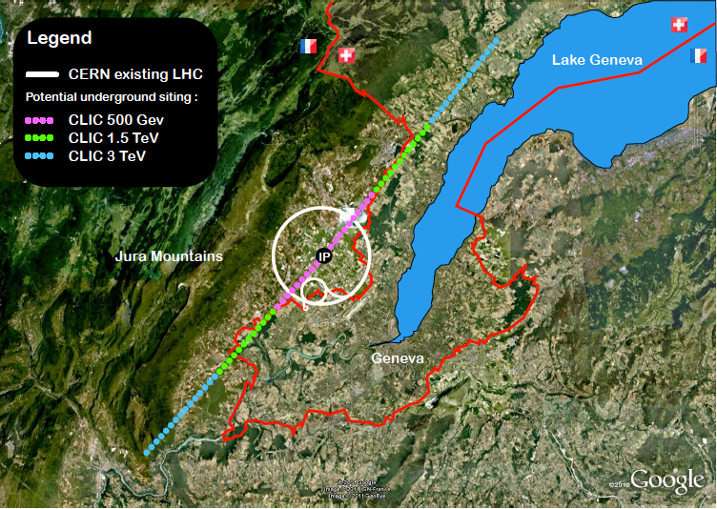
Linear Colliders (ILC and CLIC)
Outline:
ILC and CLIC – project overview
Physics consideration
Brief status and plans
Realization of the projects
Summary
ILC SCHEMATIC
Steinar Stapnes, CERN
LCC collaboration

Slide 2
Linear Colliders
Generic LC:
Key features: scalable to high energies, expandable (also with novel technologies later), very linked to light-sources (low emittance rings and FEL linacs )
Challenges: Gradients, luminosity (nano beams), power efficiency
Strategies:
Japan-KEK: Consider hosting ILC
European Strategy: High energy frontier beyond LHC: CLIC technology an option to be pursued, ILC in Japan a welcome initiative - shorter timescale, follow up Higgs discovery
Snowmass -> P5: High-lights physics potential of ILC and US participation (within 2025 Horizon)
Many other countries have their own strategies with LC activities central

Slide 3
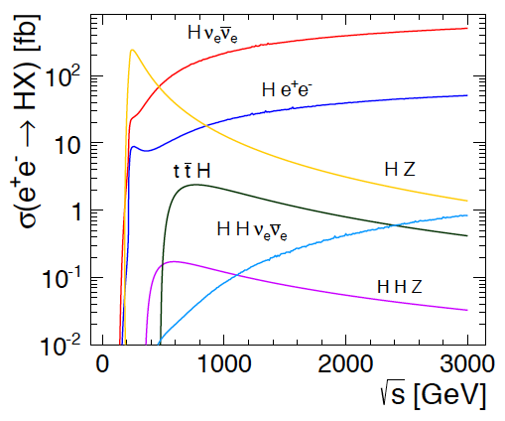
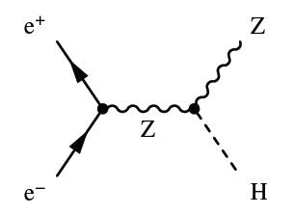
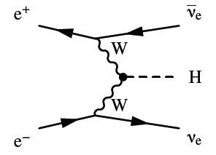
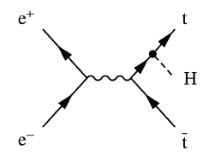
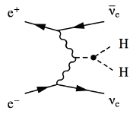

Higgs physics in e+e- collisions
Precision Higgs measurements
Model-independent
  Higgs couplings
  Higgs mass
Large energy span of linear colliders allows to collect a maximum of information:
  ILC: 500 GeV (1 TeV)
  CLIC: ~350 GeV – 3 TeV

Slide 4
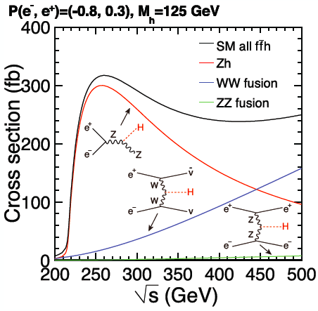
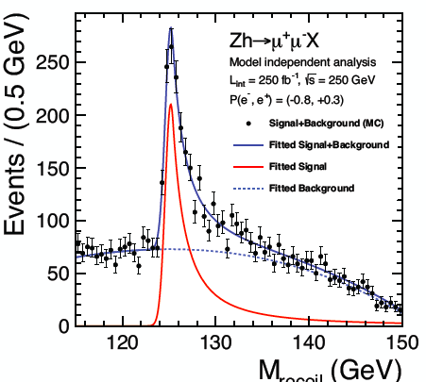

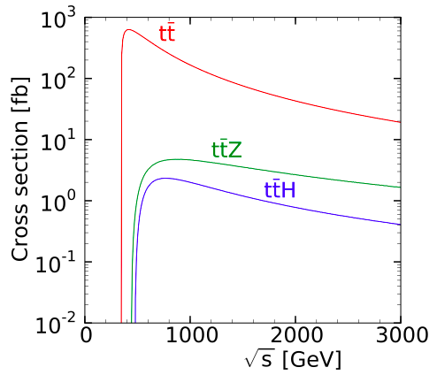
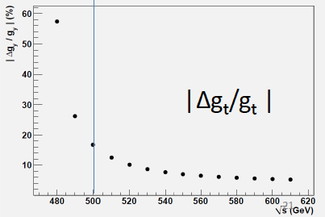
Higgs physics 250 – 500 GeV, and above
Large energy span available at Linear Colliders => access to Higgsstrahlung + WW-fusion as needed to obtain g_{HZZ}, g_{HWW}, Γ_{H} and a wide range of other couplings
Accurate mass measurement
best near 250 GeV
Δm_{H} ≈ 30 MeV
ttH threshold near 500 GeV, significant gain in going to higher energy (ultimately below 2%)

Slide 5
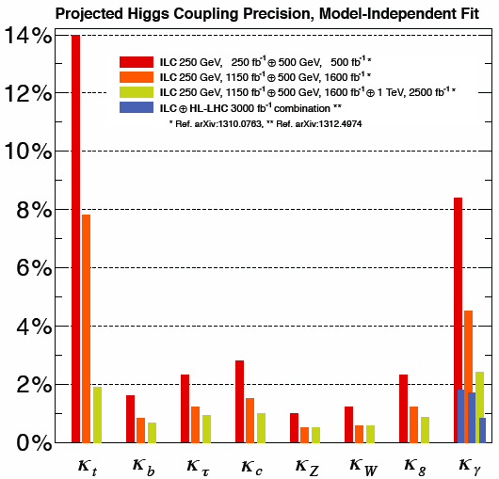
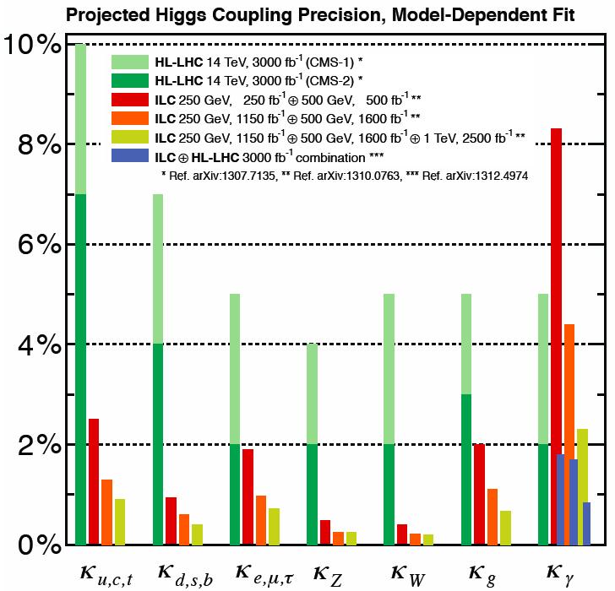
Combined Higgs results (ILC)
See talk of Kerstin Tackmann yesterday (Higgs – decays and properties)
Fully model-independent
LHC-like fits, assuming SM decay modes only

Slide 6
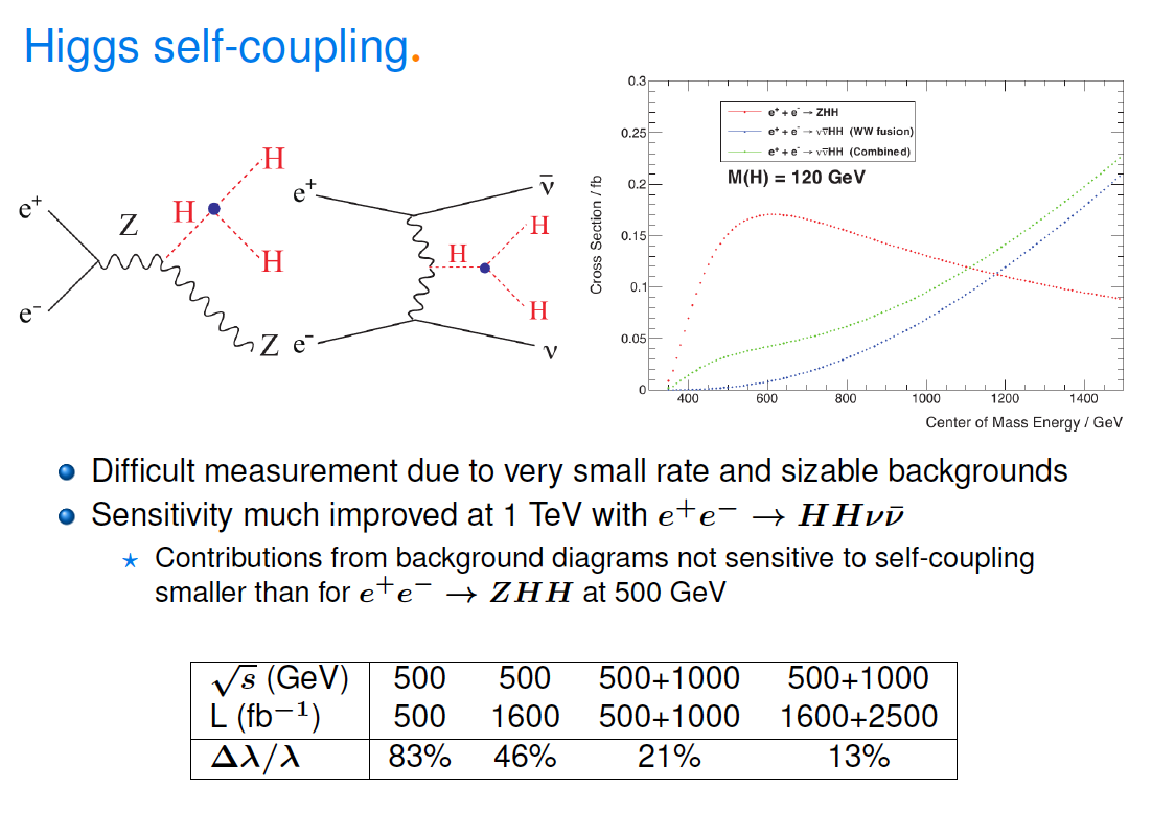
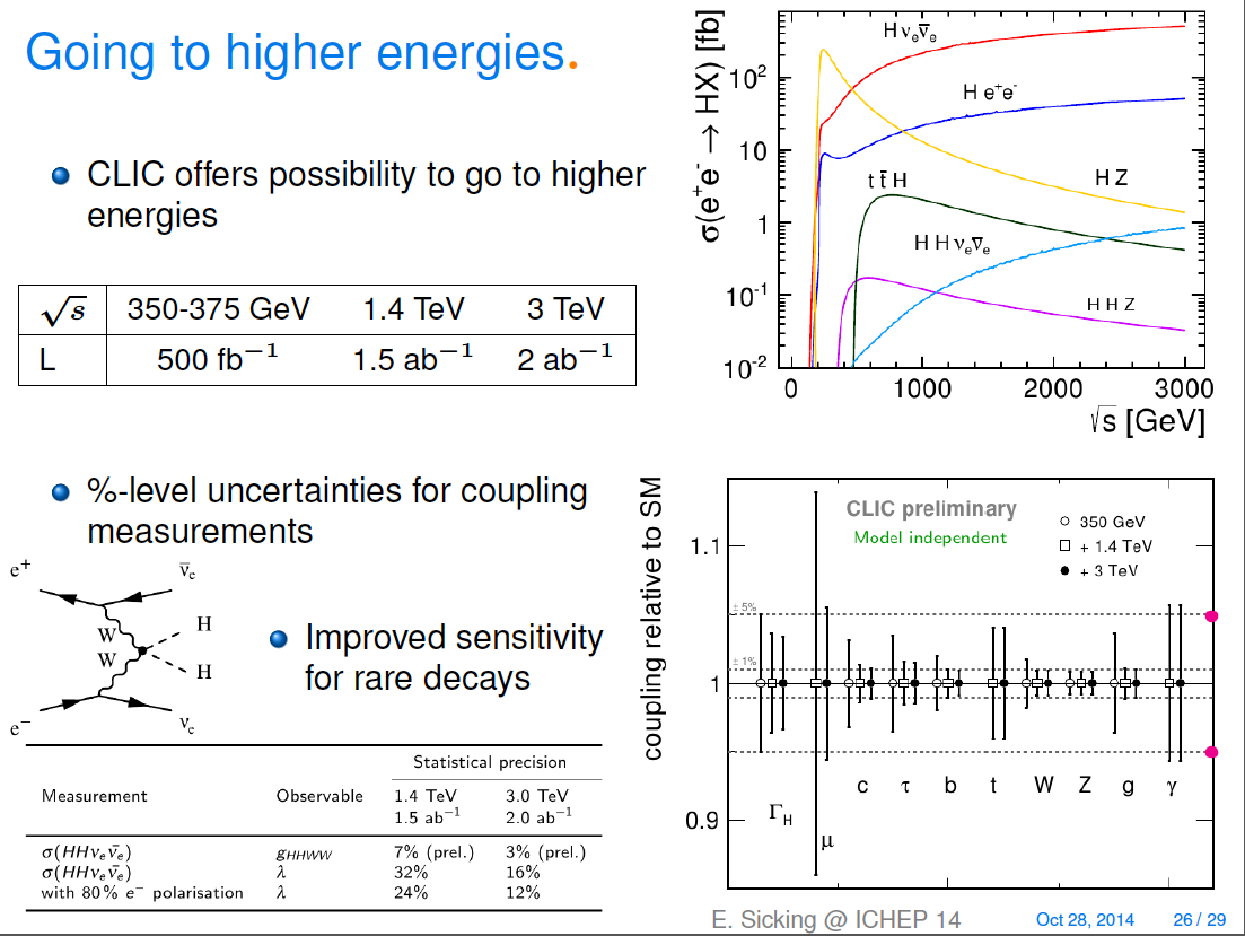
√
Double Higgs – and CLIC Higgs summary
From talk of Kerstin Tackmann (Higgs – decays and properties)

Slide 7
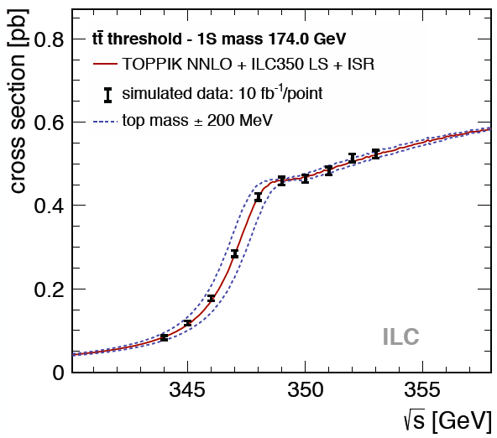
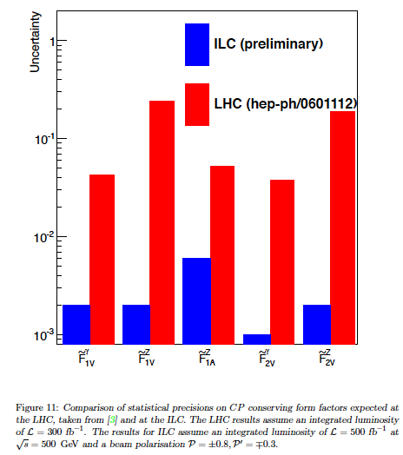
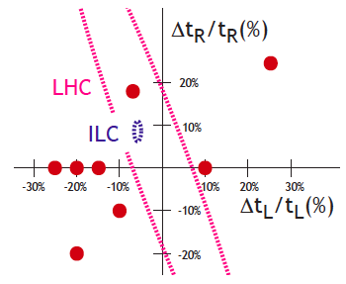
top physics
Top quark in the SM, heaviest elementary particle:
Many high-precision measurements possible in e⁺e- (like for s, c quarks) – some examples
Accurate coupling measurement from:
tt cross section
Helicity
Forward-backward asymmetry F_{AB}
ILC study at 500 GeV and 500 fb⁻¹
Provides good sensitivity to BSM physics
Sensitivity to BMS increases with energy
Threshold scan with well-defined 1S mass
Stat. accuracy Δm_{t}=20-30 MeV (ILC-CLIC)
Theor. accuracy currently Δm_{t} = 100 MeV
Note: LHC comparisons not recent (Snowmass 2005)
arXiv:1307.8102
Accuracy of left-handed and right-handed top couplings, together with deviations from various BSM models (arXiv:1403.2893)

Slide 8
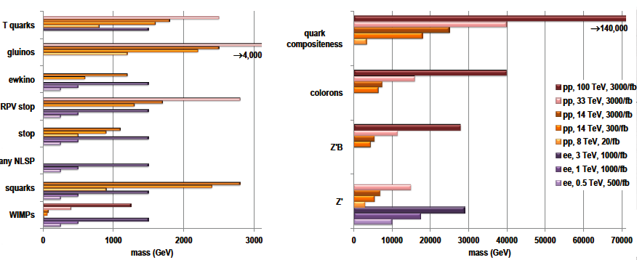
Physics beyond standard model
- many possibilities
Direct searches up to mass M ≤ √s/2
Indirect input from precision measurements
arXiv:1311.0299 (Snowmass)

Slide 9
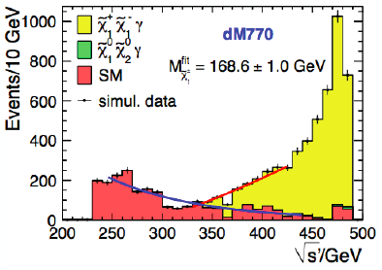
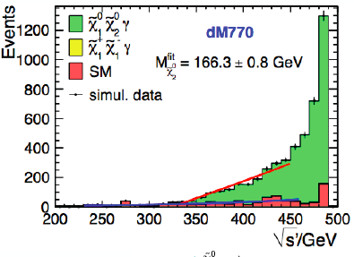
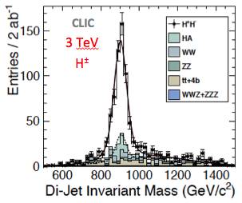
Physics beyond standard model
See talk of Monica D’Onofrio yesterday (Searches for SUSY)
Example of ILC study:
Light higgsinos with small mass splitting, tagged via soft ISR photon
ILC
ILC
Example of CLIC studies:
SUSY particles with high mass
Using end-point spectrum (left)
Reconstruction of complex multi-jet final state (right)
smuon
CLICdp
3 TeV
result: Δm/m ≤ 1%
result: Δm/m = 0.3%

Slide 10
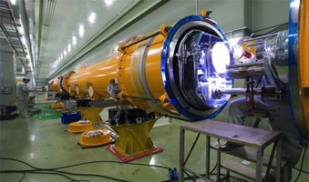
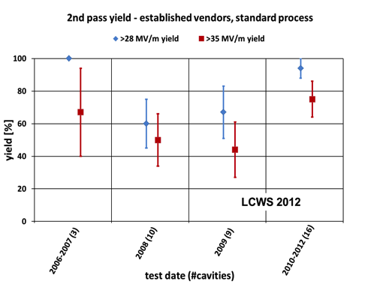
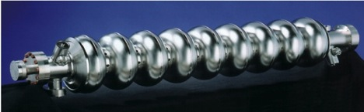
The ILC Accelerator Concept
Electron and Positron Sources (e-, e+)
Damping Ring (DR)
Ring to ML beam transport (RTML）
Main Linac (ML）：SCRF Technology
Beam Delivery System (BDS）
1.3 GHz Nb 9-cellCavities | 16,024
Cryomodules | 1,855
SC quadrupole pkg | 673
10 MW MB Klystrons & modulators | 436
Production yield: 94 % at > 35+/-20%
Average gradient: 37.1 MV/m
> R&D goal of 35 MV/m reached (2012)
Notes:
10
a polarized electron source based on a photocathode DC gun;
an undulator-based positron source, driven by the 150 GeV main electron beam;
5 GeV electron and positron damping rings (DR) with a circumference of 6.7 km, housed in a common tunnel at the center of the ILC complex;
beam transport from the damping rings to the main linacs, followed by a two-stage bunch compressor system prior to injection into the main linac;
two 11 km long main linacs, utilizing 1.3 GHz SCRF cavities, operating at an average gradient of 31.5 MV/m, with a pulse length of 1.6 ms;
a 4.5 km long beam delivery system, which brings the two beams into collision with a 14 mrad crossing angle, at a single interaction point which can be shared by two detectors.

Slide 11
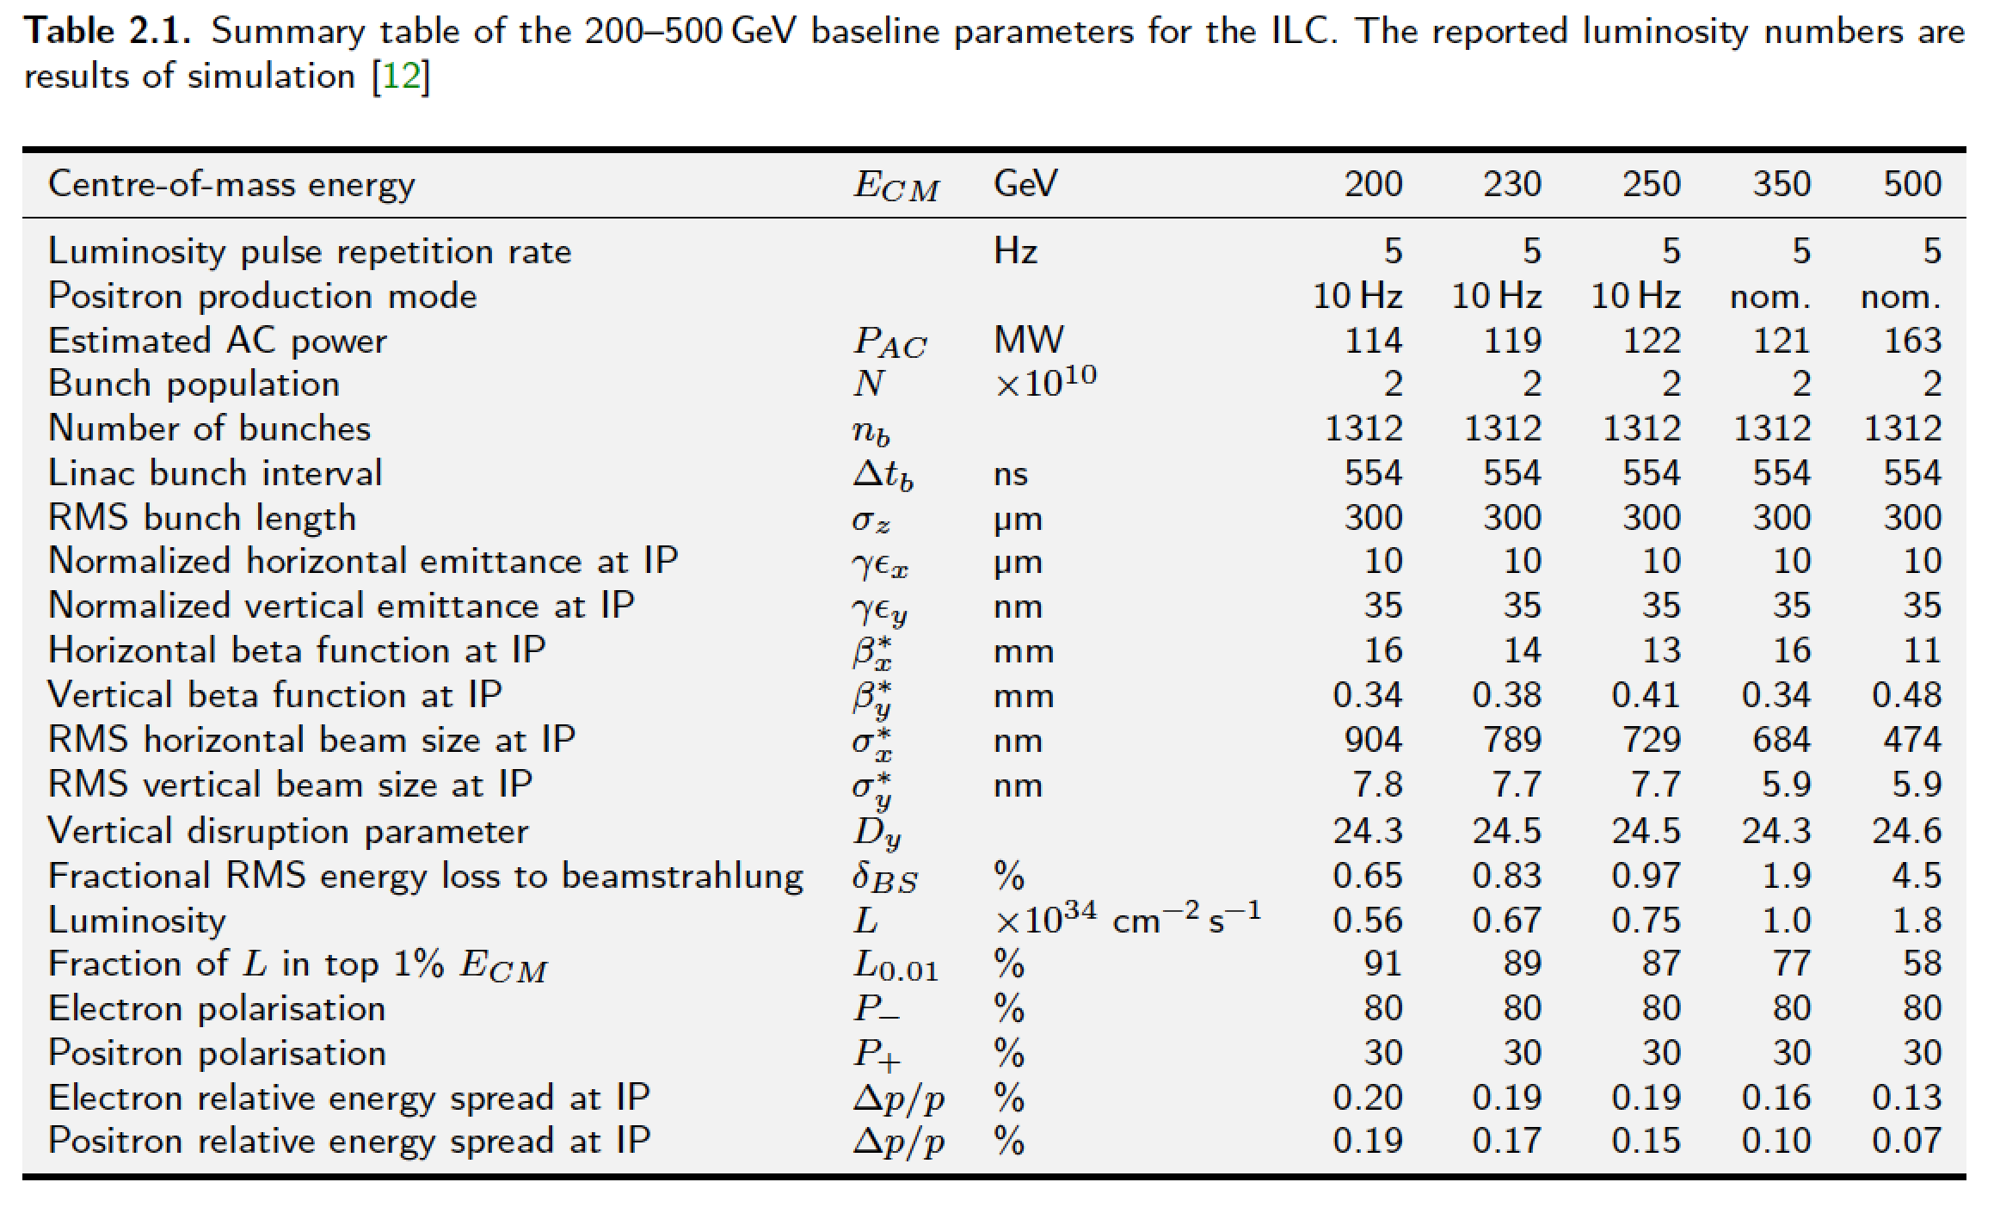
ILC parameters (TDR)
Upgradeable to 1 GeV – parameter sets also available

Slide 12
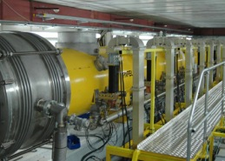
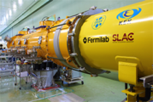
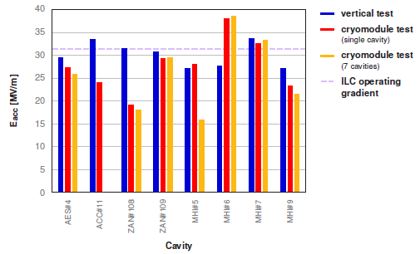
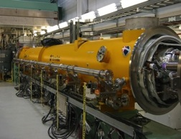
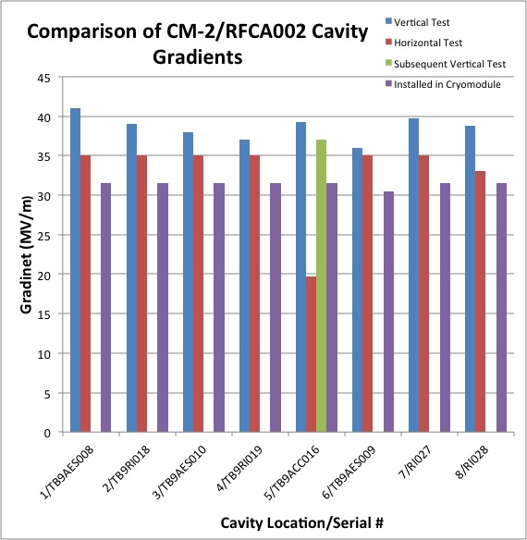
Cryomodule System Tests
DESY: FLASH
1.25 GeV linac (TESLA-Like tech.)
ILC-like bunch trains:
600 ms, 9 mA beam (2009);
800 ms 4.5 mA (2012)
RF-cryomodule string with beam → PXFEL1 operational at FLASH
XFEL Prototype at PXFEL1
← Demonstrated
PXFEL1 : ~ 32MV/m>
KEK: STF/STF2
S1-Global: completed (2010)
Quantum Beam Accelerator (Inverse Llaser Compton): 6.7 mA, 1 ms
CM1 test with beam (2014 ~2015)
STF-COI: Facility to demonstrate
CM assembly/test in near future
S1 Global Cryomodule at STF:
← Demonstrated
Cavity string: < 26MV/m>
  FNAL: ASTA
  (Advanced Superconducting Test Accelerator)
CM1 test complete
CM2 operation (2013)
CM2 with beam (soon)
CM2 at NML Facility:
CM2: > 31.5 MV/m>

Slide 13
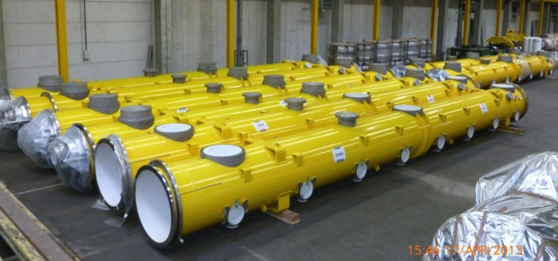
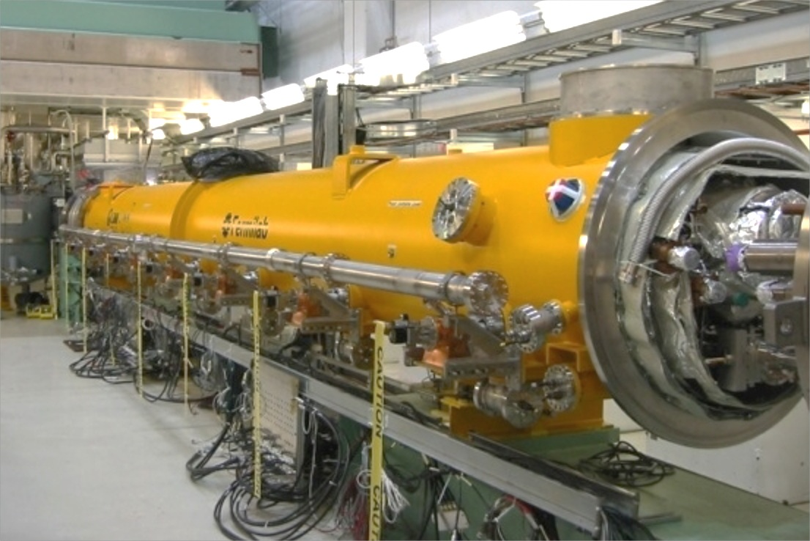

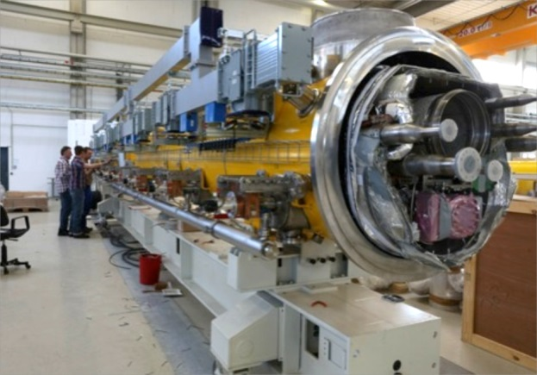

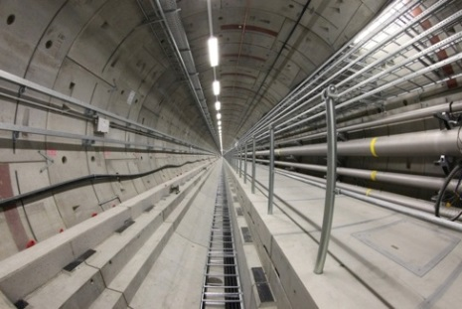
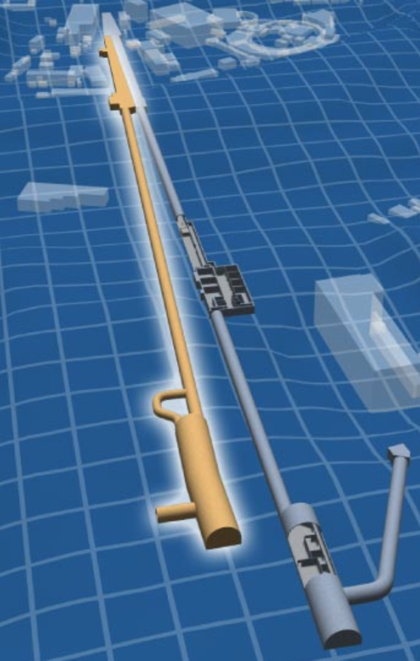
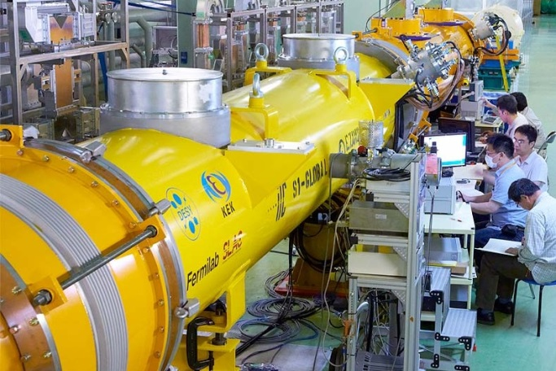
FEL and advanced linacs with SCRF modules
Largest deployment of this technology to date
100 cryomodules
800 cavities
17.5 GeV (pulsed)
Kitakami
proposed site
TRIUMF
FNAL/ANL
SLAC
◉
◉
◉
◉
Cornell
IHEP
PKU
JLab
◉
DESY
◉
LAL
Saclay
CERN
◉
KEK
LCLS-II
INFN Milan
◉
IUAC
RRCAT
preliminary data; results are not published
US infrastructure for
35 cryomodules
280 cavities
4 GeV (CW)
US and EU (industrial) production and test capacity.
Perfectly placed for start of ILC construction end
of this decade.
8

Slide 14
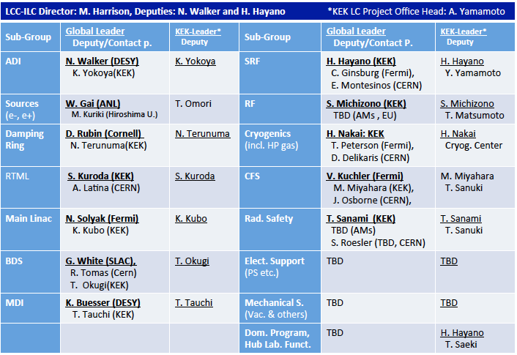
ILC post TDR team: towards site specific design

Slide 15
ILC Project Overview
Years | TDR baseline Scenario
1 - 2 | Pre-preparation for 2yrs (for technical effort continuity)
3 - 6 | Preparation (4 yrs)
7 - 15 | Construction (9 yrs)
(12 -) | (start installation)
(13 -) | (start preparation for Operation)
16 - | Beam Commissioning start
17 – | Operation at 250 ~ 500 GeV (550 GeV)
TBD | Toward 500 GeV HL upgrade
TBD | Toward 1 TeV upgrade

Slide 16
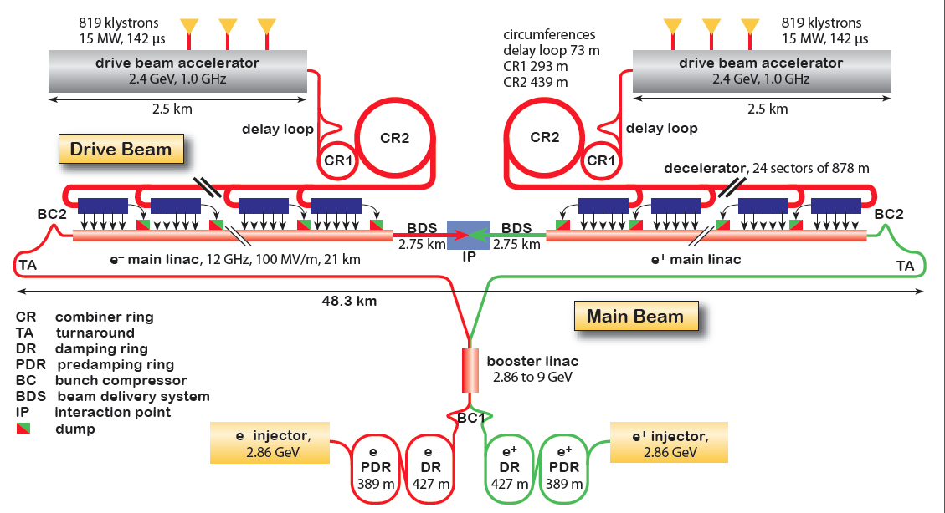
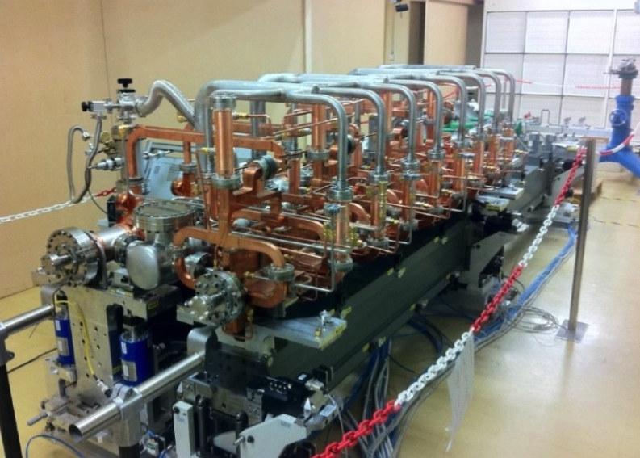
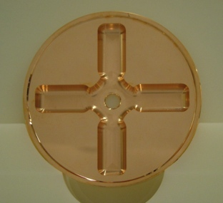
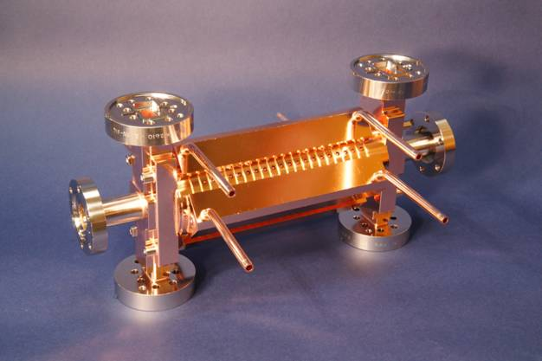
CLIC Layout at 3 TeV
Drive Beam Generation Complex
Drive beam time structure - initial
Drive beam time structure - final
240 ns
240 ns
5.8 μs
140 μs train length - 24 × 24 sub-pulses
4.2 A - 2.4 GeV – 60 cm between bunches
24 pulses – 101 A – 2.5 cm between bunches
Main Beam Generation Complex

Slide 17
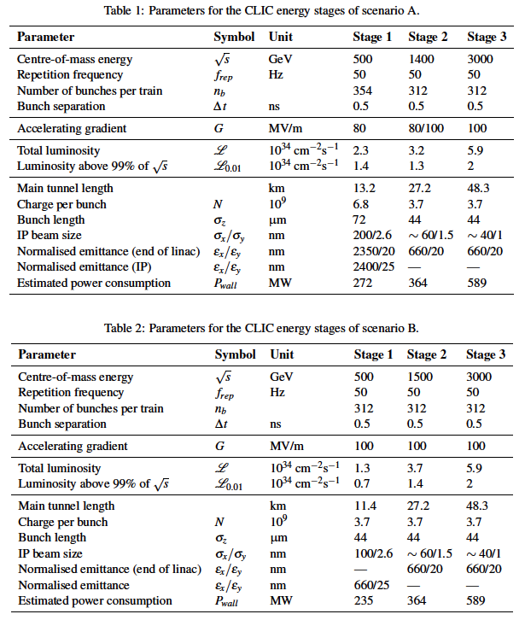
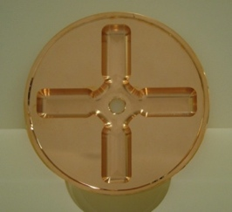
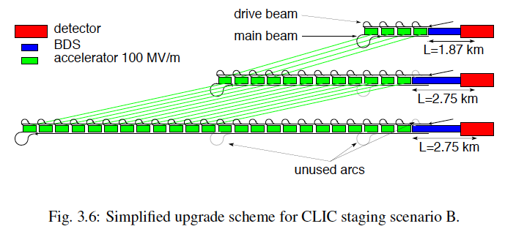
Possible CLIC stages studied in the CDR
Key features:
High gradient (energy/length)
Small beams (luminosity)
Repetition rates and bunch spacing (experimental conditions)

Slide 18
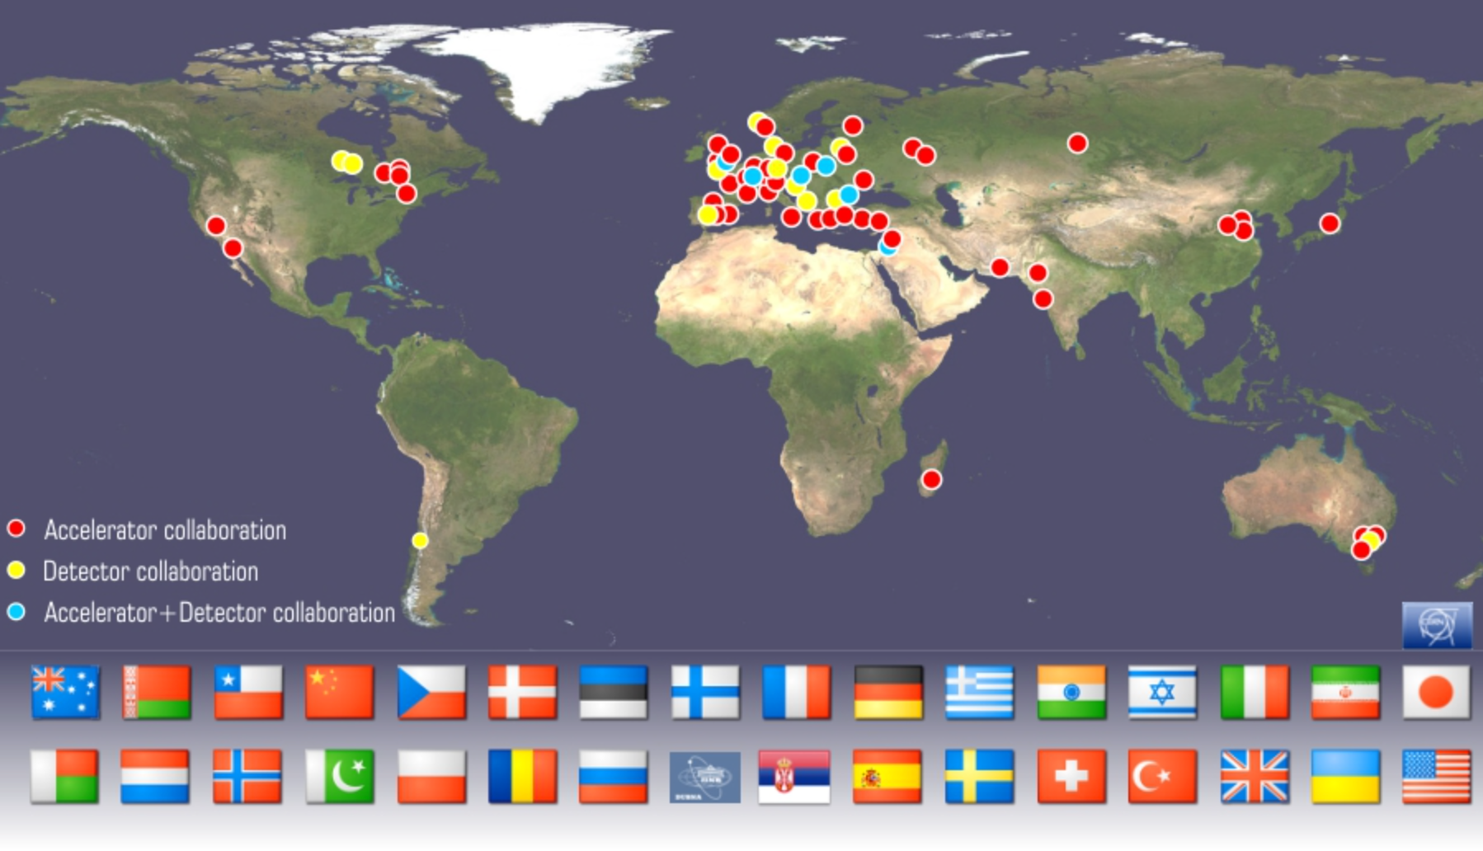
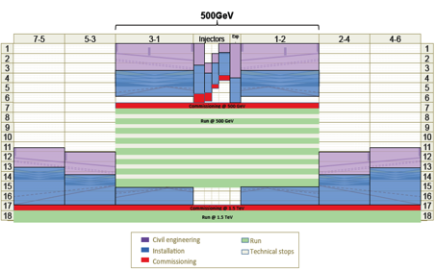
New institutes are joining:
In 2014 SINAP Shanghai and IPM Tehran
Detector collaboration operative with 23 institutes
2013-18 Development Phase
Develop a Project Plan for a staged implementation in agreement with LHC findings; further technical developments with industry, performance studies for accelerator parts and systems, as well as for detectors.
4-5 year Preparation Phase
Finalise implementation parameters, Drive Beam Facility and other system verifications, site authorisation and preparation for industrial procurement.
Prepare detailed Technical Proposals for the detector-systems.
Construction Phase
Stage 1 construction of CLIC, in parallel with detector construction.
Preparation for implementation of further stages.
Common work with ILC related to several acc. systems as part of the LC coll., also related to initial stage physics and detector developments
Common physics benchmarking with FCC pp and common detect. challenges (ex: timing, granularity), as well as project implementation studies (costs, power, infrastructures …)
2018-19 Decisions
On the basis of LHC data
and Project Plans (for CLIC and other potential projects as FCC), take decisions about next project(s) at the Energy Frontier.
2024-25 Construction Start
Ready for full construction
and main tunnel excavation.
Commissioning
Becoming ready for data-taking as the LHC programme reaches completion.

Slide 19
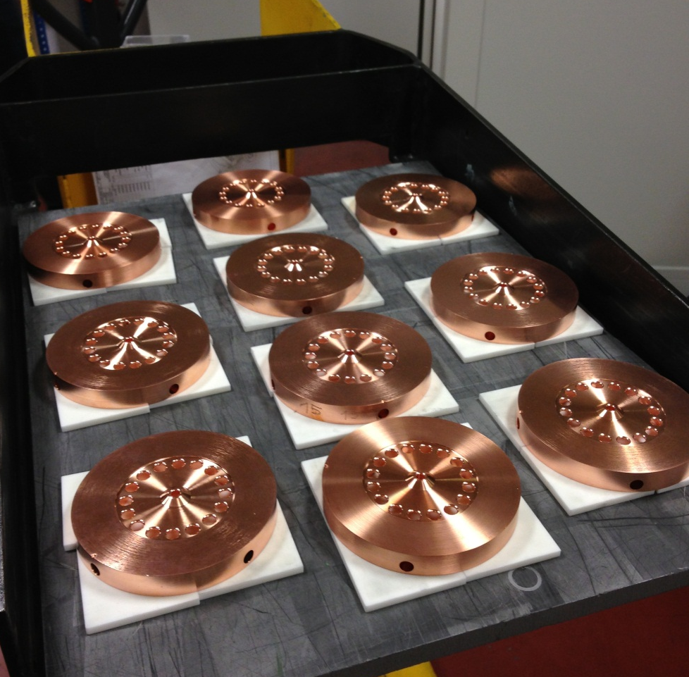
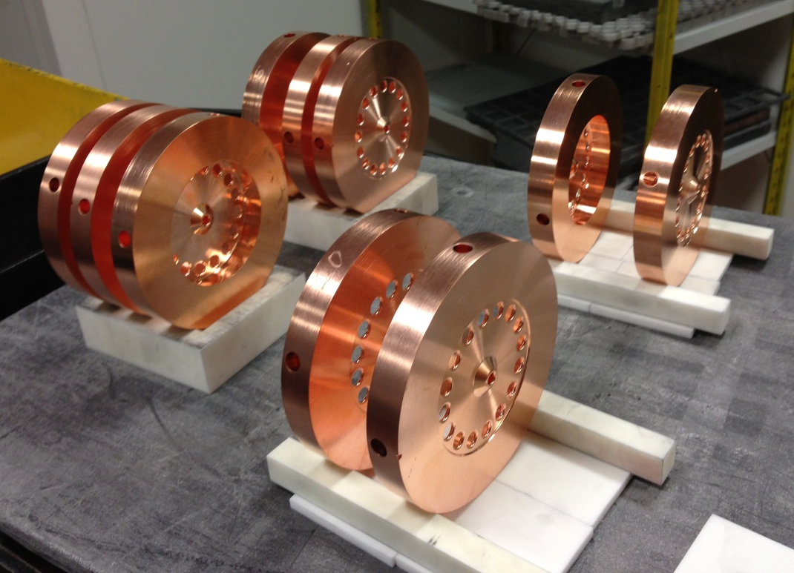
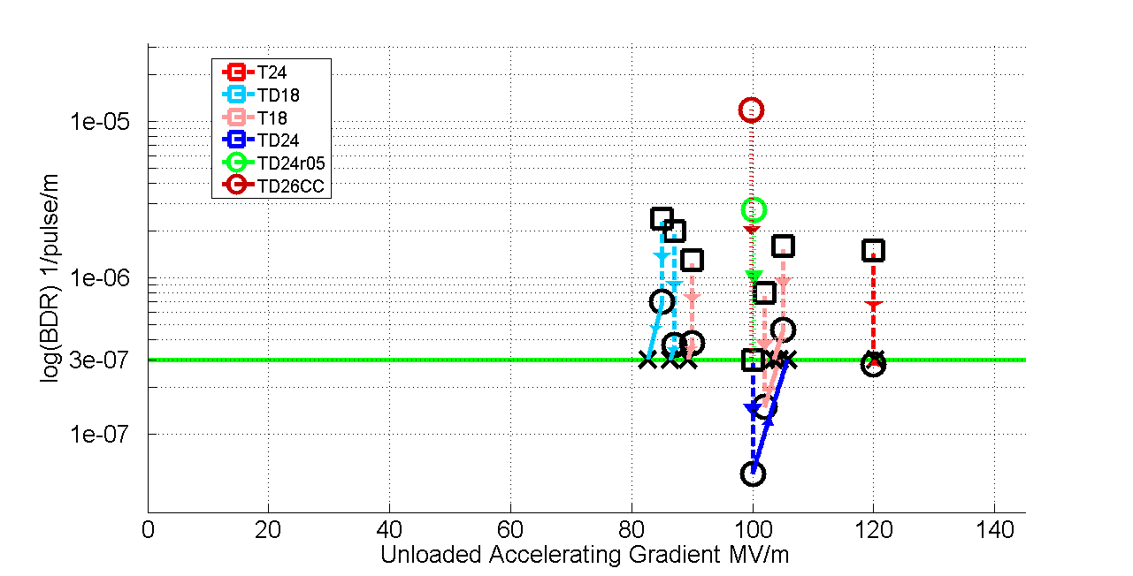
Parameters, Design and Implementation:
  Integrated Baseline Design and Parameters
  Cost and power optimisation in design and technological developments, optimal stages
  Links to experimental programme and integrate experimental results
Main activities
X-band Technologies
High gradient structures and high eff RF
New X-band High power Testing Facilities (x3)
Use of Xband technologies for FELs
Xband disk, Xband teststand

Slide 20
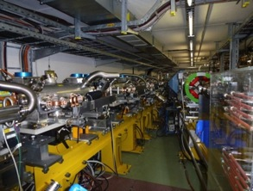






Experimental verification
Drive Beam and two beam scheme (CTF3)
Low emittance ring tests – low emittances
System Tests: ATF – final focus, FACET and FELs – beam based alignment and emittance preservation in linacs (see later)
Main activities
Technical Developments
Key components for systemtests, machine performance, cost or power reduction
Module into CTF
QD0, nm-stabilization, BPM, NbTi wiggler

Slide 21


Xband facilities - FELs
X-band technology appears interesting for compact, relatively low cost FELs – new or extensions
  Logical step after S-band and C-band
  Example similar to SwissFEL: E=6 GeV, Ne=0.25 nC, σ_{z}=8μm
Use of X-band in other projects will support industrialisation
  They will be klystron-based, additional synergy with klystron-based first energy stage
Started to collaborate on use of X-band in FELs
  Australian Light Source, Turkish Accelerator Centre, Elettra, SINAP, Cockcroft Institute, TU Athens, U. Oslo, Uppsala University, CERN
Share common work between partners
  Cost model and optimisation
  Beam dynamics, e.g. beam-based alignment
  Accelerator systems, e.g. alignment, instrumentation…
Define common standard solutions
  Common RF component design, -> industry standard
  High repetition rate klystrons (500Hz soon to be ordered for CLIC)
Great potential for collaboration

Slide 22





Main Linac Tolerances
Performance verifications – CLIC
Stabilise quadrupole
O(1nm) @ 1Hz
1) Pre-align BPMs+quads
accuracy O(10μm) over about 200m
3) Use wake-field monitors accuracy O(3.5μm) – CTF3
2) Beam-based alignment
Test of prototype shows
  vertical RMS error of 11μm
  i.e. accuracy is approx. 13.5μm

Slide 24
ATF2: Stabilisation Experiment
The CLIC coll. is very interested in a longer term programme at ATF2 and ideas exist for:
Building 2 octupoles for ATF2 (to study FFS tuning with octupoles)
Test of OTR/ODR system at ATF2
Test and use of accurate kicker/amplifier system is considered
General support for ATF2 operation

Slide 25

LC costing (from ILC TDR and CLIC CDR)
 | M&S Value (Ratio) | M&S Value (GILCU) | Labor (M person-hr)
RDR-2007 | 1 | 6.31 ¹⁾ | 24.4
RDR-2012 (15% inflation) | 1.15 | 7.27 ¹⁾ | 24.4
TDR-2012 average for 3 region | 1.23 | 7.78 ¹⁾ | 22.6
TDR- (Asia) mountain site | 1.26 | 7.98 ¹⁾ | 22.9
ILC costing 500 GeV
CLIC costing 500 GeV
1) Estimated by using PPP (purchasing power parity) methodology established by OECD
2) Conversion to Japanese Yen: using currency exchange rates
- assuming a model with 100JYen/USD, 115 Jyen/Ero
＊Budget not included, above: Project preparation, Operation, Detectors

Slide 26


e+/e- Colliders: P_{AC} vs E_{CM}
Power reductiions are being looked at (ILC more optmised than CLIC):
Design and parameters – optimise power
Look at key components – magnets
Klystron and modulator efficiences
Optimisation
Recover energy
Consider where the power is dissipated (distributed or central)
Look at daily and yearly fluctuation – can one run in “low general demand” periods
Understand and minimize the energy (consider also standby, MD, down periods, running scenarios
CERN energy consumption 2012: 1.35 TWh
26

Slide 27



Linear Collider Physics and Detectors
Main activities since publication of CLIC CDR (2012) and ILC DBD (2013)
Detector R&D (fine-grained calorimetry, pixel R&D, TPC tracking)
Detector optimisation
  Optimise performance, integrate R&D knowledge, reduce occupancies and cost
Physics studies
  Precision Higgs physics
  Precision Top physics <= emphasized in this talk
  BSM physics

Slide 28
Linear Collider Detector R&D
Very active R&D area, with spin-off within particle physics and to other fields
For example CMOS detectors are used in STAR and ALICE, DEPFET in Belle II, fine-grained calometry being considered for CMS …..

Slide 29
MEXT’s Organization for Studying ILC based on SCJ’s Recommendations
SCJ
Recommendation in 2013
MEXT
ILC Taskforce
formed in 2013
Academic Experts Committee
formed in 2014
Particle & Nuclear Phys.
Working Group
formed in 2014
TDR Validation
Working Group
formed in 2014

Slide 30
Schedule for Committee and WGs
Experts committee
 | date
1 | 5/8
2 | (11/14)
Physics WG
 | date | Subject
1 | 6/24 | Status of Particle Physics and ILC physics overview
2 | 7/29 | Future prospect in the US and in Europe
3 | 8/27 | Cosmic-ray and Astrophysics, and ILC
4 | 9/22 | Flavor and Neutrino physics, and ILC
5 | 10/21 | Interium summary to be input to the Experts Committee
TDR Validation WG
 | date | Subjects
1 | --- | Overview
2 | --- | ML and SRF
3 | --- | SRF Q&A,, CFS
4 | --- | (Schedule and Project Management including Cost and Human Resource)
Additional:
MEXT has issued a call for tender for a company to investigate technology spin-off and economic ripple effects from ILC.
A report is due 31 March 2014.

Slide 31


Site specific studies
Establish a site-specific Civil Engineering Design - map the (site independent) TDR baseline onto the preferred site - assuming “Kitakami” as a primary candidate
High-way
Proposed by JHEP community
Endorsed by LCC
Not yet decided by Japanese Government
Ofunato
Oshu
Express-
Rail
Kesen-numa
Sendai
Ichinoseki
Need to finalize:
IP / Linac orientation and length
Access points and IR infrastructure
Conventional Facilities and Siting (CFS)
…

Slide 32




ILC preferred site - Kitakami
From Enomoto et al

Slide 33

ILC pre-construction work scope
Current Status: Facility Planning Progress – CFS View
 | Underground Facilities
Work | ML | AH | DR | BDS | DH
Facility Arrangement | B/C | B/C | C | C | B/C
Basic Shape, Dimension | B/C | B/C | B/C | C | B/C
Civil/Architectural Design | C | C | C | C/D | C
Electronic Design | C | C | C | C/D | C
Mechanical Design | C | C | C | C/D | C
Surface Facilities
AY | CS | CC
D | C | D
D | C | D
D | C | D
D | C | D
D | C | D
Legend: Progress degree
Legend: Facility
 | Requirement | Technical Study
A | Clear | Completed
B | Clear | Under study
C | Unclear(50%) | Partially executed
D | Unclear | Not yet started
 | Technical Study
AH | Access Hall
AY | Access Yard
CS | Central Substation
CC | Central Campus
From Miyahara et al

Slide 34
Key points
The ILC and CLIC accelerator studies are organised under the heading of LCC with goals:
Strongly support the Japanese initiative to construct a linear collider as a staged project in Japan
Prepare CLIC machine and detectors as an option for a future high-energy linear collider at CERN
Further improve collaboration between CLIC and ILC machine experts
Beyond the significant progress on the basic RF studies, increased and successful effort on system-studies of various types (FACET, ATF, etc)
Many common challenges with 3rd generation light sources and FELs, the latter providing very important industrial/lab production experiences
Comprehensive physics studies – and in parallel technical detector R&D and concept studies – demonstrate the realism and unique impact of LC e+e- measurements and searches at energy scales from 250 to 3 TeV
The on-going process in Japan for ILC is nevertheless (by some margin) the most central activity right now

Slide 35
Thanks
Slides/figures/advice from LCC collaboration members and others
Knowingly from M.Harrison, A.Yamamoto, L. Linssen, J.Fuster, A. Latina, L. Evans, K.Kubo and ATF colleagues, D.Schulte, Y.Yamamoto, W.Fang, W.Wuensch and Xband team, M. Miyahara, N.Walker, T.Lefevre, M.Modena, R.Tomas, G.D’Auria … probably several more unknowingly
Please see also talks yesterday concerning SM physics, Higgs and BSM (Rohini Godbole, Kerstin Tackmann, Monica D’Onofrio)

Slide 37

ILC TDR 2013
Text about TDR and picture
http://www.linearcollider.org/ILC/Publications/Technical-Design-Report

Slide 38
CDR 2013 -> input to strategy processes
Vol 1: The CLIC accelerator and site facilities
- CLIC concept with exploration over multi-TeV energy range up to 3 TeV
- Feasibility study of CLIC parameters optimized at 3 TeV (most demanding)
- Consider also 500 GeV, and intermediate energy range
- https://edms.cern.ch/document/1234244/
Vol 2: Physics and detectors at CLIC
- Physics at a multi-TeV CLIC machine can be measured with high precision, despite challenging background conditions
- External review procedure in October 2011
- http://arxiv.org/pdf/1202.5940v1
Vol 3: “CLIC study summary”
- Summary and available for the European Strategy process, including possible implementation stages for a CLIC machine as well as costing and cost-drives
- Proposing objectives and work plan of post CDR phase (2012-16)
- http://arxiv.org/pdf/1209.2543v1
In addition a shorter overview document was submitted as input to the European Strategy update, available at:
http://arxiv.org/pdf/1208.1402v1
Input documents to Snowmass 2013 has also been submitted:
http://arxiv.org/abs/1305.5766 and
http://arxiv.org/abs/1307.5288

