Slide 1
国家重大科技基础设施中长期发展规划 — 十二五建设项目建议
强流重离子加速器
High Intensity Heavy-ion Accelerator Facility
杨建成
中国科学院近代物理研究所
SAP 2014, 兰州
Notes:
1

Slide 2
主要内容
项目意义和必要性
项目建设内容
项目关键技术与挑战性
项目造价、进度、选址

Slide 3
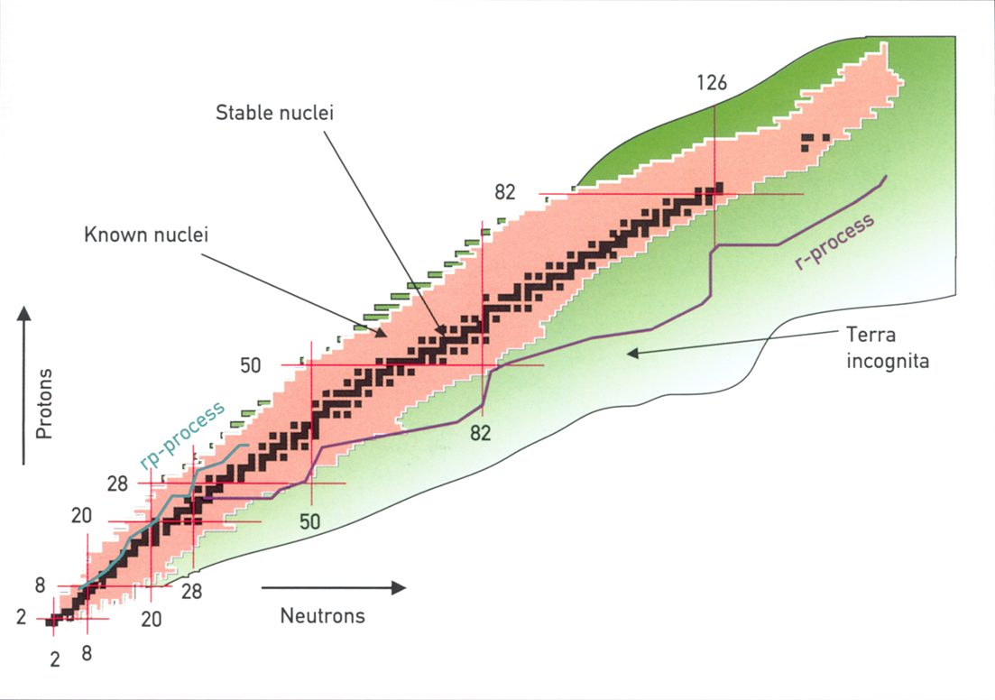
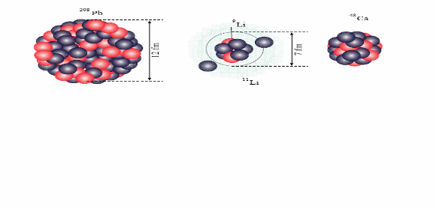
原子核层次的前沿科学问题
项目提出的背景
物质层次
传统知识主要来自于对稳定原子核的研究(～300)
放射性核束带来了新现象、新规律的发现
前沿科学问题
探寻原子核存在的极限
新现象、新规律
宇宙中重元素来源
…
⇓
高强度RIB
²⁰⁸Pb
¹¹Li
RIB强度最高者占领制高点

Slide 4
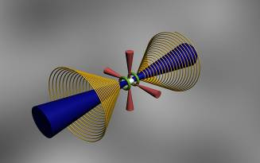
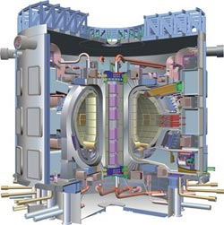
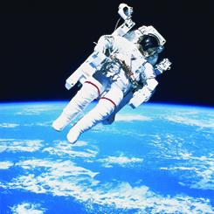
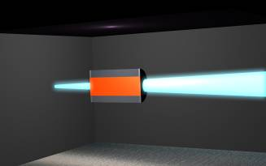
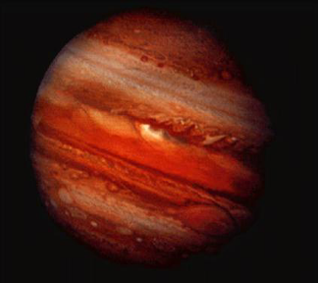
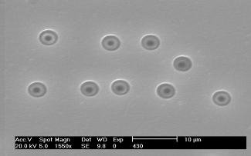
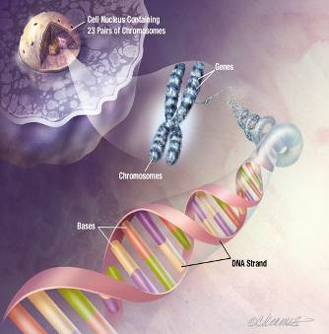
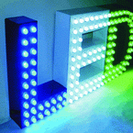
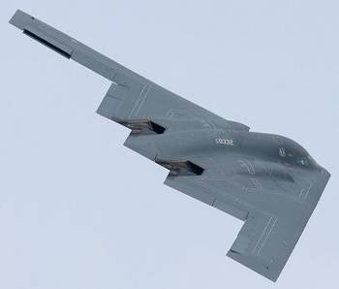
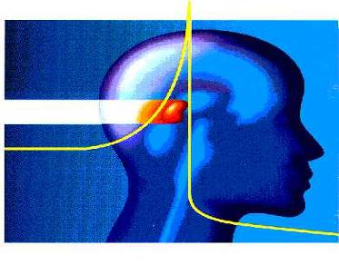
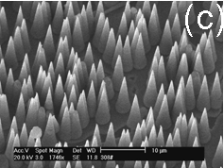
项目提出的背景
经济社会发展高技术需求
先进能源相关材料
高能量密度物理
空间辐照效应
重离子的特点
物理特点：种类丰富、能量沉积大、…
生物特点：生物效应大、突变率高、…
技术特点：易操控、可精确定位、…
物态研究
微生物与作物
离子径迹与纳米技术
生物学
特殊功能材料
生命科学

Slide 5
项目提出的背景
HIAF的定位
两个面向
基础研究：
提供高强度放射性核束使我国核层次上的物理研究全面进入国际领先行列。
提供高功率重离子束团开展高能量密度物理以及新物态探索。
应用研究：
面向国家战略需求，利用重离子的特点，为解决航天、核能等领域的瓶颈问题做出重大贡献。
Notes:
不分开

Slide 6
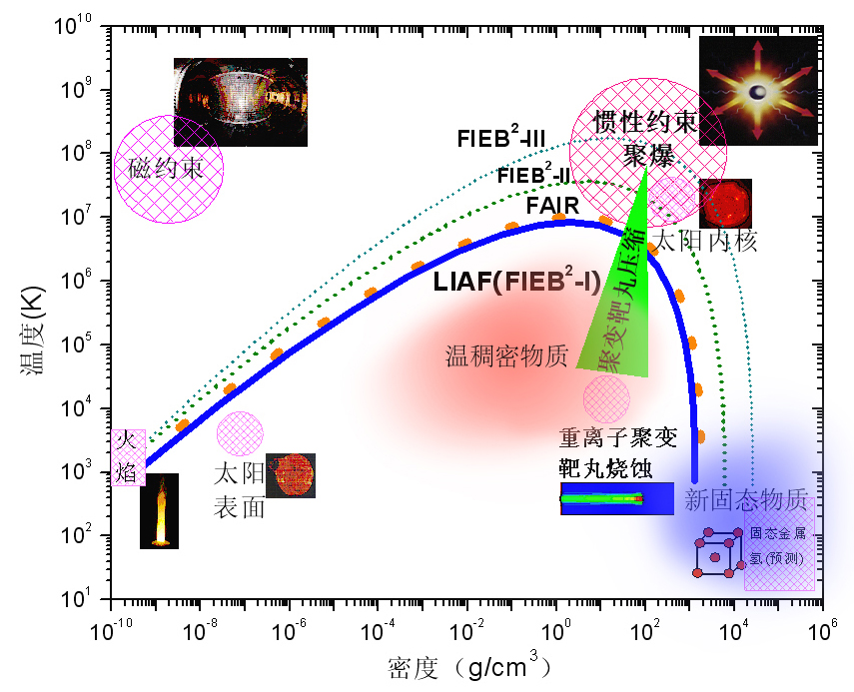
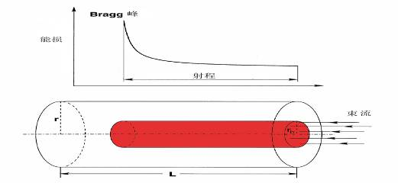
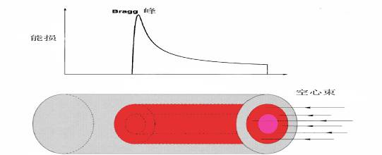
主要科学目标举例
高能量密度物理研究
高能量密度物理研究有非常重大的应用前景：
新物态的探索；
惯性约束核聚变；
…
重离子束具有能沉积率高、可对大块物质进行操作等特点，是一种与激光互补的新的研究手段。
要求：高功率束团
冲击波压缩
等熵压缩

Slide 7
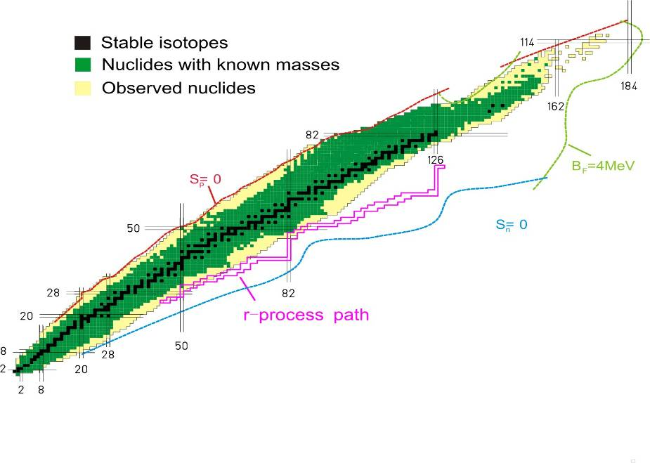
主要科学目标举例
短寿命核质量的精确测量
质量是原子核最基本的性质之一，不同精度的原子核质量数据揭示不同层次的物理规律。同时还涉及“宇宙中元素铁到铀是如何形成的”这一重大科学问题。
δm/m ~ 10⁻⁵ - 10⁻⁶
一般的化学、物理规律
δm/m ~ 10⁻⁶ - 10⁻⁸
核模型，核存在的极限
天体核合成，爆发性天体现象
δm/m ~ 10⁻⁸ - 10⁻¹⁰
对称性检验
预言有6000~8000种核素，仅近2300种有不同精度的质量数据，而未知质量核素的寿命大多在毫秒量级一下。
要求：强流放射性核束产生装置；飞行中测量
Notes:
超重在合适的地方谈出来，
非稳定核或短寿命
反应堆的精细设计（－5～－6的精度）
放射性核束的应用，专门作为一个目标（ADS靶系统放射性束示踪、…）

Slide 8
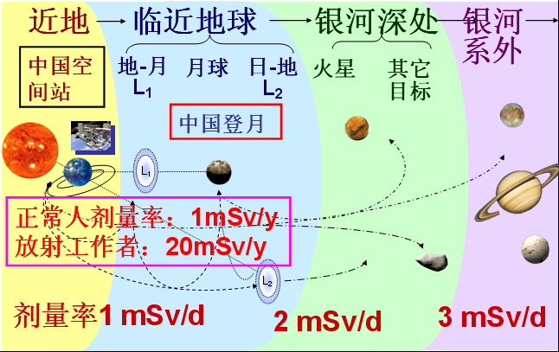
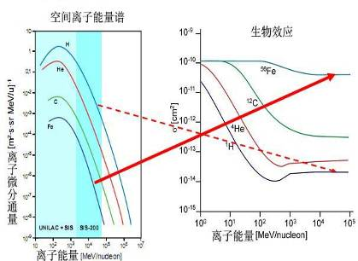
主要科学目标举例
空间离子辐射生物学
深空飞行离子辐射的特点：低剂量率、高LET值、照射周期长等，而且高能重离子(HZE)比例增加。
效应未知！重离子束流是HZE离子地面模拟的唯一途径
10 MeV~ 10 GeV
要求：几十MeV/u~几个GeV/u的重离子束流

Slide 9
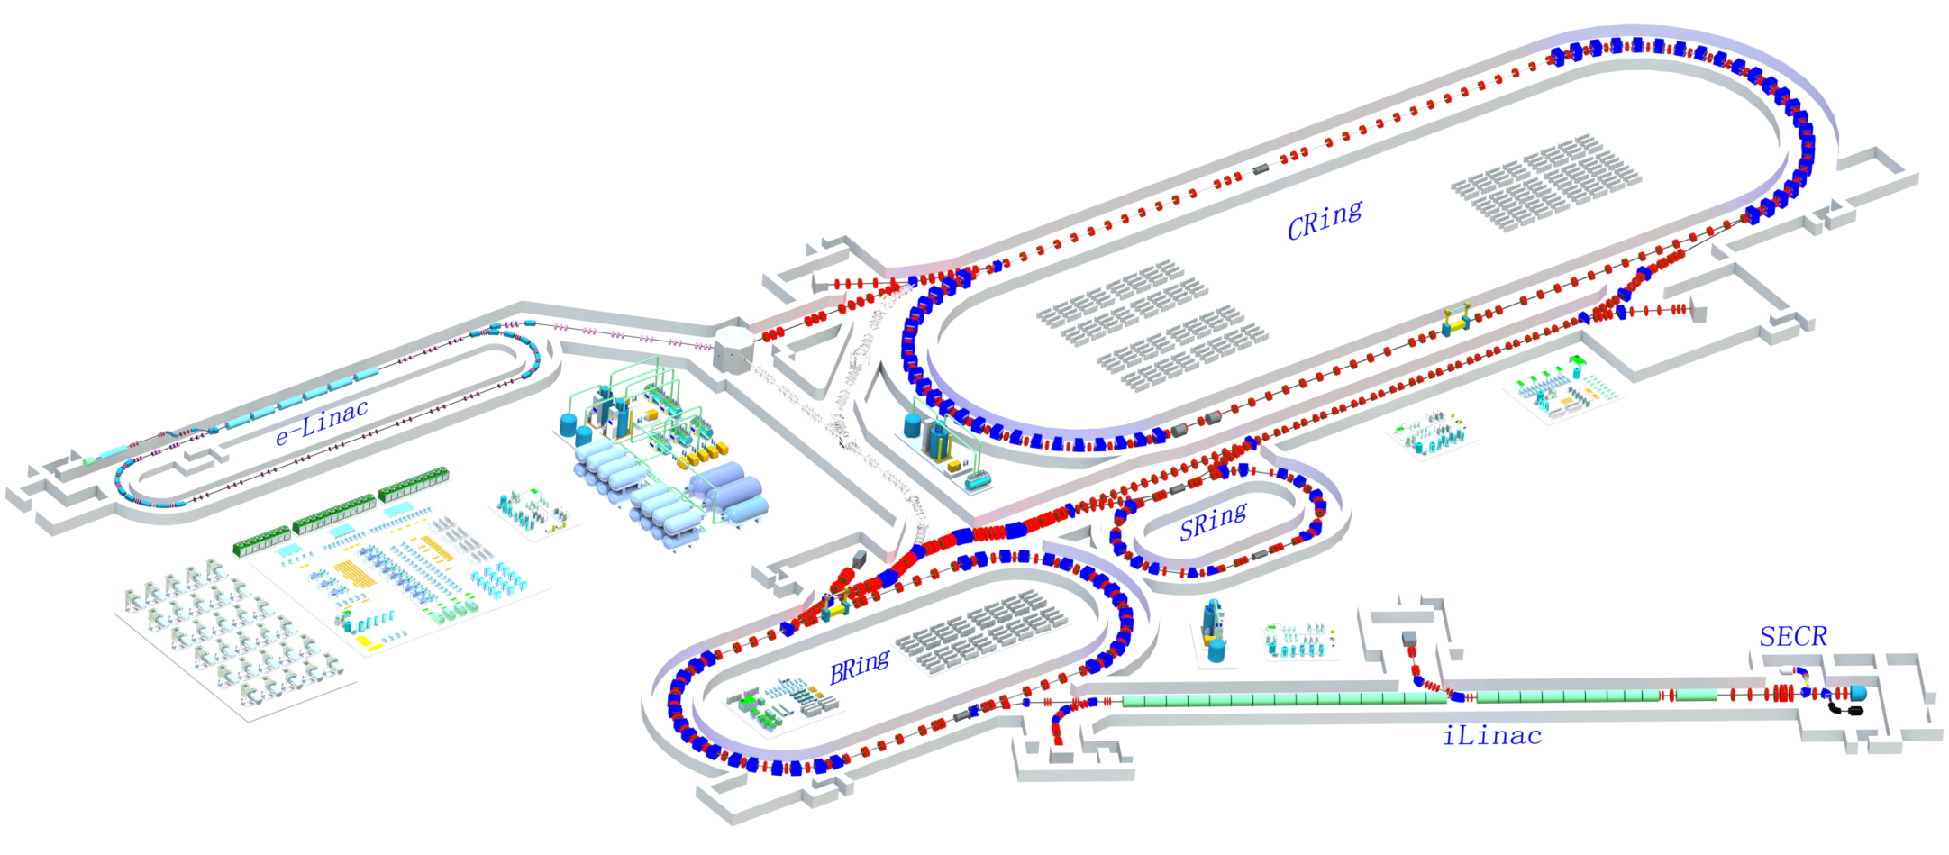
HIAF装置总体方案
强流脉冲超导重离子直线 +大接受度增强器 +超短束团压缩储存环
脉冲流强最
高超导直线
注入能量最高
累积流强最高
纳秒束团压缩
高能束流冷却
Notes:
多功能辐照站加墙；直线U字形（低能段拐回）；FRS型设计
两个注入点
破折线（双弯弯）去掉
材料线站换图

Slide 10
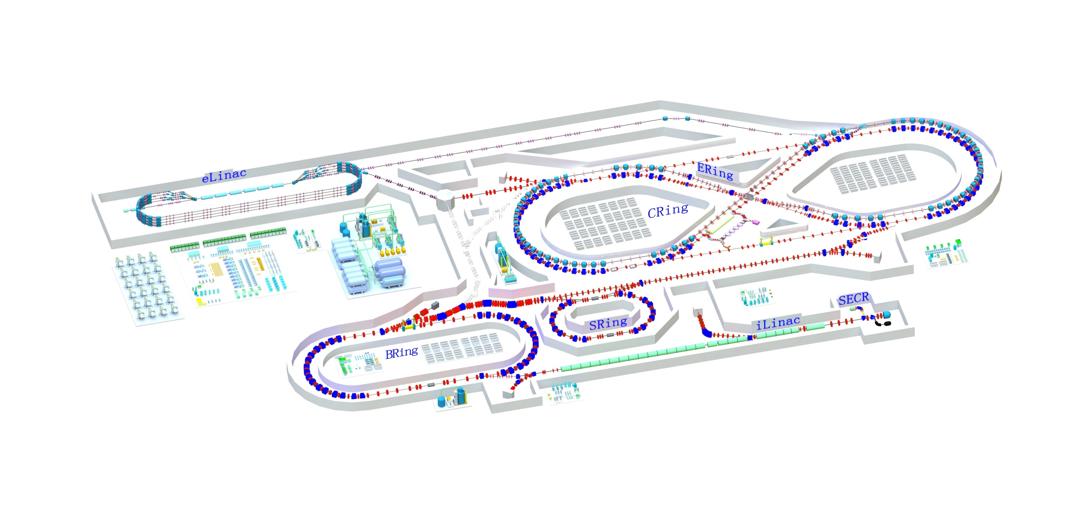
HIAF装置总体方案
强流脉冲超导重离子直线 +大接受度增强器 +超短束团压缩储存环 + 高亮度EIC
脉冲流强最
高超导直线
注入能量最高
累积流强最高
纳秒束团压缩
高能束流冷却
双极化
高能电子冷却
Notes:
多功能辐照站加墙；直线U字形（低能段拐回）；FRS型设计
两个注入点
破折线（双弯弯）去掉
材料线站换图

Slide 11
HIAF主要指标
先进性与创新性
iLinac 提供最强的高电荷态重离子脉冲束流
CRing 产生最高功率短脉冲高能重离子束团
SRing 制备高品质放射性束开展高精度实验
离子 | 最高能量 (GeV/u) | 脉冲流强（ppp）
p | 12.0 | 8.0×10¹²
¹⁸O⁶⁺ | 3.2 | 4.0×10¹²
⁷⁸Kr¹⁹⁺ | 2.2 | 2.4×10¹²
²³⁸U³⁴⁺ | 1.1 | 1.0×10¹²
  与HIRFL相比
  与德国FAIR相比
  能量 ~ 10倍， 流强 ~ 1000倍
  放射性束流强 1000 ~ 10000倍
  能量沉积率 1000 ~ 10000倍
  流强 ~ 2.5倍， 能量沉积率 ~ 3倍
  高能电子冷却（0.5-1.0mm束班）
  高能电子/质子束诊断
兰州重离子研究装置
德国反质子与离子研究装置
Notes:
In用激光离子源：10^12为隐性目标。
HIRFL指标：输出能量20J, 能量沉积率0.1J/g
SIS18指标：输出能量60J, 能量沉积率1kJ/g
SIS100指标：输出能量6kJ, 能量沉积率100kJ/g
LIAF指标：输出能量10kJ, 能量沉积率<200kJ/g
入射粒子种类 Kr
能量 0.4 GeV/u
束流强度 1*10^12 ppp
束流总能量 5.3kJ
纵向长度 100ns
束流功率 53GW
束斑直径 <1mm / 0.15~1mm
单位沉积能量 46kJ/g

Slide 12
HIAF装置建设内容
SECR- high current SC ECR source
iLinac- high current SC pulse ion Linac
BRing- booster synchrotron
CRing- compression synchrotron
SRing- high precision spectrometer

Slide 13
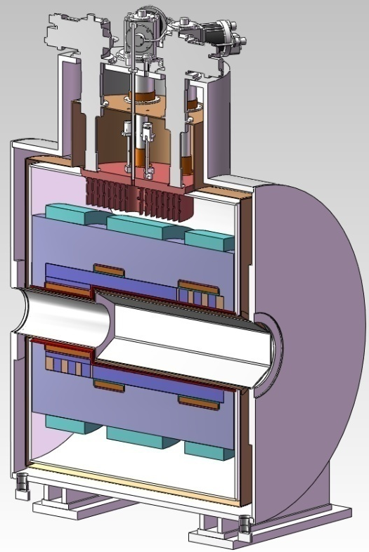
HIAF装置建设内容
SECR
Ion | Energy（keV/u） | Particle current （pmA） | Ion Current （mA） | mode | Repetition rate （Hz） | Pulse length （ms） | Source
¹⁸O⁶⁺ | 14 | 0.30 | 1.80 | pulse | 5 | 1 | SECR
⁷⁸K¹⁹⁺ | 14 | 0.08 | 1.52 | pulse | 5 | 1 | SECR
²³⁸U³⁴⁺ | 14 | 0.05 | 1.70 | pulse | 5 | 1 | SECR
H₂⁺ | 14 | 2.0 | 2.00 | pulse | 5 | 1 | LIPS

Slide 14
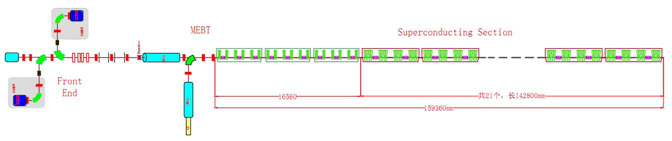
HIAF装置建设内容
iLinac
Features: SC, high charge state, high pulse current
LEBT:
QWR:
Beam parameters of iLinac
RFQ:
Output energy:1.5MeV/u
Number of cavity:18 Number of solenoid:9
Number of CM:3
Length:14.94m
Input energy:0.014MeV/u
Output energy:0.5MeV/u
RFQ length:6m
Ions | Charge to mass ratio | Energy（MeV/u）
²³⁸U³⁴⁺ | 1/7 | 25
⁷⁸Kr¹⁹⁺ | 19/78 | 45
¹⁸O⁶⁺ | 1/3 | 57
H₂⁺ | 1/2 | 70
HWR1:
HWR2:
Output energy:5MeV/u
Number of cavity:42 Number of solenoid:21
Number of CM:7
Length:38.43m
Output energy:25MeV/u
Number of cavity:96 Number of solenoid:24
Number of CM:12
Length:80.88m

Slide 15
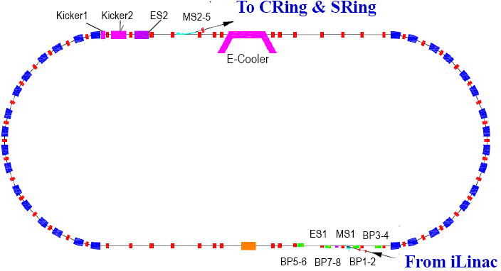
HIAF装置建设内容
BRing
Main functions
Beam accumulation
  Two planes painting injection
  Accumulate U³⁴⁺ to 5.0×10¹¹
Beam Cooling
High current fast electron cooling
Beam acceleration
Main parameters
Circumference: 402 m
Rigidity: 34 Tm
Acceptance: 250/120 pimmmrad
Aperture: 230/115 mm
Injection current: 0.028pmA (U³⁴⁺)
In-Energy: 25MeV/u (U³⁴⁺)
Ex-Energy: 0.8GeV/u (U³⁴⁺)
Pulse intensity: 3.3×10¹¹ ppp
Super-ferric dipole with warm iron yoke

Slide 16
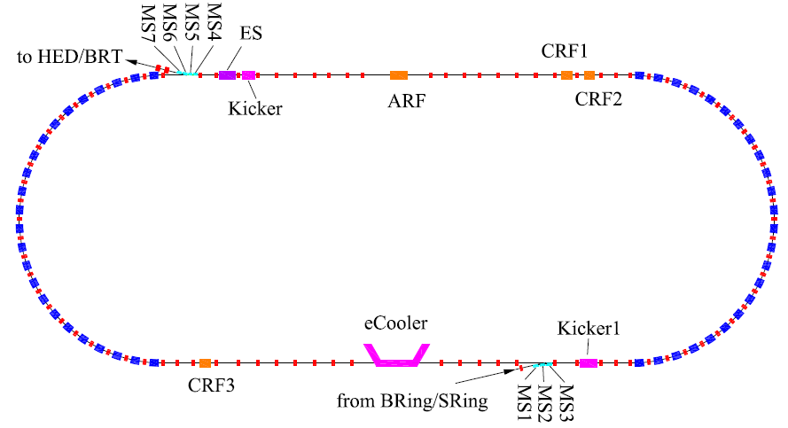
HIAF装置建设内容
CRing
Barrier bucket stacking
Beam cooling
  Beam compression
Beam acceleration
In-beam experiment
Circumference: 800 m
Rigidity: 43 Tm
Main features of CRing
Barrier bucket stacking U³⁴⁺ beam to 1.0×10¹² ppp
Beam compression to provide 50-150 ns pulse beam
Beam cooling to reach 0.5-1mm beam size

Slide 17
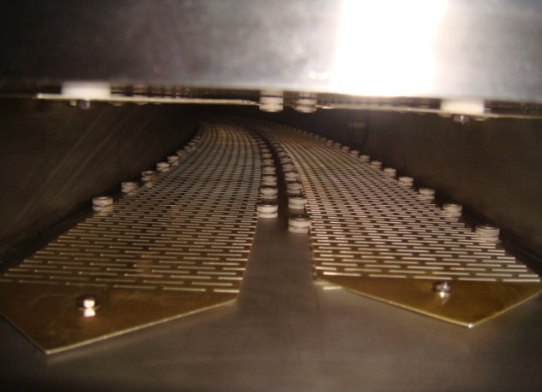
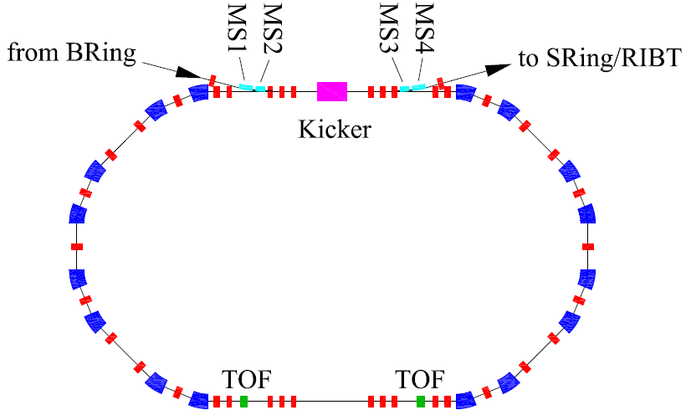
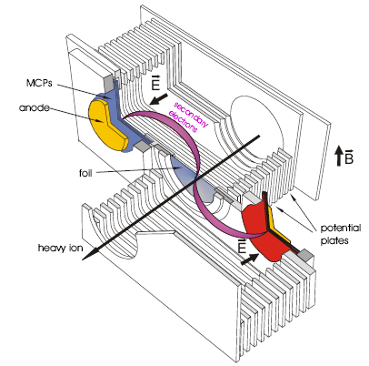
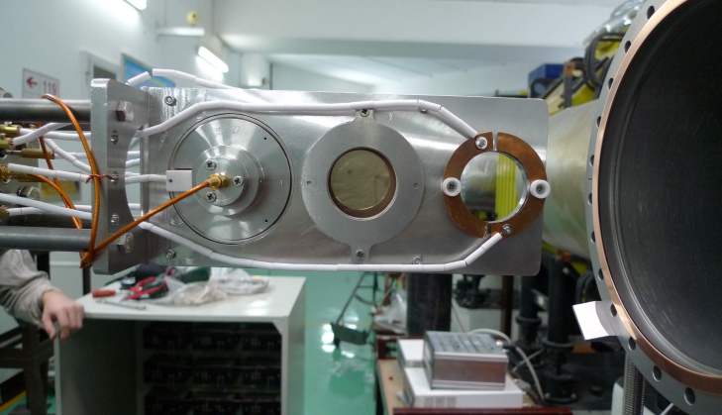
HIAF装置建设内容
SRing
Mass measurements for short-lived secondary rare isotope beams
Collect and cool the isotope beams from the beam line
Storage beam for internal target experiment
Circumference:188.7m
Rigidity: 13Tm
Electron/Stochastic cooling
Two TOF detectors
Three operation modes

Slide 18
HIAF加速器关键技术与挑战性
High current SC ECR source
High current SC pulse ion Linac
Two planes painting injection
High intensity introduced beam loss
Longitudinal barrier bucket stacking
Ultra-short bunch compression

Slide 19
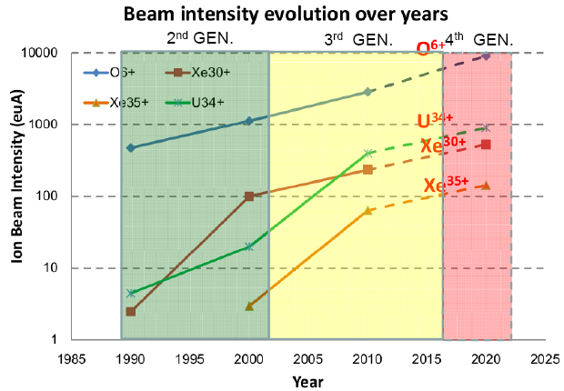
HIAF加速器挑战性-1
Challenges of SECR
None of existing highly charged ion sources can meet HIAF requirements for the moment
But the 4th Generation ECRIS seems to provide a feasible solution
Ion | Bi³⁰⁺ | U³⁴⁺
HIAF Beam Intensity (euA) | 1500 | 1700
World Record Intensity (euA) | 422 | 400
3rd Generation Sources | SECRAL/24 GHz
Gain for HIAF | 3.6 | 4.2
Critical Issues for 4th Generation SECR:
High field B-min configuration magnet
Efficient coupling to the plasma of 10-20 kW/50-60 GHz microwave power
Intense high charge state ion beam (20-40 emA) extraction and transmission；
Ion beam quality and stability from the ion source working at 10-20 kW/50-60 GHz

Slide 20
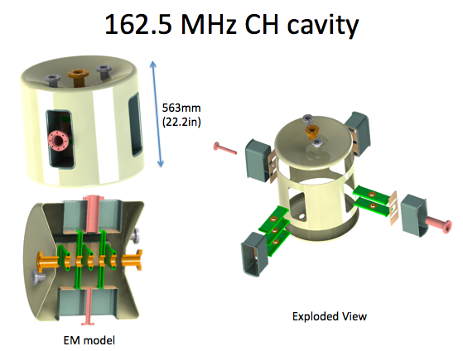
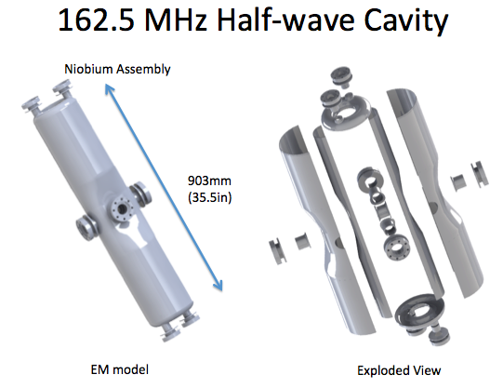
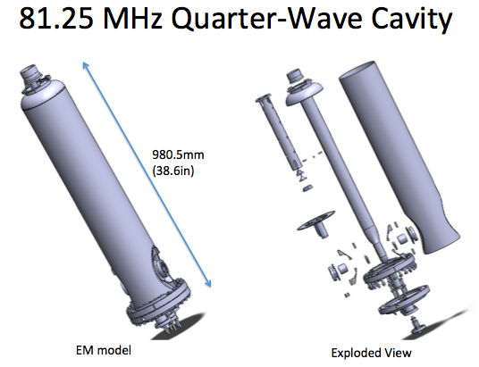
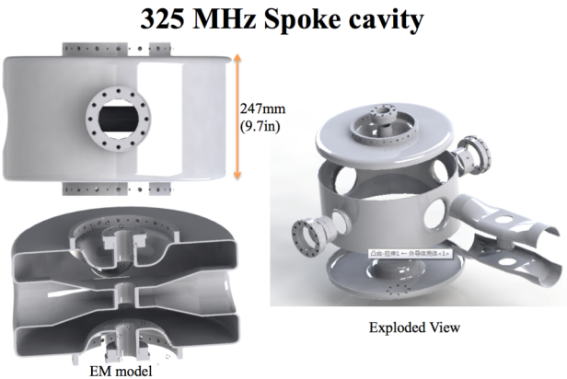
HIAF加速器挑战性-2
Challenges of iLinac
Highest peak current pulse for superconducting ion linac in the world,
the peak current is four times of the FRIB (CW mode)
Low-Beta SRF cryomodules design and prototype development.
There are four types of superconducting cavities developed at IMP
The average uncontrolled beam loss should be limited to below 1 W/m level

Slide 21
HIAF加速器挑战性-3
High intensity effect- Space charge limit
_{ΔQ}^{sc} _{: tune} shift limit by the space charge field of ion beam
εx,y : emittance or acceptance, rp : classical proton radii
_{Bf : bunching factor,} _{equals to 1 for coasting beam}
g1: a constant related to transverse distribution, here it’s 1.4
Injection
energy
Operation
mode
Injector
design
Space
charge
limit
High space charge limit requires high injection energy and low charge state.
Low charge state and high energy mean high cost for the injector
Charge
state
Work point
Dynamic
vacuum

Slide 22
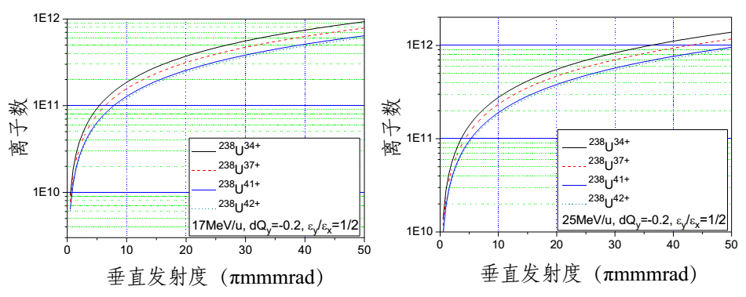
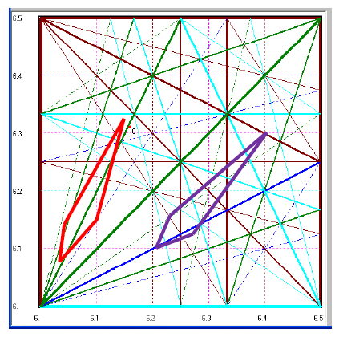
High intensity effect-Space charge limit
R&D
Ions | Energy（MeV/u） | SCL intensity
p | 100 | 2.1×10¹³
¹²C⁶⁺ | 75 | 5.1×10¹²
¹⁶O⁸⁺ | 50 | 2.4×10¹²
⁷⁸Kr²⁹⁺ | 40 | 7.1×10¹¹
²³⁸U³⁴⁺ | 17 | 6.5×10¹¹
²³⁸U³⁴⁺ | 25 | 9.6×10¹¹
²³⁸U³⁴⁺ | 50 | 2.0×10¹²
SCL Intensity
Two work points is considered:
(6.17,6.32) and (6.41,6.31)
Incoherent space charge tune shift:
△Q_{y} =-0.2
Challenge:
The incoherent tune shift is tolerable for relatively short “waiting time”
The maximum tolerable tune shifts for long dwelling time (accumulation time in the presence of electron cooling ), how much?

Slide 23
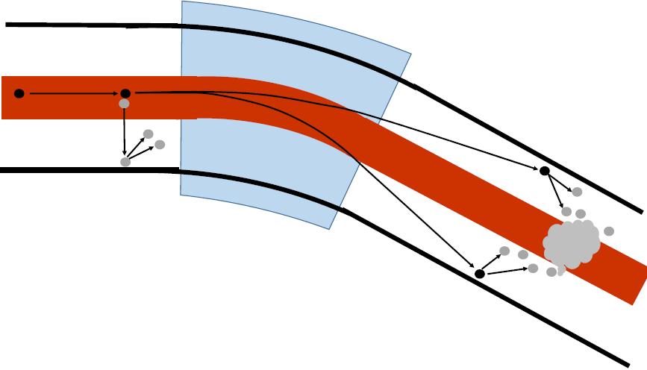
HIAF加速器挑战性-3
High intensity effect- Dynamic vacuum
Bending magnet
Beam loss mechanism:
Charge exchange of intermediate charge state ions (²³⁸U³⁴⁺) due to collision
q-1
q+1
Charge exchange processes:
Electron loss and capture
Desorption from the
gas-covered chamber wall
Probability depends on residual gas density, gas composition, and beam energy. Involved ions are lost and drive a pressure bump and self amplification can develop to complete beam loss
Challenges:
- increase pumping speed
- localize beam loss
minimize desorption

Slide 24
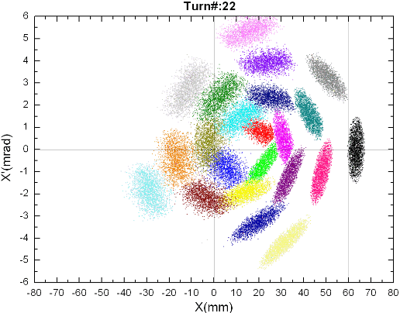
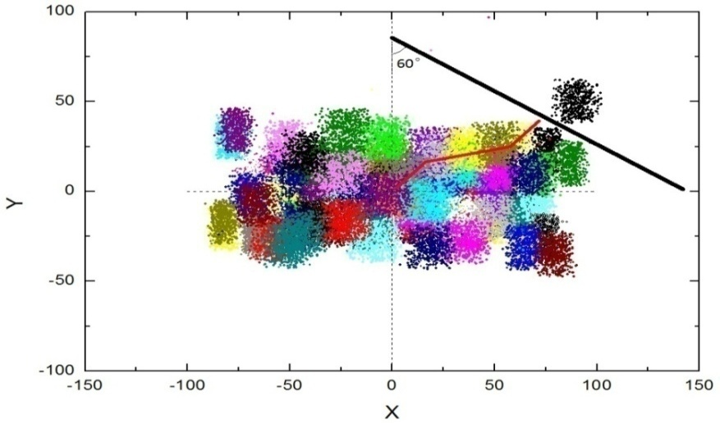
HIAF加速器挑战性-4
Two planes painting injection
Single plane injection
Two planes painting injection
ES
Dilution factor:1.5
Simultaneous injection in H and V
phase spaces using tilted septum
Correlated painting:
Two groups of orbit bump for both horizontal and vertical
Challenges:
Many dynamics designs should be studied carefully
ring lattice, injection optics match, septum angle
Non-linear space charge effect will cause
tune spread, beam halo, emittance growth
Electron cooling
No experience to use the tilted septum injection

Slide 25
Two planes painting injection
R&D
Simulation of BRing painting injection
Ions | Energy (MeV/u) | Injection current （pmA） | Plane | Injection turns | Single time | Injection times | intensity
²³⁸U³⁴⁺ | 25 | 0.028 | H | 33 | 3.3×10¹⁰ | 10 | 3.3×10¹¹
 |  |  | V | 16 | 1.6×10¹⁰ | 20 | 3.3×10¹¹
 |  |  | H+V | 150 | 1.6×10¹¹ | 2 | 3.3×10¹¹
Only one plane painting injection
10-20 times injection to reach the design intensity
Two planes painting injection
5 times of only horizontal painting injection
2 times injection can reach the design intensity

Slide 26
HIAF加速器挑战性-5
Barrier bucket stacking
Goals:
High intensity for High Energy Density Physics (HEDP)
3-4 times increase of beam intensity will be expected through barrier bucket
340MeV/u (²³⁸U³⁴⁺)
3.3×10¹¹
3-4 times
Barrier bucket
1.1GeV/u (²³⁸U³⁴⁺)
1.0×10¹²
iLinac
BRing
CRing
HEDP Terminal
Challenges:
- Fast e-cooling for high energy heavy ion
- High intensity effect
No any experience for high intensity heavy ion barrier bucket stacking

Slide 27
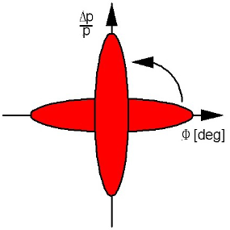

HIAF加速器挑战性-6
Beam compression in CRing
Goals:
To get the ultra-short bunch length for High Energy Density Physics
The short bunch can be obtained by fast bunch rotation
l_{f}, the last bunch length, A/q, Mass to charge ratio V_{i},V_{f} the initial voltage and compression voltage, Δp/p,the initial momentum spread
Challenges:
- Efficient e-cooling to reduce the momentum spread
- Control of the beam loss during bunch rotation
Magneto-alloy compression cavity design and fabrication

Slide 28
HIAF建设经费概算
HIAF工程造价估算
Items | Budget(100M RMB)
iLinac | 0.4+5.1
BRing | 3.2
CRing | 3.7
eLinac | 0.5
ERing
Beam transfer line | 0.5
Experiment setups | 3.3
Cryogenics | 2.05
Civil engineering | 2.45
Tunnel construction | 1.8
Contingency cost | 0.7
Total | 23.7
The local government will support the land and all infrastructure.

Slide 29
HIAF建设经费概算
HIAF工程造价估算-EIC
Items | 1st phase (100M RMB) | EIC Budget(100M RMB)
iLinac | 0.4+5.1
BRing | 3.2 | 0.1
CRing | 3.7 | 1.9
eLinac | 0.5 | 3.57
ERing |  | 4.0
High energy electron cooling |  | 1.0
Beam transfer line | 0.5 | 0.25
Experiment setups | 3.3 | 3.1 (EIC Detector)
Cryogenics | 2.05 | 1.2
Civil engineering | 2.45 | 1.73
Tunnel construction | 1.8 | 0.9
Contingency cost | 0.7 | 1.3
Total | 23.7 | 19.35

Slide 30
HIAF工程进度安排
20~ | 09 | 10 | 11 | 12 | 13 | 14 | 15 | 16 | 17 | 18 | 19 | 20 | 21 | 22
Critical Points
Design
Construction and Installation
Commissioning
Budget periods
Plan
Approval
Commissioning
Operation
Start
construction
Key technologies R&D
Idea design
Conceptual design
Design report preparation,
submission,
approval
Detailed design &
prototype
Civil construction
Equipment construction, Fabrication
Installation
iLinac, BRing, CRing commissioning
Combined commissioning
Start of operation
BP1
BP2
BP3
BP4

Slide 31
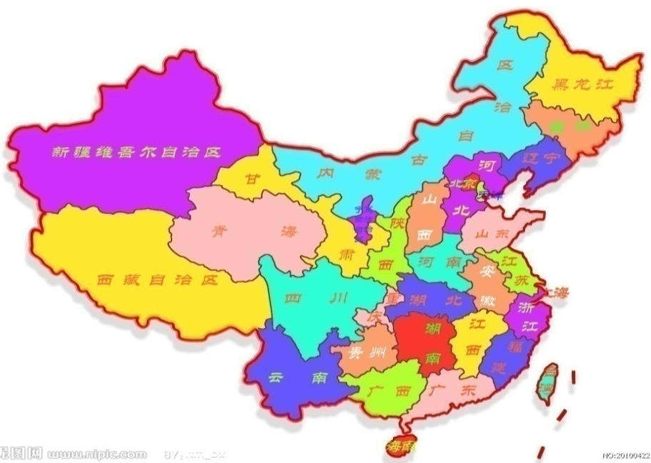
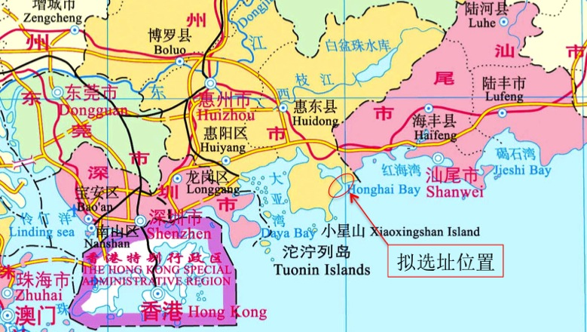
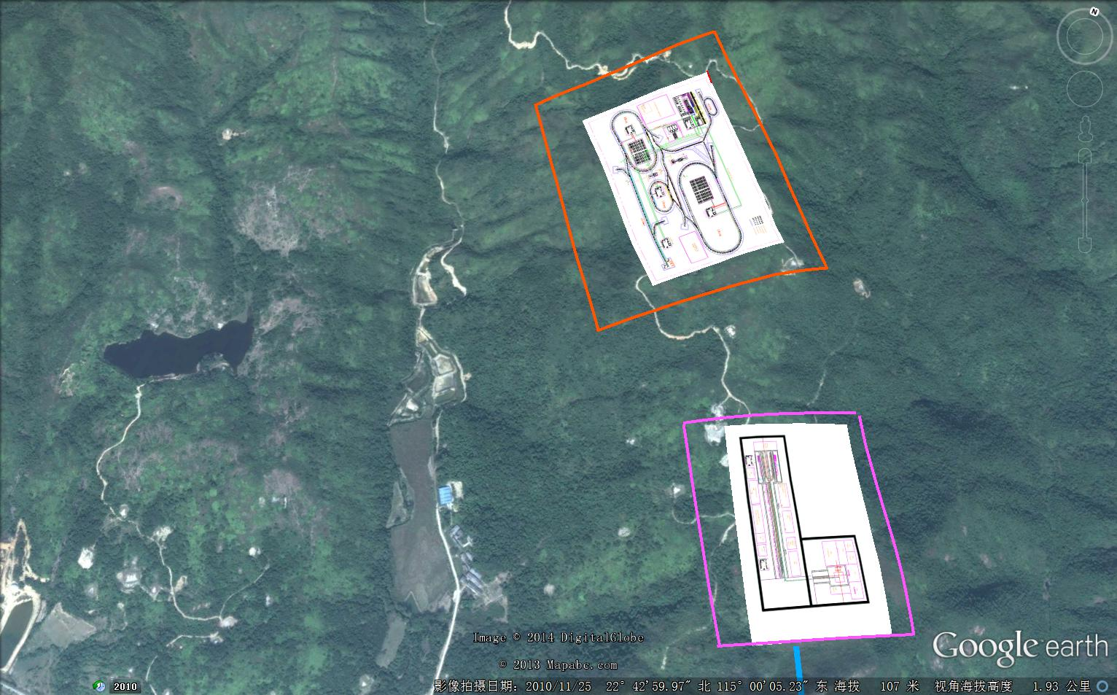
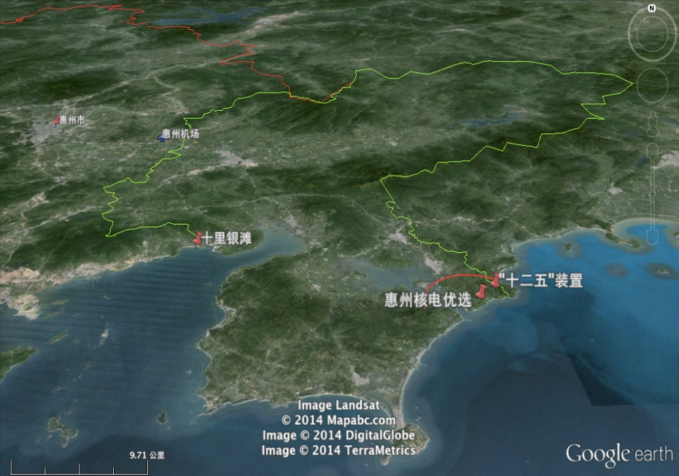
选址与院地合作：优选址
HIAF 工程选址
HIAF site
HIAF site
HIAF
HIAF site
ADS

Slide 32
谢谢！

Slide 33
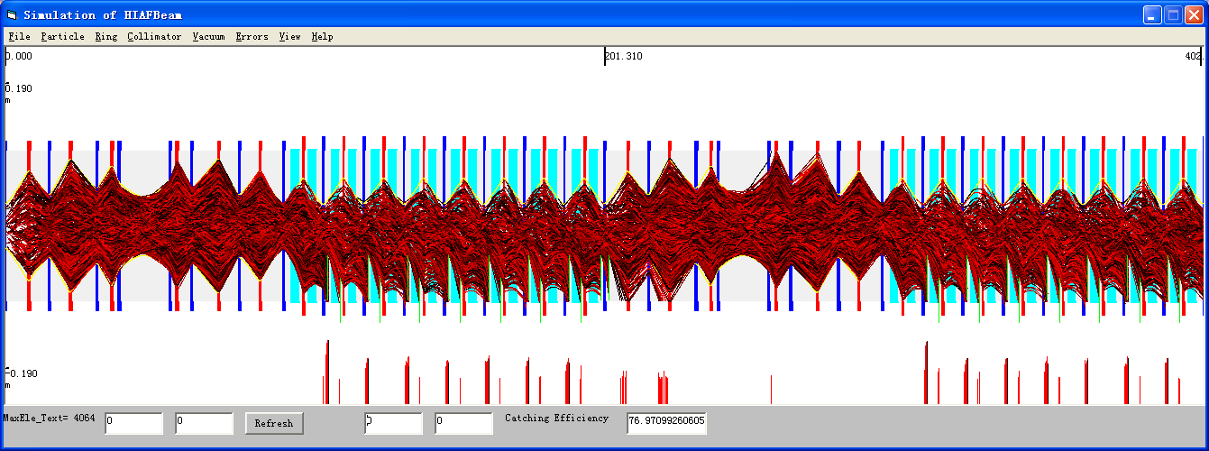
High intensity effect- Dynamic vacuum
R&D
The HIAF lattice design should be optimized to reach a high catching efficiency and keep free space for the catchers installation
quadrupole magnet
ion catcher
dipole magnet
The simulation results show the ions loss distribution is strongly localized between the quadruple and the catching efficiency is about 70%

Slide 34
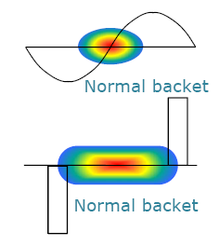
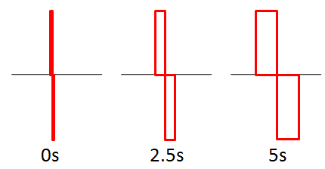
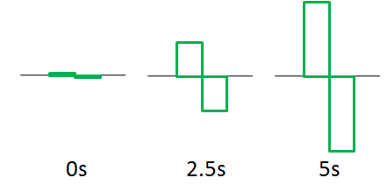
Barrier bucket stacking
Normal Bucket
Barrier Bucket
Two methods of barrier bucket manipulation:
(1) pulse manipulation (2) voltage manipulation
Pulse manipulation
Voltage manipulation
Less beam load impact
Wider band requirement
Less band requirement
More beam load impact

Slide 35
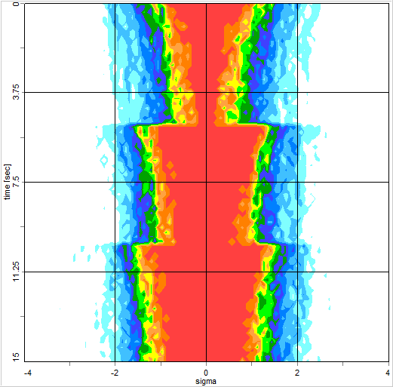
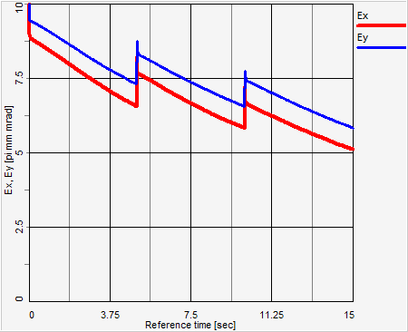

Barrier bucket stacking of CRing
R&D
Simulation of CRing barrier bucket stacking
Momentum spread
Ion species | U³⁴⁺
Energy | 340MeV/u
Particles per injection | 3.5×10¹¹
Circumference | 800m
Barrier voltage | 5kV
Cooler current | 1A
Horz. emit.,rms | 10πmm•mrad
Vert. emit., rms | 10πmm•mrad
Momentum spread | 0.5‰
Emittance
3 stackings
1×10¹²
Efficiency = 92％
Intensity

Slide 36
Application of electron cooling in HIAF
  Electron cooling plays important role for preserving the beam quality and fulfilling the experiment requirements (Beam size, etc).
  Electron cooling of BRing
  The crucial point for BRing injection.
  Electron cooling of CRing
  Low energy (several hundreds keV)
  Get more focused beam ions for HEDP research.
  Medium energy (several MeV) electron cooling
  Particularly important for preserving the collider luminosity and its
  lifetime by suppressing IBS induced heating:
  Electrostatic accelerating apparatuses that are used for accelerating
  the electron beam in all existing low energy electron cooling facilities
  ERL circulator cooler, rely on RF or SRF technology, and also photo-
  cathode electron source
  Coherent electron cooling, new concept, it is yet to be demonstrated
  experimentally.

