Slide 1
Review of crosstalk between beam-beam interaction and lattice nonlinearity in e+e- colliders
ZHANG Yuan(IHEP), ZHOU Demin(KEK)

Slide 2
Outline
DAFNE
DAFNE upgrade
KEKB
Super-KEKB
BEPCII

Slide 3
DAFNE

Slide 4

DAFNE: Cubic lattice nonlinearity
Only one IP
|C₁₁| < 200
M. Zobov, DAFNE Techinial Note G-57, 2001

Slide 5

DAFNE: Cubic lattice nonlinearity
One IP + 2 nearest PC
1 IP
1 IP + 2PC
1 IP + 2PC + C11
M. Zobov, DAFNE Techinial Note G-57, 2001

Slide 6
DAFNE-Upgrade

Slide 7
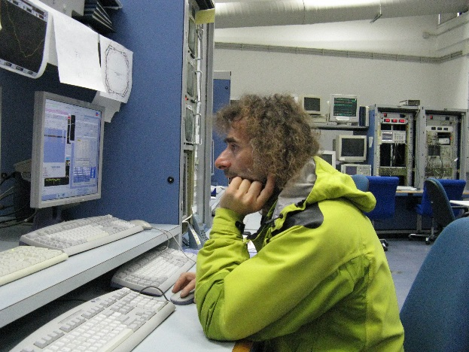
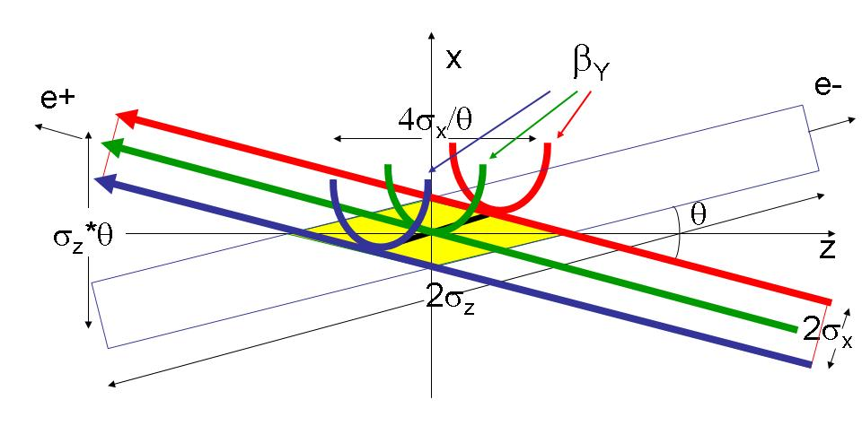
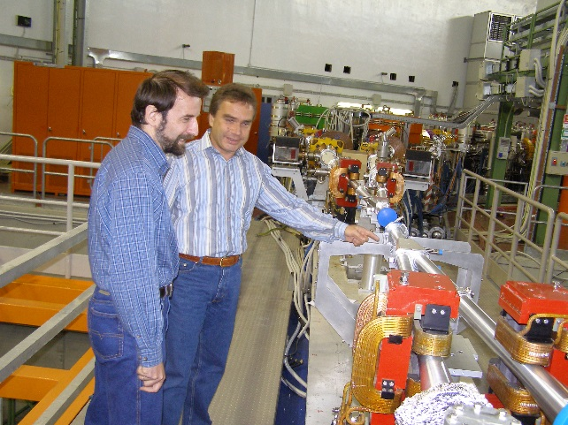
Crab Waist in 3 Steps
Large Piwinski’s angle Φ = tg(θ/2)σ_{z}/σ_{x}
Vertical beta comparable with overlap area β_{y} 2σ_{x}/θ
Crab waist transformation y = xy’/θ
physics/0702033
1. P.Raimondi, 2° SuperB Workshop, March 2006
2. P.Raimondi, D.Shatilov, M.Zobov, physics/0702033
physics/0702033

Slide 8
Crabbed Waist Advantages
Luminosity gain with N
Very low horizontal tune shift
Vertical tune shift decreases with oscillation amplitude
Large Piwinski’s angle
Φ = tg(θ/2)σ_{z}/σ_{x}
2. Vertical beta comparable
with overlap area
β_{y} 2σ_{x}/θ
3. Crabbed waist transformation
y = xy’/θ
Geometric luminosity gain
Lower vertical tune shift
Suppression of vertical synchro-betatron resonances
Geometric luminosity gain
Suppression of X-Y betatron and synchro-betatron resonances
M.Zobov, C.Milardi， BB’2013

Slide 9
M.Zobov, C.Milardi， BB’2013
X-Y Resonance Suppression
Much higher luminosity!
Typical case (KEKB, DAΦNE etc.):
1. low Piwinski angle Φ < 1
2. β_{y} comparable with σ_{z}
Crab Waist On:
1. large Piwinski angle Φ >> 1
2. β_{y} comparable with σ_{x}/θ

Slide 10
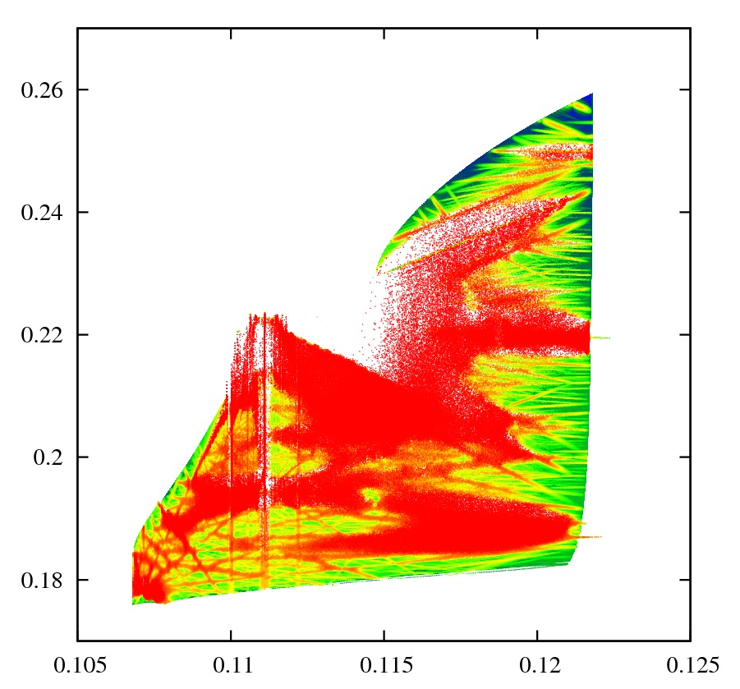
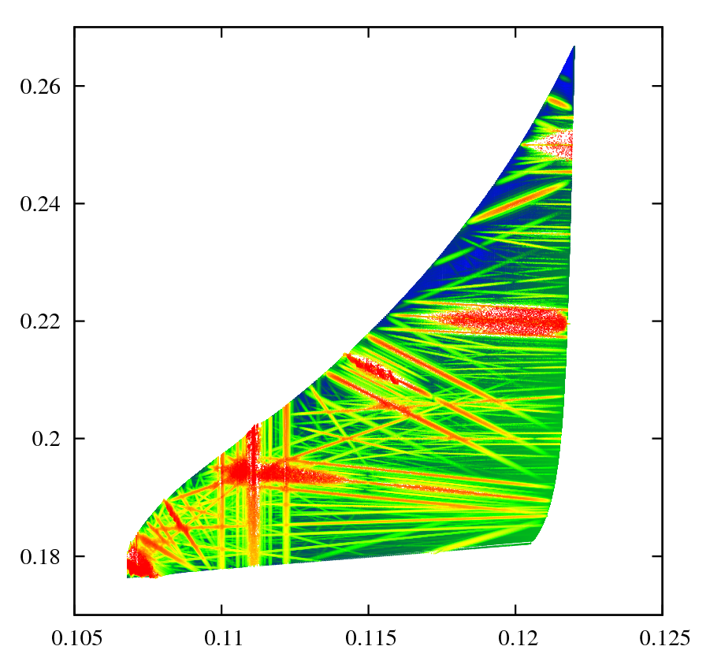
Frequency Map Analysis of Beam-Beam Interaction
Δν_{y}
Δν_{y}
Crab OFF
Crab ON
Δν_{x}
Δν_{x}
D.Shatilov, E.Levichev, E.Simonov and M.Zobov
Phys.Rev.ST Accel.Beams 14 (2011) 014001

Slide 11
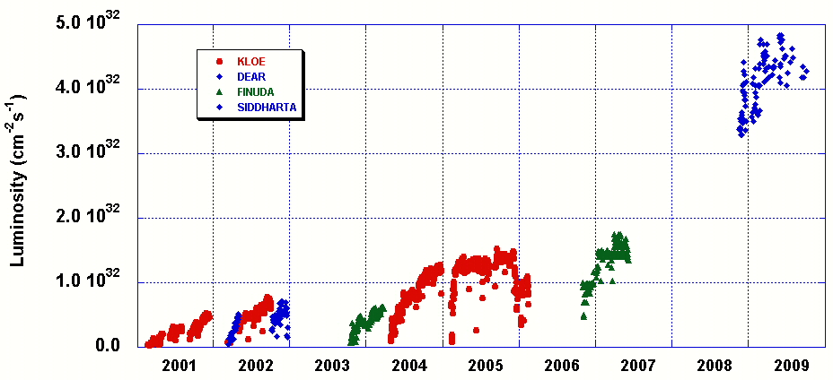
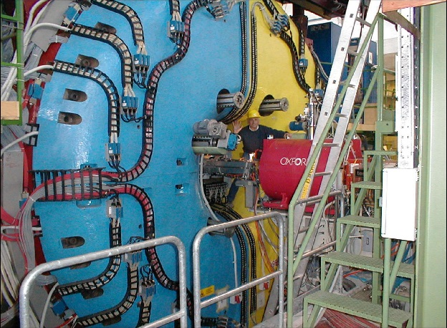
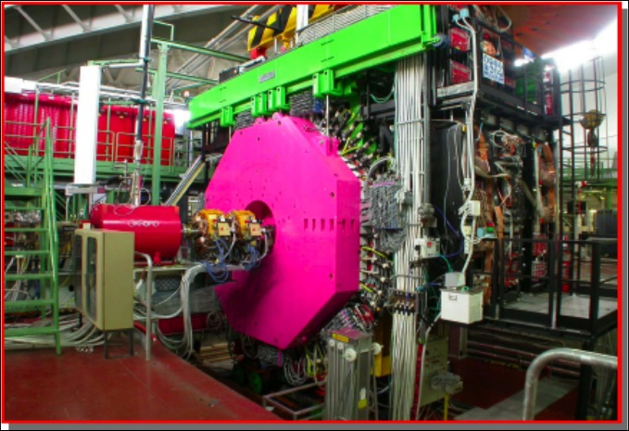
M.Zobov, C.Milardi， BB’2013
DAΦNE Peak Luminosity
Design Goal
NEW COLLISION SCHEME
M.Zobov, C.Milardi， BB-2013

Slide 12
Crabbed Waist Scheme
Sextupole
IP
(Anti)sextupole
Sextupole strength
Equivalent Hamiltonian
M.Zobov, C.Milardi， BB’2013

Slide 13
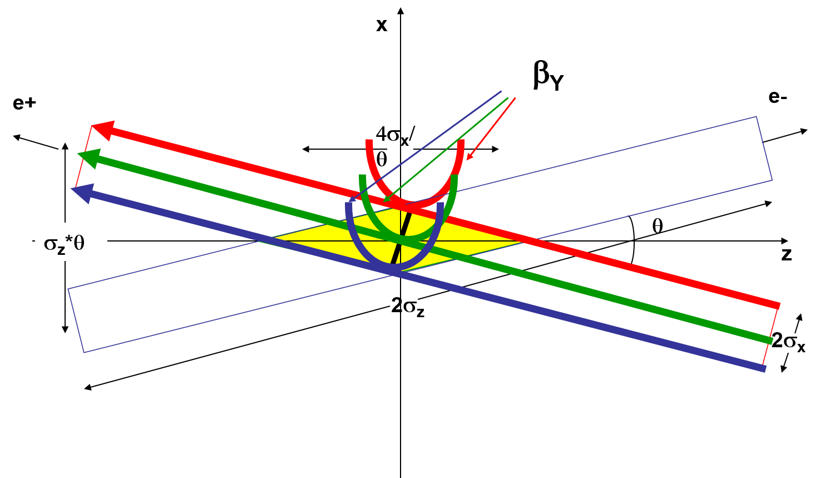
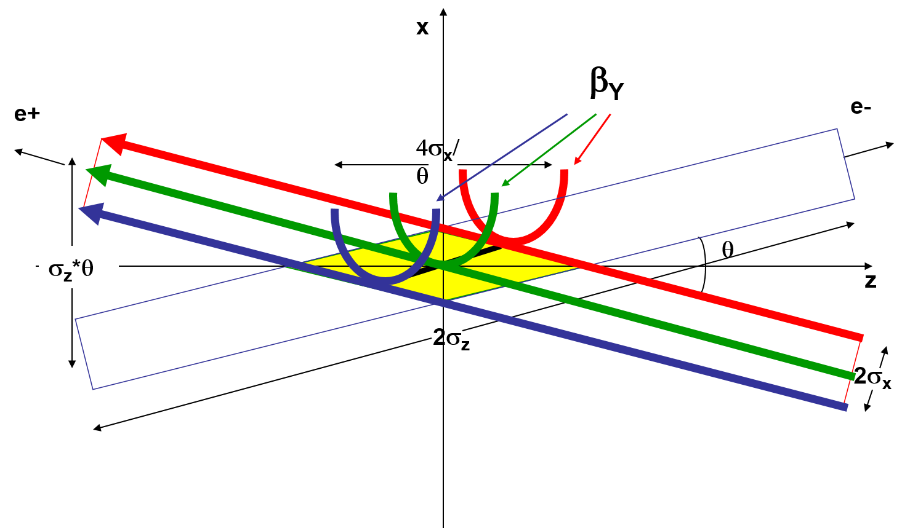
M.Zobov, C.Milardi， BB’2013
Logarithm of the bunch density at IP (z=0).
The scales are ± 10 sigma for X and Y.
D. Shatilov

Slide 14

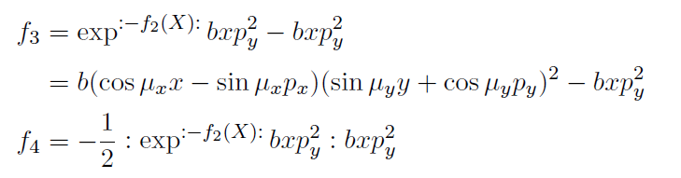
Normal form analysis of crabed- wasit transformtaion
One-turn map with beam-beam
One-turn map without beam-beam at IP
There only exist 3rd order generating function：

Slide 15
KEKB

Slide 16
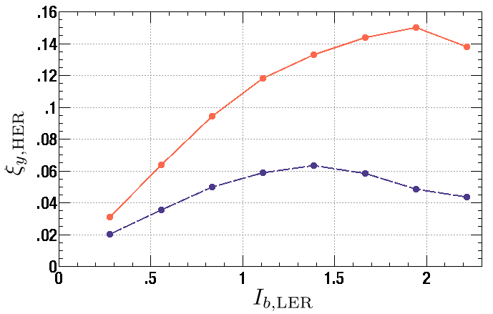
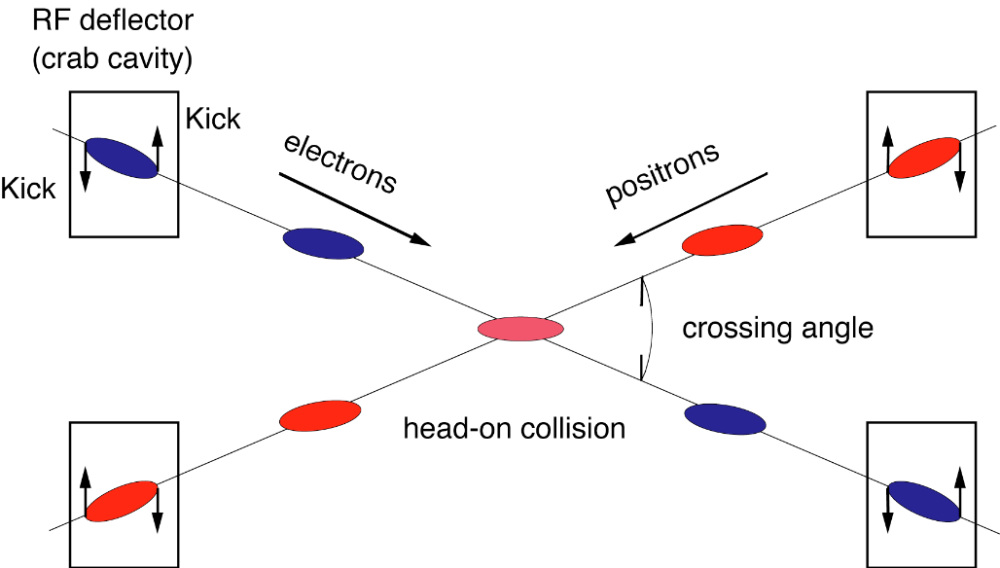
Motivation of crab cavity at KEKB
Y. Funakoshi， Beam-Beam Workshop, CERN, 2013
Crab Crossing can boost the beam-beam parameter higher than 0.15 ! (K. Ohmi)
Head-on (crab)
Strong-strong beam-beam
simulation
22mrad crossing angle
Head-on
}
ξ_{y} ~0.15
(mA)
ν_{x} =.508
Luminosity would be doubled
with crab cavities!!!
After this simulation appeared, the
development of crab cavities was
revitalized.
First proposed by R. B. Palmer in 1988 for linear colliders.

Slide 17
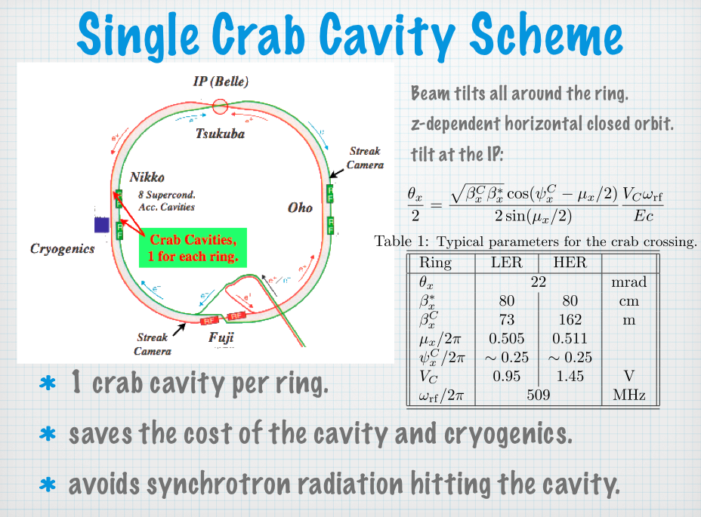
Y. Funakoshi， Beam-Beam Workshop, CERN, 2013

Slide 18
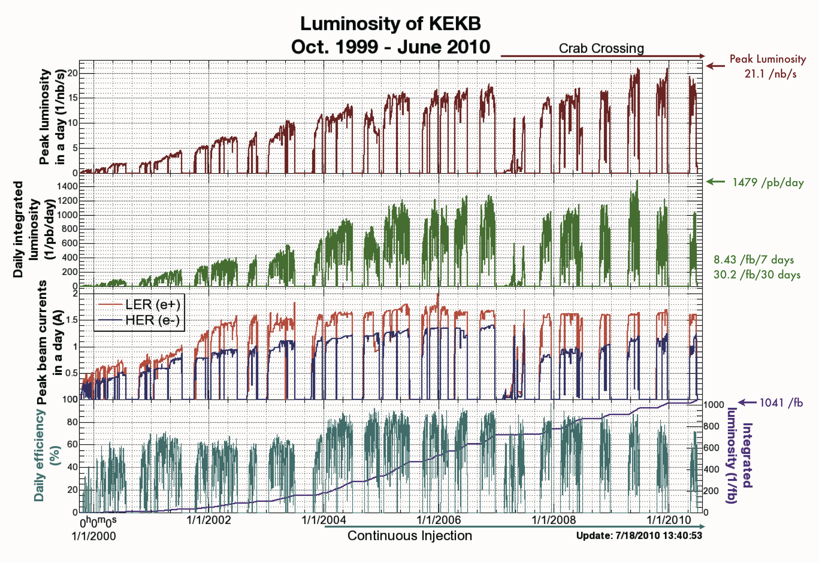
Y. Funakoshi， Beam-Beam Workshop, CERN, 2013
Skew-sextupoles
Beam lifetime problem

Slide 19
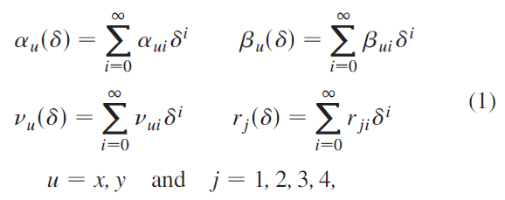

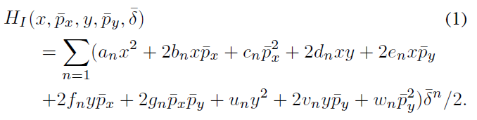
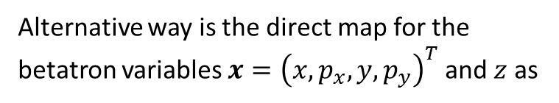
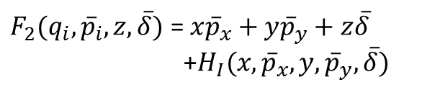
General Chromaticity
K. Ohmi, ICAP-09
D. Zhou, K. Ohmi, Y. Seimiya etal., PRST-AB 13, 021001, 2010
Y. Seimiya, K. Ohmi, D. Zhou etal,
Prog. Theor. Phys. (2012) 127 (6): 1099-1119
The chromaticities of Twiss parameters and X-Y couplings
The δ-dependent transverse matrix can be split into the product of two matrices. All the chromatic dependences are lumped into M_{H}(δ)
Generating function F₂ is used to represent the transformation of M_{H}(δ). The generating function guarantees the 6D symplectic condition. Hamiltonian which expresses generalized chromaticity is given by
$F_{2}(q_{i}, {\overline{p}}_{i},z,\overline{δ})$ = ${x\overline{p}}_{x}+y{\overline{p}}_{y}+z\overline{δ}$
+$H_{I}(x,{\overline{p}}_{x},y,{\overline{p}}_{y},\overline{δ})$
Alternative way is the direct map for the betatron variables $x={\left(x,p_{x},y,p_{y}\right)}^{T}$ and $z$ as

Slide 21

Scan of first-order chromatic coupling (WS, Crab on)
D. Zhou, et al., PRST-­‐AB 13, 021001 (2010).
Vertical size
Horizontal size

Slide 22
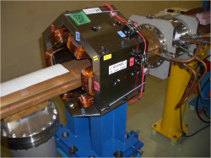
Chromaticity of x-y coupling at IP
Y. Funakoshi， Beam-Beam Workshop, CERN, 2013
Ohmi et al. showed that the linear chromaticity of x-y coupling parameters at IP could degrade the luminosity, if the residual values, which depend on machine errors, are large.
To control the chromaticity, skew sextupole magnets were installed during winter shutdown 2009.
The skew sextuples are very effective to increase the luminosity at KEKB.
The gain of the luminosity by these magnets is ~15%.

Slide 23
D. Zhou, 2011

Slide 27
Super-KEKB

Slide 29
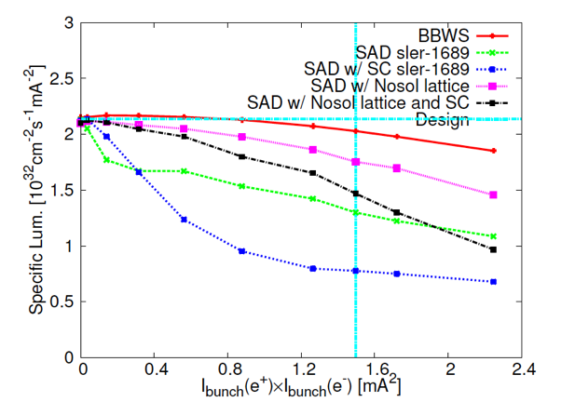
LER: Simplied IR
Simplified lattice by H. Sugimoto
Sler_simple001.sad: no solenoid but preserve main optics parameters
No significant luminosity degradation at low current
Solenoid is the main source of lattice nonlinearity?
D. Zhou and Y. Zhang(IHEP),
SuperKEKB optics meeting,
Apr.17, 2014

Slide 30
Lattice nonlinearity from turn-by-turn data
Initial coordinates (x0, 0, 0, 0, 0, 0);
x0 changes from 0 to 5σ_{x}
Watch point is at IP, beam-beam is off

Slide 31
Lattice nonlinearity from turn-by-turn data (Cont.)
Evidence of nonlinear X-Y coupling
COD in Y direction as function of X offset

Slide 32
Frequency Analysis

Slide 33
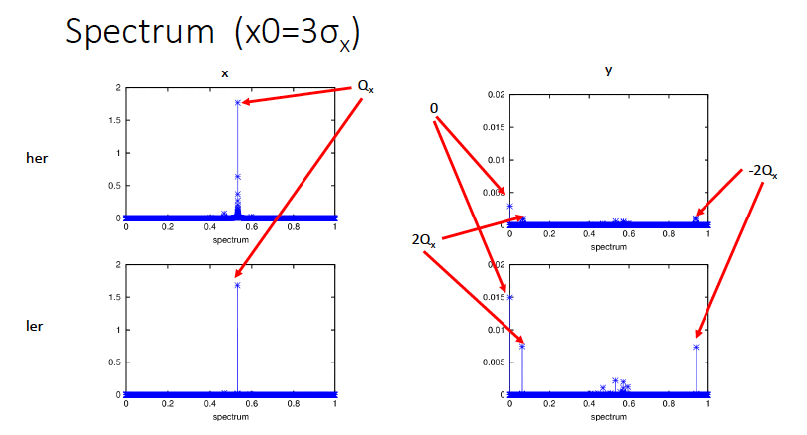
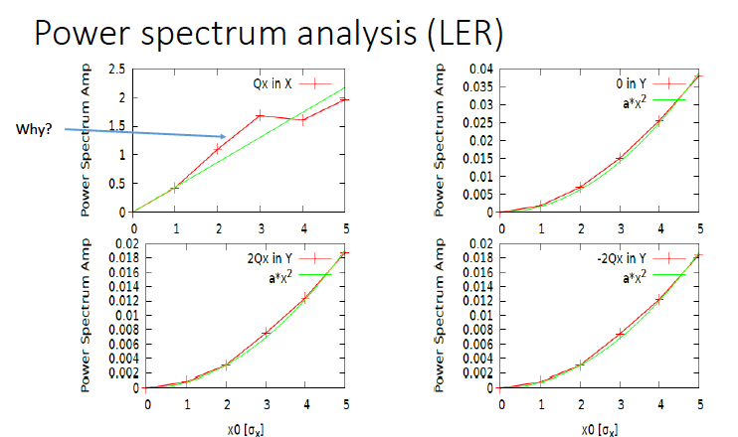
Frequency Analysis (cont.)

Slide 35
Compensation with a skew-sext map
Test by inserting a map of H=K*x²y into the LER lattice
COD and oscillation amplitude in y are well suppressed as expected

Slide 36
Compensation with a skew-sext map
(Cont.)

Slide 37
Compensation with a skew-sext map
(Cont.)

Slide 38
BEPCII

Slide 43
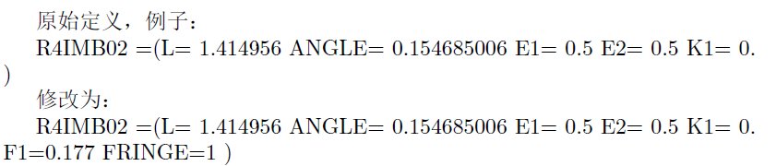
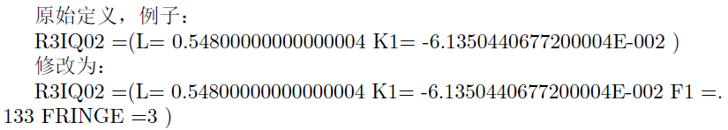
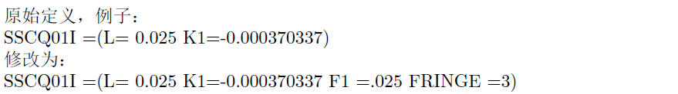
Fringe effect in BEPCII （using SAD）
二极铁
四极铁
超导四极铁
螺线管场
D. Zhou(KEK), 2014

Slide 44
D. Zhou(KEK), 2014

Slide 45
原始模型，+边缘场，+LOCO校正
D. Zhou(KEK), 2014

Slide 46
原始模型，+边缘场，+LOCO校正（cont.）
D. Zhou(KEK), 2014

Slide 47
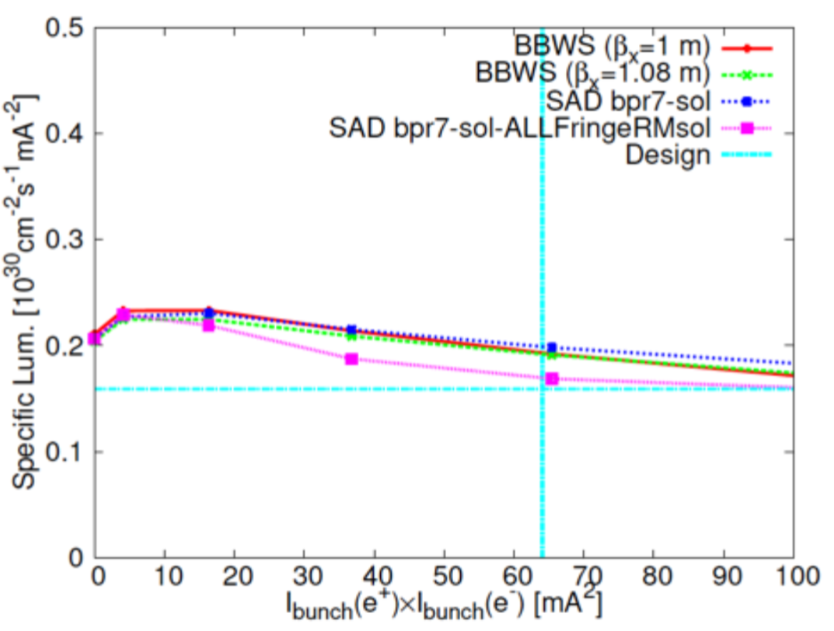
亮度： 原始模型 vs 边缘场+LOCO校正
loss~15%
D. Zhou(KEK), 2014

Slide 48
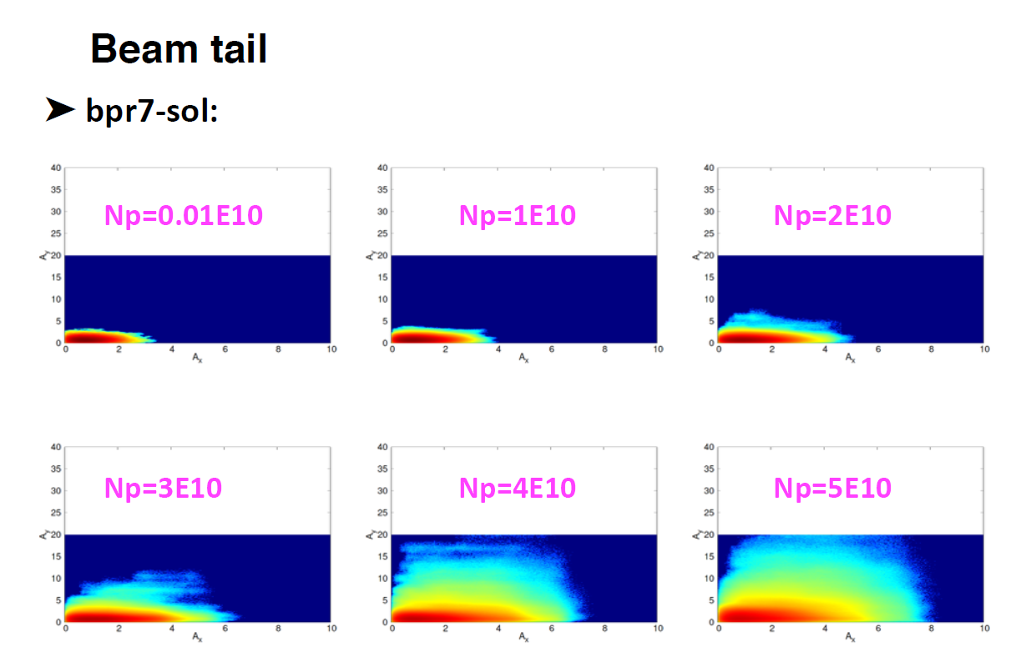
D. Zhou(KEK), 2014

Slide 49
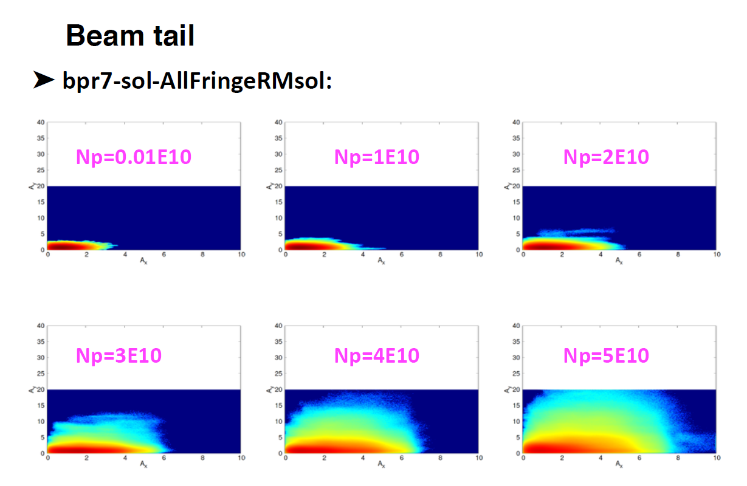
D. Zhou(KEK), 2014

Slide 50
Summary
所有的非线性都已经在“实际”机器中被发现对亮度产生影响：
Detuning
Choromaticity（tune/twiss parameters/coupling）
noraml/skew multipole magnet

