Slide 1

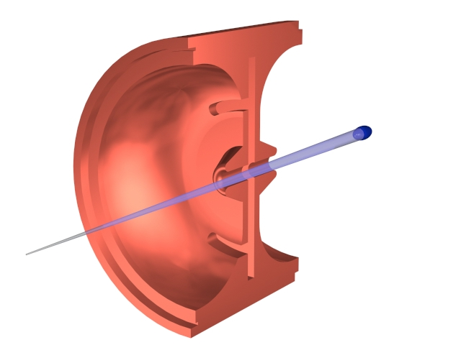

The 12th Symposium on Accelerator Physics
ACCELERATOR LABORATORY of TSINGHUA UNIVERSITY
Intrinsic Nonlinearity of Dipole Magnets in Small Rings
Haisheng Xu (许海生), Wenhui Huang, Chuanxiang Tang
haishengxu@gmail.com
清华大学工程物理系
Department of Engineering Physics,
Tsinghua University
Aug. 14, 2014

Slide 2
Outline
Introduction to TTX
Intrinsic nonlinearity in small rings
  Analytical analysis;
  Simulation;
Status of the small ring for TTX
Tsinghua Thomson scattering X-ray source
ACCELERATOR LABORATORY of TSINGHUA UNIVERSITY

Slide 3
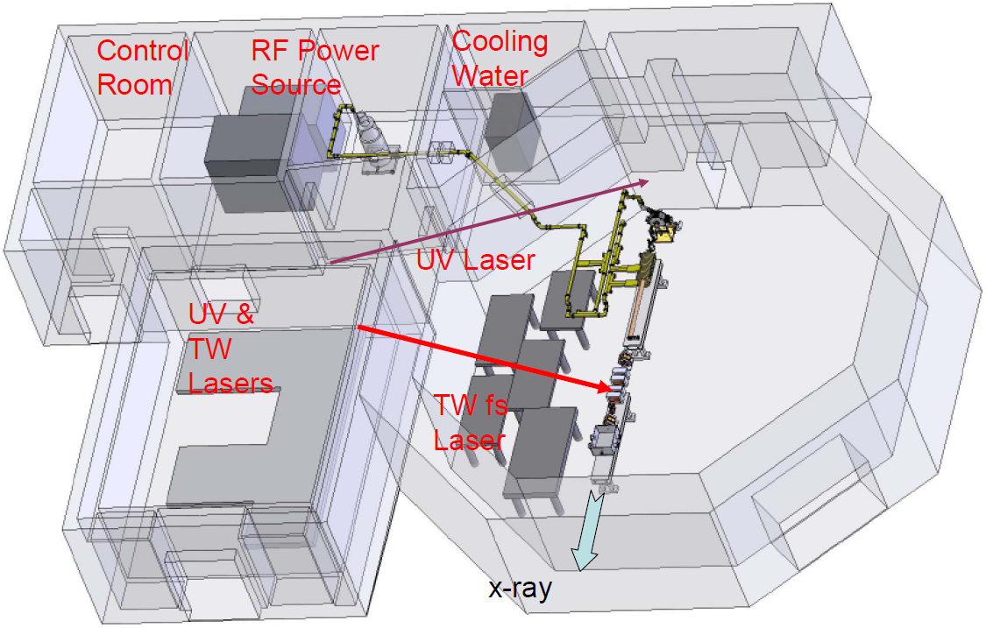
TTX – Layout

Slide 4
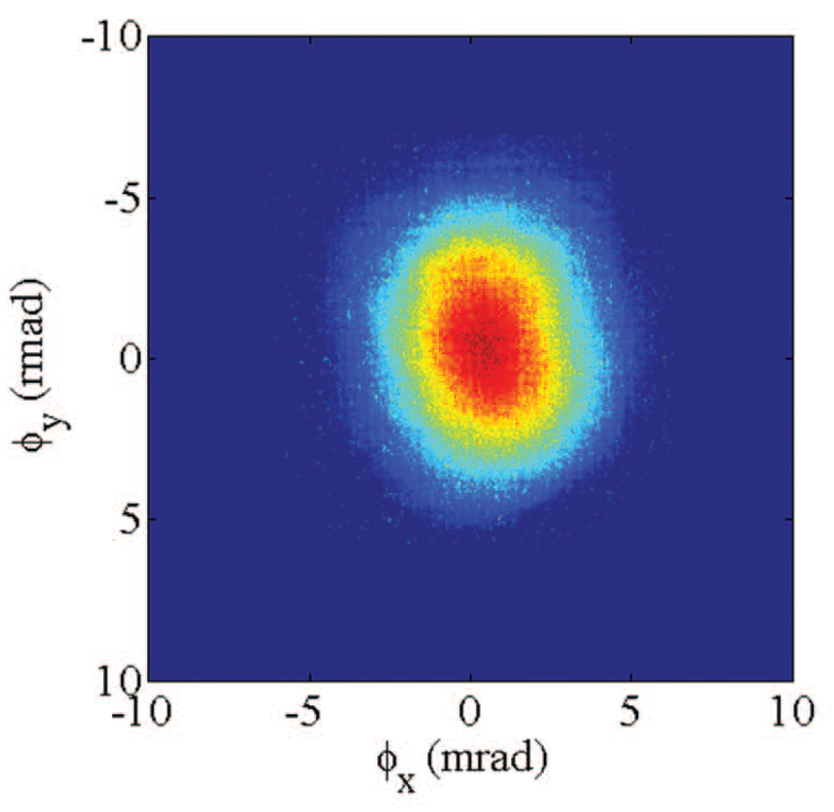
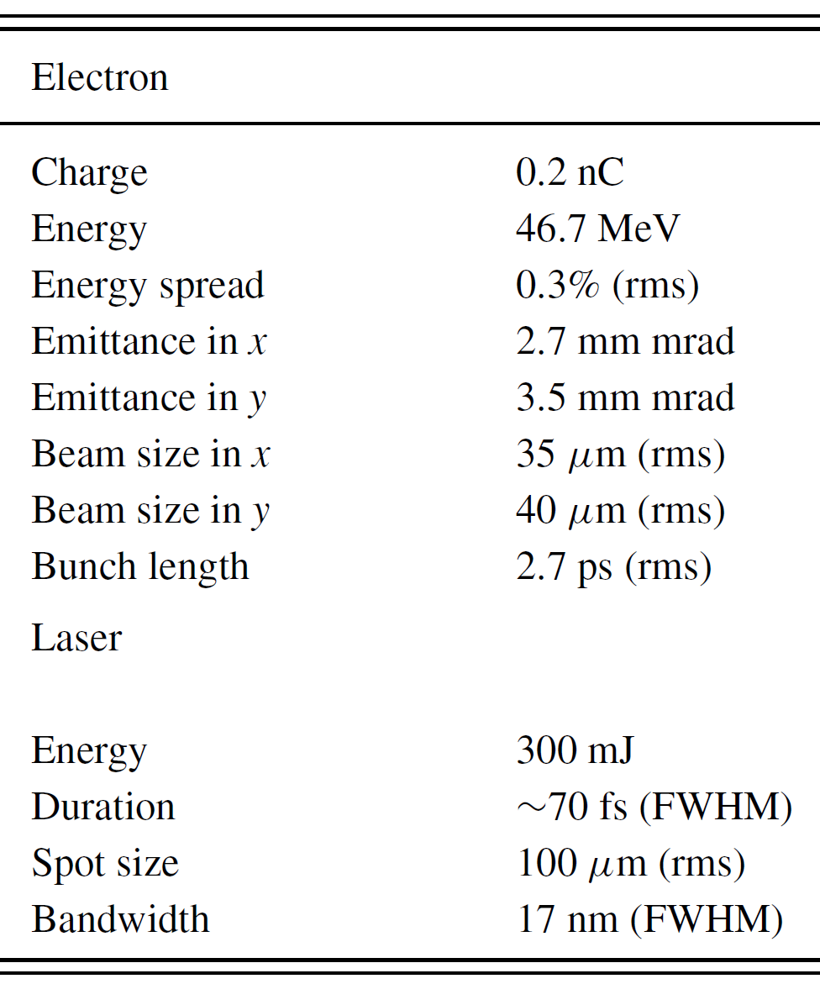

TTX – Status
~${10}^{6}$ photons/pulse !
Yingchao Du et.al., Rev. Sci. Instrum 84, 053301 (2013)

Slide 5

TTX – Next
A small ring!

Slide 6
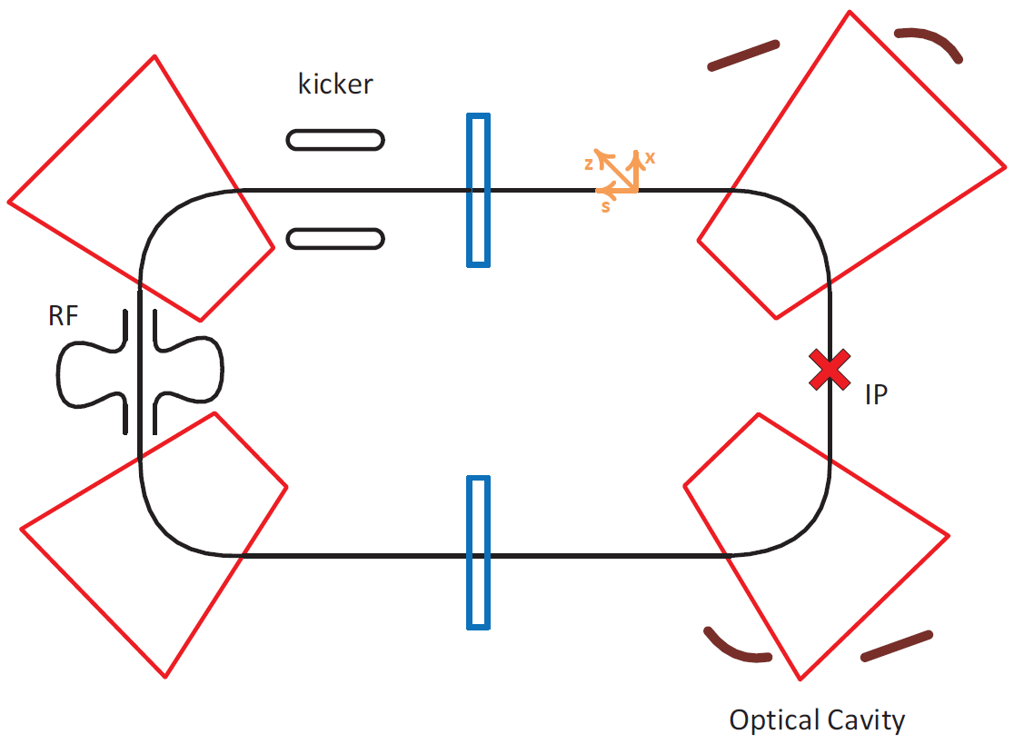
TTX – Next

Slide 7
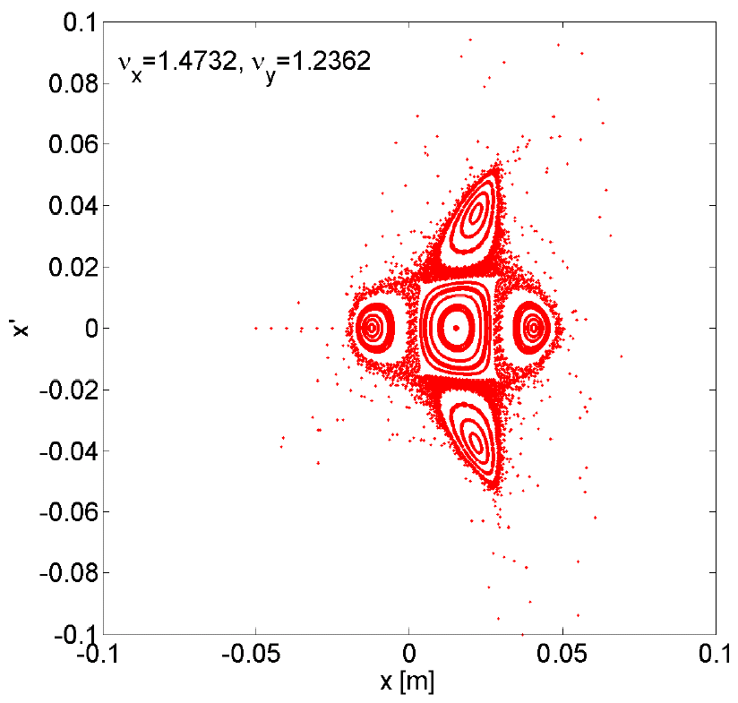
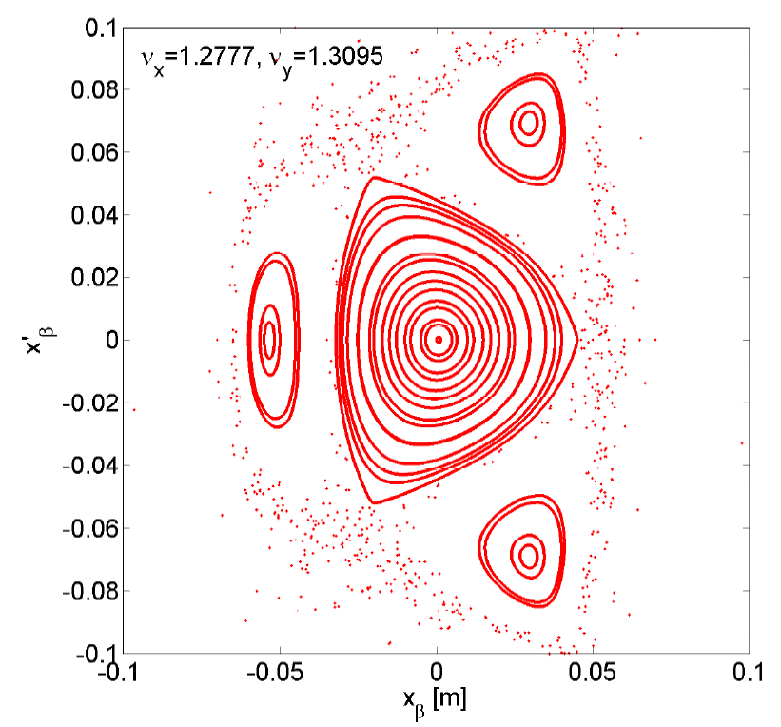
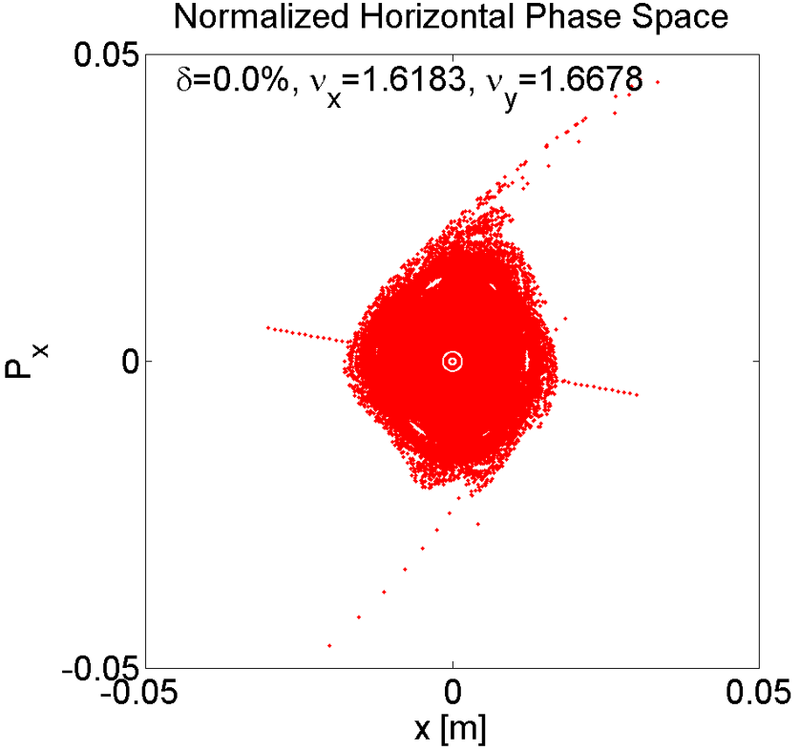
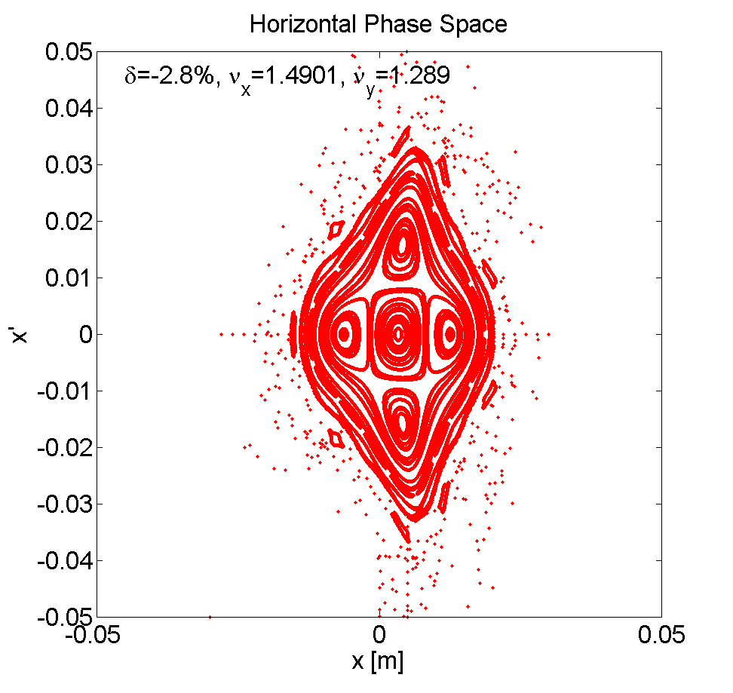
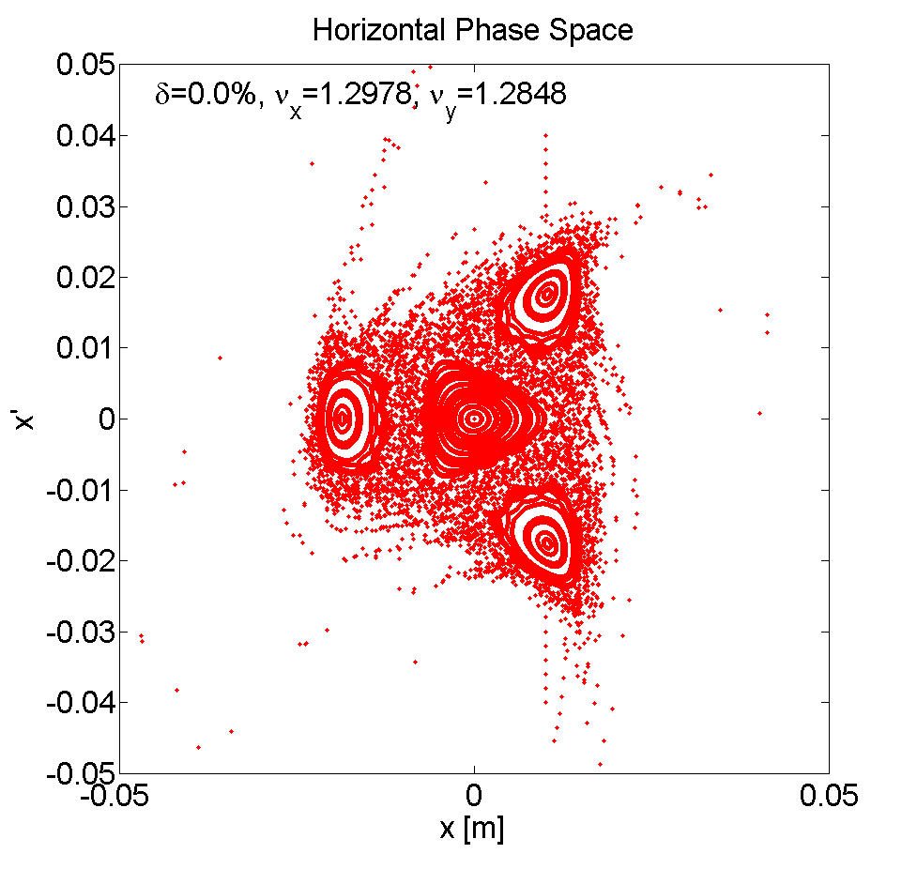


Observation of Nonlinear Resonances!

Slide 8
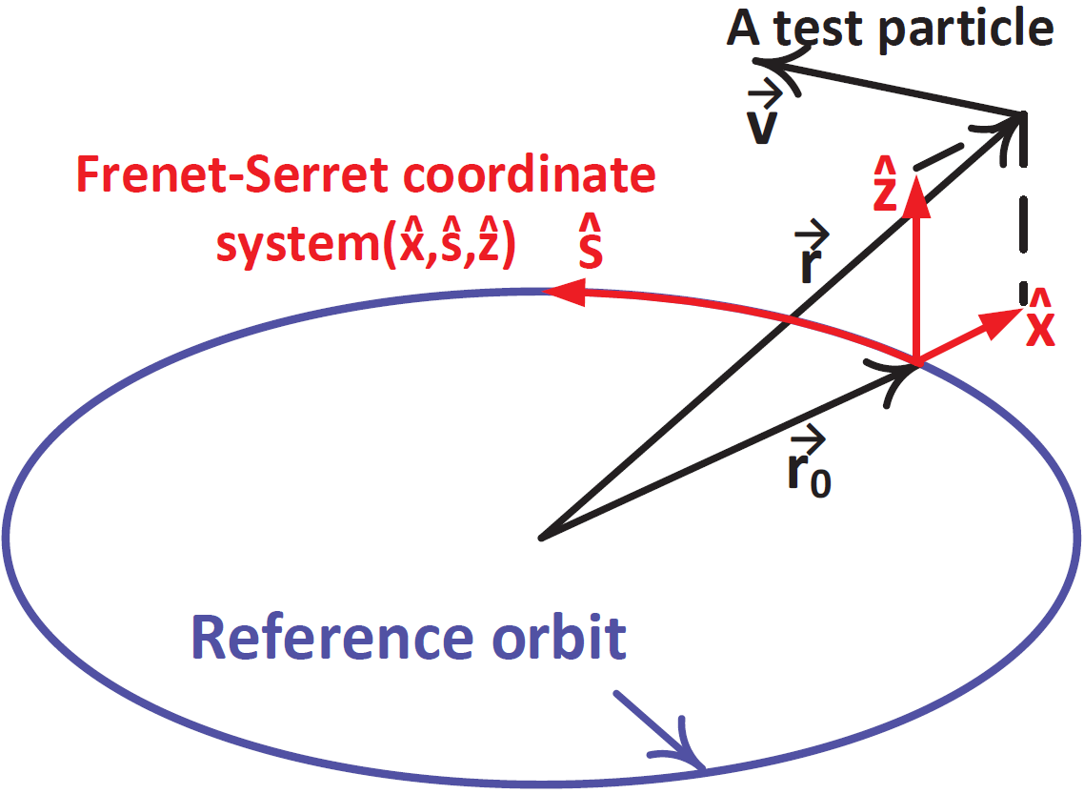

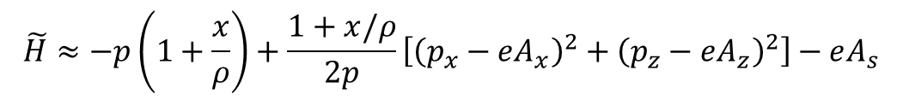
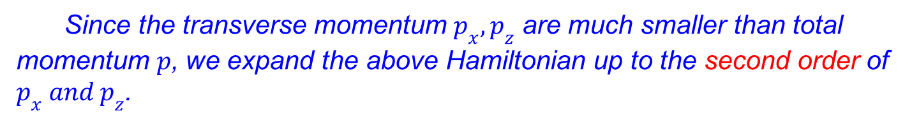
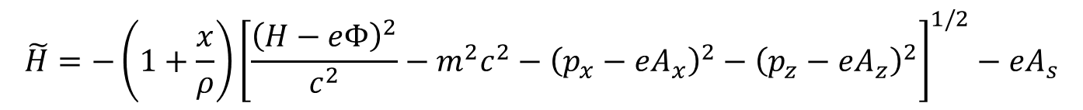
Analytical Analysis
We carry out the analytical analysis in Frenet-Serret coordinate system.
The Hamiltonian can be expressed as
$$\tilde{H}=−\left(1+\frac{x}{ρ}\right){\left[\frac{{\left(H−eΦ\right)}^{2}}{c^{2}}−m^{2}c^{2}−{\left(p_{x}−eA_{x}\right)}^{2}−{\left(p_{z}−eA_{z}\right)}^{2}\right]}^{1/2}−eA_{s}$$
where the variables are $\left(x,p_{x},z,p_{z},t,−H\right)$.
Since the transverse momentum $p_{x}, p_{z}$ are much smaller than total momentum $p$, we expand the above Hamiltonian up to the second order of $p_{x} and p_{z}$.
$$\tilde{H}≈−p\left(1+\frac{x}{ρ}\right)+\frac{1+x/ρ}{2p}\left[{\left(p_{x}−eA_{x}\right)}^{2}+{\left(p_{z}−eA_{z}\right)}^{2}\right]−eA_{s}$$

Slide 9

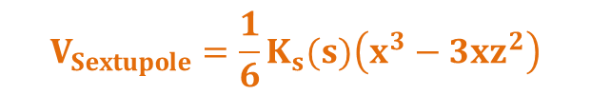



Analytical Analysis
Consider an accelerator with ideal dipoles and quadrupoles, there are transverse magnetic field only. The vector potential can be expressed as
$A_{x}=A_{z}=0$，$A_{s}\left(x,z\right)=B_{0}x+\frac{1}{2ρ}B_{0}x^{2}+\frac{1}{2}B_{1}x^{2}−\frac{1}{2}B_{1}z^{2}$
Substitute them into the above Hamiltonian $\tilde{H}$. After some algebra, the Hamiltonian becomes
$$H=\tilde{H}/p=H_{0}+V_{nonlinear}$$
$$H_{0}=\left[\frac{1}{2}{\tilde{p_{x}}}^{2}+\frac{1}{2}K_{x}\left(s\right)x^{2}+\frac{1}{2}{\tilde{p_{z}}}^{2}+\frac{1}{2}K_{z}\left(s\right)z^{2}\right]$$
Linear Part
Intrinsic
$$V_{nonlinear}=\frac{1}{2}\frac{x}{ρ}\left({\tilde{p_{x}}}^{2}+{\tilde{p_{z}}}^{2}\right)$$
Nonlinear Part
Different !!!
where, $\tilde{p_{x}}=p_{x}/p$ $\tilde{p_{z}}=p_{z}/p$
$$V_{Sextupole}=\frac{1}{6}K_{s}(s)\left(x^{3}−3xz^{2}\right)$$

Slide 10
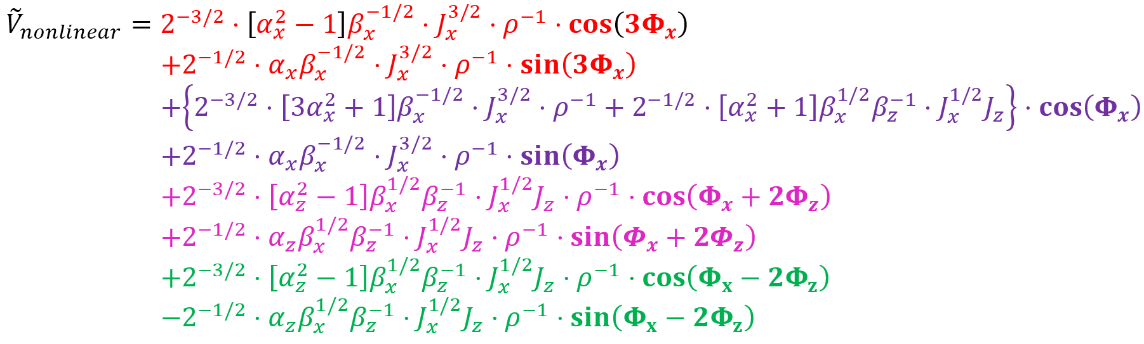
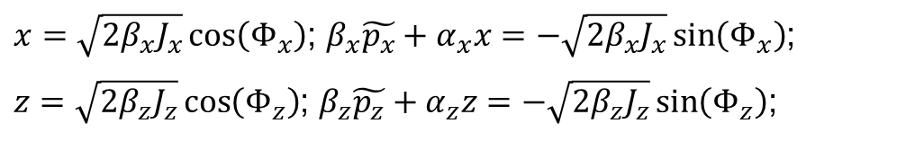
Analytical Analysis
We then carry out the Floquet Transformation and coordinates transformation $\left(x,p_{x},z,p_{z}\right)→\left(J_{x},φ_{x},J_{z},φ_{z}\right)$.
$x=\sqrt{2β_{x}J_{x}}\cos\left(Φ_{x}\right)$; $β_{x}\tilde{p_{x}}+α_{x}x=−\sqrt{2β_{x}J_{x}}\sin\left(Φ_{x}\right)$;
$z=\sqrt{2β_{z}J_{z}}\cos\left(Φ_{z}\right)$; $β_{z}\tilde{p_{z}}+α_{z}z=−\sqrt{2β_{z}J_{z}}\sin\left(Φ_{z}\right)$;
The nonlinear potential ${\tilde{V}}_{nonlinear}$ becomes

Slide 11
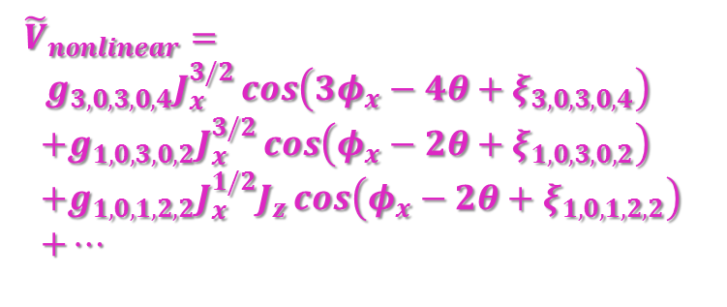
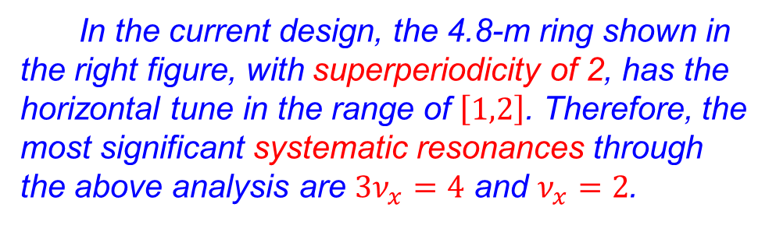
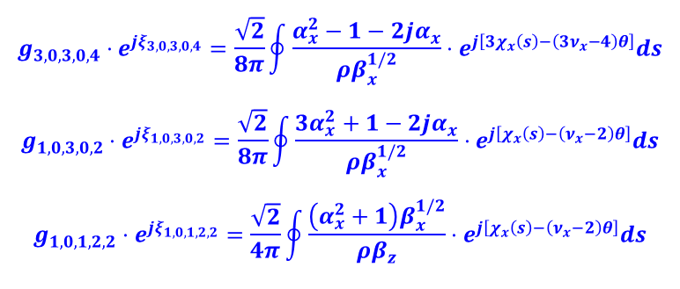
Analytical Analysis
Therefore, when the particles’ tunes are closed to the resonance $mν_{x}+nν_{z}=ℓ$, the Hamiltonian can be approximated by
$$H=ν_{x}J_{x}+ν_{z}J_{z}+g_{m,n,p,q,ℓ}⋅J_{x}^{p/2}J_{z}^{q/2}⋅\cos\left(mφ_{x}+nφ_{z}−ℓθ+ξ_{m,n,p,q,ℓ}\right)$$
where, $m,n,p,q,ℓ$ are integers; $g_{m,n,p,q,ℓ}$ represents the resonance strength; $\left|m\right|+\left|n\right|$ denotes the order of the resonance.
In the current design, the 4.8-m ring shown in the right figure, with superperiodicity of 2, has the horizontal tune in the range of $\left[1,2\right]$. Therefore, the most significant systematic resonances through the above analysis are $3ν_{x}=4$ and $ν_{x}=2$.
${\tilde{V}}_{nonlinear}=$
$g_{3,0,3,0,4}J_{x}^{3/2}\cos\left(3φ_{x}−4θ+ξ_{3,0,3,0,4}\right)$
$+g_{1,0,3,0,2}J_{x}^{3/2}\cos\left(φ_{x}−2θ+ξ_{1,0,3,0,2}\right)$
$+g_{1,0,1,2,2}J_{x}^{1/2}J_{z}\cos\left(φ_{x}−2θ+ξ_{1,0,1,2,2}\right)$
$+…$
$$g_{3,0,3,0,4}⋅e^{jξ_{3,0,3,0,4}}=\frac{\sqrt{2}}{8π}\oint{\frac{α_{x}^{2}−1−2jα_{x}}{ρβ_{x}^{1/2}}}⋅e^{j\left[3χ_{x}\left(s\right)−\left(3ν_{x}−4\right)θ\right]}ds$$
$$g_{1,0,3,0,2}⋅e^{jξ_{1,0,3,0,2}}=\frac{\sqrt{2}}{8π}\oint{\frac{3α_{x}^{2}+1−2jα_{x}}{ρβ_{x}^{1/2}}⋅e^{j\left[χ_{x}\left(s\right)−\left(ν_{x}−2\right)θ\right]}ds}$$
$$g_{1,0,1,2,2}⋅e^{jξ_{1,0,1,2,2}}=\frac{\sqrt{2}}{4π}\oint{\frac{\left(α_{x}^{2}+1\right)β_{x}^{1/2}}{ρβ_{z}}⋅e^{j\left[χ_{x}\left(s\right)−\left(ν_{x}−2\right)θ\right]}ds}$$

Slide 12
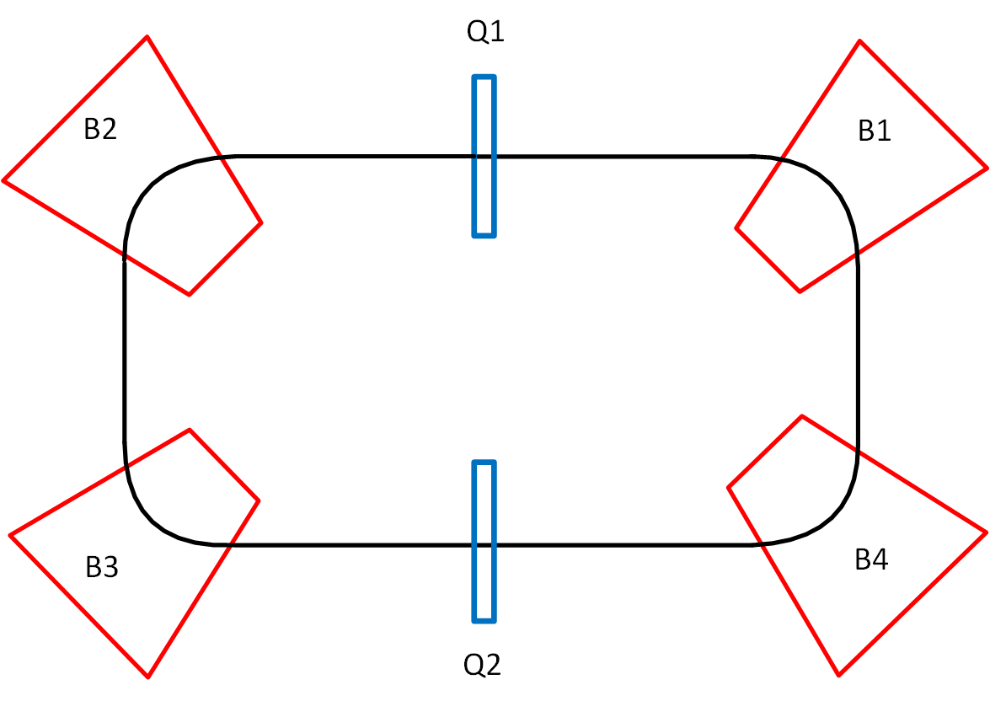
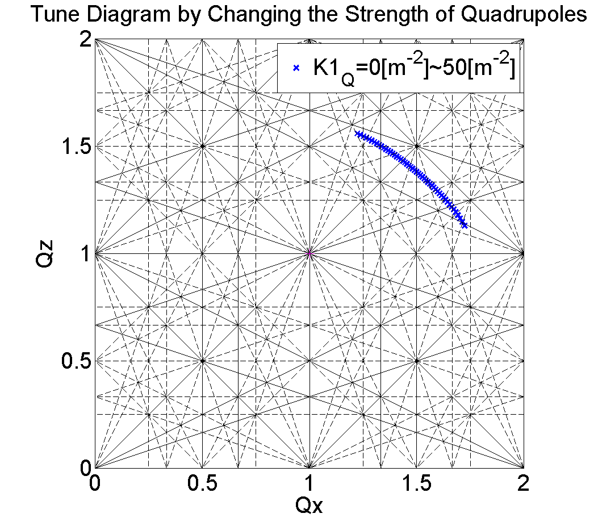
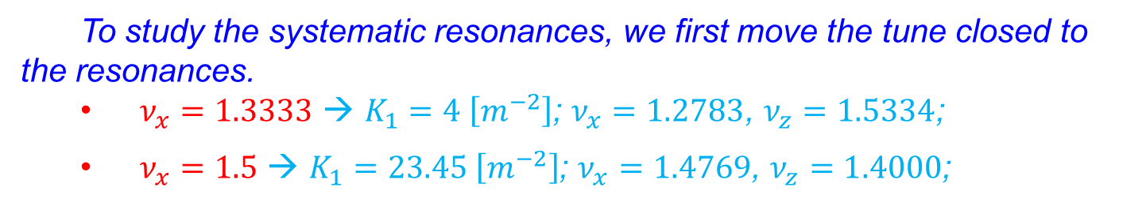
Simulation – Particle Tracking
By adjusting the quadrupoles’ strength simultaneously, the betatron tunes can be varied in a large range.
To study the systematic resonances, we first move the tune closed to the resonances.
  $ν_{x}=1.3333$ → $K_{1}=4 \left[m^{−2}\right]$; $ν_{x}=1.2783$, $ν_{z}=1.5334$;
  $ν_{x}=1.5$ → $K_{1}=23.45 \left[m^{−2}\right]$; $ν_{x}=1.4769$, $ν_{z}=1.4000$;

Slide 13
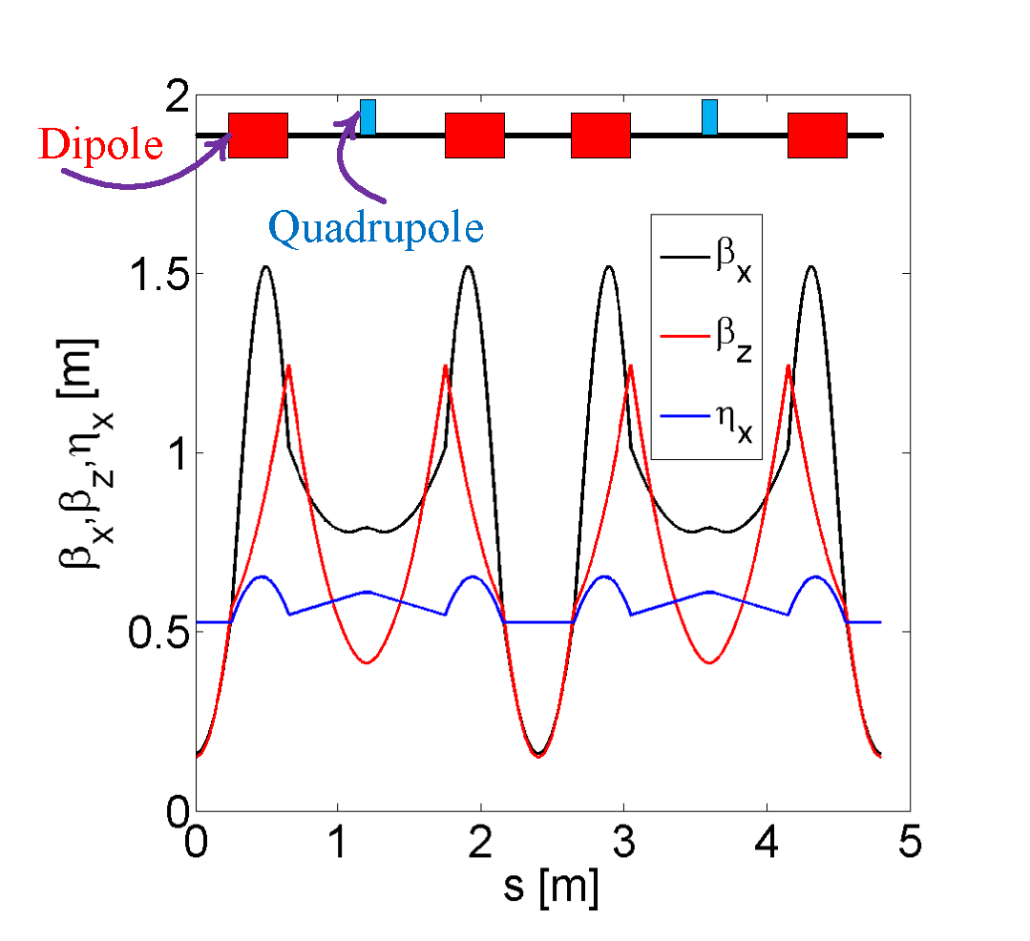
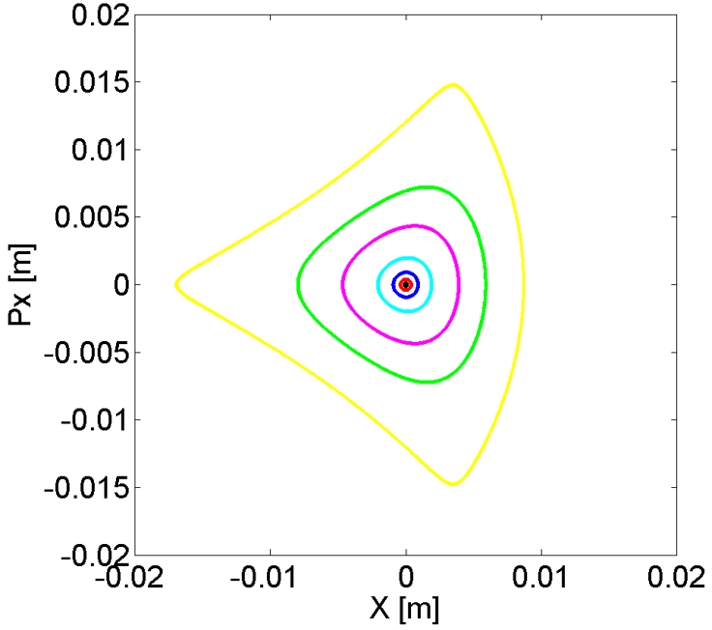
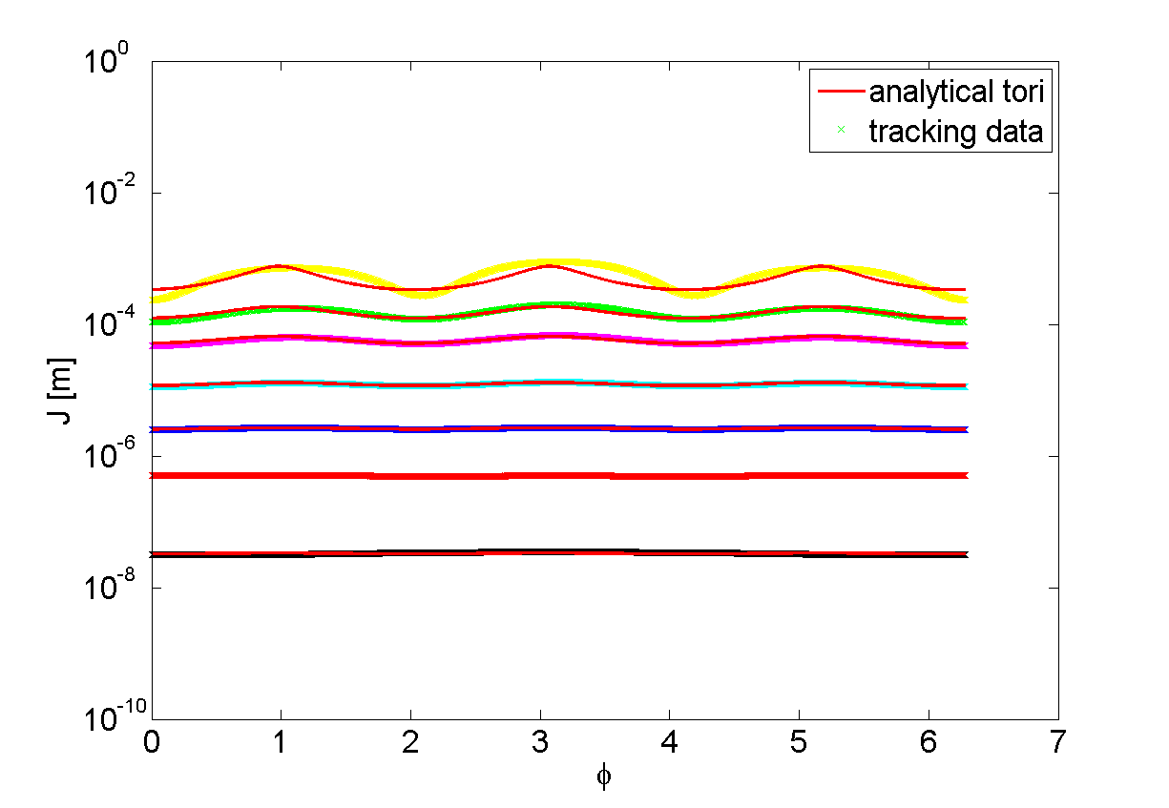
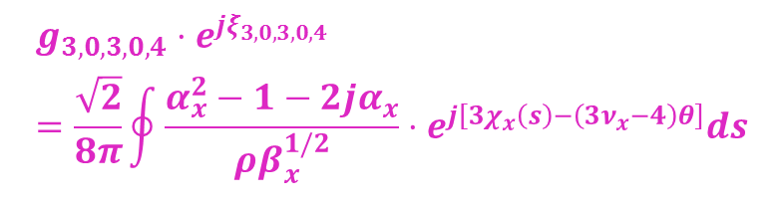


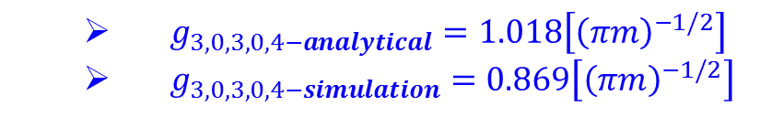
Simulation – $3ν_{x}=4$ Resonance
$H≈ν_{x}J_{x}$ $+g_{3,0,3,0,4}J_{x}^{3/2}\cos\left(3ϕ_{x}−4θ+ξ_{3,0,3,0,4}\right)$
$$g_{3,0,3,0,4}⋅e^{jξ_{3,0,3,0,4}}=\frac{\sqrt{2}}{8π}\oint{\frac{α_{x}^{2}−1−2jα_{x}}{ρβ_{x}^{1/2}}}⋅e^{j\left[3χ_{x}\left(s\right)−\left(3ν_{x}−4\right)θ\right]}ds$$
  $g_{3,0,3,0,4−analytical}=1.018\left[{\left(πm\right)}^{−1/2}\right]$
  $g_{3,0,3,0,4−simulation}=0.869\left[{\left(πm\right)}^{−1/2}\right]$

Slide 14
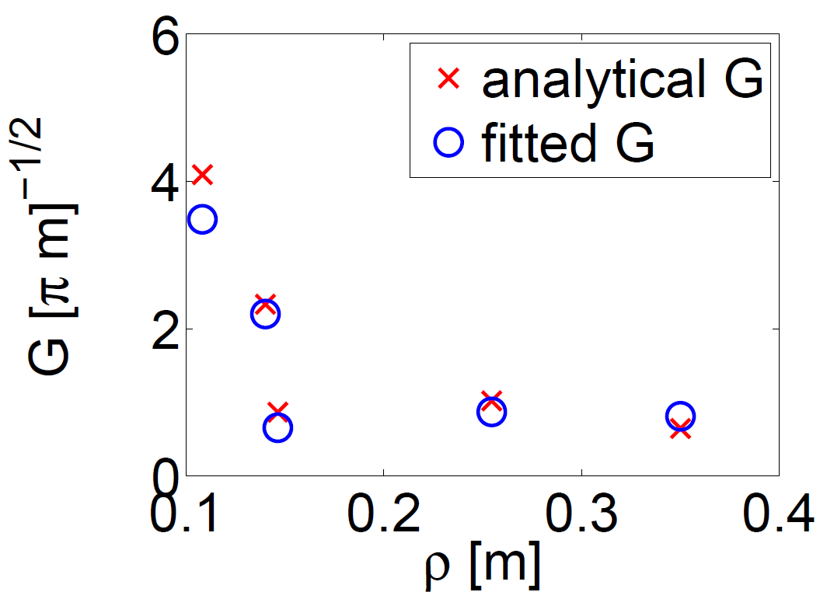
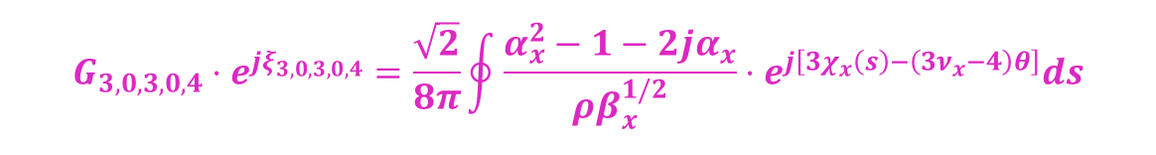

Simulation – $3ν_{x}=4$ Resonance
$H≈ν_{x}J_{x}$ $+g_{3,0,3,0,4}J_{x}^{3/2}\cos\left(3ϕ_{x}−4θ+ξ_{3,0,3,0,4}\right)$
$$G_{3,0,3,0,4}⋅e^{jξ_{3,0,3,0,4}}=\frac{\sqrt{2}}{8π}\oint{\frac{α_{x}^{2}−1−2jα_{x}}{ρβ_{x}^{1/2}}}⋅e^{j\left[3χ_{x}\left(s\right)−\left(3ν_{x}−4\right)θ\right]}ds$$
Varying bending radius of dipoles, we can obtain resonance strength both analytically and by particle tracking.

Slide 15
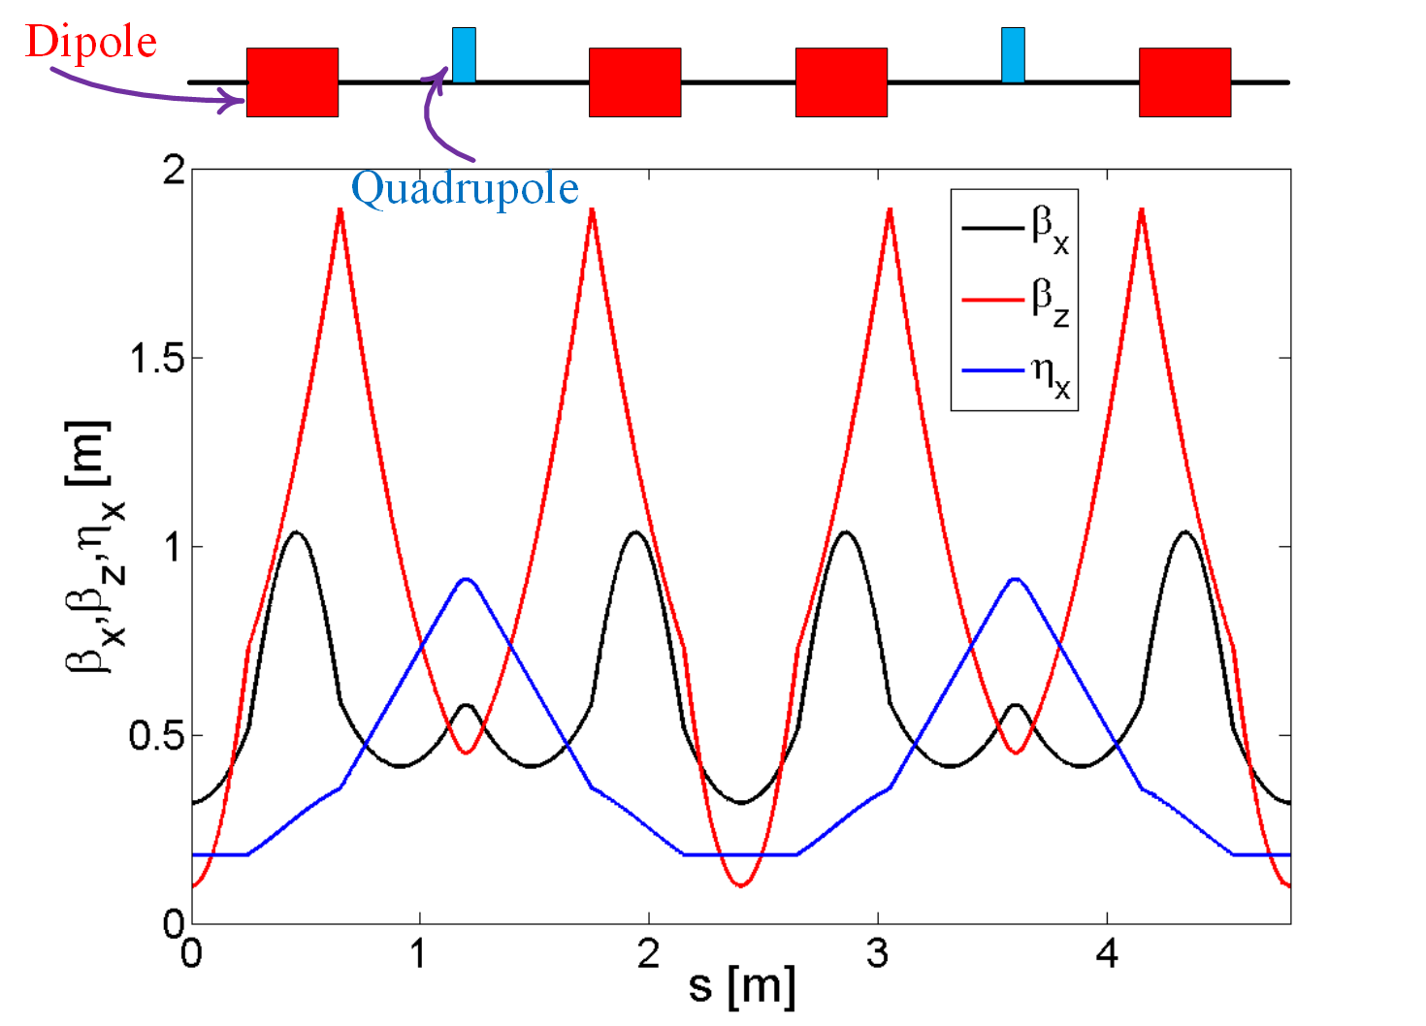
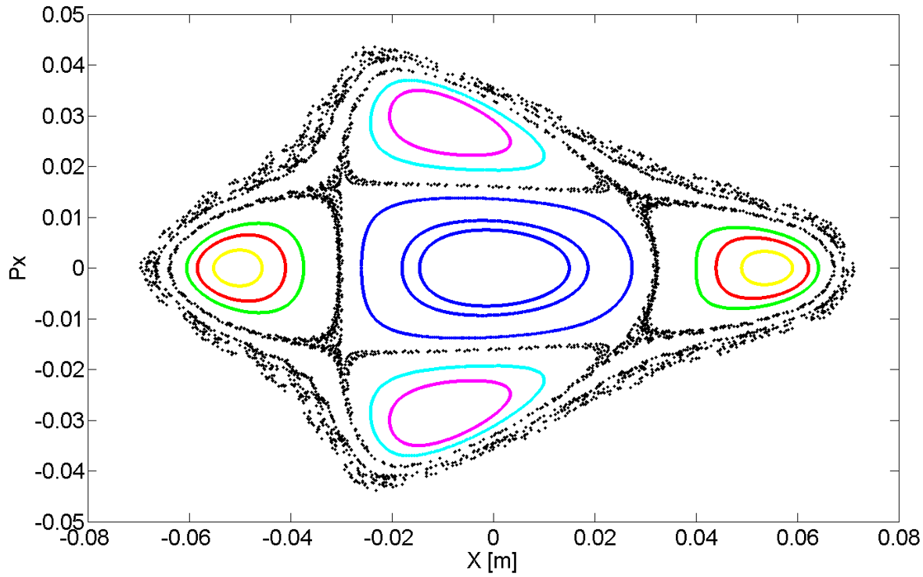

Simulation – 4$ν_{x}=6$ Resonance
$ν_{x}=1.4769$, $ν_{z}=1.4000$;
  Four stable islands;
  Rectangular shape distortion of the phase trajectories of particles in the central region;

Slide 16
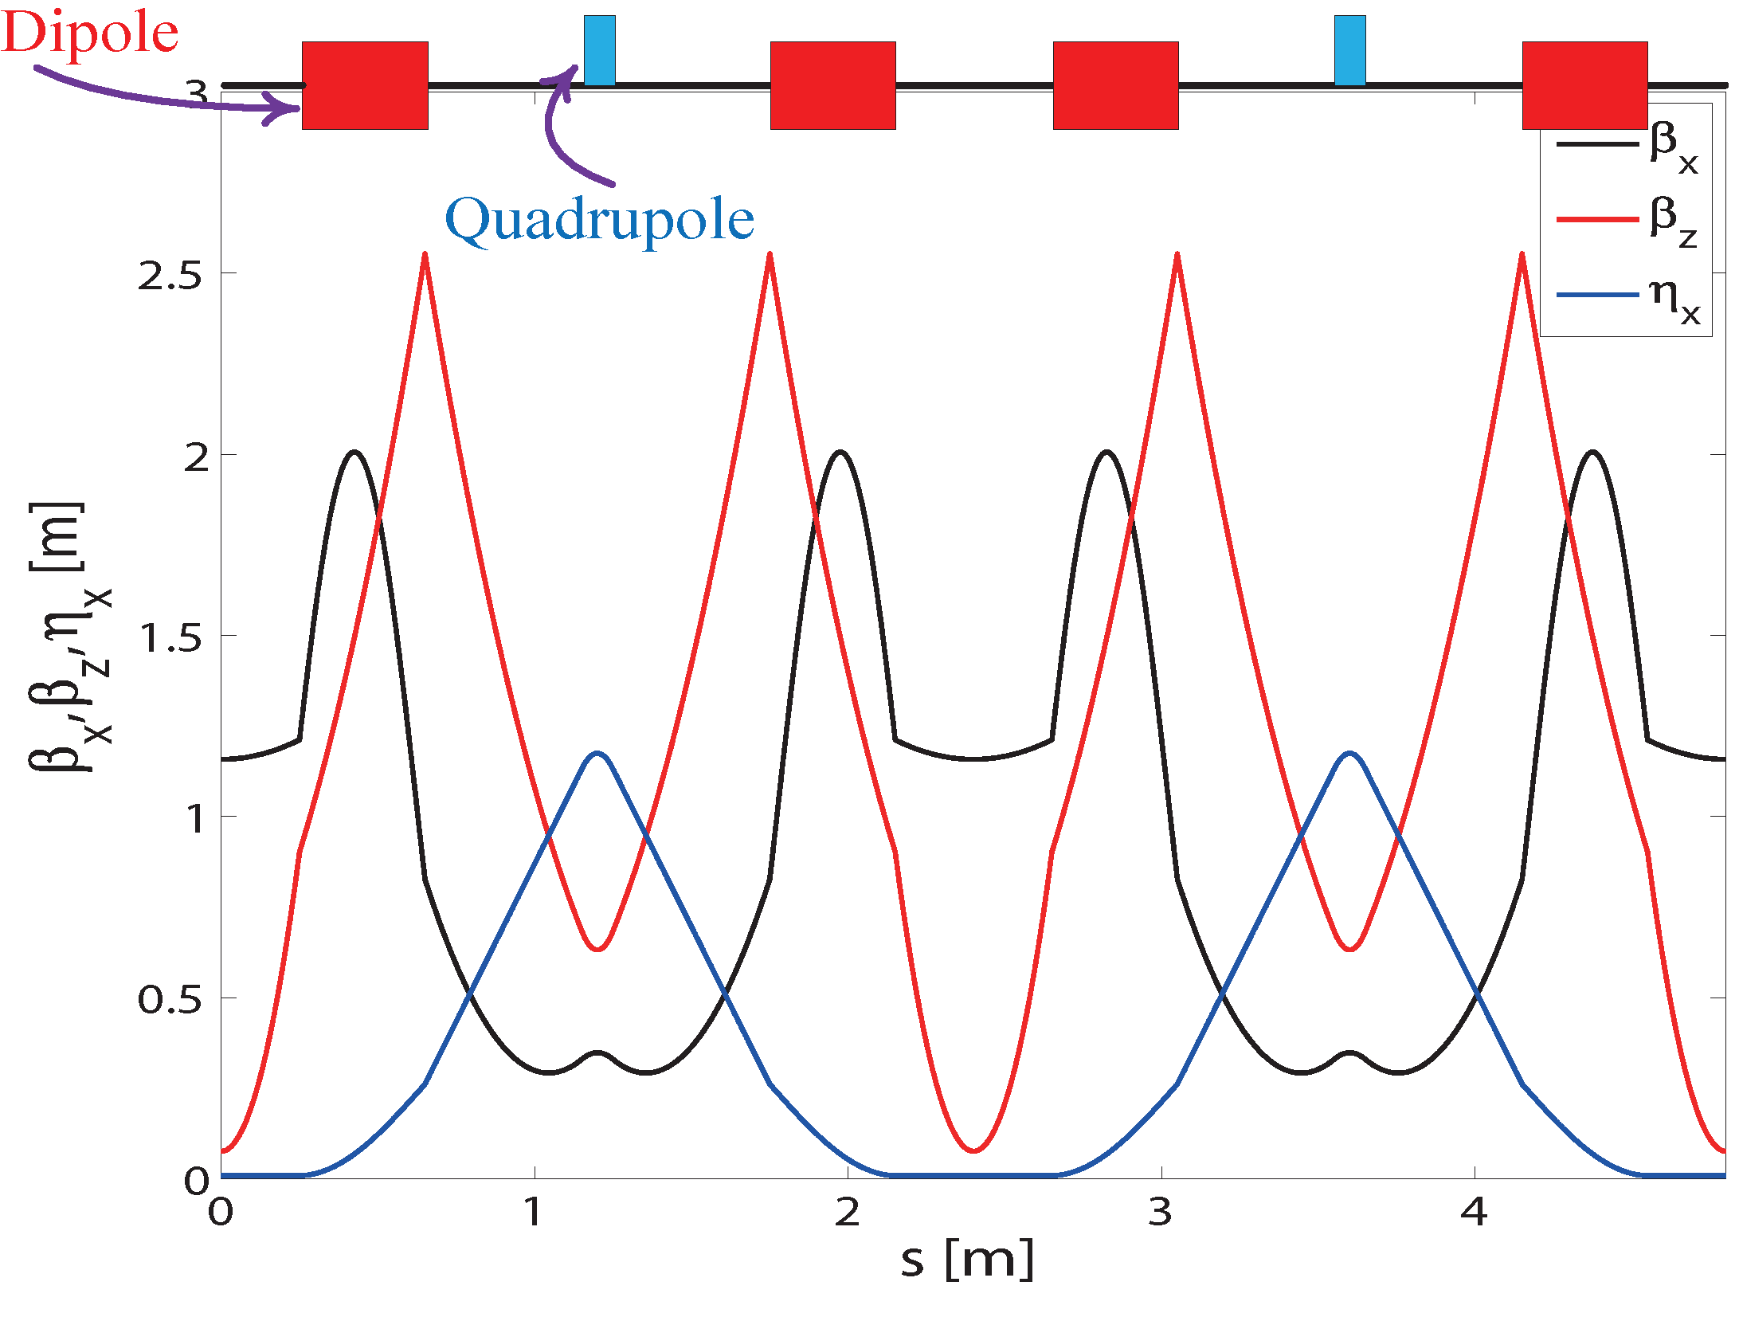
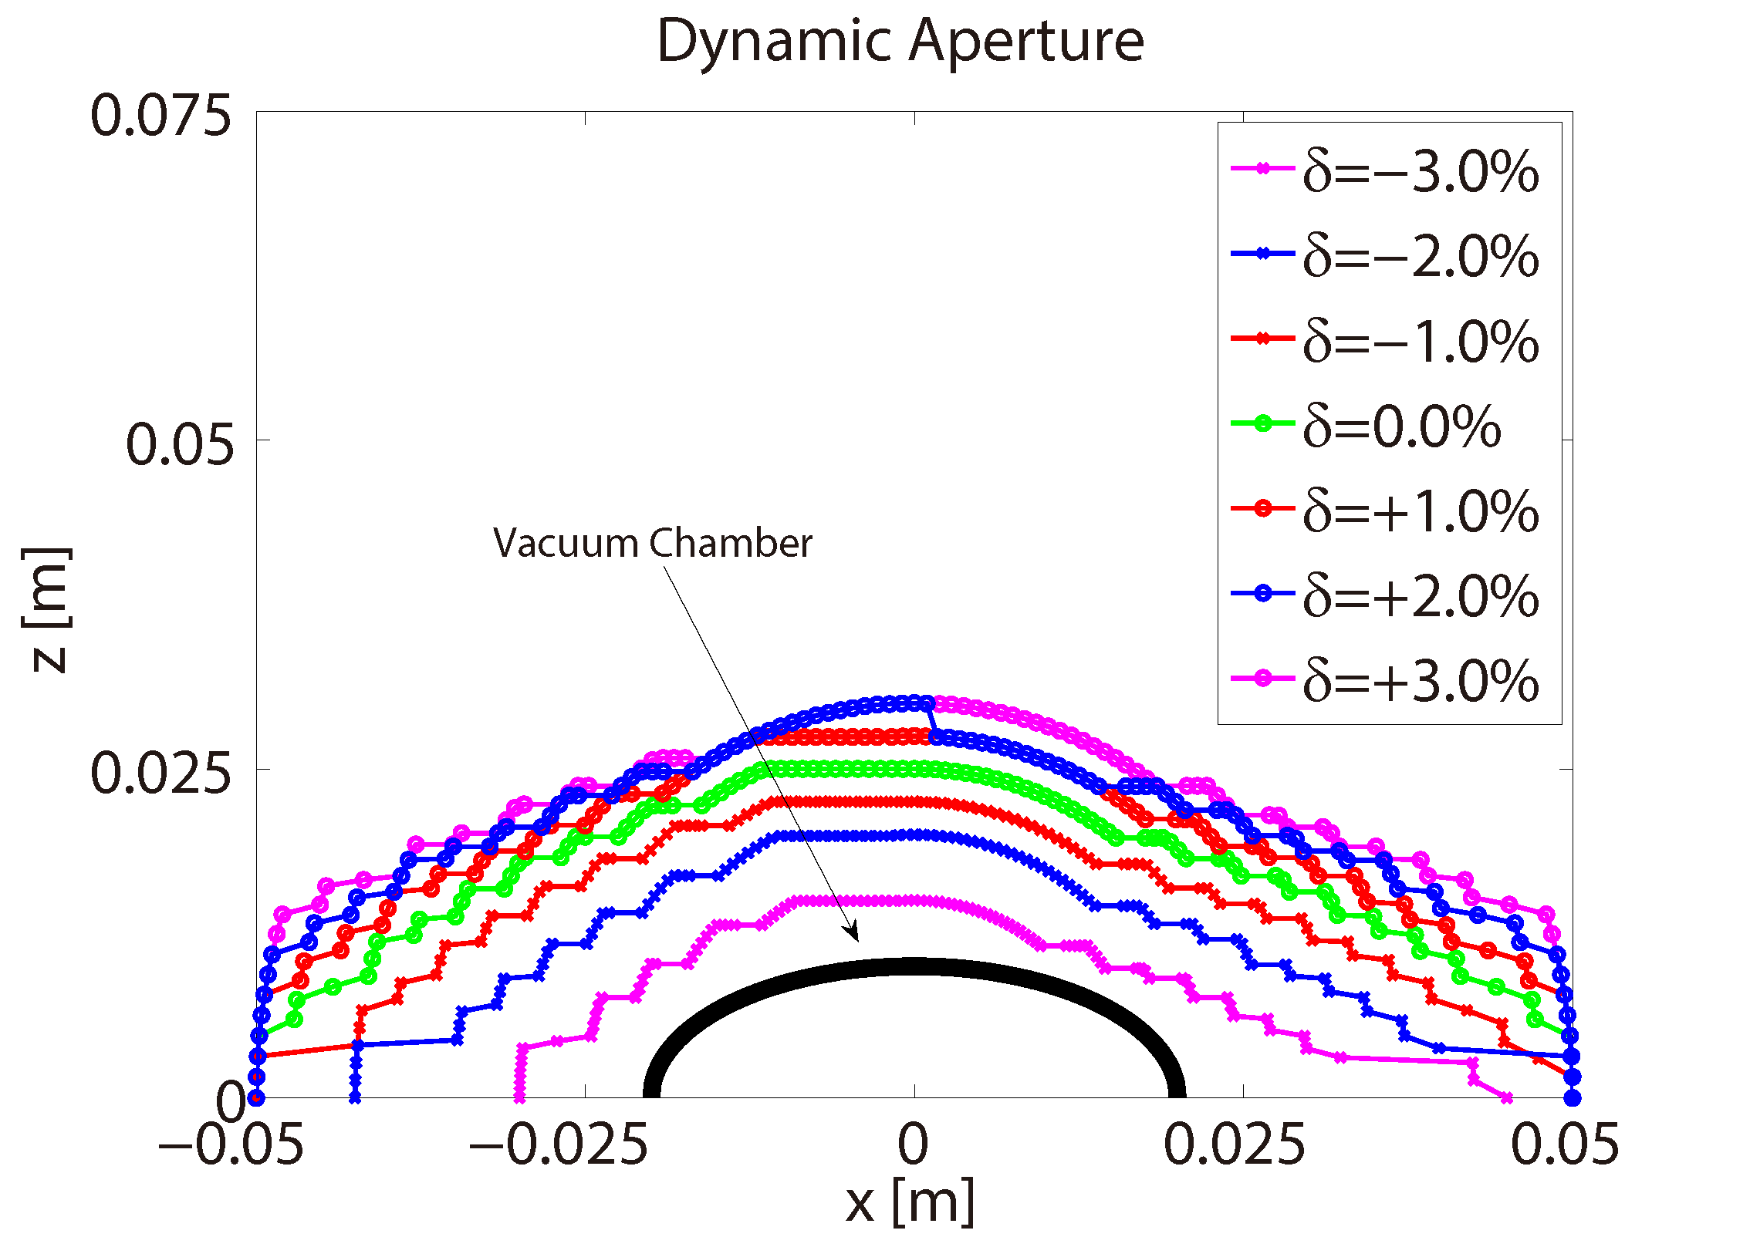
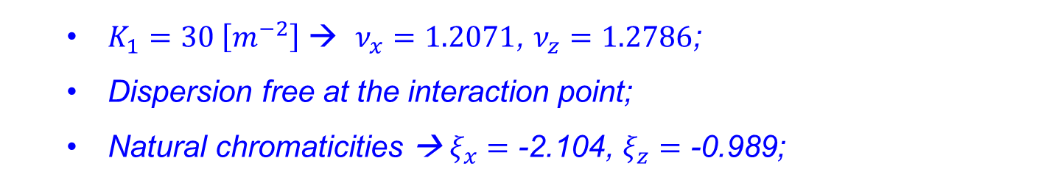
Baseline Design
  $K_{1}=30 \left[m^{−2}\right]$ → $ν_{x}=1.2071$, $ν_{z}=1.2786$;
  Dispersion free at the interaction point;
  Natural chromaticities → $ξ_{x}=\text{−2.104}$, $ξ_{z}=\text{−0.989}$;
  H.S. Xu, W.H. Huang, C.X. Tang, and S.Y. Lee, Phys. Rev. ST Accel. Beams, 2014, 17:070101 [Editors’ Suggestion]

Slide 17
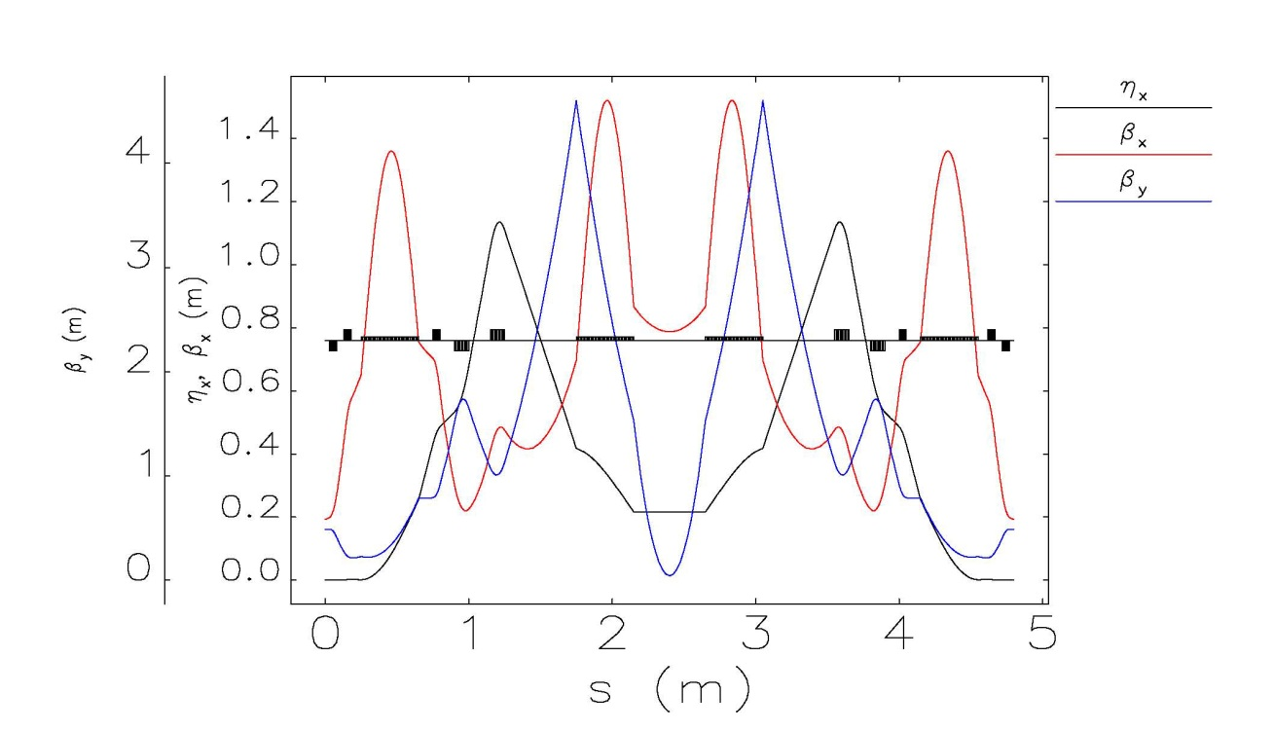
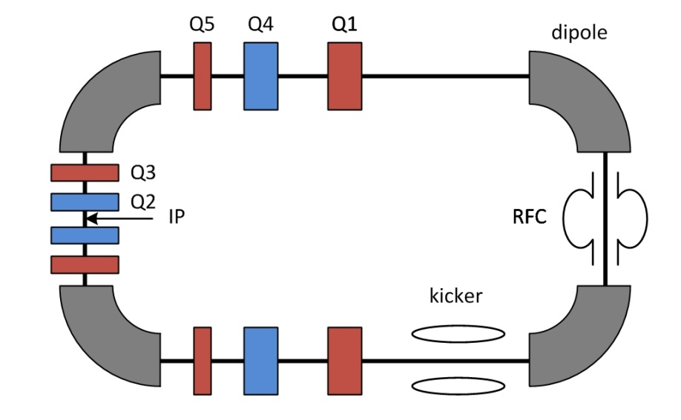
Mini beta
Mini-beta Design
Parameters | Value
Betax/Betay at IP (m) | 0.194 / 0.489
Dispersion at IP (m) | 1.00e-3
Tune (ν_{x} / ν_{y}) | 1.40 / 1.40
Chromaticity (ξ_{x} / ξ_{y}) | -1.10 / -1.10
Horizontal damping partition number (J_{x}) | 0.999
Momentum compaction factor (α_{c}) | 0.280
  Courtesy of Tenghui Rui

Slide 18
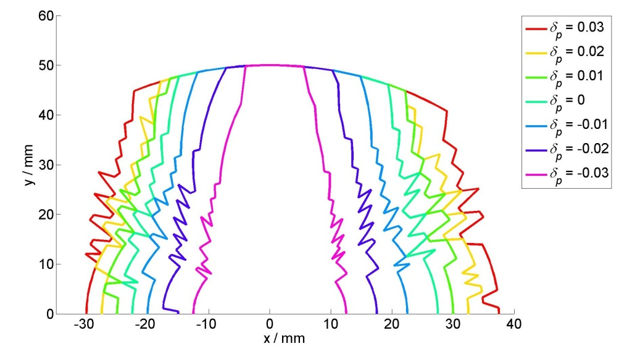
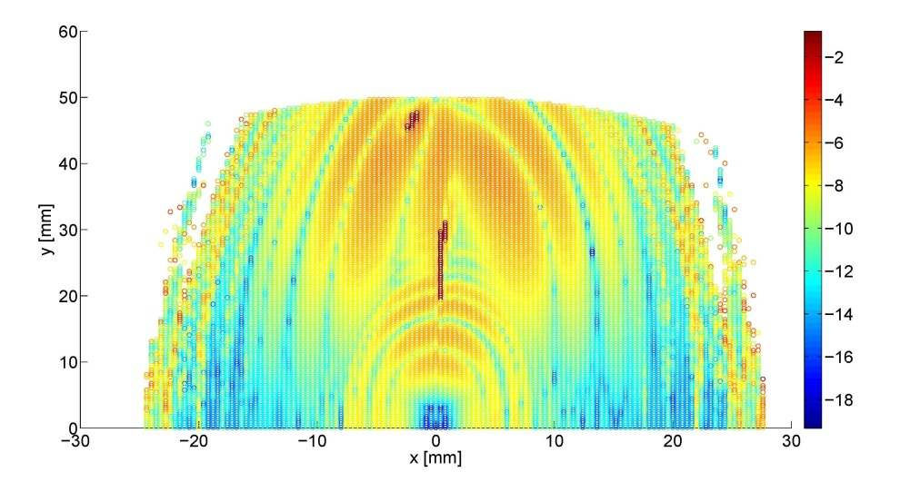
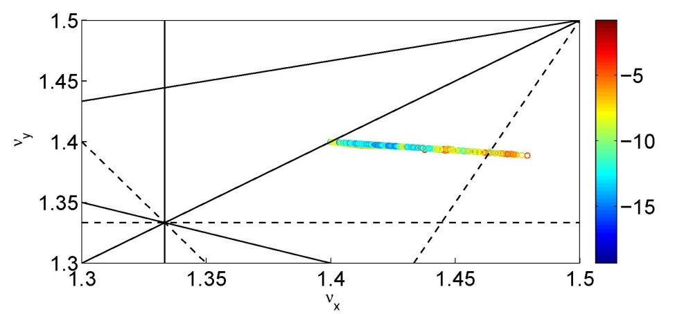
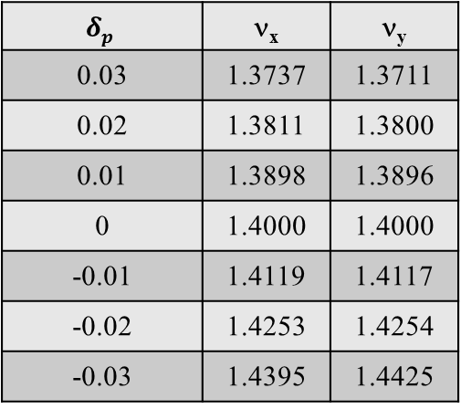
Mini beta
Mini-beta Design
$$δp$$ | ν_{x} | ν_{y}
0.03 | 1.3737 | 1.3711
0.02 | 1.3811 | 1.3800
0.01 | 1.3898 | 1.3896
0 | 1.4000 | 1.4000
-0.01 | 1.4119 | 1.4117
-0.02 | 1.4253 | 1.4254
-0.03 | 1.4395 | 1.4425
  Courtesy of Tenghui Rui

Slide 19
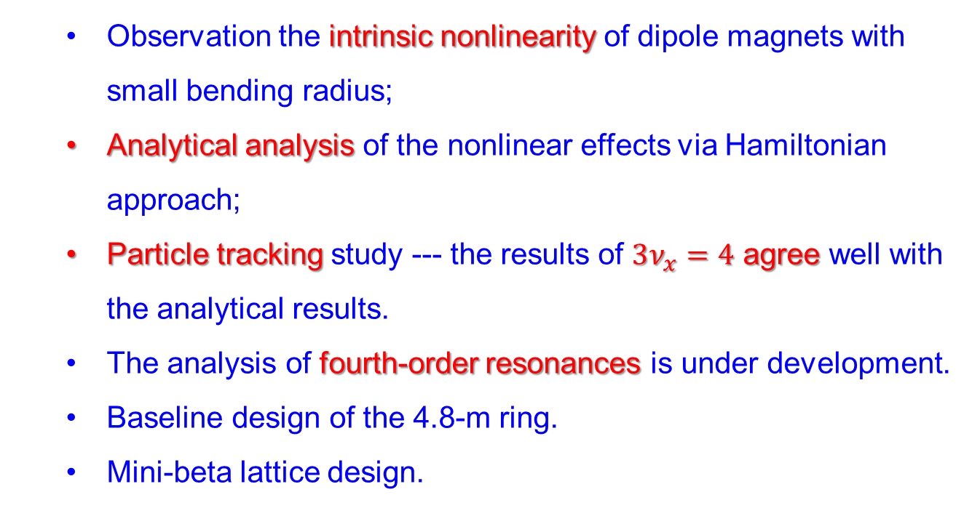
Summary
  Observation the intrinsic nonlinearity of dipole magnets with small bending radius;
  Analytical analysis of the nonlinear effects via Hamiltonian approach;
  Particle tracking study --- the results of $3ν_{x}=4$ agree well with the analytical results.
  The analysis of fourth-order resonances is under development.
  Baseline design of the 4.8-m ring.
  Mini-beta lattice design.

Slide 20
The 12th Symposium on Accelerator Physics
ACCELERATOR LABORATORY of TSINGHUA UNIVERSITY
Thanks
谢谢

