Slide 1
World HEP Program – Today and Tomorrow
&
The Chinese Dream – No. 1 in Energy Frontier
Weiren Chou (周为仁)
Fermilab
Presentation to the 3rd CEPC-SppC Workshop
March 19, 2014, IHEP, Beijing, China

Slide 2
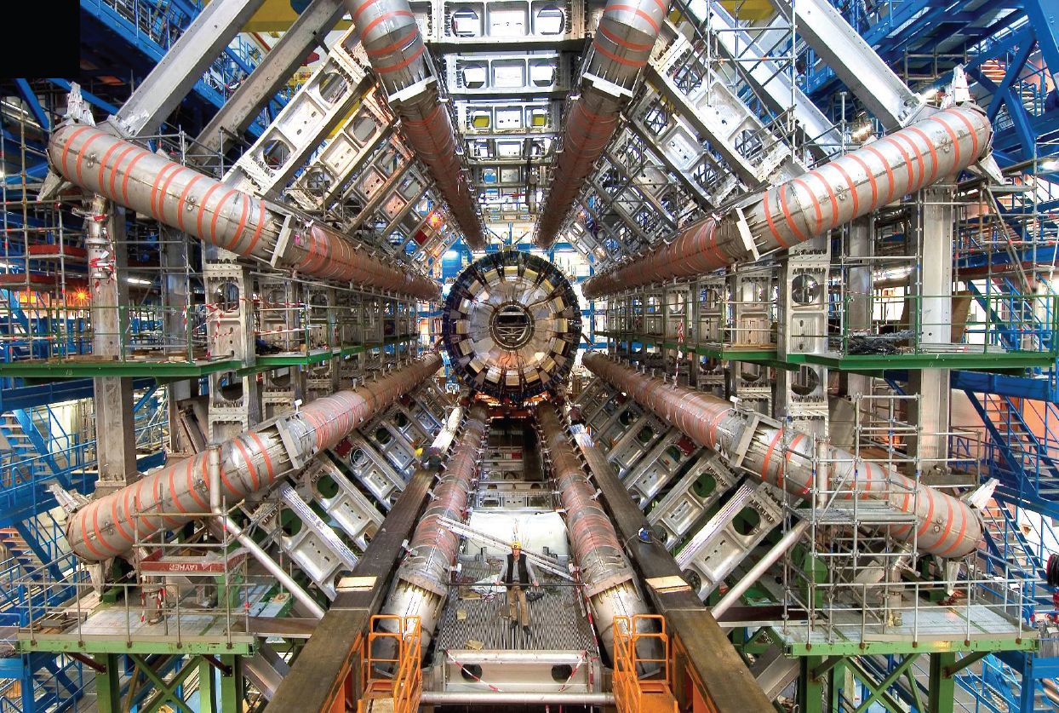
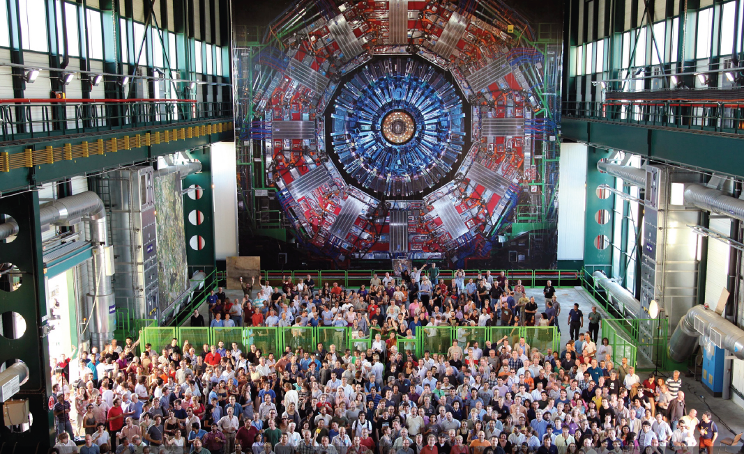
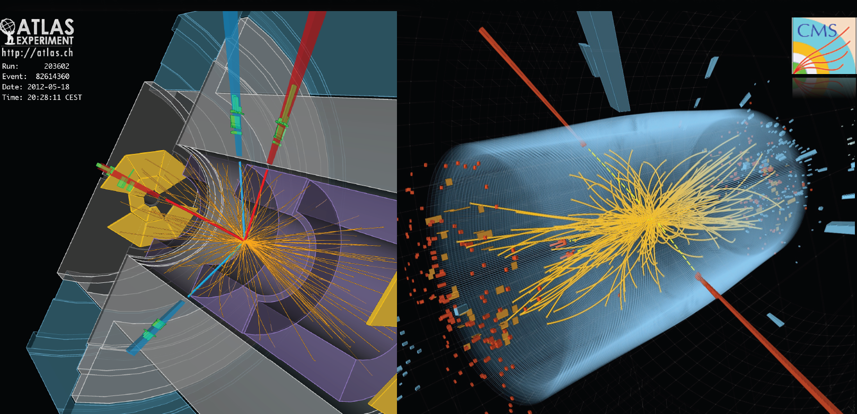
July 4, 2012 was a milestone in the history of particle physics – Higgs was discovered at both ATLAS and CMS at CERN.

Slide 3

One in 16 of the passengers passing through Geneva airport are in some way associated with CERN.

Slide 4

Science
“No recent scientific advance has generated more hoopla than this one.”

Slide 5
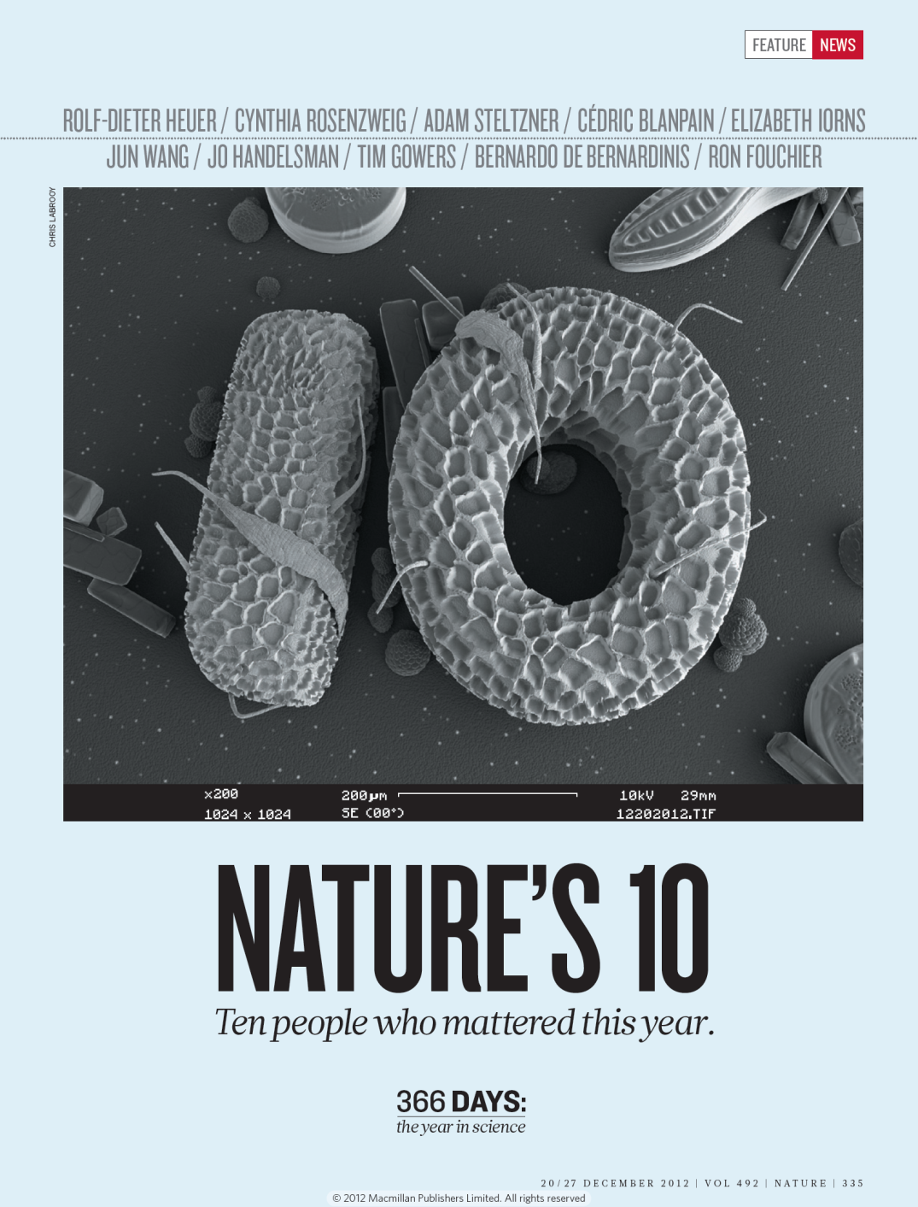
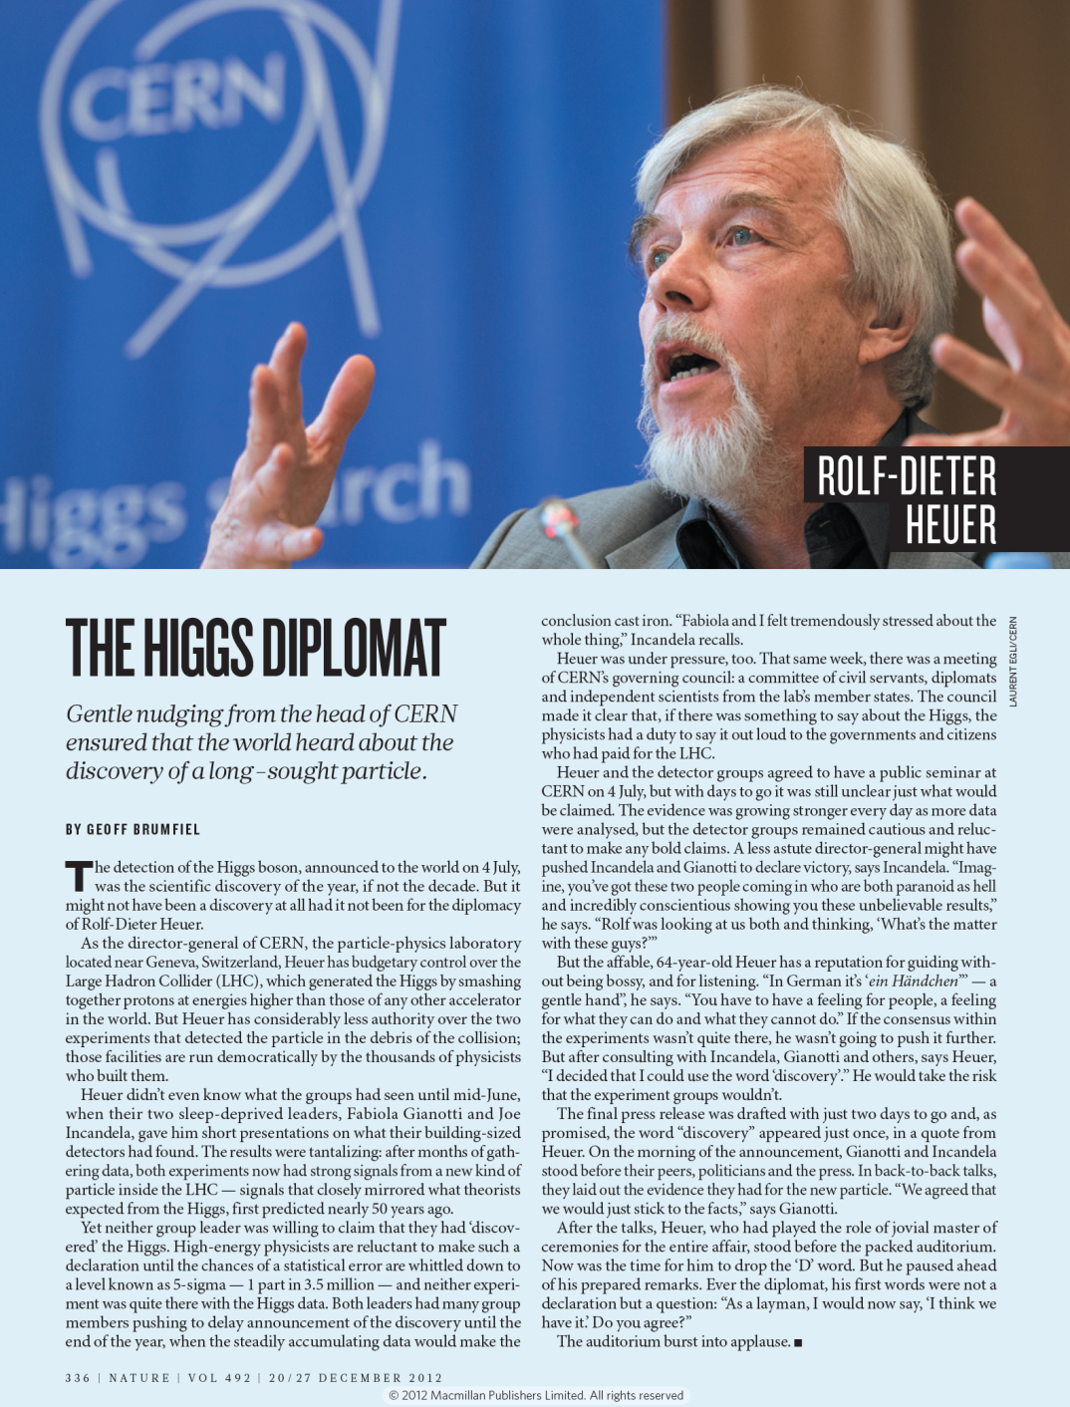

Slide 6

Time’s
Person of the Year
- a particle Physicist!
(Higgs) Particle of the Year
Discovery of the Year

Slide 7
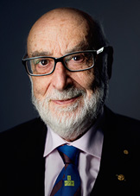

The Nobel Prize in Physics 2013
François Englert
Prize share: 1/2
Peter W. Higgs
Prize share: 1/2
“for the theoretical discovery of a mechanism that contributes to our understanding of the origin of mass of subatomic particles, and which recently was confirmed through the discovery of the predicted fundamental particle, by the ATLAS and CMS experiments at CERN's Large Hadron Collider"

Slide 8
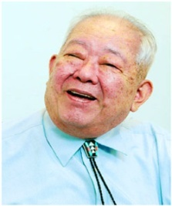
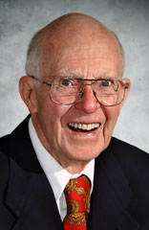


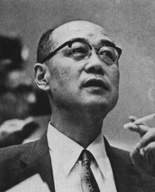
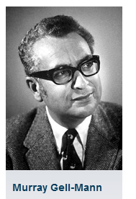
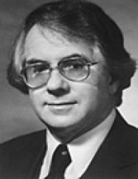
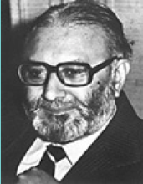

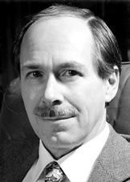
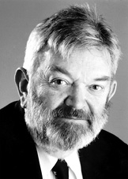
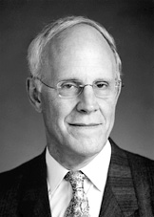
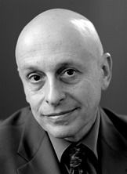
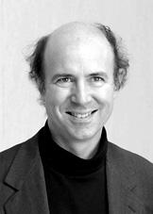
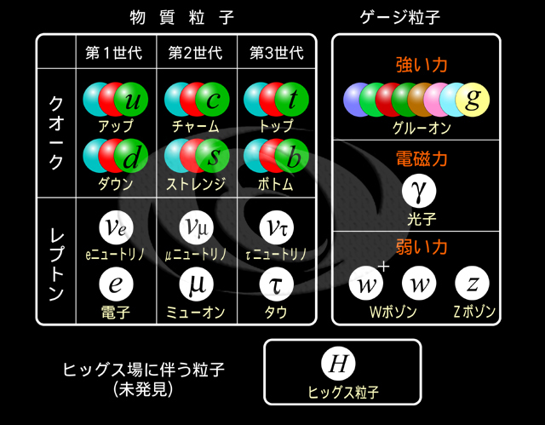
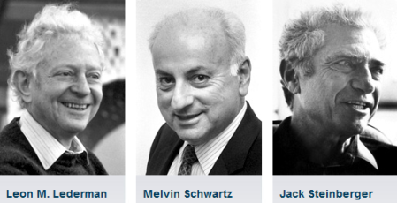
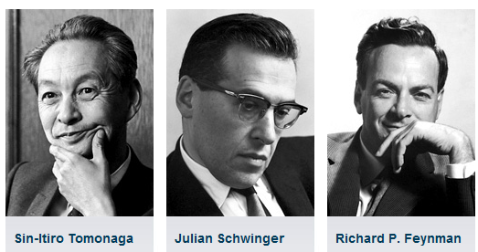
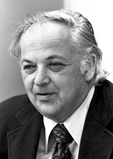
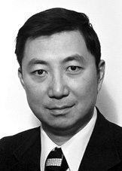
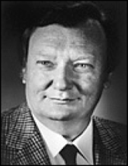
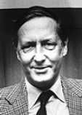
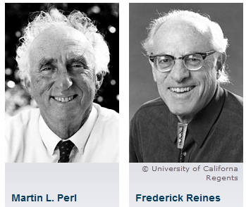
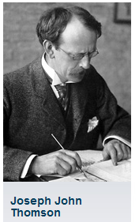
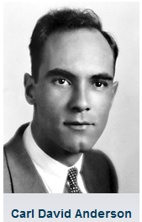
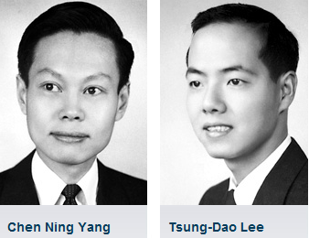
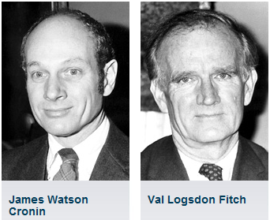
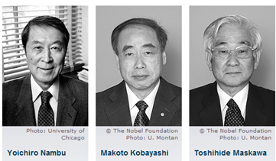
素粒子の探求とノーベル賞
Quest for Elementary Particles and Novel Prizes
1969
1979
2002
2013
1949
1999
2004
Sheldon Glashow
Abdus Salam
Steven Weinberg
Gerard 't Hooft
Martinus Veltman
David Gross
David Politzer
Frank Wilczek
1988
1965
1976
vvv
1984
cc
1995
Burt Richter
Sam Ting
1906
Carlo Rubbia
Simon van der Meer
2008
1936
1957
1980

Slide 9
Letter to the editor (ICFA BD Newsletter, no. 53, December 2010)
This letter carried out an extensive survey of a large body of literature from Nobel Prize committee and laureates – a total of 331 documents (a stack of 60 cm high).
From 1939 (when Ernest Lawrence received a Nobel Prize for his invention of the cyclotron) to 2009, nearly 30% of the Nobel Prizes in Physics had a direct contribution from accelerators.
On the average, accelerator science contributed to a Nobel Prize in Physics every 3 years.

Slide 10
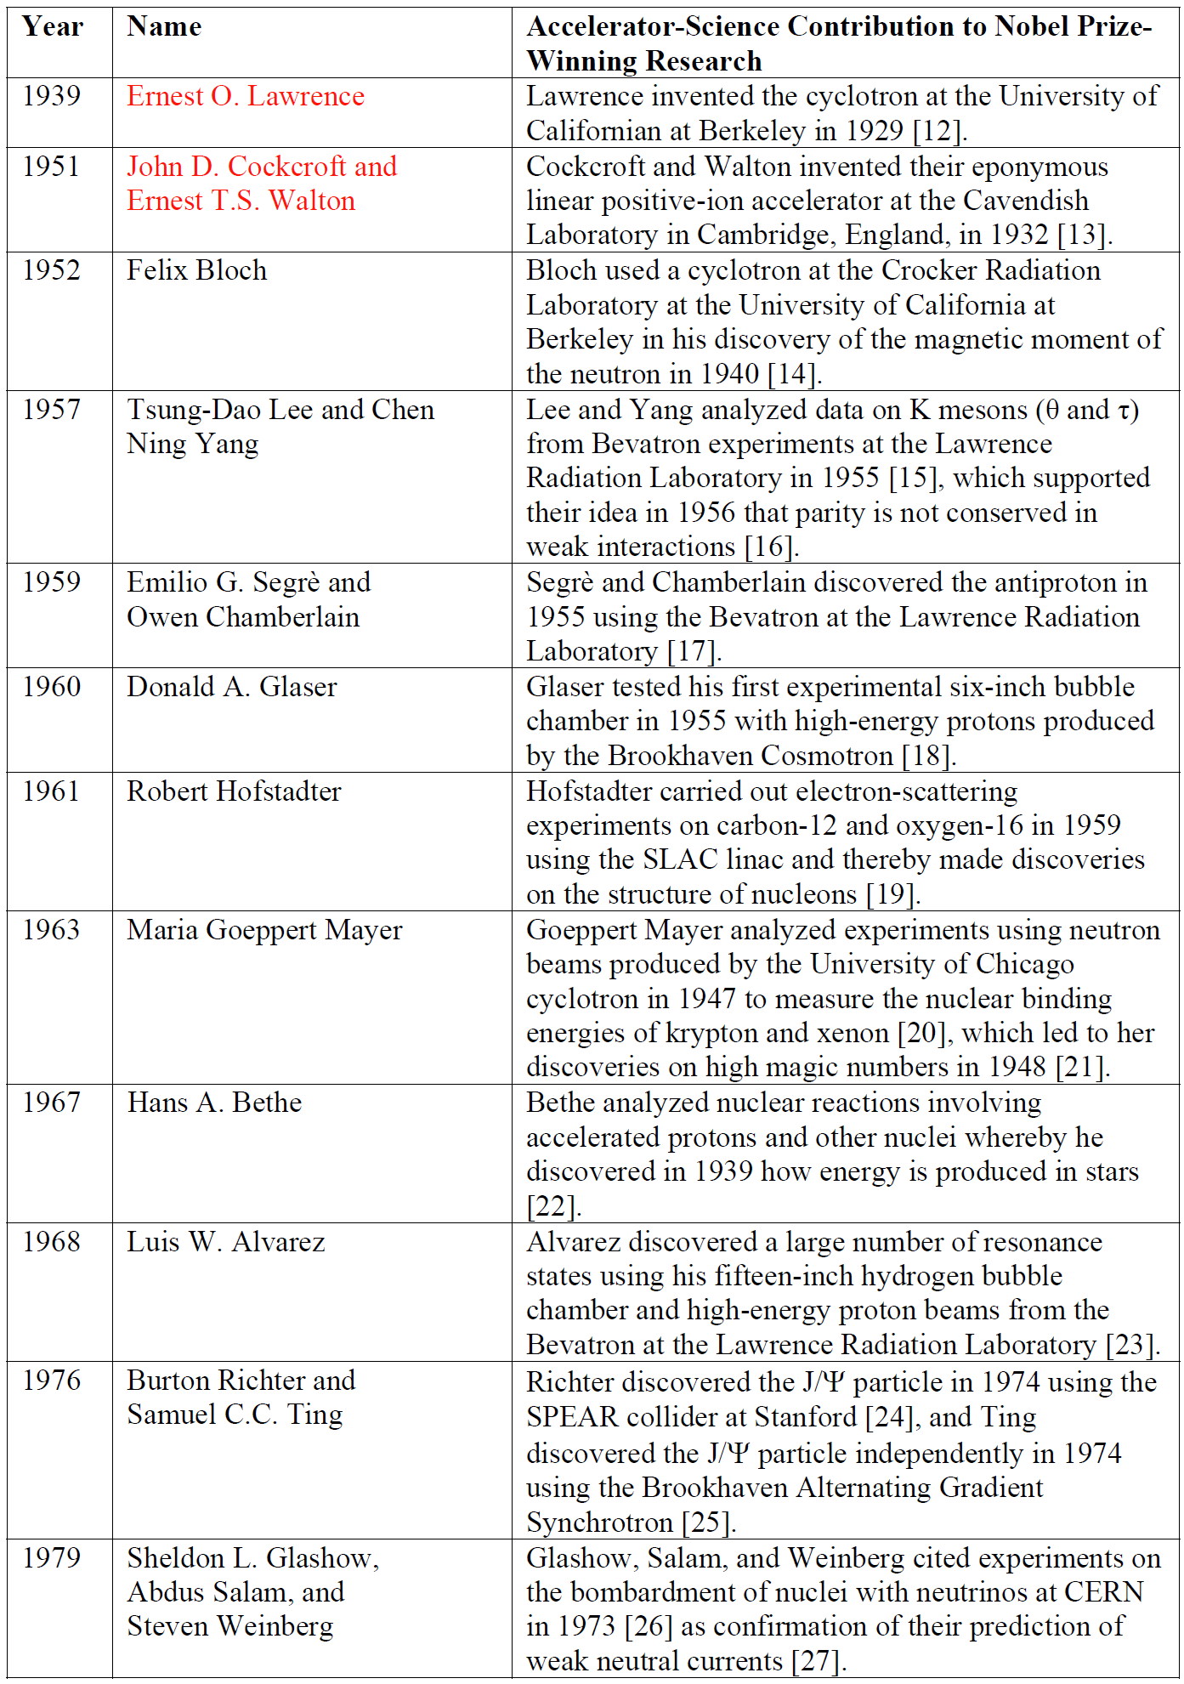
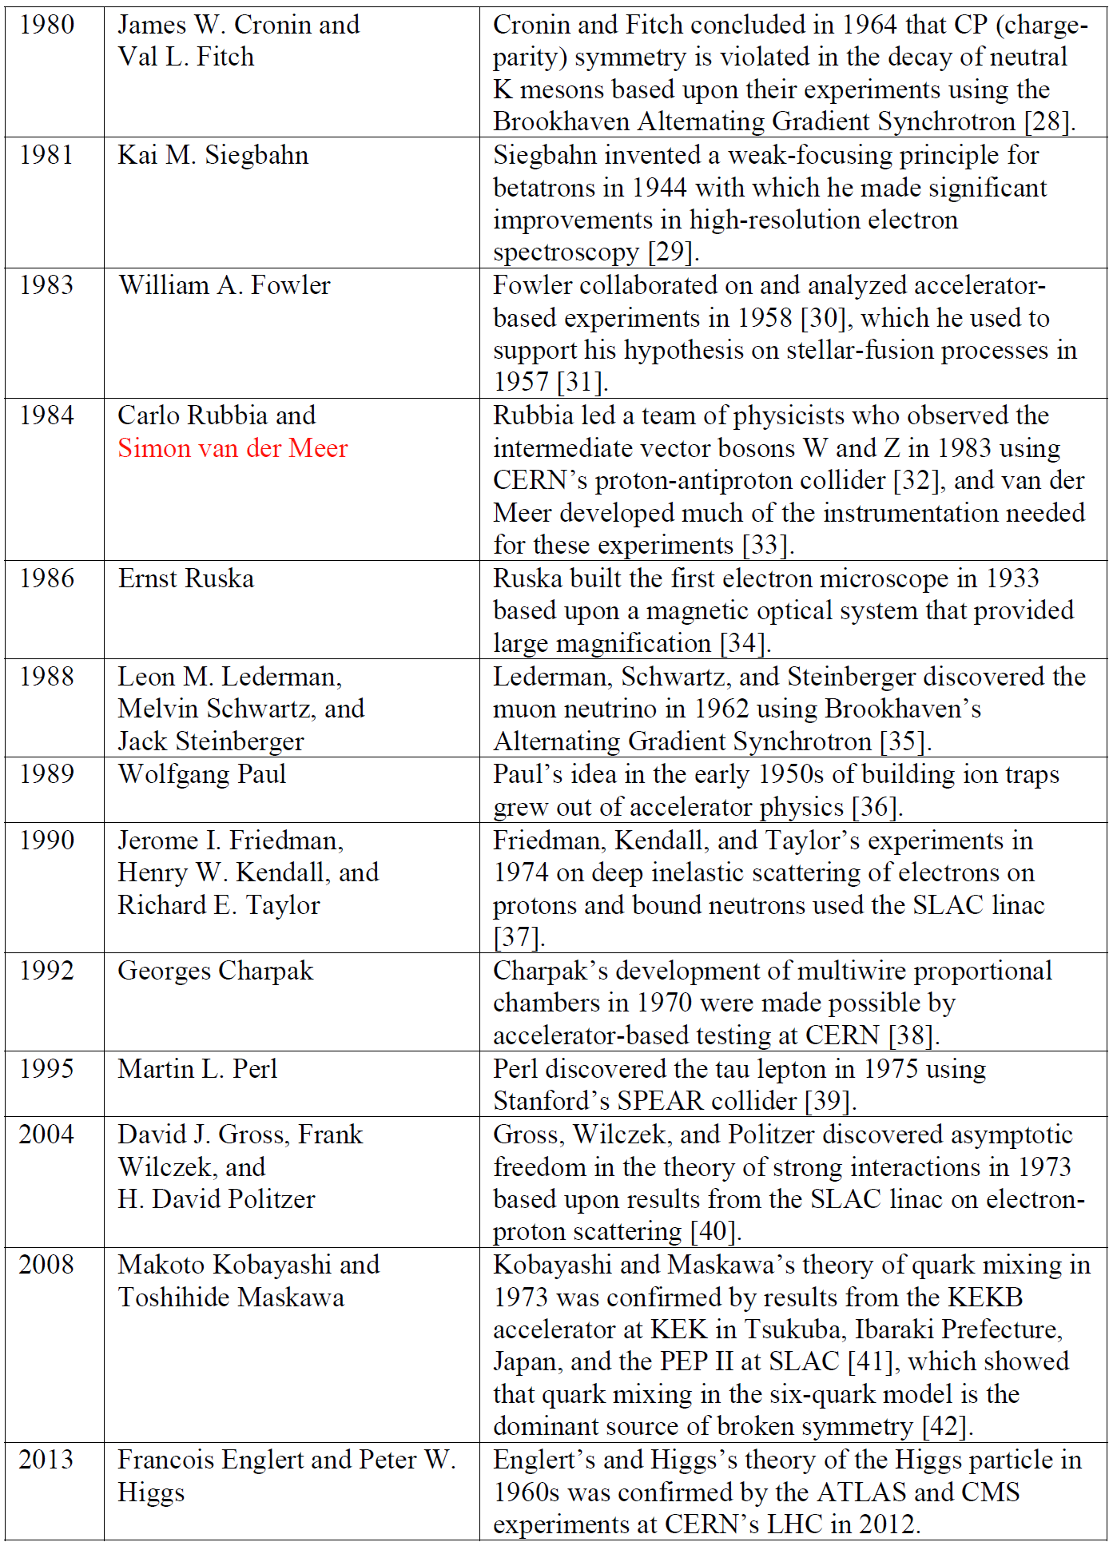
25 Nobel Prizes in Physics that had direct contribution from accelerators

Slide 11
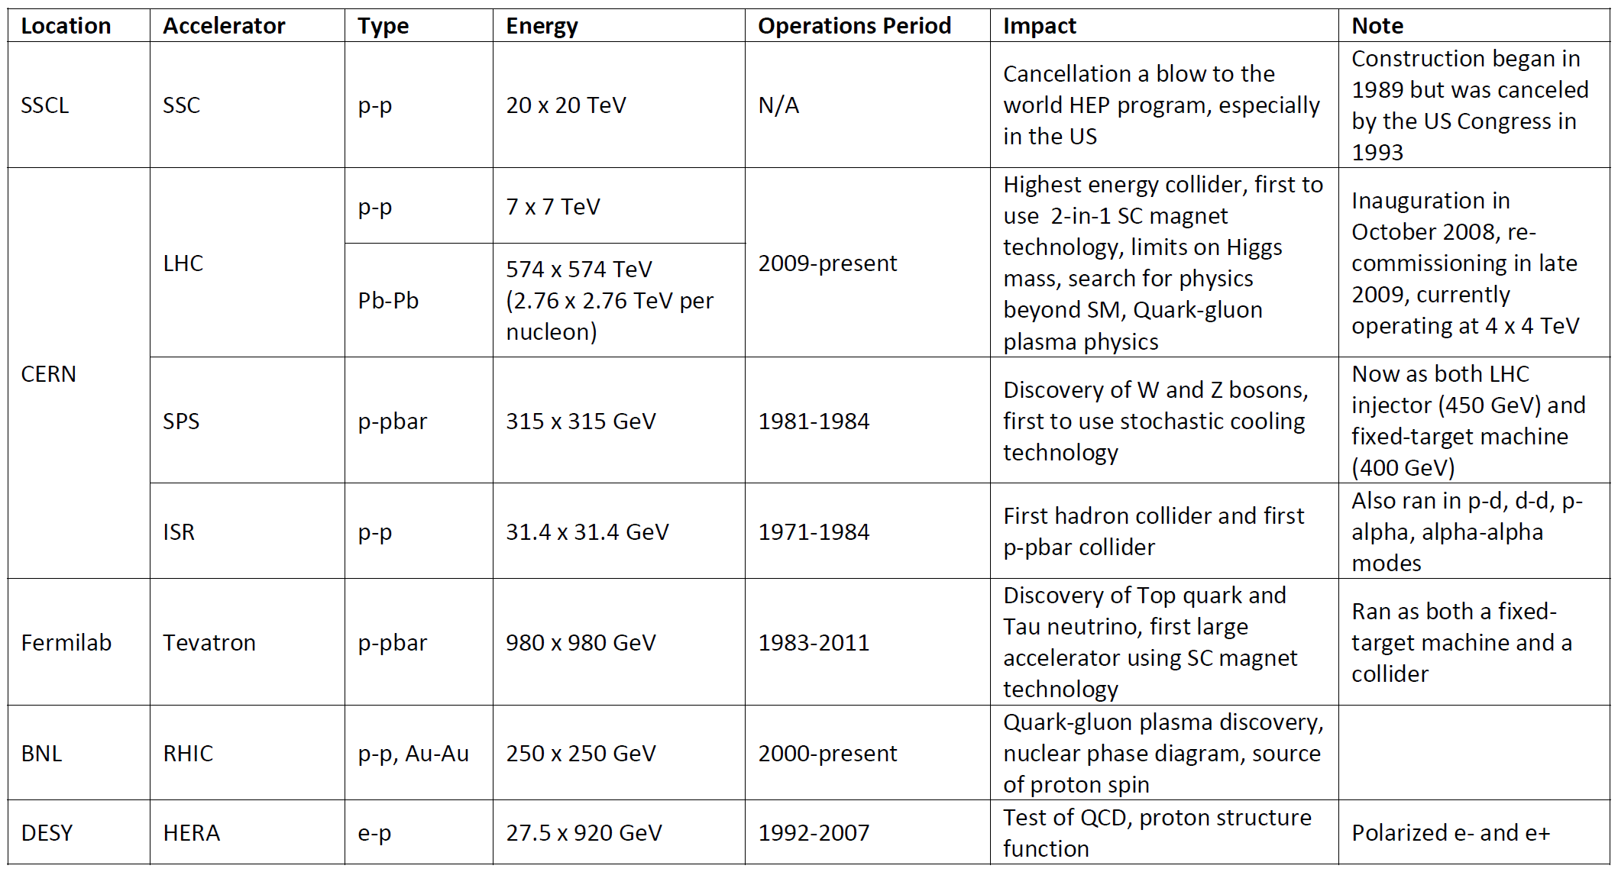
Hadron Colliders in the Last 30 Years (1984 – 2014)

Slide 12
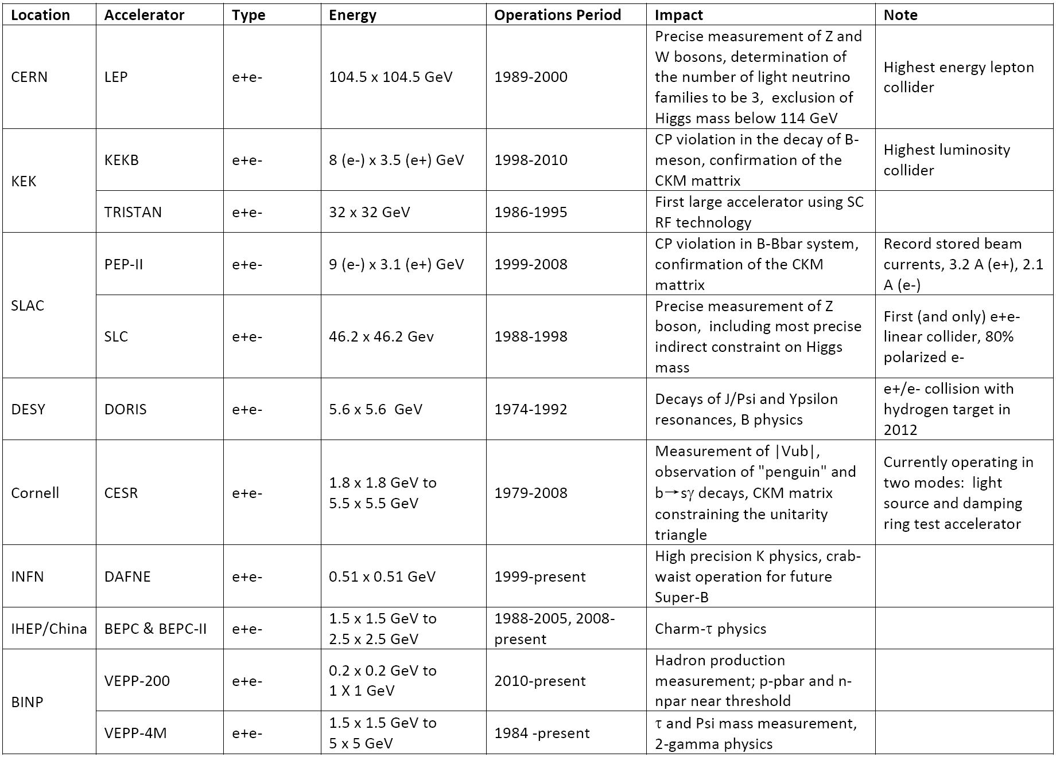
e⁺e⁻ Collider in the Last 20 Years (1991 – 2011)

Slide 13
The World HEP Planning – a Circle
2001 Snowmass
2004 ICFA
After 4th of July 2012
Linear e+e-
  Cold (TESLA)
  Warm (NLC/JLC)
Circular e+e-
VLHC / VLLC
Muon collider
High intensity proton source (aka Proton Driver)
Cold Linear e+e- (ILC)
Linear e+e-
  ILC
  CLIC
  X-band klystron based
Circular e+e-
  Fermilab site filler
  LEP3 and TLEP
  SuperTRISTAN
  China Higgs Factory (CHF)
  VLLC
Muon collider
Photon cillider
  ILC-based
  CLIC-based
  SAPPHiRE
  SLC-type
  ERL-based

Slide 14
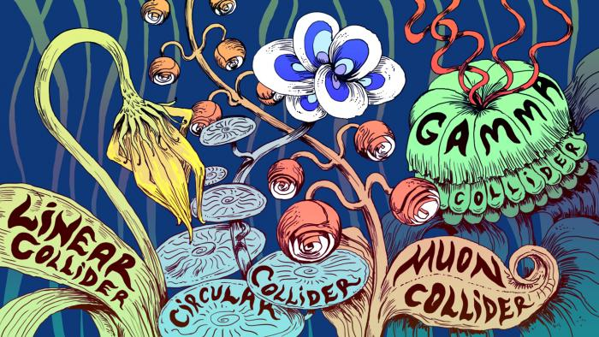
Hundred Flowers Bloom
- Symmetry magazine

Slide 15
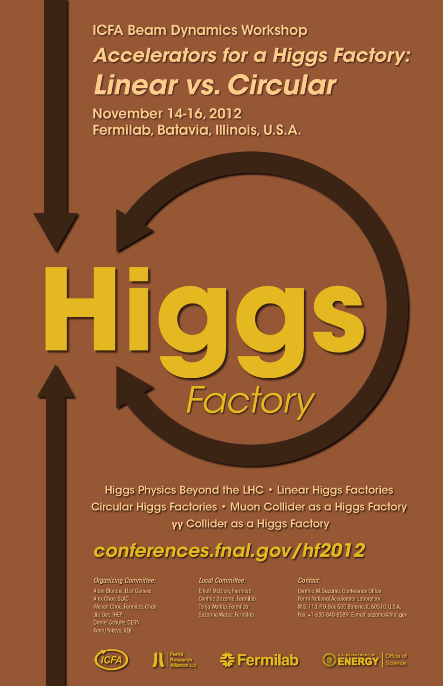
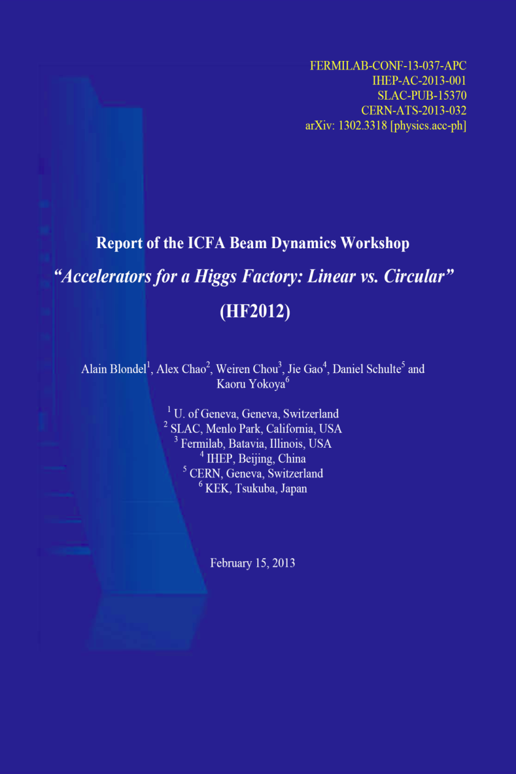

Slide 16
(1) Linear e⁺e⁻ Collider as a Higgs Factory
Advantages:
  Extensive design and prototyping work have been done
  Big investment have been made. Key technologies are in hand.
  There exist well-organized international collaborations led respectively by the ILC GDE and CLIC Collaboration (to be combined under the Linear Collider Director appointed by ICFA)
  Important step towards high energy e+e- collisions
  Polarized beams (e- 80%, e+ 30%)
  A front runner (in terms of readiness)
Challenges:
  High cost
Specific issues:
  ILC
    FFS
    Positron source
    Industrialization of SRF
    For Higgs factory: Need 10 Hz for e+ production, or use unpolarized e+ beam as a backup scheme
  CLIC
    Accelerating structure
    Industrialization of major components
    From CDR to TDR

Slide 17
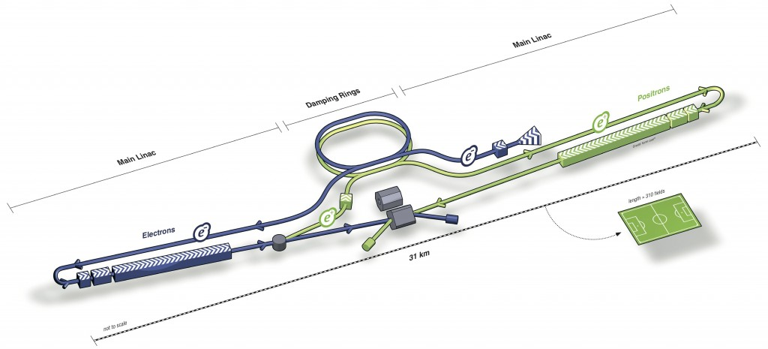
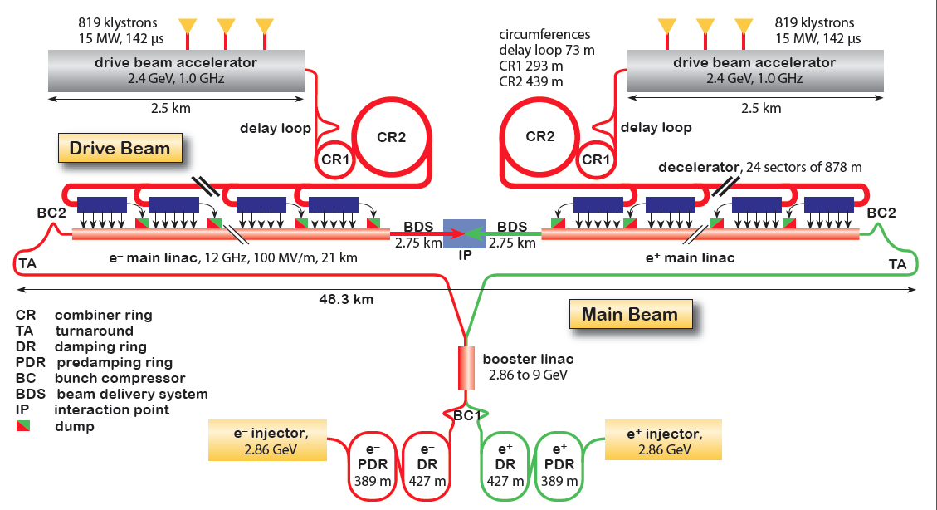
(1) Linear e⁺e⁻ Collider as a Higgs Factory
ILC
CLIC (also has a klystron version for low energy)

Slide 18
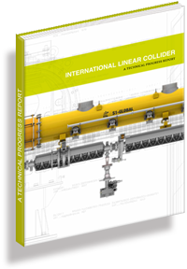
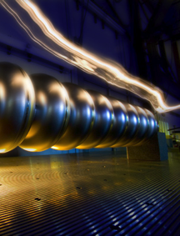
TDR Technical Volumes
2007
2011
2013*
TDR Part I:
R&D
~250 pages
Deliverable 2
ILC Technical Progress Report
(“interim report”)
AD&I
TDR Part II:
Baseline
Reference
Report
~300 pages
Deliverables 1,3 and 4
Technical Design Report
Reference Design Report
* end of 2012 – formal publication early 2013

Slide 19
TDR 500 GeV Baseline
15.4 km
(site length ~31 km)
1.1 km
10.8 km
1.3 km
2.2 km
Main Linac
BDS
e+ src
IP
bunch comp.
Main Linac
<G_{cavity}> = 31.5 MV/m
G_{eff} ≈ 22.7 MV/m
(fill fact. = 0.72)
central region
Cost: 100%
P_{AC}: 161 MW

Slide 20
250 GeV staged (scenario 1)
15.4 km
1.1 km
5.1 km
1.3 km
2.2 km
Main Linac
BDS
e+ src
IP
bunch comp.
central region
Half the linac
Full-length BDS tunnel & vacuum (TeV)
½ BDS magnets (instrumentation, CF etc)
½ RTML LTL
Extended tunnel/CFS already 500 GeV stage
10Hz mode e- linac

Slide 21
250 GeV staged (scenario 2)
15.4 km
1.1 km
5.1 km
1.3 km
2.2 km
Main Linac
BDS
e+ src
IP
bunch comp.
125 GeV transport
central region
Half the linac
Full-length BDS tunnel & vacuum (TeV)
½ BDS magnets (instrumentation, CF etc)
1 RTML LTL
5km 125 GeV transport line
Extended tunnel/CFS already 500 GeV stage
10Hz mode e- linac
quasi-adiabatic energy upgrade?

Slide 22
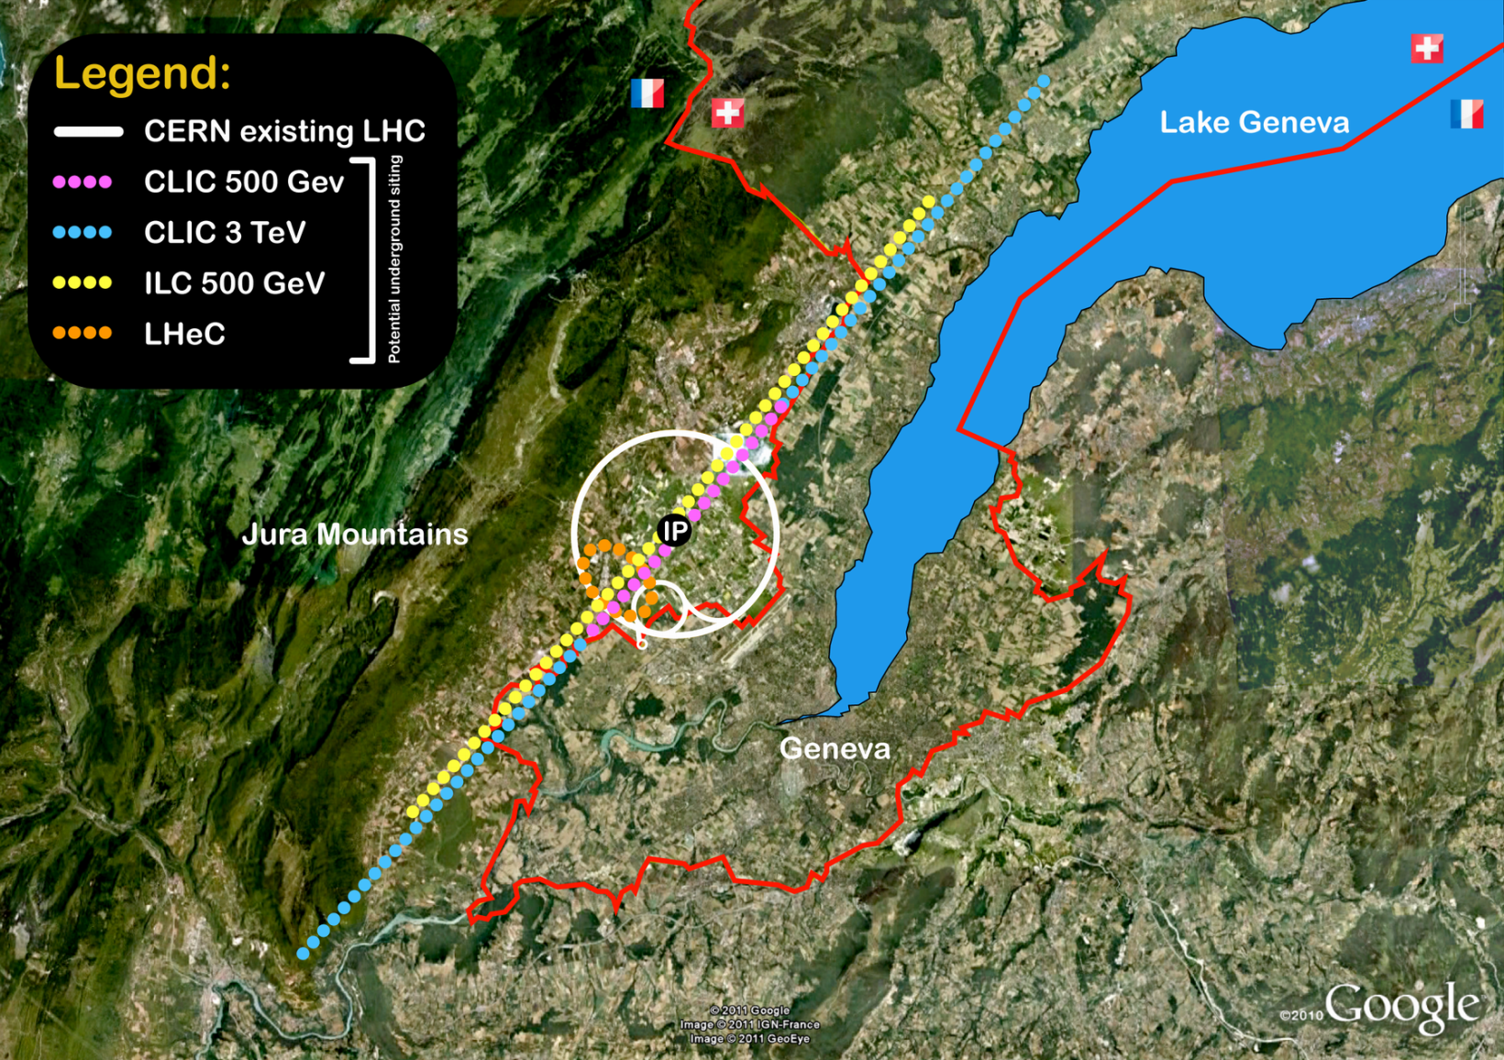
CLIC Layout
14 km, ~100 m deep
31 km, ~100 m deep

Slide 23
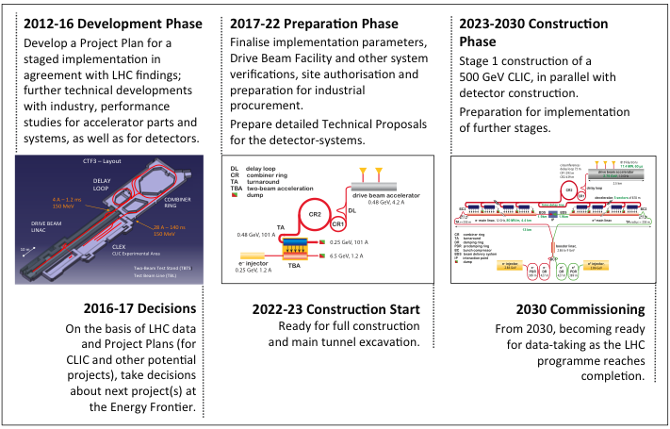
Timeline

Slide 24
(2) Circular e⁺e⁻ Collider as a Higgs Factory
Advantages:
  At 240 GeV, potentially a higher luminosity to cost ratio than a linear one
  Based on mature technology and rich experience
  Some designs can use existing tunnel and site
  More than one IP
  Tunnel of a large ring can be reused as a pp collider in the future
Challenges:
  Beamstrahlung limiting beam life time requires lattice with large momentum acceptance
  RF and vacuum problem from synchrotron radiation
  A lattice with low emittance
  Efficiency of converting wall power to synchrotron radiation power
  Limited energy reach
  No comprehensive study; design study report needed.

Slide 25
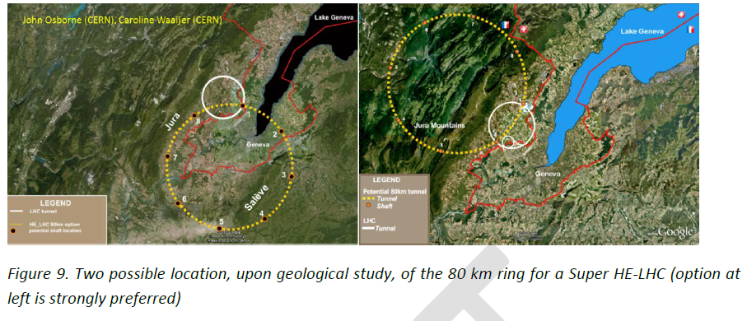
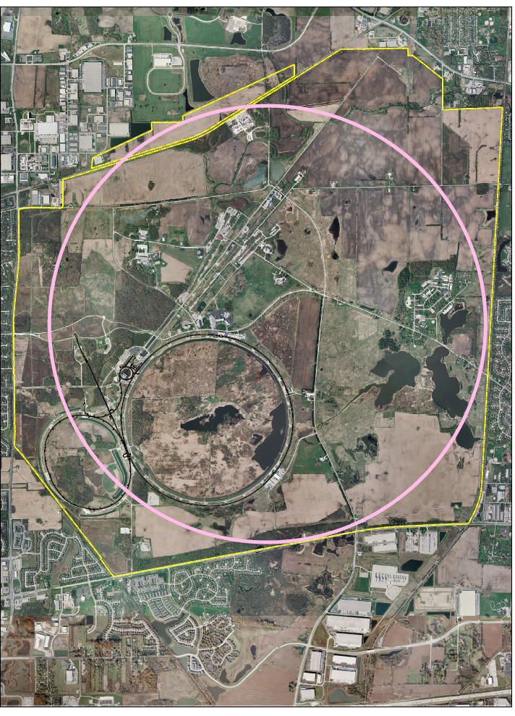
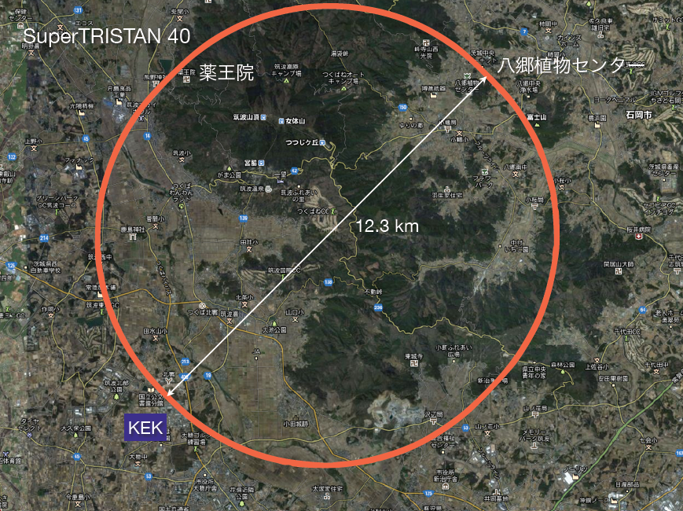
(2) Circular e⁺e⁻ Collider as a Higgs Factory
LEP3 and TLEP
Fermilab Site-Filler
SuperTRISTAN

Slide 26
What is a (CHF + SppC) (Q. Qin)
China Higgs Factory (CHF)
Circular Higgs factory (phase I) + super pp collider (phase II) in the same tunnel
pp collider
e⁻e⁺ Higgs Factory
IHEP proposal:
Dig a big ring (50 – 70 km)
First build a “cheap” 240 GeV Higgs factory (CHF)
Then build a 100 TeV pp collider (SppC)
Physics focused on low energy (W, Z and H) or very high energy (new frontier), bypassing the ILC energy window
Aiming at World No. 1

Slide 27
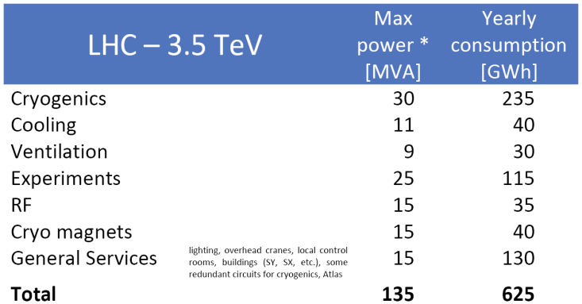
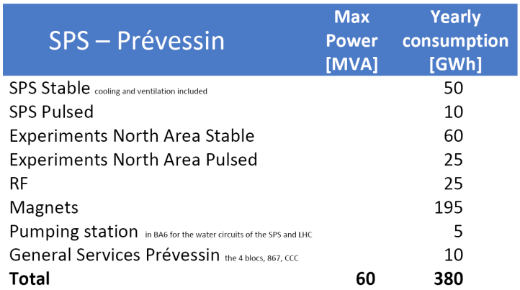
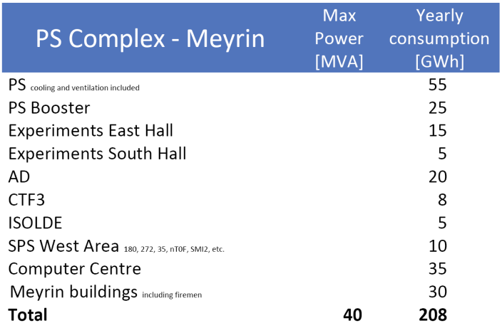
Power Consumption
CERN: current average 183 MW (R. Saban)
Fermilab: 2010 average 58 MW (D. Wolff)

Slide 28
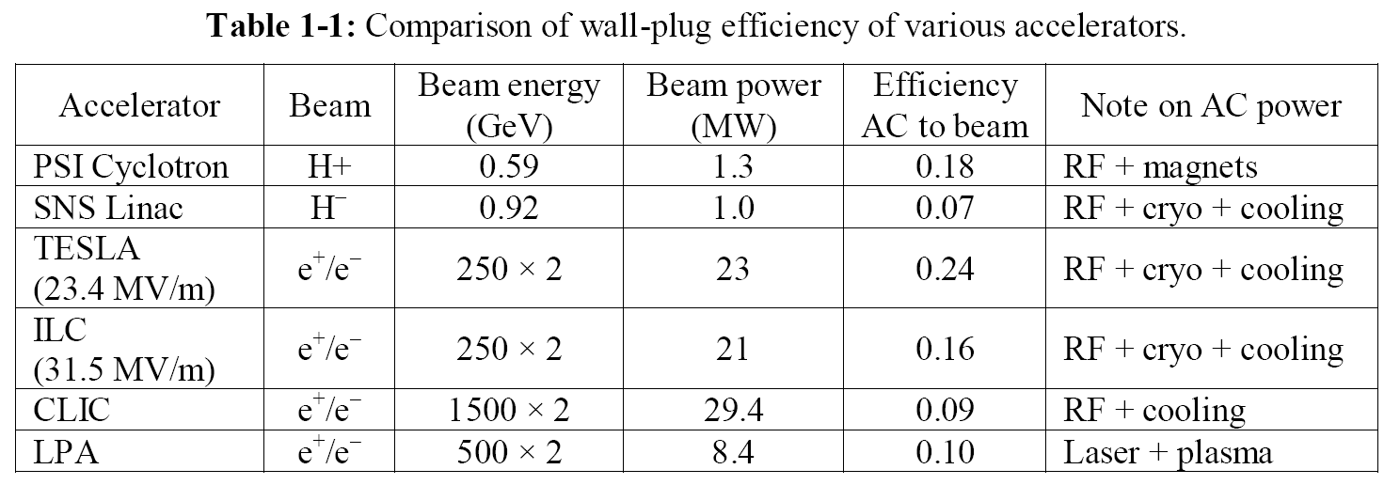
Electricity Bill and Wall Plug Efficiency
Fermilab current electricity bill:
  $ 440k per MW-year
  $ 20M a year
If increased to 200 MW:
  $ 80M a year
  i.e., 20% of the lab budget
CERN current electricity bill:
  1,200 GWh /year
  CHF 65M a year

Slide 29
(3) Muon Collider as a Higgs Factory
Advantages:
  Large cross section σ (μ+μ- → h) = 41 pb in s-channel resonance will compensate low luminosity (to compare to e+e- → ZH at 0.2 pb)
  Small size footprint
  No synchrotron radiation problem
  No beamstrahlung problem
  Unique way for direct measurement of the Higgs line shape and total decay width Γ
  Exquisite energy calibration
  A path to very high energy lepton-lepton collisions
Challenges:
  Muon 4D and 6D cooling needs to be demonstrated
  Need small c.o.m energy spread (0.003%)
  RF in a strong magnetic field
  Background from constant muon decay
  Significant R&D required towards end-to-end design and firming up luminosity figures
  Cost unknown (not much cheaper than a TeV muon collider)

Slide 30


(3) Muon Collider as a Higgs Factory

Slide 31

Scale of facility
Collider Ring
Proton Ring
Target +π→μ
Capture
RLA
Cooling line
Linac

Slide 32
(4) γγ Collider as a Higgs Factory
Advantages:
  Allow access to CP property of the Higgs
  Lower beam energy (80 GeV per e- beam to generate 63 GeV γ beam)
  High polarization in the colliding γ beams
  No need for e+ beam
  160 GeV e- linac has a lower cost w.r.t. a 240 GeV linear e+e- collider
  Can be added on a linear e+e- collider
Challenges:
  Physics not as comprehensive as a 240 GeV e+e- collider would be.
  Background problem
  IR design
  No comprehensive study.; design study report needed.
Specific issues:
  ILC-based
    Optical cavity
  CLIC-based
    Laser can piggy-back on the Livermore LIFE fusion project. (But the project schedule is unknown.)
  Recirculating linac-based:
    Polarized low emittance e- gun

Slide 33




(4) γγ Collider as a Higgs Factory
CLIC-based
SAPPHiRE
SLC-type

Slide 34

Fermilab – a Bird’s View
Tevatron

Slide 35

HFiTT – Higgs Factory in Tevatron Tunnel
Goal: 10,000 Higgs/year
RF (1.3 GHz, 8 sets, 5 cryomodules 1.25 GV /set)
RF
RF
e⁻ (80 GeV)
2000 m
Fiber Laser
(0.351 μm, 5 J, 47.7 kHz)
γγ collision
(125 GeV)
2.438 m
(8 ft)
e⁻ (80 GeV)
RF
RF
e⁻ (0.75-8 GeV)
Project X or ASTA
e⁻ (0.75-8 GeV)
E = 80 GeV
= 800 m
U = 4.53 GeV/turn
I = 0.15 mA x 2
P(rf) = 27 MW
Tunnel Cross Section
(16 permanent magnet beam lines,
B = 0.05 – 3.3 kG)
RF
RF
3.048 m (10 ft)
RF

Slide 36
Nature Photonics (G, Mourou et al., v. 7, p. 258, April 2013)
Figure 2: Principle of a coherent amplifier network (CAN) based on fiber laser technology. An initial pulse from a seed laser (1) is stretched (2), and split into many fibre channels (3). Each channel is amplified in several stages, with the final stages producing pulses of ~1 mJ at a high repetition rate (4). All the channels are combined coherently, compressed (5) and focused (6) to produce a pulse with an energy of >10 J at a repetition rate of 10 kHz (7). [5]

Slide 37
Snowmass White Paper
Fermilab-TM-2558-APC
arXiv: 1305.5202[physics.acc-ph]
HFiTT – Higgs Factory in Tevatron Tunnel (Rev. 3)
Weiren Chou¹, Gerard Mourou², Nikolay Solyak¹, Toshiki Tajima³, Mayda Velasco⁴
¹ Fermilab, USA
² École Polytechnique, France
³ University of California at Irvine, USA
⁴ Northwestern University, USA
May 20, 2013
White Paper for the 2013 US HEP Community Summer Study (Snowmass2013)
Introduction
Among various options for a Higgs factory [1], a photon collider has the distinct advantage of the lowest energy requirement for an electron beam. This advantage is especially important for a circular Higgs factory, in which the synchrotron radiation power increases to the fourth power of the electron energy. For an e⁺e⁻ collider, the minimum required energy per beam is 120 GeV, while for a photon collider it is 80 GeV. The corresponding ratio of synchrotron radiation power is 5 to 1. This makes it possible to consider building a photon collider at Fermilab, which will be named HFiTT, or Higgs Factory in Tevatron Tunnel. The layout is shown in Figure 1.

Slide 38
World HEP Planning Status
All three regions – Europe, North America and Asia – have been carrying out strategic HEP planning in the last 1-1/2 years since the Higgs discovery.
European Strategic Plan – identified four high priority items:
  LHC and luminosity upgrade
  New energy frontier lepton and proton accelerators (CLIC and FCC/TLEP)
  Support for the ILC in Japan
  Support for neutrino experiments in the US and Japan
US Snowmass meeting and P5 process:
  P5 draft report due in March, final report in May
  Full support for the LHC and upgrade
  Fermilab will be a neutrino/muon lab (LBNE, NOvA, MicroBooNE, muon g-2, mu2e, etc.)
Japan’s plan:
  To host the ILC – but need support from the Japanese government and non-HEP science communities
  Also need support from foreign countries for cost sharing (~50%)
  First stage of the ILC can be 250 GeV for Higgs factory
China’s plan:
  Dig a big circular tunnel (which is cheap and almost trivial in China)
  First use it for CEPC, a Higgs factory
  Then use it for SppC, a world no.1 energy frontier machine

Slide 39
World Economic Power
US
EU
Japan
China

Slide 40
World HEP Accelerators
CEPC-SppC
LHC
ILC
Tevatron
KEKB
BEPC

Slide 41

Toward ILC Construction : Japan Activities
at European Strategy Meeting
Dec. 11, 2012
2012
2013
2014
2015~6
Positive Reference
from New Prime Minister
ILC Project Office
ILC Strategy Council
Establish ILC Pre-
J-Lab.
Establish ILC Pre-
J-Lab.
Establish ILC -Lab.
The review by the Japan Science Council had two concerns about hosting the ILC in Japan: (1) possible resulting funding cuts to other research fields; (2) the difficulty of finding > 1000 scientists and technicians for the project. It will take 2-3 years before the Japanese government makes a decision.
Set-up JLCB and JLCB
ILC Pre-Lab.
JLCC
ILC -Lab.
HEP
Researchers
Cite Decision
Design ILC Lab.
～2013.9
Cite/Host
Establish
Project Proposal to Science Council of Japan
Formal Message
on Hosting ILC in Japan
ILC Host Recommendation to Government
Detailed Design of International Country
Japan Policy Council
Oct. 16
starting governmental negotiations toward hosting ILC in Japan

Slide 42

Proposal for FCC Study Time Line
2014 |  |  |  | 2015 |  |  |  | 2016 |  |  |  | 2017 |  |  |  | 2018
Q1 | Q2 | Q3 | Q4 | Q1 | Q2 | Q3 | Q4 | Q1 | Q2 | Q3 | Q4 | Q1 | Q2 | Q3 | Q4 | Q1 | Q2 | Q3 | Q4
Prepare
Kick-off, collaboration forming,
→study plan and organisation
Ph 1: Explore options
“weak interaction”
Workshop & Review →identification of baseline
Ph 2: Conceptual study of baseline “strong interact.”
Workshop & Review, cost model, LHC results → study re-scoping?
Ph 3: Study
consolidation
4 large FCC Workshops distributed over participating regions
Workshop & Review
→ contents of CDR
Report
Release CDR & Workshop on next steps

Slide 43
Timeline (dream)
CEPC
  Pre-study, R&D and preparation work
    Pre-study: 2013-15
      Pre-CDR by the end of 2014 for R&D funding request
    R&D: 2016-2020
    Engineering Design: 2015-2020
  Construction: 2021-2027
  Data taking: 2028-2035
SppC
  Pre-study, R&D and preparation work
    Pre-study: 2013-2020
    R&D: 2020-2030
    Engineering Design: 2030-2035
  Construction: 2035-2042
  Data taking: 2042 -

Slide 44
Comments
CERN is busy with the LHC and its upgrade.
US seems to be content with leading the intensity frontier and has no plan to build a big accelerator in the foreseeable future.
Japan has hands full with the ILC.
Therefore, there is a window of opportunity for China to become a world leader in HEP by constructing a big ring collider as a Higgs factory and upgradable to a pp collider.
CERN’s FCC is both a competitor and collaborator. If we work with the FCC team properly, it can be a big help.
ICFA’s statement on February 21, 2014:
“ICFA supports studies of energy frontier circular colliders and encourages global coordination.”
ICFA workshop on Higgs factory October 8-11, 2014 in Beijing, CERN FCC leaders (Benedikt, Zimmermann, Blondel and Wenninger) and IHEP CEPC leaders (Qin, Gao, Lou) are all on the Organizing Committee. So we will organize this important international workshop together.

Slide 45
Concluding Remarks
To imitate J.F. Kennedy’s famous 1961 speech when he announced the US will send man to the moon in a decade, one can say:
We choose the CEPC-SppC as our next project, not because it is easy, but because it is hard, because that goal will serve to organize and measure the best of our energies and skills, because that challenge is one that we are willing to accept, one we are unwilling to postpone, and one which we intend to win.

Slide 46
Questions?

