Slide 1
Simulation of Beam-Beam Effect
&
Optimization of Machine Parameters
ZHANG, Yuan (zhangy@ihep.ac.cn)
Third Workshop on Future High Energy Circular Colliders, Beijing, 2014-03-19
Thanks:
Dmitry Shatilov, Kazuhito Ohmi, Demin Zhou, Huiping Geng, Yuemei Peng, Yuanyuan Guo

Slide 2
Main beam parameters for CEPC at 50km
Parameter | Unit | Value | Parameter | Unit | Value
Energy | GeV | 120 | Circumference | km | 50
Number of IP |  | 1 | SR loss | (GeV/turn) | 2.96
N_{e}/bunch | 1E11 | 3.52 | N_{b}/beam |  | 50
Beam current | mA | 16.9 | SR power/beam | MW | 50
Partition Je |  | 2 | Long. damp. time | ms | 6.7
Dipole field | Tesla | 0.065 | Bending radius | km | 6.2
Dipole length | m | 9.978 | Bending angle | mrad | 1.609
Emittance (x/y) | nm | 6.69/0.033 | β_{IP} (x/y) | mm | 200/1
Trans. size (x/y) | μm | 36.6/0.18 | Mom. compaction | 1E-4 | 0.4
ξ_{x,y} /IP |  | 0.1/0.1 | Bunch length | mm | 3
RF voltage V_{rf} | GV | 4.2 | RF frequency f_{rf} | GHz | 0.7
Long. tune ν_{s} |  | 0.13 | Harmonic number |  | 116747
Hourglass factor |  | 0.6 | n_{γ} |  | 0.42
Energy spread SR |  | 0.0013 | Energy spread BS |  | 0.00014
Energy acceptance | % | 2.7 | Lifetime BS | hr | 1.6
L₀ /IP (10³⁴) | cm⁻²s⁻¹ | 2.65 | L_{limit} /IP (10³⁴) | cm⁻²s⁻¹ | 1.26

Slide 3
Tune Scan
Beamstrahlung OFF
Beamstrahlung ON

Slide 4
Tune Scan w/ Beamstrahlung
16.9mA*16.9mA,
50bunches,
BBWS,
Luminosity ~ 1.6e34
But ……
Quasi-Strong-Strong simulation only shows
Luminosity ~ 1.1e34
(0.52, 0.61)

Slide 5
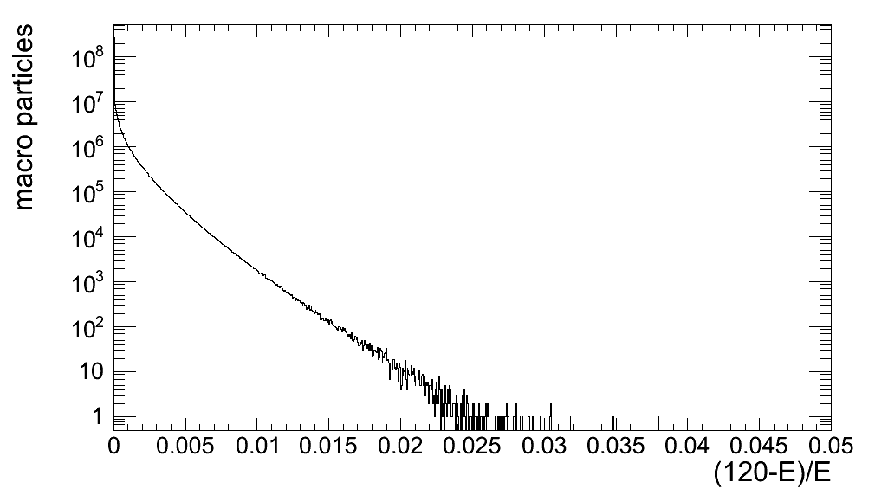
Energy Distribution
BBWS vs GuineaPig
Equilibrium vs First Collision
Marco Zanetti, “Beamstrahlung at circular e⁺e⁻ higgs factories”, HF2012
TLEP-H
CEPC

Slide 6
Beam Lifetime vs dynamic aperture
Simulation & analysis not consistent?

Slide 7
Difficulity of SuperKEKB & TLEP
K. Oide, “Final Focus & Injection”, FCC Kick-off Meeting, Feb 13, 2014

Slide 8
Dynamic aperture w/o and w/ beam-beam interaction@SuperKEKB
Y. Ohnishi, “Optics Issues”, 18th KEKB Review, March 3-5, 2014

Slide 9
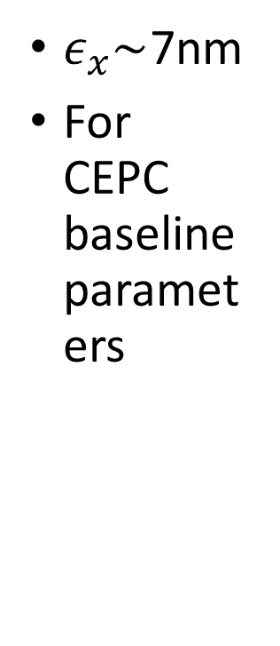
SuperKEKB, http://www-superkekb.kek.jp/index.html
$ε_{x}\sim$7nm
For CEPC baseline parameters

Slide 10
Yunhai Cai, FCC-2014-KICKOFF

Slide 11
Effective Beam-Beam Parameter versus z for different bunch length

Slide 12
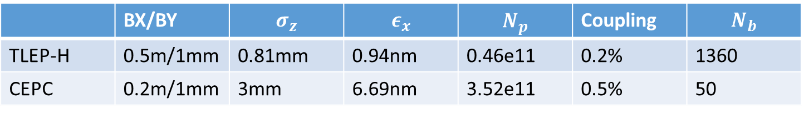
 | LEP1 | LEP2 | TLEP Z | TLEP W | TLEP H | TLEP tt
Circumference [km] | 26.7 |  | 100
Bending radius [km] | 3.1 |  | 11
Beam energy [GeV] | 45.4 | 104 | 45.5 | 80 | 120 | 175
Beam current [mA] | 2.6 | 3.04 | 1450 | 152 | 30 | 6.6
Bunches / beam | 12 | 4 | 16700 | 4490 | 1360 | 98
Bunch population [10¹¹] | 1.8 | 4.2 | 1.8 | 0.7 | 0.46 | 1.4
Transverse emittance e Horizontal [nm] Vertical [pm] | 20 400 | 22 250 | 29.2 60 | 3.3 7 | 0.94 1.9 | 2 2
Momentum comp. [10⁻⁵] | 18.6 | 14 | 18 | 2 | 0.5 | 0.5
Betatron function at IP b* Horizontal [m] Vertical [mm] | 2 50 | 1.2 50 | 0.5 1 | 0.5 1 | 0.5 1 | 1 1
Beam size at IP s* [mm] Horizontal Vertical | 224 4.5 | 182 3.2 | 121 0.25 | 26 0.13 | 22 0.044 | 45 0.045
Energy spread [%] Synchrotron radiation Total (including BS) | 0.07 0.07 | 0.16 0.16 | 0.04 0.06 | 0.07 0.09 | 0.10 0.14 | 0.14 0.19
Bunch length [mm] Synchrotron radiation Total | 8.6 8.6 | 11.5 11.5 | 1.64 2.56 | 1.01 1.49 | 0.81 1.17 | 1.16 1.49
Energy loss / turn [GeV] | 0.12⁽¹⁾ | 3.34 | 0.03 | 0.33 | 1.67 | 7.55
SR power / beam [MW] | 0.3⁽¹⁾ | 11 | 50
Total RF voltage [GV] | 0.24 | 3.5 | 2.5 | 4 | 5.5 | 11
RF frequency [MHz] | 352 |  | 800
Longitudinal damping time t_{E} [turns] | 371 | 31 | 1320 | 243 | 72 | 23
Energy acceptance RF [%] | 1.7 | 0.8 | 2.7 | 7.2 | 11.2 | 7.1
Synchrotron tune Q_{s} | 0.065 | 0.083 | 0.65 | 0.21 | 0.096 | 0.10
Polarization time t_{p} [min] | 252 | 4 | 11200 | 672 | 89 | 13
Hourglass factor H | 1 | 1 | 0.64 | 0.77 | 0.83 | 0.78
Luminosity/IP [10³⁴ cm⁻²s⁻¹] | 0.002 | 0.012 | 28.0 | 12.0 | 6.0 | 1.8
Beam-beam parameter Horizontal Vertical | 0.044 0.044 | 0.040 0.060 | 0.031 0.030 | 0.060 0.059 | 0.093 0.093 | 0.092 0.092
Luminosity lifetime [min]⁽²⁾ | 1250 | 310 | 213 | 52 | 21 | 15
Beamstrahlung critical | No |  | No | No | Yes | Yes
FCC-ACC-SPC-0004
 | BX/BY | $$σ_{z}$$ | $$ε_{x}$$ | $$N_{p}$$ | Coupling | $$N_{b}$$
TLEP-H | 0.5m/1mm | 0.81mm | 0.94nm | 0.46e11 | 0.2% | 1360
CEPC | 0.2m/1mm | 3mm | 6.69nm | 3.52e11 | 0.5% | 50

Slide 13
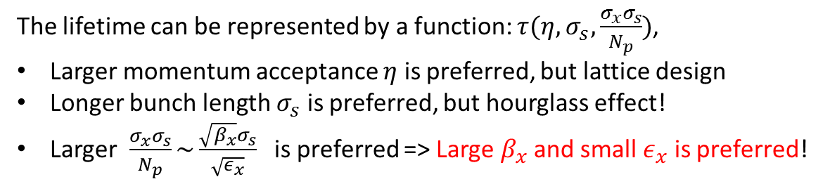
Beamstrahlung lifetime
arxiv, 1311.1580, 2013
The lifetime can be represented by a function: $τ(η, σ_{s}, \frac{σ_{x}σ_{s}}{N_{p}})$,
Larger momentum acceptance $η$ is preferred, but lattice design
Longer bunch length $σ_{s}$ is preferred, but hourglass effect!
Larger $\frac{σ_{x}σ_{s}}{N_{p}}\sim \frac{\sqrt{β_{x}}σ_{s}}{\sqrt{ε_{x}}}$ is preferred => Large $β_{x}$ and small $ε_{x}$ is preferred!

Slide 14
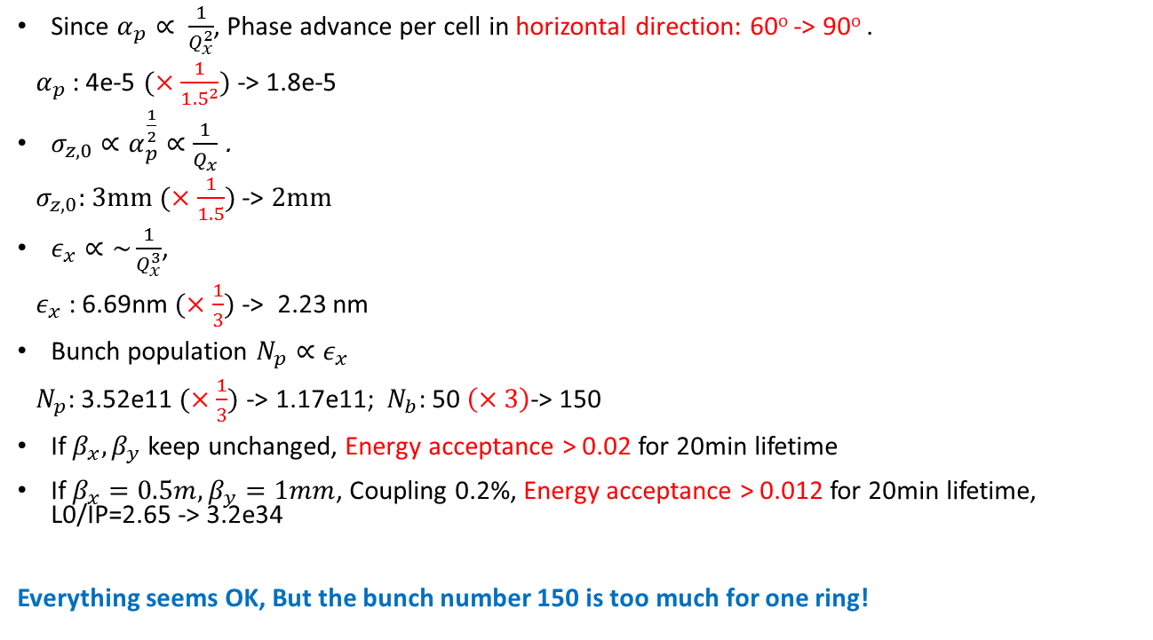
Phase Advance: 60º -> 90º
Since $α_{p}∝ \frac{1}{Q_{x}^{2}}$, Phase advance per cell in horizontal direction: 60º -> 90º .
$α_{p}$: 4e-5 $(×\frac{1}{{1.5}^{2}})$ -> 1.8e-5
$σ_{z,0}∝α_{p}^{\frac{1}{2}}∝\frac{1}{Q_{x}}$ .
${ σ}_{z,0}$: 3mm $(×\frac{1}{1.5})$ -> 2mm
$ε_{x}∝\sim \frac{1}{Q_{x}^{3}}$,
$ε_{x}$ : 6.69nm $(×\frac{1}{3})$ -> 2.23 nm
Bunch population $N_{p}∝ε_{x}$
$N_{p}$: 3.52e11 $(×\frac{1}{3})$ -> 1.17e11; $N_{b}$: 50 $\left(×3\right)$-> 150
If $β_{x}, β_{y}$ keep unchanged, Energy acceptance > 0.02 for 20min lifetime
If $β_{x}=0.5m, β_{y}=1mm$, Coupling 0.2%, Energy acceptance > 0.012 for 20min lifetime, L0/IP=2.65 -> 3.2e34
Everything seems OK, But the bunch number 150 is too much for one ring!

Slide 15

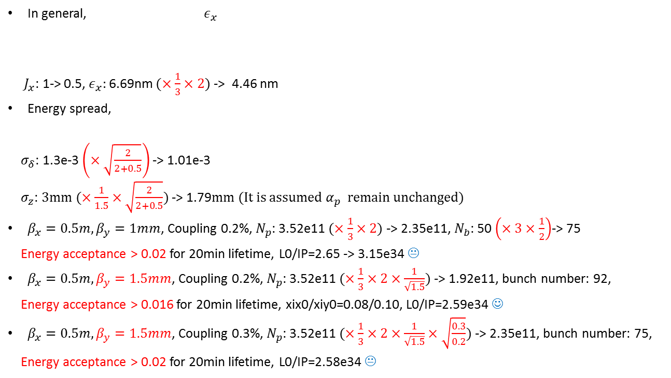
Phase Advance: 60º -> 90º + Damping Partition Number
In general, $ε_{x}$
$J_{x}$: 1-> 0.5, $ε_{x}:$6.69nm $(×\frac{1}{3}×2)$ -> 4.46 nm
Energy spread,
$σ_{δ}$: 1.3e-3 $\left(×\sqrt{\frac{2}{2+0.5}}\right)$ -> 1.01e-3
$σ_{z}$: 3mm $(×\frac{1}{1.5}×\sqrt{\frac{2}{2+0.5}})$ -> 1.79mm (It is assumed $α_{p}$ remain unchanged)
$β_{x}=0.5m, β_{y}=1mm$, Coupling 0.2%, $N_{p}$: 3.52e11 $(×\frac{1}{3}×2)$ -> 2.35e11, $N_{b}$: 50 $\left(×3×\frac{1}{2}\right)$-> 75
Energy acceptance > 0.02 for 20min lifetime, L0/IP=2.65 -> 3.15e34 😐
$β_{x}=0.5m, β_{y}=1.5mm$, Coupling 0.2%, $N_{p}$: 3.52e11 $(×\frac{1}{3}×2×\frac{1}{\sqrt{1.5}})$ -> 1.92e11, bunch number: 92,
Energy acceptance > 0.016 for 20min lifetime, xix0/xiy0=0.08/0.10, L0/IP=2.59e34 ☺
$β_{x}=0.5m, β_{y}=1.5mm$, Coupling 0.3%, $N_{p}$: 3.52e11 $(×\frac{1}{3}×2×\frac{1}{\sqrt{1.5}}×\sqrt{\frac{0.3}{0.2}})$ -> 2.35e11, bunch number: 75,
Energy acceptance > 0.02 for 20min lifetime, L0/IP=2.58e34 😐

Slide 16
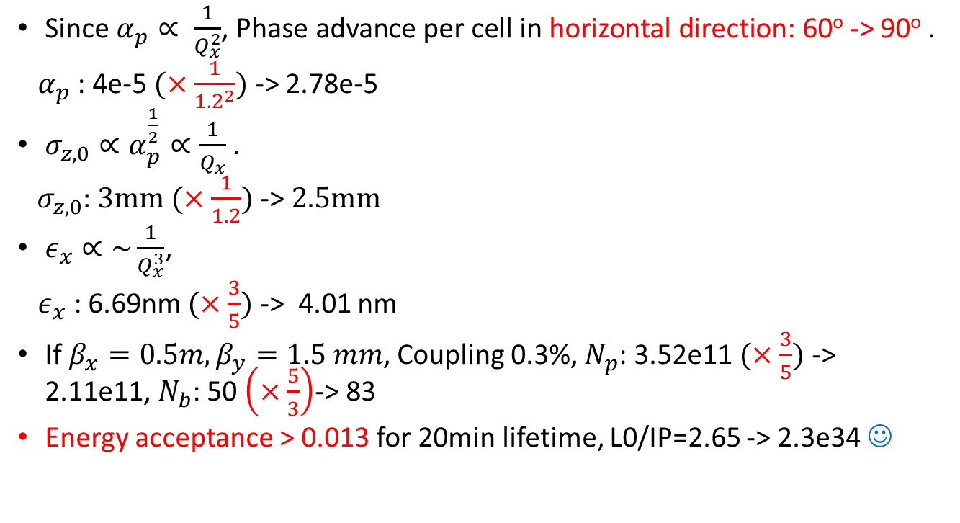
Phase Advance: 60º -> 72º
Since $α_{p}∝ \frac{1}{Q_{x}^{2}}$, Phase advance per cell in horizontal direction: 60º -> 90º .
$α_{p}$: 4e-5 $(×\frac{1}{{1.2}^{2}})$ -> 2.78e-5
$σ_{z,0}∝α_{p}^{\frac{1}{2}}∝\frac{1}{Q_{x}}$ .
${ σ}_{z,0}$: 3mm $(×\frac{1}{1.2})$ -> 2.5mm
$ε_{x}∝\sim \frac{1}{Q_{x}^{3}}$,
$ε_{x}$ : 6.69nm $(×\frac{3}{5})$ -> 4.01 nm
If $β_{x}=0.5m, β_{y}=1.5 mm$, Coupling 0.3%, $N_{p}$: 3.52e11 $(×\frac{3}{5})$ -> 2.11e11, $N_{b}$: 50 $\left(×\frac{5}{3}\right)$-> 83
Energy acceptance > 0.013 for 20min lifetime, L0/IP=2.65 -> 2.3e34 ☺

Slide 17
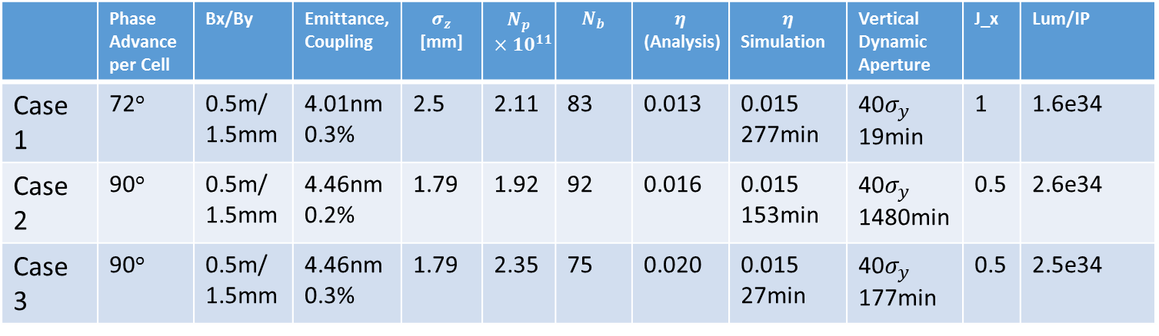
Optimization Summary
 | Phase Advance per Cell | Bx/By | Emittance, Coupling | $σ_{z}$ [mm] | $$N_{p}$$ $$×10^{11}$$ | $$N_{b}$$ | $$η$$ (Analysis) | $$η$$ Simulation | Vertical Dynamic Aperture | J_x | Lum/IP
Case 1 | 72º | 0.5m/ 1.5mm | 4.01nm 0.3% | 2.5 | 2.11 | 83 | 0.013 | 0.015 277min | 40$σ_{y}$ 19min | 1 | 1.6e34
Case 2 | 90º | 0.5m/ 1.5mm | 4.46nm 0.2% | 1.79 | 1.92 | 92 | 0.016 | 0.015 153min | 40$σ_{y}$ 1480min | 0.5 | 2.6e34
Case 3 | 90º | 0.5m/ 1.5mm | 4.46nm 0.3% | 1.79 | 2.35 | 75 | 0.020 | 0.015 27min | 40$σ_{y}$ 177min | 0.5 | 2.5e34
Lum is calculated by quasi-strong-strong simulation
Dynamic Aperture is for 20min beamstrahlung lifetime

Slide 18
Error tolerance
K. Ohmi, D. Zhou (KEK)
SuperKEKB MAC
Feb. 7-9, 2011
K. Ohmi, D. Zhou, “Beam Dynamics Issue in Nano Beam Scheme, SuperKEKB MAC, Feb. 7-9, 2011

Slide 19
Summary & Discussion
Beamstrahlung model in different codes( BBWS, LIFETRAC, GUINEA-PIG)
We still don’t know if the first few collisions is more critical for beam loss
Lifetime calculation, analyais & simulation does not agree ?
If we could not shorten the bunch length, it is not wise to suppress by* to 1mm. 1.5mm is more attractive for us.
Is it possible to achieve 0.2 or 0.3% coupling. Optics measurement & correction by simulation with error should be studied.
~100 bunches in one ring is achievable?
The result should be checked
More questions to be answered (If xiy > 0.1?). If aperture with beam-beam is a problem? In the following time, some visitors will attend ihep. We wish a fruitful April.

Slide 20
Thanks for your attention!

