Slide 1

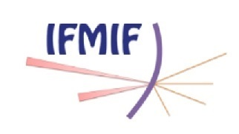

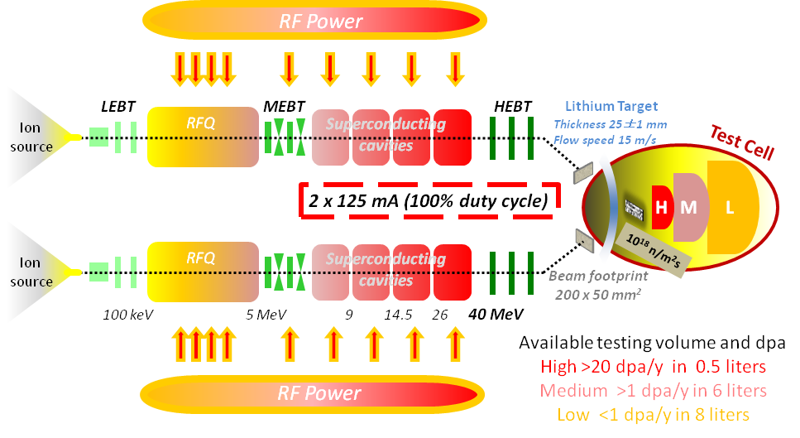
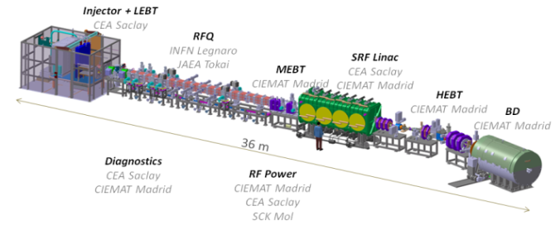
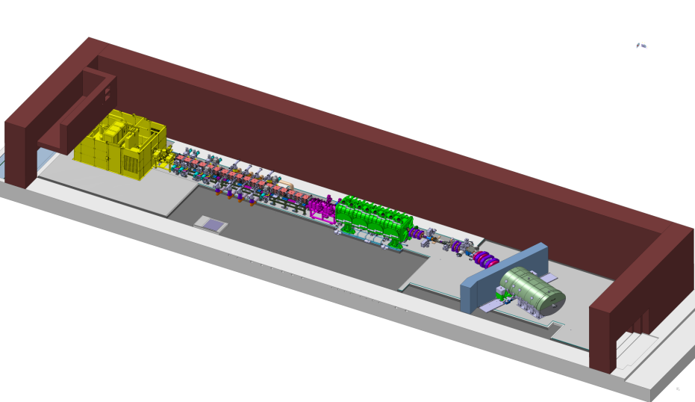
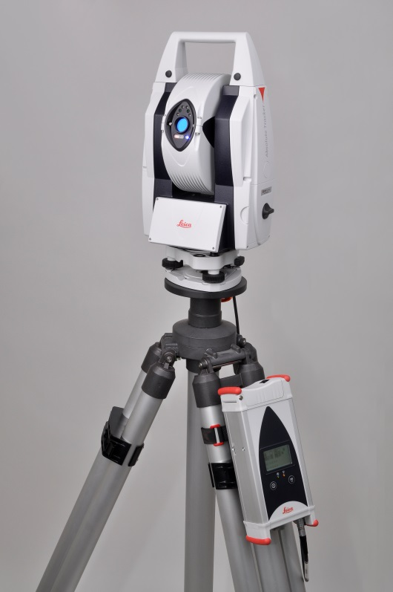
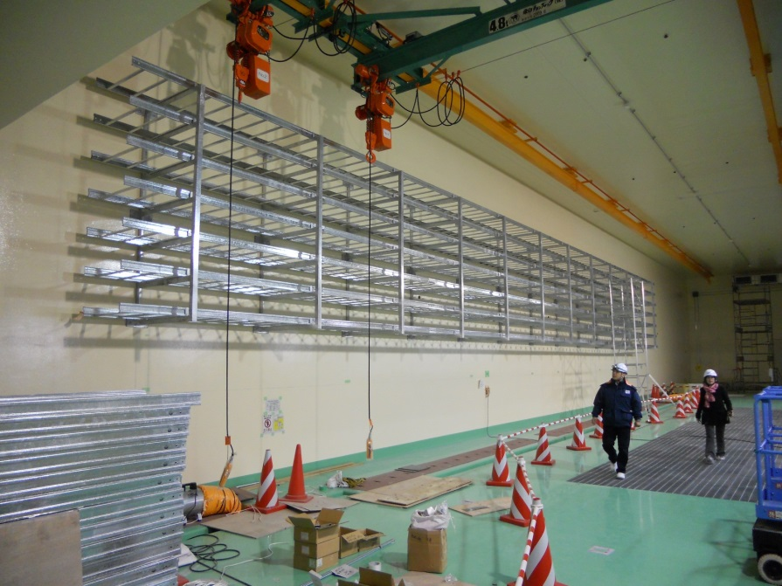
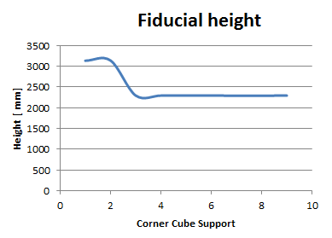
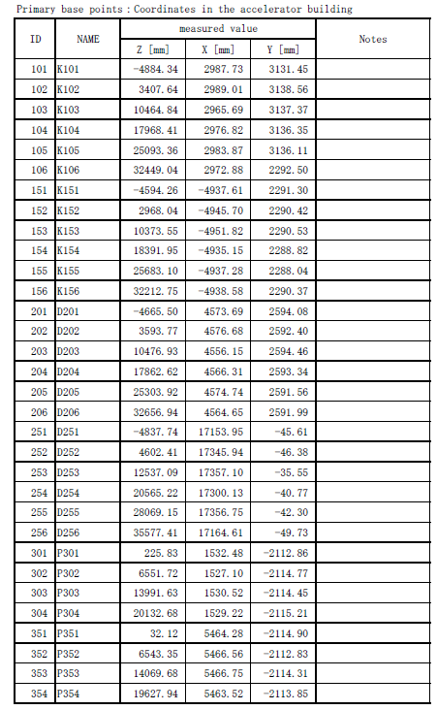
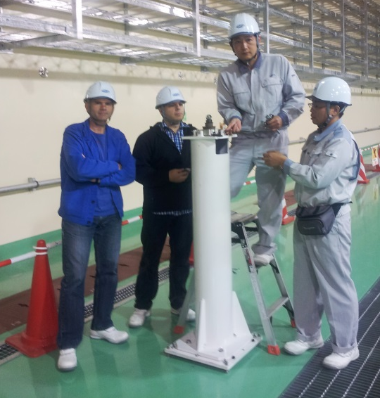
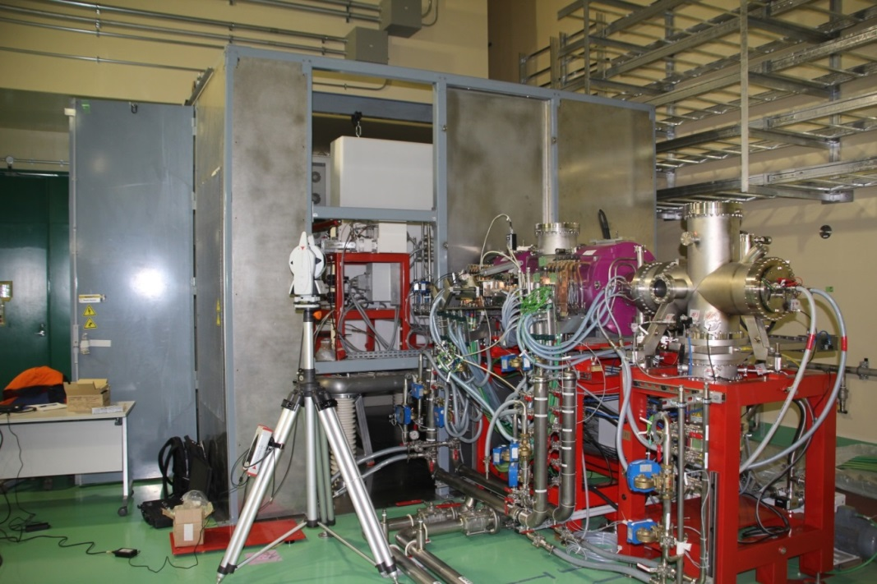
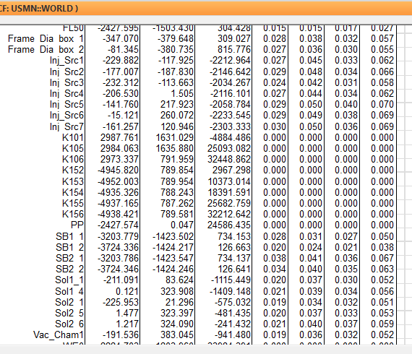
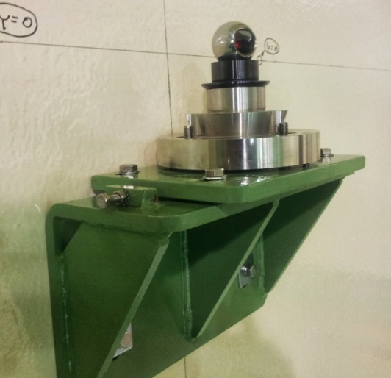
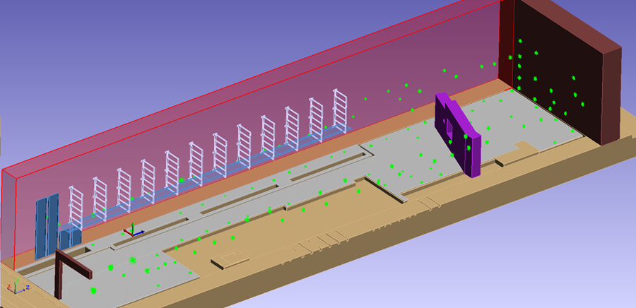
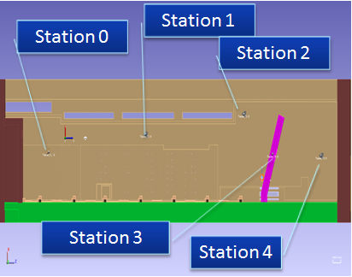
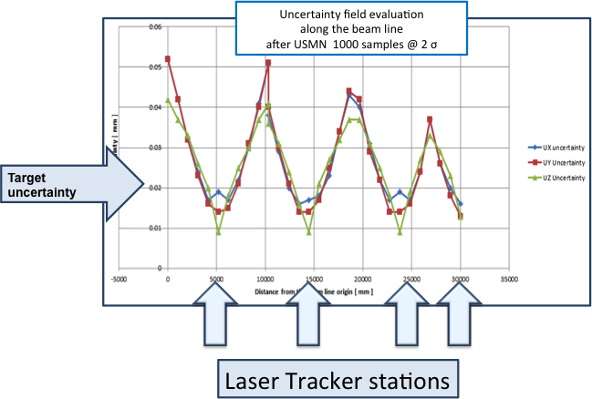
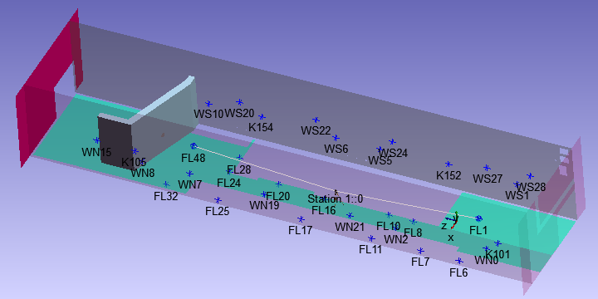
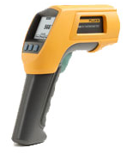
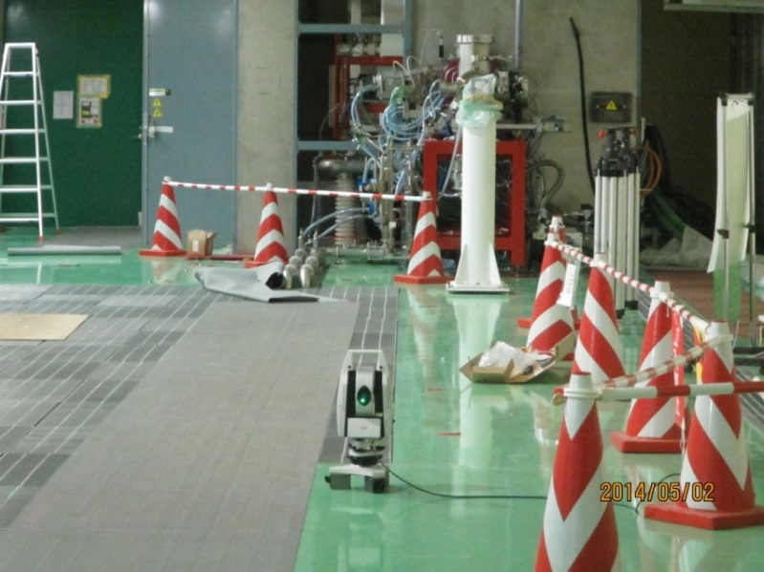
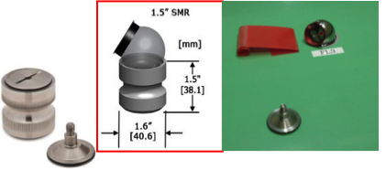
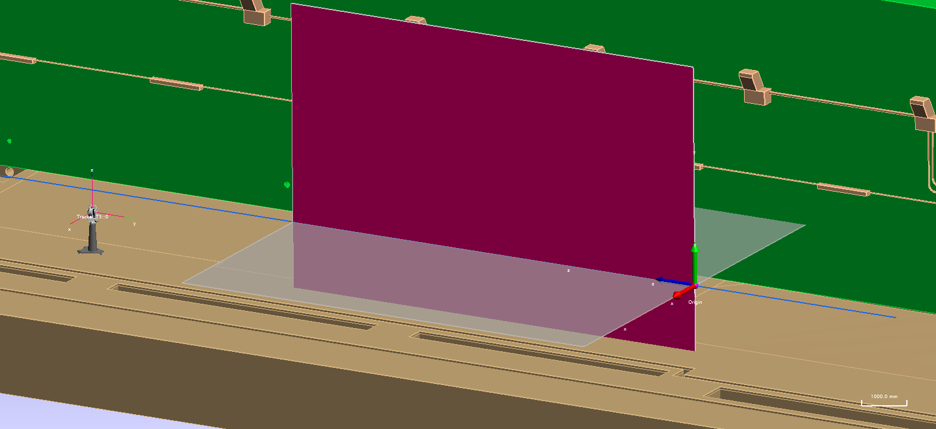
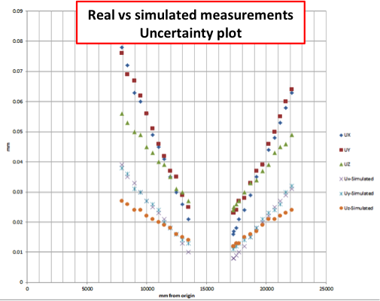
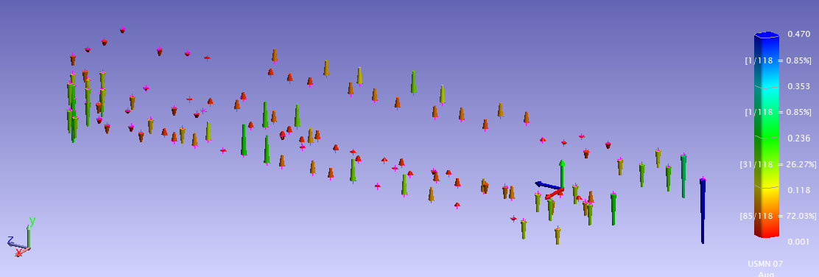
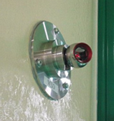
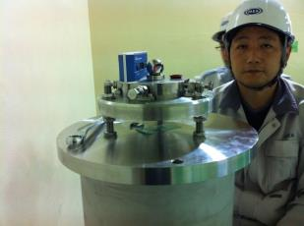
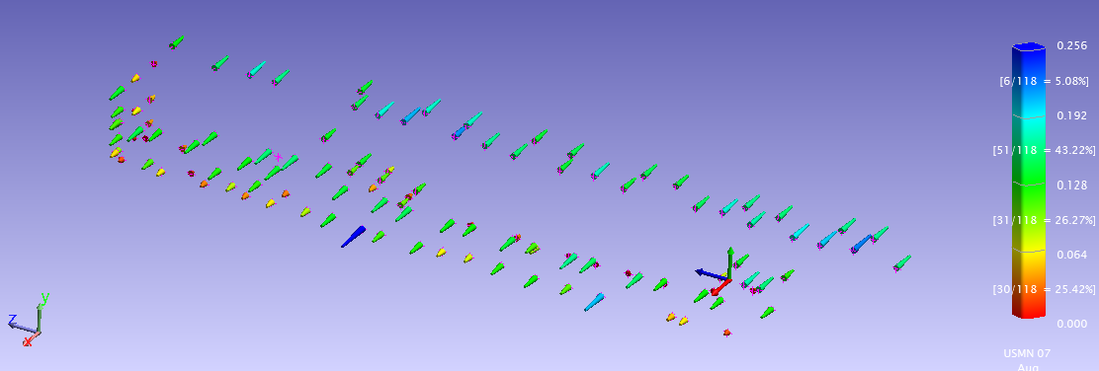
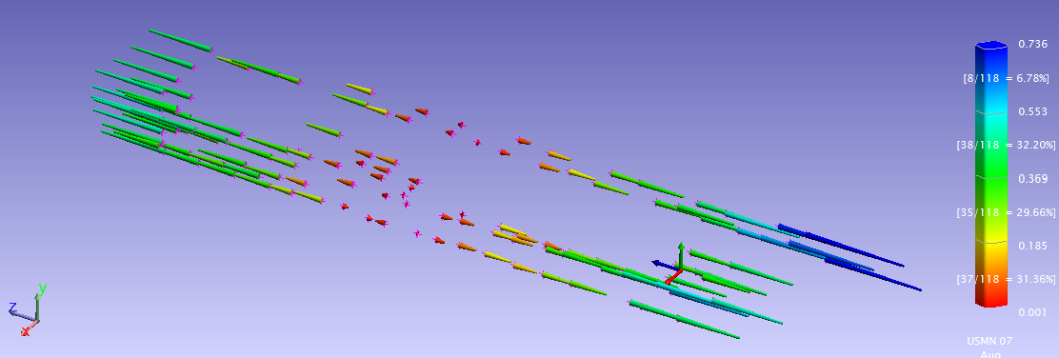
Alignment of LIPAc, the IFMIF prototype high current deuteron accelerator: requirements and current status
F. Scantamburloª, L. Semeraro^{b}, A. Lo Bue^{b}, L. Poncet^{b}, P. Cara^{b}, J. Knasterª, Y. Okumuraª, A. Kasugai^{c}, H. Shidara^{c}, T. Morishita^{c}, H. Sakaki^{c}, M. Shingalaª, K. Tsutsumi^{c}
ªIFMIF/EVEDA Project Team, Japan / ^{b}F4E / ^{c}JAEA
IFMIF
A fusion relevant neutron source is almost four decades long pending step for the successful development of fusion energy. In commercial fusion reactors, neutrons fluxes in the order of 10¹⁸ m⁻²s⁻¹ with an energy of 14.1 MeV will occur, which will be absorbed in its first wall, undergoing potentially >15 dpaNRT per year of operation. This irradiation will degrade structural materials in an unknown manner.
IFMIF, the International Fusion Materials Irradiation Facility, will generate a neutron flux with a broad peak at 14 MeV by Li(d,xn) reactions thanks to two parallel deuteron accelerators colliding in a liquid Li screen. The energy of the beam (40 MeV) and the current of the parallel accelerators (2 x 125 mA) have been tuned to maximize the neutrons flux and reach irradiation conditions comparable to those in the first wall of a fusion reactor and will allow qualification and characterization of suitable materials.
LIPAC, the IFMIF/EVEDA accelerator
LIPAc LIPAc, the Linear IFMIF Prototype Accelerator, will run in 2017:
  Deuteron beam
  9 MeV
  125 mA in CW
will validate IFMIF’s (same current at 40 MeV).
Alignment tolerance of ±0.1 mm are required to:
  allow stand on maintenance, limiting beam losses up to 1 W/m to reduce component activation
  meet beam halo requirement
8 m
40 m
35 m
Metrology Software:
NIST, ISO, GUM claim that a measurement is complete only when accompanied by an uncertainty statement. Spatial Analyzer (SA) Ultimate has been adopted as metrology software:
  USMN algorithm combines different measurements from different measurement systems with advenced techniques to increase accuracy.
  USMN algorithm can estimate uncertainty . It is GUM and ISO compliant
  USMN algorithm estimates instrument uncertainty and verify instrument performance in the real environment.
  Capability to fabricate measurements simulating instrument performance.
Measurement instrumentation:
Leica AT401 Laser Tracker:
  MPE distance accuracy: ± 10 µm
  MPE angular accuracy: ± (15 µm +6 µm/m)
  Level accuracy: ± 1 arcsec
Upgrade of the network in June 2013
According to ITER metrology Handbook, a factor 5 should be guaranteed between tolerance and measurement uncertainty. A target uncertainty below 0.02 mm shall be guaranteed in the accelerator vault, quite at the limit of current available instrument performance.
Injector alignment
The installation of the injector (source + LEBT) was completed in May 2014. The alignement has been performed with Taylor Hobson telescope. The references has been aligned to the beam line frame by AT401. Source and LEBT were surveyed and fiducialized after their installation with uncertainty less than 40 μm at 2σ.
SA existing network: SA simulated uncertainty 0.134 mm
8 available targets
SA new network simulations with 130 fiducials: ucert. < 0.02 mm
Thermal expansion of the building
A procedure has been established to evaluate the thermal expansion of the building and if needed to compensate the measurements.
Upgrade of the nework and survey
Network update

