Slide 1
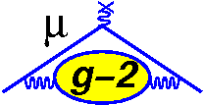
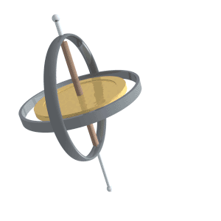
The g-2 Project at FNAL
Horst Friedsam
John Kyle
IWAA 2014 at Beijing
13-17 October 2014

Slide 2
The g-2 Project at FNAL Outline
History and project purpose
P5 and the Muon Campus development
The meaning of the gyromagnetic ratio “g”
Alignment requirements
Status
Summary

Slide 3
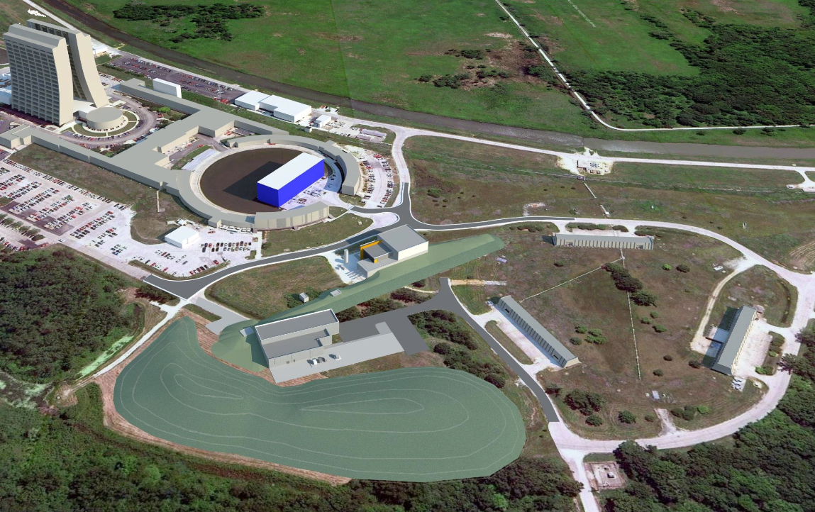
The g-2 Project at FNAL P5 and the FNAL Muon Campus
Recently the US Particle Physics Project Prioritization Panel (P5) recommended for FNAL to concentrate on a near term MUON and a longer term NEUTRINO program.
In accordance with these recommendations FNAL is currently developing a MUON campus to host the g-2 and Mu2e programs making optimum use of the upgraded accelerator infrastructure producing copious amounts of muons.

Slide 4
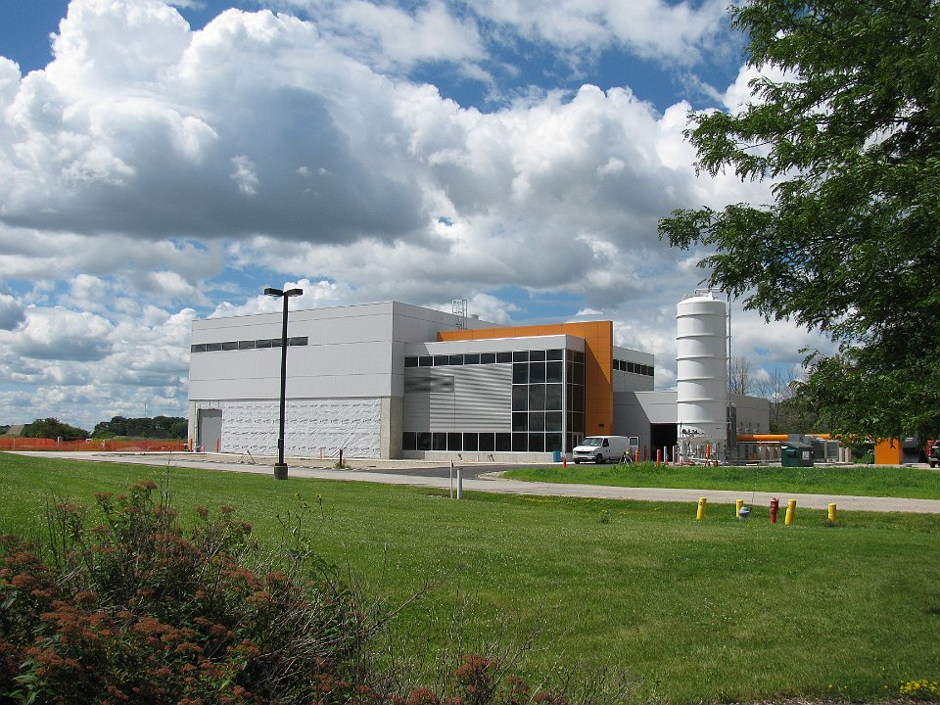
The g-2 Project at FNAL Relocation
The g-2 project operated at BNL in the 1990 yielding the most accurate measurement of the value “g” to this date.
The experiment has now been relocated to FNAL capitalizing on the accelerator’s higher muon yield.

Slide 5
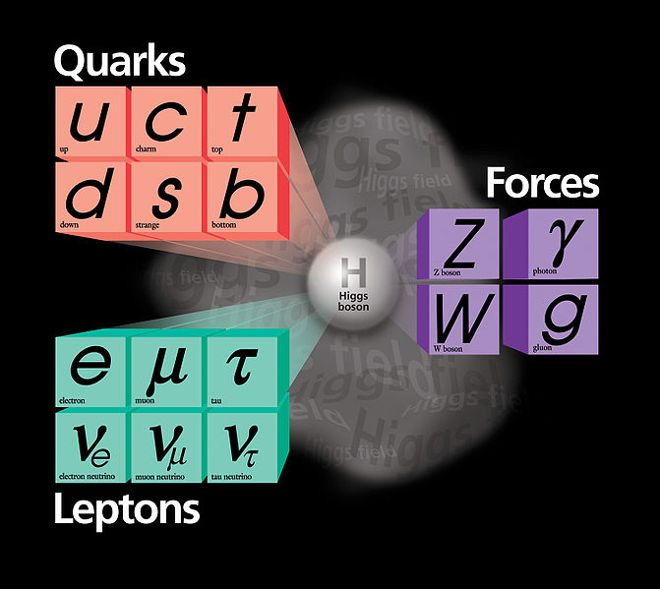
The g-2 Project at FNAL The Meaning of the Quantity g
Muons have an internal magnet and an angular momentum, called spin. The muon's gyromagnetic ratio "g“ predicted to be 2 by theory is derived from the strength of the magnet and the rate of the muon’s gyration.
Precision measurements show a deviation of about 0.1% from the theoretical value indicating the possibility of new physics beyond the Standard Model.
When placed in a magnetic field, the muons spin axes want to align along the magnetic field lines. However, the muons angular momenta prevent this and instead the muons spin axes precess, about the magnetic field axis, similar to a spinning top whose spin axis is not exactly vertical.
One can determine precisely the precession rate of the muon spin axis about the magnetic field lines.
The muon's g-value is affected by particles that appear and disappear within the vacuum. So the muon precession rate is altered leading to changes in the value of “g” hinting at new physics beyond the SM.
g(Dirac) 2.00000000000
g(SM) 2.00233183630
g(BNL Experiment) 2.00233184178

Slide 6
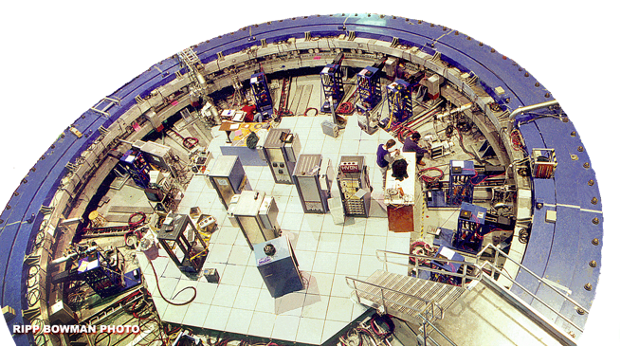
The g-2 Project at FNAL Two essential Ingredients
1. Accelerator upgrade for muon 2. A precision magnetic field in the
production serving g-2 form of a Storage Ring
and Mu2e for g-2

Slide 7
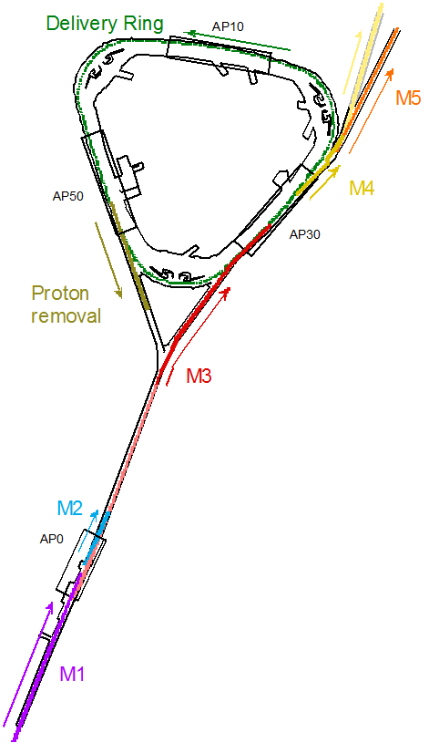
The g-2 Project at FNAL Accelerator Upgrades
Mu2e
G-2
The accelerator upgrade for the muon production is currently underway and scheduled to be ready for operation in 2017
The MI delivery system, production target and PBar accumulator ring are being refurbished for this purpose.
A new injection line between the PBar and g-2 storage ring needs to be build and fitted with an injection transport line.

Slide 8
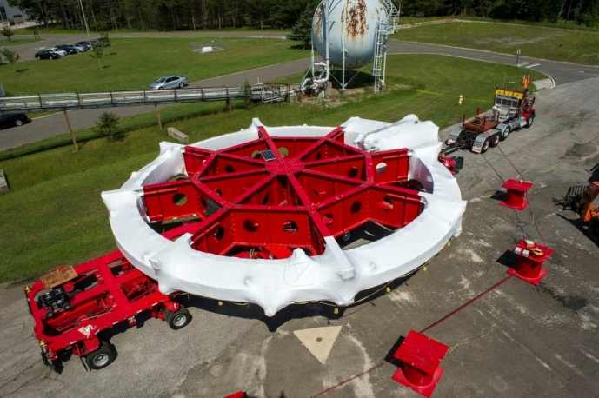
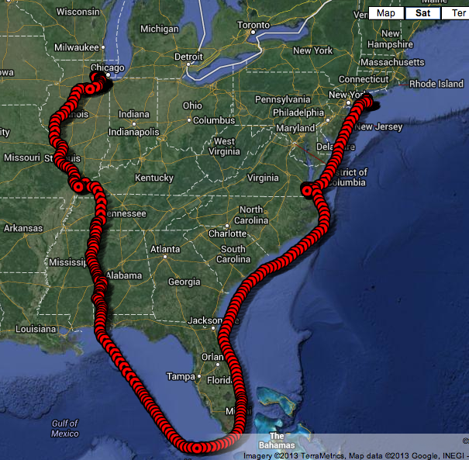
The g-2 Project at FNAL Storage Ring on the move
The storage ring had been used in the 1990 at BNL to obtain the best known value for “g” so far.
The ~700 ton storage ring consists of 12 x 30° C-shaped dipole segments and three super conducting coils operating at 5 K with 5200 A producing a magnetic field of 1.45 Tesla ^{[1]}.
The coils have a diameter of 15.24 m and needed to be moved as one unit from BNL to FNAL posing a challenge in transporting the system without exceeding the deformation limit of ± 2 mm.
^{[1]} G.T.Danby et al. NIM in Physics Research A 457 (2001) pages 151 - 174

Slide 9
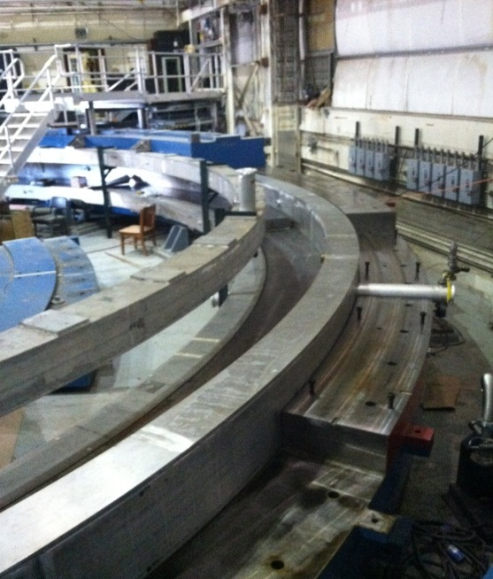
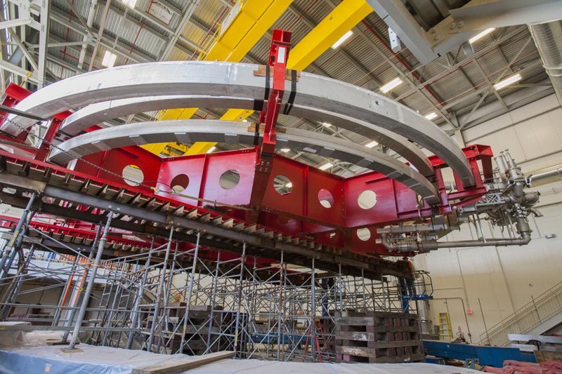
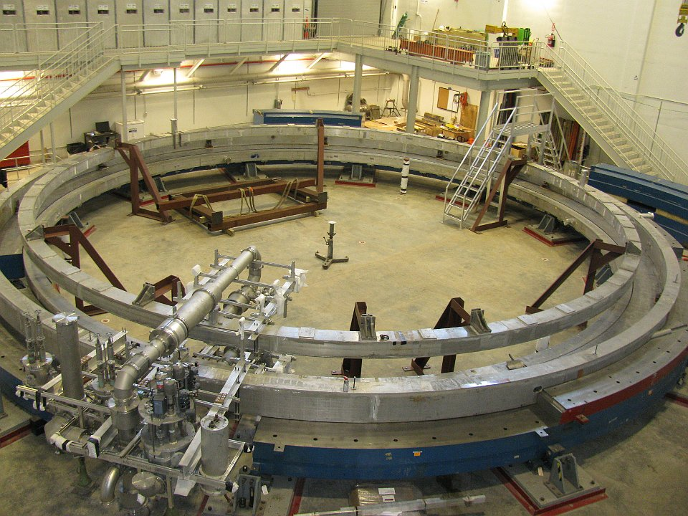
The g-2 Project at FNAL Storage Ring
The storage ring is now being re-assembled and the coils have been put in place.
The cryo-plant and power supplies are being assembled for a first test to determine the performance of the super conducting coils early 2015.
The precision alignment of the system will commence after the current accelerator service shutdown is completed end of October 2014.

Slide 10
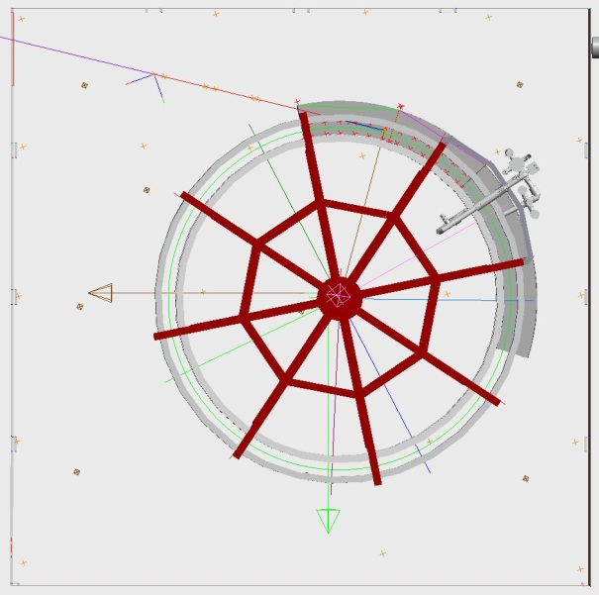
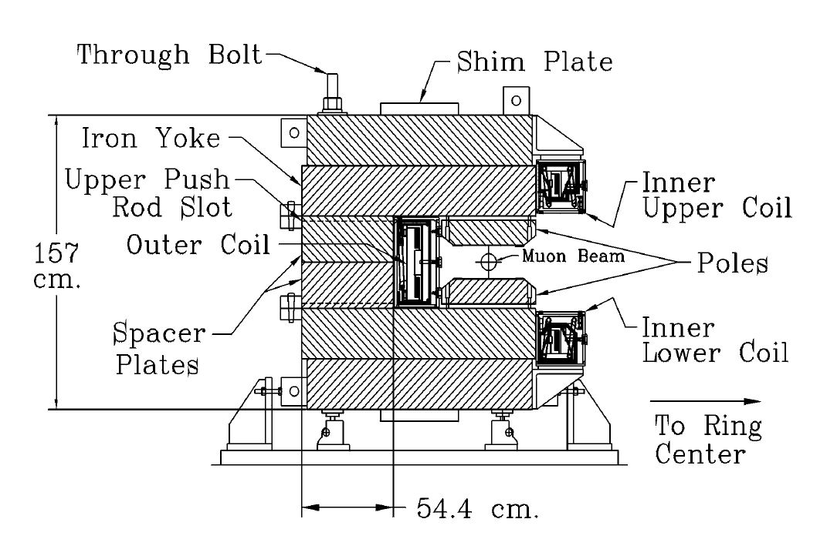
The g-2 Project at FNAL Dimensions and layout
12x30° C-shaped steel segments with 3x10° poles supported by 4 shims
Iron Mass: 682 tons
Ideal beam radius: 7.112 m
Change in outer coil radius warm-cold δr=31 mm; δC=195 mm; δh=3 mm
Nominal pole gap 180 mm
Asymmetric gap closing under full magnetic force 0.333 mrad
Clocking the coils
Storage Ring Cross Section

Slide 11
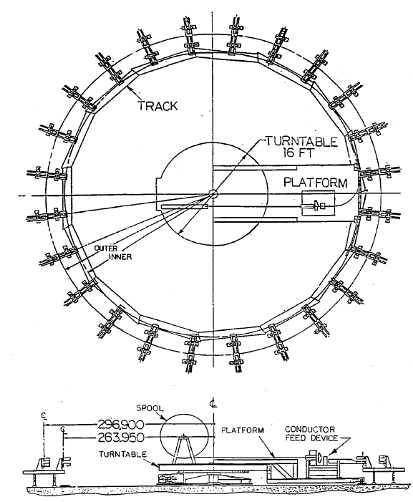
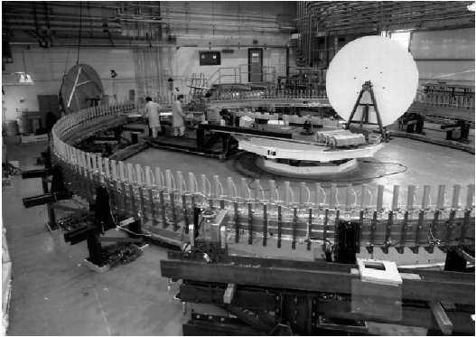
The g-2 Project at FNAL BNL tools and achieved tolerances
Winding turn table located at the center of the ring with a mechanical arm
Radius controlled by interferometer with LVDT attachments to measure the distance to the yokes/poles and elevation
Yokes:
Radial placement ±130 µm corresponding to the machining tolerances
Azimuthal gaps between yokes 0.5 mm
Peak to peak gap spacing 0.4 mm with ±90 µm RMS
Poles
Radial placement ±50 µm corresponding to the machining tolerances
Azimuthal gap between poles 80 µm equal to the inserted Kapton tape thickness
Ideal gap opening 180 mm
Peak to peak gap variation 0.13 mm with a ±23 µm RMS
Preset gap opening angle anticipating gap change when powered
These tolerances are our guidelines for the reassembly of the storage ring. We need to achieve similar or even tighter tolerances with the most important one a constant gap opening as close as possible to being parallel.

Slide 12
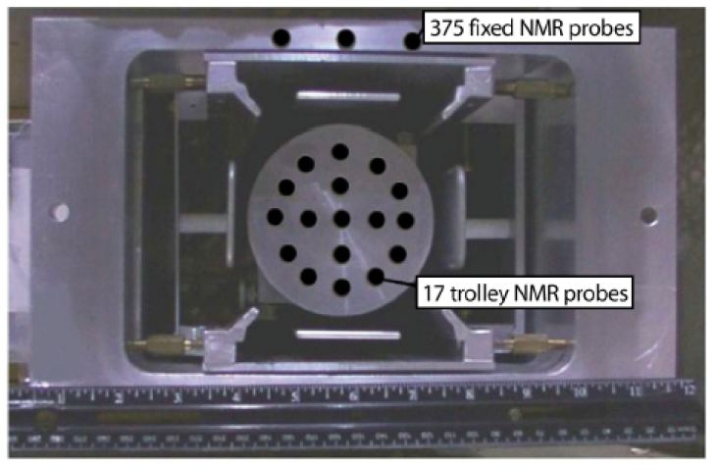
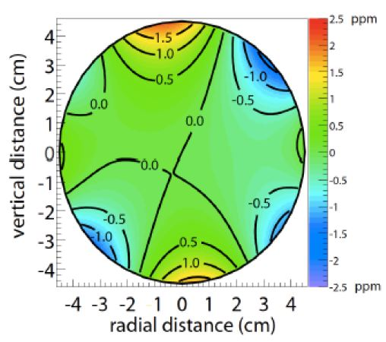
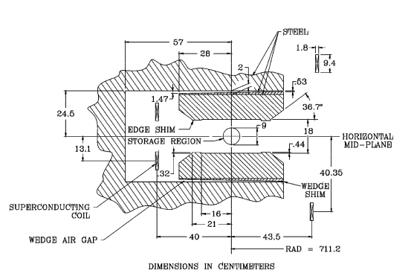
The g-2 Project at FNAL Ultimate fine tuning of the magnetic field
So far I only discussed the mechanical alignment tools and requirements that can only provide the start condition for the precise magnetic shimming process.
The ultimate fine tuning of the magnetic field will be done while the ring is powered, utilizing a quartz shimming trolley inserted in the magnet gap while no VCs are installed. During operations an NMR probe trolley circulates in the vacuum system for frequent calibration.
We will be involved with the setup of the shimming trolley as this system requires feedback of its position while the trolley works its way around the storage ring.

Slide 13
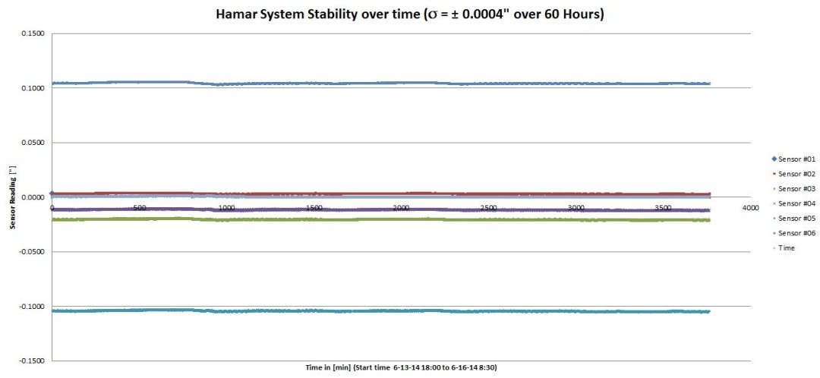
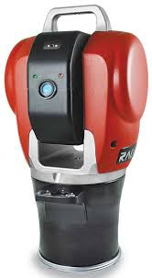
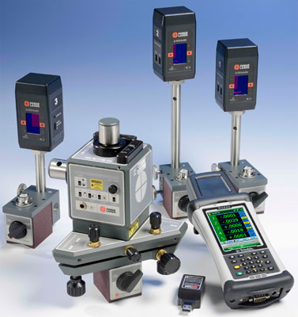
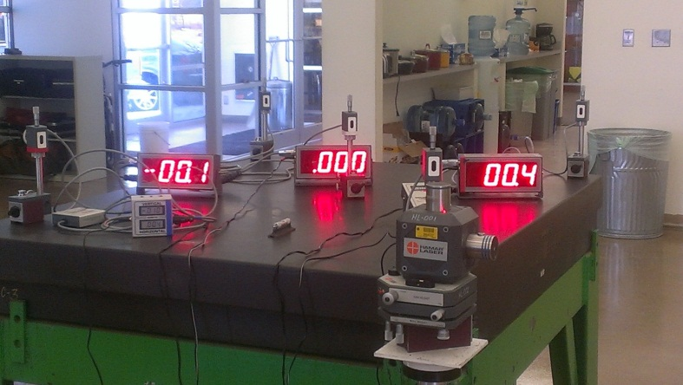
The g-2 Project at FNAL FNAL tools
Laser Trackers (±50 µm@10m)
HAMAR Laser Level System (±2.5 µrad)
Capacitance proximity sensors (1mm range ±1 µm)

Slide 14
The g-2 Project at FNAL Re-assembly Status
Dimensional QC verification of 17% of the poles
Dimensional QC verification of all lower yokes prior to installation
All lower yokes are rough aligned
Almost all spacer plates are installed. These plates are pinned in place and therefore self-aligning
The coils have been installed and rough aligned
We are now waiting for the installation of the upper yokes and poles
The precision ground shims are still attached to the pole pieces and should seat very closely wrt their original position, so that the internal pole placement is preserved from the BNL setup and only yoke to yoke adjustments are required
Hamar support

Slide 15
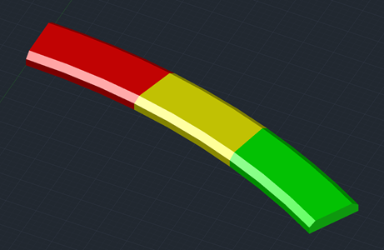
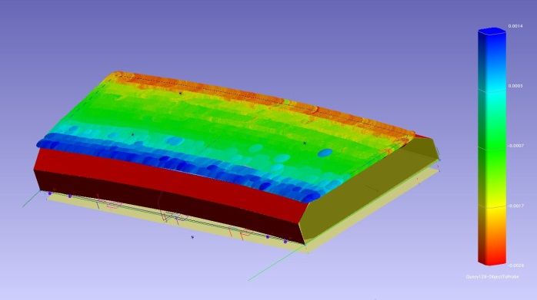
The g-2 Project at FNAL Dimensional QC of the poles
The BNL g-2 hardware has been decommissioned for many years.
In order to verify the dimensional parameters of the poles we checked 6 lower and 6 corresponding upper poles.
The surface flatness as RMS value of a plane fit to the poles varies between ±4.3 and ±15.3 µm (p2p ±65 µm) and are well within the specified machining tolerances of ±25 µm.
The pole thickness with respect to nominal varies on the order of ±47 µm in good agreement with the specified nominal thickness of 0.133 m ±40 µm
3D Solid Model of the poles
Pole top surface flatness; good field region green at pole center; edge shim locations in the blue and red areas

Slide 16
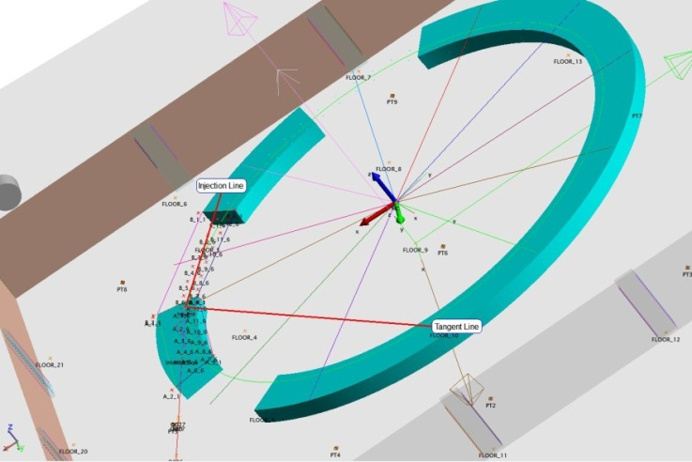
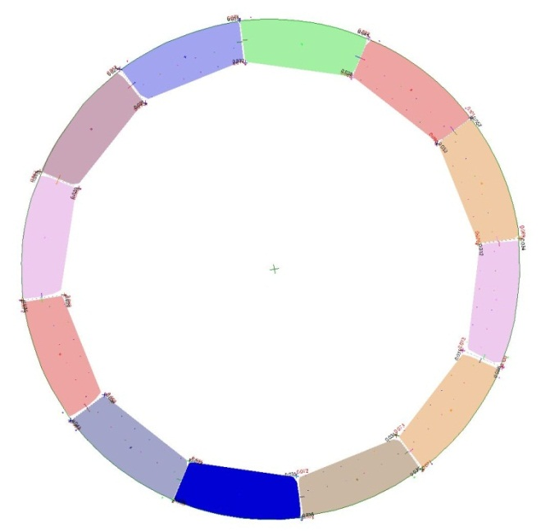
The g-2 Project at FNAL Dimensional QC of the lower yokes
In the transfer of the system to FNAL the information of the azimuthal gap spacing was lost. However, historic data indicated the none uniform gap spacing between the yokes affecting the radius of the ring.
We were able to reference and characterize the dimensions of all lower yokes prior to installation ^{[2]}.
Utilizing Spatial Analyzer we positioned the components close to the provided legacy data while holding the radius.
This reverse engineering approach provided the final position information for each yoke.
Lower yoke layout
Final yoke placement
^{[2]} C. Wilson AMD SA expert and AMD technical support personnel

Slide 17
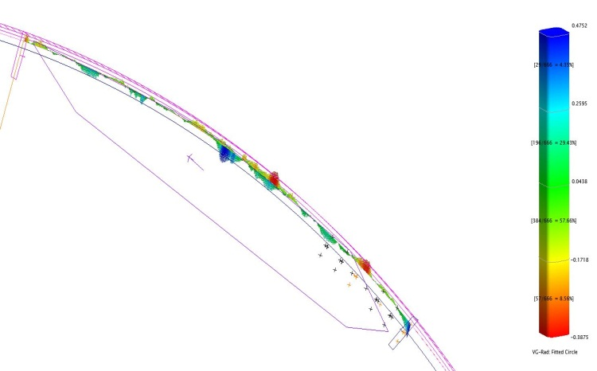
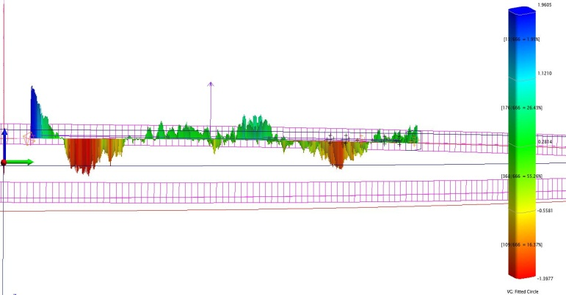
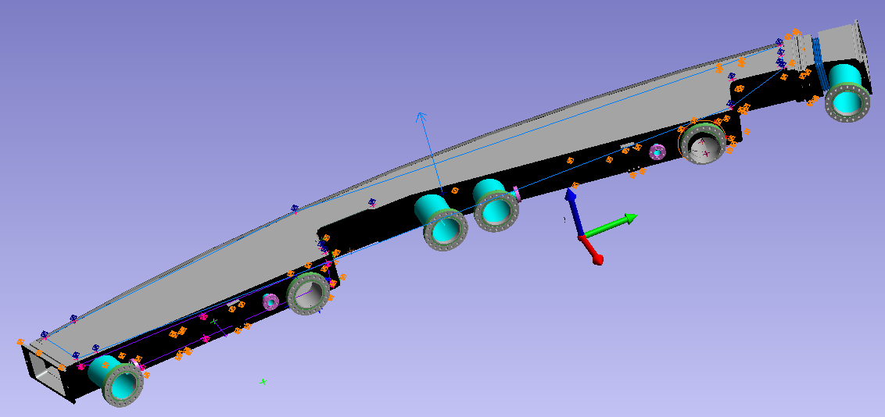
The g-2 Project at FNAL Vacuum and Trolley System
An important part of the experiment is the ability to characterize the magnetic field in situ via NMR probes on a trolley in the vacuum system.
The trolley runs on a rail system mounted to a cage that is inserted and positioned within each of the 12 VCs.
The vertical positioning tolerances are relaxed to the mm-level as the magnetic field is homogeneous in that direction.
In the radial direction however the trolley needs to stay within ±0.5 mm of the ideal beam path. First measurements show this has been achieved, however the obtained radius deviates from the ideal by several millimeters.
The cage is also used to attach other devices such as electro –static quadrupoles requiring similar radial positioning tolerances as the NMR trolley.
NMR Trolley path radial deviations
NMR Trolley path vertical deviations

Slide 18
The g-2 Project at FNAL Summary
The g-2 storage ring is currently being re-assembled at FNAL and the rough alignment of the lower yokes has been performed.
A first cool down test of the cryogenic system is envisioned in the Spring of 2015.
The re-machining of the vacuum chambers will start at the beginning of 2015.
Modifications to the accelerator system for the delivery of muons is underway and in preparation for the new component installation we updated our control network and started component referencing.
Finally, there are several hurdles to overcome in the placement of the poles and the final alignment of the system.

