Slide 1
Status Report of the Realignment for J-PARC 3GeV RCS
N. Tani, H. Hotchi, M. Yamamoto,
J. Kamiya, K. Horino, M. Kinsho
J-PARC Center, JAEA
Outline
1. Introduction
2. Misalignment caused by the earthquake
3. Strategy of the realignment
4. Results of the realignment
5. Summary

Slide 2
Introduction
J-PARC 3GeV RCS magnets suffered from the misalignment from designed beamline caused by the earthquake in March, 2011.
As the result of the obit calculation showed that the beam loss was acceptable for beam operation at 300kW.
Therefore, beam operation with the current placement was implemented until May, 2013.
As beam loss increased at 1 MW operation, realignmnet of beamlines was necessary.
In addition to realignment of magnets, alignment for ducts of vacuum devices was implemented in order to secure the ring acceptance.
In this presentation the method and result of the realignment of RCS beamline implemented last year will be reported.

Slide 3
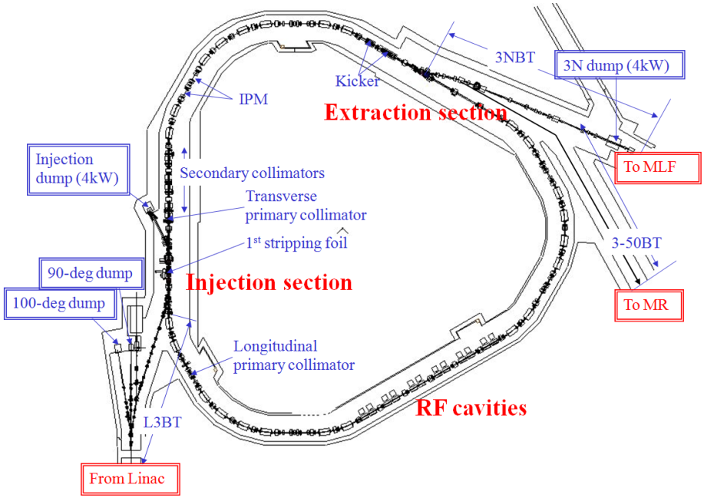
Placement of the beamline for RCS
Injetced beam energy : 400 MeV
Extracted beam energy : 3 GeV
Circumference : 348.333 mm

Slide 4
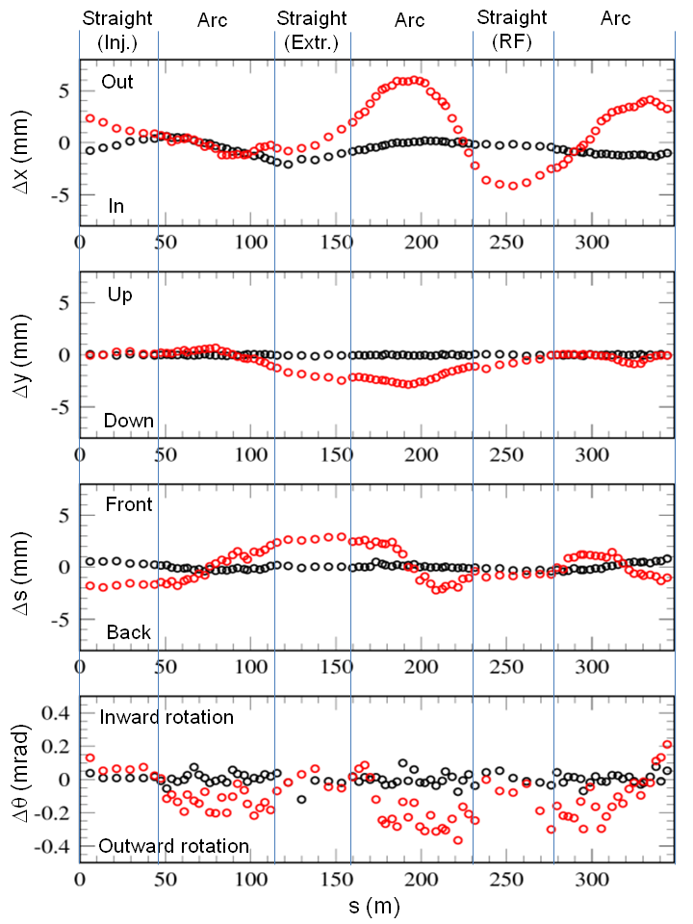
Misalignment caused by the earthquake
Measurement of the magnets
The survey of the RCS magnets was carried out using a laser tracker and a digital level.
It was about 3 mm displacement to horizontal direction before the earthquake.
Expect for that, displacement was small.
Horizontal direction moved largely from the extraction straight section to the injection straight section after the earthquake.
As the result, it was found out that the maximum displacement from design value of magnets
about 6.0 mm in horizontal direction,
about 2.8 mm in vertical direction
and about 2.8 mm in longitudinal direction.
The circumference of RCS ring expanded by 10.4mm.
Δx ;
Δy ;
Δs ;
Misalignment of RCS magnets before/after
the earthquake
Black dots are values taken before and red dots are values taken after the earthquake.

Slide 5
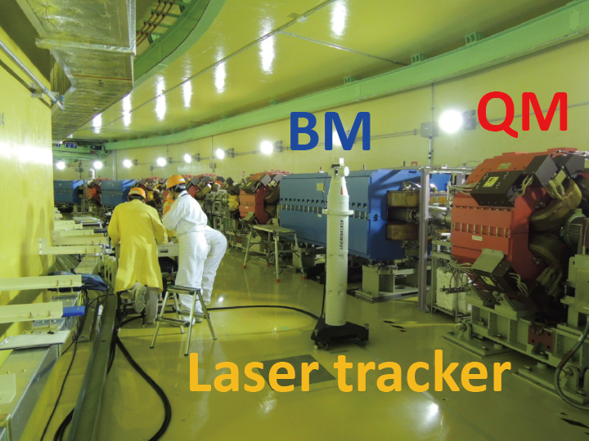
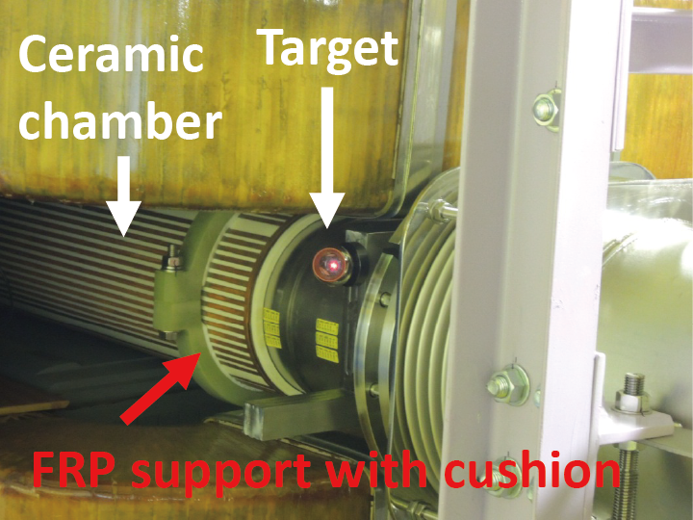
Measurement of the ceramic chambers
Ceramic chamber is used for a vacuum duct of RCS in order to reduce eddy current.
The measurement of displacement for the ceramic chambers of dipole and quadrupole magnets was also carried out using a laser tracker and a measurement device of target in 2012 summer.
Measurement of up/down stream parts of each ceramic chamber was implemented by attaching a measurement device on a titanium sleeve connecting ceramic part and flange part of a ceramic chamber.

Slide 6
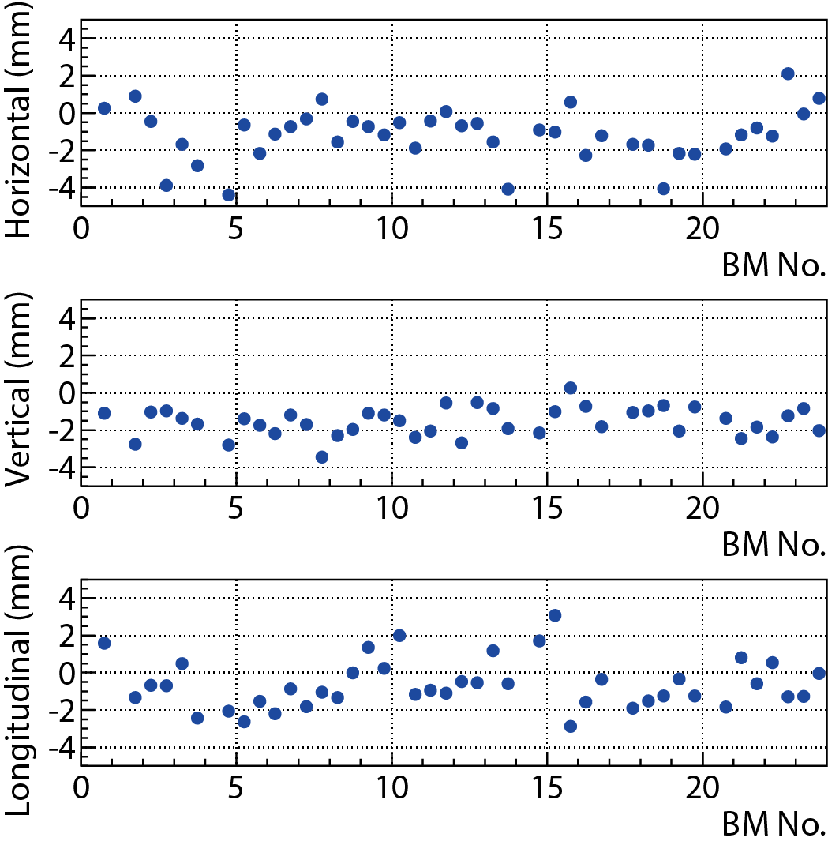
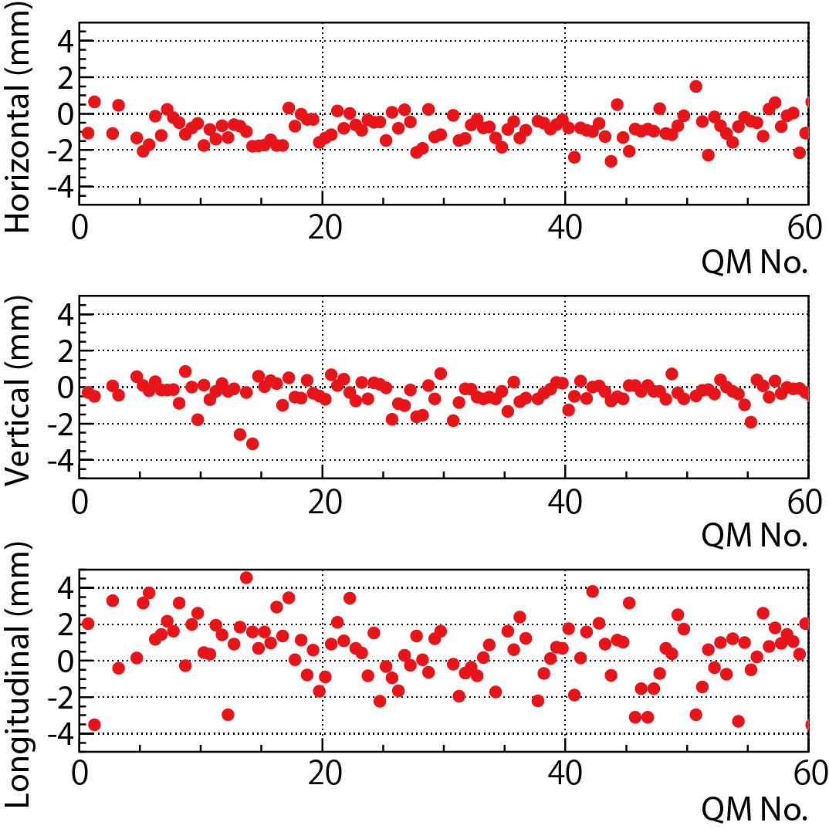
Ceramic chambers of dipole magnet
Ceramic chambers of quadrupole magnet
Alignment accuracy of ceramic chamber at the time of installation was within ±0.5 mm. Ceramic chamber shifted from the ideal position.
It is considered this displacement was mainly caused by the earthquake.
⇒This measurement date was used to evaluate the acceptance of the ceramic chamber.
Accordingly, it was found out that for some ceramic chambers acceptance was not enough. Therefore realignment was necessary also for ceramic chambers.

Slide 7
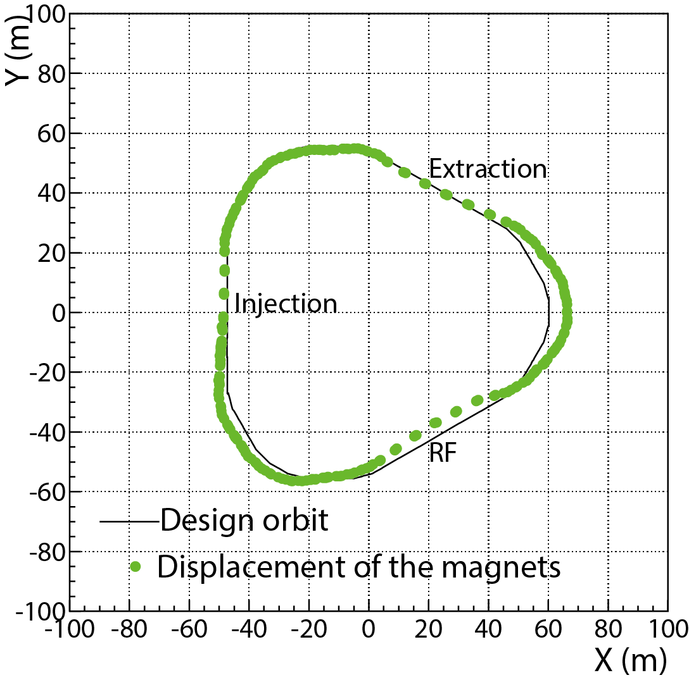
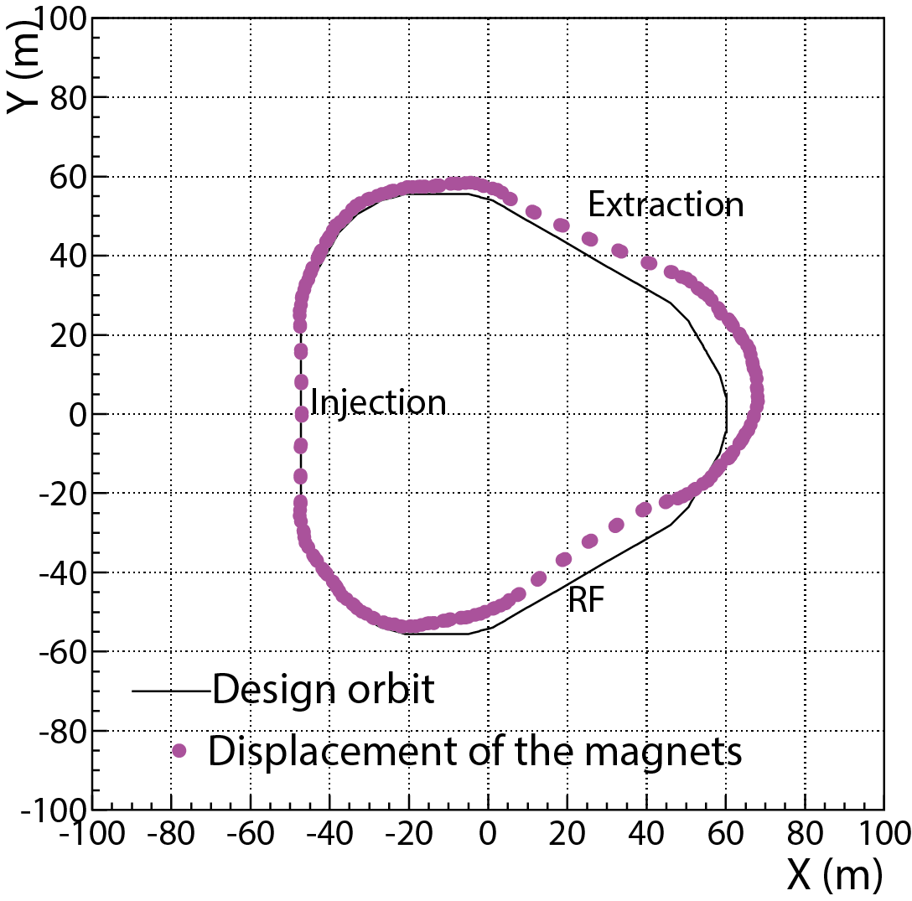
Strategy of the realignment
The most difficult part was adjustment of magnets near the injection collimator, because this area has high radiation dose and workability was very low.
Fortunately, relative displacement of all components at injection area was less than ±0.2mm.
⇒Therefore, it was decided that magnets in the injection straight section would be fixed and the rest magnets would be adjusted. Height of the beam line was decided base on the magnets near the collimator (QDL4 and QFL5).
Decision of the RCS ring coordinate
Ring coordinate adjustment to
keep injection section.
The displacement is magnified
by 1000 for convenience
Before coordinate adjustment
After coordinate adjustment

Slide 8
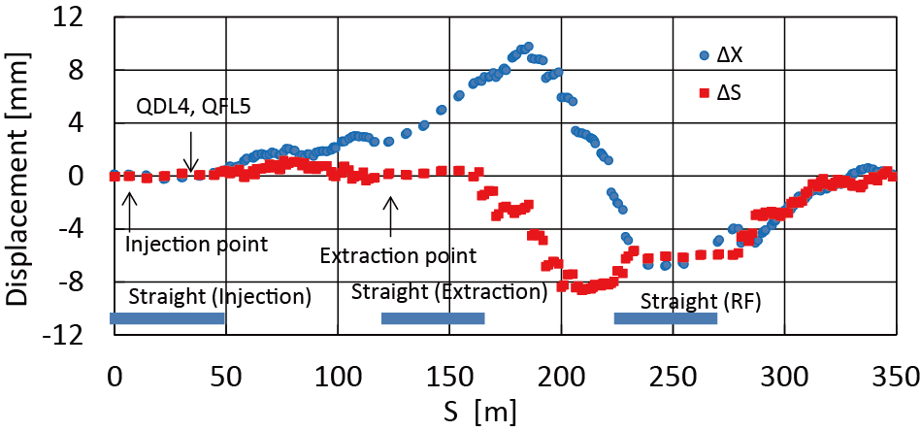
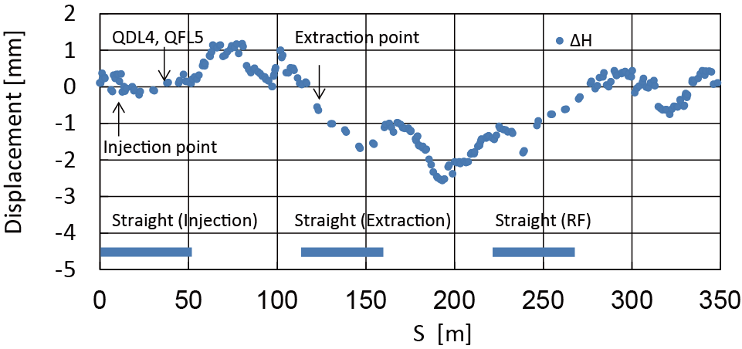
Displacement of magnets when converted into new ring coordinate
The maximum displacement from new design value of magnets
about 10.9 mm in horizontal direction,
about 8.6 mm in longitudinal direction
and about 2.8 mm in vertical direction.
Displacement became bigger in the straight section between the extraction and RF due to the new coordinate.
However this displacement can be adjusted sufficiently within the range of the magnets movement.
Δx ;
Δs;
ΔH ;
Displacement of the horizontal and longitudinal
direction
Displacement of the vertical direction

Slide 9
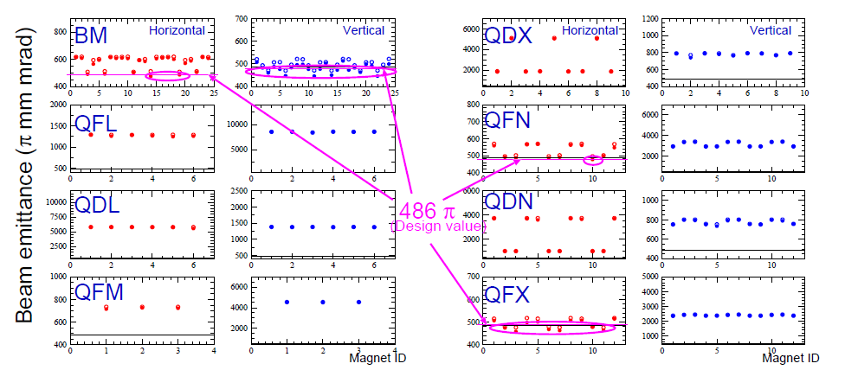
Realignment of the ceramic chambers
Ring acceptance must be secured to realize 1MW beam operation.
Acceptance calculation was implemented in consideration of misalignment and COD of 3mm for the ceramic chambers.
Acceptance (π mm mrad)
Acceptance including COD of 3mm and misaligment
Calculation conditions:
● Large β operation
● C.O.D. of 3 mm
Acceptance including COD of 3mm
⇒Acceptance can’t be secured mainly for diapole and quadrupole magnets (QFN, QFX).

Slide 10
In addition, bellows will be installed up/down stream of the ceramic chamber.
Adjustment range of bellows is within 1mm.
When there is a displacement of more than 1mm between bellows and flanges, vacuum ducts can’t be connected because of adjustment of bellows.
Therefore ceramic chambers there have to be aligned.
Realignment ceramics chambers
The amount of the realignment components
Ceramics chambers | Realignment | Total
BM | 20 | 24
QM | 23 | 60
SM | 6 | 18
Component | Realignment | Total
BM | 24 | 24
QM | 53 | 60
SM | 18 | 18
Ext. Sept. | 2 | 3
Ext. kicker | 2 (8 kicker-mag. installed in 2 vacuum chambers) | 2
RF Cavity | 11 and new 1 cavity installed | 12
Monitors, vacuum pumps, exciters, ….
Connected flanges : 336

Slide 11
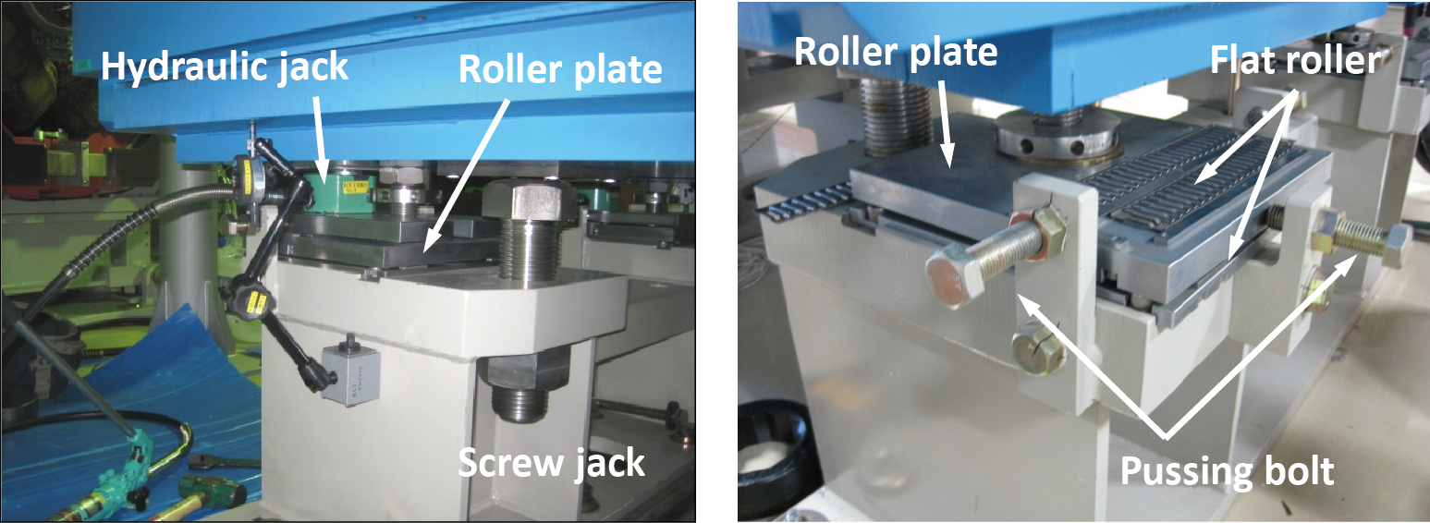
Method of the realignment for the dipole magnet
Alignment of magnets was carried out using a laser tracker and a digital clinometer.
Generally magnets are adjusted first in the vertical direction and then in the horizontal direction.
Magnets were adjusted within ±0.2 mm after repetition of adjustment in vertical and horizontal directions.
Dipole magnets of RCS weigh 38 ton. ⇒ Normal adjustment can’t move them.
To reduce weight and friction at the time of adjustment, 4 sets of hydraulic jack and roller plate were installed between the magnets and the girder.
Hydraulic jack was used for adjustment in vertical direction.
In order to adjust both in horizontal and longitudinal directions 2 roller plates were set.
⇒ These jigs made the very smooth adjustment of dipole magnets possible.

Slide 12
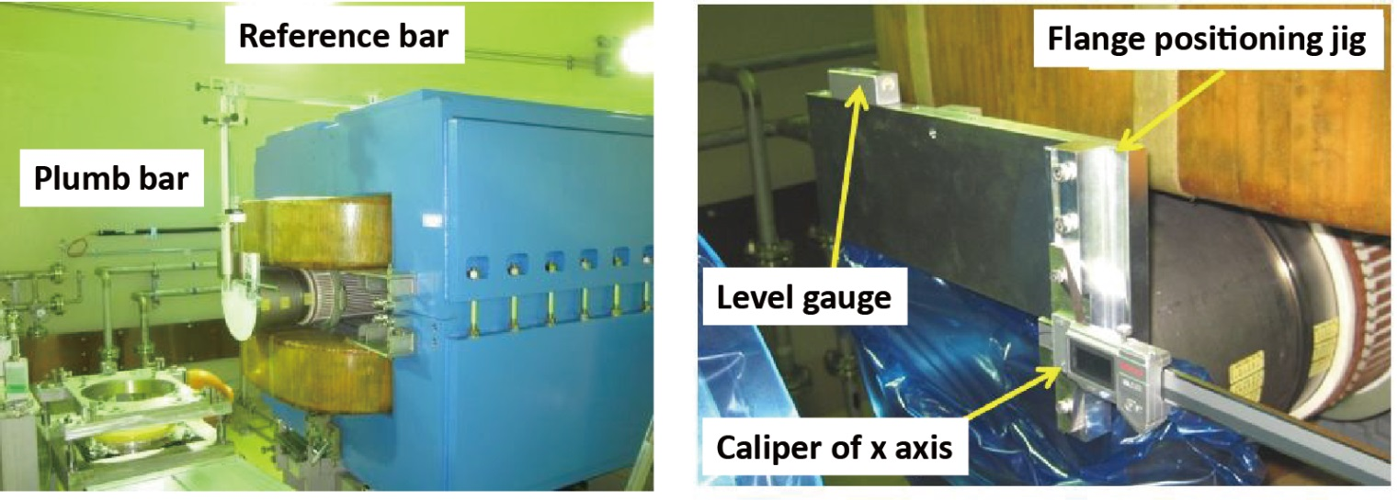
Method of the realignment for the dipole magnet ducts
At the beginning of installation, duct alignment was carried out by separating diapole magnets into upper and lower part. This time magnets were not separated to save working time and space and a jig exclusively for alignment was made.
First, a flange positioning jig was set on the side of duct sleeve in order to adjust a duct tilt.
Then a reference bar was fixed on the fiducial point located on the upper part of a magnet.
Alignment in the beam axis direction was implemented by hanging a plumb bob from the end the reference bar.
Finally alignment in height and in horizontal direction was carried out with a caliper, hanging a plumb bar from the reference bar.
⇒ Therefore for ceramic chambers of dipole magnets, duct adjustment became possible with an accuracy of less than ±0.1mm.

Slide 13
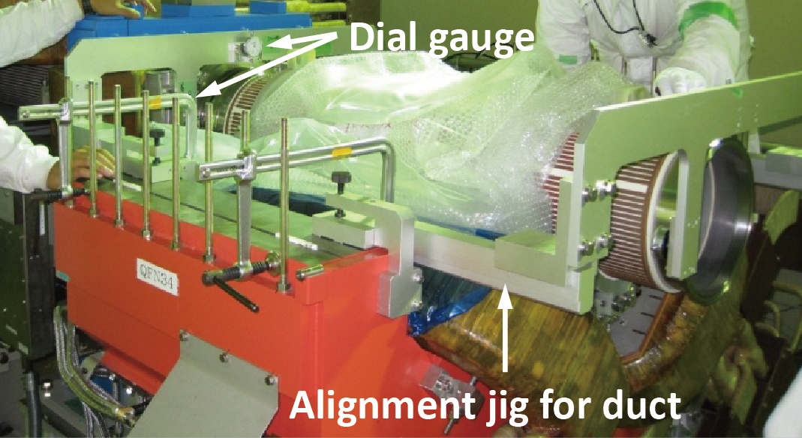
Method of the realignment for the quadrupole magnet ducts
As with the case of diapole magnets, a method not to separate magnets was considered for realignment of quadrupole and sextupole magnets.
But with that method a working space would narrow and adjustment would become complicated. Therefore the magnets were separated into upper and lower parts.
An alignment jig for ducts was set on the divided face of a lower iron core.
A dial gauge of each axis set on a alignment jig was used for alignment in height and horizontal direction.
However as the jig mounting surface inside the magnets was rough because of the adhesive seeped from a steel sheet, the installation accuracy of the alignment jig was not good.
Therefore this ceramic chamber was relatively moved using the measured data of Laser Tracker. Measurement accuracy of this method was within ±0.5mm.

Slide 14
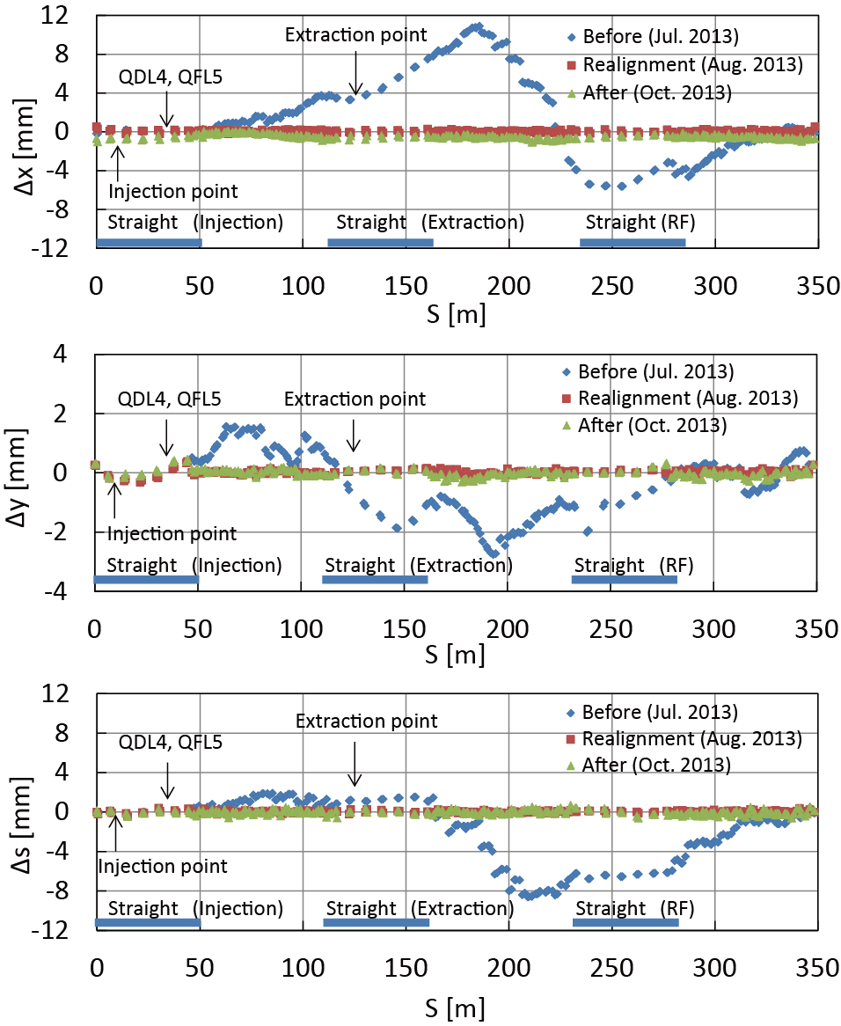
Results of the realignment
Displacement of magnets before/after realignment
Magents and fiducial points on the wall were measured before the realignment.
Using the fiducial points at that time, the realignment of magnets was carried out from August to September, 2013.
The realigned magnets were adjusted within ±0.2mm compared with the design value.
The measurement after the realignment found that the fiducial points on the wall and the magnets were contracted inward.
As a result, the beam line of RCS was displaced inward by 0.5mm and its circumference shortened by 3.1mm.

Slide 15
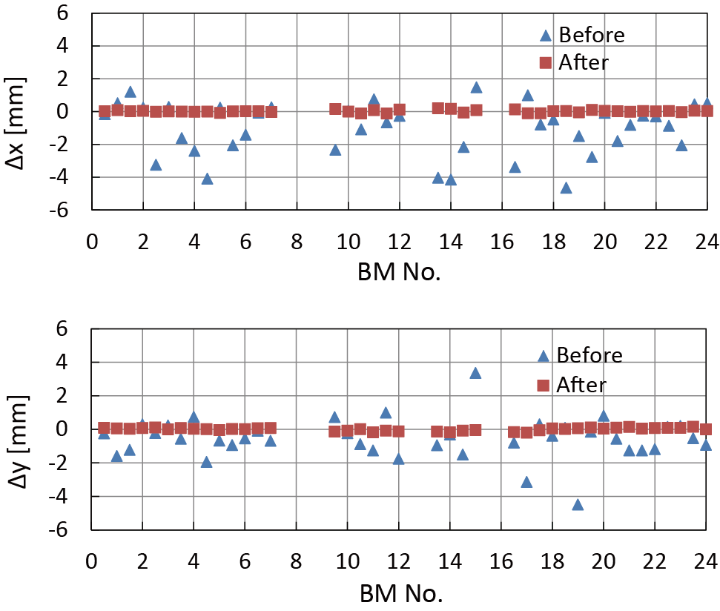
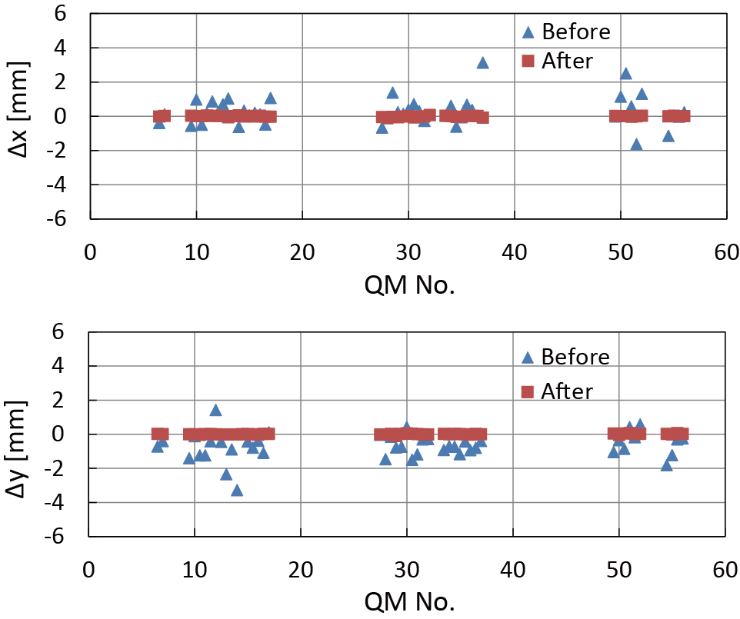
Displacement of ceramic chambers before/after realignment
Ceramic chambers of dipole magnet
Ceramic chambers of quadrupole magnet
The realignment of ceramic chambers was carried out from August to October, 2013.
The ceramic chambers of BM were adjusted within ±0.2mm.
The ceramic chambers of QM were adjusted within ±0.1mm.
Alignment accuracy of the ceramic chambers is deemed to be about ±0.6mm at a maximum when installation accuracy of the mesurement device for a laser tracker measurement (±0.5mm) is considered.
Although alignment accuracy of the ceramic chambers exceeded the targeted value (±0.5mm), the value is well accepted.

Slide 16
Summary
The alignment of the RCS has been successfully completed within long shutdown period. Working period was 5 months from 22 June to 27 November 2013.
The alignment procedure for RCS beamline equipment was confirmed for the first time by the realignment and it was carried out.
The magnets of the beamline were adjusted to within ±0.2mm.
The ceramic chambers were aimed to be adjusted within ±0.5mm.
As a result, a sufficient ring acceptance to achieve the 1MW operation was secured.
Beam commissioning started on January 30, 2014. RCS succeeded in injection of 400MeV beam from the upgraded Linac, and extraction of 3GeV beam to MLF.

Slide 17
Thank you for your attention!!

