Slide 1

IWAA 2014 – IHEP
October 2014
HIE-ISOLDE
General presentation of the
Monitoring and Alignment Tracking for Hie-IsoLDE
Jean-Christophe Gayde EN/MEF-SU
Guillaume Kautzmann EN/MEF-SU

Slide 2
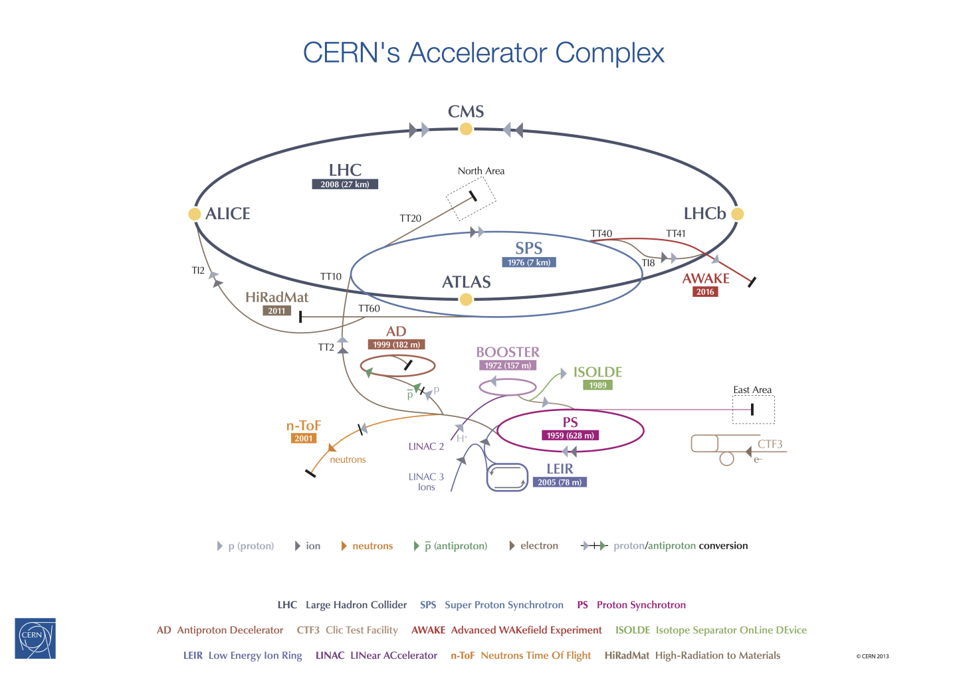
Introduction
+
2016

Slide 3
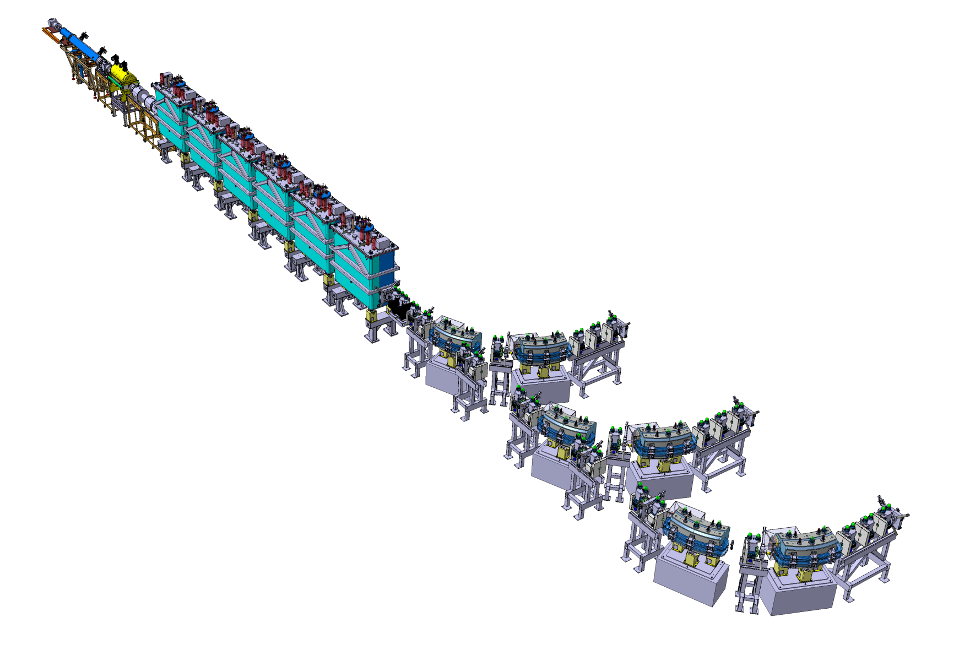
Introduction
HIE-ISOLDE SUPERCONDUCTING LINAC
~16m
2016
Phase 2
Transfer Lines
High Intensity and Energy ISOLDE → Important upgrades of REX-ISOLDE
Goal: Increase the energy and the quality of post-accelerated Ion Beams

Slide 4
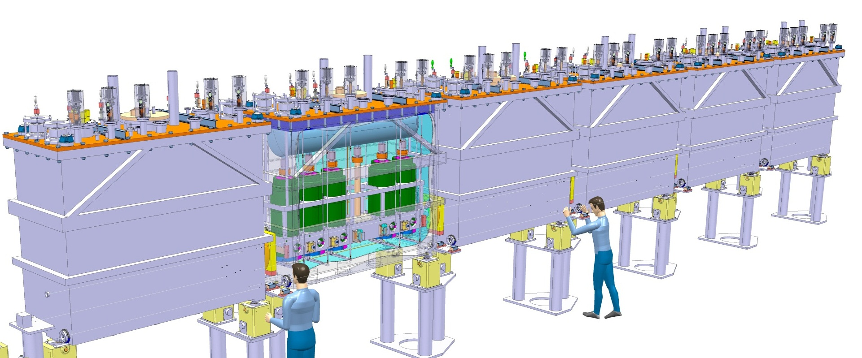
Alignment specifications
General
Alignment and monitoring of the Cavities and Solenoids in the Cryomodules w.r.to a common nominal beam line (NBL) along the Linac
Permanent system
Common Vacuum and Cryogenics (4.5K) conditions
Precision asked along radial and height axis at 1 sigma level :
  300 microns for the Cavities
  150 microns for the Solenoids
~16 m
NBL
+/-150 micr
+/-300 micr

Slide 5
MATHILDE
Proposed Concept
CONCEPT
Creation of a closed geometrical network continuously measured
Observation and position reconstruction of Cavities and Solenoid in this Network
SYSTEM
RF cavities and solenoid equipped with targets
Interface Atmosphere / High Vacuum → Precise viewports
BCAM cameras fixed to inter-module metrological tables
External Lines => Position and orientation of metrological tables and BCAMs
Internal Lines => Position of the targets inside the tank
RF Cavity
Solenoid
BCAM
External Line
Pillars
Pillars
Cryo-module
Metrologic Table
Internal Line
BCAM observations

Slide 6
MATHILDE
Proposed Concept
Top view
Overlapping zone of BCAM obs. on external lines
Double sided targets observations on internal lines
=> Redundancy
Side view
Ext. line
Overlapping
Pillar
Pillar
BCAM
BCAM to BCAM observations
Metrological Table
BCAM to Pillar observations

Slide 7
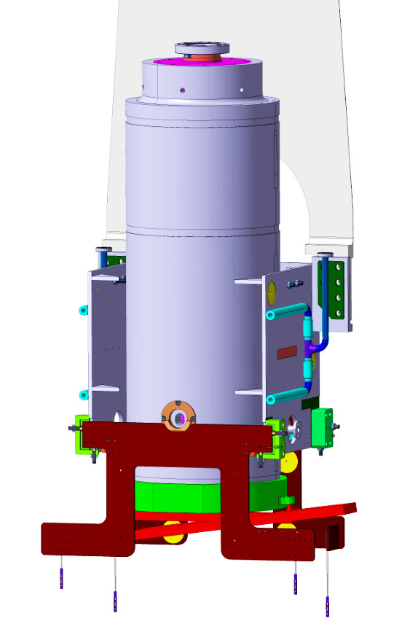
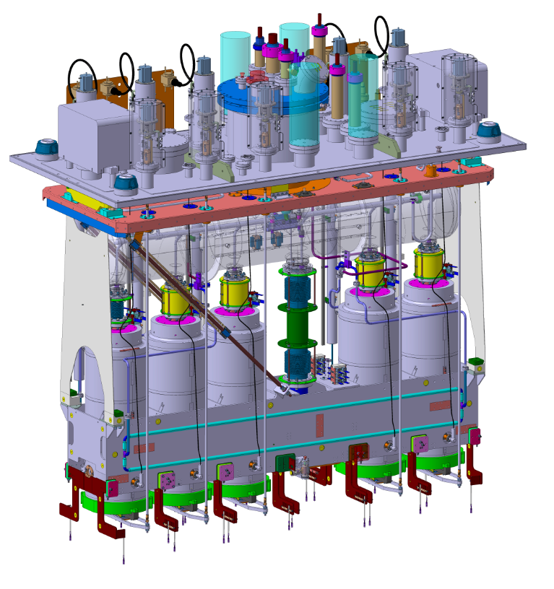
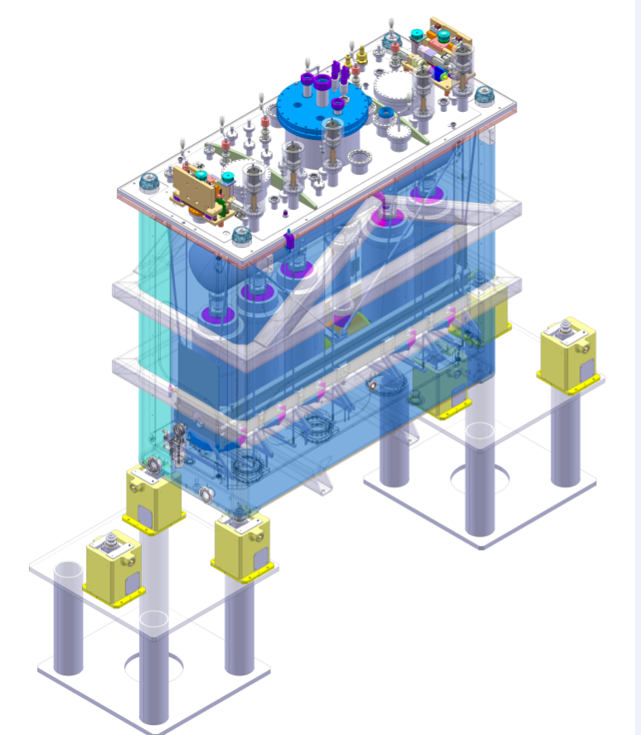
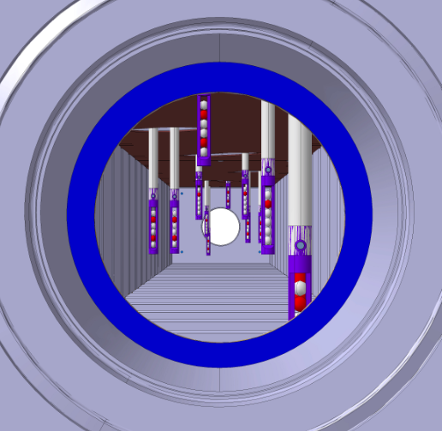
Supporting and Adjustment
Cavity and solenoid support:
  Top Plate Reference
  2 adjustable omega plates per element
  Isostatic interface: hollow Sphere – V-shape
  Cryomodule assembly in ISO Class 5 clean room
    → Alignment done with AT401 Laser Tracker + check with MATHILDE
    Once assembled, three levels of alignment:
  Jacks
  Frame
  Independent solenoid
Courtesy of: Y. Leclercq (TE-MSC)

Slide 8
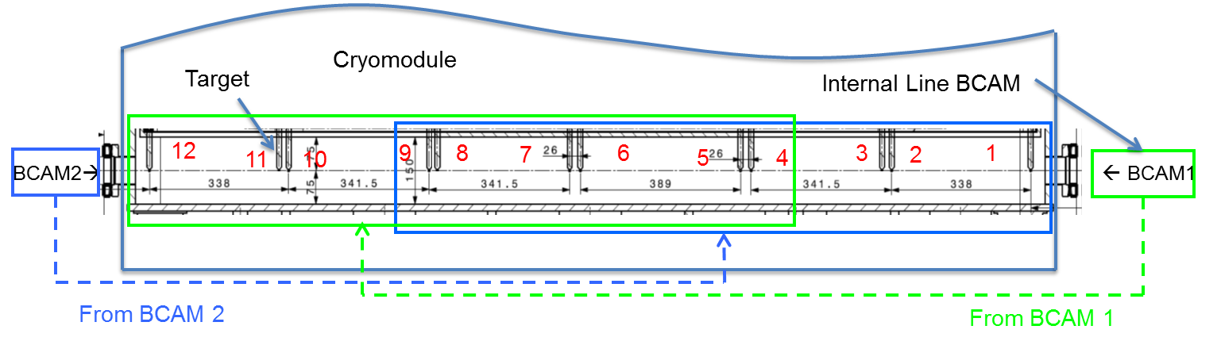
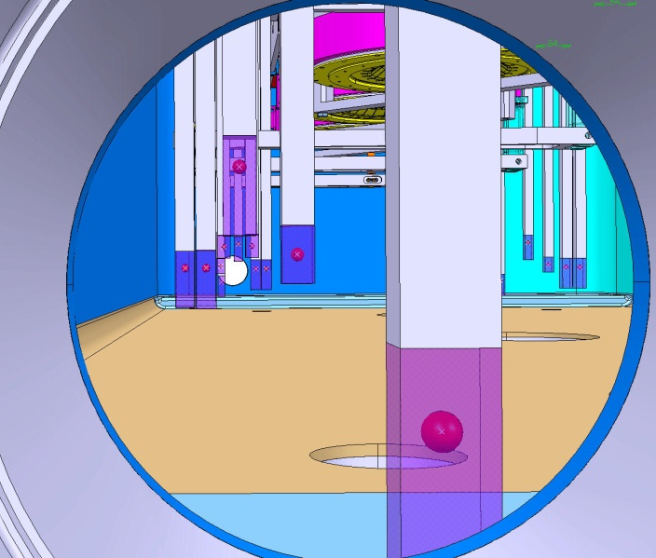
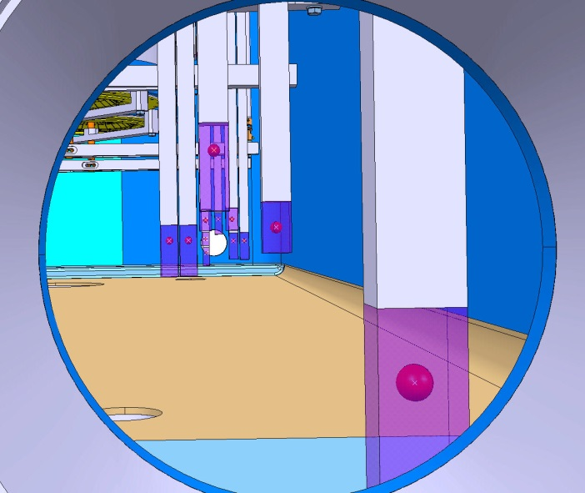

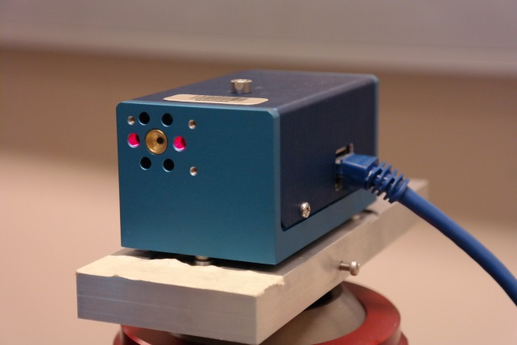
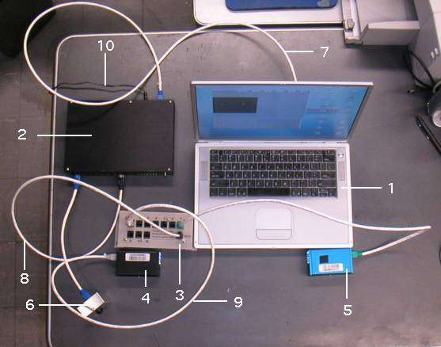
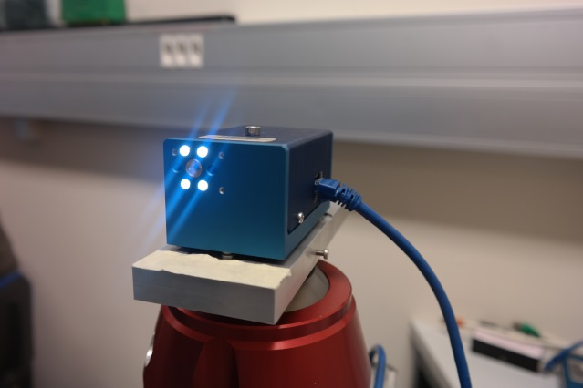
HBCAMs
Developed in 1999 by Brandeis University for ATLAS Muon alignment
OSI (Open Source Instruments) → http://alignment.hep.brandeis.edu/
Original BCAM → HBCAM
Camera focal length: 72 mm → 49 mm – 50 mm
Sensor: 336 x 243 pixels 10 micr → 659p × 494p, 7.4 microns
Field of view: 40 mrad x 30 mrad → ~ 100 x 70 mrad
Sources: Laser Diodes 650 nm + Calibration of their power to 5mW
Additional synchronized illumination system
Mounting: "Plug-in" isostatic system under the chassis
Double sided model
Cable length BCAM/Driver > 60 m + Connection on the side
From HBCAM2
From HBCAM1
HBCAM vs BCAM Field of view

Slide 9
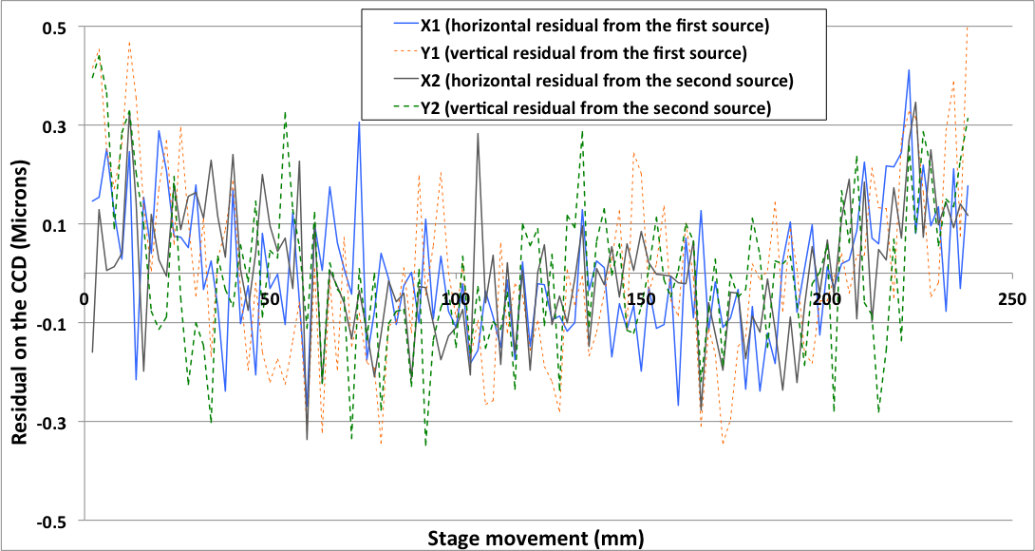
HBCAMs
Resolution: 5 micro radians constructor (OSI) → Same range
Accuracy of 50 micro radians to absolute → Same range
Delivered calibrated with respect to the mounting balls
Focus around 1.5m
Tested resolution: 3 micro radians

Slide 10
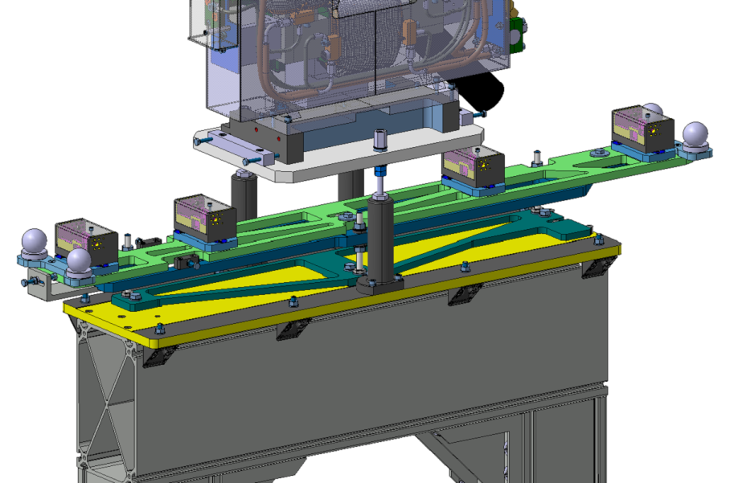
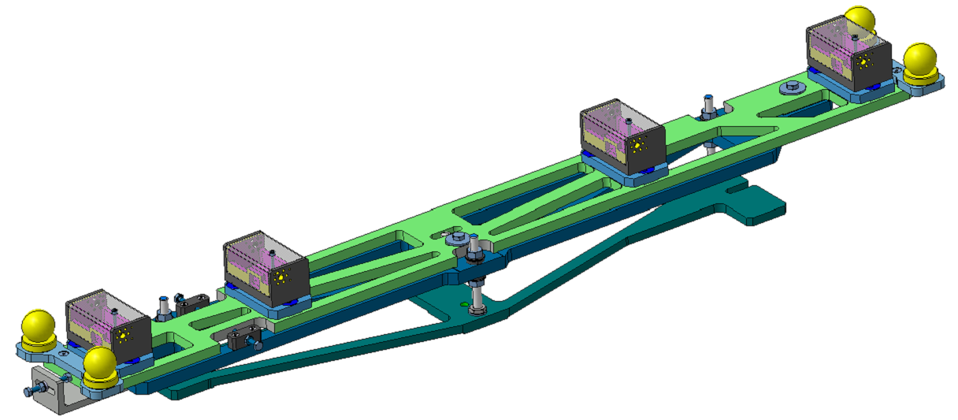
Metrologic Table
Integration in a busy space
  Metrology to link the HBCAM mounting balls and fiducial marks
  Special measurable adapter to improve the HBCAMs relative angles obs.
    Table inserted as an ensemble
    Holes to lighten the table (~11kg) whilst keeping rigidity
    Supporting decoupled from the DB and Steerer
    →BUT…. Still need to be qualified
318mm
500mm
222mm
160mm
1200mm
Courtesy of: E. Urrutia (EN-MME)
G. Vandoni (TE-VSC)

Slide 11
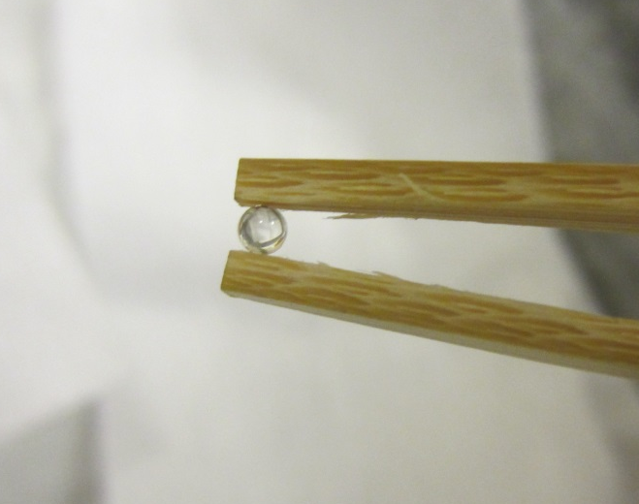
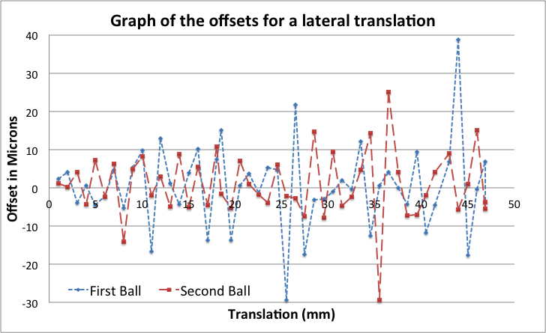
Targets
HBCAM Measurement
Distance to target:
1.2 m
Scan over 40% of the field of view
Precision of the reconstructed movement: ~10 microns at one sigma level
Expectation: around 10 urad
20 microns

Slide 12
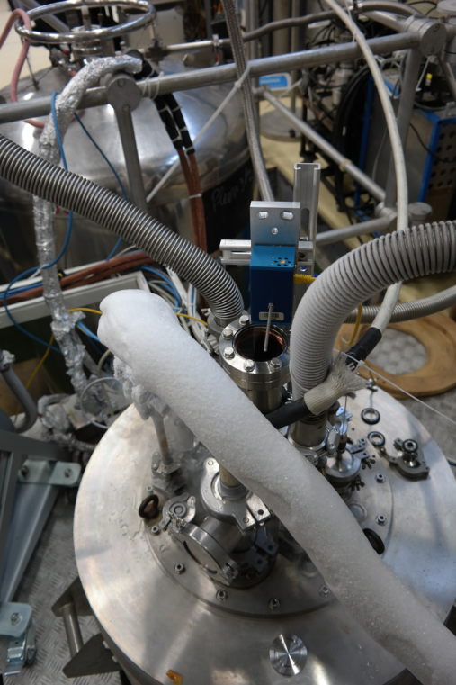
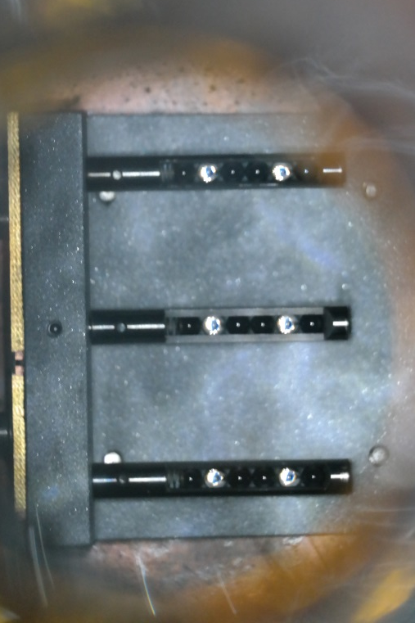
Targets
Cryogenic and Vacuum Behavior
Outgassing at background level for an equivalent of 20 Ø4mm balls or 80 Ø2 mm balls.
Cryo-test:
  Down to 5 k and 40•10-6 mbar, HBCAM measurements OK
  No damages or unexpected behavior noticed
    Outgassing test done by Mario Hermann (TE/VSC)

Slide 13
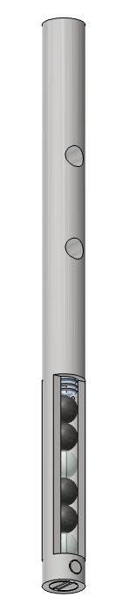
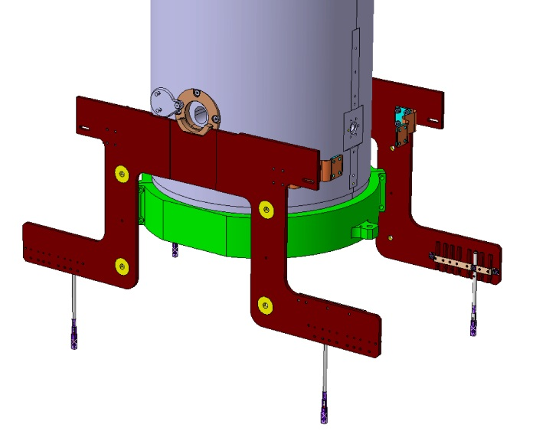
Targets
Final Design
Based on Ø4mm glass balls
Titanium made narrow silhouette (6mm)
Interface with Omega plate:
  V-Groove → Lateral position
  Pin → Height blocking
  Screw → Fixation
  Double sided
  Flashed by HBCAM Lasers
    Multi-ball targets
    5 different lengths/CM
    Good geometrical results
    High vacuum compatible
    Cryogenic conditions compatible

Slide 14
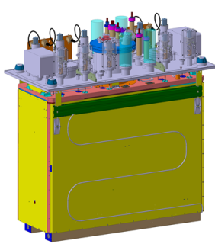
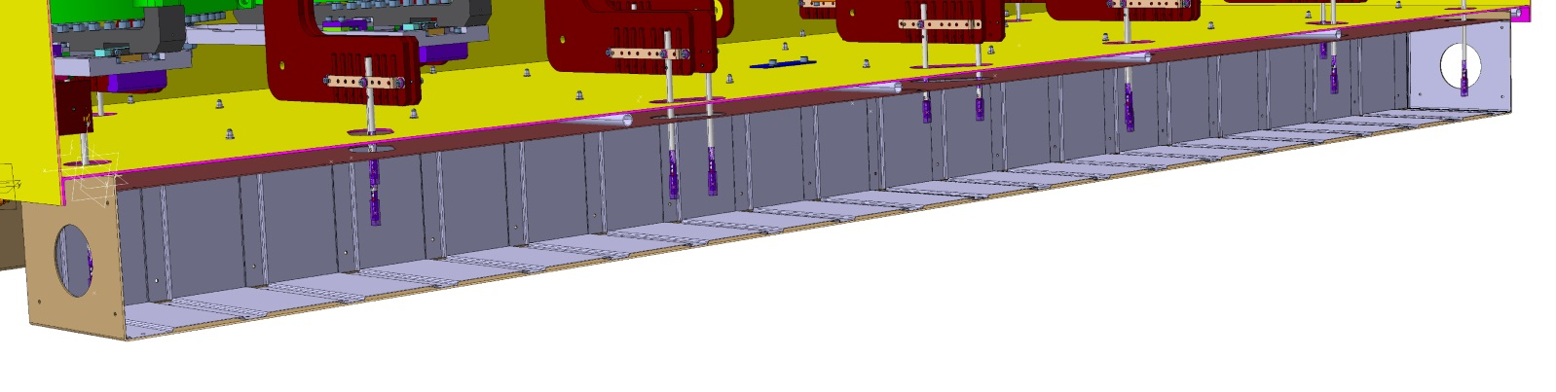
Targets
Thermal Shield Crossing
Targets need to cross the thermal shield
  Addition of 2 thermalized alignment corridors:
  Holes to allow target envelopes to cross it
  Minimal addition to the heat budget
  Still visible from upstream/downstream HBCAMs
  Walls covered with anodized aluminum plates
Courtesy of: J. Dequaire (EN-MME)

Slide 15
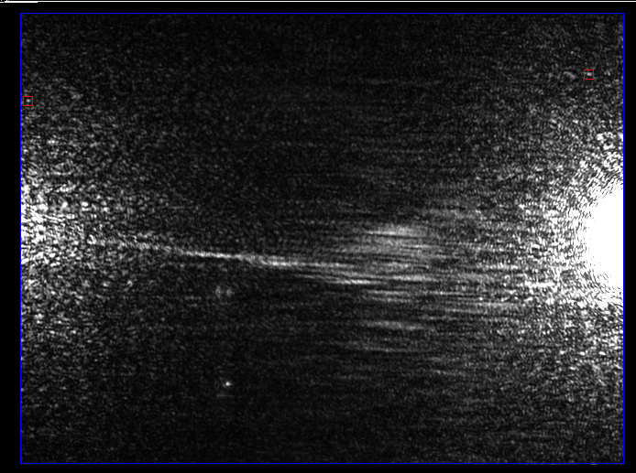
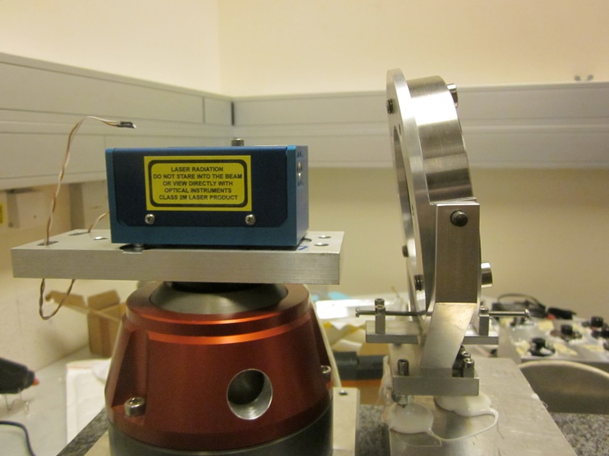
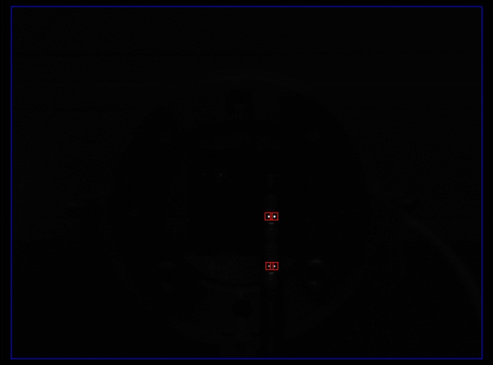
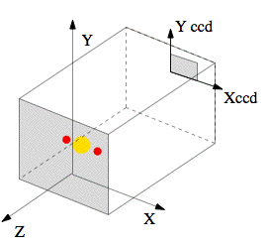
Viewports
Orientation
A viewport with an angle:
    Viewport with 5 degree angle w.r.t. the HBCAM axis
    → Avoiding parasitic reflection for passive target observation
    → Viewport mounted with a 5 deg. angle in the flange
    Minimum rotation values:
    Around Y 3 deg.
    Around X 2 deg.

Slide 16
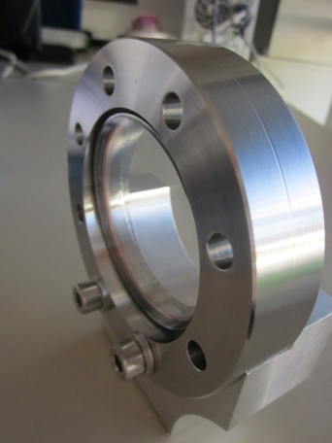
Viewports
Summary
Atmosphere / Vacuum interface
6.55 mm thick
Studied and validated for:
  Wedge angle
  Parallel plate effect
  Deformation due to vacuum
Angle w.r.t HBCAM axis ≈ 5 deg
Integrated in the viewport design
Special request to the manufacturer
Effect corrected by software
→ Viewport for 2 CM delivered and validated

Slide 17
MATHIS Software
Coordinate Frames
Each element has a specific coordinate system atached
even a point or a viewport
Hierarchical scheme of coordinates systems :
  Topmost: HIE system → Link to the NBL
  For each table: Table system → Link between the HBCAMs
  For each HBCAM: Mount system → Calibration parameters
  CDD System → Observation
  Pivot point, lasers sources,....

Slide 18
MATHIS Software
Parameter Adjustment
Translations and rotations for each table need to be estimated: 6 parameters per table in the setup
Relations between mount systems on the same table are fixed
→ Tables considered as a floating rigid body
Highly Versatile and Flexible Principle
Can Virtually create any configuration with BCAM type sensors
7 Table conf. reconstruction within 20 micr. at 1 sigma level (→ IWWA2012)

Slide 19
MATHIS Software
Data Flow
Description of the full system by 3 XML files
Geometrical conf.
Sensor Param
Observation conf.
Correction for frame thermal retractions
T from CERN DB
Automatically generates
LWDAQ Script
Only temperature data
LWDAQ
Complete
Geometrical conf.
PRE-PROCESSING
HBCAM calibration parameters
Observations on targets
Observation and computation scheme
Pre-Processing:
Viewport crossing correction
Glass ball target center reconstruction
Measurements averaging
- etc…
Input file for LGC V2
Least square adjustment
LGC V2
Data formatting
Results sent to DB and to Control room

Slide 20
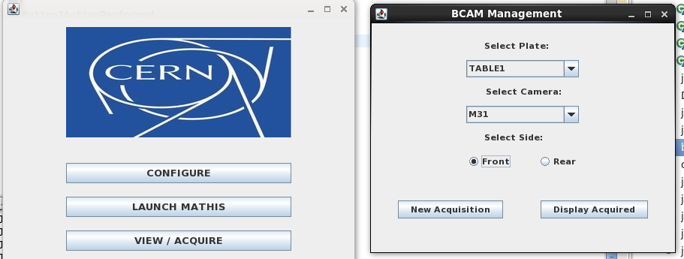
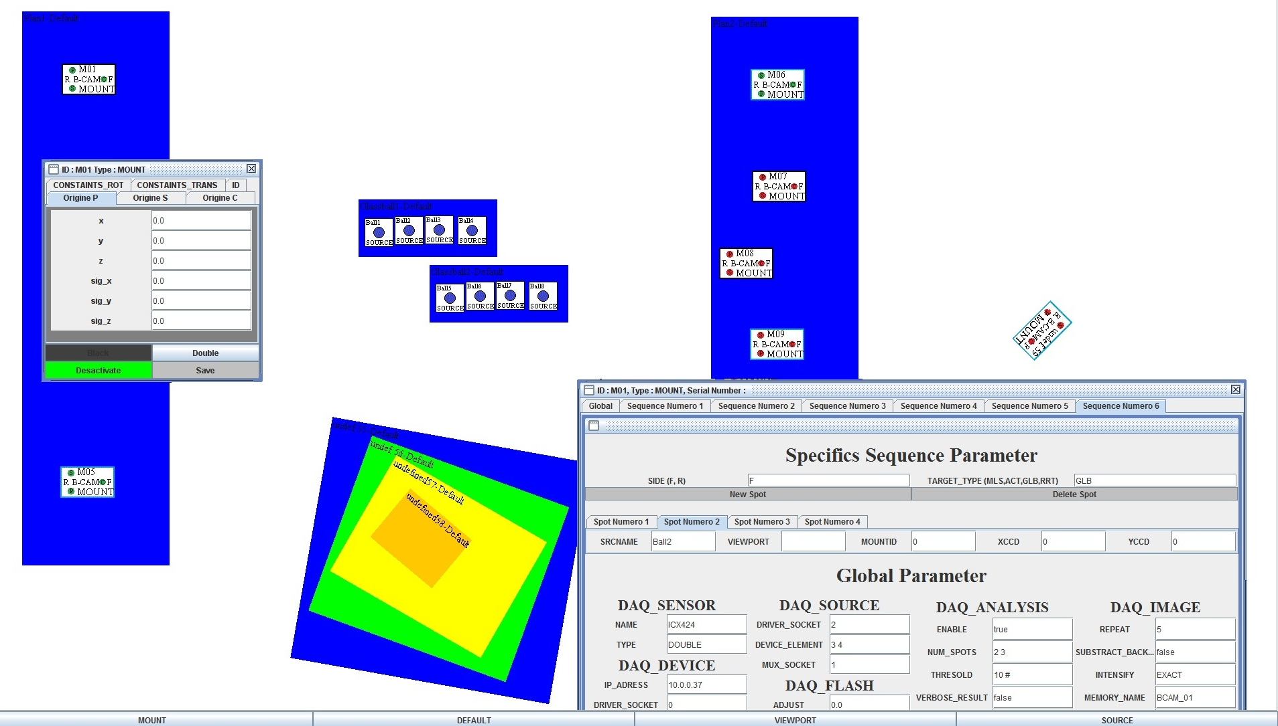
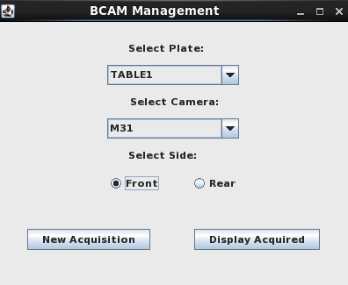
MATHIS Software
Graphical User Interface

Slide 21
Conclusion
ALIGNMENT SYSTEM MAINLY VALIDATED
HBCAMs
  Proved and used devices
  HBCAM developed, validated and procured
METROLOGICAL TABLE
  Integrated in the Inter-Tank area
  Close to final design
VIEWPORTS
  Fit well to the theory → Easy BCAM observation corrections
  High optical quality needed
  Delivered and validated
TARGETS
  Passive glass balls
  Targets ordered
SOFTWARE
  Development on-going
  Use of LGC V2

Slide 22




Acknowledgement
This research project has been supported by a Marie Curie Early Training Network Fellowship of the European Community’s Seventh Framework Programme under contract number (PITN-GA-2010-264330-CATHI).
Official partners :
Brandeis University, Faculty of Physics (USA): J. Bensinger, K. Hashemi
Top Tec and technical university of Liberec (CZ): M. Šulc
Y. Leclercq, J. Dequaire, G. Vandoni, S. Maridor, S. Rokopanos, T. Basilien, F. Klumb, S. Waniorek, D. Duarte Ramos, M. Herrmann, E. Urrutia… All others involved in HIE-ISOLDE Project

Slide 23
MATHILDE
Thanks for your attention
谢谢

Slide 24


HBCAMs

Slide 25
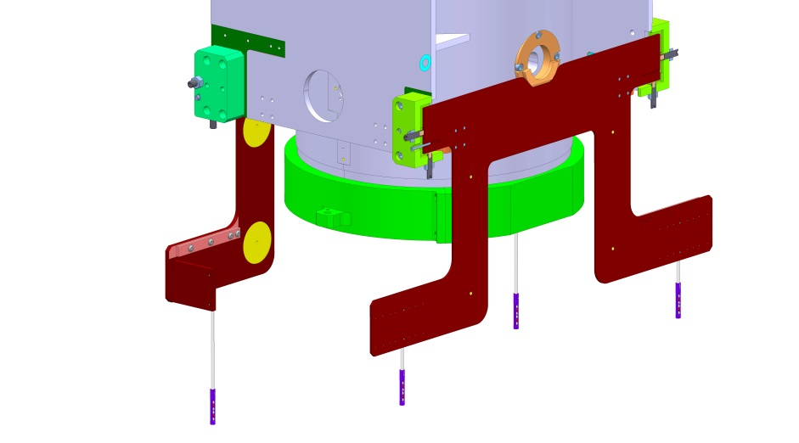
Targets
Different options
Constraints → HIGH VACUUM - CRYO CONDITIONS - SIZE
    Studied Target Types
    Silica Silica optical fiber end
      - feed-through needed, one-sided target
    + easy light level control, OK with cold and vacuum (tested)
    Silica ilica optical fiber ended by a ceramic ball
    - feed-through needed, connection fiber/ball
    + visible from all positions, good diffuser
    Retro-reflective targets
        - illumination needed, all targets in one shot
        + double-sided, passive target, no feed-through

Slide 26
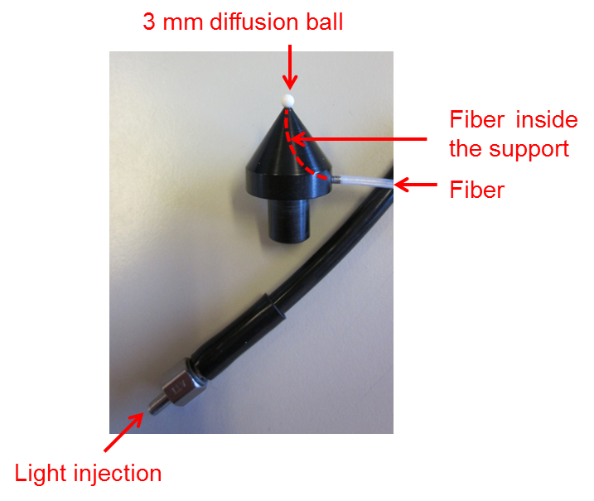
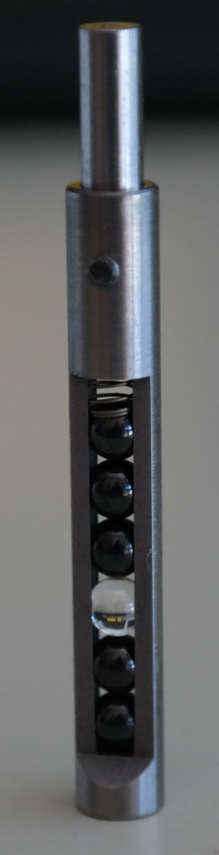
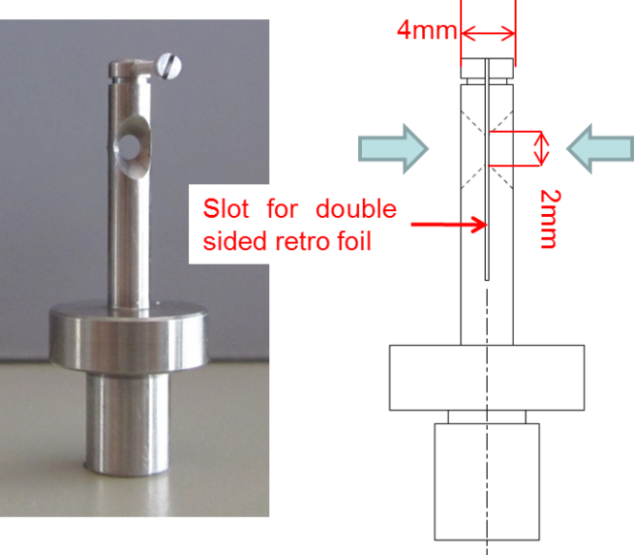
Targets
Different options
    Three types of “double sided” targets considered
Laser illuminated ceramic balls
Retro-reflective bi-directional target
Retro-reflective Glass ball target
Test prototype for an illuminated ceramic ball synchronized to the acquisition system
But Active targets
Double sided retro-reflective target Prototype
But Not High-Vacuum compatible

Slide 27
Targets
Spatial Distribution
From HBCAM2
From HBCAM1
HBCAM vs BCAM Field of view

Slide 28
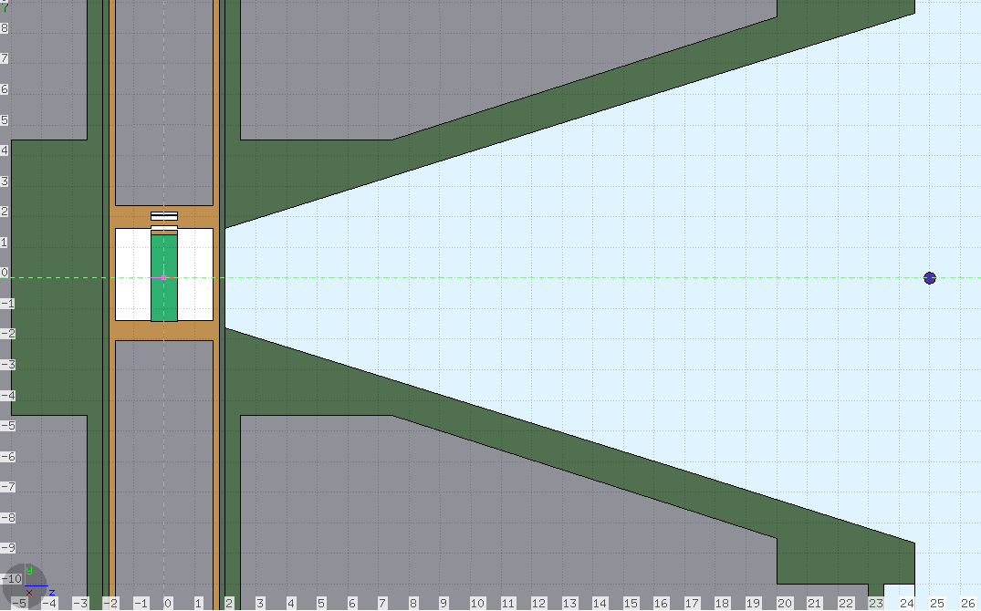
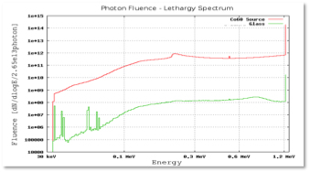
Targets
Planification of a radiation test
    Collaboration with Institute for Nuclear Research Atomki (Debrecen – Hungary)
Fluka Simulation On-Going
Up to 5kGy
  Real test done in the near future

Slide 29
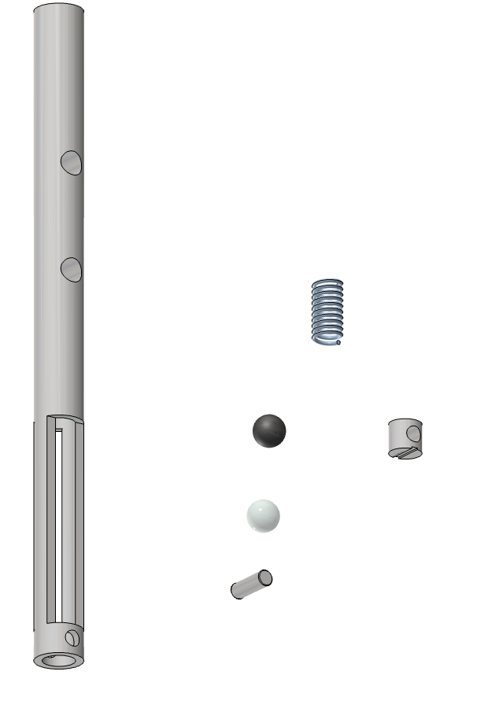
Targets
Final Design : Components
1 x
Stainless steel spring
4 x
Ø4mm Ceramic Ball
2 x
Ø4mm glass Ball
Titanium target body
1 x
1 x
Ø2mm Stainless steel pin
1 x
Titanium target plug

Slide 30
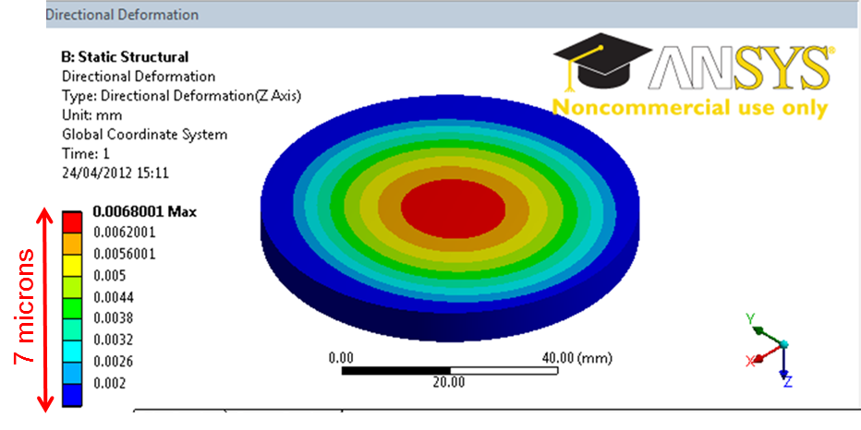
Viewports
Studies
Wedge angle
    10 microrad wedge angle acceptable
    Parallel Plate Effect
    Incident angle change of 1gon (0.9deg) → 37 microns radial object “displacement”
    Match the theory by a few microns → Easy observation correction by software
Window | Given wedge angle (microrad) from window’s technical data | Wedge angle observed (microrad) | Influence on target at 1m (micr) | Influence on target at 2m (micr)
A | 25 | 5 | 2.5 | 5
B | 50 | 10 | 5 | 10
C | 500 | 300 | 150 | 300
    Vacuum deformation
    Less than 7 microns deformation at the center
    Less than 0.015 degree of angular deviation
    Deformation measurements Liberec University (CZ):
      Results match the calculated deformations by a few microns
      Same deformation on both side → Parallelism kept

Slide 31
MATHIS Software
Graphical User Interface
GUI developed
→ Automated generation of the XML Files
Geometrical (frame hierarchy,..)
Observation configuration
…

Slide 32
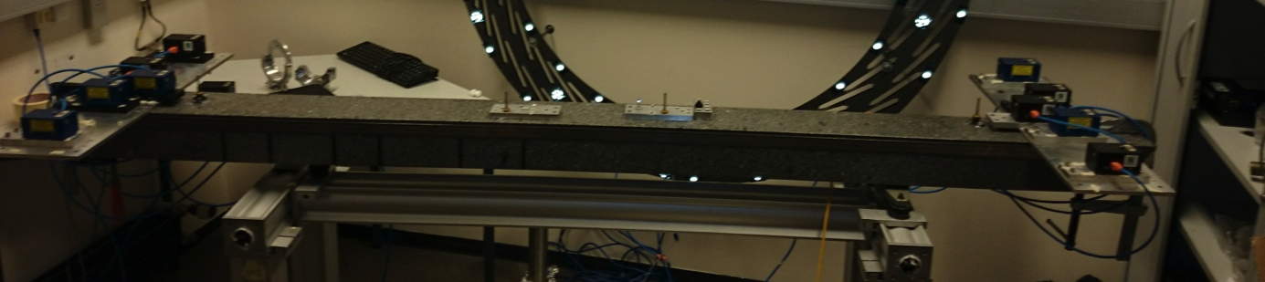
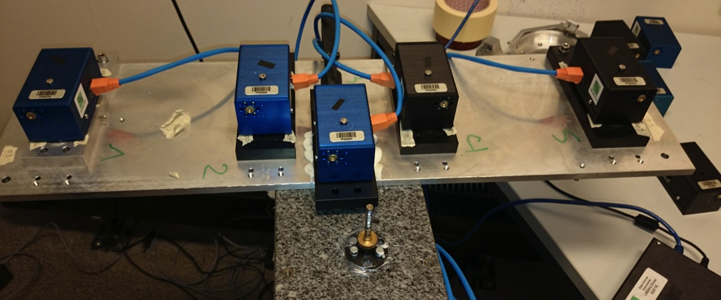
MATHIS Software
Software checking small Bench

Slide 33
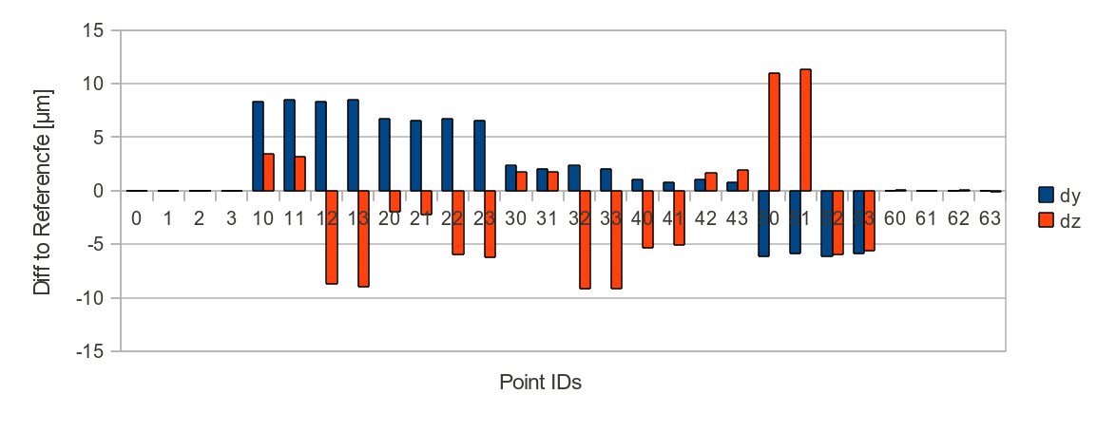
MATHIS Software
Simulation Results
Test result using a computation shell prototype
20 microns
Σ₀²=0.0117 | σty [μm] | σtz [μm] | σrx [μrad] | σry [μrad] | σrz [μrad]
0 | 0.49 | 0.53 | 1.54 | 3.51 | 1.2
1 | 9.19 | 10.72 | 34.5 | 4.16 | 3.78
2 | 12.72 | 15.38 | 38.2 | 3.59 | 3.39
3 | 13.67 | 16.87 | 38.02 | 2.82 | 2.69
4 | 12.73 | 15.6 | 38.27 | 3.56 | 3.39
5 | 9.21 | 11.01 | 34.54 | 4.18 | 3.78
6 | 0.9 | 1.07 | 3.18 | 3.93 | 1.23
Overlapping improves the results by a factor 2
Still some error budget for the reconstruction of the targets

