Slide 1
Technology and Application of Laser Tracker in Large Space Measurement
Yang Fan, Li Guangyun, Fan Baixing
Zhengzhou Institute of Surveying and Mapping
IWAA2014 in Beijing, China

Slide 2
主要内容
1 Introduction
2 Accuracy analysis of Laser Tracker
3 Three dimensional adjustment
4 Example and application
5 Summary

Slide 3
1 Introduction

Slide 4
1 Introduction
In recent years, with the development of modern industry, especially the rapid development of manufacturing industry, the 3D precision measurements for all kinds of large-scale engineering or large pieces of the structures appeared, including measurements about position, attitude and shape detection etc.
The characteristics of this kind of works is large scale, high precision, on-site measurement, dynamic measurement and attitude measurement, the traditional CMM can not meet these requirements, so large scale coordinate measurement technology appeared.
At the same time, many new problems appeared in large scale measurements, and we need the knowledge of several disciplines to solve them, such as geodetic, engineering survey and instruments etc.

Slide 5
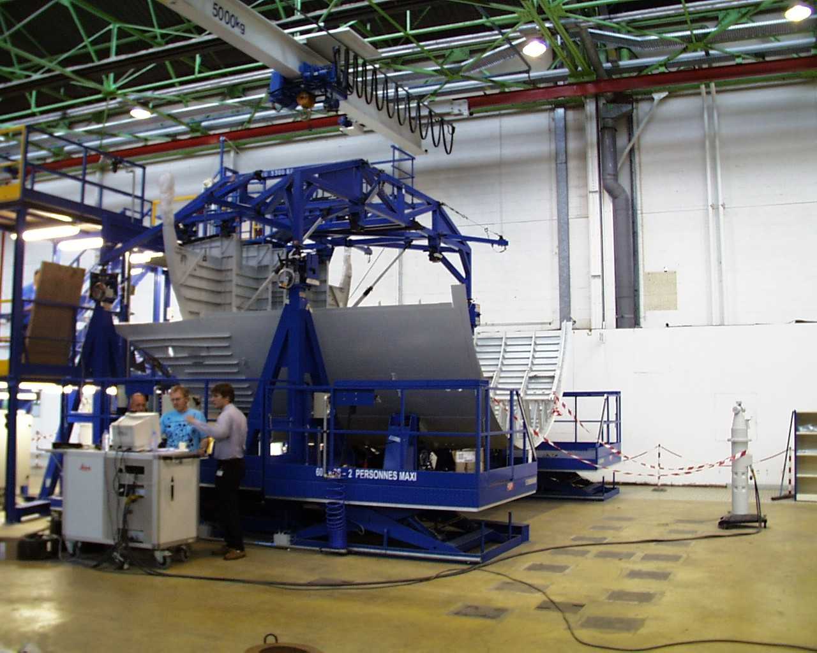
1 Introduction

Slide 6
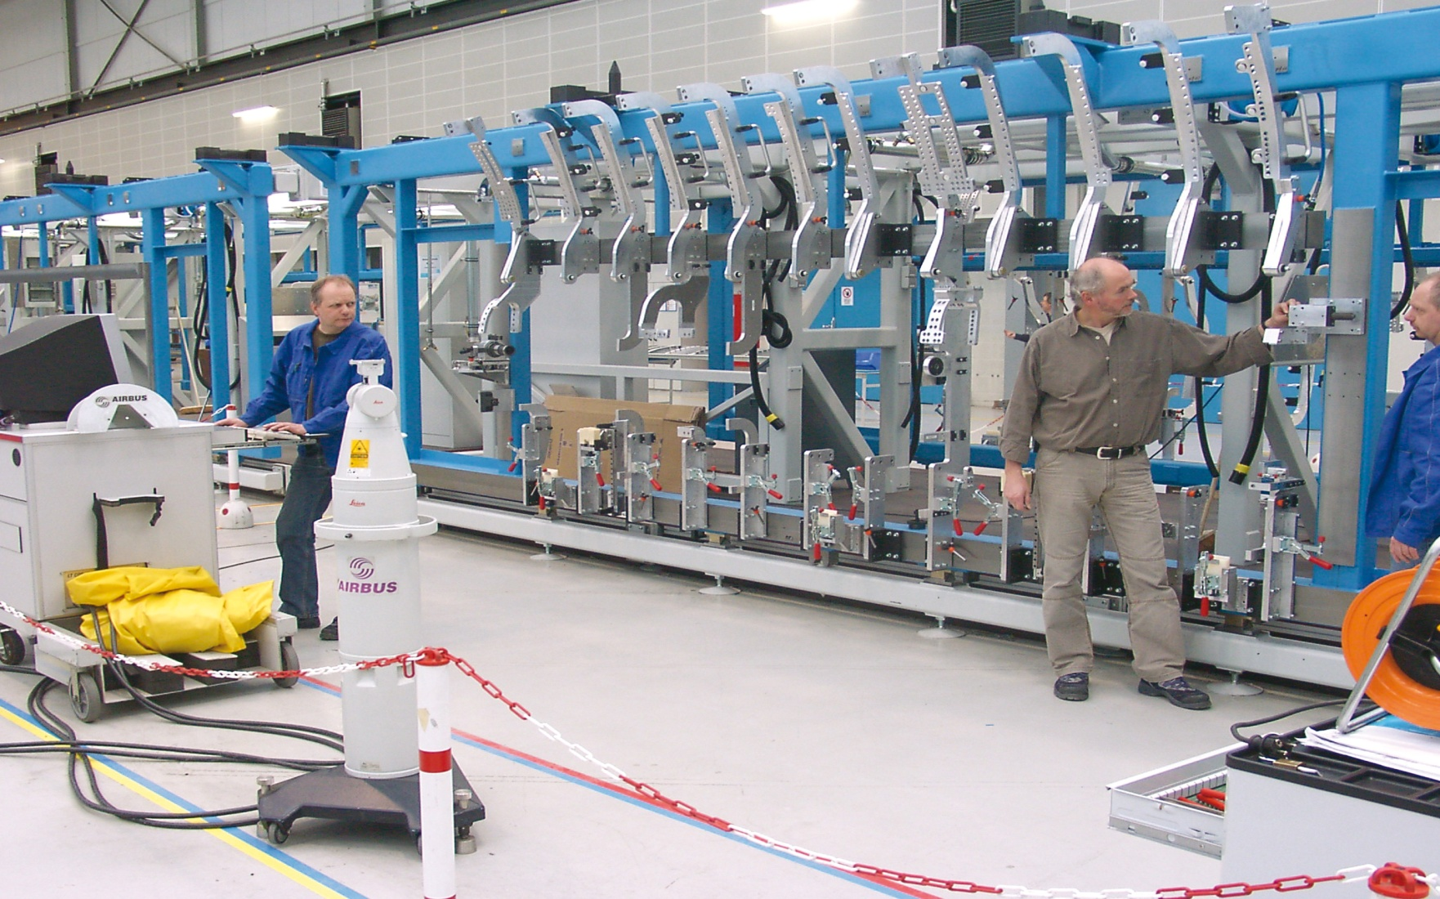
1 Introduction
Fixture measuring

Slide 7
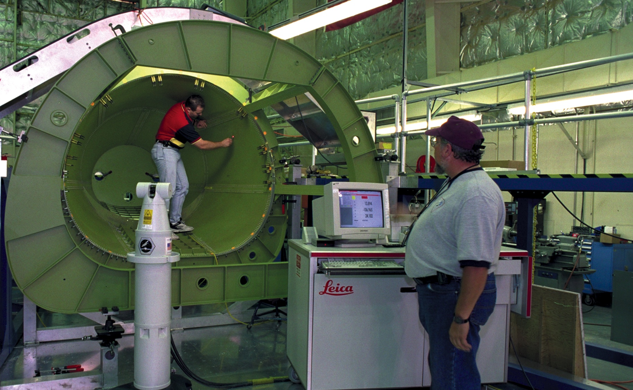
1 Introduction
Tailcone measuring of spacecraft

Slide 8
1 Introduction
Detection of car’s body

Slide 9
1 Introduction
The above cases can be measured by single station of laser tracker.
Based on observation of distance and angles, we can:
1、Calculate X, Y, and Z parameters of targets.
2、Calculate attitude parameters.
3、Reflect the space geometric information of the targets (relation between points, lines, and surfaces)
But some large scale projects, can not be measured by single station.

Slide 10
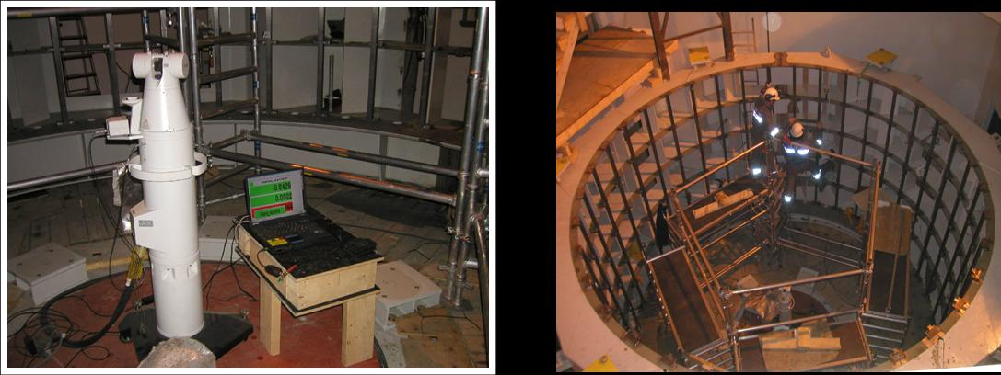
1 Introduction
Large hydropower station measuring

Slide 11
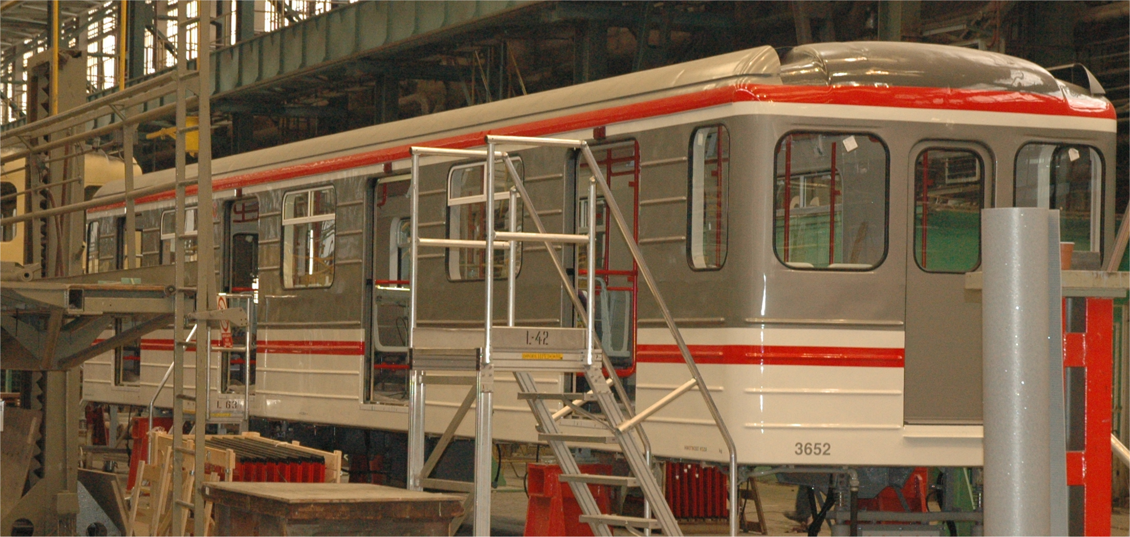
1 Introduction
Detection of production line

Slide 12
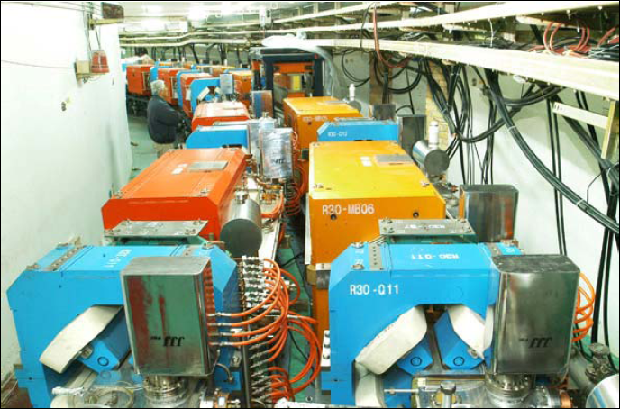
1 Introduction
Accelerator alignment

Slide 13
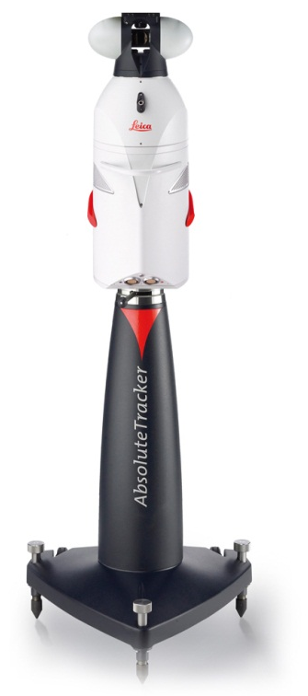
1 Introduction
To the large scale projects which can not be measured by single station, we can use the method of:
Free station and
Multi-station match (by common points)
So, we should find a method to transform the points’ coordinates of each station to a unified coordinate system.
The method is three dimensional adjustment.

Slide 14
2 Accuracy analysis of Laser Tracker

Slide 15
2 Accuracy analysis of Laser Tracker
Problem
The measuring errors of laser tracker is mainly including angle errors and distance error.
The purpose of accuracy analysis is :
Reflect the error source of laser tracker
Provide theoretical evidence for the weight of observations in 3D adjustment

Slide 16
2 Accuracy analysis of Laser Tracker
Problem
Leica AT901-B for example：
Angle accuracy：
Distance accuracy：
Coordinate accuracy：
Range：
Two problems：
(1) What is relationship between the angle accuracy expression of μm and ″？
(2) Why is the angle accuracy equal to coordinate accuracy?

Slide 17
2 Accuracy analysis of Laser Tracker
1、Angle error
（1）theoretical accuracy
The equation from μm to ″
S（m） | 1 | 5 | 10 | 20 | 30 | 40 | 50 | 60 | 70 | 80
error（″） | 4.3 | 1.9 | 1.6 | 1.4 | 1.3 | 1.3 | 1.3 | 1.3 | 1.3 | 1.3

Slide 18
2 Accuracy analysis of Laser Tracker
1、Angle error
（1）theoretical accuracy
The theoretical angle error of laser tracker, which is especially large in short distance, decreases while distance value increases.
When the distance is over 10 meters, ,and it tends to be stable.

Slide 19
2 Accuracy analysis of Laser Tracker
1、Angle error
（2）actual error by experiment——horizontal angle
layout several points around laser tracker，cover 360°horizontal range，same height with LT to avoid vertical error.

Slide 20
2 Accuracy analysis of Laser Tracker
1、Angle error
（2）actual error by experiment——horizontal angle
RMS | 0.78(0.40)
Horizontal error of each point | P1 | P2 | P3 |  | P4 | P5
 | 0.53(0.30) | 0.62(0.41) | 0.46(0.34) |  | 0.67(0.42) | 0.53(0.70)
 | P6 | P7 | P8 |  | P9 | P10
 | 0.44(0.23) | 0.69(0.63) | 0.69(0.24) |  | 0.64(0.77) | 0.61(0.18)
Single face error | Face I |  |  | 0.92(0.47)
 | Face Ⅱ |  |  | 0.77(0.59)
1）The distance from points to LT is 3.6m ~ 6.9m，in this range the theoretical error is 1.7″~ 2.1″，so the actual error is lower than theoretical .
2）The two-face error is 0.59″（leveling 0.43″），lower than face I 0.92″（0.47″）and face II 0.77″（0.59″）.

Slide 21
2 Accuracy analysis of Laser Tracker
1、Angle error
（2） actual error by experiment——vertical angle
layout several points in front of laser tracker in a vertical line on the wall，cover ±45°vertical range.

Slide 22
2 Accuracy analysis of Laser Tracker
1、Angle error
（2） actual error by experiment——vertical angle
 | theoretical （″） | Actual error （″, unleveling/leveling)） | Single face error （″, unleveling/leveling)）
 |  |  | I面 | Ⅱ面
1（48m） | 1.3 | 0.67(0.59) | 0.80(0.90) | 0.84(0.74)
2（38m） | 1.3 | 0.53(0.57) | 0.76(0.57) | 0.72(0.78)
3（28m） | 1.3 | 0.47(0.55) | 0.57(0.56) | 0.54(0.77)
4（18m） | 1.4 | 0.53(0.41) | 0.64(0.54) | 0.67(0.55)
5（10m） | 1.5 | 0.50(0.42) | 0.73(0.54) | 0.64(0.54)
1）The two-face vertical error is 0.52″，while single face error is 0.67″（I）and 0.68″（Ⅱ）. Both are lower than theoretical value and two-face error is lower than single face.
2）its nearly the same accuracy between face I and face II.

Slide 23
2 Accuracy analysis of Laser Tracker
1、Angle error
（3） actual error by experiment——coordinates
in space(7m×5m×3m)，layout 11 points，two stations of AT901:
observations from single face I and II.

Slide 24
2 Accuracy analysis of Laser Tracker
2、distance error
Distance accuracy of AT901：
distance(m) | 1 | 5 | 10 | 20 | 30 | 40 | 50
angle error(μm) | 21 | 45 | 75 | 135 | 195 | 255 | 315
distance error(μm) | 0.5 | 2.5 | 5 | 10 | 10 | 10 | 10

Slide 25
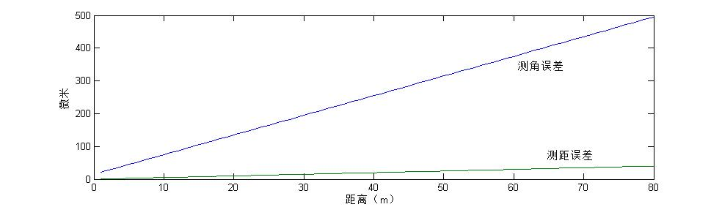
2 Accuracy analysis of Laser Tracker
2、distance error
conclusion：
Based on the comparison of angle error and distance error, we can get the conclusion that:
the angle error is the main part of LT measuring errors, and it can be reduced by two-face observation.
So it explains the equation

Slide 26
3 Three dimensional adjustment

Slide 27
3 Three dimensional adjustment
1、Modeling
each single coordinate system transform to unified coordinate system：

Slide 28
3 Three dimensional adjustment
1、Modeling
the relationship between observations and coordinates：

Slide 29
3 Three dimensional adjustment
2、parameters estimation
Based on the coordinate transformation：
3、observations’ weight decision
1）experiential methods
2）component of variance model
Calculate equations：
Terminate condition of iteration:

Slide 30
4 Example and application

Slide 31
4 Example and application
1、Application
The total length of a new production line in BAOSTEEL is more than 500 m, about 10m wide, and in order to install production equipment, it is necessary to establish high control network.

Slide 32
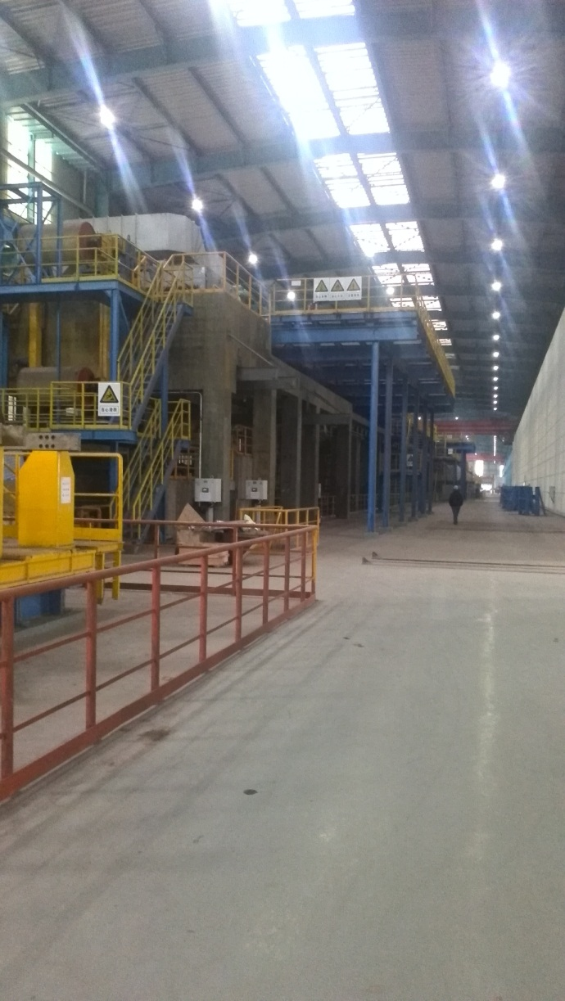
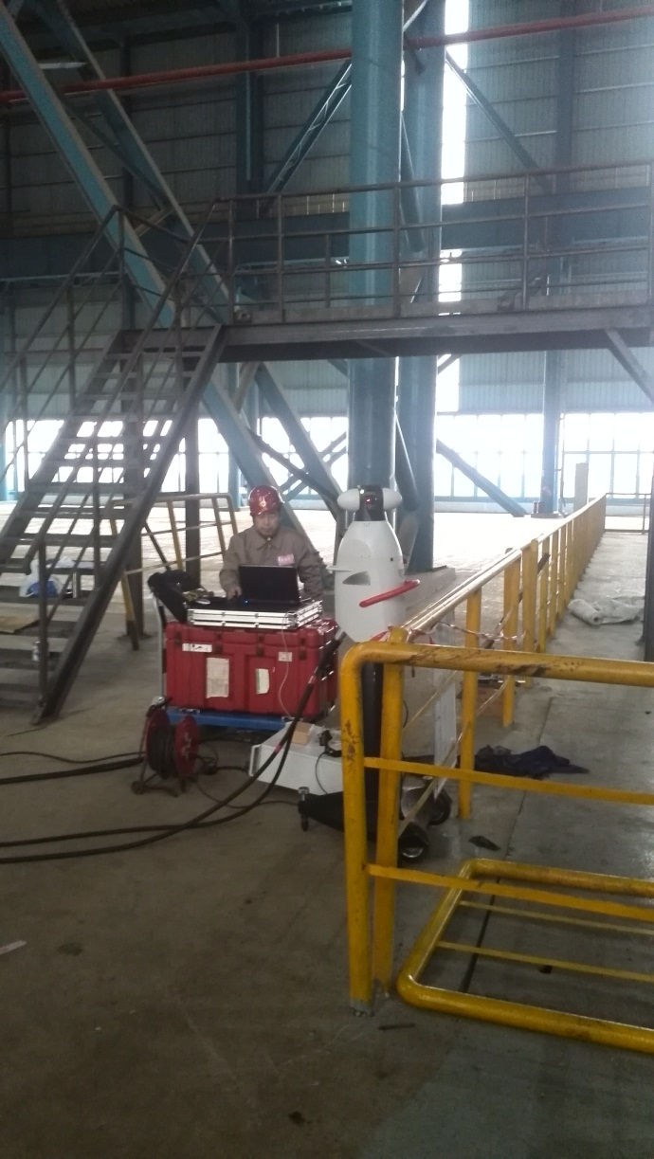
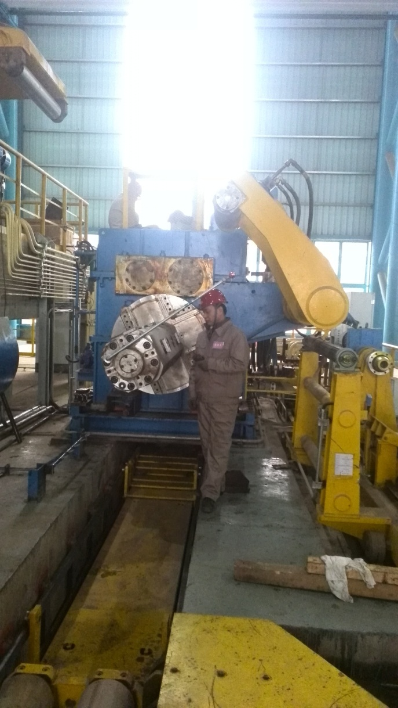
4 Example and application
Measuring on site

Slide 33
4 Example and application
Control network survey
（1）Instrument: Leica AT901-B，CCR1.5″ reflector，72 control points(G1~G72).
（2）In order to control the error accumulation of multi-station method, the measuring began from middle to both sides, and the coordinate system of first station was suggested for unified system after adjustment。

Slide 34
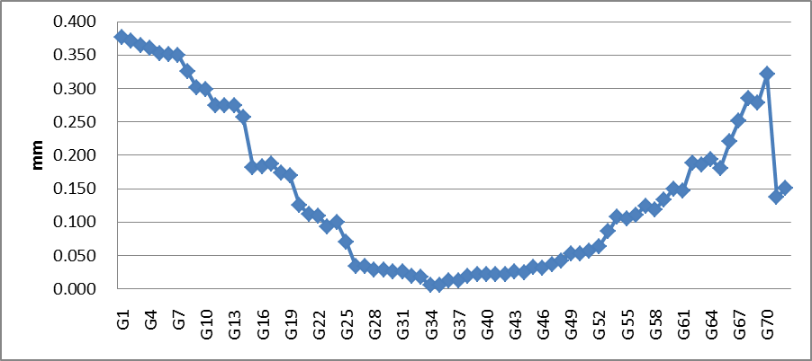
4 Example and application
2、 data processing
Coordinate error
After 3D adjustment, according to the calculation, the length of production line was 488m, and there were 72 control points which were used for adjustment. The RMS of point coordinate is 0.185mm, and the maximum is 0.377mm.

Slide 35
4 Example and application
2、data processing
Axis errors
(1)The error of each axis is gradually accumulated from center to sides.
(2) The accuracy of XY plane is 0.076mm,while the accuracy of Z axis is 0.167mm,so the error of Z axis is higher than X axis and Y axis apparently.
(3)The deviation between each axis is enlarging sharply with the increasing of stations and length.

Slide 36
5 Summary

Slide 37
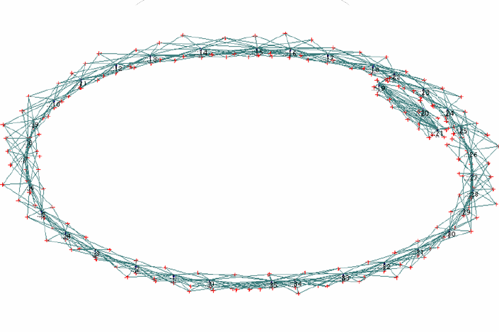
5 Summary
1、The error of X axis is lower than Y axis, because the network is too narrow in Y axis ,so that the stability of network in X axis is better than Y.
Method: Add length constraints in Y direction to improve accuracy

Slide 38
5 Summary
2、The accumulated error in Z axis is larger than X axis and Y axis, because of the influence of vertical error. So leveling data can be considered for adjustment in the 3D model together for restraining accumulated errors in Z axis.
principle of middle method by total station
equation of elevation between two points：
condition equation：

Slide 39
Thanks for your attention!

