Slide 1
superKEKB main ring tunnel motion
M. Masuzawa, T. Adachi, H. Iinuma, T. Kawamoto and Y. Ohsawa, KEK Tsukuba, Japan

Slide 2
Contents
Introduction
SuperKEKB Main Ring
Construction of the new facility buildings & BT line
Effects of the facility buildings seen by DNA03 survey
Effects of the new Beam line monitored by HLS
GPS data
Other SuperKEKB activities
Summary

Slide 3
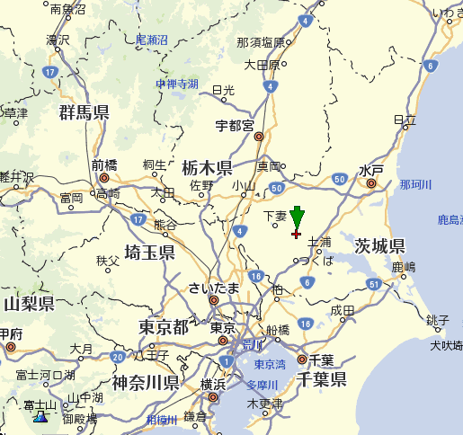
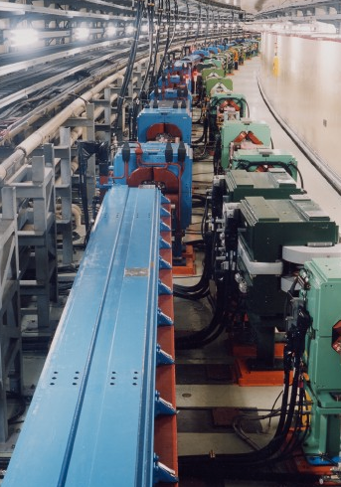
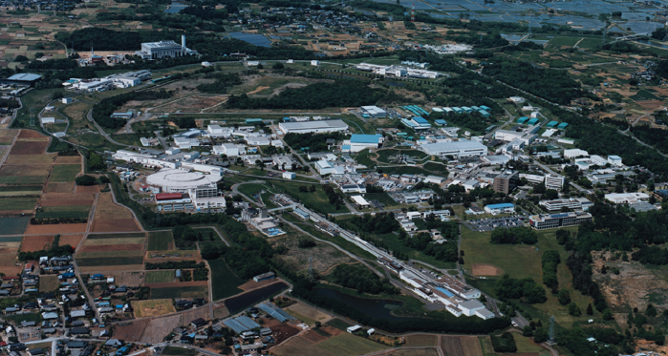
SuperKEKB Main Ring
KEK
The tunnel was originally built for
TRISTAN (1986~1995)
And then reused for
➔KEKB (1998~2010,ended before the big earthquake.)
And again for
➔:SuperKEKB (under construction)
TOKYO
Mt.Fuji
7 GeV electron
4 GeV positron
3 km ring
11 m below GL
Double ring
Side by side
LINAC

Slide 4
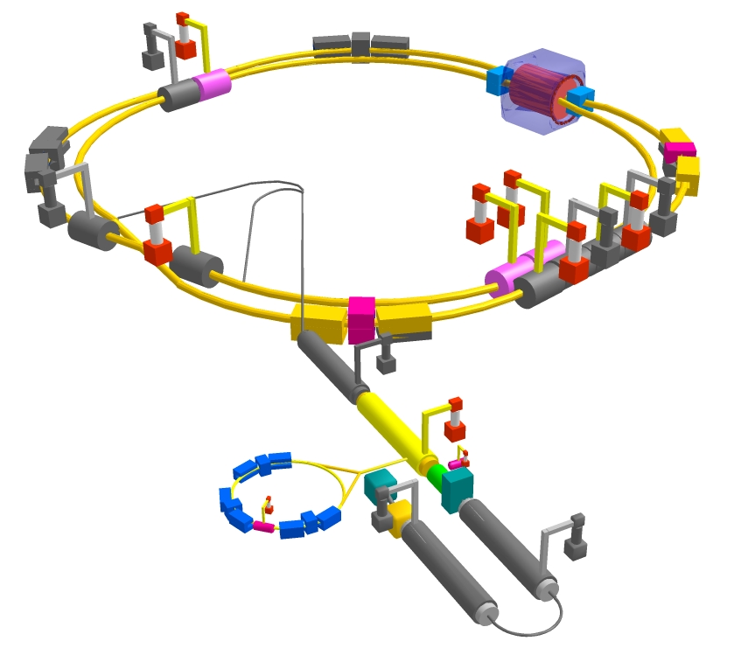
SuperKEKB Main Ring
To collide σ_{y} = 60 nanometer beams, precise magnet alignment is needed.
IR
& stable environment
Temperature
Tunnel motion …
1st beam circulation is expected to be sometime late next year.
Construction everywhere
not only in the tunnel but also above the tunnel… (next page)

Slide 5
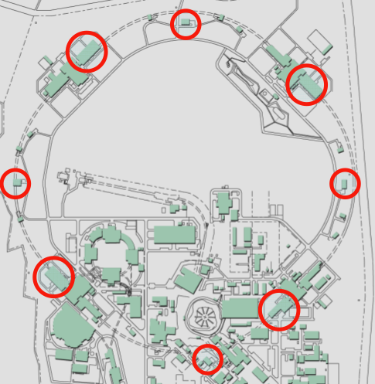
Construction of the new facility buildings & beam transport line
# of magnets is increased by 20 % for SuperKEKB.
Cooling water for magnets:
4 pump systems for KEKB, each ~3600 l/min. They were operated at ~100% capacity level.
The PS buildings are already very crowded.
We requested additional space & power distribution facilities.
new
GOOD NEWS
➔4 new pump systems and 4 power buildings for power supplies are being built.
BAD NEWS
➔Construction takes place at the same time as the survey and 1st round alignment work in the tunnel.

Slide 6
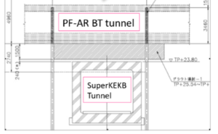
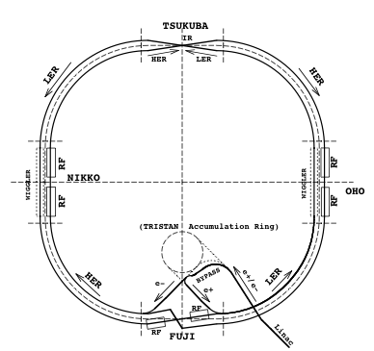
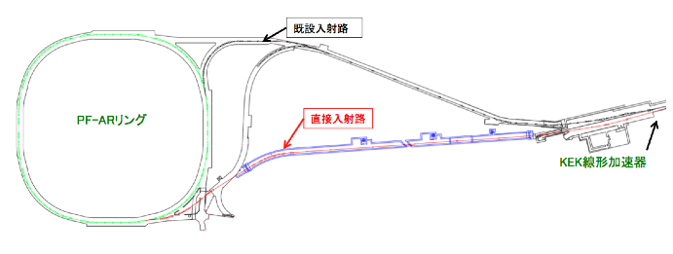
Construction of the new facility buildings & beam transport line
This is how two tunnels cross
(vertically)
2.74 m
New beam transport line to the PF-AR
(Photon Factory Advanced Ring)
LINAC
BAD NEWS
➔Construction takes place at the same time as the survey and 1st round alignment work in the tunnel.

Slide 7
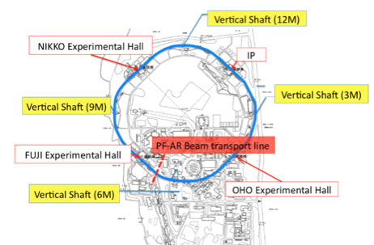
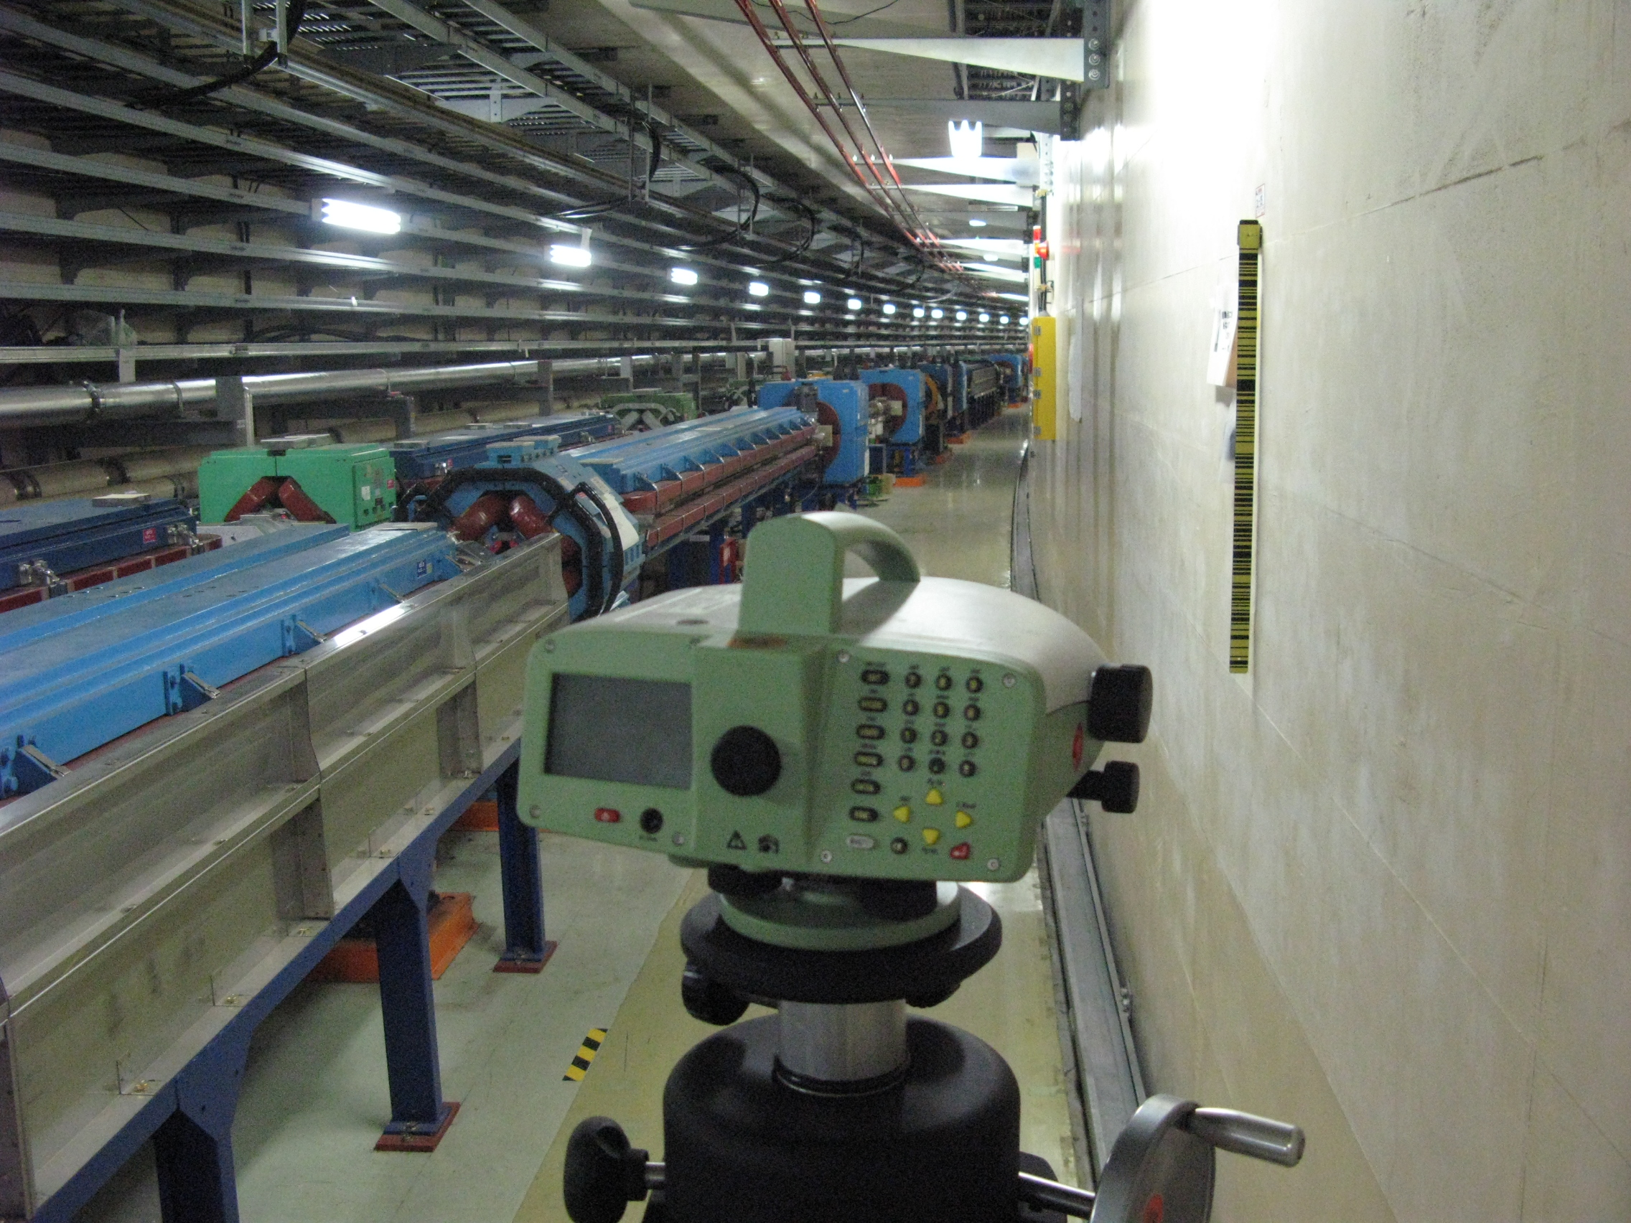
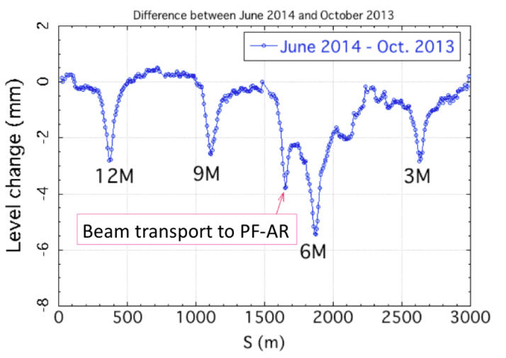
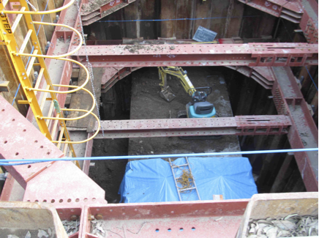
Effects of the facility buildings seen by level survey with DNA03
Δ Level between Oct.2013 and June 2014
IP
IP
Vertical shaft at the 12M site. Ground water removal is carried out by turbine pumps (deep well method).

Slide 8
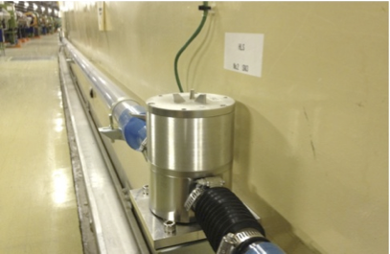
Effects of the new BT line to the PF-AR monitored by HLS
One tunnel block unit
Expansion joints
(every ~60-70m)
19 HLS units

Slide 9
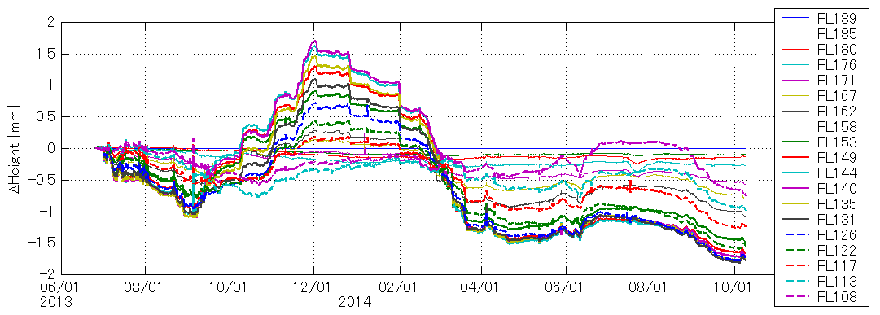
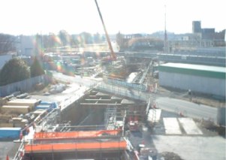
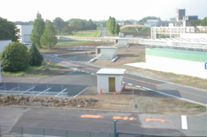
Effects of the new BT line to the PF-AR monitored by HLS
Spikes are
either earthquakes
or pile drilling.
today
Still sinking, why??
Dec. 2013: Removal of the soil
May 2014: Refilling of the soil

Slide 10
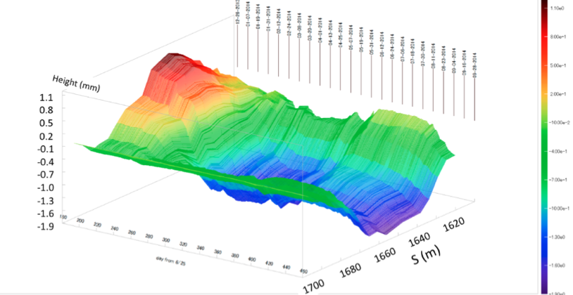
Effects of the new BT line to the PF-AR monitored by HLS
This tunnel block unit has been deformed.
No indication of recovery is seen.

Slide 11
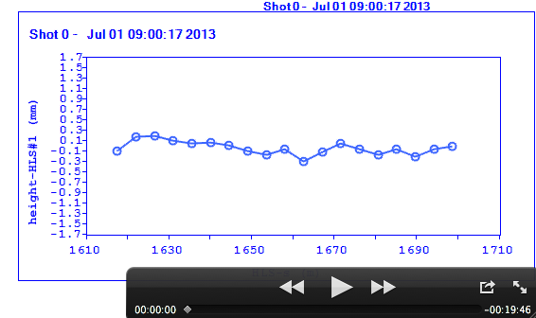
Effects of the new BT line to the PF-AR monitored by HLS

Slide 12
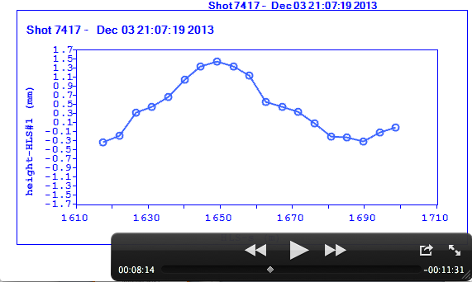
Effects of the new BT line to the PF-AR monitored by HLS
This is when we did the 1st round alignment of this section, mainly to smooth out misalignment caused by the big earthquake but…

Slide 13
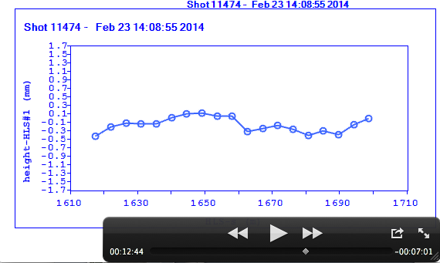
Effects of the new BT line to the PF-AR monitored by HLS

Slide 14
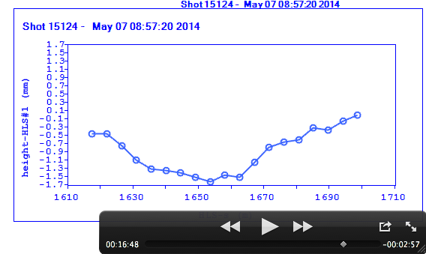
Effects of the new BT line to the PF-AR monitored by HLS

Slide 15
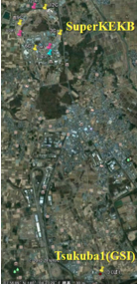
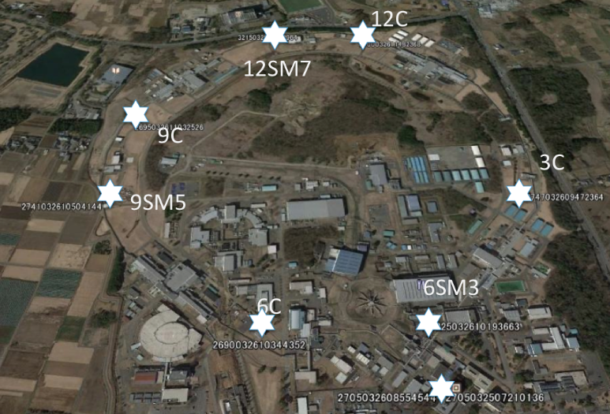
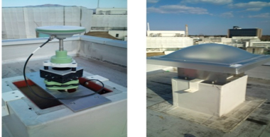
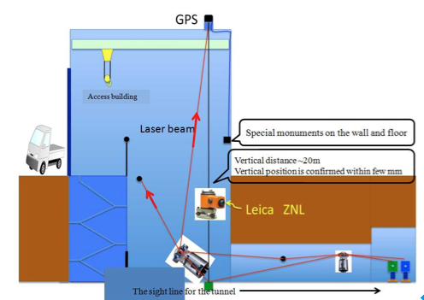
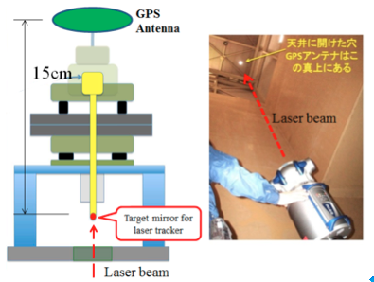
GPS data
~5 km
IP
The coordinates of the seven GPS antennas are obtained using one of the GPS-based control stations, Tsukuba-1, at the Geographical Survey Institute (GSI).
A GPS network system was installed in 2012, after the Great East Japan Earthquake struck Japan in 2011:
(1) to connect the tunnel survey network to the surface network
(2) to monitor long-term ground and building motion.
7 GPS antennas (Leica, GS10) are placed on the roofs of buildings called, going clockwise from near the IP: 3C, 6SM3, 6C, 9SM5, 9C, 12SM7 and 12C.

Slide 16
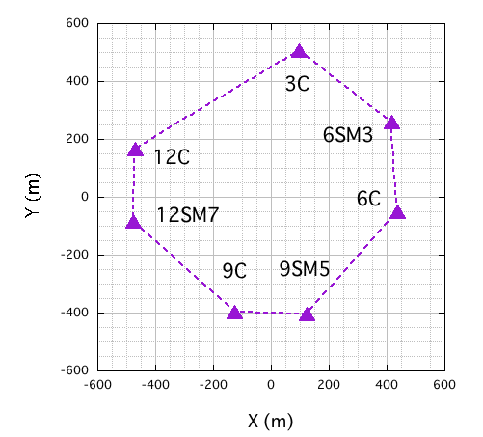
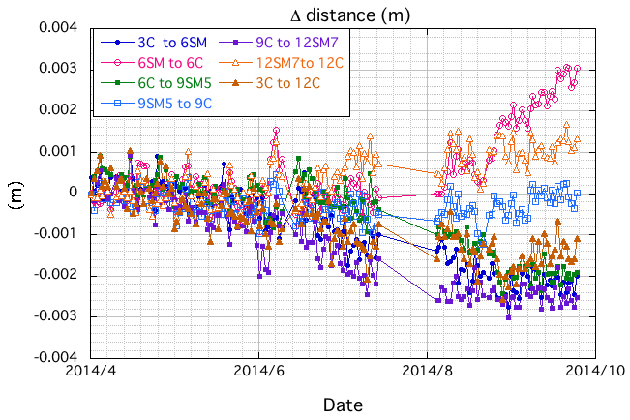
GPS data
Each side of the heptagon
Missing data, trying to recover.

Slide 17
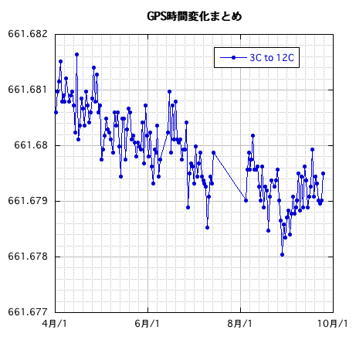
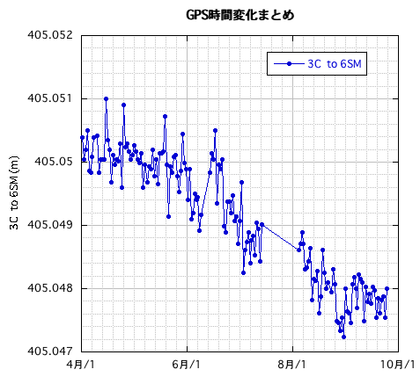
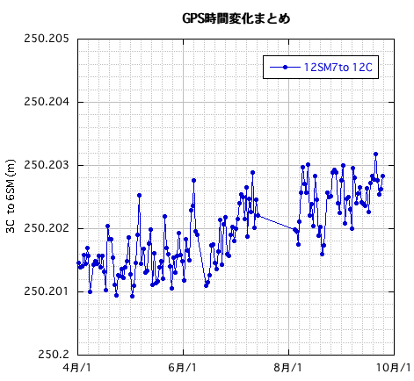
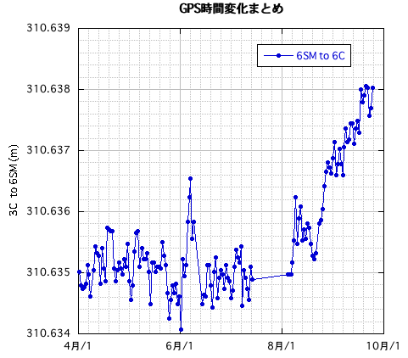
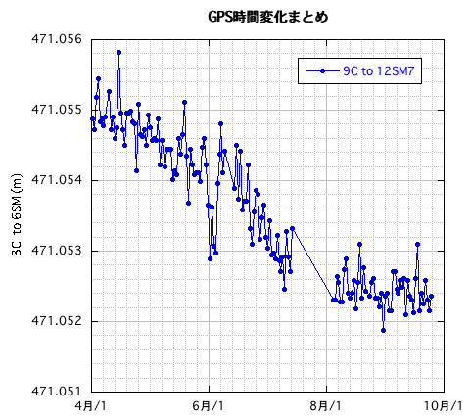
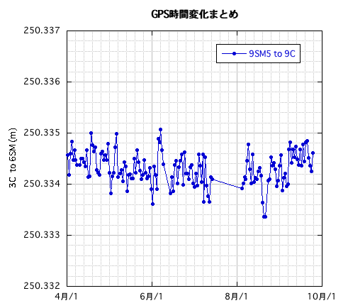
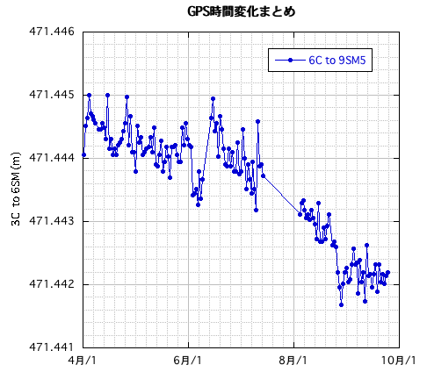
Δ slope distances
5 mm

Slide 18
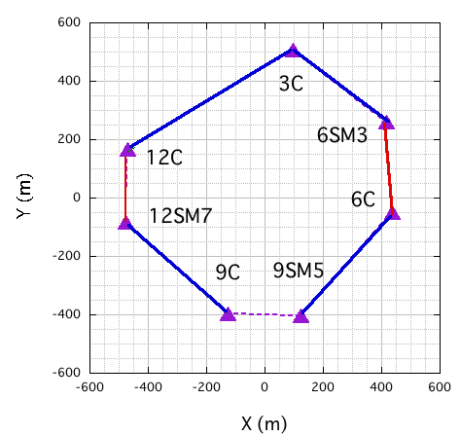
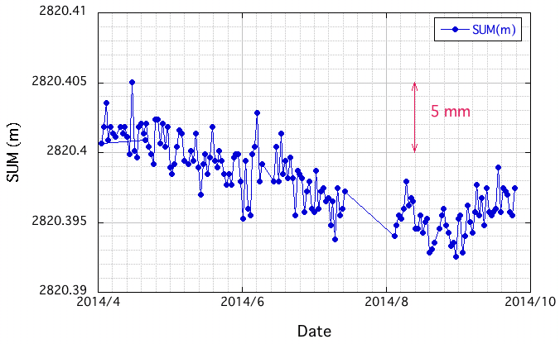
Δ sum of slope distances
Distance became
Longer (red)
Shorter (blue)
Unchanged (dotted purple)

Slide 19
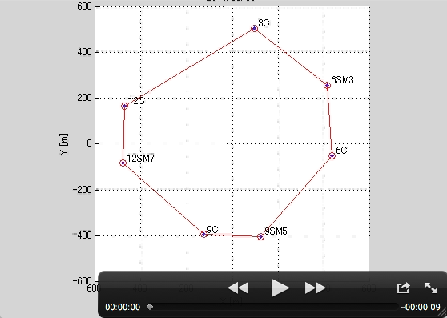
GPS data
Slope distances observed by the GPS antennas

Slide 20
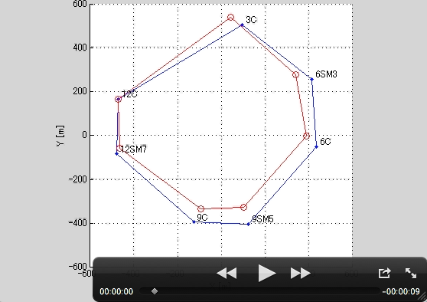
GPS data
Slope distances observed by the GPS antennas

Slide 21
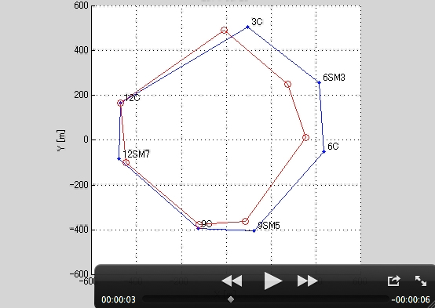
GPS data
Slope distances observed by the GPS antennas

Slide 22
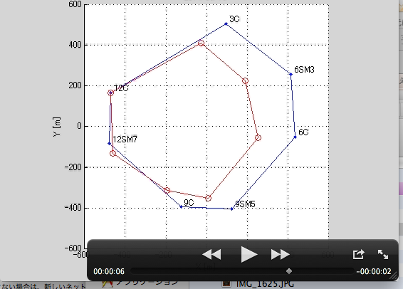
GPS data
Slope distances observed by the GPS antennas

Slide 23
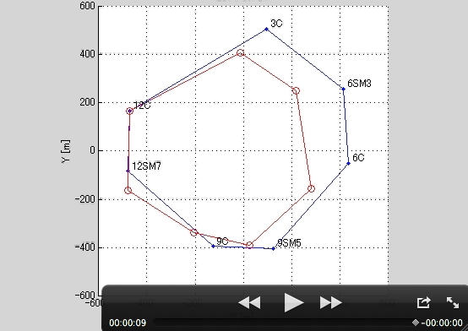
GPS data
Slope distances observed by the GPS antennas

Slide 24
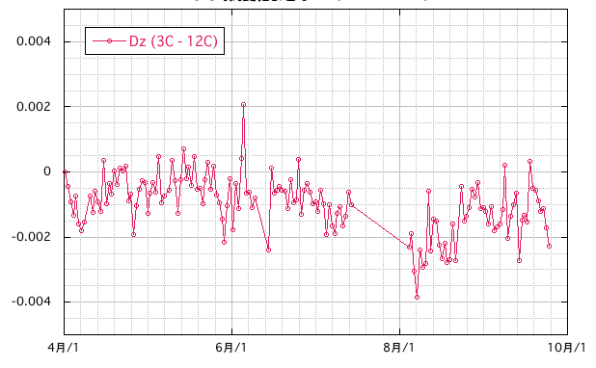
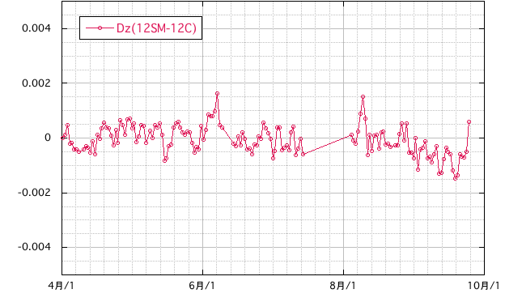
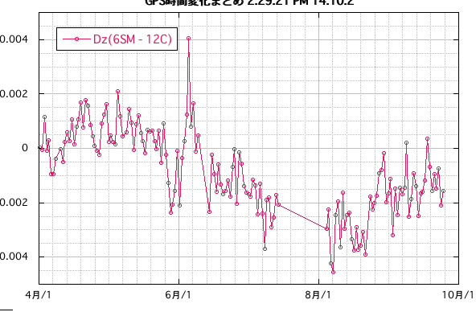
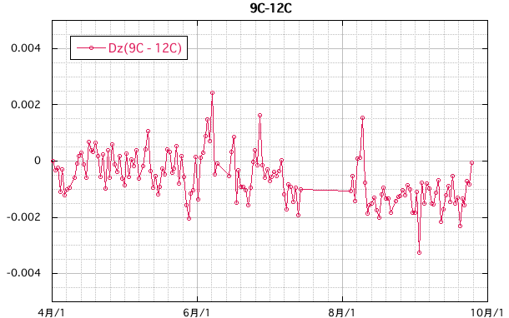
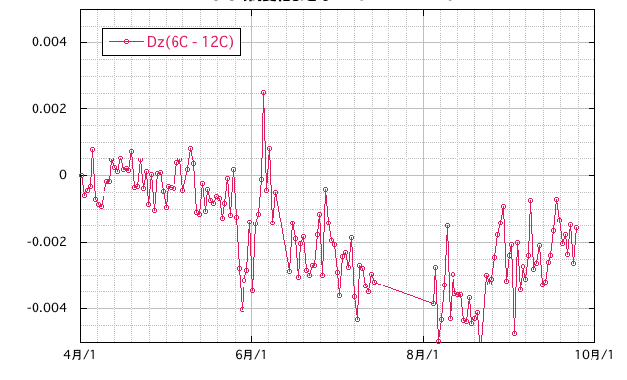
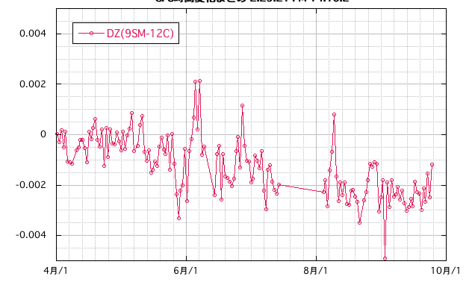
GPS data
level
w.r.t. 12C antenna
Sinking?

Slide 25
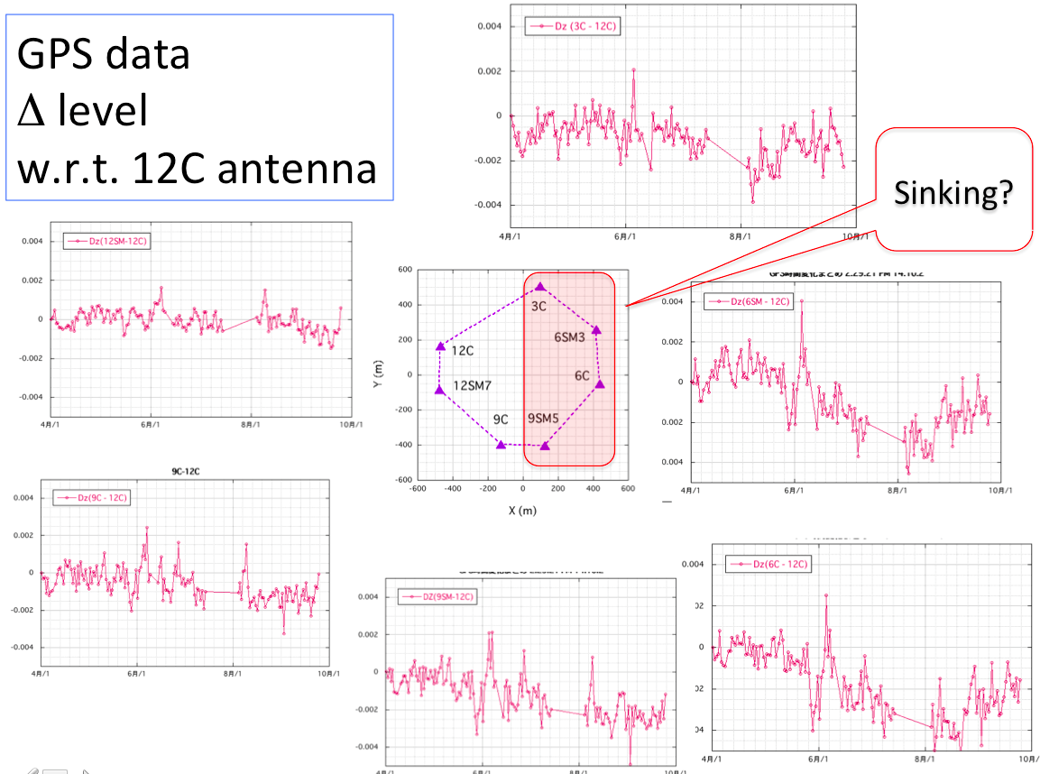
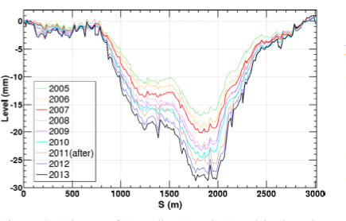
GPS data
It is probably too early to say this has some connections to the yearly sinking of the south part of the SuperKEKB tunnel.
But it could be related.
Further investigation will be carried out.

Slide 26
Other SuperKEKB activities
Large angle precision tilting tables for 24 sextupole magnets (R. Sugahara et al)
Self-leveling floor for the movable table at the IP (H.Yamaoka et al)
Ryuhei Sugahara, still active.
Stretched hair cross wires, which indicates the magnet center.

Slide 27
Summary
Effects of the construction of new facility buildings along the SuperKEKB tunnel were observed by surveying the tunnel level markers using a DNA03➔As large as ~6 mm over 8 months.
Continuous monitoring of tunnel level variation is carried out in the south arc section of the SuperKEKB tunnel, the area where the new beam transport tunnel is excavated, by 19 HLS units.
Correlation between tunnel motion and the type of construction work (excavating, refilling and so on) is seen.
Re-alignment of the magnets is obviously needed, the timing of the final alignment is crucial. We may have a conflict between the construction schedule and the optimal timing for alignment.
We hope to increase the number of HLS units to cover a wider area of the SuperKEKB tunnel as the effects of such construction is large.

Slide 28
Test of Balluff capacitive sensor Seeking the possibility to get more (less expensive)HLS units to cover larger area
Many thanks to Dominique, Helene and Andrea (CERN)

Slide 29
Summary
Recent GPS data obtained using 7 GPS antennas along the SuperKEKB tunnel are presented.
GPS data are stable enough to see a variation of a few millimeters when a daily average is taken.
The GPS data indicate a drift of the tunnel circumference and level change, though further investigation is needed.
We may have a conflict between the construction schedule and the optimal timing for alignment.
謝々

