Slide 1
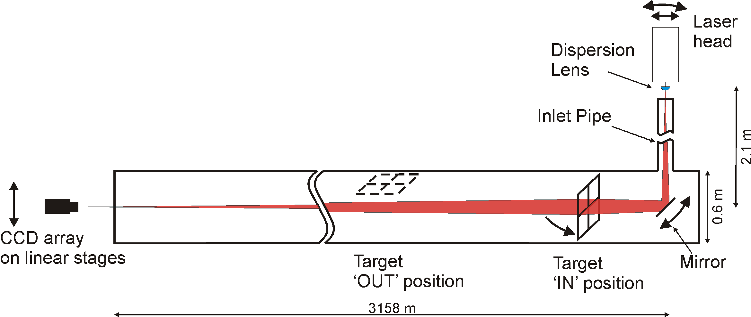
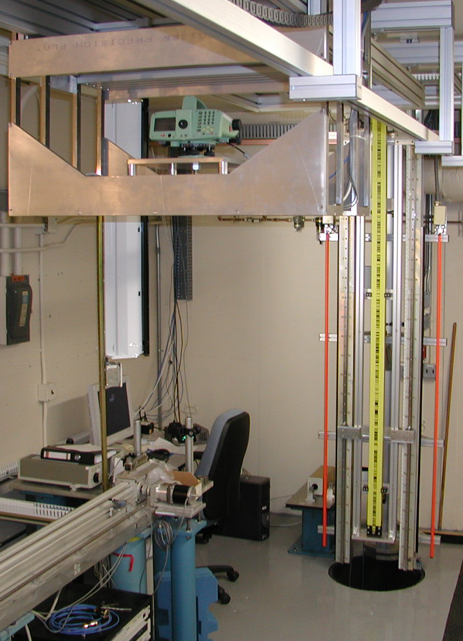
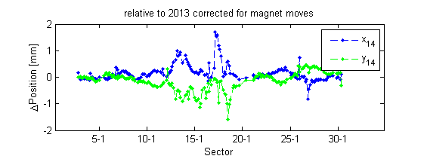
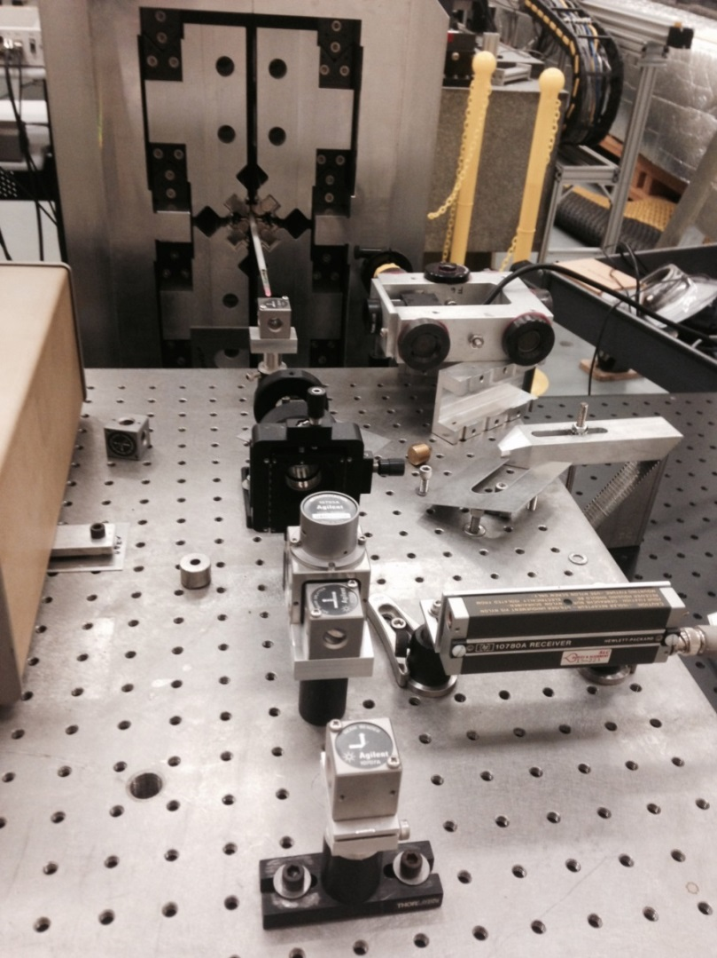
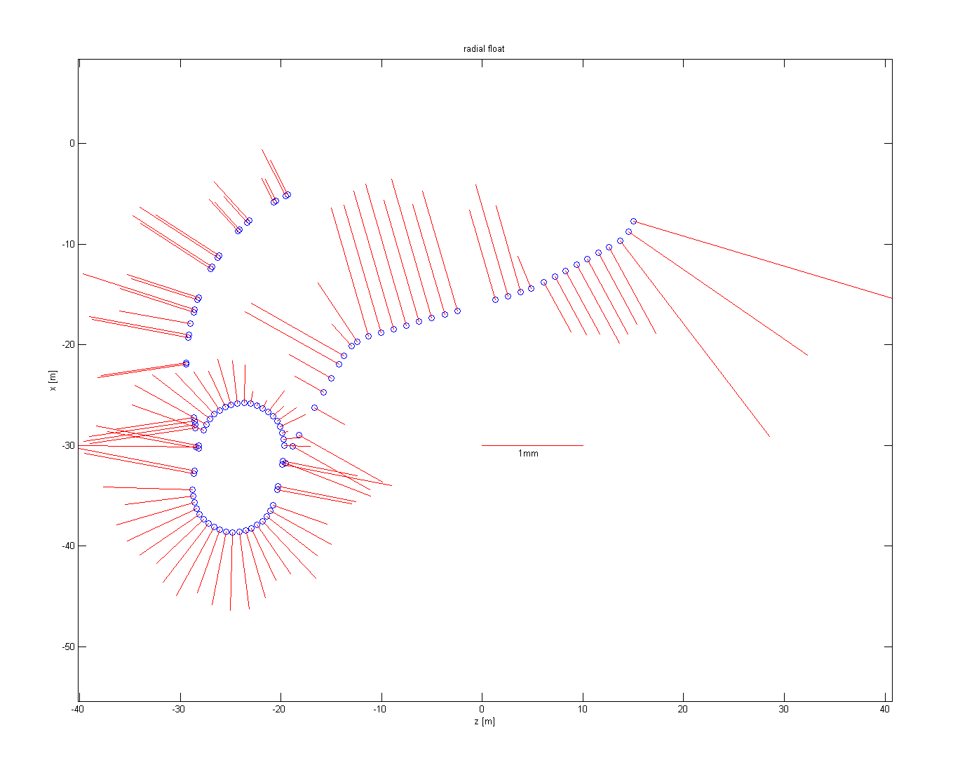
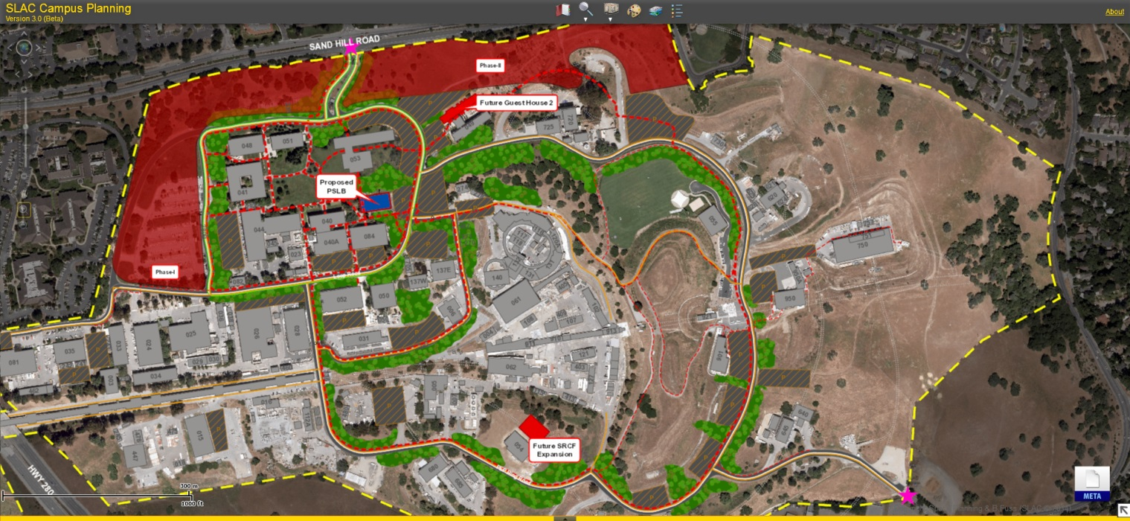
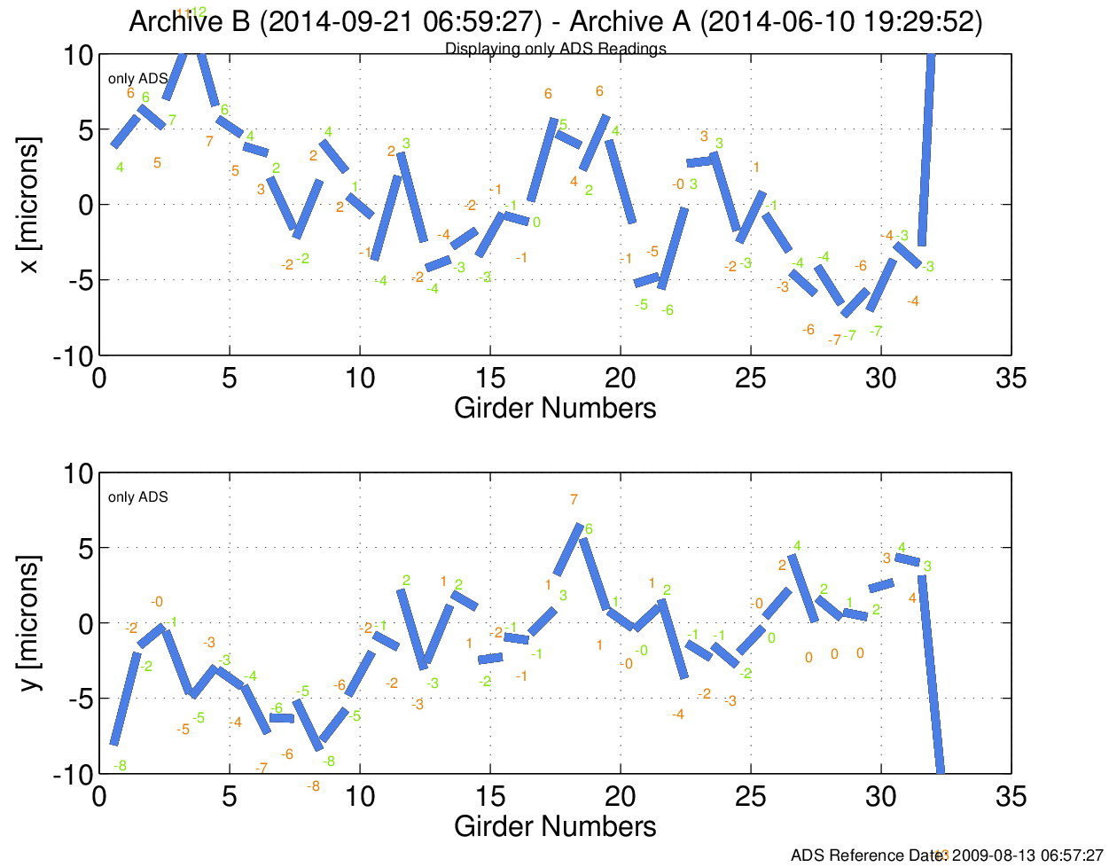
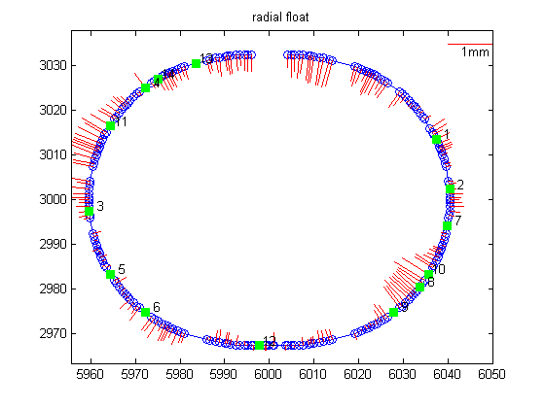
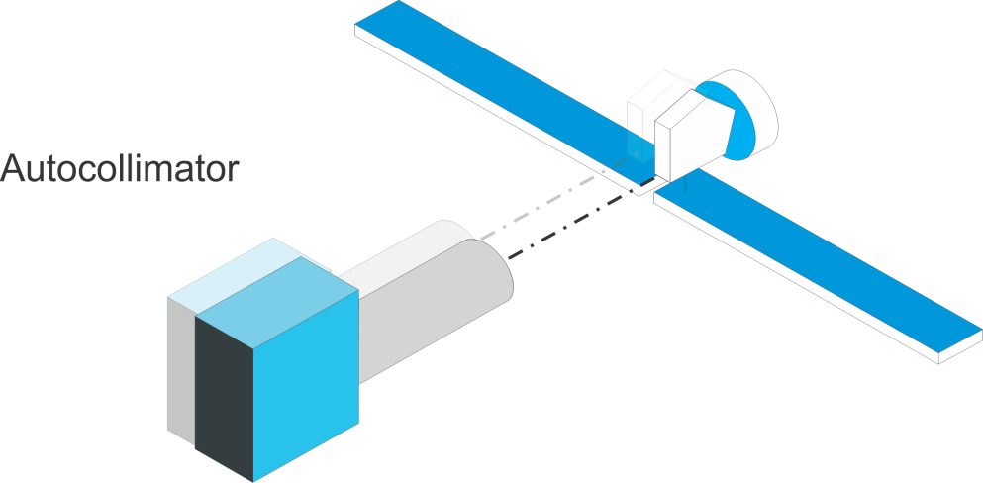
SLAC Status Report 2014
Georg Gassner, Robert Ruland
Sector 0
Geodetic Laboratory
After the 2014 South Napa earthquake, the Alignment Group was tasked to check the alignment of the linac. The linac laser alignment system is perfectly suited for this purpose, as measurements could be taken for the entire 3km linac within 8hours. It was confirmed that the movements were within the expected range for movements over a one year period.
The Geodetic Laboratory at Sector 10 along the linac is situated in an old access tunnel with highly stable temperatures and stable walls. It is used for a variety of tasks from routine calibration runs of leveling equipment and distance meters to HLS sensor calibration. Laser tracker distance and angle measurement calibration tests are carried out as well as general acceptance tests performed after instruments are shipped across the country for maintenance.
A setup to determine the thermal coefficient of expansion of leveling rods has been developed. Two first-article rods have been measured successfully.
For the measurement of a variable gap on the LCLS-II undulators we are currently investigating an absolute distance multiline system from Etalon.
The LCLS-II project consists of a new gun, a new superconducting linac, and new variable gap undulators. Civil construction will be at a minimum, and existing tunnels will be reused.
We support the projects by designing the different alignment networks, as-built measurements and vibration measurements. For the undulators we are investigating an absolute multiline system to monitor and reproduce the gap between the undulator jaws.
Tube Laser Alignment System
For magnetic measurements of a delta undulator, the position of a Hall probe has to be known to a few tens of micrometers. The hall probe is inserted through a 3.2m long 4.8mm diameter vacuum chamber. To localize the probe while being pushed through the vacuum chamber, a dedicated laser alignment system is under development. The system is based on an interferometer laser which is narrowed down to a 3mm beam and a retroreflector at the end of the hall probe package. The laser beam travels through the vacuum chamber, reflects off of the retroreflector back out through the vacuum chamber where it is projected 90 degrees onto a CCD camera. The image on the CCD camera is used to determine the position of the retroreflector normal to the tube axis.
NEH
FEH
4 GeV SC Linac
In sectors 0-10
14 GeV LCLS linac still used
for x-rays up to 25 keV
North side source:
0.2-1.3 keV (≥ 100kHz)
South side source:
1.0 - 25 keV (120 Hz, copper” linac )
1.0 - 5 keV (≥100 kHz, SC Linac)
Mirror
Laser Head
Interferometer
Retroreflector
Hall Probe
Facility for Advanced aCcelerator Experimental Tests
FACET uses part of SLAC's two-mile-long linear accelerator to generate high-density beams of electrons and their antimatter counterparts, positrons. This produces large electric and magnetic fields in a very short time - ideal for creating exotic states of matter and researching advanced accelerator technologies.
The facility is in its 3rd year of operation, the latest addition was the restart of positron production, for this the south damping ring was completely mapped and re-aligned.
Mirror
Focusing
Lenses
Beam Splitter
Vacuum Tube (Ø4.8mm, length=3.2m)
Receiver
CCD Camera
GIS
GIS at SLAC continues to be used for supporting various site activities ranging from visualizing alignment data, facilities space planning, utility management, asset inventories as well as emergency support in terms of evacuation maps, pre-incident planning for buildings, fire mitigation with grass maps, power supply, and hydrant and extinguisher maps. The system is tied in with SLAC’s enterprise Oracle database allowing for interactive websites based on SLAC’s buildings and personnel data. The GIS was recently used as an integral part of SLAC’s long-range planning, providing many layers of data showing current and future layouts of the site.
A substantial task of reconfiguring the webpages onto a new enterprise server are ongoing, as the main web interface of Adobe Flex is being deprecated. The existing GIS webpages based on Adobe Flex will need to be rebuilt using JavaScript as the new development environment.
Linac Coherent Light Source Machine
The alignment network has been re-measured several times to correct for a shrinking tunnel. The data were analysed including a set of stretched wire measurements from the BTH through the undulator hall.
One of the more involved alignment tasks was to align the SXRSS (Soft X-Ray Self Seeding Project). The goal was to align a series of mirrors and gratings to within a few microradians without touching them. To do this, optical tooling was used to determine their translation and a laser beam was used to determine their orientation within a few arc seconds.
More details in: G. Gassner, Laser beam trajectory measurement with a CCD camera
Linac Coherent Light Source Experiments
The LCLS I is now at the beginning of its 10th user run. All experimental hutches have been updated and are user operated. Experiments change constantly and require the alignment group to adapt from electron beam alignment to laser beam alignment. One of the more challenging tasks was relative alignment of mirrors parallel to each other to better than a few microradians.
Alignment Diagnostic System (ADS)
The undulator spans a distance of 132 meters and is structured into 33 girders. Each girder is equipped with four hydrostatic leveling sensors and four wire position monitors, part of the ADS. The ADS uses these sensor readings to provide relative position information for all girders with respect to each other. The system has been in continuous operation since 2009.
SPEAR3 ring was completely re-aligned to new nominal positions correcting for long term floor movements. This resulted in an 2.3 mm larger circumference for the ring than originally designed.
Stanford Synchrotron Radiation Light Source
Since the SPEAR ring is built on unstable soil, an HLS system has been installed in the ring and on several beam lines. Based on the results of the HLS measurements it was decided to insulate walls and ceilings of selected areas around the ring to reduce floor movements.
During the 2014 machine shut down, the
Acknowledgments
We would like to thank our colleagues Brian Fuss, Francis Gaudreault, Michael Gaydosh, Levirt Griffin, Hans Imfeld, Franz Peters, Michael Rogers and Bryan Rutledge.
Work supported by Department of Energy contract DE-AC02-76SF00515

