Slide 1
Alignment of Insertion Device at Siam Photon Source
The 13th IWAA2014 October 13-17,2014
IHEP, Beijing, China
S. Srichan, A. Kwankasem, V. Sooksrimuang, M. Sophon, S. Klinkhieo
P. Klysubun
Synchrotron Light Research Institute(SLRI)
THAILAND
Synchrotron Light Research Institute (Public Organization)

Slide 2
Outline
Introduction
Installation and alignment of a 6.5 T superconducting wavelength shifter (SWLS)
Installation and alignment of a 2.4 T multipole wiggler (MPW)
Conclusion
Synchrotron Light Research Institute (Public Organization)

Slide 3
Siam Photon Source (SPS)
Siam Photon Source (SPS) is a dedicated 1.2-GeV synchrotron light source operated by the Synchrotron Light Research Institute (SLRI), and is located in Suranaree University of Tecchnology campus, Nakhon Ratchasima (~ 250 km northeast of Bangkok), Thailand.
Synchrotron Light Research Institute (Public Organization)

Slide 4
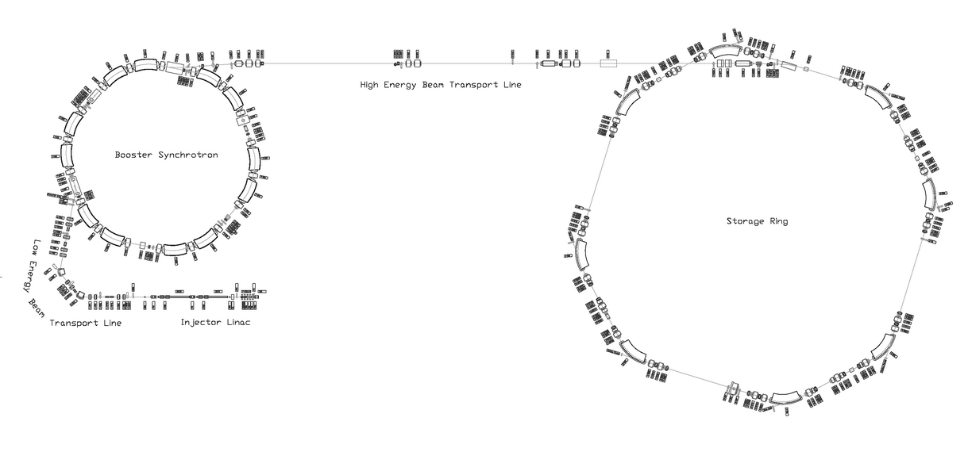
Components of the Siam Photon Source
1.0 GeV
Layout of the SPS
1.2 GeV
Machine components
2 20-MeV injector linacs
Low-energy electron transport line
1.0-GeV booster synchrotron
High-energy electron transport line
1.2-GeV electron storage ring
The beam is injected to the storage ring from a 1.0-GeV booster synchrotron, and then ramped up to 1.2 GeV in the storage ring.
Synchrotron Light Research Institute (Public Organization)

Slide 5
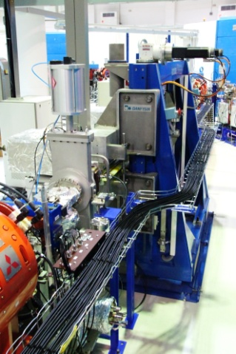
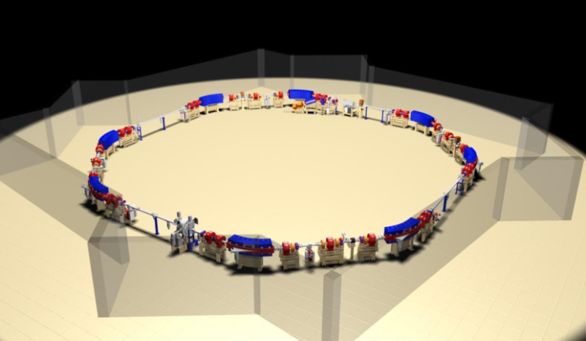
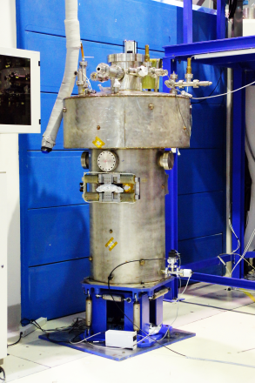
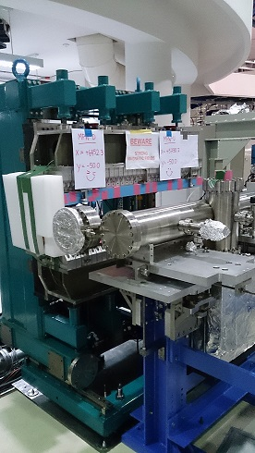
Insertion Devices
U60 permanent magnet planar undulator
(Hallback-type) 0.5467 T (g = 26.5 mm)
60 mm-period length, 41 periods
SPS electron storage ring
1.2 GeV storage ring
Double bend achromatic (DBA) lattice
81.3 m circumference
4 7-m straight sections
6.5T superconducting WLS from NSRRC, Taiwan
3 poles
Lhe consumption rate <2 L/hr
2.4T normal-conducting multipole wiggler
from ASTeC, United Kingdom
9 full strength poles
Synchrotron Light Research Institute (Public Organization)

Slide 6
SPS machine shutdown on August-September, 2013
6.5 T superconducting wavelength shifter installation
2.4 T multipole wiggler installation
Synchrotron Light Research Institute (Public Organization)

Slide 7
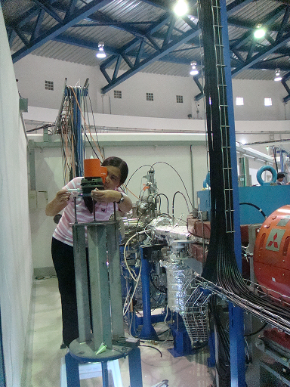
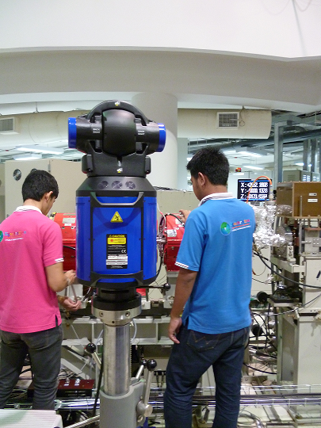
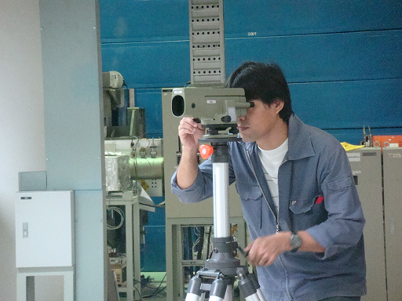
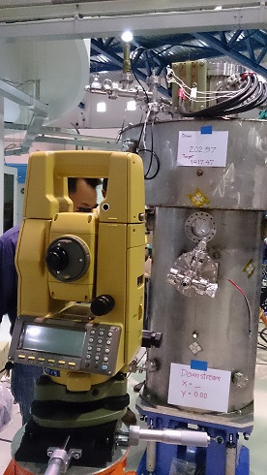
Insertion device alignment
The instruments were used including laser tracker, theodolites, precision optical level NAK2 and precision optical plummet.
Synchrotron Light Research Institute (Public Organization)

Slide 8
Insertion device alignment
The tolerance of insertion device alignment
Components | Reference components or marks | Required precision (mm) |  | Tilt (mm/m)
 |  | X and Y | Beam stream
SWLS | Dipole Reference marks / Level marks | 0.2 | 0.2 | 0.2
MPW | Dipole reference marks / Level marks | 0.2 | 0.2 | 0.2
Synchrotron Light Research Institute (Public Organization)

Slide 9
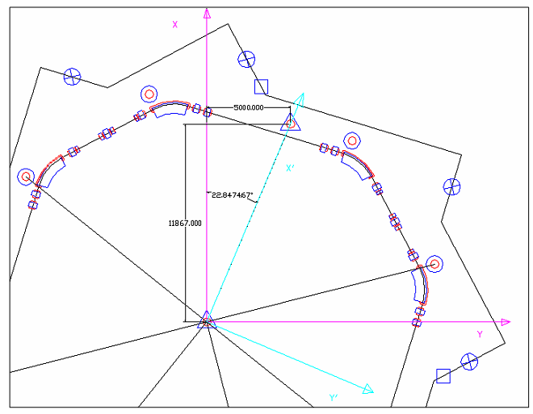
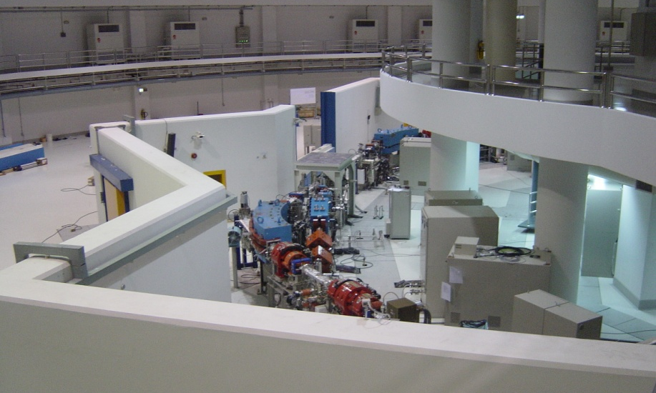
Insertion device alignment
X-Y Plane
Leveling Z
Synchrotron Light Research Institute (Public Organization)

Slide 10
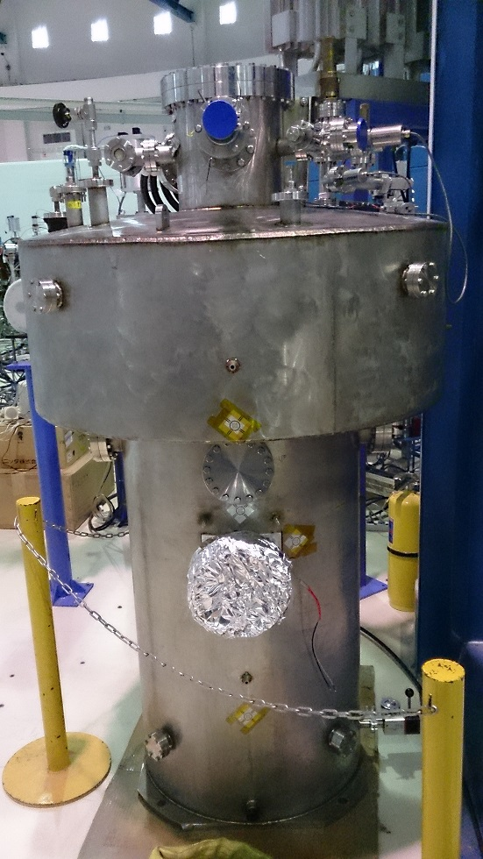
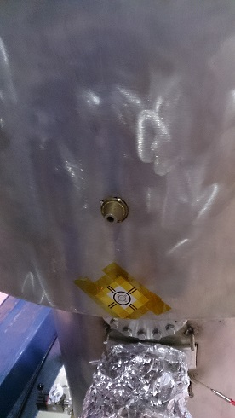
Installation and alignment of SWLS
FIDUCIAL MARKS
Synchrotron Light Research Institute (Public Organization)

Slide 11
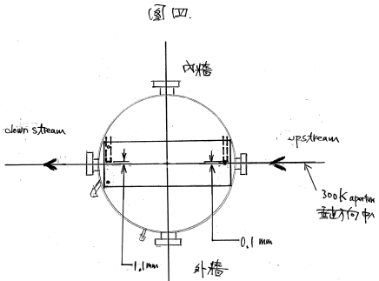
Pre-alignment of SWLS
Position and leveling data
Level of Lhe vessel
in
Z=202.69 mm
Z=202.57 mm
Z=202.69 mm
Y< 0.1 mm
Y< 1.1 mm
out
Z=202.69 mm
Synchrotron Light Research Institute (Public Organization)

Slide 12
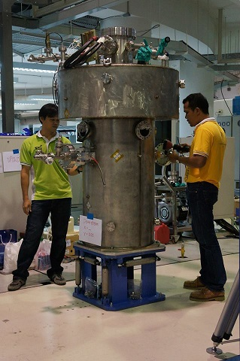
Pre-alignment of SWLS
Optical leveling 3
Optical leveling 2
Optical level 1
Optical leveling 4
Theodolite 2
Temporary axis
Theodolite 1
Synchrotron Light Research Institute (Public Organization)

Slide 13
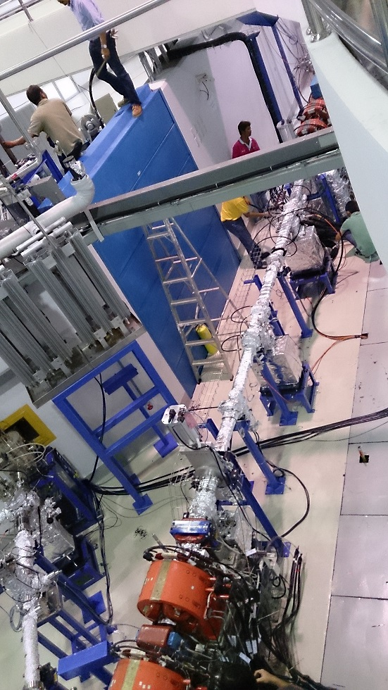
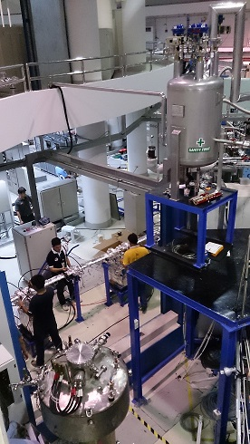
Installation and alignment of SWLS
Synchrotron Light Research Institute (Public Organization)

Slide 14
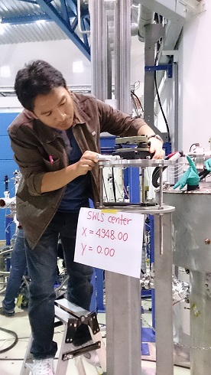
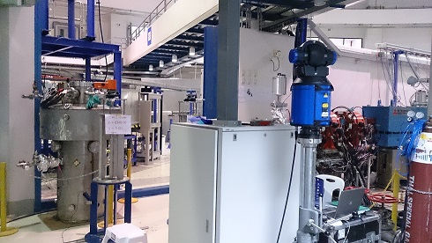
SWLS Alignment
Synchrotron Light Research Institute (Public Organization)

Slide 15
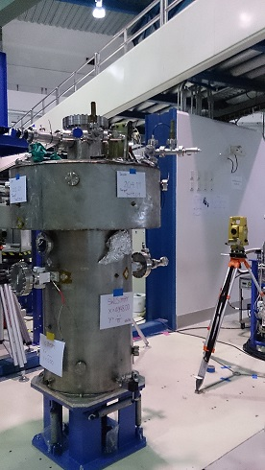
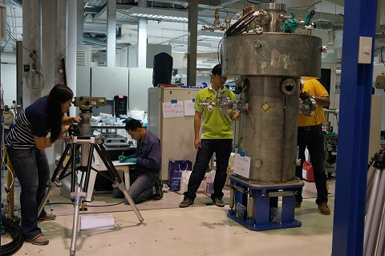
Installation and alignment of SWLS
Synchrotron Light Research Institute (Public Organization)

Slide 16
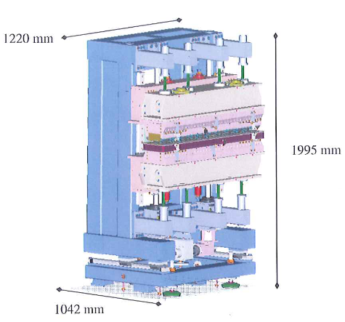
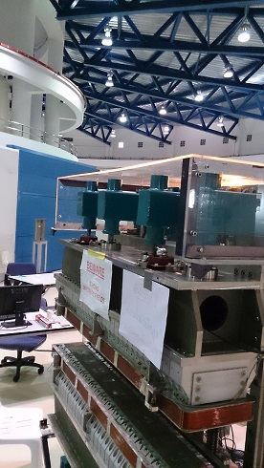
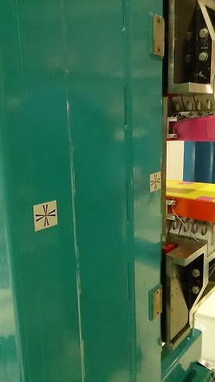
Installation and alignment of MPW
FIDUCIAL MARKS
Synchrotron Light Research Institute (Public Organization)

Slide 17
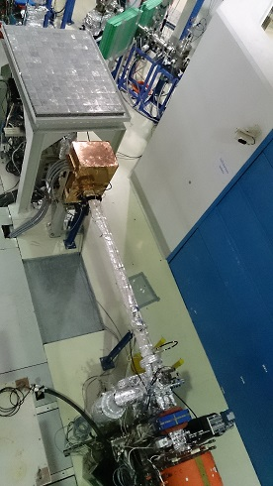
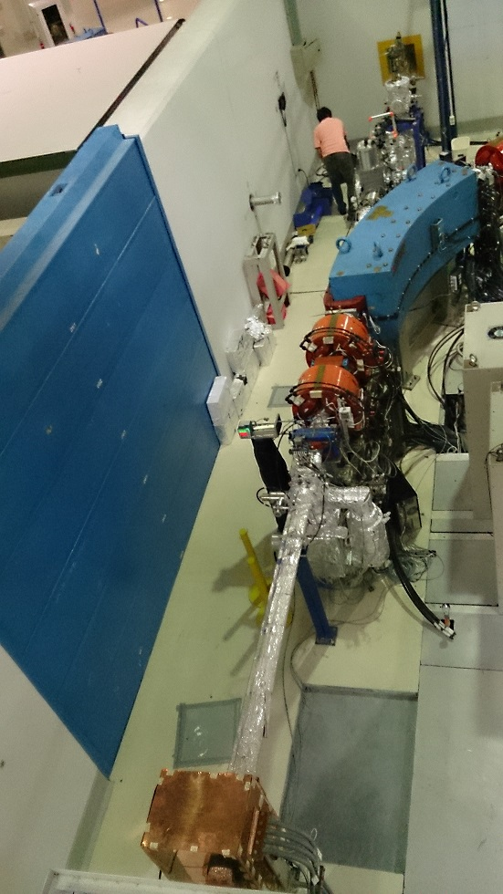
Installation and alignment of MPW
Synchrotron Light Research Institute (Public Organization)

Slide 18
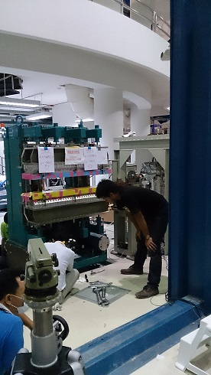
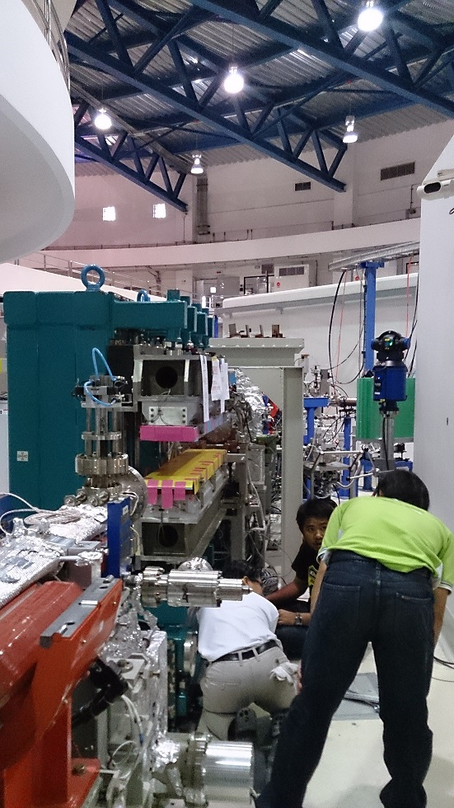
Installation and alignment of MPW
Synchrotron Light Research Institute (Public Organization)

Slide 19
The result of installation
 | Component | Design(mm) |  | Setting(mm) |  | Difference
 |  | X | Y | X | Y | ∆X | ∆Y
S1 | Ref. BM8
 | MPW | 6121.50 | 0.00 | 6121.20 | 0.02 | -0.20 | +0.02
 | Ref. BM1
S7 | Ref. BM6
 | SWLS | 4948.00 | 0.00 | 4948.20 | 0.02 | +0.20 | +0.02
 | Ref. BM7
Synchrotron Light Research Institute (Public Organization)

Slide 20
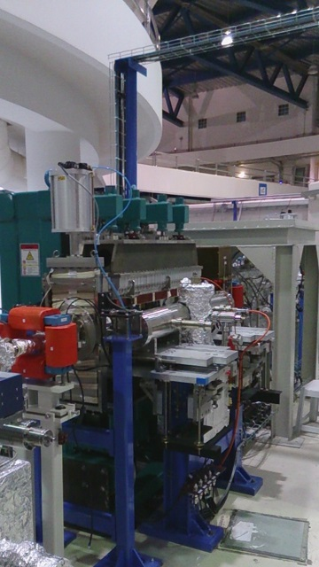
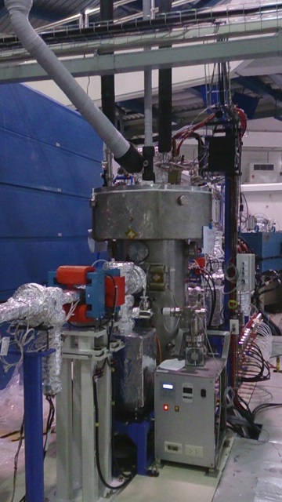
Conclusion
The two insertion devices, a 6.5 T superconducting wavelength shifter and a 2.4 T multipole wiggler, have been successfully installed at Siam Photon Source.
The commissioning of SWLS and MPW in the SPS storage ring were successfully carried out in September,2013.
In the near future, the installation and alignment of hard x-ray beamlines will be started with the same alignment team.
MPW 2.4 T
SWLS 6.5 T
Synchrotron Light Research Institute (Public Organization)

Slide 21
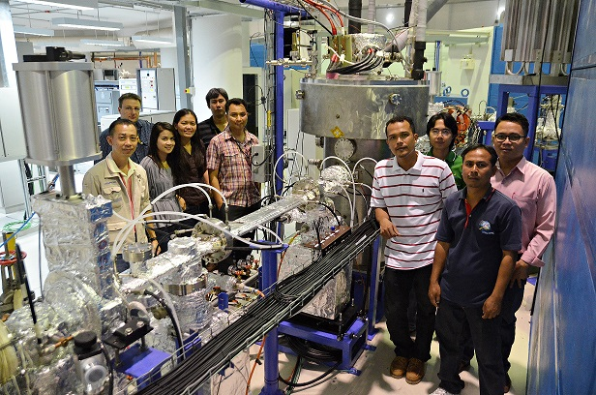
Acknowledgement
The authors would like to thank for Prof. C.S. Hwang of NSRRC for his assistance on the SWLS and Prof. Jim Clarke of ASTeC for his support on MPW.
Synchrotron Light Research Institute (Public Organization)

Slide 22
Thank you for your attention
Welcome to
Nakhon Ratchasima Thailand
www.slri.or.th
supawan@slri.or.th

